Slide 1
MODULE 1
Introduction to NoSQL Databases
MongoDB is one member of a broader family of non-relational database technologies
Defining NoSQL
Document, KV & Graph Stores
MongoDB Architecture
Core Features
Practical Benefits
MASTERING MONGODB • MODULE 1
Notes:
The slide title is: Introduction to NoSQL Databases.
The slide says: MongoDB is one member of a broader family of non-relational database technologies.

Slide 2
MODULE LEARNING OBJECTIVES
MODULE 1
🎯
YOU WILL BE ABLE TO
• Define NoSQL as a category, not one product
• Compare document, key-value, column-family, and graph models
• Explain MongoDB documents, collections, and BSON
• Describe the basic MongoDB architecture
• Select workloads that are — and are not — good MongoDB candidates
1
© 2026 by Innovation In Software Corporation
Notes:
This slide lists key points under Module Learning Objectives.
The slide title is: Module Learning Objectives.
The slide says: By the end of this module you will be able to:.
Bullet 1 on the slide: Define NoSQL as a category, not one product.
Bullet 2 on the slide: Compare document, key-value, column-family, and graph models.
Bullet 3 on the slide: Explain MongoDB documents, collections, and BSON.
Bullet 4 on the slide: Describe the basic MongoDB architecture.
Bullet 5 on the slide: Select workloads that are — and are not — good MongoDB candidates.

Slide 3
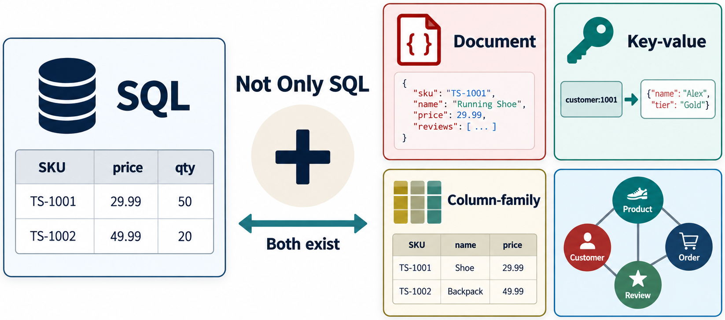
DEFINING NOSQL
MODULE 1
📌
KEY POINTS
NoSQL means “Not Only SQL.” It refers to databases designed to store and retrieve data using models other than traditional relational tables.
Relational databases organize data into fixed tables containing rows and columns. They work well when the data structure is stable and relationships must be strictly enforced. However, modern applications often produce large volumes of rapidly changing or semi-structured data.
NoSQL databases address challenges such as:
• Frequently changing data structures
• Large volumes of data
• High-speed reads and writes
• Distributed applications
• Horizontal scaling across multiple servers
• Data that does not fit naturally into tables
• Rapid application development
2
© 2026 by Innovation In Software Corporation
Notes:
NoSQL means 'Not Only SQL': databases built for data models other than relational tables, addressing changing structures, scale, and speed.

Slide 4
NOSQL IN PRACTICE: FLEXIBLE PRODUCT RECORDS
MODULE 1
📌
KEY POINTS
For example, an e-commerce product may contain different attributes depending on its category:
A book might require different fields:
A relational system may require several tables or many optional columns. A document database can store each product with the fields appropriate to it.
NoSQL does not mean that SQL databases are obsolete. The appropriate database depends on the application’s data, access patterns, consistency requirements and scale.
{
"name": "Laptop",
"brand": "Lenovo",
"ram": "16 GB",
"processor": "Intel Core i7"
}
{
"name": "MongoDB Fundamentals",
"author": "A. Singh",
"isbn": "978-1234567890"
}
3
© 2026 by Innovation In Software Corporation
Notes:
Two JSON examples (a laptop, a book) show how a document can carry only the fields that product needs, instead of many optional relational columns.

Slide 5
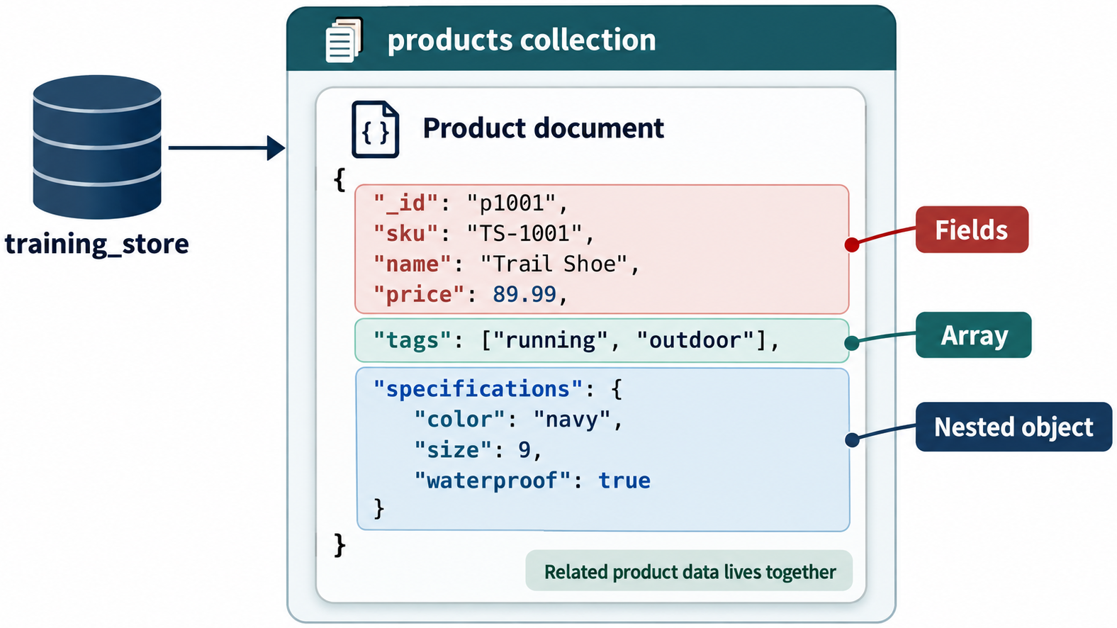
DOCUMENT DATABASES
MODULE 1
📌
KEY POINTS
Document databases store information as self-contained documents, usually in a JSON-like format.
Example:
Common products include MongoDB and Couchbase.
{
"_id": 1001,
"customer": {
"name": "Aman",
"email": "aman@example.com"
},
"items": [
{
"product": "Keyboard",
"quantity": 2,
"price": 49.99
}
],
"status": "Shipped"
}
4
© 2026 by Innovation In Software Corporation
Notes:
Document databases (MongoDB, Couchbase) store self-contained JSON-like documents -- one order example shown.

Slide 6
DOCUMENT DATABASES — USE CASES
MODULE 1
📌
KEY POINTS
Document databases are suitable for:
• Product catalogues
• Customer profiles
• Content-management systems
• Mobile and web applications
• Order-management systems
Their main advantage is that an application object can often be stored as one document without splitting it across many tables.
5
© 2026 by Innovation In Software Corporation
Notes:
Document databases suit catalogues, profiles, CMS, and order management -- an application object often maps to one document.

Slide 7
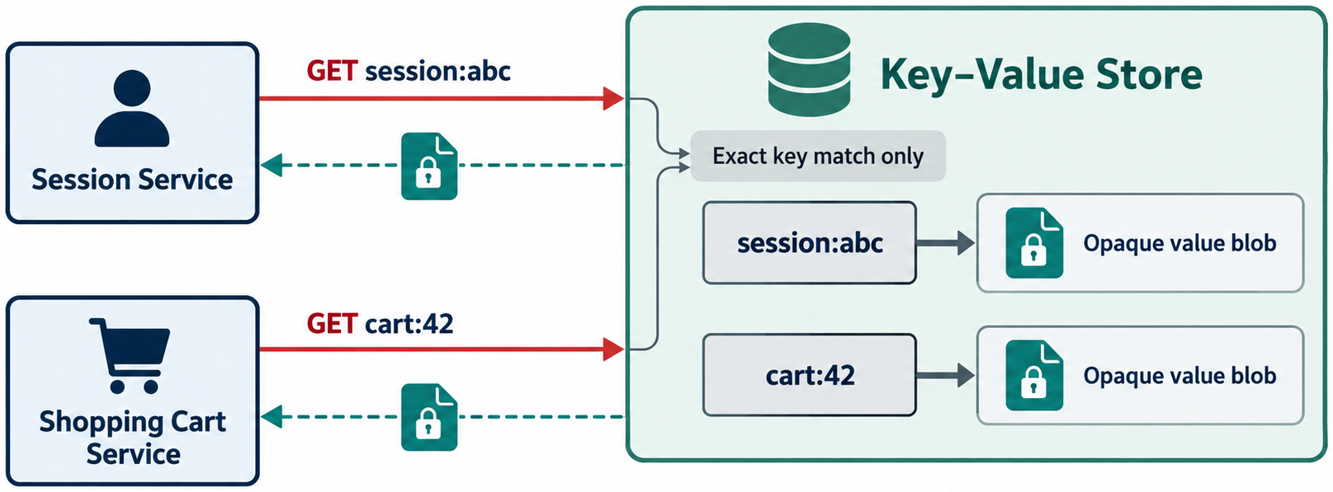
KEY-VALUE DATABASES
MODULE 1
📌
KEY POINTS
Key-value databases store each value under a unique key.
The application provides the key, and the database returns the associated value.
Common products include Redis and Amazon DynamoDB.
Key: session:78421
Value: {"customerId": 1001, "cartItems": 4}
6
© 2026 by Innovation In Software Corporation
Notes:
Key-value stores (Redis, DynamoDB) map a unique key straight to a value for very fast lookups.

Slide 8
KEY-VALUE DATABASES — USE CASES
MODULE 1
📌
KEY POINTS
Key-value databases are suitable for:
• Caching
• User sessions
• Shopping carts
• Application preferences
• Real-time counters
They provide very fast access when the application knows the required key. However, complex relationship-based queries may be difficult.
7
© 2026 by Innovation In Software Corporation
Notes:
Best for caching, sessions, carts, and counters -- fast by key, but weaker for complex relationship queries.

Slide 9
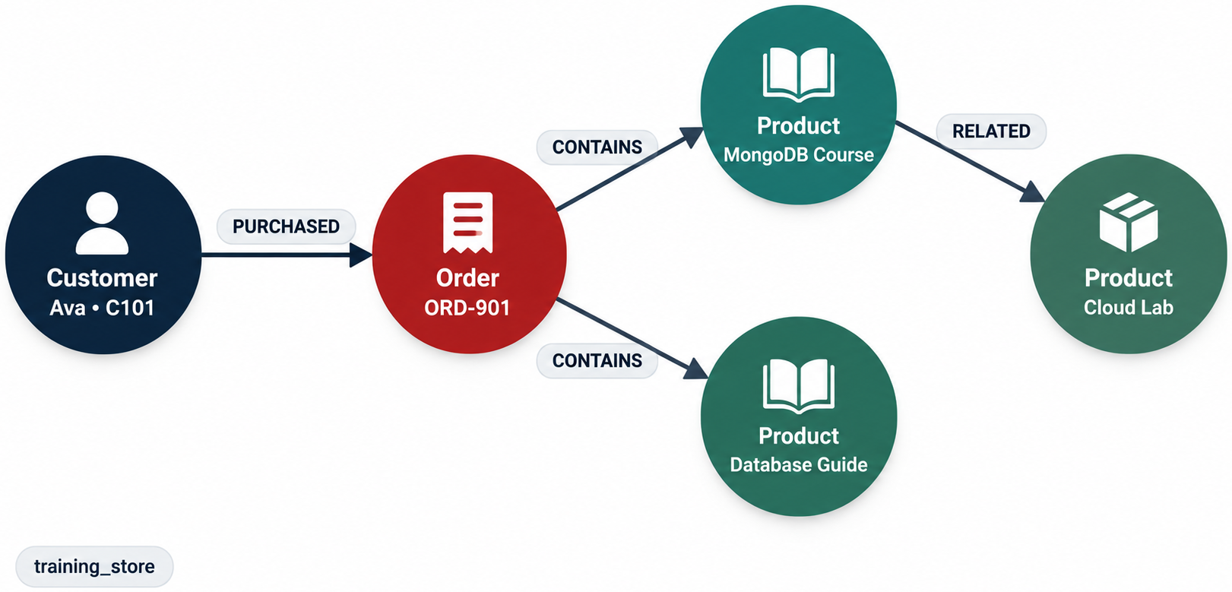
GRAPH DATABASES
MODULE 1
📌
KEY POINTS
Graph databases represent data using:
• Nodes: entities such as customers or products
• Edges: relationships between entities
• Properties: information about nodes and relationships
Example:
Common products include Neo4j and Amazon Neptune.
(Customer: Asha) ──PURCHASED──> (Product: Laptop)
(Customer: Asha) ──KNOWS──────> (Customer: Ravi)
8
© 2026 by Innovation In Software Corporation
Notes:
Graph databases (Neo4j, Neptune) model nodes, edges, and properties -- relationships are first-class data.

Slide 10
GRAPH DATABASES — USE CASES
MODULE 1
📌
KEY POINTS
Graph databases are suitable for:
• Social networks
• Recommendation engines
• Fraud detection
• Network analysis
• Identity and access relationships
They are particularly effective when relationships are as important as the entities themselves.
9
© 2026 by Innovation In Software Corporation
Notes:
Graph databases shine for social networks, recommendations, fraud detection, and access relationships.

Slide 11
COMPARING DOCUMENT, KEY-VALUE, AND GRAPH STORES
MODULE 1
Type | Data model | Main strength | Typical use
Document | JSON-like documents | Flexible, application-friendly records | Catalogues and profiles
Key-value | Key mapped to a value | Extremely fast lookup | Caching and sessions
Graph | Nodes and relationships | Relationship traversal | Fraud and recommendations
10
© 2026 by Innovation In Software Corporation
Notes:
Side-by-side comparison: data model, main strength, and typical use for each of the three store types.

Slide 12
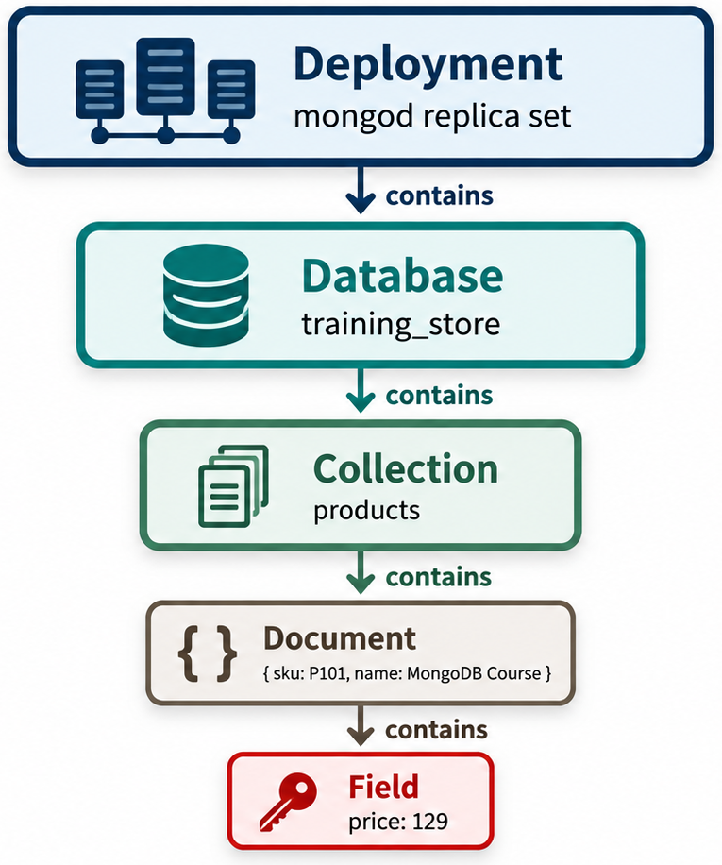
INTRODUCING MONGODB
MODULE 1
📌
KEY POINTS
MongoDB is a document-oriented NoSQL database. It stores data as BSON documents. BSON is a binary representation of JSON-like data that supports additional types such as dates, decimals and ObjectIds.
Using an e-commerce example:
MongoDB deployment
└── Database
└── Collection
└── Document
└── Field
Database: training_store
Collection: products
Document: One product
Fields: name, category, price, stock
11
© 2026 by Innovation In Software Corporation
Notes:
MongoDB is a document-oriented database storing BSON; deployment -> database -> collection -> document -> field.

Slide 13
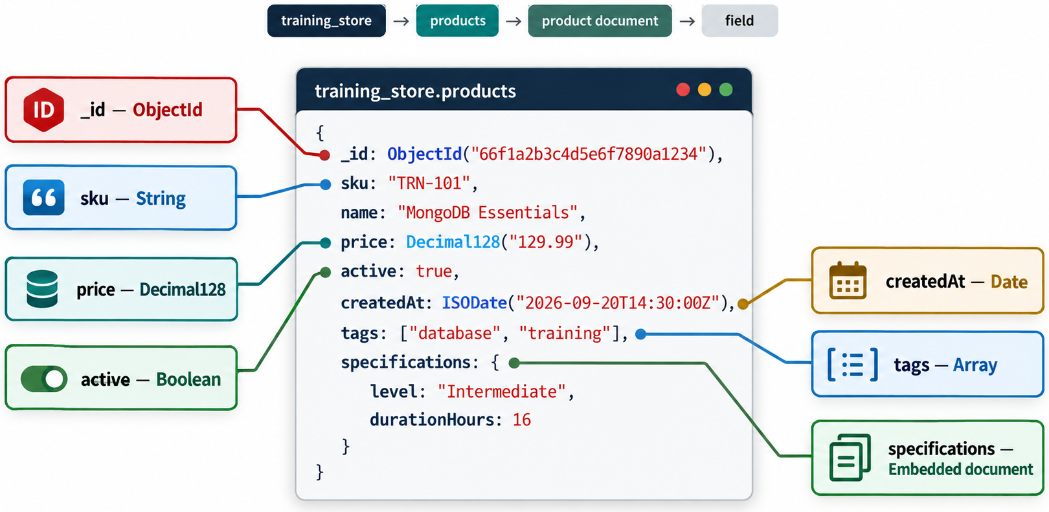
ANATOMY OF A MONGODB DOCUMENT
MODULE 1
📌
KEY POINTS
Example document:
{
_id: ObjectId("..."),
name: "Wireless Mouse",
category: "Electronics",
price: 39.99,
stock: 120,
specifications: {
connection: "Bluetooth",
colour: "Black"
},
tags: ["wireless", "accessory"]
}
12
© 2026 by Innovation In Software Corporation
Notes:
A full example document for a wireless mouse product, including nested specifications and a tags array.

Slide 14
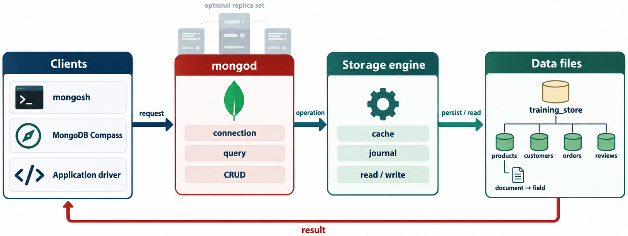
MONGODB ARCHITECTURE OVERVIEW
MODULE 1
🧭
KEY POINTS
MongoDB client
Applications communicate with MongoDB through language-specific drivers. Administrators and developers can also use tools such as mongosh and MongoDB Compass.
mongod process
mongod is the primary MongoDB server process. It manages:
• Data storage
• Queries
• Indexes
• Authentication
• Replication
• Database operations
13
© 2026 by Innovation In Software Corporation
Notes:
Clients (drivers, mongosh, Compass) talk to the mongod server process, which owns storage, queries, indexes, auth, and replication.

Slide 15
REPLICA SETS
MODULE 1
📌
KEY POINTS
Replica set
A replica set is a group of MongoDB servers that maintain copies of the same data.
• The primary node accepts writes.
• Secondary nodes replicate the primary’s data.
• If the primary fails, an eligible secondary can become the new primary.
Replica sets provide redundancy and high availability.
14
© 2026 by Innovation In Software Corporation
Notes:
A replica set keeps copies of the same data on multiple servers; the primary takes writes and an eligible secondary can be elected if it fails.

Slide 16
SHARDED CLUSTERS
MODULE 1
📌
KEY POINTS
Sharded cluster
Sharding distributes a large dataset across multiple servers called shards.
A sharded cluster typically includes:
• Shards that store the data
• Configuration servers that store cluster metadata
• mongos query routers that direct requests to appropriate shards
Sharding supports horizontal scaling when one server cannot efficiently handle the complete dataset or workload.
15
© 2026 by Innovation In Software Corporation
Notes:
Sharding spreads data across shards, config servers, and mongos routers so one server doesn't have to hold the whole dataset.

Slide 17
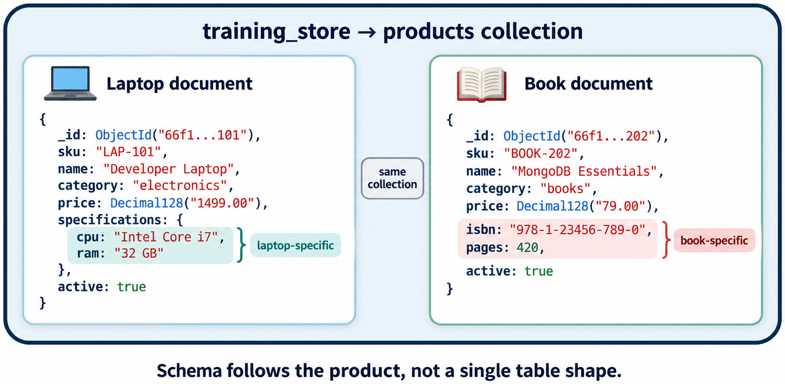
FLEXIBLE DOCUMENT MODEL
MODULE 1
📌
KEY POINTS
Documents in the same collection do not always need identical fields.
This flexibility helps applications evolve without requiring constant table redesign.
// Physical product
{
name: "Laptop",
price: 1200,
weight: 1.8
}
// Digital product
{
name: "Python Course",
price: 99,
durationHours: 30
}
16
© 2026 by Innovation In Software Corporation
Notes:
Documents in the same collection don't need identical fields -- a physical and a digital product example side by side.

Slide 18
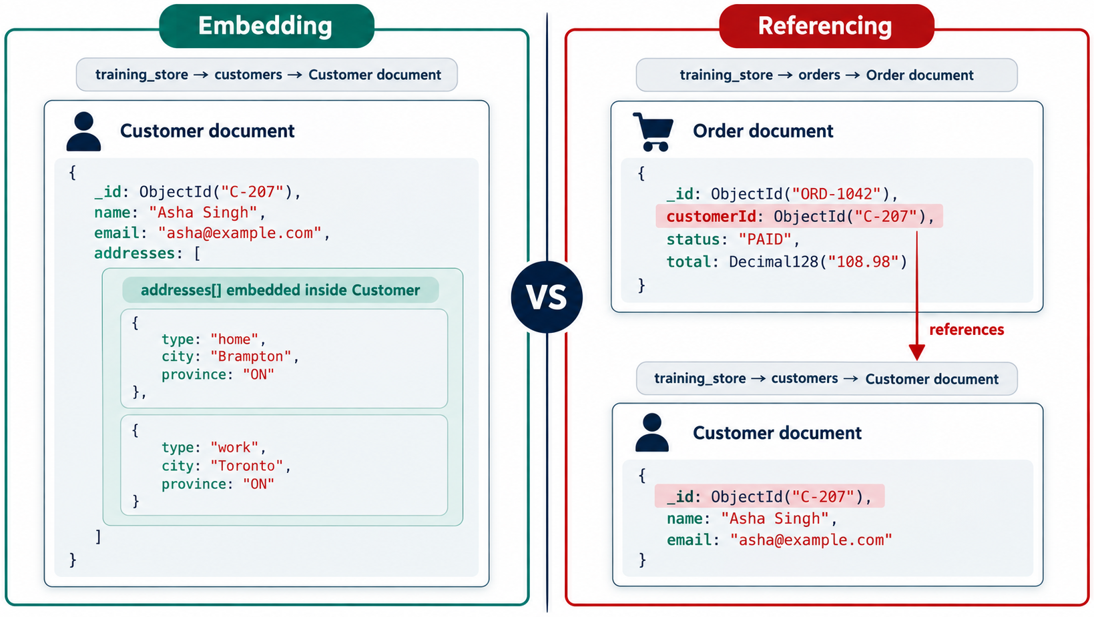
EMBEDDED DOCUMENTS AND ARRAYS
MODULE 1
📌
KEY POINTS
MongoDB can store related information together:
This can reduce the number of joins and queries required to retrieve complete business objects.
{
orderId: 5001,
customerId: 101,
items: [
{ productId: 10, quantity: 2 },
{ productId: 24, quantity: 1 }
],
shippingAddress: {
city: "Brampton",
province: "Ontario"
}
}
17
© 2026 by Innovation In Software Corporation
Notes:
An order document embeds its line items and shipping address, cutting the joins needed to read one business object.

Slide 19
RICH QUERY LANGUAGE
MODULE 1
📌
KEY POINTS
MongoDB supports:
• Filtering
• Sorting
• Projection
• Updates
• Array queries
• Geospatial queries
• Text and search capabilities
• Aggregation pipelines
Example:
db.products.find(
{
category: "Electronics",
price: { $lt: 100 }
},
{
name: 1,
price: 1
}
)
18
© 2026 by Innovation In Software Corporation
Notes:
MongoDB's query language covers filtering, sorting, projection, updates, geospatial and text search, and aggregation.

Slide 20
INDEXING
MODULE 1
📌
KEY POINTS
Indexes improve query performance by helping MongoDB locate documents without scanning the entire collection.
Indexes should be designed around the application’s common query patterns.
db.products.createIndex({ category: 1, price: 1 })
19
© 2026 by Innovation In Software Corporation
Notes:
Indexes let MongoDB find documents without scanning the whole collection; design them around real query patterns.

Slide 21
AGGREGATION FRAMEWORK
MODULE 1
📊
KEY POINTS
Aggregation pipelines process documents through a sequence of stages:
This can be used for reporting, transformation and analytical processing.
db.orders.aggregate([
{
$match: {
status: "Completed"
}
},
{
$group: {
_id: "$customerId",
totalSpent: { $sum: "$total" }
}
},
{
$sort: {
totalSpent: -1
}
}
])
20
© 2026 by Innovation In Software Corporation
Notes:
Aggregation pipelines chain stages like $match, $group, and $sort for reporting and analytics.

Slide 22
REPLICATION, SCALING, AND TRANSACTIONS
MODULE 1
📌
KEY POINTS
Replica sets protect applications from individual server failures by maintaining multiple copies of the data and supporting automatic election of a new primary.
MongoDB can distribute data across multiple shards. New servers can be added as the dataset and workload grow.
Although MongoDB has a flexible schema, it can still enforce document rules using schema validation. It also supports atomic operations and multi-document transactions when a business process requires them.
21
© 2026 by Innovation In Software Corporation
Notes:
Replica sets give high availability, sharding gives horizontal scale, and MongoDB still supports schema validation and multi-document transactions.

Slide 23
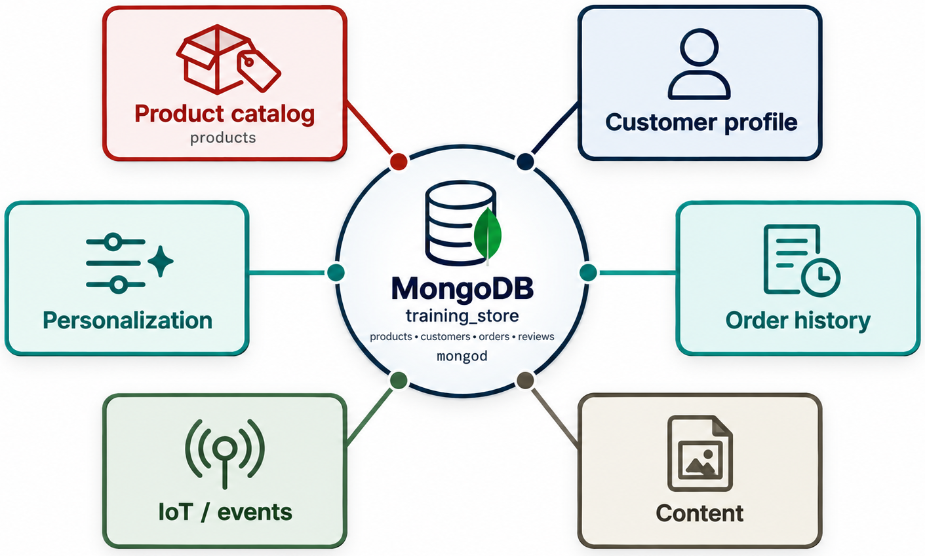
PRACTICAL BENEFITS
MODULE 1
📌
KEY POINTS
MongoDB can provide:
• Faster development with JSON-like documents
• Natural mapping between application objects and stored data
• Support for changing business requirements
• Efficient storage of nested and hierarchical information
• High availability through replication
• Horizontal scaling through sharding
• Powerful operational and analytical queries
A good MongoDB design does not simply move relational tables into collections. It models documents around how the application reads, writes and updates its data.
The central principle is:
KEY TAKEAWAY Store information together when the application commonly accesses it together.
22
© 2026 by Innovation In Software Corporation
Notes:
MongoDB's benefits add up to faster development and natural object mapping -- design around how the application actually reads and writes data.

Slide 24
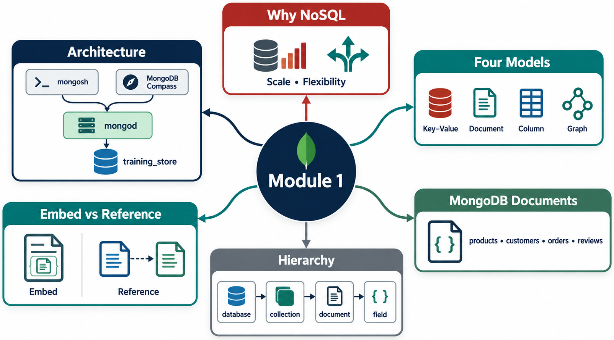
MODULE SUMMARY
MODULE 1
🧭
KEY POINTS
• NoSQL is more than one model
• MongoDB stores BSON documents
• Flexible schema still needs design
• Choose from the access pattern
23
© 2026 by Innovation In Software Corporation
Notes:
This slide includes a diagram — Module Summary.
The slide title is: Module Summary.
The slide says: <div class="cols">.
The slide says: <div class="col-text">.
The slide says: </div>.
The slide says: <div class="col-visual">.
Bullet 1 on the slide: NoSQL is more than one model.
Bullet 2 on the slide: MongoDB stores BSON documents.
Bullet 3 on the slide: Flexible schema still needs design.
Bullet 4 on the slide: Choose from the access pattern.
The figure on this slide is titled: Concept map from NoSQL through MongoDB to BSON collections and documents.

Slide 25
KNOWLEDGE CHECK
MODULE 1
❓
KEY POINTS
1. What does “Not Only SQL” communicate?
2. Which NoSQL model fits highly connected data?
3. MongoDB equivalent of a relational row?
4. MongoDB equivalent of a table?
5. Which field uniquely identifies a document?
6. What is BSON?
7. Why might a product catalog fit a document database?
8. Does flexible schema mean schema design is unnecessary?
24
© 2026 by Innovation In Software Corporation
Notes:
Let's look at Knowledge Check.
The slide title is: Knowledge Check.
The slide says: 1. What does “Not Only SQL” communicate?.
The slide says: 2. Which NoSQL model fits highly connected data?.
The slide says: 3. MongoDB equivalent of a relational row?.
The slide says: 4. MongoDB equivalent of a table?.
The slide says: 5. Which field uniquely identifies a document?.
The slide says: 6. What is BSON?.
The slide says: 7. Why might a product catalog fit a document database?.
The slide says: 8. Does flexible schema mean schema design is unnecessary?.
Number 1 on the slide: What does “Not Only SQL” communicate?.
Number 2 on the slide: Which NoSQL model fits highly connected data?.
Number 3 on the slide: MongoDB equivalent of a relational row?.
Number 4 on the slide: MongoDB equivalent of a table?.
Number 5 on the slide: Which field uniquely identifies a document?.
Number 6 on the slide: What is BSON?.
Number 7 on the slide: Why might a product catalog fit a document database?.
Number 8 on the slide: Does flexible schema mean schema design is unnecessary?.

Slide 26
EXERCISE 1.1 — CHOOSE THE DATA MODEL
MODULE 1
🛠️
KEY POINTS
Match each scenario to one model:
Relational · Document · Key-value · Column-family · Graph
The justification matters more than the product name.
LAB GUIDE Exercise 1.1
25
© 2026 by Innovation In Software Corporation
Notes:
This slide includes a diagram — Exercise 1.1 — Choose the Data Model.
The slide title is: Exercise 1.1 — Choose the Data Model.
The slide says: <div class="cols">.
The slide says: <div class="col-text">.
The slide says: Match each scenario to one model:.
The slide says: Relational · Document · Key-value · Column-family · Graph.
The slide says: The justification matters more than the product name.
The slide says: Lab guide: [Exercise 1.1](../slide-exercises/module-01/exercise-1.1-choose-the-data-model.md).
The slide says: </div>.
The slide says: <div class="col-visual">.
The figure on this slide is titled: Six scenario cards to map to database models.

Slide 27
EXERCISE 1.1 — STEPS 1–2
MODULE 1
🛠️
KEY POINTS
LAB GUIDE Exercise 1.1
Follow along (Windows) — key steps:
Step 1 — Review the five database models
• Do: Confirm the models you may choose from: Relational, Document, Key-value, Column-family, Graph. For each, name the primary structure (tables, JSON-like documents, key→value, column families, nodes and edges).
• Expected: The group can name all five models and one sentence for what each optimizes.
Step 2 — Classify scenarios A–C
• Do: For A, B, and C, pick one initial model and write a one-line justification. | Scenario | Key requirement | |----------|-----------------| | A. Online shopping sessions | Retrieve session data by a unique session ID | | B
• Expected: Your table has a model and a justification for A, B, and C. The justification mentions the access pattern (lookup by key, varied attributes, or relationship tra
Step 3 — Classify scenarios D–F
• Do: Repeat for D, E, and F. | Scenario | Key requirement | |----------|-----------------| | D. Banking ledger | Preserve strongly structured financial transactions | | E. Sensor platform | Accept large volumes of distributed
• Expected: All six rows of the deliverable table are filled. You can explain why another technology might also work, and why your first choice still fits.
_Full lab guide with every command: see Lab guide on the lesson divider slide._
• Do: For A, B, and C, pick one initial model and write a one-line justification.
• Expected: Your table has a model and a justification for A, B, and C. The justification mentions the access pattern (lookup by key, varied attributes, or relationship tra
• Do: Repeat for D, E, and F.
• Expected: All six rows of the deliverable table are filled. You can explain why another technology might also work, and why your first choice still fits.
26
© 2026 by Innovation In Software Corporation
Notes:
We are starting Exercise 1.1 — Choose the Appropriate Data Model. We have about 15 min for this lab.
Match application requirements to relational, document, key-value, column-family, or graph models.
The full lab guide is in slide-exercises/module-01/exercise-1.1-choose-the-data-model.md if you need extra detail.
On Windows: PowerShell in the integrated terminal — Ctrl+backtick — and the Agent panel — Ctrl+I. Open the repo folder with File → Open Folder.
Step 1 — Review the five database models.
Step 2 — Classify scenarios A–C.
Step 3 — Classify scenarios D–F.
Step 1 — Review the five database models.
Step 2 — Classify scenarios A–C.
Step 3 — Classify scenarios D–F.
Step 1 — Review the five database models.
Step 2 — Classify scenarios A–C.
Step 3 — Classify scenarios D–F.
Step 1 — Review the five database models.
Step 2 — Classify scenarios A–C.
Step 3 — Classify scenarios D–F.
Step 1 — Review the five database models.
Step 2 — Classify scenarios A–C.
Step 3 — Classify scenarios D–F.
Step 1 — Review the five database models.
Step 2 — Classify scenarios A–C.
Step 3 — Classify scenarios D–F.
Step 1 — Review the five database models.
Step 2 — Classify scenarios A–C.
Step 3 — Classify scenarios D–F.
Step 1 — Review the five database models.
Step 2 — Classify scenarios A–C.
Step 3 — Classify scenarios D–F.
Step 1 — Review the five database models.
Step 2 — Classify scenarios A–C.
Step 3 — Classify scenarios D–F.
Step 1 — Review the five database models.
Step 2 — Classify scenarios A–C.
Step 3 — Classify scenarios D–F.
I'll give you a few minutes to work — raise your hand if you get stuck.
The slide title is: Exercise 1.1 — Steps 1–2.
The slide says: Lab guide: [Exercise 1.1](../slide-exercises/module-01/exercise-1.1-choose-the-data-model.md).
The slide says: Follow along (Windows) — key steps:.
The slide says: _Full lab guide with every command: see Lab guide on the lesson divider slide._.
Bullet 1 on the slide: Do: Confirm the models you may choose from: Relational, Document, Key-value, Column-family, Graph. For each, name the primary structure (tables, JSON-like documents, key→value, column families, nodes and edges).
Bullet 2 on the slide: Expected: The group can name all five models and one sentence for what each optimizes.
Bullet 3 on the slide: Do: For A, B, and C, pick one initial model and write a one-line justification. | Scenario | Key requirement | |----------|-----------------| | A. Online shopping sessions | Retrieve session data by a unique session ID | | B.
Bullet 4 on the slide: Expected: Your table has a model and a justification for A, B, and C. The justification mentions the access pattern (lookup by key, varied attributes, or relationship tra.
Bullet 5 on the slide: Do: Repeat for D, E, and F. | Scenario | Key requirement | |----------|-----------------| | D. Banking ledger | Preserve strongly structured financial transactions | | E. Sensor platform | Accept large volumes of distributed.
Bullet 6 on the slide: Expected: All six rows of the deliverable table are filled. You can explain why another technology might also work, and why your first choice still fits.
Bullet 7 on the slide: Do: Confirm the models you may choose from: Relational, Document, Key-value, Column-family, Graph. For each, name the primary structure (tables, JSON-like documents, key→value, column families, nodes and edges).
Bullet 8 on the slide: Expected: The group can name all five models and one sentence for what each optimizes.
Bullet 9 on the slide: Do: For A, B, and C, pick one initial model and write a one-line justification. | Scenario | Key requirement | |----------|-----------------| | A. Online shopping sessions | Retrieve session data by a unique session ID | | B.
Bullet 10 on the slide: Expected: Your table has a model and a justification for A, B, and C. The justification mentions the access pattern (lookup by key, varied attributes, or relationship tra.
Bullet 11 on the slide: Do: Repeat for D, E, and F. | Scenario | Key requirement | |----------|-----------------| | D. Banking ledger | Preserve strongly structured financial transactions | | E. Sensor platform | Accept large volumes of distributed.
Bullet 12 on the slide: Expected: All six rows of the deliverable table are filled. You can explain why another technology might also work, and why your first choice still fits.
Bullet 13 on the slide: Do: Confirm the models you may choose from: Relational, Document, Key-value, Column-family, Graph. For each, name the primary structure (tables, JSON-like documents, key→value, column families, nodes and edges).
Bullet 14 on the slide: Expected: The group can name all five models and one sentence for what each optimizes.
Bullet 15 on the slide: Do: For A, B, and C, pick one initial model and write a one-line justification. | Scenario | Key requirement | |----------|-----------------| | A. Online shopping sessions | Retrieve session data by a unique session ID | | B.
Bullet 16 on the slide: Expected: Your table has a model and a justification for A, B, and C. The justification mentions the access pattern (lookup by key, varied attributes, or relationship tra.
Bullet 17 on the slide: Do: Repeat for D, E, and F. | Scenario | Key requirement | |----------|-----------------| | D. Banking ledger | Preserve strongly structured financial transactions | | E. Sensor platform | Accept large volumes of distributed.
Bullet 18 on the slide: Expected: All six rows of the deliverable table are filled. You can explain why another technology might also work, and why your first choice still fits.
Bullet 19 on the slide: Do: Confirm the models you may choose from: Relational, Document, Key-value, Column-family, Graph. For each, name the primary structure (tables, JSON-like documents, key→value, column families, nodes and edges).
Bullet 20 on the slide: Expected: The group can name all five models and one sentence for what each optimizes.
Bullet 21 on the slide: Do: For A, B, and C, pick one initial model and write a one-line justification. | Scenario | Key requirement | |----------|-----------------| | A. Online shopping sessions | Retrieve session data by a unique session ID | | B.
Bullet 22 on the slide: Expected: Your table has a model and a justification for A, B, and C. The justification mentions the access pattern (lookup by key, varied attributes, or relationship tra.
Bullet 23 on the slide: Do: Repeat for D, E, and F. | Scenario | Key requirement | |----------|-----------------| | D. Banking ledger | Preserve strongly structured financial transactions | | E. Sensor platform | Accept large volumes of distributed.
Bullet 24 on the slide: Expected: All six rows of the deliverable table are filled. You can explain why another technology might also work, and why your first choice still fits.
Bullet 25 on the slide: Do: Confirm the models you may choose from: Relational, Document, Key-value, Column-family, Graph. For each, name the primary structure (tables, JSON-like documents, key→value, column families, nodes and edges).
Bullet 26 on the slide: Expected: The group can name all five models and one sentence for what each optimizes.
Bullet 27 on the slide: Do: For A, B, and C, pick one initial model and write a one-line justification. | Scenario | Key requirement | |----------|-----------------| | A. Online shopping sessions | Retrieve session data by a unique session ID | | B.
Bullet 28 on the slide: Expected: Your table has a model and a justification for A, B, and C. The justification mentions the access pattern (lookup by key, varied attributes, or relationship tra.
Bullet 29 on the slide: Do: Repeat for D, E, and F. | Scenario | Key requirement | |----------|-----------------| | D. Banking ledger | Preserve strongly structured financial transactions | | E. Sensor platform | Accept large volumes of distributed.
Bullet 30 on the slide: Expected: All six rows of the deliverable table are filled. You can explain why another technology might also work, and why your first choice still fits.
Bullet 31 on the slide: Do: Confirm the models you may choose from: Relational, Document, Key-value, Column-family, Graph. For each, name the primary structure (tables, JSON-like documents, key→value, column families, nodes and edges).
Bullet 32 on the slide: Expected: The group can name all five models and one sentence for what each optimizes.
Bullet 33 on the slide: Do: For A, B, and C, pick one initial model and write a one-line justification. | Scenario | Key requirement | |----------|-----------------| | A. Online shopping sessions | Retrieve session data by a unique session ID | | B.
Bullet 34 on the slide: Expected: Your table has a model and a justification for A, B, and C. The justification mentions the access pattern (lookup by key, varied attributes, or relationship tra.
Bullet 35 on the slide: Do: Repeat for D, E, and F. | Scenario | Key requirement | |----------|-----------------| | D. Banking ledger | Preserve strongly structured financial transactions | | E. Sensor platform | Accept large volumes of distributed.
Bullet 36 on the slide: Expected: All six rows of the deliverable table are filled. You can explain why another technology might also work, and why your first choice still fits.
Bullet 37 on the slide: Do: Confirm the models you may choose from: Relational, Document, Key-value, Column-family, Graph. For each, name the primary structure (tables, JSON-like documents, key→value, column families, nodes and edges).
Bullet 38 on the slide: Expected: The group can name all five models and one sentence for what each optimizes.
Bullet 39 on the slide: Do: For A, B, and C, pick one initial model and write a one-line justification. | Scenario | Key requirement | |----------|-----------------| | A. Online shopping sessions | Retrieve session data by a unique session ID | | B.
Bullet 40 on the slide: Expected: Your table has a model and a justification for A, B, and C. The justification mentions the access pattern (lookup by key, varied attributes, or relationship tra.
Bullet 41 on the slide: Do: Repeat for D, E, and F. | Scenario | Key requirement | |----------|-----------------| | D. Banking ledger | Preserve strongly structured financial transactions | | E. Sensor platform | Accept large volumes of distributed.
Bullet 42 on the slide: Expected: All six rows of the deliverable table are filled. You can explain why another technology might also work, and why your first choice still fits.
Bullet 43 on the slide: Do: Confirm the models you may choose from: Relational, Document, Key-value, Column-family, Graph. For each, name the primary structure (tables, JSON-like documents, key→value, column families, nodes and edges).
Bullet 44 on the slide: Expected: The group can name all five models and one sentence for what each optimizes.
Bullet 45 on the slide: Do: For A, B, and C, pick one initial model and write a one-line justification. | Scenario | Key requirement | |----------|-----------------| | A. Online shopping sessions | Retrieve session data by a unique session ID | | B.
Bullet 46 on the slide: Expected: Your table has a model and a justification for A, B, and C. The justification mentions the access pattern (lookup by key, varied attributes, or relationship tra.
Bullet 47 on the slide: Do: Repeat for D, E, and F. | Scenario | Key requirement | |----------|-----------------| | D. Banking ledger | Preserve strongly structured financial transactions | | E. Sensor platform | Accept large volumes of distributed.
Bullet 48 on the slide: Expected: All six rows of the deliverable table are filled. You can explain why another technology might also work, and why your first choice still fits.
Bullet 49 on the slide: Do: Confirm the models you may choose from: Relational, Document, Key-value, Column-family, Graph. For each, name the primary structure (tables, JSON-like documents, key→value, column families, nodes and edges).
Bullet 50 on the slide: Expected: The group can name all five models and one sentence for what each optimizes.
Bullet 51 on the slide: Do: For A, B, and C, pick one initial model and write a one-line justification. | Scenario | Key requirement | |----------|-----------------| | A. Online shopping sessions | Retrieve session data by a unique session ID | | B.
Bullet 52 on the slide: Expected: Your table has a model and a justification for A, B, and C. The justification mentions the access pattern (lookup by key, varied attributes, or relationship tra.
Bullet 53 on the slide: Do: Repeat for D, E, and F. | Scenario | Key requirement | |----------|-----------------| | D. Banking ledger | Preserve strongly structured financial transactions | | E. Sensor platform | Accept large volumes of distributed.
Bullet 54 on the slide: Expected: All six rows of the deliverable table are filled. You can explain why another technology might also work, and why your first choice still fits.
Bullet 55 on the slide: Do: Confirm the models you may choose from: Relational, Document, Key-value, Column-family, Graph. For each, name the primary structure (tables, JSON-like documents, key→value, column families, nodes and edges).
Bullet 56 on the slide: Expected: The group can name all five models and one sentence for what each optimizes.
Bullet 57 on the slide: Do: For A, B, and C, pick one initial model and write a one-line justification.
Bullet 58 on the slide: Expected: Your table has a model and a justification for A, B, and C. The justification mentions the access pattern (lookup by key, varied attributes, or relationship tra.
Bullet 59 on the slide: Do: Repeat for D, E, and F.
Bullet 60 on the slide: Expected: All six rows of the deliverable table are filled. You can explain why another technology might also work, and why your first choice still fits.

Slide 28
EXERCISE 1.1 — STEPS 3–4
MODULE 1
🛠️
KEY POINTS
LAB GUIDE Exercise 1.1 Step 3 — Classify scenarios D–F
• Do: Classify banking ledger, sensor platform, and CMS. Fill all six rows of the deliverable table.
• Expected: Every row has a model and a justification you can defend.
Step 4 — Compare with the instructor solution
• Do: Share one controversial row. Adjust if the class discussion changes your reasoning.
• Expected: You can use access pattern, consistency, relationships, and scale — not popularity.
SOLUTION AFTER DEBRIEF
A key-value
B document
C graph
D relational
E column-family or time-series
F document
27
© 2026 by Innovation In Software Corporation
Notes:
Now for Steps 3–4.
Step 3 — Classify scenarios D–F.
Step 4 — Compare with the instructor solution.
I'll give you a few minutes to work — raise your hand if you get stuck.
The slide title is: Exercise 1.1 — Steps 3–4.
The slide says: Lab guide: [Exercise 1.1](../slide-exercises/module-01/exercise-1.1-choose-the-data-model.md).
The slide says: Solution after debrief: A key-value · B document · C graph · D relational · E column-family or time-series · F document.
Bullet 1 on the slide: Do: Classify banking ledger, sensor platform, and CMS. Fill all six rows of the deliverable table.
Bullet 2 on the slide: Expected: Every row has a model and a justification you can defend.
Bullet 3 on the slide: Do: Share one controversial row. Adjust if the class discussion changes your reasoning.
Bullet 4 on the slide: Expected: You can use access pattern, consistency, relationships, and scale — not popularity.

Slide 29
EXERCISE 1.1 — SUITABILITY THINKING
MODULE 1
🛠️
KEY POINTS
After you pick a model, ask:
• What is MongoDB strong at?
• What should stay relational or graph?
Use this matrix in the debrief — not as a product ranking.
28
© 2026 by Innovation In Software Corporation
Notes:
This slide includes a diagram — Exercise 1.1 — Suitability thinking.
The slide title is: Exercise 1.1 — Suitability thinking.
The slide says: <div class="cols">.
The slide says: <div class="col-text">.
The slide says: After you pick a model, ask:.
The slide says: Use this matrix in the debrief — not as a product ranking.
The slide says: </div>.
The slide says: <div class="col-visual">.
Bullet 1 on the slide: What is MongoDB strong at?.
Bullet 2 on the slide: What should stay relational or graph?.
The figure on this slide is titled: Requirements evaluated against MongoDB strengths and limits.

Slide 30
EXERCISE 1.2 — RELATIONAL STARTING POINT
MODULE 1
🛠️
KEY POINTS
Order O5001 lives in four tables.
Your job: one document that the application can read without joining.
LAB GUIDE Exercise 1.2
29
© 2026 by Innovation In Software Corporation
Notes:
This slide includes a diagram — Exercise 1.2 — Relational starting point.
The slide title is: Exercise 1.2 — Relational starting point.
The slide says: <div class="cols">.
The slide says: <div class="col-text">.
The slide says: Order O5001 lives in four tables.
The slide says: Your job: one document that the application can read without joining.
The slide says: Lab guide: [Exercise 1.2](../slide-exercises/module-01/exercise-1.2-rows-to-documents.md).
The slide says: </div>.
The slide says: <div class="col-visual">.
The figure on this slide is titled: Customer, order, order-item, and product tables with relationships.

Slide 31
EXERCISE 1.2 — STEPS 1–2
MODULE 1
🛠️
KEY POINTS
LAB GUIDE Exercise 1.2
Follow along (Windows) — key steps:
Step 1 — Read the three relational tables
• Do: Identify how you would reconstruct one complete order in SQL: join Customer to Order on customer_id, then join Order items on order_id. List every field the application needs for “show order O5001.”
• Expected: You can name the three tables and the join keys. You know the order total is 110.00 and there are two line items.
Step 2 — Draft one JSON-like order document
• Do: Create a single document that holds the order header. Do not worry about _id or nesting yet — get status and total on the page.
• Expected: A starting object exists, for example { orderId: "O5001", status: "PLACED", total: 110.00 }.
Step 3 — Embed items, customer, and _id
• Do: Embed the two order items as an array. Include essential customer information (id, name, email). Set _id to "O5001" (or an ObjectId if you prefer). Keep purchase-time price on each item.
• Expected: One document that looks like the solution below: _id, nested customer, items array, status, and total. You did not leave items in a separate table.
_Full lab guide with every command: see Lab guide on the lesson divider slide._
30
© 2026 by Innovation In Software Corporation
Notes:
We are starting Exercise 1.2 — Convert Relational Rows into a Document. We have about 20 min for this lab.
Represent related rows as one MongoDB document and decide what to embed versus snapshot.
The full lab guide is in slide-exercises/module-01/exercise-1.2-rows-to-documents.md if you need extra detail.
On Windows: PowerShell in the integrated terminal — Ctrl+backtick — and the Agent panel — Ctrl+I. Open the repo folder with File → Open Folder.
Step 1 — Read the three relational tables.
Step 2 — Draft one JSON-like order document.
Step 3 — Embed items, customer, and _id.
Step 1 — Read the three relational tables.
Step 2 — Draft one JSON-like order document.
Step 3 — Embed items, customer, and _id.
Step 1 — Read the three relational tables.
Step 2 — Draft one JSON-like order document.
Step 3 — Embed items, customer, and _id.
Step 1 — Read the three relational tables.
Step 2 — Draft one JSON-like order document.
Step 3 — Embed items, customer, and _id.
Step 1 — Read the three relational tables.
Step 2 — Draft one JSON-like order document.
Step 3 — Embed items, customer, and _id.
Step 1 — Read the three relational tables.
Step 2 — Draft one JSON-like order document.
Step 3 — Embed items, customer, and _id.
Step 1 — Read the three relational tables.
Step 2 — Draft one JSON-like order document.
Step 3 — Embed items, customer, and _id.
Step 1 — Read the three relational tables.
Step 2 — Draft one JSON-like order document.
Step 3 — Embed items, customer, and _id.
Step 1 — Read the three relational tables.
Step 2 — Draft one JSON-like order document.
Step 3 — Embed items, customer, and _id.
Step 1 — Read the three relational tables.
Step 2 — Draft one JSON-like order document.
Step 3 — Embed items, customer, and _id.
I'll give you a few minutes to work — raise your hand if you get stuck.
The slide title is: Exercise 1.2 — Steps 1–2.
The slide says: Lab guide: [Exercise 1.2](../slide-exercises/module-01/exercise-1.2-rows-to-documents.md).
The slide says: Follow along (Windows) — key steps:.
The slide says: _Full lab guide with every command: see Lab guide on the lesson divider slide._.
Bullet 1 on the slide: Do: Identify how you would reconstruct one complete order in SQL: join Customer to Order on customer_id, then join Order items on order_id. List every field the application needs for “show order O5001.”.
Bullet 2 on the slide: Expected: You can name the three tables and the join keys. You know the order total is 110.00 and there are two line items.
Bullet 3 on the slide: Do: Create a single document that holds the order header. Do not worry about _id or nesting yet — get status and total on the page.
Bullet 4 on the slide: Expected: A starting object exists, for example { orderId: "O5001", status: "PLACED", total: 110.00 }.
Bullet 5 on the slide: Do: Embed the two order items as an array. Include essential customer information (id, name, email). Set _id to "O5001" (or an ObjectId if you prefer). Keep purchase-time price on each item.
Bullet 6 on the slide: Expected: One document that looks like the solution below: _id, nested customer, items array, status, and total. You did not leave items in a separate table.
Bullet 7 on the slide: Do: Identify how you would reconstruct one complete order in SQL: join Customer to Order on customer_id, then join Order items on order_id. List every field the application needs for “show order O5001.”.
Bullet 8 on the slide: Expected: You can name the three tables and the join keys. You know the order total is 110.00 and there are two line items.
Bullet 9 on the slide: Do: Create a single document that holds the order header. Do not worry about _id or nesting yet — get status and total on the page.
Bullet 10 on the slide: Expected: A starting object exists, for example { orderId: "O5001", status: "PLACED", total: 110.00 }.
Bullet 11 on the slide: Do: Embed the two order items as an array. Include essential customer information (id, name, email). Set _id to "O5001" (or an ObjectId if you prefer). Keep purchase-time price on each item.
Bullet 12 on the slide: Expected: One document that looks like the solution below: _id, nested customer, items array, status, and total. You did not leave items in a separate table.
Bullet 13 on the slide: Do: Identify how you would reconstruct one complete order in SQL: join Customer to Order on customer_id, then join Order items on order_id. List every field the application needs for “show order O5001.”.
Bullet 14 on the slide: Expected: You can name the three tables and the join keys. You know the order total is 110.00 and there are two line items.
Bullet 15 on the slide: Do: Create a single document that holds the order header. Do not worry about _id or nesting yet — get status and total on the page.
Bullet 16 on the slide: Expected: A starting object exists, for example { orderId: "O5001", status: "PLACED", total: 110.00 }.
Bullet 17 on the slide: Do: Embed the two order items as an array. Include essential customer information (id, name, email). Set _id to "O5001" (or an ObjectId if you prefer). Keep purchase-time price on each item.
Bullet 18 on the slide: Expected: One document that looks like the solution below: _id, nested customer, items array, status, and total. You did not leave items in a separate table.
Bullet 19 on the slide: Do: Identify how you would reconstruct one complete order in SQL: join Customer to Order on customer_id, then join Order items on order_id. List every field the application needs for “show order O5001.”.
Bullet 20 on the slide: Expected: You can name the three tables and the join keys. You know the order total is 110.00 and there are two line items.
Bullet 21 on the slide: Do: Create a single document that holds the order header. Do not worry about _id or nesting yet — get status and total on the page.
Bullet 22 on the slide: Expected: A starting object exists, for example { orderId: "O5001", status: "PLACED", total: 110.00 }.
Bullet 23 on the slide: Do: Embed the two order items as an array. Include essential customer information (id, name, email). Set _id to "O5001" (or an ObjectId if you prefer). Keep purchase-time price on each item.
Bullet 24 on the slide: Expected: One document that looks like the solution below: _id, nested customer, items array, status, and total. You did not leave items in a separate table.
Bullet 25 on the slide: Do: Identify how you would reconstruct one complete order in SQL: join Customer to Order on customer_id, then join Order items on order_id. List every field the application needs for “show order O5001.”.
Bullet 26 on the slide: Expected: You can name the three tables and the join keys. You know the order total is 110.00 and there are two line items.
Bullet 27 on the slide: Do: Create a single document that holds the order header. Do not worry about _id or nesting yet — get status and total on the page.
Bullet 28 on the slide: Expected: A starting object exists, for example { orderId: "O5001", status: "PLACED", total: 110.00 }.
Bullet 29 on the slide: Do: Embed the two order items as an array. Include essential customer information (id, name, email). Set _id to "O5001" (or an ObjectId if you prefer). Keep purchase-time price on each item.
Bullet 30 on the slide: Expected: One document that looks like the solution below: _id, nested customer, items array, status, and total. You did not leave items in a separate table.
Bullet 31 on the slide: Do: Identify how you would reconstruct one complete order in SQL: join Customer to Order on customer_id, then join Order items on order_id. List every field the application needs for “show order O5001.”.
Bullet 32 on the slide: Expected: You can name the three tables and the join keys. You know the order total is 110.00 and there are two line items.
Bullet 33 on the slide: Do: Create a single document that holds the order header. Do not worry about _id or nesting yet — get status and total on the page.
Bullet 34 on the slide: Expected: A starting object exists, for example { orderId: "O5001", status: "PLACED", total: 110.00 }.
Bullet 35 on the slide: Do: Embed the two order items as an array. Include essential customer information (id, name, email). Set _id to "O5001" (or an ObjectId if you prefer). Keep purchase-time price on each item.
Bullet 36 on the slide: Expected: One document that looks like the solution below: _id, nested customer, items array, status, and total. You did not leave items in a separate table.
Bullet 37 on the slide: Do: Identify how you would reconstruct one complete order in SQL: join Customer to Order on customer_id, then join Order items on order_id. List every field the application needs for “show order O5001.”.
Bullet 38 on the slide: Expected: You can name the three tables and the join keys. You know the order total is 110.00 and there are two line items.
Bullet 39 on the slide: Do: Create a single document that holds the order header. Do not worry about _id or nesting yet — get status and total on the page.
Bullet 40 on the slide: Expected: A starting object exists, for example { orderId: "O5001", status: "PLACED", total: 110.00 }.
Bullet 41 on the slide: Do: Embed the two order items as an array. Include essential customer information (id, name, email). Set _id to "O5001" (or an ObjectId if you prefer). Keep purchase-time price on each item.
Bullet 42 on the slide: Expected: One document that looks like the solution below: _id, nested customer, items array, status, and total. You did not leave items in a separate table.
Bullet 43 on the slide: Do: Identify how you would reconstruct one complete order in SQL: join Customer to Order on customer_id, then join Order items on order_id. List every field the application needs for “show order O5001.”.
Bullet 44 on the slide: Expected: You can name the three tables and the join keys. You know the order total is 110.00 and there are two line items.
Bullet 45 on the slide: Do: Create a single document that holds the order header. Do not worry about _id or nesting yet — get status and total on the page.
Bullet 46 on the slide: Expected: A starting object exists, for example { orderId: "O5001", status: "PLACED", total: 110.00 }.
Bullet 47 on the slide: Do: Embed the two order items as an array. Include essential customer information (id, name, email). Set _id to "O5001" (or an ObjectId if you prefer). Keep purchase-time price on each item.
Bullet 48 on the slide: Expected: One document that looks like the solution below: _id, nested customer, items array, status, and total. You did not leave items in a separate table.
Bullet 49 on the slide: Do: Identify how you would reconstruct one complete order in SQL: join Customer to Order on customer_id, then join Order items on order_id. List every field the application needs for “show order O5001.”.
Bullet 50 on the slide: Expected: You can name the three tables and the join keys. You know the order total is 110.00 and there are two line items.
Bullet 51 on the slide: Do: Create a single document that holds the order header. Do not worry about _id or nesting yet — get status and total on the page.
Bullet 52 on the slide: Expected: A starting object exists, for example { orderId: "O5001", status: "PLACED", total: 110.00 }.
Bullet 53 on the slide: Do: Embed the two order items as an array. Include essential customer information (id, name, email). Set _id to "O5001" (or an ObjectId if you prefer). Keep purchase-time price on each item.
Bullet 54 on the slide: Expected: One document that looks like the solution below: _id, nested customer, items array, status, and total. You did not leave items in a separate table.
Bullet 55 on the slide: Do: Identify how you would reconstruct one complete order in SQL: join Customer to Order on customer_id, then join Order items on order_id. List every field the application needs for “show order O5001.”.
Bullet 56 on the slide: Expected: You can name the three tables and the join keys. You know the order total is 110.00 and there are two line items.
Bullet 57 on the slide: Do: Create a single document that holds the order header. Do not worry about _id or nesting yet — get status and total on the page.
Bullet 58 on the slide: Expected: A starting object exists, for example { orderId: "O5001", status: "PLACED", total: 110.00 }.
Bullet 59 on the slide: Do: Embed the two order items as an array. Include essential customer information (id, name, email). Set _id to "O5001" (or an ObjectId if you prefer). Keep purchase-time price on each item.
Bullet 60 on the slide: Expected: One document that looks like the solution below: _id, nested customer, items array, status, and total. You did not leave items in a separate table.

Slide 32
EXERCISE 1.2 — STEPS 3–4
MODULE 1
🛠️
KEY POINTS
LAB GUIDE Exercise 1.2 Step 3 — Embed items, customer, and _id
• Do: Embed two items as an array, include customer id/name/email, set _id to "O5001", keep purchase-time price on each item.
• Expected: One document — not a document per line item.
Step 4 — Identify snapshot versus stale fields
• Do: Decide email embed vs reference, purchase-time vs current price, and the main query this document supports.
• Expected: Price is a snapshot; email can go stale; the shape serves “get order O5001 in one read.”
31
© 2026 by Innovation In Software Corporation
Notes:
Now for Steps 3–4.
Step 3 — Embed items, customer, and _id.
Step 4 — Identify snapshot versus stale fields.
I'll give you a few minutes to work — raise your hand if you get stuck.
The slide title is: Exercise 1.2 — Steps 3–4.
The slide says: Lab guide: [Exercise 1.2](../slide-exercises/module-01/exercise-1.2-rows-to-documents.md).
Bullet 1 on the slide: Do: Embed two items as an array, include customer id/name/email, set _id to "O5001", keep purchase-time price on each item.
Bullet 2 on the slide: Expected: One document — not a document per line item.
Bullet 3 on the slide: Do: Decide email embed vs reference, purchase-time vs current price, and the main query this document supports.
Bullet 4 on the slide: Expected: Price is a snapshot; email can go stale; the shape serves “get order O5001 in one read.”.

Slide 33
EXERCISE 1.2 — TARGET DOCUMENT
MODULE 1
🛠️
KEY POINTS
Compare your draft with this shape:
• _id = order id
• Nested customer
• items array
• Snapshot price on each line
32
© 2026 by Innovation In Software Corporation
Notes:
This slide includes a diagram — Exercise 1.2 — Target document.
The slide title is: Exercise 1.2 — Target document.
The slide says: <div class="cols">.
The slide says: <div class="col-text">.
The slide says: Compare your draft with this shape:.
The slide says: </div>.
The slide says: <div class="col-visual">.
Bullet 1 on the slide: _id = order id.
Bullet 2 on the slide: Nested customer.
Bullet 3 on the slide: items array.
Bullet 4 on the slide: Snapshot price on each line.
The figure on this slide is titled: Order represented as one document with embedded customer and items array.

Slide 34
EXERCISE 1.3 — TRAINING DATASET
MODULE 1
🛠️
KEY POINTS
Instructor loads training_store before class.
Collections: customers · products · orders
LAB GUIDE Exercise 1.3
33
© 2026 by Innovation In Software Corporation
Notes:
This slide includes a diagram — Exercise 1.3 — Training dataset.
The slide title is: Exercise 1.3 — Training dataset.
The slide says: <div class="cols">.
The slide says: <div class="col-text">.
The slide says: Instructor loads training_store before class.
The slide says: Collections: customers · products · orders.
The slide says: Lab guide: [Exercise 1.3](../slide-exercises/module-01/exercise-1.3-explore-a-mongodb-dataset.md).
The slide says: </div>.
The slide says: <div class="col-visual">.
The figure on this slide is titled: training_store database with customers, products, and orders.

Slide 35
EXERCISE 1.3 — NAVIGATION FLOW
MODULE 1
🛠️
KEY POINTS
Memorize this path:
show dbs → use training_store → show collections → findOne()
34
© 2026 by Innovation In Software Corporation
Notes:
This slide includes a diagram — Exercise 1.3 — Navigation flow.
The slide title is: Exercise 1.3 — Navigation flow.
The slide says: <div class="cols">.
The slide says: <div class="col-text">.
The slide says: Memorize this path:.
The slide says: show dbs → use training_store → show collections → findOne().
The slide says: </div>.
The slide says: <div class="col-visual">.
The figure on this slide is titled: Connect, list databases, select, list collections, retrieve document.

Slide 36
EXERCISE 1.3 — STEPS 1–2
MODULE 1
🛠️
KEY POINTS
LAB GUIDE Exercise 1.3
Follow along (Windows) — key steps:
Step 1 — View available databases
• Do: In mongosh, run: javascript show dbs
• Expected: The database list includes training_store (and usually admin, config, and local).
Step 2 — Select the training database and list collections
• Do: Run: javascript use training_store show collections
• Expected: The prompt shows training_store. Collections include customers, products, and orders.
Step 3 — Retrieve one product document
• Do: Run: javascript db.products.findOne()
• Expected: One product document prints. You can see _id, scalar fields such as name and price, and at least one nested or category-specific field.
_Full lab guide with every command: see Lab guide on the lesson divider slide._
35
© 2026 by Innovation In Software Corporation
Notes:
We are starting Exercise 1.3 — Explore a MongoDB Dataset. We have about 25 min for this lab.
Identify databases, collections, documents, fields, arrays, and embedded objects in training_store.
The full lab guide is in slide-exercises/module-01/exercise-1.3-explore-a-mongodb-dataset.md if you need extra detail.
On Windows: PowerShell in the integrated terminal — Ctrl+backtick — and the Agent panel — Ctrl+I. Open the repo folder with File → Open Folder.
Step 1 — View available databases.
Step 2 — Select the training database and list collections.
Step 3 — Retrieve one product document.
Step 1 — View available databases.
Step 2 — Select the training database and list collections.
Step 3 — Retrieve one product document.
Step 1 — View available databases.
Step 2 — Select the training database and list collections.
Step 3 — Retrieve one product document.
Step 1 — View available databases.
Step 2 — Select the training database and list collections.
Step 3 — Retrieve one product document.
Step 1 — View available databases.
Step 2 — Select the training database and list collections.
Step 3 — Retrieve one product document.
Step 1 — View available databases.
Step 2 — Select the training database and list collections.
Step 3 — Retrieve one product document.
Step 1 — View available databases.
Step 2 — Select the training database and list collections.
Step 3 — Retrieve one product document.
Step 1 — View available databases.
Step 2 — Select the training database and list collections.
Step 3 — Retrieve one product document.
Step 1 — View available databases.
Step 2 — Select the training database and list collections.
Step 3 — Retrieve one product document.
Step 1 — View available databases.
Step 2 — Select the training database and list collections.
Step 3 — Retrieve one product document.
I'll give you a few minutes to work — raise your hand if you get stuck.
The slide title is: Exercise 1.3 — Steps 1–2.
The slide says: Lab guide: [Exercise 1.3](../slide-exercises/module-01/exercise-1.3-explore-a-mongodb-dataset.md).
The slide says: Follow along (Windows) — key steps:.
The slide says: _Full lab guide with every command: see Lab guide on the lesson divider slide._.
Bullet 1 on the slide: Do: In mongosh, run: javascript show dbs.
Bullet 2 on the slide: Expected: The database list includes training_store (and usually admin, config, and local).
Bullet 3 on the slide: Do: Run: javascript use training_store show collections.
Bullet 4 on the slide: Expected: The prompt shows training_store. Collections include customers, products, and orders.
Bullet 5 on the slide: Do: Run: javascript db.products.findOne().
Bullet 6 on the slide: Expected: One product document prints. You can see _id, scalar fields such as name and price, and at least one nested or category-specific field.
Bullet 7 on the slide: Do: In mongosh, run: javascript show dbs.
Bullet 8 on the slide: Expected: The database list includes training_store (and usually admin, config, and local).
Bullet 9 on the slide: Do: Run: javascript use training_store show collections.
Bullet 10 on the slide: Expected: The prompt shows training_store. Collections include customers, products, and orders.
Bullet 11 on the slide: Do: Run: javascript db.products.findOne().
Bullet 12 on the slide: Expected: One product document prints. You can see _id, scalar fields such as name and price, and at least one nested or category-specific field.
Bullet 13 on the slide: Do: In mongosh, run: javascript show dbs.
Bullet 14 on the slide: Expected: The database list includes training_store (and usually admin, config, and local).
Bullet 15 on the slide: Do: Run: javascript use training_store show collections.
Bullet 16 on the slide: Expected: The prompt shows training_store. Collections include customers, products, and orders.
Bullet 17 on the slide: Do: Run: javascript db.products.findOne().
Bullet 18 on the slide: Expected: One product document prints. You can see _id, scalar fields such as name and price, and at least one nested or category-specific field.
Bullet 19 on the slide: Do: In mongosh, run: javascript show dbs.
Bullet 20 on the slide: Expected: The database list includes training_store (and usually admin, config, and local).
Bullet 21 on the slide: Do: Run: javascript use training_store show collections.
Bullet 22 on the slide: Expected: The prompt shows training_store. Collections include customers, products, and orders.
Bullet 23 on the slide: Do: Run: javascript db.products.findOne().
Bullet 24 on the slide: Expected: One product document prints. You can see _id, scalar fields such as name and price, and at least one nested or category-specific field.
Bullet 25 on the slide: Do: In mongosh, run: javascript show dbs.
Bullet 26 on the slide: Expected: The database list includes training_store (and usually admin, config, and local).
Bullet 27 on the slide: Do: Run: javascript use training_store show collections.
Bullet 28 on the slide: Expected: The prompt shows training_store. Collections include customers, products, and orders.
Bullet 29 on the slide: Do: Run: javascript db.products.findOne().
Bullet 30 on the slide: Expected: One product document prints. You can see _id, scalar fields such as name and price, and at least one nested or category-specific field.
Bullet 31 on the slide: Do: In mongosh, run: javascript show dbs.
Bullet 32 on the slide: Expected: The database list includes training_store (and usually admin, config, and local).
Bullet 33 on the slide: Do: Run: javascript use training_store show collections.
Bullet 34 on the slide: Expected: The prompt shows training_store. Collections include customers, products, and orders.
Bullet 35 on the slide: Do: Run: javascript db.products.findOne().
Bullet 36 on the slide: Expected: One product document prints. You can see _id, scalar fields such as name and price, and at least one nested or category-specific field.
Bullet 37 on the slide: Do: In mongosh, run: javascript show dbs.
Bullet 38 on the slide: Expected: The database list includes training_store (and usually admin, config, and local).
Bullet 39 on the slide: Do: Run: javascript use training_store show collections.
Bullet 40 on the slide: Expected: The prompt shows training_store. Collections include customers, products, and orders.
Bullet 41 on the slide: Do: Run: javascript db.products.findOne().
Bullet 42 on the slide: Expected: One product document prints. You can see _id, scalar fields such as name and price, and at least one nested or category-specific field.
Bullet 43 on the slide: Do: In mongosh, run: javascript show dbs.
Bullet 44 on the slide: Expected: The database list includes training_store (and usually admin, config, and local).
Bullet 45 on the slide: Do: Run: javascript use training_store show collections.
Bullet 46 on the slide: Expected: The prompt shows training_store. Collections include customers, products, and orders.
Bullet 47 on the slide: Do: Run: javascript db.products.findOne().
Bullet 48 on the slide: Expected: One product document prints. You can see _id, scalar fields such as name and price, and at least one nested or category-specific field.
Bullet 49 on the slide: Do: In mongosh, run: javascript show dbs.
Bullet 50 on the slide: Expected: The database list includes training_store (and usually admin, config, and local).
Bullet 51 on the slide: Do: Run: javascript use training_store show collections.
Bullet 52 on the slide: Expected: The prompt shows training_store. Collections include customers, products, and orders.
Bullet 53 on the slide: Do: Run: javascript db.products.findOne().
Bullet 54 on the slide: Expected: One product document prints. You can see _id, scalar fields such as name and price, and at least one nested or category-specific field.
Bullet 55 on the slide: Do: In mongosh, run: javascript show dbs.
Bullet 56 on the slide: Expected: The database list includes training_store (and usually admin, config, and local).
Bullet 57 on the slide: Do: Run: javascript use training_store show collections.
Bullet 58 on the slide: Expected: The prompt shows training_store. Collections include customers, products, and orders.
Bullet 59 on the slide: Do: Run: javascript db.products.findOne().
Bullet 60 on the slide: Expected: One product document prints. You can see _id, scalar fields such as name and price, and at least one nested or category-specific field.

Slide 37
EXERCISE 1.3 — STEPS 3–4
MODULE 1
🛠️
KEY POINTS
LAB GUIDE Exercise 1.3 Step 3 — Retrieve one product document
• Do: Run db.products.findOne().
• Expected: One product with _id, scalars, and at least one nested or category-specific field.
Step 4 — Retrieve one order document
• Do: Run db.orders.findOne().
• Expected: You can point to an embedded object (customer or shippingAddress) and an array (items).
36
© 2026 by Innovation In Software Corporation
Notes:
Now for Steps 3–4.
Step 3 — Retrieve one product document.
Step 4 — Retrieve one order document.
I'll give you a few minutes to work — raise your hand if you get stuck.
The slide title is: Exercise 1.3 — Steps 3–4.
The slide says: Lab guide: [Exercise 1.3](../slide-exercises/module-01/exercise-1.3-explore-a-mongodb-dataset.md).
Bullet 1 on the slide: Do: Run db.products.findOne().
Bullet 2 on the slide: Expected: One product with _id, scalars, and at least one nested or category-specific field.
Bullet 3 on the slide: Do: Run db.orders.findOne().
Bullet 4 on the slide: Expected: You can point to an embedded object (customer or shippingAddress) and an array (items).

Slide 38
EXERCISE 1.3 — LABEL THE DOCUMENT
MODULE 1
🛠️
KEY POINTS
Fill the callouts: _id, scalar, Boolean, date, nested object, array.
Use the order or product from findOne().
37
© 2026 by Innovation In Software Corporation
Notes:
This slide includes a diagram — Exercise 1.3 — Label the document.
The slide title is: Exercise 1.3 — Label the document.
The slide says: <div class="cols">.
The slide says: <div class="col-text">.
The slide says: Fill the callouts: _id, scalar, Boolean, date, nested object, array.
The slide says: Use the order or product from findOne().
The slide says: </div>.
The slide says: <div class="col-visual">.
The figure on this slide is titled: Sample document with blank callouts to label components.

Slide 39
EXERCISE 1.3 — BSON TYPES (ANSWER KEY)
MODULE 1
🛠️
KEY POINTS
After they label, reveal:
ObjectId · string · number · Boolean · date · array · embedded document
38
© 2026 by Innovation In Software Corporation
Notes:
This slide includes a diagram — Exercise 1.3 — BSON types (answer key).
The slide title is: Exercise 1.3 — BSON types (answer key).
The slide says: <div class="cols">.
The slide says: <div class="col-text">.
The slide says: After they label, reveal:.
The slide says: ObjectId · string · number · Boolean · date · array · embedded document.
The slide says: </div>.
The slide says: <div class="col-visual">.
The figure on this slide is titled: Document annotated with ObjectId, string, number, Boolean, date, array, embedded document.

Slide 40
EXERCISE 1.3 — FLEXIBLE PRODUCTS
MODULE 1
🛠️
KEY POINTS
Run db.products.find().limit(2) and list fields that differ.
Laptop processor vs book isbn is the point.
39
© 2026 by Innovation In Software Corporation
Notes:
This slide includes a diagram — Exercise 1.3 — Flexible products.
The slide title is: Exercise 1.3 — Flexible products.
The slide says: <div class="cols">.
The slide says: <div class="col-text">.
The slide says: Run db.products.find().limit(2) and list fields that differ.
The slide says: Laptop processor vs book isbn is the point.
The slide says: </div>.
The slide says: <div class="col-visual">.
The figure on this slide is titled: Laptop, shoe, and book documents with common and category-specific fields.

Slide 41
EXERCISE 1.3 — STEPS 5–6
MODULE 1
🛠️
KEY POINTS
LAB GUIDE Exercise 1.3 Step 5 — Identify document structures
• Do: Label _id, scalars, embedded documents, arrays, dates, numbers, and booleans on the observation sheet.
• Expected: At least one example of each; _id is the unique identifier.
Step 6 — Compare two product documents
• Do: Run db.products.find().limit(2) and list fields that differ.
• Expected: You can explain that documents in one collection may have different category-specific fields.
40
© 2026 by Innovation In Software Corporation
Notes:
Now for Steps 5–6.
Step 5 — Identify document structures.
Step 6 — Compare two product documents.
I'll give you a few minutes to work — raise your hand if you get stuck.
The slide title is: Exercise 1.3 — Steps 5–6.
The slide says: Lab guide: [Exercise 1.3](../slide-exercises/module-01/exercise-1.3-explore-a-mongodb-dataset.md).
Bullet 1 on the slide: Do: Label _id, scalars, embedded documents, arrays, dates, numbers, and booleans on the observation sheet.
Bullet 2 on the slide: Expected: At least one example of each; _id is the unique identifier.
Bullet 3 on the slide: Do: Run db.products.find().limit(2) and list fields that differ.
Bullet 4 on the slide: Expected: You can explain that documents in one collection may have different category-specific fields.

Slide 42
EXERCISE 1.3 — STEP 7
MODULE 1
🛠️
KEY POINTS
LAB GUIDE Exercise 1.3 Step 7 — Complete the observation sheet
• Do: Answer the six questions in the lab guide. Be ready to share how a document resembles an application object.
• Expected: You can navigate a database, list collections, read a document, and state one difference between a table row and a document.
Exit ticket (before Module 2): one strong MongoDB candidate · one better relational case · collection vs document · one benefit and one tradeoff of flexible schema · the access pattern of the Exercise 1.2 document
41
© 2026 by Innovation In Software Corporation
Notes:
Now for Step 7.
Step 7 — Complete the observation sheet.
I'll give you a few minutes to work — raise your hand if you get stuck.
The slide title is: Exercise 1.3 — Step 7.
The slide says: Lab guide: [Exercise 1.3](../slide-exercises/module-01/exercise-1.3-explore-a-mongodb-dataset.md).
The slide says: Exit ticket (before Module 2): one strong MongoDB candidate · one better relational case · collection vs document · one benefit and one tradeoff of flexible schema · the access pattern of the Exercise 1.2 document.
Bullet 1 on the slide: Do: Answer the six questions in the lab guide. Be ready to share how a document resembles an application object.
Bullet 2 on the slide: Expected: You can navigate a database, list collections, read a document, and state one difference between a table row and a document.

Slide 43
MODULE 1 PRACTICAL PATH
MODULE 1
📌
KEY POINTS
Carry this into Module 2:
1. Business need
2. Access pattern
3. Database model
4. Sample document
42
© 2026 by Innovation In Software Corporation
Notes:
This slide includes a diagram — Module 1 Practical Path.
The slide title is: Module 1 Practical Path.
The slide says: <div class="cols">.
The slide says: <div class="col-text">.
The slide says: Carry this into Module 2:.
The slide says: 1. Business need.
The slide says: 2. Access pattern.
The slide says: 3. Database model.
The slide says: 4. Sample document.
The slide says: </div>.
The slide says: <div class="col-visual">.
Number 1 on the slide: Business need.
Number 2 on the slide: Access pattern.
Number 3 on the slide: Database model.
Number 4 on the slide: Sample document.
The figure on this slide is titled: Requirements to access patterns to model decision to sample document.

