Slide 1
MODULE 3
Data Modeling with MongoDB
Effective MongoDB schemas are designed around how an application reads, writes, and changes data
Databases, Collections & Documents
BSON & Data Types
Access-Pattern Design
Embedding vs Referencing
Common Modeling Mistakes
MASTERING MONGODB • MODULE 3
Notes:
The slide title is: Data Modeling with MongoDB.
The slide says: Effective MongoDB schemas are designed around how an application reads, writes, and changes data.

Slide 2
MODULE LEARNING OBJECTIVES
MODULE 3
🎯
YOU WILL BE ABLE TO
• Interpret MongoDB document structures
• Select appropriate BSON types
• Identify common access patterns
• Model relationships with embedding or references
• Control document and array growth
• Apply schema-validation rules
• Design the course sample application database
1
© 2026 by Innovation In Software Corporation
Notes:
This slide lists key points under Module Learning Objectives.
The slide title is: Module Learning Objectives.
The slide says: By the end of this module you will be able to:.
Bullet 1 on the slide: Interpret MongoDB document structures.
Bullet 2 on the slide: Select appropriate BSON types.
Bullet 3 on the slide: Identify common access patterns.
Bullet 4 on the slide: Model relationships with embedding or references.
Bullet 5 on the slide: Control document and array growth.
Bullet 6 on the slide: Apply schema-validation rules.
Bullet 7 on the slide: Design the course sample application database.

Slide 3
INTRODUCTION
MODULE 3
📌
KEY POINTS
Data modeling determines how application data will be organized, stored, connected and retrieved.
In a relational database, design commonly begins with entities, tables and normalization. In MongoDB, design should begin with the application’s most important operations:
• What information is read together?
• What information is updated together?
• Which queries run most frequently?
• How large can each record become?
• Which relationships are one-to-one, one-to-many or many-to-many?
The central principle is:
KEY TAKEAWAY Data that is accessed together should usually be stored together.
2
© 2026 by Innovation In Software Corporation
Notes:
Data modeling determines how application data will be organized, stored, connected and retrieved.

Slide 4
INTRODUCTION (CONT.)
MODULE 3
📌
KEY POINTS
For this module, we will use the training_store e-commerce application with four business areas:
• Products
• Customers
• Orders
• Reviews
3
© 2026 by Innovation In Software Corporation
Notes:
For this module, we will use the `training_store` e-commerce application with four business areas:

Slide 5
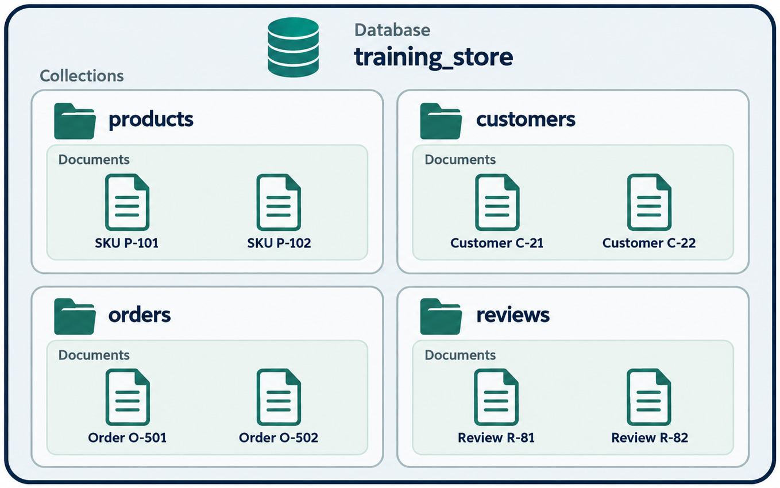
DATABASES, COLLECTIONS AND DOCUMENTS
MODULE 3
📌
KEY POINTS
MongoDB organizes data using the following hierarchy:
MongoDB deployment
└── Database: training_store
├── Collection: products
├── Collection: customers
├── Collection: orders
└── Collection: reviews
4
© 2026 by Innovation In Software Corporation
Notes:
MongoDB organizes data using the following hierarchy:

Slide 6
DATABASE
MODULE 3
📌
KEY POINTS
A database is a logical container for related collections.
The command selects the database. MongoDB physically creates it after data is written.
Check the current database:
use training_store
db
5
© 2026 by Innovation In Software Corporation
Notes:
A database is a logical container for related collections.

Slide 7
COLLECTION
MODULE 3
📌
KEY POINTS
A collection contains related documents. It is approximately comparable to a relational table, although documents in a collection can have flexible structures.
Examples:
Create a collection explicitly:
MongoDB can also create it implicitly:
products
customers
orders
reviews
db.createCollection("products")
6
© 2026 by Innovation In Software Corporation
Notes:
A collection contains related documents. It is approximately comparable to a relational table, although documents in a collection can have flexible structures.

Slide 8
COLLECTION (CONT.)
MODULE 3
📌
KEY POINTS
If customers does not exist, MongoDB creates it during the insertion.
db.customers.insertOne({
firstName: "Aman",
lastName: "Singh"
})
7
© 2026 by Innovation In Software Corporation
Notes:
If `customers` does not exist, MongoDB creates it during the insertion.

Slide 9
DOCUMENT
MODULE 3
📌
KEY POINTS
A document is a set of field-value pairs. It represents a business object such as one product, customer or order.
A document is comparable to a relational row, but it can also contain:
• Nested objects
• Arrays
• Objects inside arrays
• Arrays inside objects
• Different fields from other documents
{
_id: ObjectId("..."),
name: "Wireless Mouse",
category: "Electronics",
price: NumberDecimal("39.99"),
stock: 120,
active: true
}
8
© 2026 by Innovation In Software Corporation
Notes:
A document is a set of field-value pairs. It represents a business object such as one product, customer or order.

Slide 10
FIELD
MODULE 3
📌
KEY POINTS
A field is a named piece of information inside a document:
Here, name and price are fields.
{
name: "Wireless Mouse",
price: NumberDecimal("39.99")
}
9
© 2026 by Innovation In Software Corporation
Notes:
A field is a named piece of information inside a document:

Slide 11
THE _ID FIELD
MODULE 3
📌
KEY POINTS
Every MongoDB document must have a unique _id.
If the application does not supply one, MongoDB normally generates an ObjectId:
The _id field:
• Uniquely identifies a document
• Has a unique index automatically
• Cannot be changed after insertion
• Can contain an ObjectId, string, number or another suitable unique value
{
_id: ObjectId("68f100a93e43...")
}
10
© 2026 by Innovation In Software Corporation
Notes:
Every MongoDB document must have a unique `_id`.

Slide 12
COMMON BSON TYPES
MODULE 3
📌
KEY POINTS
MongoDB stores documents using BSON, or Binary JSON. BSON supports JSON-style structures plus additional data types.
Type | Example | Typical use
String | "Electronics" | Names and descriptions
Integer | 120 | Quantity and counters
Decimal128 | NumberDecimal("39.99") | Financial values
Double | 4.7 | Measurements and approximate values
Boolean | true | Status flags
Date | ISODate("2026-09-22T10:00:00Z") | Dates and timestamps
ObjectId | ObjectId("...") | Document identifiers
Array | ["wireless", "mouse"] | Multiple values
Embedded document | { city: "Brampton" } | Structured nested data
Null | null | Known but absent values
11
© 2026 by Innovation In Software Corporation
Notes:
Covers Common BSON types.

Slide 13
EXAMPLE WITH SEVERAL DATA TYPES
MODULE 3
{
_id: ObjectId("..."),
name: "Wireless Mouse",
price: NumberDecimal("39.99"),
stock: 120,
active: true,
createdAt: ISODate("2026-09-22T10:00:00Z"),
tags: ["wireless", "computer-accessory"],
specifications: {
connection: "Bluetooth",
colour: "Black",
rechargeable: true
}
}
12
© 2026 by Innovation In Software Corporation
Notes:
Covers Example with several data types.

Slide 14
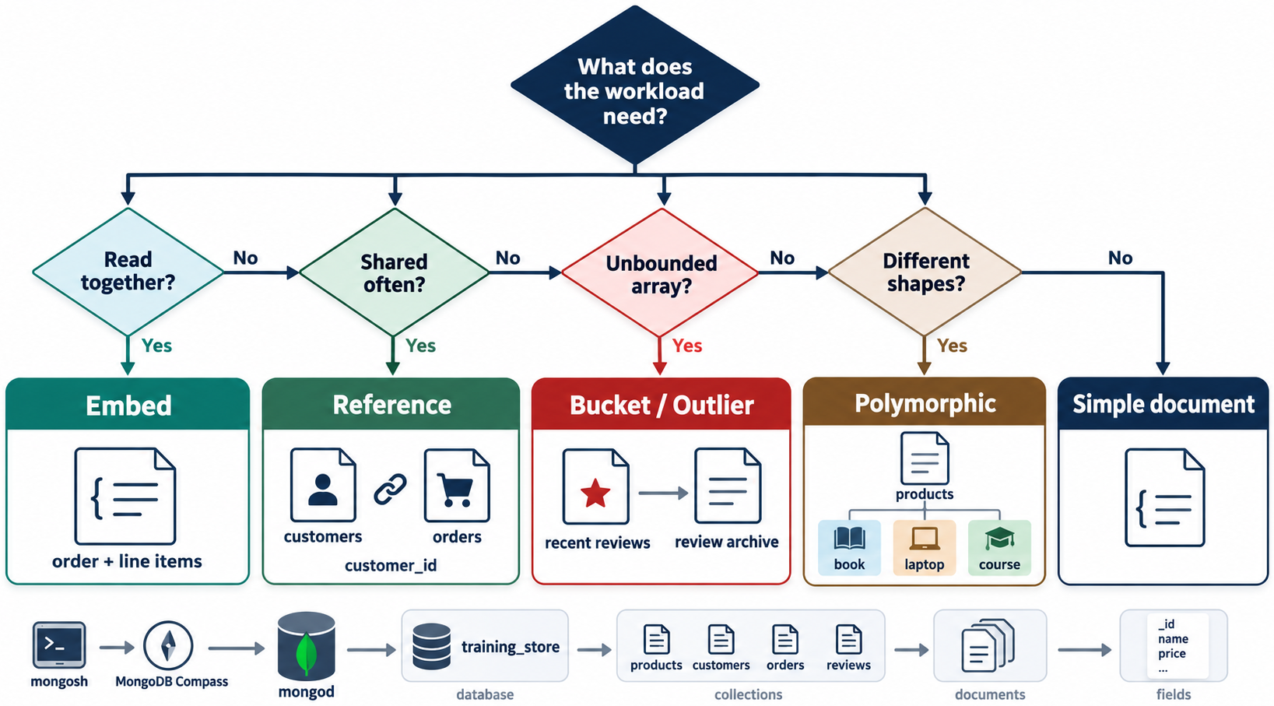
SELECTING APPROPRIATE TYPES
MODULE 3
📌
KEY POINTS
Use types that represent the business meaning accurately.
For example:
These strings make calculations, comparisons and sorting more difficult.
Better choices are:
// Poor choices
{
price: "39.99",
stock: "120",
active: "yes",
createdAt: "September 22, 2026"
}
{
price: NumberDecimal("39.99"),
stock: 120,
active: true,
createdAt: ISODate("2026-09-22T10:00:00Z")
}
13
© 2026 by Innovation In Software Corporation
Notes:
Use types that represent the business meaning accurately.

Slide 15
SELECTING APPROPRIATE TYPES (CONT.)
MODULE 3
📌
KEY POINTS
For currency, Decimal128 is often preferable to floating-point values because it avoids many binary floating-point precision issues.
14
© 2026 by Innovation In Software Corporation
Notes:
For currency, `Decimal128` is often preferable to floating-point values because it avoids many binary floating-point precision issues.

Slide 16
STEP 1: IDENTIFY BUSINESS ENTITIES
MODULE 3
📌
KEY POINTS
MongoDB has a flexible schema, but flexible does not mean unplanned.
A good schema supports the application’s common reads and writes efficiently.
For training_store, the main entities are:
Product
Customer
Order
Review
15
© 2026 by Innovation In Software Corporation
Notes:
For `training_store`, the main entities are:

Slide 17
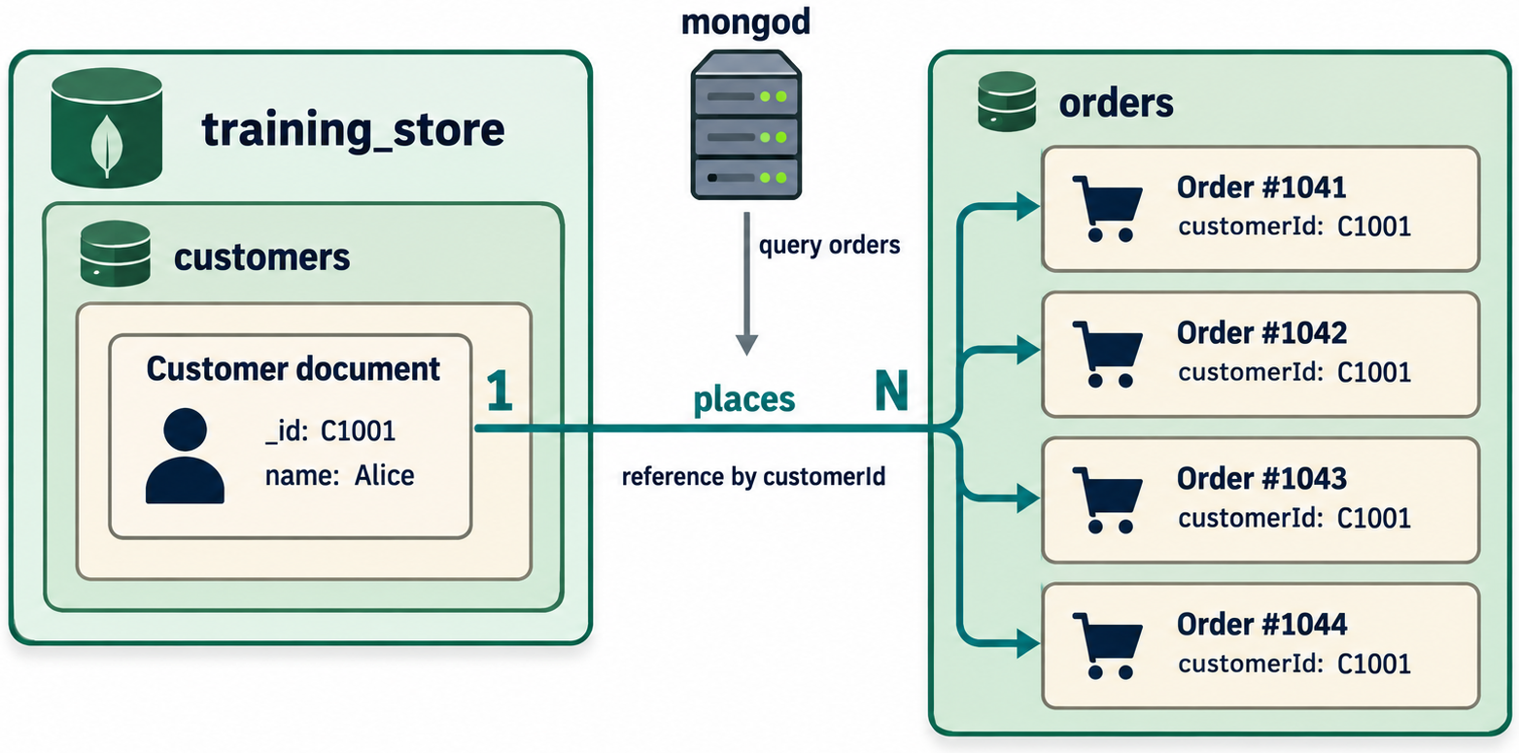
STEP 2: IDENTIFY RELATIONSHIPS
MODULE 3
Customer 1 ─── places ─── many Orders
Customer 1 ─── writes ─── many Reviews
Product 1 ─── receives ─ many Reviews
Order 1 ─── contains ─ many Order Items
16
© 2026 by Innovation In Software Corporation
Notes:
Covers Step 2: Identify relationships.

Slide 18
STEP 3: IDENTIFY IMPORTANT OPERATIONS
MODULE 3
📌
KEY POINTS
Common access patterns might include:
1. Find a product by SKU.
2. Browse products by category.
3. Search products within a price range.
4. Display one customer’s profile and addresses.
5. Display one order with all purchased items.
6. Show a customer’s order history.
7. Display reviews for one product.
8. Calculate the average product rating.
9. Update product inventory.
10. Change an order’s status.
These operations should influence the document structures.
17
© 2026 by Innovation In Software Corporation
Notes:
Common access patterns might include:

Slide 19
STEP 4: ESTIMATE DATA GROWTH
MODULE 3
📌
KEY POINTS
Ask:
• How many addresses can one customer have?
• How many items can one order contain?
• How many reviews can one product receive?
• Does the related data grow without a practical limit?
• How frequently does it change?
• Could the document approach MongoDB’s document-size limit?
A small, bounded list may be embedded. A large or continuously growing list is usually better stored separately.
18
© 2026 by Innovation In Software Corporation
Notes:
Ask:

Slide 20
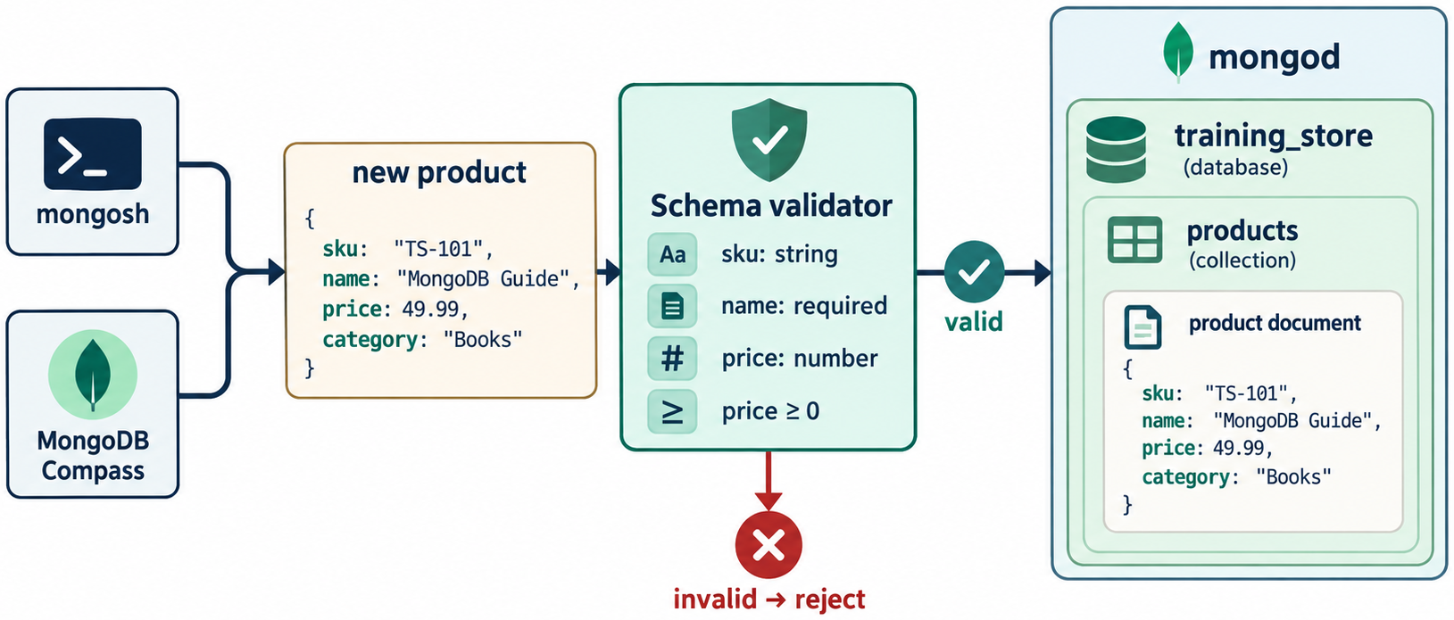
PRODUCT SCHEMA DESIGN
MODULE 3
📌
KEY POINTS
Different product categories can contain different specifications.
An electronics product:
A book:
{
sku: "ELEC-1001",
name: "Wireless Mouse",
category: "Electronics",
price: NumberDecimal("39.99"),
stock: 120,
specifications: {
connection: "Bluetooth",
colour: "Black",
rechargeable: true
}
}
19
© 2026 by Innovation In Software Corporation
Notes:
Different product categories can contain different specifications.

Slide 21
PRODUCT SCHEMA DESIGN (CONT.)
MODULE 3
📌
KEY POINTS
Both documents belong in products, but their specifications differ.
This design works when:
• All documents represent products.
• The application shares common operations across them.
• Category-specific attributes vary.
• The common fields remain consistent.
Avoid inconsistent names such as:
{
sku: "BOOK-2001",
name: "MongoDB Fundamentals",
category: "Books",
price: NumberDecimal("49.99"),
stock: 75,
specifications: {
author: "A. Singh",
isbn: "978-1234567890",
pages: 420
}
}
20
© 2026 by Innovation In Software Corporation
Notes:
Both documents belong in `products`, but their `specifications` differ.

Slide 22
PRODUCT SCHEMA DESIGN (CONT.)
MODULE 3
📌
KEY POINTS
Prefer:
// Inconsistent
{ productName: "Mouse" }
{ item_name: "Keyboard" }
{ title: "Monitor" }
{ name: "Mouse" }
{ name: "Keyboard" }
{ name: "Monitor" }
21
© 2026 by Innovation In Software Corporation
Notes:
Prefer:

Slide 23
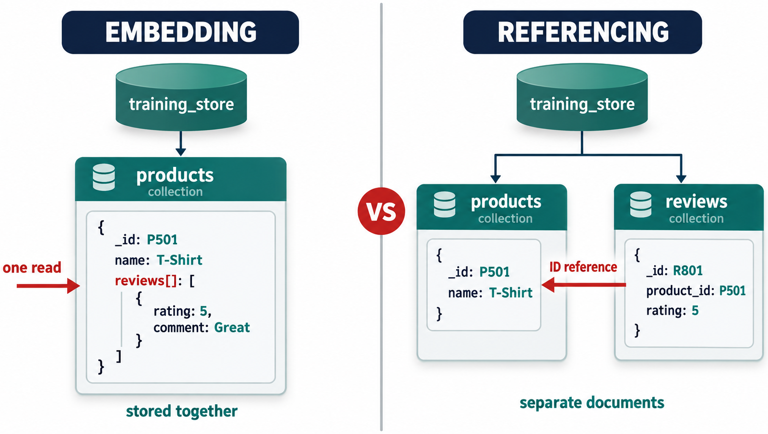
EMBEDDING
MODULE 3
📌
KEY POINTS
MongoDB represents relationships using two primary approaches:
• Embedding related information inside a document
• Referencing documents stored in another collection
Embedding stores related data inside its parent document.
Example customer with embedded addresses:
This works well because:
{
_id: ObjectId("..."),
firstName: "Aman",
lastName: "Singh",
email: "aman@example.com",
addresses: [
{
type: "home",
street: "100 Main Street",
city: "Brampton",
province: "ON",
postalCode: "L6X 1A1"
},
{
type: "work",
street: "200 King Street",
city: "Toronto",
province: "ON",
postalCode: "M5H 1B5"
}
]
}
22
© 2026 by Innovation In Software Corporation
Notes:
Embedding stores related data inside its parent document.

Slide 24
EMBEDDING (CONT.)
MODULE 3
📌
KEY POINTS
• Addresses belong to the customer.
• A customer normally has a limited number of addresses.
• The profile and addresses are commonly displayed together.
• An address does not need to exist independently.
### Advantages of embedding
• Retrieves related data in one query
• Avoids joins
• Supports atomic updates within one document
• Matches application objects naturally
• Can improve read performance
### Limitations of embedding
• Can duplicate shared information
• May produce large documents
• Is unsuitable for unbounded arrays
• Can make independent updates less convenient
23
© 2026 by Innovation In Software Corporation
Notes:
### Advantages of embedding

Slide 25
REFERENCING
MODULE 3
📌
KEY POINTS
Referencing stores related data in separate collections and connects documents using identifiers.
Customer:
Review:
{
_id: ObjectId("66a100000000000000000001"),
firstName: "Aman",
lastName: "Singh",
email: "aman@example.com"
}
24
© 2026 by Innovation In Software Corporation
Notes:
Referencing stores related data in separate collections and connects documents using identifiers.

Slide 26
REFERENCING (CONT.)
MODULE 3
📌
KEY POINTS
The review refers to the customer and product.
### Advantages of referencing
• Avoids excessive duplication
• Supports independently changing data
• Works well for many-to-many relationships
• Handles large and growing relationships
• Keeps individual documents smaller
{
_id: ObjectId("..."),
productId: ObjectId("65a100000000000000000001"),
customerId: ObjectId("66a100000000000000000001"),
rating: 5,
comment: "Easy to use and very responsive.",
createdAt: ISODate("2026-09-22T10:00:00Z")
}
25
© 2026 by Innovation In Software Corporation
Notes:
The review refers to the customer and product.

Slide 27
REFERENCING (CONT.)
MODULE 3
📌
KEY POINTS
### Limitations of referencing
• May require multiple queries
• May require $lookup aggregation
• Makes application logic more complex
• Cross-document operations may require transactions
26
© 2026 by Innovation In Software Corporation
Notes:
### Limitations of referencing

Slide 28
HOW TO CHOOSE BETWEEN THEM
MODULE 3
📌
KEY POINTS
Consideration | Embed | Reference
Data is normally read together | Yes | Possibly
Related data is small and bounded | Yes | Not required
Child belongs only to one parent | Yes | Possibly
Related data grows continuously | No | Yes
Related data is shared by many records | No | Yes
Related data changes independently | Sometimes | Yes
One-query retrieval is important | Yes | Requires lookup or another query
Duplication would be substantial | No | Yes
Atomic update is required | Strong choice | May require a transaction
A practical rule is:
27
© 2026 by Innovation In Software Corporation
Notes:
A practical rule is:

Slide 29
HOW TO CHOOSE BETWEEN THEM (CONT.)
MODULE 3
KEY TAKEAWAY Embed bounded data that belongs to the parent; reference independent, shared or unbounded data.
28
© 2026 by Innovation In Software Corporation
Notes:
Covers How to Choose Between Them.

Slide 30
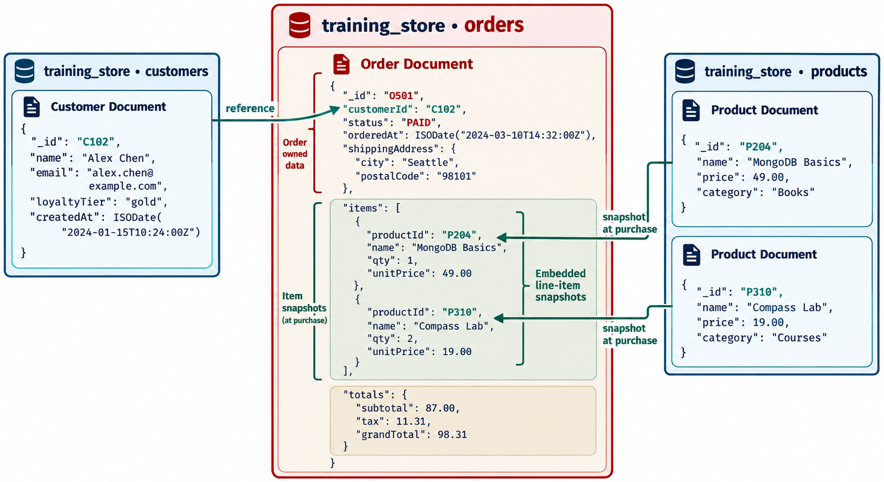
MODELING ORDERS: A HYBRID APPROACH
MODULE 3
📌
KEY POINTS
Orders demonstrate that embedding and referencing can be used together.
{
_id: ObjectId("..."),
orderNumber: "ORD-2026-1001",
customerId: ObjectId("66a100000000000000000001"),
items: [
{
productId: ObjectId("65a100000000000000000001"),
sku: "ELEC-1001",
productName: "Wireless Mouse",
unitPrice: NumberDecimal("39.99"),
quantity: 2
}
],
shippingAddress: {
street: "100 Main Street",
city: "Brampton",
province: "ON",
postalCode: "L6X 1A1"
},
status: "Shipped",
total: NumberDecimal("79.98"),
orderedAt: ISODate("2026-09-22T10:00:00Z")
}
29
© 2026 by Innovation In Software Corporation
Notes:
Orders demonstrate that embedding and referencing can be used together.

Slide 31
MODELING ORDERS: A HYBRID APPROACH (CONT.)
MODULE 3
📌
KEY POINTS
This model uses:
• A reference to the customer
• A reference to each product
• Embedded order items
• Embedded shipping address
• Copied product name, SKU and price
30
© 2026 by Innovation In Software Corporation
Notes:
This model uses:

Slide 32
WHY COPY PRODUCT INFORMATION?
MODULE 3
📌
KEY POINTS
The product name or price might change later. An order should preserve the values that were applicable when the purchase occurred.
If the current product price changes from $39.99 to $44.99, the historical order should still show $39.99.
This controlled duplication is called a snapshot or historical pattern.
31
© 2026 by Innovation In Software Corporation
Notes:
The product name or price might change later. An order should preserve the values that were applicable when the purchase occurred.

Slide 33
TREATING COLLECTIONS EXACTLY LIKE RELATIONAL TABLES
MODULE 3
📌
KEY POINTS
Creating separate collections for every small component can force the application to reconstruct objects using numerous queries.
32
© 2026 by Innovation In Software Corporation
Notes:
Creating separate collections for every small component can force the application to reconstruct objects using numerous queries.

Slide 34
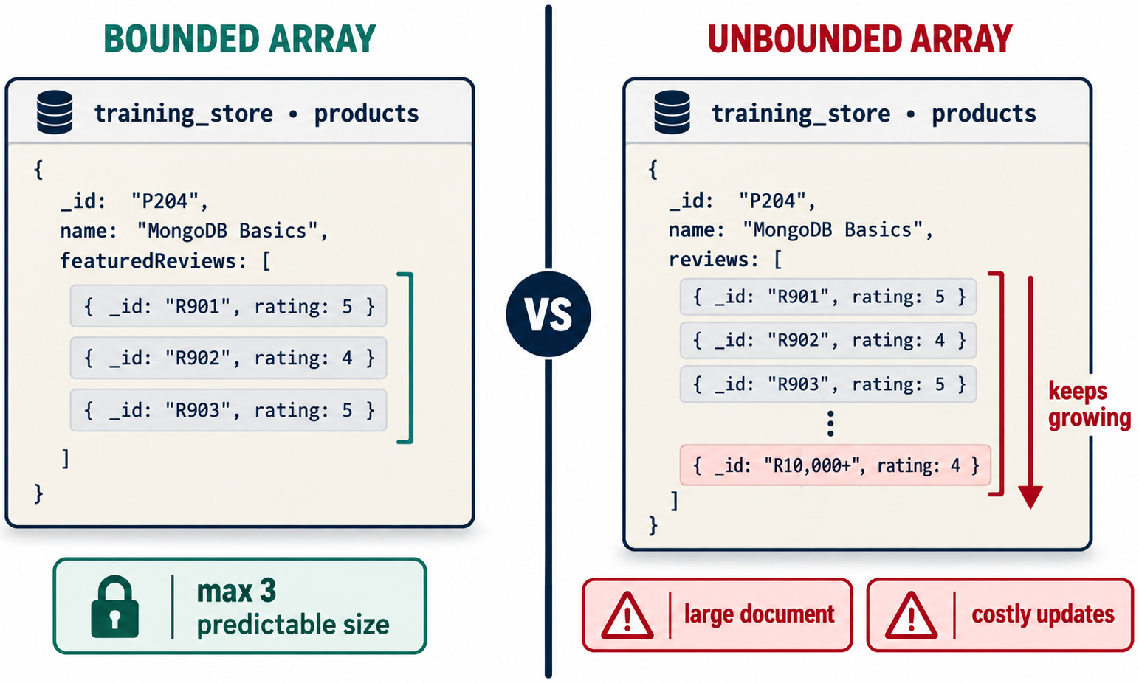
EMBEDDING AN UNBOUNDED ARRAY
MODULE 3
📌
KEY POINTS
Avoid a product document containing every review:
Store reviews in a separate collection instead.
{
name: "Wireless Mouse",
reviews: [
// Could eventually contain millions of elements
]
}
33
© 2026 by Innovation In Software Corporation
Notes:
Avoid a product document containing every review:

Slide 35
STORING FREQUENTLY CHANGING SHARED DATA EVERYWHERE
MODULE 3
📌
KEY POINTS
Duplicating a customer’s current profile in thousands of active records makes updates difficult. Duplicate only the fields that need to remain as a historical snapshot.
34
© 2026 by Innovation In Software Corporation
Notes:
Duplicating a customer’s current profile in thousands of active records makes updates difficult. Duplicate only the fields that need to remain as a historical snapshot.

Slide 36
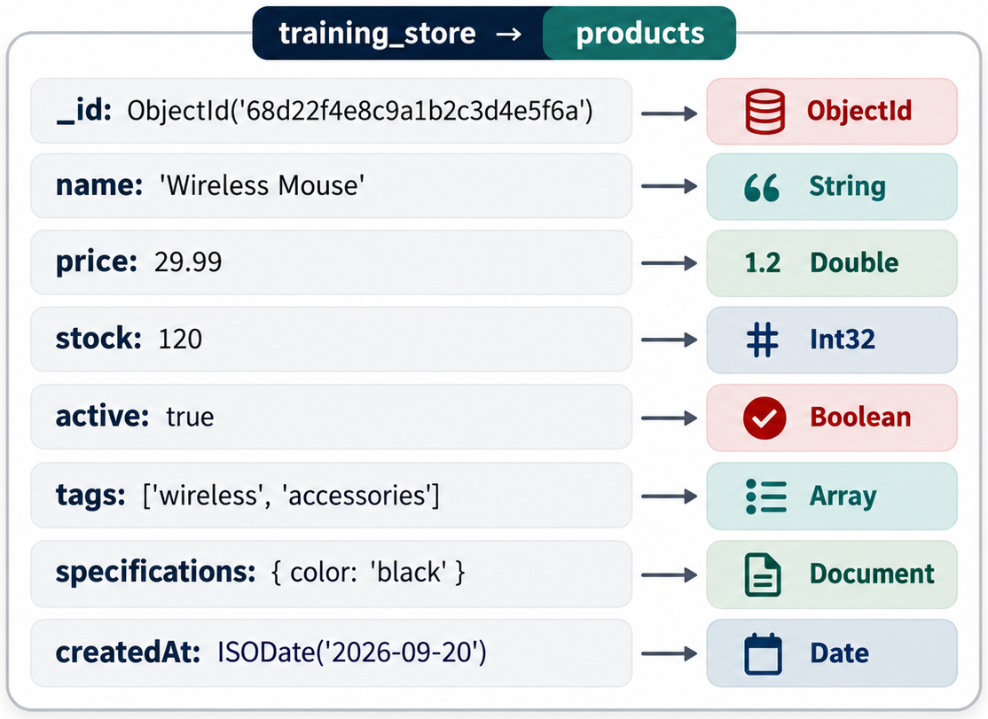
USING INCONSISTENT DATA TYPES
MODULE 3
📌
KEY POINTS
Avoid:
Choose one structure and apply it consistently.
{ price: 39.99 }
{ price: "39.99" }
{ price: { amount: 39.99 } }
35
© 2026 by Innovation In Software Corporation
Notes:
Avoid:

Slide 37
DESIGNING WITHOUT CONSIDERING QUERIES
MODULE 3
📌
KEY POINTS
A technically valid document model can still perform poorly if it does not support common queries and indexes.
36
© 2026 by Innovation In Software Corporation
Notes:
A technically valid document model can still perform poorly if it does not support common queries and indexes.

Slide 38
STEP 1: SELECT THE DATABASE
MODULE 3
use training_store
37
© 2026 by Innovation In Software Corporation
Notes:
Covers Step 1: Select the database.

Slide 39
STEP 2: REMOVE PREVIOUS LAB COLLECTIONS
MODULE 3
📌
KEY POINTS
Only run this in a disposable training database:
A result of false simply means the collection did not exist.
db.products.drop()
db.customers.drop()
db.orders.drop()
db.reviews.drop()
38
© 2026 by Innovation In Software Corporation
Notes:
Only run this in a disposable training database:

Slide 40
STEP 3: CREATE COLLECTIONS
MODULE 3
📌
KEY POINTS
Verify:
db.createCollection("products")
db.createCollection("customers")
db.createCollection("orders")
db.createCollection("reviews")
show collections
39
© 2026 by Innovation In Software Corporation
Notes:
Verify:

Slide 41
POPULATE THE PRODUCTS COLLECTION
MODULE 3
📌
KEY POINTS
To make later references easy, the lab uses predetermined ObjectId values.
Insert the products:
const mouseId =
ObjectId("65a100000000000000000001");
const keyboardId =
ObjectId("65a100000000000000000002");
const bookId =
ObjectId("65a100000000000000000003");
40
© 2026 by Innovation In Software Corporation
Notes:
To make later references easy, the lab uses predetermined `ObjectId` values.

Slide 42
POPULATE THE PRODUCTS COLLECTION (CONT.)
MODULE 3
db.products.insertMany([
{
_id: mouseId,
sku: "ELEC-1001",
name: "Wireless Mouse",
category: "Electronics",
price: NumberDecimal("39.99"),
stock: 120,
active: true,
tags: ["wireless", "mouse", "accessory"],
specifications: {
connection: "Bluetooth",
colour: "Black",
rechargeable: true
},
createdAt: ISODate("2026-09-20T09:00:00Z")
},
{
_id: keyboardId,
sku: "ELEC-1002",
name: "Mechanical Keyboard",
category: "Electronics",
price: NumberDecimal("89.99"),
stock: 45,
active: true,
tags: ["keyboard", "mechanical", "accessory"],
specifications: {
connection: "USB-C",
switchType: "Tactile",
backlit: true
},
createdAt: ISODate("2026-09-20T09:05:00Z")
},
{
_id: bookId,
sku: "BOOK-2001",
name: "MongoDB Fundamentals",
category: "Books",
price: NumberDecimal("49.99"),
stock: 75,
active: true,
tags: ["mongodb", "database", "nosql"],
specifications: {
author: "A. Singh",
isbn: "978-1234567890",
pages: 420
},
createdAt: ISODate("2026-09-20T09:10:00Z")
}
])
41
© 2026 by Innovation In Software Corporation
Notes:
Covers Populate the Products Collection.

Slide 43
POPULATE THE CUSTOMERS COLLECTION
MODULE 3
📌
KEY POINTS
Create customer identifiers:
Insert customers with embedded addresses:
const amanId =
ObjectId("66a100000000000000000001");
const priyaId =
ObjectId("66a100000000000000000002");
42
© 2026 by Innovation In Software Corporation
Notes:
Create customer identifiers:

Slide 44
POPULATE THE CUSTOMERS COLLECTION (CONT.)
MODULE 3
db.customers.insertMany([
{
_id: amanId,
firstName: "Aman",
lastName: "Singh",
email: "aman@example.com",
phone: "+1-905-555-0101",
addresses: [
{
type: "home",
street: "100 Main Street",
city: "Brampton",
province: "ON",
postalCode: "L6X 1A1",
country: "Canada",
default: true
}
],
createdAt: ISODate("2026-09-21T12:00:00Z")
},
{
_id: priyaId,
firstName: "Priya",
lastName: "Sharma",
email: "priya@example.com",
phone: "+1-416-555-0102",
addresses: [
{
type: "home",
street: "250 Lake Road",
city: "Toronto",
province: "ON",
postalCode: "M5V 2T6",
country: "Canada",
default: true
},
{
type: "work",
street: "80 King Street",
city: "Toronto",
province: "ON",
postalCode: "M5H 1J9",
country: "Canada",
default: false
}
],
createdAt: ISODate("2026-09-21T12:10:00Z")
}
])
43
© 2026 by Innovation In Software Corporation
Notes:
Covers Populate the Customers Collection.

Slide 45
POPULATE THE ORDERS COLLECTION
MODULE 3
db.orders.insertMany([
{
orderNumber: "ORD-2026-1001",
customerId: amanId,
items: [
{
productId: mouseId,
sku: "ELEC-1001",
productName: "Wireless Mouse",
unitPrice: NumberDecimal("39.99"),
quantity: 2,
lineTotal: NumberDecimal("79.98")
}
],
shippingAddress: {
street: "100 Main Street",
city: "Brampton",
province: "ON",
postalCode: "L6X 1A1",
country: "Canada"
},
status: "Shipped",
subtotal: NumberDecimal("79.98"),
tax: NumberDecimal("10.40"),
total: NumberDecimal("90.38"),
orderedAt: ISODate("2026-09-22T10:00:00Z")
},
{
orderNumber: "ORD-2026-1002",
customerId: priyaId,
items: [
{
productId: keyboardId,
sku: "ELEC-1002",
productName: "Mechanical Keyboard",
unitPrice: NumberDecimal("89.99"),
quantity: 1,
lineTotal: NumberDecimal("89.99")
},
{
productId: bookId,
sku: "BOOK-2001",
productName: "MongoDB Fundamentals",
unitPrice: NumberDecimal("49.99"),
quantity: 1,
lineTotal: NumberDecimal("49.99")
}
],
shippingAddress: {
street: "250 Lake Road",
city: "Toronto",
province: "ON",
postalCode: "M5V 2T6",
country: "Canada"
},
status: "Processing",
subtotal: NumberDecimal("139.98"),
tax: NumberDecimal("18.20"),
total: NumberDecimal("158.18"),
orderedAt: ISODate("2026-09-22T11:30:00Z")
}
])
44
© 2026 by Innovation In Software Corporation
Notes:
Covers Populate the Orders Collection.

Slide 46
POPULATE THE REVIEWS COLLECTION
MODULE 3
📌
KEY POINTS
Reviews are stored separately because their number can grow continuously.
db.reviews.insertMany([
{
productId: mouseId,
customerId: amanId,
rating: 5,
title: "Excellent mouse",
comment: "Easy to use and very responsive.",
verifiedPurchase: true,
createdAt: ISODate("2026-09-22T14:00:00Z")
},
{
productId: keyboardId,
customerId: priyaId,
rating: 4,
title: "Comfortable keyboard",
comment: "Good typing experience and build quality.",
verifiedPurchase: true,
createdAt: ISODate("2026-09-22T15:00:00Z")
},
{
productId: bookId,
customerId: priyaId,
rating: 5,
title: "Clear introduction",
comment: "The examples are practical and easy to follow.",
verifiedPurchase: true,
createdAt: ISODate("2026-09-22T15:15:00Z")
}
])
45
© 2026 by Innovation In Software Corporation
Notes:
Reviews are stored separately because their number can grow continuously.

Slide 47
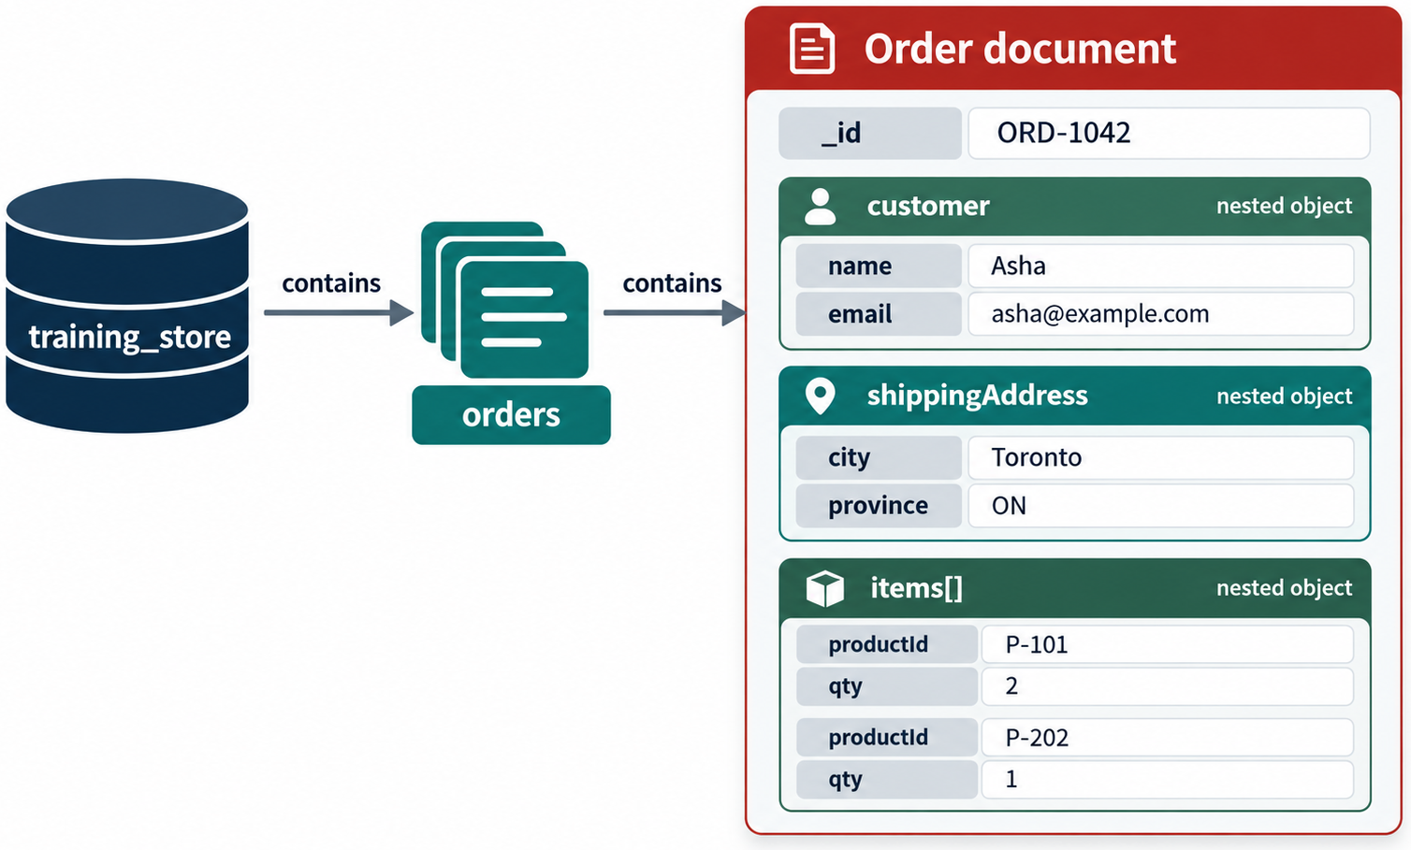
COUNT DOCUMENTS
MODULE 3
📌
KEY POINTS
Expected results:
Collection | Expected count
products | 3
customers | 2
orders | 2
reviews | 3
db.products.countDocuments()
db.customers.countDocuments()
db.orders.countDocuments()
db.reviews.countDocuments()
46
© 2026 by Innovation In Software Corporation
Notes:
Expected results:

Slide 48
FIND ELECTRONICS PRODUCTS
MODULE 3
db.products.find(
{ category: "Electronics" },
{ name: 1, price: 1, stock: 1 }
)
47
© 2026 by Innovation In Software Corporation
Notes:
Covers Find electronics products.

Slide 49
FIND PRODUCTS BELOW $50
MODULE 3
db.products.find({
price: { $lt: NumberDecimal("50.00") }
})
48
© 2026 by Innovation In Software Corporation
Notes:
Covers Find products below $50.

Slide 50
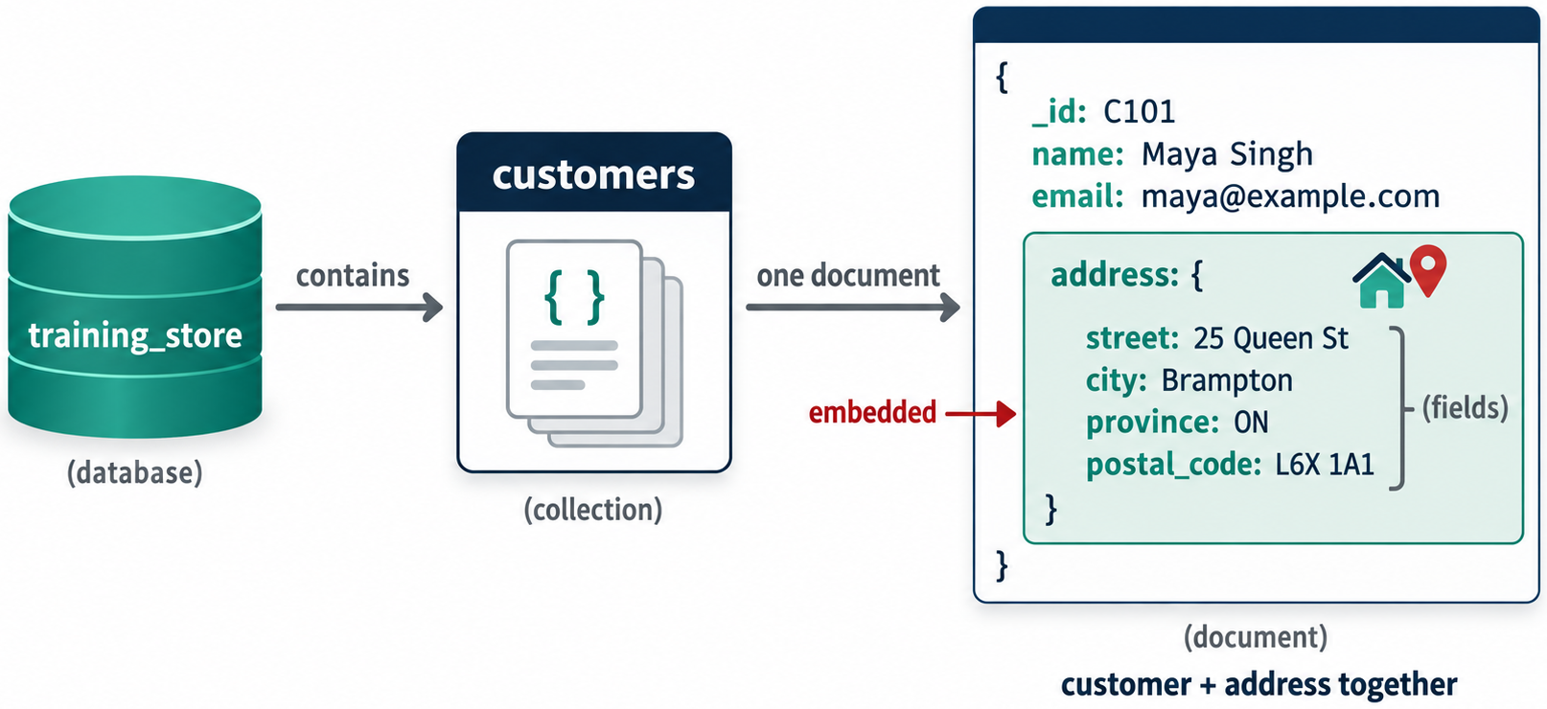
QUERY AN EMBEDDED FIELD
MODULE 3
📌
KEY POINTS
Find customers who have an address in Brampton:
db.customers.find({
"addresses.city": "Brampton"
})
49
© 2026 by Innovation In Software Corporation
Notes:
Find customers who have an address in Brampton:

Slide 51
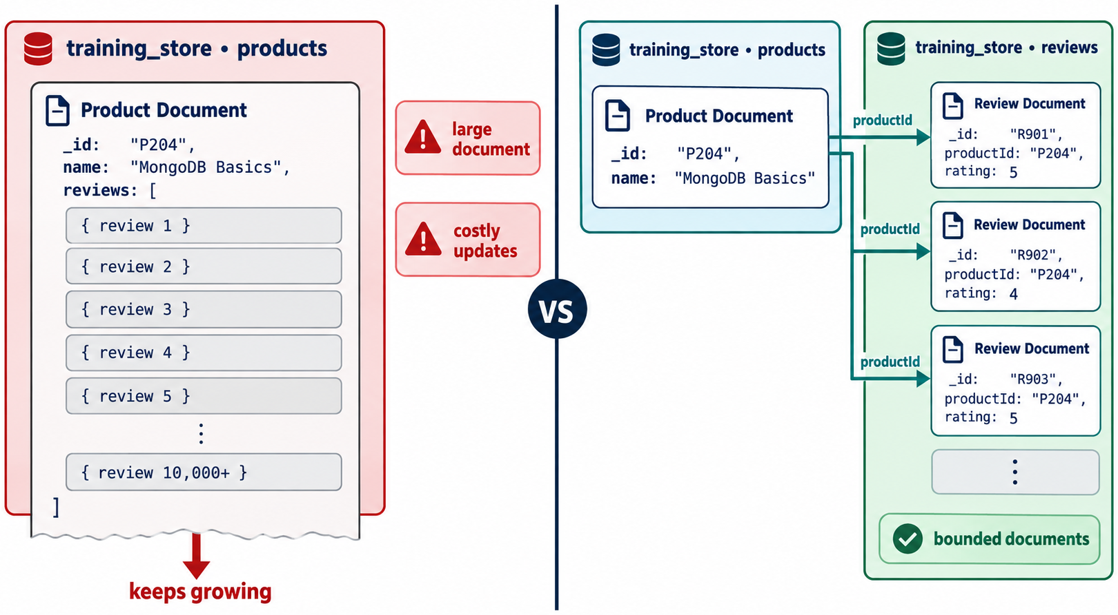
QUERY AN EMBEDDED ARRAY
MODULE 3
📌
KEY POINTS
Find orders containing the wireless mouse:
db.orders.find({
"items.productId": mouseId
})
50
© 2026 by Innovation In Software Corporation
Notes:
Find orders containing the wireless mouse:

Slide 52
FIND ONE CUSTOMER’S ORDERS
MODULE 3
db.orders.find({
customerId: amanId
})
51
© 2026 by Innovation In Software Corporation
Notes:
Covers Find one customer’s orders.

Slide 53
FIND REVIEWS FOR A PRODUCT
MODULE 3
db.reviews.find({
productId: mouseId
})
52
© 2026 by Innovation In Software Corporation
Notes:
Covers Find reviews for a product.

Slide 54
JOIN REFERENCED DATA WITH $LOOKUP
MODULE 3
📌
KEY POINTS
Retrieve reviews with product information:
This operation shows the tradeoff of referencing: related data remains independent, but combining it requires another query or an aggregation join.
db.reviews.aggregate([
{
$match: {
productId: mouseId
}
},
{
$lookup: {
from: "products",
localField: "productId",
foreignField: "_id",
as: "product"
}
},
{
$unwind: "$product"
},
{
$project: {
_id: 0,
productName: "$product.name",
rating: 1,
title: 1,
comment: 1
}
}
])
53
© 2026 by Innovation In Software Corporation
Notes:
Retrieve reviews with product information:

Slide 55
RECOMMENDED INDEXES FOR THE MODEL
MODULE 3
📌
KEY POINTS
Indexes should follow the identified access patterns.
These indexes support:
• Product lookup by SKU
• Product browsing by category and price
• Customer lookup by email
• Customer order history
• Product review history
db.products.createIndex(
{ sku: 1 },
{ unique: true }
)
db.products.createIndex({
category: 1,
price: 1
})
db.customers.createIndex(
{ email: 1 },
{ unique: true }
)
db.orders.createIndex({
customerId: 1,
orderedAt: -1
})
db.reviews.createIndex({
productId: 1,
createdAt: -1
})
54
© 2026 by Innovation In Software Corporation
Notes:
Indexes should follow the identified access patterns.

Slide 56
LAB REVIEW QUESTIONS
MODULE 3
🛠️
KEY POINTS
1. Why are customer addresses embedded?
2. Why are product reviews stored separately?
3. Why does an order contain both productId and productName?
4. What would happen to old orders if the product price changed?
5. Should order items be placed in a separate collection?
6. Which field types should be used for money and dates?
7. Which queries require references to be resolved?
8. Which arrays are bounded, and which could grow indefinitely?
55
© 2026 by Innovation In Software Corporation
Notes:
Covers Lab Review Questions.

Slide 57
SUGGESTED ANSWERS
MODULE 3
📌
KEY POINTS
• Addresses are bounded and normally retrieved with their customer.
• Reviews can grow indefinitely and exist as independent records.
• productId identifies the product, while the copied name preserves order history.
• The historical order price remains unchanged.
• Normally, order items should remain embedded because they belong to one order and are retrieved with it.
• Use Decimal128 for precise monetary values and BSON dates for timestamps.
• Orders-to-customers and reviews-to-products require separate queries or $lookup.
• Customer addresses and order items are normally bounded; product reviews may be unbounded.
56
© 2026 by Innovation In Software Corporation
Notes:
Covers Suggested answers.

Slide 58
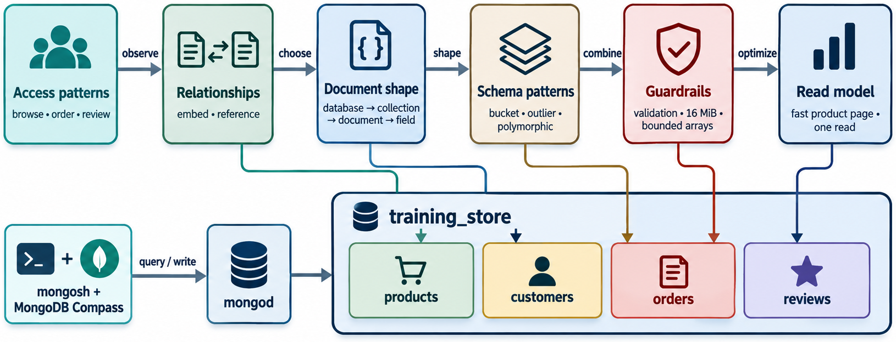
MODULE OUTCOME
MODULE 3
🧭
KEY POINTS
After completing this module, learners should be able to:
• Explain databases, collections, documents and fields.
• Select appropriate BSON data types.
• Identify application access patterns.
• Model one-to-one, one-to-many and many-to-many relationships.
• Choose between embedding and referencing.
• Apply a hybrid model where appropriate.
• Populate a connected MongoDB dataset.
• Query embedded and referenced information.
• Create initial indexes around important access patterns.
57
© 2026 by Innovation In Software Corporation
Notes:
After completing this module, learners should be able to:

Slide 59
DEMO 3.1 — INSPECT A BSON DOCUMENT
MODULE 3
🛠️
KEY POINTS
DURATION
10 minutes
instructor mongosh
Identify live: _id, strings, numbers, Boolean, Date, array, nested document.
If the collection is empty, insert the anatomy example first.
use training_store
db.products.findOne()
58
© 2026 by Innovation In Software Corporation
Notes:
The slide title is: Demo 3.1 — Inspect a BSON Document.
The slide says: Duration: 10 minutes · instructor mongosh.
The slide says: Identify live: _id, strings, numbers, Boolean, Date, array, nested document.
The slide says: If the collection is empty, insert the anatomy example first.
The code on the slide reads: use training_store db.products.findOne().

Slide 60
EXERCISE 3.1 — IDENTIFY DOCUMENT COMPONENTS
MODULE 3
🛠️
KEY POINTS
• 10 minutes · pairs
• Label every shape on the sample customer
• Then list candidate required fields
LAB GUIDE Exercise 3.1
59
© 2026 by Innovation In Software Corporation
Notes:
This slide includes a diagram — Exercise 3.1 — Identify Document Components.
The slide title is: Exercise 3.1 — Identify Document Components.
The slide says: <div class="cols">.
The slide says: <div class="col-text">.
The slide says: Lab guide: [Exercise 3.1](../slide-exercises/module-03/exercise-3.1-identify-document-components.md).
The slide says: </div>.
The slide says: <div class="col-visual">.
Bullet 1 on the slide: 10 minutes · pairs.
Bullet 2 on the slide: Label every shape on the sample customer.
Bullet 3 on the slide: Then list candidate required fields.
The figure on this slide is titled: Callouts for _id, scalars, embedded name, tags, date.

Slide 61
EXERCISE 3.1 — STEPS 1–2
MODULE 3
🛠️
KEY POINTS
LAB GUIDE Exercise 3.1
Follow along (Windows) — key steps:
Step 1 — Label identifier, scalars, and the nested name
• Do: On the sample document, mark _id, every scalar field (customerNumber, email), and the embedded name document. Write one sentence: what does _id guarantee inside a collection?
• Expected: _id is the unique identifier. customerNumber and email are scalars. name is an embedded document with first and last.
Step 2 — Label array, Boolean, date, and required fields
• Do: Mark tags as an array, active as a Boolean, and createdAt as a Date. Then list candidate required fields for every customer document in this collection.
• Expected: You named tags, active, and createdAt correctly. Required-field candidates typically include _id (always), customerNumber, name, email or contact,
_Full lab guide with every command: see Lab guide on the lesson divider slide._
• Do: Mark tags as an array, active as a Boolean, and createdAt as a Date. Then list candidate required fields for every customer document in this collection.
• Expected: You named tags, active, and createdAt correctly. Required-field candidates typically include _id, customerNumber, name, contact, active, and createdAt.
60
© 2026 by Innovation In Software Corporation
Notes:
We are starting Exercise 3.1 — Identify Document Components. We have about 10 min for this lab.
Label _id, scalars, embedded documents, arrays, booleans, dates, and candidate required fields on a sample customer document.
The full lab guide is in slide-exercises/module-03/exercise-3.1-identify-document-components.md if you need extra detail.
On Windows: PowerShell in the integrated terminal — Ctrl+backtick — and the Agent panel — Ctrl+I. Open the repo folder with File → Open Folder.
Step 1 — Label identifier, scalars, and the nested name.
Step 2 — Label array, Boolean, date, and required fields.
Step 1 — Label identifier, scalars, and the nested name.
Step 2 — Label array, Boolean, date, and required fields.
Step 1 — Label identifier, scalars, and the nested name.
Step 2 — Label array, Boolean, date, and required fields.
Step 1 — Label identifier, scalars, and the nested name.
Step 2 — Label array, Boolean, date, and required fields.
Step 1 — Label identifier, scalars, and the nested name.
Step 2 — Label array, Boolean, date, and required fields.
Step 1 — Label identifier, scalars, and the nested name.
Step 2 — Label array, Boolean, date, and required fields.
Step 1 — Label identifier, scalars, and the nested name.
Step 2 — Label array, Boolean, date, and required fields.
Step 1 — Label identifier, scalars, and the nested name.
Step 2 — Label array, Boolean, date, and required fields.
Step 1 — Label identifier, scalars, and the nested name.
Step 2 — Label array, Boolean, date, and required fields.
Step 1 — Label identifier, scalars, and the nested name.
Step 2 — Label array, Boolean, date, and required fields.
I'll give you a few minutes to work — raise your hand if you get stuck.
The slide title is: Exercise 3.1 — Steps 1–2.
The slide says: Lab guide: [Exercise 3.1](../slide-exercises/module-03/exercise-3.1-identify-document-components.md).
The slide says: Follow along (Windows) — key steps:.
The slide says: _Full lab guide with every command: see Lab guide on the lesson divider slide._.
Bullet 1 on the slide: Do: On the sample document, mark _id, every scalar field (customerNumber, email), and the embedded name document. Write one sentence: what does _id guarantee inside a collection?.
Bullet 2 on the slide: Expected: _id is the unique identifier. customerNumber and email are scalars. name is an embedded document with first and last.
Bullet 3 on the slide: Do: Mark tags as an array, active as a Boolean, and createdAt as a Date. Then list candidate required fields for every customer document in this collection.
Bullet 4 on the slide: Expected: You named tags, active, and createdAt correctly. Required-field candidates typically include _id (always), customerNumber, name, email or contact,.
Bullet 5 on the slide: Do: On the sample document, mark _id, every scalar field (customerNumber, email), and the embedded name document. Write one sentence: what does _id guarantee inside a collection?.
Bullet 6 on the slide: Expected: _id is the unique identifier. customerNumber and email are scalars. name is an embedded document with first and last.
Bullet 7 on the slide: Do: Mark tags as an array, active as a Boolean, and createdAt as a Date. Then list candidate required fields for every customer document in this collection.
Bullet 8 on the slide: Expected: You named tags, active, and createdAt correctly. Required-field candidates typically include _id (always), customerNumber, name, email or contact,.
Bullet 9 on the slide: Do: On the sample document, mark _id, every scalar field (customerNumber, email), and the embedded name document. Write one sentence: what does _id guarantee inside a collection?.
Bullet 10 on the slide: Expected: _id is the unique identifier. customerNumber and email are scalars. name is an embedded document with first and last.
Bullet 11 on the slide: Do: Mark tags as an array, active as a Boolean, and createdAt as a Date. Then list candidate required fields for every customer document in this collection.
Bullet 12 on the slide: Expected: You named tags, active, and createdAt correctly. Required-field candidates typically include _id (always), customerNumber, name, email or contact,.
Bullet 13 on the slide: Do: On the sample document, mark _id, every scalar field (customerNumber, email), and the embedded name document. Write one sentence: what does _id guarantee inside a collection?.
Bullet 14 on the slide: Expected: _id is the unique identifier. customerNumber and email are scalars. name is an embedded document with first and last.
Bullet 15 on the slide: Do: Mark tags as an array, active as a Boolean, and createdAt as a Date. Then list candidate required fields for every customer document in this collection.
Bullet 16 on the slide: Expected: You named tags, active, and createdAt correctly. Required-field candidates typically include _id (always), customerNumber, name, email or contact,.
Bullet 17 on the slide: Do: On the sample document, mark _id, every scalar field (customerNumber, email), and the embedded name document. Write one sentence: what does _id guarantee inside a collection?.
Bullet 18 on the slide: Expected: _id is the unique identifier. customerNumber and email are scalars. name is an embedded document with first and last.
Bullet 19 on the slide: Do: Mark tags as an array, active as a Boolean, and createdAt as a Date. Then list candidate required fields for every customer document in this collection.
Bullet 20 on the slide: Expected: You named tags, active, and createdAt correctly. Required-field candidates typically include _id (always), customerNumber, name, email or contact,.
Bullet 21 on the slide: Do: On the sample document, mark _id, every scalar field (customerNumber, email), and the embedded name document. Write one sentence: what does _id guarantee inside a collection?.
Bullet 22 on the slide: Expected: _id is the unique identifier. customerNumber and email are scalars. name is an embedded document with first and last.
Bullet 23 on the slide: Do: Mark tags as an array, active as a Boolean, and createdAt as a Date. Then list candidate required fields for every customer document in this collection.
Bullet 24 on the slide: Expected: You named tags, active, and createdAt correctly. Required-field candidates typically include _id (always), customerNumber, name, email or contact,.
Bullet 25 on the slide: Do: On the sample document, mark _id, every scalar field (customerNumber, email), and the embedded name document. Write one sentence: what does _id guarantee inside a collection?.
Bullet 26 on the slide: Expected: _id is the unique identifier. customerNumber and email are scalars. name is an embedded document with first and last.
Bullet 27 on the slide: Do: Mark tags as an array, active as a Boolean, and createdAt as a Date. Then list candidate required fields for every customer document in this collection.
Bullet 28 on the slide: Expected: You named tags, active, and createdAt correctly. Required-field candidates typically include _id (always), customerNumber, name, email or contact,.
Bullet 29 on the slide: Do: On the sample document, mark _id, every scalar field (customerNumber, email), and the embedded name document. Write one sentence: what does _id guarantee inside a collection?.
Bullet 30 on the slide: Expected: _id is the unique identifier. customerNumber and email are scalars. name is an embedded document with first and last.
Bullet 31 on the slide: Do: Mark tags as an array, active as a Boolean, and createdAt as a Date. Then list candidate required fields for every customer document in this collection.
Bullet 32 on the slide: Expected: You named tags, active, and createdAt correctly. Required-field candidates typically include _id (always), customerNumber, name, email or contact,.
Bullet 33 on the slide: Do: On the sample document, mark _id, every scalar field (customerNumber, email), and the embedded name document. Write one sentence: what does _id guarantee inside a collection?.
Bullet 34 on the slide: Expected: _id is the unique identifier. customerNumber and email are scalars. name is an embedded document with first and last.
Bullet 35 on the slide: Do: Mark tags as an array, active as a Boolean, and createdAt as a Date. Then list candidate required fields for every customer document in this collection.
Bullet 36 on the slide: Expected: You named tags, active, and createdAt correctly. Required-field candidates typically include _id (always), customerNumber, name, email or contact,.
Bullet 37 on the slide: Do: On the sample document, mark _id, every scalar field (customerNumber, email), and the embedded name document. Write one sentence: what does _id guarantee inside a collection?.
Bullet 38 on the slide: Expected: _id is the unique identifier. customerNumber and email are scalars. name is an embedded document with first and last.
Bullet 39 on the slide: Do: Mark tags as an array, active as a Boolean, and createdAt as a Date. Then list candidate required fields for every customer document in this collection.
Bullet 40 on the slide: Expected: You named tags, active, and createdAt correctly. Required-field candidates typically include _id, customerNumber, name, contact, active, and createdAt.

Slide 62
DEMO 3.2 — COMPARE RELATIONAL AND DOCUMENT MODELS
MODULE 3
🛠️
KEY POINTS
DURATION 15 minutes
Show five tables: customers, orders, order_items, products, addresses.
Then one **order document**: customer reference, embedded items, shipping snapshot, status, total.
OUTCOME modeling focuses on aggregates and access patterns, not on 1:1 table copies.
61
© 2026 by Innovation In Software Corporation
Notes:
Let's look at Demo 3.2 — Compare Relational and Document Models.
The slide title is: Demo 3.2 — Compare Relational and Document Models.
The slide says: Duration: 15 minutes.
The slide says: Show five tables: customers, orders, order_items, products, addresses.
The slide says: Then one order document: customer reference, embedded items, shipping snapshot, status, total.
The slide says: Outcome: modeling focuses on aggregates and access patterns, not on 1:1 table copies.

Slide 63
EXERCISE 3.2 — DISCOVER ACCESS PATTERNS
MODULE 3
🛠️
KEY POINTS
• 15 minutes · requirements analysis
• E-commerce: search, PDP, profile, orders, reviews
• Fill frequency, required data, modeling implication
LAB GUIDE Exercise 3.2
62
© 2026 by Innovation In Software Corporation
Notes:
This slide includes a diagram — Exercise 3.2 — Discover Access Patterns.
The slide title is: Exercise 3.2 — Discover Access Patterns.
The slide says: <div class="cols">.
The slide says: <div class="col-text">.
The slide says: Lab guide: [Exercise 3.2](../slide-exercises/module-03/exercise-3.2-discover-access-patterns.md).
The slide says: </div>.
The slide says: <div class="col-visual">.
Bullet 1 on the slide: 15 minutes · requirements analysis.
Bullet 2 on the slide: E-commerce: search, PDP, profile, orders, reviews.
Bullet 3 on the slide: Fill frequency, required data, modeling implication.
The figure on this slide is titled: Access-pattern table with modeling implications.

Slide 64
EXERCISE 3.2 — STEPS 1–2
MODULE 3
🛠️
KEY POINTS
LAB GUIDE Exercise 3.2
Follow along (Windows) — key steps:
Step 1 — List the high-frequency reads
• Do: Name the three operations you expect to run most often. For each, write the data that must come back in one user-facing response.
• Expected: Typical high-frequency reads: find product by SKU (full product), retrieve order by order number (items, totals, address, status), load customer profile (name,
Step 2 — Fill the access-pattern table
• Do: Complete at least four rows: | Access pattern | Frequency | Required data | Modeling implication | |----------------|----------:|---------------|----------------------| | Find product by SKU | High | Product details | Si
• Expected: Each row names frequency, the fields returned together, and whether that implies embed, reference, or a snapshot.
_Full lab guide with every command: see Lab guide on the lesson divider slide._
• Do: Complete at least four rows:.
• Expected: Each row names frequency, the fields returned together, and whether that implies embed, reference, or a snapshot.
63
© 2026 by Innovation In Software Corporation
Notes:
We are starting Exercise 3.2 — Discover Application Access Patterns. We have about 15 min for this lab.
Turn e-commerce requirements into access patterns with frequency, required data, and a modeling implication.
The full lab guide is in slide-exercises/module-03/exercise-3.2-discover-access-patterns.md if you need extra detail.
On Windows: PowerShell in the integrated terminal — Ctrl+backtick — and the Agent panel — Ctrl+I. Open the repo folder with File → Open Folder.
Step 1 — List the high-frequency reads.
Step 2 — Fill the access-pattern table.
Step 1 — List the high-frequency reads.
Step 2 — Fill the access-pattern table.
Step 1 — List the high-frequency reads.
Step 2 — Fill the access-pattern table.
Step 1 — List the high-frequency reads.
Step 2 — Fill the access-pattern table.
Step 1 — List the high-frequency reads.
Step 2 — Fill the access-pattern table.
Step 1 — List the high-frequency reads.
Step 2 — Fill the access-pattern table.
Step 1 — List the high-frequency reads.
Step 2 — Fill the access-pattern table.
Step 1 — List the high-frequency reads.
Step 2 — Fill the access-pattern table.
Step 1 — List the high-frequency reads.
Step 2 — Fill the access-pattern table.
Step 1 — List the high-frequency reads.
Step 2 — Fill the access-pattern table.
I'll give you a few minutes to work — raise your hand if you get stuck.
The slide title is: Exercise 3.2 — Steps 1–2.
The slide says: Lab guide: [Exercise 3.2](../slide-exercises/module-03/exercise-3.2-discover-access-patterns.md).
The slide says: Follow along (Windows) — key steps:.
The slide says: _Full lab guide with every command: see Lab guide on the lesson divider slide._.
Bullet 1 on the slide: Do: Name the three operations you expect to run most often. For each, write the data that must come back in one user-facing response.
Bullet 2 on the slide: Expected: Typical high-frequency reads: find product by SKU (full product), retrieve order by order number (items, totals, address, status), load customer profile (name,.
Bullet 3 on the slide: Do: Complete at least four rows: | Access pattern | Frequency | Required data | Modeling implication | |----------------|----------:|---------------|----------------------| | Find product by SKU | High | Product details | Si.
Bullet 4 on the slide: Expected: Each row names frequency, the fields returned together, and whether that implies embed, reference, or a snapshot.
Bullet 5 on the slide: Do: Name the three operations you expect to run most often. For each, write the data that must come back in one user-facing response.
Bullet 6 on the slide: Expected: Typical high-frequency reads: find product by SKU (full product), retrieve order by order number (items, totals, address, status), load customer profile (name,.
Bullet 7 on the slide: Do: Complete at least four rows: | Access pattern | Frequency | Required data | Modeling implication | |----------------|----------:|---------------|----------------------| | Find product by SKU | High | Product details | Si.
Bullet 8 on the slide: Expected: Each row names frequency, the fields returned together, and whether that implies embed, reference, or a snapshot.
Bullet 9 on the slide: Do: Name the three operations you expect to run most often. For each, write the data that must come back in one user-facing response.
Bullet 10 on the slide: Expected: Typical high-frequency reads: find product by SKU (full product), retrieve order by order number (items, totals, address, status), load customer profile (name,.
Bullet 11 on the slide: Do: Complete at least four rows: | Access pattern | Frequency | Required data | Modeling implication | |----------------|----------:|---------------|----------------------| | Find product by SKU | High | Product details | Si.
Bullet 12 on the slide: Expected: Each row names frequency, the fields returned together, and whether that implies embed, reference, or a snapshot.
Bullet 13 on the slide: Do: Name the three operations you expect to run most often. For each, write the data that must come back in one user-facing response.
Bullet 14 on the slide: Expected: Typical high-frequency reads: find product by SKU (full product), retrieve order by order number (items, totals, address, status), load customer profile (name,.
Bullet 15 on the slide: Do: Complete at least four rows: | Access pattern | Frequency | Required data | Modeling implication | |----------------|----------:|---------------|----------------------| | Find product by SKU | High | Product details | Si.
Bullet 16 on the slide: Expected: Each row names frequency, the fields returned together, and whether that implies embed, reference, or a snapshot.
Bullet 17 on the slide: Do: Name the three operations you expect to run most often. For each, write the data that must come back in one user-facing response.
Bullet 18 on the slide: Expected: Typical high-frequency reads: find product by SKU (full product), retrieve order by order number (items, totals, address, status), load customer profile (name,.
Bullet 19 on the slide: Do: Complete at least four rows: | Access pattern | Frequency | Required data | Modeling implication | |----------------|----------:|---------------|----------------------| | Find product by SKU | High | Product details | Si.
Bullet 20 on the slide: Expected: Each row names frequency, the fields returned together, and whether that implies embed, reference, or a snapshot.
Bullet 21 on the slide: Do: Name the three operations you expect to run most often. For each, write the data that must come back in one user-facing response.
Bullet 22 on the slide: Expected: Typical high-frequency reads: find product by SKU (full product), retrieve order by order number (items, totals, address, status), load customer profile (name,.
Bullet 23 on the slide: Do: Complete at least four rows: | Access pattern | Frequency | Required data | Modeling implication | |----------------|----------:|---------------|----------------------| | Find product by SKU | High | Product details | Si.
Bullet 24 on the slide: Expected: Each row names frequency, the fields returned together, and whether that implies embed, reference, or a snapshot.
Bullet 25 on the slide: Do: Name the three operations you expect to run most often. For each, write the data that must come back in one user-facing response.
Bullet 26 on the slide: Expected: Typical high-frequency reads: find product by SKU (full product), retrieve order by order number (items, totals, address, status), load customer profile (name,.
Bullet 27 on the slide: Do: Complete at least four rows: | Access pattern | Frequency | Required data | Modeling implication | |----------------|----------:|---------------|----------------------| | Find product by SKU | High | Product details | Si.
Bullet 28 on the slide: Expected: Each row names frequency, the fields returned together, and whether that implies embed, reference, or a snapshot.
Bullet 29 on the slide: Do: Name the three operations you expect to run most often. For each, write the data that must come back in one user-facing response.
Bullet 30 on the slide: Expected: Typical high-frequency reads: find product by SKU (full product), retrieve order by order number (items, totals, address, status), load customer profile (name,.
Bullet 31 on the slide: Do: Complete at least four rows: | Access pattern | Frequency | Required data | Modeling implication | |----------------|----------:|---------------|----------------------| | Find product by SKU | High | Product details | Si.
Bullet 32 on the slide: Expected: Each row names frequency, the fields returned together, and whether that implies embed, reference, or a snapshot.
Bullet 33 on the slide: Do: Name the three operations you expect to run most often. For each, write the data that must come back in one user-facing response.
Bullet 34 on the slide: Expected: Typical high-frequency reads: find product by SKU (full product), retrieve order by order number (items, totals, address, status), load customer profile (name,.
Bullet 35 on the slide: Do: Complete at least four rows: | Access pattern | Frequency | Required data | Modeling implication | |----------------|----------:|---------------|----------------------| | Find product by SKU | High | Product details | Si.
Bullet 36 on the slide: Expected: Each row names frequency, the fields returned together, and whether that implies embed, reference, or a snapshot.
Bullet 37 on the slide: Do: Name the three operations you expect to run most often. For each, write the data that must come back in one user-facing response.
Bullet 38 on the slide: Expected: Typical high-frequency reads: find product by SKU (full product), retrieve order by order number (items, totals, address, status), load customer profile (name,.
Bullet 39 on the slide: Do: Complete at least four rows:.
Bullet 40 on the slide: Expected: Each row names frequency, the fields returned together, and whether that implies embed, reference, or a snapshot.

Slide 65
DEMO 3.3 — MODEL AN E-COMMERCE ORDER
MODULE 3
🛠️
KEY POINTS
DURATION 15 minutes
Access pattern: *Retrieve a complete order by order number.*
Build live:
1. Order identity
2. Customer reference
3. Embedded items
4. Purchase-time price
5. Shipping-address snapshot
6. Status and timestamps
7. Monetary totals
64
© 2026 by Innovation In Software Corporation
Notes:
Let's look at Demo 3.3 — Model an E-Commerce Order.
The slide title is: Demo 3.3 — Model an E-Commerce Order.
The slide says: Duration: 15 minutes.
The slide says: Access pattern: Retrieve a complete order by order number.
The slide says: Build live:.
The slide says: 1. Order identity.
The slide says: 2. Customer reference.
The slide says: 3. Embedded items.
The slide says: 4. Purchase-time price.
The slide says: 5. Shipping-address snapshot.
The slide says: 6. Status and timestamps.
The slide says: 7. Monetary totals.
Number 1 on the slide: Order identity.
Number 2 on the slide: Customer reference.
Number 3 on the slide: Embedded items.
Number 4 on the slide: Purchase-time price.
Number 5 on the slide: Shipping-address snapshot.
Number 6 on the slide: Status and timestamps.
Number 7 on the slide: Monetary totals.

Slide 66
DEMO 3.4 — EMBED AND REFERENCE RELATED DATA
MODULE 3
🛠️
KEY POINTS
• Address on customer → embed
• Orders for a customer → reference
• Items on an order → embed
• Reviews for a product → reference
65
© 2026 by Innovation In Software Corporation
Notes:
This slide includes a diagram — Demo 3.4 — Embed and Reference Related Data.
The slide title is: Demo 3.4 — Embed and Reference Related Data.
The slide says: <div class="cols">.
The slide says: <div class="col-text">.
The slide says: </div>.
The slide says: <div class="col-visual">.
Bullet 1 on the slide: Address on customer → embed.
Bullet 2 on the slide: Orders for a customer → reference.
Bullet 3 on the slide: Items on an order → embed.
Bullet 4 on the slide: Reviews for a product → reference.
The figure on this slide is titled: Four relationships with embed or reference and why.

Slide 67
EXERCISE 3.3 — EMBED OR REFERENCE?
MODULE 3
🛠️
KEY POINTS
• 15 minutes · eight relationships
• Justify with ownership, cardinality, growth
• Only office address is a true ‘it depends’
LAB GUIDE Exercise 3.3
66
© 2026 by Innovation In Software Corporation
Notes:
This slide includes a diagram — Exercise 3.3 — Embed or Reference?.
The slide title is: Exercise 3.3 — Embed or Reference?.
The slide says: <div class="cols">.
The slide says: <div class="col-text">.
The slide says: Lab guide: [Exercise 3.3](../slide-exercises/module-03/exercise-3.3-embed-or-reference.md).
The slide says: </div>.
The slide says: <div class="col-visual">.
Bullet 1 on the slide: 15 minutes · eight relationships.
Bullet 2 on the slide: Justify with ownership, cardinality, growth.
Bullet 3 on the slide: Only office address is a true ‘it depends’.
The figure on this slide is titled: Expected embed versus reference choices.

Slide 68
EXERCISE 3.3 — STEPS 1–2
MODULE 3
🛠️
KEY POINTS
LAB GUIDE Exercise 3.3
Follow along (Windows) — key steps:
Step 1 — Decide relationships 1–4
• Do: For each, write Embed or Reference and a one-line why (ownership, size, or growth). 1. Customer’s primary contact information 2. Customer’s complete order history 3. Order line items 4. Product’s millions of reviews
• Expected: (1) Embed (2) Reference (3) Embed (4) Reference. The justification mentions bound vs unbounded, not only “it feels nested.”
Step 2 — Decide relationships 5–8
• Do: Repeat for: 5. Employee’s office address 6. Blog post tags 7. Purchase-time product price 8. Account’s complete transaction history Then compare with the instructor table.
• Expected: (5) Embed or reference depending on reuse across employees (6) Embed (7) Embed as a snapshot (8) Reference. You can explain why (5) is the only “it depends.”
_Full lab guide with every command: see Lab guide on the lesson divider slide._
67
© 2026 by Innovation In Software Corporation
Notes:
We are starting Exercise 3.3 — Embed or Reference?. We have about 15 min for this lab.
Choose embedding or referencing for eight relationships and justify each choice from ownership, cardinality, and growth.
The full lab guide is in slide-exercises/module-03/exercise-3.3-embed-or-reference.md if you need extra detail.
On Windows: PowerShell in the integrated terminal — Ctrl+backtick — and the Agent panel — Ctrl+I. Open the repo folder with File → Open Folder.
Step 1 — Decide relationships 1–4.
Step 2 — Decide relationships 5–8.
Step 1 — Decide relationships 1–4.
Step 2 — Decide relationships 5–8.
Step 1 — Decide relationships 1–4.
Step 2 — Decide relationships 5–8.
Step 1 — Decide relationships 1–4.
Step 2 — Decide relationships 5–8.
Step 1 — Decide relationships 1–4.
Step 2 — Decide relationships 5–8.
Step 1 — Decide relationships 1–4.
Step 2 — Decide relationships 5–8.
Step 1 — Decide relationships 1–4.
Step 2 — Decide relationships 5–8.
Step 1 — Decide relationships 1–4.
Step 2 — Decide relationships 5–8.
Step 1 — Decide relationships 1–4.
Step 2 — Decide relationships 5–8.
Step 1 — Decide relationships 1–4.
Step 2 — Decide relationships 5–8.
I'll give you a few minutes to work — raise your hand if you get stuck.
The slide title is: Exercise 3.3 — Steps 1–2.
The slide says: Lab guide: [Exercise 3.3](../slide-exercises/module-03/exercise-3.3-embed-or-reference.md).
The slide says: Follow along (Windows) — key steps:.
The slide says: _Full lab guide with every command: see Lab guide on the lesson divider slide._.
Bullet 1 on the slide: Do: For each, write Embed or Reference and a one-line why (ownership, size, or growth). 1. Customer’s primary contact information 2. Customer’s complete order history 3. Order line items 4. Product’s millions of reviews.
Bullet 2 on the slide: Expected: (1) Embed (2) Reference (3) Embed (4) Reference. The justification mentions bound vs unbounded, not only “it feels nested.”.
Bullet 3 on the slide: Do: Repeat for: 5. Employee’s office address 6. Blog post tags 7. Purchase-time product price 8. Account’s complete transaction history Then compare with the instructor table.
Bullet 4 on the slide: Expected: (5) Embed or reference depending on reuse across employees (6) Embed (7) Embed as a snapshot (8) Reference. You can explain why (5) is the only “it depends.”.
Bullet 5 on the slide: Do: For each, write Embed or Reference and a one-line why (ownership, size, or growth). 1. Customer’s primary contact information 2. Customer’s complete order history 3. Order line items 4. Product’s millions of reviews.
Bullet 6 on the slide: Expected: (1) Embed (2) Reference (3) Embed (4) Reference. The justification mentions bound vs unbounded, not only “it feels nested.”.
Bullet 7 on the slide: Do: Repeat for: 5. Employee’s office address 6. Blog post tags 7. Purchase-time product price 8. Account’s complete transaction history Then compare with the instructor table.
Bullet 8 on the slide: Expected: (5) Embed or reference depending on reuse across employees (6) Embed (7) Embed as a snapshot (8) Reference. You can explain why (5) is the only “it depends.”.
Bullet 9 on the slide: Do: For each, write Embed or Reference and a one-line why (ownership, size, or growth). 1. Customer’s primary contact information 2. Customer’s complete order history 3. Order line items 4. Product’s millions of reviews.
Bullet 10 on the slide: Expected: (1) Embed (2) Reference (3) Embed (4) Reference. The justification mentions bound vs unbounded, not only “it feels nested.”.
Bullet 11 on the slide: Do: Repeat for: 5. Employee’s office address 6. Blog post tags 7. Purchase-time product price 8. Account’s complete transaction history Then compare with the instructor table.
Bullet 12 on the slide: Expected: (5) Embed or reference depending on reuse across employees (6) Embed (7) Embed as a snapshot (8) Reference. You can explain why (5) is the only “it depends.”.
Bullet 13 on the slide: Do: For each, write Embed or Reference and a one-line why (ownership, size, or growth). 1. Customer’s primary contact information 2. Customer’s complete order history 3. Order line items 4. Product’s millions of reviews.
Bullet 14 on the slide: Expected: (1) Embed (2) Reference (3) Embed (4) Reference. The justification mentions bound vs unbounded, not only “it feels nested.”.
Bullet 15 on the slide: Do: Repeat for: 5. Employee’s office address 6. Blog post tags 7. Purchase-time product price 8. Account’s complete transaction history Then compare with the instructor table.
Bullet 16 on the slide: Expected: (5) Embed or reference depending on reuse across employees (6) Embed (7) Embed as a snapshot (8) Reference. You can explain why (5) is the only “it depends.”.
Bullet 17 on the slide: Do: For each, write Embed or Reference and a one-line why (ownership, size, or growth). 1. Customer’s primary contact information 2. Customer’s complete order history 3. Order line items 4. Product’s millions of reviews.
Bullet 18 on the slide: Expected: (1) Embed (2) Reference (3) Embed (4) Reference. The justification mentions bound vs unbounded, not only “it feels nested.”.
Bullet 19 on the slide: Do: Repeat for: 5. Employee’s office address 6. Blog post tags 7. Purchase-time product price 8. Account’s complete transaction history Then compare with the instructor table.
Bullet 20 on the slide: Expected: (5) Embed or reference depending on reuse across employees (6) Embed (7) Embed as a snapshot (8) Reference. You can explain why (5) is the only “it depends.”.
Bullet 21 on the slide: Do: For each, write Embed or Reference and a one-line why (ownership, size, or growth). 1. Customer’s primary contact information 2. Customer’s complete order history 3. Order line items 4. Product’s millions of reviews.
Bullet 22 on the slide: Expected: (1) Embed (2) Reference (3) Embed (4) Reference. The justification mentions bound vs unbounded, not only “it feels nested.”.
Bullet 23 on the slide: Do: Repeat for: 5. Employee’s office address 6. Blog post tags 7. Purchase-time product price 8. Account’s complete transaction history Then compare with the instructor table.
Bullet 24 on the slide: Expected: (5) Embed or reference depending on reuse across employees (6) Embed (7) Embed as a snapshot (8) Reference. You can explain why (5) is the only “it depends.”.
Bullet 25 on the slide: Do: For each, write Embed or Reference and a one-line why (ownership, size, or growth). 1. Customer’s primary contact information 2. Customer’s complete order history 3. Order line items 4. Product’s millions of reviews.
Bullet 26 on the slide: Expected: (1) Embed (2) Reference (3) Embed (4) Reference. The justification mentions bound vs unbounded, not only “it feels nested.”.
Bullet 27 on the slide: Do: Repeat for: 5. Employee’s office address 6. Blog post tags 7. Purchase-time product price 8. Account’s complete transaction history Then compare with the instructor table.
Bullet 28 on the slide: Expected: (5) Embed or reference depending on reuse across employees (6) Embed (7) Embed as a snapshot (8) Reference. You can explain why (5) is the only “it depends.”.
Bullet 29 on the slide: Do: For each, write Embed or Reference and a one-line why (ownership, size, or growth). 1. Customer’s primary contact information 2. Customer’s complete order history 3. Order line items 4. Product’s millions of reviews.
Bullet 30 on the slide: Expected: (1) Embed (2) Reference (3) Embed (4) Reference. The justification mentions bound vs unbounded, not only “it feels nested.”.
Bullet 31 on the slide: Do: Repeat for: 5. Employee’s office address 6. Blog post tags 7. Purchase-time product price 8. Account’s complete transaction history Then compare with the instructor table.
Bullet 32 on the slide: Expected: (5) Embed or reference depending on reuse across employees (6) Embed (7) Embed as a snapshot (8) Reference. You can explain why (5) is the only “it depends.”.
Bullet 33 on the slide: Do: For each, write Embed or Reference and a one-line why (ownership, size, or growth). 1. Customer’s primary contact information 2. Customer’s complete order history 3. Order line items 4. Product’s millions of reviews.
Bullet 34 on the slide: Expected: (1) Embed (2) Reference (3) Embed (4) Reference. The justification mentions bound vs unbounded, not only “it feels nested.”.
Bullet 35 on the slide: Do: Repeat for: 5. Employee’s office address 6. Blog post tags 7. Purchase-time product price 8. Account’s complete transaction history Then compare with the instructor table.
Bullet 36 on the slide: Expected: (5) Embed or reference depending on reuse across employees (6) Embed (7) Embed as a snapshot (8) Reference. You can explain why (5) is the only “it depends.”.
Bullet 37 on the slide: Do: For each, write Embed or Reference and a one-line why (ownership, size, or growth). 1. Customer’s primary contact information 2. Customer’s complete order history 3. Order line items 4. Product’s millions of reviews.
Bullet 38 on the slide: Expected: (1) Embed (2) Reference (3) Embed (4) Reference. The justification mentions bound vs unbounded, not only “it feels nested.”.
Bullet 39 on the slide: Do: Repeat for: 5. Employee’s office address 6. Blog post tags 7. Purchase-time product price 8. Account’s complete transaction history Then compare with the instructor table.
Bullet 40 on the slide: Expected: (5) Embed or reference depending on reuse across employees (6) Embed (7) Embed as a snapshot (8) Reference. You can explain why (5) is the only “it depends.”.

Slide 69
EXERCISE 3.4 — MODEL A PRODUCT CATALOG
MODULE 3
🛠️
KEY POINTS
• 20 minutes · laptop, shoe, book
• Same core fields, different attributes
• One products collection
LAB GUIDE Exercise 3.4
68
© 2026 by Innovation In Software Corporation
Notes:
This slide includes a diagram — Exercise 3.4 — Model a Product Catalog.
The slide title is: Exercise 3.4 — Model a Product Catalog.
The slide says: <div class="cols">.
The slide says: <div class="col-text">.
The slide says: Lab guide: [Exercise 3.4](../slide-exercises/module-03/exercise-3.4-model-a-product-catalog.md).
The slide says: </div>.
The slide says: <div class="col-visual">.
Bullet 1 on the slide: 20 minutes · laptop, shoe, book.
Bullet 2 on the slide: Same core fields, different attributes.
Bullet 3 on the slide: One products collection.
The figure on this slide is titled: Three product types sharing a collection.

Slide 70
EXERCISE 3.4 — FLEXIBLE PRODUCT CATALOG
MODULE 3
🛠️
KEY POINTS
• Laptop, shoe, book — one collection
• Identical core field names
• Type-specific data under attributes
69
© 2026 by Innovation In Software Corporation
Notes:
This slide includes a diagram — Exercise 3.4 — Flexible Product Catalog.
The slide title is: Exercise 3.4 — Flexible Product Catalog.
The slide says: <div class="cols">.
The slide says: <div class="col-text">.
The slide says: </div>.
The slide says: <div class="col-visual">.
Bullet 1 on the slide: Laptop, shoe, book — one collection.
Bullet 2 on the slide: Identical core field names.
Bullet 3 on the slide: Type-specific data under attributes.
The figure on this slide is titled: Laptop, shoe, and book schemas sharing common fields.

Slide 71
EXERCISE 3.4 — STEPS 1–2
MODULE 3
🛠️
KEY POINTS
LAB GUIDE Exercise 3.4
Follow along (Windows) — key steps:
Step 1 — Design the shared core
• Do: List the common field names and BSON types (sku string, price Decimal128, active Boolean, createdAt Date). Decide whether category-specific fields live at the top level or under attributes.
• Expected: One core field list used by all three products. You did not invent productPrice on one document and price on another.
Step 2 — Write three documents
• Do: Draft one laptop, one shoe, and one book in the same products collection. Keep the core identical. Put type-specific data in attributes (or an equivalent nested object).
• Expected: Three documents that a later find({ category: "LAPTOP" }) and find({ "attributes.isbn": ... }) could use. Category-specific fields do not appear as required
_Full lab guide with every command: see Lab guide on the lesson divider slide._
70
© 2026 by Innovation In Software Corporation
Notes:
We are starting Exercise 3.4 — Model a Product Catalog. We have about 20 min for this lab.
Design three product types in one collection with a shared core and category-specific attributes.
The full lab guide is in slide-exercises/module-03/exercise-3.4-model-a-product-catalog.md if you need extra detail.
On Windows: PowerShell in the integrated terminal — Ctrl+backtick — and the Agent panel — Ctrl+I. Open the repo folder with File → Open Folder.
Step 1 — Design the shared core.
Step 2 — Write three documents.
Step 1 — Design the shared core.
Step 2 — Write three documents.
Step 1 — Design the shared core.
Step 2 — Write three documents.
Step 1 — Design the shared core.
Step 2 — Write three documents.
Step 1 — Design the shared core.
Step 2 — Write three documents.
Step 1 — Design the shared core.
Step 2 — Write three documents.
Step 1 — Design the shared core.
Step 2 — Write three documents.
Step 1 — Design the shared core.
Step 2 — Write three documents.
Step 1 — Design the shared core.
Step 2 — Write three documents.
Step 1 — Design the shared core.
Step 2 — Write three documents.
I'll give you a few minutes to work — raise your hand if you get stuck.
The slide title is: Exercise 3.4 — Steps 1–2.
The slide says: Lab guide: [Exercise 3.4](../slide-exercises/module-03/exercise-3.4-model-a-product-catalog.md).
The slide says: Follow along (Windows) — key steps:.
The slide says: _Full lab guide with every command: see Lab guide on the lesson divider slide._.
Bullet 1 on the slide: Do: List the common field names and BSON types (sku string, price Decimal128, active Boolean, createdAt Date). Decide whether category-specific fields live at the top level or under attributes.
Bullet 2 on the slide: Expected: One core field list used by all three products. You did not invent productPrice on one document and price on another.
Bullet 3 on the slide: Do: Draft one laptop, one shoe, and one book in the same products collection. Keep the core identical. Put type-specific data in attributes (or an equivalent nested object).
Bullet 4 on the slide: Expected: Three documents that a later find({ category: "LAPTOP" }) and find({ "attributes.isbn": ... }) could use. Category-specific fields do not appear as required.
Bullet 5 on the slide: Do: List the common field names and BSON types (sku string, price Decimal128, active Boolean, createdAt Date). Decide whether category-specific fields live at the top level or under attributes.
Bullet 6 on the slide: Expected: One core field list used by all three products. You did not invent productPrice on one document and price on another.
Bullet 7 on the slide: Do: Draft one laptop, one shoe, and one book in the same products collection. Keep the core identical. Put type-specific data in attributes (or an equivalent nested object).
Bullet 8 on the slide: Expected: Three documents that a later find({ category: "LAPTOP" }) and find({ "attributes.isbn": ... }) could use. Category-specific fields do not appear as required.
Bullet 9 on the slide: Do: List the common field names and BSON types (sku string, price Decimal128, active Boolean, createdAt Date). Decide whether category-specific fields live at the top level or under attributes.
Bullet 10 on the slide: Expected: One core field list used by all three products. You did not invent productPrice on one document and price on another.
Bullet 11 on the slide: Do: Draft one laptop, one shoe, and one book in the same products collection. Keep the core identical. Put type-specific data in attributes (or an equivalent nested object).
Bullet 12 on the slide: Expected: Three documents that a later find({ category: "LAPTOP" }) and find({ "attributes.isbn": ... }) could use. Category-specific fields do not appear as required.
Bullet 13 on the slide: Do: List the common field names and BSON types (sku string, price Decimal128, active Boolean, createdAt Date). Decide whether category-specific fields live at the top level or under attributes.
Bullet 14 on the slide: Expected: One core field list used by all three products. You did not invent productPrice on one document and price on another.
Bullet 15 on the slide: Do: Draft one laptop, one shoe, and one book in the same products collection. Keep the core identical. Put type-specific data in attributes (or an equivalent nested object).
Bullet 16 on the slide: Expected: Three documents that a later find({ category: "LAPTOP" }) and find({ "attributes.isbn": ... }) could use. Category-specific fields do not appear as required.
Bullet 17 on the slide: Do: List the common field names and BSON types (sku string, price Decimal128, active Boolean, createdAt Date). Decide whether category-specific fields live at the top level or under attributes.
Bullet 18 on the slide: Expected: One core field list used by all three products. You did not invent productPrice on one document and price on another.
Bullet 19 on the slide: Do: Draft one laptop, one shoe, and one book in the same products collection. Keep the core identical. Put type-specific data in attributes (or an equivalent nested object).
Bullet 20 on the slide: Expected: Three documents that a later find({ category: "LAPTOP" }) and find({ "attributes.isbn": ... }) could use. Category-specific fields do not appear as required.
Bullet 21 on the slide: Do: List the common field names and BSON types (sku string, price Decimal128, active Boolean, createdAt Date). Decide whether category-specific fields live at the top level or under attributes.
Bullet 22 on the slide: Expected: One core field list used by all three products. You did not invent productPrice on one document and price on another.
Bullet 23 on the slide: Do: Draft one laptop, one shoe, and one book in the same products collection. Keep the core identical. Put type-specific data in attributes (or an equivalent nested object).
Bullet 24 on the slide: Expected: Three documents that a later find({ category: "LAPTOP" }) and find({ "attributes.isbn": ... }) could use. Category-specific fields do not appear as required.
Bullet 25 on the slide: Do: List the common field names and BSON types (sku string, price Decimal128, active Boolean, createdAt Date). Decide whether category-specific fields live at the top level or under attributes.
Bullet 26 on the slide: Expected: One core field list used by all three products. You did not invent productPrice on one document and price on another.
Bullet 27 on the slide: Do: Draft one laptop, one shoe, and one book in the same products collection. Keep the core identical. Put type-specific data in attributes (or an equivalent nested object).
Bullet 28 on the slide: Expected: Three documents that a later find({ category: "LAPTOP" }) and find({ "attributes.isbn": ... }) could use. Category-specific fields do not appear as required.
Bullet 29 on the slide: Do: List the common field names and BSON types (sku string, price Decimal128, active Boolean, createdAt Date). Decide whether category-specific fields live at the top level or under attributes.
Bullet 30 on the slide: Expected: One core field list used by all three products. You did not invent productPrice on one document and price on another.
Bullet 31 on the slide: Do: Draft one laptop, one shoe, and one book in the same products collection. Keep the core identical. Put type-specific data in attributes (or an equivalent nested object).
Bullet 32 on the slide: Expected: Three documents that a later find({ category: "LAPTOP" }) and find({ "attributes.isbn": ... }) could use. Category-specific fields do not appear as required.
Bullet 33 on the slide: Do: List the common field names and BSON types (sku string, price Decimal128, active Boolean, createdAt Date). Decide whether category-specific fields live at the top level or under attributes.
Bullet 34 on the slide: Expected: One core field list used by all three products. You did not invent productPrice on one document and price on another.
Bullet 35 on the slide: Do: Draft one laptop, one shoe, and one book in the same products collection. Keep the core identical. Put type-specific data in attributes (or an equivalent nested object).
Bullet 36 on the slide: Expected: Three documents that a later find({ category: "LAPTOP" }) and find({ "attributes.isbn": ... }) could use. Category-specific fields do not appear as required.
Bullet 37 on the slide: Do: List the common field names and BSON types (sku string, price Decimal128, active Boolean, createdAt Date). Decide whether category-specific fields live at the top level or under attributes.
Bullet 38 on the slide: Expected: One core field list used by all three products. You did not invent productPrice on one document and price on another.
Bullet 39 on the slide: Do: Draft one laptop, one shoe, and one book in the same products collection. Keep the core identical. Put type-specific data in attributes (or an equivalent nested object).
Bullet 40 on the slide: Expected: Three documents that a later find({ category: "LAPTOP" }) and find({ "attributes.isbn": ... }) could use. Category-specific fields do not appear as required.

Slide 72
EXERCISE 3.5 — MODEL AN ORDER DOCUMENT
MODULE 3
🛠️
KEY POINTS
• 20 minutes · one aggregate
• Find by order number; list by customer
• Preserve purchase-time prices and ship-to address
LAB GUIDE Exercise 3.5
71
© 2026 by Innovation In Software Corporation
Notes:
This slide includes a diagram — Exercise 3.5 — Model an Order Document.
The slide title is: Exercise 3.5 — Model an Order Document.
The slide says: <div class="cols">.
The slide says: <div class="col-text">.
The slide says: Lab guide: [Exercise 3.5](../slide-exercises/module-03/exercise-3.5-model-an-order-document.md).
The slide says: </div>.
The slide says: <div class="col-visual">.
Bullet 1 on the slide: 20 minutes · one aggregate.
Bullet 2 on the slide: Find by order number; list by customer.
Bullet 3 on the slide: Preserve purchase-time prices and ship-to address.
The figure on this slide is titled: Order aggregate with embedded items and referenced customer.

Slide 73
EXERCISE 3.5 — BUILD AN ORDER AGGREGATE
MODULE 3
🛠️
KEY POINTS
• Reference the customer
• Embed items, prices, and ship-to
• That is the Lab 3.4 shape
72
© 2026 by Innovation In Software Corporation
Notes:
This slide includes a diagram — Exercise 3.5 — Build an Order Aggregate.
The slide title is: Exercise 3.5 — Build an Order Aggregate.
The slide says: <div class="cols">.
The slide says: <div class="col-text">.
The slide says: </div>.
The slide says: <div class="col-visual">.
Bullet 1 on the slide: Reference the customer.
Bullet 2 on the slide: Embed items, prices, and ship-to.
Bullet 3 on the slide: That is the Lab 3.4 shape.
The figure on this slide is titled: Customer, product, address, and payment arranged into an order.

Slide 74
EXERCISE 3.5 — STEPS 1–2
MODULE 3
🛠️
KEY POINTS
LAB GUIDE Exercise 3.5
Follow along (Windows) — key steps:
Step 1 — Decide embed versus reference
• Do: Write four decisions: line items, purchase-time price, shipping address, customer. Mark which of those are historical snapshots.
• Expected: Items, prices, and shipping address are embedded snapshots. Customer is a reference (customerId). Current product catalog is not copied in full.
Step 2 — Write the document and required fields
• Do: Draft one order document including orderNumber, customerId, items[] (sku, name, quantity, unitPrice), shippingAddress, statuses, monetary totals as Decimal128, and createdAt. List required fields.
• Expected: A complete order JSON-like object plus a short justification: one read by order number, customer orders via customerId, prices never silently follow the catal
_Full lab guide with every command: see Lab guide on the lesson divider slide._
73
© 2026 by Innovation In Software Corporation
Notes:
We are starting Exercise 3.5 — Model an Order Document. We have about 20 min for this lab.
Design one order aggregate with embedded snapshots, a customer reference, required fields, and BSON types.
The full lab guide is in slide-exercises/module-03/exercise-3.5-model-an-order-document.md if you need extra detail.
On Windows: PowerShell in the integrated terminal — Ctrl+backtick — and the Agent panel — Ctrl+I. Open the repo folder with File → Open Folder.
Step 1 — Decide embed versus reference.
Step 2 — Write the document and required fields.
Step 1 — Decide embed versus reference.
Step 2 — Write the document and required fields.
Step 1 — Decide embed versus reference.
Step 2 — Write the document and required fields.
Step 1 — Decide embed versus reference.
Step 2 — Write the document and required fields.
Step 1 — Decide embed versus reference.
Step 2 — Write the document and required fields.
Step 1 — Decide embed versus reference.
Step 2 — Write the document and required fields.
Step 1 — Decide embed versus reference.
Step 2 — Write the document and required fields.
Step 1 — Decide embed versus reference.
Step 2 — Write the document and required fields.
Step 1 — Decide embed versus reference.
Step 2 — Write the document and required fields.
Step 1 — Decide embed versus reference.
Step 2 — Write the document and required fields.
I'll give you a few minutes to work — raise your hand if you get stuck.
The slide title is: Exercise 3.5 — Steps 1–2.
The slide says: Lab guide: [Exercise 3.5](../slide-exercises/module-03/exercise-3.5-model-an-order-document.md).
The slide says: Follow along (Windows) — key steps:.
The slide says: _Full lab guide with every command: see Lab guide on the lesson divider slide._.
Bullet 1 on the slide: Do: Write four decisions: line items, purchase-time price, shipping address, customer. Mark which of those are historical snapshots.
Bullet 2 on the slide: Expected: Items, prices, and shipping address are embedded snapshots. Customer is a reference (customerId). Current product catalog is not copied in full.
Bullet 3 on the slide: Do: Draft one order document including orderNumber, customerId, items[] (sku, name, quantity, unitPrice), shippingAddress, statuses, monetary totals as Decimal128, and createdAt. List required fields.
Bullet 4 on the slide: Expected: A complete order JSON-like object plus a short justification: one read by order number, customer orders via customerId, prices never silently follow the catal.
Bullet 5 on the slide: Do: Write four decisions: line items, purchase-time price, shipping address, customer. Mark which of those are historical snapshots.
Bullet 6 on the slide: Expected: Items, prices, and shipping address are embedded snapshots. Customer is a reference (customerId). Current product catalog is not copied in full.
Bullet 7 on the slide: Do: Draft one order document including orderNumber, customerId, items[] (sku, name, quantity, unitPrice), shippingAddress, statuses, monetary totals as Decimal128, and createdAt. List required fields.
Bullet 8 on the slide: Expected: A complete order JSON-like object plus a short justification: one read by order number, customer orders via customerId, prices never silently follow the catal.
Bullet 9 on the slide: Do: Write four decisions: line items, purchase-time price, shipping address, customer. Mark which of those are historical snapshots.
Bullet 10 on the slide: Expected: Items, prices, and shipping address are embedded snapshots. Customer is a reference (customerId). Current product catalog is not copied in full.
Bullet 11 on the slide: Do: Draft one order document including orderNumber, customerId, items[] (sku, name, quantity, unitPrice), shippingAddress, statuses, monetary totals as Decimal128, and createdAt. List required fields.
Bullet 12 on the slide: Expected: A complete order JSON-like object plus a short justification: one read by order number, customer orders via customerId, prices never silently follow the catal.
Bullet 13 on the slide: Do: Write four decisions: line items, purchase-time price, shipping address, customer. Mark which of those are historical snapshots.
Bullet 14 on the slide: Expected: Items, prices, and shipping address are embedded snapshots. Customer is a reference (customerId). Current product catalog is not copied in full.
Bullet 15 on the slide: Do: Draft one order document including orderNumber, customerId, items[] (sku, name, quantity, unitPrice), shippingAddress, statuses, monetary totals as Decimal128, and createdAt. List required fields.
Bullet 16 on the slide: Expected: A complete order JSON-like object plus a short justification: one read by order number, customer orders via customerId, prices never silently follow the catal.
Bullet 17 on the slide: Do: Write four decisions: line items, purchase-time price, shipping address, customer. Mark which of those are historical snapshots.
Bullet 18 on the slide: Expected: Items, prices, and shipping address are embedded snapshots. Customer is a reference (customerId). Current product catalog is not copied in full.
Bullet 19 on the slide: Do: Draft one order document including orderNumber, customerId, items[] (sku, name, quantity, unitPrice), shippingAddress, statuses, monetary totals as Decimal128, and createdAt. List required fields.
Bullet 20 on the slide: Expected: A complete order JSON-like object plus a short justification: one read by order number, customer orders via customerId, prices never silently follow the catal.
Bullet 21 on the slide: Do: Write four decisions: line items, purchase-time price, shipping address, customer. Mark which of those are historical snapshots.
Bullet 22 on the slide: Expected: Items, prices, and shipping address are embedded snapshots. Customer is a reference (customerId). Current product catalog is not copied in full.
Bullet 23 on the slide: Do: Draft one order document including orderNumber, customerId, items[] (sku, name, quantity, unitPrice), shippingAddress, statuses, monetary totals as Decimal128, and createdAt. List required fields.
Bullet 24 on the slide: Expected: A complete order JSON-like object plus a short justification: one read by order number, customer orders via customerId, prices never silently follow the catal.
Bullet 25 on the slide: Do: Write four decisions: line items, purchase-time price, shipping address, customer. Mark which of those are historical snapshots.
Bullet 26 on the slide: Expected: Items, prices, and shipping address are embedded snapshots. Customer is a reference (customerId). Current product catalog is not copied in full.
Bullet 27 on the slide: Do: Draft one order document including orderNumber, customerId, items[] (sku, name, quantity, unitPrice), shippingAddress, statuses, monetary totals as Decimal128, and createdAt. List required fields.
Bullet 28 on the slide: Expected: A complete order JSON-like object plus a short justification: one read by order number, customer orders via customerId, prices never silently follow the catal.
Bullet 29 on the slide: Do: Write four decisions: line items, purchase-time price, shipping address, customer. Mark which of those are historical snapshots.
Bullet 30 on the slide: Expected: Items, prices, and shipping address are embedded snapshots. Customer is a reference (customerId). Current product catalog is not copied in full.
Bullet 31 on the slide: Do: Draft one order document including orderNumber, customerId, items[] (sku, name, quantity, unitPrice), shippingAddress, statuses, monetary totals as Decimal128, and createdAt. List required fields.
Bullet 32 on the slide: Expected: A complete order JSON-like object plus a short justification: one read by order number, customer orders via customerId, prices never silently follow the catal.
Bullet 33 on the slide: Do: Write four decisions: line items, purchase-time price, shipping address, customer. Mark which of those are historical snapshots.
Bullet 34 on the slide: Expected: Items, prices, and shipping address are embedded snapshots. Customer is a reference (customerId). Current product catalog is not copied in full.
Bullet 35 on the slide: Do: Draft one order document including orderNumber, customerId, items[] (sku, name, quantity, unitPrice), shippingAddress, statuses, monetary totals as Decimal128, and createdAt. List required fields.
Bullet 36 on the slide: Expected: A complete order JSON-like object plus a short justification: one read by order number, customer orders via customerId, prices never silently follow the catal.
Bullet 37 on the slide: Do: Write four decisions: line items, purchase-time price, shipping address, customer. Mark which of those are historical snapshots.
Bullet 38 on the slide: Expected: Items, prices, and shipping address are embedded snapshots. Customer is a reference (customerId). Current product catalog is not copied in full.
Bullet 39 on the slide: Do: Draft one order document including orderNumber, customerId, items[] (sku, name, quantity, unitPrice), shippingAddress, statuses, monetary totals as Decimal128, and createdAt. List required fields.
Bullet 40 on the slide: Expected: A complete order JSON-like object plus a short justification: one read by order number, customer orders via customerId, prices never silently follow the catal.

Slide 75
DEMO 3.5 — CREATE A COLLECTION WITH VALIDATION
MODULE 3
🛠️
KEY POINTS
DURATION 15 minutes
Create products_validated with required sku, name, category, price.
• Insert a valid document → success
• Insert price as a string → rejected
• Read the validation error together
74
© 2026 by Innovation In Software Corporation
Notes:
This slide lists key points under Demo 3.5 — Create a Collection with Validation.
The slide title is: Demo 3.5 — Create a Collection with Validation.
The slide says: Duration: 15 minutes.
The slide says: Create products_validated with required sku, name, category, price.
Bullet 1 on the slide: Insert a valid document → success.
Bullet 2 on the slide: Insert price as a string → rejected.
Bullet 3 on the slide: Read the validation error together.

Slide 76
DEMO 3.6 — EVOLVE A DOCUMENT SCHEMA
MODULE 3
🛠️
KEY POINTS
• v1: price as Decimal128
• v2: price: { amount, currency } plus schemaVersion
• Keep old documents readable
75
© 2026 by Innovation In Software Corporation
Notes:
This slide includes a diagram — Demo 3.6 — Evolve a Document Schema.
The slide title is: Demo 3.6 — Evolve a Document Schema.
The slide says: <div class="cols">.
The slide says: <div class="col-text">.
The slide says: </div>.
The slide says: <div class="col-visual">.
Bullet 1 on the slide: v1: price as Decimal128.
Bullet 2 on the slide: v2: price: { amount, currency } plus schemaVersion.
Bullet 3 on the slide: Keep old documents readable.
The figure on this slide is titled: Price field evolving from scalar to object.

Slide 77
EXERCISE 3.6 — FIND AND CORRECT ANTI-PATTERNS
MODULE 3
⚠️
KEY POINTS
• 15 minutes · flawed product document
• String price, text Boolean, unbounded reviews, string date
LAB GUIDE Exercise 3.6
76
© 2026 by Innovation In Software Corporation
Notes:
This slide includes a diagram — Exercise 3.6 — Find and Correct Anti-Patterns.
The slide title is: Exercise 3.6 — Find and Correct Anti-Patterns.
The slide says: <div class="cols">.
The slide says: <div class="col-text">.
The slide says: Lab guide: [Exercise 3.6](../slide-exercises/module-03/exercise-3.6-correct-schema-anti-patterns.md).
The slide says: </div>.
The slide says: <div class="col-visual">.
Bullet 1 on the slide: 15 minutes · flawed product document.
Bullet 2 on the slide: String price, text Boolean, unbounded reviews, string date.
The figure on this slide is titled: Anti-pattern grid used as a checklist.

Slide 78
EXERCISE 3.6 — FIND THE ANTI-PATTERNS
MODULE 3
⚠️
KEY POINTS
• String price, text Boolean
• Unbounded reviews, display date
77
© 2026 by Innovation In Software Corporation
Notes:
This slide includes a diagram — Exercise 3.6 — Find the Anti-Patterns.
The slide title is: Exercise 3.6 — Find the Anti-Patterns.
The slide says: <div class="cols">.
The slide says: <div class="col-text">.
The slide says: </div>.
The slide says: <div class="col-visual">.
Bullet 1 on the slide: String price, text Boolean.
Bullet 2 on the slide: Unbounded reviews, display date.
The figure on this slide is titled: Problematic document with inconsistent types and unbounded arrays.

Slide 79
EXERCISE 3.6 — STEPS 1–2
MODULE 3
🛠️
KEY POINTS
LAB GUIDE Exercise 3.6
Follow along (Windows) — key steps:
Step 1 — Name the problems
• Do: List every issue you can see: types, growth, naming, identifier strategy.
• Expected: Price stored as a string; Boolean stored as text; unbounded allReviews array; nonstandard date string; identifier is productId rather than _id or sku wi
Step 2 — Rewrite the document
• Do: Produce a corrected document. Move reviews out (reference). Use Decimal128, Boolean, Date, and a clear _id/sku convention.
• Expected: Something like sku/_id, price: Decimal128("49.99"), active: true, createdAt: ISODate(...), and no allReviews array.
_Full lab guide with every command: see Lab guide on the lesson divider slide._
78
© 2026 by Innovation In Software Corporation
Notes:
We are starting Exercise 3.6 — Find and Correct Schema Anti-Patterns. We have about 15 min for this lab.
Spot string prices, text booleans, unbounded arrays, and nonstandard dates, then rewrite the document.
The full lab guide is in slide-exercises/module-03/exercise-3.6-correct-schema-anti-patterns.md if you need extra detail.
On Windows: PowerShell in the integrated terminal — Ctrl+backtick — and the Agent panel — Ctrl+I. Open the repo folder with File → Open Folder.
Step 1 — Name the problems.
Step 2 — Rewrite the document.
Step 1 — Name the problems.
Step 2 — Rewrite the document.
Step 1 — Name the problems.
Step 2 — Rewrite the document.
Step 1 — Name the problems.
Step 2 — Rewrite the document.
Step 1 — Name the problems.
Step 2 — Rewrite the document.
Step 1 — Name the problems.
Step 2 — Rewrite the document.
Step 1 — Name the problems.
Step 2 — Rewrite the document.
Step 1 — Name the problems.
Step 2 — Rewrite the document.
Step 1 — Name the problems.
Step 2 — Rewrite the document.
Step 1 — Name the problems.
Step 2 — Rewrite the document.
I'll give you a few minutes to work — raise your hand if you get stuck.
The slide title is: Exercise 3.6 — Steps 1–2.
The slide says: Lab guide: [Exercise 3.6](../slide-exercises/module-03/exercise-3.6-correct-schema-anti-patterns.md).
The slide says: Follow along (Windows) — key steps:.
The slide says: _Full lab guide with every command: see Lab guide on the lesson divider slide._.
Bullet 1 on the slide: Do: List every issue you can see: types, growth, naming, identifier strategy.
Bullet 2 on the slide: Expected: Price stored as a string; Boolean stored as text; unbounded allReviews array; nonstandard date string; identifier is productId rather than _id or sku wi.
Bullet 3 on the slide: Do: Produce a corrected document. Move reviews out (reference). Use Decimal128, Boolean, Date, and a clear _id/sku convention.
Bullet 4 on the slide: Expected: Something like sku/_id, price: Decimal128("49.99"), active: true, createdAt: ISODate(...), and no allReviews array.
Bullet 5 on the slide: Do: List every issue you can see: types, growth, naming, identifier strategy.
Bullet 6 on the slide: Expected: Price stored as a string; Boolean stored as text; unbounded allReviews array; nonstandard date string; identifier is productId rather than _id or sku wi.
Bullet 7 on the slide: Do: Produce a corrected document. Move reviews out (reference). Use Decimal128, Boolean, Date, and a clear _id/sku convention.
Bullet 8 on the slide: Expected: Something like sku/_id, price: Decimal128("49.99"), active: true, createdAt: ISODate(...), and no allReviews array.
Bullet 9 on the slide: Do: List every issue you can see: types, growth, naming, identifier strategy.
Bullet 10 on the slide: Expected: Price stored as a string; Boolean stored as text; unbounded allReviews array; nonstandard date string; identifier is productId rather than _id or sku wi.
Bullet 11 on the slide: Do: Produce a corrected document. Move reviews out (reference). Use Decimal128, Boolean, Date, and a clear _id/sku convention.
Bullet 12 on the slide: Expected: Something like sku/_id, price: Decimal128("49.99"), active: true, createdAt: ISODate(...), and no allReviews array.
Bullet 13 on the slide: Do: List every issue you can see: types, growth, naming, identifier strategy.
Bullet 14 on the slide: Expected: Price stored as a string; Boolean stored as text; unbounded allReviews array; nonstandard date string; identifier is productId rather than _id or sku wi.
Bullet 15 on the slide: Do: Produce a corrected document. Move reviews out (reference). Use Decimal128, Boolean, Date, and a clear _id/sku convention.
Bullet 16 on the slide: Expected: Something like sku/_id, price: Decimal128("49.99"), active: true, createdAt: ISODate(...), and no allReviews array.
Bullet 17 on the slide: Do: List every issue you can see: types, growth, naming, identifier strategy.
Bullet 18 on the slide: Expected: Price stored as a string; Boolean stored as text; unbounded allReviews array; nonstandard date string; identifier is productId rather than _id or sku wi.
Bullet 19 on the slide: Do: Produce a corrected document. Move reviews out (reference). Use Decimal128, Boolean, Date, and a clear _id/sku convention.
Bullet 20 on the slide: Expected: Something like sku/_id, price: Decimal128("49.99"), active: true, createdAt: ISODate(...), and no allReviews array.
Bullet 21 on the slide: Do: List every issue you can see: types, growth, naming, identifier strategy.
Bullet 22 on the slide: Expected: Price stored as a string; Boolean stored as text; unbounded allReviews array; nonstandard date string; identifier is productId rather than _id or sku wi.
Bullet 23 on the slide: Do: Produce a corrected document. Move reviews out (reference). Use Decimal128, Boolean, Date, and a clear _id/sku convention.
Bullet 24 on the slide: Expected: Something like sku/_id, price: Decimal128("49.99"), active: true, createdAt: ISODate(...), and no allReviews array.
Bullet 25 on the slide: Do: List every issue you can see: types, growth, naming, identifier strategy.
Bullet 26 on the slide: Expected: Price stored as a string; Boolean stored as text; unbounded allReviews array; nonstandard date string; identifier is productId rather than _id or sku wi.
Bullet 27 on the slide: Do: Produce a corrected document. Move reviews out (reference). Use Decimal128, Boolean, Date, and a clear _id/sku convention.
Bullet 28 on the slide: Expected: Something like sku/_id, price: Decimal128("49.99"), active: true, createdAt: ISODate(...), and no allReviews array.
Bullet 29 on the slide: Do: List every issue you can see: types, growth, naming, identifier strategy.
Bullet 30 on the slide: Expected: Price stored as a string; Boolean stored as text; unbounded allReviews array; nonstandard date string; identifier is productId rather than _id or sku wi.
Bullet 31 on the slide: Do: Produce a corrected document. Move reviews out (reference). Use Decimal128, Boolean, Date, and a clear _id/sku convention.
Bullet 32 on the slide: Expected: Something like sku/_id, price: Decimal128("49.99"), active: true, createdAt: ISODate(...), and no allReviews array.
Bullet 33 on the slide: Do: List every issue you can see: types, growth, naming, identifier strategy.
Bullet 34 on the slide: Expected: Price stored as a string; Boolean stored as text; unbounded allReviews array; nonstandard date string; identifier is productId rather than _id or sku wi.
Bullet 35 on the slide: Do: Produce a corrected document. Move reviews out (reference). Use Decimal128, Boolean, Date, and a clear _id/sku convention.
Bullet 36 on the slide: Expected: Something like sku/_id, price: Decimal128("49.99"), active: true, createdAt: ISODate(...), and no allReviews array.
Bullet 37 on the slide: Do: List every issue you can see: types, growth, naming, identifier strategy.
Bullet 38 on the slide: Expected: Price stored as a string; Boolean stored as text; unbounded allReviews array; nonstandard date string; identifier is productId rather than _id or sku wi.
Bullet 39 on the slide: Do: Produce a corrected document. Move reviews out (reference). Use Decimal128, Boolean, Date, and a clear _id/sku convention.
Bullet 40 on the slide: Expected: Something like sku/_id, price: Decimal128("49.99"), active: true, createdAt: ISODate(...), and no allReviews array.

Slide 80
EXERCISE 3.8 — DESIGN COLLECTION VALIDATION
MODULE 3
🛠️
KEY POINTS
• 15 minutes · $jsonSchema on paper or in a scratch file
• Required sku, name, category, price, active, createdAt
LAB GUIDE Exercise 3.8
79
© 2026 by Innovation In Software Corporation
Notes:
This slide includes a diagram — Exercise 3.8 — Design Collection Validation.
The slide title is: Exercise 3.8 — Design Collection Validation.
The slide says: <div class="cols">.
The slide says: <div class="col-text">.
The slide says: Lab guide: [Exercise 3.8](../slide-exercises/module-03/exercise-3.8-design-collection-validation.md).
The slide says: </div>.
The slide says: <div class="col-visual">.
Bullet 1 on the slide: 15 minutes · $jsonSchema on paper or in a scratch file.
Bullet 2 on the slide: Required sku, name, category, price, active, createdAt.
The figure on this slide is titled: jsonSchema keywords for the product validator.

Slide 81
EXERCISE 3.8 — DESIGN VALIDATION RULES
MODULE 3
🛠️
KEY POINTS
• Six required fields
• decimal price ≥ 0, bool, date
80
© 2026 by Innovation In Software Corporation
Notes:
This slide includes a diagram — Exercise 3.8 — Design Validation Rules.
The slide title is: Exercise 3.8 — Design Validation Rules.
The slide says: <div class="cols">.
The slide says: <div class="col-text">.
The slide says: </div>.
The slide says: <div class="col-visual">.
Bullet 1 on the slide: Six required fields.
Bullet 2 on the slide: decimal price ≥ 0, bool, date.
The figure on this slide is titled: Product requirements transformed into validation.

Slide 82
EXERCISE 3.8 — STEPS 1–2
MODULE 3
🛠️
KEY POINTS
LAB GUIDE Exercise 3.8
Follow along (Windows) — key steps:
Step 1 — List required fields and bsonTypes
• Do: Write the required array and a properties map with bsonType for each field. Put minimum: 0 on price.
• Expected: Six required names. price is decimal (not double or string). active is bool. createdAt is date.
Step 2 — Assemble $jsonSchema
• Do: Wrap the design in: javascript { $jsonSchema: { bsonType: "object", required: [ /* ... */ ], properties: { /* ... */ } } } Note validationAction / validationLevel if you know them. You will apply a similar val
• Expected: A complete validator object you could pass to db.createCollection. Extra optional fields are still allowed.
_Full lab guide with every command: see Lab guide on the lesson divider slide._
81
© 2026 by Innovation In Software Corporation
Notes:
We are starting Exercise 3.8 — Design Collection Validation. We have about 15 min for this lab.
Write a $jsonSchema validator for required product fields, Decimal128 price, Boolean active, and Date createdAt.
The full lab guide is in slide-exercises/module-03/exercise-3.8-design-collection-validation.md if you need extra detail.
On Windows: PowerShell in the integrated terminal — Ctrl+backtick — and the Agent panel — Ctrl+I. Open the repo folder with File → Open Folder.
Step 1 — List required fields and bsonTypes.
Step 2 — Assemble $jsonSchema.
Step 1 — List required fields and bsonTypes.
Step 2 — Assemble $jsonSchema.
Step 1 — List required fields and bsonTypes.
Step 2 — Assemble $jsonSchema.
Step 1 — List required fields and bsonTypes.
Step 2 — Assemble $jsonSchema.
Step 1 — List required fields and bsonTypes.
Step 2 — Assemble $jsonSchema.
Step 1 — List required fields and bsonTypes.
Step 2 — Assemble $jsonSchema.
Step 1 — List required fields and bsonTypes.
Step 2 — Assemble $jsonSchema.
Step 1 — List required fields and bsonTypes.
Step 2 — Assemble $jsonSchema.
Step 1 — List required fields and bsonTypes.
Step 2 — Assemble $jsonSchema.
Step 1 — List required fields and bsonTypes.
Step 2 — Assemble $jsonSchema.
I'll give you a few minutes to work — raise your hand if you get stuck.
The slide title is: Exercise 3.8 — Steps 1–2.
The slide says: Lab guide: [Exercise 3.8](../slide-exercises/module-03/exercise-3.8-design-collection-validation.md).
The slide says: Follow along (Windows) — key steps:.
The slide says: _Full lab guide with every command: see Lab guide on the lesson divider slide._.
Bullet 1 on the slide: Do: Write the required array and a properties map with bsonType for each field. Put minimum: 0 on price.
Bullet 2 on the slide: Expected: Six required names. price is decimal (not double or string). active is bool. createdAt is date.
Bullet 3 on the slide: Do: Wrap the design in: javascript { $jsonSchema: { bsonType: "object", required: [ / ... / ], properties: { / ... / } } } Note validationAction / validationLevel if you know them. You will apply a similar val.
Bullet 4 on the slide: Expected: A complete validator object you could pass to db.createCollection. Extra optional fields are still allowed.
Bullet 5 on the slide: Do: Write the required array and a properties map with bsonType for each field. Put minimum: 0 on price.
Bullet 6 on the slide: Expected: Six required names. price is decimal (not double or string). active is bool. createdAt is date.
Bullet 7 on the slide: Do: Wrap the design in: javascript { $jsonSchema: { bsonType: "object", required: [ / ... / ], properties: { / ... / } } } Note validationAction / validationLevel if you know them. You will apply a similar val.
Bullet 8 on the slide: Expected: A complete validator object you could pass to db.createCollection. Extra optional fields are still allowed.
Bullet 9 on the slide: Do: Write the required array and a properties map with bsonType for each field. Put minimum: 0 on price.
Bullet 10 on the slide: Expected: Six required names. price is decimal (not double or string). active is bool. createdAt is date.
Bullet 11 on the slide: Do: Wrap the design in: javascript { $jsonSchema: { bsonType: "object", required: [ / ... / ], properties: { / ... / } } } Note validationAction / validationLevel if you know them. You will apply a similar val.
Bullet 12 on the slide: Expected: A complete validator object you could pass to db.createCollection. Extra optional fields are still allowed.
Bullet 13 on the slide: Do: Write the required array and a properties map with bsonType for each field. Put minimum: 0 on price.
Bullet 14 on the slide: Expected: Six required names. price is decimal (not double or string). active is bool. createdAt is date.
Bullet 15 on the slide: Do: Wrap the design in: javascript { $jsonSchema: { bsonType: "object", required: [ / ... / ], properties: { / ... / } } } Note validationAction / validationLevel if you know them. You will apply a similar val.
Bullet 16 on the slide: Expected: A complete validator object you could pass to db.createCollection. Extra optional fields are still allowed.
Bullet 17 on the slide: Do: Write the required array and a properties map with bsonType for each field. Put minimum: 0 on price.
Bullet 18 on the slide: Expected: Six required names. price is decimal (not double or string). active is bool. createdAt is date.
Bullet 19 on the slide: Do: Wrap the design in: javascript { $jsonSchema: { bsonType: "object", required: [ / ... / ], properties: { / ... / } } } Note validationAction / validationLevel if you know them. You will apply a similar val.
Bullet 20 on the slide: Expected: A complete validator object you could pass to db.createCollection. Extra optional fields are still allowed.
Bullet 21 on the slide: Do: Write the required array and a properties map with bsonType for each field. Put minimum: 0 on price.
Bullet 22 on the slide: Expected: Six required names. price is decimal (not double or string). active is bool. createdAt is date.
Bullet 23 on the slide: Do: Wrap the design in: javascript { $jsonSchema: { bsonType: "object", required: [ / ... / ], properties: { / ... / } } } Note validationAction / validationLevel if you know them. You will apply a similar val.
Bullet 24 on the slide: Expected: A complete validator object you could pass to db.createCollection. Extra optional fields are still allowed.
Bullet 25 on the slide: Do: Write the required array and a properties map with bsonType for each field. Put minimum: 0 on price.
Bullet 26 on the slide: Expected: Six required names. price is decimal (not double or string). active is bool. createdAt is date.
Bullet 27 on the slide: Do: Wrap the design in: javascript { $jsonSchema: { bsonType: "object", required: [ / ... / ], properties: { / ... / } } } Note validationAction / validationLevel if you know them. You will apply a similar val.
Bullet 28 on the slide: Expected: A complete validator object you could pass to db.createCollection. Extra optional fields are still allowed.
Bullet 29 on the slide: Do: Write the required array and a properties map with bsonType for each field. Put minimum: 0 on price.
Bullet 30 on the slide: Expected: Six required names. price is decimal (not double or string). active is bool. createdAt is date.
Bullet 31 on the slide: Do: Wrap the design in: javascript { $jsonSchema: { bsonType: "object", required: [ / ... / ], properties: { / ... / } } } Note validationAction / validationLevel if you know them. You will apply a similar val.
Bullet 32 on the slide: Expected: A complete validator object you could pass to db.createCollection. Extra optional fields are still allowed.
Bullet 33 on the slide: Do: Write the required array and a properties map with bsonType for each field. Put minimum: 0 on price.
Bullet 34 on the slide: Expected: Six required names. price is decimal (not double or string). active is bool. createdAt is date.
Bullet 35 on the slide: Do: Wrap the design in: javascript { $jsonSchema: { bsonType: "object", required: [ / ... / ], properties: { / ... / } } } Note validationAction / validationLevel if you know them. You will apply a similar val.
Bullet 36 on the slide: Expected: A complete validator object you could pass to db.createCollection. Extra optional fields are still allowed.
Bullet 37 on the slide: Do: Write the required array and a properties map with bsonType for each field. Put minimum: 0 on price.
Bullet 38 on the slide: Expected: Six required names. price is decimal (not double or string). active is bool. createdAt is date.
Bullet 39 on the slide: Do: Wrap the design in: javascript { $jsonSchema: { bsonType: "object", required: [ / ... / ], properties: { / ... / } } } Note validationAction / validationLevel if you know them. You will apply a similar val.
Bullet 40 on the slide: Expected: A complete validator object you could pass to db.createCollection. Extra optional fields are still allowed.

Slide 83
EXERCISE 3.7 — SELECT A SCHEMA DESIGN PATTERN
MODULE 3
🛠️
KEY POINTS
• 15 minutes · match seven requirements
• One pattern each; then name a tradeoff
LAB GUIDE Exercise 3.7
82
© 2026 by Innovation In Software Corporation
Notes:
This slide includes a diagram — Exercise 3.7 — Select a Schema Design Pattern.
The slide title is: Exercise 3.7 — Select a Schema Design Pattern.
The slide says: <div class="cols">.
The slide says: <div class="col-text">.
The slide says: Lab guide: [Exercise 3.7](../slide-exercises/module-03/exercise-3.7-select-a-schema-pattern.md).
The slide says: </div>.
The slide says: <div class="col-visual">.
Bullet 1 on the slide: 15 minutes · match seven requirements.
Bullet 2 on the slide: One pattern each; then name a tradeoff.
The figure on this slide is titled: Answer key mapping requirements to patterns.

Slide 84
EXERCISE 3.7 — STEPS 1–2
MODULE 3
🛠️
KEY POINTS
LAB GUIDE Exercise 3.7
Follow along (Windows) — key steps:
Step 1 — Match the first four requirements
• Do: Assign a pattern to: - Sensor readings grouped by hour - Latest three product reviews - Stored average rating - Dynamic product specifications
• Expected: Bucket, Subset, Computed, Attribute — in that order.
Step 2 — Match the remaining three and debrief
• Do: Assign a pattern to: - Customer name copied into an order - Rare products with extremely high review volume - Multiple product types in one collection Compare with the instructor answer key.
• Expected: Extended reference, Outlier, Polymorphic. You can state one benefit and one tradeoff for any two patterns.
_Full lab guide with every command: see Lab guide on the lesson divider slide._
83
© 2026 by Innovation In Software Corporation
Notes:
We are starting Exercise 3.7 — Select a Schema Design Pattern. We have about 15 min for this lab.
Match seven modeling requirements to Attribute, Bucket, Subset, Computed, Extended reference, Outlier, or Polymorphic.
The full lab guide is in slide-exercises/module-03/exercise-3.7-select-a-schema-pattern.md if you need extra detail.
On Windows: PowerShell in the integrated terminal — Ctrl+backtick — and the Agent panel — Ctrl+I. Open the repo folder with File → Open Folder.
Step 1 — Match the first four requirements.
Step 2 — Match the remaining three and debrief.
Step 1 — Match the first four requirements.
Step 2 — Match the remaining three and debrief.
Step 1 — Match the first four requirements.
Step 2 — Match the remaining three and debrief.
Step 1 — Match the first four requirements.
Step 2 — Match the remaining three and debrief.
Step 1 — Match the first four requirements.
Step 2 — Match the remaining three and debrief.
Step 1 — Match the first four requirements.
Step 2 — Match the remaining three and debrief.
Step 1 — Match the first four requirements.
Step 2 — Match the remaining three and debrief.
Step 1 — Match the first four requirements.
Step 2 — Match the remaining three and debrief.
Step 1 — Match the first four requirements.
Step 2 — Match the remaining three and debrief.
Step 1 — Match the first four requirements.
Step 2 — Match the remaining three and debrief.
I'll give you a few minutes to work — raise your hand if you get stuck.
The slide title is: Exercise 3.7 — Steps 1–2.
The slide says: Lab guide: [Exercise 3.7](../slide-exercises/module-03/exercise-3.7-select-a-schema-pattern.md).
The slide says: Follow along (Windows) — key steps:.
The slide says: _Full lab guide with every command: see Lab guide on the lesson divider slide._.
Bullet 1 on the slide: Do: Assign a pattern to: - Sensor readings grouped by hour - Latest three product reviews - Stored average rating - Dynamic product specifications.
Bullet 2 on the slide: Expected: Bucket, Subset, Computed, Attribute — in that order.
Bullet 3 on the slide: Do: Assign a pattern to: - Customer name copied into an order - Rare products with extremely high review volume - Multiple product types in one collection Compare with the instructor answer key.
Bullet 4 on the slide: Expected: Extended reference, Outlier, Polymorphic. You can state one benefit and one tradeoff for any two patterns.
Bullet 5 on the slide: Do: Assign a pattern to: - Sensor readings grouped by hour - Latest three product reviews - Stored average rating - Dynamic product specifications.
Bullet 6 on the slide: Expected: Bucket, Subset, Computed, Attribute — in that order.
Bullet 7 on the slide: Do: Assign a pattern to: - Customer name copied into an order - Rare products with extremely high review volume - Multiple product types in one collection Compare with the instructor answer key.
Bullet 8 on the slide: Expected: Extended reference, Outlier, Polymorphic. You can state one benefit and one tradeoff for any two patterns.
Bullet 9 on the slide: Do: Assign a pattern to: - Sensor readings grouped by hour - Latest three product reviews - Stored average rating - Dynamic product specifications.
Bullet 10 on the slide: Expected: Bucket, Subset, Computed, Attribute — in that order.
Bullet 11 on the slide: Do: Assign a pattern to: - Customer name copied into an order - Rare products with extremely high review volume - Multiple product types in one collection Compare with the instructor answer key.
Bullet 12 on the slide: Expected: Extended reference, Outlier, Polymorphic. You can state one benefit and one tradeoff for any two patterns.
Bullet 13 on the slide: Do: Assign a pattern to: - Sensor readings grouped by hour - Latest three product reviews - Stored average rating - Dynamic product specifications.
Bullet 14 on the slide: Expected: Bucket, Subset, Computed, Attribute — in that order.
Bullet 15 on the slide: Do: Assign a pattern to: - Customer name copied into an order - Rare products with extremely high review volume - Multiple product types in one collection Compare with the instructor answer key.
Bullet 16 on the slide: Expected: Extended reference, Outlier, Polymorphic. You can state one benefit and one tradeoff for any two patterns.
Bullet 17 on the slide: Do: Assign a pattern to: - Sensor readings grouped by hour - Latest three product reviews - Stored average rating - Dynamic product specifications.
Bullet 18 on the slide: Expected: Bucket, Subset, Computed, Attribute — in that order.
Bullet 19 on the slide: Do: Assign a pattern to: - Customer name copied into an order - Rare products with extremely high review volume - Multiple product types in one collection Compare with the instructor answer key.
Bullet 20 on the slide: Expected: Extended reference, Outlier, Polymorphic. You can state one benefit and one tradeoff for any two patterns.
Bullet 21 on the slide: Do: Assign a pattern to: - Sensor readings grouped by hour - Latest three product reviews - Stored average rating - Dynamic product specifications.
Bullet 22 on the slide: Expected: Bucket, Subset, Computed, Attribute — in that order.
Bullet 23 on the slide: Do: Assign a pattern to: - Customer name copied into an order - Rare products with extremely high review volume - Multiple product types in one collection Compare with the instructor answer key.
Bullet 24 on the slide: Expected: Extended reference, Outlier, Polymorphic. You can state one benefit and one tradeoff for any two patterns.
Bullet 25 on the slide: Do: Assign a pattern to: - Sensor readings grouped by hour - Latest three product reviews - Stored average rating - Dynamic product specifications.
Bullet 26 on the slide: Expected: Bucket, Subset, Computed, Attribute — in that order.
Bullet 27 on the slide: Do: Assign a pattern to: - Customer name copied into an order - Rare products with extremely high review volume - Multiple product types in one collection Compare with the instructor answer key.
Bullet 28 on the slide: Expected: Extended reference, Outlier, Polymorphic. You can state one benefit and one tradeoff for any two patterns.
Bullet 29 on the slide: Do: Assign a pattern to: - Sensor readings grouped by hour - Latest three product reviews - Stored average rating - Dynamic product specifications.
Bullet 30 on the slide: Expected: Bucket, Subset, Computed, Attribute — in that order.
Bullet 31 on the slide: Do: Assign a pattern to: - Customer name copied into an order - Rare products with extremely high review volume - Multiple product types in one collection Compare with the instructor answer key.
Bullet 32 on the slide: Expected: Extended reference, Outlier, Polymorphic. You can state one benefit and one tradeoff for any two patterns.
Bullet 33 on the slide: Do: Assign a pattern to: - Sensor readings grouped by hour - Latest three product reviews - Stored average rating - Dynamic product specifications.
Bullet 34 on the slide: Expected: Bucket, Subset, Computed, Attribute — in that order.
Bullet 35 on the slide: Do: Assign a pattern to: - Customer name copied into an order - Rare products with extremely high review volume - Multiple product types in one collection Compare with the instructor answer key.
Bullet 36 on the slide: Expected: Extended reference, Outlier, Polymorphic. You can state one benefit and one tradeoff for any two patterns.
Bullet 37 on the slide: Do: Assign a pattern to: - Sensor readings grouped by hour - Latest three product reviews - Stored average rating - Dynamic product specifications.
Bullet 38 on the slide: Expected: Bucket, Subset, Computed, Attribute — in that order.
Bullet 39 on the slide: Do: Assign a pattern to: - Customer name copied into an order - Rare products with extremely high review volume - Multiple product types in one collection Compare with the instructor answer key.
Bullet 40 on the slide: Expected: Extended reference, Outlier, Polymorphic. You can state one benefit and one tradeoff for any two patterns.

Slide 85
LAB SEQUENCE — BUILD TRAINING_STORE
MODULE 3
🛠️
KEY POINTS
• One mongosh session
• Replace the Module 1 starter shape
• This is the Day 2 dataset
84
© 2026 by Innovation In Software Corporation
Notes:
This slide includes a diagram — Lab sequence — build training_store.
The slide title is: Lab sequence — build training_store.
The slide says: <div class="cols">.
The slide says: <div class="col-text">.
The slide says: </div>.
The slide says: <div class="col-visual">.
Bullet 1 on the slide: One mongosh session.
Bullet 2 on the slide: Replace the Module 1 starter shape.
Bullet 3 on the slide: This is the Day 2 dataset.
The figure on this slide is titled: Seven lab steps from database through model review.

Slide 86
LAB 3.1 — STEPS 1–2
MODULE 3
🛠️
KEY POINTS
LAB GUIDE Lab 3.1
Follow along (Windows) — key steps:
Step 1 — Select the database
• Do: Run use training_store.
• Expected: Prompt shows training_store.
Step 2 — Create the four collections
• Do: createCollection for products, customers, orders, reviews; then show collections.
• Expected: All four names are listed. Existing collections from Module 1 are fine.
85
© 2026 by Innovation In Software Corporation
Notes:
This slide lists key points under Lab 3.1 — Steps 1–2.
The slide title is: Lab 3.1 — Steps 1–2.
The slide says: Lab guide: [Lab 3.1](../slide-exercises/module-03/lab-3.1-create-the-sample-database.md).
The slide says: Follow along (Windows) — key steps:.
Step 1 — Select the database.
Step 2 — Create the four collections.
Bullet 1 on the slide: Do: Run use training_store.
Bullet 2 on the slide: Expected: Prompt shows training_store.
Bullet 3 on the slide: Do: createCollection for products, customers, orders, reviews; then show collections.
Bullet 4 on the slide: Expected: All four names are listed. Existing collections from Module 1 are fine.

Slide 87
LAB 3.2 — PRODUCTS TO INSERT
MODULE 3
🛠️
KEY POINTS
Shared core: sku, name, category, price, tags, active, createdAt.
sku | category | notable attributes
L100 | LAPTOP | processor, memoryGB 16
S200 | SHOE | sizes, color, material
B300 | BOOK | author, isbn, language
Full insertMany is in the lab guide. Optionally deleteMany first.
86
© 2026 by Innovation In Software Corporation
Notes:
This slide is a table — Lab 3.2 — Products to insert.
The slide title is: Lab 3.2 — Products to insert.
The slide says: Shared core: sku, name, category, price, tags, active, createdAt.
The slide says: Full insertMany is in the lab guide. Optionally deleteMany first.
In the table, sku — category. Use case on slide: notable attributes.
In the table, L100 — LAPTOP. Use case on slide: processor, memoryGB 16.
In the table, S200 — SHOE. Use case on slide: sizes, color, material.
In the table, B300 — BOOK. Use case on slide: author, isbn, language.

Slide 88
LAB 3.2 — PRODUCT DATASET STRUCTURE
MODULE 3
🛠️
KEY POINTS
• L100 laptop, S200 shoe, B300 book
• Shared core + attributes
• Decimal128 prices
87
© 2026 by Innovation In Software Corporation
Notes:
This slide includes a diagram — Lab 3.2 — Product Dataset Structure.
The slide title is: Lab 3.2 — Product Dataset Structure.
The slide says: <div class="cols">.
The slide says: <div class="col-text">.
The slide says: </div>.
The slide says: <div class="col-visual">.
Bullet 1 on the slide: L100 laptop, S200 shoe, B300 book.
Bullet 2 on the slide: Shared core + attributes.
Bullet 3 on the slide: Decimal128 prices.
The figure on this slide is titled: Three product types with shared and category-specific fields.

Slide 89
LAB 3.2 — STEPS 1–2
MODULE 3
🛠️
KEY POINTS
LAB GUIDE Lab 3.2
Follow along (Windows) — key steps:
Step 1 — Clear previous products
• Do: db.products.deleteMany({}) unless the instructor says to keep Module 1 docs.
• Expected: countDocuments is 0.
Step 2 — Insert the three products
• Do: Run insertMany from the lab guide; then db.products.find().
• Expected: Three documents with nested attributes and Decimal128 prices.
88
© 2026 by Innovation In Software Corporation
Notes:
This slide lists key points under Lab 3.2 — Steps 1–2.
The slide title is: Lab 3.2 — Steps 1–2.
The slide says: Lab guide: [Lab 3.2](../slide-exercises/module-03/lab-3.2-populate-products.md).
The slide says: Follow along (Windows) — key steps:.
Step 1 — Clear previous products.
Step 2 — Insert the three products.
Bullet 1 on the slide: Do: db.products.deleteMany({}) unless the instructor says to keep Module 1 docs.
Bullet 2 on the slide: Expected: countDocuments is 0.
Bullet 3 on the slide: Do: Run insertMany from the lab guide; then db.products.find().
Bullet 4 on the slide: Expected: Three documents with nested attributes and Decimal128 prices.

Slide 90
LAB 3.3 — STEPS 1–2
MODULE 3
🛠️
KEY POINTS
LAB GUIDE Lab 3.3
Follow along (Windows) — key steps:
Step 1 — Insert Aisha Khan
• Do: insertOne customer C101 with nested name, contact, one Toronto shipping address.
• Expected: acknowledged true and an insertedId.
Step 2 — Verify by customer number
• Do: db.customers.findOne({ customerNumber: "C101" }).
• Expected: You can point at name, contact, and addresses[0].city.
89
© 2026 by Innovation In Software Corporation
Notes:
This slide lists key points under Lab 3.3 — Steps 1–2.
The slide title is: Lab 3.3 — Steps 1–2.
The slide says: Lab guide: [Lab 3.3](../slide-exercises/module-03/lab-3.3-populate-customers.md).
The slide says: Follow along (Windows) — key steps:.
Step 1 — Insert Aisha Khan.
Step 2 — Verify by customer number.
Bullet 1 on the slide: Do: insertOne customer C101 with nested name, contact, one Toronto shipping address.
Bullet 2 on the slide: Expected: acknowledged true and an insertedId.
Bullet 3 on the slide: Do: db.customers.findOne({ customerNumber: "C101" }).
Bullet 4 on the slide: Expected: You can point at name, contact, and addresses[0].city.

Slide 91
LAB 3.3 — CUSTOMER DATASET STRUCTURE
MODULE 3
🛠️
KEY POINTS
• C101 with nested name and contact
• One SHIPPING address in Toronto
• Bounded array — not a collection
90
© 2026 by Innovation In Software Corporation
Notes:
This slide includes a diagram — Lab 3.3 — Customer Dataset Structure.
The slide title is: Lab 3.3 — Customer Dataset Structure.
The slide says: <div class="cols">.
The slide says: <div class="col-text">.
The slide says: </div>.
The slide says: <div class="col-visual">.
Bullet 1 on the slide: C101 with nested name and contact.
Bullet 2 on the slide: One SHIPPING address in Toronto.
Bullet 3 on the slide: Bounded array — not a collection.
The figure on this slide is titled: Customer profile with embedded contact, addresses, and preferences.

Slide 92
LAB 3.4 — STEPS 1–2
MODULE 3
🛠️
KEY POINTS
LAB GUIDE Lab 3.4
Follow along (Windows) — key steps:
Step 1 — Load the customer and product
• Do: findOne C101 and sku L100 into customer and product. Confirm not null.
• Expected: You will copy _id and price into the order.
Step 2 — Insert the order and verify
• Do: insertOne O5001 with customerId, item snapshot, address snapshot, Decimal128 totals.
• Expected: findOne by orderNumber shows embedded items and a referenced customer.
91
© 2026 by Innovation In Software Corporation
Notes:
This slide lists key points under Lab 3.4 — Steps 1–2.
The slide title is: Lab 3.4 — Steps 1–2.
The slide says: Lab guide: [Lab 3.4](../slide-exercises/module-03/lab-3.4-populate-orders.md).
The slide says: Follow along (Windows) — key steps:.
Step 1 — Load the customer and product.
Step 2 — Insert the order and verify.
Bullet 1 on the slide: Do: findOne C101 and sku L100 into customer and product. Confirm not null.
Bullet 2 on the slide: Expected: You will copy _id and price into the order.
Bullet 3 on the slide: Do: insertOne O5001 with customerId, item snapshot, address snapshot, Decimal128 totals.
Bullet 4 on the slide: Expected: findOne by orderNumber shows embedded items and a referenced customer.

Slide 93
LAB 3.4 — ORDER DATASET STRUCTURE
MODULE 3
🛠️
KEY POINTS
• customerId is a reference
• Items and address are snapshots
• Totals are Decimal128
92
© 2026 by Innovation In Software Corporation
Notes:
This slide includes a diagram — Lab 3.4 — Order Dataset Structure.
The slide title is: Lab 3.4 — Order Dataset Structure.
The slide says: <div class="cols">.
The slide says: <div class="col-text">.
The slide says: </div>.
The slide says: <div class="col-visual">.
Bullet 1 on the slide: customerId is a reference.
Bullet 2 on the slide: Items and address are snapshots.
Bullet 3 on the slide: Totals are Decimal128.
The figure on this slide is titled: Order with embedded line items, snapshots, totals, and statuses.

Slide 94
LAB 3.5 — NESTED AND ARRAY QUERIES
MODULE 3
🛠️
KEY POINTS
Dot notation walks into nested documents and into arrays of documents.
db.products.find({ category: "LAPTOP" })
db.products.find({ "attributes.memoryGB": 16 })
db.products.find({ tags: "technology" })
db.customers.find({ "addresses.city": "Toronto" })
db.orders.find({ "items.sku": "L100" })
93
© 2026 by Innovation In Software Corporation
Notes:
The slide title is: Lab 3.5 — Nested and array queries.
The slide says: Dot notation walks into nested documents and into arrays of documents.
The code on the slide reads: db.products.find({ category: "LAPTOP" }) db.products.find({ "attributes.memoryGB": 16 }) db.products.find({ tags: "technology" }) db.customers.find({ "addresses.city": "Toronto" }) db.orders.find({ "items.sku": "L100" }).

Slide 95
LAB 3.5 — NESTED-FIELD QUERY PATHS
MODULE 3
🛠️
KEY POINTS
• Dot notation walks nested objects
• And into arrays of documents
• Quotes around dotted keys matter
94
© 2026 by Innovation In Software Corporation
Notes:
This slide includes a diagram — Lab 3.5 — Nested-Field Query Paths.
The slide title is: Lab 3.5 — Nested-Field Query Paths.
The slide says: <div class="cols">.
The slide says: <div class="col-text">.
The slide says: </div>.
The slide says: <div class="col-visual">.
Bullet 1 on the slide: Dot notation walks nested objects.
Bullet 2 on the slide: And into arrays of documents.
Bullet 3 on the slide: Quotes around dotted keys matter.
The figure on this slide is titled: Dot notation from document root to nested attributes and array elements.

Slide 96
LAB 3.5 — STEPS 1–2
MODULE 3
🛠️
KEY POINTS
LAB GUIDE Lab 3.5
Follow along (Windows) — key steps:
Step 1 — Query products by category and nested attribute
• Do: category LAPTOP, attributes.memoryGB 16, tags technology.
• Expected: Laptop, laptop, book.
Step 2 — Query nested customer address and order items
• Do: addresses.city Toronto; items.sku L100.
• Expected: C101 and O5001.
95
© 2026 by Innovation In Software Corporation
Notes:
This slide lists key points under Lab 3.5 — Steps 1–2.
The slide title is: Lab 3.5 — Steps 1–2.
The slide says: Lab guide: [Lab 3.5](../slide-exercises/module-03/lab-3.5-query-nested-documents.md).
The slide says: Follow along (Windows) — key steps:.
Step 1 — Query products by category and nested attribute.
Step 2 — Query nested customer address and order items.
Bullet 1 on the slide: Do: category LAPTOP, attributes.memoryGB 16, tags technology.
Bullet 2 on the slide: Expected: Laptop, laptop, book.
Bullet 3 on the slide: Do: addresses.city Toronto; items.sku L100.
Bullet 4 on the slide: Expected: C101 and O5001.

Slide 97
LAB 3.6 — STEPS 1–2
MODULE 3
🛠️
KEY POINTS
LAB GUIDE Lab 3.6
Follow along (Windows) — key steps:
Step 1 — Create validated_products and insert a valid product
• Do: createCollection with $jsonSchema; insert A100 with Decimal128, Boolean, Date.
• Expected: Insert succeeds.
Step 2 — Attempt an invalid insert and read the error
• Do: String price, active 'yes', missing createdAt. Read the write error.
• Expected: Insert rejected; you can name the failed rules.
96
© 2026 by Innovation In Software Corporation
Notes:
This slide lists key points under Lab 3.6 — Steps 1–2.
The slide title is: Lab 3.6 — Steps 1–2.
The slide says: Lab guide: [Lab 3.6](../slide-exercises/module-03/lab-3.6-add-collection-validation.md).
The slide says: Follow along (Windows) — key steps:.
Step 1 — Create validated_products and insert a valid product.
Step 2 — Attempt an invalid insert and read the error.
Bullet 1 on the slide: Do: createCollection with $jsonSchema; insert A100 with Decimal128, Boolean, Date.
Bullet 2 on the slide: Expected: Insert succeeds.
Bullet 3 on the slide: Do: String price, active 'yes', missing createdAt. Read the write error.
Bullet 4 on the slide: Expected: Insert rejected; you can name the failed rules.

Slide 98
LAB 3.6 — VALIDATION TEST FLOW
MODULE 3
🛠️
KEY POINTS
• Valid A100 insert succeeds
• Invalid A101 is rejected
• Read the error text
97
© 2026 by Innovation In Software Corporation
Notes:
This slide includes a diagram — Lab 3.6 — Validation Test Flow.
The slide title is: Lab 3.6 — Validation Test Flow.
The slide says: <div class="cols">.
The slide says: <div class="col-text">.
The slide says: </div>.
The slide says: <div class="col-visual">.
Bullet 1 on the slide: Valid A100 insert succeeds.
Bullet 2 on the slide: Invalid A101 is rejected.
Bullet 3 on the slide: Read the error text.
The figure on this slide is titled: Valid insert accepted and invalid insert rejected.

Slide 99
LAB 3.7 — STEPS 1–2
MODULE 3
🛠️
KEY POINTS
LAB GUIDE Lab 3.7
Follow along (Windows) — key steps:
Step 1 — Check togetherness, growth, and types
• Do: Together? Arrays bounded? Money decimal? Timestamps dates?
• Expected: Order aggregate together; addresses bounded; reviews separate.
Step 2 — Check relationships, snapshots, and naming
• Do: Complete the lab checklist. Note one future improvement (often an index).
• Expected: You can defend the model and you are ready for Module 4.
98
© 2026 by Innovation In Software Corporation
Notes:
This slide lists key points under Lab 3.7 — Steps 1–2.
The slide title is: Lab 3.7 — Steps 1–2.
The slide says: Lab guide: [Lab 3.7](../slide-exercises/module-03/lab-3.7-validate-the-data-model.md).
The slide says: Follow along (Windows) — key steps:.
Step 1 — Check togetherness, growth, and types.
Step 2 — Check relationships, snapshots, and naming.
Bullet 1 on the slide: Do: Together? Arrays bounded? Money decimal? Timestamps dates?.
Bullet 2 on the slide: Expected: Order aggregate together; addresses bounded; reviews separate.
Bullet 3 on the slide: Do: Complete the lab checklist. Note one future improvement (often an index).
Bullet 4 on the slide: Expected: You can defend the model and you are ready for Module 4.

Slide 100
LAB 3.7 — DATA MODEL REVIEW CHECKLIST
MODULE 3
✅
KEY POINTS
• Togetherness, growth, types
• Relationships, snapshots, names
• Note one future improvement — often an index
99
© 2026 by Innovation In Software Corporation
Notes:
This slide includes a diagram — Lab 3.7 — Data Model Review Checklist.
The slide title is: Lab 3.7 — Data Model Review Checklist.
The slide says: <div class="cols">.
The slide says: <div class="col-text">.
The slide says: </div>.
The slide says: <div class="col-visual">.
Bullet 1 on the slide: Togetherness, growth, types.
Bullet 2 on the slide: Relationships, snapshots, names.
Bullet 3 on the slide: Note one future improvement — often an index.
The figure on this slide is titled: Checklist covering access patterns, relationships, growth, types, consistency.

Slide 101
MODULE SUMMARY
MODULE 3
🧭
KEY POINTS
• Model around access patterns
• Embed bounded owned data; reference the rest
• Duplication can be intentional — snapshots often should not sync
• Avoid unbounded arrays; validate the contract; plan evolution
100
© 2026 by Innovation In Software Corporation
Notes:
This slide includes a diagram — Module Summary.
The slide title is: Module Summary.
The slide says: <div class="cols">.
The slide says: <div class="col-text">.
The slide says: </div>.
The slide says: <div class="col-visual">.
Bullet 1 on the slide: Model around access patterns.
Bullet 2 on the slide: Embed bounded owned data; reference the rest.
Bullet 3 on the slide: Duplication can be intentional — snapshots often should not sync.
Bullet 4 on the slide: Avoid unbounded arrays; validate the contract; plan evolution.
The figure on this slide is titled: Module 3 concept map.

Slide 102
KNOWLEDGE CHECK
MODULE 3
❓
KEY POINTS
1. Collection vs document?
2. What is BSON?
3. Purpose of _id?
4. When is embedding appropriate?
5. When is referencing appropriate?
6. Why are unbounded arrays dangerous?
7. Maximum BSON document size?
8. Why copy product price onto an order?
9. What does schema validation enforce?
10. Pattern for time-based measurements?
11. Pattern that copies referenced fields?
12. Pattern that stores calculated results?
101
© 2026 by Innovation In Software Corporation
Notes:
Let's look at Knowledge Check.
The slide title is: Knowledge Check.
The slide says: 1. Collection vs document?.
The slide says: 2. What is BSON?.
The slide says: 3. Purpose of _id?.
The slide says: 4. When is embedding appropriate?.
The slide says: 5. When is referencing appropriate?.
The slide says: 6. Why are unbounded arrays dangerous?.
The slide says: 7. Maximum BSON document size?.
The slide says: 8. Why copy product price onto an order?.
The slide says: 9. What does schema validation enforce?.
The slide says: 10. Pattern for time-based measurements?.
The slide says: 11. Pattern that copies referenced fields?.
The slide says: 12. Pattern that stores calculated results?.
Number 1 on the slide: Collection vs document?.
Number 2 on the slide: What is BSON?.
Number 3 on the slide: Purpose of _id?.
Number 4 on the slide: When is embedding appropriate?.
Number 5 on the slide: When is referencing appropriate?.
Number 6 on the slide: Why are unbounded arrays dangerous?.
Number 7 on the slide: Maximum BSON document size?.
Number 8 on the slide: Why copy product price onto an order?.
Number 9 on the slide: What does schema validation enforce?.
Number 10 on the slide: Pattern for time-based measurements?.
Number 11 on the slide: Pattern that copies referenced fields?.
Number 12 on the slide: Pattern that stores calculated results?.

Slide 103
PRACTICAL CHALLENGE — SUPPORT TICKETS
MODULE 3
📌
KEY POINTS
• 25 minutes · design only
• Embed summary, assignment, tags, recent comments
• Separate unbounded comments and audit history
102
© 2026 by Innovation In Software Corporation
Notes:
This slide includes a diagram — Practical Challenge — Support Tickets.
The slide title is: Practical Challenge — Support Tickets.
The slide says: <div class="cols">.
The slide says: <div class="col-text">.
The slide says: </div>.
The slide says: <div class="col-visual">.
Bullet 1 on the slide: 25 minutes · design only.
Bullet 2 on the slide: Embed summary, assignment, tags, recent comments.
Bullet 3 on the slide: Separate unbounded comments and audit history.
The figure on this slide is titled: Support-ticket embed versus reference guidance.

Slide 104
EXERCISE 3.9 — STEPS 1–2
MODULE 3
🛠️
KEY POINTS
LAB GUIDE Exercise 3.9
Follow along (Windows) — key steps:
Step 1 — Access patterns and collections
• Do: List the main access patterns. Name the collections. Mark what is embedded vs referenced, and what could grow without bound.
• Expected: Collections such as tickets, customers, agents, comments and/or audit_events. Recent comments and tags are bounded on the ticket. Full comment and aud
Step 2 — Sample document, validation, and indexes
• Do: Draft one ticket document with BSON types. List required fields for validation. Explain how complete audit history is stored. Name likely future indexes (do not create them yet).
• Expected: A ticket with ticketNumber, customerId, assignee, status, priority, tags, recentComments[], timestamps. Validation requires those keys. Audit even
_Full lab guide with every command: see Lab guide on the lesson divider slide._
103
© 2026 by Innovation In Software Corporation
Notes:
We are starting Exercise 3.9 — Design a Support-Ticket Data Model. We have about 25 min for this lab.
Design collections, embed versus reference choices, a sample ticket document, and validation for a support-ticket workload.
The full lab guide is in slide-exercises/module-03/exercise-3.9-support-ticket-challenge.md if you need extra detail.
On Windows: PowerShell in the integrated terminal — Ctrl+backtick — and the Agent panel — Ctrl+I. Open the repo folder with File → Open Folder.
Step 1 — Access patterns and collections.
Step 2 — Sample document, validation, and indexes.
Step 1 — Access patterns and collections.
Step 2 — Sample document, validation, and indexes.
Step 1 — Access patterns and collections.
Step 2 — Sample document, validation, and indexes.
Step 1 — Access patterns and collections.
Step 2 — Sample document, validation, and indexes.
Step 1 — Access patterns and collections.
Step 2 — Sample document, validation, and indexes.
Step 1 — Access patterns and collections.
Step 2 — Sample document, validation, and indexes.
Step 1 — Access patterns and collections.
Step 2 — Sample document, validation, and indexes.
Step 1 — Access patterns and collections.
Step 2 — Sample document, validation, and indexes.
Step 1 — Access patterns and collections.
Step 2 — Sample document, validation, and indexes.
Step 1 — Access patterns and collections.
Step 2 — Sample document, validation, and indexes.
I'll give you a few minutes to work — raise your hand if you get stuck.
The slide title is: Exercise 3.9 — Steps 1–2.
The slide says: Lab guide: [Exercise 3.9](../slide-exercises/module-03/exercise-3.9-support-ticket-challenge.md).
The slide says: Follow along (Windows) — key steps:.
The slide says: _Full lab guide with every command: see Lab guide on the lesson divider slide._.
Bullet 1 on the slide: Do: List the main access patterns. Name the collections. Mark what is embedded vs referenced, and what could grow without bound.
Bullet 2 on the slide: Expected: Collections such as tickets, customers, agents, comments and/or audit_events. Recent comments and tags are bounded on the ticket. Full comment and aud.
Bullet 3 on the slide: Do: Draft one ticket document with BSON types. List required fields for validation. Explain how complete audit history is stored. Name likely future indexes (do not create them yet).
Bullet 4 on the slide: Expected: A ticket with ticketNumber, customerId, assignee, status, priority, tags, recentComments[], timestamps. Validation requires those keys. Audit even.
Bullet 5 on the slide: Do: List the main access patterns. Name the collections. Mark what is embedded vs referenced, and what could grow without bound.
Bullet 6 on the slide: Expected: Collections such as tickets, customers, agents, comments and/or audit_events. Recent comments and tags are bounded on the ticket. Full comment and aud.
Bullet 7 on the slide: Do: Draft one ticket document with BSON types. List required fields for validation. Explain how complete audit history is stored. Name likely future indexes (do not create them yet).
Bullet 8 on the slide: Expected: A ticket with ticketNumber, customerId, assignee, status, priority, tags, recentComments[], timestamps. Validation requires those keys. Audit even.
Bullet 9 on the slide: Do: List the main access patterns. Name the collections. Mark what is embedded vs referenced, and what could grow without bound.
Bullet 10 on the slide: Expected: Collections such as tickets, customers, agents, comments and/or audit_events. Recent comments and tags are bounded on the ticket. Full comment and aud.
Bullet 11 on the slide: Do: Draft one ticket document with BSON types. List required fields for validation. Explain how complete audit history is stored. Name likely future indexes (do not create them yet).
Bullet 12 on the slide: Expected: A ticket with ticketNumber, customerId, assignee, status, priority, tags, recentComments[], timestamps. Validation requires those keys. Audit even.
Bullet 13 on the slide: Do: List the main access patterns. Name the collections. Mark what is embedded vs referenced, and what could grow without bound.
Bullet 14 on the slide: Expected: Collections such as tickets, customers, agents, comments and/or audit_events. Recent comments and tags are bounded on the ticket. Full comment and aud.
Bullet 15 on the slide: Do: Draft one ticket document with BSON types. List required fields for validation. Explain how complete audit history is stored. Name likely future indexes (do not create them yet).
Bullet 16 on the slide: Expected: A ticket with ticketNumber, customerId, assignee, status, priority, tags, recentComments[], timestamps. Validation requires those keys. Audit even.
Bullet 17 on the slide: Do: List the main access patterns. Name the collections. Mark what is embedded vs referenced, and what could grow without bound.
Bullet 18 on the slide: Expected: Collections such as tickets, customers, agents, comments and/or audit_events. Recent comments and tags are bounded on the ticket. Full comment and aud.
Bullet 19 on the slide: Do: Draft one ticket document with BSON types. List required fields for validation. Explain how complete audit history is stored. Name likely future indexes (do not create them yet).
Bullet 20 on the slide: Expected: A ticket with ticketNumber, customerId, assignee, status, priority, tags, recentComments[], timestamps. Validation requires those keys. Audit even.
Bullet 21 on the slide: Do: List the main access patterns. Name the collections. Mark what is embedded vs referenced, and what could grow without bound.
Bullet 22 on the slide: Expected: Collections such as tickets, customers, agents, comments and/or audit_events. Recent comments and tags are bounded on the ticket. Full comment and aud.
Bullet 23 on the slide: Do: Draft one ticket document with BSON types. List required fields for validation. Explain how complete audit history is stored. Name likely future indexes (do not create them yet).
Bullet 24 on the slide: Expected: A ticket with ticketNumber, customerId, assignee, status, priority, tags, recentComments[], timestamps. Validation requires those keys. Audit even.
Bullet 25 on the slide: Do: List the main access patterns. Name the collections. Mark what is embedded vs referenced, and what could grow without bound.
Bullet 26 on the slide: Expected: Collections such as tickets, customers, agents, comments and/or audit_events. Recent comments and tags are bounded on the ticket. Full comment and aud.
Bullet 27 on the slide: Do: Draft one ticket document with BSON types. List required fields for validation. Explain how complete audit history is stored. Name likely future indexes (do not create them yet).
Bullet 28 on the slide: Expected: A ticket with ticketNumber, customerId, assignee, status, priority, tags, recentComments[], timestamps. Validation requires those keys. Audit even.
Bullet 29 on the slide: Do: List the main access patterns. Name the collections. Mark what is embedded vs referenced, and what could grow without bound.
Bullet 30 on the slide: Expected: Collections such as tickets, customers, agents, comments and/or audit_events. Recent comments and tags are bounded on the ticket. Full comment and aud.
Bullet 31 on the slide: Do: Draft one ticket document with BSON types. List required fields for validation. Explain how complete audit history is stored. Name likely future indexes (do not create them yet).
Bullet 32 on the slide: Expected: A ticket with ticketNumber, customerId, assignee, status, priority, tags, recentComments[], timestamps. Validation requires those keys. Audit even.
Bullet 33 on the slide: Do: List the main access patterns. Name the collections. Mark what is embedded vs referenced, and what could grow without bound.
Bullet 34 on the slide: Expected: Collections such as tickets, customers, agents, comments and/or audit_events. Recent comments and tags are bounded on the ticket. Full comment and aud.
Bullet 35 on the slide: Do: Draft one ticket document with BSON types. List required fields for validation. Explain how complete audit history is stored. Name likely future indexes (do not create them yet).
Bullet 36 on the slide: Expected: A ticket with ticketNumber, customerId, assignee, status, priority, tags, recentComments[], timestamps. Validation requires those keys. Audit even.
Bullet 37 on the slide: Do: List the main access patterns. Name the collections. Mark what is embedded vs referenced, and what could grow without bound.
Bullet 38 on the slide: Expected: Collections such as tickets, customers, agents, comments and/or audit_events. Recent comments and tags are bounded on the ticket. Full comment and aud.
Bullet 39 on the slide: Do: Draft one ticket document with BSON types. List required fields for validation. Explain how complete audit history is stored. Name likely future indexes (do not create them yet).
Bullet 40 on the slide: Expected: A ticket with ticketNumber, customerId, assignee, status, priority, tags, recentComments[], timestamps. Validation requires those keys. Audit even.

Slide 105
EXIT TICKET
MODULE 3
❓
KEY POINTS
1. Database vs collection vs document?
2. Why is _id important?
3. JSON vs BSON?
4. What is an access pattern?
5. When to embed? When to reference?
6. Why are unbounded arrays dangerous?
7. Why duplicate product info on an order?
8. Purpose of collection validation?
9. How can a schema evolve safely?
10. Pattern for time-series? For calculated values?
104
© 2026 by Innovation In Software Corporation
Notes:
Let's look at Exit Ticket.
The slide title is: Exit Ticket.
The slide says: 1. Database vs collection vs document?.
The slide says: 2. Why is _id important?.
The slide says: 3. JSON vs BSON?.
The slide says: 4. What is an access pattern?.
The slide says: 5. When to embed? When to reference?.
The slide says: 6. Why are unbounded arrays dangerous?.
The slide says: 7. Why duplicate product info on an order?.
The slide says: 8. Purpose of collection validation?.
The slide says: 9. How can a schema evolve safely?.
The slide says: 10. Pattern for time-series? For calculated values?.
Number 1 on the slide: Database vs collection vs document?.
Number 2 on the slide: Why is _id important?.
Number 3 on the slide: JSON vs BSON?.
Number 4 on the slide: What is an access pattern?.
Number 5 on the slide: When to embed? When to reference?.
Number 6 on the slide: Why are unbounded arrays dangerous?.
Number 7 on the slide: Why duplicate product info on an order?.
Number 8 on the slide: Purpose of collection validation?.
Number 9 on the slide: How can a schema evolve safely?.
Number 10 on the slide: Pattern for time-series? For calculated values?.

Slide 106
MODULE COMPLETION CHECKLIST
MODULE 3
✅
KEY POINTS
Participants can:
• Design a valid BSON document and choose types
• Identify access patterns and relationship types
• Justify embedding and referencing
• Recognize unbounded arrays
• Apply at least one named schema pattern
• Create and populate related collections
• Query embedded fields and arrays
• Create basic collection validation
105
© 2026 by Innovation In Software Corporation
Notes:
This slide lists key points under Module Completion Checklist.
The slide title is: Module Completion Checklist.
The slide says: Participants can:.
Bullet 1 on the slide: Design a valid BSON document and choose types.
Bullet 2 on the slide: Identify access patterns and relationship types.
Bullet 3 on the slide: Justify embedding and referencing.
Bullet 4 on the slide: Recognize unbounded arrays.
Bullet 5 on the slide: Apply at least one named schema pattern.
Bullet 6 on the slide: Create and populate related collections.
Bullet 7 on the slide: Query embedded fields and arrays.
Bullet 8 on the slide: Create basic collection validation.

Slide 107
QUESTIONS AND ANSWERS
MODULE 3
❓
KEY POINTS
Open questions on:
• Embed vs reference in *their* application
• Snapshots vs live copies
• Validation versus application rules
• Which pattern they would apply on Monday
Park index and $lookup depth for Modules 4 and 6 unless a short answer unblocks them.
106
© 2026 by Innovation In Software Corporation
Notes:
This slide lists key points under Questions and Answers.
The slide title is: Questions and Answers.
The slide says: Open questions on:.
The slide says: Park index and $lookup depth for Modules 4 and 6 unless a short answer unblocks them.
Bullet 1 on the slide: Embed vs reference in their application.
Bullet 2 on the slide: Snapshots vs live copies.
Bullet 3 on the slide: Validation versus application rules.
Bullet 4 on the slide: Which pattern they would apply on Monday.

Slide 108
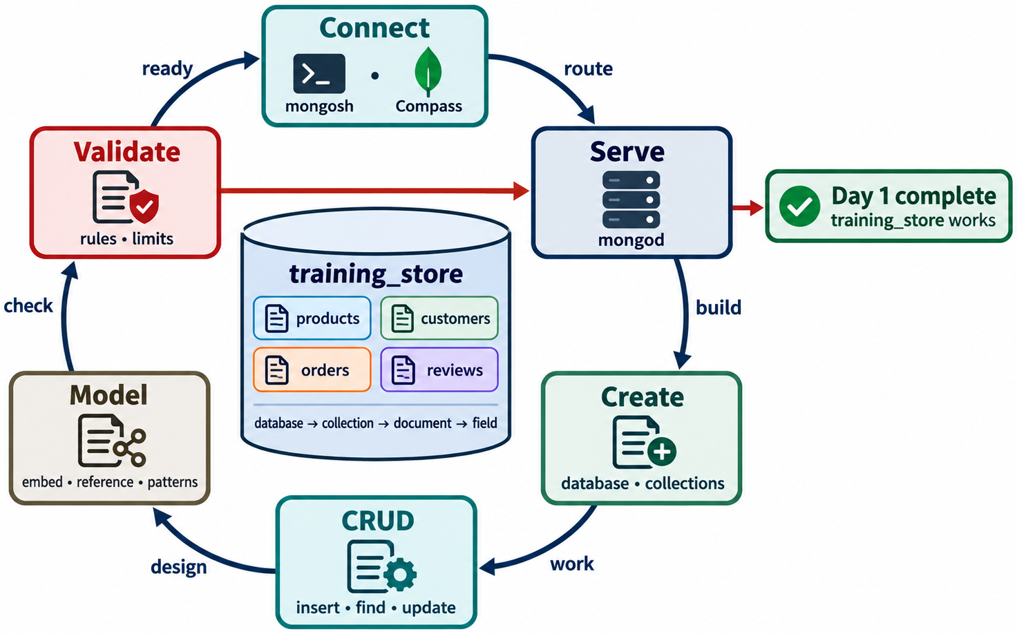
DAY 1 REVIEW AND CLOSURE
MODULE 3
📌
KEY POINTS
• NoSQL landscape and a working instance
• Documents designed around access patterns
• training_store ready for querying
107
© 2026 by Innovation In Software Corporation
Notes:
This slide includes a diagram — Day 1 Review and Closure.
The slide title is: Day 1 Review and Closure.
The slide says: <div class="cols">.
The slide says: <div class="col-text">.
The slide says: </div>.
The slide says: <div class="col-visual">.
Bullet 1 on the slide: NoSQL landscape and a working instance.
Bullet 2 on the slide: Documents designed around access patterns.
Bullet 3 on the slide: training_store ready for querying.
The figure on this slide is titled: Day 1 path from landscape to populated dataset.

Slide 109
TRANSITION TO MODULE 4
MODULE 3
🧭
KEY POINTS
Module 4 uses training_store to teach:
• find() and findOne()
• Query filters and operators
• Projection
• Array queries
• Sort, limit, count
• Insert, update, replace, delete
• Update operators
• Precise, safe data changes
Keep tomorrow’s laptop on the same connection string.
108
© 2026 by Innovation In Software Corporation
Notes:
This slide lists key points under Transition to Module 4.
The slide title is: Transition to Module 4.
The slide says: Module 4 uses training_store to teach:.
The slide says: Keep tomorrow’s laptop on the same connection string.
Bullet 1 on the slide: find() and findOne().
Bullet 2 on the slide: Query filters and operators.
Bullet 3 on the slide: Projection.
Bullet 4 on the slide: Array queries.
Bullet 5 on the slide: Sort, limit, count.
Bullet 6 on the slide: Insert, update, replace, delete.
Bullet 7 on the slide: Update operators.
Bullet 8 on the slide: Precise, safe data changes.

