Slide 1
MODULE 5
The Aggregation Framework
Pipelines transform raw MongoDB documents into summaries, calculations, and reports
Pipeline Structure
$match & $group Stages
$project & $sort Stages
$lookup & $facet
Pipeline Performance
MASTERING MONGODB • MODULE 5
Notes:
The slide title is: The Aggregation Framework.
The slide says: Pipelines transform raw MongoDB documents into summaries, calculations, and reports.

Slide 2
MODULE LEARNING OBJECTIVES
MODULE 5
🎯
YOU WILL BE ABLE TO
• Construct pipelines one stage at a time
• Understand how stage order changes results
• Group and summarize documents
• Create calculated fields
• Analyze embedded arrays
• Combine related collections
• Produce multiple metrics from one input set
• Improve pipeline clarity and efficiency
1
© 2026 by Innovation In Software Corporation
Notes:
This slide lists key points under Module Learning Objectives.
The slide title is: Module Learning Objectives.
The slide says: By the end of this module you will be able to:.
Bullet 1 on the slide: Construct pipelines one stage at a time.
Bullet 2 on the slide: Understand how stage order changes results.
Bullet 3 on the slide: Group and summarize documents.
Bullet 4 on the slide: Create calculated fields.
Bullet 5 on the slide: Analyze embedded arrays.
Bullet 6 on the slide: Combine related collections.
Bullet 7 on the slide: Produce multiple metrics from one input set.
Bullet 8 on the slide: Improve pipeline clarity and efficiency.

Slide 3
INTRODUCTION
MODULE 5
📌
KEY POINTS
The MongoDB Aggregation Framework processes documents through a sequence of stages called a pipeline.
Aggregation is useful when an application must:
• Filter documents
• Group related records
• Calculate totals, averages and counts
• Reshape output
• Sort and rank results
• Combine data from multiple collections
• Produce reports and dashboards
The central idea is:
We will continue using the training_store database:
KEY TAKEAWAY Each pipeline stage receives documents, transforms them and passes its results to the next stage.
2
© 2026 by Innovation In Software Corporation
Notes:
The MongoDB Aggregation Framework processes documents through a sequence of stages called a pipeline.

Slide 4
INTRODUCTION (CONT.)
MODULE 5
📌
KEY POINTS
Collections:
use training_store
training_store
├── products
├── customers
├── orders
└── reviews
3
© 2026 by Innovation In Software Corporation
Notes:
Collections:

Slide 5
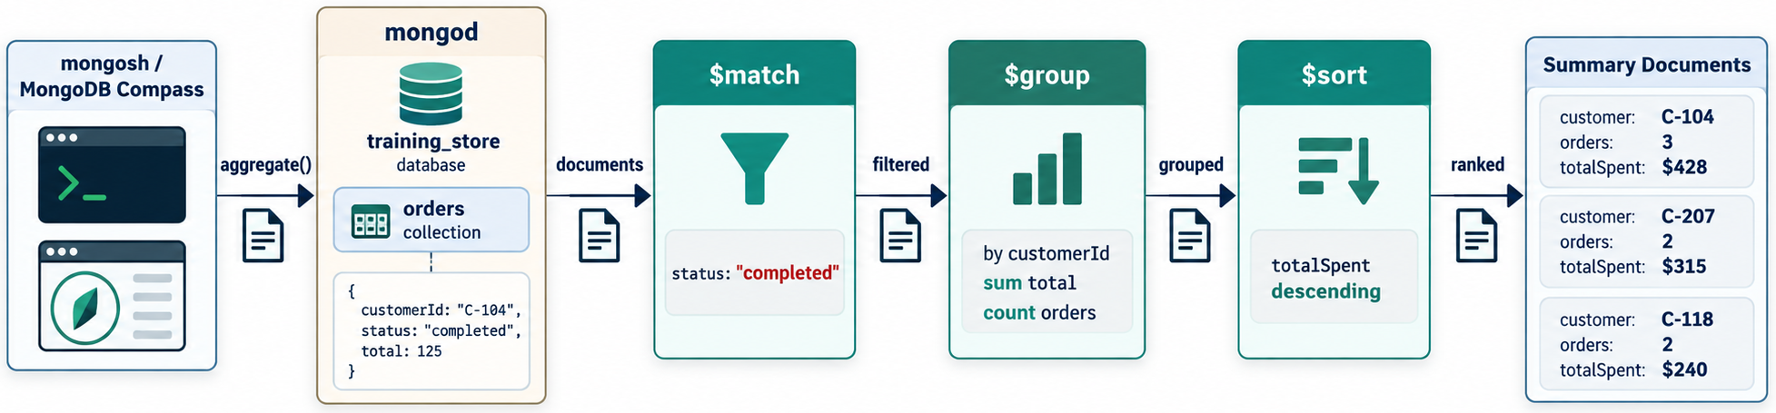
AGGREGATION PIPELINE STRUCTURE
MODULE 5
📊
KEY POINTS
An aggregation pipeline is an array of stage documents:
A simple example is:
The pipeline operates as follows:
db.collection.aggregate([
{ stage1 },
{ stage2 },
{ stage3 }
])
db.products.aggregate([
{
$match: {
category: "Electronics"
}
},
{
$project: {
_id: 0,
name: 1,
price: 1
}
},
{
$sort: {
price: 1
}
}
])
4
© 2026 by Innovation In Software Corporation
Notes:
An aggregation pipeline is an array of stage documents:

Slide 6
AGGREGATION PIPELINE STRUCTURE (CONT.)
MODULE 5
products
│
▼
$match
Keep Electronics
│
▼
$project
Select name and price
│
▼
$sort
Order by price
│
▼
Final results
5
© 2026 by Innovation In Software Corporation
Notes:
Covers Aggregation Pipeline Structure.

Slide 7
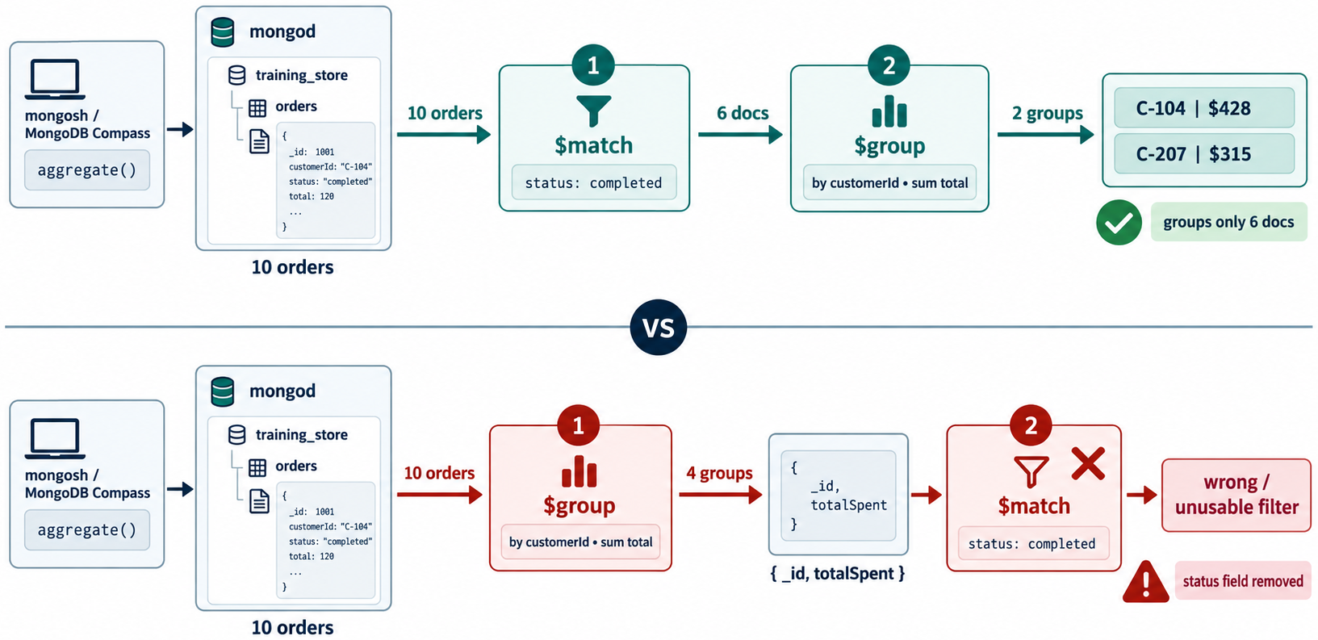
STAGE ORDER MATTERS
MODULE 5
📌
KEY POINTS
The output from one stage becomes the input to the next stage.
These pipelines do not necessarily mean the same thing:
This takes an initial set of five documents and sorts those five.
This finds the five most expensive products.
[
{ $limit: 5 },
{ $sort: { price: -1 } }
]
[
{ $sort: { price: -1 } },
{ $limit: 5 }
]
6
© 2026 by Innovation In Software Corporation
Notes:
The output from one stage becomes the input to the next stage.

Slide 8
AGGREGATION VERSUS REGULAR QUERIES
MODULE 5
📊
KEY POINTS
A regular query is appropriate for straightforward retrieval:
Aggregation is more appropriate when the result requires calculations or transformations:
Use aggregation for questions such as:
db.products.find({
category: "Electronics"
})
db.products.aggregate([
{
$match: {
category: "Electronics"
}
},
{
$group: {
_id: "$category",
averagePrice: {
$avg: "$price"
}
}
}
])
7
© 2026 by Innovation In Software Corporation
Notes:
A regular query is appropriate for straightforward retrieval:

Slide 9
AGGREGATION VERSUS REGULAR QUERIES (CONT.)
MODULE 5
📊
KEY POINTS
• How much revenue did each customer generate?
• What is the average product price by category?
• Which products have the highest average ratings?
• How many orders are in each status?
• What are the top five products by quantity sold?
8
© 2026 by Innovation In Software Corporation
Notes:
Covers Aggregation Versus Regular Queries.

Slide 10
FILTER BY EXACT VALUE
MODULE 5
📌
KEY POINTS
$match filters documents.
Its syntax is similar to the filter used by find():
{
$match: {
field: condition
}
}
db.products.aggregate([
{
$match: {
category: "Electronics"
}
}
])
9
© 2026 by Innovation In Software Corporation
Notes:
Covers Filter by exact value.

Slide 11
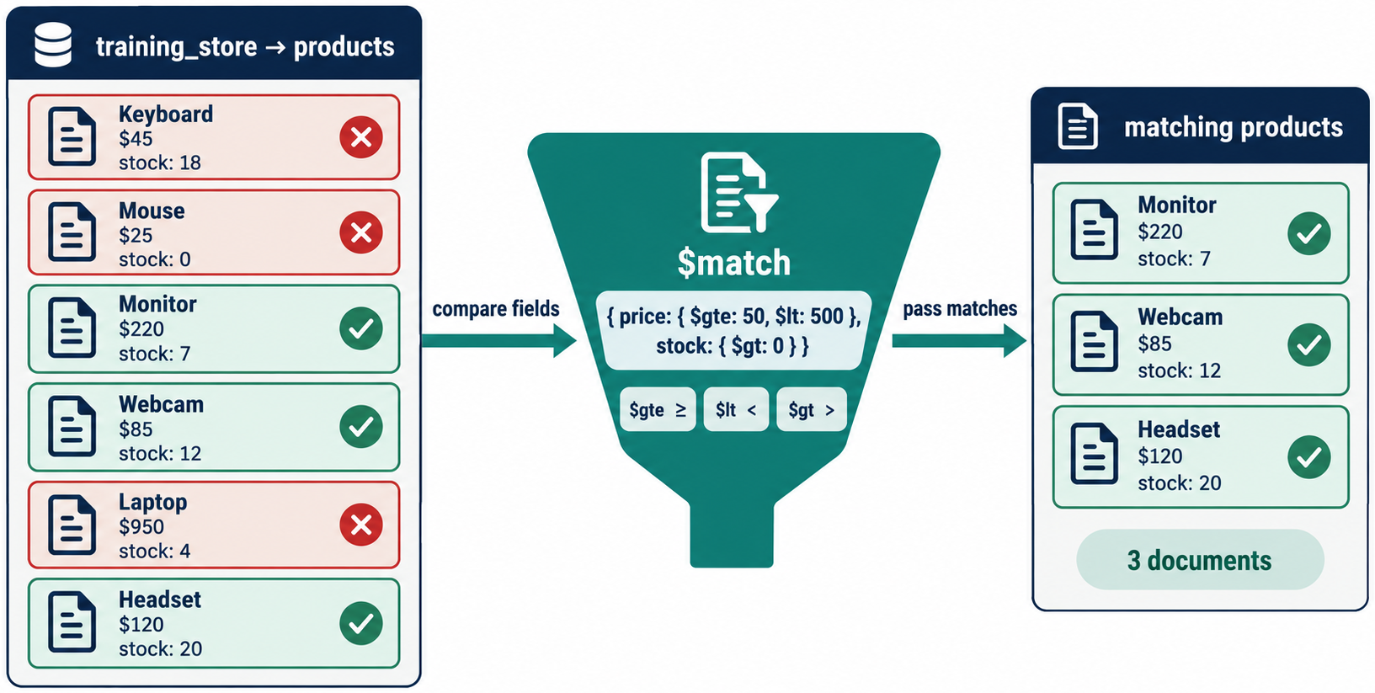
FILTER USING COMPARISON OPERATORS
MODULE 5
db.products.aggregate([
{
$match: {
price: {
$gte: NumberDecimal("40.00"),
$lte: NumberDecimal("100.00")
}
}
}
])
10
© 2026 by Innovation In Software Corporation
Notes:
Covers Filter using comparison operators.

Slide 12
COMBINE MULTIPLE CONDITIONS
MODULE 5
db.products.aggregate([
{
$match: {
category: "Electronics",
active: true,
stock: {
$gt: 0
}
}
}
])
11
© 2026 by Innovation In Software Corporation
Notes:
Covers Combine multiple conditions.

Slide 13
FILTER BY DATE RANGE
MODULE 5
db.orders.aggregate([
{
$match: {
orderedAt: {
$gte: ISODate("2026-09-01T00:00:00Z"),
$lt: ISODate("2026-10-01T00:00:00Z")
}
}
}
])
12
© 2026 by Innovation In Software Corporation
Notes:
Covers Filter by date range.

Slide 14
PLACE SELECTIVE MATCHING EARLY
MODULE 5
📌
KEY POINTS
When possible, place $match near the start of the pipeline:
This reduces the number of documents processed by later stages. An early $match may also benefit from an appropriate index.
db.orders.aggregate([
{
$match: {
status: "Completed"
}
},
{
$group: {
_id: "$customerId",
totalSpent: {
$sum: "$total"
}
}
}
])
13
© 2026 by Innovation In Software Corporation
Notes:
When possible, place `$match` near the start of the pipeline:

Slide 15
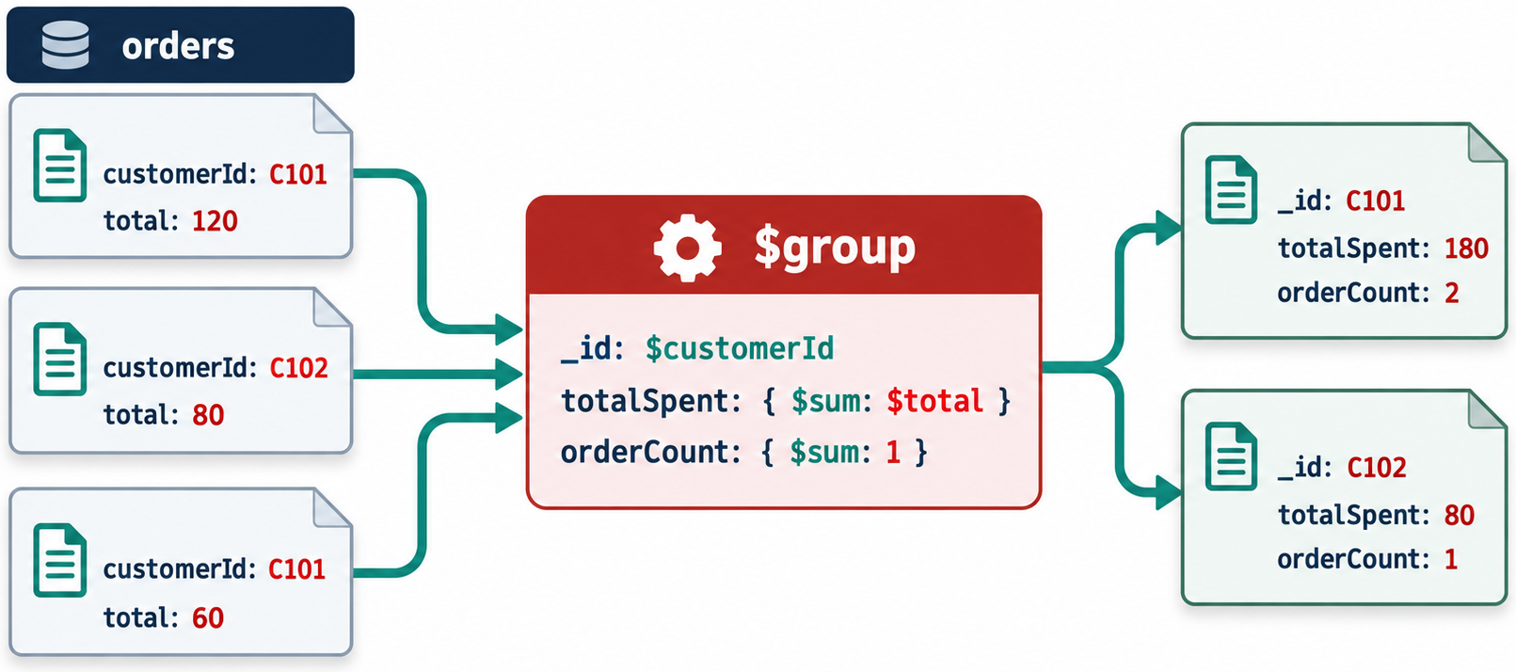
THE $GROUP STAGE
MODULE 5
📌
KEY POINTS
$group combines documents using a grouping key and calculates aggregated values.
General syntax:
The _id field defines the grouping key.
{
$group: {
_id: <grouping-expression>,
resultField: {
<accumulator>: <expression>
}
}
}
14
© 2026 by Innovation In Software Corporation
Notes:
`$group` combines documents using a grouping key and calculates aggregated values.

Slide 16
COUNT PRODUCTS BY CATEGORY
MODULE 5
📌
KEY POINTS
Possible result:
`$sum: 1` adds one for every document in the group.
db.products.aggregate([
{
$group: {
_id: "$category",
productCount: {
$sum: 1
}
}
}
])
[
{
_id: "Electronics",
productCount: 2
},
{
_id: "Books",
productCount: 1
}
]
15
© 2026 by Innovation In Software Corporation
Notes:
Possible result:

Slide 17
CALCULATE AVERAGE PRICE BY CATEGORY
MODULE 5
db.products.aggregate([
{
$group: {
_id: "$category",
averagePrice: {
$avg: "$price"
}
}
}
])
16
© 2026 by Innovation In Software Corporation
Notes:
Covers Calculate average price by category.

Slide 18
CALCULATE SEVERAL METRICS
MODULE 5
db.products.aggregate([
{
$group: {
_id: "$category",
productCount: {
$sum: 1
},
averagePrice: {
$avg: "$price"
},
lowestPrice: {
$min: "$price"
},
highestPrice: {
$max: "$price"
},
totalInventory: {
$sum: "$stock"
}
}
}
])
17
© 2026 by Innovation In Software Corporation
Notes:
Covers Calculate several metrics.

Slide 19
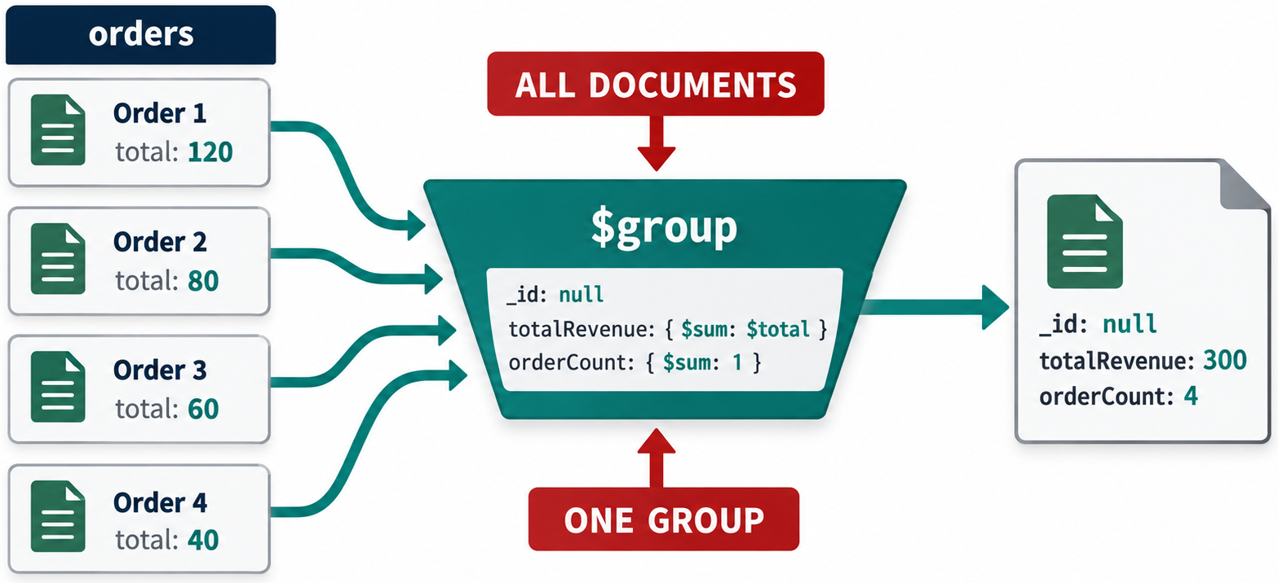
GROUP ALL DOCUMENTS TOGETHER
MODULE 5
📌
KEY POINTS
Use `_id: null` when the entire input should form one group:
db.orders.aggregate([
{
$group: {
_id: null,
orderCount: {
$sum: 1
},
totalRevenue: {
$sum: "$total"
},
averageOrderValue: {
$avg: "$total"
}
}
}
])
18
© 2026 by Innovation In Software Corporation
Notes:
Use `_id: null` when the entire input should form one group:

Slide 20
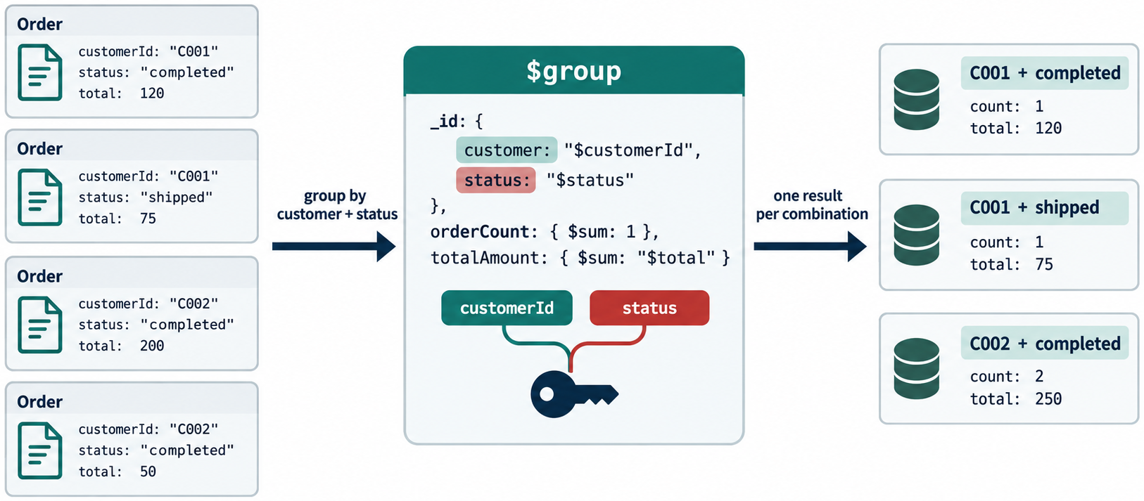
GROUP BY MULTIPLE FIELDS
MODULE 5
📌
KEY POINTS
Each unique combination of status and customerId creates a separate group.
db.orders.aggregate([
{
$group: {
_id: {
status: "$status",
customerId: "$customerId"
},
orderCount: {
$sum: 1
},
totalValue: {
$sum: "$total"
}
}
}
])
19
© 2026 by Innovation In Software Corporation
Notes:
Each unique combination of `status` and `customerId` creates a separate group.

Slide 21
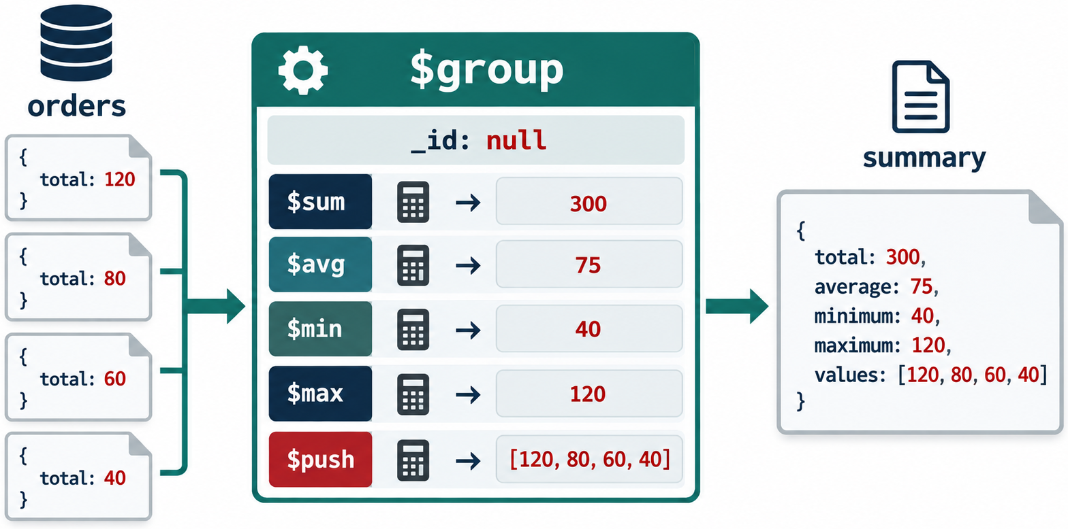
COMMON ACCUMULATOR OPERATORS
MODULE 5
📌
KEY POINTS
Accumulator operators calculate values across documents in a group.
Operator | Purpose
$sum | Calculates a total or count
$avg | Calculates an average
$min | Returns the lowest value
$max | Returns the highest value
$first | Returns the first value in a group
$last | Returns the last value in a group
$push | Collects values, including duplicates
$addToSet | Collects unique values
20
© 2026 by Innovation In Software Corporation
Notes:
Accumulator operators calculate values across documents in a group.

Slide 22
COLLECT PRODUCT NAMES BY CATEGORY
MODULE 5
db.products.aggregate([
{
$group: {
_id: "$category",
products: {
$push: "$name"
}
}
}
])
21
© 2026 by Innovation In Software Corporation
Notes:
Covers Collect product names by category.

Slide 23
COLLECT UNIQUE CUSTOMER IDS BY ORDER STATUS
MODULE 5
db.orders.aggregate([
{
$group: {
_id: "$status",
customers: {
$addToSet: "$customerId"
}
}
}
])
22
© 2026 by Innovation In Software Corporation
Notes:
Covers Collect unique customer IDs by order status.

Slide 24
USE $FIRST AFTER SORTING
MODULE 5
📌
KEY POINTS
To find the most expensive product in each category:
The preceding $sort determines which document is considered first.
db.products.aggregate([
{
$sort: {
category: 1,
price: -1
}
},
{
$group: {
_id: "$category",
mostExpensiveProduct: {
$first: "$name"
},
highestPrice: {
$first: "$price"
}
}
}
])
23
© 2026 by Innovation In Software Corporation
Notes:
To find the most expensive product in each category:

Slide 25
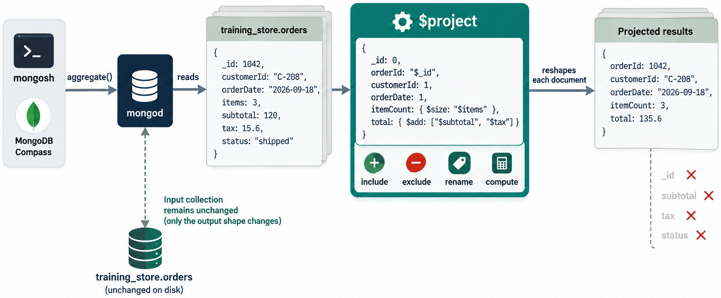
SELECT FIELDS
MODULE 5
📌
KEY POINTS
$project controls the output shape.
It can:
• Include fields
• Exclude fields
• Rename fields
• Create calculated fields
• Restructure documents
• Apply expressions
db.products.aggregate([
{
$project: {
_id: 0,
sku: 1,
name: 1,
price: 1
}
}
])
24
© 2026 by Innovation In Software Corporation
Notes:
Covers Select fields.

Slide 26
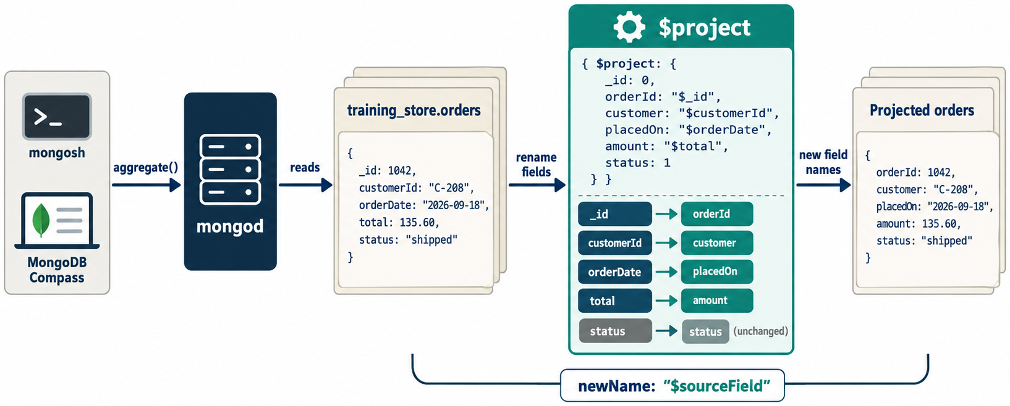
RENAME A FIELD IN THE RESULT
MODULE 5
📌
KEY POINTS
This changes only the pipeline result. It does not rename fields in stored documents.
db.products.aggregate([
{
$project: {
_id: 0,
productName: "$name",
unitPrice: "$price"
}
}
])
25
© 2026 by Innovation In Software Corporation
Notes:
This changes only the pipeline result. It does not rename fields in stored documents.

Slide 27
CALCULATE A FIELD
MODULE 5
📌
KEY POINTS
Calculate inventory value:
db.products.aggregate([
{
$project: {
_id: 0,
name: 1,
price: 1,
stock: 1,
inventoryValue: {
$multiply: [
"$price",
"$stock"
]
}
}
}
])
26
© 2026 by Innovation In Software Corporation
Notes:
Calculate inventory value:

Slide 28
BUILD A FULL NAME
MODULE 5
db.customers.aggregate([
{
$project: {
_id: 0,
email: 1,
fullName: {
$concat: [
"$firstName",
" ",
"$lastName"
]
}
}
}
])
27
© 2026 by Innovation In Software Corporation
Notes:
Covers Build a full name.

Slide 29
ROUND A CALCULATED VALUE
MODULE 5
db.products.aggregate([
{
$group: {
_id: "$category",
averagePrice: {
$avg: "$price"
}
}
},
{
$project: {
_id: 0,
category: "$_id",
averagePrice: {
$round: [
"$averagePrice",
2
]
}
}
}
])
28
© 2026 by Innovation In Software Corporation
Notes:
Covers Round a calculated value.

Slide 30
CREATE A CONDITIONAL FIELD
MODULE 5
db.products.aggregate([
{
$project: {
_id: 0,
name: 1,
stock: 1,
stockStatus: {
$cond: {
if: {
$eq: ["$stock", 0]
},
then: "Out of stock",
else: {
$cond: {
if: {
$lt: ["$stock", 50]
},
then: "Low stock",
else: "Available"
}
}
}
}
}
}
])
29
© 2026 by Innovation In Software Corporation
Notes:
Covers Create a conditional field.

Slide 31
SORT PRODUCTS BY PRICE
MODULE 5
📌
KEY POINTS
$sort orders pipeline results.
• 1 means ascending.
• -1 means descending.
{
$sort: {
field: 1
}
}
db.products.aggregate([
{
$sort: {
price: -1
}
}
])
30
© 2026 by Innovation In Software Corporation
Notes:
Covers Sort products by price.

Slide 32
SORT USING MULTIPLE FIELDS
MODULE 5
📌
KEY POINTS
MongoDB sorts by:
1. Category in ascending order
2. Price in descending order within each category
3. Name in ascending order when prices are equal
For predictable results, include a unique tie-breaker when appropriate:
db.products.aggregate([
{
$sort: {
category: 1,
price: -1,
name: 1
}
}
])
{
$sort: {
price: -1,
_id: 1
}
}
31
© 2026 by Innovation In Software Corporation
Notes:
MongoDB sorts by:

Slide 33
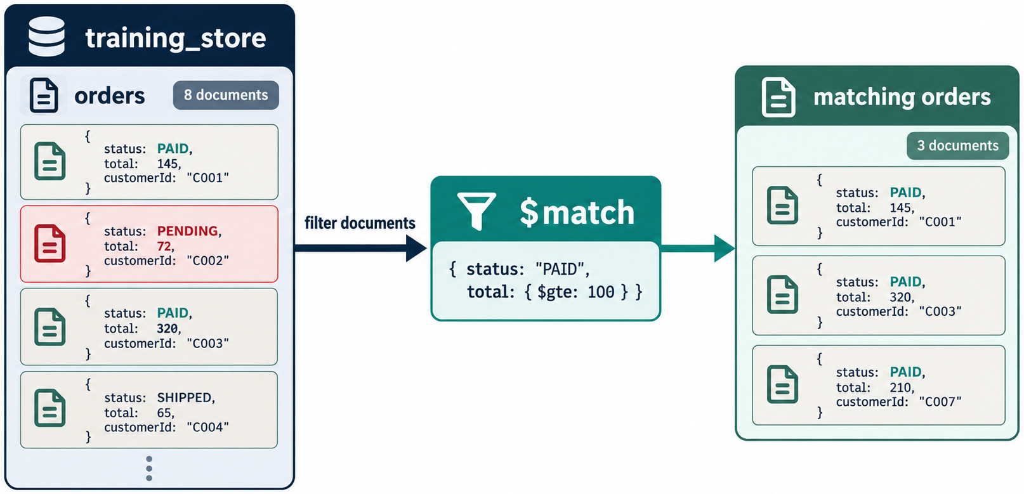
THE $LIMIT STAGE
MODULE 5
📌
KEY POINTS
$limit restricts the number of documents passed to the next stage.
This returns the three most expensive products.
db.products.aggregate([
{
$sort: {
price: -1
}
},
{
$limit: 3
}
])
32
© 2026 by Innovation In Software Corporation
Notes:
`$limit` restricts the number of documents passed to the next stage.

Slide 34
$SKIP WITH $LIMIT
MODULE 5
📌
KEY POINTS
For simple pagination:
Large skip values can become inefficient. Range-based pagination is often preferable for large production datasets.
db.products.aggregate([
{
$sort: {
name: 1,
_id: 1
}
},
{
$skip: 10
},
{
$limit: 10
}
])
33
© 2026 by Innovation In Software Corporation
Notes:
For simple pagination:

Slide 35
BUSINESS REQUIREMENT
MODULE 5
📌
KEY POINTS
Management wants a category-level inventory report showing:
• Active products only
• Number of products
• Average product price
• Lowest price
• Highest price
• Total units in stock
• Total inventory value
• Categories ordered by inventory value
• Only the top five categories
34
© 2026 by Innovation In Software Corporation
Notes:
Management wants a category-level inventory report showing:

Slide 36
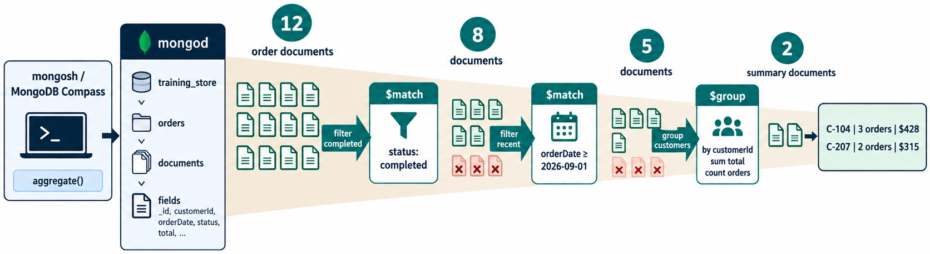
PIPELINE
MODULE 5
db.products.aggregate([
{
$match: {
active: true
}
},
{
$group: {
_id: "$category",
productCount: {
$sum: 1
},
averagePrice: {
$avg: "$price"
},
lowestPrice: {
$min: "$price"
},
highestPrice: {
$max: "$price"
},
totalUnits: {
$sum: "$stock"
},
35
© 2026 by Innovation In Software Corporation
Notes:
Covers Pipeline.

Slide 37
PIPELINE (CONT.)
MODULE 5
totalInventoryValue: {
$sum: {
$multiply: [
"$price",
"$stock"
]
}
}
}
},
{
$project: {
_id: 0,
category: "$_id",
productCount: 1,
averagePrice: {
$round: [
"$averagePrice",
2
]
},
lowestPrice: 1,
highestPrice: 1,
totalUnits: 1,
totalInventoryValue: 1
}
},
{
$sort: {
totalInventoryValue: -1
}
},
{
$limit: 5
}
])
36
© 2026 by Innovation In Software Corporation
Notes:
Covers Pipeline.

Slide 38
STAGE-BY-STAGE EXPLANATION
MODULE 5
📌
KEY POINTS
#### Stage 1: $match
Removes inactive products.
#### Stage 2: $group
Creates one group for each category and calculates its metrics.
{
$match: {
active: true
}
}
{
$group: {
_id: "$category",
...
}
}
37
© 2026 by Innovation In Software Corporation
Notes:
#### Stage 1: `$match`

Slide 39
STAGE-BY-STAGE EXPLANATION (CONT.)
MODULE 5
📌
KEY POINTS
#### Stage 3: $project
Reshapes the report and gives the grouping key a business-friendly name.
#### Stage 4: $sort
Ranks categories from highest to lowest inventory value.
{
$project: {
category: "$_id",
...
}
}
{
$sort: {
totalInventoryValue: -1
}
}
38
© 2026 by Innovation In Software Corporation
Notes:
#### Stage 3: `$project`

Slide 40
STAGE-BY-STAGE EXPLANATION (CONT.)
MODULE 5
📌
KEY POINTS
#### Stage 5: $limit
Returns the five highest-ranking categories.
{
$limit: 5
}
39
© 2026 by Innovation In Software Corporation
Notes:
#### Stage 5: `$limit`

Slide 41
REQUIREMENT
MODULE 5
📌
KEY POINTS
Show the number and value of orders in each status.
db.orders.aggregate([
{
$group: {
_id: "$status",
orderCount: {
$sum: 1
},
totalValue: {
$sum: "$total"
},
averageOrderValue: {
$avg: "$total"
}
}
},
{
$project: {
_id: 0,
40
© 2026 by Innovation In Software Corporation
Notes:
Show the number and value of orders in each status.

Slide 42
REQUIREMENT (CONT.)
MODULE 5
status: "$_id",
orderCount: 1,
totalValue: 1,
averageOrderValue: {
$round: [
"$averageOrderValue",
2
]
}
}
},
{
$sort: {
totalValue: -1
}
}
])
41
© 2026 by Innovation In Software Corporation
Notes:
Covers Requirement.

Slide 43
MONTHLY SALES ANALYSIS
MODULE 5
📌
KEY POINTS
Dates can be grouped by month using $dateTrunc.
db.orders.aggregate([
{
$match: {
status: {
$in: [
"Shipped",
"Delivered",
"Completed"
]
}
}
},
{
$group: {
_id: {
$dateTrunc: {
date: "$orderedAt",
unit: "month",
timezone: "America/Toronto"
}
},
orderCount: {
42
© 2026 by Innovation In Software Corporation
Notes:
Dates can be grouped by month using `$dateTrunc`.

Slide 44
MONTHLY SALES ANALYSIS (CONT.)
MODULE 5
📌
KEY POINTS
The selected timezone affects how timestamps near month boundaries are classified.
$sum: 1
},
revenue: {
$sum: "$total"
}
}
},
{
$project: {
_id: 0,
month: "$_id",
orderCount: 1,
revenue: 1
}
},
{
$sort: {
month: 1
}
}
])
43
© 2026 by Innovation In Software Corporation
Notes:
The selected timezone affects how timestamps near month boundaries are classified.

Slide 45
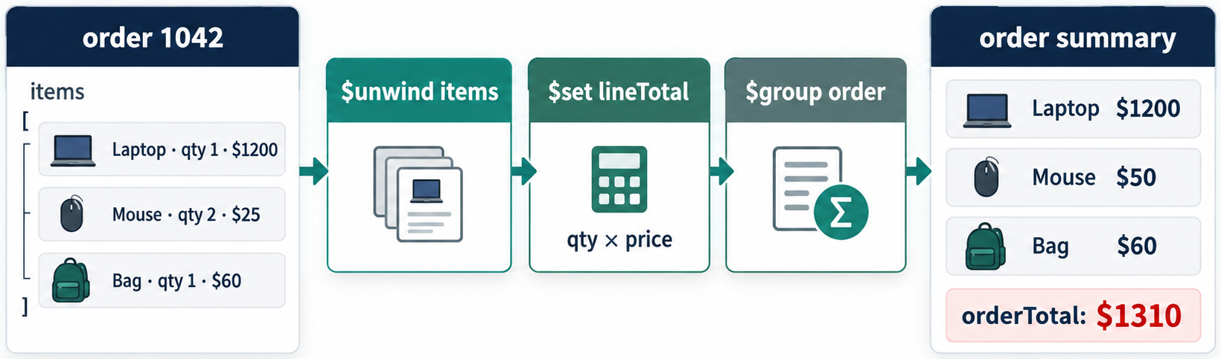
WORKING WITH ORDER-ITEM ARRAYS
MODULE 5
📌
KEY POINTS
Each order contains an items array:
To analyze individual products, the array must first be expanded.
{
orderNumber: "ORD-2026-1002",
items: [
{
sku: "ELEC-1002",
productName: "Mechanical Keyboard",
quantity: 1,
lineTotal: NumberDecimal("89.99")
},
{
sku: "BOOK-2001",
productName: "MongoDB Fundamentals",
quantity: 1,
lineTotal: NumberDecimal("49.99")
}
]
}
44
© 2026 by Innovation In Software Corporation
Notes:
Each order contains an `items` array:

Slide 46
$UNWIND
MODULE 5
📌
KEY POINTS
One order containing two items becomes two pipeline documents.
The original stored order is not changed.
db.orders.aggregate([
{
$unwind: "$items"
}
])
45
© 2026 by Innovation In Software Corporation
Notes:
One order containing two items becomes two pipeline documents.

Slide 47
REQUIREMENT
MODULE 5
📌
KEY POINTS
Find the top five products by units sold.
db.orders.aggregate([
{
$match: {
status: {
$in: [
"Shipped",
"Delivered",
"Completed"
]
}
}
},
{
$unwind: "$items"
},
{
$group: {
_id: {
productId: "$items.productId",
sku: "$items.sku",
productName: "$items.productName"
},
unitsSold: {
$sum: "$items.quantity"
},
46
© 2026 by Innovation In Software Corporation
Notes:
Find the top five products by units sold.

Slide 48
REQUIREMENT (CONT.)
MODULE 5
📌
KEY POINTS
The data flow is:
salesValue: {
$sum: "$items.lineTotal"
}
}
},
{
$project: {
_id: 0,
productId: "$_id.productId",
sku: "$_id.sku",
productName: "$_id.productName",
unitsSold: 1,
salesValue: 1
}
},
{
$sort: {
unitsSold: -1,
salesValue: -1
}
},
{
$limit: 5
}
])
47
© 2026 by Innovation In Software Corporation
Notes:
The data flow is:

Slide 49
REQUIREMENT (CONT.)
MODULE 5
Orders
│
▼
Keep completed sales
│
▼
Expand order items
│
▼
Group by product
│
▼
Calculate units and sales
│
▼
Rank and return top five
48
© 2026 by Innovation In Software Corporation
Notes:
Covers Requirement.

Slide 50
REQUIREMENT
MODULE 5
📌
KEY POINTS
Show products with:
• At least one review
• Average rating
• Total review count
• Highest and lowest rating
• Highest-rated products first
db.reviews.aggregate([
{
$group: {
_id: "$productId",
reviewCount: {
$sum: 1
},
averageRating: {
$avg: "$rating"
},
highestRating: {
$max: "$rating"
},
lowestRating: {
$min: "$rating"
}
}
},
{
$project: {
49
© 2026 by Innovation In Software Corporation
Notes:
Show products with:

Slide 51
REQUIREMENT (CONT.)
MODULE 5
📌
KEY POINTS
This report contains product IDs but not product names. To obtain names from the products collection, use $lookup.
_id: 0,
productId: "$_id",
reviewCount: 1,
averageRating: {
$round: [
"$averageRating",
2
]
},
highestRating: 1,
lowestRating: 1
}
},
{
$sort: {
averageRating: -1,
reviewCount: -1
}
}
])
50
© 2026 by Innovation In Software Corporation
Notes:
This report contains product IDs but not product names. To obtain names from the `products` collection, use `$lookup`.

Slide 52
ADD PRODUCT INFORMATION TO THE REVIEW REPORT
MODULE 5
📊
KEY POINTS
$lookup performs a left outer join between collections.
db.reviews.aggregate([
{
$group: {
_id: "$productId",
reviewCount: {
$sum: 1
},
averageRating: {
$avg: "$rating"
}
}
},
{
$lookup: {
from: "products",
localField: "_id",
foreignField: "_id",
as: "product"
}
},
{
$unwind: "$product"
},
{
$project: {
_id: 0,
productId: "$_id",
productName: "$product.name",
category: "$product.category",
reviewCount: 1,
averageRating: {
$round: [
"$averageRating",
2
]
}
}
},
{
$sort: {
averageRating: -1,
reviewCount: -1
}
}
])
51
© 2026 by Innovation In Software Corporation
Notes:
Covers Add product information to the review report.

Slide 53
$LOOKUP OUTPUT
MODULE 5
📌
KEY POINTS
Before $unwind:
After $unwind:
Because $lookup produces an array, $unwind is commonly used when exactly one matching document is expected.
{
_id: ObjectId("..."),
reviewCount: 3,
product: [
{
_id: ObjectId("..."),
name: "Wireless Mouse"
}
]
}
{
_id: ObjectId("..."),
reviewCount: 3,
product: {
_id: ObjectId("..."),
name: "Wireless Mouse"
}
}
52
© 2026 by Innovation In Software Corporation
Notes:
Before `$unwind`:

Slide 54
REQUIREMENT
MODULE 5
📌
KEY POINTS
Find the highest-spending customers and include their names and email addresses.
db.orders.aggregate([
{
$match: {
status: {
$in: [
"Shipped",
"Delivered",
"Completed"
]
}
}
},
{
$group: {
_id: "$customerId",
orderCount: {
$sum: 1
},
totalSpent: {
$sum: "$total"
},
averageOrderValue: {
$avg: "$total"
},
53
© 2026 by Innovation In Software Corporation
Notes:
Find the highest-spending customers and include their names and email addresses.

Slide 55
REQUIREMENT (CONT.)
MODULE 5
lastOrderAt: {
$max: "$orderedAt"
}
}
},
{
$lookup: {
from: "customers",
localField: "_id",
foreignField: "_id",
as: "customer"
}
},
{
$unwind: "$customer"
},
{
$project: {
_id: 0,
customerId: "$_id",
customerName: {
$concat: [
"$customer.firstName",
" ",
"$customer.lastName"
]
},
email: "$customer.email",
orderCount: 1,
totalSpent: 1,
averageOrderValue: {
$round: [
"$averageOrderValue",
2
]
},
lastOrderAt: 1
}
},
{
$sort: {
totalSpent: -1
}
},
{
$limit: 10
}
])
54
© 2026 by Innovation In Software Corporation
Notes:
Covers Requirement.

Slide 56
USING $COUNT
MODULE 5
📌
KEY POINTS
$count counts the documents reaching that stage.
Possible result:
Unlike countDocuments(), $count operates on the intermediate results of the pipeline.
db.products.aggregate([
{
$match: {
active: true,
stock: {
$gt: 0
}
}
},
{
$count: "availableProductCount"
}
])
{
availableProductCount: 3
}
55
© 2026 by Innovation In Software Corporation
Notes:
`$count` counts the documents reaching that stage.

Slide 57
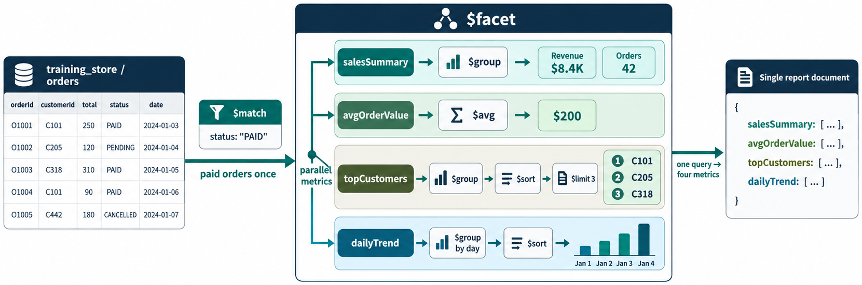
PRODUCT DASHBOARD
MODULE 5
📊
KEY POINTS
$facet runs multiple sub-pipelines against the same input.
db.products.aggregate([
{
$match: {
active: true
}
},
{
$facet: {
categorySummary: [
{
$group: {
_id: "$category",
productCount: {
$sum: 1
},
averagePrice: {
$avg: "$price"
}
}
},
{
$sort: {
productCount: -1
}
}
],
lowStockProducts: [
{
$match: {
stock: {
$lt: 50
}
}
},
{
$project: {
_id: 0,
sku: 1,
name: 1,
stock: 1
}
},
{
$sort: {
stock: 1
}
}
],
56
© 2026 by Innovation In Software Corporation
Notes:
Covers Product dashboard.

Slide 58
PRODUCT DASHBOARD (CONT.)
MODULE 5
📊
KEY POINTS
The result contains three report sections in one document.
mostExpensiveProducts: [
{
$sort: {
price: -1
}
},
{
$limit: 5
},
{
$project: {
_id: 0,
name: 1,
price: 1
}
}
]
}
}
])
57
© 2026 by Innovation In Software Corporation
Notes:
The result contains three report sections in one document.

Slide 59
WRITING AGGREGATION RESULTS WITH $MERGE
MODULE 5
📊
KEY POINTS
Aggregation normally returns results without changing the source collection.
$merge can store or update materialized reporting results.
db.orders.aggregate([
{
$match: {
status: {
$in: [
"Shipped",
"Delivered",
"Completed"
]
}
}
},
{
$group: {
_id: "$customerId",
orderCount: {
$sum: 1
},
58
© 2026 by Innovation In Software Corporation
Notes:
Aggregation normally returns results without changing the source collection.

Slide 60
WRITING AGGREGATION RESULTS WITH $MERGE (CONT.)
MODULE 5
📊
KEY POINTS
This creates or refreshes documents in customer_sales_summary.
Because $merge writes data, it should be tested carefully before being used in a production database.
totalSpent: {
$sum: "$total"
},
calculatedAt: {
$max: "$orderedAt"
}
}
},
{
$merge: {
into: "customer_sales_summary",
on: "_id",
whenMatched: "replace",
whenNotMatched: "insert"
}
}
])
59
© 2026 by Innovation In Software Corporation
Notes:
This creates or refreshes documents in `customer_sales_summary`.

Slide 61
STEP 1: START WITH MATCHING
MODULE 5
📌
KEY POINTS
Complex pipelines should be built incrementally.
db.orders.aggregate([
{
$match: {
status: "Shipped"
}
}
])
60
© 2026 by Innovation In Software Corporation
Notes:
Covers Step 1: Start with matching.

Slide 62
STEP 2: ADD ARRAY EXPANSION
MODULE 5
db.orders.aggregate([
{
$match: {
status: "Shipped"
}
},
{
$unwind: "$items"
}
])
61
© 2026 by Innovation In Software Corporation
Notes:
Covers Step 2: Add array expansion.

Slide 63
STEP 3: ADD GROUPING
MODULE 5
db.orders.aggregate([
{
$match: {
status: "Shipped"
}
},
{
$unwind: "$items"
},
{
$group: {
_id: "$items.sku",
unitsSold: {
$sum: "$items.quantity"
}
}
}
])
62
© 2026 by Innovation In Software Corporation
Notes:
Covers Step 3: Add grouping.

Slide 64
STEP 4: SHAPE THE RESULT
MODULE 5
{
$project: {
_id: 0,
sku: "$_id",
unitsSold: 1
}
}
63
© 2026 by Innovation In Software Corporation
Notes:
Covers Step 4: Shape the result.

Slide 65
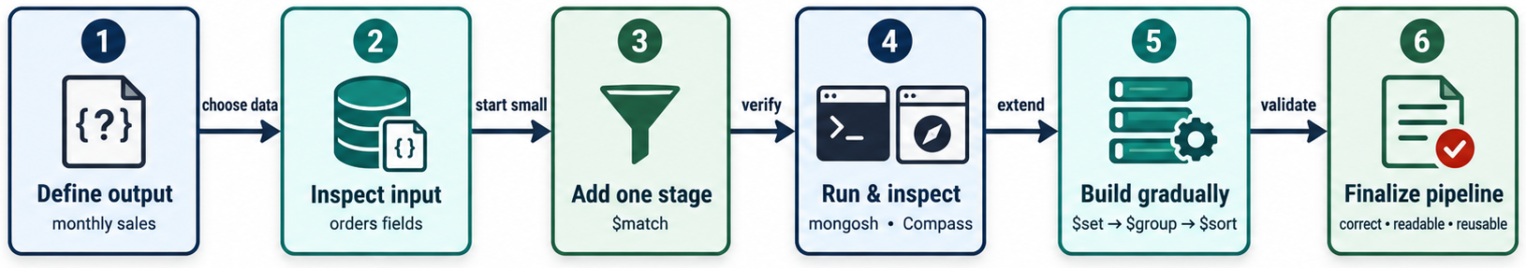
STEP 5: SORT AND LIMIT
MODULE 5
📌
KEY POINTS
Verify each new stage before adding the next one. This makes incorrect filters, field paths and group expressions easier to locate.
{
$sort: {
unitsSold: -1
}
},
{
$limit: 5
}
64
© 2026 by Innovation In Software Corporation
Notes:
Verify each new stage before adding the next one. This makes incorrect filters, field paths and group expressions easier to locate.

Slide 66
FILTER EARLY
MODULE 5
📌
KEY POINTS
Use $match as early as logically possible to reduce input volume.
65
© 2026 by Innovation In Software Corporation
Notes:
Use `$match` as early as logically possible to reduce input volume.

Slide 67
PROJECT ONLY WHEN USEFUL
MODULE 5
📌
KEY POINTS
Removing unnecessary large fields early can reduce intermediate document size. However, MongoDB may already optimize straightforward field dependencies, so avoid adding stages that do not improve clarity or behavior.
66
© 2026 by Innovation In Software Corporation
Notes:
Removing unnecessary large fields early can reduce intermediate document size. However, MongoDB may already optimize straightforward field dependencies, so avoid adding stages that do not improve...

Slide 68
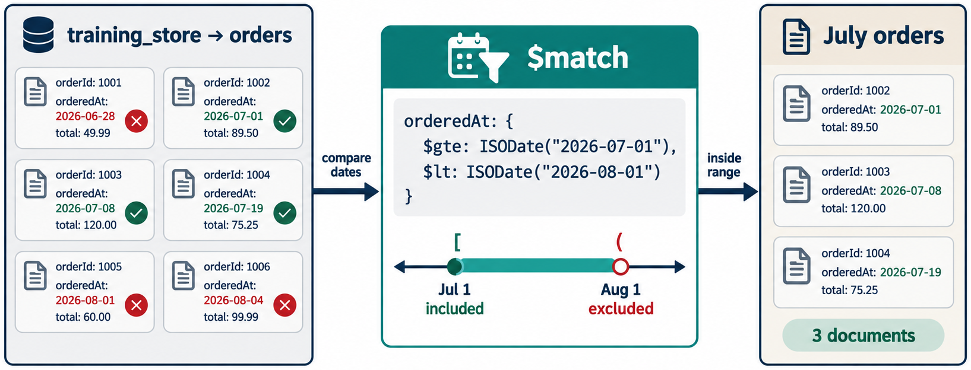
SORT AFTER FILTERING
MODULE 5
📌
KEY POINTS
This:
is generally preferable to sorting the complete collection before filtering it.
[
{
$match: {
category: "Electronics"
}
},
{
$sort: {
price: -1
}
}
]
67
© 2026 by Innovation In Software Corporation
Notes:
This:

Slide 69
INDEX IMPORTANT EARLY STAGES
MODULE 5
📌
KEY POINTS
A pipeline beginning with:
may benefit from:
{
$match: {
status: "Completed",
orderedAt: {
$gte: ISODate("2026-09-01T00:00:00Z")
}
}
}
db.orders.createIndex({
status: 1,
orderedAt: 1
})
68
© 2026 by Innovation In Software Corporation
Notes:
A pipeline beginning with:

Slide 70
CONTROL $UNWIND EXPANSION
MODULE 5
📌
KEY POINTS
One document with 100 array elements produces 100 intermediate documents after $unwind.
Filter before $unwind when possible:
[
{
$match: {
status: "Completed"
}
},
{
$unwind: "$items"
}
]
69
© 2026 by Innovation In Software Corporation
Notes:
One document with 100 array elements produces 100 intermediate documents after `$unwind`.

Slide 71
USE EXPLAIN()
MODULE 5
📊
KEY POINTS
Inspect execution behavior:
Look for:
• Whether an index was used
• Documents examined
• Documents returned
• Expensive sorts
• Large intermediate results
db.orders.explain("executionStats").aggregate([
{
$match: {
status: "Completed"
}
},
{
$group: {
_id: "$customerId",
totalSpent: {
$sum: "$total"
}
}
}
])
70
© 2026 by Innovation In Software Corporation
Notes:
Inspect execution behavior:

Slide 72
BUSINESS REQUIREMENT
MODULE 5
📌
KEY POINTS
Create a report of the top-selling product categories for completed sales.
The report must:
• Include only shipped, delivered or completed orders.
• Expand individual order items.
• Join order items to current products.
• Group results by product category.
• Calculate total units sold.
• Calculate total sales.
• Count distinct customers.
• Calculate sales per customer.
• Show only categories with sales of at least $50.
• Sort from highest to lowest sales.
• Return the top five categories.
71
© 2026 by Innovation In Software Corporation
Notes:
Create a report of the top-selling product categories for completed sales.

Slide 73
SOLUTION
MODULE 5
db.orders.aggregate([
{
$match: {
status: {
$in: [
"Shipped",
"Delivered",
"Completed"
]
}
}
},
{
$unwind: "$items"
},
{
$lookup: {
from: "products",
localField: "items.productId",
foreignField: "_id",
as: "product"
}
},
{
$unwind: "$product"
},
{
$group: {
_id: "$product.category",
totalUnitsSold: {
$sum: "$items.quantity"
},
totalSales: {
$sum: "$items.lineTotal"
},
customers: {
$addToSet: "$customerId"
}
}
},
{
$project: {
_id: 0,
category: "$_id",
totalUnitsSold: 1,
totalSales: 1,
uniqueCustomerCount: {
$size: "$customers"
},
72
© 2026 by Innovation In Software Corporation
Notes:
Covers Solution.

Slide 74
SOLUTION (CONT.)
MODULE 5
salesPerCustomer: {
$cond: [
{
$gt: [
{
$size: "$customers"
},
0
]
},
{
$divide: [
"$totalSales",
{
$size: "$customers"
}
]
},
0
]
}
}
},
{
$match: {
totalSales: {
$gte: NumberDecimal("50.00")
}
}
},
{
$sort: {
totalSales: -1
}
},
{
$limit: 5
}
])
73
© 2026 by Innovation In Software Corporation
Notes:
Covers Solution.

Slide 75
WHY ARE THERE TWO $MATCH STAGES?
MODULE 5
📌
KEY POINTS
The first $match filters stored order documents:
The second $match filters calculated group results:
totalSales does not exist in the original order documents. It is created by $group, so it can only be filtered afterward.
# Module Outcome
{
status: {
$in: ["Shipped", "Delivered", "Completed"]
}
}
{
totalSales: {
$gte: NumberDecimal("50.00")
}
}
74
© 2026 by Innovation In Software Corporation
Notes:
The first `$match` filters stored order documents:

Slide 76
WHY ARE THERE TWO $MATCH STAGES? (CONT.)
MODULE 5
📌
KEY POINTS
After completing this module, learners should be able to:
• Explain how documents flow through an aggregation pipeline.
• Filter pipeline input with $match.
• Group documents and calculate metrics with $group.
• Reshape and calculate output fields with $project.
• Rank results using $sort and $limit.
• Expand arrays using $unwind.
• Combine collections using $lookup.
• Build category, customer, inventory and sales reports.
• Construct complex pipelines incrementally.
• Explain why pipeline-stage order affects results and performance.
• Apply basic aggregation performance practices.
75
© 2026 by Innovation In Software Corporation
Notes:
After completing this module, learners should be able to:

Slide 77
DEMO 5.1 — BUILD A PIPELINE ONE STAGE AT A TIME
MODULE 5
🛠️
KEY POINTS
• 15 minutes · instructor mongosh
• Start with paid orders
• Add $group, then $sort, then $project
• Inspect after every stage
76
© 2026 by Innovation In Software Corporation
Notes:
This slide includes a diagram — Demo 5.1 — Build a Pipeline One Stage at a Time.
The slide title is: Demo 5.1 — Build a Pipeline One Stage at a Time.
The slide says: <div class="cols">.
The slide says: <div class="col-text">.
The slide says: </div>.
The slide says: <div class="col-visual">.
Bullet 1 on the slide: 15 minutes · instructor mongosh.
Bullet 2 on the slide: Start with paid orders.
Bullet 3 on the slide: Add $group, then $sort, then $project.
Bullet 4 on the slide: Inspect after every stage.
The figure on this slide is titled: Match, group, sort, project.

Slide 78
DEMO 5.1 — COMMANDS
MODULE 5
🛠️
KEY POINTS
Then append:
Finish with a $project that renames _id to fulfillmentStatus.
db.orders.aggregate([
{ $match: { paymentStatus: "PAID" } }
])
{ $group: {
_id: "$fulfillmentStatus",
orderCount: { $sum: 1 },
revenue: { $sum: "$total" }
} }
{ $sort: { revenue: -1 } }
77
© 2026 by Innovation In Software Corporation
Notes:
The slide title is: Demo 5.1 — commands.
The slide says: Then append:.
The slide says: Finish with a $project that renames _id to fulfillmentStatus.
The code on the slide reads: db.orders.aggregate([ { $match: { paymentStatus: "PAID" } } ]).
The code on the slide reads: { $group: { _id: "$fulfillmentStatus", orderCount: { $sum: 1 }, revenue: { $sum: "$total" } } } { $sort: { revenue: -1 } }.

Slide 79
EXERCISE 5.1 — ARRANGE PIPELINE STAGES
MODULE 5
🛠️
KEY POINTS
• 10 minutes · pairs
• Top five products by line revenue
• Six stages, one correct teaching order
LAB GUIDE Exercise 5.1
78
© 2026 by Innovation In Software Corporation
Notes:
This slide includes a diagram — Exercise 5.1 — Arrange Pipeline Stages.
The slide title is: Exercise 5.1 — Arrange Pipeline Stages.
The slide says: <div class="cols">.
The slide says: <div class="col-text">.
The slide says: Lab guide: [Exercise 5.1](../slide-exercises/module-05/exercise-5.1-arrange-pipeline-stages.md).
The slide says: </div>.
The slide says: <div class="col-visual">.
Bullet 1 on the slide: 10 minutes · pairs.
Bullet 2 on the slide: Top five products by line revenue.
Bullet 3 on the slide: Six stages, one correct teaching order.
The figure on this slide is titled: Match unwind set group sort limit.

Slide 80
EXERCISE 5.1 — STEPS 1–2
MODULE 5
🛠️
KEY POINTS
LAB GUIDE Exercise 5.1
Follow along (Windows) — key steps:
Step 1 — Propose an order
• Do: Write the six stages in the sequence you would run. Next to each stage, write one sentence on what the documents look like afterwards.
• Expected: A defensible sequence, not a guess. If two orders could work, note the trade-off.
Step 2 — Check against the teaching pattern
• Do: Compare your list with the instructor’s reveal: $match → $unwind → $set → $group → $sort → $limit.
• Expected: You can explain why $limit cannot come before $sort, and why $unwind must come before grouping by SKU.
_Full lab guide with every command: see Lab guide on the lesson divider slide._
• Do: Sequence the six stages and describe the documents after each.
• Expected: A defensible sequence, not a guess.
Step 2 — Check the pattern
• Do: $match → $unwind → $set → $group → $sort → $limit.
• Expected: You can explain why limit cannot precede sort.
79
© 2026 by Innovation In Software Corporation
Notes:
We are starting Exercise 5.1 — Arrange Pipeline Stages. We have about 10 min for this lab.
Put aggregation stages in the order required for a correct top-five-product report.
The full lab guide is in slide-exercises/module-05/exercise-5.1-arrange-pipeline-stages.md if you need extra detail.
On Windows: PowerShell in the integrated terminal — Ctrl+backtick — and the Agent panel — Ctrl+I. Open the repo folder with File → Open Folder.
Step 1 — Propose an order.
Step 2 — Check against the teaching pattern.
Step 1 — Propose an order.
Step 2 — Check against the teaching pattern.
Step 1 — Propose an order.
Step 2 — Check against the teaching pattern.
Step 1 — Propose an order.
Step 2 — Check the pattern.
I'll give you a few minutes to work — raise your hand if you get stuck.
The slide title is: Exercise 5.1 — Steps 1–2.
The slide says: Lab guide: [Exercise 5.1](../slide-exercises/module-05/exercise-5.1-arrange-pipeline-stages.md).
The slide says: Follow along (Windows) — key steps:.
The slide says: _Full lab guide with every command: see Lab guide on the lesson divider slide._.
Bullet 1 on the slide: Do: Write the six stages in the sequence you would run. Next to each stage, write one sentence on what the documents look like afterwards.
Bullet 2 on the slide: Expected: A defensible sequence, not a guess. If two orders could work, note the trade-off.
Bullet 3 on the slide: Do: Compare your list with the instructor’s reveal: $match → $unwind → $set → $group → $sort → $limit.
Bullet 4 on the slide: Expected: You can explain why $limit cannot come before $sort, and why $unwind must come before grouping by SKU.
Bullet 5 on the slide: Do: Write the six stages in the sequence you would run. Next to each stage, write one sentence on what the documents look like afterwards.
Bullet 6 on the slide: Expected: A defensible sequence, not a guess. If two orders could work, note the trade-off.
Bullet 7 on the slide: Do: Compare your list with the instructor’s reveal: $match → $unwind → $set → $group → $sort → $limit.
Bullet 8 on the slide: Expected: You can explain why $limit cannot come before $sort, and why $unwind must come before grouping by SKU.
Bullet 9 on the slide: Do: Write the six stages in the sequence you would run. Next to each stage, write one sentence on what the documents look like afterwards.
Bullet 10 on the slide: Expected: A defensible sequence, not a guess. If two orders could work, note the trade-off.
Bullet 11 on the slide: Do: Compare your list with the instructor’s reveal: $match → $unwind → $set → $group → $sort → $limit.
Bullet 12 on the slide: Expected: You can explain why $limit cannot come before $sort, and why $unwind must come before grouping by SKU.
Bullet 13 on the slide: Do: Sequence the six stages and describe the documents after each.
Bullet 14 on the slide: Expected: A defensible sequence, not a guess.
Bullet 15 on the slide: Do: $match → $unwind → $set → $group → $sort → $limit.
Bullet 16 on the slide: Expected: You can explain why limit cannot precede sort.

Slide 81
LAB 5.1 — AGGREGATION DATASET VERIFICATION
MODULE 5
🛠️
KEY POINTS
• 15 minutes · every laptop
• Count collections; inspect types
• Record field paths for later labs
LAB GUIDE Lab 5.1
80
© 2026 by Innovation In Software Corporation
Notes:
This slide includes a diagram — Lab 5.1 — Aggregation Dataset Verification.
The slide title is: Lab 5.1 — Aggregation Dataset Verification.
The slide says: <div class="cols">.
The slide says: <div class="col-text">.
The slide says: Lab guide: [Lab 5.1](../slide-exercises/module-05/lab-5.1-aggregation-dataset-verification.md).
The slide says: </div>.
The slide says: <div class="col-visual">.
Bullet 1 on the slide: 15 minutes · every laptop.
Bullet 2 on the slide: Count collections; inspect types.
Bullet 3 on the slide: Record field paths for later labs.
The figure on this slide is titled: training_store collections.

Slide 82
LAB 5.1 — STEPS 1–2
MODULE 5
🛠️
KEY POINTS
LAB GUIDE Lab 5.1
Follow along (Windows) — key steps:
Step 1 — Select and count
• Do: use training_store and count customers, products, orders, reviews, paid orders.
• Expected: 6, 12, 17, 6, and 13 paid.
Step 2 — Inspect documents
• Do: findOne on each collection; note Decimal128, Date, and items.
• Expected: O6201 has no shippingFee. That gap is intentional.
81
© 2026 by Innovation In Software Corporation
Notes:
This slide lists key points under Lab 5.1 — Steps 1–2.
The slide title is: Lab 5.1 — Steps 1–2.
The slide says: Lab guide: [Lab 5.1](../slide-exercises/module-05/lab-5.1-aggregation-dataset-verification.md).
The slide says: Follow along (Windows) — key steps:.
Step 1 — Select and count.
Step 2 — Inspect documents.
Bullet 1 on the slide: Do: use training_store and count customers, products, orders, reviews, paid orders.
Bullet 2 on the slide: Expected: 6, 12, 17, 6, and 13 paid.
Bullet 3 on the slide: Do: findOne on each collection; note Decimal128, Date, and items.
Bullet 4 on the slide: Expected: O6201 has no shippingFee. That gap is intentional.

Slide 83
DEMO 5.2 — FILTER AND RESHAPE DOCUMENTS
MODULE 5
🛠️
KEY POINTS
• 15 minutes
• Active products: sku, name, category, price
• Add a price band with $cond
82
© 2026 by Innovation In Software Corporation
Notes:
This slide includes a diagram — Demo 5.2 — Filter and Reshape Documents.
The slide title is: Demo 5.2 — Filter and Reshape Documents.
The slide says: <div class="cols">.
The slide says: <div class="col-text">.
The slide says: </div>.
The slide says: <div class="col-visual">.
Bullet 1 on the slide: 15 minutes.
Bullet 2 on the slide: Active products: sku, name, category, price.
Bullet 3 on the slide: Add a price band with $cond.
The figure on this slide is titled: Project reshape.

Slide 84
DEMO 5.3 — ADD CALCULATED FIELDS
MODULE 5
🛠️
KEY POINTS
• 15 minutes
• Subtotal + tax + shipping
• $ifNull on shippingFee
• HIGH_VALUE class and reporting month
83
© 2026 by Innovation In Software Corporation
Notes:
This slide includes a diagram — Demo 5.3 — Add Calculated Fields.
The slide title is: Demo 5.3 — Add Calculated Fields.
The slide says: <div class="cols">.
The slide says: <div class="col-text">.
The slide says: </div>.
The slide says: <div class="col-visual">.
Bullet 1 on the slide: 15 minutes.
Bullet 2 on the slide: Subtotal + tax + shipping.
Bullet 3 on the slide: $ifNull on shippingFee.
Bullet 4 on the slide: HIGH_VALUE class and reporting month.
The figure on this slide is titled: set versus project.

Slide 85
EXERCISE 5.2 — BUILD A $MATCH STAGE
MODULE 5
🛠️
KEY POINTS
• 10 minutes
• Paid, high-value, categories, dates, provinces
LAB GUIDE Exercise 5.2
84
© 2026 by Innovation In Software Corporation
Notes:
This slide includes a diagram — Exercise 5.2 — Build a `$match` Stage.
The slide title is: Exercise 5.2 — Build a `$match` Stage.
You will also see the heading: Exercise 5.2 — Build a $match Stage.
The slide says: <div class="cols">.
The slide says: <div class="col-text">.
The slide says: Lab guide: [Exercise 5.2](../slide-exercises/module-05/exercise-5.2-build-a-match-stage.md).
The slide says: </div>.
The slide says: <div class="col-visual">.
Bullet 1 on the slide: 10 minutes.
Bullet 2 on the slide: Paid, high-value, categories, dates, provinces.
The figure on this slide is titled: Match stage.

Slide 86
EXERCISE 5.2 — STEPS 1–2
MODULE 5
🛠️
KEY POINTS
LAB GUIDE Exercise 5.2
Follow along (Windows) — key steps:
Step 1 — Paid and high-value paid orders
• Do: Run: javascript db.orders.aggregate([{ $match: { paymentStatus: "PAID" } }]) db.orders.aggregate([ { $match: { paymentStatus: "PAID", total: { $gte: Decimal128("1000.00") } } } ])
• Expected: First pipeline: 13 documents. Second: four high-value paid orders (O6101, O6202, O6301, O6304).
Step 2 — Products, reviews, and provinces
• Do: Run: javascript db.products.aggregate([ { $match: { active: true, category: { $in: ["LAPTOP", "ACCESSORY"] } } } ]) db.reviews.aggregate([ { $match: { createdAt: { $gte: ISODate("2026-08-01T00:00:00Z"), $lt: ISODate("
• Expected: Laptops plus accessories that are active; August reviews; customers whose nested address province is Ontario or Quebec (including inactive C515).
_Full lab guide with every command: see Lab guide on the lesson divider slide._
Step 1 — Paid and high-value
• Do: paymentStatus: PAID then add total $gte Decimal128 1000.00.
• Expected: 13 paid; four high-value.
Step 2 — Products, reviews, provinces
• Do: Active LAPTOP/ACCESSORY; August reviews; Ontario/Quebec addresses.
• Expected: Dotted path addresses.province.
85
© 2026 by Innovation In Software Corporation
Notes:
We are starting Exercise 5.2 — Build a $match Stage. We have about 10 min for this lab.
Write $match stages for paid orders, high-value orders, active products, review dates, and customer provinces.
The full lab guide is in slide-exercises/module-05/exercise-5.2-build-a-match-stage.md if you need extra detail.
On Windows: PowerShell in the integrated terminal — Ctrl+backtick — and the Agent panel — Ctrl+I. Open the repo folder with File → Open Folder.
Step 1 — Paid and high-value paid orders.
Step 2 — Products, reviews, and provinces.
Step 1 — Paid and high-value paid orders.
Step 2 — Products, reviews, and provinces.
Step 1 — Paid and high-value paid orders.
Step 2 — Products, reviews, and provinces.
Step 1 — Paid and high-value.
Step 2 — Products, reviews, provinces.
I'll give you a few minutes to work — raise your hand if you get stuck.
The slide title is: Exercise 5.2 — Steps 1–2.
The slide says: Lab guide: [Exercise 5.2](../slide-exercises/module-05/exercise-5.2-build-a-match-stage.md).
The slide says: Follow along (Windows) — key steps:.
The slide says: _Full lab guide with every command: see Lab guide on the lesson divider slide._.
Bullet 1 on the slide: Do: Run: javascript db.orders.aggregate([{ $match: { paymentStatus: "PAID" } }]) db.orders.aggregate([ { $match: { paymentStatus: "PAID", total: { $gte: Decimal128("1000.00") } } } ]).
Bullet 2 on the slide: Expected: First pipeline: 13 documents. Second: four high-value paid orders (O6101, O6202, O6301, O6304).
Bullet 3 on the slide: Do: Run: javascript db.products.aggregate([ { $match: { active: true, category: { $in: ["LAPTOP", "ACCESSORY"] } } } ]) db.reviews.aggregate([ { $match: { createdAt: { $gte: ISODate("2026-08-01T00:00:00Z"), $lt: ISODate(".
Bullet 4 on the slide: Expected: Laptops plus accessories that are active; August reviews; customers whose nested address province is Ontario or Quebec (including inactive C515).
Bullet 5 on the slide: Do: Run: javascript db.orders.aggregate([{ $match: { paymentStatus: "PAID" } }]) db.orders.aggregate([ { $match: { paymentStatus: "PAID", total: { $gte: Decimal128("1000.00") } } } ]).
Bullet 6 on the slide: Expected: First pipeline: 13 documents. Second: four high-value paid orders (O6101, O6202, O6301, O6304).
Bullet 7 on the slide: Do: Run: javascript db.products.aggregate([ { $match: { active: true, category: { $in: ["LAPTOP", "ACCESSORY"] } } } ]) db.reviews.aggregate([ { $match: { createdAt: { $gte: ISODate("2026-08-01T00:00:00Z"), $lt: ISODate(".
Bullet 8 on the slide: Expected: Laptops plus accessories that are active; August reviews; customers whose nested address province is Ontario or Quebec (including inactive C515).
Bullet 9 on the slide: Do: Run: javascript db.orders.aggregate([{ $match: { paymentStatus: "PAID" } }]) db.orders.aggregate([ { $match: { paymentStatus: "PAID", total: { $gte: Decimal128("1000.00") } } } ]).
Bullet 10 on the slide: Expected: First pipeline: 13 documents. Second: four high-value paid orders (O6101, O6202, O6301, O6304).
Bullet 11 on the slide: Do: Run: javascript db.products.aggregate([ { $match: { active: true, category: { $in: ["LAPTOP", "ACCESSORY"] } } } ]) db.reviews.aggregate([ { $match: { createdAt: { $gte: ISODate("2026-08-01T00:00:00Z"), $lt: ISODate(".
Bullet 12 on the slide: Expected: Laptops plus accessories that are active; August reviews; customers whose nested address province is Ontario or Quebec (including inactive C515).
Bullet 13 on the slide: Do: paymentStatus: PAID then add total $gte Decimal128 1000.00.
Bullet 14 on the slide: Expected: 13 paid; four high-value.
Bullet 15 on the slide: Do: Active LAPTOP/ACCESSORY; August reviews; Ontario/Quebec addresses.
Bullet 16 on the slide: Expected: Dotted path addresses.province.

Slide 87
EXERCISE 5.3 — RESHAPE DOCUMENTS WITH $PROJECT
MODULE 5
🛠️
KEY POINTS
• 15 minutes
• Rename fields; then nest product and pricing
LAB GUIDE Exercise 5.3
86
© 2026 by Innovation In Software Corporation
Notes:
This slide includes a diagram — Exercise 5.3 — Reshape Documents with `$project`.
The slide title is: Exercise 5.3 — Reshape Documents with `$project`.
You will also see the heading: Exercise 5.3 — Reshape Documents with $project.
The slide says: <div class="cols">.
The slide says: <div class="col-text">.
The slide says: Lab guide: [Exercise 5.3](../slide-exercises/module-05/exercise-5.3-reshape-documents-with-project.md).
The slide says: </div>.
The slide says: <div class="col-visual">.
Bullet 1 on the slide: 15 minutes.
Bullet 2 on the slide: Rename fields; then nest product and pricing.
The figure on this slide is titled: Project reshape.

Slide 88
EXERCISE 5.3 — STEPS 1–2
MODULE 5
🛠️
KEY POINTS
LAB GUIDE Exercise 5.3
Follow along (Windows) — key steps:
Step 1 — Flat renamed projection
• Do: Run: javascript db.products.aggregate([ { $project: { _id: 0, productCode: "$sku", productName: "$name", category: 1, sellingPrice: "$price" } } ])
• Expected: Twelve documents. Fields are productCode, productName, category, sellingPrice. No _id.
Step 2 — Nested output
• Do: Run: javascript db.products.aggregate([ { $match: { sku: "L100" } }, { $project: { _id: 0, product: { code: "$sku", name: "$name" }, pricing: { amount: "$price" } } } ])
• Expected: One document: product.code is L100, pricing.amount is Decimal128 1299.99.
_Full lab guide with every command: see Lab guide on the lesson divider slide._
• Do: productCode, productName, category, sellingPrice; _id: 0.
• Expected: Twelve documents, no _id.
• Do: Match L100; project product and pricing objects.
• Expected: product.code is L100.
87
© 2026 by Innovation In Software Corporation
Notes:
We are starting Exercise 5.3 — Reshape Documents with $project. We have about 15 min for this lab.
Rename product fields and build a nested report document without _id.
The full lab guide is in slide-exercises/module-05/exercise-5.3-reshape-documents-with-project.md if you need extra detail.
On Windows: PowerShell in the integrated terminal — Ctrl+backtick — and the Agent panel — Ctrl+I. Open the repo folder with File → Open Folder.
Step 1 — Flat renamed projection.
Step 2 — Nested output.
Step 1 — Flat renamed projection.
Step 2 — Nested output.
Step 1 — Flat renamed projection.
Step 2 — Nested output.
Step 1 — Flat renamed projection.
Step 2 — Nested output.
I'll give you a few minutes to work — raise your hand if you get stuck.
The slide title is: Exercise 5.3 — Steps 1–2.
The slide says: Lab guide: [Exercise 5.3](../slide-exercises/module-05/exercise-5.3-reshape-documents-with-project.md).
The slide says: Follow along (Windows) — key steps:.
The slide says: _Full lab guide with every command: see Lab guide on the lesson divider slide._.
Bullet 1 on the slide: Do: Run: javascript db.products.aggregate([ { $project: { _id: 0, productCode: "$sku", productName: "$name", category: 1, sellingPrice: "$price" } } ]).
Bullet 2 on the slide: Expected: Twelve documents. Fields are productCode, productName, category, sellingPrice. No _id.
Bullet 3 on the slide: Do: Run: javascript db.products.aggregate([ { $match: { sku: "L100" } }, { $project: { _id: 0, product: { code: "$sku", name: "$name" }, pricing: { amount: "$price" } } } ]).
Bullet 4 on the slide: Expected: One document: product.code is L100, pricing.amount is Decimal128 1299.99.
Bullet 5 on the slide: Do: Run: javascript db.products.aggregate([ { $project: { _id: 0, productCode: "$sku", productName: "$name", category: 1, sellingPrice: "$price" } } ]).
Bullet 6 on the slide: Expected: Twelve documents. Fields are productCode, productName, category, sellingPrice. No _id.
Bullet 7 on the slide: Do: Run: javascript db.products.aggregate([ { $match: { sku: "L100" } }, { $project: { _id: 0, product: { code: "$sku", name: "$name" }, pricing: { amount: "$price" } } } ]).
Bullet 8 on the slide: Expected: One document: product.code is L100, pricing.amount is Decimal128 1299.99.
Bullet 9 on the slide: Do: Run: javascript db.products.aggregate([ { $project: { _id: 0, productCode: "$sku", productName: "$name", category: 1, sellingPrice: "$price" } } ]).
Bullet 10 on the slide: Expected: Twelve documents. Fields are productCode, productName, category, sellingPrice. No _id.
Bullet 11 on the slide: Do: Run: javascript db.products.aggregate([ { $match: { sku: "L100" } }, { $project: { _id: 0, product: { code: "$sku", name: "$name" }, pricing: { amount: "$price" } } } ]).
Bullet 12 on the slide: Expected: One document: product.code is L100, pricing.amount is Decimal128 1299.99.
Bullet 13 on the slide: Do: productCode, productName, category, sellingPrice; _id: 0.
Bullet 14 on the slide: Expected: Twelve documents, no _id.
Bullet 15 on the slide: Do: Match L100; project product and pricing objects.
Bullet 16 on the slide: Expected: product.code is L100.

Slide 89
EXERCISE 5.4 — CREATE CALCULATED FIELDS
MODULE 5
🛠️
KEY POINTS
• 15 minutes
• Line revenue, shipping-safe total, name, class, month
LAB GUIDE Exercise 5.4
88
© 2026 by Innovation In Software Corporation
Notes:
This slide includes a diagram — Exercise 5.4 — Create Calculated Fields.
The slide title is: Exercise 5.4 — Create Calculated Fields.
The slide says: <div class="cols">.
The slide says: <div class="col-text">.
The slide says: Lab guide: [Exercise 5.4](../slide-exercises/module-05/exercise-5.4-create-calculated-fields.md).
The slide says: </div>.
The slide says: <div class="col-visual">.
Bullet 1 on the slide: 15 minutes.
Bullet 2 on the slide: Line revenue, shipping-safe total, name, class, month.
The figure on this slide is titled: Expression categories.

Slide 90
EXERCISE 5.4 — STEPS 1–2
MODULE 5
🛠️
KEY POINTS
LAB GUIDE Exercise 5.4
Follow along (Windows) — key steps:
Step 1 — Line revenue and total with shipping
• Do: Run: javascript db.orders.aggregate([ { $match: { orderNumber: "O6301" } }, { $unwind: "$items" }, { $set: { lineRevenue: { $multiply: ["$items.quantity", "$items.unitPrice"] }, shippingFeeSafe: { $ifNull: ["$shipping
• Expected: Two item documents for O6301. Line revenues 1299.99 and 24.99. totalWithShipping matches stored total 1512.23.
Step 2 — Name, class, and month
• Do: Run: javascript db.customers.aggregate([ { $project: { _id: 0, customerNumber: 1, customerName: { $concat: ["$name.first", " ", "$name.last"] } } } ]) db.orders.aggregate([ { $match: { orderNumber: { $in: ["O6201", "O
• Expected: Full names such as Aisha Khan. O6201 is STANDARD in 2026-08; O6202 is HIGH_VALUE in 2026-08.
_Full lab guide with every command: see Lab guide on the lesson divider slide._
Step 1 — Line revenue and shipping
• Do: Unwind O6301 items; multiply; $ifNull shippingFee.
• Expected: Line revenues 1299.99 and 24.99.
Step 2 — Name, class, month
• Do: $concat names; $cond HIGH_VALUE; $dateToString month.
• Expected: O6202 is HIGH_VALUE in 2026-08.
89
© 2026 by Innovation In Software Corporation
Notes:
We are starting Exercise 5.4 — Create Calculated Fields. We have about 15 min for this lab.
Add line revenue, shipping-safe totals, full names, value class, and reporting month.
The full lab guide is in slide-exercises/module-05/exercise-5.4-create-calculated-fields.md if you need extra detail.
On Windows: PowerShell in the integrated terminal — Ctrl+backtick — and the Agent panel — Ctrl+I. Open the repo folder with File → Open Folder.
Step 1 — Line revenue and total with shipping.
Step 2 — Name, class, and month.
Step 1 — Line revenue and total with shipping.
Step 2 — Name, class, and month.
Step 1 — Line revenue and total with shipping.
Step 2 — Name, class, and month.
Step 1 — Line revenue and shipping.
Step 2 — Name, class, month.
I'll give you a few minutes to work — raise your hand if you get stuck.
The slide title is: Exercise 5.4 — Steps 1–2.
The slide says: Lab guide: [Exercise 5.4](../slide-exercises/module-05/exercise-5.4-create-calculated-fields.md).
The slide says: Follow along (Windows) — key steps:.
The slide says: _Full lab guide with every command: see Lab guide on the lesson divider slide._.
Bullet 1 on the slide: Do: Run: javascript db.orders.aggregate([ { $match: { orderNumber: "O6301" } }, { $unwind: "$items" }, { $set: { lineRevenue: { $multiply: ["$items.quantity", "$items.unitPrice"] }, shippingFeeSafe: { $ifNull: ["$shipping.
Bullet 2 on the slide: Expected: Two item documents for O6301. Line revenues 1299.99 and 24.99. totalWithShipping matches stored total 1512.23.
Bullet 3 on the slide: Do: Run: javascript db.customers.aggregate([ { $project: { _id: 0, customerNumber: 1, customerName: { $concat: ["$name.first", " ", "$name.last"] } } } ]) db.orders.aggregate([ { $match: { orderNumber: { $in: ["O6201", "O.
Bullet 4 on the slide: Expected: Full names such as Aisha Khan. O6201 is STANDARD in 2026-08; O6202 is HIGH_VALUE in 2026-08.
Bullet 5 on the slide: Do: Run: javascript db.orders.aggregate([ { $match: { orderNumber: "O6301" } }, { $unwind: "$items" }, { $set: { lineRevenue: { $multiply: ["$items.quantity", "$items.unitPrice"] }, shippingFeeSafe: { $ifNull: ["$shipping.
Bullet 6 on the slide: Expected: Two item documents for O6301. Line revenues 1299.99 and 24.99. totalWithShipping matches stored total 1512.23.
Bullet 7 on the slide: Do: Run: javascript db.customers.aggregate([ { $project: { _id: 0, customerNumber: 1, customerName: { $concat: ["$name.first", " ", "$name.last"] } } } ]) db.orders.aggregate([ { $match: { orderNumber: { $in: ["O6201", "O.
Bullet 8 on the slide: Expected: Full names such as Aisha Khan. O6201 is STANDARD in 2026-08; O6202 is HIGH_VALUE in 2026-08.
Bullet 9 on the slide: Do: Run: javascript db.orders.aggregate([ { $match: { orderNumber: "O6301" } }, { $unwind: "$items" }, { $set: { lineRevenue: { $multiply: ["$items.quantity", "$items.unitPrice"] }, shippingFeeSafe: { $ifNull: ["$shipping.
Bullet 10 on the slide: Expected: Two item documents for O6301. Line revenues 1299.99 and 24.99. totalWithShipping matches stored total 1512.23.
Bullet 11 on the slide: Do: Run: javascript db.customers.aggregate([ { $project: { _id: 0, customerNumber: 1, customerName: { $concat: ["$name.first", " ", "$name.last"] } } } ]) db.orders.aggregate([ { $match: { orderNumber: { $in: ["O6201", "O.
Bullet 12 on the slide: Expected: Full names such as Aisha Khan. O6201 is STANDARD in 2026-08; O6202 is HIGH_VALUE in 2026-08.
Bullet 13 on the slide: Do: Unwind O6301 items; multiply; $ifNull shippingFee.
Bullet 14 on the slide: Expected: Line revenues 1299.99 and 24.99.
Bullet 15 on the slide: Do: $concat names; $cond HIGH_VALUE; $dateToString month.
Bullet 16 on the slide: Expected: O6202 is HIGH_VALUE in 2026-08.

Slide 91
DEMO 5.4 — GROUP AND SUMMARIZE PRODUCT DATA
MODULE 5
🛠️
KEY POINTS
• 15 minutes
• Count, average, min, max by category
• Sort by average price
90
© 2026 by Innovation In Software Corporation
Notes:
This slide includes a diagram — Demo 5.4 — Group and Summarize Product Data.
The slide title is: Demo 5.4 — Group and Summarize Product Data.
The slide says: <div class="cols">.
The slide says: <div class="col-text">.
The slide says: </div>.
The slide says: <div class="col-visual">.
Bullet 1 on the slide: 15 minutes.
Bullet 2 on the slide: Count, average, min, max by category.
Bullet 3 on the slide: Sort by average price.
The figure on this slide is titled: Product summary flow.

Slide 92
EXERCISE 5.5 — GROUP AND CALCULATE TOTALS
MODULE 5
🛠️
KEY POINTS
• 15 minutes
• Active products by category
LAB GUIDE Exercise 5.5
91
© 2026 by Innovation In Software Corporation
Notes:
This slide includes a diagram — Exercise 5.5 — Group and Calculate Totals.
The slide title is: Exercise 5.5 — Group and Calculate Totals.
The slide says: <div class="cols">.
The slide says: <div class="col-text">.
The slide says: Lab guide: [Exercise 5.5](../slide-exercises/module-05/exercise-5.5-group-and-calculate-totals.md).
The slide says: </div>.
The slide says: <div class="col-visual">.
Bullet 1 on the slide: 15 minutes.
Bullet 2 on the slide: Active products by category.
The figure on this slide is titled: Category stats.

Slide 93
EXERCISE 5.5 — STEPS 1–2
MODULE 5
🛠️
KEY POINTS
LAB GUIDE Exercise 5.5
Follow along (Windows) — key steps:
Step 1 — Group active products
• Do: Run: javascript db.products.aggregate([ { $match: { active: true } }, { $group: { _id: "$category", productCount: { $sum: 1 }, averagePrice: { $avg: "$price" }, minimumPrice: { $min: "$price" }, maximumPrice: { $max:
• Expected: Four groups. LAPTOP count 2 (L190 is inactive). ACCESSORY count 4. SHOE 3. BOOK 2.
Step 2 — Sort by average price
• Do: Add { $sort: { averagePrice: -1 } } as the last stage and rerun.
• Expected: LAPTOP first (highest average), then ACCESSORY, SHOE, BOOK.
_Full lab guide with every command: see Lab guide on the lesson divider slide._
• Do: $match active then $group by category with count/avg/min/max.
• Expected: Four groups; LAPTOP count 2.
Step 2 — Sort by average
• Do: $sort: { averagePrice: -1 }.
• Expected: LAPTOP first.
92
© 2026 by Innovation In Software Corporation
Notes:
We are starting Exercise 5.5 — Group and Calculate Totals. We have about 15 min for this lab.
Group active products by category and compute count, average, min, and max price.
The full lab guide is in slide-exercises/module-05/exercise-5.5-group-and-calculate-totals.md if you need extra detail.
On Windows: PowerShell in the integrated terminal — Ctrl+backtick — and the Agent panel — Ctrl+I. Open the repo folder with File → Open Folder.
Step 1 — Group active products.
Step 2 — Sort by average price.
Step 1 — Group active products.
Step 2 — Sort by average price.
Step 1 — Group active products.
Step 2 — Sort by average price.
Step 1 — Group active products.
Step 2 — Sort by average.
I'll give you a few minutes to work — raise your hand if you get stuck.
The slide title is: Exercise 5.5 — Steps 1–2.
The slide says: Lab guide: [Exercise 5.5](../slide-exercises/module-05/exercise-5.5-group-and-calculate-totals.md).
The slide says: Follow along (Windows) — key steps:.
The slide says: _Full lab guide with every command: see Lab guide on the lesson divider slide._.
Bullet 1 on the slide: Do: Run: javascript db.products.aggregate([ { $match: { active: true } }, { $group: { _id: "$category", productCount: { $sum: 1 }, averagePrice: { $avg: "$price" }, minimumPrice: { $min: "$price" }, maximumPrice: { $max:.
Bullet 2 on the slide: Expected: Four groups. LAPTOP count 2 (L190 is inactive). ACCESSORY count 4. SHOE 3. BOOK 2.
Bullet 3 on the slide: Do: Add { $sort: { averagePrice: -1 } } as the last stage and rerun.
Bullet 4 on the slide: Expected: LAPTOP first (highest average), then ACCESSORY, SHOE, BOOK.
Bullet 5 on the slide: Do: Run: javascript db.products.aggregate([ { $match: { active: true } }, { $group: { _id: "$category", productCount: { $sum: 1 }, averagePrice: { $avg: "$price" }, minimumPrice: { $min: "$price" }, maximumPrice: { $max:.
Bullet 6 on the slide: Expected: Four groups. LAPTOP count 2 (L190 is inactive). ACCESSORY count 4. SHOE 3. BOOK 2.
Bullet 7 on the slide: Do: Add { $sort: { averagePrice: -1 } } as the last stage and rerun.
Bullet 8 on the slide: Expected: LAPTOP first (highest average), then ACCESSORY, SHOE, BOOK.
Bullet 9 on the slide: Do: Run: javascript db.products.aggregate([ { $match: { active: true } }, { $group: { _id: "$category", productCount: { $sum: 1 }, averagePrice: { $avg: "$price" }, minimumPrice: { $min: "$price" }, maximumPrice: { $max:.
Bullet 10 on the slide: Expected: Four groups. LAPTOP count 2 (L190 is inactive). ACCESSORY count 4. SHOE 3. BOOK 2.
Bullet 11 on the slide: Do: Add { $sort: { averagePrice: -1 } } as the last stage and rerun.
Bullet 12 on the slide: Expected: LAPTOP first (highest average), then ACCESSORY, SHOE, BOOK.
Bullet 13 on the slide: Do: $match active then $group by category with count/avg/min/max.
Bullet 14 on the slide: Expected: Four groups; LAPTOP count 2.
Bullet 15 on the slide: Do: $sort: { averagePrice: -1 }.
Bullet 16 on the slide: Expected: LAPTOP first.

Slide 94
EXERCISE 5.6 — GROUP BY MULTIPLE DIMENSIONS
MODULE 5
🛠️
KEY POINTS
• 15 minutes
• Payment × fulfillment
LAB GUIDE Exercise 5.6
93
© 2026 by Innovation In Software Corporation
Notes:
This slide includes a diagram — Exercise 5.6 — Group by Multiple Dimensions.
The slide title is: Exercise 5.6 — Group by Multiple Dimensions.
The slide says: <div class="cols">.
The slide says: <div class="col-text">.
The slide says: Lab guide: [Exercise 5.6](../slide-exercises/module-05/exercise-5.6-group-by-multiple-dimensions.md).
The slide says: </div>.
The slide says: <div class="col-visual">.
Bullet 1 on the slide: 15 minutes.
Bullet 2 on the slide: Payment × fulfillment.
The figure on this slide is titled: Compound group id.

Slide 95
EXERCISE 5.6 — STEPS 1–2
MODULE 5
🛠️
KEY POINTS
LAB GUIDE Exercise 5.6
Follow along (Windows) — key steps:
Step 1 — Compound _id
• Do: Run: javascript db.orders.aggregate([ { $group: { _id: { paymentStatus: "$paymentStatus", fulfillmentStatus: "$fulfillmentStatus" }, orderCount: { $sum: 1 }, revenue: { $sum: "$total" }, averageOrderValue: { $avg: "$t
• Expected: Several combination documents. PAID + SHIPPED is a high-revenue group. PENDING + NEW includes O5001 and O6499.
Step 2 — Read the grouping key
• Do: Pick one output document and rewrite _id in words: “this is all orders that are X and Y.”
• Expected: You do not treat _id as the original order ObjectId. It is the grouping key of the summary document.
_Full lab guide with every command: see Lab guide on the lesson divider slide._
• Do: Group by paymentStatus and fulfillmentStatus; sum count and revenue.
• Expected: Several combination documents.
Step 2 — Read the key
• Do: Rewrite one _id in words.
• Expected: _id is the group key, not the order id.
94
© 2026 by Innovation In Software Corporation
Notes:
We are starting Exercise 5.6 — Group by Multiple Dimensions. We have about 15 min for this lab.
Group orders by payment status and fulfillment status with count, revenue, and average.
The full lab guide is in slide-exercises/module-05/exercise-5.6-group-by-multiple-dimensions.md if you need extra detail.
On Windows: PowerShell in the integrated terminal — Ctrl+backtick — and the Agent panel — Ctrl+I. Open the repo folder with File → Open Folder.
Step 1 — Compound _id.
Step 2 — Read the grouping key.
Step 1 — Compound _id.
Step 2 — Read the grouping key.
Step 1 — Compound _id.
Step 2 — Read the grouping key.
Step 1 — Compound _id.
Step 2 — Read the key.
I'll give you a few minutes to work — raise your hand if you get stuck.
The slide title is: Exercise 5.6 — Steps 1–2.
The slide says: Lab guide: [Exercise 5.6](../slide-exercises/module-05/exercise-5.6-group-by-multiple-dimensions.md).
The slide says: Follow along (Windows) — key steps:.
The slide says: _Full lab guide with every command: see Lab guide on the lesson divider slide._.
Bullet 1 on the slide: Do: Run: javascript db.orders.aggregate([ { $group: { _id: { paymentStatus: "$paymentStatus", fulfillmentStatus: "$fulfillmentStatus" }, orderCount: { $sum: 1 }, revenue: { $sum: "$total" }, averageOrderValue: { $avg: "$t.
Bullet 2 on the slide: Expected: Several combination documents. PAID + SHIPPED is a high-revenue group. PENDING + NEW includes O5001 and O6499.
Bullet 3 on the slide: Do: Pick one output document and rewrite _id in words: “this is all orders that are X and Y.”.
Bullet 4 on the slide: Expected: You do not treat _id as the original order ObjectId. It is the grouping key of the summary document.
Bullet 5 on the slide: Do: Run: javascript db.orders.aggregate([ { $group: { _id: { paymentStatus: "$paymentStatus", fulfillmentStatus: "$fulfillmentStatus" }, orderCount: { $sum: 1 }, revenue: { $sum: "$total" }, averageOrderValue: { $avg: "$t.
Bullet 6 on the slide: Expected: Several combination documents. PAID + SHIPPED is a high-revenue group. PENDING + NEW includes O5001 and O6499.
Bullet 7 on the slide: Do: Pick one output document and rewrite _id in words: “this is all orders that are X and Y.”.
Bullet 8 on the slide: Expected: You do not treat _id as the original order ObjectId. It is the grouping key of the summary document.
Bullet 9 on the slide: Do: Run: javascript db.orders.aggregate([ { $group: { _id: { paymentStatus: "$paymentStatus", fulfillmentStatus: "$fulfillmentStatus" }, orderCount: { $sum: 1 }, revenue: { $sum: "$total" }, averageOrderValue: { $avg: "$t.
Bullet 10 on the slide: Expected: Several combination documents. PAID + SHIPPED is a high-revenue group. PENDING + NEW includes O5001 and O6499.
Bullet 11 on the slide: Do: Pick one output document and rewrite _id in words: “this is all orders that are X and Y.”.
Bullet 12 on the slide: Expected: You do not treat _id as the original order ObjectId. It is the grouping key of the summary document.
Bullet 13 on the slide: Do: Group by paymentStatus and fulfillmentStatus; sum count and revenue.
Bullet 14 on the slide: Expected: Several combination documents.
Bullet 15 on the slide: Do: Rewrite one _id in words.
Bullet 16 on the slide: Expected: _id is the group key, not the order id.

Slide 96
LAB 5.2 — PRODUCT SUMMARY PIPELINE
MODULE 5
🛠️
KEY POINTS
• 25 minutes
• Category report with renamed fields
LAB GUIDE Lab 5.2
95
© 2026 by Innovation In Software Corporation
Notes:
This slide includes a diagram — Lab 5.2 — Product Summary Pipeline.
The slide title is: Lab 5.2 — Product Summary Pipeline.
The slide says: <div class="cols">.
The slide says: <div class="col-text">.
The slide says: Lab guide: [Lab 5.2](../slide-exercises/module-05/lab-5.2-product-summary-pipeline.md).
The slide says: </div>.
The slide says: <div class="col-visual">.
Bullet 1 on the slide: 25 minutes.
Bullet 2 on the slide: Category report with renamed fields.
The figure on this slide is titled: Product summary pipeline.

Slide 97
LAB 5.2 — STEPS 1–2
MODULE 5
🛠️
KEY POINTS
LAB GUIDE Lab 5.2
Follow along (Windows) — key steps:
Step 1 — Filter and group
• Do: Active products; group by category with four accumulators.
• Expected: Four categories; LAPTOP count 2.
Step 2 — Sort and rename
• Do: Sort averagePrice descending; project category: $_id.
• Expected: LAPTOP first; field is category.
96
© 2026 by Innovation In Software Corporation
Notes:
This slide lists key points under Lab 5.2 — Steps 1–2.
The slide title is: Lab 5.2 — Steps 1–2.
The slide says: Lab guide: [Lab 5.2](../slide-exercises/module-05/lab-5.2-product-summary-pipeline.md).
The slide says: Follow along (Windows) — key steps:.
Step 1 — Filter and group.
Step 2 — Sort and rename.
Bullet 1 on the slide: Do: Active products; group by category with four accumulators.
Bullet 2 on the slide: Expected: Four categories; LAPTOP count 2.
Bullet 3 on the slide: Do: Sort averagePrice descending; project category: $_id.
Bullet 4 on the slide: Expected: LAPTOP first; field is category.

Slide 98
LAB 5.3 — ORDER REVENUE PIPELINE
MODULE 5
🛠️
KEY POINTS
• 25 minutes
• Paid revenue by fulfillment status
LAB GUIDE Lab 5.3
97
© 2026 by Innovation In Software Corporation
Notes:
This slide includes a diagram — Lab 5.3 — Order Revenue Pipeline.
The slide title is: Lab 5.3 — Order Revenue Pipeline.
The slide says: <div class="cols">.
The slide says: <div class="col-text">.
The slide says: Lab guide: [Lab 5.3](../slide-exercises/module-05/lab-5.3-order-revenue-pipeline.md).
The slide says: </div>.
The slide says: <div class="col-visual">.
Bullet 1 on the slide: 25 minutes.
Bullet 2 on the slide: Paid revenue by fulfillment status.
The figure on this slide is titled: Group summaries.

Slide 99
LAB 5.3 — STEPS 1–2
MODULE 5
🛠️
KEY POINTS
LAB GUIDE Lab 5.3
Follow along (Windows) — key steps:
Step 1 — Match, group, sort, project
• Do: Paid only; group fulfillmentStatus; sort totalRevenue.
• Expected: SHIPPED highest revenue; PENDING absent.
Step 2 — Spot-check
• Do: countDocuments PAID + SHIPPED versus pipeline orderCount.
• Expected: Both are 6.
98
© 2026 by Innovation In Software Corporation
Notes:
This slide lists key points under Lab 5.3 — Steps 1–2.
The slide title is: Lab 5.3 — Steps 1–2.
The slide says: Lab guide: [Lab 5.3](../slide-exercises/module-05/lab-5.3-order-revenue-pipeline.md).
The slide says: Follow along (Windows) — key steps:.
Step 1 — Match, group, sort, project.
Step 2 — Spot-check.
Bullet 1 on the slide: Do: Paid only; group fulfillmentStatus; sort totalRevenue.
Bullet 2 on the slide: Expected: SHIPPED highest revenue; PENDING absent.
Bullet 3 on the slide: Do: countDocuments PAID + SHIPPED versus pipeline orderCount.
Bullet 4 on the slide: Expected: Both are 6.

Slide 100
DEMO 5.5 — ANALYZE ORDER ITEMS WITH $UNWIND
MODULE 5
🛠️
KEY POINTS
• 20 minutes
• Paid → unwind → line revenue → group SKU
• Sort by revenue; top products
99
© 2026 by Innovation In Software Corporation
Notes:
This slide includes a diagram — Demo 5.5 — Analyze Order Items with `$unwind`.
The slide title is: Demo 5.5 — Analyze Order Items with `$unwind`.
You will also see the heading: Demo 5.5 — Analyze Order Items with $unwind.
The slide says: <div class="cols">.
The slide says: <div class="col-text">.
The slide says: </div>.
The slide says: <div class="col-visual">.
Bullet 1 on the slide: 20 minutes.
Bullet 2 on the slide: Paid → unwind → line revenue → group SKU.
Bullet 3 on the slide: Sort by revenue; top products.
The figure on this slide is titled: Product sales pipeline.

Slide 101
EXERCISE 5.7 — ANALYZE ARRAYS WITH $UNWIND
MODULE 5
🛠️
KEY POINTS
• 15 minutes
• Units, revenue, order count per SKU
LAB GUIDE Exercise 5.7
100
© 2026 by Innovation In Software Corporation
Notes:
This slide includes a diagram — Exercise 5.7 — Analyze Arrays with `$unwind`.
The slide title is: Exercise 5.7 — Analyze Arrays with `$unwind`.
You will also see the heading: Exercise 5.7 — Analyze Arrays with $unwind.
The slide says: <div class="cols">.
The slide says: <div class="col-text">.
The slide says: Lab guide: [Exercise 5.7](../slide-exercises/module-05/exercise-5.7-analyze-arrays-with-unwind.md).
The slide says: </div>.
The slide says: <div class="col-visual">.
Bullet 1 on the slide: 15 minutes.
Bullet 2 on the slide: Units, revenue, order count per SKU.
The figure on this slide is titled: Unwind then group.

Slide 102
EXERCISE 5.7 — STEPS 1–2
MODULE 5
🛠️
KEY POINTS
LAB GUIDE Exercise 5.7
Follow along (Windows) — key steps:
Step 1 — Unwind and compute line revenue
• Do: Run: javascript db.orders.aggregate([ { $match: { paymentStatus: "PAID" } }, { $unwind: "$items" }, { $set: { lineRevenue: { $multiply: ["$items.quantity", "$items.unitPrice"] } } }, { $group: { _id: "$items.sku", uni
• Expected: L110 is first by revenue (3799.98). No order repeats a SKU, so $sum: 1 is the number of orders containing that SKU.
Step 2 — Name the highest-revenue SKU
• Do: Write the top _id and its unitsSold.
• Expected: L110, 2 units. L100 is second by revenue.
_Full lab guide with every command: see Lab guide on the lesson divider slide._
Step 1 — Unwind and group
• Do: Paid, unwind, lineRevenue, group by items.sku.
• Expected: L110 first at 3799.98.
Step 2 — Name the top SKU
• Do: Write _id and unitsSold.
• Expected: L110, 2 units.
101
© 2026 by Innovation In Software Corporation
Notes:
We are starting Exercise 5.7 — Analyze Arrays with $unwind. We have about 15 min for this lab.
Unwind paid order items and compute units, revenue, and order count per SKU.
The full lab guide is in slide-exercises/module-05/exercise-5.7-analyze-arrays-with-unwind.md if you need extra detail.
On Windows: PowerShell in the integrated terminal — Ctrl+backtick — and the Agent panel — Ctrl+I. Open the repo folder with File → Open Folder.
Step 1 — Unwind and compute line revenue.
Step 2 — Name the highest-revenue SKU.
Step 1 — Unwind and compute line revenue.
Step 2 — Name the highest-revenue SKU.
Step 1 — Unwind and compute line revenue.
Step 2 — Name the highest-revenue SKU.
Step 1 — Unwind and group.
Step 2 — Name the top SKU.
I'll give you a few minutes to work — raise your hand if you get stuck.
The slide title is: Exercise 5.7 — Steps 1–2.
The slide says: Lab guide: [Exercise 5.7](../slide-exercises/module-05/exercise-5.7-analyze-arrays-with-unwind.md).
The slide says: Follow along (Windows) — key steps:.
The slide says: _Full lab guide with every command: see Lab guide on the lesson divider slide._.
Bullet 1 on the slide: Do: Run: javascript db.orders.aggregate([ { $match: { paymentStatus: "PAID" } }, { $unwind: "$items" }, { $set: { lineRevenue: { $multiply: ["$items.quantity", "$items.unitPrice"] } } }, { $group: { _id: "$items.sku", uni.
Bullet 2 on the slide: Expected: L110 is first by revenue (3799.98). No order repeats a SKU, so $sum: 1 is the number of orders containing that SKU.
Bullet 3 on the slide: Do: Write the top _id and its unitsSold.
Bullet 4 on the slide: Expected: L110, 2 units. L100 is second by revenue.
Bullet 5 on the slide: Do: Run: javascript db.orders.aggregate([ { $match: { paymentStatus: "PAID" } }, { $unwind: "$items" }, { $set: { lineRevenue: { $multiply: ["$items.quantity", "$items.unitPrice"] } } }, { $group: { _id: "$items.sku", uni.
Bullet 6 on the slide: Expected: L110 is first by revenue (3799.98). No order repeats a SKU, so $sum: 1 is the number of orders containing that SKU.
Bullet 7 on the slide: Do: Write the top _id and its unitsSold.
Bullet 8 on the slide: Expected: L110, 2 units. L100 is second by revenue.
Bullet 9 on the slide: Do: Run: javascript db.orders.aggregate([ { $match: { paymentStatus: "PAID" } }, { $unwind: "$items" }, { $set: { lineRevenue: { $multiply: ["$items.quantity", "$items.unitPrice"] } } }, { $group: { _id: "$items.sku", uni.
Bullet 10 on the slide: Expected: L110 is first by revenue (3799.98). No order repeats a SKU, so $sum: 1 is the number of orders containing that SKU.
Bullet 11 on the slide: Do: Write the top _id and its unitsSold.
Bullet 12 on the slide: Expected: L110, 2 units. L100 is second by revenue.
Bullet 13 on the slide: Do: Paid, unwind, lineRevenue, group by items.sku.
Bullet 14 on the slide: Expected: L110 first at 3799.98.
Bullet 15 on the slide: Do: Write _id and unitsSold.
Bullet 16 on the slide: Expected: L110, 2 units.

Slide 103
EXERCISE 5.8 — BUILD A TOP-N REPORT
MODULE 5
🛠️
KEY POINTS
• 15 minutes
• Customers, products, orders, categories
LAB GUIDE Exercise 5.8
102
© 2026 by Innovation In Software Corporation
Notes:
This slide includes a diagram — Exercise 5.8 — Build a Top-N Report.
The slide title is: Exercise 5.8 — Build a Top-N Report.
The slide says: <div class="cols">.
The slide says: <div class="col-text">.
The slide says: Lab guide: [Exercise 5.8](../slide-exercises/module-05/exercise-5.8-build-a-top-n-report.md).
The slide says: </div>.
The slide says: <div class="col-visual">.
Bullet 1 on the slide: 15 minutes.
Bullet 2 on the slide: Customers, products, orders, categories.
The figure on this slide is titled: Top-N pattern.

Slide 104
EXERCISE 5.8 — STEPS 1–2
MODULE 5
🛠️
KEY POINTS
LAB GUIDE Exercise 5.8
Follow along (Windows) — key steps:
Step 1 — Top customers and highest-value orders
• Do: Run: javascript db.orders.aggregate([ { $match: { paymentStatus: "PAID" } }, { $group: { _id: "$customerId", totalSpent: { $sum: "$total" } } }, { $sort: { totalSpent: -1 } }, { $limit: 5 } ]) db.orders.aggregate([ {
• Expected: Top spender is C101. Three highest paid orders include O6202 and O6304 (both 2146.99).
Step 2 — Top products by units and categories by count
• Do: Run: javascript db.orders.aggregate([ { $match: { paymentStatus: "PAID" } }, { $unwind: "$items" }, { $group: { id: "$items.sku", unitsSold: { $sum: "$items.quantity" } } }, { $sort: { unitsSold: -1, id: 1 } }, { $l
• Expected: A410 is among the unit leaders (4). Category counts: ACCESSORY 4, then SHOE 3, LAPTOP 3, BOOK 2 (including inactive L190).
_Full lab guide with every command: see Lab guide on the lesson divider slide._
Step 1 — Customers and high-value orders
• Do: Top five spenders; three highest paid orders.
• Expected: C101 first; O6202 and O6304 in the top three.
Step 2 — Units and categories
• Do: Top three SKUs by units; $sortByCount category.
• Expected: A410 among unit leaders; ACCESSORY has four products.
103
© 2026 by Innovation In Software Corporation
Notes:
We are starting Exercise 5.8 — Build a Top-N Report. We have about 15 min for this lab.
Build top-N reports for customers, products, orders, and categories using group, sort, and limit.
The full lab guide is in slide-exercises/module-05/exercise-5.8-build-a-top-n-report.md if you need extra detail.
On Windows: PowerShell in the integrated terminal — Ctrl+backtick — and the Agent panel — Ctrl+I. Open the repo folder with File → Open Folder.
Step 1 — Top customers and highest-value orders.
Step 2 — Top products by units and categories by count.
Step 1 — Top customers and highest-value orders.
Step 2 — Top products by units and categories by count.
Step 1 — Top customers and highest-value orders.
Step 2 — Top products by units and categories by count.
Step 1 — Customers and high-value orders.
Step 2 — Units and categories.
I'll give you a few minutes to work — raise your hand if you get stuck.
The slide title is: Exercise 5.8 — Steps 1–2.
The slide says: Lab guide: [Exercise 5.8](../slide-exercises/module-05/exercise-5.8-build-a-top-n-report.md).
The slide says: Follow along (Windows) — key steps:.
The slide says: _Full lab guide with every command: see Lab guide on the lesson divider slide._.
Bullet 1 on the slide: Do: Run: javascript db.orders.aggregate([ { $match: { paymentStatus: "PAID" } }, { $group: { _id: "$customerId", totalSpent: { $sum: "$total" } } }, { $sort: { totalSpent: -1 } }, { $limit: 5 } ]) db.orders.aggregate([ {.
Bullet 2 on the slide: Expected: Top spender is C101. Three highest paid orders include O6202 and O6304 (both 2146.99).
Bullet 3 on the slide: Do: Run: javascript db.orders.aggregate([ { $match: { paymentStatus: "PAID" } }, { $unwind: "$items" }, { $group: { _id: "$items.sku", unitsSold: { $sum: "$items.quantity" } } }, { $sort: { unitsSold: -1, _id: 1 } }, { $l.
Bullet 4 on the slide: Expected: A410 is among the unit leaders (4). Category counts: ACCESSORY 4, then SHOE 3, LAPTOP 3, BOOK 2 (including inactive L190).
Bullet 5 on the slide: Do: Run: javascript db.orders.aggregate([ { $match: { paymentStatus: "PAID" } }, { $group: { _id: "$customerId", totalSpent: { $sum: "$total" } } }, { $sort: { totalSpent: -1 } }, { $limit: 5 } ]) db.orders.aggregate([ {.
Bullet 6 on the slide: Expected: Top spender is C101. Three highest paid orders include O6202 and O6304 (both 2146.99).
Bullet 7 on the slide: Do: Run: javascript db.orders.aggregate([ { $match: { paymentStatus: "PAID" } }, { $unwind: "$items" }, { $group: { _id: "$items.sku", unitsSold: { $sum: "$items.quantity" } } }, { $sort: { unitsSold: -1, _id: 1 } }, { $l.
Bullet 8 on the slide: Expected: A410 is among the unit leaders (4). Category counts: ACCESSORY 4, then SHOE 3, LAPTOP 3, BOOK 2 (including inactive L190).
Bullet 9 on the slide: Do: Run: javascript db.orders.aggregate([ { $match: { paymentStatus: "PAID" } }, { $group: { _id: "$customerId", totalSpent: { $sum: "$total" } } }, { $sort: { totalSpent: -1 } }, { $limit: 5 } ]) db.orders.aggregate([ {.
Bullet 10 on the slide: Expected: Top spender is C101. Three highest paid orders include O6202 and O6304 (both 2146.99).
Bullet 11 on the slide: Do: Run: javascript db.orders.aggregate([ { $match: { paymentStatus: "PAID" } }, { $unwind: "$items" }, { $group: { _id: "$items.sku", unitsSold: { $sum: "$items.quantity" } } }, { $sort: { unitsSold: -1, _id: 1 } }, { $l.
Bullet 12 on the slide: Expected: A410 is among the unit leaders (4). Category counts: ACCESSORY 4, then SHOE 3, LAPTOP 3, BOOK 2 (including inactive L190).
Bullet 13 on the slide: Do: Top five spenders; three highest paid orders.
Bullet 14 on the slide: Expected: C101 first; O6202 and O6304 in the top three.
Bullet 15 on the slide: Do: Top three SKUs by units; $sortByCount category.
Bullet 16 on the slide: Expected: A410 among unit leaders; ACCESSORY has four products.

Slide 105
LAB 5.4 — PRODUCT SALES PIPELINE
MODULE 5
🛠️
KEY POINTS
• 30 minutes
• Top five SKUs by line revenue
LAB GUIDE Lab 5.4
104
© 2026 by Innovation In Software Corporation
Notes:
This slide includes a diagram — Lab 5.4 — Product Sales Pipeline.
The slide title is: Lab 5.4 — Product Sales Pipeline.
The slide says: <div class="cols">.
The slide says: <div class="col-text">.
The slide says: Lab guide: [Lab 5.4](../slide-exercises/module-05/lab-5.4-product-sales-pipeline.md).
The slide says: </div>.
The slide says: <div class="col-visual">.
Bullet 1 on the slide: 30 minutes.
Bullet 2 on the slide: Top five SKUs by line revenue.
The figure on this slide is titled: Top five products.

Slide 106
LAB 5.4 — STEPS 1–2
MODULE 5
🛠️
KEY POINTS
LAB GUIDE Lab 5.4
Follow along (Windows) — key steps:
Step 1 — Full pipeline
• Do: Match, unwind, set lineRevenue, group, sort, limit 5.
• Expected: L110, L100, A500 lead.
Step 2 — Explain orderCount
• Do: Is $sum: 1 orders or lines?
• Expected: Orders, because SKUs are unique per order here.
105
© 2026 by Innovation In Software Corporation
Notes:
This slide lists key points under Lab 5.4 — Steps 1–2.
The slide title is: Lab 5.4 — Steps 1–2.
The slide says: Lab guide: [Lab 5.4](../slide-exercises/module-05/lab-5.4-product-sales-pipeline.md).
The slide says: Follow along (Windows) — key steps:.
Step 1 — Full pipeline.
Step 2 — Explain orderCount.
Bullet 1 on the slide: Do: Match, unwind, set lineRevenue, group, sort, limit 5.
Bullet 2 on the slide: Expected: L110, L100, A500 lead.
Bullet 3 on the slide: Do: Is $sum: 1 orders or lines?.
Bullet 4 on the slide: Expected: Orders, because SKUs are unique per order here.

Slide 107
DEMO 5.6 — JOIN CUSTOMERS AND ORDERS
MODULE 5
🛠️
KEY POINTS
• 20 minutes
• $lookup then unwind
• Build customerName; keep O6499 with preserve
106
© 2026 by Innovation In Software Corporation
Notes:
This slide includes a diagram — Demo 5.6 — Join Customers and Orders.
The slide title is: Demo 5.6 — Join Customers and Orders.
The slide says: <div class="cols">.
The slide says: <div class="col-text">.
The slide says: </div>.
The slide says: <div class="col-visual">.
Bullet 1 on the slide: 20 minutes.
Bullet 2 on the slide: $lookup then unwind.
Bullet 3 on the slide: Build customerName; keep O6499 with preserve.
The figure on this slide is titled: Lookup customers.

Slide 108
DEMO 5.7 — MULTI-METRIC DASHBOARD RESULT
MODULE 5
🛠️
KEY POINTS
• 20 minutes
• One $facet document
• Count, revenue, status, top customers, high-value
107
© 2026 by Innovation In Software Corporation
Notes:
This slide includes a diagram — Demo 5.7 — Multi-Metric Dashboard Result.
The slide title is: Demo 5.7 — Multi-Metric Dashboard Result.
The slide says: <div class="cols">.
The slide says: <div class="col-text">.
The slide says: </div>.
The slide says: <div class="col-visual">.
Bullet 1 on the slide: 20 minutes.
Bullet 2 on the slide: One $facet document.
Bullet 3 on the slide: Count, revenue, status, top customers, high-value.
The figure on this slide is titled: Facet dashboard result.

Slide 109
EXERCISE 5.9 — JOIN RELATED COLLECTIONS
MODULE 5
🛠️
KEY POINTS
• 20 minutes
• Names, sort by total, unmatched O6499
LAB GUIDE Exercise 5.9
108
© 2026 by Innovation In Software Corporation
Notes:
This slide includes a diagram — Exercise 5.9 — Join Related Collections.
The slide title is: Exercise 5.9 — Join Related Collections.
The slide says: <div class="cols">.
The slide says: <div class="col-text">.
The slide says: Lab guide: [Exercise 5.9](../slide-exercises/module-05/exercise-5.9-join-related-collections.md).
The slide says: </div>.
The slide says: <div class="col-visual">.
Bullet 1 on the slide: 20 minutes.
Bullet 2 on the slide: Names, sort by total, unmatched O6499.
The figure on this slide is titled: Local and foreign fields.

Slide 110
EXERCISE 5.9 — STEPS 1–2
MODULE 5
🛠️
KEY POINTS
LAB GUIDE Exercise 5.9
Follow along (Windows) — key steps:
Step 1 — Join and flatten matches
• Do: Run: javascript db.orders.aggregate([ { $lookup: { from: "customers", localField: "customerId", foreignField: "_id", as: "customer" } }, { $unwind: { path: "$customer", preserveNullAndEmptyArrays: true } }, { $project
• Expected: Most rows show a customer number and full name. Totals sort descending.
Step 2 — Find the unmatched order
• Do: Scan for a document whose customerNumber is missing. Confirm its orderNumber.
• Expected: O6499 has an empty lookup array. Because preserveNullAndEmptyArrays is true, it still appears.
_Full lab guide with every command: see Lab guide on the lesson divider slide._
Step 1 — Join and flatten
• Do: Lookup customers; unwind with preserve; project name and total; sort.
• Expected: Most rows have names; totals descending.
• Do: Look for missing customerNumber.
• Expected: O6499 still present.
109
© 2026 by Innovation In Software Corporation
Notes:
We are starting Exercise 5.9 — Join Related Collections. We have about 20 min for this lab.
Lookup customers from orders, format names, sort by total, and keep unmatched orders.
The full lab guide is in slide-exercises/module-05/exercise-5.9-join-related-collections.md if you need extra detail.
On Windows: PowerShell in the integrated terminal — Ctrl+backtick — and the Agent panel — Ctrl+I. Open the repo folder with File → Open Folder.
Step 1 — Join and flatten matches.
Step 2 — Find the unmatched order.
Step 1 — Join and flatten matches.
Step 2 — Find the unmatched order.
Step 1 — Join and flatten matches.
Step 2 — Find the unmatched order.
Step 1 — Join and flatten.
Step 2 — Find the unmatched order.
I'll give you a few minutes to work — raise your hand if you get stuck.
The slide title is: Exercise 5.9 — Steps 1–2.
The slide says: Lab guide: [Exercise 5.9](../slide-exercises/module-05/exercise-5.9-join-related-collections.md).
The slide says: Follow along (Windows) — key steps:.
The slide says: _Full lab guide with every command: see Lab guide on the lesson divider slide._.
Bullet 1 on the slide: Do: Run: javascript db.orders.aggregate([ { $lookup: { from: "customers", localField: "customerId", foreignField: "_id", as: "customer" } }, { $unwind: { path: "$customer", preserveNullAndEmptyArrays: true } }, { $project.
Bullet 2 on the slide: Expected: Most rows show a customer number and full name. Totals sort descending.
Bullet 3 on the slide: Do: Scan for a document whose customerNumber is missing. Confirm its orderNumber.
Bullet 4 on the slide: Expected: O6499 has an empty lookup array. Because preserveNullAndEmptyArrays is true, it still appears.
Bullet 5 on the slide: Do: Run: javascript db.orders.aggregate([ { $lookup: { from: "customers", localField: "customerId", foreignField: "_id", as: "customer" } }, { $unwind: { path: "$customer", preserveNullAndEmptyArrays: true } }, { $project.
Bullet 6 on the slide: Expected: Most rows show a customer number and full name. Totals sort descending.
Bullet 7 on the slide: Do: Scan for a document whose customerNumber is missing. Confirm its orderNumber.
Bullet 8 on the slide: Expected: O6499 has an empty lookup array. Because preserveNullAndEmptyArrays is true, it still appears.
Bullet 9 on the slide: Do: Run: javascript db.orders.aggregate([ { $lookup: { from: "customers", localField: "customerId", foreignField: "_id", as: "customer" } }, { $unwind: { path: "$customer", preserveNullAndEmptyArrays: true } }, { $project.
Bullet 10 on the slide: Expected: Most rows show a customer number and full name. Totals sort descending.
Bullet 11 on the slide: Do: Scan for a document whose customerNumber is missing. Confirm its orderNumber.
Bullet 12 on the slide: Expected: O6499 has an empty lookup array. Because preserveNullAndEmptyArrays is true, it still appears.
Bullet 13 on the slide: Do: Lookup customers; unwind with preserve; project name and total; sort.
Bullet 14 on the slide: Expected: Most rows have names; totals descending.
Bullet 15 on the slide: Do: Look for missing customerNumber.
Bullet 16 on the slide: Expected: O6499 still present.

Slide 111
EXERCISE 5.10 — BUILD A $FACET REPORT
MODULE 5
🛠️
KEY POINTS
• 20 minutes
• Five product facets in one document
LAB GUIDE Exercise 5.10
110
© 2026 by Innovation In Software Corporation
Notes:
This slide includes a diagram — Exercise 5.10 — Build a `$facet` Report.
The slide title is: Exercise 5.10 — Build a `$facet` Report.
You will also see the heading: Exercise 5.10 — Build a $facet Report.
The slide says: <div class="cols">.
The slide says: <div class="col-text">.
The slide says: Lab guide: [Exercise 5.10](../slide-exercises/module-05/exercise-5.10-build-a-facet-report.md).
The slide says: </div>.
The slide says: <div class="col-visual">.
Bullet 1 on the slide: 20 minutes.
Bullet 2 on the slide: Five product facets in one document.
The figure on this slide is titled: Facet report.

Slide 112
EXERCISE 5.10 — STEPS 1–2
MODULE 5
🛠️
KEY POINTS
LAB GUIDE Exercise 5.10
Follow along (Windows) — key steps:
Step 1 — Build five facets
• Do: Run: javascript db.products.aggregate([ { $facet: { totals: [{ $count: "totalProducts" }], byCategory: [{ $sortByCount: "$category" }], averagePrice: [ { $group: { _id: null, averagePrice: { $avg: "$price" } } } ], pr
• Expected: Exactly one document. totals is an array with 12. mostExpensive starts with L110.
Step 2 — Read each array
• Do: For each facet key, state whether the array holds one summary or many rows.
• Expected: totals and averagePrice are one-element arrays. byCategory, priceBands, and mostExpensive have several.
_Full lab guide with every command: see Lab guide on the lesson divider slide._
• Do: totals, byCategory, averagePrice, priceBands, mostExpensive.
• Expected: One document; 12 products; L110 most expensive.
• Do: Which facets are one-element arrays?
• Expected: totals and averagePrice.
111
© 2026 by Innovation In Software Corporation
Notes:
We are starting Exercise 5.10 — Build a $facet Report. We have about 20 min for this lab.
Return one document with product totals, category counts, average price, price bands, and top expensive products.
The full lab guide is in slide-exercises/module-05/exercise-5.10-build-a-facet-report.md if you need extra detail.
On Windows: PowerShell in the integrated terminal — Ctrl+backtick — and the Agent panel — Ctrl+I. Open the repo folder with File → Open Folder.
Step 1 — Build five facets.
Step 2 — Read each array.
Step 1 — Build five facets.
Step 2 — Read each array.
Step 1 — Build five facets.
Step 2 — Read each array.
Step 1 — Build five facets.
Step 2 — Read each array.
I'll give you a few minutes to work — raise your hand if you get stuck.
The slide title is: Exercise 5.10 — Steps 1–2.
The slide says: Lab guide: [Exercise 5.10](../slide-exercises/module-05/exercise-5.10-build-a-facet-report.md).
The slide says: Follow along (Windows) — key steps:.
The slide says: _Full lab guide with every command: see Lab guide on the lesson divider slide._.
Bullet 1 on the slide: Do: Run: javascript db.products.aggregate([ { $facet: { totals: [{ $count: "totalProducts" }], byCategory: [{ $sortByCount: "$category" }], averagePrice: [ { $group: { _id: null, averagePrice: { $avg: "$price" } } } ], pr.
Bullet 2 on the slide: Expected: Exactly one document. totals is an array with 12. mostExpensive starts with L110.
Bullet 3 on the slide: Do: For each facet key, state whether the array holds one summary or many rows.
Bullet 4 on the slide: Expected: totals and averagePrice are one-element arrays. byCategory, priceBands, and mostExpensive have several.
Bullet 5 on the slide: Do: Run: javascript db.products.aggregate([ { $facet: { totals: [{ $count: "totalProducts" }], byCategory: [{ $sortByCount: "$category" }], averagePrice: [ { $group: { _id: null, averagePrice: { $avg: "$price" } } } ], pr.
Bullet 6 on the slide: Expected: Exactly one document. totals is an array with 12. mostExpensive starts with L110.
Bullet 7 on the slide: Do: For each facet key, state whether the array holds one summary or many rows.
Bullet 8 on the slide: Expected: totals and averagePrice are one-element arrays. byCategory, priceBands, and mostExpensive have several.
Bullet 9 on the slide: Do: Run: javascript db.products.aggregate([ { $facet: { totals: [{ $count: "totalProducts" }], byCategory: [{ $sortByCount: "$category" }], averagePrice: [ { $group: { _id: null, averagePrice: { $avg: "$price" } } } ], pr.
Bullet 10 on the slide: Expected: Exactly one document. totals is an array with 12. mostExpensive starts with L110.
Bullet 11 on the slide: Do: For each facet key, state whether the array holds one summary or many rows.
Bullet 12 on the slide: Expected: totals and averagePrice are one-element arrays. byCategory, priceBands, and mostExpensive have several.
Bullet 13 on the slide: Do: totals, byCategory, averagePrice, priceBands, mostExpensive.
Bullet 14 on the slide: Expected: One document; 12 products; L110 most expensive.
Bullet 15 on the slide: Do: Which facets are one-element arrays?.
Bullet 16 on the slide: Expected: totals and averagePrice.

Slide 113
LAB 5.5 — CUSTOMER ORDER SUMMARY
MODULE 5
🛠️
KEY POINTS
• 30 minutes
• Group paid spend, then lookup names
LAB GUIDE Lab 5.5
112
© 2026 by Innovation In Software Corporation
Notes:
This slide includes a diagram — Lab 5.5 — Customer Order Summary.
The slide title is: Lab 5.5 — Customer Order Summary.
The slide says: <div class="cols">.
The slide says: <div class="col-text">.
The slide says: Lab guide: [Lab 5.5](../slide-exercises/module-05/lab-5.5-customer-order-summary.md).
The slide says: </div>.
The slide says: <div class="col-visual">.
Bullet 1 on the slide: 30 minutes.
Bullet 2 on the slide: Group paid spend, then lookup names.
The figure on this slide is titled: Customer activity pipeline.

Slide 114
LAB 5.5 — STEPS 1–2
MODULE 5
🛠️
KEY POINTS
LAB GUIDE Lab 5.5
Follow along (Windows) — key steps:
Step 1 — Group then lookup
• Do: Paid group by customerId; lookup; concat name; sort spending.
• Expected: Aisha Khan first.
Step 2 — Confirm C101
• Do: Sum O6101, O6201, O6301, O6306 totals by hand.
• Expected: Matches totalSpending.
113
© 2026 by Innovation In Software Corporation
Notes:
This slide lists key points under Lab 5.5 — Steps 1–2.
The slide title is: Lab 5.5 — Steps 1–2.
The slide says: Lab guide: [Lab 5.5](../slide-exercises/module-05/lab-5.5-customer-order-summary.md).
The slide says: Follow along (Windows) — key steps:.
Step 1 — Group then lookup.
Step 2 — Confirm C101.
Bullet 1 on the slide: Do: Paid group by customerId; lookup; concat name; sort spending.
Bullet 2 on the slide: Expected: Aisha Khan first.
Bullet 3 on the slide: Do: Sum O6101, O6201, O6301, O6306 totals by hand.
Bullet 4 on the slide: Expected: Matches totalSpending.

Slide 115
LAB 5.8 — MULTI-METRIC REPORT
MODULE 5
🛠️
KEY POINTS
• 30 minutes
• $facet on paid orders
LAB GUIDE Lab 5.8
114
© 2026 by Innovation In Software Corporation
Notes:
This slide includes a diagram — Lab 5.8 — Multi-Metric Report.
The slide title is: Lab 5.8 — Multi-Metric Report.
The slide says: <div class="cols">.
The slide says: <div class="col-text">.
The slide says: Lab guide: [Lab 5.8](../slide-exercises/module-05/lab-5.8-multi-metric-report.md).
The slide says: </div>.
The slide says: <div class="col-visual">.
Bullet 1 on the slide: 30 minutes.
Bullet 2 on the slide: $facet on paid orders.
The figure on this slide is titled: Multi-metric facet.

Slide 116
LAB 5.8 — STEPS 1–2
MODULE 5
🛠️
KEY POINTS
LAB GUIDE Lab 5.8
Follow along (Windows) — key steps:
Step 1 — Paid then facet
• Do: totals, byFulfillment, topCustomers, topProducts, highValue.
• Expected: orderCount 13; highValue 4; L110 top product.
Step 2 — Describe the shape
• Do: Sketch keys; each value is an array.
• Expected: Structured result, not a UI.
115
© 2026 by Innovation In Software Corporation
Notes:
This slide lists key points under Lab 5.8 — Steps 1–2.
The slide title is: Lab 5.8 — Steps 1–2.
The slide says: Lab guide: [Lab 5.8](../slide-exercises/module-05/lab-5.8-multi-metric-report.md).
The slide says: Follow along (Windows) — key steps:.
Step 1 — Paid then facet.
Step 2 — Describe the shape.
Bullet 1 on the slide: Do: totals, byFulfillment, topCustomers, topProducts, highValue.
Bullet 2 on the slide: Expected: orderCount 13; highValue 4; L110 top product.
Bullet 3 on the slide: Do: Sketch keys; each value is an array.
Bullet 4 on the slide: Expected: Structured result, not a UI.

Slide 117
LAB 5.6 — DATE-BASED SALES REPORT
MODULE 5
🛠️
KEY POINTS
• 25 minutes
• Paid orders by calendar month
LAB GUIDE Lab 5.6
116
© 2026 by Innovation In Software Corporation
Notes:
This slide includes a diagram — Lab 5.6 — Date-Based Sales Report.
The slide title is: Lab 5.6 — Date-Based Sales Report.
The slide says: <div class="cols">.
The slide says: <div class="col-text">.
The slide says: Lab guide: [Lab 5.6](../slide-exercises/module-05/lab-5.6-date-based-sales-report.md).
The slide says: </div>.
The slide says: <div class="col-visual">.
Bullet 1 on the slide: 25 minutes.
Bullet 2 on the slide: Paid orders by calendar month.
The figure on this slide is titled: Date reporting.

Slide 118
LAB 5.6 — STEPS 1–2
MODULE 5
🛠️
KEY POINTS
LAB GUIDE Lab 5.6
Follow along (Windows) — key steps:
Step 1 — Month key and metrics
• Do: $dateToString %Y-%m; group; sort; rename reportingMonth.
• Expected: Three rows: 2026-07, 2026-08, 2026-09.
Step 2 — Optional time zone
• Do: Add timezone: America/Toronto and compare.
• Expected: Production reports must name a zone.
117
© 2026 by Innovation In Software Corporation
Notes:
This slide lists key points under Lab 5.6 — Steps 1–2.
The slide title is: Lab 5.6 — Steps 1–2.
The slide says: Lab guide: [Lab 5.6](../slide-exercises/module-05/lab-5.6-date-based-sales-report.md).
The slide says: Follow along (Windows) — key steps:.
Step 1 — Month key and metrics.
Step 2 — Optional time zone.
Bullet 1 on the slide: Do: $dateToString %Y-%m; group; sort; rename reportingMonth.
Bullet 2 on the slide: Expected: Three rows: 2026-07, 2026-08, 2026-09.
Bullet 3 on the slide: Do: Add timezone: America/Toronto and compare.
Bullet 4 on the slide: Expected: Production reports must name a zone.

Slide 119
LAB 5.7 — PRICE-BAND ANALYSIS
MODULE 5
🛠️
KEY POINTS
• 20 minutes
• $bucket with business boundaries
LAB GUIDE Lab 5.7
118
© 2026 by Innovation In Software Corporation
Notes:
This slide includes a diagram — Lab 5.7 — Price-Band Analysis.
The slide title is: Lab 5.7 — Price-Band Analysis.
The slide says: <div class="cols">.
The slide says: <div class="col-text">.
The slide says: Lab guide: [Lab 5.7](../slide-exercises/module-05/lab-5.7-price-band-analysis.md).
The slide says: </div>.
The slide says: <div class="col-visual">.
Bullet 1 on the slide: 20 minutes.
Bullet 2 on the slide: $bucket with business boundaries.
The figure on this slide is titled: Price bands.

Slide 120
LAB 5.7 — STEPS 1–2
MODULE 5
🛠️
KEY POINTS
LAB GUIDE Lab 5.7
Follow along (Windows) — key steps:
Step 1 — Define boundaries
• Do: boundaries: [0, 50, 100, 500, 2000]; push names.
• Expected: Four buckets; under-50 has five products.
Step 2 — Boundary rule
• Do: Where does price 50 go?
• Expected: Into the bucket that starts at 50.
119
© 2026 by Innovation In Software Corporation
Notes:
This slide lists key points under Lab 5.7 — Steps 1–2.
The slide title is: Lab 5.7 — Steps 1–2.
The slide says: Lab guide: [Lab 5.7](../slide-exercises/module-05/lab-5.7-price-band-analysis.md).
The slide says: Follow along (Windows) — key steps:.
Step 1 — Define boundaries.
Step 2 — Boundary rule.
Bullet 1 on the slide: Do: boundaries: [0, 50, 100, 500, 2000]; push names.
Bullet 2 on the slide: Expected: Four buckets; under-50 has five products.
Bullet 3 on the slide: Do: Where does price 50 go?.
Bullet 4 on the slide: Expected: Into the bucket that starts at 50.

Slide 121
DEMO 5.8 — INSPECT PIPELINE EXECUTION
MODULE 5
🛠️
KEY POINTS
• 15 minutes
• Late $match versus early $match
• Name an index for Module 6
120
© 2026 by Innovation In Software Corporation
Notes:
This slide includes a diagram — Demo 5.8 — Inspect Pipeline Execution.
The slide title is: Demo 5.8 — Inspect Pipeline Execution.
The slide says: <div class="cols">.
The slide says: <div class="col-text">.
The slide says: </div>.
The slide says: <div class="col-visual">.
Bullet 1 on the slide: 15 minutes.
Bullet 2 on the slide: Late $match versus early $match.
Bullet 3 on the slide: Name an index for Module 6.
The figure on this slide is titled: Explain aggregation.

Slide 122
EXERCISE 5.11 — CORRECT A BROKEN PIPELINE
MODULE 5
🛠️
KEY POINTS
• 15 minutes
• Seven defects in one pipeline
LAB GUIDE Exercise 5.11
121
© 2026 by Innovation In Software Corporation
Notes:
This slide includes a diagram — Exercise 5.11 — Correct a Broken Pipeline.
The slide title is: Exercise 5.11 — Correct a Broken Pipeline.
The slide says: <div class="cols">.
The slide says: <div class="col-text">.
The slide says: Lab guide: [Exercise 5.11](../slide-exercises/module-05/exercise-5.11-correct-a-broken-pipeline.md).
The slide says: </div>.
The slide says: <div class="col-visual">.
Bullet 1 on the slide: 15 minutes.
Bullet 2 on the slide: Seven defects in one pipeline.
The figure on this slide is titled: Common mistakes.

Slide 123
EXERCISE 5.11 — STEPS 1–2
MODULE 5
🛠️
KEY POINTS
LAB GUIDE Exercise 5.11
Follow along (Windows) — key steps:
Step 1 — List the defects
• Do: Write each defect and the symptom it causes (empty groups, wrong totals, dropped rows).
• Expected: At least five defects named, including stage order and nested field paths.
Step 2 — Rewrite and run
• Do: A correct core is: javascript db.orders.aggregate([ { $match: { paymentStatus: "PAID" } }, { $unwind: "$items" }, { $set: { lineRevenue: { $multiply: ["$items.quantity", "$items.unitPrice"] } } }, { $group: { _id: "$i
• Expected: L110 is first. You did not need $lookup for a product-revenue report.
_Full lab guide with every command: see Lab guide on the lesson divider slide._
• Do: Stage order, missing $, nested paths, no unwind, lookup as object.
• Expected: At least five defects named.
• Do: Paid, unwind, lineRevenue, group sku, sort, limit 5.
• Expected: L110 first; lookup not required.
122
© 2026 by Innovation In Software Corporation
Notes:
We are starting Exercise 5.11 — Correct a Broken Pipeline. We have about 15 min for this lab.
Diagnose aggregation mistakes and rewrite the pipeline so the top product by revenue is correct.
The full lab guide is in slide-exercises/module-05/exercise-5.11-correct-a-broken-pipeline.md if you need extra detail.
On Windows: PowerShell in the integrated terminal — Ctrl+backtick — and the Agent panel — Ctrl+I. Open the repo folder with File → Open Folder.
Step 1 — List the defects.
Step 2 — Rewrite and run.
Step 1 — List the defects.
Step 2 — Rewrite and run.
Step 1 — List the defects.
Step 2 — Rewrite and run.
Step 1 — List the defects.
Step 2 — Rewrite and run.
I'll give you a few minutes to work — raise your hand if you get stuck.
The slide title is: Exercise 5.11 — Steps 1–2.
The slide says: Lab guide: [Exercise 5.11](../slide-exercises/module-05/exercise-5.11-correct-a-broken-pipeline.md).
The slide says: Follow along (Windows) — key steps:.
The slide says: _Full lab guide with every command: see Lab guide on the lesson divider slide._.
Bullet 1 on the slide: Do: Write each defect and the symptom it causes (empty groups, wrong totals, dropped rows).
Bullet 2 on the slide: Expected: At least five defects named, including stage order and nested field paths.
Bullet 3 on the slide: Do: A correct core is: javascript db.orders.aggregate([ { $match: { paymentStatus: "PAID" } }, { $unwind: "$items" }, { $set: { lineRevenue: { $multiply: ["$items.quantity", "$items.unitPrice"] } } }, { $group: { _id: "$i.
Bullet 4 on the slide: Expected: L110 is first. You did not need $lookup for a product-revenue report.
Bullet 5 on the slide: Do: Write each defect and the symptom it causes (empty groups, wrong totals, dropped rows).
Bullet 6 on the slide: Expected: At least five defects named, including stage order and nested field paths.
Bullet 7 on the slide: Do: A correct core is: javascript db.orders.aggregate([ { $match: { paymentStatus: "PAID" } }, { $unwind: "$items" }, { $set: { lineRevenue: { $multiply: ["$items.quantity", "$items.unitPrice"] } } }, { $group: { _id: "$i.
Bullet 8 on the slide: Expected: L110 is first. You did not need $lookup for a product-revenue report.
Bullet 9 on the slide: Do: Write each defect and the symptom it causes (empty groups, wrong totals, dropped rows).
Bullet 10 on the slide: Expected: At least five defects named, including stage order and nested field paths.
Bullet 11 on the slide: Do: A correct core is: javascript db.orders.aggregate([ { $match: { paymentStatus: "PAID" } }, { $unwind: "$items" }, { $set: { lineRevenue: { $multiply: ["$items.quantity", "$items.unitPrice"] } } }, { $group: { _id: "$i.
Bullet 12 on the slide: Expected: L110 is first. You did not need $lookup for a product-revenue report.
Bullet 13 on the slide: Do: Stage order, missing $, nested paths, no unwind, lookup as object.
Bullet 14 on the slide: Expected: At least five defects named.
Bullet 15 on the slide: Do: Paid, unwind, lineRevenue, group sku, sort, limit 5.
Bullet 16 on the slide: Expected: L110 first; lookup not required.

Slide 124
EXERCISE 5.12 — OPTIMIZE A PIPELINE
MODULE 5
🛠️
KEY POINTS
• 15 minutes · discussion
• Lookup later; do not unwind to sum totals
LAB GUIDE Exercise 5.12
123
© 2026 by Innovation In Software Corporation
Notes:
This slide includes a diagram — Exercise 5.12 — Optimize a Pipeline.
The slide title is: Exercise 5.12 — Optimize a Pipeline.
The slide says: <div class="cols">.
The slide says: <div class="col-text">.
The slide says: Lab guide: [Exercise 5.12](../slide-exercises/module-05/exercise-5.12-optimize-a-pipeline.md).
The slide says: </div>.
The slide says: <div class="col-visual">.
Bullet 1 on the slide: 15 minutes · discussion.
Bullet 2 on the slide: Lookup later; do not unwind to sum totals.
The figure on this slide is titled: Optimization.

Slide 125
EXERCISE 5.12 — STEPS 1–2
MODULE 5
🛠️
KEY POINTS
LAB GUIDE Exercise 5.12
Follow along (Windows) — key steps:
Step 1 — Name the costs
• Do: Identify early $lookup, $unwind before the paid filter, grouping by order total after unwind (which repeats the order total per item), and unused large fields.
• Expected: You can explain that joining every pending order is wasted work, and that unwinding then summing total double-counts multi-item orders.
Step 2 — Write an equivalent cheaper pipeline
• Do: Match paid orders first, group by customerId on the order document (no unwind), then $lookup, then filter ACTIVE if still required. javascript db.orders.aggregate([ { $match: { paymentStatus: "PAID" } }, { $group:
• Expected: Same business question: paid spend by active customer. No item unwind. Lookup runs on one row per customer.
_Full lab guide with every command: see Lab guide on the lesson divider slide._
• Do: Early lookup, unwind before match, summing total after unwind.
• Expected: Multi-item orders would be double-counted.
Step 2 — Write the cheaper equivalent
• Do: Match paid, group customerId, lookup, match ACTIVE.
• Expected: Named index paymentStatus + customerId.
124
© 2026 by Innovation In Software Corporation
Notes:
We are starting Exercise 5.12 — Optimize a Pipeline. We have about 15 min for this lab.
Rewrite an expensive pipeline so it stays equivalent but filters earlier and looks up later.
The full lab guide is in slide-exercises/module-05/exercise-5.12-optimize-a-pipeline.md if you need extra detail.
On Windows: PowerShell in the integrated terminal — Ctrl+backtick — and the Agent panel — Ctrl+I. Open the repo folder with File → Open Folder.
Step 1 — Name the costs.
Step 2 — Write an equivalent cheaper pipeline.
Step 1 — Name the costs.
Step 2 — Write an equivalent cheaper pipeline.
Step 1 — Name the costs.
Step 2 — Write an equivalent cheaper pipeline.
Step 1 — Name the costs.
Step 2 — Write the cheaper equivalent.
I'll give you a few minutes to work — raise your hand if you get stuck.
The slide title is: Exercise 5.12 — Steps 1–2.
The slide says: Lab guide: [Exercise 5.12](../slide-exercises/module-05/exercise-5.12-optimize-a-pipeline.md).
The slide says: Follow along (Windows) — key steps:.
The slide says: _Full lab guide with every command: see Lab guide on the lesson divider slide._.
Bullet 1 on the slide: Do: Identify early $lookup, $unwind before the paid filter, grouping by order total after unwind (which repeats the order total per item), and unused large fields.
Bullet 2 on the slide: Expected: You can explain that joining every pending order is wasted work, and that unwinding then summing total double-counts multi-item orders.
Bullet 3 on the slide: Do: Match paid orders first, group by customerId on the order document (no unwind), then $lookup, then filter ACTIVE if still required. javascript db.orders.aggregate([ { $match: { paymentStatus: "PAID" } }, { $group:.
Bullet 4 on the slide: Expected: Same business question: paid spend by active customer. No item unwind. Lookup runs on one row per customer.
Bullet 5 on the slide: Do: Identify early $lookup, $unwind before the paid filter, grouping by order total after unwind (which repeats the order total per item), and unused large fields.
Bullet 6 on the slide: Expected: You can explain that joining every pending order is wasted work, and that unwinding then summing total double-counts multi-item orders.
Bullet 7 on the slide: Do: Match paid orders first, group by customerId on the order document (no unwind), then $lookup, then filter ACTIVE if still required. javascript db.orders.aggregate([ { $match: { paymentStatus: "PAID" } }, { $group:.
Bullet 8 on the slide: Expected: Same business question: paid spend by active customer. No item unwind. Lookup runs on one row per customer.
Bullet 9 on the slide: Do: Identify early $lookup, $unwind before the paid filter, grouping by order total after unwind (which repeats the order total per item), and unused large fields.
Bullet 10 on the slide: Expected: You can explain that joining every pending order is wasted work, and that unwinding then summing total double-counts multi-item orders.
Bullet 11 on the slide: Do: Match paid orders first, group by customerId on the order document (no unwind), then $lookup, then filter ACTIVE if still required. javascript db.orders.aggregate([ { $match: { paymentStatus: "PAID" } }, { $group:.
Bullet 12 on the slide: Expected: Same business question: paid spend by active customer. No item unwind. Lookup runs on one row per customer.
Bullet 13 on the slide: Do: Early lookup, unwind before match, summing total after unwind.
Bullet 14 on the slide: Expected: Multi-item orders would be double-counted.
Bullet 15 on the slide: Do: Match paid, group customerId, lookup, match ACTIVE.
Bullet 16 on the slide: Expected: Named index paymentStatus + customerId.

Slide 126
LAB 5.9 — PIPELINE PERFORMANCE REVIEW
MODULE 5
🛠️
KEY POINTS
• 20 minutes
• explain("executionStats") two orderings
LAB GUIDE Lab 5.9
125
© 2026 by Innovation In Software Corporation
Notes:
This slide includes a diagram — Lab 5.9 — Pipeline Performance Review.
The slide title is: Lab 5.9 — Pipeline Performance Review.
The slide says: <div class="cols">.
The slide says: <div class="col-text">.
The slide says: Lab guide: [Lab 5.9](../slide-exercises/module-05/lab-5.9-pipeline-performance-review.md).
The slide says: </div>.
The slide says: <div class="col-visual">.
Bullet 1 on the slide: 20 minutes.
Bullet 2 on the slide: explain("executionStats") two orderings.
The figure on this slide is titled: Explain output.

Slide 127
LAB 5.9 — STEPS 1–2
MODULE 5
🛠️
KEY POINTS
LAB GUIDE Lab 5.9
Follow along (Windows) — key steps:
Step 1 — Explain a late filter
• Do: Sort createdAt then match PAID; record examined docs.
• Expected: Likely COLLSCAN of 17 orders.
Step 2 — Match earlier
• Do: Match then sort; name { paymentStatus: 1, createdAt: -1 }.
• Expected: Same question, better stage order.
126
© 2026 by Innovation In Software Corporation
Notes:
This slide lists key points under Lab 5.9 — Steps 1–2.
The slide title is: Lab 5.9 — Steps 1–2.
The slide says: Lab guide: [Lab 5.9](../slide-exercises/module-05/lab-5.9-pipeline-performance-review.md).
The slide says: Follow along (Windows) — key steps:.
Step 1 — Explain a late filter.
Step 2 — Match earlier.
Bullet 1 on the slide: Do: Sort createdAt then match PAID; record examined docs.
Bullet 2 on the slide: Expected: Likely COLLSCAN of 17 orders.
Bullet 3 on the slide: Do: Match then sort; name { paymentStatus: 1, createdAt: -1 }.
Bullet 4 on the slide: Expected: Same question, better stage order.

Slide 128
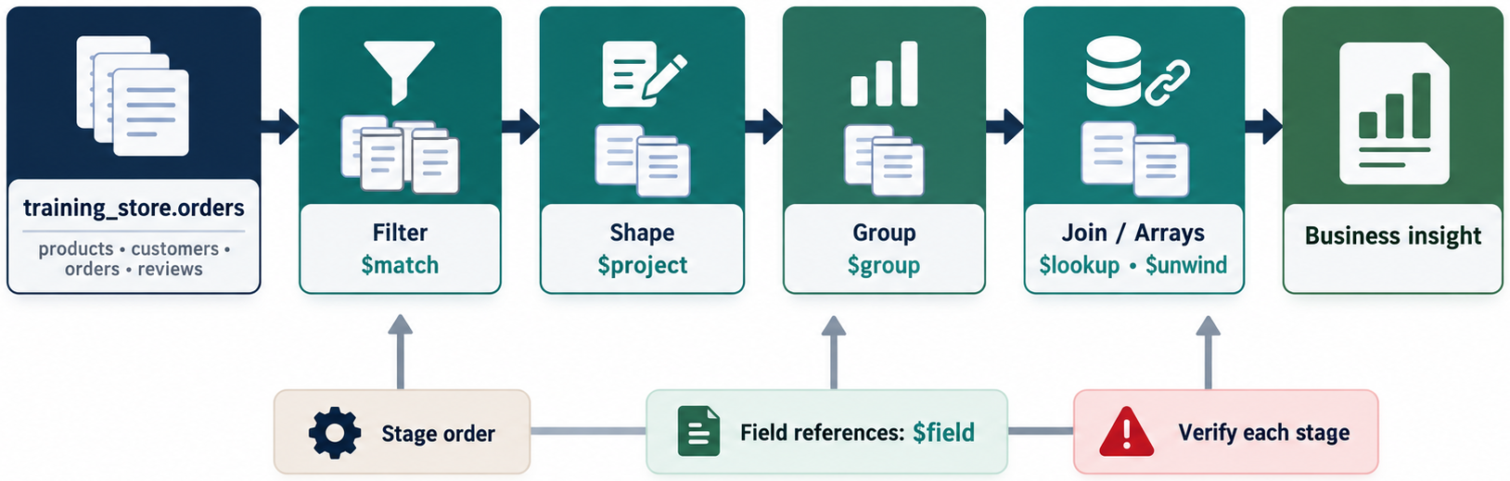
MODULE SUMMARY
MODULE 5
🧭
KEY POINTS
• Pipelines are ordered transformations
• $match $project $set $group $unwind $lookup $facet
• Stage order changes meaning and cost
127
© 2026 by Innovation In Software Corporation
Notes:
This slide includes a diagram — Module Summary.
The slide title is: Module Summary.
The slide says: <div class="cols">.
The slide says: <div class="col-text">.
The slide says: </div>.
The slide says: <div class="col-visual">.
Bullet 1 on the slide: Pipelines are ordered transformations.
Bullet 2 on the slide: $match $project $set $group $unwind $lookup $facet.
Bullet 3 on the slide: Stage order changes meaning and cost.
The figure on this slide is titled: Module 5 concept map.

Slide 129
MODULE KNOWLEDGE CHECK
MODULE 5
❓
KEY POINTS
1. What does a pipeline do?
2. Why does stage order matter?
3. $project versus $set?
4. What is $group._id?
5. How is `$sum: 1` used?
6. When is $unwind required?
7. What does $lookup return?
8. Purpose of $facet?
9. How do you handle nulls?
10. Why put selective $match early?
11. Why is $limit before $sort wrong for top-N?
12. What must be true before you optimize?
128
© 2026 by Innovation In Software Corporation
Notes:
Let's look at Module Knowledge Check.
The slide title is: Module Knowledge Check.
The slide says: 1. What does a pipeline do?.
The slide says: 2. Why does stage order matter?.
The slide says: 3. $project versus $set?.
The slide says: 4. What is $group._id?.
The slide says: 5. How is $sum: 1 used?.
The slide says: 6. When is $unwind required?.
The slide says: 7. What does $lookup return?.
The slide says: 8. Purpose of $facet?.
The slide says: 9. How do you handle nulls?.
The slide says: 10. Why put selective $match early?.
The slide says: 11. Why is $limit before $sort wrong for top-N?.
The slide says: 12. What must be true before you optimize?.
Number 1 on the slide: What does a pipeline do?.
Number 2 on the slide: Why does stage order matter?.
Number 3 on the slide: $project versus $set?.
Number 4 on the slide: What is $group._id?.
Number 5 on the slide: How is $sum: 1 used?.
Number 6 on the slide: When is $unwind required?.
Number 7 on the slide: What does $lookup return?.
Number 8 on the slide: Purpose of $facet?.
Number 9 on the slide: How do you handle nulls?.
Number 10 on the slide: Why put selective $match early?.
Number 11 on the slide: Why is $limit before $sort wrong for top-N?.
Number 12 on the slide: What must be true before you optimize?.

Slide 130
LAB 5.10 — INTEGRATED AGGREGATION CHALLENGE
MODULE 5
🛠️
KEY POINTS
• 40 minutes
• Monthly performance report
• Required stages listed in the guide
LAB GUIDE Lab 5.10
129
© 2026 by Innovation In Software Corporation
Notes:
This slide includes a diagram — Lab 5.10 — Integrated Aggregation Challenge.
The slide title is: Lab 5.10 — Integrated Aggregation Challenge.
The slide says: <div class="cols">.
The slide says: <div class="col-text">.
The slide says: Lab guide: [Lab 5.10](../slide-exercises/module-05/lab-5.10-integrated-aggregation-challenge.md).
The slide says: </div>.
The slide says: <div class="col-visual">.
Bullet 1 on the slide: 40 minutes.
Bullet 2 on the slide: Monthly performance report.
Bullet 3 on the slide: Required stages listed in the guide.
The figure on this slide is titled: Monthly report challenge.

Slide 131
LAB 5.10 — STEPS 1–2
MODULE 5
🛠️
KEY POINTS
LAB GUIDE Lab 5.10
Follow along (Windows) — key steps:
Step 1 — Monthly core metrics
• Do: Paid, month key, group count/revenue/AOV/$addToSet customers.
• Expected: Three months; $size unique customers.
Step 2 — Units, top product, status
• Do: Other facet branches; sort months; save sample output.
• Expected: Every required stage used; July validated by hand.
130
© 2026 by Innovation In Software Corporation
Notes:
This slide lists key points under Lab 5.10 — Steps 1–2.
The slide title is: Lab 5.10 — Steps 1–2.
The slide says: Lab guide: [Lab 5.10](../slide-exercises/module-05/lab-5.10-integrated-aggregation-challenge.md).
The slide says: Follow along (Windows) — key steps:.
Step 1 — Monthly core metrics.
Step 2 — Units, top product, status.
Bullet 1 on the slide: Do: Paid, month key, group count/revenue/AOV/$addToSet customers.
Bullet 2 on the slide: Expected: Three months; $size unique customers.
Bullet 3 on the slide: Do: Other facet branches; sort months; save sample output.
Bullet 4 on the slide: Expected: Every required stage used; July validated by hand.

Slide 132
EXERCISE 5.13 — EXECUTIVE SALES SUMMARY
MODULE 5
🛠️
KEY POINTS
• 30–45 minutes
• Date-bounded paid report plus catalog bands
LAB GUIDE Exercise 5.13
131
© 2026 by Innovation In Software Corporation
Notes:
This slide includes a diagram — Exercise 5.13 — Executive Sales Summary.
The slide title is: Exercise 5.13 — Executive Sales Summary.
The slide says: <div class="cols">.
The slide says: <div class="col-text">.
The slide says: Lab guide: [Exercise 5.13](../slide-exercises/module-05/exercise-5.13-executive-sales-summary.md).
The slide says: </div>.
The slide says: <div class="col-visual">.
Bullet 1 on the slide: 30–45 minutes.
Bullet 2 on the slide: Date-bounded paid report plus catalog bands.
The figure on this slide is titled: Executive sales summary.

Slide 133
EXERCISE 5.13 — STEPS 1–2
MODULE 5
🛠️
KEY POINTS
LAB GUIDE Exercise 5.13
Follow along (Windows) — key steps:
Step 1 — Choose collections and the date filter
• Do: Orders drive items 1–6. Products drive 7–8. Write the $match on createdAt and paymentStatus.
• Expected: Date range uses ISODate bounds. Pending orders are excluded.
Step 2 — Build and structure the output
• Do: Use $facet so one aggregate call returns the metrics. Join customer names only on the top-customer branch. Handle missing shippingFee if you add it into a calculation. Explain stage order in three sentences.
• Expected: One result document (or a small set of clearly named documents). Top product L110. Top customer C101. You named likely indexes: paymentStatus+createdAt, and p
_Full lab guide with every command: see Lab guide on the lesson divider slide._
Step 1 — Collections and date filter
• Do: Orders for 1–6; products for 7–8; ISODate range; PAID.
• Expected: Pending orders excluded.
Step 2 — Structure the output
• Do: $facet; lookup only on top customers; defend order and one index.
• Expected: Top product L110; top customer C101.
132
© 2026 by Innovation In Software Corporation
Notes:
We are starting Exercise 5.13 — Executive Sales Summary. We have about 30-45 min for this lab.
Produce a date-bounded executive report covering revenue, monthly trend, products, customers, categories, and price bands.
The full lab guide is in slide-exercises/module-05/exercise-5.13-executive-sales-summary.md if you need extra detail.
On Windows: PowerShell in the integrated terminal — Ctrl+backtick — and the Agent panel — Ctrl+I. Open the repo folder with File → Open Folder.
Step 1 — Choose collections and the date filter.
Step 2 — Build and structure the output.
Step 1 — Choose collections and the date filter.
Step 2 — Build and structure the output.
Step 1 — Choose collections and the date filter.
Step 2 — Build and structure the output.
Step 1 — Collections and date filter.
Step 2 — Structure the output.
I'll give you a few minutes to work — raise your hand if you get stuck.
The slide title is: Exercise 5.13 — Steps 1–2.
The slide says: Lab guide: [Exercise 5.13](../slide-exercises/module-05/exercise-5.13-executive-sales-summary.md).
The slide says: Follow along (Windows) — key steps:.
The slide says: _Full lab guide with every command: see Lab guide on the lesson divider slide._.
Bullet 1 on the slide: Do: Orders drive items 1–6. Products drive 7–8. Write the $match on createdAt and paymentStatus.
Bullet 2 on the slide: Expected: Date range uses ISODate bounds. Pending orders are excluded.
Bullet 3 on the slide: Do: Use $facet so one aggregate call returns the metrics. Join customer names only on the top-customer branch. Handle missing shippingFee if you add it into a calculation. Explain stage order in three sentences.
Bullet 4 on the slide: Expected: One result document (or a small set of clearly named documents). Top product L110. Top customer C101. You named likely indexes: paymentStatus+createdAt, and p.
Bullet 5 on the slide: Do: Orders drive items 1–6. Products drive 7–8. Write the $match on createdAt and paymentStatus.
Bullet 6 on the slide: Expected: Date range uses ISODate bounds. Pending orders are excluded.
Bullet 7 on the slide: Do: Use $facet so one aggregate call returns the metrics. Join customer names only on the top-customer branch. Handle missing shippingFee if you add it into a calculation. Explain stage order in three sentences.
Bullet 8 on the slide: Expected: One result document (or a small set of clearly named documents). Top product L110. Top customer C101. You named likely indexes: paymentStatus+createdAt, and p.
Bullet 9 on the slide: Do: Orders drive items 1–6. Products drive 7–8. Write the $match on createdAt and paymentStatus.
Bullet 10 on the slide: Expected: Date range uses ISODate bounds. Pending orders are excluded.
Bullet 11 on the slide: Do: Use $facet so one aggregate call returns the metrics. Join customer names only on the top-customer branch. Handle missing shippingFee if you add it into a calculation. Explain stage order in three sentences.
Bullet 12 on the slide: Expected: One result document (or a small set of clearly named documents). Top product L110. Top customer C101. You named likely indexes: paymentStatus+createdAt, and p.
Bullet 13 on the slide: Do: Orders for 1–6; products for 7–8; ISODate range; PAID.
Bullet 14 on the slide: Expected: Pending orders excluded.
Bullet 15 on the slide: Do: $facet; lookup only on top customers; defend order and one index.
Bullet 16 on the slide: Expected: Top product L110; top customer C101.

Slide 134
MODULE COMPLETION CHECKLIST
MODULE 5
✅
KEY POINTS
Participants can:
• Explain pipeline processing
• Build multi-stage aggregations
• Filter and reshape documents
• Create calculated fields
• Group by one or more fields
• Use accumulator operators
• Process arrays with $unwind
• Join with $lookup
• Build bucketed and $facet reports
• Handle missing values and types
• Validate calculations
• Identify basic performance improvements
133
© 2026 by Innovation In Software Corporation
Notes:
This slide lists key points under Module Completion Checklist.
The slide title is: Module Completion Checklist.
The slide says: Participants can:.
Bullet 1 on the slide: Explain pipeline processing.
Bullet 2 on the slide: Build multi-stage aggregations.
Bullet 3 on the slide: Filter and reshape documents.
Bullet 4 on the slide: Create calculated fields.
Bullet 5 on the slide: Group by one or more fields.
Bullet 6 on the slide: Use accumulator operators.
Bullet 7 on the slide: Process arrays with $unwind.
Bullet 8 on the slide: Join with $lookup.
Bullet 9 on the slide: Build bucketed and $facet reports.
Bullet 10 on the slide: Handle missing values and types.
Bullet 11 on the slide: Validate calculations.
Bullet 12 on the slide: Identify basic performance improvements.

Slide 135
QUESTIONS AND ANSWERS
MODULE 5
❓
KEY POINTS
Open questions on:
• Stage order in *their* reports
• When to unwind versus $filter
• Whether $lookup means they modeled wrong
• What they will index tomorrow
Park replica-set and shard-key questions for Module 7.
134
© 2026 by Innovation In Software Corporation
Notes:
This slide lists key points under Questions and Answers.
The slide title is: Questions and Answers.
The slide says: Open questions on:.
The slide says: Park replica-set and shard-key questions for Module 7.
Bullet 1 on the slide: Stage order in their reports.
Bullet 2 on the slide: When to unwind versus $filter.
Bullet 3 on the slide: Whether $lookup means they modeled wrong.
Bullet 4 on the slide: What they will index tomorrow.

Slide 136
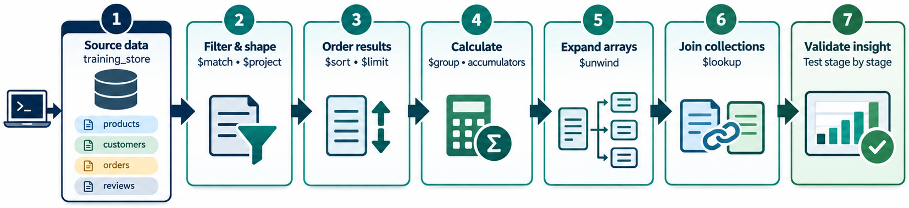
DAY 2 PATH THROUGH AGGREGATION
MODULE 5
📊
KEY POINTS
• Filter with $match
• Shape with $set / $project
• Summarize with $group
• Report with $facet
135
© 2026 by Innovation In Software Corporation
Notes:
This slide includes a diagram — Day 2 path through aggregation.
The slide title is: Day 2 path through aggregation.
The slide says: <div class="cols">.
The slide says: <div class="col-text">.
The slide says: </div>.
The slide says: <div class="col-visual">.
Bullet 1 on the slide: Filter with $match.
Bullet 2 on the slide: Shape with $set / $project.
Bullet 3 on the slide: Summarize with $group.
Bullet 4 on the slide: Report with $facet.
The figure on this slide is titled: Day 2 aggregation path.

Slide 137
TRANSITION TO MODULE 6: INDEXING
MODULE 5
🧭
KEY POINTS
Module 6 connects these pipelines to performance:
• Index structures
• Single-field and compound indexes
• Multikey, unique, text, and specialized indexes
• Prefixes and field order
• Covered queries
• Execution plans
• Maintenance and tradeoffs
Bring tomorrow’s laptop on the same connection string. Keep today’s pipelines.
136
© 2026 by Innovation In Software Corporation
Notes:
This slide lists key points under Transition to Module 6: Indexing.
The slide title is: Transition to Module 6: Indexing.
The slide says: Module 6 connects these pipelines to performance:.
The slide says: Bring tomorrow’s laptop on the same connection string. Keep today’s pipelines.
Bullet 1 on the slide: Index structures.
Bullet 2 on the slide: Single-field and compound indexes.
Bullet 3 on the slide: Multikey, unique, text, and specialized indexes.
Bullet 4 on the slide: Prefixes and field order.
Bullet 5 on the slide: Covered queries.
Bullet 6 on the slide: Execution plans.
Bullet 7 on the slide: Maintenance and tradeoffs.

