Slide 1
MODULE 6
Indexing and Query Performance
An index trades storage and write cost for faster access to selected data
How Indexes Work
Compound Indexes
Specialized Index Types
Covered Queries & Selectivity
Common Indexing Mistakes
MASTERING MONGODB • MODULE 6
Notes:
The slide title is: Indexing and Query Performance.
The slide says: An index trades storage and write cost for faster access to selected data.

Slide 2
MODULE LEARNING OBJECTIVES
MODULE 6
🎯
YOU WILL BE ABLE TO
• Recognize queries that need indexes
• Create, inspect, hide, and remove indexes
• Design compound indexes around query shapes
• Apply Equality–Sort–Range as a starting guideline
• Choose specialized index types appropriately
• Read essential explain() statistics
• Compare collection scans with index scans
• Remove unnecessary index overhead
• Recommend indexes based on evidence
1
© 2026 by Innovation In Software Corporation
Notes:
This slide lists key points under Module Learning Objectives.
The slide title is: Module Learning Objectives.
The slide says: By the end of this module you will be able to:.
Bullet 1 on the slide: Recognize queries that need indexes.
Bullet 2 on the slide: Create, inspect, hide, and remove indexes.
Bullet 3 on the slide: Design compound indexes around query shapes.
Bullet 4 on the slide: Apply Equality–Sort–Range as a starting guideline.
Bullet 5 on the slide: Choose specialized index types appropriately.
Bullet 6 on the slide: Read essential explain() statistics.
Bullet 7 on the slide: Compare collection scans with index scans.
Bullet 8 on the slide: Remove unnecessary index overhead.
Bullet 9 on the slide: Recommend indexes based on evidence.

Slide 3
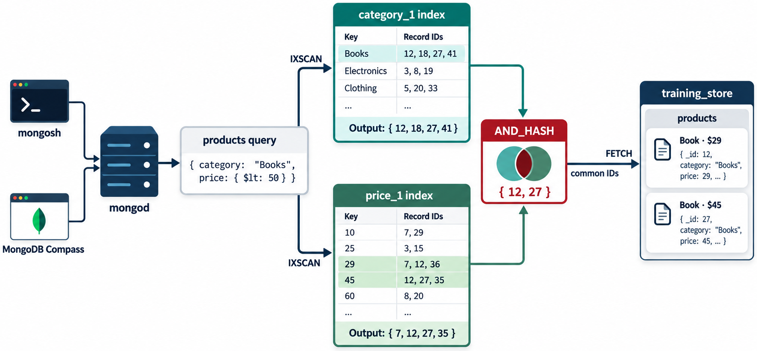
INTRODUCTION
MODULE 6
📌
KEY POINTS
An index is a data structure that helps MongoDB locate documents without scanning every document in a collection.
Without a suitable index, MongoDB may perform a collection scan:
With a suitable index:
Indexes can greatly improve query performance, but they also:
Examine every document → test filter → return matches
Search index entries → locate matching documents → return results
2
© 2026 by Innovation In Software Corporation
Notes:
An index is a data structure that helps MongoDB locate documents without scanning every document in a collection.

Slide 4
INTRODUCTION (CONT.)
MODULE 6
📌
KEY POINTS
• Consume disk and memory
• Add work to inserts, updates and deletes
• Require monitoring and maintenance
• Must be designed around real query patterns
The core principle is:
We will continue using:
use training_store
KEY TAKEAWAY Create indexes for important query shapes, not merely for every available field.
3
© 2026 by Innovation In Software Corporation
Notes:
The core principle is:

Slide 5
HOW AN INDEX WORKS
MODULE 6
📌
KEY POINTS
Suppose the products collection contains one million documents, and the application runs:
Without an index on sku, MongoDB may inspect every product until it finds the match.
Create an index:
MongoDB creates an ordered structure containing the indexed values and references to their documents.
db.products.find({
sku: "ELEC-1001"
})
db.products.createIndex({
sku: 1
})
4
© 2026 by Innovation In Software Corporation
Notes:
Suppose the `products` collection contains one million documents, and the application runs:

Slide 6
HOW AN INDEX WORKS (CONT.)
MODULE 6
📌
KEY POINTS
MongoDB can search this structure instead of reading the entire collection.
BOOK-1001 → Product document
BOOK-1002 → Product document
ELEC-1001 → Product document
ELEC-1002 → Product document
5
© 2026 by Innovation In Software Corporation
Notes:
MongoDB can search this structure instead of reading the entire collection.

Slide 7
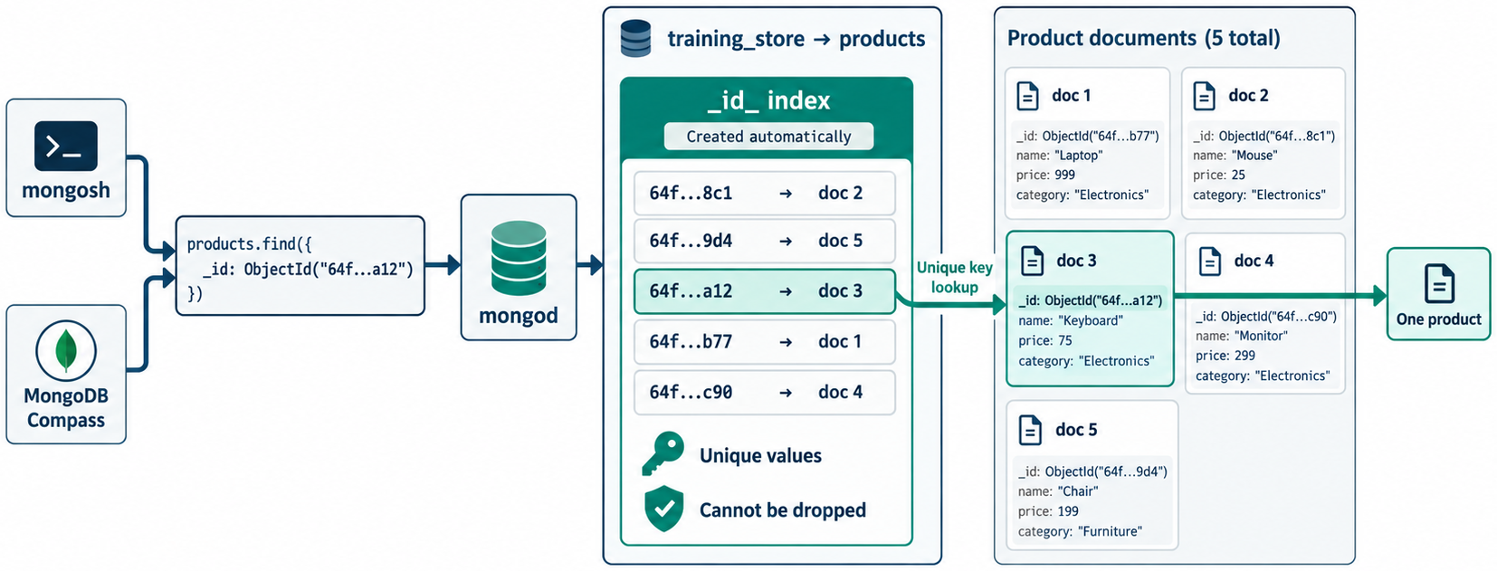
DEFAULT _ID INDEX
MODULE 6
📌
KEY POINTS
Every standard MongoDB collection automatically receives a unique index on _id:
Therefore, this query is indexed automatically:
The _id index:
• Uniquely identifies documents
• Prevents duplicate _id values
• Cannot normally be removed
• Supports efficient lookup by document identifier
{
_id: 1
}
db.products.find({
_id: ObjectId("65a100000000000000000001")
})
6
© 2026 by Innovation In Software Corporation
Notes:
Every standard MongoDB collection automatically receives a unique index on `_id`:

Slide 8
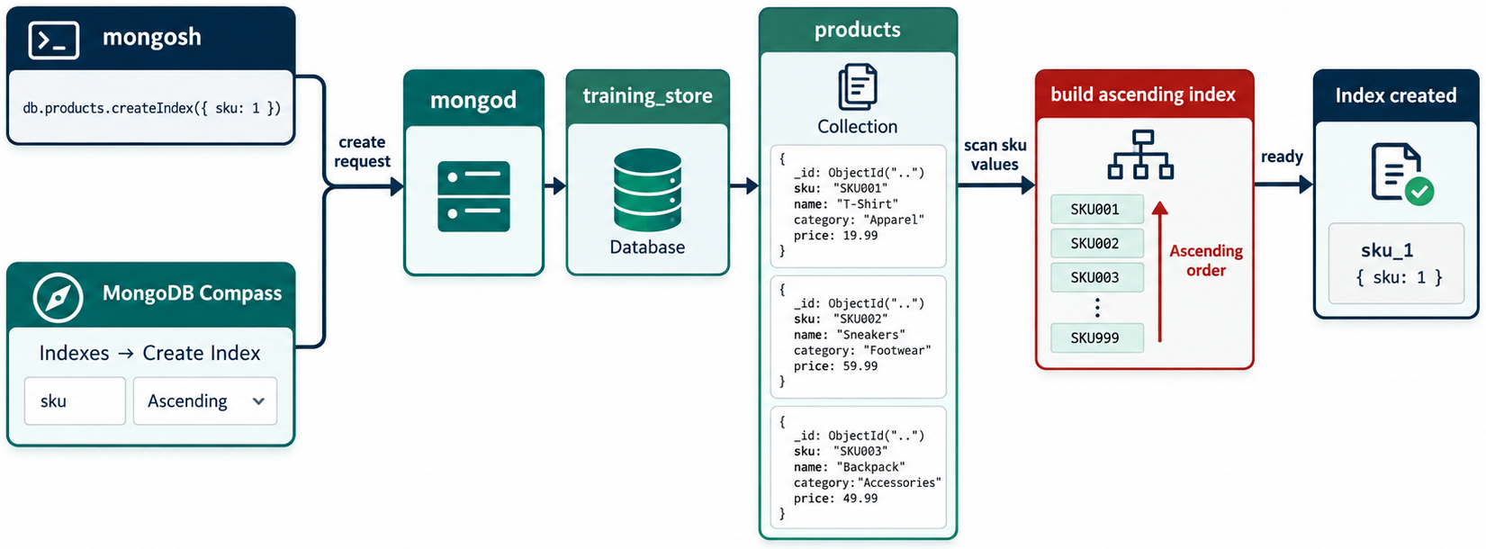
CREATING A SINGLE-FIELD INDEX
MODULE 6
📌
KEY POINTS
Create an ascending index:
Create a descending index:
For simple equality matching, ascending and descending single-field indexes generally provide equivalent lookup capability. Direction matters more when supporting sorts in compound indexes.
db.products.createIndex({
category: 1
})
db.orders.createIndex({
orderedAt: -1
})
7
© 2026 by Innovation In Software Corporation
Notes:
Create an ascending index:

Slide 9
CREATE AN INDEX WITH A CUSTOM NAME
MODULE 6
📌
KEY POINTS
A clear naming convention makes indexes easier to identify and manage.
db.products.createIndex(
{
category: 1
},
{
name: "idx_products_category"
}
)
8
© 2026 by Innovation In Software Corporation
Notes:
A clear naming convention makes indexes easier to identify and manage.

Slide 10
CREATING MULTIPLE INDEXES
MODULE 6
📌
KEY POINTS
Multiple indexes can be requested together:
MongoDB provides both createIndex() and createIndexes() for creating indexes.
db.products.createIndexes([
{
key: {
sku: 1
},
name: "uq_products_sku",
unique: true
},
{
key: {
category: 1,
price: 1
},
name: "idx_products_category_price"
},
{
key: {
tags: 1
},
name: "idx_products_tags"
}
])
9
© 2026 by Innovation In Software Corporation
Notes:
Multiple indexes can be requested together:

Slide 11
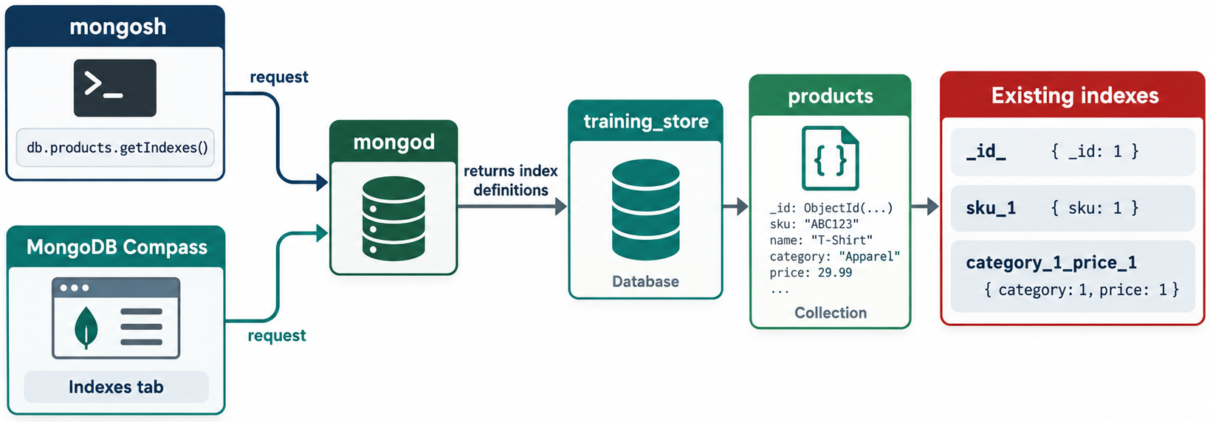
VIEWING EXISTING INDEXES
MODULE 6
📌
KEY POINTS
List a collection’s indexes:
A result may resemble:
Display only index names:
db.products.getIndexes()
[
{
key: { _id: 1 },
name: "_id_"
},
{
key: { sku: 1 },
name: "uq_products_sku",
unique: true
},
{
key: { category: 1, price: 1 },
name: "idx_products_category_price"
}
]
10
© 2026 by Innovation In Software Corporation
Notes:
List a collection’s indexes:

Slide 12
VIEWING EXISTING INDEXES (CONT.)
MODULE 6
db.products.getIndexes().map(
index => index.name
)
11
© 2026 by Innovation In Software Corporation
Notes:
Covers Viewing Existing Indexes.

Slide 13
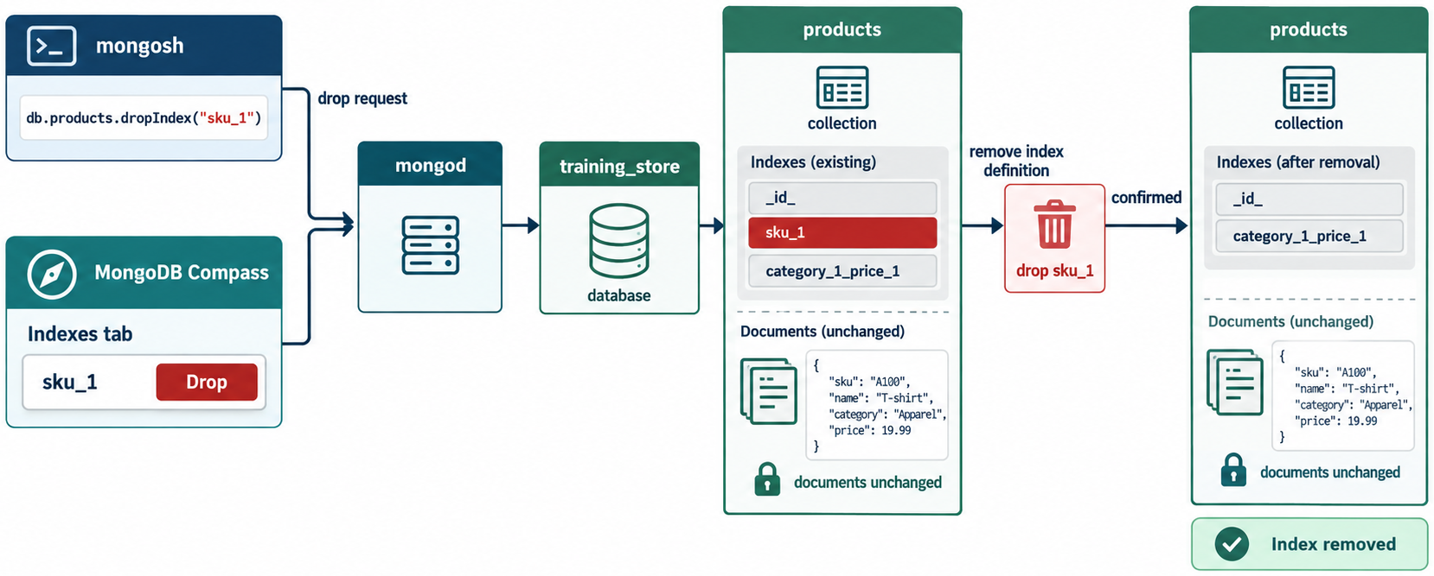
REMOVE ONE INDEX BY NAME
MODULE 6
db.products.dropIndex(
"idx_products_category"
)
12
© 2026 by Innovation In Software Corporation
Notes:
Covers Remove one index by name.

Slide 14
REMOVE ONE INDEX BY KEY SPECIFICATION
MODULE 6
db.products.dropIndex({
category: 1
})
13
© 2026 by Innovation In Software Corporation
Notes:
Covers Remove one index by key specification.

Slide 15
REMOVE ALL REMOVABLE INDEXES
MODULE 6
📌
KEY POINTS
This retains the required _id index.
Removing an index can cause performance regressions. Confirm that important queries do not depend on it before dropping it.
db.products.dropIndexes()
14
© 2026 by Innovation In Software Corporation
Notes:
This retains the required `_id` index.

Slide 16
HIDING AN INDEX FOR TESTING
MODULE 6
📌
KEY POINTS
Instead of immediately dropping a questionable index, it can be hidden from the query planner:
Run representative tests while the index is hidden.
Restore it:
db.products.hideIndex(
"idx_products_category_price"
)
db.products.unhideIndex(
"idx_products_category_price"
)
15
© 2026 by Innovation In Software Corporation
Notes:
Instead of immediately dropping a questionable index, it can be hidden from the query planner:

Slide 17
HIDING AN INDEX FOR TESTING (CONT.)
MODULE 6
📌
KEY POINTS
Hiding is safer for evaluation because the existing index structure remains available and can be restored without rebuilding it. However, a hidden index still consumes storage and must still be maintained during writes.
16
© 2026 by Innovation In Software Corporation
Notes:
Hiding is safer for evaluation because the existing index structure remains available and can be restored without rebuilding it. However, a hidden index still consumes storage and must still be...

Slide 18
WITHOUT A SUITABLE INDEX
MODULE 6
📌
KEY POINTS
Consider:
MongoDB may perform:
This means it scans collection documents.
db.products.find({
category: "Electronics",
price: {
$lt: NumberDecimal("100.00")
}
})
COLLSCAN
17
© 2026 by Innovation In Software Corporation
Notes:
MongoDB may perform:

Slide 19
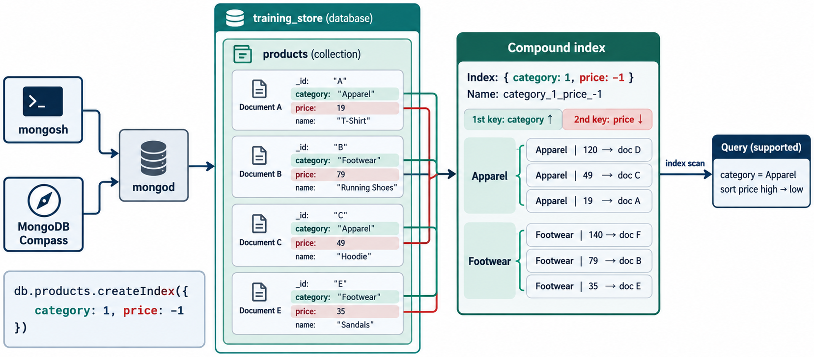
WITH A COMPOUND INDEX
MODULE 6
📌
KEY POINTS
MongoDB may perform:
• IXSCAN searches the index.
• FETCH retrieves qualifying documents.
• The query avoids examining unrelated collection documents.
db.products.createIndex({
category: 1,
price: 1
})
IXSCAN → FETCH
18
© 2026 by Innovation In Software Corporation
Notes:
MongoDB may perform:

Slide 20
PERFORMANCE IS NOT DETERMINED BY TIME ALONE
MODULE 6
📊
KEY POINTS
Execution time can vary because of:
• Caching
• Hardware activity
• Dataset size
• Concurrent workloads
• Network latency
Also compare:
• totalDocsExamined
• totalKeysExamined
• nReturned
• Selected execution stage
• Whether a blocking sort occurred
19
© 2026 by Innovation In Software Corporation
Notes:
Execution time can vary because of:

Slide 21
EXAMINING A QUERY PLAN
MODULE 6
📌
KEY POINTS
Use explain("executionStats"):
An alternative form is:
MongoDB’s executionStats mode reports query execution information including index use and examined documents.
db.products.find({
category: "Electronics",
price: {
$lt: NumberDecimal("100.00")
}
}).explain("executionStats")
db.products.explain(
"executionStats"
).find({
category: "Electronics",
price: {
$lt: NumberDecimal("100.00")
}
})
20
© 2026 by Innovation In Software Corporation
Notes:
Use `explain("executionStats")`:

Slide 22
IMPORTANT FIELDS
MODULE 6
📌
KEY POINTS
#### winningPlan
Shows the plan chosen by the query optimizer.
Look for stages such as:
#### nReturned
Number of documents returned to the caller.
COLLSCAN
IXSCAN
FETCH
SORT
21
© 2026 by Innovation In Software Corporation
Notes:
#### `winningPlan`

Slide 23
IMPORTANT FIELDS (CONT.)
MODULE 6
📌
KEY POINTS
#### totalDocsExamined
Number of collection documents inspected.
#### totalKeysExamined
Number of index entries inspected.
#### Example interpretation
nReturned: 10
totalKeysExamined: 10
totalDocsExamined: 10
22
© 2026 by Innovation In Software Corporation
Notes:
#### `totalDocsExamined`

Slide 24
IMPORTANT FIELDS (CONT.)
MODULE 6
📌
KEY POINTS
This may indicate a selective and efficient indexed query.
An index may have been used, but the query still examines many unnecessary entries and documents.
nReturned: 10
totalKeysExamined: 100,000
totalDocsExamined: 80,000
23
© 2026 by Innovation In Software Corporation
Notes:
This may indicate a selective and efficient indexed query.

Slide 25
STEP 1: INSPECT THE QUERY
MODULE 6
db.orders.find({
customerId: ObjectId("66a100000000000000000001")
}).sort({
orderedAt: -1
}).explain("executionStats")
24
© 2026 by Innovation In Software Corporation
Notes:
Covers Step 1: Inspect the query.

Slide 26
STEP 2: CREATE AN INDEX MATCHING THE FILTER AND SORT
MODULE 6
db.orders.createIndex(
{
customerId: 1,
orderedAt: -1
},
{
name: "idx_orders_customer_date"
}
)
25
© 2026 by Innovation In Software Corporation
Notes:
Covers Step 2: Create an index matching the filter and sort.

Slide 27
STEP 3: RUN THE SAME EXPLAIN OPERATION
MODULE 6
📌
KEY POINTS
The desired improvement is:
• Index scan instead of collection scan
• Fewer documents examined
• Fewer unnecessary keys examined
• No in-memory blocking sort
• Faster and more predictable execution
db.orders.find({
customerId: ObjectId("66a100000000000000000001")
}).sort({
orderedAt: -1
}).explain("executionStats")
26
© 2026 by Innovation In Software Corporation
Notes:
The desired improvement is:

Slide 28
COMPOUND INDEXES
MODULE 6
📌
KEY POINTS
A compound index contains multiple fields:
The index is ordered first by category and then by price within each category.
Compound indexes support queries using the indexed fields and their prefixes.
db.products.createIndex({
category: 1,
price: 1
})
Books
19.99
29.99
49.99
Electronics
39.99
89.99
499.99
27
© 2026 by Innovation In Software Corporation
Notes:
A compound index contains multiple fields:

Slide 29
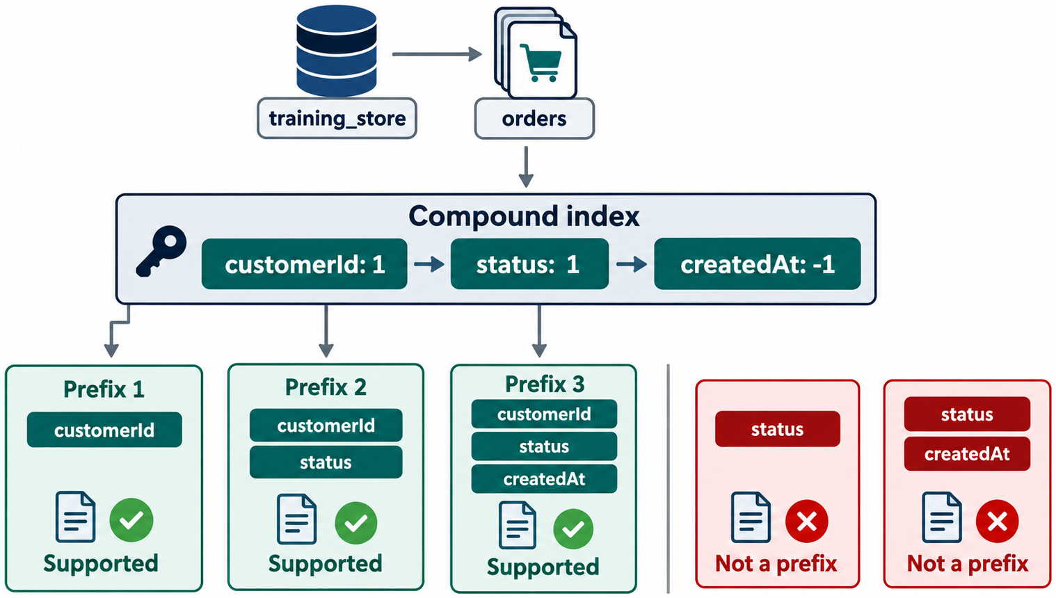
INDEX-PREFIX RULE
MODULE 6
📌
KEY POINTS
For:
Useful prefixes include:
A query using only price normally cannot use this index as effectively as a query beginning with category.
This does not mean every query must include every indexed field. It means field order controls which leading portions of the index are directly useful.
{
category: 1,
price: 1,
stock: 1
}
{ category: 1 }
{ category: 1, price: 1 }
{ category: 1, price: 1, stock: 1 }
28
© 2026 by Innovation In Software Corporation
Notes:
For:

Slide 30
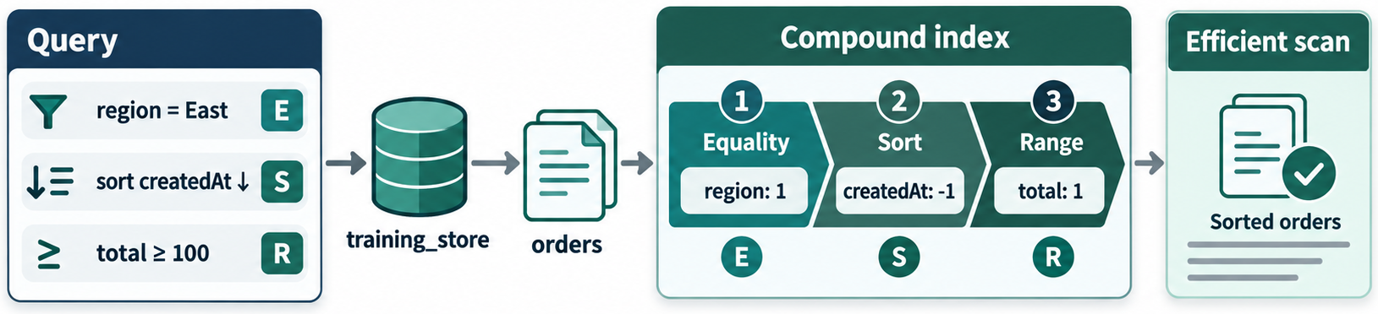
EQUALITY, SORT AND RANGE GUIDELINE
MODULE 6
📌
KEY POINTS
A practical compound-index design guideline is ESR:
1. Equality
2. Sort
3. Range
Suppose the query is:
Possible index:
db.orders.find({
customerId: customerId,
status: "Completed",
total: {
$gte: NumberDecimal("100.00")
}
}).sort({
orderedAt: -1
})
db.orders.createIndex({
customerId: 1,
status: 1,
orderedAt: -1,
total: 1
})
29
© 2026 by Innovation In Software Corporation
Notes:
A practical compound-index design guideline is ESR:

Slide 31
EQUALITY, SORT AND RANGE GUIDELINE (CONT.)
MODULE 6
📌
KEY POINTS
• customerId and status are equality conditions.
• orderedAt supports sorting.
• total is a range condition.
ESR is a guideline, not an absolute rule. Query selectivity, sorting requirements and actual explain results should determine the final design.
30
© 2026 by Innovation In Software Corporation
Notes:
ESR is a guideline, not an absolute rule. Query selectivity, sorting requirements and actual explain results should determine the final design.

Slide 32
SUPPORTING SORTS
MODULE 6
📌
KEY POINTS
Consider:
Recommended index:
The index groups entries by customer and arranges each customer’s orders by date.
db.orders.find({
customerId: customerId
}).sort({
orderedAt: -1
})
db.orders.createIndex({
customerId: 1,
orderedAt: -1
})
31
© 2026 by Innovation In Software Corporation
Notes:
Consider:

Slide 33
REVERSE TRAVERSAL
MODULE 6
📌
KEY POINTS
An index:
can generally support the exact direction:
and its complete reverse:
{
customerId: 1,
orderedAt: -1
}
{
customerId: -1,
orderedAt: 1
}
32
© 2026 by Innovation In Software Corporation
Notes:
An index:

Slide 34
REVERSE TRAVERSAL (CONT.)
MODULE 6
📌
KEY POINTS
It does not directly support every arbitrary combination of directions.
33
© 2026 by Innovation In Software Corporation
Notes:
It does not directly support every arbitrary combination of directions.

Slide 35
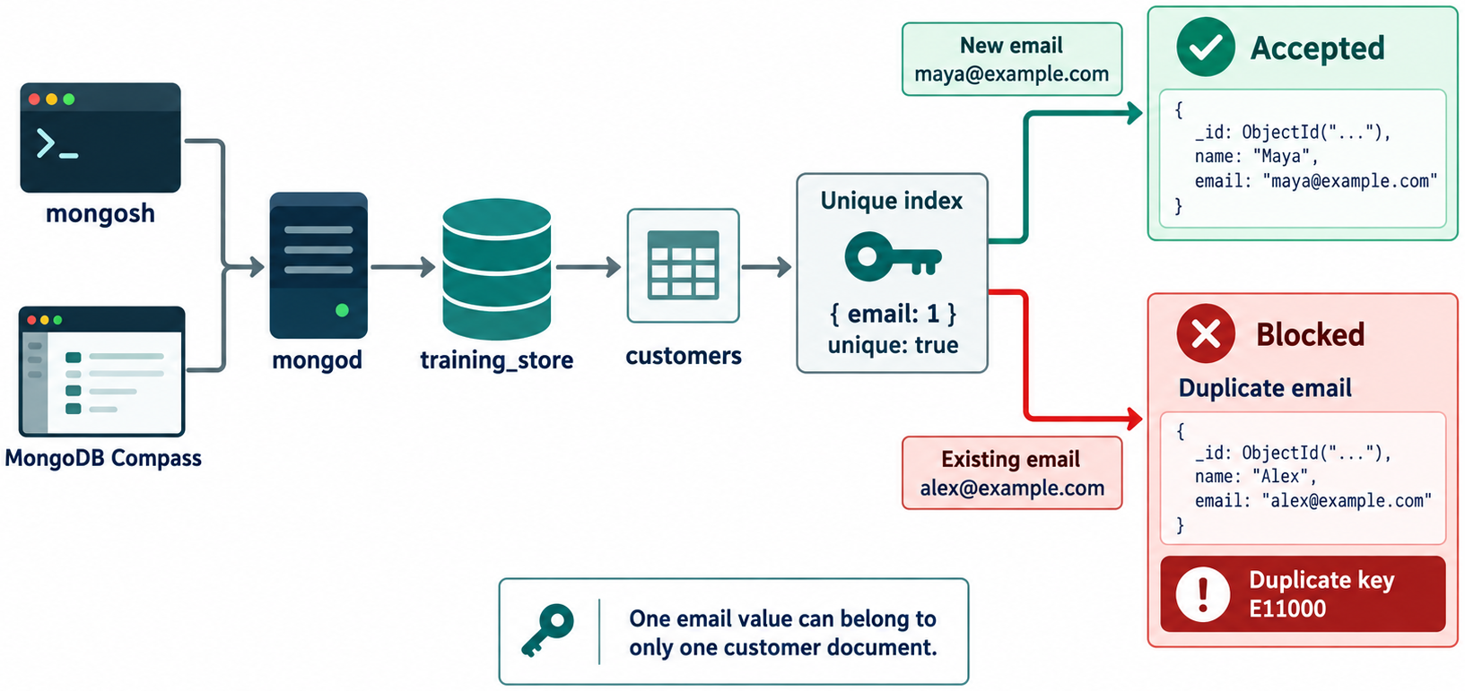
UNIQUE INDEXES
MODULE 6
📌
KEY POINTS
A unique index prevents duplicate indexed values.
Attempting to insert another product with the same SKU causes a duplicate-key error.
db.products.createIndex(
{
sku: 1
},
{
unique: true,
name: "uq_products_sku"
}
)
34
© 2026 by Innovation In Software Corporation
Notes:
A unique index prevents duplicate indexed values.

Slide 36
UNIQUE CUSTOMER EMAIL
MODULE 6
db.customers.createIndex(
{
email: 1
},
{
unique: true,
name: "uq_customers_email"
}
)
35
© 2026 by Innovation In Software Corporation
Notes:
Covers Unique customer email.

Slide 37
CASE-INSENSITIVE UNIQUENESS
MODULE 6
📌
KEY POINTS
The strings below differ in case:
For case-insensitive comparison, an index can use collation:
Queries must use a compatible collation to use that index:
priya@example.com
PRIYA@EXAMPLE.COM
db.customers.createIndex(
{
email: 1
},
{
unique: true,
name: "uq_customers_email_ci",
collation: {
locale: "en",
strength: 2
}
}
)
36
© 2026 by Innovation In Software Corporation
Notes:
The strings below differ in case:

Slide 38
CASE-INSENSITIVE UNIQUENESS (CONT.)
MODULE 6
📌
KEY POINTS
Applications should also normalize email addresses before storing them when that matches the business rule.
db.customers.find({
email: "PRIYA@EXAMPLE.COM"
}).collation({
locale: "en",
strength: 2
})
37
© 2026 by Innovation In Software Corporation
Notes:
Applications should also normalize email addresses before storing them when that matches the business rule.

Slide 39
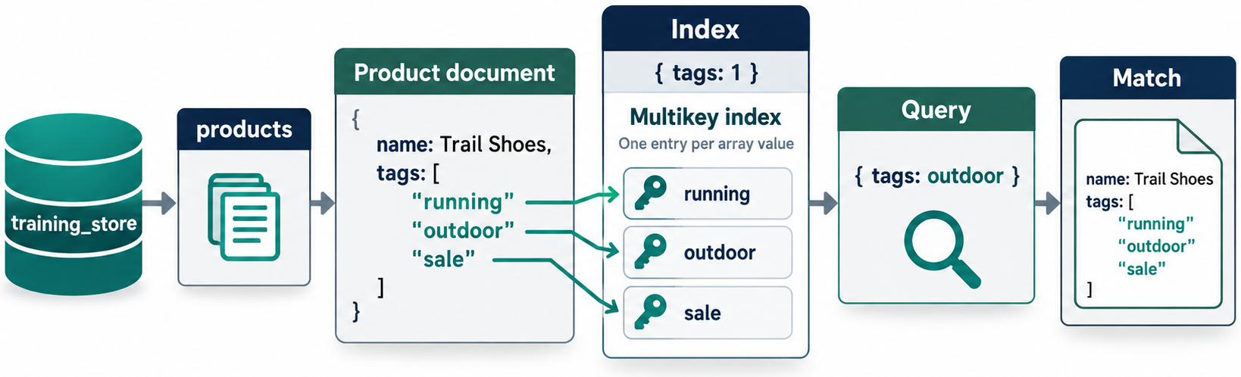
MULTIKEY INDEXES FOR ARRAYS
MODULE 6
📌
KEY POINTS
When an index is created on an array field, MongoDB creates a multikey index.
It supports queries such as:
MongoDB’s multikey indexes collect and sort values stored in arrays.
db.products.createIndex({
tags: 1
})
db.products.find({
tags: "wireless"
})
38
© 2026 by Innovation In Software Corporation
Notes:
When an index is created on an array field, MongoDB creates a multikey index.

Slide 40
ARRAY OF EMBEDDED DOCUMENTS
MODULE 6
📌
KEY POINTS
This can support:
db.orders.createIndex({
"items.productId": 1
})
db.orders.find({
"items.productId": mouseId
})
39
© 2026 by Innovation In Software Corporation
Notes:
This can support:

Slide 41
MULTIKEY CONSIDERATION
MODULE 6
📌
KEY POINTS
Arrays may produce multiple index entries per document. Large arrays can therefore create large indexes and increase write overhead.
Compound multikey indexes also have restrictions when multiple indexed fields are arrays. Test the intended document structure before adopting such an index.
40
© 2026 by Innovation In Software Corporation
Notes:
Arrays may produce multiple index entries per document. Large arrays can therefore create large indexes and increase write overhead.

Slide 42
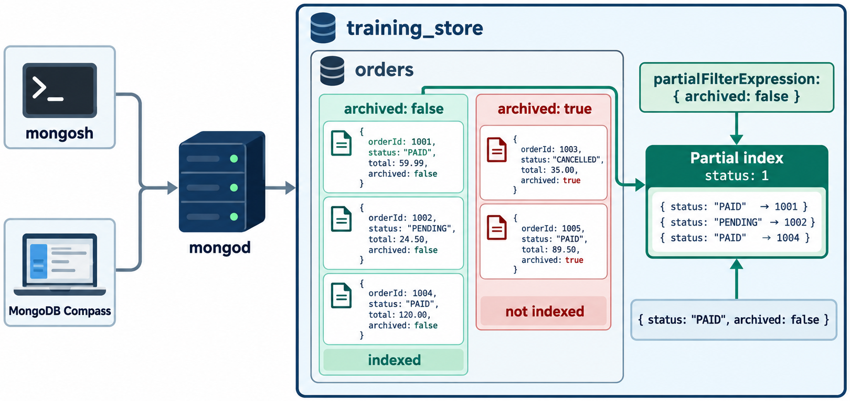
PARTIAL INDEXES
MODULE 6
📌
KEY POINTS
A partial index includes only documents matching a filter.
Suppose most product queries retrieve active products:
The index includes only active products.
This can:
• Reduce index size
• Reduce index maintenance
• Improve queries that match the partial condition
db.products.createIndex(
{
category: 1,
price: 1
},
{
name: "idx_active_products_category_price",
partialFilterExpression: {
active: true
}
}
)
41
© 2026 by Innovation In Software Corporation
Notes:
A partial index includes only documents matching a filter.

Slide 43
PARTIAL INDEXES (CONT.)
MODULE 6
📌
KEY POINTS
A query must satisfy the partial-filter condition for MongoDB to safely use the index:
A query that does not restrict active to true cannot generally rely on this partial index because inactive matching documents are absent from it.
db.products.find({
active: true,
category: "Electronics",
price: {
$lt: NumberDecimal("100.00")
}
})
42
© 2026 by Innovation In Software Corporation
Notes:
A query must satisfy the partial-filter condition for MongoDB to safely use the index:

Slide 44
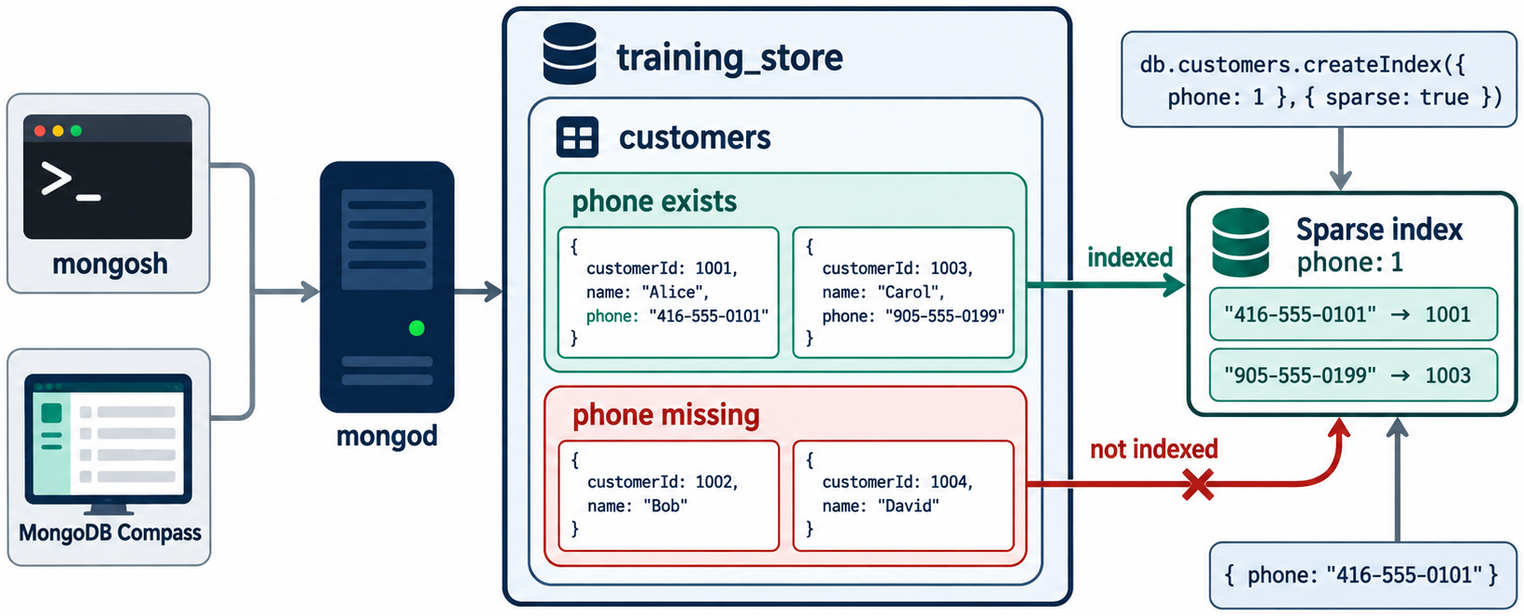
SPARSE INDEXES
MODULE 6
📌
KEY POINTS
A sparse index includes documents that contain the indexed field.
Sparse indexes can be useful for optional fields, but partial indexes offer more precise control and are often preferred.
Be especially careful with unique sparse indexes because uniqueness applies only to indexed documents.
db.customers.createIndex(
{
loyaltyNumber: 1
},
{
sparse: true,
name: "idx_customers_loyalty_sparse"
}
)
43
© 2026 by Innovation In Software Corporation
Notes:
A sparse index includes documents that contain the indexed field.

Slide 45
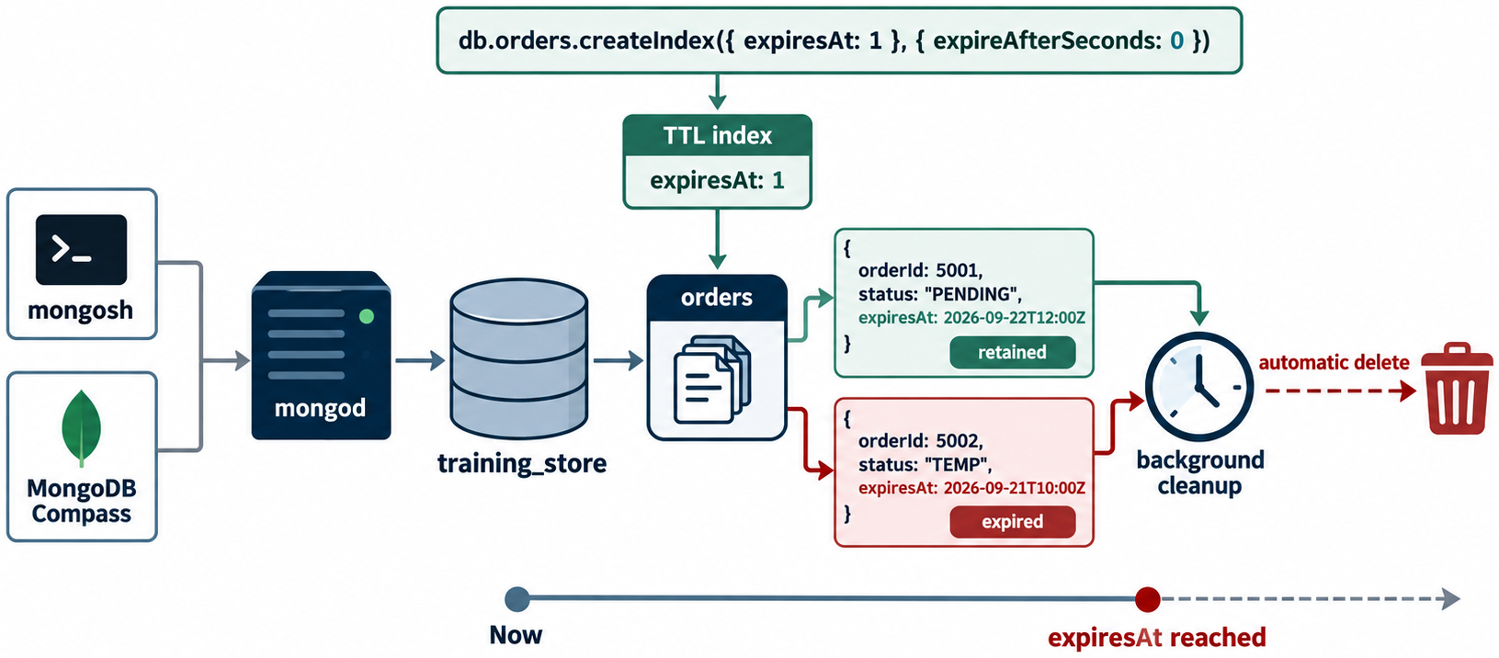
TTL INDEXES
MODULE 6
📌
KEY POINTS
A TTL, or time-to-live, index automatically removes expired documents.
Example session document:
Create a TTL index:
{
sessionId: "S-1001",
customerId: customerId,
expiresAt: ISODate("2026-09-22T20:00:00Z")
}
db.sessions.createIndex(
{
expiresAt: 1
},
{
expireAfterSeconds: 0,
name: "ttl_sessions_expiresAt"
}
)
44
© 2026 by Innovation In Software Corporation
Notes:
A TTL, or time-to-live, index automatically removes expired documents.

Slide 46
TTL INDEXES (CONT.)
MODULE 6
📌
KEY POINTS
With `expireAfterSeconds: 0, each document expires based on the date stored in expiresAt`.
TTL indexes are single-field indexes, and deletion can occur after the precise expiration time rather than exactly at that instant.
Common uses include:
• Login sessions
• Temporary verification codes
• Short-lived event data
• Temporary processing records
• Expiring audit data when permitted by policy
Do not use TTL deletion for records that must be retained for legal, audit or business purposes.
45
© 2026 by Innovation In Software Corporation
Notes:
With `expireAfterSeconds: 0`, each document expires based on the date stored in `expiresAt`.

Slide 47
TEXT INDEXES
MODULE 6
📌
KEY POINTS
A self-managed MongoDB deployment can use a text index for basic $text searches:
Query:
Return the text score:
db.products.createIndex(
{
name: "text",
description: "text"
},
{
name: "txt_products_name_description"
}
)
db.products.find({
$text: {
$search: "wireless ergonomic"
}
})
46
© 2026 by Innovation In Software Corporation
Notes:
A self-managed MongoDB deployment can use a text index for basic `$text` searches:

Slide 48
TEXT INDEXES (CONT.)
MODULE 6
📌
KEY POINTS
Traditional text indexes support basic word-based text queries, but they add write and storage cost. MongoDB recommends its newer search capabilities for more advanced search requirements.
Use a dedicated search solution when requirements include:
db.products.find(
{
$text: {
$search: "wireless ergonomic"
}
},
{
name: 1,
score: {
$meta: "textScore"
}
}
).sort({
score: {
$meta: "textScore"
}
})
47
© 2026 by Innovation In Software Corporation
Notes:
Traditional text indexes support basic word-based text queries, but they add write and storage cost. MongoDB recommends its newer search capabilities for more advanced search requirements.

Slide 49
TEXT INDEXES (CONT.)
MODULE 6
📌
KEY POINTS
• Autocomplete
• Fuzzy matching
• Relevance tuning
• Faceting
• Synonyms
• Semantic or vector search
• Advanced language analysis
48
© 2026 by Innovation In Software Corporation
Notes:
Covers Text Indexes.

Slide 50
WILDCARD INDEXES
MODULE 6
📌
KEY POINTS
A wildcard index can cover varying or unpredictable field names.
The specifications fields differ by product category:
A wildcard index can cover specification fields:
// Electronics
{
specifications: {
connection: "Bluetooth",
rechargeable: true
}
}
// Book
{
specifications: {
author: "A. Singh",
pages: 420
}
}
49
© 2026 by Innovation In Software Corporation
Notes:
A wildcard index can cover varying or unpredictable field names.

Slide 51
WILDCARD INDEXES (CONT.)
MODULE 6
📌
KEY POINTS
This may help varied queries such as:
or:
db.products.createIndex(
{
"specifications.$**": 1
},
{
name: "idx_products_specifications_wildcard"
}
)
db.products.find({
"specifications.connection": "Bluetooth"
})
db.products.find({
"specifications.pages": {
$gte: 300
}
})
50
© 2026 by Innovation In Software Corporation
Notes:
This may help varied queries such as:

Slide 52
WILDCARD INDEXES (CONT.)
MODULE 6
📌
KEY POINTS
Wildcard indexes support flexible schemas with varying field names.
They are not a substitute for intentional indexes on stable, high-volume query patterns.
51
© 2026 by Innovation In Software Corporation
Notes:
Wildcard indexes support flexible schemas with varying field names.

Slide 53
GEOSPATIAL INDEXES
MODULE 6
📌
KEY POINTS
Use a 2dsphere index for Earth-like geographic coordinates.
Store GeoJSON points with longitude first:
Create the index:
Find nearby stores:
{
name: "Brampton Store",
location: {
type: "Point",
coordinates: [
-79.7624,
43.7315
]
}
}
db.stores.createIndex(
{
location: "2dsphere"
},
{
name: "geo_stores_location"
}
)
52
© 2026 by Innovation In Software Corporation
Notes:
Use a `2dsphere` index for Earth-like geographic coordinates.

Slide 54
GEOSPATIAL INDEXES (CONT.)
MODULE 6
📌
KEY POINTS
Geospatial indexes are designed for geographic proximity and containment queries.
db.stores.find({
location: {
$near: {
$geometry: {
type: "Point",
coordinates: [
-79.7624,
43.7315
]
},
$maxDistance: 10000
}
}
})
53
© 2026 by Innovation In Software Corporation
Notes:
Geospatial indexes are designed for geographic proximity and containment queries.

Slide 55
HASHED INDEXES
MODULE 6
📌
KEY POINTS
A hashed index stores a hash of a field’s value:
Hashed indexes are primarily associated with hashed sharding and distributing values across shards.
They support equality-oriented access but are not appropriate for:
• Range queries
• Sorting by the original field value
• Prefix-based searches
MongoDB describes hashed indexes as indexing the hash of a field value and using them to support hashed sharding.
db.customers.createIndex({
customerNumber: "hashed"
})
54
© 2026 by Innovation In Software Corporation
Notes:
A hashed index stores a hash of a field’s value:

Slide 56
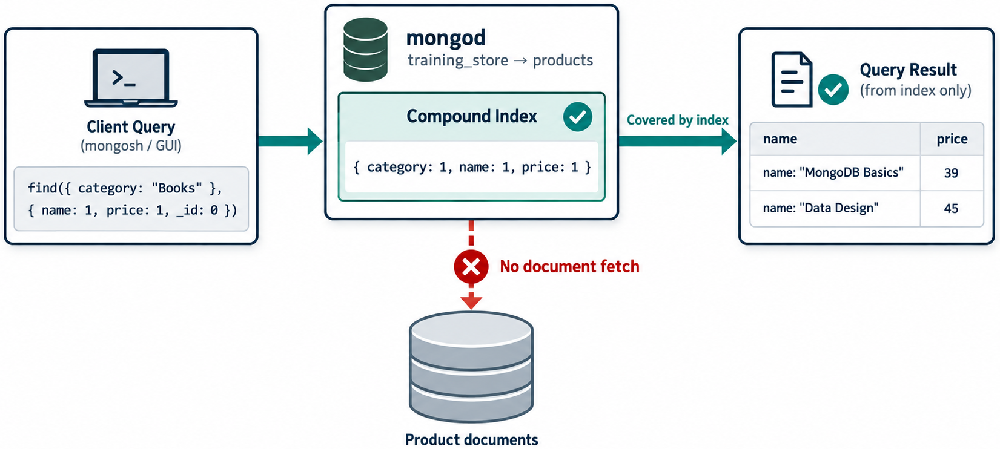
COVERED QUERIES
MODULE 6
📌
KEY POINTS
A covered query can be answered entirely from the index without retrieving the full collection documents.
Create:
Query only indexed fields:
db.products.createIndex({
category: 1,
name: 1,
price: 1
})
db.products.find(
{
category: "Electronics"
},
{
_id: 0,
category: 1,
name: 1,
price: 1
}
)
55
© 2026 by Innovation In Software Corporation
Notes:
A covered query can be answered entirely from the index without retrieving the full collection documents.

Slide 57
COVERED QUERIES (CONT.)
MODULE 6
📌
KEY POINTS
Because the filter and returned fields are contained in the index, MongoDB may avoid the document-fetch stage.
If _id is not part of the index, exclude it from the projection when attempting to create a covered query.
56
© 2026 by Innovation In Software Corporation
Notes:
Because the filter and returned fields are contained in the index, MongoDB may avoid the document-fetch stage.

Slide 58
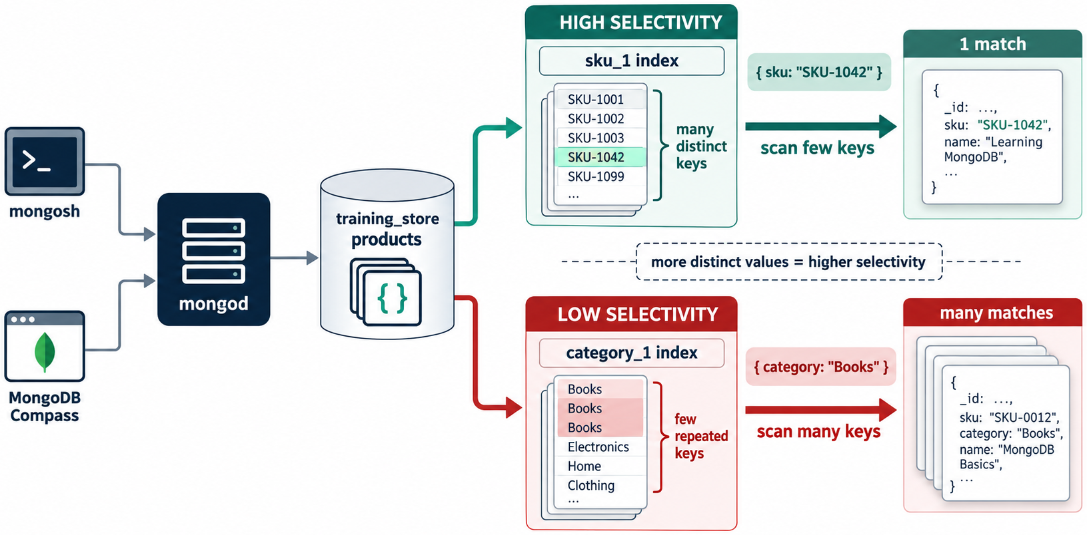
INDEX SELECTIVITY
MODULE 6
📌
KEY POINTS
A selective condition matches a relatively small portion of a collection.
Highly selective:
Potentially low selectivity:
If nearly every product is active, an index on active alone may provide little value.
{
sku: "ELEC-1001"
}
{
active: true
}
57
© 2026 by Innovation In Software Corporation
Notes:
A selective condition matches a relatively small portion of a collection.

Slide 59
INDEX SELECTIVITY (CONT.)
MODULE 6
📌
KEY POINTS
Instead, combine it with other fields used by the query:
Whether this is the best field order depends on:
• Query frequencies
• Data distribution
• Sorting requirements
• Range conditions
• Explain-plan results
db.products.createIndex({
active: 1,
category: 1,
price: 1
})
58
© 2026 by Innovation In Software Corporation
Notes:
Instead, combine it with other fields used by the query:

Slide 60
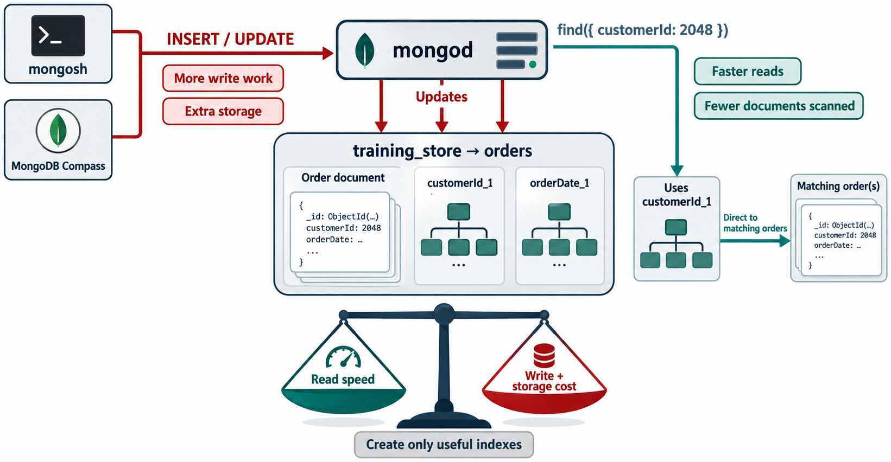
STORAGE COST
MODULE 6
📌
KEY POINTS
Indexes improve reads, but every additional index has a cost.
Indexes consume disk space.
59
© 2026 by Innovation In Software Corporation
Notes:
Indexes consume disk space.

Slide 61
MEMORY PRESSURE
MODULE 6
📌
KEY POINTS
Frequently used index pages compete for memory.
60
© 2026 by Innovation In Software Corporation
Notes:
Frequently used index pages compete for memory.

Slide 62
WRITE AMPLIFICATION
MODULE 6
📌
KEY POINTS
For an insertion:
MongoDB must update:
• The collection data
• The _id index
• The SKU index
• Every other applicable index
db.products.insertOne({
sku: "ELEC-3000",
name: "Webcam"
})
61
© 2026 by Innovation In Software Corporation
Notes:
For an insertion:

Slide 63
UPDATE COST
MODULE 6
📌
KEY POINTS
Changing an indexed field requires updating its index entries:
db.products.updateOne(
{
sku: "ELEC-3000"
},
{
$set: {
category: "Computer Accessories"
}
}
)
62
© 2026 by Innovation In Software Corporation
Notes:
Changing an indexed field requires updating its index entries:

Slide 64
OPERATIONAL COST
MODULE 6
📌
KEY POINTS
More indexes mean:
• Longer index builds
• More monitoring
• More complex query-plan choices
• Additional backup and replication volume
Avoid indexing every field “just in case.”
63
© 2026 by Innovation In Software Corporation
Notes:
More indexes mean:

Slide 65
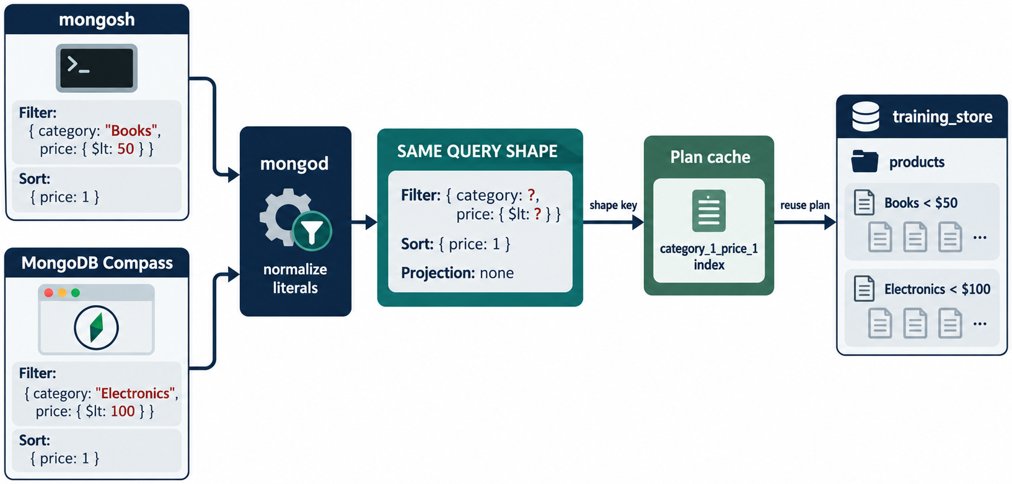
QUERY-SHAPE WORKSHEET
MODULE 6
📌
KEY POINTS
Index selection begins with the complete query shape:
• Filter fields
• Equality conditions
• Range conditions
• Sort fields and directions
• Projected fields
• Query frequency
• Number of matching documents
• Read-versus-write balance
Workload question | Example
Which collection? | orders
Equality filters? | customerId, status
Range filters? | orderedAt
Sort fields? | orderedAt: -1
Returned fields? | orderNumber, total, status
Frequency? | Every customer-profile request
Expected matches? | 20–100 orders per customer
Write rate? | Moderate
Possible index:
64
© 2026 by Innovation In Software Corporation
Notes:
Possible index:

Slide 66
QUERY-SHAPE WORKSHEET (CONT.)
MODULE 6
db.orders.createIndex({
customerId: 1,
status: 1,
orderedAt: -1
})
65
© 2026 by Innovation In Software Corporation
Notes:
Covers Query-shape worksheet.

Slide 67
PRODUCT LOOKUP BY SKU
MODULE 6
📌
KEY POINTS
Query:
Index:
db.products.findOne({
sku: "ELEC-1001"
})
db.products.createIndex(
{
sku: 1
},
{
unique: true,
name: "uq_products_sku"
}
)
66
© 2026 by Innovation In Software Corporation
Notes:
Query:

Slide 68
BROWSE PRODUCTS BY CATEGORY AND PRICE
MODULE 6
📌
KEY POINTS
Query:
Index:
db.products.find({
category: "Electronics",
price: {
$lte: NumberDecimal("100.00")
}
}).sort({
price: 1
})
db.products.createIndex(
{
category: 1,
price: 1
},
{
name: "idx_products_category_price"
}
)
67
© 2026 by Innovation In Software Corporation
Notes:
Query:

Slide 69
CUSTOMER LOOKUP BY EMAIL
MODULE 6
db.customers.createIndex(
{
email: 1
},
{
unique: true,
name: "uq_customers_email"
}
)
68
© 2026 by Innovation In Software Corporation
Notes:
Covers Customer lookup by email.

Slide 70
CUSTOMER ORDER HISTORY
MODULE 6
📌
KEY POINTS
Query:
Index:
db.orders.find({
customerId: customerId
}).sort({
orderedAt: -1
})
db.orders.createIndex(
{
customerId: 1,
orderedAt: -1
},
{
name: "idx_orders_customer_date"
}
)
69
© 2026 by Innovation In Software Corporation
Notes:
Query:

Slide 71
OPERATIONAL ORDER QUEUE
MODULE 6
📌
KEY POINTS
Query:
Index:
db.orders.find({
status: "Processing"
}).sort({
orderedAt: 1
})
db.orders.createIndex(
{
status: 1,
orderedAt: 1
},
{
name: "idx_orders_status_date"
}
)
70
© 2026 by Innovation In Software Corporation
Notes:
Query:

Slide 72
PRODUCT REVIEW HISTORY
MODULE 6
📌
KEY POINTS
Query:
Index:
db.reviews.find({
productId: productId
}).sort({
createdAt: -1
})
db.reviews.createIndex(
{
productId: 1,
createdAt: -1
},
{
name: "idx_reviews_product_date"
}
)
71
© 2026 by Innovation In Software Corporation
Notes:
Query:

Slide 73
PREVENT DUPLICATE CUSTOMER REVIEWS
MODULE 6
📌
KEY POINTS
If one customer may review a product only once:
This index enforces the business rule at the database level.
db.reviews.createIndex(
{
productId: 1,
customerId: 1
},
{
unique: true,
name: "uq_reviews_product_customer"
}
)
72
© 2026 by Innovation In Software Corporation
Notes:
If one customer may review a product only once:

Slide 74
INDEX-TYPE SELECTION GUIDE
MODULE 6
📌
KEY POINTS
Workload | Appropriate index
Lookup by one stable field | Single-field
Filter and sort across several fields | Compound
Enforce unique SKU or email | Unique
Search array elements | Multikey
Index only qualifying documents | Partial
Optional field exists in some records | Partial or sparse
Automatically expire documents | TTL
Basic self-managed word search | Text
Advanced full-text search | MongoDB Search
Flexible and unpredictable fields | Wildcard
Geographic proximity | 2dsphere
Hashed shard-key distribution | Hashed
MongoDB supports compound, multikey, wildcard, geospatial, hashed, text and clustered index types, among others.
73
© 2026 by Innovation In Software Corporation
Notes:
MongoDB supports compound, multikey, wildcard, geospatial, hashed, text and clustered index types, among others.

Slide 75
EXERCISE 1: ESTABLISH THE BASELINE
MODULE 6
🛠️
KEY POINTS
Run:
Record:
const customerId =
ObjectId("66a100000000000000000001");
db.orders.find({
customerId: customerId
}).sort({
orderedAt: -1
}).explain("executionStats")
winning plan:
nReturned:
totalKeysExamined:
totalDocsExamined:
74
© 2026 by Innovation In Software Corporation
Notes:
Run:

Slide 76
EXERCISE 2: CREATE THE INDEX
MODULE 6
db.orders.createIndex(
{
customerId: 1,
orderedAt: -1
},
{
name: "idx_orders_customer_date"
}
)
75
© 2026 by Innovation In Software Corporation
Notes:
Covers Exercise 2: Create the index.

Slide 77
EXERCISE 3: MEASURE AGAIN
MODULE 6
🛠️
KEY POINTS
Compare the execution metrics.
db.orders.find({
customerId: customerId
}).sort({
orderedAt: -1
}).explain("executionStats")
76
© 2026 by Innovation In Software Corporation
Notes:
Compare the execution metrics.

Slide 78
EXERCISE 4: TEST A DIFFERENT QUERY SHAPE
MODULE 6
🛠️
KEY POINTS
The customer-history index is not designed for this query because its leading field is customerId.
Create a workload-specific index:
Run explain() again.
db.orders.find({
status: "Processing"
}).sort({
orderedAt: 1
}).explain("executionStats")
db.orders.createIndex(
{
status: 1,
orderedAt: 1
},
{
name: "idx_orders_status_date"
}
)
77
© 2026 by Innovation In Software Corporation
Notes:
The customer-history index is not designed for this query because its leading field is `customerId`.

Slide 79
EXERCISE 5: TEST A MULTIKEY INDEX
MODULE 6
🛠️
KEY POINTS
Create:
Analyze:
db.products.createIndex(
{
tags: 1
},
{
name: "idx_products_tags"
}
)
db.products.find({
tags: "wireless"
}).explain("executionStats")
78
© 2026 by Innovation In Software Corporation
Notes:
Create:

Slide 80
EXERCISE 6: REVIEW ALL INDEXES
MODULE 6
🛠️
KEY POINTS
For every non-_id index, document:
• Which query it supports
• How frequently that query runs
• Whether it supports sorting
• Whether it enforces a business rule
• Its expected write cost
• Whether another index makes it redundant
db.products.getIndexes()
db.customers.getIndexes()
db.orders.getIndexes()
db.reviews.getIndexes()
79
© 2026 by Innovation In Software Corporation
Notes:
For every non-`_id` index, document:

Slide 81
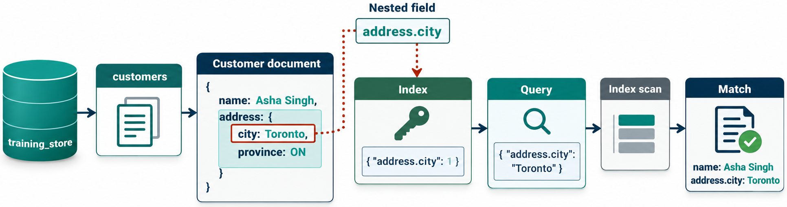
INDEXING EVERY FIELD
MODULE 6
📌
KEY POINTS
This wastes storage and harms write performance.
80
© 2026 by Innovation In Software Corporation
Notes:
This wastes storage and harms write performance.

Slide 82
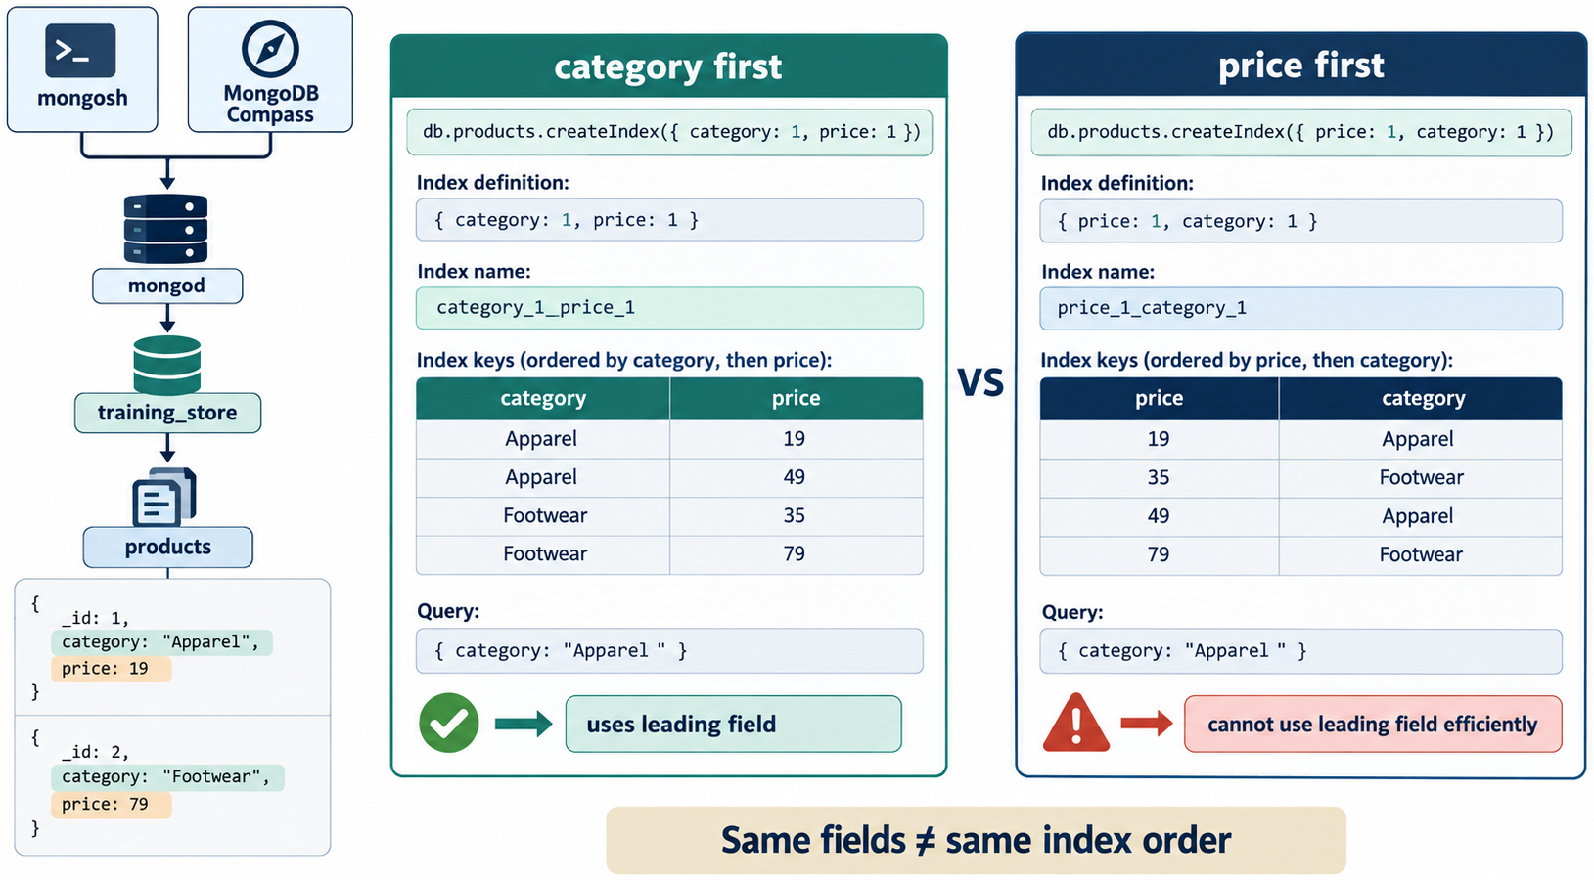
IGNORING COMPOUND FIELD ORDER
MODULE 6
📌
KEY POINTS
These are different indexes:
They support different prefixes and query shapes.
{ category: 1, price: 1 }
{ price: 1, category: 1 }
81
© 2026 by Innovation In Software Corporation
Notes:
These are different indexes:

Slide 83
CREATING SEPARATE INDEXES WHEN A COMPOUND INDEX IS REQUIRED
MODULE 6
📌
KEY POINTS
Separate indexes:
do not necessarily support filtering and sorting as effectively as:
{ customerId: 1 }
{ orderedAt: -1 }
{
customerId: 1,
orderedAt: -1
}
82
© 2026 by Innovation In Software Corporation
Notes:
Separate indexes:

Slide 84
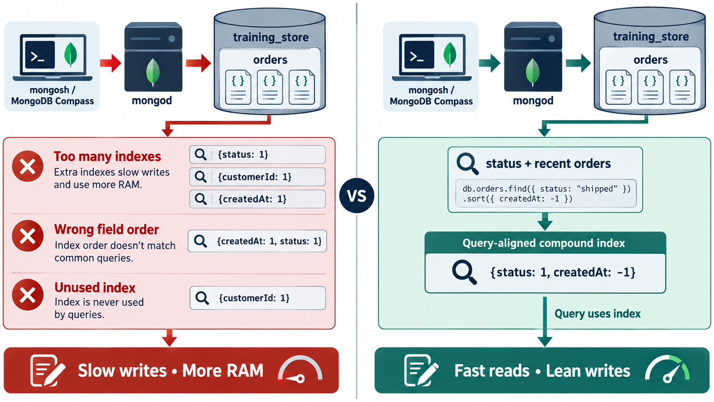
KEEPING REDUNDANT INDEXES
MODULE 6
📌
KEY POINTS
If the collection has:
and:
the single-field index may be redundant because the compound index begins with category. Verify differences such as uniqueness, sparsity, collation and workload behavior before removing anything.
{ category: 1 }
{ category: 1, price: 1 }
83
© 2026 by Innovation In Software Corporation
Notes:
If the collection has:

Slide 85
JUDGING ONLY BY EXECUTION TIME
MODULE 6
📌
KEY POINTS
A tiny collection may be faster with a collection scan. Use realistic data volumes and examine keys and documents inspected.
84
© 2026 by Innovation In Software Corporation
Notes:
A tiny collection may be faster with a collection scan. Use realistic data volumes and examine keys and documents inspected.

Slide 86
USING HINT() AS A PERMANENT FIRST RESPONSE
MODULE 6
📌
KEY POINTS
hint() forces a particular index:
It is valuable for testing, but forcing an index can become harmful as data distribution and workloads change. Allow the query planner to choose unless testing demonstrates a specific need.
# Module Outcome
After completing this module, learners should be able to:
db.products.find({
category: "Electronics"
}).hint({
category: 1,
price: 1
})
85
© 2026 by Innovation In Software Corporation
Notes:
`hint()` forces a particular index:

Slide 87
USING HINT() AS A PERMANENT FIRST RESPONSE (CONT.)
MODULE 6
📌
KEY POINTS
• Explain how MongoDB indexes improve data access.
• Create, list, hide, restore and remove indexes.
• Interpret COLLSCAN, IXSCAN, FETCH and SORT.
• Compare query behavior using explain("executionStats").
• Design compound indexes around filters and sorts.
• Apply the equality-sort-range guideline.
• Use unique indexes to enforce business rules.
• Identify multikey, partial, sparse, TTL, text, wildcard, geospatial and hashed index use cases.
• Recognize the storage and write costs of indexing.
• Select indexes according to real query shapes and workload evidence.
86
© 2026 by Innovation In Software Corporation
Notes:
Covers Using `hint()` as a permanent first response.

Slide 88
DEMO 6.1 — COMPARE A COLLECTION SCAN AND INDEX SCAN
MODULE 6
🛠️
KEY POINTS
• Time: 15 min
• Explain `find({ category: "ACCESSORY" })` — record stage, keys, docs, nReturned
• Create idx_products_category
• Explain again and compare
• training_store is small — teach the plan, not the clock
87
© 2026 by Innovation In Software Corporation
Notes:
This slide includes a diagram — Demo 6.1 — Compare a Collection Scan and Index Scan.
The slide title is: Demo 6.1 — Compare a Collection Scan and Index Scan.
The slide says: <div class="cols">.
The slide says: <div class="col-text">.
The slide says: </div>.
The slide says: <div class="col-visual">.
Bullet 1 on the slide: Time: 15 min.
Bullet 2 on the slide: Explain find({ category: "ACCESSORY" }) — record stage, keys, docs, nReturned.
Bullet 3 on the slide: Create idx_products_category.
Bullet 4 on the slide: Explain again and compare.
Bullet 5 on the slide: training_store is small — teach the plan, not the clock.
The figure on this slide is titled: Compare a Collection Scan and Index Scan.

Slide 89
DEMO 6.1 — COMMANDS
MODULE 6
🛠️
KEY POINTS
Record winning stage, totalKeysExamined, totalDocsExamined, nReturned.
db.products.find({ category: "ACCESSORY" }).explain("executionStats")
db.products.createIndex(
{ category: 1 },
{ name: "idx_products_category" }
)
db.products.find({ category: "ACCESSORY" }).explain("executionStats")
88
© 2026 by Innovation In Software Corporation
Notes:
The slide title is: Demo 6.1 — Commands.
The slide says: Record winning stage, totalKeysExamined, totalDocsExamined, nReturned.
The code on the slide reads: db.products.find({ category: "ACCESSORY" }).explain("executionStats") db.products.createIndex( { category: 1 }, { name: "idx_products_category" } ) db.products.find({ category: "ACCESSORY" }).explain("executionStats").

Slide 90
DEMO 6.2 — CREATE AND INSPECT A SINGLE-FIELD INDEX
MODULE 6
🛠️
KEY POINTS
• Time: 10 min
• Create `idx_products_sku` on `{ sku: 1 }`
• getIndexes() — name, key, unique flag
• Explain `find({ sku: "L100" })`
89
© 2026 by Innovation In Software Corporation
Notes:
This slide includes a diagram — Demo 6.2 — Create and Inspect a Single-Field Index.
The slide title is: Demo 6.2 — Create and Inspect a Single-Field Index.
The slide says: <div class="cols">.
The slide says: <div class="col-text">.
The slide says: </div>.
The slide says: <div class="col-visual">.
Bullet 1 on the slide: Time: 10 min.
Bullet 2 on the slide: Create idx_products_sku on { sku: 1 }.
Bullet 3 on the slide: getIndexes() — name, key, unique flag.
Bullet 4 on the slide: Explain find({ sku: "L100" }).
The figure on this slide is titled: Create and Inspect a Single-Field Index.

Slide 91
DEMO 6.3 — DESIGN A COMPOUND INDEX
MODULE 6
🛠️
KEY POINTS
• Time: 15 min
• Query: ACCESSORY + active, sort price
• Create idx_products_category_active_price
• Compare explain before and after — watch for SORT
90
© 2026 by Innovation In Software Corporation
Notes:
This slide includes a diagram — Demo 6.3 — Design a Compound Index.
The slide title is: Demo 6.3 — Design a Compound Index.
The slide says: <div class="cols">.
The slide says: <div class="col-text">.
The slide says: </div>.
The slide says: <div class="col-visual">.
Bullet 1 on the slide: Time: 15 min.
Bullet 2 on the slide: Query: ACCESSORY + active, sort price.
Bullet 3 on the slide: Create idx_products_category_active_price.
Bullet 4 on the slide: Compare explain before and after — watch for SORT.
The figure on this slide is titled: Design a Compound Index.

Slide 92
DEMO 6.4 — APPLY EQUALITY–SORT–RANGE
MODULE 6
🛠️
KEY POINTS
• Time: 20 min
• Customer order history: equality customerId, sort createdAt, range total — or date range on createdAt
• Test alternative field orders
• Compare examined keys
91
© 2026 by Innovation In Software Corporation
Notes:
This slide includes a diagram — Demo 6.4 — Apply Equality–Sort–Range.
The slide title is: Demo 6.4 — Apply Equality–Sort–Range.
The slide says: <div class="cols">.
The slide says: <div class="col-text">.
The slide says: </div>.
The slide says: <div class="col-visual">.
Bullet 1 on the slide: Time: 20 min.
Bullet 2 on the slide: Customer order history: equality customerId, sort createdAt, range total — or date range on createdAt.
Bullet 3 on the slide: Test alternative field orders.
Bullet 4 on the slide: Compare examined keys.
The figure on this slide is titled: Apply Equality–Sort–Range.

Slide 93
EXERCISE 6.1 — IDENTIFY CANDIDATE INDEXES
MODULE 6
🛠️
KEY POINTS
• Time: 15 min
• Name indexed fields for six recurring training_store queries.
• Lab guide: Exercise 6.1
92
© 2026 by Innovation In Software Corporation
Notes:
This slide includes a diagram — Exercise 6.1 — Identify Candidate Indexes.
The slide title is: Exercise 6.1 — Identify Candidate Indexes.
The slide says: <div class="cols">.
The slide says: <div class="col-text">.
The slide says: </div>.
The slide says: <div class="col-visual">.
Bullet 1 on the slide: Time: 15 min.
Bullet 2 on the slide: Name indexed fields for six recurring training_store queries.
Bullet 3 on the slide: Lab guide: [Exercise 6.1](../slide-exercises/module-06/exercise-6.1-identify-candidate-indexes.md).
The figure on this slide is titled: Candidate index fields for common queries.

Slide 94
EXERCISE 6.1 — STEPS 1–2
MODULE 6
🛠️
KEY POINTS
LAB GUIDE Exercise 6.1
Follow along (Windows) — key steps:
Step 1 — Identifier lookups
• Do: For (1) product by SKU and (2) customer by email, write the collection, the filter field, and whether uniqueness is a business rule.
• Expected: products.sku (unique) and customers.contact.email (unique if the store treats email as a login). _id already covers ObjectId lookups.
Step 2 — History and catalog queries
• Do: For (3) a customer’s orders newest first, (4) active products by category and price, (5) reviews by product and date, and (6) orders by payment status and creation date, list equality, sort, and range fields.
• Expected: (3) customerId equality, createdAt sort. (4) category + active equality, price sort/range. (5) productId equality, createdAt sort. (6) paymentStatus equality, c
_Full lab guide with every command: see Lab guide on the lesson divider slide._
93
© 2026 by Innovation In Software Corporation
Notes:
We are starting Exercise 6.1 — Identify Candidate Indexes. We have about 15 min for this lab.
Name the fields that belong in an index for six recurring training_store queries.
The full lab guide is in slide-exercises/module-06/exercise-6.1-identify-candidate-indexes.md if you need extra detail.
On Windows: PowerShell in the integrated terminal — Ctrl+backtick — and the Agent panel — Ctrl+I. Open the repo folder with File → Open Folder.
Step 1 — Identifier lookups.
Step 2 — History and catalog queries.
Step 1 — Identifier lookups.
Step 2 — History and catalog queries.
Step 1 — Identifier lookups.
Step 2 — History and catalog queries.
Step 1 — Identifier lookups.
Step 2 — History and catalog queries.
I'll give you a few minutes to work — raise your hand if you get stuck.
The slide title is: Exercise 6.1 — Steps 1–2.
The slide says: Lab guide: [Exercise 6.1](../slide-exercises/module-06/exercise-6.1-identify-candidate-indexes.md).
The slide says: Follow along (Windows) — key steps:.
The slide says: _Full lab guide with every command: see Lab guide on the lesson divider slide._.
Bullet 1 on the slide: Do: For (1) product by SKU and (2) customer by email, write the collection, the filter field, and whether uniqueness is a business rule.
Bullet 2 on the slide: Expected: products.sku (unique) and customers.contact.email (unique if the store treats email as a login). _id already covers ObjectId lookups.
Bullet 3 on the slide: Do: For (3) a customer’s orders newest first, (4) active products by category and price, (5) reviews by product and date, and (6) orders by payment status and creation date, list equality, sort, and range fields.
Bullet 4 on the slide: Expected: (3) customerId equality, createdAt sort. (4) category + active equality, price sort/range. (5) productId equality, createdAt sort. (6) paymentStatus equality, c.
Bullet 5 on the slide: Do: For (1) product by SKU and (2) customer by email, write the collection, the filter field, and whether uniqueness is a business rule.
Bullet 6 on the slide: Expected: products.sku (unique) and customers.contact.email (unique if the store treats email as a login). _id already covers ObjectId lookups.
Bullet 7 on the slide: Do: For (3) a customer’s orders newest first, (4) active products by category and price, (5) reviews by product and date, and (6) orders by payment status and creation date, list equality, sort, and range fields.
Bullet 8 on the slide: Expected: (3) customerId equality, createdAt sort. (4) category + active equality, price sort/range. (5) productId equality, createdAt sort. (6) paymentStatus equality, c.
Bullet 9 on the slide: Do: For (1) product by SKU and (2) customer by email, write the collection, the filter field, and whether uniqueness is a business rule.
Bullet 10 on the slide: Expected: products.sku (unique) and customers.contact.email (unique if the store treats email as a login). _id already covers ObjectId lookups.
Bullet 11 on the slide: Do: For (3) a customer’s orders newest first, (4) active products by category and price, (5) reviews by product and date, and (6) orders by payment status and creation date, list equality, sort, and range fields.
Bullet 12 on the slide: Expected: (3) customerId equality, createdAt sort. (4) category + active equality, price sort/range. (5) productId equality, createdAt sort. (6) paymentStatus equality, c.
Bullet 13 on the slide: Do: For (1) product by SKU and (2) customer by email, write the collection, the filter field, and whether uniqueness is a business rule.
Bullet 14 on the slide: Expected: products.sku (unique) and customers.contact.email (unique if the store treats email as a login). _id already covers ObjectId lookups.
Bullet 15 on the slide: Do: For (3) a customer’s orders newest first, (4) active products by category and price, (5) reviews by product and date, and (6) orders by payment status and creation date, list equality, sort, and range fields.
Bullet 16 on the slide: Expected: (3) customerId equality, createdAt sort. (4) category + active equality, price sort/range. (5) productId equality, createdAt sort. (6) paymentStatus equality, c.

Slide 95
EXERCISE 6.2 — SELECT SINGLE OR COMPOUND INDEXES
MODULE 6
🛠️
KEY POINTS
• Time: 15 min
• Classify requirements as single-field, compound, specialized, or not enough evidence.
• Lab guide: Exercise 6.2
94
© 2026 by Innovation In Software Corporation
Notes:
This slide includes a diagram — Exercise 6.2 — Select Single or Compound Indexes.
The slide title is: Exercise 6.2 — Select Single or Compound Indexes.
The slide says: <div class="cols">.
The slide says: <div class="col-text">.
The slide says: </div>.
The slide says: <div class="col-visual">.
Bullet 1 on the slide: Time: 15 min.
Bullet 2 on the slide: Classify requirements as single-field, compound, specialized, or not enough evidence.
Bullet 3 on the slide: Lab guide: [Exercise 6.2](../slide-exercises/module-06/exercise-6.2-select-single-or-compound.md).
The figure on this slide is titled: Choosing an index type.

Slide 96
EXERCISE 6.2 — STEPS 1–2
MODULE 6
🛠️
KEY POINTS
LAB GUIDE Exercise 6.2
Follow along (Windows) — key steps:
Step 1 — Classify four requirements
• Do: Classify: (A) lookup product by SKU, (B) active accessories sorted by price, (C) expire session documents, (D) a manager’s one-time ad-hoc count of all orders.
• Expected: A single-field unique. B compound. C specialized TTL. D no new index without evidence — one-time reporting is not a standing query shape.
Step 2 — Justify one borderline case
• Do: Write two sentences on why a boolean active field is a poor standalone index but a useful compound or partial-index field.
• Expected: Low selectivity: most products are active, so { active: 1 } barely narrows the scan. Combined with category (and optionally a partial filter) it supports the
_Full lab guide with every command: see Lab guide on the lesson divider slide._
• Do: Write two sentences on why a boolean active field is a poor standalone index but a useful compound or partial-index field.
• Expected: Low selectivity: most products are active, so { active: 1 } barely narrows the scan. Combined with category (and optionally a partial filter) it supports the
95
© 2026 by Innovation In Software Corporation
Notes:
We are starting Exercise 6.2 — Select Single or Compound Indexes. We have about 15 min for this lab.
Classify each requirement as a single-field, compound, specialized, or not-enough-evidence index.
The full lab guide is in slide-exercises/module-06/exercise-6.2-select-single-or-compound.md if you need extra detail.
On Windows: PowerShell in the integrated terminal — Ctrl+backtick — and the Agent panel — Ctrl+I. Open the repo folder with File → Open Folder.
Step 1 — Classify four requirements.
Step 2 — Justify one borderline case.
Step 1 — Classify four requirements.
Step 2 — Justify one borderline case.
Step 1 — Classify four requirements.
Step 2 — Justify one borderline case.
Step 1 — Classify four requirements.
Step 2 — Justify one borderline case.
I'll give you a few minutes to work — raise your hand if you get stuck.
The slide title is: Exercise 6.2 — Steps 1–2.
The slide says: Lab guide: [Exercise 6.2](../slide-exercises/module-06/exercise-6.2-select-single-or-compound.md).
The slide says: Follow along (Windows) — key steps:.
The slide says: _Full lab guide with every command: see Lab guide on the lesson divider slide._.
Bullet 1 on the slide: Do: Classify: (A) lookup product by SKU, (B) active accessories sorted by price, (C) expire session documents, (D) a manager’s one-time ad-hoc count of all orders.
Bullet 2 on the slide: Expected: A single-field unique. B compound. C specialized TTL. D no new index without evidence — one-time reporting is not a standing query shape.
Bullet 3 on the slide: Do: Write two sentences on why a boolean active field is a poor standalone index but a useful compound or partial-index field.
Bullet 4 on the slide: Expected: Low selectivity: most products are active, so { active: 1 } barely narrows the scan. Combined with category (and optionally a partial filter) it supports the.
Bullet 5 on the slide: Do: Classify: (A) lookup product by SKU, (B) active accessories sorted by price, (C) expire session documents, (D) a manager’s one-time ad-hoc count of all orders.
Bullet 6 on the slide: Expected: A single-field unique. B compound. C specialized TTL. D no new index without evidence — one-time reporting is not a standing query shape.
Bullet 7 on the slide: Do: Write two sentences on why a boolean active field is a poor standalone index but a useful compound or partial-index field.
Bullet 8 on the slide: Expected: Low selectivity: most products are active, so { active: 1 } barely narrows the scan. Combined with category (and optionally a partial filter) it supports the.
Bullet 9 on the slide: Do: Classify: (A) lookup product by SKU, (B) active accessories sorted by price, (C) expire session documents, (D) a manager’s one-time ad-hoc count of all orders.
Bullet 10 on the slide: Expected: A single-field unique. B compound. C specialized TTL. D no new index without evidence — one-time reporting is not a standing query shape.
Bullet 11 on the slide: Do: Write two sentences on why a boolean active field is a poor standalone index but a useful compound or partial-index field.
Bullet 12 on the slide: Expected: Low selectivity: most products are active, so { active: 1 } barely narrows the scan. Combined with category (and optionally a partial filter) it supports the.
Bullet 13 on the slide: Do: Classify: (A) lookup product by SKU, (B) active accessories sorted by price, (C) expire session documents, (D) a manager’s one-time ad-hoc count of all orders.
Bullet 14 on the slide: Expected: A single-field unique. B compound. C specialized TTL. D no new index without evidence — one-time reporting is not a standing query shape.
Bullet 15 on the slide: Do: Write two sentences on why a boolean active field is a poor standalone index but a useful compound or partial-index field.
Bullet 16 on the slide: Expected: Low selectivity: most products are active, so { active: 1 } barely narrows the scan. Combined with category (and optionally a partial filter) it supports the.

Slide 97
EXERCISE 6.3 — ARRANGE COMPOUND-INDEX FIELDS
MODULE 6
🛠️
KEY POINTS
• Time: 15 min
• Propose field order for a paid high-value order query that sorts by date.
• Lab guide: Exercise 6.3
96
© 2026 by Innovation In Software Corporation
Notes:
This slide includes a diagram — Exercise 6.3 — Arrange Compound-Index Fields.
The slide title is: Exercise 6.3 — Arrange Compound-Index Fields.
The slide says: <div class="cols">.
The slide says: <div class="col-text">.
The slide says: </div>.
The slide says: <div class="col-visual">.
Bullet 1 on the slide: Time: 15 min.
Bullet 2 on the slide: Propose field order for a paid high-value order query that sorts by date.
Bullet 3 on the slide: Lab guide: [Exercise 6.3](../slide-exercises/module-06/exercise-6.3-arrange-compound-fields.md).
The figure on this slide is titled: ESR field order.

Slide 98
EXERCISE 6.3 — STEPS 1–2
MODULE 6
🛠️
KEY POINTS
LAB GUIDE Exercise 6.3
Follow along (Windows) — key steps:
Step 1 — Label ESR roles
• Do: Given: javascript db.orders .find({ customerId: customerId, paymentStatus: "PAID", total: { $gte: Decimal128("500.00") } }) .sort({ createdAt: -1 }) Label each field as equality, sort, or range.
• Expected: Equality: customerId, paymentStatus. Sort: createdAt. Range: total.
Step 2 — Propose order and an alternative
• Do: Write a candidate key following Equality–Sort–Range. Then note when you might put the more selective equality field first if paymentStatus is a small set of values.
• Expected: Candidate { customerId: 1, paymentStatus: 1, createdAt: -1, total: 1 }. Alternative: still lead with customerId (high selectivity) even if paymentStatus is lo
_Full lab guide with every command: see Lab guide on the lesson divider slide._
• Do: Given: ``javascript db.orders .find({ customerId: customerId, paymentStatus: "PAID", total: { $gte: Decimal128("500.00") } }) .sort({ createdAt: -1 }) `` Label each field as equality, sort, or range.
• Expected: Equality: customerId, paymentStatus. Sort: createdAt. Range: total.
97
© 2026 by Innovation In Software Corporation
Notes:
We are starting Exercise 6.3 — Arrange Compound-Index Fields. We have about 15 min for this lab.
Propose a compound-index field order using Equality–Sort–Range.
The full lab guide is in slide-exercises/module-06/exercise-6.3-arrange-compound-fields.md if you need extra detail.
On Windows: PowerShell in the integrated terminal — Ctrl+backtick — and the Agent panel — Ctrl+I. Open the repo folder with File → Open Folder.
Step 1 — Label ESR roles.
Step 2 — Propose order and an alternative.
Step 1 — Label ESR roles.
Step 2 — Propose order and an alternative.
Step 1 — Label ESR roles.
Step 2 — Propose order and an alternative.
Step 1 — Label ESR roles.
Step 2 — Propose order and an alternative.
I'll give you a few minutes to work — raise your hand if you get stuck.
The slide title is: Exercise 6.3 — Steps 1–2.
The slide says: Lab guide: [Exercise 6.3](../slide-exercises/module-06/exercise-6.3-arrange-compound-fields.md).
The slide says: Follow along (Windows) — key steps:.
The slide says: _Full lab guide with every command: see Lab guide on the lesson divider slide._.
Bullet 1 on the slide: Do: Given: javascript db.orders .find({ customerId: customerId, paymentStatus: "PAID", total: { $gte: Decimal128("500.00") } }) .sort({ createdAt: -1 }) Label each field as equality, sort, or range.
Bullet 2 on the slide: Expected: Equality: customerId, paymentStatus. Sort: createdAt. Range: total.
Bullet 3 on the slide: Do: Write a candidate key following Equality–Sort–Range. Then note when you might put the more selective equality field first if paymentStatus is a small set of values.
Bullet 4 on the slide: Expected: Candidate { customerId: 1, paymentStatus: 1, createdAt: -1, total: 1 }. Alternative: still lead with customerId (high selectivity) even if paymentStatus is lo.
Bullet 5 on the slide: Do: Given: javascript db.orders .find({ customerId: customerId, paymentStatus: "PAID", total: { $gte: Decimal128("500.00") } }) .sort({ createdAt: -1 }) Label each field as equality, sort, or range.
Bullet 6 on the slide: Expected: Equality: customerId, paymentStatus. Sort: createdAt. Range: total.
Bullet 7 on the slide: Do: Write a candidate key following Equality–Sort–Range. Then note when you might put the more selective equality field first if paymentStatus is a small set of values.
Bullet 8 on the slide: Expected: Candidate { customerId: 1, paymentStatus: 1, createdAt: -1, total: 1 }. Alternative: still lead with customerId (high selectivity) even if paymentStatus is lo.
Bullet 9 on the slide: Do: Given: javascript db.orders .find({ customerId: customerId, paymentStatus: "PAID", total: { $gte: Decimal128("500.00") } }) .sort({ createdAt: -1 }) Label each field as equality, sort, or range.
Bullet 10 on the slide: Expected: Equality: customerId, paymentStatus. Sort: createdAt. Range: total.
Bullet 11 on the slide: Do: Write a candidate key following Equality–Sort–Range. Then note when you might put the more selective equality field first if paymentStatus is a small set of values.
Bullet 12 on the slide: Expected: Candidate { customerId: 1, paymentStatus: 1, createdAt: -1, total: 1 }. Alternative: still lead with customerId (high selectivity) even if paymentStatus is lo.
Bullet 13 on the slide: Do: Given: ``javascript db.orders .find({ customerId: customerId, paymentStatus: "PAID", total: { $gte: Decimal128("500.00") } }) .sort({ createdAt: -1 }) `` Label each field as equality, sort, or range.
Bullet 14 on the slide: Expected: Equality: customerId, paymentStatus. Sort: createdAt. Range: total.
Bullet 15 on the slide: Do: Write a candidate key following Equality–Sort–Range. Then note when you might put the more selective equality field first if paymentStatus is a small set of values.
Bullet 16 on the slide: Expected: Candidate { customerId: 1, paymentStatus: 1, createdAt: -1, total: 1 }. Alternative: still lead with customerId (high selectivity) even if paymentStatus is lo.

Slide 99
EXERCISE 6.4 — APPLY EQUALITY–SORT–RANGE
MODULE 6
🛠️
KEY POINTS
• Time: 15 min
• Label equality, sort, and range on three shapes and propose compound indexes.
• Lab guide: Exercise 6.4
98
© 2026 by Innovation In Software Corporation
Notes:
This slide includes a diagram — Exercise 6.4 — Apply Equality–Sort–Range.
The slide title is: Exercise 6.4 — Apply Equality–Sort–Range.
The slide says: <div class="cols">.
The slide says: <div class="col-text">.
The slide says: </div>.
The slide says: <div class="col-visual">.
Bullet 1 on the slide: Time: 15 min.
Bullet 2 on the slide: Label equality, sort, and range on three shapes and propose compound indexes.
Bullet 3 on the slide: Lab guide: [Exercise 6.4](../slide-exercises/module-06/exercise-6.4-apply-equality-sort-range.md).
The figure on this slide is titled: Three ESR shapes.

Slide 100
EXERCISE 6.4 — STEPS 1–2
MODULE 6
🛠️
KEY POINTS
LAB GUIDE Exercise 6.4
Follow along (Windows) — key steps:
Step 1 — Catalog and history shapes
• Do: Shape A: active products in category ACCESSORY, price ≤ 100, sort by price. Shape B: one customerId, createdAt in a date range, sort createdAt descending. Label ESR and propose indexes.
• Expected: A: equality category+active, sort/range price → { category: 1, active: 1, price: 1 }. B: equality customerId, sort createdAt, range createdAt (same field) → `
Step 2 — Reporting shape
• Do: Shape C: paymentStatus PAID, createdAt ≥ start, sort createdAt descending. Propose an index and one sentence on why paymentStatus still belongs first even though it is low selectivity.
• Expected: { paymentStatus: 1, createdAt: -1 }. Equality first partitions the index so the date sort/range walks one status’s keys instead of mixing statuses.
_Full lab guide with every command: see Lab guide on the lesson divider slide._
99
© 2026 by Innovation In Software Corporation
Notes:
We are starting Exercise 6.4 — Apply Equality–Sort–Range. We have about 15 min for this lab.
Label equality, sort, and range fields on several query shapes and propose compound indexes.
The full lab guide is in slide-exercises/module-06/exercise-6.4-apply-equality-sort-range.md if you need extra detail.
On Windows: PowerShell in the integrated terminal — Ctrl+backtick — and the Agent panel — Ctrl+I. Open the repo folder with File → Open Folder.
Step 1 — Catalog and history shapes.
Step 2 — Reporting shape.
Step 1 — Catalog and history shapes.
Step 2 — Reporting shape.
Step 1 — Catalog and history shapes.
Step 2 — Reporting shape.
Step 1 — Catalog and history shapes.
Step 2 — Reporting shape.
I'll give you a few minutes to work — raise your hand if you get stuck.
The slide title is: Exercise 6.4 — Steps 1–2.
The slide says: Lab guide: [Exercise 6.4](../slide-exercises/module-06/exercise-6.4-apply-equality-sort-range.md).
The slide says: Follow along (Windows) — key steps:.
The slide says: _Full lab guide with every command: see Lab guide on the lesson divider slide._.
Bullet 1 on the slide: Do: Shape A: active products in category ACCESSORY, price ≤ 100, sort by price. Shape B: one customerId, createdAt in a date range, sort createdAt descending. Label ESR and propose indexes.
Bullet 2 on the slide: Expected: A: equality category+active, sort/range price → { category: 1, active: 1, price: 1 }. B: equality customerId, sort createdAt, range createdAt (same field) → `.
Bullet 3 on the slide: Do: Shape C: paymentStatus PAID, createdAt ≥ start, sort createdAt descending. Propose an index and one sentence on why paymentStatus still belongs first even though it is low selectivity.
Bullet 4 on the slide: Expected: { paymentStatus: 1, createdAt: -1 }. Equality first partitions the index so the date sort/range walks one status’s keys instead of mixing statuses.
Bullet 5 on the slide: Do: Shape A: active products in category ACCESSORY, price ≤ 100, sort by price. Shape B: one customerId, createdAt in a date range, sort createdAt descending. Label ESR and propose indexes.
Bullet 6 on the slide: Expected: A: equality category+active, sort/range price → { category: 1, active: 1, price: 1 }. B: equality customerId, sort createdAt, range createdAt (same field) → `.
Bullet 7 on the slide: Do: Shape C: paymentStatus PAID, createdAt ≥ start, sort createdAt descending. Propose an index and one sentence on why paymentStatus still belongs first even though it is low selectivity.
Bullet 8 on the slide: Expected: { paymentStatus: 1, createdAt: -1 }. Equality first partitions the index so the date sort/range walks one status’s keys instead of mixing statuses.
Bullet 9 on the slide: Do: Shape A: active products in category ACCESSORY, price ≤ 100, sort by price. Shape B: one customerId, createdAt in a date range, sort createdAt descending. Label ESR and propose indexes.
Bullet 10 on the slide: Expected: A: equality category+active, sort/range price → { category: 1, active: 1, price: 1 }. B: equality customerId, sort createdAt, range createdAt (same field) → `.
Bullet 11 on the slide: Do: Shape C: paymentStatus PAID, createdAt ≥ start, sort createdAt descending. Propose an index and one sentence on why paymentStatus still belongs first even though it is low selectivity.
Bullet 12 on the slide: Expected: { paymentStatus: 1, createdAt: -1 }. Equality first partitions the index so the date sort/range walks one status’s keys instead of mixing statuses.
Bullet 13 on the slide: Do: Shape A: active products in category ACCESSORY, price ≤ 100, sort by price. Shape B: one customerId, createdAt in a date range, sort createdAt descending. Label ESR and propose indexes.
Bullet 14 on the slide: Expected: A: equality category+active, sort/range price → { category: 1, active: 1, price: 1 }. B: equality customerId, sort createdAt, range createdAt (same field) → `.
Bullet 15 on the slide: Do: Shape C: paymentStatus PAID, createdAt ≥ start, sort createdAt descending. Propose an index and one sentence on why paymentStatus still belongs first even though it is low selectivity.
Bullet 16 on the slide: Expected: { paymentStatus: 1, createdAt: -1 }. Equality first partitions the index so the date sort/range walks one status’s keys instead of mixing statuses.

Slide 101
EXERCISE 6.5 — IDENTIFY INDEX PREFIXES
MODULE 6
🛠️
KEY POINTS
• Time: 10 min
• List prefixes of `{ customerId: 1, paymentStatus: 1, createdAt: -1 }` and mark unsupported shapes.
• Lab guide: Exercise 6.5
100
© 2026 by Innovation In Software Corporation
Notes:
This slide includes a diagram — Exercise 6.5 — Identify Index Prefixes.
The slide title is: Exercise 6.5 — Identify Index Prefixes.
The slide says: <div class="cols">.
The slide says: <div class="col-text">.
The slide says: </div>.
The slide says: <div class="col-visual">.
Bullet 1 on the slide: Time: 10 min.
Bullet 2 on the slide: List prefixes of { customerId: 1, paymentStatus: 1, createdAt: -1 } and mark unsupported shapes.
Bullet 3 on the slide: Lab guide: [Exercise 6.5](../slide-exercises/module-06/exercise-6.5-identify-index-prefixes.md).
The figure on this slide is titled: Compound index prefixes.

Slide 102
EXERCISE 6.5 — STEPS 1–2
MODULE 6
🛠️
KEY POINTS
LAB GUIDE Exercise 6.5
Follow along (Windows) — key steps:
Step 1 — List usable prefixes
• Do: Given { customerId: 1, paymentStatus: 1, createdAt: -1 }, list the prefixes MongoDB can use from the left.
• Expected: customerId; customerId + paymentStatus; customerId + paymentStatus + createdAt.
Step 2 — Mark unsupported shapes
• Do: Decide whether these can use that index as a leading prefix: (1) filter only paymentStatus, (2) filter customerId, (3) filter customerId and sort createdAt without paymentStatus.
• Expected: (1) No — paymentStatus is not leading. (2) Yes. (3) Usually not for the sort: skipping paymentStatus breaks the sort prefix, so an extra SORT is likely.
_Full lab guide with every command: see Lab guide on the lesson divider slide._
101
© 2026 by Innovation In Software Corporation
Notes:
We are starting Exercise 6.5 — Identify Index Prefixes. We have about 10 min for this lab.
State which query prefixes a compound index can support directly.
The full lab guide is in slide-exercises/module-06/exercise-6.5-identify-index-prefixes.md if you need extra detail.
On Windows: PowerShell in the integrated terminal — Ctrl+backtick — and the Agent panel — Ctrl+I. Open the repo folder with File → Open Folder.
Step 1 — List usable prefixes.
Step 2 — Mark unsupported shapes.
Step 1 — List usable prefixes.
Step 2 — Mark unsupported shapes.
Step 1 — List usable prefixes.
Step 2 — Mark unsupported shapes.
Step 1 — List usable prefixes.
Step 2 — Mark unsupported shapes.
I'll give you a few minutes to work — raise your hand if you get stuck.
The slide title is: Exercise 6.5 — Steps 1–2.
The slide says: Lab guide: [Exercise 6.5](../slide-exercises/module-06/exercise-6.5-identify-index-prefixes.md).
The slide says: Follow along (Windows) — key steps:.
The slide says: _Full lab guide with every command: see Lab guide on the lesson divider slide._.
Bullet 1 on the slide: Do: Given { customerId: 1, paymentStatus: 1, createdAt: -1 }, list the prefixes MongoDB can use from the left.
Bullet 2 on the slide: Expected: customerId; customerId + paymentStatus; customerId + paymentStatus + createdAt.
Bullet 3 on the slide: Do: Decide whether these can use that index as a leading prefix: (1) filter only paymentStatus, (2) filter customerId, (3) filter customerId and sort createdAt without paymentStatus.
Bullet 4 on the slide: Expected: (1) No — paymentStatus is not leading. (2) Yes. (3) Usually not for the sort: skipping paymentStatus breaks the sort prefix, so an extra SORT is likely.
Bullet 5 on the slide: Do: Given { customerId: 1, paymentStatus: 1, createdAt: -1 }, list the prefixes MongoDB can use from the left.
Bullet 6 on the slide: Expected: customerId; customerId + paymentStatus; customerId + paymentStatus + createdAt.
Bullet 7 on the slide: Do: Decide whether these can use that index as a leading prefix: (1) filter only paymentStatus, (2) filter customerId, (3) filter customerId and sort createdAt without paymentStatus.
Bullet 8 on the slide: Expected: (1) No — paymentStatus is not leading. (2) Yes. (3) Usually not for the sort: skipping paymentStatus breaks the sort prefix, so an extra SORT is likely.
Bullet 9 on the slide: Do: Given { customerId: 1, paymentStatus: 1, createdAt: -1 }, list the prefixes MongoDB can use from the left.
Bullet 10 on the slide: Expected: customerId; customerId + paymentStatus; customerId + paymentStatus + createdAt.
Bullet 11 on the slide: Do: Decide whether these can use that index as a leading prefix: (1) filter only paymentStatus, (2) filter customerId, (3) filter customerId and sort createdAt without paymentStatus.
Bullet 12 on the slide: Expected: (1) No — paymentStatus is not leading. (2) Yes. (3) Usually not for the sort: skipping paymentStatus breaks the sort prefix, so an extra SORT is likely.
Bullet 13 on the slide: Do: Given { customerId: 1, paymentStatus: 1, createdAt: -1 }, list the prefixes MongoDB can use from the left.
Bullet 14 on the slide: Expected: customerId; customerId + paymentStatus; customerId + paymentStatus + createdAt.
Bullet 15 on the slide: Do: Decide whether these can use that index as a leading prefix: (1) filter only paymentStatus, (2) filter customerId, (3) filter customerId and sort createdAt without paymentStatus.
Bullet 16 on the slide: Expected: (1) No — paymentStatus is not leading. (2) Yes. (3) Usually not for the sort: skipping paymentStatus breaks the sort prefix, so an extra SORT is likely.

Slide 103
DEMO 6.5 — CREATE A MULTIKEY INDEX
MODULE 6
🛠️
KEY POINTS
• Time: 10 min
• Create idx_products_tags
• Query `tags: "technology"`
• Show multikey in getIndexes or explain
102
© 2026 by Innovation In Software Corporation
Notes:
This slide includes a diagram — Demo 6.5 — Create a Multikey Index.
The slide title is: Demo 6.5 — Create a Multikey Index.
The slide says: <div class="cols">.
The slide says: <div class="col-text">.
The slide says: </div>.
The slide says: <div class="col-visual">.
Bullet 1 on the slide: Time: 10 min.
Bullet 2 on the slide: Create idx_products_tags.
Bullet 3 on the slide: Query tags: "technology".
Bullet 4 on the slide: Show multikey in getIndexes or explain.
The figure on this slide is titled: Create a Multikey Index.

Slide 104
DEMO 6.6 — ENFORCE UNIQUENESS
MODULE 6
🛠️
KEY POINTS
• Time: 10 min
• Drop idx_products_sku if present (same keys)
• Create uq_products_sku
• Insert a second L100 — read the duplicate-key error
103
© 2026 by Innovation In Software Corporation
Notes:
This slide includes a diagram — Demo 6.6 — Enforce Uniqueness.
The slide title is: Demo 6.6 — Enforce Uniqueness.
The slide says: <div class="cols">.
The slide says: <div class="col-text">.
The slide says: </div>.
The slide says: <div class="col-visual">.
Bullet 1 on the slide: Time: 10 min.
Bullet 2 on the slide: Drop idx_products_sku if present (same keys).
Bullet 3 on the slide: Create uq_products_sku.
Bullet 4 on the slide: Insert a second L100 — read the duplicate-key error.
The figure on this slide is titled: Enforce Uniqueness.

Slide 105
DEMO 6.7 — USE A PARTIAL INDEX
MODULE 6
🛠️
KEY POINTS
• Time: 15 min
• Create `idx_active_products_category_price` with `active: true`
• Explain a query that includes `active: true`
• Explain the same category/price query that omits it
104
© 2026 by Innovation In Software Corporation
Notes:
This slide includes a diagram — Demo 6.7 — Use a Partial Index.
The slide title is: Demo 6.7 — Use a Partial Index.
The slide says: <div class="cols">.
The slide says: <div class="col-text">.
The slide says: </div>.
The slide says: <div class="col-visual">.
Bullet 1 on the slide: Time: 15 min.
Bullet 2 on the slide: Create idx_active_products_category_price with active: true.
Bullet 3 on the slide: Explain a query that includes active: true.
Bullet 4 on the slide: Explain the same category/price query that omits it.
The figure on this slide is titled: Use a Partial Index.

Slide 106
DEMO 6.8 — CREATE A TTL INDEX
MODULE 6
🛠️
KEY POINTS
• Time: 10 min
• Use a dedicated sessions collection — not a second app dataset
• Index expiresAt with expireAfterSeconds 0
• Insert one future and one past document
• Explain async cleanup
105
© 2026 by Innovation In Software Corporation
Notes:
This slide includes a diagram — Demo 6.8 — Create a TTL Index.
The slide title is: Demo 6.8 — Create a TTL Index.
The slide says: <div class="cols">.
The slide says: <div class="col-text">.
The slide says: </div>.
The slide says: <div class="col-visual">.
Bullet 1 on the slide: Time: 10 min.
Bullet 2 on the slide: Use a dedicated sessions collection — not a second app dataset.
Bullet 3 on the slide: Index expiresAt with expireAfterSeconds 0.
Bullet 4 on the slide: Insert one future and one past document.
Bullet 5 on the slide: Explain async cleanup.
The figure on this slide is titled: Create a TTL Index.

Slide 107
EXERCISE 6.6 — SELECT SPECIALIZED INDEX TYPES
MODULE 6
🛠️
KEY POINTS
• Time: 15 min
• Match eight requirements to unique, partial, sparse, TTL, text, wildcard, geospatial, or hashed.
• Lab guide: Exercise 6.6
106
© 2026 by Innovation In Software Corporation
Notes:
This slide includes a diagram — Exercise 6.6 — Select Specialized Index Types.
The slide title is: Exercise 6.6 — Select Specialized Index Types.
The slide says: <div class="cols">.
The slide says: <div class="col-text">.
The slide says: </div>.
The slide says: <div class="col-visual">.
Bullet 1 on the slide: Time: 15 min.
Bullet 2 on the slide: Match eight requirements to unique, partial, sparse, TTL, text, wildcard, geospatial, or hashed.
Bullet 3 on the slide: Lab guide: [Exercise 6.6](../slide-exercises/module-06/exercise-6.6-select-specialized-index-types.md).
The figure on this slide is titled: Specialized index chooser.

Slide 108
EXERCISE 6.6 — STEPS 1–2
MODULE 6
🛠️
KEY POINTS
LAB GUIDE Exercise 6.6
Follow along (Windows) — key steps:
Step 1 — Match the first four
• Do: Match: (1) product SKU must never duplicate, (2) index only active products, (3) optional discountCode present on few documents, (4) delete sessions after expiresAt.
• Expected: 1 unique, 2 partial, 3 sparse (or a partial filter on $exists), 4 TTL.
Step 2 — Match the last four
• Do: Match: (5) word search on product names, (6) unpredictable attributes.* paths, (7) nearby stores from a GeoJSON point, (8) hashed shard-key distribution on tenantId.
• Expected: 5 text (or an external search product for advanced relevance), 6 wildcard, 7 geospatial 2dsphere, 8 hashed.
_Full lab guide with every command: see Lab guide on the lesson divider slide._
107
© 2026 by Innovation In Software Corporation
Notes:
We are starting Exercise 6.6 — Select Specialized Index Types. We have about 15 min for this lab.
Match requirements to unique, partial, sparse, TTL, text, wildcard, geospatial, or hashed indexes.
The full lab guide is in slide-exercises/module-06/exercise-6.6-select-specialized-index-types.md if you need extra detail.
On Windows: PowerShell in the integrated terminal — Ctrl+backtick — and the Agent panel — Ctrl+I. Open the repo folder with File → Open Folder.
Step 1 — Match the first four.
Step 2 — Match the last four.
Step 1 — Match the first four.
Step 2 — Match the last four.
Step 1 — Match the first four.
Step 2 — Match the last four.
Step 1 — Match the first four.
Step 2 — Match the last four.
I'll give you a few minutes to work — raise your hand if you get stuck.
The slide title is: Exercise 6.6 — Steps 1–2.
The slide says: Lab guide: [Exercise 6.6](../slide-exercises/module-06/exercise-6.6-select-specialized-index-types.md).
The slide says: Follow along (Windows) — key steps:.
The slide says: _Full lab guide with every command: see Lab guide on the lesson divider slide._.
Bullet 1 on the slide: Do: Match: (1) product SKU must never duplicate, (2) index only active products, (3) optional discountCode present on few documents, (4) delete sessions after expiresAt.
Bullet 2 on the slide: Expected: 1 unique, 2 partial, 3 sparse (or a partial filter on $exists), 4 TTL.
Bullet 3 on the slide: Do: Match: (5) word search on product names, (6) unpredictable attributes.* paths, (7) nearby stores from a GeoJSON point, (8) hashed shard-key distribution on tenantId.
Bullet 4 on the slide: Expected: 5 text (or an external search product for advanced relevance), 6 wildcard, 7 geospatial 2dsphere, 8 hashed.
Bullet 5 on the slide: Do: Match: (1) product SKU must never duplicate, (2) index only active products, (3) optional discountCode present on few documents, (4) delete sessions after expiresAt.
Bullet 6 on the slide: Expected: 1 unique, 2 partial, 3 sparse (or a partial filter on $exists), 4 TTL.
Bullet 7 on the slide: Do: Match: (5) word search on product names, (6) unpredictable attributes.* paths, (7) nearby stores from a GeoJSON point, (8) hashed shard-key distribution on tenantId.
Bullet 8 on the slide: Expected: 5 text (or an external search product for advanced relevance), 6 wildcard, 7 geospatial 2dsphere, 8 hashed.
Bullet 9 on the slide: Do: Match: (1) product SKU must never duplicate, (2) index only active products, (3) optional discountCode present on few documents, (4) delete sessions after expiresAt.
Bullet 10 on the slide: Expected: 1 unique, 2 partial, 3 sparse (or a partial filter on $exists), 4 TTL.
Bullet 11 on the slide: Do: Match: (5) word search on product names, (6) unpredictable attributes.* paths, (7) nearby stores from a GeoJSON point, (8) hashed shard-key distribution on tenantId.
Bullet 12 on the slide: Expected: 5 text (or an external search product for advanced relevance), 6 wildcard, 7 geospatial 2dsphere, 8 hashed.
Bullet 13 on the slide: Do: Match: (1) product SKU must never duplicate, (2) index only active products, (3) optional discountCode present on few documents, (4) delete sessions after expiresAt.
Bullet 14 on the slide: Expected: 1 unique, 2 partial, 3 sparse (or a partial filter on $exists), 4 TTL.
Bullet 15 on the slide: Do: Match: (5) word search on product names, (6) unpredictable attributes.* paths, (7) nearby stores from a GeoJSON point, (8) hashed shard-key distribution on tenantId.
Bullet 16 on the slide: Expected: 5 text (or an external search product for advanced relevance), 6 wildcard, 7 geospatial 2dsphere, 8 hashed.

Slide 109
DEMO 6.9 — IDENTIFY A COVERED QUERY
MODULE 6
🛠️
KEY POINTS
• Time: 15 min
• Create idx_products_category_price_name
• Query BOOK with `_id: 0`, name, price
• Inspect whether FETCH is absent
108
© 2026 by Innovation In Software Corporation
Notes:
This slide includes a diagram — Demo 6.9 — Identify a Covered Query.
The slide title is: Demo 6.9 — Identify a Covered Query.
The slide says: <div class="cols">.
The slide says: <div class="col-text">.
The slide says: </div>.
The slide says: <div class="col-visual">.
Bullet 1 on the slide: Time: 15 min.
Bullet 2 on the slide: Create idx_products_category_price_name.
Bullet 3 on the slide: Query BOOK with _id: 0, name, price.
Bullet 4 on the slide: Inspect whether FETCH is absent.
The figure on this slide is titled: Identify a Covered Query.

Slide 110
DEMO 6.10 — EVALUATE INDEXES WITH EXPLAIN()
MODULE 6
🛠️
KEY POINTS
• Time: 20 min
• Walk winning plan, index name, nReturned, keys, docs
• Find SORT if present
• Glance at rejected plans
109
© 2026 by Innovation In Software Corporation
Notes:
This slide includes a diagram — Demo 6.10 — Evaluate Indexes with explain().
The slide title is: Demo 6.10 — Evaluate Indexes with explain().
The slide says: <div class="cols">.
The slide says: <div class="col-text">.
The slide says: </div>.
The slide says: <div class="col-visual">.
Bullet 1 on the slide: Time: 20 min.
Bullet 2 on the slide: Walk winning plan, index name, nReturned, keys, docs.
Bullet 3 on the slide: Find SORT if present.
Bullet 4 on the slide: Glance at rejected plans.
The figure on this slide is titled: Evaluate Indexes with explain().

Slide 111
EXERCISE 6.7 — INTERPRET EXPLAIN OUTPUT
MODULE 6
🛠️
KEY POINTS
• Time: 20 min
• Identify COLLSCAN vs IXSCAN, examined counts, extra sort, and poor selectivity.
• Lab guide: Exercise 6.7
110
© 2026 by Innovation In Software Corporation
Notes:
This slide includes a diagram — Exercise 6.7 — Interpret Explain Output.
The slide title is: Exercise 6.7 — Interpret Explain Output.
The slide says: <div class="cols">.
The slide says: <div class="col-text">.
The slide says: </div>.
The slide says: <div class="col-visual">.
Bullet 1 on the slide: Time: 20 min.
Bullet 2 on the slide: Identify COLLSCAN vs IXSCAN, examined counts, extra sort, and poor selectivity.
Bullet 3 on the slide: Lab guide: [Exercise 6.7](../slide-exercises/module-06/exercise-6.7-interpret-explain-output.md).
The figure on this slide is titled: Interpreting explain statistics.

Slide 112
EXERCISE 6.7 — STEPS 1–2
MODULE 6
🛠️
KEY POINTS
LAB GUIDE Exercise 6.7
Follow along (Windows) — key steps:
Step 1 — Label the sample plan
• Do: Using this training-style output, name the winning stage path, the index, and whether a FETCH occurred: text winningPlan.stage: FETCH winningPlan.inputStage.stage: IXSCAN winningPlan.inputStage.indexName: idx_products
• Expected: IXSCAN on idxproductscategory, then FETCH. Four keys, four docs, four returned — targeted for this dataset.
Step 2 — Contrast a bad ratio
• Do: If another query showed COLLSCAN, totalDocsExamined 12, nReturned 1, write what you would try next. If it showed IXSCAN with keys examined 50,000 and nReturned 10, why is IXSCAN not enough?
• Expected: COLLSCAN: add an index on the filter/sort shape. High-key IXSCAN: the index is used but not selective (wrong order, low-selectivity leading field, or a wide ran
_Full lab guide with every command: see Lab guide on the lesson divider slide._
• Do: Using this training-style output, name the winning stage path, the index, and whether a FETCH occurred: ```text winningPlan.stage: FETCH winningPlan.inputStage.stage: IXSCAN winningPlan.inputStage.indexName: idx_products
• Expected: IXSCAN on idxproductscategory, then FETCH. Four keys, four docs, four returned — targeted for this dataset.
111
© 2026 by Innovation In Software Corporation
Notes:
We are starting Exercise 6.7 — Interpret Explain Output. We have about 20 min for this lab.
Read COLLSCAN versus IXSCAN, examined counts, extra sorts, and selectivity signals.
The full lab guide is in slide-exercises/module-06/exercise-6.7-interpret-explain-output.md if you need extra detail.
On Windows: PowerShell in the integrated terminal — Ctrl+backtick — and the Agent panel — Ctrl+I. Open the repo folder with File → Open Folder.
Step 1 — Label the sample plan.
Step 2 — Contrast a bad ratio.
Step 1 — Label the sample plan.
Step 2 — Contrast a bad ratio.
Step 1 — Label the sample plan.
Step 2 — Contrast a bad ratio.
Step 1 — Label the sample plan.
Step 2 — Contrast a bad ratio.
I'll give you a few minutes to work — raise your hand if you get stuck.
The slide title is: Exercise 6.7 — Steps 1–2.
The slide says: Lab guide: [Exercise 6.7](../slide-exercises/module-06/exercise-6.7-interpret-explain-output.md).
The slide says: Follow along (Windows) — key steps:.
The slide says: _Full lab guide with every command: see Lab guide on the lesson divider slide._.
Bullet 1 on the slide: Do: Using this training-style output, name the winning stage path, the index, and whether a FETCH occurred: text winningPlan.stage: FETCH winningPlan.inputStage.stage: IXSCAN winningPlan.inputStage.indexName: idx_products.
Bullet 2 on the slide: Expected: IXSCAN on idx_products_category, then FETCH. Four keys, four docs, four returned — targeted for this dataset.
Bullet 3 on the slide: Do: If another query showed COLLSCAN, totalDocsExamined 12, nReturned 1, write what you would try next. If it showed IXSCAN with keys examined 50,000 and nReturned 10, why is IXSCAN not enough?.
Bullet 4 on the slide: Expected: COLLSCAN: add an index on the filter/sort shape. High-key IXSCAN: the index is used but not selective (wrong order, low-selectivity leading field, or a wide ran.
Bullet 5 on the slide: Do: Using this training-style output, name the winning stage path, the index, and whether a FETCH occurred: text winningPlan.stage: FETCH winningPlan.inputStage.stage: IXSCAN winningPlan.inputStage.indexName: idx_products.
Bullet 6 on the slide: Expected: IXSCAN on idx_products_category, then FETCH. Four keys, four docs, four returned — targeted for this dataset.
Bullet 7 on the slide: Do: If another query showed COLLSCAN, totalDocsExamined 12, nReturned 1, write what you would try next. If it showed IXSCAN with keys examined 50,000 and nReturned 10, why is IXSCAN not enough?.
Bullet 8 on the slide: Expected: COLLSCAN: add an index on the filter/sort shape. High-key IXSCAN: the index is used but not selective (wrong order, low-selectivity leading field, or a wide ran.
Bullet 9 on the slide: Do: Using this training-style output, name the winning stage path, the index, and whether a FETCH occurred: text winningPlan.stage: FETCH winningPlan.inputStage.stage: IXSCAN winningPlan.inputStage.indexName: idx_products.
Bullet 10 on the slide: Expected: IXSCAN on idx_products_category, then FETCH. Four keys, four docs, four returned — targeted for this dataset.
Bullet 11 on the slide: Do: If another query showed COLLSCAN, totalDocsExamined 12, nReturned 1, write what you would try next. If it showed IXSCAN with keys examined 50,000 and nReturned 10, why is IXSCAN not enough?.
Bullet 12 on the slide: Expected: COLLSCAN: add an index on the filter/sort shape. High-key IXSCAN: the index is used but not selective (wrong order, low-selectivity leading field, or a wide ran.
Bullet 13 on the slide: Do: Using this training-style output, name the winning stage path, the index, and whether a FETCH occurred: ```text winningPlan.stage: FETCH winningPlan.inputStage.stage: IXSCAN winningPlan.inputStage.indexName: idx_products.
Bullet 14 on the slide: Expected: IXSCAN on idx_products_category, then FETCH. Four keys, four docs, four returned — targeted for this dataset.
Bullet 15 on the slide: Do: If another query showed COLLSCAN, totalDocsExamined 12, nReturned 1, write what you would try next. If it showed IXSCAN with keys examined 50,000 and nReturned 10, why is IXSCAN not enough?.
Bullet 16 on the slide: Expected: COLLSCAN: add an index on the filter/sort shape. High-key IXSCAN: the index is used but not selective (wrong order, low-selectivity leading field, or a wide ran.

Slide 113
EXERCISE 6.8 — IDENTIFY COVERED QUERIES
MODULE 6
🛠️
KEY POINTS
• Time: 15 min
• Decide which query/projection pairs may be covered by { category: 1, price: 1, name: 1 }.
• Lab guide: Exercise 6.8
112
© 2026 by Innovation In Software Corporation
Notes:
This slide includes a diagram — Exercise 6.8 — Identify Covered Queries.
The slide title is: Exercise 6.8 — Identify Covered Queries.
The slide says: <div class="cols">.
The slide says: <div class="col-text">.
The slide says: </div>.
The slide says: <div class="col-visual">.
Bullet 1 on the slide: Time: 15 min.
Bullet 2 on the slide: Decide which query/projection pairs may be covered by { category: 1, price: 1, name: 1 }.
Bullet 3 on the slide: Lab guide: [Exercise 6.8](../slide-exercises/module-06/exercise-6.8-identify-covered-queries.md).
The figure on this slide is titled: Covered query combinations.

Slide 114
EXERCISE 6.8 — STEPS 1–2
MODULE 6
🛠️
KEY POINTS
LAB GUIDE Exercise 6.8
Follow along (Windows) — key steps:
Step 1 — Index and three queries
• Do: Index { category: 1, price: 1, name: 1 }. Decide coverage for: (Q1) filter category, project name and price with _id: 0; (Q2) same filter, project name, price, and tags; (Q3) filter category, project name only but le
• Expected: Q1 may be covered. Q2 is not — tags are not in the index, so FETCH. Q3 is not covered unless _id is in the index — default _id forces a document fetch.
Step 2 — State the confirmation rule
• Do: Write the three conditions for coverage and the explain signal you would look for.
• Expected: Filter fields indexed, returned fields indexed, _id excluded or indexed. Confirm with explain: IXSCAN without FETCH (projection-covered plan).
_Full lab guide with every command: see Lab guide on the lesson divider slide._
113
© 2026 by Innovation In Software Corporation
Notes:
We are starting Exercise 6.8 — Identify Covered Queries. We have about 15 min for this lab.
Decide which query and projection combinations may be covered by a given index.
The full lab guide is in slide-exercises/module-06/exercise-6.8-identify-covered-queries.md if you need extra detail.
On Windows: PowerShell in the integrated terminal — Ctrl+backtick — and the Agent panel — Ctrl+I. Open the repo folder with File → Open Folder.
Step 1 — Index and three queries.
Step 2 — State the confirmation rule.
Step 1 — Index and three queries.
Step 2 — State the confirmation rule.
Step 1 — Index and three queries.
Step 2 — State the confirmation rule.
Step 1 — Index and three queries.
Step 2 — State the confirmation rule.
I'll give you a few minutes to work — raise your hand if you get stuck.
The slide title is: Exercise 6.8 — Steps 1–2.
The slide says: Lab guide: [Exercise 6.8](../slide-exercises/module-06/exercise-6.8-identify-covered-queries.md).
The slide says: Follow along (Windows) — key steps:.
The slide says: _Full lab guide with every command: see Lab guide on the lesson divider slide._.
Bullet 1 on the slide: Do: Index { category: 1, price: 1, name: 1 }. Decide coverage for: (Q1) filter category, project name and price with _id: 0; (Q2) same filter, project name, price, and tags; (Q3) filter category, project name only but le.
Bullet 2 on the slide: Expected: Q1 may be covered. Q2 is not — tags are not in the index, so FETCH. Q3 is not covered unless _id is in the index — default _id forces a document fetch.
Bullet 3 on the slide: Do: Write the three conditions for coverage and the explain signal you would look for.
Bullet 4 on the slide: Expected: Filter fields indexed, returned fields indexed, _id excluded or indexed. Confirm with explain: IXSCAN without FETCH (projection-covered plan).
Bullet 5 on the slide: Do: Index { category: 1, price: 1, name: 1 }. Decide coverage for: (Q1) filter category, project name and price with _id: 0; (Q2) same filter, project name, price, and tags; (Q3) filter category, project name only but le.
Bullet 6 on the slide: Expected: Q1 may be covered. Q2 is not — tags are not in the index, so FETCH. Q3 is not covered unless _id is in the index — default _id forces a document fetch.
Bullet 7 on the slide: Do: Write the three conditions for coverage and the explain signal you would look for.
Bullet 8 on the slide: Expected: Filter fields indexed, returned fields indexed, _id excluded or indexed. Confirm with explain: IXSCAN without FETCH (projection-covered plan).
Bullet 9 on the slide: Do: Index { category: 1, price: 1, name: 1 }. Decide coverage for: (Q1) filter category, project name and price with _id: 0; (Q2) same filter, project name, price, and tags; (Q3) filter category, project name only but le.
Bullet 10 on the slide: Expected: Q1 may be covered. Q2 is not — tags are not in the index, so FETCH. Q3 is not covered unless _id is in the index — default _id forces a document fetch.
Bullet 11 on the slide: Do: Write the three conditions for coverage and the explain signal you would look for.
Bullet 12 on the slide: Expected: Filter fields indexed, returned fields indexed, _id excluded or indexed. Confirm with explain: IXSCAN without FETCH (projection-covered plan).
Bullet 13 on the slide: Do: Index { category: 1, price: 1, name: 1 }. Decide coverage for: (Q1) filter category, project name and price with _id: 0; (Q2) same filter, project name, price, and tags; (Q3) filter category, project name only but le.
Bullet 14 on the slide: Expected: Q1 may be covered. Q2 is not — tags are not in the index, so FETCH. Q3 is not covered unless _id is in the index — default _id forces a document fetch.
Bullet 15 on the slide: Do: Write the three conditions for coverage and the explain signal you would look for.
Bullet 16 on the slide: Expected: Filter fields indexed, returned fields indexed, _id excluded or indexed. Confirm with explain: IXSCAN without FETCH (projection-covered plan).

Slide 115
DEMO 6.11 — HIDE AN INDEX FOR TESTING
MODULE 6
🛠️
KEY POINTS
• Time: 10 min
• Hide a noncritical training index (not _id_, not unique SKU)
• Rerun explain — planner should skip it
• Unhide
• Writes still paid the whole time
114
© 2026 by Innovation In Software Corporation
Notes:
This slide includes a diagram — Demo 6.11 — Hide an Index for Testing.
The slide title is: Demo 6.11 — Hide an Index for Testing.
The slide says: <div class="cols">.
The slide says: <div class="col-text">.
The slide says: </div>.
The slide says: <div class="col-visual">.
Bullet 1 on the slide: Time: 10 min.
Bullet 2 on the slide: Hide a noncritical training index (not _id_, not unique SKU).
Bullet 3 on the slide: Rerun explain — planner should skip it.
Bullet 4 on the slide: Unhide.
Bullet 5 on the slide: Writes still paid the whole time.
The figure on this slide is titled: Hide an Index for Testing.

Slide 116
DEMO 6.12 — IDENTIFY A REDUNDANT INDEX
MODULE 6
🛠️
KEY POINTS
• Time: 15 min
• Compare `{ category: 1 } with { category: 1, price: 1 }` (or the active+price compound)
• Review prefix support, plans, stats, size
• Do not drop until evidence supports it
115
© 2026 by Innovation In Software Corporation
Notes:
This slide includes a diagram — Demo 6.12 — Identify a Redundant Index.
The slide title is: Demo 6.12 — Identify a Redundant Index.
The slide says: <div class="cols">.
The slide says: <div class="col-text">.
The slide says: </div>.
The slide says: <div class="col-visual">.
Bullet 1 on the slide: Time: 15 min.
Bullet 2 on the slide: Compare { category: 1 } with { category: 1, price: 1 } (or the active+price compound).
Bullet 3 on the slide: Review prefix support, plans, stats, size.
Bullet 4 on the slide: Do not drop until evidence supports it.
The figure on this slide is titled: Identify a Redundant Index.

Slide 117
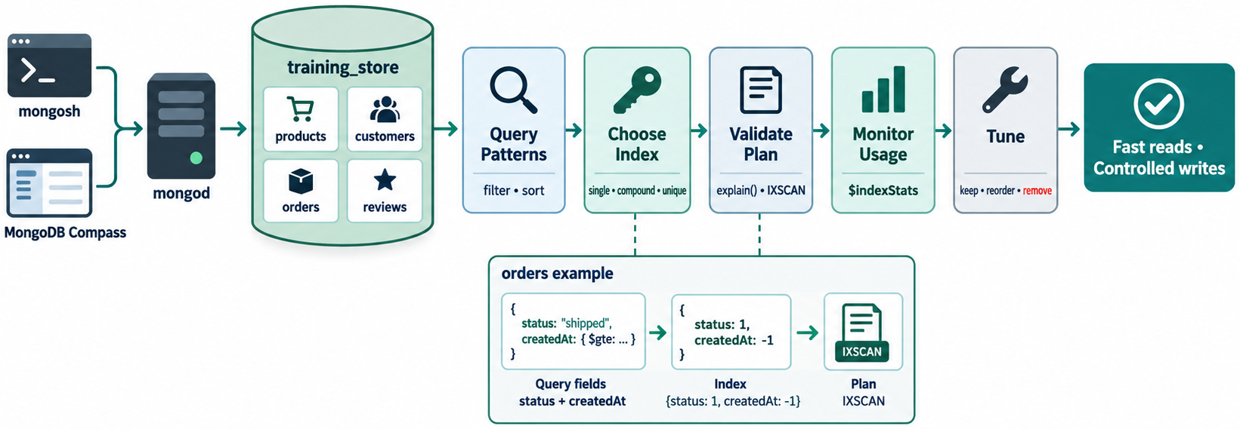
MODULE SUMMARY
MODULE 6
🧭
KEY POINTS
• Indexes speed selected reads and tax writes/storage
• Compound order and prefixes define supported shapes
• ESR is a starting guideline
• Arrays become multikey; specialized types solve specific jobs
• explain() is evidence; IXSCAN is not a trophy
• Hide, measure, maintain
116
© 2026 by Innovation In Software Corporation
Notes:
This slide includes a diagram — Module Summary.
The slide title is: Module Summary.
The slide says: <div class="cols">.
The slide says: <div class="col-text">.
The slide says: </div>.
The slide says: <div class="col-visual">.
Bullet 1 on the slide: Indexes speed selected reads and tax writes/storage.
Bullet 2 on the slide: Compound order and prefixes define supported shapes.
Bullet 3 on the slide: ESR is a starting guideline.
Bullet 4 on the slide: Arrays become multikey; specialized types solve specific jobs.
Bullet 5 on the slide: explain() is evidence; IXSCAN is not a trophy.
Bullet 6 on the slide: Hide, measure, maintain.
The figure on this slide is titled: Module 6 concept map.

Slide 118
EXERCISE 6.9 — FIND REDUNDANT INDEXES
MODULE 6
🛠️
KEY POINTS
• Time: 15 min
• Spot overlapping prefixes and list evidence required before hiding one.
• Lab guide: Exercise 6.9
117
© 2026 by Innovation In Software Corporation
Notes:
This slide includes a diagram — Exercise 6.9 — Find Redundant Indexes.
The slide title is: Exercise 6.9 — Find Redundant Indexes.
The slide says: <div class="cols">.
The slide says: <div class="col-text">.
The slide says: </div>.
The slide says: <div class="col-visual">.
Bullet 1 on the slide: Time: 15 min.
Bullet 2 on the slide: Spot overlapping prefixes and list evidence required before hiding one.
Bullet 3 on the slide: Lab guide: [Exercise 6.9](../slide-exercises/module-06/exercise-6.9-find-redundant-indexes.md).
The figure on this slide is titled: Overlapping index prefixes.

Slide 119
EXERCISE 6.9 — STEPS 1–2
MODULE 6
🛠️
KEY POINTS
LAB GUIDE Exercise 6.9
Follow along (Windows) — key steps:
Step 1 — Mark overlap
• Do: Indexes: { category: 1 }, { category: 1, price: 1 }, { category: 1, price: 1, name: 1 }, { price: 1 }. Which pairs share a prefix? Which index is not a prefix of the others?
• Expected: The three category-leading indexes overlap; the two-field and three-field keys can serve category-only queries. { price: 1 } is not a prefix of the category i
Step 2 — Decide what evidence is required
• Do: List four things to check before hiding { category: 1 } in favor of a wider compound index.
• Expected: Query shapes and sort needs; covered-query projections; unique/partial/TTL options; $indexStats usage; index size vs write cost. Do not drop from visual simil
_Full lab guide with every command: see Lab guide on the lesson divider slide._
118
© 2026 by Innovation In Software Corporation
Notes:
We are starting Exercise 6.9 — Find Redundant Indexes. We have about 15 min for this lab.
Spot overlapping prefixes without dropping an index on appearance alone.
The full lab guide is in slide-exercises/module-06/exercise-6.9-find-redundant-indexes.md if you need extra detail.
On Windows: PowerShell in the integrated terminal — Ctrl+backtick — and the Agent panel — Ctrl+I. Open the repo folder with File → Open Folder.
Step 1 — Mark overlap.
Step 2 — Decide what evidence is required.
Step 1 — Mark overlap.
Step 2 — Decide what evidence is required.
Step 1 — Mark overlap.
Step 2 — Decide what evidence is required.
Step 1 — Mark overlap.
Step 2 — Decide what evidence is required.
I'll give you a few minutes to work — raise your hand if you get stuck.
The slide title is: Exercise 6.9 — Steps 1–2.
The slide says: Lab guide: [Exercise 6.9](../slide-exercises/module-06/exercise-6.9-find-redundant-indexes.md).
The slide says: Follow along (Windows) — key steps:.
The slide says: _Full lab guide with every command: see Lab guide on the lesson divider slide._.
Bullet 1 on the slide: Do: Indexes: { category: 1 }, { category: 1, price: 1 }, { category: 1, price: 1, name: 1 }, { price: 1 }. Which pairs share a prefix? Which index is not a prefix of the others?.
Bullet 2 on the slide: Expected: The three category-leading indexes overlap; the two-field and three-field keys can serve category-only queries. { price: 1 } is not a prefix of the category i.
Bullet 3 on the slide: Do: List four things to check before hiding { category: 1 } in favor of a wider compound index.
Bullet 4 on the slide: Expected: Query shapes and sort needs; covered-query projections; unique/partial/TTL options; $indexStats usage; index size vs write cost. Do not drop from visual simil.
Bullet 5 on the slide: Do: Indexes: { category: 1 }, { category: 1, price: 1 }, { category: 1, price: 1, name: 1 }, { price: 1 }. Which pairs share a prefix? Which index is not a prefix of the others?.
Bullet 6 on the slide: Expected: The three category-leading indexes overlap; the two-field and three-field keys can serve category-only queries. { price: 1 } is not a prefix of the category i.
Bullet 7 on the slide: Do: List four things to check before hiding { category: 1 } in favor of a wider compound index.
Bullet 8 on the slide: Expected: Query shapes and sort needs; covered-query projections; unique/partial/TTL options; $indexStats usage; index size vs write cost. Do not drop from visual simil.
Bullet 9 on the slide: Do: Indexes: { category: 1 }, { category: 1, price: 1 }, { category: 1, price: 1, name: 1 }, { price: 1 }. Which pairs share a prefix? Which index is not a prefix of the others?.
Bullet 10 on the slide: Expected: The three category-leading indexes overlap; the two-field and three-field keys can serve category-only queries. { price: 1 } is not a prefix of the category i.
Bullet 11 on the slide: Do: List four things to check before hiding { category: 1 } in favor of a wider compound index.
Bullet 12 on the slide: Expected: Query shapes and sort needs; covered-query projections; unique/partial/TTL options; $indexStats usage; index size vs write cost. Do not drop from visual simil.
Bullet 13 on the slide: Do: Indexes: { category: 1 }, { category: 1, price: 1 }, { category: 1, price: 1, name: 1 }, { price: 1 }. Which pairs share a prefix? Which index is not a prefix of the others?.
Bullet 14 on the slide: Expected: The three category-leading indexes overlap; the two-field and three-field keys can serve category-only queries. { price: 1 } is not a prefix of the category i.
Bullet 15 on the slide: Do: List four things to check before hiding { category: 1 } in favor of a wider compound index.
Bullet 16 on the slide: Expected: Query shapes and sort needs; covered-query projections; unique/partial/TTL options; $indexStats usage; index size vs write cost. Do not drop from visual simil.

Slide 120
EXERCISE 6.10 — BALANCE READ AND WRITE PERFORMANCE
MODULE 6
🛠️
KEY POINTS
• Time: 15 min
• Plan evidence, hide-testing, and metrics for a write-heavy cluster with 14 secondary indexes.
• Lab guide: Exercise 6.10
119
© 2026 by Innovation In Software Corporation
Notes:
This slide includes a diagram — Exercise 6.10 — Balance Read and Write Performance.
The slide title is: Exercise 6.10 — Balance Read and Write Performance.
The slide says: <div class="cols">.
The slide says: <div class="col-text">.
The slide says: </div>.
The slide says: <div class="col-visual">.
Bullet 1 on the slide: Time: 15 min.
Bullet 2 on the slide: Plan evidence, hide-testing, and metrics for a write-heavy cluster with 14 secondary indexes.
Bullet 3 on the slide: Lab guide: [Exercise 6.10](../slide-exercises/module-06/exercise-6.10-balance-read-and-write.md).
The figure on this slide is titled: Write-heavy over-indexing scenario.

Slide 121
EXERCISE 6.10 — STEPS 1–2
MODULE 6
🛠️
KEY POINTS
LAB GUIDE Exercise 6.10
Follow along (Windows) — key steps:
Step 1 — Evidence to collect
• Do: List the measurements you would gather before dropping anything.
• Expected: Insert/update latency and opcounters; index sizes (collStats / indexSizes); $indexStats since last restart; slow query log / profiler; explain on the 20%
Step 2 — Safe test path
• Do: Describe how to test removal of one unused-looking index and which metrics to watch afterward.
• Expected: Hide the index (it still costs writes until dropped). Rerun the read queries and explain. If reads stay healthy, drop in a maintenance window. Monitor insert la
_Full lab guide with every command: see Lab guide on the lesson divider slide._
120
© 2026 by Innovation In Software Corporation
Notes:
We are starting Exercise 6.10 — Balance Read and Write Performance. We have about 15 min for this lab.
Plan evidence, hide-testing, and metrics for a write-heavy over-indexed workload.
The full lab guide is in slide-exercises/module-06/exercise-6.10-balance-read-and-write.md if you need extra detail.
On Windows: PowerShell in the integrated terminal — Ctrl+backtick — and the Agent panel — Ctrl+I. Open the repo folder with File → Open Folder.
Step 1 — Evidence to collect.
Step 2 — Safe test path.
Step 1 — Evidence to collect.
Step 2 — Safe test path.
Step 1 — Evidence to collect.
Step 2 — Safe test path.
Step 1 — Evidence to collect.
Step 2 — Safe test path.
I'll give you a few minutes to work — raise your hand if you get stuck.
The slide title is: Exercise 6.10 — Steps 1–2.
The slide says: Lab guide: [Exercise 6.10](../slide-exercises/module-06/exercise-6.10-balance-read-and-write.md).
The slide says: Follow along (Windows) — key steps:.
The slide says: _Full lab guide with every command: see Lab guide on the lesson divider slide._.
Bullet 1 on the slide: Do: List the measurements you would gather before dropping anything.
Bullet 2 on the slide: Expected: Insert/update latency and opcounters; index sizes (collStats / indexSizes); $indexStats since last restart; slow query log / profiler; explain on the 20%.
Bullet 3 on the slide: Do: Describe how to test removal of one unused-looking index and which metrics to watch afterward.
Bullet 4 on the slide: Expected: Hide the index (it still costs writes until dropped). Rerun the read queries and explain. If reads stay healthy, drop in a maintenance window. Monitor insert la.
Bullet 5 on the slide: Do: List the measurements you would gather before dropping anything.
Bullet 6 on the slide: Expected: Insert/update latency and opcounters; index sizes (collStats / indexSizes); $indexStats since last restart; slow query log / profiler; explain on the 20%.
Bullet 7 on the slide: Do: Describe how to test removal of one unused-looking index and which metrics to watch afterward.
Bullet 8 on the slide: Expected: Hide the index (it still costs writes until dropped). Rerun the read queries and explain. If reads stay healthy, drop in a maintenance window. Monitor insert la.
Bullet 9 on the slide: Do: List the measurements you would gather before dropping anything.
Bullet 10 on the slide: Expected: Insert/update latency and opcounters; index sizes (collStats / indexSizes); $indexStats since last restart; slow query log / profiler; explain on the 20%.
Bullet 11 on the slide: Do: Describe how to test removal of one unused-looking index and which metrics to watch afterward.
Bullet 12 on the slide: Expected: Hide the index (it still costs writes until dropped). Rerun the read queries and explain. If reads stay healthy, drop in a maintenance window. Monitor insert la.
Bullet 13 on the slide: Do: List the measurements you would gather before dropping anything.
Bullet 14 on the slide: Expected: Insert/update latency and opcounters; index sizes (collStats / indexSizes); $indexStats since last restart; slow query log / profiler; explain on the 20%.
Bullet 15 on the slide: Do: Describe how to test removal of one unused-looking index and which metrics to watch afterward.
Bullet 16 on the slide: Expected: Hide the index (it still costs writes until dropped). Rerun the read queries and explain. If reads stay healthy, drop in a maintenance window. Monitor insert la.

Slide 122
EXERCISE 6.11 — CORRECT INDEXING ANTI-PATTERNS
MODULE 6
⚠️
KEY POINTS
• Time: 15 min
• Rewrite seven unsafe indexing habits as safer practices.
• Lab guide: Exercise 6.11
121
© 2026 by Innovation In Software Corporation
Notes:
This slide includes a diagram — Exercise 6.11 — Correct Indexing Anti-Patterns.
The slide title is: Exercise 6.11 — Correct Indexing Anti-Patterns.
The slide says: <div class="cols">.
The slide says: <div class="col-text">.
The slide says: </div>.
The slide says: <div class="col-visual">.
Bullet 1 on the slide: Time: 15 min.
Bullet 2 on the slide: Rewrite seven unsafe indexing habits as safer practices.
Bullet 3 on the slide: Lab guide: [Exercise 6.11](../slide-exercises/module-06/exercise-6.11-correct-indexing-anti-patterns.md).
The figure on this slide is titled: Indexing anti-patterns.

Slide 123
EXERCISE 6.11 — STEPS 1–2
MODULE 6
🛠️
KEY POINTS
LAB GUIDE Exercise 6.11
Follow along (Windows) — key steps:
Step 1 — Correct the first four
• Do: Rewrite: index every field; one new index per query without checking overlap; put a range field first in every compound index; drop unused indexes immediately.
• Expected: Index recurring query shapes. Reuse prefixes. Equality (then sort) before range. Hide, measure, then drop.
Step 2 — Correct the last three
• Do: Rewrite: treat every IXSCAN as optimal; ignore write overhead; design indexes only on development-sized data.
• Expected: Read examined keys/docs. Count secondary indexes on the write path. Validate with production-like volume and distribution.
_Full lab guide with every command: see Lab guide on the lesson divider slide._
122
© 2026 by Innovation In Software Corporation
Notes:
We are starting Exercise 6.11 — Correct Indexing Anti-Patterns. We have about 15 min for this lab.
Rewrite unsafe indexing habits as safer, evidence-based practices.
The full lab guide is in slide-exercises/module-06/exercise-6.11-correct-indexing-anti-patterns.md if you need extra detail.
On Windows: PowerShell in the integrated terminal — Ctrl+backtick — and the Agent panel — Ctrl+I. Open the repo folder with File → Open Folder.
Step 1 — Correct the first four.
Step 2 — Correct the last three.
Step 1 — Correct the first four.
Step 2 — Correct the last three.
Step 1 — Correct the first four.
Step 2 — Correct the last three.
Step 1 — Correct the first four.
Step 2 — Correct the last three.
I'll give you a few minutes to work — raise your hand if you get stuck.
The slide title is: Exercise 6.11 — Steps 1–2.
The slide says: Lab guide: [Exercise 6.11](../slide-exercises/module-06/exercise-6.11-correct-indexing-anti-patterns.md).
The slide says: Follow along (Windows) — key steps:.
The slide says: _Full lab guide with every command: see Lab guide on the lesson divider slide._.
Bullet 1 on the slide: Do: Rewrite: index every field; one new index per query without checking overlap; put a range field first in every compound index; drop unused indexes immediately.
Bullet 2 on the slide: Expected: Index recurring query shapes. Reuse prefixes. Equality (then sort) before range. Hide, measure, then drop.
Bullet 3 on the slide: Do: Rewrite: treat every IXSCAN as optimal; ignore write overhead; design indexes only on development-sized data.
Bullet 4 on the slide: Expected: Read examined keys/docs. Count secondary indexes on the write path. Validate with production-like volume and distribution.
Bullet 5 on the slide: Do: Rewrite: index every field; one new index per query without checking overlap; put a range field first in every compound index; drop unused indexes immediately.
Bullet 6 on the slide: Expected: Index recurring query shapes. Reuse prefixes. Equality (then sort) before range. Hide, measure, then drop.
Bullet 7 on the slide: Do: Rewrite: treat every IXSCAN as optimal; ignore write overhead; design indexes only on development-sized data.
Bullet 8 on the slide: Expected: Read examined keys/docs. Count secondary indexes on the write path. Validate with production-like volume and distribution.
Bullet 9 on the slide: Do: Rewrite: index every field; one new index per query without checking overlap; put a range field first in every compound index; drop unused indexes immediately.
Bullet 10 on the slide: Expected: Index recurring query shapes. Reuse prefixes. Equality (then sort) before range. Hide, measure, then drop.
Bullet 11 on the slide: Do: Rewrite: treat every IXSCAN as optimal; ignore write overhead; design indexes only on development-sized data.
Bullet 12 on the slide: Expected: Read examined keys/docs. Count secondary indexes on the write path. Validate with production-like volume and distribution.
Bullet 13 on the slide: Do: Rewrite: index every field; one new index per query without checking overlap; put a range field first in every compound index; drop unused indexes immediately.
Bullet 14 on the slide: Expected: Index recurring query shapes. Reuse prefixes. Equality (then sort) before range. Hide, measure, then drop.
Bullet 15 on the slide: Do: Rewrite: treat every IXSCAN as optimal; ignore write overhead; design indexes only on development-sized data.
Bullet 16 on the slide: Expected: Read examined keys/docs. Count secondary indexes on the write path. Validate with production-like volume and distribution.

Slide 124
EXERCISE 6.12 — BUILD AN INDEXING RECOMMENDATION
MODULE 6
🛠️
KEY POINTS
• Time: 20 min
• Write query shape, plan, proposed index, benefit, cost, validation, and rollback.
• Lab guide: Exercise 6.12
123
© 2026 by Innovation In Software Corporation
Notes:
This slide includes a diagram — Exercise 6.12 — Build an Indexing Recommendation.
The slide title is: Exercise 6.12 — Build an Indexing Recommendation.
The slide says: <div class="cols">.
The slide says: <div class="col-text">.
The slide says: </div>.
The slide says: <div class="col-visual">.
Bullet 1 on the slide: Time: 20 min.
Bullet 2 on the slide: Write query shape, plan, proposed index, benefit, cost, validation, and rollback.
Bullet 3 on the slide: Lab guide: [Exercise 6.12](../slide-exercises/module-06/exercise-6.12-build-an-indexing-recommendation.md).
The figure on this slide is titled: Indexing recommendation template.

Slide 125
EXERCISE 6.12 — STEPS 1–2
MODULE 6
🛠️
KEY POINTS
LAB GUIDE Exercise 6.12
Follow along (Windows) — key steps:
Step 1 — Fill the template
• Do: Pick the catalog query (active products in a category, sorted by price) or customer order history. Write: query shape, current plan assumption, proposed index, expected improvement, write/storage cost.
• Expected: A complete paragraph or bullet list covering those five items. Example: { category: 1, active: 1, price: 1 } named idx_products_category_active_price.
Step 2 — Validation and rollback
• Do: Add a validation procedure (explain before/after, examined counts) and a rollback procedure (dropIndex of the named index; keep the createIndex snippet).
• Expected: Baseline explain → createIndex → explain again → compare nReturned vs keys/docs examined and SORT absence. Rollback: `db.products.dropIndex("idxproductscatego
_Full lab guide with every command: see Lab guide on the lesson divider slide._
124
© 2026 by Innovation In Software Corporation
Notes:
We are starting Exercise 6.12 — Build an Indexing Recommendation. We have about 20 min for this lab.
Write a recommendation with query shape, proposed index, cost, validation, and rollback.
The full lab guide is in slide-exercises/module-06/exercise-6.12-build-an-indexing-recommendation.md if you need extra detail.
On Windows: PowerShell in the integrated terminal — Ctrl+backtick — and the Agent panel — Ctrl+I. Open the repo folder with File → Open Folder.
Step 1 — Fill the template.
Step 2 — Validation and rollback.
Step 1 — Fill the template.
Step 2 — Validation and rollback.
Step 1 — Fill the template.
Step 2 — Validation and rollback.
Step 1 — Fill the template.
Step 2 — Validation and rollback.
I'll give you a few minutes to work — raise your hand if you get stuck.
The slide title is: Exercise 6.12 — Steps 1–2.
The slide says: Lab guide: [Exercise 6.12](../slide-exercises/module-06/exercise-6.12-build-an-indexing-recommendation.md).
The slide says: Follow along (Windows) — key steps:.
The slide says: _Full lab guide with every command: see Lab guide on the lesson divider slide._.
Bullet 1 on the slide: Do: Pick the catalog query (active products in a category, sorted by price) or customer order history. Write: query shape, current plan assumption, proposed index, expected improvement, write/storage cost.
Bullet 2 on the slide: Expected: A complete paragraph or bullet list covering those five items. Example: { category: 1, active: 1, price: 1 } named idx_products_category_active_price.
Bullet 3 on the slide: Do: Add a validation procedure (explain before/after, examined counts) and a rollback procedure (dropIndex of the named index; keep the createIndex snippet).
Bullet 4 on the slide: Expected: Baseline explain → createIndex → explain again → compare nReturned vs keys/docs examined and SORT absence. Rollback: `db.products.dropIndex("idx_products_catego.
Bullet 5 on the slide: Do: Pick the catalog query (active products in a category, sorted by price) or customer order history. Write: query shape, current plan assumption, proposed index, expected improvement, write/storage cost.
Bullet 6 on the slide: Expected: A complete paragraph or bullet list covering those five items. Example: { category: 1, active: 1, price: 1 } named idx_products_category_active_price.
Bullet 7 on the slide: Do: Add a validation procedure (explain before/after, examined counts) and a rollback procedure (dropIndex of the named index; keep the createIndex snippet).
Bullet 8 on the slide: Expected: Baseline explain → createIndex → explain again → compare nReturned vs keys/docs examined and SORT absence. Rollback: `db.products.dropIndex("idx_products_catego.
Bullet 9 on the slide: Do: Pick the catalog query (active products in a category, sorted by price) or customer order history. Write: query shape, current plan assumption, proposed index, expected improvement, write/storage cost.
Bullet 10 on the slide: Expected: A complete paragraph or bullet list covering those five items. Example: { category: 1, active: 1, price: 1 } named idx_products_category_active_price.
Bullet 11 on the slide: Do: Add a validation procedure (explain before/after, examined counts) and a rollback procedure (dropIndex of the named index; keep the createIndex snippet).
Bullet 12 on the slide: Expected: Baseline explain → createIndex → explain again → compare nReturned vs keys/docs examined and SORT absence. Rollback: `db.products.dropIndex("idx_products_catego.
Bullet 13 on the slide: Do: Pick the catalog query (active products in a category, sorted by price) or customer order history. Write: query shape, current plan assumption, proposed index, expected improvement, write/storage cost.
Bullet 14 on the slide: Expected: A complete paragraph or bullet list covering those five items. Example: { category: 1, active: 1, price: 1 } named idx_products_category_active_price.
Bullet 15 on the slide: Do: Add a validation procedure (explain before/after, examined counts) and a rollback procedure (dropIndex of the named index; keep the createIndex snippet).
Bullet 16 on the slide: Expected: Baseline explain → createIndex → explain again → compare nReturned vs keys/docs examined and SORT absence. Rollback: `db.products.dropIndex("idx_products_catego.

Slide 126
HANDS-ON LABS
MODULE 6
🛠️
KEY POINTS
Same training_store database. Reload load.js if data or indexes are messy — then re-create only the indexes the lab asks for.
Lab | Focus
6.1 | Baseline explain — no new indexes
6.2–6.4 | Single-field, compound, filter+sort
6.5–6.7 | Nested/multikey, unique, partial/TTL
6.8–6.9 | Covered query, aggregation
6.10–6.11 | Audit/hide, integrated challenge
3-day time-box (~2 h module): Labs 6.1, 6.2, 6.3, 6.4, and 6.11. Remaining labs are stretch.
125
© 2026 by Innovation In Software Corporation
Notes:
This slide is a table — Hands-on Labs.
The slide title is: Hands-on Labs.
The slide says: Same training_store database. Reload load.js if data or indexes are messy — then re-create only the indexes the lab asks for.
The slide says: 3-day time-box (~2 h module): Labs 6.1, 6.2, 6.3, 6.4, and 6.11. Remaining labs are stretch.
The table header columns are: Lab, Focus.
In the table, 6.1: Baseline explain — no new indexes.
In the table, 6.2–6.4: Single-field, compound, filter+sort.
In the table, 6.5–6.7: Nested/multikey, unique, partial/TTL.
In the table, 6.8–6.9: Covered query, aggregation.
In the table, 6.10–6.11: Audit/hide, integrated challenge.

Slide 127
LAB 6.1 — ESTABLISH A PERFORMANCE BASELINE
MODULE 6
🛠️
KEY POINTS
• Time: 20 min
• Record explain baselines for catalog and order-history queries without creating indexes.
• Lab guide: Lab 6.1
126
© 2026 by Innovation In Software Corporation
Notes:
This slide includes a diagram — Lab 6.1 — Establish a Performance Baseline.
The slide title is: Lab 6.1 — Establish a Performance Baseline.
The slide says: <div class="cols">.
The slide says: <div class="col-text">.
The slide says: </div>.
The slide says: <div class="col-visual">.
Bullet 1 on the slide: Time: 20 min.
Bullet 2 on the slide: Record explain baselines for catalog and order-history queries without creating indexes.
Bullet 3 on the slide: Lab guide: [Lab 6.1](../slide-exercises/module-06/lab-6.1-establish-a-performance-baseline.md).
The figure on this slide is titled: Baseline before indexing.

Slide 128
LAB 6.1 — STEPS 1–2
MODULE 6
🛠️
KEY POINTS
LAB GUIDE Lab 6.1
Follow along (Windows) — key steps:
Step 1 — Confirm the dataset
• Do: Run: ``javascript use training_store db.products.countDocuments() db.orders.countDocuments() db.products.getIndexes() db.orders.getIndexes() ``
• Expected: About 12 products and 17 orders. Each collection should show the default _id_ index. Note any extra indexes left from a demo.
Step 2 — Explain the catalog query
• Do: Run and record winning stage, nReturned, totalKeysExamined, totalDocsExamined, and any SORT: ``javascript db.products.find( { category: "ACCESSORY", active: true } ).sort({ price: 1 }).explain("executionStats") ``
• Expected: Likely COLLSCAN (unless a prior demo index remains). Record the numbers even if they are small.
127
© 2026 by Innovation In Software Corporation
Notes:
The slide title is: Lab 6.1 — Steps 1–2.
The slide says: Lab guide: [Lab 6.1](../slide-exercises/module-06/lab-6.1-establish-a-performance-baseline.md).
The slide says: Follow along (Windows) — key steps:.
Step 1 — Confirm the dataset.
Step 2 — Explain the catalog query.
Bullet 1 on the slide: Do: Run: ``javascript use training_store db.products.countDocuments() db.orders.countDocuments() db.products.getIndexes() db.orders.getIndexes() ``.
Bullet 2 on the slide: Expected: About 12 products and 17 orders. Each collection should show the default _id_ index. Note any extra indexes left from a demo.
Bullet 3 on the slide: Do: Run and record winning stage, nReturned, totalKeysExamined, totalDocsExamined, and any SORT: ``javascript db.products.find( { category: "ACCESSORY", active: true } ).sort({ price: 1 }).explain("executionStats") ``.
Bullet 4 on the slide: Expected: Likely COLLSCAN (unless a prior demo index remains). Record the numbers even if they are small.

Slide 129
LAB 6.1 — STEPS 3–4
MODULE 6
🛠️
KEY POINTS
Follow along (Windows) — key steps:
Step 3 — Explain order history
• Do: Replace cid with C101’s _id from db.customers.findOne({ customerNumber: "C101" }), then: ```javascript db.orders.find({ customerId: cid, paymentStatus: "PAID" }).sort({ createdAt: -1 }).limit(10).explain("execution
• Expected: A baseline row exists: filter, sort, projection (none), winning plan, counts, in-memory sort yes/no.
Step 4 — Fill the baseline table
• Do: In notes, one row per query: filter, sort, projection, winning plan, nReturned, keys examined, docs examined, extra sort.
• Expected: Two completed rows. No new indexes created in this lab.
128
© 2026 by Innovation In Software Corporation
Notes:
The slide title is: Lab 6.1 — Steps 3–4.
The slide says: Follow along (Windows) — key steps:.
Step 3 — Explain order history.
Step 4 — Fill the baseline table.
Bullet 1 on the slide: Do: Replace cid with C101’s _id from db.customers.findOne({ customerNumber: "C101" }), then: ```javascript db.orders.find({ customerId: cid, paymentStatus: "PAID" }).sort({ createdAt: -1 }).limit(10).explain("execution.
Bullet 2 on the slide: Expected: A baseline row exists: filter, sort, projection (none), winning plan, counts, in-memory sort yes/no.
Bullet 3 on the slide: Do: In notes, one row per query: filter, sort, projection, winning plan, nReturned, keys examined, docs examined, extra sort.
Bullet 4 on the slide: Expected: Two completed rows. No new indexes created in this lab.

Slide 130
LAB 6.2 — CREATE AND TEST A SINGLE-FIELD INDEX
MODULE 6
🛠️
KEY POINTS
• Time: 20 min
• Index SKU and compare examined documents before and after.
• Lab guide: Lab 6.2
129
© 2026 by Innovation In Software Corporation
Notes:
This slide includes a diagram — Lab 6.2 — Create and Test a Single-Field Index.
The slide title is: Lab 6.2 — Create and Test a Single-Field Index.
The slide says: <div class="cols">.
The slide says: <div class="col-text">.
The slide says: </div>.
The slide says: <div class="col-visual">.
Bullet 1 on the slide: Time: 20 min.
Bullet 2 on the slide: Index SKU and compare examined documents before and after.
Bullet 3 on the slide: Lab guide: [Lab 6.2](../slide-exercises/module-06/lab-6.2-create-and-test-a-single-field-index.md).
The figure on this slide is titled: Single-field SKU index lab.

Slide 131
LAB 6.2 — STEPS 1–2
MODULE 6
🛠️
KEY POINTS
LAB GUIDE Lab 6.2
Follow along (Windows) — key steps:
Step 1 — Baseline SKU lookup
• Do: Run: ``javascript db.products.find({ sku: "L100" }).explain("executionStats") ``
• Expected: Record winning stage and examined counts. Expect COLLSCAN unless an earlier SKU index exists.
Step 2 — Create the index
• Do: Run: ``javascript db.products.createIndex( { sku: 1 }, { name: "idx_products_sku" } ) db.products.getIndexes() ``
• Expected: The index list includes idx_products_sku with key { sku: 1 }.
130
© 2026 by Innovation In Software Corporation
Notes:
The slide title is: Lab 6.2 — Steps 1–2.
The slide says: Lab guide: [Lab 6.2](../slide-exercises/module-06/lab-6.2-create-and-test-a-single-field-index.md).
The slide says: Follow along (Windows) — key steps:.
Step 1 — Baseline SKU lookup.
Step 2 — Create the index.
Bullet 1 on the slide: Do: Run: ``javascript db.products.find({ sku: "L100" }).explain("executionStats") ``.
Bullet 2 on the slide: Expected: Record winning stage and examined counts. Expect COLLSCAN unless an earlier SKU index exists.
Bullet 3 on the slide: Do: Run: ``javascript db.products.createIndex( { sku: 1 }, { name: "idx_products_sku" } ) db.products.getIndexes() ``.
Bullet 4 on the slide: Expected: The index list includes idx_products_sku with key { sku: 1 }.

Slide 132
LAB 6.2 — STEPS 3–4
MODULE 6
🛠️
KEY POINTS
Follow along (Windows) — key steps:
Step 3 — Re-explain
• Do: Repeat the L100 find explain. Confirm the winning index name.
• Expected: IXSCAN on idxproductssku. Keys and docs examined should be near 1, nReturned 1.
Step 4 — Tradeoff note
• Do: Write one sentence: what write and storage cost did you add, and which query shape it serves.
• Expected: Each product insert/update of sku maintains this index. It serves equality lookup by SKU.
131
© 2026 by Innovation In Software Corporation
Notes:
This slide lists key points under Lab 6.2 — Steps 3–4.
The slide title is: Lab 6.2 — Steps 3–4.
The slide says: Follow along (Windows) — key steps:.
Step 3 — Re-explain.
Step 4 — Tradeoff note.
Bullet 1 on the slide: Do: Repeat the L100 find explain. Confirm the winning index name.
Bullet 2 on the slide: Expected: IXSCAN on idx_products_sku. Keys and docs examined should be near 1, nReturned 1.
Bullet 3 on the slide: Do: Write one sentence: what write and storage cost did you add, and which query shape it serves.
Bullet 4 on the slide: Expected: Each product insert/update of sku maintains this index. It serves equality lookup by SKU.

Slide 133
LAB 6.3 — DESIGN A COMPOUND INDEX
MODULE 6
🛠️
KEY POINTS
• Time: 25 min
• Build { category, active, price } and test which prefixes it supports.
• Lab guide: Lab 6.3
132
© 2026 by Innovation In Software Corporation
Notes:
This slide includes a diagram — Lab 6.3 — Design a Compound Index.
The slide title is: Lab 6.3 — Design a Compound Index.
The slide says: <div class="cols">.
The slide says: <div class="col-text">.
The slide says: </div>.
The slide says: <div class="col-visual">.
Bullet 1 on the slide: Time: 25 min.
Bullet 2 on the slide: Build { category, active, price } and test which prefixes it supports.
Bullet 3 on the slide: Lab guide: [Lab 6.3](../slide-exercises/module-06/lab-6.3-design-a-compound-index.md).
The figure on this slide is titled: Compound catalog index lab.

Slide 134
LAB 6.3 — STEPS 1–2
MODULE 6
🛠️
KEY POINTS
LAB GUIDE Lab 6.3
Follow along (Windows) — key steps:
Step 1 — Identify fields
• Do: For find({ category: "ACCESSORY", active: true }).sort({ price: 1 }), write equality vs sort fields and propose a key.
• Expected: Equality: category, active. Sort: price. Proposal { category: 1, active: 1, price: 1 }.
Step 2 — Create and explain
• Do: Run: ```javascript db.products.createIndex( { category: 1, active: 1, price: 1 }, { name: "idxproductscategoryactiveprice" } ) db.products.find({ category: "ACCESSORY", active: true }).sort({ price: 1 }).explain("exe
• Expected: Winning index is the new compound index. Look for IXSCAN and no blocking SORT.
133
© 2026 by Innovation In Software Corporation
Notes:
The slide title is: Lab 6.3 — Steps 1–2.
The slide says: Lab guide: [Lab 6.3](../slide-exercises/module-06/lab-6.3-design-a-compound-index.md).
The slide says: Follow along (Windows) — key steps:.
Step 1 — Identify fields.
Step 2 — Create and explain.
Bullet 1 on the slide: Do: For find({ category: "ACCESSORY", active: true }).sort({ price: 1 }), write equality vs sort fields and propose a key.
Bullet 2 on the slide: Expected: Equality: category, active. Sort: price. Proposal { category: 1, active: 1, price: 1 }.
Bullet 3 on the slide: Do: Run: ```javascript db.products.createIndex( { category: 1, active: 1, price: 1 }, { name: "idx_products_category_active_price" } ) db.products.find({ category: "ACCESSORY", active: true }).sort({ price: 1 }).explain("exe.
Bullet 4 on the slide: Expected: Winning index is the new compound index. Look for IXSCAN and no blocking SORT.

Slide 135
LAB 6.3 — STEPS 3–4
MODULE 6
🛠️
KEY POINTS
Follow along (Windows) — key steps:
Step 3 — Test a prefix query
• Do: Explain db.products.find({ category: "LAPTOP" }) and db.products.find({ active: true }).
• Expected: Category-only can use the leading prefix. Active-only generally cannot.
Step 4 — Record unsupported shapes
• Do: Write one query this index does not support well (for example sort by name, or filter only price).
• Expected: A concrete unsupported shape is written, with a one-line reason (prefix or sort mismatch).
134
© 2026 by Innovation In Software Corporation
Notes:
This slide lists key points under Lab 6.3 — Steps 3–4.
The slide title is: Lab 6.3 — Steps 3–4.
The slide says: Follow along (Windows) — key steps:.
Step 3 — Test a prefix query.
Step 4 — Record unsupported shapes.
Bullet 1 on the slide: Do: Explain db.products.find({ category: "LAPTOP" }) and db.products.find({ active: true }).
Bullet 2 on the slide: Expected: Category-only can use the leading prefix. Active-only generally cannot.
Bullet 3 on the slide: Do: Write one query this index does not support well (for example sort by name, or filter only price).
Bullet 4 on the slide: Expected: A concrete unsupported shape is written, with a one-line reason (prefix or sort mismatch).

Slide 136
LAB 6.4 — SUPPORT FILTERING AND SORTING
MODULE 6
🛠️
KEY POINTS
• Time: 25 min
• Compare compound orders for C101’s newest orders in a date range, limit 10.
• Lab guide: Lab 6.4
135
© 2026 by Innovation In Software Corporation
Notes:
This slide includes a diagram — Lab 6.4 — Support Filtering and Sorting.
The slide title is: Lab 6.4 — Support Filtering and Sorting.
The slide says: <div class="cols">.
The slide says: <div class="col-text">.
The slide says: </div>.
The slide says: <div class="col-visual">.
Bullet 1 on the slide: Time: 25 min.
Bullet 2 on the slide: Compare compound orders for C101’s newest orders in a date range, limit 10.
Bullet 3 on the slide: Lab guide: [Lab 6.4](../slide-exercises/module-06/lab-6.4-support-filtering-and-sorting.md).
The figure on this slide is titled: Order-history compound index lab.

Slide 137
LAB 6.4 — STEPS 1–2
MODULE 6
🛠️
KEY POINTS
LAB GUIDE Lab 6.4
Follow along (Windows) — key steps:
Step 1 — Write the query
• Do: Using C101’s _id as cid and a start date of ISODate("2026-08-01T00:00:00Z"): ```javascript db.orders.find({ customerId: cid, createdAt: { $gte: ISODate("2026-08-01T00:00:00Z") } }).sort({ createdAt: -1 }).limit(10)
• Expected: Baseline plan recorded. Equality customerId, sort/range createdAt.
Step 2 — Create the ESR-aligned index
• Do: Run: ``javascript db.orders.createIndex( { customerId: 1, createdAt: -1 }, { name: "idx_orders_customer_created" } ) `` Re-explain the query.
• Expected: IXSCAN on idxorderscustomer_created. Sort should be satisfied by the index.
136
© 2026 by Innovation In Software Corporation
Notes:
The slide title is: Lab 6.4 — Steps 1–2.
The slide says: Lab guide: [Lab 6.4](../slide-exercises/module-06/lab-6.4-support-filtering-and-sorting.md).
The slide says: Follow along (Windows) — key steps:.
Step 1 — Write the query.
Step 2 — Create the ESR-aligned index.
Bullet 1 on the slide: Do: Using C101’s _id as cid and a start date of ISODate("2026-08-01T00:00:00Z"): ```javascript db.orders.find({ customerId: cid, createdAt: { $gte: ISODate("2026-08-01T00:00:00Z") } }).sort({ createdAt: -1 }).limit(10).
Bullet 2 on the slide: Expected: Baseline plan recorded. Equality customerId, sort/range createdAt.
Bullet 3 on the slide: Do: Run: ``javascript db.orders.createIndex( { customerId: 1, createdAt: -1 }, { name: "idx_orders_customer_created" } ) `` Re-explain the query.
Bullet 4 on the slide: Expected: IXSCAN on idx_orders_customer_created. Sort should be satisfied by the index.

Slide 138
LAB 6.4 — STEPS 3–4
MODULE 6
🛠️
KEY POINTS
Follow along (Windows) — key steps:
Step 3 — Compare a worse order
• Do: Create { createdAt: -1, customerId: 1 } as idx_orders_created_customer only if you have time, explain the same query, then drop that experimental index.
• Expected: Leading with the range/sort field scans more keys across customers. Evidence favors customerId first. Drop the experimental index.
Step 4 — Choose and document
• Do: Keep idxorderscustomer_created. Write why ESR put equality first here.
• Expected: A short justification: one customer’s keys are contiguous, then dates are ordered for newest-first and the range.
137
© 2026 by Innovation In Software Corporation
Notes:
This slide lists key points under Lab 6.4 — Steps 3–4.
The slide title is: Lab 6.4 — Steps 3–4.
The slide says: Follow along (Windows) — key steps:.
Step 3 — Compare a worse order.
Step 4 — Choose and document.
Bullet 1 on the slide: Do: Create { createdAt: -1, customerId: 1 } as idx_orders_created_customer only if you have time, explain the same query, then drop that experimental index.
Bullet 2 on the slide: Expected: Leading with the range/sort field scans more keys across customers. Evidence favors customerId first. Drop the experimental index.
Bullet 3 on the slide: Do: Keep idx_orders_customer_created. Write why ESR put equality first here.
Bullet 4 on the slide: Expected: A short justification: one customer’s keys are contiguous, then dates are ordered for newest-first and the range.

Slide 139
LAB 6.5 — INDEX NESTED FIELDS AND ARRAYS
MODULE 6
🛠️
KEY POINTS
• Time: 25 min
• Index contact.email and tags; confirm dotted lookup and multikey.
• Lab guide: Lab 6.5
138
© 2026 by Innovation In Software Corporation
Notes:
This slide includes a diagram — Lab 6.5 — Index Nested Fields and Arrays.
The slide title is: Lab 6.5 — Index Nested Fields and Arrays.
The slide says: <div class="cols">.
The slide says: <div class="col-text">.
The slide says: </div>.
The slide says: <div class="col-visual">.
Bullet 1 on the slide: Time: 25 min.
Bullet 2 on the slide: Index contact.email and tags; confirm dotted lookup and multikey.
Bullet 3 on the slide: Lab guide: [Lab 6.5](../slide-exercises/module-06/lab-6.5-index-nested-fields-and-arrays.md).
The figure on this slide is titled: Nested and multikey lab.

Slide 140
LAB 6.5 — STEPS 1–2
MODULE 6
🛠️
KEY POINTS
LAB GUIDE Lab 6.5
Follow along (Windows) — key steps:
Step 1 — Nested email index
• Do: Run: ``javascript db.customers.createIndex( { "contact.email": 1 }, { name: "idx_customers_contact_email" } ) db.customers.find({ "contact.email": "aisha@example.com" }).explain("executionStats") ``
• Expected: IXSCAN on idxcustomerscontact_email. nReturned 1.
Step 2 — Multikey tags index
• Do: Run: ``javascript db.products.createIndex( { tags: 1 }, { name: "idx_products_tags" } ) db.products.find({ tags: "technology" }).explain("executionStats") db.products.getIndexes() ``
• Expected: The tags index is listed. Explain uses it. getIndexes / explain may show multikey: true.
139
© 2026 by Innovation In Software Corporation
Notes:
The slide title is: Lab 6.5 — Steps 1–2.
The slide says: Lab guide: [Lab 6.5](../slide-exercises/module-06/lab-6.5-index-nested-fields-and-arrays.md).
The slide says: Follow along (Windows) — key steps:.
Step 1 — Nested email index.
Step 2 — Multikey tags index.
Bullet 1 on the slide: Do: Run: ``javascript db.customers.createIndex( { "contact.email": 1 }, { name: "idx_customers_contact_email" } ) db.customers.find({ "contact.email": "aisha@example.com" }).explain("executionStats") ``.
Bullet 2 on the slide: Expected: IXSCAN on idx_customers_contact_email. nReturned 1.
Bullet 3 on the slide: Do: Run: ``javascript db.products.createIndex( { tags: 1 }, { name: "idx_products_tags" } ) db.products.find({ tags: "technology" }).explain("executionStats") db.products.getIndexes() ``.
Bullet 4 on the slide: Expected: The tags index is listed. Explain uses it. getIndexes / explain may show multikey: true.

Slide 141
LAB 6.5 — STEPS 3–4
MODULE 6
🛠️
KEY POINTS
Follow along (Windows) — key steps:
Step 3 — Inspect multikey
• Do: In getIndexes output for idxproductstags, find multikey (and optional multikeyPaths). Query tags "wireless" as well.
• Expected: multikey is true because tags is an array. Several accessories match wireless.
Step 4 — Record examined counts
• Do: Write keys examined and docs examined for the email query and the technology-tag query.
• Expected: Two rows of stats. Email should be a single-key lookup; tags examines keys for matching array values.
140
© 2026 by Innovation In Software Corporation
Notes:
This slide lists key points under Lab 6.5 — Steps 3–4.
The slide title is: Lab 6.5 — Steps 3–4.
The slide says: Follow along (Windows) — key steps:.
Step 3 — Inspect multikey.
Step 4 — Record examined counts.
Bullet 1 on the slide: Do: In getIndexes output for idx_products_tags, find multikey (and optional multikeyPaths). Query tags "wireless" as well.
Bullet 2 on the slide: Expected: multikey is true because tags is an array. Several accessories match wireless.
Bullet 3 on the slide: Do: Write keys examined and docs examined for the email query and the technology-tag query.
Bullet 4 on the slide: Expected: Two rows of stats. Email should be a single-key lookup; tags examines keys for matching array values.

Slide 142
LAB 6.6 — IMPLEMENT DATA-INTEGRITY INDEXES
MODULE 6
🛠️
KEY POINTS
• Time: 20 min
• Unique SKU, customerNumber, and orderNumber; prove a duplicate SKU fails.
• Lab guide: Lab 6.6
141
© 2026 by Innovation In Software Corporation
Notes:
This slide includes a diagram — Lab 6.6 — Implement Data-Integrity Indexes.
The slide title is: Lab 6.6 — Implement Data-Integrity Indexes.
The slide says: <div class="cols">.
The slide says: <div class="col-text">.
The slide says: </div>.
The slide says: <div class="col-visual">.
Bullet 1 on the slide: Time: 20 min.
Bullet 2 on the slide: Unique SKU, customerNumber, and orderNumber; prove a duplicate SKU fails.
Bullet 3 on the slide: Lab guide: [Lab 6.6](../slide-exercises/module-06/lab-6.6-implement-data-integrity-indexes.md).
The figure on this slide is titled: Unique index lab.

Slide 143
LAB 6.6 — STEPS 1–2
MODULE 6
🛠️
KEY POINTS
LAB GUIDE Lab 6.6
Follow along (Windows) — key steps:
Step 1 — Unique SKU
• Do: If idx_products_sku exists, drop it first (MongoDB cannot keep two indexes on the same keys). Then: ```javascript db.products.dropIndex("idxproductssku") db.products.createIndex( { sku: 1 }, { unique: true, name: "uq
• Expected: uqproductssku exists with unique: true. dropIndex errors if the non-unique index was never created — that is fine; proceed to createIndex.
Step 2 — Unique customer and order numbers
• Do: Run: ``javascript db.customers.createIndex( { customerNumber: 1 }, { unique: true, name: "uq_customers_customer_number" } ) db.orders.createIndex( { orderNumber: 1 }, { unique: true, name: "uq_orders_order_number" } )
• Expected: Both unique indexes build because the loader has no duplicates.
142
© 2026 by Innovation In Software Corporation
Notes:
The slide title is: Lab 6.6 — Steps 1–2.
The slide says: Lab guide: [Lab 6.6](../slide-exercises/module-06/lab-6.6-implement-data-integrity-indexes.md).
The slide says: Follow along (Windows) — key steps:.
Step 1 — Unique SKU.
Step 2 — Unique customer and order numbers.
Bullet 1 on the slide: Do: If idx_products_sku exists, drop it first (MongoDB cannot keep two indexes on the same keys). Then: ```javascript db.products.dropIndex("idx_products_sku") db.products.createIndex( { sku: 1 }, { unique: true, name: "uq.
Bullet 2 on the slide: Expected: uq_products_sku exists with unique: true. dropIndex errors if the non-unique index was never created — that is fine; proceed to createIndex.
Bullet 3 on the slide: Do: Run: ``javascript db.customers.createIndex( { customerNumber: 1 }, { unique: true, name: "uq_customers_customer_number" } ) db.orders.createIndex( { orderNumber: 1 }, { unique: true, name: "uq_orders_order_number" } ).
Bullet 4 on the slide: Expected: Both unique indexes build because the loader has no duplicates.

Slide 144
LAB 6.6 — STEPS 3–4
MODULE 6
🛠️
KEY POINTS
Follow along (Windows) — key steps:
Step 3 — Attempt a duplicate SKU
• Do: Run: ``javascript db.products.insertOne({ sku: "L100", name: "Duplicate SKU test", category: "LAPTOP", price: Decimal128("1.00"), active: false, tags: ["temp"], createdAt: new Date() }) ``
• Expected: Duplicate key error (E11000) mentioning sku / uqproductssku. The extra document is not inserted.
Step 4 — Cleanup discussion
• Do: Write what you would do if unique creation failed because duplicates already existed.
• Expected: Find duplicates with a $group on the key having $sum: 1 and $match count > 1, merge or delete extras, then retry createIndex. Do not skip uniqueness becau
143
© 2026 by Innovation In Software Corporation
Notes:
The slide title is: Lab 6.6 — Steps 3–4.
The slide says: Follow along (Windows) — key steps:.
Step 3 — Attempt a duplicate SKU.
Step 4 — Cleanup discussion.
Bullet 1 on the slide: Do: Run: ``javascript db.products.insertOne({ sku: "L100", name: "Duplicate SKU test", category: "LAPTOP", price: Decimal128("1.00"), active: false, tags: ["temp"], createdAt: new Date() }) ``.
Bullet 2 on the slide: Expected: Duplicate key error (E11000) mentioning sku / uq_products_sku. The extra document is not inserted.
Bullet 3 on the slide: Do: Write what you would do if unique creation failed because duplicates already existed.
Bullet 4 on the slide: Expected: Find duplicates with a $group on the key having $sum: 1 and $match count > 1, merge or delete extras, then retry createIndex. Do not skip uniqueness becau.

Slide 145
LAB 6.7 — IMPLEMENT PARTIAL AND TTL INDEXES
MODULE 6
🛠️
KEY POINTS
• Time: 25 min
• Partial index for active products; TTL on a sessions collection.
• Lab guide: Lab 6.7
144
© 2026 by Innovation In Software Corporation
Notes:
This slide includes a diagram — Lab 6.7 — Implement Partial and TTL Indexes.
The slide title is: Lab 6.7 — Implement Partial and TTL Indexes.
The slide says: <div class="cols">.
The slide says: <div class="col-text">.
The slide says: </div>.
The slide says: <div class="col-visual">.
Bullet 1 on the slide: Time: 25 min.
Bullet 2 on the slide: Partial index for active products; TTL on a sessions collection.
Bullet 3 on the slide: Lab guide: [Lab 6.7](../slide-exercises/module-06/lab-6.7-implement-partial-and-ttl-indexes.md).
The figure on this slide is titled: Partial and TTL lab.

Slide 146
LAB 6.7 — STEPS 1–2
MODULE 6
🛠️
KEY POINTS
LAB GUIDE Lab 6.7
Follow along (Windows) — key steps:
Step 1 — Partial index
• Do: Run: ``javascript db.products.createIndex( { category: 1, price: 1 }, { partialFilterExpression: { active: true }, name: "idx_active_products_category_price" } ) db.products.getIndexes() ``
• Expected: The index lists partialFilterExpression { active: true }.
Step 2 — Compatible vs incompatible query
• Do: Explain both: ```javascript db.products.find({ category: "LAPTOP", active: true, price: { $lte: Decimal128("2000.00") } }).explain("executionStats") db.products.find({ category: "LAPTOP", price: { $lte: Decimal128("2000.
• Expected: The query that includes active: true can use the partial index. The query that omits it typically will not, because inactive laptops (L190) are not in that in
145
© 2026 by Innovation In Software Corporation
Notes:
The slide title is: Lab 6.7 — Steps 1–2.
The slide says: Lab guide: [Lab 6.7](../slide-exercises/module-06/lab-6.7-implement-partial-and-ttl-indexes.md).
The slide says: Follow along (Windows) — key steps:.
Step 1 — Partial index.
Step 2 — Compatible vs incompatible query.
Bullet 1 on the slide: Do: Run: ``javascript db.products.createIndex( { category: 1, price: 1 }, { partialFilterExpression: { active: true }, name: "idx_active_products_category_price" } ) db.products.getIndexes() ``.
Bullet 2 on the slide: Expected: The index lists partialFilterExpression { active: true }.
Bullet 3 on the slide: Do: Explain both: ```javascript db.products.find({ category: "LAPTOP", active: true, price: { $lte: Decimal128("2000.00") } }).explain("executionStats") db.products.find({ category: "LAPTOP", price: { $lte: Decimal128("2000.
Bullet 4 on the slide: Expected: The query that includes active: true can use the partial index. The query that omits it typically will not, because inactive laptops (L190) are not in that in.

Slide 147
LAB 6.7 — STEPS 3–4
MODULE 6
🛠️
KEY POINTS
Follow along (Windows) — key steps:
Step 3 — Create sessions and TTL
• Do: Run: ```javascript db.sessions.drop() db.sessions.insertMany([ { sessionId: "S1", user: "aisha", expiresAt: new Date(Date.now() + 60 * 60 * 1000) }, { sessionId: "S-EXPIRED", user: "temp", expiresAt: new Date(Date.now()
• Expected: ttlsessionsexpires_at exists with expireAfterSeconds: 0. Two documents are present immediately after insert.
Step 4 — Observe asynchronous expiration
• Do: Wait about 60 seconds (TTL monitor interval), then db.sessions.find(). Do not block the class if the expired row is still there — record that expiration is asynchronous.
• Expected: S-EXPIRED may disappear after the TTL thread runs. The lab succeeds if the index is configured correctly even if the delete has not fired yet. Never treat TTL a
146
© 2026 by Innovation In Software Corporation
Notes:
The slide title is: Lab 6.7 — Steps 3–4.
The slide says: Follow along (Windows) — key steps:.
Step 3 — Create sessions and TTL.
Step 4 — Observe asynchronous expiration.
Bullet 1 on the slide: Do: Run: ```javascript db.sessions.drop() db.sessions.insertMany([ { sessionId: "S1", user: "aisha", expiresAt: new Date(Date.now() + 60 60 1000) }, { sessionId: "S-EXPIRED", user: "temp", expiresAt: new Date(Date.now().
Bullet 2 on the slide: Expected: ttl_sessions_expires_at exists with expireAfterSeconds: 0. Two documents are present immediately after insert.
Bullet 3 on the slide: Do: Wait about 60 seconds (TTL monitor interval), then db.sessions.find(). Do not block the class if the expired row is still there — record that expiration is asynchronous.
Bullet 4 on the slide: Expected: S-EXPIRED may disappear after the TTL thread runs. The lab succeeds if the index is configured correctly even if the delete has not fired yet. Never treat TTL a.

Slide 148
LAB 6.8 — BUILD A COVERED QUERY
MODULE 6
🛠️
KEY POINTS
• Time: 20 min
• Cover category/price/name and confirm FETCH disappears when _id is excluded.
• Lab guide: Lab 6.8
147
© 2026 by Innovation In Software Corporation
Notes:
This slide includes a diagram — Lab 6.8 — Build a Covered Query.
The slide title is: Lab 6.8 — Build a Covered Query.
The slide says: <div class="cols">.
The slide says: <div class="col-text">.
The slide says: </div>.
The slide says: <div class="col-visual">.
Bullet 1 on the slide: Time: 20 min.
Bullet 2 on the slide: Cover category/price/name and confirm FETCH disappears when _id is excluded.
Bullet 3 on the slide: Lab guide: [Lab 6.8](../slide-exercises/module-06/lab-6.8-build-a-covered-query.md).
The figure on this slide is titled: Covered query lab.

Slide 149
LAB 6.8 — STEPS 1–2
MODULE 6
🛠️
KEY POINTS
LAB GUIDE Lab 6.8
Follow along (Windows) — key steps:
Step 1 — Create the covering index
• Do: Run: ``javascript db.products.createIndex( { category: 1, price: 1, name: 1 }, { name: "idx_products_category_price_name" } ) ``
• Expected: Index exists. _id is not in this key.
Step 2 — Query that can be covered
• Do: Run: ``javascript db.products.find( { category: "BOOK" }, { _id: 0, name: 1, price: 1 } ).explain("executionStats") ``
• Expected: Look for IXSCAN on idxproductscategorypricename and no FETCH (or a covering projection stage). totalDocsExamined is often 0 when covered.
148
© 2026 by Innovation In Software Corporation
Notes:
The slide title is: Lab 6.8 — Steps 1–2.
The slide says: Lab guide: [Lab 6.8](../slide-exercises/module-06/lab-6.8-build-a-covered-query.md).
The slide says: Follow along (Windows) — key steps:.
Step 1 — Create the covering index.
Step 2 — Query that can be covered.
Bullet 1 on the slide: Do: Run: ``javascript db.products.createIndex( { category: 1, price: 1, name: 1 }, { name: "idx_products_category_price_name" } ) ``.
Bullet 2 on the slide: Expected: Index exists. _id is not in this key.
Bullet 3 on the slide: Do: Run: ``javascript db.products.find( { category: "BOOK" }, { _id: 0, name: 1, price: 1 } ).explain("executionStats") ``.
Bullet 4 on the slide: Expected: Look for IXSCAN on idx_products_category_price_name and no FETCH (or a covering projection stage). totalDocsExamined is often 0 when covered.

Slide 150
LAB 6.8 — STEPS 3–4
MODULE 6
🛠️
KEY POINTS
Follow along (Windows) — key steps:
Step 3 — Break coverage
• Do: Re-explain the same filter with { name: 1, price: 1 } ( _id included) and with { name: 1, tags: 1, _id: 0 }.
• Expected: Including _id or tags should introduce FETCH / document examination.
Step 4 — Write the rule
• Do: One sentence: when is this catalog projection covered, and how do you confirm?
• Expected: Covered when filter and output fields (including _id handling) live in the index; confirm with explain, not by guessing.
149
© 2026 by Innovation In Software Corporation
Notes:
This slide lists key points under Lab 6.8 — Steps 3–4.
The slide title is: Lab 6.8 — Steps 3–4.
The slide says: Follow along (Windows) — key steps:.
Step 3 — Break coverage.
Step 4 — Write the rule.
Bullet 1 on the slide: Do: Re-explain the same filter with { name: 1, price: 1 } ( _id included) and with { name: 1, tags: 1, _id: 0 }.
Bullet 2 on the slide: Expected: Including _id or tags should introduce FETCH / document examination.
Bullet 3 on the slide: Do: One sentence: when is this catalog projection covered, and how do you confirm?.
Bullet 4 on the slide: Expected: Covered when filter and output fields (including _id handling) live in the index; confirm with explain, not by guessing.

Slide 151
LAB 6.9 — TUNE AN AGGREGATION PIPELINE
MODULE 6
🛠️
KEY POINTS
• Time: 25 min
• Index paid-order $match/$sort; explain why $group still needs memory.
• Lab guide: Lab 6.9
150
© 2026 by Innovation In Software Corporation
Notes:
This slide includes a diagram — Lab 6.9 — Tune an Aggregation Pipeline.
The slide title is: Lab 6.9 — Tune an Aggregation Pipeline.
The slide says: <div class="cols">.
The slide says: <div class="col-text">.
The slide says: </div>.
The slide says: <div class="col-visual">.
Bullet 1 on the slide: Time: 25 min.
Bullet 2 on the slide: Index paid-order $match/$sort; explain why $group still needs memory.
Bullet 3 on the slide: Lab guide: [Lab 6.9](../slide-exercises/module-06/lab-6.9-tune-an-aggregation-pipeline.md).
The figure on this slide is titled: Aggregation index lab.

Slide 152
LAB 6.9 — STEPS 1–2
MODULE 6
🛠️
KEY POINTS
LAB GUIDE Lab 6.9
Follow along (Windows) — key steps:
Step 1 — Baseline pipeline explain
• Do: Run: ```javascript db.orders.explain("executionStats").aggregate([ { $match: { paymentStatus: "PAID" } }, { $sort: { createdAt: -1 } }, { $group: { _id: "$fulfillmentStatus", revenue: { $sum: "$total" }, orderCount: { $s
• Expected: Record whether $match/$sort used COLLSCAN and whether a sort stage appears. Do not expect $group to use an index.
Step 2 — Create a supporting index
• Do: Run: ``javascript db.orders.createIndex( { paymentStatus: 1, createdAt: -1 }, { name: "idx_orders_payment_created" } ) `` Re-explain the same pipeline.
• Expected: Winning plan for the cursor should show IXSCAN on idxorderspayment_created for the match/sort prefix.
151
© 2026 by Innovation In Software Corporation
Notes:
The slide title is: Lab 6.9 — Steps 1–2.
The slide says: Lab guide: [Lab 6.9](../slide-exercises/module-06/lab-6.9-tune-an-aggregation-pipeline.md).
The slide says: Follow along (Windows) — key steps:.
Step 1 — Baseline pipeline explain.
Step 2 — Create a supporting index.
Bullet 1 on the slide: Do: Run: ```javascript db.orders.explain("executionStats").aggregate([ { $match: { paymentStatus: "PAID" } }, { $sort: { createdAt: -1 } }, { $group: { _id: "$fulfillmentStatus", revenue: { $sum: "$total" }, orderCount: { $s.
Bullet 2 on the slide: Expected: Record whether $match/$sort used COLLSCAN and whether a sort stage appears. Do not expect $group to use an index.
Bullet 3 on the slide: Do: Run: ``javascript db.orders.createIndex( { paymentStatus: 1, createdAt: -1 }, { name: "idx_orders_payment_created" } ) `` Re-explain the same pipeline.
Bullet 4 on the slide: Expected: Winning plan for the cursor should show IXSCAN on idx_orders_payment_created for the match/sort prefix.

Slide 153
LAB 6.9 — STEPS 3–4
MODULE 6
🛠️
KEY POINTS
Follow along (Windows) — key steps:
Step 3 — Compare statistics
• Do: Compare totalDocsExamined / keys examined before and after. Note nReturned from the group (number of fulfillment statuses).
• Expected: Examined counts should drop or the stage should switch from COLLSCAN to IXSCAN. Group output still has a few buckets (SHIPPED, DELIVERED, and similar).
Step 4 — Explain remaining memory work
• Do: Write which stages still cannot be served by this index.
• Expected: $group (and accumulators) still process documents in the pipeline after the indexed match/sort. Indexing does not remove grouping work.
152
© 2026 by Innovation In Software Corporation
Notes:
This slide lists key points under Lab 6.9 — Steps 3–4.
The slide title is: Lab 6.9 — Steps 3–4.
The slide says: Follow along (Windows) — key steps:.
Step 3 — Compare statistics.
Step 4 — Explain remaining memory work.
Bullet 1 on the slide: Do: Compare totalDocsExamined / keys examined before and after. Note nReturned from the group (number of fulfillment statuses).
Bullet 2 on the slide: Expected: Examined counts should drop or the stage should switch from COLLSCAN to IXSCAN. Group output still has a few buckets (SHIPPED, DELIVERED, and similar).
Bullet 3 on the slide: Do: Write which stages still cannot be served by this index.
Bullet 4 on the slide: Expected: $group (and accumulators) still process documents in the pipeline after the indexed match/sort. Indexing does not remove grouping work.

Slide 154
LAB 6.10 — AUDIT AND RATIONALIZE INDEXES
MODULE 6
🛠️
KEY POINTS
• Time: 25 min
• Inventory indexes, hide one candidate, test, unhide, recommend — do not drop.
• Lab guide: Lab 6.10
153
© 2026 by Innovation In Software Corporation
Notes:
This slide includes a diagram — Lab 6.10 — Audit and Rationalize Indexes.
The slide title is: Lab 6.10 — Audit and Rationalize Indexes.
The slide says: <div class="cols">.
The slide says: <div class="col-text">.
The slide says: </div>.
The slide says: <div class="col-visual">.
Bullet 1 on the slide: Time: 25 min.
Bullet 2 on the slide: Inventory indexes, hide one candidate, test, unhide, recommend — do not drop.
Bullet 3 on the slide: Lab guide: [Lab 6.10](../slide-exercises/module-06/lab-6.10-audit-and-rationalize-indexes.md).
The figure on this slide is titled: Index audit lab.

Slide 155
LAB 6.10 — STEPS 1–2
MODULE 6
🛠️
KEY POINTS
LAB GUIDE Lab 6.10
Follow along (Windows) — key steps:
Step 1 — Inventory
• Do: Run for products, customers, orders, reviews, and sessions: ``javascript db.getCollectionNames() db.products.getIndexes() db.orders.getIndexes() db.products.aggregate([{ $indexStats: {} }]) ``
• Expected: A table of indexes by collection. Usage counts may be low or zero depending on process uptime — interpret with that caveat.
Step 2 — Spot overlap
• Do: On products, compare category-leading indexes (single-field category, category+active+price, category+price+name, partial category+price). Note prefix overlap.
• Expected: At least one overlapping prefix pair is written down.
154
© 2026 by Innovation In Software Corporation
Notes:
The slide title is: Lab 6.10 — Steps 1–2.
The slide says: Lab guide: [Lab 6.10](../slide-exercises/module-06/lab-6.10-audit-and-rationalize-indexes.md).
The slide says: Follow along (Windows) — key steps:.
Step 1 — Inventory.
Step 2 — Spot overlap.
Bullet 1 on the slide: Do: Run for products, customers, orders, reviews, and sessions: ``javascript db.getCollectionNames() db.products.getIndexes() db.orders.getIndexes() db.products.aggregate([{ $indexStats: {} }]) ``.
Bullet 2 on the slide: Expected: A table of indexes by collection. Usage counts may be low or zero depending on process uptime — interpret with that caveat.
Bullet 3 on the slide: Do: On products, compare category-leading indexes (single-field category, category+active+price, category+price+name, partial category+price). Note prefix overlap.
Bullet 4 on the slide: Expected: At least one overlapping prefix pair is written down.

Slide 156
LAB 6.10 — STEPS 3–4
MODULE 6
🛠️
KEY POINTS
Follow along (Windows) — key steps:
Step 3 — Hide and test
• Do: Hide a non-unique, non-TTL training index you suspect is redundant, for example idx_products_category if it exists: ```javascript db.products.hideIndex("idxproductscategory") db.products.find({ category: "ACCESSO
• Expected: While hidden, the planner should not select that index. After unhide, it is eligible again. If the name does not exist, hide another secondary index from your l
Step 4 — Recommend
• Do: For the hidden candidate, write retain, redesign, or remove, with one evidence sentence. Do not drop it in this lab.
• Expected: A recommendation exists. No production-style drop was performed.
155
© 2026 by Innovation In Software Corporation
Notes:
The slide title is: Lab 6.10 — Steps 3–4.
The slide says: Follow along (Windows) — key steps:.
Step 3 — Hide and test.
Step 4 — Recommend.
Bullet 1 on the slide: Do: Hide a non-unique, non-TTL training index you suspect is redundant, for example idx_products_category if it exists: ```javascript db.products.hideIndex("idx_products_category") db.products.find({ category: "ACCESSO.
Bullet 2 on the slide: Expected: While hidden, the planner should not select that index. After unhide, it is eligible again. If the name does not exist, hide another secondary index from your l.
Bullet 3 on the slide: Do: For the hidden candidate, write retain, redesign, or remove, with one evidence sentence. Do not drop it in this lab.
Bullet 4 on the slide: Expected: A recommendation exists. No production-style drop was performed.

Slide 157
LAB 6.11 — INTEGRATED QUERY-TUNING CHALLENGE
MODULE 6
🛠️
KEY POINTS
• Time: 40–45 min
• Tune catalog and order-history pages with baselines, ESR, explain, and a cost note.
• Lab guide: Lab 6.11
156
© 2026 by Innovation In Software Corporation
Notes:
This slide includes a diagram — Lab 6.11 — Integrated Query-Tuning Challenge.
The slide title is: Lab 6.11 — Integrated Query-Tuning Challenge.
The slide says: <div class="cols">.
The slide says: <div class="col-text">.
The slide says: </div>.
The slide says: <div class="col-visual">.
Bullet 1 on the slide: Time: 40–45 min.
Bullet 2 on the slide: Tune catalog and order-history pages with baselines, ESR, explain, and a cost note.
Bullet 3 on the slide: Lab guide: [Lab 6.11](../slide-exercises/module-06/lab-6.11-integrated-query-tuning-challenge.md).
The figure on this slide is titled: Integrated catalog and history tuning.

Slide 158
LAB 6.11 — STEPS 1–2
MODULE 6
🛠️
KEY POINTS
LAB GUIDE Lab 6.11
Follow along (Windows) — key steps:
Step 1 — Capture both shapes
• Do: Catalog: active products, category ACCESSORY, optional price ≤ 100, sort price, return name, price, category. History: C101, PAID, newest first, createdAt ≥ 2026-08-01, limit 20. Write both queries.
• Expected: Two complete mongosh queries including projection and limit.
Step 2 — Baselines
• Do: explain("executionStats") both queries before changing indexes. Fill nReturned, keys, docs, SORT yes/no.
• Expected: Two baseline rows. Existing indexes from earlier labs are allowed; note them.
157
© 2026 by Innovation In Software Corporation
Notes:
This slide lists key points under Lab 6.11 — Steps 1–2.
The slide title is: Lab 6.11 — Steps 1–2.
The slide says: Lab guide: [Lab 6.11](../slide-exercises/module-06/lab-6.11-integrated-query-tuning-challenge.md).
The slide says: Follow along (Windows) — key steps:.
Step 1 — Capture both shapes.
Step 2 — Baselines.
Bullet 1 on the slide: Do: Catalog: active products, category ACCESSORY, optional price ≤ 100, sort price, return name, price, category. History: C101, PAID, newest first, createdAt ≥ 2026-08-01, limit 20. Write both queries.
Bullet 2 on the slide: Expected: Two complete mongosh queries including projection and limit.
Bullet 3 on the slide: Do: explain("executionStats") both queries before changing indexes. Fill nReturned, keys, docs, SORT yes/no.
Bullet 4 on the slide: Expected: Two baseline rows. Existing indexes from earlier labs are allowed; note them.

Slide 159
LAB 6.11 — STEPS 3–4
MODULE 6
🛠️
KEY POINTS
Follow along (Windows) — key steps:
Step 3 — Propose and create ESR indexes
• Do: Catalog candidate { category: 1, active: 1, price: 1 } (may already exist). History candidate { customerId: 1, paymentStatus: 1, createdAt: -1 } or { customerId: 1, createdAt: -1 } depending on whether PAID is alwa
• Expected: Indexes exist. Field order is written with equality, sort, and range labeled.
Step 4 — Re-explain and compare
• Do: Rerun both explains. Compare examined vs returned. For the catalog projection, optionally exclude _id and extra fields and note coverage.
• Expected: IXSCAN on the intended indexes. Examined counts are closer to returned counts than the baseline, or SORT is gone.
158
© 2026 by Innovation In Software Corporation
Notes:
This slide lists key points under Lab 6.11 — Steps 3–4.
The slide title is: Lab 6.11 — Steps 3–4.
The slide says: Follow along (Windows) — key steps:.
Step 3 — Propose and create ESR indexes.
Step 4 — Re-explain and compare.
Bullet 1 on the slide: Do: Catalog candidate { category: 1, active: 1, price: 1 } (may already exist). History candidate { customerId: 1, paymentStatus: 1, createdAt: -1 } or { customerId: 1, createdAt: -1 } depending on whether PAID is alwa.
Bullet 2 on the slide: Expected: Indexes exist. Field order is written with equality, sort, and range labeled.
Bullet 3 on the slide: Do: Rerun both explains. Compare examined vs returned. For the catalog projection, optionally exclude _id and extra fields and note coverage.
Bullet 4 on the slide: Expected: IXSCAN on the intended indexes. Examined counts are closer to returned counts than the baseline, or SORT is gone.

Slide 160
LAB 6.11 — STEPS 5–5
MODULE 6
🛠️
KEY POINTS
Follow along (Windows) — key steps:
Step 5 — Cost and recommendation
• Do: List the indexes you would keep for these two pages, their write/storage impact, and one index you would not add.
• Expected: A short recommendation: keep the two (or three) named indexes; do not index every catalog field; unique SKU remains a separate integrity index.
159
© 2026 by Innovation In Software Corporation
Notes:
This slide lists key points under Lab 6.11 — Steps 5–5.
The slide title is: Lab 6.11 — Steps 5–5.
The slide says: Follow along (Windows) — key steps:.
Step 5 — Cost and recommendation.
Bullet 1 on the slide: Do: List the indexes you would keep for these two pages, their write/storage impact, and one index you would not add.
Bullet 2 on the slide: Expected: A short recommendation: keep the two (or three) named indexes; do not index every catalog field; unique SKU remains a separate integrity index.

Slide 161
EXERCISE 6.13 — E-COMMERCE INDEX REVIEW
MODULE 6
🛠️
KEY POINTS
• Time: 30–45 min
• Recommend indexes for ten application query patterns, including specialized types and overlap.
• Lab guide: Exercise 6.13
160
© 2026 by Innovation In Software Corporation
Notes:
This slide includes a diagram — Exercise 6.13 — E-Commerce Index Review.
The slide title is: Exercise 6.13 — E-Commerce Index Review.
The slide says: <div class="cols">.
The slide says: <div class="col-text">.
The slide says: </div>.
The slide says: <div class="col-visual">.
Bullet 1 on the slide: Time: 30–45 min.
Bullet 2 on the slide: Recommend indexes for ten application query patterns, including specialized types and overlap.
Bullet 3 on the slide: Lab guide: [Exercise 6.13](../slide-exercises/module-06/exercise-6.13-practical-challenge.md).
The figure on this slide is titled: Practical challenge workload.

Slide 162
EXERCISE 6.13 — STEPS 1–2
MODULE 6
🛠️
KEY POINTS
LAB GUIDE Exercise 6.13
Follow along (Windows) — key steps:
Step 1 — Tabulate ten patterns
• Do: For each workload item (SKU lookup, category browse, tags, email, order number, order history, paid reporting, reviews newest first, session expiration, dynamic attributes), write query shape and a proposed index.
• Expected: A ten-row table exists. Unique, multikey, partial, TTL, and wildcard candidates are marked.
Step 2 — Justify field order and costs
• Do: For every compound index, state ESR roles and one write/storage sentence. Flag any overlapping prefixes (for example category vs category+active+price).
• Expected: Compound orders are justified. At least one overlap is called out with a retain/hide plan.
Step 3 — Validation plan
• Do: Write how you would prove two high-traffic indexes with explain (catalog and order history) and how you would roll back.
• Expected: Baseline → createIndex → executionStats comparison → dropIndex rollback with the original createIndex saved.
_Full lab guide with every command: see Lab guide on the lesson divider slide._
161
© 2026 by Innovation In Software Corporation
Notes:
We are starting Exercise 6.13 — E-Commerce Index Review. We have about 30–45 min for this lab.
Recommend indexes for ten application query patterns, including specialized types and overlap checks.
The full lab guide is in slide-exercises/module-06/exercise-6.13-practical-challenge.md if you need extra detail.
On Windows: PowerShell in the integrated terminal — Ctrl+backtick — and the Agent panel — Ctrl+I. Open the repo folder with File → Open Folder.
Step 1 — Tabulate ten patterns.
Step 2 — Justify field order and costs.
Step 3 — Validation plan.
Step 1 — Tabulate ten patterns.
Step 2 — Justify field order and costs.
Step 3 — Validation plan.
Step 1 — Tabulate ten patterns.
Step 2 — Justify field order and costs.
Step 3 — Validation plan.
Step 1 — Tabulate ten patterns.
Step 2 — Justify field order and costs.
I'll give you a few minutes to work — raise your hand if you get stuck.
The slide title is: Exercise 6.13 — Steps 1–2.
The slide says: Lab guide: [Exercise 6.13](../slide-exercises/module-06/exercise-6.13-practical-challenge.md).
The slide says: Follow along (Windows) — key steps:.
The slide says: _Full lab guide with every command: see Lab guide on the lesson divider slide._.
Bullet 1 on the slide: Do: For each workload item (SKU lookup, category browse, tags, email, order number, order history, paid reporting, reviews newest first, session expiration, dynamic attributes), write query shape and a proposed index.
Bullet 2 on the slide: Expected: A ten-row table exists. Unique, multikey, partial, TTL, and wildcard candidates are marked.
Bullet 3 on the slide: Do: For every compound index, state ESR roles and one write/storage sentence. Flag any overlapping prefixes (for example category vs category+active+price).
Bullet 4 on the slide: Expected: Compound orders are justified. At least one overlap is called out with a retain/hide plan.
Bullet 5 on the slide: Do: Write how you would prove two high-traffic indexes with explain (catalog and order history) and how you would roll back.
Bullet 6 on the slide: Expected: Baseline → createIndex → executionStats comparison → dropIndex rollback with the original createIndex saved.
Bullet 7 on the slide: Do: For each workload item (SKU lookup, category browse, tags, email, order number, order history, paid reporting, reviews newest first, session expiration, dynamic attributes), write query shape and a proposed index.
Bullet 8 on the slide: Expected: A ten-row table exists. Unique, multikey, partial, TTL, and wildcard candidates are marked.
Bullet 9 on the slide: Do: For every compound index, state ESR roles and one write/storage sentence. Flag any overlapping prefixes (for example category vs category+active+price).
Bullet 10 on the slide: Expected: Compound orders are justified. At least one overlap is called out with a retain/hide plan.
Bullet 11 on the slide: Do: Write how you would prove two high-traffic indexes with explain (catalog and order history) and how you would roll back.
Bullet 12 on the slide: Expected: Baseline → createIndex → executionStats comparison → dropIndex rollback with the original createIndex saved.
Bullet 13 on the slide: Do: For each workload item (SKU lookup, category browse, tags, email, order number, order history, paid reporting, reviews newest first, session expiration, dynamic attributes), write query shape and a proposed index.
Bullet 14 on the slide: Expected: A ten-row table exists. Unique, multikey, partial, TTL, and wildcard candidates are marked.
Bullet 15 on the slide: Do: For every compound index, state ESR roles and one write/storage sentence. Flag any overlapping prefixes (for example category vs category+active+price).
Bullet 16 on the slide: Expected: Compound orders are justified. At least one overlap is called out with a retain/hide plan.
Bullet 17 on the slide: Do: Write how you would prove two high-traffic indexes with explain (catalog and order history) and how you would roll back.
Bullet 18 on the slide: Expected: Baseline → createIndex → executionStats comparison → dropIndex rollback with the original createIndex saved.
Bullet 19 on the slide: Do: For each workload item (SKU lookup, category browse, tags, email, order number, order history, paid reporting, reviews newest first, session expiration, dynamic attributes), write query shape and a proposed index.
Bullet 20 on the slide: Expected: A ten-row table exists. Unique, multikey, partial, TTL, and wildcard candidates are marked.
Bullet 21 on the slide: Do: For every compound index, state ESR roles and one write/storage sentence. Flag any overlapping prefixes (for example category vs category+active+price).
Bullet 22 on the slide: Expected: Compound orders are justified. At least one overlap is called out with a retain/hide plan.

Slide 163
EXERCISE 6.13 — STEPS 3–3
MODULE 6
🛠️
KEY POINTS
Follow along (Windows) — key steps:
Step 3 — Validation plan
• Do: Write how you would prove two high-traffic indexes with explain (catalog and order history) and how you would roll back.
• Expected: Baseline → createIndex → executionStats comparison → dropIndex rollback with the original createIndex saved.
162
© 2026 by Innovation In Software Corporation
Notes:
Now for Steps 3–3.
Step 3 — Validation plan.
I'll give you a few minutes to work — raise your hand if you get stuck.
The slide title is: Exercise 6.13 — Steps 3–3.
The slide says: Follow along (Windows) — key steps:.
Bullet 1 on the slide: Do: Write how you would prove two high-traffic indexes with explain (catalog and order history) and how you would roll back.
Bullet 2 on the slide: Expected: Baseline → createIndex → executionStats comparison → dropIndex rollback with the original createIndex saved.

Slide 164
MODULE 6 EXIT TICKET
MODULE 6
❓
KEY POINTS
Write a short answer for each:
1. COLLSCAN vs IXSCAN?
2. Why compound field order matters
3. What is an index prefix?
4. What does ESR mean?
5. When is an index multikey?
6. What does a unique index provide?
7. Partial vs sparse
8. What is a TTL index for?
9. What is a covered query?
10. Which explain values compare work vs results?
11. Why can an index slow writes?
12. Why hide before drop?
13. Does IXSCAN always mean efficient?
14. Why design around query shapes?
COMPLETION explain cost; create/inspect indexes; design compound keys; use prefixes and ESR; apply specialized types; read explain; recommend with evidence.
163
© 2026 by Innovation In Software Corporation
Notes:
Let's look at Module 6 Exit Ticket.
The slide title is: Module 6 Exit Ticket.
The slide says: Write a short answer for each:.
The slide says: 1. COLLSCAN vs IXSCAN?.
The slide says: 2. Why compound field order matters.
The slide says: 3. What is an index prefix?.
The slide says: 4. What does ESR mean?.
The slide says: 5. When is an index multikey?.
The slide says: 6. What does a unique index provide?.
The slide says: 7. Partial vs sparse.
The slide says: 8. What is a TTL index for?.
The slide says: 9. What is a covered query?.
The slide says: 10. Which explain values compare work vs results?.
The slide says: 11. Why can an index slow writes?.
The slide says: 12. Why hide before drop?.
The slide says: 13. Does IXSCAN always mean efficient?.
The slide says: 14. Why design around query shapes?.
The slide says: Completion: explain cost; create/inspect indexes; design compound keys; use prefixes and ESR; apply specialized types; read explain; recommend with evidence.
Number 1 on the slide: COLLSCAN vs IXSCAN?.
Number 2 on the slide: Why compound field order matters.
Number 3 on the slide: What is an index prefix?.
Number 4 on the slide: What does ESR mean?.
Number 5 on the slide: When is an index multikey?.
Number 6 on the slide: What does a unique index provide?.
Number 7 on the slide: Partial vs sparse.
Number 8 on the slide: What is a TTL index for?.
Number 9 on the slide: What is a covered query?.
Number 10 on the slide: Which explain values compare work vs results?.
Number 11 on the slide: Why can an index slow writes?.
Number 12 on the slide: Why hide before drop?.
Number 13 on the slide: Does IXSCAN always mean efficient?.
Number 14 on the slide: Why design around query shapes?.

Slide 165
MODULE COMPLETION CHECKLIST
MODULE 6
✅
KEY POINTS
Participants can:
• [ ] Explain the role and cost of indexes
• [ ] Create, list, hide, and drop indexes
• [ ] Design single-field and compound indexes
• [ ] Apply prefixes and Equality–Sort–Range
• [ ] Create multikey and unique indexes
• [ ] Explain partial, sparse, TTL, wildcard, text, geo, hashed
• [ ] Identify possible covered queries
• [ ] Read essential explain output
• [ ] Distinguish COLLSCAN from IXSCAN
• [ ] Detect redundant indexes
• [ ] Recommend indexes using measured evidence
164
© 2026 by Innovation In Software Corporation
Notes:
This slide lists key points under Module Completion Checklist.
The slide title is: Module Completion Checklist.
The slide says: Participants can:.
Bullet 1 on the slide: [ ] Explain the role and cost of indexes.
Bullet 2 on the slide: [ ] Create, list, hide, and drop indexes.
Bullet 3 on the slide: [ ] Design single-field and compound indexes.
Bullet 4 on the slide: [ ] Apply prefixes and Equality–Sort–Range.
Bullet 5 on the slide: [ ] Create multikey and unique indexes.
Bullet 6 on the slide: [ ] Explain partial, sparse, TTL, wildcard, text, geo, hashed.
Bullet 7 on the slide: [ ] Identify possible covered queries.
Bullet 8 on the slide: [ ] Read essential explain output.
Bullet 9 on the slide: [ ] Distinguish COLLSCAN from IXSCAN.
Bullet 10 on the slide: [ ] Detect redundant indexes.
Bullet 11 on the slide: [ ] Recommend indexes using measured evidence.

Slide 166
QUESTIONS AND ANSWERS
MODULE 6
❓
KEY POINTS
Open floor.
Parking-lot prompts if the room is quiet:
• Would you index active by itself?
• How would you prove a hidden index is safe to drop?
• When is a wildcard index the wrong answer?
• Why might $lookup still be slow with an index on _id?
Park replica-set lag and shard-key design for Module 7.
165
© 2026 by Innovation In Software Corporation
Notes:
This slide lists key points under Questions and Answers.
The slide title is: Questions and Answers.
The slide says: Open floor.
The slide says: Parking-lot prompts if the room is quiet:.
The slide says: Park replica-set lag and shard-key design for Module 7.
Bullet 1 on the slide: Would you index active by itself?.
Bullet 2 on the slide: How would you prove a hidden index is safe to drop?.
Bullet 3 on the slide: When is a wildcard index the wrong answer?.
Bullet 4 on the slide: Why might $lookup still be slow with an index on _id?.

Slide 167
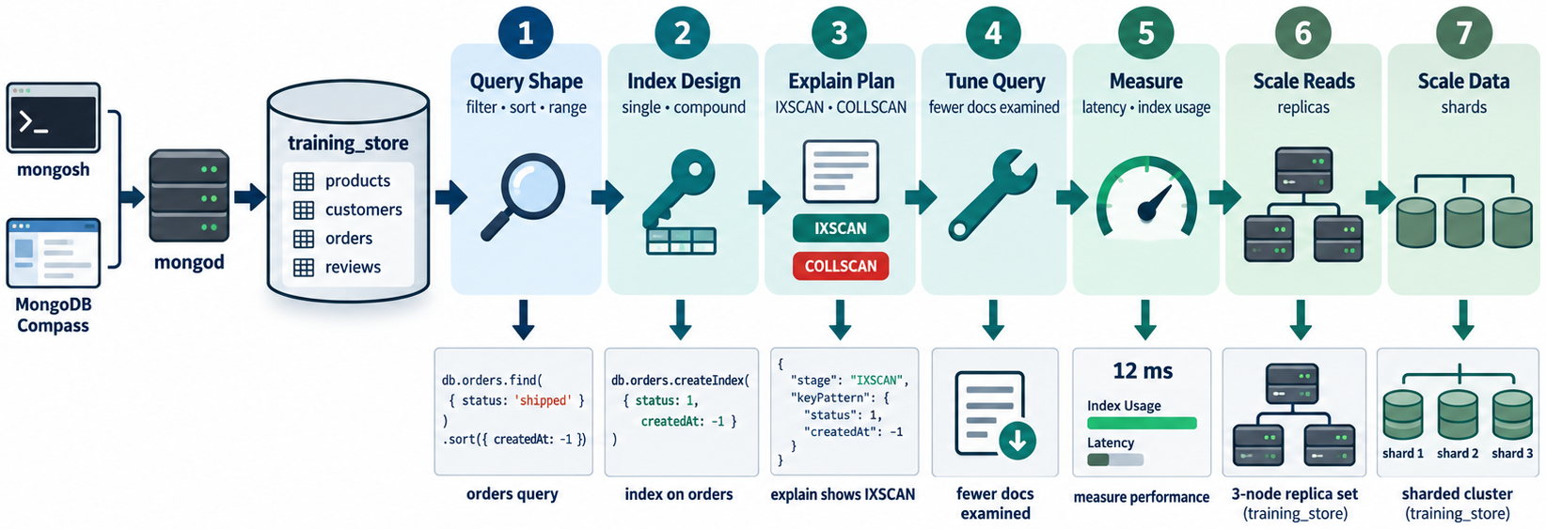
DAY 3 PATH — FROM QUERY SHAPE TO SCALE
MODULE 6
📌
KEY POINTS
• Index the recurring shape
• Prove it with explain
• Watch write and storage cost
• Next: replica sets and sharding
166
© 2026 by Innovation In Software Corporation
Notes:
This slide includes a diagram — Day 3 Path — From Query Shape to Scale.
The slide title is: Day 3 Path — From Query Shape to Scale.
The slide says: <div class="cols">.
The slide says: <div class="col-text">.
The slide says: </div>.
The slide says: <div class="col-visual">.
Bullet 1 on the slide: Index the recurring shape.
Bullet 2 on the slide: Prove it with explain.
Bullet 3 on the slide: Watch write and storage cost.
Bullet 4 on the slide: Next: replica sets and sharding.
The figure on this slide is titled: Path from indexing into Module 7.

Slide 168
TRANSITION TO MODULE 7: REPLICATION AND SHARDING
MODULE 6
🧭
KEY POINTS
Module 7 moves from individual query performance to distributed availability and scale:
• Replica-set architecture
• Primary and secondary members
• Elections and automatic failover
• Read and write concerns
• Sharding architecture and shard keys
• Routers and configuration servers
• Balancing and data distribution
• Replication versus sharding
• High-availability and scaling decisions
Hashed indexes you saw today reappear as hashed shard keys.
167
© 2026 by Innovation In Software Corporation
Notes:
This slide lists key points under Transition to Module 7: Replication and Sharding.
The slide title is: Transition to Module 7: Replication and Sharding.
The slide says: Module 7 moves from individual query performance to distributed availability and scale:.
The slide says: Hashed indexes you saw today reappear as hashed shard keys.
Bullet 1 on the slide: Replica-set architecture.
Bullet 2 on the slide: Primary and secondary members.
Bullet 3 on the slide: Elections and automatic failover.
Bullet 4 on the slide: Read and write concerns.
Bullet 5 on the slide: Sharding architecture and shard keys.
Bullet 6 on the slide: Routers and configuration servers.
Bullet 7 on the slide: Balancing and data distribution.
Bullet 8 on the slide: Replication versus sharding.
Bullet 9 on the slide: High-availability and scaling decisions.

