Slide 1
MODULE 8
MongoDB Best Practices, Security, and Troubleshooting
A database is not production-ready merely because it accepts queries
Data Modeling Guidelines
Performance & Indexing
Security Considerations
Backups & Troubleshooting
Production Readiness
MASTERING MONGODB • MODULE 8
Notes:
The slide title is: MongoDB Best Practices, Security, and Troubleshooting.
The slide says: A database is not production-ready merely because it accepts queries.

Slide 2
MODULE LEARNING OBJECTIVES
MODULE 8
🎯
YOU WILL BE ABLE TO
• Review MongoDB solutions systematically
• Recognize design and operational risks
• Protect databases and credentials
• Monitor health and performance
• Troubleshoot common problems
• Verify recovery capabilities
• Make controlled production changes
• Establish an improvement plan
1
© 2026 by Innovation In Software Corporation
Notes:
This slide lists key points under Module Learning Objectives.
The slide title is: Module Learning Objectives.
The slide says: Participants will learn to:.
Bullet 1 on the slide: Review MongoDB solutions systematically.
Bullet 2 on the slide: Recognize design and operational risks.
Bullet 3 on the slide: Protect databases and credentials.
Bullet 4 on the slide: Monitor health and performance.
Bullet 5 on the slide: Troubleshoot common problems.
Bullet 6 on the slide: Verify recovery capabilities.
Bullet 7 on the slide: Make controlled production changes.
Bullet 8 on the slide: Establish an improvement plan.

Slide 3
INTRODUCTION
MODULE 8
📌
KEY POINTS
This module brings together data modeling, querying, aggregation, indexing, security and operations.
A production-ready MongoDB solution should be:
• Correct for the application’s access patterns
• Efficient at expected data volumes
• Secure by default
• Observable and recoverable
• Resilient to application and infrastructure failures
• Maintainable as requirements evolve
2
© 2026 by Innovation In Software Corporation
Notes:
This module brings together data modeling, querying, aggregation, indexing, security and operations.

Slide 4
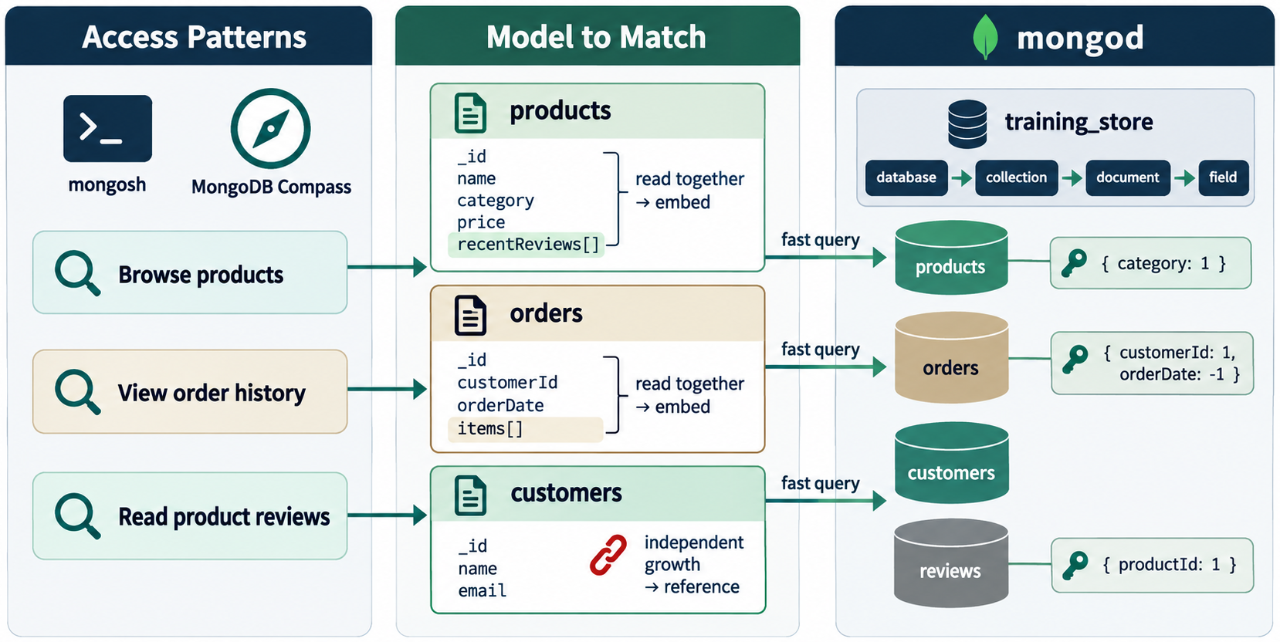
MODEL AROUND ACCESS PATTERNS
MODULE 8
📌
KEY POINTS
MongoDB’s flexible schema allows documents to evolve, but flexibility should be governed by explicit design rules.
Start with the application’s most important operations:
• What data is read together?
• What data is updated together?
• Which queries run most often?
• Which operations are latency-sensitive?
• How large can each relationship become?
• Which information must remain historically accurate?
For training_store, an order can embed its purchased items:
3
© 2026 by Innovation In Software Corporation
Notes:
Start with the application’s most important operations:

Slide 5
MODEL AROUND ACCESS PATTERNS (CONT.)
MODULE 8
📌
KEY POINTS
This is appropriate because order items:
• Belong to one order
• Are normally retrieved with the order
• Form a bounded group
• Must preserve historical product and price information
{
orderNumber: "ORD-2026-1001",
customerId: ObjectId("..."),
items: [
{
productId: ObjectId("..."),
sku: "ELEC-1001",
productName: "Wireless Mouse",
unitPrice: NumberDecimal("39.99"),
quantity: 2,
lineTotal: NumberDecimal("79.98")
}
],
total: NumberDecimal("90.38"),
status: "Delivered"
}
4
© 2026 by Innovation In Software Corporation
Notes:
This is appropriate because order items:

Slide 6
EMBED BOUNDED, OWNED INFORMATION
MODULE 8
📌
KEY POINTS
Embedding works well when related data:
• Belongs to one parent
• Is normally accessed with the parent
• Has a practical size limit
• Is updated with the parent
• Benefits from single-document atomicity
Examples:
• Order items inside an order
• Shipping address snapshot inside an order
• A small number of addresses inside a customer
• Product specifications inside a product
5
© 2026 by Innovation In Software Corporation
Notes:
Embedding works well when related data:

Slide 7
REFERENCE INDEPENDENT OR UNBOUNDED INFORMATION
MODULE 8
📌
KEY POINTS
Referencing is generally better when related data:
• Grows without a practical limit
• Is shared among many documents
• Changes independently
• Must be queried separately
• Would make the parent document excessively large
Product reviews should normally be independent documents:
Avoid placing every review in the product:
{
productId: ObjectId("..."),
customerId: ObjectId("..."),
rating: 5,
comment: "Excellent product.",
createdAt: new Date()
}
6
© 2026 by Innovation In Software Corporation
Notes:
Referencing is generally better when related data:

Slide 8
REFERENCE INDEPENDENT OR UNBOUNDED INFORMATION (CONT.)
MODULE 8
📌
KEY POINTS
MongoDB identifies unbounded arrays as a schema anti-pattern because they can produce oversized documents and reduce performance.
{
name: "Wireless Mouse",
reviews: [
// Potentially millions of reviews
]
}
7
© 2026 by Innovation In Software Corporation
Notes:
MongoDB identifies unbounded arrays as a schema anti-pattern because they can produce oversized documents and reduce performance.

Slide 9
KEEP DOCUMENTS FOCUSED
MODULE 8
📌
KEY POINTS
A document should contain information commonly used together.
Avoid bloated documents containing:
• Large fields rarely returned
• Unbounded event histories
• Repeated copies of unrelated records
• Large binary objects that most queries do not need
Large documents can reduce working-set efficiency and increase disk access. Separating information that is not commonly retrieved together can improve performance.
8
© 2026 by Innovation In Software Corporation
Notes:
A document should contain information commonly used together.

Slide 10
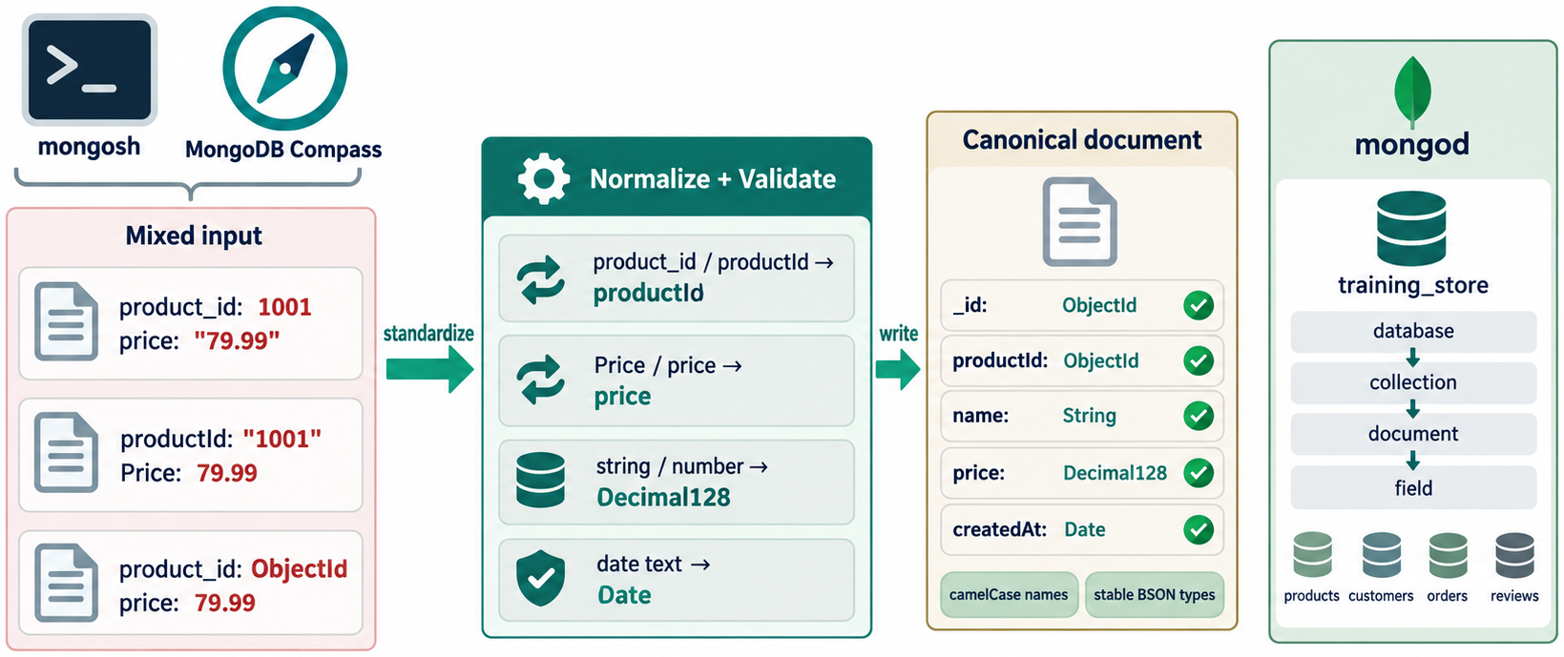
USE CONSISTENT FIELD NAMES
MODULE 8
📌
KEY POINTS
Avoid several names for the same concept:
Choose and enforce one:
A common convention is:
{ customerId: ObjectId("...") }
{ customer_id: ObjectId("...") }
{ custId: ObjectId("...") }
{
customerId: ObjectId("...")
}
9
© 2026 by Innovation In Software Corporation
Notes:
Avoid several names for the same concept:

Slide 11
USE CONSISTENT FIELD NAMES (CONT.)
MODULE 8
Collections: plural nouns
Fields: camelCase
Booleans: active, verifiedPurchase, emailConfirmed
Dates: createdAt, updatedAt, orderedAt
References: customerId, productId
10
© 2026 by Innovation In Software Corporation
Notes:
Covers Use consistent field names.

Slide 12
USE CONSISTENT BSON TYPES
MODULE 8
📌
KEY POINTS
Poor consistency:
Preferred:
Recommended examples:
{ price: "39.99" }
{ price: 39.99 }
{ price: NumberDecimal("39.99") }
{
price: NumberDecimal("39.99")
}
11
© 2026 by Innovation In Software Corporation
Notes:
Poor consistency:

Slide 13
USE CONSISTENT BSON TYPES (CONT.)
MODULE 8
Business value | Suitable type
Monetary amount | Decimal128
Timestamp | BSON Date
Count or quantity | Integer
Identifier | ObjectId or consistently defined key
Status flag | Boolean
Multiple values | Array
Structured sub-object | Embedded document
12
© 2026 by Innovation In Software Corporation
Notes:
Covers Use consistent BSON types.

Slide 14
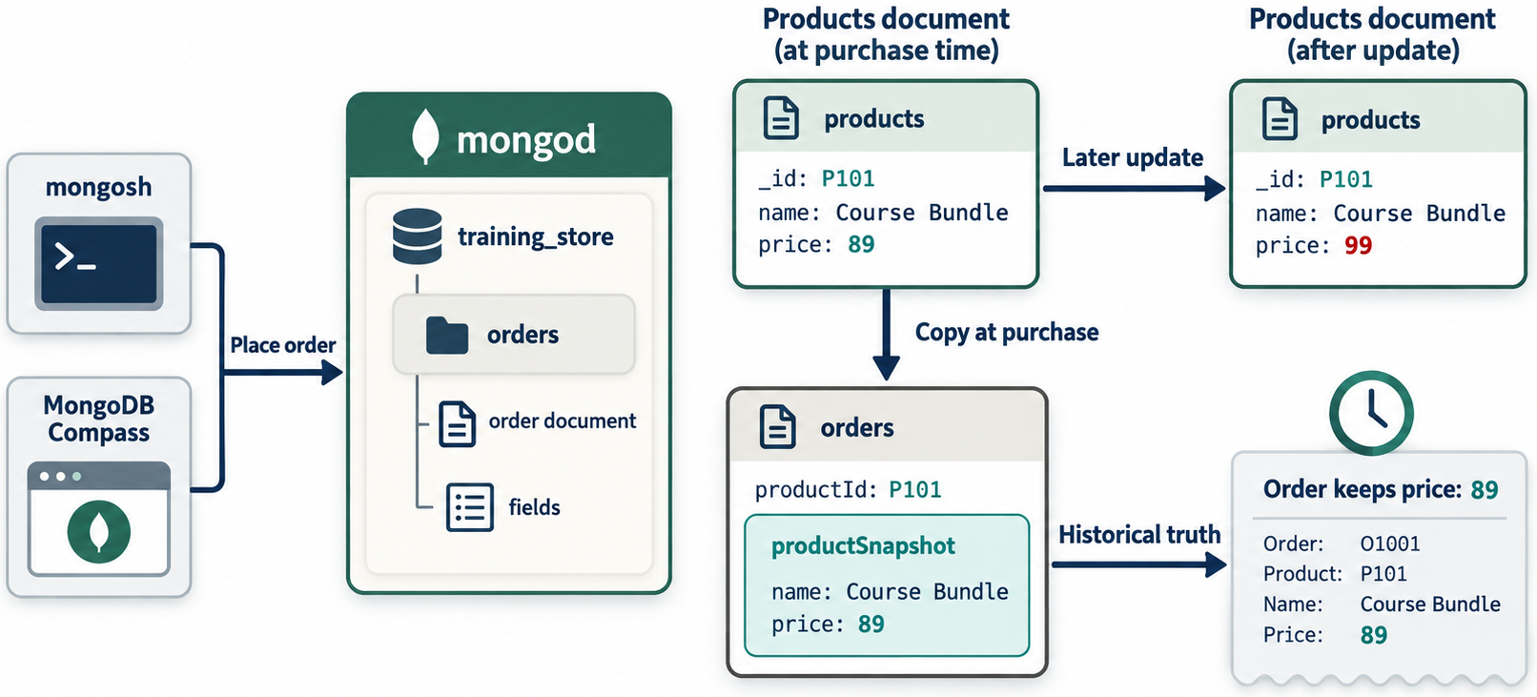
PRESERVE HISTORICAL SNAPSHOTS
MODULE 8
📌
KEY POINTS
An order should preserve the information applicable when it was placed.
If the current product is renamed or repriced, the historical order remains accurate.
This is intentional duplication, not accidental inconsistency.
{
items: [
{
productId: ObjectId("..."),
productName: "Wireless Mouse",
unitPrice: NumberDecimal("39.99")
}
]
}
13
© 2026 by Innovation In Software Corporation
Notes:
An order should preserve the information applicable when it was placed.

Slide 15
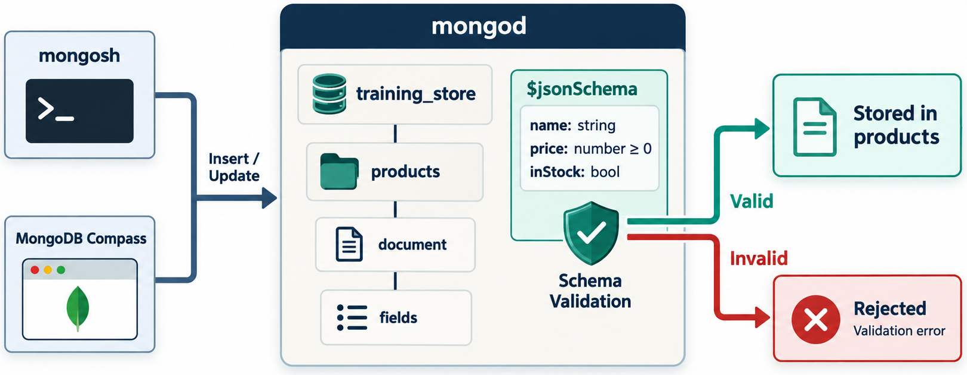
USE SCHEMA VALIDATION
MODULE 8
📌
KEY POINTS
MongoDB’s flexible model can still enforce essential business rules.
Example validator for products:
14
© 2026 by Innovation In Software Corporation
Notes:
MongoDB’s flexible model can still enforce essential business rules.

Slide 16
USE SCHEMA VALIDATION (CONT.)
MODULE 8
db.createCollection("validated_products", {
validator: {
$jsonSchema: {
bsonType: "object",
required: [
"sku",
"name",
"category",
"price",
"stock",
"active"
],
properties: {
sku: {
bsonType: "string",
description: "SKU must be a string"
},
name: {
bsonType: "string",
minLength: 1
},
category: {
bsonType: "string"
},
price: {
bsonType: "decimal",
minimum: NumberDecimal("0")
},
stock: {
bsonType: [
"int",
"long"
],
minimum: 0
},
active: {
bsonType: "bool"
},
tags: {
bsonType: "array",
items: {
bsonType: "string"
}
}
}
}
},
validationLevel: "strict",
validationAction: "error"
})
15
© 2026 by Innovation In Software Corporation
Notes:
Covers Use Schema Validation.

Slide 17
USE SCHEMA VALIDATION (CONT.)
MODULE 8
📌
KEY POINTS
Schema-validation rules can cover only the fields the application needs to control; they do not necessarily need to define every possible field.
Use validation for:
• Required fields
• Data types
• Allowed enumerations
• Numeric ranges
• Nested structures
• Application invariants
Validation should complement—not replace—application validation.
16
© 2026 by Innovation In Software Corporation
Notes:
Schema-validation rules can cover only the fields the application needs to control; they do not necessarily need to define every possible field.

Slide 18
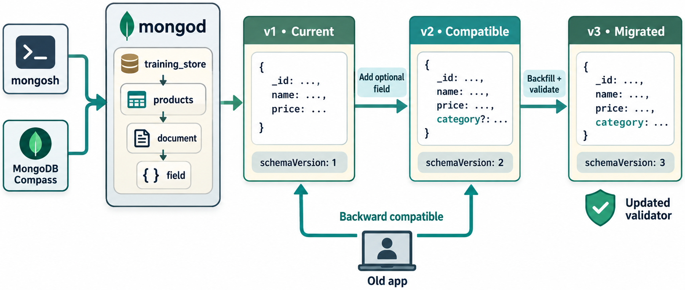
PLAN FOR SCHEMA EVOLUTION
MODULE 8
📌
KEY POINTS
Production schemas change over time.
Suppose version 1 uses:
Version 2 adds:
Useful migration approaches include:
{
name: "Wireless Mouse",
price: NumberDecimal("39.99")
}
{
schemaVersion: 2,
active: true,
pricing: {
amount: NumberDecimal("39.99"),
currency: "CAD"
}
}
17
© 2026 by Innovation In Software Corporation
Notes:
Production schemas change over time.

Slide 19
PLAN FOR SCHEMA EVOLUTION (CONT.)
MODULE 8
📌
KEY POINTS
• Background batch migration
• Migration during deployment
• Read-old/write-new application logic
• Lazy migration when a document is accessed
• Explicit schema-version fields
• Temporary compatibility with both formats
Migration process:
1. Add application support for both formats.
2. Begin writing the new format.
3. Migrate existing documents in controlled batches.
4. Measure progress and failures.
5. Add or update validation rules.
6. Remove obsolete compatibility code after verification.
Avoid applying a massive untested update to a production collection.
18
© 2026 by Innovation In Software Corporation
Notes:
Migration process:

Slide 20
PERFORMANCE OPTIMIZATION TECHNIQUES
MODULE 8
📊
KEY POINTS
Performance tuning should follow evidence:
Do not begin by creating many speculative indexes.
Observe → Measure → Diagnose → Change → Measure again
19
© 2026 by Innovation In Software Corporation
Notes:
Performance tuning should follow evidence:

Slide 21
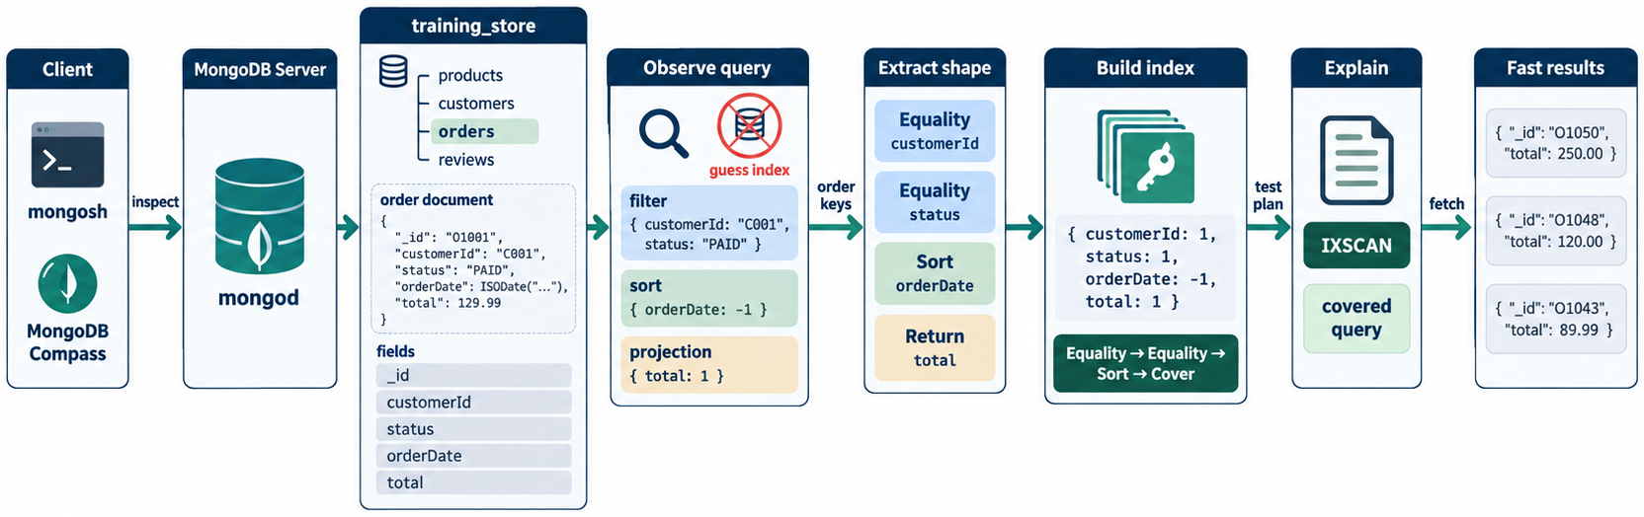
UNDERSTAND QUERY SHAPES
MODULE 8
📌
KEY POINTS
A query shape includes:
• Filter fields
• Operators
• Sort fields
• Projection
• Collation
• Limit
• Aggregation stages
Example:
Potential index:
db.orders.find(
{
customerId: customerId,
status: "Completed"
},
{
orderNumber: 1,
total: 1,
orderedAt: 1
}
).sort({
orderedAt: -1
}).limit(20)
db.orders.createIndex({
customerId: 1,
status: 1,
orderedAt: -1
})
20
© 2026 by Innovation In Software Corporation
Notes:
A query shape includes:

Slide 22
FILTER EARLY
MODULE 8
📌
KEY POINTS
In aggregation pipelines, place selective $match stages early when logically possible:
Filtering before $unwind reduces the number of documents and array elements processed downstream.
db.orders.aggregate([
{
$match: {
status: "Delivered",
orderedAt: {
$gte: ISODate("2026-09-01T00:00:00Z")
}
}
},
{
$unwind: "$items"
},
{
$group: {
_id: "$items.productId",
unitsSold: {
$sum: "$items.quantity"
}
}
}
])
21
© 2026 by Innovation In Software Corporation
Notes:
In aggregation pipelines, place selective `$match` stages early when logically possible:

Slide 23
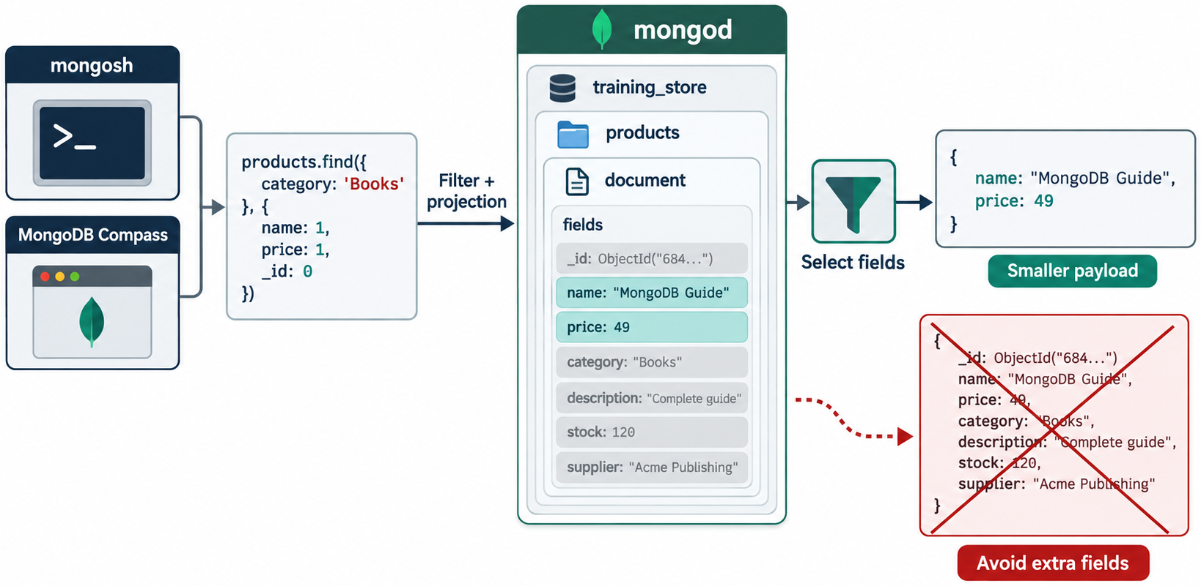
PROJECT ONLY NEEDED FIELDS
MODULE 8
📌
KEY POINTS
For application queries:
This reduces unnecessary network transfer and application processing.
Within aggregation, early projection may help when it removes very large fields, although MongoDB can optimize straightforward field dependencies automatically.
db.products.find(
{
category: "Electronics"
},
{
_id: 0,
sku: 1,
name: 1,
price: 1
}
)
22
© 2026 by Innovation In Software Corporation
Notes:
For application queries:

Slide 24
LIMIT RESULTS
MODULE 8
📌
KEY POINTS
Avoid returning an unbounded result set:
Use pagination for user-facing lists.
For large datasets, range-based pagination is often more scalable than large $skip values.
db.orders.find({
customerId: customerId
}).sort({
orderedAt: -1
}).limit(25)
db.orders.find({
customerId: customerId,
orderedAt: {
$lt: lastSeenDate
}
}).sort({
orderedAt: -1,
_id: -1
}).limit(25)
23
© 2026 by Innovation In Software Corporation
Notes:
Avoid returning an unbounded result set:

Slide 25
USE BULK OPERATIONS
MODULE 8
📌
KEY POINTS
Instead of sending many individual writes:
Bulk operations can reduce client-server round trips.
db.products.bulkWrite([
{
updateOne: {
filter: {
sku: "ELEC-1001"
},
update: {
$inc: {
stock: 10
}
}
}
},
{
updateOne: {
filter: {
sku: "ELEC-1002"
},
update: {
$inc: {
stock: 20
}
}
}
}
])
24
© 2026 by Innovation In Software Corporation
Notes:
Instead of sending many individual writes:

Slide 26
USE ATOMIC OPERATORS
MODULE 8
📌
KEY POINTS
Prefer:
This is safer than:
1. Reading the stock into the application
2. Calculating a new value
3. Writing it back separately
The guarded filter prevents stock from falling below zero in this operation.
db.products.updateOne(
{
sku: "ELEC-1001",
stock: {
$gte: 2
}
},
{
$inc: {
stock: -2
}
}
)
25
© 2026 by Innovation In Software Corporation
Notes:
Prefer:

Slide 27
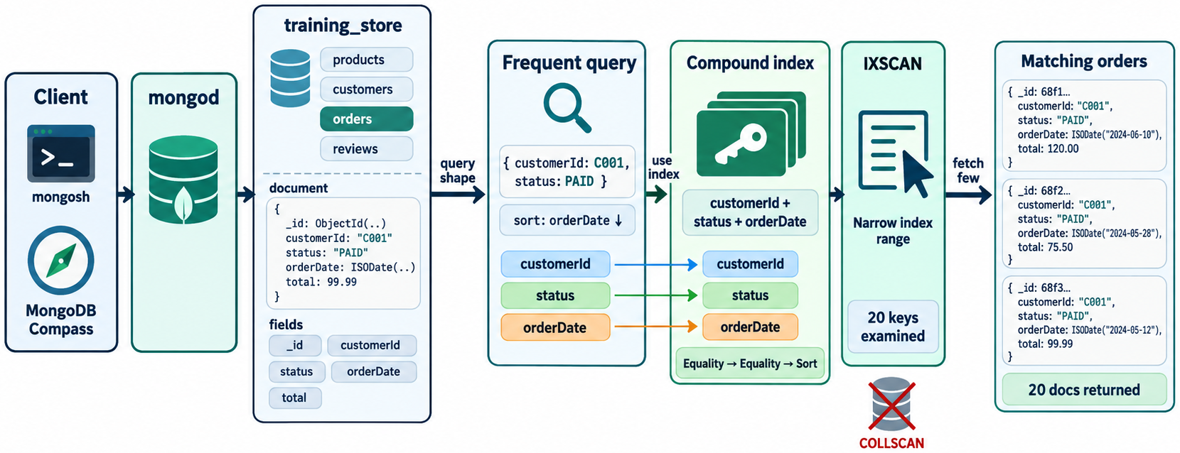
INDEX IMPORTANT QUERIES
MODULE 8
📌
KEY POINTS
Create indexes for frequent, important query patterns:
db.products.createIndex(
{
sku: 1
},
{
unique: true
}
)
db.products.createIndex({
category: 1,
price: 1
})
db.orders.createIndex({
customerId: 1,
orderedAt: -1
})
db.reviews.createIndex({
productId: 1,
createdAt: -1
})
26
© 2026 by Innovation In Software Corporation
Notes:
Create indexes for frequent, important query patterns:

Slide 28
FOLLOW COMPOUND-INDEX FIELD ORDER CAREFULLY
MODULE 8
📌
KEY POINTS
For many workloads, begin with:
1. Equality fields
2. Sort fields
3. Range fields
Example query:
A candidate index might be:
db.orders.find({
status: "Completed",
orderedAt: {
$gte: ISODate("2026-09-01T00:00:00Z")
}
}).sort({
total: -1
})
db.orders.createIndex({
status: 1,
total: -1,
orderedAt: 1
})
27
© 2026 by Innovation In Software Corporation
Notes:
For many workloads, begin with:

Slide 29
FOLLOW COMPOUND-INDEX FIELD ORDER CAREFULLY (CONT.)
MODULE 8
📌
KEY POINTS
Whether this is best depends on:
• Date selectivity
• Importance of avoiding an in-memory sort
• Distribution of statuses
• Result size
• Frequency of the query
Validate it with realistic data and explain().
28
© 2026 by Innovation In Software Corporation
Notes:
Whether this is best depends on:

Slide 30
AVOID EXCESSIVE INDEXING
MODULE 8
📌
KEY POINTS
Each index:
• Uses storage
• Consumes cache
• Adds insert cost
• Adds update cost
• Adds delete cost
• Increases operational complexity
Before creating an index, identify the query it serves.
Before dropping one, hide and test it where appropriate.
29
© 2026 by Innovation In Software Corporation
Notes:
Each index:

Slide 31
MEASURE WITH EXPLAIN()
MODULE 8
📊
KEY POINTS
Use:
For aggregation:
Review:
• winningPlan
• nReturned
• totalDocsExamined
• totalKeysExamined
• executionTimeMillis
• Collection scan versus index scan
• Blocking sorts
• Index bounds
db.orders.find({
status: "Completed"
}).explain("executionStats")
db.orders.explain(
"executionStats"
).aggregate([
{
$match: {
status: "Completed"
}
}
])
30
© 2026 by Innovation In Software Corporation
Notes:
Use:

Slide 32
MEASURE WITH EXPLAIN() (CONT.)
MODULE 8
📊
KEY POINTS
A high documents-examined-to-documents-returned ratio can indicate an inefficient query or missing index.
31
© 2026 by Innovation In Software Corporation
Notes:
A high documents-examined-to-documents-returned ratio can indicate an inefficient query or missing index.

Slide 33
TYPICAL STAGES
MODULE 8
📌
KEY POINTS
Stage | Meaning
COLLSCAN | Collection scan
IXSCAN | Index scan
FETCH | Retrieve full documents
SORT | Sort results
GROUP | Group documents
PROJECTION | Reshape output
A collection scan is not automatically wrong. It may be appropriate when:
• The collection is small
• Most documents must be returned
• The operation is an occasional administrative task
• An index would not be selective
32
© 2026 by Innovation In Software Corporation
Notes:
A collection scan is not automatically wrong. It may be appropriate when:

Slide 34
MONITOR SLOW OPERATIONS
MODULE 8
📊
KEY POINTS
Potential tools include:
• MongoDB diagnostic logs
• Database profiler
• Atlas Query Profiler
• Atlas Performance Advisor
• MongoDB Compass explain plans
• Application performance monitoring
• Driver command monitoring
MongoDB’s diagnostic logs record slow operations, while its profiler and Atlas tools help identify inefficient query patterns.
33
© 2026 by Innovation In Software Corporation
Notes:
Potential tools include:

Slide 35
DATABASE PROFILER CAUTION
MODULE 8
⚠️
KEY POINTS
Profiling can add overhead, especially at aggressive settings. MongoDB warns that the database profiler can degrade performance.
Enable it deliberately and with an appropriate threshold or filter:
Check the current configuration:
Return to disabled profiling:
db.setProfilingLevel(
1,
{
slowms: 200,
sampleRate: 0.2
}
)
db.getProfilingStatus()
34
© 2026 by Innovation In Software Corporation
Notes:
Profiling can add overhead, especially at aggressive settings. MongoDB warns that the database profiler can degrade performance.

Slide 36
DATABASE PROFILER CAUTION (CONT.)
MODULE 8
⚠️
KEY POINTS
Profiler behavior and performance impact should be evaluated before use on a busy production system.
db.setProfilingLevel(0)
35
© 2026 by Innovation In Software Corporation
Notes:
Profiler behavior and performance impact should be evaluated before use on a busy production system.

Slide 37
RESOURCE AND CAPACITY OPTIMIZATION
MODULE 8
📌
KEY POINTS
Monitor at least:
• CPU utilization
• Memory utilization
• Disk latency and throughput
• Available disk space
• Network throughput
• Connection count
• Query latency
• Replication lag
• Oplog window
• Cache pressure
• Page faults
• Active operations
• Shard balance
• Chunk migrations
36
© 2026 by Innovation In Software Corporation
Notes:
Monitor at least:

Slide 38
WORKING SET
MODULE 8
📌
KEY POINTS
The working set is the data and index information actively used by the workload.
If the active working set does not fit efficiently in memory, MongoDB must perform more disk I/O, increasing latency.
Possible responses include:
• Improve indexes
• Reduce unnecessary data retrieval
• Archive cold data
• Remodel large documents
• Increase memory
• Separate workloads
• Scale horizontally when justified
37
© 2026 by Innovation In Software Corporation
Notes:
The working set is the data and index information actively used by the workload.

Slide 39
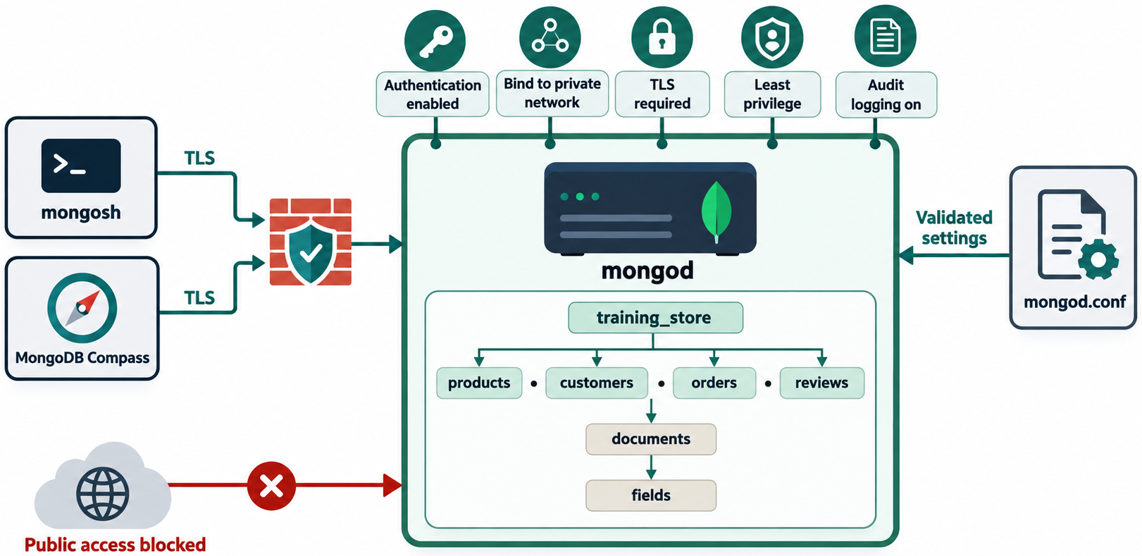
SECURITY CONSIDERATIONS
MODULE 8
📌
KEY POINTS
MongoDB should not be exposed to an untrusted network without appropriate controls.
A secure deployment uses multiple layers:
MongoDB’s self-managed security checklist emphasizes authentication, TLS and restricted network exposure.
Network controls
+
TLS encryption
+
Authentication
+
Authorization
+
Encryption at rest
+
Auditing and monitoring
+
Backups and recovery
38
© 2026 by Innovation In Software Corporation
Notes:
MongoDB should not be exposed to an untrusted network without appropriate controls.

Slide 40
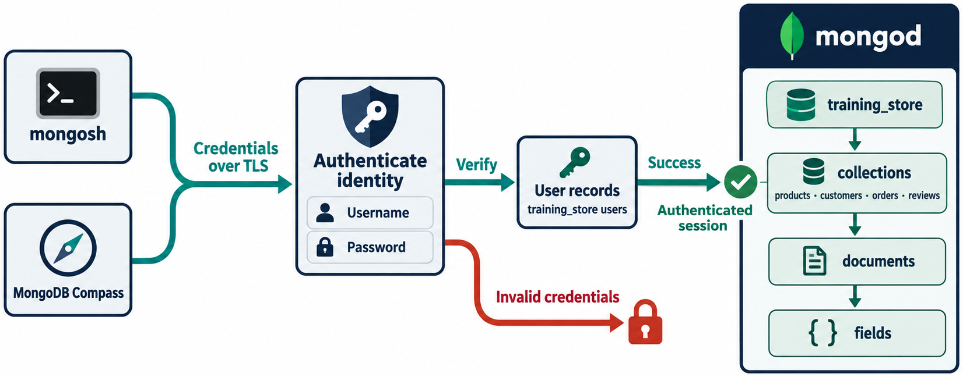
ENABLE AUTHENTICATION
MODULE 8
📌
KEY POINTS
Authentication answers:
Never rely only on network location as proof of identity.
For a self-managed deployment, authorization must be enabled through the MongoDB security configuration.
Conceptual configuration:
security:
authorization: enabled
KEY TAKEAWAY Who is connecting?
39
© 2026 by Innovation In Software Corporation
Notes:
Authentication answers:

Slide 41
ENABLE AUTHENTICATION (CONT.)
MODULE 8
📌
KEY POINTS
MongoDB documents security.authorization as the setting that enables authorization.
Create administrative users before enforcing authentication according to the supported deployment procedure.
40
© 2026 by Innovation In Software Corporation
Notes:
MongoDB documents `security.authorization` as the setting that enables authorization.

Slide 42
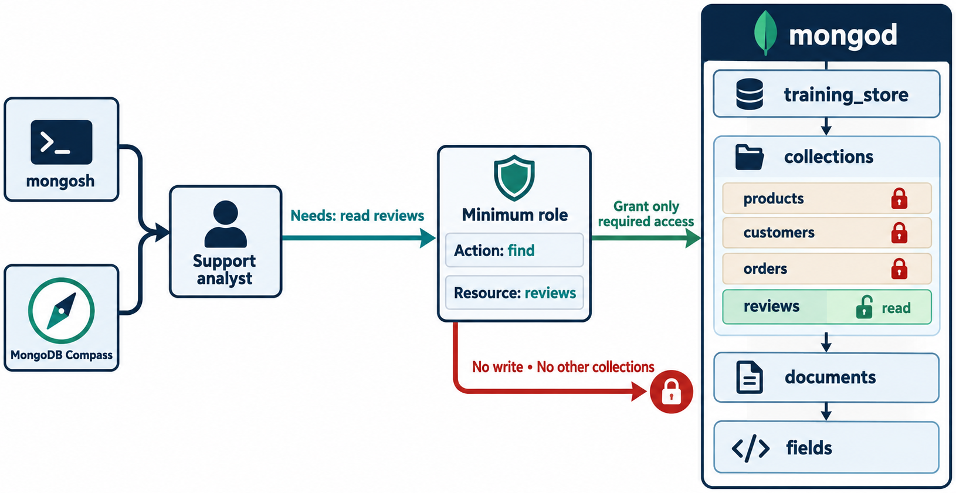
APPLY LEAST PRIVILEGE
MODULE 8
📌
KEY POINTS
Authorization answers:
Create role-appropriate accounts:
• Application read/write user
• Reporting read-only user
• Backup operator
• Monitoring user
• Database administrator
Example application user:
use training_store
db.createUser({
user: "trainingStoreApp",
pwd: passwordPrompt(),
roles: [
{
role: "readWrite",
db: "training_store"
}
]
})
KEY TAKEAWAY What may this identity do?
41
© 2026 by Innovation In Software Corporation
Notes:
Authorization answers:

Slide 43
APPLY LEAST PRIVILEGE (CONT.)
MODULE 8
📌
KEY POINTS
Avoid giving an application broad administrative privileges.
Use separate identities for:
• Applications
• Developers
• Administrators
• Automated jobs
• Monitoring systems
42
© 2026 by Innovation In Software Corporation
Notes:
Avoid giving an application broad administrative privileges.

Slide 44
PROTECT CREDENTIALS
MODULE 8
📌
KEY POINTS
Do not place credentials directly in:
• Source code
• Git repositories
• Container images
• Shared screenshots
• Course materials
• Shell-history commands
• Unprotected configuration files
Use:
• Environment-specific secret stores
• Cloud secret-management services
• Kubernetes Secrets with appropriate protection
• Rotated credentials
• Short-lived authentication when supported
• Restricted service accounts
A connection string should be treated as sensitive:
43
© 2026 by Innovation In Software Corporation
Notes:
Do not place credentials directly in:

Slide 45
PROTECT CREDENTIALS (CONT.)
MODULE 8
mongodb+srv://username:<password>@cluster.example.net/
44
© 2026 by Innovation In Software Corporation
Notes:
Covers Protect credentials.

Slide 46
ENCRYPT TRAFFIC WITH TLS
MODULE 8
📌
KEY POINTS
TLS protects data in transit between:
• Applications and MongoDB
• Administrative tools and MongoDB
• Replica-set members
• Sharded-cluster components
MongoDB supports TLS for encrypting network traffic.
Production clients should:
• Validate the server certificate
• Use trusted certificate authorities
• Avoid disabling certificate validation
• Protect private keys
• Rotate expiring certificates
45
© 2026 by Innovation In Software Corporation
Notes:
TLS protects data in transit between:

Slide 47
RESTRICT NETWORK EXPOSURE
MODULE 8
📌
KEY POINTS
Use:
• Private networks
• Firewalls
• Security groups
• Atlas IP access lists
• Private endpoints where appropriate
• Restricted bindIp settings
• Segmented administrative access
• VPN or controlled bastion access
Do not expose port 27017 broadly to the public internet.
bindIp controls the interfaces on which a self-managed MongoDB process listens.
46
© 2026 by Innovation In Software Corporation
Notes:
Use:

Slide 48
PROTECT DATA AT REST
MODULE 8
📌
KEY POINTS
Depending on the deployment, use:
• Encrypted storage volumes
• Cloud-provider encryption
• MongoDB-supported encryption features
• Key-management systems
• Client-side field-level protection for sensitive fields where appropriate
Highly sensitive data might include:
• Government identifiers
• Payment-related information
• Medical information
• Authentication secrets
• Private customer information
Passwords should not be stored as plain text. Application passwords require an appropriate password-hashing design; encryption is not a substitute for secure password hashing.
47
© 2026 by Innovation In Software Corporation
Notes:
Depending on the deployment, use:

Slide 49
AUDIT IMPORTANT ACTIVITY
MODULE 8
📌
KEY POINTS
Security monitoring should detect:
• Failed authentication attempts
• Privilege changes
• User creation
• Unusual exports
• Unexpected schema or index changes
• Large deletions
• Configuration changes
• Access from unusual locations
Audit capabilities vary by MongoDB edition and deployment model. Application-level audit events may also be necessary.
48
© 2026 by Innovation In Software Corporation
Notes:
Security monitoring should detect:

Slide 50
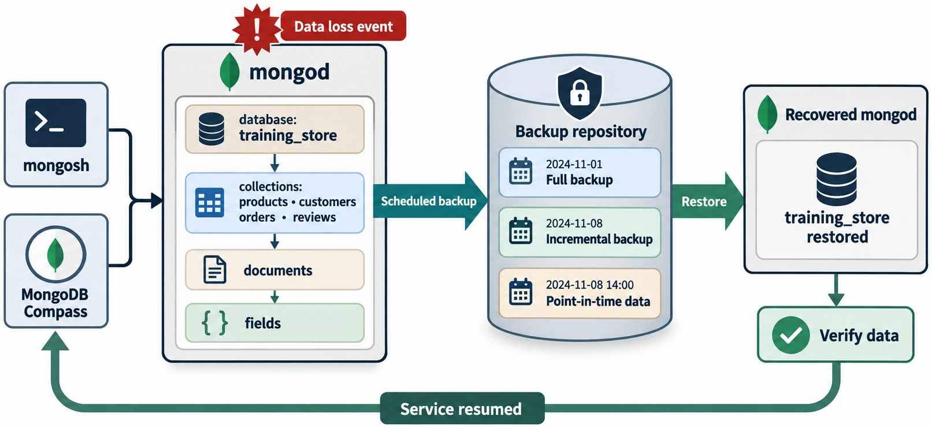
BACKUPS AND RECOVERY
MODULE 8
📌
KEY POINTS
Replication is not a backup.
An accidental deletion is replicated:
A recovery plan should define:
• Backup frequency
• Retention period
• Encryption
• Offsite or separate-account storage
• Point-in-time recovery requirements
• Restore procedures
• Restore testing
• Recovery time objective
• Recovery point objective
db.orders.deleteMany({})
49
© 2026 by Innovation In Software Corporation
Notes:
Replication is not a backup.

Slide 51
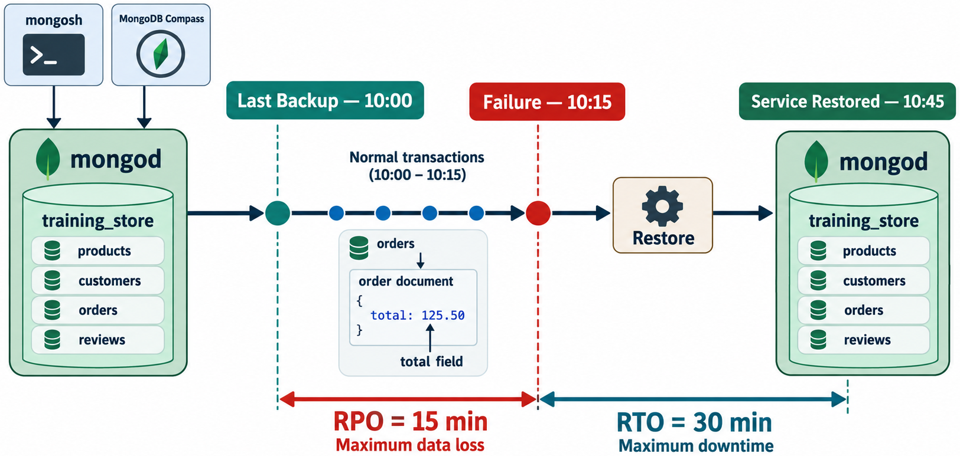
RECOVERY OBJECTIVES
MODULE 8
📌
KEY POINTS
Recovery Point Objective (RPO) asks:
Recovery Time Objective (RTO) asks:
Backups are useful only if restoration works. Schedule restoration exercises rather than assuming backups are valid.
KEY TAKEAWAY How much data loss is acceptable?
50
© 2026 by Innovation In Software Corporation
Notes:
Backups are useful only if restoration works. Schedule restoration exercises rather than assuming backups are valid.

Slide 52
STEP 1: DEFINE THE SYMPTOM
MODULE 8
📌
KEY POINTS
Use a systematic process:
Avoid vague descriptions such as:
Prefer:
Symptom → Scope → Evidence → Layer → Cause → Fix → Verify
MongoDB is slow.
The customer order-history endpoint increased from
100 ms to 2.5 seconds after the September release.
51
© 2026 by Innovation In Software Corporation
Notes:
Avoid vague descriptions such as:

Slide 53
STEP 2: DETERMINE THE SCOPE
MODULE 8
📌
KEY POINTS
Ask:
• One query or all queries?
• One application instance or every instance?
• One collection or the complete database?
• One replica-set member or the entire cluster?
• Reads, writes or both?
• Continuous or intermittent?
• Started after a deployment?
• Related to data growth or traffic?
52
© 2026 by Innovation In Software Corporation
Notes:
Ask:

Slide 54
STEP 3: GATHER EVIDENCE
MODULE 8
📌
KEY POINTS
Collect:
• Application error and trace
• Timestamp and timezone
• Query shape
• explain() result
• MongoDB logs
• Driver logs
• Server metrics
• Replica-set status
• Current operations
• Recent schema and index changes
• Deployment changes
53
© 2026 by Innovation In Software Corporation
Notes:
Collect:

Slide 55
STEP 4: IDENTIFY THE LAYER
MODULE 8
Layer | Example issue
Application | Incorrect filter or unbounded result
Driver | Pool exhaustion or timeout
Network | DNS, firewall or TLS failure
Query | Collection scan or expensive sort
Schema | Unbounded array
Index | Missing or unsuitable compound index
Server | CPU, memory or disk pressure
Replication | Lag or election
Sharding | Scatter-gather or imbalance
Security | Authentication or authorization failure
54
© 2026 by Innovation In Software Corporation
Notes:
Covers Step 4: Identify the layer.

Slide 56
STEP 5: APPLY THE SMALLEST SAFE CORRECTION
MODULE 8
📌
KEY POINTS
Examples:
• Add a targeted index.
• Bound a query with a date range.
• Correct a connection-string option.
• Increase an undersized pool after measuring.
• Rewrite an unbounded array model.
• Fix a role rather than granting administrator access.
55
© 2026 by Innovation In Software Corporation
Notes:
Examples:

Slide 57
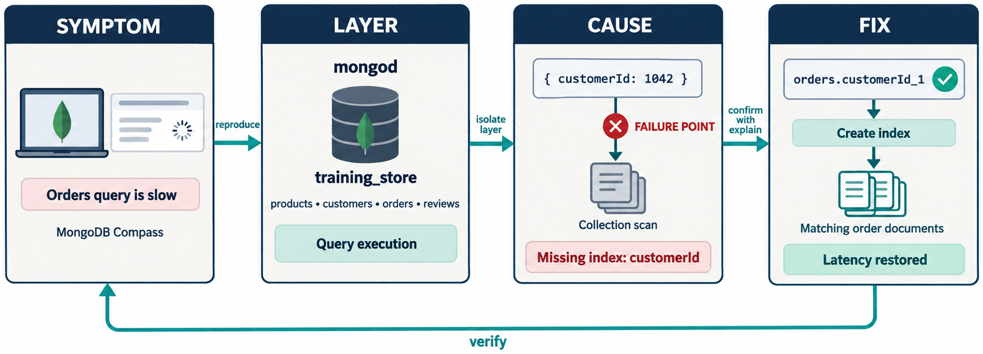
STEP 6: VERIFY
MODULE 8
📌
KEY POINTS
Repeat the same test and compare:
• Latency
• Documents examined
• Keys examined
• Error rate
• Resource usage
• Application behavior
56
© 2026 by Innovation In Software Corporation
Notes:
Repeat the same test and compare:

Slide 58
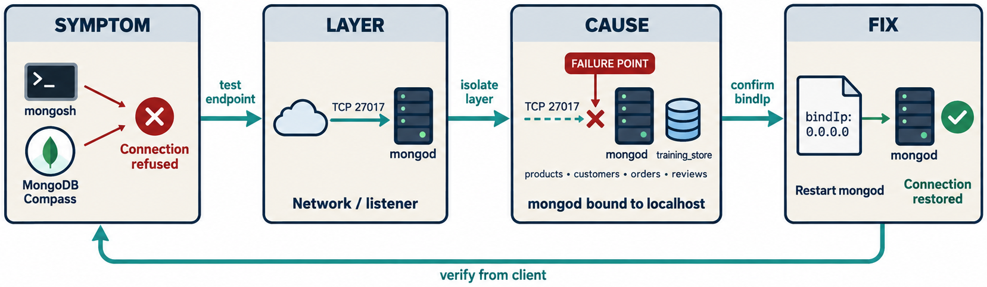
CONNECTION REFUSED
MODULE 8
📌
KEY POINTS
Possible causes:
• mongod is stopped.
• Incorrect host or port
• Firewall restriction
• bindIp restriction
• Container port not exposed
• DNS failure
Checks:
Operating-system checks may include service state and port connectivity.
db.hello()
57
© 2026 by Innovation In Software Corporation
Notes:
Possible causes:

Slide 59
AUTHENTICATION FAILED
MODULE 8
📌
KEY POINTS
Check:
• Username
• Password
• Authentication database
• Authentication mechanism
• Credential encoding
• Atlas database-user configuration
The database user may have been created in admin even though the application accesses training_store.
Example:
mongodb://user@host/training_store?authSource=admin
58
© 2026 by Innovation In Software Corporation
Notes:
Check:

Slide 60
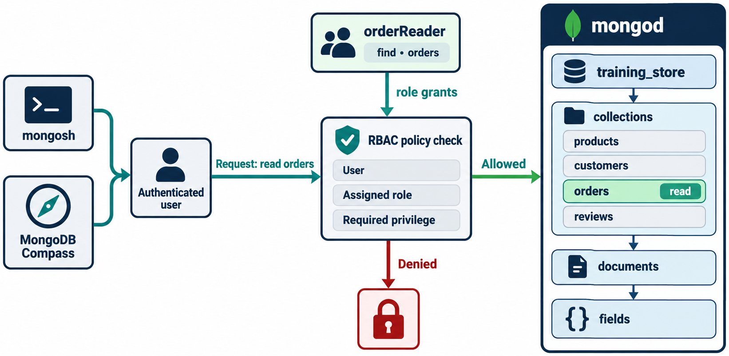
AUTHORIZATION FAILURE
MODULE 8
⚠️
KEY POINTS
Authentication succeeded, but the user lacks permission.
Inspect the current connection’s authenticated roles through appropriate administrative methods and grant only the required privilege.
Do not solve every authorization error by assigning root.
59
© 2026 by Innovation In Software Corporation
Notes:
Authentication succeeded, but the user lacks permission.

Slide 61
SLOW QUERY
MODULE 8
📌
KEY POINTS
Run:
Check for:
• COLLSCAN
• Large totalDocsExamined
• Large totalKeysExamined
• Blocking sort
• Low selectivity
• Excessive result count
db.orders.find({
customerId: customerId
}).sort({
orderedAt: -1
}).explain("executionStats")
60
© 2026 by Innovation In Software Corporation
Notes:
Run:

Slide 62
DUPLICATE-KEY ERROR
MODULE 8
📌
KEY POINTS
Typical code:
Likely causes:
• Duplicate _id
• Duplicate SKU
• Duplicate email
• Compound unique-index violation
Treat expected uniqueness conflicts as business outcomes where appropriate:
E11000
“This email is already registered.”
61
© 2026 by Innovation In Software Corporation
Notes:
Typical code:

Slide 63
DUPLICATE-KEY ERROR (CONT.)
MODULE 8
📌
KEY POINTS
Do not expose the raw database error to the user.
62
© 2026 by Innovation In Software Corporation
Notes:
Do not expose the raw database error to the user.

Slide 64
DOCUMENT-VALIDATION FAILURE
MODULE 8
⚠️
KEY POINTS
A failed schema rule may generate error code 121.
Possible causes:
• Missing required field
• Incorrect BSON type
• Value outside allowed range
• Invalid nested structure
Log the validation details securely and return a safe application-level message.
63
© 2026 by Innovation In Software Corporation
Notes:
A failed schema rule may generate error code `121`.

Slide 65
WRITE CONFLICT OR TRANSIENT TRANSACTION ERROR
MODULE 8
📌
KEY POINTS
Applications using transactions should follow the driver’s supported retry pattern.
Avoid blindly retrying every operation. A retry should be:
• Supported for that error type
• Bounded
• Observable
• Safe from duplicate side effects
• Designed for idempotency where possible
64
© 2026 by Innovation In Software Corporation
Notes:
Applications using transactions should follow the driver’s supported retry pattern.

Slide 66
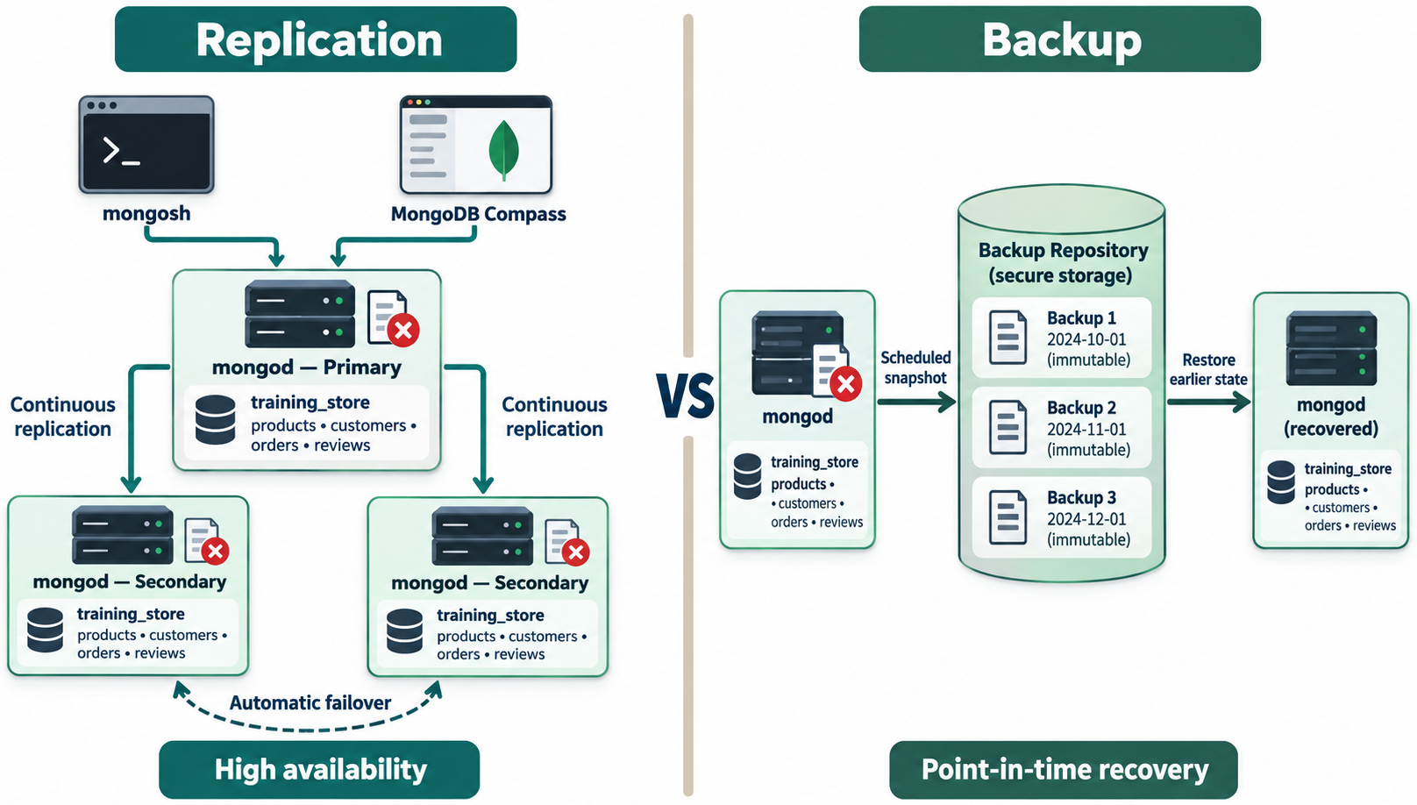
REPLICATION LAG
MODULE 8
📌
KEY POINTS
Check:
Possible causes:
• Slow secondary storage
• Network delay
• Heavy write volume
• Long-running operations
• Undersized oplog
• Resource saturation
rs.status()
65
© 2026 by Innovation In Software Corporation
Notes:
Check:

Slide 67
NO PRIMARY AVAILABLE
MODULE 8
📌
KEY POINTS
Possible causes:
• Election in progress
• Loss of voting majority
• Network partition
• Misconfigured replica set
• Multiple members unavailable
Check:
rs.status()
db.hello()
66
© 2026 by Innovation In Software Corporation
Notes:
Possible causes:

Slide 68
SHARDED QUERY CONTACTS EVERY SHARD
MODULE 8
📌
KEY POINTS
Likely cause:
• Query does not include an appropriate shard-key predicate.
Investigate:
• Shard key
• Query shape
• Targeting information
• Data distribution
• Whether the workload has changed since shard-key selection
67
© 2026 by Innovation In Software Corporation
Notes:
Likely cause:

Slide 69
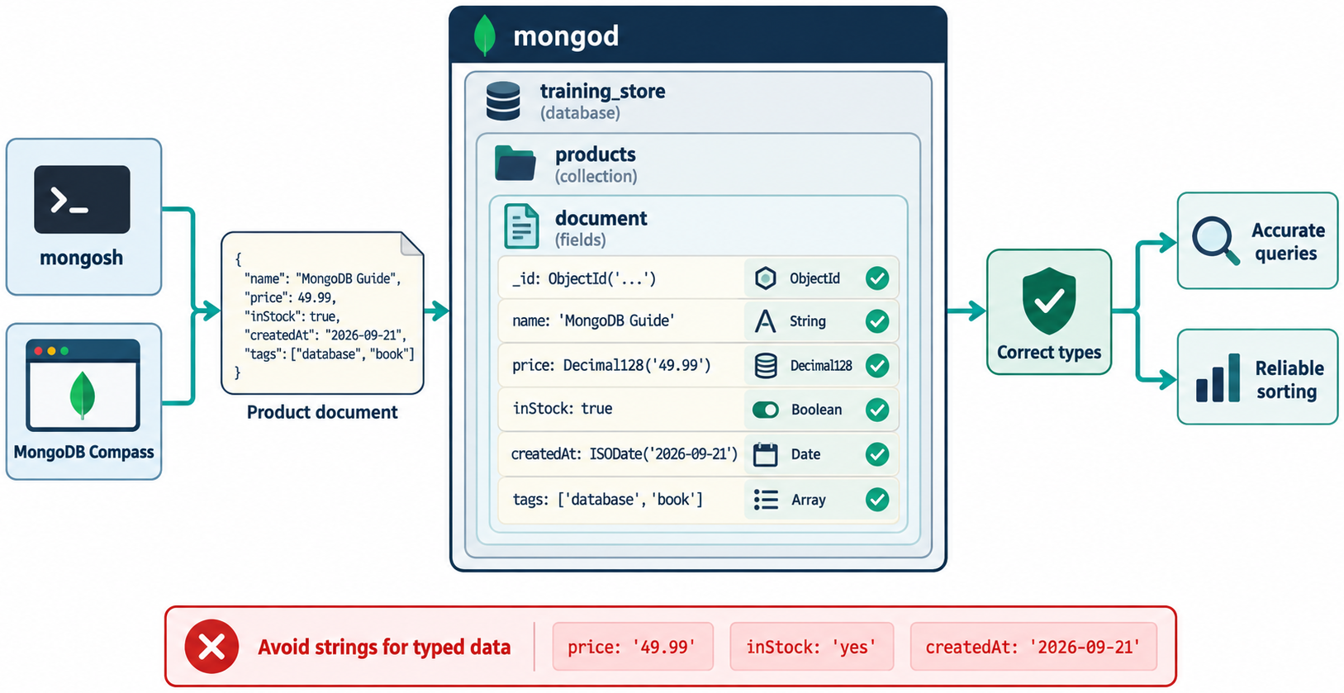
RETURN APPROPRIATE MESSAGES
MODULE 8
📌
KEY POINTS
Internal log:
User-facing response:
Do not expose:
• Stack traces
• Server hostnames
• Database names unnecessarily
• Connection strings
• Credentials
• Internal topology
• Complete raw documents
MongoServerError: E11000 duplicate key error
collection: training_store.customers
index: uq_customers_email
An account already exists for that email address.
68
© 2026 by Innovation In Software Corporation
Notes:
Internal log:

Slide 70
USE STRUCTURED LOGGING
MODULE 8
📌
KEY POINTS
A useful log record may contain:
Avoid logging credentials or unrestricted personal data.
{
event: "order_query_failed",
requestId: "REQ-2026-1025",
operation: "findCustomerOrders",
customerId: "masked-or-authorized-value",
durationMs: 2200,
errorCategory: "database_timeout",
occurredAt: "2026-09-22T18:20:00Z"
}
69
© 2026 by Innovation In Software Corporation
Notes:
A useful log record may contain:

Slide 71
USE TIMEOUTS
MODULE 8
📌
KEY POINTS
Database operations should not wait indefinitely.
Configure appropriate:
• Server-selection timeout
• Connection timeout
• Socket timeout
• Operation time limit
• Transaction timeout
• Application request timeout
For selected operations:
Timeouts must be chosen according to the workload. Extremely low limits can create avoidable failures.
db.orders.find({
status: "Processing"
}).maxTimeMS(3000)
70
© 2026 by Innovation In Software Corporation
Notes:
Database operations should not wait indefinitely.

Slide 72
DESIGN IDEMPOTENT OPERATIONS
MODULE 8
📌
KEY POINTS
A retried request should not unintentionally create duplicate business effects.
Use:
• Unique request keys
• Unique order numbers
• Upserts where semantically appropriate
• Guarded state transitions
• Idempotency records
Example:
Running it again does not rematch an already shipped order.
db.orders.updateOne(
{
orderNumber: "ORD-2026-1002",
status: "Processing"
},
{
$set: {
status: "Shipped"
},
$currentDate: {
shippedAt: true
}
}
)
71
© 2026 by Innovation In Software Corporation
Notes:
A retried request should not unintentionally create duplicate business effects.

Slide 73
BUSINESS REQUIREMENT
MODULE 8
📌
KEY POINTS
Create a sales report showing the top products for a selected date range.
The report must:
• Include only Shipped, Delivered or Completed orders.
• Include orders from September 2026.
• Expand individual order items.
• Group by product.
• Calculate units sold.
• Calculate sales revenue.
• Count the number of contributing orders.
• Sort by revenue.
• Return the top ten products.
72
© 2026 by Innovation In Software Corporation
Notes:
Create a sales report showing the top products for a selected date range.

Slide 74
STEP 1: VERIFY THE DATA RANGE
MODULE 8
📌
KEY POINTS
Confirm that orderedAt is a BSON Date rather than a string.
db.orders.find(
{},
{
orderNumber: 1,
status: 1,
orderedAt: 1,
total: 1
}
).sort({
orderedAt: 1
})
73
© 2026 by Innovation In Software Corporation
Notes:
Confirm that `orderedAt` is a BSON Date rather than a string.

Slide 75
STEP 2: CONSTRUCT THE PIPELINE
MODULE 8
const salesPipeline = [
{
$match: {
status: {
$in: [
"Shipped",
"Delivered",
"Completed"
]
},
orderedAt: {
$gte: ISODate("2026-09-01T00:00:00Z"),
$lt: ISODate("2026-10-01T00:00:00Z")
}
}
},
{
$unwind: "$items"
},
{
$group: {
_id: {
productId: "$items.productId",
sku: "$items.sku",
productName: "$items.productName"
},
unitsSold: {
$sum: "$items.quantity"
},
revenue: {
$sum: "$items.lineTotal"
},
orderIds: {
$addToSet: "$_id"
}
}
},
{
$project: {
_id: 0,
productId: "$_id.productId",
sku: "$_id.sku",
productName: "$_id.productName",
unitsSold: 1,
revenue: 1,
orderCount: {
$size: "$orderIds"
}
}
},
74
© 2026 by Innovation In Software Corporation
Notes:
Covers Step 2: Construct the pipeline.

Slide 76
STEP 2: CONSTRUCT THE PIPELINE (CONT.)
MODULE 8
📌
KEY POINTS
Run it:
{
$sort: {
revenue: -1
}
},
{
$limit: 10
}
];
db.orders.aggregate(salesPipeline)
75
© 2026 by Innovation In Software Corporation
Notes:
Run it:

Slide 77
STEP 3: EXPLAIN THE BASELINE
MODULE 8
📌
KEY POINTS
Record:
On a small classroom dataset, differences may be tiny. The important lesson is how the execution plan changes.
db.orders.explain(
"executionStats"
).aggregate(salesPipeline)
Winning input stage:
Documents examined:
Keys examined:
Documents returned by the initial match:
Execution time:
Blocking sort present:
76
© 2026 by Innovation In Software Corporation
Notes:
Record:

Slide 78
STEP 4: IDENTIFY THE INDEXABLE PIPELINE STAGE
MODULE 8
📌
KEY POINTS
The first stage is:
The relevant fields are:
Candidate compound index:
{
$match: {
status: {
$in: [
"Shipped",
"Delivered",
"Completed"
]
},
orderedAt: {
$gte: ISODate("2026-09-01T00:00:00Z"),
$lt: ISODate("2026-10-01T00:00:00Z")
}
}
}
status → equality-style membership condition
orderedAt → date range
77
© 2026 by Innovation In Software Corporation
Notes:
The first stage is:

Slide 79
STEP 4: IDENTIFY THE INDEXABLE PIPELINE STAGE (CONT.)
MODULE 8
{
status: 1,
orderedAt: 1
}
78
© 2026 by Innovation In Software Corporation
Notes:
Covers Step 4: Identify the indexable pipeline stage.

Slide 80
STEP 5: CREATE THE INDEX
MODULE 8
📌
KEY POINTS
Verify:
db.orders.createIndex(
{
status: 1,
orderedAt: 1
},
{
name: "idx_orders_status_orderedAt"
}
)
db.orders.getIndexes()
79
© 2026 by Innovation In Software Corporation
Notes:
Verify:

Slide 81
STEP 6: EXPLAIN THE TUNED PIPELINE
MODULE 8
📌
KEY POINTS
Compare with the baseline:
Metric | Before index | After index
Collection scan | Record result | Record result
Index scan | Record result | Record result
Documents examined | Record value | Record value
Keys examined | Record value | Record value
Documents matched | Record value | Record value
Execution time | Record value | Record value
db.orders.explain(
"executionStats"
).aggregate(salesPipeline)
80
© 2026 by Innovation In Software Corporation
Notes:
Compare with the baseline:

Slide 82
STEP 6: EXPLAIN THE TUNED PIPELINE (CONT.)
MODULE 8
📌
KEY POINTS
Expected behavior on a sufficiently large and selective dataset:
• $match can use the compound index.
• Fewer unrelated order documents are examined.
• Less data reaches $unwind.
• Less data reaches $group.
• Downstream processing becomes less expensive.
The index does not directly perform the $group; it reduces the input that the aggregation must group.
81
© 2026 by Innovation In Software Corporation
Notes:
Expected behavior on a sufficiently large and selective dataset:

Slide 83
STEP 7: TEST THE FIELD ORDER
MODULE 8
📌
KEY POINTS
Create an alternative index for controlled comparison:
Test each index using hint():
db.orders.createIndex(
{
orderedAt: 1,
status: 1
},
{
name: "idx_orders_orderedAt_status_test"
}
)
db.orders.explain(
"executionStats"
).aggregate(
salesPipeline,
{
hint: "idx_orders_status_orderedAt"
}
)
82
© 2026 by Innovation In Software Corporation
Notes:
Create an alternative index for controlled comparison:

Slide 84
STEP 7: TEST THE FIELD ORDER (CONT.)
MODULE 8
📌
KEY POINTS
Compare:
• Keys examined
• Documents examined
• Execution time
• Index bounds
• Behavior across different months and status distributions
Do not keep both automatically. Retain the index that best supports the broader workload, not merely one isolated test.
db.orders.explain(
"executionStats"
).aggregate(
salesPipeline,
{
hint: "idx_orders_orderedAt_status_test"
}
)
83
© 2026 by Innovation In Software Corporation
Notes:
Compare:

Slide 85
STEP 8: ADD PRODUCT-CATEGORY ANALYSIS
MODULE 8
📌
KEY POINTS
Join the current product record:
const categorySalesPipeline = [
{
$match: {
status: {
$in: [
"Shipped",
"Delivered",
"Completed"
]
},
orderedAt: {
$gte: ISODate("2026-09-01T00:00:00Z"),
$lt: ISODate("2026-10-01T00:00:00Z")
}
}
},
{
$unwind: "$items"
},
{
$lookup: {
from: "products",
localField: "items.productId",
foreignField: "_id",
as: "product"
}
},
84
© 2026 by Innovation In Software Corporation
Notes:
Join the current product record:

Slide 86
STEP 8: ADD PRODUCT-CATEGORY ANALYSIS (CONT.)
MODULE 8
{
$unwind: "$product"
},
{
$group: {
_id: "$product.category",
unitsSold: {
$sum: "$items.quantity"
},
revenue: {
$sum: "$items.lineTotal"
},
uniqueCustomers: {
$addToSet: "$customerId"
}
}
},
{
$project: {
_id: 0,
category: "$_id",
unitsSold: 1,
revenue: 1,
customerCount: {
$size: "$uniqueCustomers"
}
}
},
{
$sort: {
revenue: -1
}
}
];
85
© 2026 by Innovation In Software Corporation
Notes:
Covers Step 8: Add product-category analysis.

Slide 87
STEP 8: ADD PRODUCT-CATEGORY ANALYSIS (CONT.)
MODULE 8
📌
KEY POINTS
Run:
The foreign field used by $lookup is products._id, which already has an index by default.
db.orders.aggregate(categorySalesPipeline)
86
© 2026 by Innovation In Software Corporation
Notes:
Run:

Slide 88
STEP 9: VALIDATE CORRECTNESS
MODULE 8
📌
KEY POINTS
Performance tuning must not change the report’s meaning.
Check:
Validate sample totals manually:
Confirm:
db.orders.countDocuments({
status: {
$in: [
"Shipped",
"Delivered",
"Completed"
]
},
orderedAt: {
$gte: ISODate("2026-09-01T00:00:00Z"),
$lt: ISODate("2026-10-01T00:00:00Z")
}
})
db.orders.find({
orderNumber: "ORD-2026-1001"
})
87
© 2026 by Innovation In Software Corporation
Notes:
Performance tuning must not change the report’s meaning.

Slide 89
STEP 9: VALIDATE CORRECTNESS (CONT.)
MODULE 8
📌
KEY POINTS
• Included statuses are correct.
• Date boundaries are correct.
• Cancelled orders are excluded.
• Quantities are not double-counted.
• lineTotal uses a consistent numeric type.
• Missing product matches are handled intentionally.
• The report timezone matches the business requirement.
88
© 2026 by Innovation In Software Corporation
Notes:
Covers Step 9: Validate correctness.

Slide 90
STEP 10: CLEAN UP THE TEST-ONLY INDEX
MODULE 8
📌
KEY POINTS
If testing shows the reverse-order index is unnecessary:
Keep:
only if it supports an important workload and provides measurable value.
db.orders.dropIndex(
"idx_orders_orderedAt_status_test"
)
idx_orders_status_orderedAt
89
© 2026 by Innovation In Software Corporation
Notes:
If testing shows the reverse-order index is unnecessary:

Slide 91
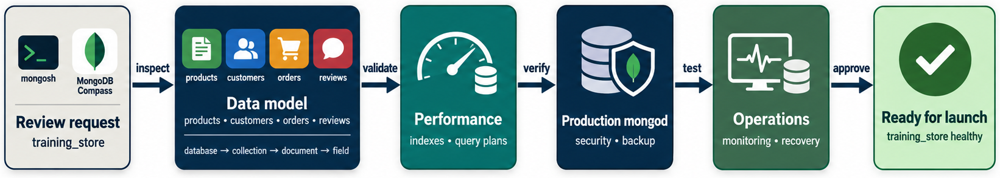
DATA MODEL
MODULE 8
📌
KEY POINTS
• Documents reflect access patterns.
• Embedded arrays are bounded.
• Historical snapshots are intentional.
• Field names and BSON types are consistent.
• Large documents have been evaluated.
• Validation rules protect essential invariants.
• Schema evolution has a migration strategy.
90
© 2026 by Innovation In Software Corporation
Notes:
Covers Data model.

Slide 92
QUERIES
MODULE 8
📌
KEY POINTS
• Results are filtered and bounded.
• Pagination is implemented where required.
• Queries use appropriate projection.
• Array queries use $elemMatch where necessary.
• Dates and timezones are handled consistently.
• Expensive query shapes have been tested at realistic scale.
91
© 2026 by Innovation In Software Corporation
Notes:
Covers Queries.

Slide 93
INDEXES
MODULE 8
📌
KEY POINTS
• Important query shapes have supporting indexes.
• Compound field order has been validated.
• Unique indexes enforce business rules.
• Redundant and unused indexes are reviewed.
• Write overhead has been measured.
• Explain plans have been captured before and after tuning.
92
© 2026 by Innovation In Software Corporation
Notes:
Covers Indexes.

Slide 94
AGGREGATION
MODULE 8
📊
KEY POINTS
• Selective $match stages appear early.
• $unwind expansion is controlled.
• $lookup fields are indexed appropriately.
• Grouping cardinality is understood.
• Large sorts are monitored.
• Output is verified for correctness.
93
© 2026 by Innovation In Software Corporation
Notes:
Covers Aggregation.

Slide 95
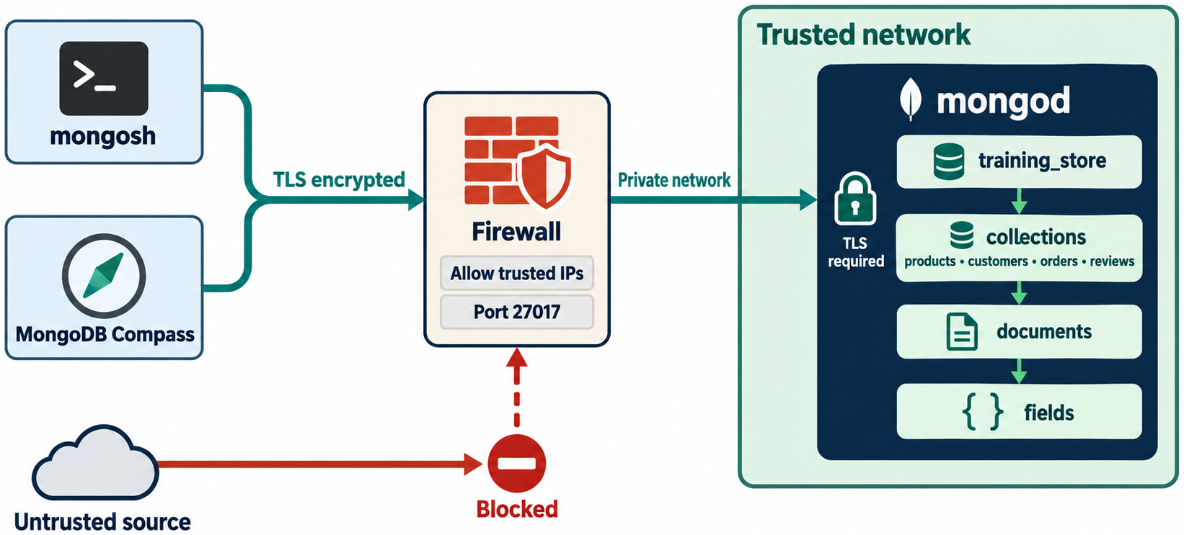
SECURITY
MODULE 8
📌
KEY POINTS
• Authentication is enabled.
• Least-privilege roles are used.
• TLS protects network traffic.
• Credentials are stored securely.
• Network exposure is restricted.
• Sensitive fields are protected appropriately.
• Security activity is monitored.
• Dependencies and MongoDB versions are patched according to policy.
94
© 2026 by Innovation In Software Corporation
Notes:
Covers Security.

Slide 96
AVAILABILITY AND RECOVERY
MODULE 8
📌
KEY POINTS
• Production deployments use appropriate replication.
• Clients use topology-aware connection strings.
• Read and write concerns match business requirements.
• Backups are independent from replication.
• Restore procedures are tested.
• RPO and RTO are documented.
• Failover behavior is tested.
95
© 2026 by Innovation In Software Corporation
Notes:
Covers Availability and recovery.

Slide 97
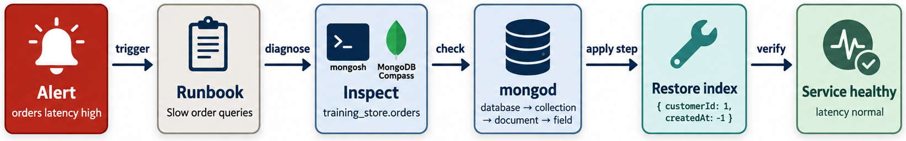
OPERATIONS
MODULE 8
📌
KEY POINTS
• Metrics and alerts are configured.
• Slow queries are monitored.
• Logs are centralized and protected.
• Capacity trends are reviewed.
• Replication lag is monitored.
• Disk space alerts are configured.
• Deployment changes are documented.
• Operational runbooks exist.
96
© 2026 by Innovation In Software Corporation
Notes:
Covers Operations.

Slide 98
COURSE WRAP-UP
MODULE 8
🧭
KEY POINTS
The course progression can be summarized as follows:
Module | Core capability
1. Introduction to NoSQL | Select an appropriate database model
2. Installation and Setup | Establish and verify MongoDB
3. Data Modeling | Design documents around access patterns
4. Query Language | Retrieve and manipulate documents
5. Aggregation | Transform data into analytical results
6. Indexing | Improve query performance using evidence
7. Replication and Sharding | Design for availability and scale
8. Best Practices | Operate MongoDB securely and reliably
97
© 2026 by Innovation In Software Corporation
Notes:
The course progression can be summarized as follows:

Slide 99
COURSE WRAP-UP (CONT.)
MODULE 8
🧭
KEY POINTS
The most important principles are:
1. Model around how the application uses data.
2. Embed bounded data that belongs together.
3. Reference shared, independent or unbounded data.
4. Keep field names and data types consistent.
5. Design indexes around real query shapes.
6. Measure performance before and after optimization.
7. Filter early in aggregation pipelines.
8. Apply authentication, authorization, TLS and network restrictions.
9. Treat replication, sharding and backups as different capabilities.
10. Troubleshoot from evidence instead of assumptions.
98
© 2026 by Innovation In Software Corporation
Notes:
The most important principles are:

Slide 100
QUESTION-AND-ANSWER DISCUSSION PROMPTS
MODULE 8
❓
KEY POINTS
Use these prompts to close the course:
1. When would you choose MongoDB instead of a relational database?
2. When should related data be embedded?
3. When should related data be referenced?
4. Why is an unbounded array dangerous?
5. What is the difference between find() and aggregation?
6. How does a compound-index prefix affect query support?
7. Why can too many indexes harm performance?
8. What does COLLSCAN mean?
9. How are replication and sharding different?
10. Why is replication not a backup?
11. What makes a strong shard key?
12. How would you diagnose a suddenly slow API endpoint?
13. Which security controls are essential before production?
14. How would you prevent duplicate order processing?
15. Which metrics would you monitor after deployment?
99
© 2026 by Innovation In Software Corporation
Notes:
Use these prompts to close the course:

Slide 101
QUESTION-AND-ANSWER DISCUSSION PROMPTS (CONT.)
MODULE 8
❓
KEY POINTS
After completing the module, learners should be able to review a MongoDB application from schema, query, performance, security and operational perspectives—and justify each recommendation with observable evidence.
100
© 2026 by Innovation In Software Corporation
Notes:
After completing the module, learners should be able to review a MongoDB application from schema, query, performance, security and operational perspectives—and justify each recommendation with...

Slide 102
DEMO 8.1 — REVIEW AND IMPROVE A DATA MODEL
MODULE 8
🛠️
KEY POINTS
• Time: 15 min
• Start from mixed prices, unbounded reviews, string dates, and a password hash on the document
• Correct types, split reviews, standardize names, add validation, protect secrets
• Keep the catalog and order access patterns fast
101
© 2026 by Innovation In Software Corporation
Notes:
This slide includes a diagram — Demo 8.1 — Review and Improve a Data Model.
The slide title is: Demo 8.1 — Review and Improve a Data Model.
The slide says: <div class="cols">.
The slide says: <div class="col-text">.
The slide says: </div>.
The slide says: <div class="col-visual">.
Bullet 1 on the slide: Time: 15 min.
Bullet 2 on the slide: Start from mixed prices, unbounded reviews, string dates, and a password hash on the document.
Bullet 3 on the slide: Correct types, split reviews, standardize names, add validation, protect secrets.
Bullet 4 on the slide: Keep the catalog and order access patterns fast.
The figure on this slide is titled: Review and Improve a Data Model.

Slide 103
EXERCISE 8.1 — REVIEW A DOCUMENT MODEL
MODULE 8
🛠️
KEY POINTS
• Time: 15 min
• Score an order-shaped document and rewrite the boundary, snapshots, and first validator.
• Lab guide: Exercise 8.1
102
© 2026 by Innovation In Software Corporation
Notes:
This slide includes a diagram — Exercise 8.1 — Review a Document Model.
The slide title is: Exercise 8.1 — Review a Document Model.
The slide says: <div class="cols">.
The slide says: <div class="col-text">.
The slide says: </div>.
The slide says: <div class="col-visual">.
Bullet 1 on the slide: Time: 15 min.
Bullet 2 on the slide: Score an order-shaped document and rewrite the boundary, snapshots, and first validator.
Bullet 3 on the slide: Lab guide: [Exercise 8.1](../slide-exercises/module-08/exercise-8.1-review-a-document-model.md).
The figure on this slide is titled: Order versus customer boundary.

Slide 104
EXERCISE 8.1 — STEPS 1–2
MODULE 8
🛠️
KEY POINTS
LAB GUIDE Exercise 8.1
Follow along (Windows) — key steps:
Step 1 — Score the document
• Do: Review this order-shaped document and mark each area as strong, risky, or missing: access patterns, ownership, duplication, BSON types, array growth, historical snapshots, sensitive fields, and validation. { _id: ObjectI
• Expected: Risky/missing: price as string, date as string, unbounded notes, live customer fields (email, loyalty, password hash) instead of a snapshot plus a reference,
Step 2 — Rewrite the boundary
• Do: Write the corrected document boundary: what stays on the order, what is referenced, and one validation rule you would add first.
• Expected: Order keeps orderNumber, customerId, purchase-time name/address/price snapshots, items, statuses, Decimal128 total, Date createdAt. Customer master stays in cus
103
© 2026 by Innovation In Software Corporation
Notes:
We are starting Exercise 8.1 — Review a Document Model. We have about 15 min for this lab.
Evaluate an order-shaped document for access patterns, snapshots, types, growth, sensitive data, and validation.
The full lab guide is in slide-exercises/module-08/exercise-8.1-review-a-document-model.md if you need extra detail.
On Windows: PowerShell in the integrated terminal — Ctrl+backtick — and the Agent panel — Ctrl+I. Open the repo folder with File → Open Folder.
Step 1 — Score the document.
Step 2 — Rewrite the boundary.
I'll give you a few minutes to work — raise your hand if you get stuck.
The slide title is: Exercise 8.1 — Steps 1–2.
The slide says: Lab guide: [Exercise 8.1](../slide-exercises/module-08/exercise-8.1-review-a-document-model.md).
The slide says: Follow along (Windows) — key steps:.
Bullet 1 on the slide: Do: Review this order-shaped document and mark each area as strong, risky, or missing: access patterns, ownership, duplication, BSON types, array growth, historical snapshots, sensitive fields, and validation. { _id: ObjectI.
Bullet 2 on the slide: Expected: Risky/missing: price as string, date as string, unbounded notes, live customer fields (email, loyalty, password hash) instead of a snapshot plus a reference,.
Bullet 3 on the slide: Do: Write the corrected document boundary: what stays on the order, what is referenced, and one validation rule you would add first.
Bullet 4 on the slide: Expected: Order keeps orderNumber, customerId, purchase-time name/address/price snapshots, items, statuses, Decimal128 total, Date createdAt. Customer master stays in cus.

Slide 105
EXERCISE 8.2 — FIND THE SCHEMA ANTI-PATTERNS
MODULE 8
⚠️
KEY POINTS
• Time: 15 min
• Name seven anti-patterns on a messy product document and sketch the repair.
• Lab guide: Exercise 8.2
104
© 2026 by Innovation In Software Corporation
Notes:
This slide includes a diagram — Exercise 8.2 — Find the Schema Anti-Patterns.
The slide title is: Exercise 8.2 — Find the Schema Anti-Patterns.
The slide says: <div class="cols">.
The slide says: <div class="col-text">.
The slide says: </div>.
The slide says: <div class="col-visual">.
Bullet 1 on the slide: Time: 15 min.
Bullet 2 on the slide: Name seven anti-patterns on a messy product document and sketch the repair.
Bullet 3 on the slide: Lab guide: [Exercise 8.2](../slide-exercises/module-08/exercise-8.2-find-the-schema-anti-patterns.md).
The figure on this slide is titled: Schema anti-patterns.

Slide 106
EXERCISE 8.2 — STEPS 1–2
MODULE 8
🛠️
KEY POINTS
LAB GUIDE Exercise 8.2
Follow along (Windows) — key steps:
Step 1 — Name the anti-patterns
• Do: On the product document below, list every anti-pattern from the module list. { Product_Name: "Trail shoe", productPrice: "89.99", details: { catalog: { store: { web: { active: "yes" } } } }, customer: { email: "aisha@exa
• Expected: Unbounded reviews; price as text; mixed names (Product_Name vs productPrice); unnecessary nesting; live customer data on a product; missing sku/category/Dec
Step 2 — Corrected sketch
• Do: Sketch the replacement: product core fields, where reviews live, and how customer data is removed.
• Expected: products: sku, name, category, Decimal128 price, Boolean active, Date updatedAt, bounded attributes. reviews collection keyed by productId. No customer object o
105
© 2026 by Innovation In Software Corporation
Notes:
We are starting Exercise 8.2 — Find the Schema Anti-Patterns. We have about 15 min for this lab.
Identify unbounded arrays, textual prices, inconsistent names, and related anti-patterns, then sketch a repair.
The full lab guide is in slide-exercises/module-08/exercise-8.2-find-the-schema-anti-patterns.md if you need extra detail.
On Windows: PowerShell in the integrated terminal — Ctrl+backtick — and the Agent panel — Ctrl+I. Open the repo folder with File → Open Folder.
Step 1 — Name the anti-patterns.
Step 2 — Corrected sketch.
I'll give you a few minutes to work — raise your hand if you get stuck.
The slide title is: Exercise 8.2 — Steps 1–2.
The slide says: Lab guide: [Exercise 8.2](../slide-exercises/module-08/exercise-8.2-find-the-schema-anti-patterns.md).
The slide says: Follow along (Windows) — key steps:.
Bullet 1 on the slide: Do: On the product document below, list every anti-pattern from the module list. { Product_Name: "Trail shoe", productPrice: "89.99", details: { catalog: { store: { web: { active: "yes" } } } }, customer: { email: "aisha@exa.
Bullet 2 on the slide: Expected: Unbounded reviews; price as text; mixed names (Product_Name vs productPrice); unnecessary nesting; live customer data on a product; missing sku/category/Dec.
Bullet 3 on the slide: Do: Sketch the replacement: product core fields, where reviews live, and how customer data is removed.
Bullet 4 on the slide: Expected: products: sku, name, category, Decimal128 price, Boolean active, Date updatedAt, bounded attributes. reviews collection keyed by productId. No customer object o.

Slide 107
DEMO 8.2 — DIAGNOSE A SLOW QUERY
MODULE 8
⚠️
KEY POINTS
• Time: 20 min
• Capture the query → explain("executionStats")
• Spot COLLSCAN or weak scanning
• Fix filter, sort, projection; add an index; compare examined vs returned
• Discuss write and storage cost
106
© 2026 by Innovation In Software Corporation
Notes:
This slide includes a diagram — Demo 8.2 — Diagnose a Slow Query.
The slide title is: Demo 8.2 — Diagnose a Slow Query.
The slide says: <div class="cols">.
The slide says: <div class="col-text">.
The slide says: </div>.
The slide says: <div class="col-visual">.
Bullet 1 on the slide: Time: 20 min.
Bullet 2 on the slide: Capture the query → explain("executionStats").
Bullet 3 on the slide: Spot COLLSCAN or weak scanning.
Bullet 4 on the slide: Fix filter, sort, projection; add an index; compare examined vs returned.
Bullet 5 on the slide: Discuss write and storage cost.
The figure on this slide is titled: Diagnose a Slow Query.

Slide 108
EXERCISE 8.3 — REVIEW A QUERY AND PROJECTION
MODULE 8
🛠️
KEY POINTS
• Time: 15 min
• Rewrite find({}) into a selective, projected, sorted, limited query and name an ESR index.
• Lab guide: Exercise 8.3
107
© 2026 by Innovation In Software Corporation
Notes:
This slide includes a diagram — Exercise 8.3 — Review a Query and Projection.
The slide title is: Exercise 8.3 — Review a Query and Projection.
The slide says: <div class="cols">.
The slide says: <div class="col-text">.
The slide says: </div>.
The slide says: <div class="col-visual">.
Bullet 1 on the slide: Time: 15 min.
Bullet 2 on the slide: Rewrite find({}) into a selective, projected, sorted, limited query and name an ESR index.
Bullet 3 on the slide: Lab guide: [Exercise 8.3](../slide-exercises/module-08/exercise-8.3-review-a-query-and-projection.md).
The figure on this slide is titled: Selective query rewrite.

Slide 109
EXERCISE 8.3 — STEPS 1–2
MODULE 8
🛠️
KEY POINTS
LAB GUIDE Exercise 8.3
Follow along (Windows) — key steps:
Step 1 — Rewrite the query
• Do: The application only needs C101’s paid orders, newest first, ten at a time, showing orderNumber, fulfillmentStatus, total, and createdAt. Rewrite: db.orders.find({})
• Expected: Filter on customerId + paymentStatus PAID; projection of the four fields (and usually _id: 0); .sort({ createdAt: -1 }); .limit(10).
Step 2 — Name a candidate index
• Do: Write one compound index that supports the filter and sort. Label equality vs sort fields.
• Expected: { customerId: 1, paymentStatus: 1, createdAt: -1 } — equality, equality, sort. Do not lead with createdAt.
108
© 2026 by Innovation In Software Corporation
Notes:
We are starting Exercise 8.3 — Review a Query and Projection. We have about 15 min for this lab.
Rewrite a broad find into a selective, projected, sorted, limited query with an ESR index.
The full lab guide is in slide-exercises/module-08/exercise-8.3-review-a-query-and-projection.md if you need extra detail.
On Windows: PowerShell in the integrated terminal — Ctrl+backtick — and the Agent panel — Ctrl+I. Open the repo folder with File → Open Folder.
Step 1 — Rewrite the query.
Step 2 — Name a candidate index.
I'll give you a few minutes to work — raise your hand if you get stuck.
The slide title is: Exercise 8.3 — Steps 1–2.
The slide says: Lab guide: [Exercise 8.3](../slide-exercises/module-08/exercise-8.3-review-a-query-and-projection.md).
The slide says: Follow along (Windows) — key steps:.
Bullet 1 on the slide: Do: The application only needs C101’s paid orders, newest first, ten at a time, showing orderNumber, fulfillmentStatus, total, and createdAt. Rewrite: db.orders.find({}).
Bullet 2 on the slide: Expected: Filter on customerId + paymentStatus PAID; projection of the four fields (and usually _id: 0); .sort({ createdAt: -1 }); .limit(10).
Bullet 3 on the slide: Do: Write one compound index that supports the filter and sort. Label equality vs sort fields.
Bullet 4 on the slide: Expected: { customerId: 1, paymentStatus: 1, createdAt: -1 } — equality, equality, sort. Do not lead with createdAt.

Slide 110
DEMO 8.3 — TUNE AN AGGREGATION PIPELINE
MODULE 8
🛠️
KEY POINTS
• Time: 20 min
• Start with $lookup → $unwind → $match → $group → $sort
• Aim for $match → $project → (maybe lookup) → controlled unwind → $group → $sort
• Business logic decides the exact order
• Measure before and after
109
© 2026 by Innovation In Software Corporation
Notes:
This slide includes a diagram — Demo 8.3 — Tune an Aggregation Pipeline.
The slide title is: Demo 8.3 — Tune an Aggregation Pipeline.
The slide says: <div class="cols">.
The slide says: <div class="col-text">.
The slide says: </div>.
The slide says: <div class="col-visual">.
Bullet 1 on the slide: Time: 20 min.
Bullet 2 on the slide: Start with $lookup → $unwind → $match → $group → $sort.
Bullet 3 on the slide: Aim for $match → $project → (maybe lookup) → controlled unwind → $group → $sort.
Bullet 4 on the slide: Business logic decides the exact order.
Bullet 5 on the slide: Measure before and after.
The figure on this slide is titled: Tune an Aggregation Pipeline.

Slide 111
EXERCISE 8.4 — OPTIMIZE AN AGGREGATION PIPELINE
MODULE 8
🛠️
KEY POINTS
• Time: 20 min
• Name defects in a lookup-first pipeline and propose a safer stage order that does not double-count.
• Lab guide: Exercise 8.4
110
© 2026 by Innovation In Software Corporation
Notes:
This slide includes a diagram — Exercise 8.4 — Optimize an Aggregation Pipeline.
The slide title is: Exercise 8.4 — Optimize an Aggregation Pipeline.
The slide says: <div class="cols">.
The slide says: <div class="col-text">.
The slide says: </div>.
The slide says: <div class="col-visual">.
Bullet 1 on the slide: Time: 20 min.
Bullet 2 on the slide: Name defects in a lookup-first pipeline and propose a safer stage order that does not double-count.
Bullet 3 on the slide: Lab guide: [Exercise 8.4](../slide-exercises/module-08/exercise-8.4-optimize-an-aggregation-pipeline.md).
The figure on this slide is titled: Unwind expansion.

Slide 112
EXERCISE 8.4 — STEPS 1–2
MODULE 8
🛠️
KEY POINTS
LAB GUIDE Exercise 8.4
Follow along (Windows) — key steps:
Step 1 — Name the defects
• Do: The pipeline runs $lookup customers, then $unwind items, then $match PAID, then $sort by date, then $group summing total. List what is wrong and why $group after $unwind can over-count revenue.
• Expected: Lookup and unwind happen before filtering; unused customer fields travel the pipeline; sort before the final metric is wasted work; summing parent total after
Step 2 — Propose a safer order
• Do: Write a conceptual stage order that preserves paid-order monthly revenue and unique customers. State where $unwind is allowed.
• Expected: $match PAID (and date window if any) → $project needed fields → $set month → group for order-level metrics first, or unwind only to sum line quantities. `
111
© 2026 by Innovation In Software Corporation
Notes:
We are starting Exercise 8.4 — Optimize an Aggregation Pipeline. We have about 20 min for this lab.
Reorder a lookup-first pipeline and avoid double-counting parent totals after $unwind.
The full lab guide is in slide-exercises/module-08/exercise-8.4-optimize-an-aggregation-pipeline.md if you need extra detail.
On Windows: PowerShell in the integrated terminal — Ctrl+backtick — and the Agent panel — Ctrl+I. Open the repo folder with File → Open Folder.
Step 1 — Name the defects.
Step 2 — Propose a safer order.
I'll give you a few minutes to work — raise your hand if you get stuck.
The slide title is: Exercise 8.4 — Steps 1–2.
The slide says: Lab guide: [Exercise 8.4](../slide-exercises/module-08/exercise-8.4-optimize-an-aggregation-pipeline.md).
The slide says: Follow along (Windows) — key steps:.
Bullet 1 on the slide: Do: The pipeline runs $lookup customers, then $unwind items, then $match PAID, then $sort by date, then $group summing total. List what is wrong and why $group after $unwind can over-count revenue.
Bullet 2 on the slide: Expected: Lookup and unwind happen before filtering; unused customer fields travel the pipeline; sort before the final metric is wasted work; summing parent total after.
Bullet 3 on the slide: Do: Write a conceptual stage order that preserves paid-order monthly revenue and unique customers. State where $unwind is allowed.
Bullet 4 on the slide: Expected: $match PAID (and date window if any) → $project needed fields → $set month → group for order-level metrics first, or unwind only to sum line quantities. `.

Slide 113
EXERCISE 8.5 — RATIONALIZE AN INDEX PORTFOLIO
MODULE 8
🛠️
KEY POINTS
• Time: 20 min
• Map overlapping category indexes, low-selectivity active, and a hide-then-monitor plan.
• Lab guide: Exercise 8.5
112
© 2026 by Innovation In Software Corporation
Notes:
This slide includes a diagram — Exercise 8.5 — Rationalize an Index Portfolio.
The slide title is: Exercise 8.5 — Rationalize an Index Portfolio.
The slide says: <div class="cols">.
The slide says: <div class="col-text">.
The slide says: </div>.
The slide says: <div class="col-visual">.
Bullet 1 on the slide: Time: 20 min.
Bullet 2 on the slide: Map overlapping category indexes, low-selectivity active, and a hide-then-monitor plan.
Bullet 3 on the slide: Lab guide: [Exercise 8.5](../slide-exercises/module-08/exercise-8.5-rationalize-an-index-portfolio.md).
The figure on this slide is titled: Overlapping category indexes.

Slide 114
EXERCISE 8.5 — STEPS 1–2
MODULE 8
🛠️
KEY POINTS
LAB GUIDE Exercise 8.5
Follow along (Windows) — key steps:
Step 1 — Map overlap
• Do: Given these indexes, mark which prefixes overlap and which queries each can support: { category: 1 } { category: 1, price: 1 } { category: 1, price: 1, name: 1 } { active: 1 } { category: 1, active: 1, price: 1 }
• Expected: The three category+price variants overlap; { category: 1 } is a prefix of the others. { active: 1 } is low-selectivity and does not overlap those prefixes.
Step 2 — Safe testing plan
• Do: Write the sequence before dropping any index: workload review, explain, hide, monitor, drop with rollback. Name one index you would not hide on appearance alone.
• Expected: Hide { category: 1 } only after catalog and reporting explains still use a remaining compound index. Do not hide { category: 1, active: 1, price: 1 } withou
113
© 2026 by Innovation In Software Corporation
Notes:
We are starting Exercise 8.5 — Rationalize an Index Portfolio. We have about 20 min for this lab.
Map overlapping prefixes, low-selectivity keys, and a hide-then-monitor removal plan.
The full lab guide is in slide-exercises/module-08/exercise-8.5-rationalize-an-index-portfolio.md if you need extra detail.
On Windows: PowerShell in the integrated terminal — Ctrl+backtick — and the Agent panel — Ctrl+I. Open the repo folder with File → Open Folder.
Step 1 — Map overlap.
Step 2 — Safe testing plan.
I'll give you a few minutes to work — raise your hand if you get stuck.
The slide title is: Exercise 8.5 — Steps 1–2.
The slide says: Lab guide: [Exercise 8.5](../slide-exercises/module-08/exercise-8.5-rationalize-an-index-portfolio.md).
The slide says: Follow along (Windows) — key steps:.
Bullet 1 on the slide: Do: Given these indexes, mark which prefixes overlap and which queries each can support: { category: 1 } { category: 1, price: 1 } { category: 1, price: 1, name: 1 } { active: 1 } { category: 1, active: 1, price: 1 }.
Bullet 2 on the slide: Expected: The three category+price variants overlap; { category: 1 } is a prefix of the others. { active: 1 } is low-selectivity and does not overlap those prefixes.
Bullet 3 on the slide: Do: Write the sequence before dropping any index: workload review, explain, hide, monitor, drop with rollback. Name one index you would not hide on appearance alone.
Bullet 4 on the slide: Expected: Hide { category: 1 } only after catalog and reporting explains still use a remaining compound index. Do not hide { category: 1, active: 1, price: 1 } withou.

Slide 115
DEMO 8.4 — APPLY COLLECTION VALIDATION
MODULE 8
🛠️
KEY POINTS
• Time: 15 min
• Require orderNumber, customerId, items, statuses, decimal total, createdAt
• Test valid insert, missing field, wrong type, illegal status
• Prefer training_store_ops so orders stays loadable
114
© 2026 by Innovation In Software Corporation
Notes:
This slide lists key points under Demo 8.4 — Apply Collection Validation.
The slide title is: Demo 8.4 — Apply Collection Validation.
Bullet 1 on the slide: Time: 15 min.
Bullet 2 on the slide: Require orderNumber, customerId, items, statuses, decimal total, createdAt.
Bullet 3 on the slide: Test valid insert, missing field, wrong type, illegal status.
Bullet 4 on the slide: Prefer training_store_ops so orders stays loadable.

Slide 116
DEMO 8.5 — DEMONSTRATE ROLE-BASED ACCESS
MODULE 8
🛠️
KEY POINTS
• Time: 15 min
• Instructor-controlled environment only
• App user: readWrite data; reporter: read; monitor: metrics; admin: separate identity
• Never display real credentials
115
© 2026 by Innovation In Software Corporation
Notes:
This slide includes a diagram — Demo 8.5 — Demonstrate Role-Based Access.
The slide title is: Demo 8.5 — Demonstrate Role-Based Access.
The slide says: <div class="cols">.
The slide says: <div class="col-text">.
The slide says: </div>.
The slide says: <div class="col-visual">.
Bullet 1 on the slide: Time: 15 min.
Bullet 2 on the slide: Instructor-controlled environment only.
Bullet 3 on the slide: App user: readWrite data; reporter: read; monitor: metrics; admin: separate identity.
Bullet 4 on the slide: Never display real credentials.
The figure on this slide is titled: Demonstrate Role-Based Access.

Slide 117
DEMO 8.6 — IDENTIFY AN UNSAFE CONFIGURATION
MODULE 8
🛠️
KEY POINTS
• Time: 10 min
• Public bind, auth disabled, shared admin, no TLS, no backup, no monitoring
• Participants name risks and controls
116
© 2026 by Innovation In Software Corporation
Notes:
This slide includes a diagram — Demo 8.6 — Identify an Unsafe Configuration.
The slide title is: Demo 8.6 — Identify an Unsafe Configuration.
The slide says: <div class="cols">.
The slide says: <div class="col-text">.
The slide says: </div>.
The slide says: <div class="col-visual">.
Bullet 1 on the slide: Time: 10 min.
Bullet 2 on the slide: Public bind, auth disabled, shared admin, no TLS, no backup, no monitoring.
Bullet 3 on the slide: Participants name risks and controls.
The figure on this slide is titled: Identify an Unsafe Configuration.

Slide 118
EXERCISE 8.6 — DESIGN LEAST-PRIVILEGE ROLES
MODULE 8
🛠️
KEY POINTS
• Time: 20 min
• Permit/deny matrix for app, reporting, support, monitoring, backup, and DBA identities.
• Lab guide: Exercise 8.6
117
© 2026 by Innovation In Software Corporation
Notes:
This slide includes a diagram — Exercise 8.6 — Design Least-Privilege Roles.
The slide title is: Exercise 8.6 — Design Least-Privilege Roles.
The slide says: <div class="cols">.
The slide says: <div class="col-text">.
The slide says: </div>.
The slide says: <div class="col-visual">.
Bullet 1 on the slide: Time: 20 min.
Bullet 2 on the slide: Permit/deny matrix for app, reporting, support, monitoring, backup, and DBA identities.
Bullet 3 on the slide: Lab guide: [Exercise 8.6](../slide-exercises/module-08/exercise-8.6-design-least-privilege-roles.md).
The figure on this slide is titled: Least-privilege roles.

Slide 119
EXERCISE 8.6 — STEPS 1–2
MODULE 8
🛠️
KEY POINTS
LAB GUIDE Exercise 8.6
Follow along (Windows) — key steps:
Step 1 — Fill the permission matrix
• Do: For each identity — application service, reporting service, support engineer, monitoring service, backup service, database administrator — list one permitted operation and one prohibited operation on training_store.
• Expected: App: read/write app collections, not userAdmin. Reporting: read approved collections, not update. Support: read (maybe limited PII), not drop. Monitoring: clust
Step 2 — Call out the anti-pattern
• Do: Write two sentences on why the application must not use a cluster-administrator account, even in training-like environments that later become production.
• Expected: A stolen app credential would inherit every privilege. Least privilege limits blast radius and makes audit trails meaningful.
118
© 2026 by Innovation In Software Corporation
Notes:
We are starting Exercise 8.6 — Design Least-Privilege Roles. We have about 20 min for this lab.
Define permit and deny operations for application, reporting, support, monitoring, backup, and DBA identities.
The full lab guide is in slide-exercises/module-08/exercise-8.6-design-least-privilege-roles.md if you need extra detail.
On Windows: PowerShell in the integrated terminal — Ctrl+backtick — and the Agent panel — Ctrl+I. Open the repo folder with File → Open Folder.
Step 1 — Fill the permission matrix.
Step 2 — Call out the anti-pattern.
I'll give you a few minutes to work — raise your hand if you get stuck.
The slide title is: Exercise 8.6 — Steps 1–2.
The slide says: Lab guide: [Exercise 8.6](../slide-exercises/module-08/exercise-8.6-design-least-privilege-roles.md).
The slide says: Follow along (Windows) — key steps:.
Bullet 1 on the slide: Do: For each identity — application service, reporting service, support engineer, monitoring service, backup service, database administrator — list one permitted operation and one prohibited operation on training_store.
Bullet 2 on the slide: Expected: App: read/write app collections, not userAdmin. Reporting: read approved collections, not update. Support: read (maybe limited PII), not drop. Monitoring: clust.
Bullet 3 on the slide: Do: Write two sentences on why the application must not use a cluster-administrator account, even in training-like environments that later become production.
Bullet 4 on the slide: Expected: A stolen app credential would inherit every privilege. Least privilege limits blast radius and makes audit trails meaningful.

Slide 120
EXERCISE 8.7 — IDENTIFY SECURITY RISKS
MODULE 8
⚠️
KEY POINTS
• Time: 15 min
• Rank six fictional risks and attach one mitigation to each.
• Lab guide: Exercise 8.7
119
© 2026 by Innovation In Software Corporation
Notes:
This slide includes a diagram — Exercise 8.7 — Identify Security Risks.
The slide title is: Exercise 8.7 — Identify Security Risks.
The slide says: <div class="cols">.
The slide says: <div class="col-text">.
The slide says: </div>.
The slide says: <div class="col-visual">.
Bullet 1 on the slide: Time: 15 min.
Bullet 2 on the slide: Rank six fictional risks and attach one mitigation to each.
Bullet 3 on the slide: Lab guide: [Exercise 8.7](../slide-exercises/module-08/exercise-8.7-identify-security-risks.md).
The figure on this slide is titled: Security anti-patterns.

Slide 121
EXERCISE 8.7 — STEPS 1–2
MODULE 8
🛠️
KEY POINTS
LAB GUIDE Exercise 8.7
Follow along (Windows) — key steps:
Step 1 — Rank the six risks
• Do: Rank these from most urgent to least: public database endpoint; shared administrator account; plaintext URI in source control; no TLS; unprotected backups; production data copied to development. Give a one-line business
• Expected: Typical top three: public endpoint (internet attack surface), no TLS (credential and data interception), secrets in source control (credential leak). Shared adm
Step 2 — Propose mitigations
• Do: For each of the six, write one concrete control (network, identity, encryption, secret storage, or data handling).
• Expected: Private network + allowlist; named accounts + MFA/rotation; secret manager; TLS with validation; encrypted backups with access control; masked or synthetic non-
120
© 2026 by Innovation In Software Corporation
Notes:
We are starting Exercise 8.7 — Identify Security Risks. We have about 15 min for this lab.
Rank public exposure, shared admin, secrets in git, missing TLS, open backups, and prod-in-dev, then mitigate.
The full lab guide is in slide-exercises/module-08/exercise-8.7-identify-security-risks.md if you need extra detail.
On Windows: PowerShell in the integrated terminal — Ctrl+backtick — and the Agent panel — Ctrl+I. Open the repo folder with File → Open Folder.
Step 1 — Rank the six risks.
Step 2 — Propose mitigations.
I'll give you a few minutes to work — raise your hand if you get stuck.
The slide title is: Exercise 8.7 — Steps 1–2.
The slide says: Lab guide: [Exercise 8.7](../slide-exercises/module-08/exercise-8.7-identify-security-risks.md).
The slide says: Follow along (Windows) — key steps:.
Bullet 1 on the slide: Do: Rank these from most urgent to least: public database endpoint; shared administrator account; plaintext URI in source control; no TLS; unprotected backups; production data copied to development. Give a one-line business.
Bullet 2 on the slide: Expected: Typical top three: public endpoint (internet attack surface), no TLS (credential and data interception), secrets in source control (credential leak). Shared adm.
Bullet 3 on the slide: Do: For each of the six, write one concrete control (network, identity, encryption, secret storage, or data handling).
Bullet 4 on the slide: Expected: Private network + allowlist; named accounts + MFA/rotation; secret manager; TLS with validation; encrypted backups with access control; masked or synthetic non-.

Slide 122
DEMO 8.9 — TEST A BACKUP AND RESTORE WORKFLOW
MODULE 8
🛠️
KEY POINTS
• Time: 20 min
• Known test data → backup → change data → restore to an isolated target
• Validate counts, samples, indexes, access, duration
• Disposable environment only
121
© 2026 by Innovation In Software Corporation
Notes:
This slide includes a diagram — Demo 8.9 — Test a Backup and Restore Workflow.
The slide title is: Demo 8.9 — Test a Backup and Restore Workflow.
The slide says: <div class="cols">.
The slide says: <div class="col-text">.
The slide says: </div>.
The slide says: <div class="col-visual">.
Bullet 1 on the slide: Time: 20 min.
Bullet 2 on the slide: Known test data → backup → change data → restore to an isolated target.
Bullet 3 on the slide: Validate counts, samples, indexes, access, duration.
Bullet 4 on the slide: Disposable environment only.
The figure on this slide is titled: Test a Backup and Restore Workflow.

Slide 123
EXERCISE 8.8 — DEFINE RPO AND RTO
MODULE 8
🛠️
KEY POINTS
• Time: 15 min
• Set RPO, RTO, frequency, method, and validation for catalog, customers, orders, payments, and reviews.
• Lab guide: Exercise 8.8
122
© 2026 by Innovation In Software Corporation
Notes:
This slide includes a diagram — Exercise 8.8 — Define RPO and RTO.
The slide title is: Exercise 8.8 — Define RPO and RTO.
The slide says: <div class="cols">.
The slide says: <div class="col-text">.
The slide says: </div>.
The slide says: <div class="col-visual">.
Bullet 1 on the slide: Time: 15 min.
Bullet 2 on the slide: Set RPO, RTO, frequency, method, and validation for catalog, customers, orders, payments, and reviews.
Bullet 3 on the slide: Lab guide: [Exercise 8.8](../slide-exercises/module-08/exercise-8.8-define-rpo-and-rto.md).
The figure on this slide is titled: RPO and RTO.

Slide 124
EXERCISE 8.8 — STEPS 1–2
MODULE 8
🛠️
KEY POINTS
LAB GUIDE Exercise 8.8
Follow along (Windows) — key steps:
Step 1 — Assign objectives
• Do: For product catalog, customer profiles, orders, payments, and reviews, write RPO, RTO, and a backup frequency that could meet the RPO. Use the store as a small retailer, not a global bank.
• Expected: Payments and orders typically get the tightest RPO (minutes) and tested point-in-time recovery. Catalog can often tolerate a longer RPO. Reviews are usually the
Step 2 — Name validation
• Do: For orders, write how you would prove a restore: counts, sample order numbers, indexes, and a checkout read.
• Expected: Compare countDocuments to the pre-restore note; find O5001 and a paid total; getIndexes(); application can read an order. Backup success alone is not enough
123
© 2026 by Innovation In Software Corporation
Notes:
We are starting Exercise 8.8 — Define RPO and RTO. We have about 15 min for this lab.
Set recovery objectives, backup frequency, method, and validation for catalog, customers, orders, payments, and reviews.
The full lab guide is in slide-exercises/module-08/exercise-8.8-define-rpo-and-rto.md if you need extra detail.
On Windows: PowerShell in the integrated terminal — Ctrl+backtick — and the Agent panel — Ctrl+I. Open the repo folder with File → Open Folder.
Step 1 — Assign objectives.
Step 2 — Name validation.
I'll give you a few minutes to work — raise your hand if you get stuck.
The slide title is: Exercise 8.8 — Steps 1–2.
The slide says: Lab guide: [Exercise 8.8](../slide-exercises/module-08/exercise-8.8-define-rpo-and-rto.md).
The slide says: Follow along (Windows) — key steps:.
Bullet 1 on the slide: Do: For product catalog, customer profiles, orders, payments, and reviews, write RPO, RTO, and a backup frequency that could meet the RPO. Use the store as a small retailer, not a global bank.
Bullet 2 on the slide: Expected: Payments and orders typically get the tightest RPO (minutes) and tested point-in-time recovery. Catalog can often tolerate a longer RPO. Reviews are usually the.
Bullet 3 on the slide: Do: For orders, write how you would prove a restore: counts, sample order numbers, indexes, and a checkout read.
Bullet 4 on the slide: Expected: Compare countDocuments to the pre-restore note; find O5001 and a paid total; getIndexes(); application can read an order. Backup success alone is not enough.

Slide 125
DEMO 8.7 — INSPECT HEALTH AND PERFORMANCE METRICS
MODULE 8
🛠️
KEY POINTS
• Time: 15 min
• Ops rate, query latency, connections, CPU, memory, disk, lag, storage, slow queries
• Correlate with a simulated load bump
124
© 2026 by Innovation In Software Corporation
Notes:
This slide includes a diagram — Demo 8.7 — Inspect Health and Performance Metrics.
The slide title is: Demo 8.7 — Inspect Health and Performance Metrics.
The slide says: <div class="cols">.
The slide says: <div class="col-text">.
The slide says: </div>.
The slide says: <div class="col-visual">.
Bullet 1 on the slide: Time: 15 min.
Bullet 2 on the slide: Ops rate, query latency, connections, CPU, memory, disk, lag, storage, slow queries.
Bullet 3 on the slide: Correlate with a simulated load bump.
The figure on this slide is titled: Inspect Health and Performance Metrics.

Slide 126
DEMO 8.8 — READ AND CORRELATE MONGODB LOGS
MODULE 8
🛠️
KEY POINTS
• Time: 15 min
• Trace connection failure, auth failure, slow query, election, replication and storage warnings
• Align timestamps with the application
125
© 2026 by Innovation In Software Corporation
Notes:
This slide lists key points under Demo 8.8 — Read and Correlate MongoDB Logs.
The slide title is: Demo 8.8 — Read and Correlate MongoDB Logs.
Bullet 1 on the slide: Time: 15 min.
Bullet 2 on the slide: Trace connection failure, auth failure, slow query, election, replication and storage warnings.
Bullet 3 on the slide: Align timestamps with the application.

Slide 127
EXERCISE 8.9 — DESIGN A MONITORING DASHBOARD
MODULE 8
🛠️
KEY POINTS
• Time: 20 min
• Choose at most twelve on-call tiles, each with a purpose question, and drop two vanity metrics.
• Lab guide: Exercise 8.9
126
© 2026 by Innovation In Software Corporation
Notes:
This slide includes a diagram — Exercise 8.9 — Design a Monitoring Dashboard.
The slide title is: Exercise 8.9 — Design a Monitoring Dashboard.
The slide says: <div class="cols">.
The slide says: <div class="col-text">.
The slide says: </div>.
The slide says: <div class="col-visual">.
Bullet 1 on the slide: Time: 20 min.
Bullet 2 on the slide: Choose at most twelve on-call tiles, each with a purpose question, and drop two vanity metrics.
Bullet 3 on the slide: Lab guide: [Exercise 8.9](../slide-exercises/module-08/exercise-8.9-design-a-monitoring-dashboard.md).
The figure on this slide is titled: Dashboard questions.

Slide 128
EXERCISE 8.9 — STEPS 1–2
MODULE 8
🛠️
KEY POINTS
LAB GUIDE Exercise 8.9
Follow along (Windows) — key steps:
Step 1 — Pick twelve tiles
• Do: Choose at most twelve dashboard tiles that a weekday on-call would actually use. For each, write the metric and the question it answers. Reject vanity metrics.
• Expected: Examples: primary/alive, request latency p99, slow ops, CPU, disk %, connections vs limit, replication lag, oplog window, targeted vs scatter (if sharded), back
Step 2 — Drop two candidates
• Do: Name two metrics you would leave off the primary dashboard and why.
• Expected: Per-collection document counts or raw opcounters without a baseline are noise. Shard-balancer internals may belong on a secondary view unless the cluster is sha
127
© 2026 by Innovation In Software Corporation
Notes:
We are starting Exercise 8.9 — Design a Monitoring Dashboard. We have about 20 min for this lab.
Select essential on-call metrics with a purpose for each tile and drop vanity signals.
The full lab guide is in slide-exercises/module-08/exercise-8.9-design-a-monitoring-dashboard.md if you need extra detail.
On Windows: PowerShell in the integrated terminal — Ctrl+backtick — and the Agent panel — Ctrl+I. Open the repo folder with File → Open Folder.
Step 1 — Pick twelve tiles.
Step 2 — Drop two candidates.
I'll give you a few minutes to work — raise your hand if you get stuck.
The slide title is: Exercise 8.9 — Steps 1–2.
The slide says: Lab guide: [Exercise 8.9](../slide-exercises/module-08/exercise-8.9-design-a-monitoring-dashboard.md).
The slide says: Follow along (Windows) — key steps:.
Bullet 1 on the slide: Do: Choose at most twelve dashboard tiles that a weekday on-call would actually use. For each, write the metric and the question it answers. Reject vanity metrics.
Bullet 2 on the slide: Expected: Examples: primary/alive, request latency p99, slow ops, CPU, disk %, connections vs limit, replication lag, oplog window, targeted vs scatter (if sharded), back.
Bullet 3 on the slide: Do: Name two metrics you would leave off the primary dashboard and why.
Bullet 4 on the slide: Expected: Per-collection document counts or raw opcounters without a baseline are noise. Shard-balancer internals may belong on a secondary view unless the cluster is sha.

Slide 129
EXERCISE 8.10 — SET ALERT PRIORITIES
MODULE 8
🛠️
KEY POINTS
• Time: 15 min
• Classify eight alerts and attach first actions for critical and high.
• Lab guide: Exercise 8.10
128
© 2026 by Innovation In Software Corporation
Notes:
This slide includes a diagram — Exercise 8.10 — Set Alert Priorities.
The slide title is: Exercise 8.10 — Set Alert Priorities.
The slide says: <div class="cols">.
The slide says: <div class="col-text">.
The slide says: </div>.
The slide says: <div class="col-visual">.
Bullet 1 on the slide: Time: 15 min.
Bullet 2 on the slide: Classify eight alerts and attach first actions for critical and high.
Bullet 3 on the slide: Lab guide: [Exercise 8.10](../slide-exercises/module-08/exercise-8.10-set-alert-priorities.md).
The figure on this slide is titled: Alert priorities.

Slide 130
EXERCISE 8.10 — STEPS 1–2
MODULE 8
🛠️
KEY POINTS
LAB GUIDE Exercise 8.10
Follow along (Windows) — key steps:
Step 1 — Classify eight alerts
• Do: Classify: no primary; increasing replication lag; disk 90% full; backup failed; authentication-failure spike; slow-query increase; one secondary unavailable; high connection usage.
• Expected: Critical: no primary. High: disk 90%, backup failed, auth-failure spike, lag still growing toward oplog risk. Medium: one secondary down (if majority remains),
Step 2 — Attach first actions
• Do: For critical and high items, write the first action and the runbook name you would open.
• Expected: No primary → check replica-set status and network, do not reconfigure hastily. Disk 90% → identify growth, free space, page the owner. Backup failed → verify jo
129
© 2026 by Innovation In Software Corporation
Notes:
We are starting Exercise 8.10 — Set Alert Priorities. We have about 15 min for this lab.
Classify operational alerts and attach a first action for critical and high events.
The full lab guide is in slide-exercises/module-08/exercise-8.10-set-alert-priorities.md if you need extra detail.
On Windows: PowerShell in the integrated terminal — Ctrl+backtick — and the Agent panel — Ctrl+I. Open the repo folder with File → Open Folder.
Step 1 — Classify eight alerts.
Step 2 — Attach first actions.
I'll give you a few minutes to work — raise your hand if you get stuck.
The slide title is: Exercise 8.10 — Steps 1–2.
The slide says: Lab guide: [Exercise 8.10](../slide-exercises/module-08/exercise-8.10-set-alert-priorities.md).
The slide says: Follow along (Windows) — key steps:.
Bullet 1 on the slide: Do: Classify: no primary; increasing replication lag; disk 90% full; backup failed; authentication-failure spike; slow-query increase; one secondary unavailable; high connection usage.
Bullet 2 on the slide: Expected: Critical: no primary. High: disk 90%, backup failed, auth-failure spike, lag still growing toward oplog risk. Medium: one secondary down (if majority remains),.
Bullet 3 on the slide: Do: For critical and high items, write the first action and the runbook name you would open.
Bullet 4 on the slide: Expected: No primary → check replica-set status and network, do not reconfigure hastily. Disk 90% → identify growth, free space, page the owner. Backup failed → verify jo.

Slide 131
EXERCISE 8.11 — DIAGNOSE AN OPERATIONAL INCIDENT
MODULE 8
⚠️
KEY POINTS
• Time: 20 min
• Post-release slowness: examined docs up, no election, filter changed, indexes unchanged.
• Lab guide: Exercise 8.11
130
© 2026 by Innovation In Software Corporation
Notes:
This slide includes a diagram — Exercise 8.11 — Diagnose an Operational Incident.
The slide title is: Exercise 8.11 — Diagnose an Operational Incident.
The slide says: <div class="cols">.
The slide says: <div class="col-text">.
The slide says: </div>.
The slide says: <div class="col-visual">.
Bullet 1 on the slide: Time: 20 min.
Bullet 2 on the slide: Post-release slowness: examined docs up, no election, filter changed, indexes unchanged.
Bullet 3 on the slide: Lab guide: [Exercise 8.11](../slide-exercises/module-08/exercise-8.11-diagnose-an-operational-incident.md).
The figure on this slide is titled: Slow application investigation.

Slide 132
EXERCISE 8.11 — STEPS 1–2
MODULE 8
🛠️
KEY POINTS
LAB GUIDE Exercise 8.11
Follow along (Windows) — key steps:
Step 1 — Form the hypothesis
• Do: Evidence: CPU moderately up; documents examined up sharply; no election; connections normal; a query filter changed; indexes unchanged. What is the likely cause, and what is not the cause?
• Expected: Likely: the new filter no longer uses the existing index (predicate, type, or field name), causing a collection scan or a weakly selective plan. Not: failover,
Step 2 — Mitigate and prevent
• Do: Write immediate mitigation, evidence to collect, permanent correction, and one prevention action for the next release.
• Expected: Mitigate: revert the filter or add a matching index if the new shape is intended. Collect: the exact query, explain before/after, deploy diff. Permanent: index
131
© 2026 by Innovation In Software Corporation
Notes:
We are starting Exercise 8.11 — Diagnose an Operational Incident. We have about 20 min for this lab.
Explain post-release slowness from a filter change using examined-document growth, not failover.
The full lab guide is in slide-exercises/module-08/exercise-8.11-diagnose-an-operational-incident.md if you need extra detail.
On Windows: PowerShell in the integrated terminal — Ctrl+backtick — and the Agent panel — Ctrl+I. Open the repo folder with File → Open Folder.
Step 1 — Form the hypothesis.
Step 2 — Mitigate and prevent.
I'll give you a few minutes to work — raise your hand if you get stuck.
The slide title is: Exercise 8.11 — Steps 1–2.
The slide says: Lab guide: [Exercise 8.11](../slide-exercises/module-08/exercise-8.11-diagnose-an-operational-incident.md).
The slide says: Follow along (Windows) — key steps:.
Bullet 1 on the slide: Do: Evidence: CPU moderately up; documents examined up sharply; no election; connections normal; a query filter changed; indexes unchanged. What is the likely cause, and what is not the cause?.
Bullet 2 on the slide: Expected: Likely: the new filter no longer uses the existing index (predicate, type, or field name), causing a collection scan or a weakly selective plan. Not: failover,.
Bullet 3 on the slide: Do: Write immediate mitigation, evidence to collect, permanent correction, and one prevention action for the next release.
Bullet 4 on the slide: Expected: Mitigate: revert the filter or add a matching index if the new shape is intended. Collect: the exact query, explain before/after, deploy diff. Permanent: index.

Slide 133
EXERCISE 8.12 — CREATE AN OPERATIONAL RUNBOOK
MODULE 8
🛠️
KEY POINTS
• Time: 20 min
• Fill a twelve-section runbook for one named alert.
• Lab guide: Exercise 8.12
132
© 2026 by Innovation In Software Corporation
Notes:
This slide includes a diagram — Exercise 8.12 — Create an Operational Runbook.
The slide title is: Exercise 8.12 — Create an Operational Runbook.
The slide says: <div class="cols">.
The slide says: <div class="col-text">.
The slide says: </div>.
The slide says: <div class="col-visual">.
Bullet 1 on the slide: Time: 20 min.
Bullet 2 on the slide: Fill a twelve-section runbook for one named alert.
Bullet 3 on the slide: Lab guide: [Exercise 8.12](../slide-exercises/module-08/exercise-8.12-create-an-operational-runbook.md).
The figure on this slide is titled: Incident workflow.

Slide 134
EXERCISE 8.12 — STEPS 1–2
MODULE 8
🛠️
KEY POINTS
LAB GUIDE Exercise 8.12
Follow along (Windows) — key steps:
Step 1 — Fill the template
• Do: Pick one event. Write: alert name, meaning, business impact, required access, diagnostic commands, expected normal state, decision points, corrective actions, escalation, rollback, verification, and where the incident is
• Expected: A complete page exists. Diagnostics are real commands (rs.status(), explain, disk checks). Corrective actions are sequenced. Escalation has a person or role
Step 2 — Add a verification step
• Do: Write how you know the incident is over (metric + user-facing check) and what you will change so it does not recur silently.
• Expected: Example: primary exists for 15 minutes, checkout succeeds, lag < baseline. Follow-up: alert threshold, dashboard tile, or change-review item.
133
© 2026 by Innovation In Software Corporation
Notes:
We are starting Exercise 8.12 — Create an Operational Runbook. We have about 20 min for this lab.
Write a twelve-section runbook for one named MongoDB alert.
The full lab guide is in slide-exercises/module-08/exercise-8.12-create-an-operational-runbook.md if you need extra detail.
On Windows: PowerShell in the integrated terminal — Ctrl+backtick — and the Agent panel — Ctrl+I. Open the repo folder with File → Open Folder.
Step 1 — Fill the template.
Step 2 — Add a verification step.
I'll give you a few minutes to work — raise your hand if you get stuck.
The slide title is: Exercise 8.12 — Steps 1–2.
The slide says: Lab guide: [Exercise 8.12](../slide-exercises/module-08/exercise-8.12-create-an-operational-runbook.md).
The slide says: Follow along (Windows) — key steps:.
Bullet 1 on the slide: Do: Pick one event. Write: alert name, meaning, business impact, required access, diagnostic commands, expected normal state, decision points, corrective actions, escalation, rollback, verification, and where the incident is.
Bullet 2 on the slide: Expected: A complete page exists. Diagnostics are real commands (rs.status(), explain, disk checks). Corrective actions are sequenced. Escalation has a person or role.
Bullet 3 on the slide: Do: Write how you know the incident is over (metric + user-facing check) and what you will change so it does not recur silently.
Bullet 4 on the slide: Expected: Example: primary exists for 15 minutes, checkout succeeds, lag < baseline. Follow-up: alert threshold, dashboard tile, or change-review item.

Slide 135
DEMO 8.10 — CONDUCT A PRODUCTION-READINESS REVIEW
MODULE 8
✅
KEY POINTS
• Time: 20 min
• Score schema, queries, indexes, security, availability, backup, monitoring, runbooks, ownership
• Prioritize critical / high / medium / low improvements
134
© 2026 by Innovation In Software Corporation
Notes:
This slide includes a diagram — Demo 8.10 — Conduct a Production-Readiness Review.
The slide title is: Demo 8.10 — Conduct a Production-Readiness Review.
The slide says: <div class="cols">.
The slide says: <div class="col-text">.
The slide says: </div>.
The slide says: <div class="col-visual">.
Bullet 1 on the slide: Time: 20 min.
Bullet 2 on the slide: Score schema, queries, indexes, security, availability, backup, monitoring, runbooks, ownership.
Bullet 3 on the slide: Prioritize critical / high / medium / low improvements.
The figure on this slide is titled: Conduct a Production-Readiness Review.

Slide 136
EXERCISE 8.13 — COMPLETE A PRODUCTION-READINESS ASSESSMENT
MODULE 8
✅
KEY POINTS
• Time: 25 min
• Score nine areas of the fictional deployment and classify ready / conditional / not ready.
• Lab guide: Exercise 8.13
135
© 2026 by Innovation In Software Corporation
Notes:
This slide includes a diagram — Exercise 8.13 — Complete a Production-Readiness Assessment.
The slide title is: Exercise 8.13 — Complete a Production-Readiness Assessment.
The slide says: <div class="cols">.
The slide says: <div class="col-text">.
The slide says: </div>.
The slide says: <div class="col-visual">.
Bullet 1 on the slide: Time: 25 min.
Bullet 2 on the slide: Score nine areas of the fictional deployment and classify ready / conditional / not ready.
Bullet 3 on the slide: Lab guide: [Exercise 8.13](../slide-exercises/module-08/exercise-8.13-complete-a-production-readiness-assessment.md).
The figure on this slide is titled: Production-readiness checklist.

Slide 137
EXERCISE 8.13 — STEPS 1–2
MODULE 8
🛠️
KEY POINTS
LAB GUIDE Exercise 8.13
Follow along (Windows) — key steps:
Step 1 — Score nine areas
• Do: Using the fictional training_store production story on the slides (no validation, mixed price types, embedded unbounded reviews, broad queries, overlapping indexes, shared admin credentials, public network, untested fa
• Expected: Most areas are Not ready. Indexes might be Conditional if some useful keys exist but overlap is unproven. Availability is Conditional (replica set exists, failo
Step 2 — Classify the deployment
• Do: Choose one overall label and list the three conditions that would have to be true before a go-live.
• Expected: Not production-ready. Conditions typically: authentication + network restriction, tested backup restore, and indexed selective queries with a baseline. Shared a
136
© 2026 by Innovation In Software Corporation
Notes:
We are starting Exercise 8.13 — Complete a Production-Readiness Assessment. We have about 25 min for this lab.
Score a fictional deployment and classify it as ready, ready with conditions, or not ready.
The full lab guide is in slide-exercises/module-08/exercise-8.13-complete-a-production-readiness-assessment.md if you need extra detail.
On Windows: PowerShell in the integrated terminal — Ctrl+backtick — and the Agent panel — Ctrl+I. Open the repo folder with File → Open Folder.
Step 1 — Score nine areas.
Step 2 — Classify the deployment.
I'll give you a few minutes to work — raise your hand if you get stuck.
The slide title is: Exercise 8.13 — Steps 1–2.
The slide says: Lab guide: [Exercise 8.13](../slide-exercises/module-08/exercise-8.13-complete-a-production-readiness-assessment.md).
The slide says: Follow along (Windows) — key steps:.
Bullet 1 on the slide: Do: Using the fictional training_store production story on the slides (no validation, mixed price types, embedded unbounded reviews, broad queries, overlapping indexes, shared admin credentials, public network, untested fa.
Bullet 2 on the slide: Expected: Most areas are Not ready. Indexes might be Conditional if some useful keys exist but overlap is unproven. Availability is Conditional (replica set exists, failo.
Bullet 3 on the slide: Do: Choose one overall label and list the three conditions that would have to be true before a go-live.
Bullet 4 on the slide: Expected: Not production-ready. Conditions typically: authentication + network restriction, tested backup restore, and indexed selective queries with a baseline. Shared a.

Slide 138
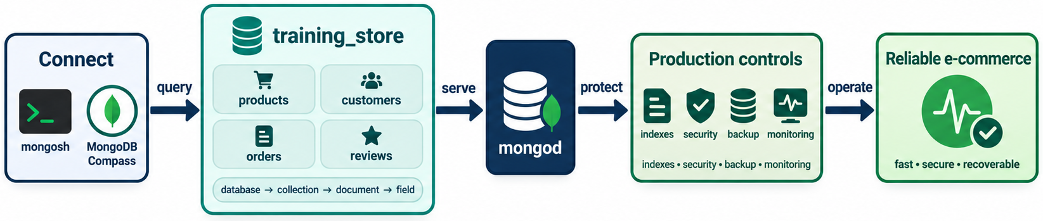
MODULE SUMMARY
MODULE 8
🧭
KEY POINTS
• Intentional data modeling and efficient queries
• Evidence-based indexes and layered security
• Tested backups, monitoring, and alerting
• Reliable replication and deliberate scaling
• Documented troubleshooting and controlled change
137
© 2026 by Innovation In Software Corporation
Notes:
This slide includes a diagram — Module Summary.
The slide title is: Module Summary.
The slide says: <div class="cols">.
The slide says: <div class="col-text">.
The slide says: </div>.
The slide says: <div class="col-visual">.
Bullet 1 on the slide: Intentional data modeling and efficient queries.
Bullet 2 on the slide: Evidence-based indexes and layered security.
Bullet 3 on the slide: Tested backups, monitoring, and alerting.
Bullet 4 on the slide: Reliable replication and deliberate scaling.
Bullet 5 on the slide: Documented troubleshooting and controlled change.
The figure on this slide is titled: Module 8 sits on Modules 1–7.

Slide 139
HANDS-ON LABS — TIME-BOX GUIDE
MODULE 8
🛠️
KEY POINTS
Full sequence: Labs 8.1–8.11 (~4 hours if every laptop does everything).
In the 3-day package, prefer:
1. Lab 8.2 query/projection
2. Lab 8.3 monthly pipeline (or 8.4 if 5.6 already landed)
3. Lab 8.6 validation on training_store_ops
4. Lab 8.9 backup/restore isolated
5. Lab 8.11 integrated challenge
Discussion labs 8.7, 8.8, 8.10 can be instructor-led with the worksheets.
138
© 2026 by Innovation In Software Corporation
Notes:
Let's look at Hands-on Labs — Time-box Guide.
The slide title is: Hands-on Labs — Time-box Guide.
The slide says: Full sequence: Labs 8.1–8.11 (~4 hours if every laptop does everything).
The slide says: In the 3-day package, prefer:.
The slide says: 1. Lab 8.2 query/projection.
The slide says: 2. Lab 8.3 monthly pipeline (or 8.4 if 5.6 already landed).
The slide says: 3. Lab 8.6 validation on training_store_ops.
The slide says: 4. Lab 8.9 backup/restore isolated.
The slide says: 5. Lab 8.11 integrated challenge.
The slide says: Discussion labs 8.7, 8.8, 8.10 can be instructor-led with the worksheets.
Number 1 on the slide: Lab 8.2 query/projection.
Number 2 on the slide: Lab 8.3 monthly pipeline (or 8.4 if 5.6 already landed).
Number 3 on the slide: Lab 8.6 validation on training_store_ops.
Number 4 on the slide: Lab 8.9 backup/restore isolated.
Number 5 on the slide: Lab 8.11 integrated challenge.

Slide 140
LAB 8.1 — DATA-MODEL REVIEW AND REPAIR
MODULE 8
🛠️
KEY POINTS
• Time: 25 min
• Inspect types, growth, and snapshots; propose validation and an XBAD migration note.
• Lab guide: Lab 8.1
139
© 2026 by Innovation In Software Corporation
Notes:
This slide includes a diagram — Lab 8.1 — Data-Model Review and Repair.
The slide title is: Lab 8.1 — Data-Model Review and Repair.
The slide says: <div class="cols">.
The slide says: <div class="col-text">.
The slide says: </div>.
The slide says: <div class="col-visual">.
Bullet 1 on the slide: Time: 25 min.
Bullet 2 on the slide: Inspect types, growth, and snapshots; propose validation and an XBAD migration note.
Bullet 3 on the slide: Lab guide: [Lab 8.1](../slide-exercises/module-08/lab-8.1-data-model-review-and-repair.md).
The figure on this slide is titled: Model repair.

Slide 141
LAB 8.1 — STEPS 1–2
MODULE 8
🛠️
KEY POINTS
LAB GUIDE Lab 8.1
Follow along (Windows) — key steps:
Step 1 — Inspect types and names
• Do: Run and record field-name and type surprises: use training_store db.products.find({}, { sku: 1, name: 1, price: 1, active: 1 }).limit(5) db.products.find({ sku: "XBAD" }, { sku: 1, price: 1 }) db.products.aggregate([ { $
• Expected: XBAD shows price as string. Healthy products show Decimal128. That mixed type is the catalog anti-pattern to repair.
Step 2 — Check growth and snapshots
• Do: Compare db.products.findOne({}, { reviews: 1, sku: 1 }) with db.reviews.findOne() and db.orders.findOne({ orderNumber: "O5001" }, { items: 1, customerId: 1, shippingAddress: 1 }). Note whether reviews are embedded
• Expected: Reviews live in reviews (good). Orders embed line snapshots and reference customerId (good). Call out any missing snapshot fields you would still add (for e
140
© 2026 by Innovation In Software Corporation
Notes:
This slide lists key points under Lab 8.1 — Steps 1–2.
The slide title is: Lab 8.1 — Steps 1–2.
The slide says: Lab guide: [Lab 8.1](../slide-exercises/module-08/lab-8.1-data-model-review-and-repair.md).
The slide says: Follow along (Windows) — key steps:.
Step 1 — Inspect types and names.
Step 2 — Check growth and snapshots.
Bullet 1 on the slide: Do: Run and record field-name and type surprises: use training_store db.products.find({}, { sku: 1, name: 1, price: 1, active: 1 }).limit(5) db.products.find({ sku: "XBAD" }, { sku: 1, price: 1 }) db.products.aggregate([ { $.
Bullet 2 on the slide: Expected: XBAD shows price as string. Healthy products show Decimal128. That mixed type is the catalog anti-pattern to repair.
Bullet 3 on the slide: Do: Compare db.products.findOne({}, { reviews: 1, sku: 1 }) with db.reviews.findOne() and db.orders.findOne({ orderNumber: "O5001" }, { items: 1, customerId: 1, shippingAddress: 1 }). Note whether reviews are embedded.
Bullet 4 on the slide: Expected: Reviews live in reviews (good). Orders embed line snapshots and reference customerId (good). Call out any missing snapshot fields you would still add (for e.

Slide 142
LAB 8.1 — STEPS 3–3
MODULE 8
🛠️
KEY POINTS
Follow along (Windows) — key steps:
Step 3 — Propose validation and migration
• Do: Write: (1) three validator rules for products, (2) what to do with XBAD, (3) whether to migrate in place or insert into a new collection first.
• Expected: Rules include sku string, Decimal128 price, Boolean active. XBAD is converted or quarantined. Prefer adding compatible fields and validationAction: "warn" o
141
© 2026 by Innovation In Software Corporation
Notes:
This slide lists key points under Lab 8.1 — Steps 3–3.
The slide title is: Lab 8.1 — Steps 3–3.
The slide says: Follow along (Windows) — key steps:.
Step 3 — Propose validation and migration.
Bullet 1 on the slide: Do: Write: (1) three validator rules for products, (2) what to do with XBAD, (3) whether to migrate in place or insert into a new collection first.
Bullet 2 on the slide: Expected: Rules include sku string, Decimal128 price, Boolean active. XBAD is converted or quarantined. Prefer adding compatible fields and validationAction: "warn" o.

Slide 143
LAB 8.2 — QUERY AND PROJECTION OPTIMIZATION
MODULE 8
🛠️
KEY POINTS
• Time: 25 min
• Baseline find({}), then filter, project, sort, limit, explain, and recommend an ESR index.
• Lab guide: Lab 8.2
142
© 2026 by Innovation In Software Corporation
Notes:
This slide includes a diagram — Lab 8.2 — Query and Projection Optimization.
The slide title is: Lab 8.2 — Query and Projection Optimization.
The slide says: <div class="cols">.
The slide says: <div class="col-text">.
The slide says: </div>.
The slide says: <div class="col-visual">.
Bullet 1 on the slide: Time: 25 min.
Bullet 2 on the slide: Baseline find({}), then filter, project, sort, limit, explain, and recommend an ESR index.
Bullet 3 on the slide: Lab guide: [Lab 8.2](../slide-exercises/module-08/lab-8.2-query-and-projection-optimization.md).
The figure on this slide is titled: Query optimization lab.

Slide 144
LAB 8.2 — STEPS 1–2
MODULE 8
🛠️
KEY POINTS
LAB GUIDE Lab 8.2
Follow along (Windows) — key steps:
Step 1 — Baseline the broad query
• Do: Run and record nReturned and totalDocsExamined: use training_store db.orders.find({}).explain("executionStats")
• Expected: The plan examines every order. nReturned equals the collection size. This is the ‘return everything’ anti-pattern.
Step 2 — Add filter, projection, sort, and limit
• Do: Look up C101’s _id, then run: const c101 = db.customers.findOne({ customerNumber: "C101" }).id db.orders.find( { customerId: c101, paymentStatus: "PAID" }, { id: 0, orderNumber: 1, fulfillmentStatus: 1, total: 1, cre
• Expected: Only C101 paid orders, shaped fields, newest first, at most ten documents.
143
© 2026 by Innovation In Software Corporation
Notes:
This slide lists key points under Lab 8.2 — Steps 1–2.
The slide title is: Lab 8.2 — Steps 1–2.
The slide says: Lab guide: [Lab 8.2](../slide-exercises/module-08/lab-8.2-query-and-projection-optimization.md).
The slide says: Follow along (Windows) — key steps:.
Step 1 — Baseline the broad query.
Step 2 — Add filter, projection, sort, and limit.
Bullet 1 on the slide: Do: Run and record nReturned and totalDocsExamined: use training_store db.orders.find({}).explain("executionStats").
Bullet 2 on the slide: Expected: The plan examines every order. nReturned equals the collection size. This is the ‘return everything’ anti-pattern.
Bullet 3 on the slide: Do: Look up C101’s _id, then run: const c101 = db.customers.findOne({ customerNumber: "C101" })._id db.orders.find( { customerId: c101, paymentStatus: "PAID" }, { _id: 0, orderNumber: 1, fulfillmentStatus: 1, total: 1, cre.
Bullet 4 on the slide: Expected: Only C101 paid orders, shaped fields, newest first, at most ten documents.

Slide 145
LAB 8.2 — STEPS 3–3
MODULE 8
🛠️
KEY POINTS
Follow along (Windows) — key steps:
Step 3 — Explain and recommend an index
• Do: Run .explain("executionStats") on the improved query. Record winning stage, docs examined, and whether a SORT stage appears. Write one candidate index.
• Expected: Likely COLLSCAN on this small set unless Module 6 indexes remain. Candidate { customerId: 1, paymentStatus: 1, createdAt: -1 }. Note examined vs returned.
144
© 2026 by Innovation In Software Corporation
Notes:
This slide lists key points under Lab 8.2 — Steps 3–3.
The slide title is: Lab 8.2 — Steps 3–3.
The slide says: Follow along (Windows) — key steps:.
Step 3 — Explain and recommend an index.
Bullet 1 on the slide: Do: Run .explain("executionStats") on the improved query. Record winning stage, docs examined, and whether a SORT stage appears. Write one candidate index.
Bullet 2 on the slide: Expected: Likely COLLSCAN on this small set unless Module 6 indexes remain. Candidate { customerId: 1, paymentStatus: 1, createdAt: -1 }. Note examined vs returned.

Slide 146
LAB 8.3 — AGGREGATION PIPELINE CONSTRUCTION
MODULE 8
🛠️
KEY POINTS
• Time: 30 min
• Monthly paid sales with six metrics; two $group stages so unwind does not inflate revenue.
• Lab guide: Lab 8.3
145
© 2026 by Innovation In Software Corporation
Notes:
This slide includes a diagram — Lab 8.3 — Aggregation Pipeline Construction.
The slide title is: Lab 8.3 — Aggregation Pipeline Construction.
The slide says: <div class="cols">.
The slide says: <div class="col-text">.
The slide says: </div>.
The slide says: <div class="col-visual">.
Bullet 1 on the slide: Time: 30 min.
Bullet 2 on the slide: Monthly paid sales with six metrics; two $group stages so unwind does not inflate revenue.
Bullet 3 on the slide: Lab guide: [Lab 8.3](../slide-exercises/module-08/lab-8.3-aggregation-pipeline-construction.md).
The figure on this slide is titled: Monthly sales pipeline.

Slide 147
LAB 8.3 — STEPS 1–2
MODULE 8
🛠️
KEY POINTS
LAB GUIDE Lab 8.3
Follow along (Windows) — key steps:
Step 1 — Filter and stamp the month
• Do: Start a pipeline that matches paymentStatus: "PAID" and sets month from createdAt (UTC date-to-string YYYY-MM is acceptable in training). db.orders.aggregate([ { $match: { paymentStatus: "PAID" } }, { $set: { mon
• Expected: About 13 paid orders remain. Each document has a month such as 2026-07.
Step 2 — Unwind safely, then group twice
• Do: Unwind items, group by { month: "$month", orderNumber: "$orderNumber" } keeping total with $first, customerId with $first, and units as $sum of $items.quantity. Then group by month: `orderCount: { $sum:
• Expected: Revenue is not multiplied by line count. Units come from item quantities. July–September 2026 months appear.
146
© 2026 by Innovation In Software Corporation
Notes:
This slide lists key points under Lab 8.3 — Steps 1–2.
The slide title is: Lab 8.3 — Steps 1–2.
The slide says: Lab guide: [Lab 8.3](../slide-exercises/module-08/lab-8.3-aggregation-pipeline-construction.md).
The slide says: Follow along (Windows) — key steps:.
Step 1 — Filter and stamp the month.
Step 2 — Unwind safely, then group twice.
Bullet 1 on the slide: Do: Start a pipeline that matches paymentStatus: "PAID" and sets month from createdAt (UTC date-to-string YYYY-MM is acceptable in training). db.orders.aggregate([ { $match: { paymentStatus: "PAID" } }, { $set: { mon.
Bullet 2 on the slide: Expected: About 13 paid orders remain. Each document has a month such as 2026-07.
Bullet 3 on the slide: Do: Unwind items, group by { month: "$month", orderNumber: "$orderNumber" } keeping total with $first, customerId with $first, and units as $sum of $items.quantity. Then group by month: `orderCount: { $sum:.
Bullet 4 on the slide: Expected: Revenue is not multiplied by line count. Units come from item quantities. July–September 2026 months appear.

Slide 148
LAB 8.3 — STEPS 3–3
MODULE 8
🛠️
KEY POINTS
Follow along (Windows) — key steps:
Step 3 — Sort and shape
• Do: Add $set for uniqueCustomerCount: { $size: "$uniqueCustomers" } and averageOrderValue: { $divide: ["$revenue", "$orderCount"] }, $sort by _id / month, and a final $project that outputs month, orderCount, reve
• Expected: One document per month, sorted, with all six business metrics. No leftover _id object unless you alias it to month.
147
© 2026 by Innovation In Software Corporation
Notes:
This slide lists key points under Lab 8.3 — Steps 3–3.
The slide title is: Lab 8.3 — Steps 3–3.
The slide says: Follow along (Windows) — key steps:.
Step 3 — Sort and shape.
Bullet 1 on the slide: Do: Add $set for uniqueCustomerCount: { $size: "$uniqueCustomers" } and averageOrderValue: { $divide: ["$revenue", "$orderCount"] }, $sort by _id / month, and a final $project that outputs month, orderCount, reve.
Bullet 2 on the slide: Expected: One document per month, sorted, with all six business metrics. No leftover _id object unless you alias it to month.

Slide 149
LAB 8.4 — AGGREGATION PIPELINE TUNING
MODULE 8
🛠️
KEY POINTS
• Time: 25 min
• Compare lookup-first versus match-first; verify C101 revenue by hand.
• Lab guide: Lab 8.4
148
© 2026 by Innovation In Software Corporation
Notes:
This slide includes a diagram — Lab 8.4 — Aggregation Pipeline Tuning.
The slide title is: Lab 8.4 — Aggregation Pipeline Tuning.
The slide says: <div class="cols">.
The slide says: <div class="col-text">.
The slide says: </div>.
The slide says: <div class="col-visual">.
Bullet 1 on the slide: Time: 25 min.
Bullet 2 on the slide: Compare lookup-first versus match-first; verify C101 revenue by hand.
Bullet 3 on the slide: Lab guide: [Lab 8.4](../slide-exercises/module-08/lab-8.4-aggregation-pipeline-tuning.md).
The figure on this slide is titled: Pipeline tuning.

Slide 150
LAB 8.4 — STEPS 1–2
MODULE 8
🛠️
KEY POINTS
LAB GUIDE Lab 8.4
Follow along (Windows) — key steps:
Step 1 — Run the slow shape
• Do: Run this inefficient pipeline once and save the result documents plus explain("executionStats") notes (stage order, docs leaving $lookup): db.orders.aggregate([ { $lookup: { from: "customers", localField: "customerId
• Expected: Lookup and unwind run on unpaid orders too. Revenue is inflated where orders have multiple items. Record the output even if the numbers look ‘busy’.
Step 2 — Rewrite and compare
• Do: Rewrite: $match PAID first, $project only fields you need, $group by customerId summing $total without unwinding, then $lookup names, then $sort. Compare revenue to a manual find of paid totals for C1
• Expected: C101’s paid total sum matches the grouped revenue. Unpaid orders never enter $lookup. Explain shows a smaller working set after $match.
149
© 2026 by Innovation In Software Corporation
Notes:
This slide lists key points under Lab 8.4 — Steps 1–2.
The slide title is: Lab 8.4 — Steps 1–2.
The slide says: Lab guide: [Lab 8.4](../slide-exercises/module-08/lab-8.4-aggregation-pipeline-tuning.md).
The slide says: Follow along (Windows) — key steps:.
Step 1 — Run the slow shape.
Step 2 — Rewrite and compare.
Bullet 1 on the slide: Do: Run this inefficient pipeline once and save the result documents plus explain("executionStats") notes (stage order, docs leaving $lookup): db.orders.aggregate([ { $lookup: { from: "customers", localField: "customerId.
Bullet 2 on the slide: Expected: Lookup and unwind run on unpaid orders too. Revenue is inflated where orders have multiple items. Record the output even if the numbers look ‘busy’.
Bullet 3 on the slide: Do: Rewrite: $match PAID first, $project only fields you need, $group by customerId summing $total without unwinding, then $lookup names, then $sort. Compare revenue to a manual find of paid totals for C1.
Bullet 4 on the slide: Expected: C101’s paid total sum matches the grouped revenue. Unpaid orders never enter $lookup. Explain shows a smaller working set after $match.

Slide 151
LAB 8.4 — STEPS 3–3
MODULE 8
🛠️
KEY POINTS
Follow along (Windows) — key steps:
Step 3 — Index recommendation
• Do: Write whether { paymentStatus: 1, createdAt: -1 } (or { paymentStatus: 1 }) would help this pipeline’s $match, and whether a $lookup on customers._id already has an index.
• Expected: _id is already indexed. A paymentStatus (and optional date) index can support the early $match. Do not index every grouped field.
150
© 2026 by Innovation In Software Corporation
Notes:
This slide lists key points under Lab 8.4 — Steps 3–3.
The slide title is: Lab 8.4 — Steps 3–3.
The slide says: Follow along (Windows) — key steps:.
Step 3 — Index recommendation.
Bullet 1 on the slide: Do: Write whether { paymentStatus: 1, createdAt: -1 } (or { paymentStatus: 1 }) would help this pipeline’s $match, and whether a $lookup on customers._id already has an index.
Bullet 2 on the slide: Expected: _id is already indexed. A paymentStatus (and optional date) index can support the early $match. Do not index every grouped field.

Slide 152
LAB 8.5 — INDEX DESIGN AND VALIDATION
MODULE 8
🛠️
KEY POINTS
• Time: 25 min
• Inventory indexes, create history and paid-report keys, explain, do not drop.
• Lab guide: Lab 8.5
151
© 2026 by Innovation In Software Corporation
Notes:
This slide includes a diagram — Lab 8.5 — Index Design and Validation.
The slide title is: Lab 8.5 — Index Design and Validation.
The slide says: <div class="cols">.
The slide says: <div class="col-text">.
The slide says: </div>.
The slide says: <div class="col-visual">.
Bullet 1 on the slide: Time: 25 min.
Bullet 2 on the slide: Inventory indexes, create history and paid-report keys, explain, do not drop.
Bullet 3 on the slide: Lab guide: [Lab 8.5](../slide-exercises/module-08/lab-8.5-index-design-and-validation.md).
The figure on this slide is titled: Index validation.

Slide 153
LAB 8.5 — STEPS 1–2
MODULE 8
🛠️
KEY POINTS
LAB GUIDE Lab 8.5
Follow along (Windows) — key steps:
Step 1 — List current indexes
• Do: Run db.orders.getIndexes(), db.products.getIndexes(), and db.reviews.getIndexes(). Note leftovers from Module 6.
• Expected: A written inventory exists. _id_ is present. Extra indexes from Day 3 morning are labeled, not blindly dropped.
Step 2 — Create or reuse two useful indexes
• Do: If missing, create training indexes (names optional): db.orders.createIndex( { customerId: 1, paymentStatus: 1, createdAt: -1 }, { name: "ixorderscustpaydate" } ) db.orders.createIndex( { paymentStatus: 1, createdAt:
• Expected: Winning plans show IXSCAN (unless a better leftover index wins). Examined counts are written down. Prefix overlap between the two new indexes is noted.
152
© 2026 by Innovation In Software Corporation
Notes:
This slide lists key points under Lab 8.5 — Steps 1–2.
The slide title is: Lab 8.5 — Steps 1–2.
The slide says: Lab guide: [Lab 8.5](../slide-exercises/module-08/lab-8.5-index-design-and-validation.md).
The slide says: Follow along (Windows) — key steps:.
Step 1 — List current indexes.
Step 2 — Create or reuse two useful indexes.
Bullet 1 on the slide: Do: Run db.orders.getIndexes(), db.products.getIndexes(), and db.reviews.getIndexes(). Note leftovers from Module 6.
Bullet 2 on the slide: Expected: A written inventory exists. _id_ is present. Extra indexes from Day 3 morning are labeled, not blindly dropped.
Bullet 3 on the slide: Do: If missing, create training indexes (names optional): db.orders.createIndex( { customerId: 1, paymentStatus: 1, createdAt: -1 }, { name: "ix_orders_cust_pay_date" } ) db.orders.createIndex( { paymentStatus: 1, createdAt:.
Bullet 4 on the slide: Expected: Winning plans show IXSCAN (unless a better leftover index wins). Examined counts are written down. Prefix overlap between the two new indexes is noted.

Slide 154
LAB 8.5 — STEPS 3–3
MODULE 8
🛠️
KEY POINTS
Follow along (Windows) — key steps:
Step 3 — Overlap decision
• Do: State whether both new indexes should survive in production, or whether one prefix makes the other a hide candidate. Do not drop indexes in this lab.
• Expected: A sentence exists: keep both only if both query shapes are hot; otherwise hide the redundant one after monitoring. No dropIndex in this lab.
153
© 2026 by Innovation In Software Corporation
Notes:
This slide lists key points under Lab 8.5 — Steps 3–3.
The slide title is: Lab 8.5 — Steps 3–3.
The slide says: Follow along (Windows) — key steps:.
Step 3 — Overlap decision.
Bullet 1 on the slide: Do: State whether both new indexes should survive in production, or whether one prefix makes the other a hide candidate. Do not drop indexes in this lab.
Bullet 2 on the slide: Expected: A sentence exists: keep both only if both query shapes are hot; otherwise hide the redundant one after monitoring. No dropIndex in this lab.

Slide 155
LAB 8.6 — SCHEMA VALIDATION IMPLEMENTATION
MODULE 8
🛠️
KEY POINTS
• Time: 20 min
• Validator on trainingstoreops.orders_validated; prove valid and three invalid inserts.
• Lab guide: Lab 8.6
154
© 2026 by Innovation In Software Corporation
Notes:
This slide includes a diagram — Lab 8.6 — Schema Validation Implementation.
The slide title is: Lab 8.6 — Schema Validation Implementation.
The slide says: <div class="cols">.
The slide says: <div class="col-text">.
The slide says: </div>.
The slide says: <div class="col-visual">.
Bullet 1 on the slide: Time: 20 min.
Bullet 2 on the slide: Validator on training_store_ops.orders_validated; prove valid and three invalid inserts.
Bullet 3 on the slide: Lab guide: [Lab 8.6](../slide-exercises/module-08/lab-8.6-schema-validation-implementation.md).
The figure on this slide is titled: Collection validation.

Slide 156
LAB 8.6 — STEPS 1–2
MODULE 8
🛠️
KEY POINTS
LAB GUIDE Lab 8.6
Follow along (Windows) — key steps:
Step 1 — Create a scratch collection
• Do: Copy two paid orders into a new collection so production-shaped data exists without locking orders: use trainingstoreops db.ordersvalidated.drop() db.getSiblingDB("trainingstore").orders.find({ paymentStatus: "PAID
• Expected: training_store_ops.orders_validated has two documents.
Step 2 — Attach the validator
• Do: Run collMod (or createCollection) with $jsonSchema requiring orderNumber (string), customerId (objectId), items (array minItems: 1), paymentStatus enum PAID/PENDING/FAILED, fulfillmentStatus enum
• Expected: collMod / create succeeds. db.getCollectionInfos({ name: "orders_validated" }) shows the validator.
155
© 2026 by Innovation In Software Corporation
Notes:
This slide lists key points under Lab 8.6 — Steps 1–2.
The slide title is: Lab 8.6 — Steps 1–2.
The slide says: Lab guide: [Lab 8.6](../slide-exercises/module-08/lab-8.6-schema-validation-implementation.md).
The slide says: Follow along (Windows) — key steps:.
Step 1 — Create a scratch collection.
Step 2 — Attach the validator.
Bullet 1 on the slide: Do: Copy two paid orders into a new collection so production-shaped data exists without locking orders: use training_store_ops db.orders_validated.drop() db.getSiblingDB("training_store").orders.find({ paymentStatus: "PAID.
Bullet 2 on the slide: Expected: training_store_ops.orders_validated has two documents.
Bullet 3 on the slide: Do: Run collMod (or createCollection) with $jsonSchema requiring orderNumber (string), customerId (objectId), items (array minItems: 1), paymentStatus enum PAID/PENDING/FAILED, fulfillmentStatus enum.
Bullet 4 on the slide: Expected: collMod / create succeeds. db.getCollectionInfos({ name: "orders_validated" }) shows the validator.

Slide 157
LAB 8.6 — STEPS 3–3
MODULE 8
🛠️
KEY POINTS
Follow along (Windows) — key steps:
Step 3 — Prove accept and reject
• Do: Insert one valid order (new orderNumber). Then attempt: missing orderNumber; total: "9.99"; paymentStatus: "PAID_NOW". Record the error messages.
• Expected: Valid insert succeeds. Each invalid insert is rejected. Existing copied documents remain.
156
© 2026 by Innovation In Software Corporation
Notes:
This slide lists key points under Lab 8.6 — Steps 3–3.
The slide title is: Lab 8.6 — Steps 3–3.
The slide says: Follow along (Windows) — key steps:.
Step 3 — Prove accept and reject.
Bullet 1 on the slide: Do: Insert one valid order (new orderNumber). Then attempt: missing orderNumber; total: "9.99"; paymentStatus: "PAID_NOW". Record the error messages.
Bullet 2 on the slide: Expected: Valid insert succeeds. Each invalid insert is rejected. Existing copied documents remain.

Slide 158
LAB 8.7 — SECURITY CONFIGURATION REVIEW
MODULE 8
🛠️
KEY POINTS
• Time: 25 min
• Mark findings on the fictional YAML; P1–P3 remediation; role sketches with redacted passwords.
• Lab guide: Lab 8.7
157
© 2026 by Innovation In Software Corporation
Notes:
This slide includes a diagram — Lab 8.7 — Security Configuration Review.
The slide title is: Lab 8.7 — Security Configuration Review.
The slide says: <div class="cols">.
The slide says: <div class="col-text">.
The slide says: </div>.
The slide says: <div class="col-visual">.
Bullet 1 on the slide: Time: 25 min.
Bullet 2 on the slide: Mark findings on the fictional YAML; P1–P3 remediation; role sketches with redacted passwords.
Bullet 3 on the slide: Lab guide: [Lab 8.7](../slide-exercises/module-08/lab-8.7-security-configuration-review.md).
The figure on this slide is titled: Unsafe configuration.

Slide 159
LAB 8.7 — STEPS 1–2
MODULE 8
🛠️
KEY POINTS
LAB GUIDE Lab 8.7
Follow along (Windows) — key steps:
Step 1 — Mark every finding
• Do: Read the fictional configuration in the worksheet below. List every unsafe item under network, identity, encryption, secrets, backup, logging, and environment.
• Expected: Findings include bindIp: 0.0.0.0 with no auth, disabled security, shared admin/admin, mongodb:// without TLS, URI in source, open backup bucket, verbose log
Step 2 — Prioritize remediation
• Do: Write a P1 / P2 / P3 list with owners (role names, not classmates’ personal emails). P1 must be items that would stop a go-live.
• Expected: P1: enable auth, restrict bind/firewall, TLS, remove secrets from git, stop public backup. P2: least-privilege roles, log redaction, env separation. P3: audit l
158
© 2026 by Innovation In Software Corporation
Notes:
This slide lists key points under Lab 8.7 — Steps 1–2.
The slide title is: Lab 8.7 — Steps 1–2.
The slide says: Lab guide: [Lab 8.7](../slide-exercises/module-08/lab-8.7-security-configuration-review.md).
The slide says: Follow along (Windows) — key steps:.
Step 1 — Mark every finding.
Step 2 — Prioritize remediation.
Bullet 1 on the slide: Do: Read the fictional configuration in the worksheet below. List every unsafe item under network, identity, encryption, secrets, backup, logging, and environment.
Bullet 2 on the slide: Expected: Findings include bindIp: 0.0.0.0 with no auth, disabled security, shared admin/admin, mongodb:// without TLS, URI in source, open backup bucket, verbose log.
Bullet 3 on the slide: Do: Write a P1 / P2 / P3 list with owners (role names, not classmates’ personal emails). P1 must be items that would stop a go-live.
Bullet 4 on the slide: Expected: P1: enable auth, restrict bind/firewall, TLS, remove secrets from git, stop public backup. P2: least-privilege roles, log redaction, env separation. P3: audit l.

Slide 160
LAB 8.7 — STEPS 3–3
MODULE 8
🛠️
KEY POINTS
Follow along (Windows) — key steps:
Step 3 — Design roles only
• Do: Do not enable authentication on the shared class database. Write createRole / createUser sketches for appUser and reportUser using placeholder names only.
• Expected: appUser: readWrite on training_store. reportUser: read on training_store. Neither is root. No real passwords in the notes.
159
© 2026 by Innovation In Software Corporation
Notes:
This slide lists key points under Lab 8.7 — Steps 3–3.
The slide title is: Lab 8.7 — Steps 3–3.
The slide says: Follow along (Windows) — key steps:.
Step 3 — Design roles only.
Bullet 1 on the slide: Do: Do not enable authentication on the shared class database. Write createRole / createUser sketches for appUser and reportUser using placeholder names only.
Bullet 2 on the slide: Expected: appUser: readWrite on training_store. reportUser: read on training_store. Neither is root. No real passwords in the notes.

Slide 161
LAB 8.8 — MONITORING AND LOG ANALYSIS
MODULE 8
🛠️
KEY POINTS
• Time: 25 min
• Timeline from sample logs; cause is the filter field/case change; propose an alert.
• Lab guide: Lab 8.8
160
© 2026 by Innovation In Software Corporation
Notes:
This slide includes a diagram — Lab 8.8 — Monitoring and Log Analysis.
The slide title is: Lab 8.8 — Monitoring and Log Analysis.
The slide says: <div class="cols">.
The slide says: <div class="col-text">.
The slide says: </div>.
The slide says: <div class="col-visual">.
Bullet 1 on the slide: Time: 25 min.
Bullet 2 on the slide: Timeline from sample logs; cause is the filter field/case change; propose an alert.
Bullet 3 on the slide: Lab guide: [Lab 8.8](../slide-exercises/module-08/lab-8.8-monitoring-and-log-analysis.md).
The figure on this slide is titled: Log correlation.

Slide 162
LAB 8.8 — STEPS 1–2
MODULE 8
🛠️
KEY POINTS
LAB GUIDE Lab 8.8
Follow along (Windows) — key steps:
Step 1 — Build the timeline
• Do: Using the sample log and metric extract below, write a timeline with at least four rows: time, signal, source (app or mongod).
• Expected: Order is roughly: deploy at 14:02 → query shape change in app logs → documentsExamined rise at 14:04 → slow query log lines → customer checkout latency. No elec
Step 2 — Name cause and alert
• Do: State the likely root cause in one sentence. Write one alert (metric, threshold idea, severity) that would have paged sooner, and one runbook step to add.
• Expected: Cause: post-deploy filter no longer matches the index. Alert: slow query rate or examined/returned ratio vs baseline, high severity during checkout hours. Runbo
161
© 2026 by Innovation In Software Corporation
Notes:
This slide lists key points under Lab 8.8 — Steps 1–2.
The slide title is: Lab 8.8 — Steps 1–2.
The slide says: Lab guide: [Lab 8.8](../slide-exercises/module-08/lab-8.8-monitoring-and-log-analysis.md).
The slide says: Follow along (Windows) — key steps:.
Step 1 — Build the timeline.
Step 2 — Name cause and alert.
Bullet 1 on the slide: Do: Using the sample log and metric extract below, write a timeline with at least four rows: time, signal, source (app or mongod).
Bullet 2 on the slide: Expected: Order is roughly: deploy at 14:02 → query shape change in app logs → documentsExamined rise at 14:04 → slow query log lines → customer checkout latency. No elec.
Bullet 3 on the slide: Do: State the likely root cause in one sentence. Write one alert (metric, threshold idea, severity) that would have paged sooner, and one runbook step to add.
Bullet 4 on the slide: Expected: Cause: post-deploy filter no longer matches the index. Alert: slow query rate or examined/returned ratio vs baseline, high severity during checkout hours. Runbo.

Slide 163
LAB 8.8 — STEPS 3–3
MODULE 8
🛠️
KEY POINTS
Follow along (Windows) — key steps:
Step 3 — Recommend a dashboard change
• Do: Name two tiles that should sit next to each other so this incident is obvious next time.
• Expected: Application p99 latency beside mongod slow-ops / documents examined (or query planner collection-scan count). CPU-only would have missed it.
162
© 2026 by Innovation In Software Corporation
Notes:
This slide lists key points under Lab 8.8 — Steps 3–3.
The slide title is: Lab 8.8 — Steps 3–3.
The slide says: Follow along (Windows) — key steps:.
Step 3 — Recommend a dashboard change.
Bullet 1 on the slide: Do: Name two tiles that should sit next to each other so this incident is obvious next time.
Bullet 2 on the slide: Expected: Application p99 latency beside mongod slow-ops / documents examined (or query planner collection-scan count). CPU-only would have missed it.

Slide 164
LAB 8.9 — BACKUP AND RESTORE VERIFICATION
MODULE 8
🛠️
KEY POINTS
• Time: 30 min
• Dump trainingstore; restore to trainingstore_restore; verify counts, sample, indexes, duration vs RTO.
• Lab guide: Lab 8.9
163
© 2026 by Innovation In Software Corporation
Notes:
This slide includes a diagram — Lab 8.9 — Backup and Restore Verification.
The slide title is: Lab 8.9 — Backup and Restore Verification.
The slide says: <div class="cols">.
The slide says: <div class="col-text">.
The slide says: </div>.
The slide says: <div class="col-visual">.
Bullet 1 on the slide: Time: 30 min.
Bullet 2 on the slide: Dump training_store; restore to training_store_restore; verify counts, sample, indexes, duration vs RTO.
Bullet 3 on the slide: Lab guide: [Lab 8.9](../slide-exercises/module-08/lab-8.9-backup-and-restore-verification.md).
The figure on this slide is titled: Backup and restore.

Slide 165
LAB 8.9 — STEPS 1–2
MODULE 8
🛠️
KEY POINTS
LAB GUIDE Lab 8.9
Follow along (Windows) — key steps:
Step 1 — Record the source
• Do: In notes: db.orders.countDocuments(), db.products.countDocuments(), three orderNumber values, and db.orders.getIndexes(). Use training_store.
• Expected: Counts match the loader (about 17 orders, 13 products) unless the class mutated data — write the actual numbers. Three order numbers and index names are recorde
Step 2 — Take a backup
• Do: From the course repo in PowerShell (MongoDB Database Tools must be on PATH), run: New-Item -ItemType Directory -Force -Path .\datasets\backups | Out-Null mongodump --uri="mongodb://localhost:27017" --db=training_store --
• Expected: A dump directory (or JSON export) exists. The command finished without authentication errors (or the instructor supplied a URI).
164
© 2026 by Innovation In Software Corporation
Notes:
This slide lists key points under Lab 8.9 — Steps 1–2.
The slide title is: Lab 8.9 — Steps 1–2.
The slide says: Lab guide: [Lab 8.9](../slide-exercises/module-08/lab-8.9-backup-and-restore-verification.md).
The slide says: Follow along (Windows) — key steps:.
Step 1 — Record the source.
Step 2 — Take a backup.
Bullet 1 on the slide: Do: In notes: db.orders.countDocuments(), db.products.countDocuments(), three orderNumber values, and db.orders.getIndexes(). Use training_store.
Bullet 2 on the slide: Expected: Counts match the loader (about 17 orders, 13 products) unless the class mutated data — write the actual numbers. Three order numbers and index names are recorde.
Bullet 3 on the slide: Do: From the course repo in PowerShell (MongoDB Database Tools must be on PATH), run: New-Item -ItemType Directory -Force -Path .\datasets\backups | Out-Null mongodump --uri="mongodb://localhost:27017" --db=training_store --.
Bullet 4 on the slide: Expected: A dump directory (or JSON export) exists. The command finished without authentication errors (or the instructor supplied a URI).

Slide 166
LAB 8.9 — STEPS 3–3
MODULE 8
🛠️
KEY POINTS
Follow along (Windows) — key steps:
Step 3 — Restore isolated and verify
• Do: Restore into a new database name: mongorestore --uri="mongodb://localhost:27017" --nsFrom="trainingstore.*" --nsTo="trainingstorerestore.*" --drop ".\datasets\backups\lab89\trainingstore" Then in mongosh: compa
• Expected: Counts match the source note. Sample order exists. Indexes are present (rebuild may apply for some logical imports). Elapsed time is written and compared to a c
165
© 2026 by Innovation In Software Corporation
Notes:
This slide lists key points under Lab 8.9 — Steps 3–3.
The slide title is: Lab 8.9 — Steps 3–3.
The slide says: Follow along (Windows) — key steps:.
Step 3 — Restore isolated and verify.
Bullet 1 on the slide: Do: Restore into a new database name: mongorestore --uri="mongodb://localhost:27017" --nsFrom="training_store." --nsTo="training_store_restore." --drop ".\datasets\backups\lab89\training_store" Then in mongosh: compa.
Bullet 2 on the slide: Expected: Counts match the source note. Sample order exists. Indexes are present (rebuild may apply for some logical imports). Elapsed time is written and compared to a c.

Slide 167
LAB 8.10 — TROUBLESHOOTING CHALLENGE
MODULE 8
⚠️
KEY POINTS
• Time: 30 min
• Five concurrent symptoms; do not collapse them; ordered investigation plus verify steps.
• Lab guide: Lab 8.10
166
© 2026 by Innovation In Software Corporation
Notes:
This slide includes a diagram — Lab 8.10 — Troubleshooting Challenge.
The slide title is: Lab 8.10 — Troubleshooting Challenge.
The slide says: <div class="cols">.
The slide says: <div class="col-text">.
The slide says: </div>.
The slide says: <div class="col-visual">.
Bullet 1 on the slide: Time: 30 min.
Bullet 2 on the slide: Five concurrent symptoms; do not collapse them; ordered investigation plus verify steps.
Bullet 3 on the slide: Lab guide: [Lab 8.10](../slide-exercises/module-08/lab-8.10-troubleshooting-challenge.md).
The figure on this slide is titled: Multi-incident challenge.

Slide 168
LAB 8.10 — STEPS 1–2
MODULE 8
🛠️
KEY POINTS
LAB GUIDE Lab 8.10
Follow along (Windows) — key steps:
Step 1 — Separate the incidents
• Do: Symptoms: product browsing is slow; some orders are missing from a report; secondary lag is increasing; authentication failures appear in logs; disk utilization is approaching its threshold. Write five problem statements
• Expected: Five independent hypotheses exist (for example: missing catalog index; report $match type/status bug; secondary I/O or network; brute force or bad app secret;
Step 2 — Order the investigation
• Do: Rank what you would check first for a live checkout site and why. Attach one evidence source per symptom (explain, log field, rs.printSecondaryReplicationInfo(), auth log, db.stats() / disk).
• Expected: Auth failures and disk may be P1 if they threaten availability; lag if oplog is at risk; slow browse if revenue is hurting; missing report rows if finance is bl
167
© 2026 by Innovation In Software Corporation
Notes:
This slide lists key points under Lab 8.10 — Steps 1–2.
The slide title is: Lab 8.10 — Steps 1–2.
The slide says: Lab guide: [Lab 8.10](../slide-exercises/module-08/lab-8.10-troubleshooting-challenge.md).
The slide says: Follow along (Windows) — key steps:.
Step 1 — Separate the incidents.
Step 2 — Order the investigation.
Bullet 1 on the slide: Do: Symptoms: product browsing is slow; some orders are missing from a report; secondary lag is increasing; authentication failures appear in logs; disk utilization is approaching its threshold. Write five problem statements.
Bullet 2 on the slide: Expected: Five independent hypotheses exist (for example: missing catalog index; report $match type/status bug; secondary I/O or network; brute force or bad app secret;.
Bullet 3 on the slide: Do: Rank what you would check first for a live checkout site and why. Attach one evidence source per symptom (explain, log field, rs.printSecondaryReplicationInfo(), auth log, db.stats() / disk).
Bullet 4 on the slide: Expected: Auth failures and disk may be P1 if they threaten availability; lag if oplog is at risk; slow browse if revenue is hurting; missing report rows if finance is bl.

Slide 169
LAB 8.10 — STEPS 3–3
MODULE 8
🛠️
KEY POINTS
Follow along (Windows) — key steps:
Step 3 — Actions and verification
• Do: For each of the five: one immediate action, one long-term correction, one verification signal.
• Expected: Table with 5 rows. Immediate actions are reversible (hide index, rotate a leaked demo password, page storage). Verification is a metric or query result, not ‘lo
168
© 2026 by Innovation In Software Corporation
Notes:
This slide lists key points under Lab 8.10 — Steps 3–3.
The slide title is: Lab 8.10 — Steps 3–3.
The slide says: Follow along (Windows) — key steps:.
Step 3 — Actions and verification.
Bullet 1 on the slide: Do: For each of the five: one immediate action, one long-term correction, one verification signal.
Bullet 2 on the slide: Expected: Table with 5 rows. Immediate actions are reversible (hide index, rotate a leaked demo password, page storage). Verification is a metric or query result, not ‘lo.

Slide 170
LAB 8.11 — FINAL INTEGRATED PRODUCTION CHALLENGE
MODULE 8
🛠️
KEY POINTS
• Time: 45–60 min
• Schema fix, validation, pipeline, explains, ops pack, and a scored checklist.
• Lab guide: Lab 8.11
169
© 2026 by Innovation In Software Corporation
Notes:
This slide includes a diagram — Lab 8.11 — Final Integrated Production Challenge.
The slide title is: Lab 8.11 — Final Integrated Production Challenge.
The slide says: <div class="cols">.
The slide says: <div class="col-text">.
The slide says: </div>.
The slide says: <div class="col-visual">.
Bullet 1 on the slide: Time: 45–60 min.
Bullet 2 on the slide: Schema fix, validation, pipeline, explains, ops pack, and a scored checklist.
Bullet 3 on the slide: Lab guide: [Lab 8.11](../slide-exercises/module-08/lab-8.11-final-integrated-production-challenge.md).
The figure on this slide is titled: Integrated production challenge.

Slide 171
LAB 8.11 — STEPS 1–2
MODULE 8
🛠️
KEY POINTS
LAB GUIDE Lab 8.11
Follow along (Windows) — key steps:
Step 1 — Fix one schema problem
• Do: Document XBAD’s string price (or another real defect you found). On training_store_ops, copy products and convert the bad price or quarantine the document. Do not silently rewrite historical orders.
• Expected: A before/after note exists. training_store catalog may stay unchanged; the ops copy shows the repaired type.
Step 2 — Validation + monthly pipeline
• Do: Reuse or complete Lab 8.6 validation on orders_validated. Run your Lab 8.3/8.4 monthly paid-sales pipeline against training_store.orders and save the result documents.
• Expected: Validator rejects a bad insert. Pipeline output has month, order count, revenue, AOV, unique customers, units sold.
170
© 2026 by Innovation In Software Corporation
Notes:
This slide lists key points under Lab 8.11 — Steps 1–2.
The slide title is: Lab 8.11 — Steps 1–2.
The slide says: Lab guide: [Lab 8.11](../slide-exercises/module-08/lab-8.11-final-integrated-production-challenge.md).
The slide says: Follow along (Windows) — key steps:.
Step 1 — Fix one schema problem.
Step 2 — Validation + monthly pipeline.
Bullet 1 on the slide: Do: Document XBAD’s string price (or another real defect you found). On training_store_ops, copy products and convert the bad price or quarantine the document. Do not silently rewrite historical orders.
Bullet 2 on the slide: Expected: A before/after note exists. training_store catalog may stay unchanged; the ops copy shows the repaired type.
Bullet 3 on the slide: Do: Reuse or complete Lab 8.6 validation on orders_validated. Run your Lab 8.3/8.4 monthly paid-sales pipeline against training_store.orders and save the result documents.
Bullet 4 on the slide: Expected: Validator rejects a bad insert. Pipeline output has month, order count, revenue, AOV, unique customers, units sold.

Slide 172
LAB 8.11 — STEPS 3–4
MODULE 8
🛠️
KEY POINTS
Follow along (Windows) — key steps:
Step 3 — Indexes and explain
• Do: Ensure at least one history index and one paid-report index exist (create on training_store only if the instructor allows Day 3 leftovers). Explain the C101 history query and the pipeline $match. Record IXSCAN vs COL
• Expected: Two explain summaries are in the notes. Overlap is mentioned if both indexes share a prefix.
Step 4 — Ops pack
• Do: In one page: least-privilege table (app vs report vs admin); RPO/RTO for orders; three critical alerts; one runbook (backup failed or no primary); checklist scores for the six production-readiness areas.
• Expected: The page is complete. Classification is Ready with conditions or Not ready, with evidence. No production-ready claim without auth, tested restore, and restricte
171
© 2026 by Innovation In Software Corporation
Notes:
This slide lists key points under Lab 8.11 — Steps 3–4.
The slide title is: Lab 8.11 — Steps 3–4.
The slide says: Follow along (Windows) — key steps:.
Step 3 — Indexes and explain.
Step 4 — Ops pack.
Bullet 1 on the slide: Do: Ensure at least one history index and one paid-report index exist (create on training_store only if the instructor allows Day 3 leftovers). Explain the C101 history query and the pipeline $match. Record IXSCAN vs COL.
Bullet 2 on the slide: Expected: Two explain summaries are in the notes. Overlap is mentioned if both indexes share a prefix.
Bullet 3 on the slide: Do: In one page: least-privilege table (app vs report vs admin); RPO/RTO for orders; three critical alerts; one runbook (backup failed or no primary); checklist scores for the six production-readiness areas.
Bullet 4 on the slide: Expected: The page is complete. Classification is Ready with conditions or Not ready, with evidence. No production-ready claim without auth, tested restore, and restricte.

Slide 173
EXERCISE 8.14 — PRODUCTION-READINESS REVIEW FOR TRAINING_STORE
MODULE 8
✅
KEY POINTS
• Time: 45 min
• Six-part action plan and a classification with evidence. Not production-ready is the defensible call.
• Lab guide: Exercise 8.14
172
© 2026 by Innovation In Software Corporation
Notes:
This slide includes a diagram — Exercise 8.14 — Production-Readiness Review for training_store.
The slide title is: Exercise 8.14 — Production-Readiness Review for training_store.
The slide says: <div class="cols">.
The slide says: <div class="col-text">.
The slide says: </div>.
The slide says: <div class="col-visual">.
Bullet 1 on the slide: Time: 45 min.
Bullet 2 on the slide: Six-part action plan and a classification with evidence. Not production-ready is the defensible call.
Bullet 3 on the slide: Lab guide: [Exercise 8.14](../slide-exercises/module-08/exercise-8.14-practical-challenge.md).
The figure on this slide is titled: Practical challenge.

Slide 174
EXERCISE 8.14 — STEPS 1–2
MODULE 8
🛠️
KEY POINTS
LAB GUIDE Exercise 8.14
Follow along (Windows) — key steps:
Step 1 — Write model and performance recommendations
• Do: Correct BSON types; separate unbounded reviews; preserve order snapshots; add validation; plan migration. Then rewrite broad queries, add projections, tune the sales aggregation, recommend indexes, flag redundant indexes
• Expected: A two-section note exists. Reviews are a collection. Prices are Decimal128. Queries are selective. Indexes follow ESR. At least one overlapping index is flagged
Step 2 — Write security, reliability, and monitoring
• Do: Restrict network access; replace shared credentials; least privilege; TLS; secret storage; audit privileged activity. Test failover; review lag and oplog; define RPO/RTO; test restore. Add query, connection, storage, rep
• Expected: Security list includes network, authn, authz, TLS, secrets. Reliability includes tested failover and restore plus RPO/RTO. Monitoring has owners, not only metri
173
© 2026 by Innovation In Software Corporation
Notes:
We are starting Exercise 8.14 — Production-Readiness Review for training_store. We have about 45 min for this lab.
Produce a six-part action plan and an evidence-based production-readiness classification.
The full lab guide is in slide-exercises/module-08/exercise-8.14-practical-challenge.md if you need extra detail.
On Windows: PowerShell in the integrated terminal — Ctrl+backtick — and the Agent panel — Ctrl+I. Open the repo folder with File → Open Folder.
Step 1 — Write model and performance recommendations.
Step 2 — Write security, reliability, and monitoring.
I'll give you a few minutes to work — raise your hand if you get stuck.
The slide title is: Exercise 8.14 — Steps 1–2.
The slide says: Lab guide: [Exercise 8.14](../slide-exercises/module-08/exercise-8.14-practical-challenge.md).
The slide says: Follow along (Windows) — key steps:.
Bullet 1 on the slide: Do: Correct BSON types; separate unbounded reviews; preserve order snapshots; add validation; plan migration. Then rewrite broad queries, add projections, tune the sales aggregation, recommend indexes, flag redundant indexes.
Bullet 2 on the slide: Expected: A two-section note exists. Reviews are a collection. Prices are Decimal128. Queries are selective. Indexes follow ESR. At least one overlapping index is flagged.
Bullet 3 on the slide: Do: Restrict network access; replace shared credentials; least privilege; TLS; secret storage; audit privileged activity. Test failover; review lag and oplog; define RPO/RTO; test restore. Add query, connection, storage, rep.
Bullet 4 on the slide: Expected: Security list includes network, authn, authz, TLS, secrets. Reliability includes tested failover and restore plus RPO/RTO. Monitoring has owners, not only metri.

Slide 175
EXERCISE 8.14 — STEPS 3–3
MODULE 8
🛠️
KEY POINTS
Follow along (Windows) — key steps:
Step 3 — Classify with evidence
• Do: Select Production-ready, Ready with conditions, or Not production-ready. Cite evidence from the current environment list (no validation, public network, untested restore, CPU-only monitoring, and the rest).
• Expected: Not production-ready is the defensible call. Ready with conditions is acceptable only if conditions are explicit and blocking. Production-ready is not justified
174
© 2026 by Innovation In Software Corporation
Notes:
Now for Steps 3–3.
Step 3 — Classify with evidence.
I'll give you a few minutes to work — raise your hand if you get stuck.
The slide title is: Exercise 8.14 — Steps 3–3.
The slide says: Follow along (Windows) — key steps:.
Bullet 1 on the slide: Do: Select Production-ready, Ready with conditions, or Not production-ready. Cite evidence from the current environment list (no validation, public network, untested restore, CPU-only monitoring, and the rest).
Bullet 2 on the slide: Expected: Not production-ready is the defensible call. Ready with conditions is acceptable only if conditions are explicit and blocking. Production-ready is not justified.

Slide 176
FINAL COURSE KNOWLEDGE ASSESSMENT
MODULE 8
📌
KEY POINTS
Write short answers (pairs or solo):
1. Why design schemas around access patterns?
2. Why are unbounded arrays dangerous?
3. Why return only required fields?
4. Why reduce aggregation input early?
5. What risk does $unwind introduce?
6. Why index $lookup foreign fields?
7. Why not index every field?
8. What is least privilege?
9. Authentication vs authorization?
10. Why TLS?
175
© 2026 by Innovation In Software Corporation
Notes:
Let's look at Final Course Knowledge Assessment.
The slide title is: Final Course Knowledge Assessment.
The slide says: Write short answers (pairs or solo):.
The slide says: 1. Why design schemas around access patterns?.
The slide says: 2. Why are unbounded arrays dangerous?.
The slide says: 3. Why return only required fields?.
The slide says: 4. Why reduce aggregation input early?.
The slide says: 5. What risk does $unwind introduce?.
The slide says: 6. Why index $lookup foreign fields?.
The slide says: 7. Why not index every field?.
The slide says: 8. What is least privilege?.
The slide says: 9. Authentication vs authorization?.
The slide says: 10. Why TLS?.
Number 1 on the slide: Why design schemas around access patterns?.
Number 2 on the slide: Why are unbounded arrays dangerous?.
Number 3 on the slide: Why return only required fields?.
Number 4 on the slide: Why reduce aggregation input early?.
Number 5 on the slide: What risk does $unwind introduce?.
Number 6 on the slide: Why index $lookup foreign fields?.
Number 7 on the slide: Why not index every field?.
Number 8 on the slide: What is least privilege?.
Number 9 on the slide: Authentication vs authorization?.
Number 10 on the slide: Why TLS?.

Slide 177
FINAL COURSE KNOWLEDGE ASSESSMENT (CONTINUED)
MODULE 8
📌
KEY POINTS
11. Why keep credentials out of source code?
12. Why is replication not a backup?
13. What do RPO and RTO mean?
14. Why test restores?
15. Metrics for a slow query?
16. Metrics for replication problems?
17. What makes an alert actionable?
18. What belongs in a runbook?
19. Why rollback plans for production changes?
20. What evidence is required before calling a deployment production-ready?
176
© 2026 by Innovation In Software Corporation
Notes:
Let's look at Final Course Knowledge Assessment (continued).
The slide title is: Final Course Knowledge Assessment (continued).
The slide says: 11. Why keep credentials out of source code?.
The slide says: 12. Why is replication not a backup?.
The slide says: 13. What do RPO and RTO mean?.
The slide says: 14. Why test restores?.
The slide says: 15. Metrics for a slow query?.
The slide says: 16. Metrics for replication problems?.
The slide says: 17. What makes an alert actionable?.
The slide says: 18. What belongs in a runbook?.
The slide says: 19. Why rollback plans for production changes?.
The slide says: 20. What evidence is required before calling a deployment production-ready?.
Number 11 on the slide: Why keep credentials out of source code?.
Number 12 on the slide: Why is replication not a backup?.
Number 13 on the slide: What do RPO and RTO mean?.
Number 14 on the slide: Why test restores?.
Number 15 on the slide: Metrics for a slow query?.
Number 16 on the slide: Metrics for replication problems?.
Number 17 on the slide: What makes an alert actionable?.
Number 18 on the slide: What belongs in a runbook?.
Number 19 on the slide: Why rollback plans for production changes?.
Number 20 on the slide: What evidence is required before calling a deployment production-ready?.

Slide 178
FINAL PRACTICAL ASSESSMENT
MODULE 8
📌
KEY POINTS
Design a production-oriented e-commerce MongoDB solution:
1. Collections and sample documents
2. Embed vs reference decisions
3. CRUD queries and one aggregation
4. Index strategy; replica-set architecture; sharding recommendation
5. Security checklist; backup/recovery; monitoring; one runbook
BAR correct BSON types, access-pattern design, bounded growth, accurate queries and aggregations, evidence-based indexes, HA and scale that match the load, least privilege, tested recovery, actionable ops.
177
© 2026 by Innovation In Software Corporation
Notes:
Let's look at Final Practical Assessment.
The slide title is: Final Practical Assessment.
The slide says: Design a production-oriented e-commerce MongoDB solution:.
The slide says: 1. Collections and sample documents.
The slide says: 2. Embed vs reference decisions.
The slide says: 3. CRUD queries and one aggregation.
The slide says: 4. Index strategy; replica-set architecture; sharding recommendation.
The slide says: 5. Security checklist; backup/recovery; monitoring; one runbook.
The slide says: Bar: correct BSON types, access-pattern design, bounded growth, accurate queries and aggregations, evidence-based indexes, HA and scale that match the load, least privilege, tested recovery, actionable ops.
Number 1 on the slide: Collections and sample documents.
Number 2 on the slide: Embed vs reference decisions.
Number 3 on the slide: CRUD queries and one aggregation.
Number 4 on the slide: Index strategy; replica-set architecture; sharding recommendation.
Number 5 on the slide: Security checklist; backup/recovery; monitoring; one runbook.

Slide 179
PARTICIPANT ACTION PLAN
MODULE 8
📌
KEY POINTS
Before the next work week, write:
• One schema or validation change you will propose
• One query or index you will explain
• One security control you will verify (auth, network, secrets)
• One restore test you will schedule
• One alert or runbook you will add
• A named owner for each item
178
© 2026 by Innovation In Software Corporation
Notes:
This slide lists key points under Participant Action Plan.
The slide title is: Participant Action Plan.
The slide says: Before the next work week, write:.
Bullet 1 on the slide: One schema or validation change you will propose.
Bullet 2 on the slide: One query or index you will explain.
Bullet 3 on the slide: One security control you will verify (auth, network, secrets).
Bullet 4 on the slide: One restore test you will schedule.
Bullet 5 on the slide: One alert or runbook you will add.
Bullet 6 on the slide: A named owner for each item.

Slide 180
MODULE 8 COMPLETION CHECKLIST
MODULE 8
✅
KEY POINTS
Participants can:
• [ ] Review and improve a MongoDB data model
• [ ] Spot query and aggregation inefficiencies
• [ ] Recommend and validate indexes
• [ ] Apply layered security and least privilege
• [ ] Explain backup/recovery, RPO, and RTO
• [ ] Select metrics and actionable alerts
• [ ] Diagnose common incidents and write a runbook
• [ ] Complete a production-readiness assessment
179
© 2026 by Innovation In Software Corporation
Notes:
This slide lists key points under Module 8 Completion Checklist.
The slide title is: Module 8 Completion Checklist.
The slide says: Participants can:.
Bullet 1 on the slide: [ ] Review and improve a MongoDB data model.
Bullet 2 on the slide: [ ] Spot query and aggregation inefficiencies.
Bullet 3 on the slide: [ ] Recommend and validate indexes.
Bullet 4 on the slide: [ ] Apply layered security and least privilege.
Bullet 5 on the slide: [ ] Explain backup/recovery, RPO, and RTO.
Bullet 6 on the slide: [ ] Select metrics and actionable alerts.
Bullet 7 on the slide: [ ] Diagnose common incidents and write a runbook.
Bullet 8 on the slide: [ ] Complete a production-readiness assessment.

Slide 181
QUESTIONS AND ANSWERS
MODULE 8
❓
KEY POINTS
Open floor.
Parking-lot prompts if the room is quiet:
• Would you go live on training_store tonight? Why not?
• Where does your current team store the database URI?
• When did you last restore a backup on purpose?
• Which alert would you delete this week?
Driver-language wiring belongs in the sample-app README, not a new module.
180
© 2026 by Innovation In Software Corporation
Notes:
This slide lists key points under Questions and Answers.
The slide title is: Questions and Answers.
The slide says: Open floor.
The slide says: Parking-lot prompts if the room is quiet:.
The slide says: Driver-language wiring belongs in the sample-app README, not a new module.
Bullet 1 on the slide: Would you go live on training_store tonight? Why not?.
Bullet 2 on the slide: Where does your current team store the database URI?.
Bullet 3 on the slide: When did you last restore a backup on purpose?.
Bullet 4 on the slide: Which alert would you delete this week?.

Slide 182
COURSE REVIEW
MODULE 8
📌
KEY POINTS
Day 1 — Why documents, a working instance, a schema for training_store.
Day 2 — Query language and aggregation on the same data.
Day 3 — Indexes and explain; replica sets and sharding; production operations.
The dataset stayed still so the skills could compound.
181
© 2026 by Innovation In Software Corporation
Notes:
Let's look at Course Review.
The slide title is: Course Review.
The slide says: Day 1 — Why documents, a working instance, a schema for training_store.
The slide says: Day 2 — Query language and aggregation on the same data.
The slide says: Day 3 — Indexes and explain; replica sets and sharding; production operations.
The slide says: The dataset stayed still so the skills could compound.

Slide 183
NEXT STEPS AND CONTINUED LEARNING
MODULE 8
📌
KEY POINTS
• Apply the six-area checklist to one real database
• Schedule a restore test and a failover test
• Read current MongoDB security and ops manuals for your version and platform
• Practice explain on the queries that pay the bills
• Keep secrets out of git
182
© 2026 by Innovation In Software Corporation
Notes:
This slide includes a diagram — Next Steps and Continued Learning.
The slide title is: Next Steps and Continued Learning.
The slide says: <div class="cols">.
The slide says: <div class="col-text">.
The slide says: </div>.
The slide says: <div class="col-visual">.
Bullet 1 on the slide: Apply the six-area checklist to one real database.
Bullet 2 on the slide: Schedule a restore test and a failover test.
Bullet 3 on the slide: Read current MongoDB security and ops manuals for your version and platform.
Bullet 4 on the slide: Practice explain on the queries that pay the bills.
Bullet 5 on the slide: Keep secrets out of git.
The figure on this slide is titled: From indexed shapes to operable systems.

