Slide 1
"NoSQL means Not Only SQL."
MODULE 1
Introduction to NoSQL Databases
Why NoSQL databases exist, how the four NoSQL models differ, and where MongoDB's document model fits.
Why NoSQL
Four NoSQL models
MongoDB documents
MongoDB architecture
When MongoDB fits
MASTERING MONGODB • MODULE 1
Notes:
KEY TALKING POINTS
------------------
- NoSQL is a family, not a product
Start by saying that NoSQL is a category of databases.
It is not one product, and it is not a replacement for SQL.
MongoDB is one member of that family: a document database.
- What this module does
We look at why NoSQL databases appeared, compare the four main NoSQL models, and then meet MongoDB: its documents, its architecture and when it fits.
Everything uses one sample database, training_store.
- Where the course goes next
Module 2 installs MongoDB and mongosh.
Module 3 goes deep on data modeling.
This module gives the vocabulary both of them need.
REAL-WORLD EXAMPLES
-------------------
- An online store can keep its product catalog in MongoDB, its shopping sessions in Redis and its general ledger in a relational database.
Each store is chosen for the way that data is used.

Slide 2
LEARNING OBJECTIVES
What you will understand by the end of this module.
🎯
BY THE END OF THIS MODULE, YOU CAN
❓
SIX QUESTIONS THIS MODULE ANSWERS
1. Define NoSQL as a category, not one product
2. Compare the four NoSQL data models
3. Explain documents, collections and BSON
4. Describe the basic MongoDB architecture
5. Judge when MongoDB is — and isn't — a fit
6. Explore training_store in mongosh
WHY
did NoSQL databases appear?
WHAT
are the four NoSQL models?
WHAT
exactly is a MongoDB document?
HOW
is MongoDB built?
WHEN
is MongoDB the right choice?
HOW
do we read real data in mongosh?
🗺️
MODULE ROADMAP
Data today
Why NoSQL
Four models
Documents
BSON
Architecture
Fit
KEY TAKEAWAY Choose a data model from the access pattern — not from a product's popularity.
2
© 2026 by Innovation In Software Corporation
Notes:
KEY TALKING POINTS
------------------
- By the end of this module
Walk through the six objectives on the left.
Learners should be able to define NoSQL as a category and compare the four NoSQL models.
They should be able to explain documents, collections and BSON, and describe the basic MongoDB architecture.
They should also be able to judge when MongoDB is and isn't a good fit, and read real documents in mongosh.
- Six questions this module answers
Why did NoSQL databases appear?
What are the four NoSQL models?
What exactly is a MongoDB document?
How is MongoDB built?
When is MongoDB the right choice?
And how do we read real data with mongosh?
- Set the expectation
The skill we are building is choosing a data model from the access pattern.
Product popularity is not a reason.
The roadmap at the bottom shows the path through the four parts.

Slide 3
KEY TERMS FOR THIS MODULE
Plain definitions for the words we'll use most.
1
NoSQL
2
Document
Not Only SQL: databases that store data in models other than relational tables.
One record stored as field-value pairs, like a JSON object — one product or one order.
3
Collection
4
BSON
A group of related documents inside a database, such as products or orders.
Binary JSON: MongoDB's typed storage format, with dates, decimals and ObjectIds.
5
_id and ObjectId
6
Flexible schema
_id uniquely identifies a document in its collection; ObjectId is its default value.
Documents in one collection may have different fields; validation rules are optional.
7
Access pattern
8
Replica set
How the application reads and writes its data — it drives the model you choose.
Several mongod servers holding copies of the same data, for high availability.
KEY TAKEAWAY Agree on the words first — every later slide builds on them.
3
© 2026 by Innovation In Software Corporation
Notes:
KEY TALKING POINTS
------------------
- How to run this slide
Read each term once and give a quick example from the training_store sample database.
- NoSQL
Not Only SQL: databases that store data in models other than relational tables.
- Document
One record stored as field-value pairs, like a JSON object — one product or one order.
- Collection
A group of related documents inside a database, such as products or orders.
- BSON
Binary JSON: MongoDB's typed storage format, with dates, decimals and ObjectIds.
- _id and ObjectId
_id uniquely identifies a document in its collection; ObjectId is its default value.
- Flexible schema
Documents in one collection may have different fields; validation rules are optional.
- Access pattern
How the application reads and writes its data — it drives the model you choose.
- Replica set
Several mongod servers holding copies of the same data, for high availability.

Slide 4
FULL FORMS USED IN THIS MODULE
Every abbreviation on these slides, spelled out.
ACID
Atomicity, Consistency, Isolation, Durability
ID
Identifier
RAM
Random Access Memory
API
Application Programming Interface
IoT
Internet of Things
SKU
Stock Keeping Unit
BSON
Binary JSON
ISBN
International Standard Book Number
SQL
Structured Query Language
CPU
Central Processing Unit
JSON
JavaScript Object Notation
USB
Universal Serial Bus
CRUD
Create, Read, Update, Delete
NoSQL
Not Only SQL
FK
Foreign Key
PK
Primary Key
KEY TAKEAWAY When an abbreviation isn't clear, the full form is on this slide.
4
© 2026 by Innovation In Software Corporation
Notes:
KEY TALKING POINTS
------------------
- How to run this slide
Don't read every row.
Point out the few this module uses most, and say the full list is here for reference.
- Reference
ACID is Atomicity, Consistency, Isolation, Durability; API is Application Programming Interface; BSON is Binary JSON; CPU is Central Processing Unit; CRUD is Create, Read, Update, Delete; FK is Foreign Key; ID is Identifier; IoT is Internet of Things; ISBN is International Standard Book Number; JSON is JavaScript Object Notation; NoSQL is Not Only SQL; PK is Primary Key; RAM is Random Access Memory; SKU is Stock Keeping Unit; SQL is Structured Query Language; USB is Universal Serial Bus.

Slide 5
ONE STORY THROUGH THE MODULE
The training_store sample database — and the exercises you will run on it.
🛒
THE TRAINING_STORE SAMPLE DATABASE
YOUR LAB: TRAINING_STORE
customers
6 documents
products
13 documents
orders
17 documents
reviews
6 documents
Exercise 1.3 opens this database in mongosh. The instructor loads it before class; Module 2 shows you how.
🧾
ONE ORDER, STEP BY STEP
FIRST COMMANDS
Luis (C204) shops
Adds shoe + keyboard
Order O6102 placed
Payment PAID
Order DELIVERED
show dbs
use training_store
show collections
db.orders.findOne()
THE MODULE'S QUESTION Where should data like this live — and in what shape should each record be stored?
KEY TAKEAWAY The same store runs through every slide, so each new idea builds on the last.
5
© 2026 by Innovation In Software Corporation
Notes:
KEY TALKING POINTS
------------------
- Why a running example
Instead of jumping between unrelated examples, we follow one online store, training_store, through the whole module and the whole course.
- The four collections
customers holds 6 buyer profiles, products holds 13 catalog items in four categories, orders holds 17 orders and reviews holds 6 product reviews.
- One order
Luis Romero, customer C204, bought a Running Shoe and a Wireless Keyboard.
That is order O6102: total 211.38, paid and delivered.
We will see this order as rows, as a document and in mongosh.
- The question
Where should data like this live, and in what shape?
Every part of the module helps answer that.
- Link to the lab
In Exercise 1.3 learners run these first commands against the loaded dataset.
If mongosh isn't installed yet, they follow on the instructor's screen; Module 2 installs it.

Slide 6
PART 1: WHY NOSQL
Start with the data modern applications produce.
Part 1
Why NoSQL
Part 2
Four NoSQL models
Part 3
MongoDB's data model
Part 4
Architecture and fit
SO FAR
NEXT QUESTION
Why did databases beyond relational tables become necessary?
✓
You know the goals of this module
✓
You met the training_store database
IN THIS PART
1
Three kinds of application data
2
Where relational databases work well
3
Where they start to struggle
4
What NoSQL means
5
Why organizations adopt it
6
© 2026 by Innovation In Software Corporation
Notes:
KEY TALKING POINTS
------------------
- Where we start
Relational databases have run business applications for decades, and they still do.
We start by looking at the data itself.
- What this part answers
We look at the kinds of data applications store, where tables work well, and where they start to struggle.
That explains why NoSQL appeared.

Slide 7
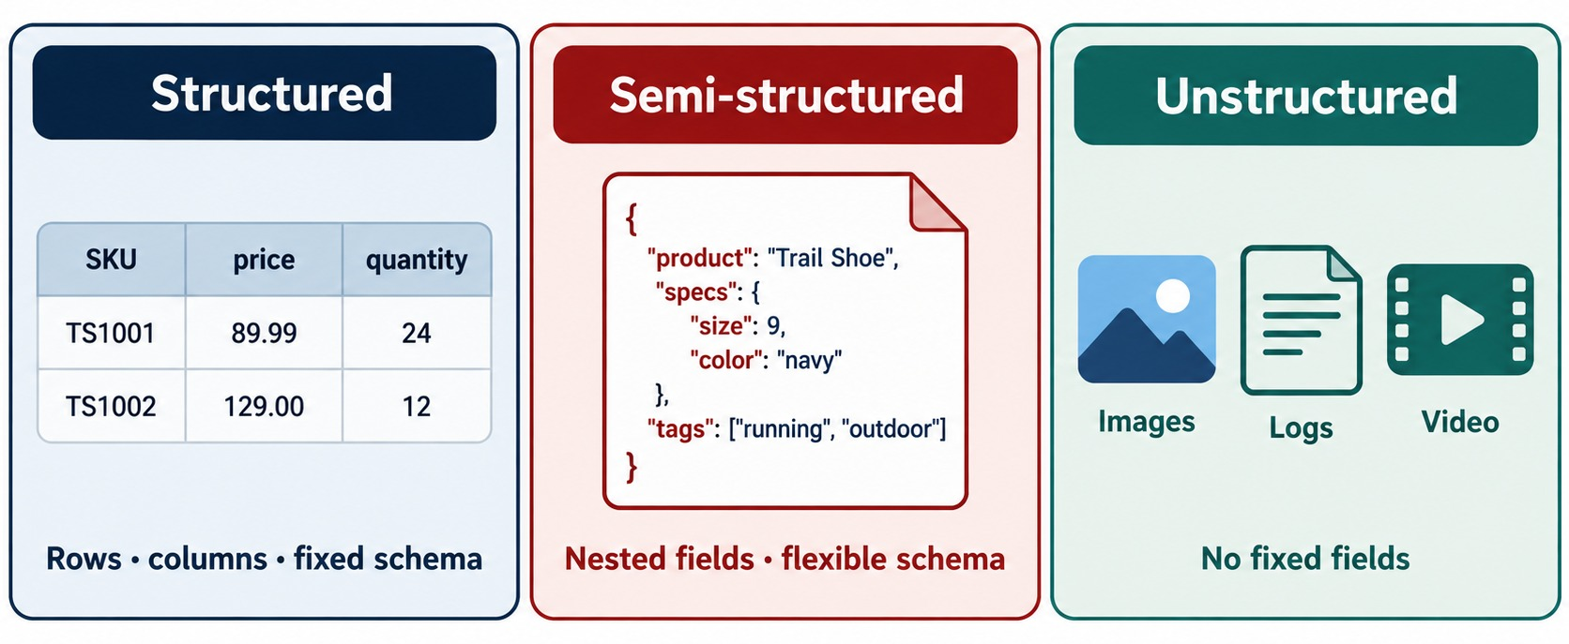
STRUCTURED, SEMI-STRUCTURED AND UNSTRUCTURED DATA
Rows and columns, nested fields — and data with no fixed fields.
Structured
Rows and columns with a fixed schema — prices and quantities.
Semi-structured
Nested fields and arrays whose shape can vary — product specs and tags.
Unstructured
No fixed fields at all — images, logs and video.
OUR DATASET training_store products are semi-structured: each category has its own attributes.
KEY TAKEAWAY Tables are built for structured data — much of what modern apps store is semi-structured.
7
© 2026 by Innovation In Software Corporation
Notes:
KEY TALKING POINTS
------------------
- Three kinds of data
Structured data has rows, columns and a fixed schema, like a table of SKUs, prices and quantities.
Semi-structured data has nested fields and arrays, and its shape can vary.
Unstructured data, such as images, logs and video, has no fixed fields at all.
- Why this matters
Relational tables are built for the first kind.
Modern applications produce a lot of the second kind: products with different attributes, customer profiles, reviews and events.
- Our dataset
In training_store, order totals and quantities are structured values.
The products are semi-structured: a laptop has a processor and memory, a shoe has sizes and a material, a book has an author and an ISBN.
- What it shows
Three kinds of data side by side: a structured table of SKU, price and quantity; a semi-structured JSON product with nested specs and a tags array; and unstructured images, logs and video.
- How to read it
Read the caption under each panel: rows, columns and a fixed schema; nested fields and a flexible schema; no fixed fields.
- Key point
Relational tables are built for the first panel.
Much of what modern applications store looks like the second.

Slide 8
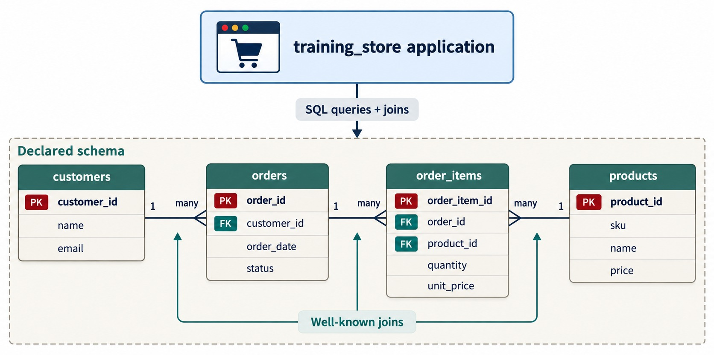
WHERE RELATIONAL DATABASES WORK WELL
A declared schema, enforced keys and well-known joins.
Declared schema
Tables, columns and types are fixed before data arrives.
Enforced relationships
Foreign keys tie every order to a real customer.
Well-known joins
SQL rebuilds the full picture from customers, orders, items and products.
STILL THE RIGHT TOOL Stable structure plus strict integrity.
KEY TAKEAWAY When the structure is stable and relationships must be enforced, relational databases work very well.
8
© 2026 by Innovation In Software Corporation
Notes:
KEY TALKING POINTS
------------------
- Relational databases are good at this
Relational databases organize data into fixed tables of rows and columns.
They work well when the structure is stable and relationships must be strictly enforced.
- Keys and joins
Primary keys identify rows.
Foreign keys tie an order to a real customer and an order item to a real product.
SQL joins put the pieces back together when the application asks.
- Keep this in mind
Nothing in this module says relational databases are obsolete.
For stable, strongly related data with strict integrity rules, they are often the best choice.
- What it shows
The training_store application sends SQL queries and joins to a declared schema of four tables: customers, orders, order_items and products.
- How to read it
PK marks each table's primary key and FK its foreign keys.
The one-to-many lines show that a customer has many orders and an order has many items.
- Key point
When the structure is stable and the joins are well known, this model works very well.
REAL-WORLD EXAMPLES
-------------------
- A bank's general ledger has a fixed structure, strict integrity rules and transactions that touch several accounts at once.
That is classic relational territory.

Slide 9
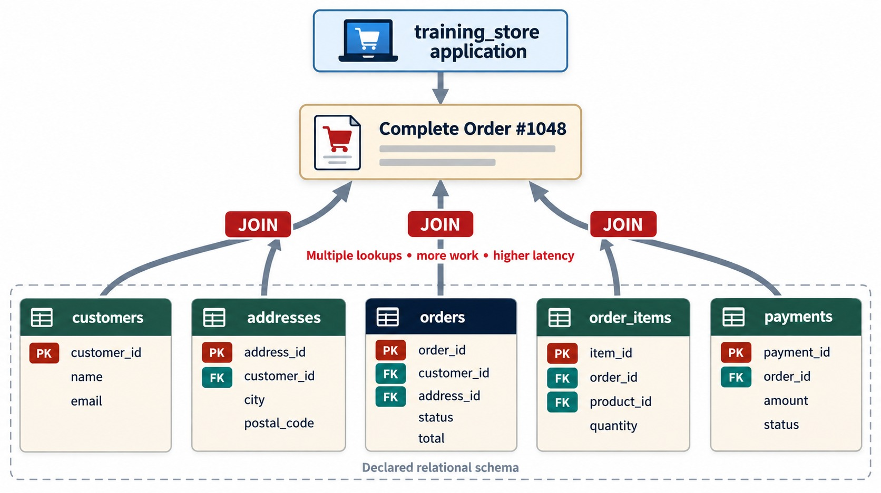
CHALLENGES WITH TRADITIONAL RELATIONAL MODELS
One complete order means joining five tables.
Many lookups
Customer, address, order, items and payment — joined on every read.
Rigid change
A new product attribute needs a migration or more optional columns.
Harder to scale out
Joined tables are hard to spread across many servers.
COSTS, NOT FAILURES They grow with change and volume.
KEY TAKEAWAY The more pieces one business object is split into, the more work every read and every change does.
9
© 2026 by Innovation In Software Corporation
Notes:
KEY TALKING POINTS
------------------
- One page, many tables
To show one complete order, the application reads the customer, the address, the order, every order item and the payment.
That is five tables and several joins for a single page.
- Change is expensive
When the catalog adds a new kind of product with new attributes, a fixed schema needs new columns, new tables or many optional columns.
Each change means a migration.
- Scale is harder
Relational databases traditionally scale up on a bigger server.
Spreading joined tables across many servers is hard.
- Be fair
These are costs, not failures.
They grow as the data changes faster and the volume grows.
- What it shows
To build Complete Order #1048, the application joins customers, addresses, orders, order_items and payments.
- How to read it
Follow the JOIN arrows up to the order.
The red text sums up the cost: multiple lookups, more work and higher latency.
- Key point
The more pieces one business object is split into, the more work every read does.
USE-CASE SCENARIO
-----------------
Imagine the store's busiest page is the order history.
Every page view runs the same five-table join, thousands of times a minute.
The data rarely changes after the order is placed, yet it is reassembled every time.

Slide 10
ADDING A NEW KIND OF PRODUCT
The catalog starts selling shoes — what has to change?
Relational: change the table first
✓
Document: insert the new shape
ALTER TABLE products
ADD COLUMN sizes VARCHAR(40);
ALTER TABLE products
ADD COLUMN color VARCHAR(20);
ALTER TABLE products
ADD COLUMN material VARCHAR(20);
-- laptops and books now carry
-- three empty columns each
db.products.insertOne({
sku: "S200",
name: "Running Shoe",
category: "SHOE",
price: Decimal128("129.99"),
attributes: {
sizes: [7, 8, 9, 10],
color: "Blue", material: "Mesh"
}
})
Relational
Document
STILL DESIGNED Flexible isn't random — Module 3 models it.
Every new attribute is a schema change, plus empty columns elsewhere.
Each product carries only the fields it needs.
KEY TAKEAWAY A fixed schema turns every new attribute into a migration; documents let each product carry its own fields.
10
© 2026 by Innovation In Software Corporation
Notes:
KEY TALKING POINTS
------------------
- The relational version
To sell shoes, the products table first needs new columns for sizes, color and material.
Every laptop and book row now has three empty columns.
The alternative is extra attribute tables, which means more joins.
- The document version
In MongoDB we insert the shoe with the fields it needs.
This is the shape of the real Running Shoe, SKU S200, in training_store, trimmed for the slide; the real document also has tags, active and createdAt.
- Don't run it on the loaded data
training_store already contains S200, and sku has a unique index, so this insert would fail with a duplicate key error.
It shows how the product got there.
- The balance
Flexible doesn't mean random.
Module 3 decides which fields every product must share and which can vary.

Slide 11
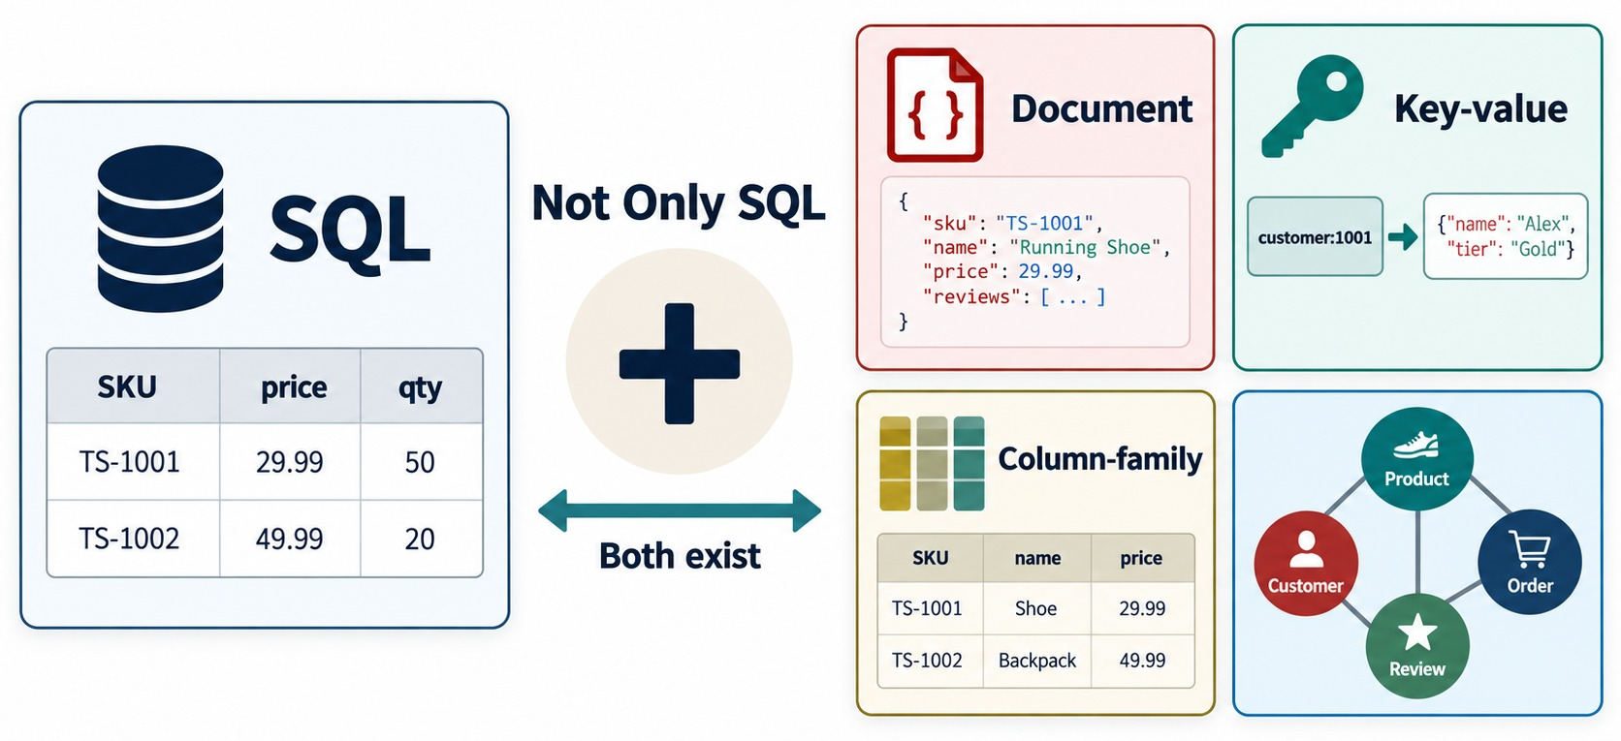
WHAT DOES NOSQL MEAN?
Not Only SQL — relational and non-relational models side by side.
Not Only SQL
Databases that store data in models other than relational tables.
Four families
Document, key-value, column-family and graph.
BOTH EXIST Many real systems use SQL and NoSQL together.
KEY TAKEAWAY NoSQL adds data models — it doesn't make SQL databases obsolete.
11
© 2026 by Innovation In Software Corporation
Notes:
KEY TALKING POINTS
------------------
- Not Only SQL
NoSQL means Not Only SQL.
It refers to databases designed to store and retrieve data using models other than relational tables.
- Four families
The four main NoSQL families are document, key-value, column-family and graph.
Each organizes data differently, and each is fast at a different kind of access.
- Both exist
NoSQL doesn't mean SQL databases are obsolete.
The right database depends on the application's data, access patterns, consistency requirements and scale.
Many real systems use both.
- What it shows
A SQL table on the left and the four NoSQL families on the right: document, key-value, column-family and graph.
- How to read it
The plus sign and the two-way arrow say both exist.
NoSQL adds models; it doesn't remove SQL.
- Key point
NoSQL is a family of models, and SQL remains one of the options.

Slide 12
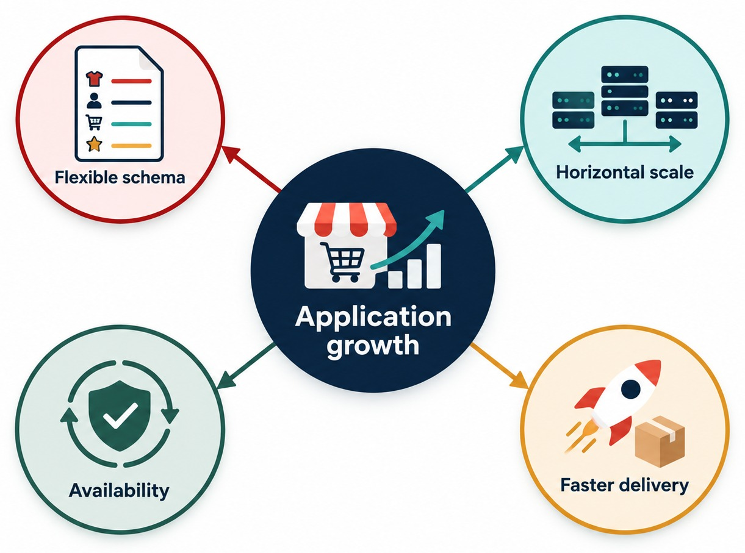
WHY ORGANIZATIONS ADOPT NOSQL
Application growth creates four needs.
Flexible schema
Fields change as the product changes — no migration first.
Horizontal scale
Add servers instead of buying a bigger one.
Availability
Copies on several servers survive one failure.
Faster delivery
Store objects the way the application already uses them.
KEY TAKEAWAY The right database depends on the data, the access patterns, the consistency needs and the scale.
12
© 2026 by Innovation In Software Corporation
Notes:
KEY TALKING POINTS
------------------
- What pushed teams to NoSQL
NoSQL databases address frequently changing data structures, large volumes of data and high-speed reads and writes.
They also address distributed applications and horizontal scaling across many servers.
- The four outcomes
Flexible schema lets fields change as the product changes.
Horizontal scale adds servers instead of buying a bigger one.
Availability keeps copies on several servers, so one failure doesn't stop the application.
Faster delivery comes from storing objects the way the application already uses them.
- Keep the balance
These are reasons to consider NoSQL, not a guarantee.
A good design still starts from how the application reads and writes.
- What it shows
Application growth in the center, pointing to four needs: flexible schema, horizontal scale, availability and faster delivery.
- How to read it
Each circle is one reason teams reach for a NoSQL database as the application grows.
- Key point
Teams adopt NoSQL for concrete needs, not because it is newer.

Slide 13
EXERCISE: WHAT DOES ONE ORDER PAGE COST?
Count the work behind a single page in the relational design.
PRACTICE EXERCISE
10 MIN
SCENARIO
YOUR TASKS
EXPECTED OUTCOME
The order page shows O6102: Luis Romero's Running Shoe and Wireless Keyboard, total 211.38.
In the relational design on the challenges slide, that order lives in five tables.
1
List the tables the page must read
✓
customers, addresses, orders, order_items, payments
2
Count the joins needed
Four joins — five with products for item names
✓
3
Name the key columns that link them
✓
customer_id, address_id, order_id, product_id
4
Sketch what one order document would hold
One document: order, items and shipping address
✓
KEY TAKEAWAY One page can hide many joins — a document shaped like the page needs one read.
13
© 2026 by Innovation In Software Corporation
Notes:
KEY TALKING POINTS
------------------
- How to run it
Pairs, five minutes, then compare.
Point back to the challenges diagram with its five tables.
- The joins
Five tables need four joins.
Showing product names adds the products table and a fifth join.
- The keys
customer_id links customers to orders and addresses, address_id links the order to its address, order_id links items and payments, and product_id links items to products.
- The document
In training_store, O6102 is one document.
Its items and shipping address are embedded, and it holds a customerId reference to Luis.
The payment is a paymentStatus field.
We look at this shape in Part 3.

Slide 14
PART 2: FOUR NOSQL MODELS
NoSQL is a family. Meet its four members.
✓ Part 1
Why NoSQL
Part 2
Four NoSQL models
Part 3
MongoDB's data model
Part 4
Architecture and fit
SO FAR
NEXT QUESTION
How do the four NoSQL models store data differently — and what is each one best at?
✓
Data comes structured, semi-structured and unstructured
✓
Relational tables excel at stable, related data
IN THIS PART
1
The four families at a glance
✓
NoSQL adds models for flexibility and scale
2
Document databases
3
Key-value databases
4
Column-family databases
5
Graph databases
6
All five models side by side
14
© 2026 by Innovation In Software Corporation
Notes:
KEY TALKING POINTS
------------------
- Connecting the parts
Part 1 explained why NoSQL appeared.
Part 2 shows that NoSQL is four quite different models.
- Watch for
For each model, notice the access pattern it is fast at.
That is the skill Exercise 1.1 tests.

Slide 15
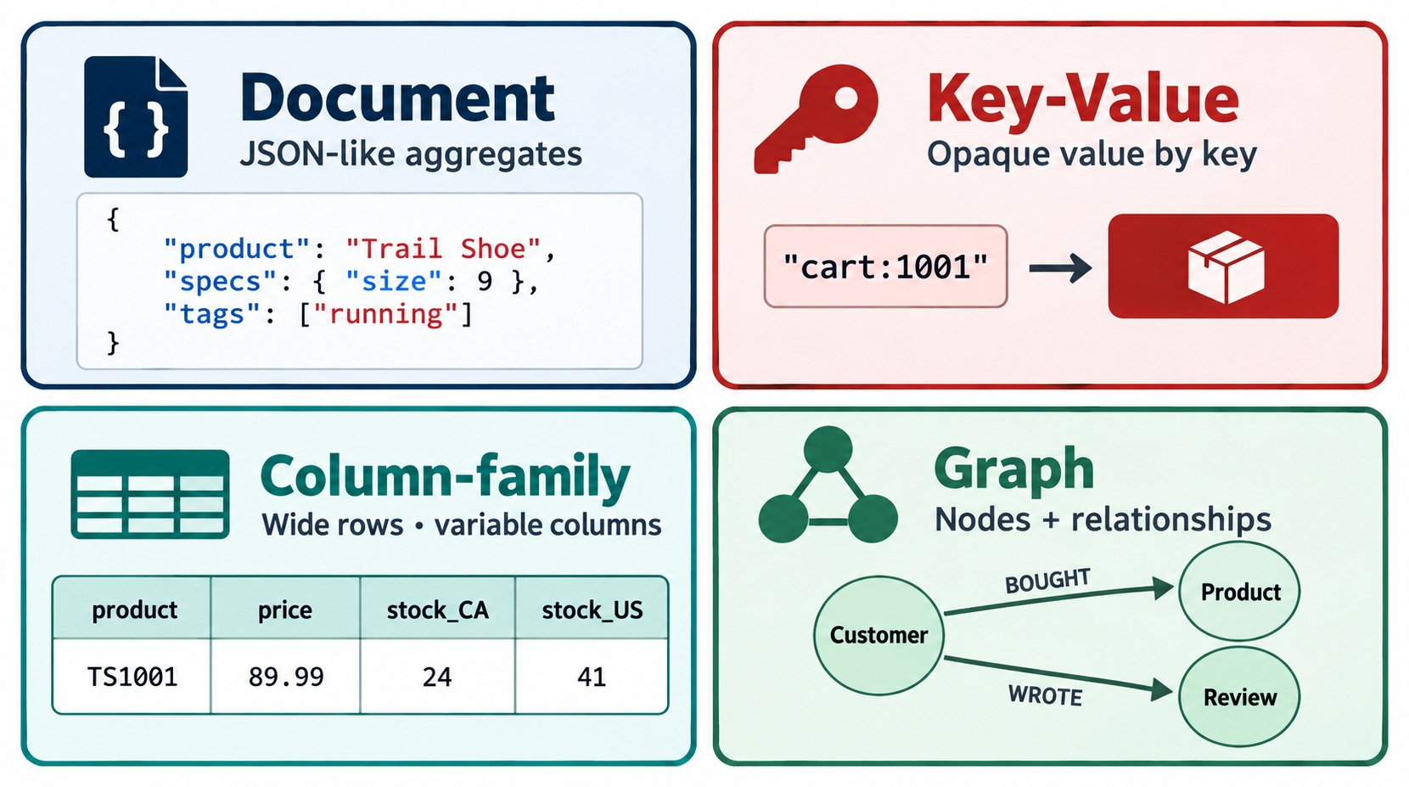
THE FOUR MAJOR NOSQL DATABASE TYPES
Document, key-value, column-family and graph.
Document
Whole records as JSON-like documents — MongoDB, Couchbase.
Key-value
One opaque value per key — Redis, Amazon DynamoDB.
Column-family
Wide rows with variable columns — Apache Cassandra, HBase.
Graph
Nodes and relationships — Neo4j, Amazon Neptune.
KEY TAKEAWAY Each NoSQL family is optimized for a different way of reading and writing data.
15
© 2026 by Innovation In Software Corporation
Notes:
KEY TALKING POINTS
------------------
- Document
A document database stores self-contained, JSON-like documents.
Examples are MongoDB and Couchbase.
- Key-value
A key-value store keeps each value under a unique key and returns it when you give it that key.
Examples are Redis and Amazon DynamoDB.
- Column-family
A column-family store keeps wide rows found by a row key, with columns grouped into families, and rows can have different columns.
Examples are Apache Cassandra and HBase.
- Graph
A graph database stores nodes and the relationships between them as first-class data.
Examples are Neo4j and Amazon Neptune.
- What it shows
The four NoSQL families, each with a small example: a JSON-like document, a cart:1001 key pointing to a value, a wide row with stock_CA and stock_US columns, and a customer who bought a product and wrote a review.
- How to read it
Read the subtitle in each box: JSON-like aggregates, opaque value by key, wide rows with variable columns, nodes plus relationships.
- Key point
Each family is optimized for a different way of reading and writing data.

Slide 16
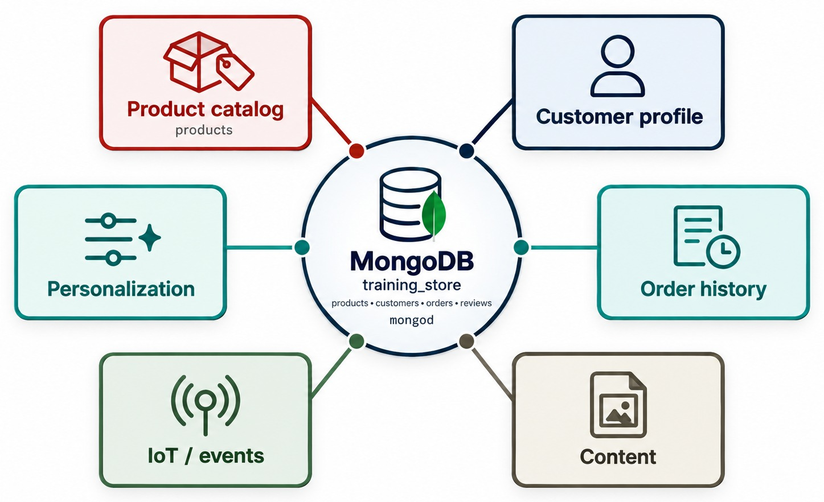
DOCUMENT DATABASES
Store one application object as one self-contained document.
A training_store product (trimmed)
{ sku: "S210",
name: "Trail Shoe",
category: "SHOE",
price: Decimal128("89.99"),
attributes: {
sizes: [8, 9, 10, 11],
color: "Grey",
material: "Synthetic" },
tags: ["trail", "sports"] }
Good fit
Catalogs, customer profiles, content and order management.
MAIN ADVANTAGE One object stays one document — not many tables.
KEY TAKEAWAY A document database keeps each business object together, in the shape the application uses.
16
© 2026 by Innovation In Software Corporation
Notes:
KEY TALKING POINTS
------------------
- Self-contained documents
Document databases store information as self-contained documents, usually in a JSON-like format.
Their main advantage is that one application object can often be stored as one document, without splitting it across many tables.
- A real training_store product
The code card shows the Trail Shoe, SKU S210, from our products collection.
Its sizes array and its color and material sit inside an attributes sub-document.
A laptop in the same collection has a processor and memory instead.
- Where they fit
Document databases suit product catalogs, customer profiles, content management, mobile and web applications, and order management.
- What it shows
MongoDB and training_store in the center, surrounded by six use cases: product catalog, customer profile, order history, personalization, IoT and events, and content.
- How to read it
Each box is a kind of application object that maps naturally to one document.
- Key point
Document databases shine when one business object can live in one document.

Slide 17
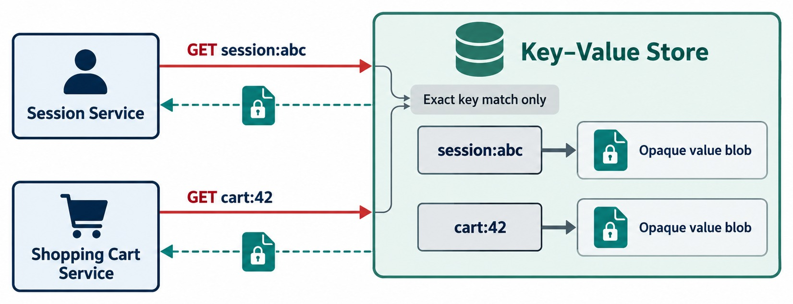
KEY-VALUE DATABASES
The application supplies the exact key; the store returns the value.
How it works
GET session:abc returns that session's value — nothing else.
Good fit
Caching, sessions, shopping carts, preferences, counters.
Trade-off
Very fast by key; weak for queries about what's inside the value.
EXAMPLES
Redis
Amazon DynamoDB
KEY TAKEAWAY Key-value stores are the fastest path when the application always knows the key.
17
© 2026 by Innovation In Software Corporation
Notes:
KEY TALKING POINTS
------------------
- How it works
A key-value database stores each value under a unique key.
The application provides the key, and the database returns the value.
- Opaque values
The store usually treats the value as an opaque blob.
It doesn't query inside the value; it simply returns it.
- Strengths and limits
Access is very fast when the application knows the key.
Typical uses are caching, user sessions, shopping carts, preferences and real-time counters.
Complex, relationship-based queries are difficult.
- What it shows
A Session Service asks for session:abc and a Shopping Cart Service asks for cart:42.
The key-value store returns each opaque value blob.
- How to read it
Solid red arrows are GET requests by key.
Dashed arrows are the values coming back.
The store matches the exact key only.
- Key point
Very fast when you know the key, but the store doesn't search inside the value.
REAL-WORLD EXAMPLES
-------------------
- A web store keeps each shopper's session under a key like session:abc in Redis.
Every page request reads it by that key in well under a millisecond.

Slide 18
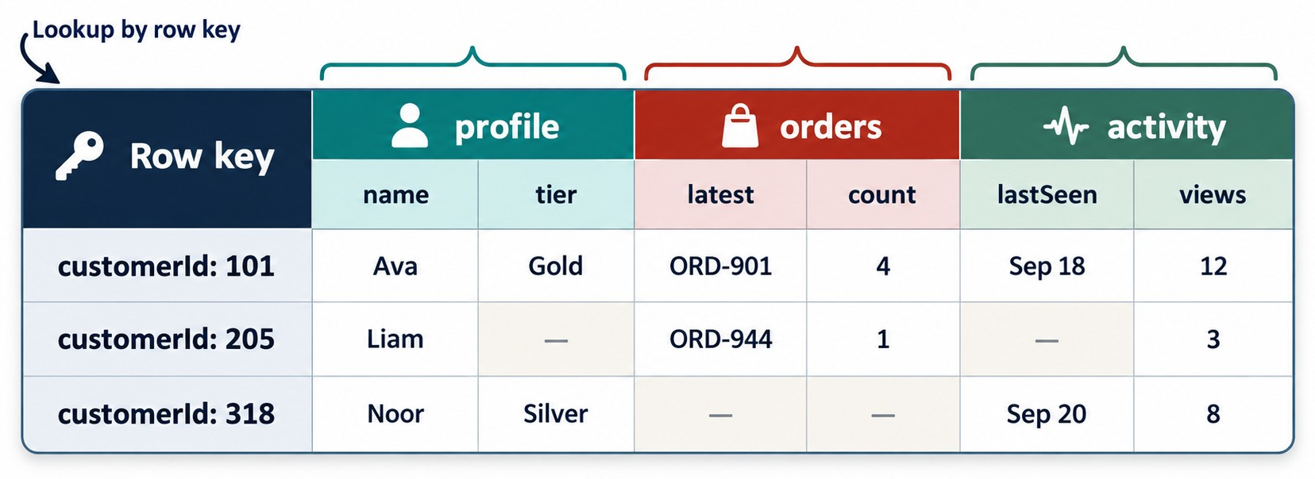
COLUMN-FAMILY DATABASES
Rows found by row key, with related columns grouped into families.
Row key
Every lookup starts from the row key, e.g. customerId 101.
Column families
Related columns sit together: profile, orders, activity.
Sparse rows
A row stores only the columns it has — gaps cost nothing.
Good fit
Huge write volumes: events, sensors, time series — Cassandra, HBase.
KEY TAKEAWAY Column-family stores handle huge, distributed write volumes looked up by row key.
18
© 2026 by Innovation In Software Corporation
Notes:
KEY TALKING POINTS
------------------
- Row key first
In a column-family store, every lookup starts from a row key, here a customerId.
- Families of columns
Related columns are grouped into column families: profile, orders and activity.
The application usually reads one family at a time.
- Sparse rows
A row stores only the columns it actually has.
The dashes in the diagram are missing values, and they cost nothing.
- Where they fit
Column-family stores such as Apache Cassandra and HBase handle very large, distributed write volumes, such as events, sensor readings and time series.
- What it shows
A table keyed by customerId with three column families: profile, orders and activity.
- How to read it
Look along a row.
Customer 205 has no tier and no lastSeen, and customer 318 has no orders — the dashes are simply missing columns.
- Key point
Lookups start from the row key, and rows only store the columns they have.

Slide 19
GRAPH DATABASES
Nodes, relationships and properties — real training_store facts drawn as a graph.
Nodes and edges
Luis Romero
Customer C204
ORDERED
Business Laptop
Product L100
Nodes are things, edges are relationships — and both can carry properties.
REVIEWED
rating: 5
Good fit
SUGGEST?
ORDERED
Social networks, recommendations, fraud detection and access relationships.
USB Hub
Product A400
ORDERED
Aisha Khan
Customer C101
EXAMPLES
Neo4j
Amazon Neptune
TRAVERSAL Luis → L100 ← Aisha → A400: suggest the USB Hub to Luis.
STRENGTH Multi-step walks along relationships stay fast.
KEY TAKEAWAY Choose a graph database when the relationships matter as much as the things they connect.
19
© 2026 by Innovation In Software Corporation
Notes:
KEY TALKING POINTS
------------------
- Nodes, edges and properties
A graph database represents data as nodes, such as customers and products, and edges, the relationships between them.
Both nodes and edges can carry properties.
- The same store, as a graph
These are real training_store facts drawn as a graph.
Aisha Khan, customer C101, ordered the Business Laptop and the USB Hub, and reviewed the laptop with five stars.
Luis Romero, customer C204, ordered the Business Laptop too.
- Traversal is the strength
A recommendation is a walk along the edges: Luis ordered L100, Aisha also ordered L100, and Aisha ordered A400.
So we can suggest the USB Hub to Luis.
Graph databases make multi-step walks like this fast.
- Where they fit
Social networks, recommendation engines, fraud detection, network analysis and identity and access relationships.
Examples are Neo4j and Amazon Neptune.

Slide 20
COMPARING THE DATA MODELS
The four NoSQL families — and relational — side by side.
Model | Data model | Main strength | Typical use
Relational | Tables, fixed schema | Integrity, joins, transactions | Ledgers, finance
Document | JSON-like documents | Flexible, app-friendly records | Catalogs, profiles, orders
Key-value | A key mapped to a value | Extremely fast lookup | Caching, sessions, carts
Column-family | Wide rows by row key | Huge distributed writes | Events, time series
Graph | Nodes and relationships | Relationship traversal | Fraud, recommendations
More than one can work
Many workloads have two workable models — justify your first choice.
Look at the access
By key? Whole object? Huge writes? Deep relationships?
EXERCISE 1.1 You'll match six workloads to these five models.
KEY TAKEAWAY Start from how the data is read and written — then pick the model built for that access pattern.
20
© 2026 by Innovation In Software Corporation
Notes:
KEY TALKING POINTS
------------------
- How to read the table
Each row is one model: how it stores data, what it is best at, and where it is typically used.
- Relational is on the list
Exercise 1.1 includes relational as one of five choices, because for some workloads it is still the best one.
- The questions to ask
Is the data read by an exact key?
As a whole object?
Written in huge volumes?
Or walked along relationships?
Each answer points to a different row.
- No single winner
More than one model can often work.
The justification, based on the access pattern, matters more than the product name.

Slide 21
PART 3: MONGODB'S DATA MODEL
From the document family in general to MongoDB in particular.
✓ Part 1
Why NoSQL
✓ Part 2
Four NoSQL models
Part 3
MongoDB's data model
Part 4
Architecture and fit
SO FAR
NEXT QUESTION
What exactly is a MongoDB document — and how is the data organized?
✓
Four NoSQL families, each with its strength
✓
Choose the model from the access pattern
IN THIS PART
Document databases keep whole objects together
1
MongoDB at a glance
✓
2
Database, collection, document, field
3
Relational terms in MongoDB
4
BSON types in a document
5
From rows to documents
6
Embed or reference
7
Flexible schema in one collection
21
© 2026 by Innovation In Software Corporation
Notes:
KEY TALKING POINTS
------------------
- Why this part
MongoDB is the document database this course teaches.
Now we look closely at how it organizes data.
- What to watch
Keep comparing with the relational tables from Part 1.
By the end, learners should be able to read a training_store document and name every part of it.

Slide 22
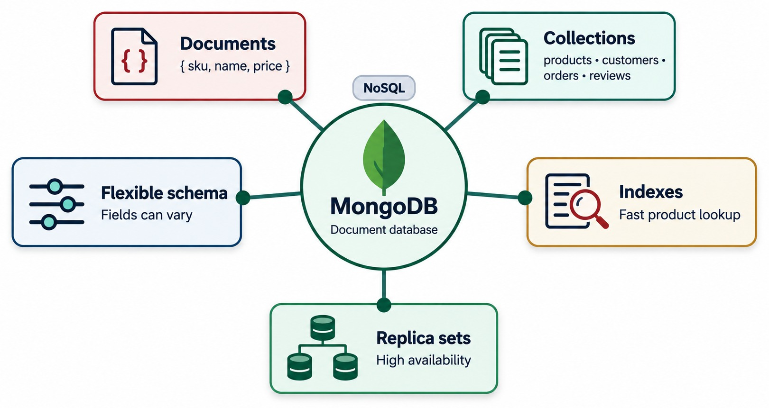
INTRODUCING MONGODB
A document database that stores BSON documents in collections.
Document database
Data is stored as documents, grouped into collections.
BSON
Binary JSON — adds types JSON lacks: dates, decimals, ObjectIds.
training_store
products, customers, orders and reviews — our four collections.
BEYOND STORAGE Indexes and replica sets are built in.
KEY TAKEAWAY MongoDB is a document database: BSON documents, grouped into collections, with indexing and replication built in.
22
© 2026 by Innovation In Software Corporation
Notes:
KEY TALKING POINTS
------------------
- A document database
MongoDB is a document-oriented NoSQL database.
It stores data as BSON documents, grouped into collections.
- BSON
BSON is a binary representation of JSON-like data.
It adds types that JSON doesn't have, such as dates, decimals and ObjectIds.
- Our four collections
training_store has four collections: customers, products, orders and reviews.
After the full load there are 6 customers, 13 products, 17 orders and 6 reviews.
- What it shows
MongoDB, a NoSQL document database, in the center, linked to documents, collections, flexible schema, indexes and replica sets.
- How to read it
The collections box lists our four training_store collections: products, customers, orders and reviews.
- Key point
These five ideas are the building blocks of the rest of the course.

Slide 23
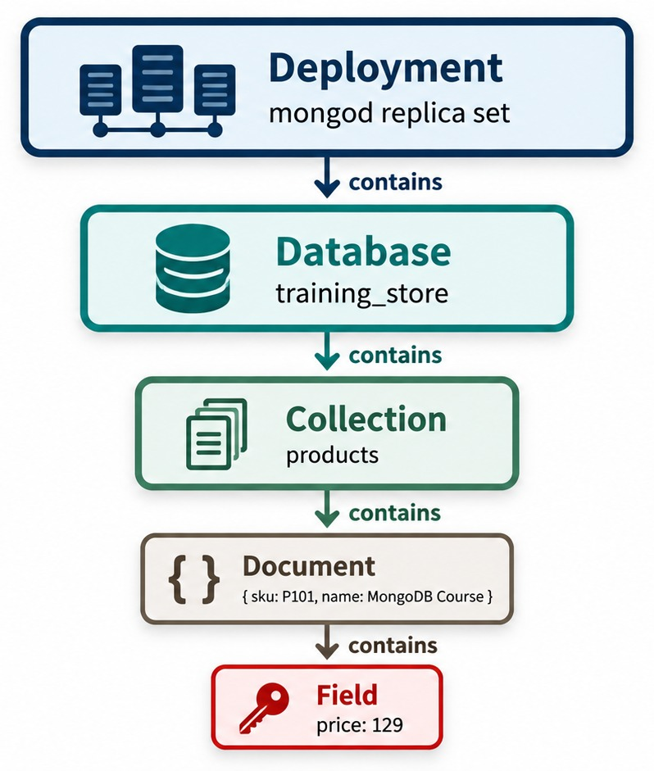
THE MONGODB DATA HIERARCHY
Deployment → database → collection → document → field.
Walk it in mongosh
show dbs
use training_store
show collections
db.products.findOne()
Created on first write
A database or collection appears the first time you insert into it.
OUR DATASET 13 products — e.g. B300, MongoDB Fundamentals.
KEY TAKEAWAY Every mongosh command works at one level of the hierarchy: database, collection, document or field.
23
© 2026 by Innovation In Software Corporation
Notes:
KEY TALKING POINTS
------------------
- The hierarchy
A MongoDB deployment contains databases.
A database contains collections.
A collection contains documents, and a document contains fields.
- Walking it in mongosh
show dbs lists the databases.
use training_store selects ours.
show collections lists its collections, and db.products.findOne() prints one document.
That is exactly the path of Exercise 1.3.
- Created on first write
MongoDB creates a database or a collection the first time you insert into it.
There is no separate CREATE TABLE step.
- About the sample document
The document in the diagram is a simplified illustration.
A real one from our products collection is B300, MongoDB Fundamentals, priced at 59.99.
- What it shows
Five levels, each containing the next: a deployment, the training_store database, the products collection, one document, and one field.
- How to read it
Read top to bottom and say contains at each arrow.
- Key point
Every command you type in mongosh works at one of these levels.

Slide 24
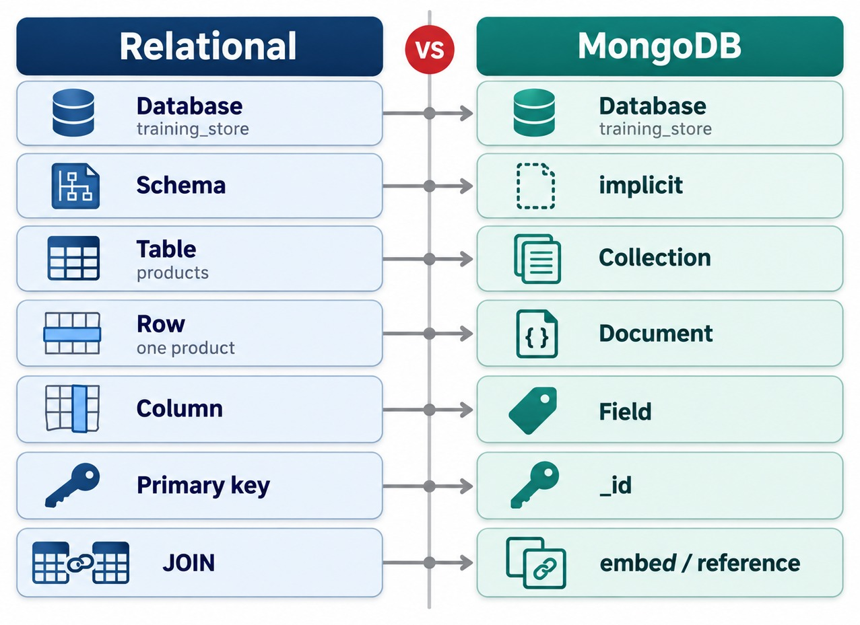
RELATIONAL-TO-MONGODB TERMINOLOGY
The words map neatly — the designs often don't.
Row → document
A document can hold nested objects and arrays a row can't.
JOIN → embed / reference
Embed what is read together; reference the rest. $lookup joins when needed.
Schema → implicit
Fields come from the documents; add validation rules when needed.
NOT ONE-TO-ONE Don't copy each table into a collection.
KEY TAKEAWAY Table, row and column become collection, document and field — but one document often replaces several joined rows.
24
© 2026 by Innovation In Software Corporation
Notes:
KEY TALKING POINTS
------------------
- The mapping
A relational table maps to a collection, a row to a document, and a column to a field.
The primary key maps to _id.
- Where the mapping breaks
A document can hold nested objects and arrays that a single row can't.
So one document often replaces several joined rows.
- Joins
Instead of joining at read time, MongoDB usually embeds data that is read together, or stores a reference to another document.
When a join is really needed, the $lookup aggregation stage can do one.
- Schema
The schema is implicit: it comes from the documents themselves.
When fields must always exist or have a type, you add schema validation.
- What it shows
Relational terms on the left and their MongoDB equivalents on the right, from database down to JOIN.
- How to read it
Schema maps to implicit, primary key maps to _id, and JOIN maps to embed or reference.
- Key point
The words map neatly; the designs often don't.
A document can replace several joined rows.

Slide 25
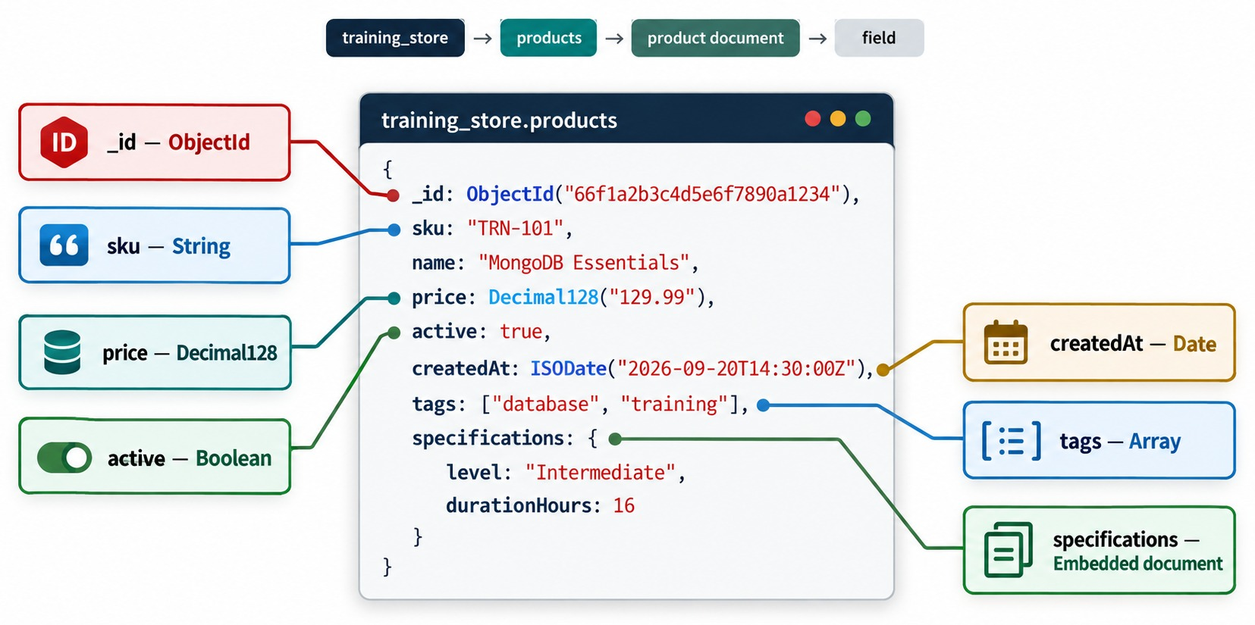
ANATOMY OF A MONGODB DOCUMENT
Every field keeps its BSON type.
_id
Unique in its collection; an ObjectId is added if you don't supply one.
Typed values
String, Decimal128, Boolean, Date, Array and embedded document.
BSON
Stored as typed binary, shown as JSON-like text in mongosh.
MONEY Store prices as Decimal128, never as strings.
KEY TAKEAWAY BSON keeps real types, so IDs, money and dates behave correctly in queries.
25
© 2026 by Innovation In Software Corporation
Notes:
KEY TALKING POINTS
------------------
- _id
Every document has an _id field that is unique within its collection.
If you don't supply one, the driver or mongosh adds an ObjectId.
An ObjectId is 12 bytes and starts with a timestamp.
- Typed values
BSON keeps real types: String, Decimal128, Boolean, Date, arrays and embedded documents.
mongosh shows them as JSON-like text, but they are stored as typed binary.
- Money and time
Use Decimal128 for prices, so 129.99 stays exactly 129.99.
Use real dates, not date strings, so you can sort and filter by time.
- A warning from our dataset
training_store deliberately contains one product, XBAD, whose price is the string "49.99" instead of a number.
Module 4 uses it in the $type labs to find and fix values stored with the wrong type.
- What it shows
One document from training_store.products with each field labeled by its BSON type.
- How to read it
_id is an ObjectId, sku a String, price a Decimal128, active a Boolean, createdAt a Date, tags an Array and specifications an embedded document.
- Key point
Unlike JSON, BSON stores real types, so money, dates and IDs behave correctly.

Slide 26
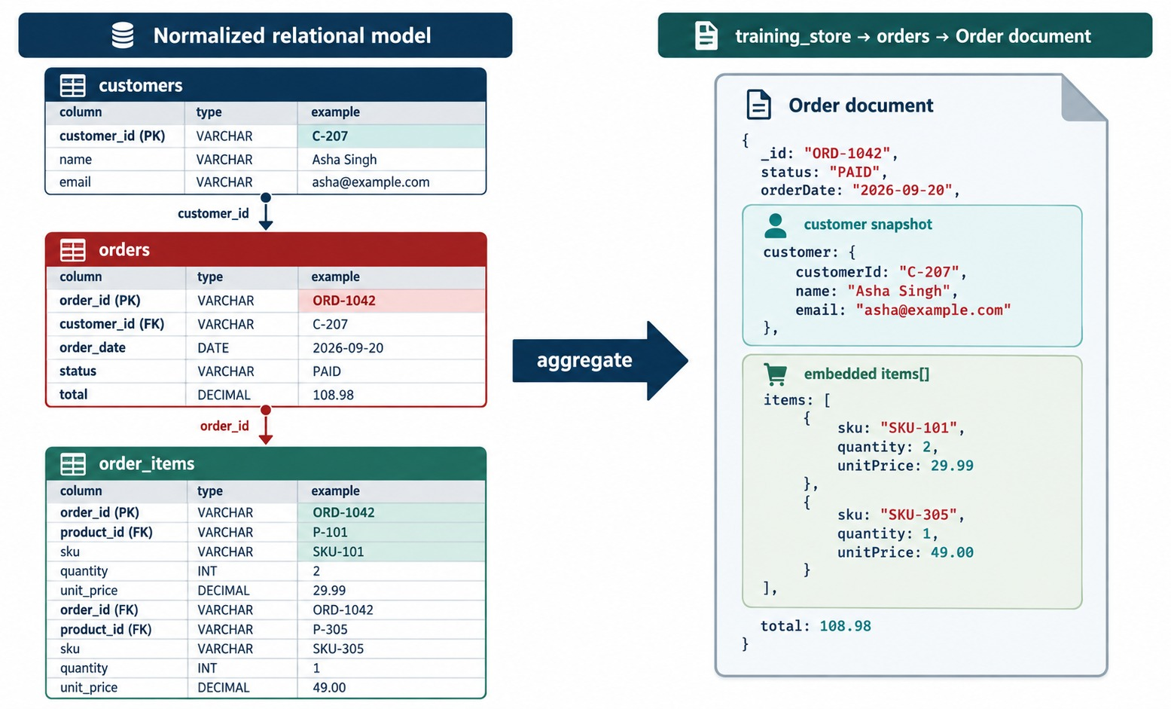
FROM ROWS TO DOCUMENTS
Three normalized tables become one order document.
Rows
customers, orders and order_items — joined on customer_id and order_id.
One document
Order fields, a customer snapshot and an embedded items array.
Purchase-time price
Each item keeps the price paid, even if the catalog changes.
EXERCISE 1.2 You'll make this conversion yourself.
KEY TAKEAWAY Shape the document like the thing the application shows — here, one complete order.
26
© 2026 by Innovation In Software Corporation
Notes:
KEY TALKING POINTS
------------------
- Normalized rows
In the relational model, one order is spread across three tables: customers, orders and order_items.
Showing it means joining them on customer_id and order_id.
- One aggregate
In MongoDB the order becomes one document.
The line items are an embedded array, and each keeps its purchase-time price.
- Snapshot or reference
This diagram embeds a customer snapshot: id, name and email.
That is one valid choice, and it is the shape Exercise 1.2 asks for.
Our training_store orders make the other choice: they keep a customerId reference.
The next slide shows why.
- What it shows
On the left, one order spread across the customers, orders and order_items tables.
On the right, the same order as one document.
- How to read it
The customer becomes an embedded customer snapshot and the order items become an embedded items array.
The total, 108.98, is carried across.
- Key point
The document is shaped like the thing the application shows: one order.

Slide 27
EMBED OR REFERENCE? HOW TRAINING_STORE DECIDES
Real documents from the orders and reviews collections.
✓
orders: O6102 (trimmed)
✓
reviews: their own collection (trimmed)
{
orderNumber: "O6102",
customerId: ObjectId("…"), // reference
items: [ // embedded
{ sku: "S200", quantity: 1,
unitPrice: Decimal128("129.99") },
{ sku: "P1001", quantity: 1,
unitPrice: Decimal128("49.99") }
],
shippingAddress: { city: "Austin", … },
total: Decimal128("211.38")
}
{
productId: ObjectId("…"), // reference
sku: "S200",
customerId: ObjectId("…"), // reference
rating: 4,
title: "Comfortable",
body: "Good for daily runs."
}
Embed
Reference
RULE OF THUMB Store together what the app reads together.
Items and the shipping address are read with the order and keep purchase-time values.
Customers are shared and change; reviews grow without limit.
KEY TAKEAWAY Embed what is read together and belongs to one object; reference what is shared, changes or grows without limit.
27
© 2026 by Innovation In Software Corporation
Notes:
KEY TALKING POINTS
------------------
- Read the order
Order O6102 embeds its two line items and its shipping address.
Each item keeps the unit price Luis paid.
The customer is not embedded: customerId points to Luis Romero's document in customers.
- Compare with the last diagram
The rows-to-documents diagram embedded a customer snapshot.
That is valid too.
training_store chose a reference, because a customer changes their email or address independently of past orders.
- Read the review
Reviews live in their own collection and reference both the product and the customer.
If every review were embedded in its product, a popular product's document would grow without limit.
- The rule
Store together what the application reads together.
Module 3 turns this rule into a full modeling method.

Slide 28
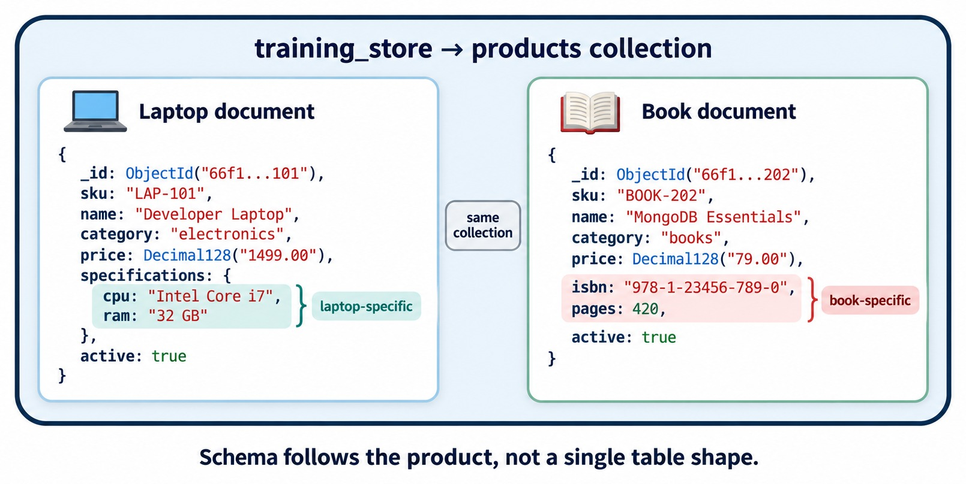
FLEXIBLE SCHEMA WITHIN A COLLECTION
Two products, one collection, different fields.
Different fields
The laptop has cpu and ram; the book has isbn and pages.
A shared core
Both keep _id, sku, name, category, price and active.
In training_store
LAPTOP, SHOE, BOOK and ACCESSORY each keep their own attributes.
FLEXIBLE ≠ UNPLANNED Schema validation can require key fields.
KEY TAKEAWAY Documents in one collection can differ — design the shared core, and validate what must always be there.
28
© 2026 by Innovation In Software Corporation
Notes:
KEY TALKING POINTS
------------------
- Same collection, different fields
Documents in the same collection don't need identical fields.
The laptop carries cpu and ram; the book carries isbn and pages.
- A shared core
Both documents still share the core fields: _id, sku, name, category, price and active.
The application can rely on those.
- Flexible doesn't mean unplanned
This flexibility helps applications evolve without constant table redesign.
But a flexible schema still needs design.
Schema validation can require fields and types where the business needs rules.
- What it shows
A laptop document and a book document in the same products collection.
- How to read it
The highlighted fields are category-specific: cpu and ram for the laptop, isbn and pages for the book.
- Key point
Schema follows the product, not a single table shape.
REAL-WORLD EXAMPLES
-------------------
- In training_store the products collection holds four categories: LAPTOP, SHOE, BOOK and ACCESSORY.
Each one keeps its own attributes, such as memoryGB for laptops and sizes for shoes.

Slide 29
EXERCISE: TRANSLATE SQL THINKING INTO MONGODB
Rewrite a relational description of the store in MongoDB terms.
PRACTICE EXERCISE
10 MIN
SCENARIO
YOUR TASKS
EXPECTED OUTCOME
A teammate describes training_store in relational terms:
1
Rewrite each sentence in MongoDB terms
✓
The products collection holds 13 documents
"The products table has 13 rows."
"Each row's key is product_id."
"Order lines live in order_items."
"We join them to show an order."
2
Name the field that replaces product_id
✓
_id — plus sku as a unique business key
Say what replaces the order_items join
✓
An items array embedded in each order
3
✓
db.products.countDocuments() returns 13
4
Write the mongosh command that counts products
KEY TAKEAWAY Speaking MongoDB's vocabulary is the first step to thinking in documents.
29
© 2026 by Innovation In Software Corporation
Notes:
KEY TALKING POINTS
------------------
- How to run it
Individually for five minutes, then compare in pairs.
Accept any wording that uses collection, document, field and _id correctly.
- product_id
Every product has an _id, an ObjectId in our dataset.
The loader also creates a unique index on sku, so sku works as the business key people use.
- The join
There is no order_items collection.
Each order document embeds its items array, so showing an order needs no join.
- The count
db.products.countDocuments() returns 13 after the full load.
If learners don't have mongosh yet, run it on the instructor screen.

Slide 30
PART 4: ARCHITECTURE AND FIT
How MongoDB runs — and when to choose it.
✓ Part 1
Why NoSQL
✓ Part 2
Four NoSQL models
✓ Part 3
MongoDB's data model
Part 4
Architecture and fit
SO FAR
NEXT QUESTION
How does MongoDB run — and when is it the right choice?
✓
MongoDB stores BSON documents in collections
✓
Embed what is read together; reference the rest
IN THIS PART
1
Clients, mongod and the storage engine
✓
A flexible schema still needs design
2
How a request is processed
3
Replica sets and sharded clusters
4
Core features in mongosh
5
When MongoDB fits — and when it doesn't
6
A modernization scenario
7
Misconceptions and anti-patterns
30
© 2026 by Innovation In Software Corporation
Notes:
KEY TALKING POINTS
------------------
- Why this part
Knowing the data model isn't enough.
We also need to know what runs it, how it stays available and how it scales.
- Outcome
By the end, learners should be able to argue for or against MongoDB for a given workload.

Slide 31
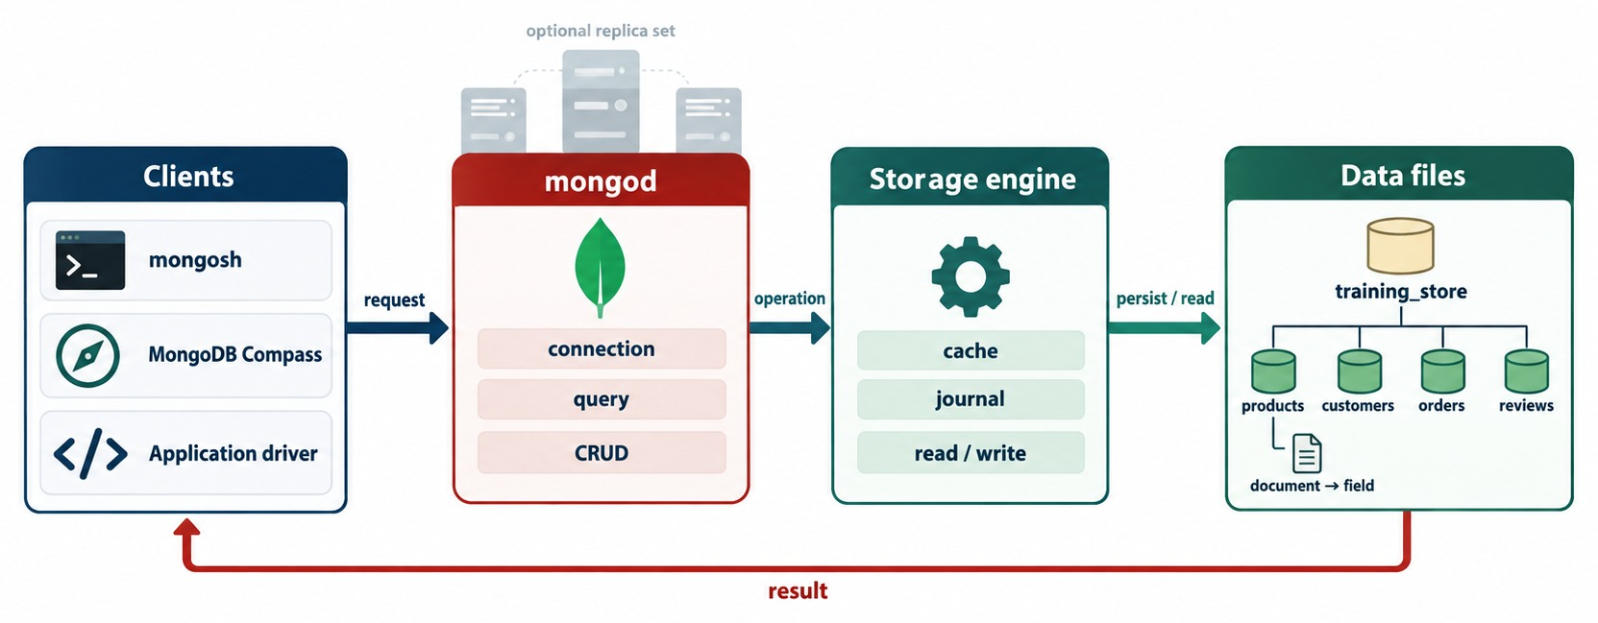
MONGODB ARCHITECTURE OVERVIEW
Clients, the mongod server, the storage engine and the data files.
Clients
mongosh, MongoDB Compass and application drivers.
mongod
The server process: connections, queries, CRUD, indexes, authentication.
Storage engine
WiredTiger by default: cache, journal, reads and writes.
MODULE 2 You'll install mongod and connect with mongosh.
KEY TAKEAWAY Every client talks to mongod — the server process that owns storage, queries and indexes.
31
© 2026 by Innovation In Software Corporation
Notes:
KEY TALKING POINTS
------------------
- Clients
Applications talk to MongoDB through language-specific drivers.
People use mongosh, the MongoDB Shell, and MongoDB Compass, the graphical tool.
- mongod
mongod is the main MongoDB server process.
It manages connections, queries, indexes, authentication, replication and database operations.
- Storage engine and data files
Below mongod, the storage engine, WiredTiger by default, keeps a cache, writes a journal for durability, and reads and writes the data files.
Those files hold our databases and collections.
- What it shows
Clients send a request to mongod, which passes the operation to the storage engine, which reads and writes the data files.
The result returns to the client.
- How to read it
Follow the arrows left to right, then the red result arrow back.
The faded servers above mongod are an optional replica set.
- Key point
mongod is the server process at the center of every MongoDB deployment.

Slide 32
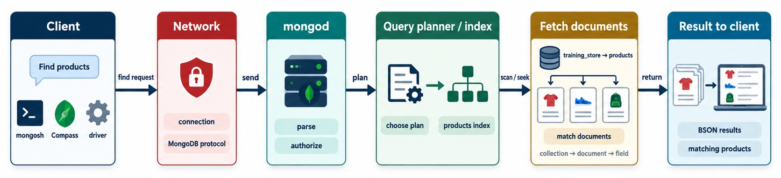
HOW A MONGODB REQUEST IS PROCESSED
Follow one find request from the client to the result.
Find products
Parse and authorize
Choose a plan
Return BSON
db.products.find(
{ category: "LAPTOP" }
)
mongod checks the request and the user's rights.
Use an index, or scan the whole collection.
Matching documents go back to the client.
KEY TAKEAWAY The query planner's choice — index or collection scan — decides how much work each request does.
32
© 2026 by Innovation In Software Corporation
Notes:
KEY TALKING POINTS
------------------
- Follow one request
A client asks for products.
The request travels over the MongoDB wire protocol to mongod on port 27017 by default.
- Inside mongod
mongod parses the request and checks that the user is authorized.
The query planner then chooses a plan: an index seek, or a scan of the whole collection.
- The result
Matching documents are fetched and returned to the client as BSON.
The driver or mongosh turns them into objects you can read.
- What it shows
One find request for products, step by step, from the client to the result.
- How to read it
Each box is one stage: connect over the MongoDB protocol, parse and authorize, choose a plan, fetch matching documents, return BSON results.
- Key point
The query planner's choice, index or scan, decides how much work the request does.

Slide 33
REPLICA SETS AND SHARDED CLUSTERS
Copies of the data for availability — and pieces of the data for scale.
🔁
REPLICA SET: COPIES FOR AVAILABILITY
🧩
SHARDED CLUSTER: SPLIT DATA FOR SCALE
Application (driver)
Application (driver)
writes
PRIMARY
accepts writes
mongos
query router
metadata
Config servers
replicate
SECONDARY
copies the oplog
SECONDARY
copies the oplog
Shard A
a replica set
Shard B
a replica set
Shard C
a replica set
FAILOVER If the primary fails, the members elect a secondary as the new primary.
SHARD KEY Decides which shard stores each document — Module 7.
KEY TAKEAWAY Replica sets keep the data available through a failure; sharding lets it grow past one server.
33
© 2026 by Innovation In Software Corporation
Notes:
KEY TALKING POINTS
------------------
- Replica set
A replica set is a group of MongoDB servers that keep copies of the same data.
The primary accepts writes.
Secondaries copy the primary's changes from its operations log, the oplog.
- Automatic failover
If the primary fails, the remaining members hold an election and an eligible secondary becomes the new primary.
Three members is the usual minimum, so a majority can still vote.
- Sharded cluster
Sharding spreads a large dataset across several shards.
Each shard is itself a replica set.
Config servers store the cluster metadata, and mongos routers send each request to the right shards.
- When to shard
Sharding is for when one server can't efficiently handle the whole dataset or workload.
Module 7 covers both topics in depth.

Slide 34
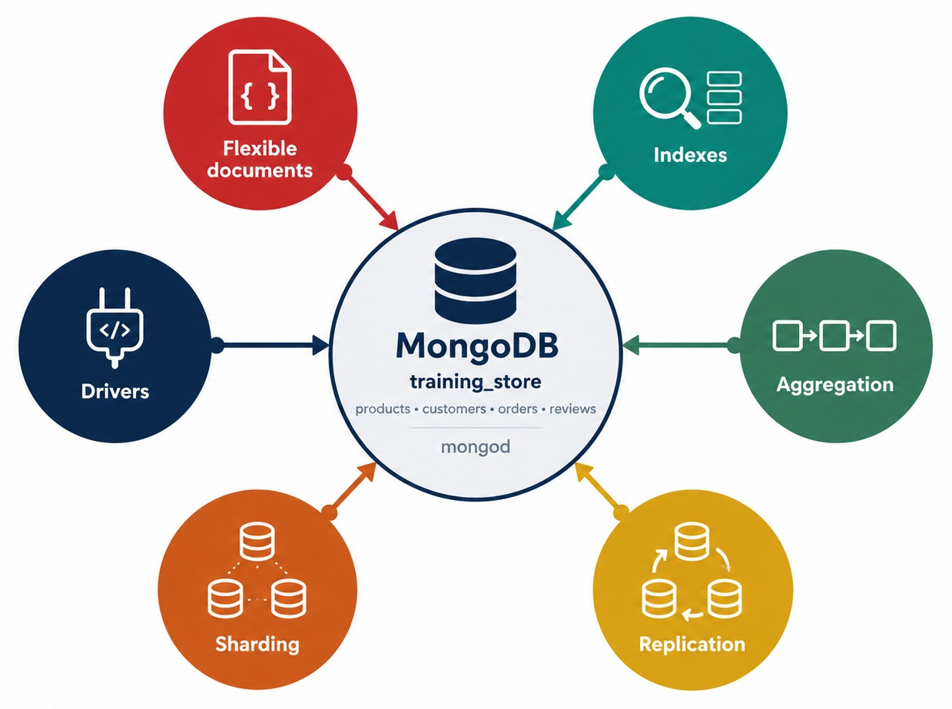
CORE MONGODB FEATURES
Flexible documents, indexes, aggregation, replication, sharding and drivers.
Rich queries
Filter, sort, project and update — plus arrays, geospatial and text.
Indexes
Find documents without scanning the whole collection.
Aggregation
Pipelines of stages for reporting and analysis.
Rules when needed
Schema validation, atomic writes and multi-document transactions.
KEY TAKEAWAY MongoDB is more than flexible storage: it queries, indexes, aggregates, replicates and scales.
34
© 2026 by Innovation In Software Corporation
Notes:
KEY TALKING POINTS
------------------
- Rich queries
MongoDB supports filtering, sorting, projection and updates.
It can also query arrays, run geospatial and text searches, and build aggregation pipelines.
- Indexes and aggregation
Indexes help MongoDB find documents without scanning the whole collection.
Aggregation pipelines pass documents through stages for reporting and analysis.
- Replication and sharding
Replica sets give high availability, and sharding gives horizontal scale.
Drivers connect applications in many languages.
- Rules when you need them
A flexible schema can still enforce rules with schema validation.
Single-document writes are atomic, and multi-document ACID transactions are available when a business process needs them.
- What it shows
MongoDB and training_store in the center, with six features around it: flexible documents, indexes, aggregation, replication, sharding and drivers.
- How to read it
Each circle is a capability we practise later in the course.
- Key point
MongoDB is more than flexible storage: it queries, indexes, aggregates and scales.

Slide 35
QUERIES, INDEXES AND AGGREGATION IN MONGOSH
Three commands on training_store — covered in depth on Days 2 and 3.
Filter and project
Index a common query
Aggregate paid orders
db.products.find(
{ category: "BOOK" },
{ name: 1, price: 1, _id: 0 }
)
db.products.createIndex(
{ category: 1, price: 1 }
)
db.orders.aggregate([
{ $match: {
paymentStatus: "PAID" } },
{ $group: {
_id: "$customerId",
spent: { $sum: "$total" } } },
{ $sort: { spent: -1 } }
])
find
createIndex
aggregate
Returns the two books — name and price only.
Supports queries that filter on category and price.
Totals paid orders per customer; C101 comes first.
KEY TAKEAWAY One query language filters, indexes and aggregates — all on the same documents.
35
© 2026 by Innovation In Software Corporation
Notes:
KEY TALKING POINTS
------------------
- find
The first argument is the filter, the second the projection.
This returns MongoDB Fundamentals at 59.99 and Query Cookbook at 39.99, showing only name and price.
Module 4 covers queries in depth.
- createIndex
A compound index on category and price supports queries that filter by category and sort or filter by price.
Design indexes around real query patterns; Module 6 covers this.
- aggregate
The pipeline keeps the 13 paid orders, groups them by customerId and sums the totals, then sorts.
Aisha Khan, C101, comes first with 3418.62.
Module 5 covers aggregation.
- Field names
Our orders use paymentStatus, not a generic status field.
Using the real field names is the habit to build now.

Slide 36
EXERCISE: PREDICT THE QUERY RESULT
Read a query and say what mongosh prints — before running it.
PRACTICE EXERCISE
5 MIN
SCENARIO
YOUR TASKS
EXPECTED OUTCOME
training_store has three shoes: Running Shoe 129.99, Trail Shoe 89.99 and Clearance Shoe 44.99.
1
Say which shoes match the filter
✓
Clearance Shoe (44.99), then Trail Shoe (89.99)
2
Put them in the order sort() returns
Running Shoe is excluded: 129.99 is not under 100
✓
db.products.find(
{ category: "SHOE",
price: { $lt: 100 } },
{ name: 1, price: 1, _id: 0 }
).sort({ price: 1 })
3
List the fields each result shows
✓
Only name and price — _id is hidden
4
Check your answer on the instructor's screen
Prices print as Decimal128 values
✓
KEY TAKEAWAY Reading a query before running it is the fastest way to learn the query language.
36
© 2026 by Innovation In Software Corporation
Notes:
KEY TALKING POINTS
------------------
- How to run it
Give everyone two minutes to write their prediction, then run the query on the instructor screen.
- The filter
category must equal SHOE and price must be less than 100.
Only the Trail Shoe and the Clearance Shoe qualify.
- Sort and projection
sort({ price: 1 }) is ascending, so Clearance Shoe comes first.
The projection shows name and price and hides _id.
- Decimal128
Prices are stored as Decimal128, so mongosh prints them as Decimal128('44.99').
MongoDB still compares them with the number 100 correctly.

Slide 37
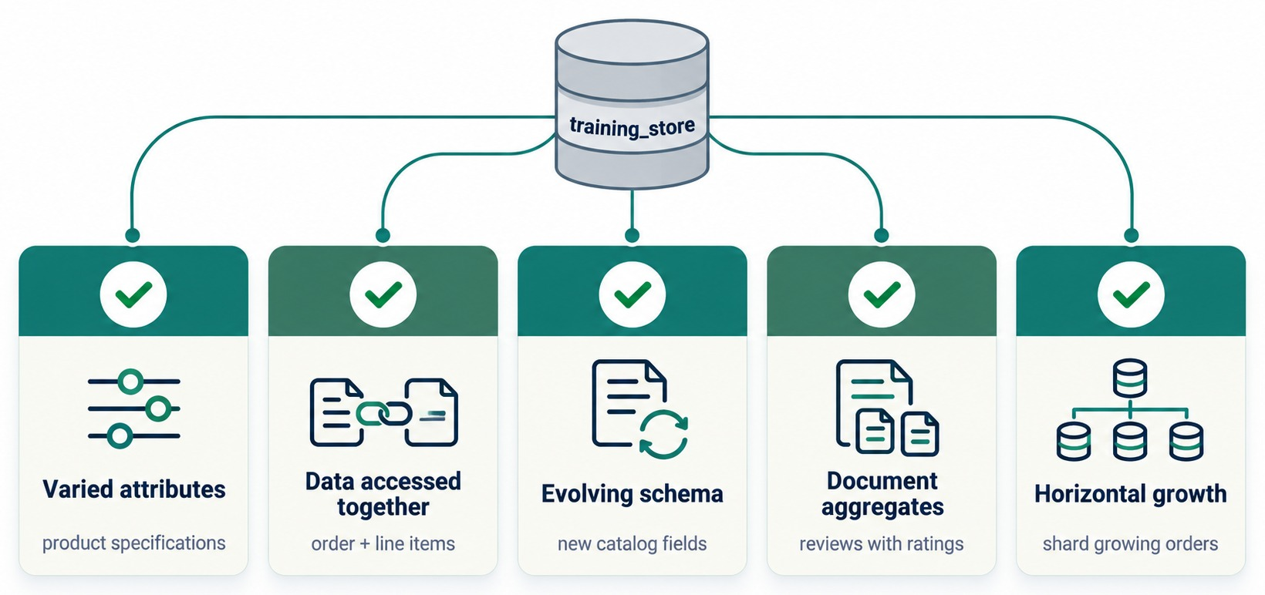
WHEN TO USE MONGODB
Five signals that point to a document database.
Varied attributes
Products with category-specific specifications.
Accessed together
An order and its line items, read in one call.
Evolving schema
New catalog fields without a migration.
Horizontal growth
Shard a fast-growing orders collection.
KEY TAKEAWAY The more of these signals a workload shows, the better MongoDB fits.
37
© 2026 by Innovation In Software Corporation
Notes:
KEY TALKING POINTS
------------------
- Strong signals for MongoDB
Varied attributes, such as product specifications.
Data accessed together, such as an order and its line items.
An evolving schema, such as new catalog fields.
- More signals
Document aggregates, such as a review with its rating.
And horizontal growth, such as a fast-growing orders collection that may one day need sharding.
- The principle
A good MongoDB design doesn't simply move relational tables into collections.
It models documents around how the application reads, writes and updates its data.
- What it shows
Five checked cards: varied attributes, data accessed together, evolving schema, document aggregates and horizontal growth.
- How to read it
Each card has a training_store example underneath, from product specifications to sharding growing orders.
- Key point
The more of these signals a workload shows, the better MongoDB fits.

Slide 38
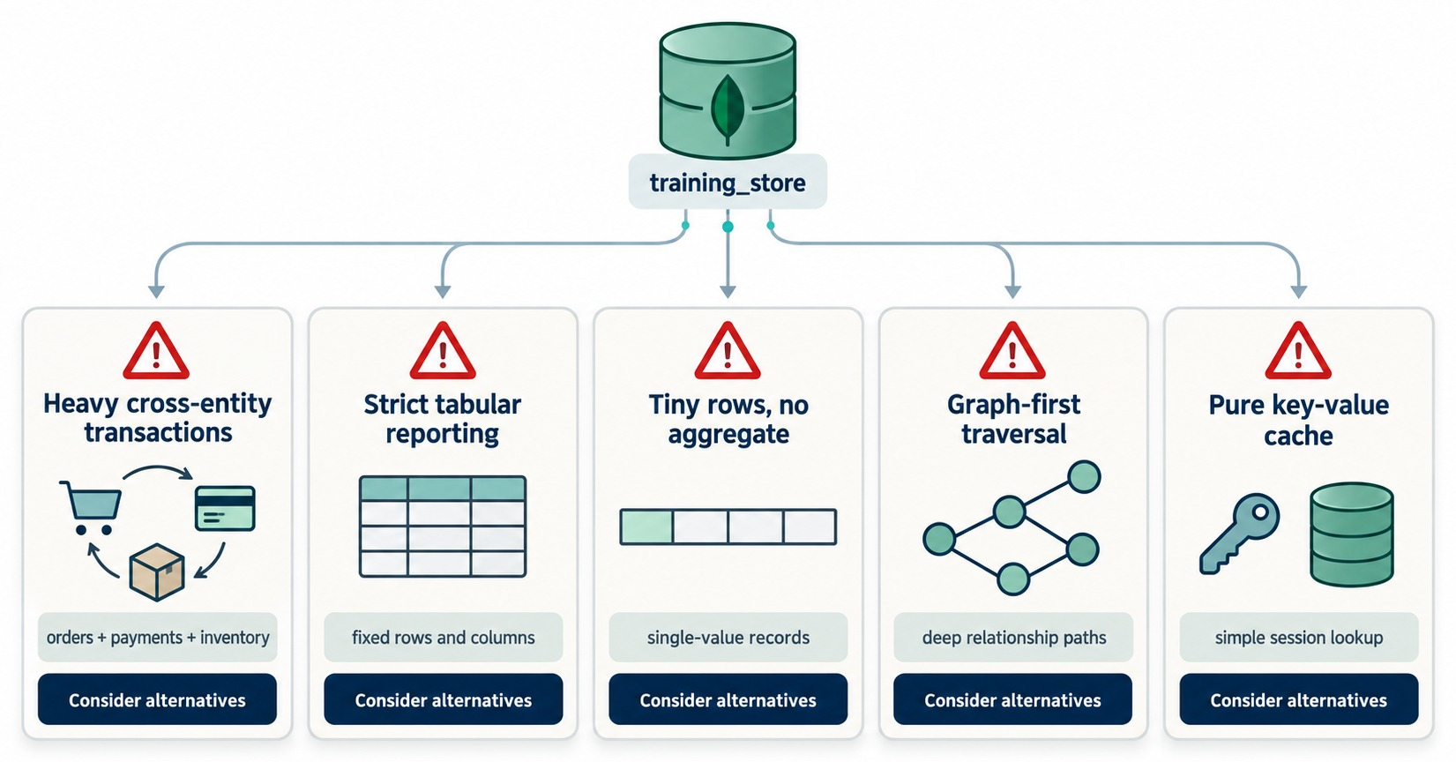
WHEN MONGODB MAY NOT BE THE BEST CHOICE
Five workloads where another model may fit better.
Cross-entity transactions
Supported — but if most work spans many entities, relational may be simpler.
Strict tabular reporting
Fixed rows and columns suit relational tools.
Graph-first or pure cache
Deep traversal → graph; session lookup → key-value.
CONSIDER ALTERNATIVES Check the workload — don't rule MongoDB out.
KEY TAKEAWAY Knowing when not to use MongoDB is part of choosing it well.
38
© 2026 by Innovation In Software Corporation
Notes:
KEY TALKING POINTS
------------------
- Consider alternatives
These are workloads where another database may fit better.
They are not things MongoDB cannot do.
- Transactions and reporting
MongoDB supports multi-document transactions.
But if most of the work spans many entities at once, like orders, payments and inventory together, a relational design may be simpler.
Strict, fixed tabular reporting is also a natural relational fit.
- Other shapes
Tiny single-value records with no aggregate gain little from documents.
Deep relationship paths suit a graph database.
A pure session cache suits a key-value store.
- What it shows
Five warning cards: heavy cross-entity transactions, strict tabular reporting, tiny rows with no aggregate, graph-first traversal and a pure key-value cache.
- How to read it
Each card says consider alternatives.
That means check the workload, not avoid MongoDB.
- Key point
Knowing when not to use a tool is part of choosing it well.

Slide 39
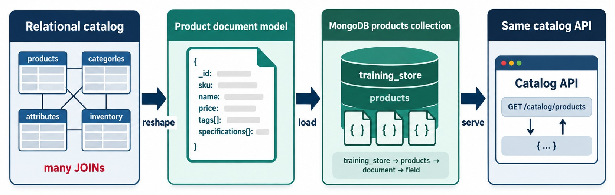
SCENARIO: MODERNIZING A PRODUCT CATALOG
Reshape the data, load it, and serve the same API.
Before
Reshape and load
Same API
MODEL FIRST Reshape around reads — don't copy tables.
products, categories, attributes and inventory tables — many joins.
One product document: sku, name, price, tags, specifications.
GET /catalog/products keeps its contract; one read per product.
KEY TAKEAWAY Modernizing starts by reshaping the data around how it is read — not by copying the tables.
39
© 2026 by Innovation In Software Corporation
Notes:
KEY TALKING POINTS
------------------
- Before
The relational catalog spreads each product across products, categories, attributes and inventory tables.
Every catalog page needs many joins.
- Reshape and load
The team reshapes each product into one document with its sku, name, price, tags and specifications.
Then it loads those documents into the products collection.
- Same API
The catalog API, GET /catalog/products, keeps its contract.
Behind it, each product is now one document read.
- What it shows
A relational catalog with many joins is reshaped into a product document, loaded into the products collection and served through the same catalog API.
- How to read it
Follow the arrows: reshape, load, serve.
- Key point
Modernizing starts with reshaping the data, not with copying the tables.
USE-CASE SCENARIO
-----------------
A retailer's product pages are slow because each one joins four tables.
The team models one product document around what the page shows, loads the catalog into MongoDB and switches the API to read it.
The web and mobile apps don't change at all.

Slide 40
MISCONCEPTIONS AND ANTI-PATTERNS
Beliefs that lead first MongoDB designs into trouble.
MISCONCEPTION
REALITY
ANTI-PATTERNS TO AVOID
NoSQL means SQL is obsolete
Not Only SQL — relational still fits many workloads
✕
One collection per relational table
✕
Unbounded arrays, e.g. every review inside its product
Schemaless means no design
A flexible schema still needs a model — and can be validated
✕
Prices stored as strings
✕
No indexes for common queries
✕
A $lookup join on every read
MongoDB has no transactions
Single-document writes are atomic; multi-document transactions exist
REMEMBER Store together what the application reads together.
Copy each table into a collection
Model documents around how the app reads and writes
NoSQL is one technology
Four families with very different strengths
KEY TAKEAWAY Most first-design problems come from treating MongoDB like tables with a new syntax.
40
© 2026 by Innovation In Software Corporation
Notes:
KEY TALKING POINTS
------------------
- Why this slide
Before the checks, clear away the beliefs that cause the most trouble in first designs.
- NoSQL and schema
Not Only SQL means more options, not the end of SQL.
And a flexible schema still needs a deliberate model; schema validation can enforce the fields that matter.
- Transactions
Every single-document write is atomic.
Multi-document ACID transactions are available too, though a good document design needs them less often.
- Anti-patterns
Watch for one collection per table, arrays that grow forever, prices stored as strings, missing indexes, and joining with $lookup on every read.
training_store keeps reviews in their own collection for exactly this reason.

Slide 41
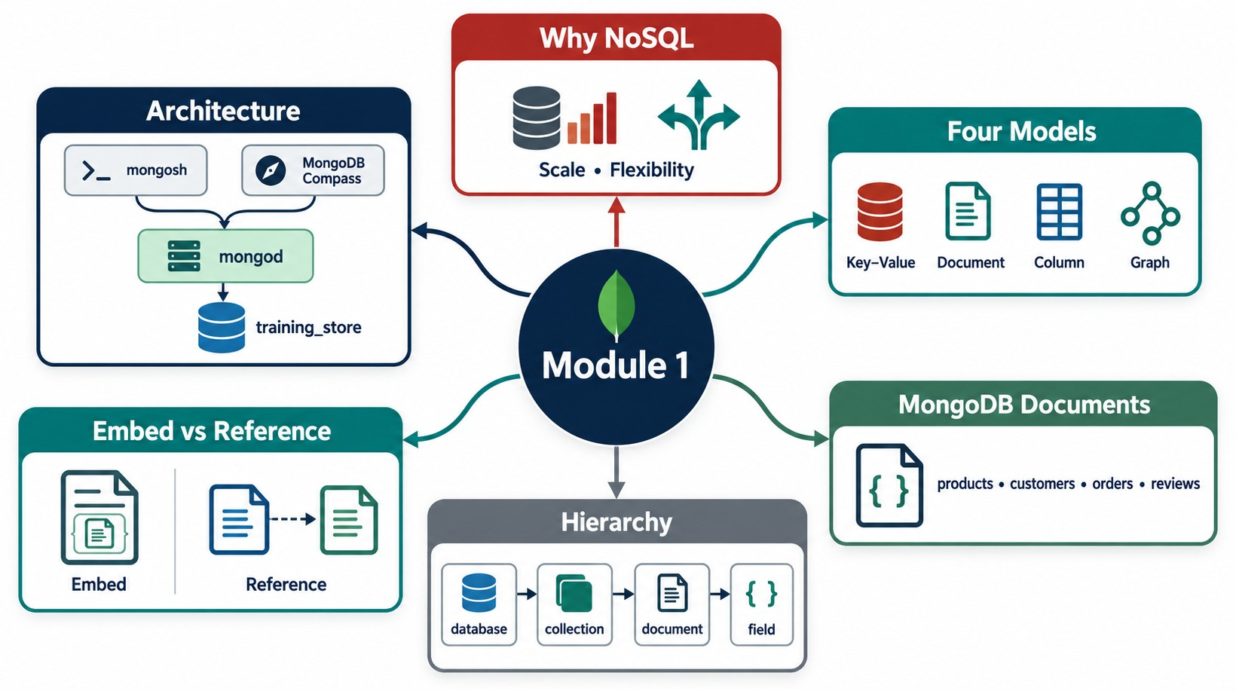
MODULE 1 AT A GLANCE
Why NoSQL, four models, MongoDB documents and architecture — on one page.
KEY TAKEAWAY NoSQL is a family of models; MongoDB stores BSON documents shaped around how the application reads them.
41
© 2026 by Innovation In Software Corporation
Notes:
KEY TALKING POINTS
------------------
- Why NoSQL
Scale and flexibility for data that doesn't fit fixed tables.
- Four models
Key-value, document, column-family and graph, each fast at a different access pattern.
- MongoDB
BSON documents in collections, arranged as database, collection, document and field.
Related data is embedded or referenced.
- Architecture
mongosh, Compass and drivers talk to mongod, which stores training_store.
- What it shows
A concept map of Module 1: why NoSQL, four models, MongoDB documents, hierarchy, embed versus reference, and architecture.
- How to use it
Point to each box and ask the class for one sentence about it before the knowledge check.
- Key point
Together these ideas are the vocabulary Module 2 and Module 3 build on.

Slide 42
KNOWLEDGE CHECK
Answer in your own words — then compare with a partner.
What does “Not Only SQL” communicate?
What is BSON, and why not plain JSON?
1
6
Name the four NoSQL model families.
Why might a product catalog fit a document database?
2
7
Which model fits highly connected data?
Does a flexible schema mean no schema design?
3
8
What is MongoDB's equivalent of a table? Of a row?
What do replica sets and sharding each provide?
4
9
Which field uniquely identifies a document?
Name one workload where MongoDB may not fit best.
5
10
42
© 2026 by Innovation In Software Corporation
Notes:
KEY TALKING POINTS
------------------
- 1. Not Only SQL
NoSQL is a family of non-relational models that sits beside SQL.
It doesn't replace it.
- 2. Four families
Document, key-value, column-family and graph.
- 3. Connected data
A graph database, where relationships are first-class data.
- 4. Table and row
A table maps to a collection, and a row maps to a document.
- 5. Unique field
_id.
It is unique within its collection, and an ObjectId by default.
- 6. BSON
Binary JSON.
It stores real types such as Date, Decimal128 and ObjectId, which plain JSON can't represent.
- 7. Product catalog
Products have different attributes per category, and one product is read as one object.
- 8. Flexible schema
No. You still design the document shape, and you can enforce rules with schema validation.
- 9. Replica sets and sharding
Replica sets give redundancy and automatic failover.
Sharding spreads data across servers for horizontal scale.
- 10. Not the best fit
Examples: heavy cross-entity transactions, strict tabular reporting, graph-first traversal, or a pure key-value cache.

Slide 43
EXERCISE 1.1 — CHOOSE THE APPROPRIATE DATA MODEL
Module 1 checkpoint A: match workloads to models, and justify each one.
OFFICIAL CHECKPOINT A
15 MIN
labs/day-01/exercises/exercise-1.1-choose-the-data-model.md
SCENARIO
YOUR TASKS
SOLUTION (AFTER DEBRIEF)
Pick one starting model for each workload: relational, document, key-value, column-family or graph.
1
Name each model's primary structure
✓
A key-value · B document
✓
C graph · D relational
2
Classify A–C with a one-line reason
A Online shopping sessions
B Product catalog
C Social recommendations
D Banking ledger
E Sensor platform
F Content management
✓
E column-family or time-series
3
Classify D–F the same way
✓
F document
4
Defend one controversial row to the class
✓
Every reason names an access pattern
KEY TAKEAWAY More than one technology may work — start from the access pattern, not popularity.
43
© 2026 by Innovation In Software Corporation
Notes:
KEY TALKING POINTS
------------------
- Official checkpoint
This is the official Exercise 1.1 for Module 1.
The worksheet is labs/day-01/exercises/exercise-1.1-choose-the-data-model.md.
No MongoDB is needed.
- Running it
Twelve minutes of pair work, then a three-minute debrief.
Reveal the solution column only after groups share their answers.
- The requirements
A: retrieve a session by a unique session ID.
B: products with different attributes.
C: traverse relationships between users.
D: strongly structured financial transactions.
E: large volumes of distributed time-series writes.
F: articles with nested and optional sections.
- What to listen for
Each justification should name the access pattern: lookup by key, varied attributes, relationship traversal, strict consistency, or write volume.
Product names alone don't count.

Slide 44
EXERCISE 1.2 — CONVERT RELATIONAL ROWS INTO A DOCUMENT
Module 1 checkpoint B: one order, one document.
OFFICIAL CHECKPOINT B
20 MIN
labs/day-01/exercises/exercise-1.2-rows-to-documents.md
SCENARIO
YOUR TASKS
EXPECTED OUTCOME
Order O5001 lives in three tables. Make it one document the application can read without joins.
1
Name the three tables and their join keys
✓
One document with _id: "O5001"
2
Draft the order header: status and total
✓
A nested customer and an items array
Customer C101 Aisha Khan
aisha@example.com
Order O5001 PLACED 110.00
Items P10 Keyboard 2 × 25.00
P22 Mouse 1 × 60.00
Embed the items and the customer; set _id
✓
Purchase-time price is a snapshot
3
✓
An embedded email can go stale
4
Decide what is a snapshot and what can go stale
✓
Shaped for: get O5001 in one read
KEY TAKEAWAY Some duplication is intentional when it serves the access pattern and preserves history.
44
© 2026 by Innovation In Software Corporation
Notes:
KEY TALKING POINTS
------------------
- Official checkpoint
This is the official Exercise 1.2.
The worksheet is labs/day-01/exercises/exercise-1.2-rows-to-documents.md.
Learners write the document in a scratch file; MongoDB is optional.
- The expected document
_id is O5001.
customer holds customerId C101, name Aisha Khan and her email.
items is an array of two lines: P10 Keyboard, quantity 2 at 25.00, and P22 Mouse, quantity 1 at 60.00.
status is PLACED and total is 110.00.
- Snapshot versus stale
The purchase-time price is a deliberate snapshot.
An embedded email can go stale if Aisha changes it later.
The document is shaped for one query: get order O5001 in one read.
- A note on the dataset
The worksheet's O5001 is its own small example.
The O5001 in the loaded training_store is different: a Business Laptop and two Wireless Mice, payment pending, with a customerId reference instead of an embedded customer.
Learners will see it in Exercise 1.3.

Slide 45
EXERCISE 1.3 — EXPLORE A MONGODB DATASET
Module 1 checkpoint C: navigate training_store and read real documents.
OFFICIAL CHECKPOINT C
25 MIN
labs/day-01/exercises/exercise-1.3-explore-a-mongodb-dataset.md
SCENARIO
YOUR TASKS
EXPECTED OUTCOME
The instructor has loaded training_store. No mongosh yet? Follow on screen.
1
List the databases and collections
✓
customers, orders, products, reviews
2
Read one product and one order
_id: the unique document identifier
show dbs
use training_store
show collections
db.products.findOne()
db.orders.findOne()
db.products.find().limit(2)
// a laptop and a book:
db.products.find(
{ sku: { $in: ["L100", "B300"] } })
✓
3
Label _id, scalars, objects, arrays, dates, numbers, Booleans
✓
Order: shippingAddress object, items array
4
Compare two products' fields
Products differ by category attributes
✓
5
Answer the observation sheet
✓
One row-versus-document difference
KEY TAKEAWAY A document looks like an application object: nested fields, arrays and real types in one record.
45
© 2026 by Innovation In Software Corporation
Notes:
KEY TALKING POINTS
------------------
- Official checkpoint
This is the official Exercise 1.3.
The worksheet is labs/day-01/exercises/exercise-1.3-explore-a-mongodb-dataset.md.
The instructor loads training_store before class; if mongosh isn't installed yet, learners follow on the instructor screen.
- What they will see
show dbs lists training_store beside admin, config and local.
show collections lists customers, orders, products and reviews.
db.orders.findOne() prints O5001, with a shippingAddress object and an items array; the customer is a customerId reference.
- Comparing products
On a fresh load, find().limit(2) usually returns the two laptops, L100 and L110, which share the same fields.
Use the last command on the slide to compare a laptop, with processor and memoryGB, against a book, with author and isbn.
- Observation sheet
Six questions: which databases and collections exist, the purpose of _id, which document had an embedded object, which had an array, which fields differed, and how a document resembles an application object.

Slide 46
MODULE 1 SUMMARY AND WHAT'S NEXT
From why NoSQL exists to reading real MongoDB documents.
YOU CAN NOW
NEXT: MODULE 2 — INSTALLATION AND SETUP
Explain what NoSQL means and why it emerged
1
Local MongoDB or MongoDB Atlas?
✓
Compare document, key-value, column-family and graph models
2
How do I install and start mongod and mongosh?
✓
Describe databases, collections, documents and BSON
How do I connect and load training_store?
✓
3
Explain mongod, replica sets and sharding
✓
Judge when MongoDB fits — and when it doesn't
BRING ALONG Your Exercise 1.1 table, your O5001 document and your Exercise 1.3 observation sheet.
✓
Read training_store documents in mongosh
✓
KEY TAKEAWAY Module 2 gives you your own running MongoDB, so every later module can use training_store hands-on.
46
© 2026 by Innovation In Software Corporation
Notes:
KEY TALKING POINTS
------------------
- Recap
We moved from the kinds of data applications store, to the four NoSQL models, to MongoDB's documents and BSON types, to how MongoDB runs and when it fits.
- Next module
Module 2 answers the setup questions: local MongoDB or Atlas, how to install and start mongod and mongosh, and how to connect and load training_store.
- Bring along
Keep the Exercise 1.1 table, the O5001 document from Exercise 1.2 and the Exercise 1.3 observation sheet.
Module 3 builds directly on them.

