Slide 1
"Ping, write, read — then trust it."
MODULE 2
Installation and Setup
Choose a deployment, install or provision MongoDB, connect with mongosh and Compass, and prove the environment with a write and a read.
Choose a deployment
Install and run
Connect
First commands
Secure and troubleshoot
MASTERING MONGODB • MODULE 2
Notes:
KEY TALKING POINTS
------------------
- Why this module matters
Every later lab needs a working MongoDB and a client that can reach it.
This module builds that environment and, just as important, proves it works.
- What this module does
We choose where MongoDB runs, install or provision it, start it, connect with mongosh and Compass, run our first commands in training_store, and finish with security basics and troubleshooting.
- The quote
A shell prompt is not proof.
A ping proves the server answers; a write and a read prove the environment is usable.
That is the standard for this module.
- Where the course goes next
Module 3, Data Modeling with MongoDB, starts by loading the full training_store dataset on the environment you build today.
REAL-WORLD EXAMPLES
-------------------
- A new developer joins a team and gets a connection string on day one.
Before touching application code, they connect, ping, and write and read a test document.
That ten-minute check avoids hours of debugging the wrong layer later.

Slide 2
LEARNING OBJECTIVES
What you will be able to do by the end of this module.
🎯
BY THE END OF THIS MODULE, YOU CAN
❓
SIX QUESTIONS THIS MODULE ANSWERS
1. Choose local, container, self-managed or cloud
2. Explain mongod, mongosh, Compass and drivers
3. Install or provision MongoDB and start it
4. Read and build a connection string
5. Create training_store and run CRUD checks
6. Protect credentials and diagnose failures
WHERE
should MongoDB run for this course?
HOW
do I install and start mongod?
HOW
does a client find the server?
WHAT
proves the environment really works?
HOW
do I keep passwords out of sight?
WHAT
do I check when it won't connect?
🗺️
MODULE ROADMAP
Deploy
Install
Start
Connect
First data
Secure
Troubleshoot
KEY TAKEAWAY A setup is finished only when a ping, a write and a read all succeed.
2
© 2026 by Innovation In Software Corporation
Notes:
KEY TALKING POINTS
------------------
- By the end of this module
Walk through the six objectives on the left.
Learners choose a deployment option and explain the roles of mongod, mongosh, Compass and drivers.
They install or provision MongoDB, start it and connect with a connection string.
They create training_store, run insert, find, update and delete checks, protect credentials and diagnose common failures.
- Six questions this module answers
Where should MongoDB run?
How do I install and start mongod?
How does a client find the server?
What proves the environment works?
How do I keep passwords out of sight?
And what do I check when it won't connect?
- Set the expectation
The roadmap at the bottom is also the order of the hands-on lab.
The standard is proof: ping, write and read.

Slide 3
KEY TERMS FOR THIS MODULE
Plain definitions for the words we'll use most.
1
mongod
2
mongosh
The MongoDB server process: it listens on a port, stores the data files and answers every request.
The MongoDB Shell: a command-line client that sends commands to mongod and prints the results.
3
MongoDB Compass
4
MongoDB Atlas
MongoDB's graphical client for browsing and editing the same data that mongosh sees.
MongoDB's managed cloud service: the vendor runs, backs up and scales the cluster.
5
Connection string
6
localhost:27017
A URI such as mongodb://localhost:27017 that tells a client where and how to connect.
The default address of a local mongod: this machine, port 27017.
7
Authentication vs authorization
8
Ping
Authentication proves who you are; authorization (roles) decides what you may do.
db.runCommand({ ping: 1 }) returns ok: 1 when the server answers — reachability, not write access.
KEY TAKEAWAY Agree on the words first — every later slide builds on them.
3
© 2026 by Innovation In Software Corporation
Notes:
KEY TALKING POINTS
------------------
- How to run this slide
Read each term once and give a quick example from the training_store sample database.
- mongod
The MongoDB server process: it listens on a port, stores the data files and answers every request.
- mongosh
The MongoDB Shell: a command-line client that sends commands to mongod and prints the results.
- MongoDB Compass
MongoDB's graphical client for browsing and editing the same data that mongosh sees.
- MongoDB Atlas
MongoDB's managed cloud service: the vendor runs, backs up and scales the cluster.
- Connection string
A URI such as mongodb://localhost:27017 that tells a client where and how to connect.
- localhost:27017
The default address of a local mongod: this machine, port 27017.
- Authentication vs authorization
Authentication proves who you are; authorization (roles) decides what you may do.
- Ping
db.runCommand({ ping: 1 }) returns ok: 1 when the server answers — reachability, not write access.

Slide 4
FULL FORMS USED IN THIS MODULE
Every abbreviation on these slides, spelled out.
CLI
Command-Line Interface
GUI
Graphical User Interface
SRV
Service (DNS SRV record)
CRUD
Create, Read, Update, Delete
IP
Internet Protocol
TLS
Transport Layer Security
DB
Database
MSI
Microsoft Installer (Windows Installer package)
URI
Uniform Resource Identifier
DNS
Domain Name System
OS
Operating System
VM
Virtual Machine
KEY TAKEAWAY When an abbreviation isn't clear, the full form is on this slide.
4
© 2026 by Innovation In Software Corporation
Notes:
KEY TALKING POINTS
------------------
- How to run this slide
Don't read every row.
Point out the few this module uses most, and say the full list is here for reference.
- Reference
CLI is Command-Line Interface; CRUD is Create, Read, Update, Delete; DB is Database; DNS is Domain Name System; GUI is Graphical User Interface; IP is Internet Protocol; MSI is Microsoft Installer (Windows Installer package); OS is Operating System; SRV is Service (DNS SRV record); TLS is Transport Layer Security; URI is Uniform Resource Identifier; VM is Virtual Machine.

Slide 5
FROM MODULE 1 TO MODULE 2
The ideas are in place — now we build the environment.
MODULE 1 GAVE US
🧭
THE PATH THROUGH MODULE 2
Choose where MongoDB runs
✓
NoSQL is a family of data models
1
Part 1
✓
Documents, collections and BSON
Install, configure and start mongod
2
Part 2
✓
mongod serves mongosh and Compass
Connect with a connection string
3
Part 3
✓
The training_store sample database
Create training_store; write and read
4
Part 4
✓
Exercise 1.3 on the instructor's server
Protect credentials; troubleshoot
NOW Run your own MongoDB — and prove that it works.
5
Part 5
Prove it: Exercises 2.1–2.4, Lab 1
6
Checkpoints
KEY TAKEAWAY Module 1 explained what MongoDB is; Module 2 gives every learner a running, verified copy of it.
5
© 2026 by Innovation In Software Corporation
Notes:
KEY TALKING POINTS
------------------
- Bridge from Module 1
Module 1 explained NoSQL, MongoDB's document model and the basic architecture: clients such as mongosh and Compass talk to the mongod server.
Exercise 1.3 explored training_store on the instructor's server.
- What changes now
In Module 2 every learner gets their own environment, or a verified connection to a shared one, and proves it with a ping, a write and a read.
- The path
Part 1 chooses where MongoDB runs.
Part 2 installs and starts it.
Part 3 connects.
Part 4 creates training_store and runs the first commands.
Part 5 covers credentials and troubleshooting.
The official Exercises 2.1 to 2.4 and Day 1 Lab 1 close the module.
- Promise from Module 1
Module 1 ended with three questions: local MongoDB or Atlas, how to install and start mongod and mongosh, and how to connect and load training_store.
This module answers all three.

Slide 6
PART 1: CHOOSING A DEPLOYMENT
Before installing anything, decide where MongoDB should run.
Part 1
Choose a deployment
Part 2
Install and run
Part 3
Connect
Part 4
First commands
Part 5
Secure and troubleshoot
SO FAR
NEXT QUESTION
Where should MongoDB run — on my laptop, in a container, on a server, or in the cloud?
✓
Module 1 explained documents and mongod
✓
training_store is our running example
IN THIS PART
1
Four deployment options
2
Local Community Edition
3
Containerized MongoDB
4
Managed cloud: MongoDB Atlas
5
Local versus managed cloud
6
Choosing an option
6
© 2026 by Innovation In Software Corporation
Notes:
KEY TALKING POINTS
------------------
- Why start here
The installation steps, the connection string and the security work all depend on where MongoDB runs.
So we decide that first.
- What this part answers
We compare local, container, self-managed and managed-cloud deployments, then use a simple decision flow.
Exercise 2.1 practises exactly this choice.

Slide 7
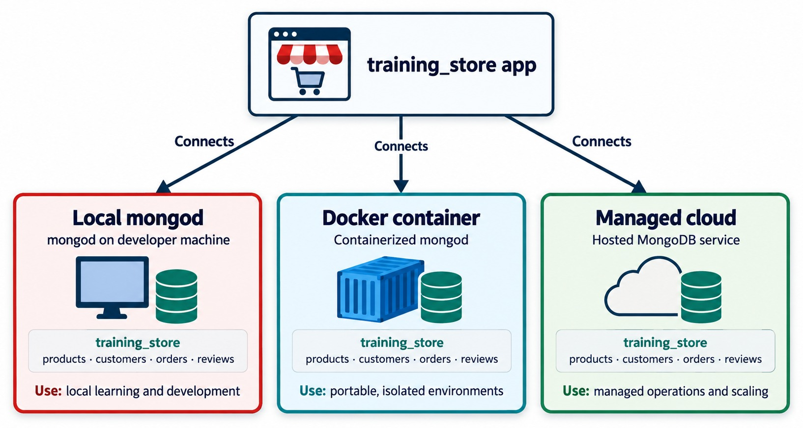
MONGODB DEPLOYMENT OPTIONS
The same training_store database — three places to run it.
Local mongod
Community Edition on your own machine — learning and development.
Docker container
Portable and isolated, easy to remove — tests and demos.
Managed cloud
MongoDB Atlas runs the cluster — teams and production.
FOURTH OPTION A self-managed server or VM — see the decision flow.
KEY TAKEAWAY Choose the deployment by who should run the server — the database and the commands stay the same.
7
© 2026 by Innovation In Software Corporation
Notes:
KEY TALKING POINTS
------------------
- Four options, one database
MongoDB can run locally with Community Edition, in a container, on a self-managed server or virtual machine, or as a managed cloud service such as MongoDB Atlas.
This diagram shows three of them; the self-managed server appears in the decision flow at the end of this part.
- What stays the same
The commands you type in mongosh, the documents and the training_store collections are the same in every option.
- What changes
Who installs, patches, backs up, secures and scales the server.
That responsibility is the real difference between the options.
- What it shows
The training_store application connecting to three kinds of deployment: a local mongod on the developer machine, a containerized mongod, and a hosted MongoDB service.
- How to read it
Each box holds the same training_store database with products, customers, orders and reviews.
Only the Use line at the bottom changes.
- Key point
The database is the same everywhere; who runs the server is what changes.

Slide 8
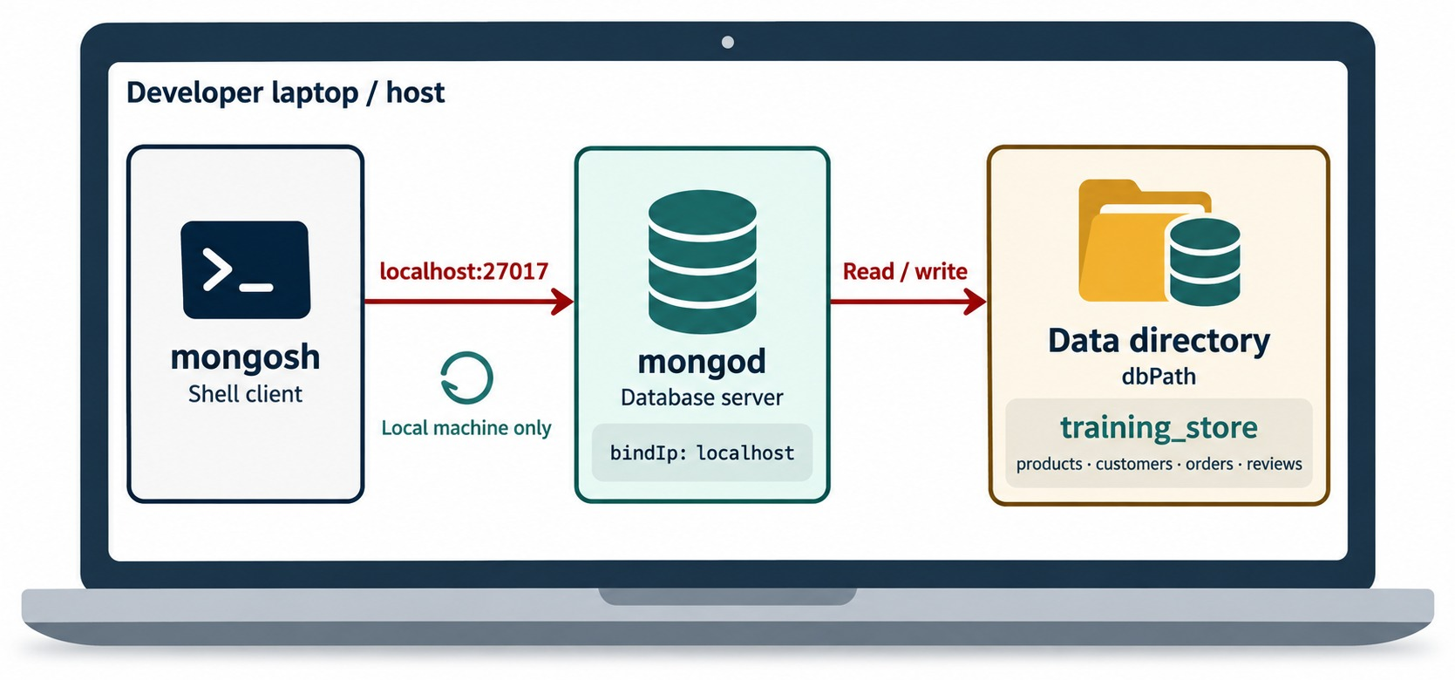
LOCAL DEPLOYMENT: MONGODB COMMUNITY EDITION
mongosh, mongod and the data directory on one machine.
Community Edition
The free server, installed from MongoDB's official packages.
localhost:27017
The default address; bindIp: localhost keeps it private.
dbPath
The data directory where mongod stores training_store.
AUTH IS OFF BY DEFAULT Fine on localhost only — never expose it.
KEY TAKEAWAY A local server is private by default — keep bindIp on localhost while authentication is off.
8
© 2026 by Innovation In Software Corporation
Notes:
KEY TALKING POINTS
------------------
- What local means
MongoDB Community Edition runs directly on the learner's computer.
No internet is needed after installation.
- Best for
Classroom exercises, offline development, learning administration commands, testing applications locally, and understanding the mongod server process.
- The safe default
A fresh local install listens on localhost only, and access control is off by default.
That is acceptable only because nobody else can reach the port.
Never widen bindIp without first enabling authentication.
- What it shows
A developer laptop running all three pieces: mongosh, mongod and the data directory, dbPath, that holds training_store.
- How to read it
mongosh reaches mongod on localhost:27017.
The bindIp: localhost label means only this machine can connect.
mongod reads and writes the data directory.
- Key point
A local install is private by default, because it listens on localhost only.

Slide 9
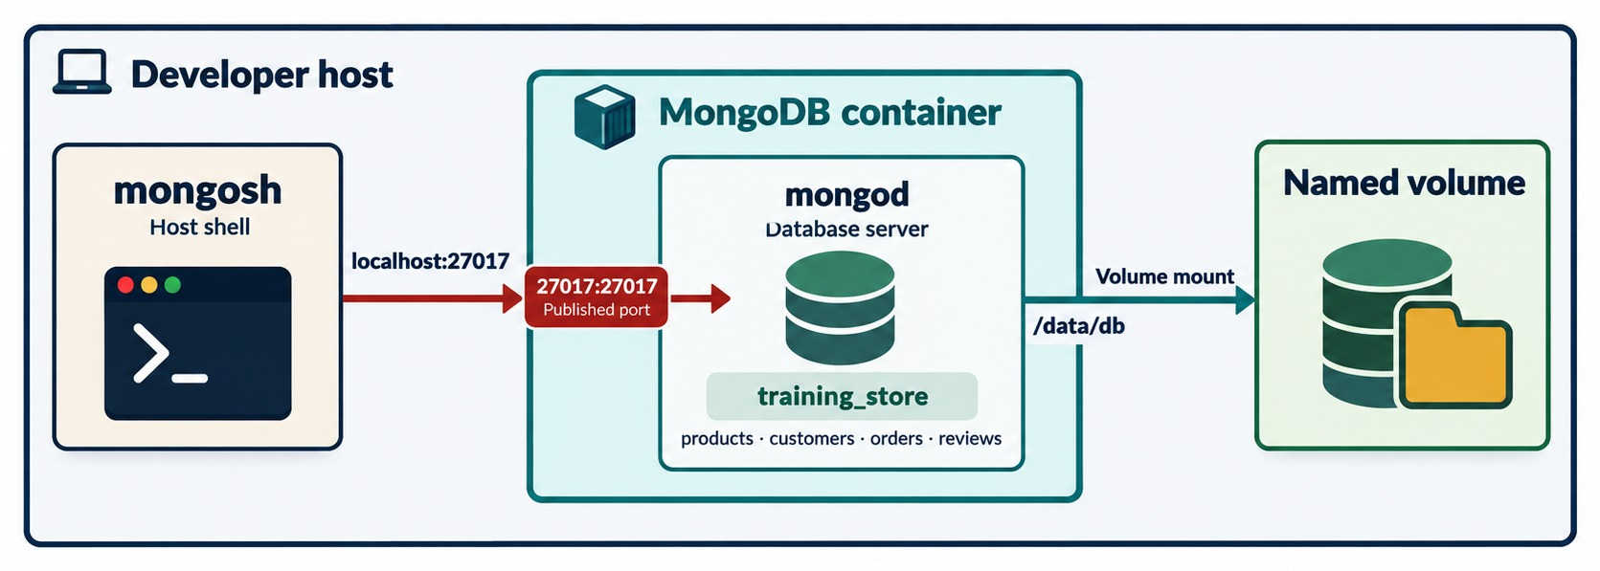
CONTAINERIZED MONGODB
mongod in a container, a published port and a named volume.
Start it (PowerShell)
docker run -d --name mongo `
-p 127.0.0.1:27017:27017 `
-v mongo-data:/data/db `
mongodb/mongodb-community-server
Published port
Host 27017 → container 27017; 127.0.0.1 keeps it on this machine.
Named volume
mongo-data outlives the container — so does training_store.
KEY TAKEAWAY A container is quick to create and remove — mount a volume so the data survives.
9
© 2026 by Innovation In Software Corporation
Notes:
KEY TALKING POINTS
------------------
- Why containers
A container gives a portable, isolated MongoDB that can be created and removed in seconds.
That suits temporary test environments and CI pipelines.
- The published port
The diagram's 27017:27017 maps host port 27017 to the container.
By default Docker publishes that port on every network interface of the host.
Our command adds 127.0.0.1 so only this machine can reach an unauthenticated server.
- The volume
The named volume mongo-data is mounted at /data/db.
Without it, docker rm deletes the data along with the container.
- The image
mongodb/mongodb-community-server is MongoDB's own Community image.
The Docker Official Image, mongo, works the same way.
Pin a version tag in real projects instead of latest.
- What it shows
A MongoDB container on the developer host.
mongosh on the host reaches it at localhost:27017 through the published port 27017:27017.
- How to read it
The container's /data/db is mounted on a named volume, so the data lives outside the container.
- Key point
Without the volume, removing the container would remove training_store with it.
- Line breaks
The command uses PowerShell's backtick to continue lines.
In bash or zsh, end each line with a backslash instead.

Slide 10
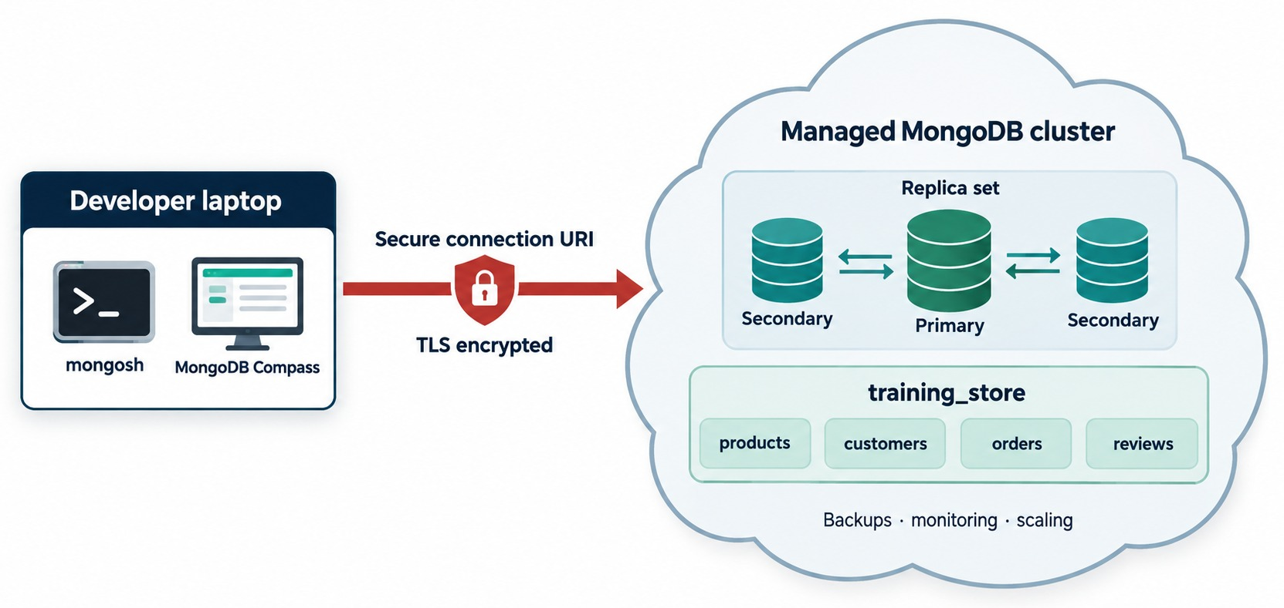
MANAGED CLOUD: MONGODB ATLAS
A managed replica set, reached through a secure connection URI.
MongoDB Atlas
MongoDB's managed cloud: servers, patches, backups and scaling.
Replica set included
One primary and two secondaries from the start.
TLS required
Clients connect with an encrypted connection URI.
YOU STILL OWN Database users, the IP access list and the secret URI.
KEY TAKEAWAY Atlas runs the servers for you — you still decide who may connect, and from where.
10
© 2026 by Innovation In Software Corporation
Notes:
KEY TALKING POINTS
------------------
- What Atlas is
MongoDB Atlas is MongoDB's managed cloud platform.
Atlas handles much of the infrastructure, maintenance and configuration.
- Best for
Team projects, remote access, cloud application development, high availability and production-style practice.
- What you still own
You still create the database users, choose which IP addresses may connect, and keep the connection string secret.
Atlas requires TLS on every connection.
- What it shows
mongosh and Compass on a developer laptop connecting over a TLS-encrypted connection URI to a managed MongoDB cluster.
- How to read it
Inside the cloud: a replica set with one primary and two secondaries, the training_store database, and the backups, monitoring and scaling the service provides.
- Key point
In the cloud you manage users, network access and the URI; the vendor runs the servers.

Slide 11
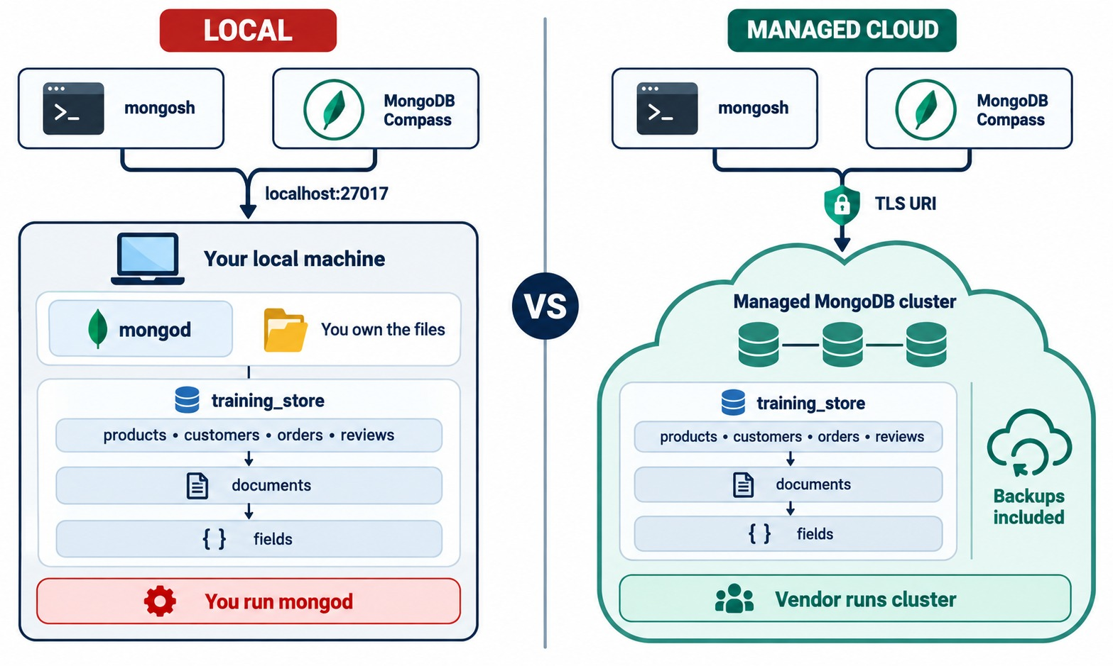
LOCAL VS. MANAGED CLOUD
You run mongod — or the vendor runs the cluster.
Internet
Local: not after installation · Atlas: always.
Who runs it
Local: you run mongod · Atlas: the vendor runs the cluster.
Address
Local: localhost:27017 · Atlas: a TLS connection URI.
Best use
Local: learning, local development · Atlas: team and cloud projects.
KEY TAKEAWAY Same documents, same commands — local gives you control, the cloud takes the operations work.
11
© 2026 by Innovation In Software Corporation
Notes:
KEY TALKING POINTS
------------------
- Internet and management
Local needs no internet after installation, and you manage it yourself.
Atlas needs internet, and Atlas manages the infrastructure.
- Setup and address
Local setup is a software installation, reached at localhost:27017.
Atlas setup is a cloud account and a cluster, reached through an Atlas connection URI.
- Remote access and best use
Local remote access requires configuration; Atlas has it built in, behind access controls.
Local is best for learning and local development; Atlas for cloud and team projects.
- What it shows
The same clients and the same training_store hierarchy on both sides: collections, documents and fields.
- How to read it
Local: clients reach localhost:27017, you own the files and you run mongod.
Managed cloud: clients use a TLS URI, backups are included and the vendor runs the cluster.
- Key point
The data model and the commands are the same; the operating responsibility moves.

Slide 12
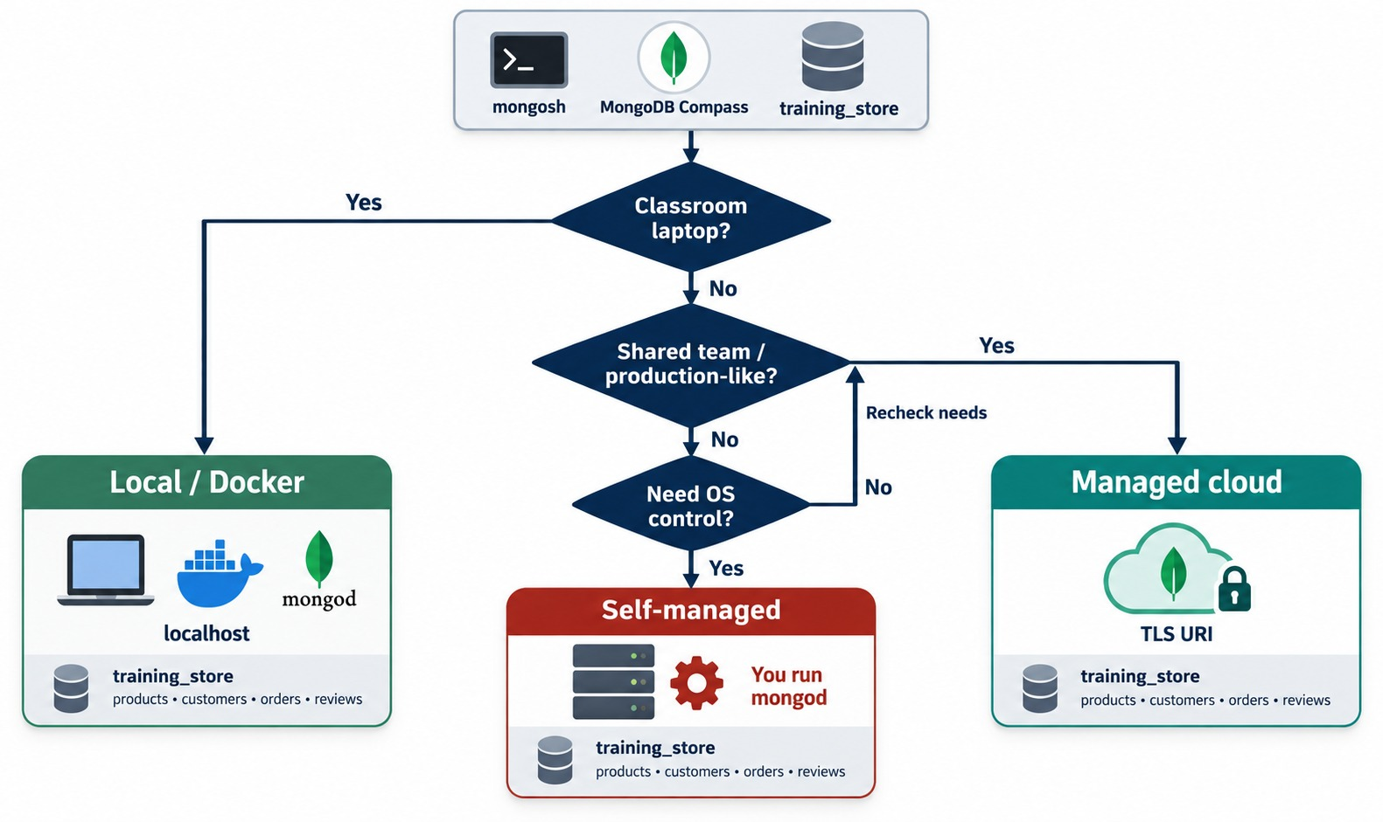
CHOOSING A DEPLOYMENT OPTION
Three questions lead to local, self-managed or managed cloud.
Classroom laptop?
Local or Docker on localhost.
Shared team or production-like?
Managed cloud with a TLS URI.
Need control of the OS?
Self-managed server or VM — you run mongod.
EXERCISE 2.1 You'll justify six choices like these.
KEY TAKEAWAY Start from the constraint — offline, disposable, shared or controlled — then pick the option that fits it.
12
© 2026 by Innovation In Software Corporation
Notes:
KEY TALKING POINTS
------------------
- Walk the flow
Start at the top: a classroom laptop points to local or Docker.
A shared or production-like need points to managed cloud.
A need for direct control of the operating system points to self-managed.
- The fourth option
Self-managed means you install and operate mongod yourself on a server or virtual machine.
Regulated organizations often choose it for direct control, at the cost of patching, backups and monitoring.
- Link to Exercise 2.1
Exercise 2.1 gives six scenarios.
Each answer must name the constraint: offline, disposable, shared, control, operations load or network.
- What it shows
A decision flow.
Classroom laptop?
Yes leads to Local or Docker.
Otherwise: shared team or production-like?
Yes leads to Managed cloud.
- How to read it
If neither, ask whether you need control of the operating system.
Yes leads to Self-managed, where you run mongod.
No sends you back to recheck your needs.
- Key point
Every path ends with the same training_store; only the operations work differs.

Slide 13
PART 2: INSTALLING AND RUNNING MONGODB
Install the server and the shell, configure them and start the service.
✓ Part 1
Choose a deployment
Part 2
Install and run
Part 3
Connect
Part 4
First commands
Part 5
Secure and troubleshoot
SO FAR
NEXT QUESTION
How do I install MongoDB, configure it and start it — or provision it in the cloud?
✓
Four deployment options, one database
✓
Local for learning; Atlas for teams
IN THIS PART
✓
The operating responsibility is what changes
The installation workflow
1
2
mongod versus mongosh
3
Installing on Windows, macOS and Linux
4
The configuration file
5
Starting and stopping MongoDB
6
Provisioning in Atlas
13
© 2026 by Innovation In Software Corporation
Notes:
KEY TALKING POINTS
------------------
- Connecting the parts
Part 1 chose where MongoDB runs.
Part 2 makes it run: the local install on each operating system, and the Atlas path for the cloud.
- Watch for
Keep two programs apart: mongod, the server, and mongosh, the client.
Most setup confusion comes from mixing them up.

Slide 14
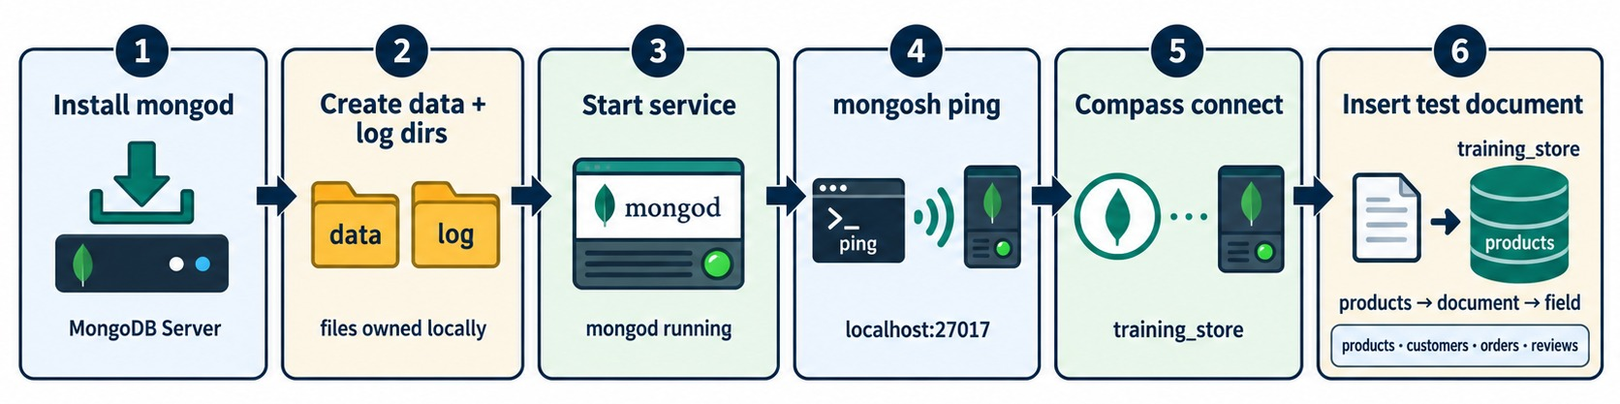
THE MONGODB INSTALLATION WORKFLOW
Six steps from download to a first test document.
Server side
Client side
What you install
OFFICIAL DOCS Follow MongoDB's install page for your OS and version.
Install mongod, check the data and log directories, start the service.
Ping from mongosh, connect Compass, insert a test document.
Community Server, mongosh, optional Compass and Database Tools.
KEY TAKEAWAY Installing is only half the job — the last three steps prove the server works.
14
© 2026 by Innovation In Software Corporation
Notes:
KEY TALKING POINTS
------------------
- The six steps
Install the MongoDB Server, make sure the data and log directories exist, start the service, ping it from mongosh, connect Compass, and insert a test document.
- What a local environment contains
MongoDB Community Server runs the database.
mongosh is the command-line client.
Compass is an optional graphical interface.
The MongoDB Database Tools are optional import, export and backup utilities.
- Follow the official page
MongoDB publishes install instructions for each operating system and version.
Use them instead of copying commands from old blog posts.
- What it shows
The local install path: install mongod, create the data and log directories, start the service, ping from mongosh, connect Compass, insert a test document.
- How to read it
Steps 1 to 3 are on the server side; steps 4 to 6 prove it from the client side.
- Key point
Installing is only half the job; the last three steps prove it works.

Slide 15
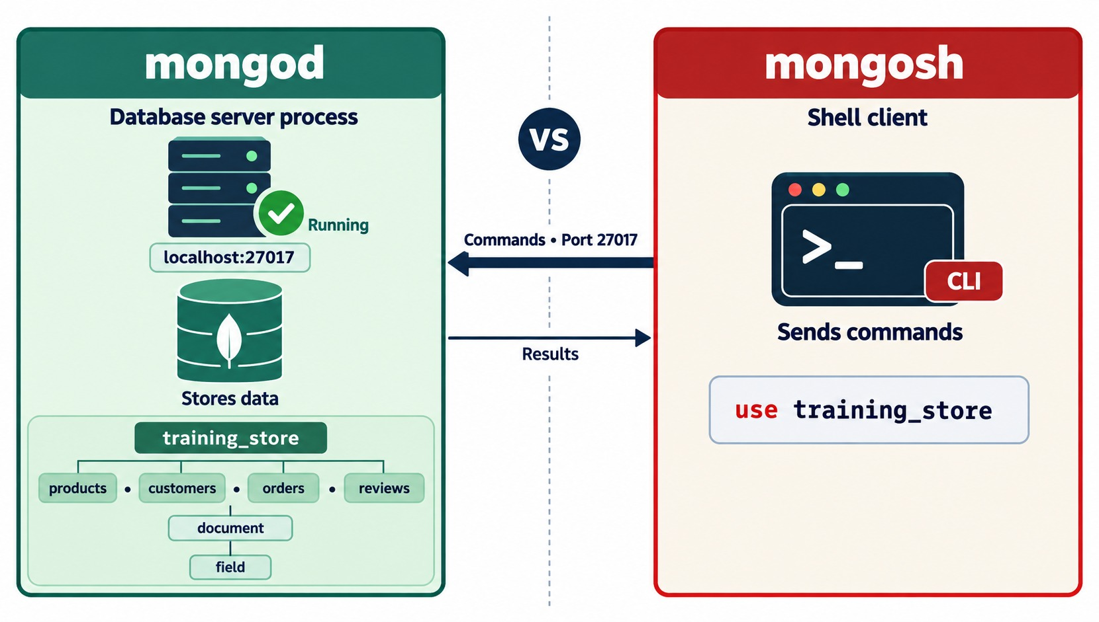
MONGOD VS. MONGOSH
The server that stores the data and the shell that sends commands.
mongod
The server: stores the data and listens on port 27017.
mongosh
The shell: sends commands and prints the results.
Separate programs
Closing mongosh never stops the database.
NO SERVER, NO SHELL If mongod isn't running, mongosh can't connect.
KEY TAKEAWAY mongod is the database; mongosh is only a window onto it.
15
© 2026 by Innovation In Software Corporation
Notes:
KEY TALKING POINTS
------------------
- mongod
mongod is the database server process.
It stores the data, listens on port 27017 by default and does the actual work.
- mongosh
mongosh is the interactive shell.
It only sends commands and prints results.
- Two consequences
Stopping mongosh does not stop the database.
And if mongod is not running, the shell cannot connect, however correct the command is.
- What it shows
mongod on the left, running on localhost:27017 and storing training_store.
mongosh on the right, a command-line client sending use training_store.
- How to read it
Commands travel from mongosh to mongod on port 27017; results travel back.
- Key point
Two separate programs: closing the shell never stops the server.

Slide 16
INSTALLING MONGODB ON WINDOWS, MACOS AND LINUX
Use MongoDB's official packages for your operating system.
Windows (PowerShell)
macOS (Homebrew)
Linux (MongoDB's repository)
# MSI installer: Complete,
# run as a Windows service,
# optionally add Compass.
# Add mongosh if not included.
Get-Service MongoDB
mongosh --version
brew tap mongodb/brew
brew install mongodb-community
brew services start mongodb-community
mongod --version
mongosh --version
# add MongoDB's repository for
# your distribution, then:
sudo systemctl start mongod
sudo systemctl status mongod
sudo systemctl enable mongod
Windows
macOS
Linux
The MSI installs mongod as the MongoDB service.
The formula comes from MongoDB's own Homebrew tap.
Use MongoDB's repository, not the distribution's default package.
KEY TAKEAWAY Install from MongoDB's official source, then confirm both the service and the shell before moving on.
16
© 2026 by Innovation In Software Corporation
Notes:
KEY TALKING POINTS
------------------
- Windows
Download MongoDB Community Server from the official website and run the MSI.
Choose Complete, install MongoDB as a Windows service, and optionally install Compass.
If mongosh isn't included in the package you chose, install it separately.
Then check the service in Windows Services or with Get-Service MongoDB.
- macOS
Homebrew uses MongoDB's own tap.
The exact formula name can change with the version, so follow MongoDB's current macOS page.
brew services start runs mongod in the background.
- Linux
Add MongoDB's official repository for your distribution; the distribution's default package is often old or not MongoDB's.
systemctl starts mongod, status shows whether it is running, and enable starts it again after a reboot.
- Verify the tools
mongosh --version prints the shell version.
On Windows, mongod.exe is in the server's bin folder and usually not on the PATH, so check the service instead of running mongod --version.

Slide 17
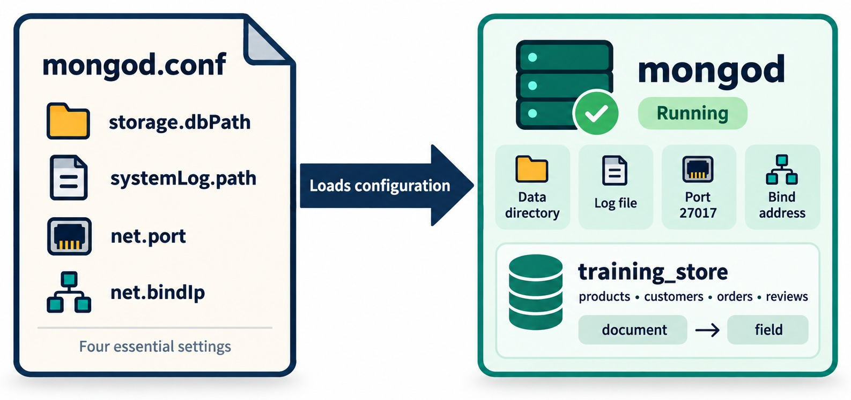
THE MONGODB CONFIGURATION FILE
Four settings mongod loads when it starts.
mongod.conf (Linux example)
storage:
dbPath: /var/lib/mongodb
systemLog:
destination: file
path: /var/log/mongodb/mongod.log
net:
port: 27017
bindIp: 127.0.0.1
bindIp 127.0.0.1
This machine only — keep it for learning.
WARNING 0.0.0.0 exposes mongod to every network — only with auth, TLS and a firewall.
KEY TAKEAWAY The config file decides where data and logs go and who can reach the port — read it first when something breaks.
17
© 2026 by Innovation In Software Corporation
Notes:
KEY TALKING POINTS
------------------
- Where the file lives
On Linux it is usually /etc/mongod.conf, and Homebrew on macOS puts one under its etc folder.
The Windows installer writes mongod.cfg in the server's bin folder.
The format is YAML in every case.
- The four settings
storage.dbPath is the data directory.
systemLog.path is the log file.
net.port is the port, 27017 by default.
net.bindIp is the address mongod listens on.
- Paths vary
Package installs pick their own default paths, such as /var/lib/mongodb on Ubuntu or a data folder under Program Files on Windows.
That is why the lab asks you to note the configuration file location.
- bindIp is a security setting
Keep 127.0.0.1 for a local learning server.
Binding to 0.0.0.0 exposes mongod to every network the machine is on.
Only do that behind a firewall, with authentication and TLS enabled.
- What it shows
A mongod.conf with four essential settings, storage.dbPath, systemLog.path, net.port and net.bindIp, loaded by a running mongod.
- How to read it
Each setting becomes one runtime property: data directory, log file, port 27017 and bind address.
- Key point
When mongod won't start or can't be reached, read the config file first.

Slide 18
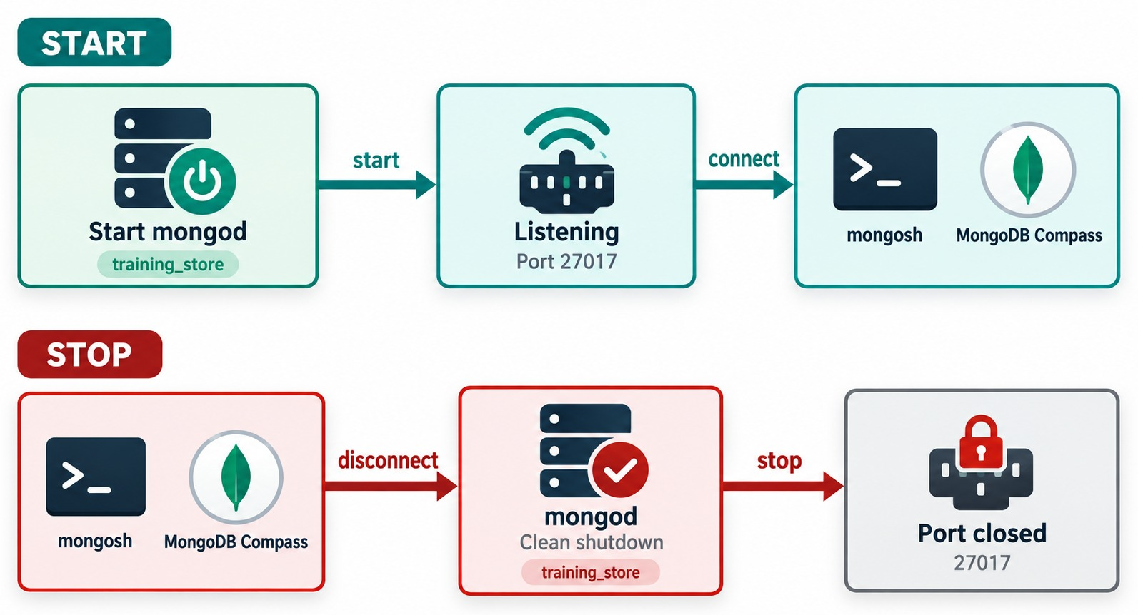
STARTING AND STOPPING MONGODB
Start, listen, connect — then disconnect, shut down cleanly, close the port.
Windows (admin PowerShell)
Start-Service MongoDB
Stop-Service MongoDB
macOS
brew services start mongodb-community
brew services stop mongodb-community
Linux
sudo systemctl start mongod
sudo systemctl stop mongod
CLEAN SHUTDOWN Use the service manager — don't kill the process.
KEY TAKEAWAY Start and stop mongod through its service manager, so every shutdown is clean.
18
© 2026 by Innovation In Software Corporation
Notes:
KEY TALKING POINTS
------------------
- Start
When mongod starts, it reads its configuration, opens the data directory, listens on port 27017 and is then ready for mongosh and Compass.
- Stop
A clean shutdown lets clients disconnect, flushes data from memory to disk, closes the files and exits.
After that the port is closed.
- Use the service manager
Use Stop-Service on Windows, brew services on macOS and systemctl on Linux.
Killing the process risks an unclean shutdown.
- Admin rights
Start-Service and Stop-Service need an Administrator PowerShell; systemctl needs sudo.
enable makes mongod start again after a reboot.
- What it shows
Two rows.
Start: start mongod, it listens on port 27017, and mongosh and Compass connect.
Stop: clients disconnect, mongod shuts down cleanly and the port closes.
- How to read it
Follow the arrows left to right in each row.
- Key point
Stop MongoDB with its service manager, so it shuts down cleanly.

Slide 19
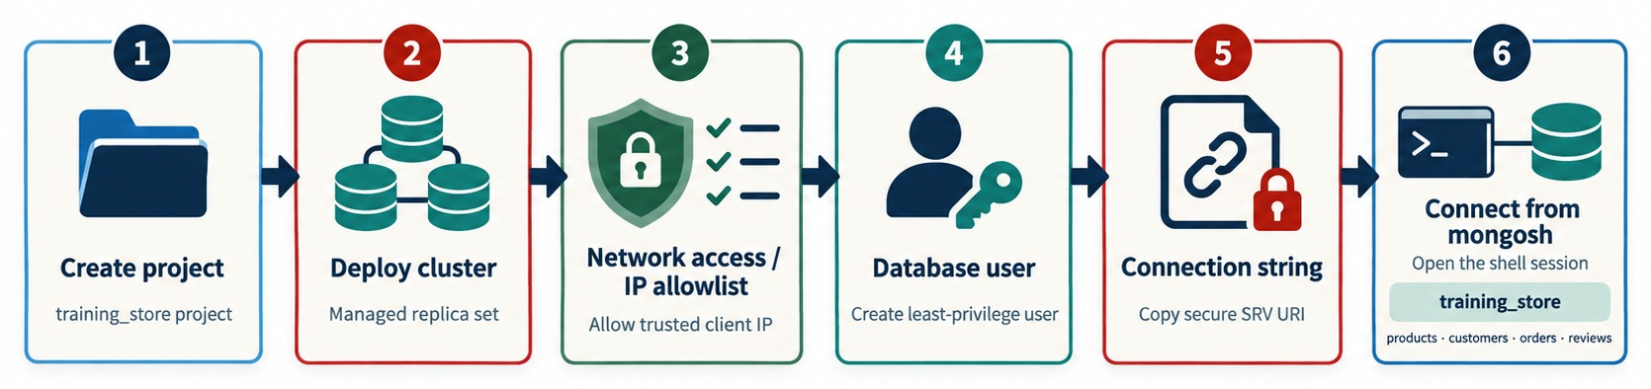
PROVISIONING MONGODB ATLAS
Project, cluster, network access, database user, connection string, connect.
Project and cluster
IP access list
Database user
Connection string
Pick a free or paid tier, a provider and a region.
Allow only the client addresses that need access.
Least privilege — not your Atlas login.
Copy the SRV URI from the Connect dialog.
KEY TAKEAWAY An Atlas cluster is reachable only after you allow an IP address and create a database user.
19
© 2026 by Innovation In Software Corporation
Notes:
KEY TALKING POINTS
------------------
- The process
Sign in to Atlas, use or create an organization and a project, and create a deployment.
Pick a free or paid tier, a cloud provider and a region.
- The two gates
Add your current IP address to the IP access list, and create a database user with only the roles it needs.
The source list gives these two steps in either order; both must exist before any client can connect.
- Two different identities
An Atlas user signs in to the Atlas website.
A database user authenticates when a client connects to the cluster.
Don't reuse your Atlas login password as a database password.
- The connection string
Copy it from the Connect dialog, because the cluster hostname is specific to your deployment.
It is an SRV string, which we unpack in Part 3.
- What it shows
Six steps to a working Atlas-style deployment, from creating the training_store project to opening a mongosh session.
- How to read it
Steps 3 and 4 are the two gates: allow a trusted client IP, and create a least-privilege database user.
Step 5 copies the secure SRV URI.
- Key point
A cluster is not reachable until both the IP allowlist and the database user exist.
USE-CASE SCENARIO
-----------------
A distributed team needs a shared training database.
The instructor creates one Atlas project, one cluster, one least-privilege database user per learner, and adds the classroom's public IP range to the access list, rather than opening the cluster to the whole internet.

Slide 20
EXERCISE: IS THE SERVER RUNNING?
Read the evidence before you change anything.
PRACTICE EXERCISE
5 MIN
SCENARIO
YOUR TASKS
EXPECTED OUTCOME
A learner installed MongoDB on Windows. mongosh reports connection refused on localhost:27017.
1
Name the layer that failed
✓
The server process: mongod is stopped
2
Give the command that fixes it
Start-Service MongoDB, as Administrator
✓
PS> Get-Service MongoDB
Status Name DisplayName
------ ---- -----------
Stopped MongoDB MongoDB Server (MongoDB)
3
Say how you'll prove the fix
✓
mongosh, then db.runCommand({ ping: 1 })
4
Name a cause if it won't start
✓
Check the log: bad dbPath or port in use
KEY TAKEAWAY Connection refused usually means nothing is listening — check the server before the client.
20
© 2026 by Innovation In Software Corporation
Notes:
KEY TALKING POINTS
------------------
- How to run it
Individually for three minutes, then discuss.
Ask for the layer first, before anyone suggests a fix.
- The layer
The service status is Stopped, so nothing listens on port 27017.
That is why mongosh gets connection refused rather than a timeout.
- The fix and the proof
Start-Service MongoDB in an Administrator PowerShell.
Then run mongosh and db.runCommand({ ping: 1 }); ok: 1 proves the fix.
- If it won't start
Read the server log named by systemLog.path.
Typical startup errors are a missing or unwritable dbPath and port 27017 already in use by another process.

Slide 21
PART 3: CONNECTING TO MONGODB
Every client needs to know where the server is — and who is asking.
✓ Part 1
Choose a deployment
✓ Part 2
Install and run
Part 3
Connect
Part 4
First commands
Part 5
Secure and troubleshoot
SO FAR
NEXT QUESTION
How does a client find the server, prove who it is, and confirm the connection works?
✓
mongod is installed and running
✓
Its config sets dbPath, log, port and bindIp
IN THIS PART
Atlas needs a user and an IP allowlist
1
Three clients, one deployment
✓
2
Localhost versus remote
3
Standard connection strings
4
SRV connection strings
5
Connecting with mongosh
6
Connecting with Compass
7
Verifying the connection
21
© 2026 by Innovation In Software Corporation
Notes:
KEY TALKING POINTS
------------------
- Connecting the parts
The server is running.
Now we connect to it from mongosh and Compass, locally and in the cloud.
- What to watch
The connection string is the key idea.
Once learners can read one left to right, most connection errors become easy to place.

Slide 22
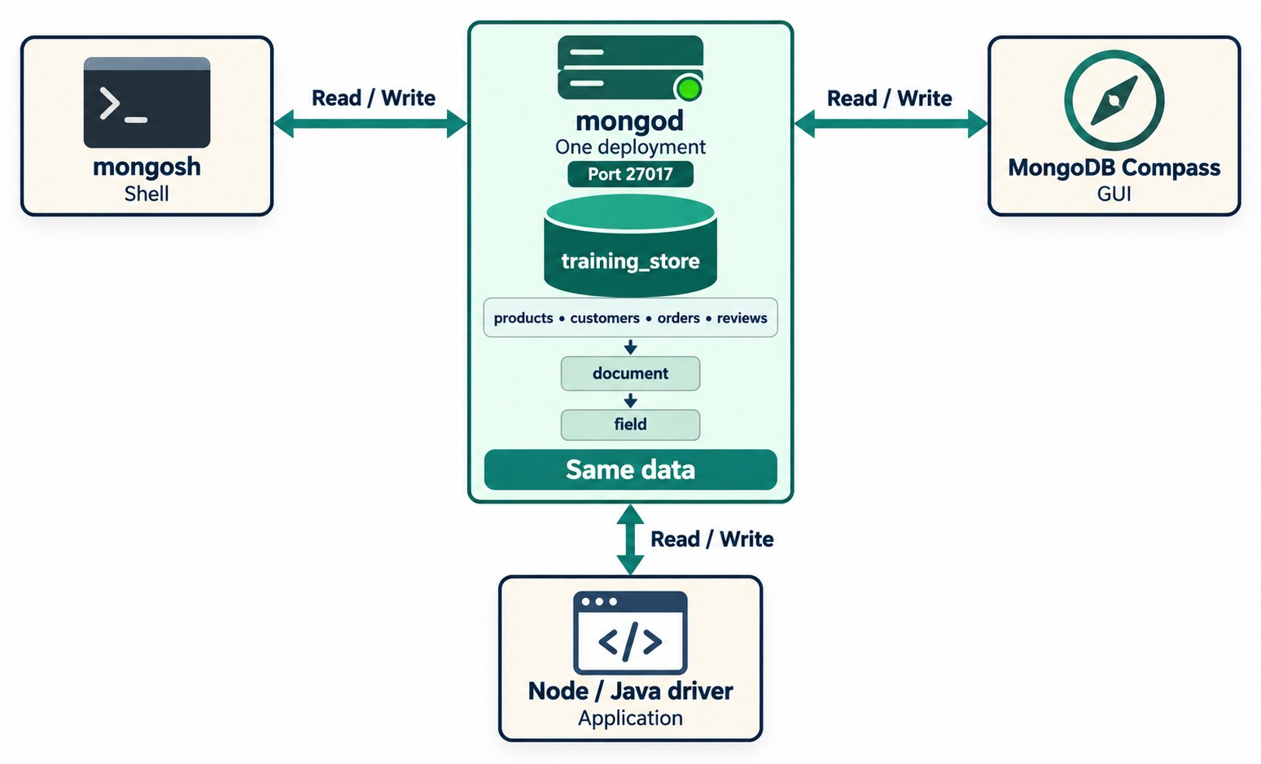
THREE CLIENTS, ONE DEPLOYMENT
mongosh, Compass and application drivers share the same data.
mongosh
The command-line shell for queries and administration.
MongoDB Compass
The graphical client to browse and edit documents.
Drivers
Libraries for application code — Node.js, Java and more.
SAME DATA A different window, not a different database.
KEY TAKEAWAY Every client reads and writes the same deployment — pick the one that suits the task.
22
© 2026 by Innovation In Software Corporation
Notes:
KEY TALKING POINTS
------------------
- Three clients
mongosh is the command-line shell, Compass is the graphical interface, and drivers are the libraries application code uses, for example the Node.js or Java driver.
- One deployment
All three connect to the same mongod on the same port and see the same training_store data.
A document inserted in mongosh appears in Compass after a refresh.
- What mongosh can do
Create databases and collections, insert and query documents, create indexes, run aggregation pipelines, inspect server information and run administrative commands.
- What it shows
One mongod on port 27017 with training_store, read and written by three clients: mongosh, MongoDB Compass and a Node or Java driver.
- How to read it
Every arrow says Read / Write; the green bar says Same data.
- Key point
A different client is a different window, not a different database.

Slide 23
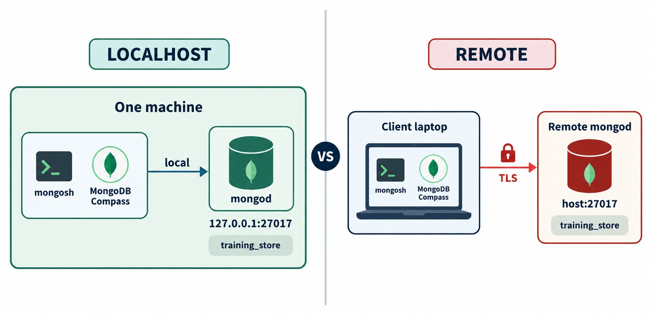
LOCALHOST VS. REMOTE CONNECTIONS
One machine — or a client laptop and a remote server.
Localhost
127.0.0.1:27017 — traffic never leaves the machine.
Remote
host:27017 across a network: TLS, authentication and an open firewall port.
BINDIP DECIDES mongod answers only on the addresses it binds to.
KEY TAKEAWAY Leaving localhost adds three requirements: a reachable port, TLS and authentication.
23
© 2026 by Innovation In Software Corporation
Notes:
KEY TALKING POINTS
------------------
- Localhost
localhost and 127.0.0.1 mean this machine.
Traffic never leaves it, which is why a local learning server can run without TLS.
- Remote
A remote mongod is reached by hostname and port across a network.
It needs the port open in firewalls, TLS on the wire, and authentication.
- The configuration link
A remote client can reach mongod only if bindIp includes an address on that network.
Widening bindIp without authentication and a firewall is how databases end up exposed on the internet.
- What it shows
Localhost: mongosh, Compass and mongod on one machine at 127.0.0.1:27017.
Remote: a client laptop reaching a remote mongod at host:27017 over TLS.
- How to read it
The lock on the right side marks the extra protection a network connection needs.
- Key point
Leaving localhost adds network, TLS and authentication to the checklist.

Slide 24
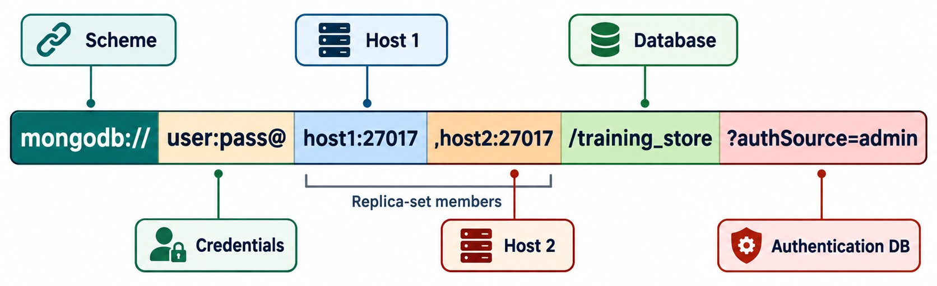
STANDARD CONNECTION-STRING FORMAT
Scheme, credentials, hosts, database and options.
Local examples
Read it left to right
authSource and encoding
mongodb://localhost:27017
mongodb://localhost:27017/training_store
Scheme, credentials, host:port list, database, then ?options.
authSource names the user's database. Percent-encode special characters in passwords.
KEY TAKEAWAY A connection string answers five questions: how, who, where, which database and which options.
24
© 2026 by Innovation In Software Corporation
Notes:
KEY TALKING POINTS
------------------
- Why connection strings
Every client, mongosh, Compass or a driver, needs the same facts: which protocol, which user, which hosts and ports, which database and which options.
The connection string holds all of them in one line.
- The standard format
mongodb:// lists every host explicitly, each with an optional port.
The port defaults to 27017.
- authSource
authSource names the database that stores the user's credentials, often admin.
A wrong authSource is a common cause of authentication failed.
- Special characters
If a password contains characters such as @, colon or slash, it must be percent-encoded in the URI.
Better still, don't put it in the URI at all.
- What it shows
A standard mongodb:// URI split into parts: scheme, credentials, two replica-set hosts, the training_store database and ?authSource=admin.
- How to read it
user:pass@ are placeholders.
host1 and host2 are both replica-set members, each on port 27017.
authSource names the authentication database.
- Key point
Read a URI left to right: how, who, where, which database, which options.
- The local examples
The first string reaches the default local server.
The second adds /training_store, so mongosh opens that database directly.

Slide 25
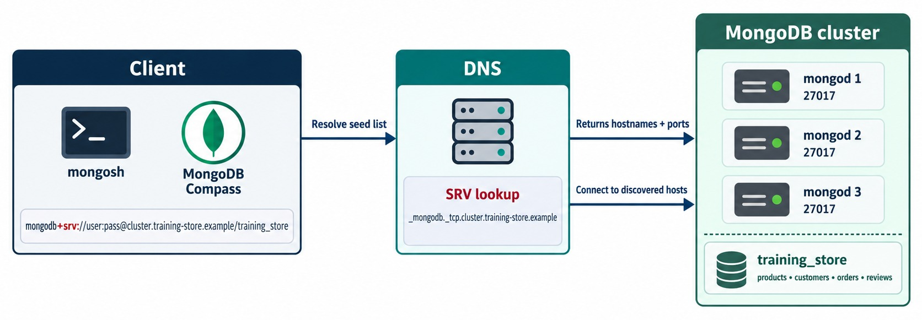
DNS SEED-LIST (SRV) CONNECTION STRINGS
mongodb+srv:// asks DNS for the member list.
Atlas pattern — placeholders only
mongodb+srv://
<username>:<password>@
<cluster-host>/
Seed list
DNS returns the members and ports — no port in the URI.
TLS on
SRV strings turn TLS on by default.
EXERCISE 2.2 Compare mongodb:// and mongodb+srv://.
KEY TAKEAWAY mongodb:// lists the hosts; mongodb+srv:// lets DNS supply them.
25
© 2026 by Innovation In Software Corporation
Notes:
KEY TALKING POINTS
------------------
- How SRV works
mongodb+srv:// gives one hostname.
The client looks up the DNS SRV record _mongodb._tcp plus that hostname and gets the list of members and ports.
- Why cloud services use it
Atlas connection strings use this form.
The string stays short, and members can change without editing every application's configuration.
- Defaults
An SRV string turns TLS on by default and never includes a port.
If DNS can't resolve the name, the connection fails before it reaches MongoDB.
- What it shows
A client with a mongodb+srv:// URI asks DNS for the seed list.
The SRV lookup returns hostnames and ports, and the client connects to the discovered mongod 1, 2 and 3.
- How to read it
The URI names one cluster host; DNS supplies the members and their ports.
- Key point
SRV strings are short and survive cluster changes; they need working DNS.

Slide 26
CONNECTING WITH MONGOSH
Local defaults, a named database, and a password prompt.
Local server (PowerShell)
✓
With a user: mongosh prompts for the password
mongosh
# same as:
mongosh "mongodb://localhost:27017"
# open training_store directly:
mongosh "mongodb://localhost:27017/training_store"
mongosh "mongodb://localhost:27017/training_store" `
--username trainingUser
# Atlas: copy the host from Connect → Shell
mongosh "mongodb+srv://cluster0.example.mongodb.net/" `
--username trainingUser
Enter password: ********
mongosh on its own
--username
ATLAS Copy the exact command from Connect → Shell.
Connects to localhost:27017 — the default.
mongosh prompts for the password: nothing lands in history.
KEY TAKEAWAY Give mongosh a connection string and a username — and let it ask for the password.
26
© 2026 by Innovation In Software Corporation
Notes:
KEY TALKING POINTS
------------------
- Local
If MongoDB runs locally on the standard port, mongosh on its own connects to mongodb://localhost:27017.
Adding /training_store to the URI selects that database as soon as the shell opens.
- With authentication
Pass --username and leave the password out.
mongosh prompts for it, so it never appears in the command, in the shell history or on a shared screen.
- Atlas
In Atlas, open the deployment, select Connect, choose Shell and copy the generated command, because the cluster hostname is specific to your deployment.
cluster0.example.mongodb.net is a placeholder.
- Line breaks
The backtick continues a PowerShell line.
In bash or zsh, use a backslash instead, as MongoDB's documentation does.

Slide 27
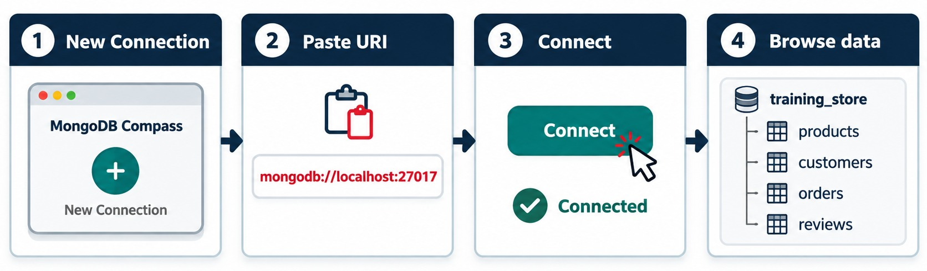
CONNECTING WITH MONGODB COMPASS
New connection, paste the URI, connect, browse.
Same URI
Password field
Browse
Paste the connection string you used in mongosh.
Type it there — never in a shared screenshot.
Databases → collections → documents; refresh to see new writes.
KEY TAKEAWAY Compass is a graphical window onto the same deployment, opened with the same connection string.
27
© 2026 by Innovation In Software Corporation
Notes:
KEY TALKING POINTS
------------------
- Same string, different client
Compass takes the same connection string as mongosh.
Paste it, connect, and browse databases, collections and documents.
- Keep the secret out of sight
When the URI includes a password, never screenshot or project the connection dialog.
Use the separate password field, and don't save the password on a shared machine.
- Four collections later
The diagram shows the full training_store with products, customers, orders and reviews.
On a new server you will see only what you have created; the four collections arrive when the dataset is loaded.
- What it shows
Four Compass steps: New Connection, paste mongodb://localhost:27017, Connect, and browse training_store with its four collections.
- How to read it
Follow the numbers left to right.
- Key point
Compass takes the same connection string as mongosh.

Slide 28
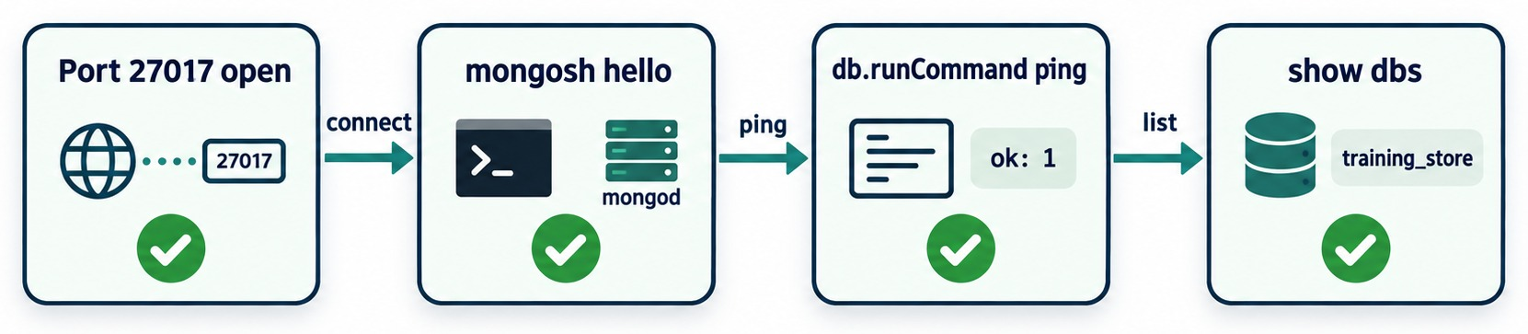
VERIFYING THE CONNECTION
Port open, shell connected, ping ok, databases listed.
Is the server answering?
Where am I?
Reading the results
test> db.runCommand({ ping: 1 })
{ ok: 1 }
test> db.version()
8.0.4
test> db
test
test> show dbs
admin 40.00 KiB
config 60.00 KiB
local 40.00 KiB
ok: 1 = reachable. A new server lists only admin, config and local; training_store joins after its first write.
KEY TAKEAWAY A ping that returns ok: 1 proves the server answers — the next part proves you can write.
28
© 2026 by Innovation In Software Corporation
Notes:
KEY TALKING POINTS
------------------
- The prompt
After connecting, the shell shows a prompt like test>.
The word test is the currently selected database.
- Versions
mongosh --version runs in the operating-system terminal and prints the shell version.
db.version() runs inside mongosh and prints the server version.
They are two different programs, so the numbers differ.
- Ping
db.runCommand({ ping: 1 }) returns ok: 1 when the server answers.
Ping proves reachability, not permission to write.
- Connection details
db shows the current database.
db.getMongo() shows the connection the shell is using.
show dbs lists only databases that hold data, so training_store appears there once it has a document.
- What it shows
Four checks in order: port 27017 open, mongosh connected to mongod, db.runCommand ping returning ok: 1, and show dbs listing training_store.
- How to read it
Each check needs the one before it; the green ticks mean each step passed.
- Key point
Check in order, so the first failure tells you which layer is broken.
- Versions and sizes
8.0.4 is an example; print your own with db.version().
The sizes after show dbs vary from machine to machine.
- About the diagram
The diagram's last box shows show dbs listing training_store.
That is the state after training_store holds data; on a brand-new server you see only admin, config and local.

Slide 29
EXERCISE: BUILD THE CONNECTION STRING
Write what each learner needs — with no password on the page.
PRACTICE EXERCISE
10 MIN
SCENARIO
YOUR TASKS
EXPECTED OUTCOME
Three learners need to connect. Write the connection string or mongosh command for each one.
1
Write learner A's URI
✓
A: mongodb://localhost:27017
2
Add the database for learner B
B: add /training_store after the port
✓
A Local server, default port
B Local server, open training_store
C Atlas: cluster0.example.mongodb.net
as database user trainingUser
3
Write learner C's mongosh command
✓
C: the mongodb+srv:// URI plus --username
4
Say where C's password goes
✓
Typed at the prompt — never in the URI
KEY TAKEAWAY If you can write the connection string, you can place most connection errors.
29
© 2026 by Innovation In Software Corporation
Notes:
KEY TALKING POINTS
------------------
- How to run it
Individually for five minutes, then compare in pairs.
Collect one answer per learner on the board, without any password.
- A and B
A is mongodb://localhost:27017, which is also what mongosh uses with no arguments.
B is mongodb://localhost:27017/training_store.
- C
mongosh "mongodb+srv://cluster0.example.mongodb.net/" --username trainingUser.
No port: the SRV lookup supplies the members and ports, and TLS is on by default.
- The password
mongosh prompts for it.
In an application, it comes from an environment variable or a secret store, never from source code.

Slide 30
PART 4: FIRST COMMANDS ON TRAINING_STORE
Prove the environment: create, read, update and delete.
✓ Part 1
Choose a deployment
✓ Part 2
Install and run
✓ Part 3
Connect
Part 4
First commands
Part 5
Secure and troubleshoot
SO FAR
NEXT QUESTION
How do I create training_store — and prove I can write, read, update and delete?
✓
Clients reach mongod through a connection string
✓
SRV strings let DNS find the cluster
IN THIS PART
A ping proves the server answers
1
Selecting a database and creating a collection
✓
2
Inserting and reading a test document
3
Update and delete with a probe document
4
Loading the full training_store dataset
5
Predicting shell output
30
© 2026 by Innovation In Software Corporation
Notes:
KEY TALKING POINTS
------------------
- Why this part
A ping proves the server answers.
It doesn't prove you can write.
This part runs the four CRUD operations as a readiness test.
- Two probe documents
Day 1 Lab 1 uses two: the environment_check collection and the LAB1 probe product.
Neither clashes with the real training_store catalog, which is loaded at the end of the part.

Slide 31
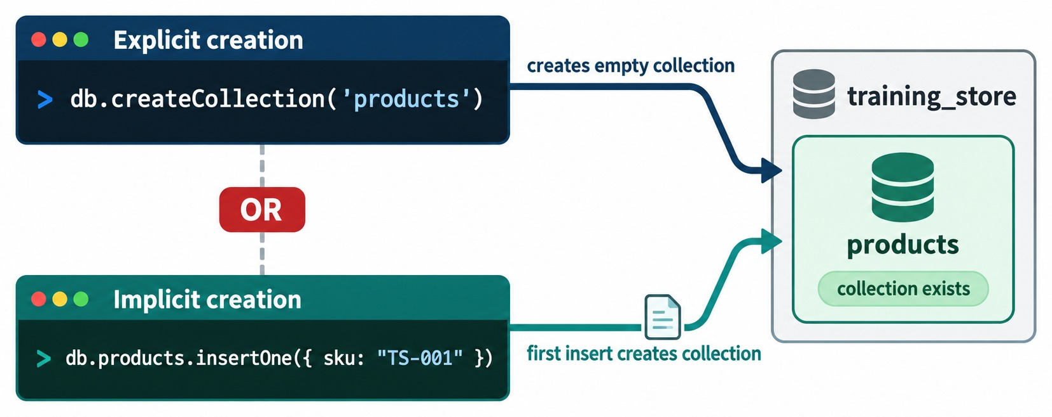
SELECTING A DATABASE AND CREATING A COLLECTION
use switches context; the first write creates the collection.
Explicit creation (Lab 1)
test> use training_store
switched to db training_store
training_store> db.createCollection(
"products")
{ ok: 1 }
Implicit creation
The first insertOne creates the collection — no createCollection needed.
USE CREATES NOTHING show dbs lists training_store only after the first write.
KEY TAKEAWAY use only selects a name — a database and its collections appear with the first write.
31
© 2026 by Innovation In Software Corporation
Notes:
KEY TALKING POINTS
------------------
- use changes context only
use training_store switches the current database.
It does not create anything on disk, so show dbs does not list training_store yet.
- Explicit or implicit
db.createCollection creates an empty collection and returns ok: 1.
Or skip it: the first insertOne creates both the collection and the database.
- Lab 1
Day 1 Lab 1 creates environment_check explicitly in Step 6, and products explicitly in Step 9, exactly as in the top half of the diagram, on an empty server.
The Predict the Shell Output exercise shows the implicit way: the first insertOne creates environment_check.
- The diagram's TS-001
The diagram's implicit example inserts a throwaway SKU, TS-001.
It is not a training_store product, so we don't insert it; Lab 1 uses its own probe, LAB1, and deletes it.
- On a loaded database
If training_store is already loaded, for example on an instructor-provided server, createCollection on an existing name such as products fails with Collection already exists.
That is expected; the collection is already there.
- What it shows
Two ways to create a collection in training_store: explicitly with db.createCollection, or implicitly with the first insertOne.
- How to read it
Both arrows end at the same result: the collection exists.
The top one creates it empty; the bottom one creates it with its first document.
- Key point
Collections and databases appear on the first write; use alone creates nothing.

Slide 32
INSERTING AND READING A TEST DOCUMENT
Lab 1's READY document in the environment_check collection.
Insert — MongoDB adds the _id
✓
Read it back
db.environment_check.insertOne({
participant: "Student",
environment: "training",
shellConnected: true,
status: "READY",
checkedAt: new Date()
})
// result
{ acknowledged: true,
insertedId: ObjectId('…') }
db.environment_check.findOne({
status: "READY"
})
// result
{ _id: ObjectId('…'),
participant: 'Student',
environment: 'training',
shellConnected: true,
status: 'READY',
checkedAt: ISODate('…') }
insertedId
checkedAt
PROOF A write and a read = usable access.
An ObjectId, generated because we didn't supply an _id.
new Date() is stored as a BSON date; mongosh prints ISODate.
KEY TAKEAWAY An acknowledged insert and a matching read prove more than any ping.
32
© 2026 by Innovation In Software Corporation
Notes:
KEY TALKING POINTS
------------------
- The insert
insertOne sends one document.
We didn't include _id, so MongoDB adds one: a new ObjectId, unique in the collection.
The result says acknowledged: true and shows that insertedId.
- The read
findOne with status READY returns the same document, now including _id.
The date comes back as ISODate: a real BSON date, not a string.
- Output style
mongosh prints strings with single quotes and shortens nothing; the ellipses on the slide stand for your own ObjectId and date.
- Link to the lab
This is Step 7 of Day 1 Lab 1.
Step 8 adds three component documents with insertMany, counts at least 4 documents, and updates the participant name.

Slide 33
UPDATE, DELETE AND THE PROBE DOCUMENT
Day 1 Lab 1 proves all four CRUD operations with sku LAB1.
Create and read
Update and delete
db.products.insertOne({
sku: "LAB1",
name: "Connectivity Probe",
category: "ACCESSORY",
active: true
})
db.products.find({ sku: "LAB1" })
db.products.updateOne(
{ sku: "LAB1" },
{ $set: { verified: true } }
)
// matchedCount: 1, modifiedCount: 1
db.products.deleteOne({ sku: "LAB1" })
// { acknowledged: true, deletedCount: 1 }
db.products.find({ sku: "LAB1" })
// no result
Create · Read
Update · Delete
REMOVE LAB1 Delete it before Lab 2 — it isn't a catalog SKU.
insertOne() returns an insertedId; find() shows the probe.
updateOne() matches 1 document; deleteOne() deletes 1.
KEY TAKEAWAY insertOne, find, updateOne and deleteOne — four operations, four results you can check.
33
© 2026 by Innovation In Software Corporation
Notes:
KEY TALKING POINTS
------------------
- The probe
Day 1 Lab 1 inserts one probe product, sku LAB1, named Connectivity Probe.
It uses the real ACCESSORY category, but it is not part of the catalog, which is why the lab deletes it at the end.
- Update
updateOne finds the probe by sku and $set adds verified: true.
matchedCount 1 means the filter found it; modifiedCount 1 means it changed.
- Delete
deleteOne removes it and reports deletedCount 1.
The final find returns nothing, which is the proof.
- A note on the sources
The module's source text inserts a Wireless Mouse under Electronics at 39.99, and MongoDB Fundamentals under Books at 49.99.
In training_store the Wireless Mouse is A410, ACCESSORY, 19.99, and MongoDB Fundamentals is B300, BOOK, 59.99, both stored as Decimal128.
So the deck uses the LAB1 probe instead of inventing conflicting products.
- On a loaded database
Lab 1 Step 9 also runs db.createCollection("products").
On an empty server that returns ok: 1.
If training_store is already loaded, it fails with Collection already exists; skip it, the rest of the lab works the same.

Slide 34
LOADING THE FULL TRAINING_STORE DATASET
Module 3's Lab 2 runs this — here is what to expect.
From the course folder, not inside mongosh
✓
Then verify in mongosh
mongosh "mongodb://localhost:27017" `
.\datasets\training_store\load.js
// prints
Loaded training_store
customers: 6
products: 13
orders: 17
reviews: 6
paid orders: 13
use training_store
show collections
// customers, environment_check,
// orders, products, reviews
db.products.countDocuments()
// 13
db.products.findOne(
{ sku: "B300" },
{ name: 1, price: 1, _id: 0 })
// { name: 'MongoDB Fundamentals',
// price: Decimal128('59.99') }
Drops, then reloads
Leaves the rest
MODULE 3 Lab 2 starts from exactly this state.
customers, products, orders and reviews start clean each time.
environment_check isn't touched — it stays in the list.
KEY TAKEAWAY One script gives everyone the same training_store — the starting point for every later lab.
34
© 2026 by Innovation In Software Corporation
Notes:
KEY TALKING POINTS
------------------
- When to run it
Module 3's Lab 2, Path A, runs this script.
Learners taking the hand-insert path build the core documents first and run it at the start of Day 2.
Run it now only if the instructor asks.
- What it does
load.js drops and reloads customers, products, orders and reviews, then creates unique indexes on sku, customerNumber, orderNumber and contact.email.
It prints the counts: 6 customers, 13 products, 17 orders, 6 reviews, and 13 paid orders.
- Verify
show collections lists the four collections plus environment_check, which load.js doesn't drop.
countDocuments on products returns 13.
B300 is MongoDB Fundamentals at Decimal128 59.99.
- Other paths
For Atlas or an instructor URI, replace the local string with your own connection string and add --username; mongosh prompts for the password before running the script.
- A note on the sources
Lab 1 says the sample data is loaded in Module 3, and that is where the lab runs it.
This slide shows the command early because Module 1 promised that Module 2 would show how.

Slide 35
EXERCISE: PREDICT THE SHELL OUTPUT
Say what mongosh prints — before you press Enter.
PRACTICE EXERCISE
5 MIN
SCENARIO
YOUR TASKS
EXPECTED OUTCOME
A brand-new local server. Nothing has been created yet.
1
Predict the first show dbs
✓
admin, config and local only
2
Say what use prints — and creates
switched to db training_store; nothing on disk
show dbs
use training_store
show dbs
db.environment_check.insertOne(
{ status: "READY" })
show dbs
show collections
✓
3
Predict show dbs after the insert
✓
training_store now appears
4
Predict show collections
✓
environment_check
KEY TAKEAWAY Databases and collections appear on the first write — predicting that saves a lot of confusion.
35
© 2026 by Innovation In Software Corporation
Notes:
KEY TALKING POINTS
------------------
- How to run it
Two minutes to write predictions, then run the commands on the instructor screen, one at a time.
- Before the insert
show dbs lists admin, config and local.
use prints switched to db training_store but creates nothing, so the second show dbs is unchanged.
- After the insert
The insert creates the collection and the database together.
show dbs now includes training_store, and show collections lists environment_check.
- Why it matters
Learners often think a typo in use created a new database.
It didn't; nothing exists until the first write.

Slide 36
PART 5: SECURITY AND TROUBLESHOOTING
Keep credentials safe — and fix connections layer by layer.
✓ Part 1
Choose a deployment
✓ Part 2
Install and run
✓ Part 3
Connect
✓ Part 4
First commands
Part 5
Secure and troubleshoot
SO FAR
NEXT QUESTION
How do I keep credentials safe — and what do I check when a connection fails?
✓
training_store exists on your server
✓
Insert, find, update and delete all work
IN THIS PART
✓
The full dataset loads with one script
Authentication and authorization
1
2
Safe credential practices
3
Common connection problems
4
A troubleshooting workflow
5
Setup misconceptions
36
© 2026 by Innovation In Software Corporation
Notes:
KEY TALKING POINTS
------------------
- Why this part
A working environment can still leak a password or be open to the internet.
And when a connection fails, guessing wastes time.
- Outcome
By the end, learners handle credentials safely and diagnose a failure by asking one question per layer.
Exercise 2.3 practises it.

Slide 37
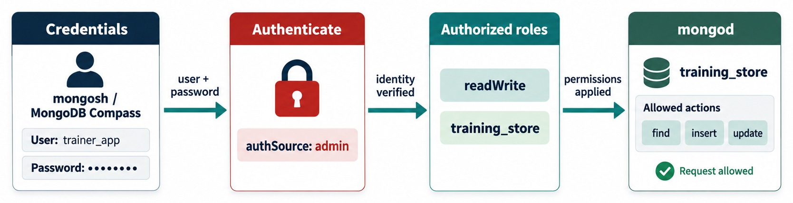
AUTHENTICATION AND AUTHORIZATION
Credentials, authentication, roles, allowed actions.
Authentication
Authorization
Local default
Least privilege
Who are you? Username, password and authSource.
What may you do? Roles such as readWrite.
Access control is off — tolerable on localhost only.
Give each user only the roles it needs.
KEY TAKEAWAY Authentication proves who you are; authorization decides what you may do.
37
© 2026 by Innovation In Software Corporation
Notes:
KEY TALKING POINTS
------------------
- Authentication
Authentication proves identity.
The client sends a username and password; mongod checks them against the authentication database named by authSource.
- Authorization
Authorization applies roles.
Here readWrite on training_store allows find, insert and update in that database, and nothing else.
- Local defaults
A fresh local Community install has access control turned off, which is tolerable only on localhost.
Atlas always requires a database user.
- Prompt for the password
Pass --username and let mongosh prompt for the password, so it never appears in the command line or shell history.
- What it shows
The user trainer_app signs in with a hidden password.
mongod authenticates the user against authSource admin, applies the readWrite role on training_store, and allows find, insert and update.
- How to read it
Left to right: who you are, proof, what you may do, the request allowed.
- Key point
Authentication proves identity; authorization decides the allowed actions.

Slide 38
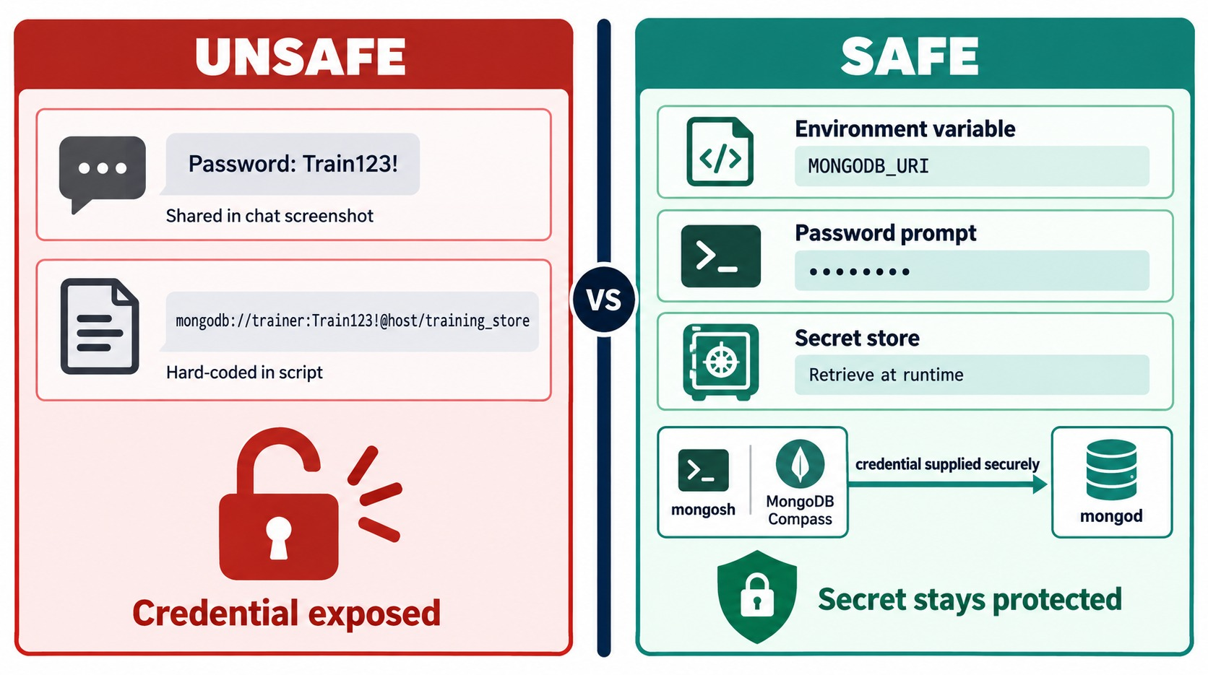
SAFE CREDENTIAL PRACTICES
Keep passwords out of chat, screenshots, scripts and Git.
✓
Let mongosh prompt
# prompt instead of typing it
mongosh "<connection-string>" `
--username <username>
Store it safely
A password manager, a secret store or an environment variable.
0.0.0.0/0 Opens Atlas to the whole internet — avoid it; never in production.
KEY TAKEAWAY A password shown once must be treated as leaked — keep it out of every screen and file.
38
© 2026 by Innovation In Software Corporation
Notes:
KEY TALKING POINTS
------------------
- Unsafe
Passwords pasted into chat or screenshots, and URIs with passwords hard-coded in scripts or committed to Git.
Once shared, a password must be treated as leaked.
- Safe
Keep the URI in an environment variable, let mongosh prompt for the password, or fetch the secret from a secret store at runtime.
- Network access
For a temporary learning cluster, people sometimes allow 0.0.0.0/0.
That opens the cluster to every address on the internet.
Prefer your own IP or the classroom range; if you must use it, pair it with strong credentials, never use it in production, and remove it after class.
- Environment variables and history
Setting the variable with the password typed inline still records it in the shell history.
Prefer a prompt or a secret store.
- What it shows
Unsafe on the left: a password shared in a chat screenshot and a URI with a hard-coded password.
Safe on the right: an environment variable, a password prompt and a secret store.
- How to read it
The password on the unsafe side is a made-up example of what never to do.
- Key point
The secret should reach mongod without ever appearing on a screen or in code.

Slide 39
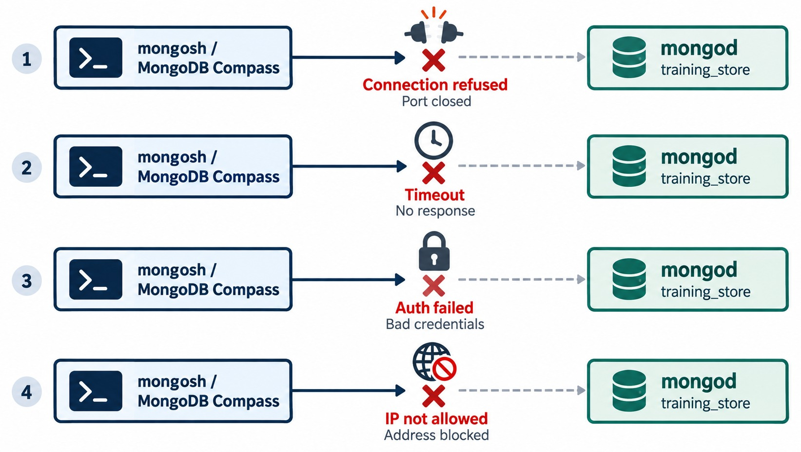
COMMON CONNECTION PROBLEMS
Refused, timed out, bad credentials, address blocked.
Connection refused
Nothing listening: mongod stopped, wrong port or bindIp.
Timeout
No answer: firewall, routing or the Atlas IP access list.
Auth failed
User, password, authSource or unencoded characters.
IP not allowed
Add your current IP — not 0.0.0.0/0.
KEY TAKEAWAY Each error names a different layer — read the message before changing anything.
39
© 2026 by Innovation In Software Corporation
Notes:
KEY TALKING POINTS
------------------
- mongosh: command not found
Before any of these: mongosh is not installed, its folder is not on the PATH, or the terminal was not reopened after installation.
- Connection refused
Nothing is listening: the mongod service is stopped, it uses a different port, its bindIp excludes your address, or something blocks the port.
- Timeout
No answer at all: a firewall, routing, a corporate proxy or the Atlas IP access list.
A refused connection answers quickly; a timeout waits.
- Authentication failed
Check the database username, the password, authSource, and special characters that need encoding.
An Atlas login is not a database user.
- What it shows
Four failed connections from mongosh or Compass to mongod: connection refused (port closed), timeout (no response), auth failed (bad credentials) and IP not allowed (address blocked).
- How to read it
Each red cross sits at a different layer between the client and the server.
- Key point
The exact error message points to the layer; read it before changing anything.

Slide 40
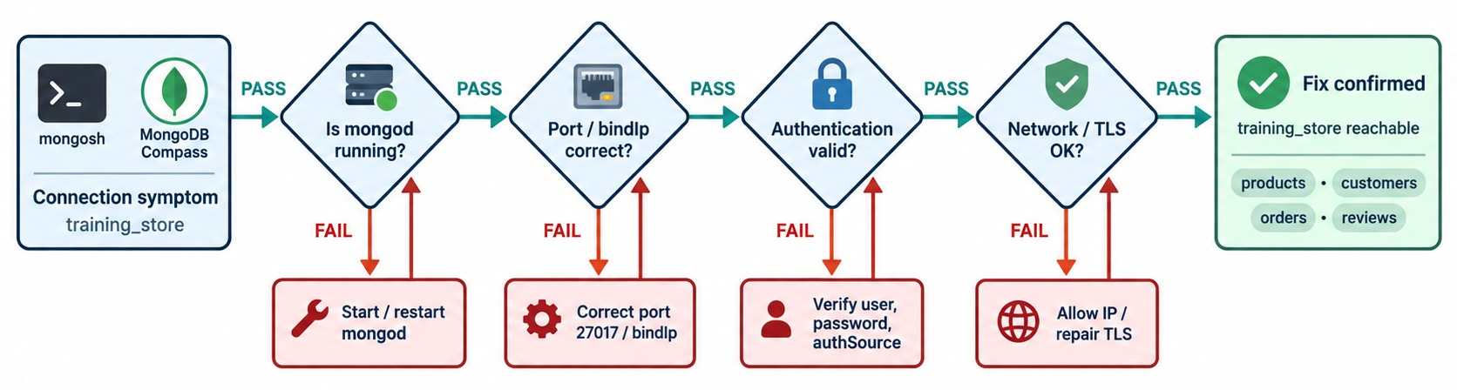
A TROUBLESHOOTING WORKFLOW
Four checks, in order, until the fix is confirmed.
1 · Process
2 · Port and bindIp
3 · Credentials
4 · Network and TLS
Is mongod running? Service status and log.
Port 27017? Listening on your address?
User, password and authSource.
IP allowlist, firewall and TLS settings.
KEY TAKEAWAY Change one thing, retest with a ping, then move to the next layer.
40
© 2026 by Innovation In Software Corporation
Notes:
KEY TALKING POINTS
------------------
- Work in order
Is mongod running?
Is the port and bindIp right?
Are the credentials valid?
Is the network and TLS path open?
Each check depends on the one before.
- One change at a time
Change one variable, then retest with the simplest client: mongosh and a ping.
Changing three settings at once hides which one fixed it.
- Where to look
The server log, set by systemLog.path, records startup errors such as a missing dbPath or a port already in use.
The client's error message names the layer.
- What it shows
From a connection symptom through four checks: is mongod running, is the port and bindIp correct, is authentication valid, is network and TLS OK.
- How to read it
PASS moves right.
FAIL drops to a fix: start mongod, correct the port or bindIp, verify user, password and authSource, allow the IP or repair TLS.
Then recheck.
- Key point
Fix one layer, retest, and only then move on.
USE-CASE SCENARIO
-----------------
A learner's Compass says connection refused.
The instructor asks one question at a time: Get-Service MongoDB shows Stopped.
Start-Service fixes the first layer, a ping returns ok: 1, and Compass connects without any other change.

Slide 41
SETUP MISCONCEPTIONS
Beliefs that waste the first hour of a lab.
MISCONCEPTION
REALITY
ANTI-PATTERNS TO AVOID
Closing mongosh stops MongoDB
mongod keeps running — it is a separate process
✕
Passwords in URIs, scripts or Git
✕
Screenshots of the connection dialog
✕
An Atlas login reused as a database user
use training_store creates it
The database appears with the first write
✕
Changing three settings at once
✕
Killing mongod instead of stopping it
A ping means I can write
Ping proves reachability — test a write and a read
REMEMBER Prove each layer: running, reachable, authenticated, writable.
Compass shows a different copy
Same deployment, same documents — refresh
0.0.0.0 makes connecting easier
It exposes the server — keep localhost or an allowlist
KEY TAKEAWAY Most setup problems come from confusing the client with the server, or reachability with access.
41
© 2026 by Innovation In Software Corporation
Notes:
KEY TALKING POINTS
------------------
- Why this slide
Before the checks, clear away the beliefs that cause the most trouble in setup labs.
- Client versus server
mongosh and Compass are clients.
Closing them never stops mongod, and Compass shows the same documents as mongosh after a refresh.
- Reachability versus access
use creates nothing, and a ping doesn't prove write permission.
Only a write and a read prove usable access.
- Anti-patterns
Passwords in URIs, scripts or Git; screenshots of connection dialogs; reusing an Atlas login as a database user; changing several settings at once; and killing mongod instead of stopping it cleanly.
Binding to 0.0.0.0 or allowing 0.0.0.0/0 without authentication exposes the data to anyone.

Slide 42
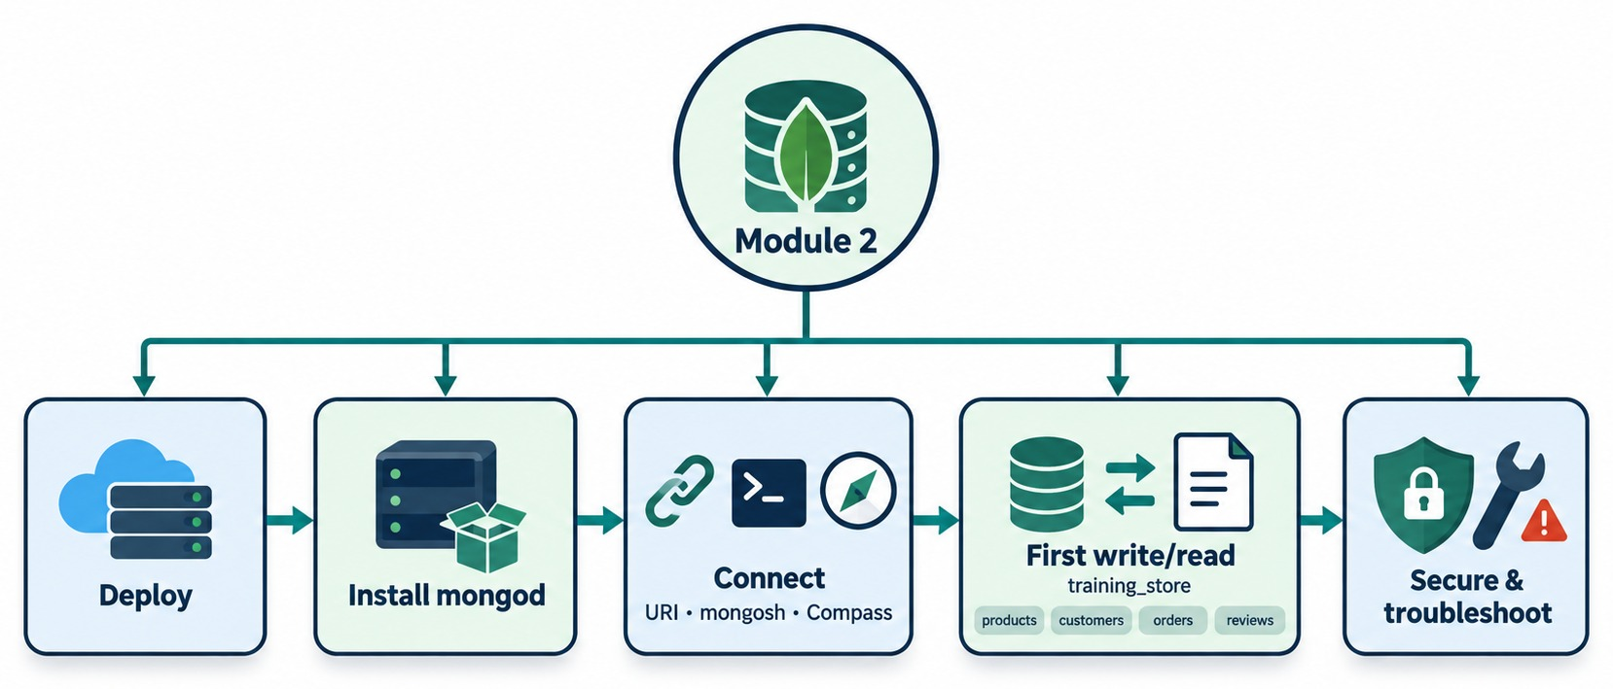
MODULE 2 AT A GLANCE
Deploy, install, connect, first write and read, secure and troubleshoot.
KEY TAKEAWAY A proven environment — running, reachable, authenticated and writable — is what every later lab needs.
42
© 2026 by Innovation In Software Corporation
Notes:
KEY TALKING POINTS
------------------
- Deploy and install
Local, container, self-managed or managed cloud.
Install mongod, or provision a cluster with a user and an IP allowlist.
- Connect
A connection string tells mongosh, Compass and drivers where the server is.
- First write and read
Ping proves reachability; a write and a read in training_store prove the environment is usable.
- Secure and troubleshoot
Keep credentials out of code and screens, and diagnose failures layer by layer.
- What it shows
Module 2 as five steps: deploy, install mongod, connect with a URI, mongosh and Compass, a first write and read in training_store, then secure and troubleshoot.
- How to use it
Point to each box and ask the class for the one command or check that proves it.
- Key point
These five steps are the setup every later lab assumes.

Slide 43
KNOWLEDGE CHECK
Answer in your own words — then compare with a partner.
What is the role of mongod?
What does db.runCommand({ ping: 1 }) verify?
1
6
What is the role of mongosh?
Why might show dbs omit a database you just selected?
2
7
What is MongoDB Compass?
What commonly causes connection refused?
3
8
What is MongoDB's default port?
What commonly causes authentication failed?
4
9
How do mongodb:// and mongodb+srv:// differ?
Why not put credentials in source code?
5
10
43
© 2026 by Innovation In Software Corporation
Notes:
KEY TALKING POINTS
------------------
- 1. mongod
The database server process.
It stores the data, listens on a port and answers requests.
- 2. mongosh
The interactive command-line shell.
It sends commands to mongod and prints the results; closing it doesn't stop the server.
- 3. Compass
MongoDB's graphical client, connected with the same connection string, showing the same data.
- 4. Default port
27017.
A local server is usually at localhost:27017.
- 5. mongodb:// and mongodb+srv://
mongodb:// lists the hosts and optional ports.
mongodb+srv:// gives one hostname and uses a DNS SRV lookup to find the members; it turns TLS on by default.
Atlas provides the +srv form.
- 6. Ping
That the server is reachable and answering.
It does not prove write permission.
- 7. show dbs
use only switches context.
A database appears in show dbs once it holds data, after the first write.
- 8. Connection refused
Nothing is listening: mongod is stopped, the port is wrong, or bindIp doesn't include the address.
- 9. Authentication failed
Wrong username or password, the wrong authSource, or special characters that weren't percent-encoded.
- 10. Credentials in code
Code is shared, copied and committed to Git, so the password leaks.
Use environment variables, a secret store or a prompt.

Slide 44
EXERCISE 2.1 — SELECT A DEPLOYMENT OPTION
Module 2 checkpoint A: match six scenarios to a deployment, with a risk.
OFFICIAL CHECKPOINT A
10 MIN
labs/day-01/exercises/exercise-2.1-select-a-deployment-option.md
SCENARIO
YOUR TASKS
SOLUTION (AFTER DEBRIEF)
Pick one option — local, self-managed server or VM, container, or managed cloud. Justify it and name the main risk.
1
Name one good fit for each option
✓
1 local · 2 container
2
Classify scenarios 1–3
✓
3 managed cloud
3
Classify scenarios 4–6
✓
4 self-managed server or VM
1 Offline learning environment
2 Temporary automated tests
3 Distributed team, shared data
4 Regulated: direct control
5 Startup: no servers to manage
6 Classroom: restricted internet
Defend one row against an alternative
✓
5 managed cloud
4
✓
6 local or a local server
KEY TAKEAWAY The commands barely change between options — the infrastructure responsibility does.
44
© 2026 by Innovation In Software Corporation
Notes:
KEY TALKING POINTS
------------------
- Official checkpoint
This is the official Exercise 2.1 for Module 2.
The worksheet is labs/day-01/exercises/exercise-2.1-select-a-deployment-option.md; the answer key is in the solution folder next to it.
No MongoDB is needed; work in pairs.
- Running it
Eight minutes of pair work, then a two-minute debrief.
Reveal the solution column only after pairs share one controversial row.
- What to listen for
Each justification names a constraint: offline, disposable, shared, control, operations load or network.
A product name alone doesn't count.
- Typical risks
Local: data lost with the laptop and no shared access.
Container: data lost without a volume.
Managed cloud: needs internet, and the IP allowlist and credentials must be managed.
Self-managed: you own patching, backups and monitoring.

Slide 45
EXERCISE 2.2 — INTERPRET A CONNECTION STRING
Module 2 checkpoint B: label every part, and keep the password secret.
OFFICIAL CHECKPOINT B
10 MIN
labs/day-01/exercises/exercise-2.2-interpret-a-connection-string.md
SCENARIO
YOUR TASKS
SOLUTION (AFTER DEBRIEF)
Label each part of this URI. It is one line, split to fit; the password is a placeholder.
1
Label protocol, user, password, host, port, database
✓
mongodb:// · trainingUser
✓
Password: placeholder only
2
Answer the four security questions
mongodb://
trainingUser:<password>@
db.example.net:27017
/training
✓
db.example.net · 27017 · training
3
Contrast mongodb:// with mongodb+srv://
✓
Secrets: env variable or secret store
4
Check labels without reading secrets aloud
✓
+srv: DNS discovers the hosts
KEY TAKEAWAY Parse a URI aloud — without ever reading the password onto a shared screen.
45
© 2026 by Innovation In Software Corporation
Notes:
KEY TALKING POINTS
------------------
- Official checkpoint
This is the official Exercise 2.2.
The worksheet is labs/day-01/exercises/exercise-2.2-interpret-a-connection-string.md.
No live connection is needed.
- The placeholder
The worksheet and the slide both show the password as <password>, a placeholder, so that no credential-looking value appears on screen.
- The database name
The sample's default database is training, not training_store.
That is deliberate: it is a generic example host, not our class server.
- Security answers
Never screenshot the password.
Store the username and password in environment variables or a secret store.
Typical failures: wrong password, host not found, port blocked, special characters not encoded, TLS mismatch.

Slide 46
EXERCISE 2.3 — DIAGNOSE CONNECTION FAILURES
Module 2 checkpoint C: six failures, one layer at a time.
OFFICIAL CHECKPOINT C
15 MIN
labs/day-01/exercises/exercise-2.3-diagnose-connection-failures.md
SCENARIO
YOUR TASKS
SOLUTION (AFTER DEBRIEF)
For each case: likely cause, first check, log or setting, fix and the command that verifies it.
1
Diagnose cases 1 and 2
✓
1 server stopped or wrong port
2
Diagnose cases 3 and 4
2 user, password or authSource
✓
1 ECONNREFUSED
2 Authentication failed
3 Server-selection timeout
4 DNS lookup failure
5 Unauthorized command
6 Invalid URI format
3
Diagnose cases 5 and 6
✓
3 firewall, routing or allowlist
4
Share one case: change one thing, retest
✓
4 hostname or DNS
✓
5 role too weak · 6 syntax or encoding
✓
Verify with a ping: ok: 1
KEY TAKEAWAY Timeout is not refused, and unauthorized is not unauthenticated — name the layer first.
46
© 2026 by Innovation In Software Corporation
Notes:
KEY TALKING POINTS
------------------
- Official checkpoint
This is the official Exercise 2.3.
The worksheet is labs/day-01/exercises/exercise-2.3-diagnose-connection-failures.md.
Don't break a working classroom cluster unless the instructor has set up a sandbox.
- Cases 1 and 2
Refused: is mongod running, on port 27017?
Check the service and net.port.
Authentication failed: retry with a known-good user; the mongod log shows the failure; fix the credentials or authSource.
- Cases 3 and 4
Timeout: can you reach host and port?
Check the Atlas IP access list and local firewall.
DNS failure: resolve the hostname; fix it or check the VPN.
- Cases 5 and 6
Unauthorized: the user authenticated but lacks the role; grant it and retry.
Invalid URI: read the whole string, fix the scheme or @, and percent-encode the password.
- The habit
Change one variable, then retest with the simplest client: mongosh and db.runCommand({ ping: 1 }).
Learners come back to this table if a step of Lab 1 fails.

Slide 47
EXERCISE 2.4 — ENVIRONMENT READINESS CHECKLIST
Module 2 checkpoint D: tick only what you have seen.
OFFICIAL CHECKPOINT D
10 MIN
labs/day-01/exercises/exercise-2.4-environment-readiness-checklist.md
SCENARIO
YOUR TASKS
EXPECTED OUTCOME
Fill it in during or right after Lab 1, the next slide. No passwords on the page.
1
Record your path, host and port
✓
Path recorded, no secrets
2
Confirm mongosh --version and Compass
✓
Only observed boxes ticked
[ ] MongoDB installed or provisioned
[ ] Server or cluster available
[ ] mongosh and Compass available
[ ] URI stored securely
[ ] Network access configured
[ ] Ping returns ok: 1
[ ] Test insert and test read
✓
Every gap has a next step
3
Tick ping, insert and read — if seen
✓
Ready for Module 3
4
List each gap: symptom, layer, next step
KEY TAKEAWAY An honest checklist is worth more than a full one — never tick a box you didn't prove.
47
© 2026 by Innovation In Software Corporation
Notes:
KEY TALKING POINTS
------------------
- Official checkpoint
This is the official Exercise 2.4.
The worksheet is labs/day-01/exercises/exercise-2.4-environment-readiness-checklist.md.
Introduce it now; learners complete it during or right after Lab 1, because it records what Lab 1 proves.
- What to record
Local, container, managed cloud or instructor-provided; the hostname or cluster name; and the port if it isn't 27017.
No password and no full connection string.
- The worksheet rows
The worksheet has ten rows.
The slide groups a few: mongosh and Compass share a line, credentials sit with the stored URI, and insert and read share a line.
- Gaps
For each unchecked item, write the symptom, the likely layer, process, network, credentials or permission, and the next check.
Exercise 2.3's table gives the first check.
Report it without exposing credentials.

Slide 48
LAB 1 — INSTALL, CONNECT AND VERIFY
Day 1 hands-on: provision MongoDB, connect, and prove write and read.
OFFICIAL LAB
40 MIN
labs/day-01/lab1/LAB-1-GUIDE.md
SCENARIO
YOUR TASKS
EXPECTED OUTCOME
One path: A local Community Edition, B managed cloud, C an instructor URI. The mongosh steps are the same.
1
Install or provision on your path
✓
Ping returns ok: 1
2
Connect with mongosh and ping
✓
Insert acknowledged, _id assigned
db.runCommand({ ping: 1 })
use training_store
db.createCollection(
"environment_check")
db.environment_check.insertOne(
{ participant: "Student",
status: "READY",
checkedAt: new Date() })
db.environment_check.findOne(
{ status: "READY" })
3
Create environment_check; insert and find
Count is 4; your name shows
✓
insertMany, count, update your name
✓
LAB1 deleted: find returns nothing
4
✓
Compass shows the same document
5
LAB1 probe: insert, find, update, delete
✓
No password shared anywhere
6
Compass, then the COMPLETE document
KEY TAKEAWAY The lab is finished when the Exercise 2.4 checklist matches what you actually saw.
48
© 2026 by Innovation In Software Corporation
Notes:
KEY TALKING POINTS
------------------
- Official lab
This is Day 1 Lab 1, labs/day-01/lab1/LAB-1-GUIDE.md, and it closes Module 2.
The instructor answer key is labs/day-01/lab1/solution/LAB-1-SOLUTION.md.
Learners fill in the Exercise 2.4 checklist as they go.
- Paths
Path A installs Community Edition and notes the config file.
Path B signs in, creates a database user, allows the current IP and copies the URI.
Path C uses an instructor-provided URI, shared securely, never in chat.
- The trimmed code
The slide trims the READY document.
The full Step 7 document also has environment: training and shellConnected: true, as on the earlier insert slide.
- Later steps
Step 8 inserts three component documents, counts 4 on a first run, and updates participant to the learner's name.
Step 9 runs the LAB1 probe in products: insert, find, update, delete; skip its createCollection if products already exists.
Step 10 opens the same document in Compass.
Step 11 inserts module: 2, validation: COMPLETE.
- Before Module 3
Make sure LAB1 is gone before Module 3's Lab 2, and that every unticked checklist box has a next step.

Slide 49
MODULE 2 SUMMARY AND WHAT'S NEXT
From choosing a deployment to a proven environment.
YOU CAN NOW
NEXT: MODULE 3 — DATA MODELING WITH MONGODB
Choose a deployment option and justify it
1
How do I load and inspect training_store?
✓
Explain mongod, mongosh, Compass and drivers
2
When do I embed, and when do I reference?
✓
Install, configure, start and stop MongoDB
How do BSON types and validation help?
✓
3
Read and build connection strings
✓
Create training_store and prove CRUD
BRING ALONG Your working connection, your Exercise 2.4 checklist and your Exercise 2.1 table.
✓
Protect credentials; troubleshoot by layer
✓
KEY TAKEAWAY Your environment is proven — Module 3 loads training_store and starts designing documents.
49
© 2026 by Innovation In Software Corporation
Notes:
KEY TALKING POINTS
------------------
- Recap
We chose a deployment, installed and started MongoDB, connected with connection strings from mongosh and Compass, proved CRUD in training_store, and learned to protect credentials and troubleshoot by layer.
- Next module
Module 3, Data Modeling with MongoDB, loads the full training_store and uses it to decide when to embed and when to reference, which BSON types to use, and how validation keeps data clean.
- Bring along
A working connection, the Exercise 2.4 checklist and the Exercise 2.1 table.
Anyone with an unresolved checklist item should see the instructor before Module 3's first lab.

