Slide 1
"Data that is accessed together should be stored together."
MODULE 3
Data Modeling with MongoDB
Design documents around how the application reads, writes and grows — then build training_store.
Documents and types
Access patterns
Embed or reference
Schema patterns
Validate and build
MASTERING MONGODB • MODULE 3
Notes:
KEY TALKING POINTS
------------------
- Design before you insert
Module 2 gave everyone a running MongoDB and a first collection.
Module 3 is about deciding what the documents should look like before we insert many more of them.
- The central principle
Data that is accessed together should usually be stored together.
Every decision in this module comes back to that sentence.
- What this module does
We look inside documents and BSON types, discover access patterns, choose between embedding and referencing, learn the common patterns and anti-patterns, and finish with validation and the training_store labs.
- End of Day 1
This is the last module of Day 1.
Tomorrow, Module 4 queries the database we model and populate today.
REAL-WORLD EXAMPLES
-------------------
- Most slow MongoDB applications are not slow because of the server.
They are slow because the documents were shaped like relational tables, so every page needs several queries.

Slide 2
LEARNING OBJECTIVES
What you will be able to do by the end of this module.
🎯
BY THE END OF THIS MODULE, YOU CAN
❓
SIX QUESTIONS THIS MODULE ANSWERS
1. Read the structure of a MongoDB document
2. Select the right BSON type for each value
3. Identify the application's access patterns
4. Model relationships by embedding or referencing
5. Keep documents and arrays bounded
6. Apply schema patterns and validation
7. Build and query training_store
WHAT
is inside a document?
WHICH
type fits each value?
HOW
does the application use the data?
WHEN
do we embed — or reference?
WHICH
patterns and pitfalls matter?
HOW
do we enforce and build the model?
🗺️
MODULE ROADMAP
Documents
Types
Access
Relationships
Embed / ref
Patterns
Validate
KEY TAKEAWAY Shape each document around how the application uses it — then justify every choice.
2
© 2026 by Innovation In Software Corporation
Notes:
KEY TALKING POINTS
------------------
- By the end of this module
Walk through the seven objectives on the left.
Learners should be able to read a document's structure, pick the right BSON type for each value, and list the application's access patterns.
They should be able to model relationships by embedding or referencing, keep arrays bounded, apply a schema pattern and a validation rule, and build and query training_store.
- Six questions this module answers
What is inside a document?
Which type fits each value?
How does the application use the data?
When do we embed, and when do we reference?
Which patterns and pitfalls matter?
And how do we enforce the model and build it?
- Set the expectation
There is rarely one correct schema.
There is a schema that fits the access patterns, and we must be able to justify it.
The roadmap at the bottom shows the path through the five parts.

Slide 3
KEY TERMS FOR THIS MODULE
Plain definitions for the words we'll use most.
1
Access pattern
2
Embedding
One read or write the application runs often — it decides the document shape.
Storing related data inside the parent document, like addresses inside a customer.
3
Referencing
4
Cardinality
Storing another document's _id instead of its data, like customerId in an order.
How many items sit on each side of a relationship: one, a few, many or millions.
5
Bounded array
6
Snapshot
An array with a known, small maximum size — an order's line items, not every review.
A copy taken at one moment and never synced, like the price paid on an order.
7
Schema pattern
8
Schema validation
A reusable modeling solution, such as Attribute, Subset, Computed or Bucket.
$jsonSchema rules on a collection that check required fields and types on writes.
KEY TAKEAWAY Agree on the words first — every later slide builds on them.
3
© 2026 by Innovation In Software Corporation
Notes:
KEY TALKING POINTS
------------------
- How to run this slide
Read each term once and give a quick example from the training_store sample database.
- Access pattern
One read or write the application runs often — it decides the document shape.
- Embedding
Storing related data inside the parent document, like addresses inside a customer.
- Referencing
Storing another document's _id instead of its data, like customerId in an order.
- Cardinality
How many items sit on each side of a relationship: one, a few, many or millions.
- Bounded array
An array with a known, small maximum size — an order's line items, not every review.
- Snapshot
A copy taken at one moment and never synced, like the price paid on an order.
- Schema pattern
A reusable modeling solution, such as Attribute, Subset, Computed or Bucket.
- Schema validation
$jsonSchema rules on a collection that check required fields and types on writes.

Slide 4
FULL FORMS USED IN THIS MODULE
Every abbreviation on these slides, spelled out.
BSON
Binary JSON
ISBN
International Standard Book Number
SKU
Stock Keeping Unit
CAD
Canadian Dollar
JSON
JavaScript Object Notation
SQL
Structured Query Language
CPU
Central Processing Unit
MiB
Mebibyte (1,048,576 bytes)
USB
Universal Serial Bus
ID
Identifier
RAM
Random Access Memory
KEY TAKEAWAY When an abbreviation isn't clear, the full form is on this slide.
4
© 2026 by Innovation In Software Corporation
Notes:
KEY TALKING POINTS
------------------
- How to run this slide
Don't read every row.
Point out the few this module uses most, and say the full list is here for reference.
- Reference
BSON is Binary JSON; CAD is Canadian Dollar; CPU is Central Processing Unit; ID is Identifier; ISBN is International Standard Book Number; JSON is JavaScript Object Notation; MiB is Mebibyte (1,048,576 bytes); RAM is Random Access Memory; SKU is Stock Keeping Unit; SQL is Structured Query Language; USB is Universal Serial Bus.

Slide 5
FROM MODULE 2 TO MODULE 3
MongoDB is running — now we decide what the documents should look like.
MODULE 2 GAVE US
🧭
OUR PATH THROUGH MODULE 3
Documents, BSON types and a shared core
✓
A running MongoDB — local or Atlas
1
Part 1
✓
mongosh connected and verified
Access patterns, relationships and growth
2
Part 2
✓
use, createCollection and insertOne
Embed, reference and snapshots
✓
A first starter products collection
3
Part 3
✓
Fixes for common connection errors
Anti-patterns and schema patterns
4
Part 4
NOW Design the documents before we insert many more of them.
Validation, evolution and the labs
5
Part 5
KEY TAKEAWAY Module 2 gave us a working database; Module 3 decides the shape of everything we store in it.
5
© 2026 by Innovation In Software Corporation
Notes:
KEY TALKING POINTS
------------------
- Bridge from Module 2
In Module 2 everyone installed or provisioned MongoDB, connected with mongosh, verified the environment and ran the first commands: use, createCollection, insertOne, find and countDocuments.
- What those first documents lacked
The Module 2 starter products stored price as a plain number, 39.99, which mongosh saves as a Double, and had no shared design.
That was fine for checking the installation.
It is not how we want to store a real catalog.
- What changes now
Module 3 designs the documents first.
Lab 2, Step 2, then replaces the starter products with the modeled catalog, so Day 2 starts from a deliberate design.
- The path
Five parts: documents and types, access patterns, embed or reference, patterns and anti-patterns, and finally validation and the labs that build training_store.

Slide 6
PART 1: DOCUMENTS AND BSON TYPES
Start with what a document can hold.
Part 1
Documents and types
Part 2
Access patterns
Part 3
Embed or reference
Part 4
Patterns
Part 5
Validate and build
SO FAR
NEXT QUESTION
What can one document hold — and which type should each value have?
✓
MongoDB is installed and mongosh connects
✓
training_store has its first collection
IN THIS PART
1
Anatomy of a training_store document
2
Nested documents and arrays
3
Common BSON types
4
Choosing types that match the meaning
5
One collection, a shared core
6
© 2026 by Innovation In Software Corporation
Notes:
KEY TALKING POINTS
------------------
- Where we start
Module 1 introduced documents, collections and BSON.
Now we look at them as designers: what a document can hold, and how each value should be typed.
- What this part answers
We read a real training_store product field by field, look at nested documents and arrays, choose BSON types, and see how one collection holds different products with a shared core.

Slide 7
ANATOMY OF A TRAINING_STORE DOCUMENT
Product L100, field by field — every value keeps its BSON type.
db.products.findOne({ sku: "L100" })
_id rules
{
_id: ObjectId("…"), // ObjectId
sku: "L100", // String
name: "Business Laptop",
category: "LAPTOP",
price: Decimal128("1299.99"), // Decimal128
attributes: { // embedded document
processor: "Intel Core i7",
memoryGB: 16, storageGB: 512 // Int32
},
tags: ["business", "portable"], // Array
active: true, // Boolean
createdAt: ISODate("2026-08-20T09:00:00Z") // Date
}
Unique in its collection, indexed automatically, and can't be changed after insert.
Any unique value
ObjectId by default — a string or a number works too, if it stays unique.
Business key
sku is a separate field with its own unique index — it is what people search by.
EXERCISE 3.1 You'll label a customer document the same way.
KEY TAKEAWAY A document is a set of typed field-value pairs — and _id is the one field every document must have.
7
© 2026 by Innovation In Software Corporation
Notes:
KEY TALKING POINTS
------------------
- Read it top to bottom
This is product L100 as mongosh prints it, trimmed: the real document also has screenSizeInches in attributes.
Each comment names the BSON type of the value.
- Fields and values
A field is a named piece of information: sku, name, price.
A value can be a scalar such as a string or number, an embedded document such as attributes, or an array such as tags.
- The _id field
Every document must have a unique _id.
If the application doesn't supply one, mongosh or the driver generates an ObjectId.
_id always has a unique index, and it can't be changed after the insert.
It may be an ObjectId, a string, a number or another unique value.
- _id versus sku
training_store keeps the ObjectId as _id and uses sku as the business key.
load.js creates a unique index on sku, named sku_unique.
- Databases and collections
use training_store selects the database; MongoDB creates it on the first write.
A collection can be created explicitly with db.createCollection, or implicitly by the first insert.
Lab 2, Step 1, creates all four explicitly.

Slide 8
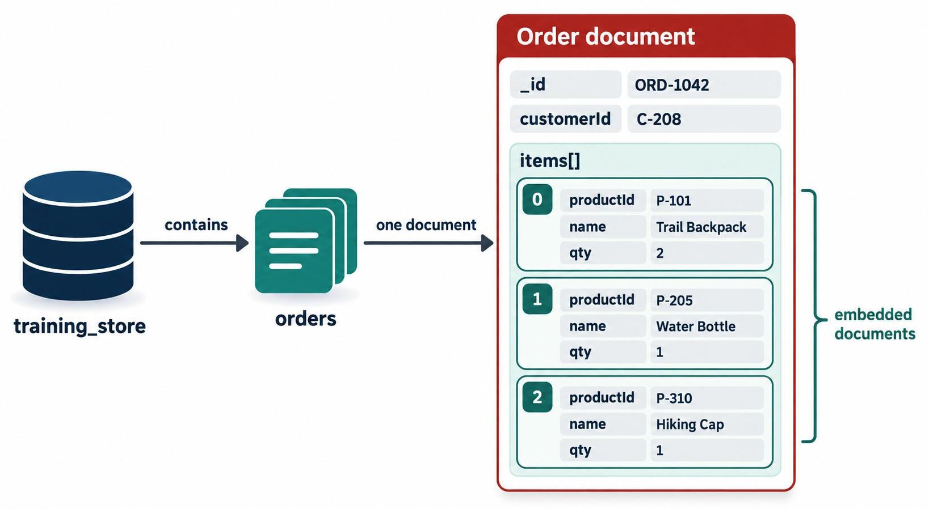
NESTED DOCUMENTS AND ARRAYS
A value can be a whole document — or a list of them.
Embedded document
A document as a value: a product's attributes, a customer's name and contact.
Array
Several values in one field: tags, or whole documents like order items and addresses.
Reach inside with dot notation
db.products.find(
{ "attributes.memoryGB": 16 })
db.orders.find(
{ "items.sku": "L100" })
QUOTES Dotted paths must be in quotes.
KEY TAKEAWAY Nested documents and arrays let one document hold a whole business object — dot notation reaches inside.
8
© 2026 by Innovation In Software Corporation
Notes:
KEY TALKING POINTS
------------------
- Nested documents
A field's value can be a whole document.
In training_store, a product's attributes and a customer's name and contact are embedded documents.
- Arrays
An array holds several values in one field.
It can hold simple values, like a product's tags, or whole documents, like an order's line items or a customer's addresses.
- Dot notation
Queries reach inside with dot notation, in quotes: "attributes.memoryGB" or "items.sku".
When the path crosses an array, MongoDB checks every element.
Lab 2, Step 5, practises this, and Module 4 goes deeper.
- What it shows
The orders collection in training_store holds one order document, ORD-1042, with a customerId and an items array of three embedded documents: a Trail Backpack, a Water Bottle and a Hiking Cap.
- How to read it
Each numbered box, 0 to 2, is one array element with its own productId, name and qty fields.
The bracket on the right marks them as embedded documents.
- Values in the diagram
The IDs and product names are illustrative.
Our training_store orders use orderNumber, and each item holds productId, sku, name, quantity and unitPrice.

Slide 9
COMMON BSON TYPES
Each type with a real training_store value.
Type | training_store example | Typical use
String | sku: "L100" | Names, codes, statuses
Int32 | memoryGB: 16 | Quantities, counters
Decimal128 | price: Decimal128("1299.99") | Money
Double | 4.6 (an average) | Measurements
Boolean | active: true | Flags
Date | createdAt: ISODate("2026-08-20…") | Timestamps
ObjectId | customerId: ObjectId("…") | Identifiers
Array | tags: ["business", "portable"] | Lists
Embedded | attributes: { processor: … } | Grouped fields
Null | contact.phone: null (C204) | Known but empty
Int32 or Double?
mongosh stores a whole number like 16 as Int32 and 4.6 as a Double.
Null or missing?
C204's phone is null; C515 has no phone field at all.
MONEY Decimal128 — never a string or a Double.
KEY TAKEAWAY BSON adds the types JSON lacks — dates, decimals and ObjectIds — so choose the one that matches the meaning.
9
© 2026 by Innovation In Software Corporation
Notes:
KEY TALKING POINTS
------------------
- BSON
MongoDB stores documents as BSON, Binary JSON.
It supports the JSON structures plus extra types such as Date, Decimal128, ObjectId and specific integer sizes.
- Read the table
Every example is a real value from training_store after load.js.
The only exception is the Double row: the dataset has no floating-point fields, so 4.6 stands for a value such as an average rating.
- Int32 and Double in mongosh
mongosh stores a whole number such as 16 as a 32-bit integer, and a number with a fraction such as 4.6 as a Double.
That is why prices are always written with Decimal128.
- Null versus missing
Luis Romero, C204, has contact.phone set to null: we know he has no phone number.
Sam Okonkwo, C515, has no phone field at all.
Module 4 shows the queries that tell these apart.
- Aliases
The content guide writes NumberDecimal(...) and ISODate(...).
Our labs write Decimal128(...) and new Date(...).
Both pairs create the same BSON types.

Slide 10
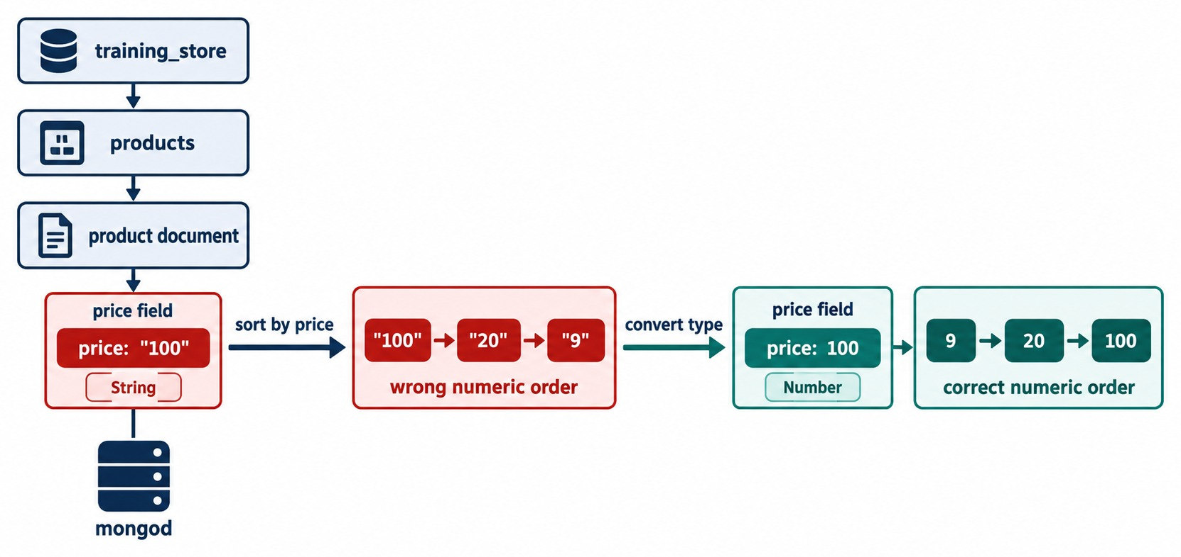
CHOOSE TYPES THAT MATCH THE MEANING
Strings make comparisons, sorting and calculations wrong.
Poor versus better
// poor
{ price: "49.99", active: "yes",
createdAt: "September 20, 2026" }
// better
{ price: Decimal128("49.99"),
active: true,
createdAt: ISODate("2026-09-20") }
Why it matters
"100" sorts before "20"; "yes" is not a Boolean; text dates don't sort by time.
IN TRAINING_STORE XBAD's price is the string "49.99" — on purpose.
KEY TAKEAWAY Store money as Decimal128, flags as Booleans and times as Dates — the type decides how values behave.
10
© 2026 by Innovation In Software Corporation
Notes:
KEY TALKING POINTS
------------------
- Types carry meaning
Choose the type that matches the business meaning.
A price is money, a quantity is a whole number, a flag is a Boolean and a timestamp is a date.
- What goes wrong
Strings compare character by character.
Sorted as strings, "100" comes before "20" and "9".
Range filters such as price below 50 also stop working, and calculations need conversions first.
- Money
For currency, Decimal128 is usually better than a Double, because it avoids binary floating-point rounding.
In mongosh you can write Decimal128("49.99") or NumberDecimal("49.99"); both create the same type.
- What it shows
A product document whose price field holds the string "100".
Sorting by price gives "100", "20", "9" — the wrong numeric order.
- How to read it
Follow the arrows: after converting the field to a number, the same values sort correctly as 9, 20, 100.
- Key point
The type decides how values compare, sort and calculate.
For money we use the Decimal128 number type.
- A deliberate fixture
training_store contains one product, XBAD, the Legacy Cable Pack, whose price is the string "49.99".
It is there on purpose: Module 4 uses it in the $type labs to find values stored with the wrong type.
Don't fix it now.

Slide 11
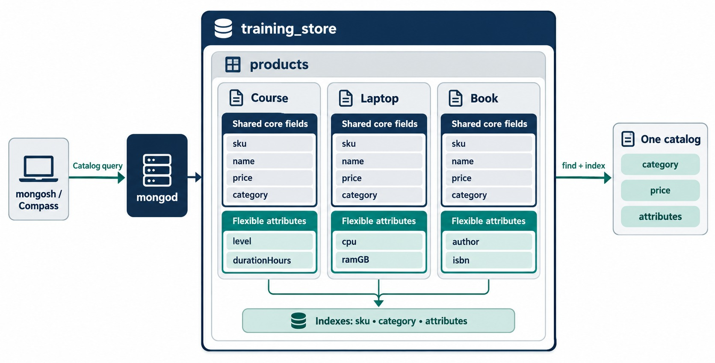
ONE COLLECTION, A SHARED CORE
Different products, the same core fields, flexible attributes.
Shared core
sku, name, category, price, tags, active, createdAt — same names, same types.
Flexible attributes
LAPTOP: processor, memoryGB · SHOE: sizes, color · BOOK: author, isbn.
One name per field
name everywhere — never productName on one product and title on another.
EXERCISE 3.4 You'll design this catalog yourself.
KEY TAKEAWAY Keep the core identical across products and put category-specific fields under attributes.
11
© 2026 by Innovation In Software Corporation
Notes:
KEY TALKING POINTS
------------------
- One collection, many shapes
All products live in one products collection, even though a laptop, a shoe and a book have different specifications.
- The shared core
Every product has the same core fields with the same names and types: sku, name, category, price, tags, active and createdAt.
Common operations such as browsing by category or price rely on them.
- Flexible attributes
Category-specific fields go under attributes: processor and memoryGB for a laptop, sizes, color and material for a shoe, author and isbn for a book.
- Consistent names
Avoid productName on one document, item_name on another and title on a third.
Pick one name, name, and use it everywhere.
- What it shows
The products collection holds three kinds of product — a course, a laptop and a book.
Each has the same shared core fields, sku, name, price and category, plus its own flexible attributes.
- How to read it
The dark block in each card is the shared core; the green block is the category-specific part.
All three feed one catalog, queried by category, price and attributes, with indexes on sku and category.
- Diagram versus dataset
training_store has no course category: its categories are LAPTOP, SHOE, BOOK and ACCESSORY, and laptops store processor and memoryGB rather than cpu and ramGB.
The shape is the same.
- Querying the flexible part
Because the variable fields live under attributes, queries stay predictable: find({ category: "LAPTOP" }) uses the core, and find({ "attributes.isbn": "978-0000000000" }) finds the book B300.

Slide 12
PART 2: DESIGNING AROUND ACCESS PATTERNS
Flexible doesn't mean unplanned.
✓ Part 1
Documents and types
Part 2
Access patterns
Part 3
Embed or reference
Part 4
Patterns
Part 5
Validate and build
SO FAR
NEXT QUESTION
How does the application actually use the data — and how should that shape the documents?
✓
A document holds typed fields, nested documents and arrays
✓
Choose each BSON type by its meaning
IN THIS PART
One collection can hold varied products
1
Model around access patterns
✓
2
training_store's access patterns
3
Relationship types
4
Estimating growth: bounded or not
12
© 2026 by Innovation In Software Corporation
Notes:
KEY TALKING POINTS
------------------
- Why this part
MongoDB has a flexible schema, but a good schema supports the application's common reads and writes efficiently.
- The four steps
Identify the entities, identify their relationships, list the important operations, and estimate how the data grows.
This part walks through all four for training_store.

Slide 13
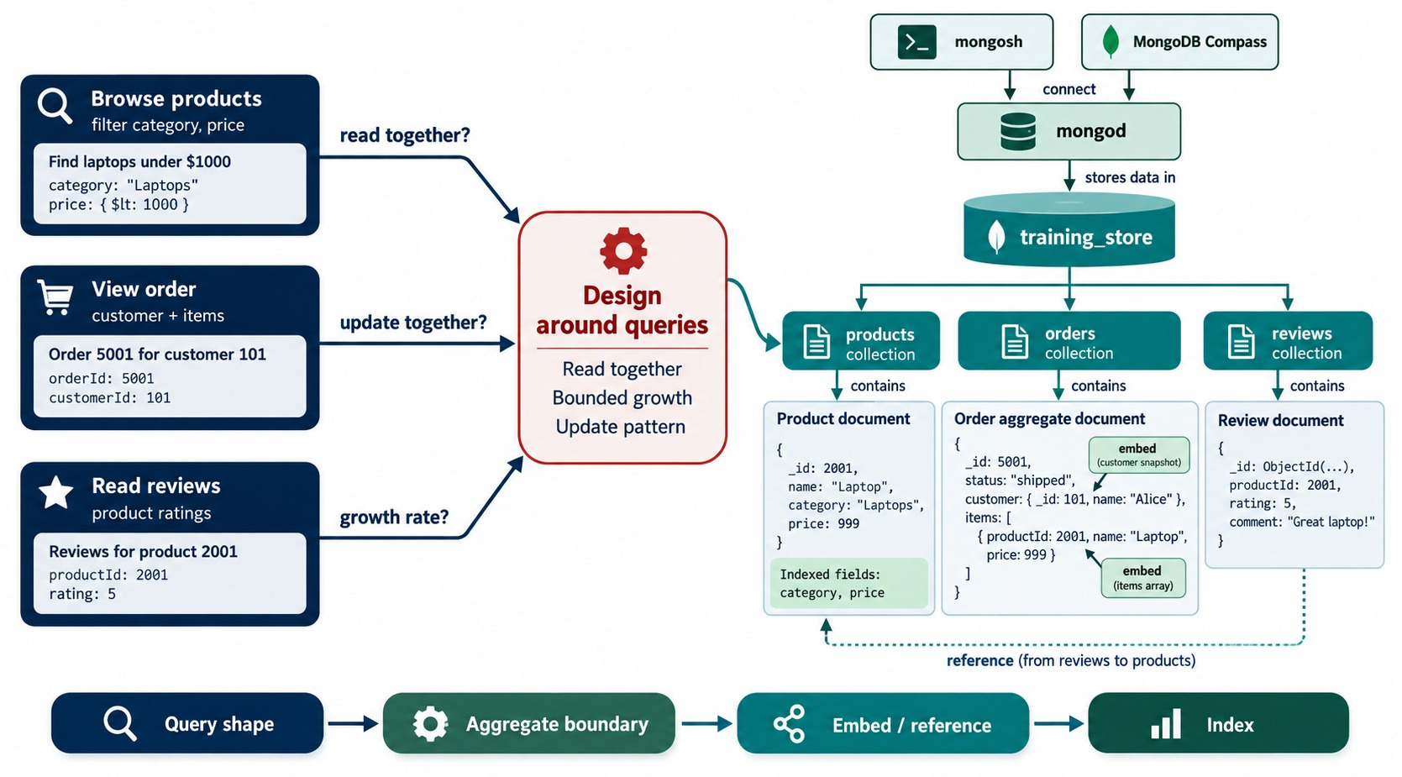
MODEL DATA AROUND ACCESS PATTERNS
Start from the operations — not from the tables.
Operations first
Browse products, view an order, read reviews — before any collection exists.
Three questions
Read together? Updated together? How fast does it grow?
Then shape and index
Aggregate boundary → embed or reference → indexes.
PRINCIPLE Data accessed together is stored together.
KEY TAKEAWAY The application's most important operations decide the document shape — design around the queries.
13
© 2026 by Innovation In Software Corporation
Notes:
KEY TALKING POINTS
------------------
- Start from the application
Relational design often starts with entities and normalization.
MongoDB design starts with the application's most important operations.
- The questions to ask
What is read together?
What is updated together?
Which queries run most often?
How large can each record become?
Which relationships are one-to-one, one-to-many or many-to-many?
- From question to design
The answers decide the aggregate boundary: what belongs in one document.
Then we choose embed or reference for each relationship, and finally the indexes that support the queries.
- What it shows
Three operations on the left — browse products, view an order, read reviews — feed a Design around queries step, which produces the products, orders and reviews collections.
- How to read it
Each arrow asks one question: read together, update together, growth rate.
The band at the bottom is the method: query shape, aggregate boundary, embed or reference, index.
- Diagram versus dataset
The sample order embeds a small customer snapshot, and the sample category is "Laptops".
training_store orders keep a customerId reference instead, and the category value is LAPTOP.

Slide 14
TRAINING_STORE ACCESS PATTERNS
The operations that shape our four collections.
Access pattern | Frequency | Returned together | Modeling implication
Find product by SKU | High | The whole product | One product document
Browse category and price | High | Name, price | Shared core fields
Show customer profile | High | Name, contact, addresses | Embed addresses
Show one order | High | Items, totals, address | Embed items, snapshot
Customer order history | Medium | Order summaries | customerId on each order
Reviews for a product | Medium | Recent reviews | Separate collection
Change order status | Medium | One order | One-document update
Entities
Product, Customer, Order, Review.
Relationships
Customer → orders and reviews; product → reviews; order → items.
EXERCISE 3.2 You'll build this table from the requirements.
KEY TAKEAWAY List each operation with how often it runs and what it returns together — the implications follow.
14
© 2026 by Innovation In Software Corporation
Notes:
KEY TALKING POINTS
------------------
- Steps 1 and 2
The entities are Product, Customer, Order and Review.
A customer places many orders and writes many reviews, a product receives many reviews, and an order contains many items.
- Step 3: the operations
The content guide lists ten: find a product by SKU, browse by category, search a price range, show a profile with addresses, show one order, show order history, show a product's reviews, calculate an average rating, update inventory and change an order's status.
The table groups the ones that shape the documents most.
- Read the last column
High-frequency reads that return one object become one document.
Lists that grow, such as order history and reviews, become references.
A status change touches one order, so it is a single-document update.
- Frequencies
The frequencies are estimates for a typical store, like the ones Exercise 3.2 asks for.
In a real project you would measure them.

Slide 15
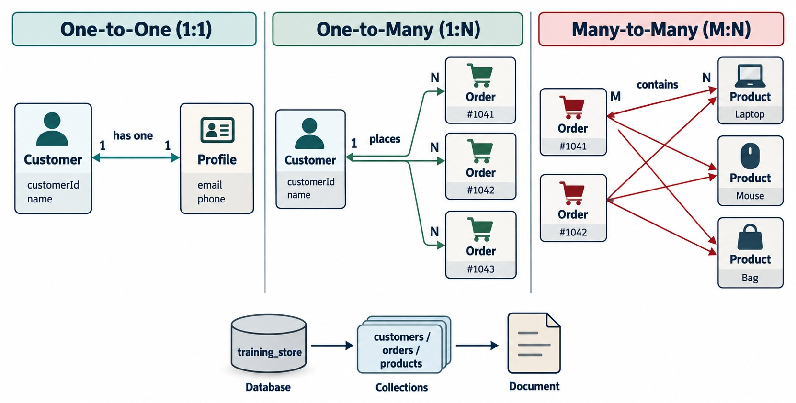
RELATIONSHIP TYPES
One-to-one, one-to-many and many-to-many.
One-to-one
Customer → preferences: embedded as one sub-document.
One-to-many
Customer → orders: each order stores customerId.
Many-to-many
Orders ↔ products: linked through items[].productId.
ALSO ASK How many on the many side — a few or millions?
KEY TAKEAWAY Name each relationship's type, then count the many side before choosing a model.
15
© 2026 by Innovation In Software Corporation
Notes:
KEY TALKING POINTS
------------------
- Three relationship types
One-to-one: a customer has one set of preferences.
One-to-many: a customer places many orders.
Many-to-many: an order contains many products, and a product appears in many orders.
- In training_store
Customer to preferences is embedded.
Customer to orders is a reference: each order stores customerId.
Orders to products is also a reference, through items[].productId.
- Count both sides
The type alone doesn't decide the model.
How many on the many side matters: a few addresses, dozens of orders or millions of reviews lead to different choices.
- What it shows
Three panels: a customer that has one profile, a customer that places many orders, and orders that contain many products while each product appears in many orders.
- How to read it
The 1, N and M labels on the arrows give the cardinality of each side.
- Key point
Name the relationship type first; then count how many sit on the many side.

Slide 16
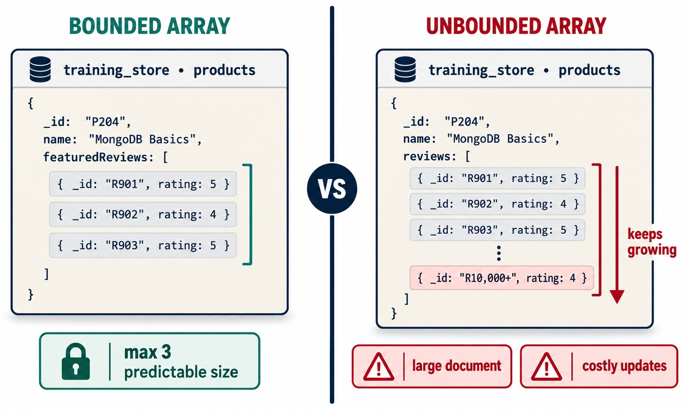
ESTIMATE GROWTH: BOUNDED OR UNBOUNDED?
Small arrays can be embedded — growing ones can't.
Bounded
A customer's few addresses; an order's handful of line items.
Unbounded
Every review a product will ever get — it keeps growing.
Hard limit
One BSON document can be at most 16 MiB.
TRAINING_STORE Reviews live in their own collection.
KEY TAKEAWAY Ask how large every array can become — embed the bounded ones, move the unbounded ones out.
16
© 2026 by Innovation In Software Corporation
Notes:
KEY TALKING POINTS
------------------
- Estimate growth
For every array ask: how many items can it hold, does it grow without a practical limit, and how often does it change?
- Bounded
A customer has a few addresses.
An order has a handful of line items.
These arrays stay small, so they can be embedded.
- Unbounded
A popular product can receive thousands of reviews.
An array like that keeps growing, every update rewrites a larger document, and it can eventually hit the 16 MiB limit for one BSON document.
- Rule
A small, bounded list may be embedded.
A large or continuously growing list belongs in its own collection.
- What it shows
Two versions of the same product document.
On the left, featuredReviews holds at most three reviews.
On the right, reviews keeps growing past ten thousand entries.
- How to read it
The green lock says max 3, predictable size.
The red warnings say large document and costly updates.
- Key point
Embed arrays that stay small; move arrays that keep growing into their own collection.

Slide 17
EXERCISE: CLASSIFY THE TRAINING_STORE RELATIONSHIPS
Name the cardinality and the growth before you pick a model.
PRACTICE EXERCISE
10 MIN
SCENARIO
YOUR TASKS
EXPECTED OUTCOME
Five relationships from the dataset. For each, decide how many sit on the many side and whether it grows without limit.
1
Name each relationship's type
✓
1, 2: one-to-few, bounded — embed
2
Say bounded or unbounded, and why
3: one-to-many, grows — customerId
✓
1 customer → addresses
2 order → line items
3 customer → orders
4 product → reviews
5 orders ↔ products
3
Decide: embed or reference
✓
4: grows without limit — productId
4
Find the field that links each pair
✓
5: many-to-many — items[].productId
✓
Growth, not nesting, decides
KEY TAKEAWAY Cardinality and growth decide the model — the same question works for any relationship.
17
© 2026 by Innovation In Software Corporation
Notes:
KEY TALKING POINTS
------------------
- How to run it
Pairs, five minutes, then compare with the expected column.
Ask each pair to justify one answer out loud.
- Addresses and items
A customer has a few addresses and an order has a few items.
Both are bounded and read with their parent, so they are embedded.
- Orders and reviews
A customer's order history keeps growing, so each order stores customerId instead of the customer holding an array of orders.
Reviews can grow without limit, so each review stores productId.
- Orders and products
One order contains many products and one product appears in many orders.
training_store links them through items[].productId, plus a snapshot of sku, name and unitPrice — Part 3 explains why.

Slide 18
PART 3: EMBEDDING VERSUS REFERENCING
The two ways MongoDB represents a relationship.
✓ Part 1
Documents and types
✓ Part 2
Access patterns
Part 3
Embed or reference
Part 4
Patterns
Part 5
Validate and build
SO FAR
NEXT QUESTION
When should related data live inside the document — and when in another collection?
✓
Design starts from access patterns
✓
Name the relationship and count the many side
IN THIS PART
Arrays must stay bounded
1
Embedding: customer profiles
✓
2
Referencing: product reviews
3
How to choose between them
4
A decision tree
5
Orders: a hybrid model
6
Historical snapshots
18
© 2026 by Innovation In Software Corporation
Notes:
KEY TALKING POINTS
------------------
- The two approaches
MongoDB represents relationships in two main ways: embed the related data inside a document, or reference a document stored in another collection.
- Where this part ends
By the end, learners should be able to explain every embed and reference choice in training_store, and why an order copies some product fields.

Slide 19
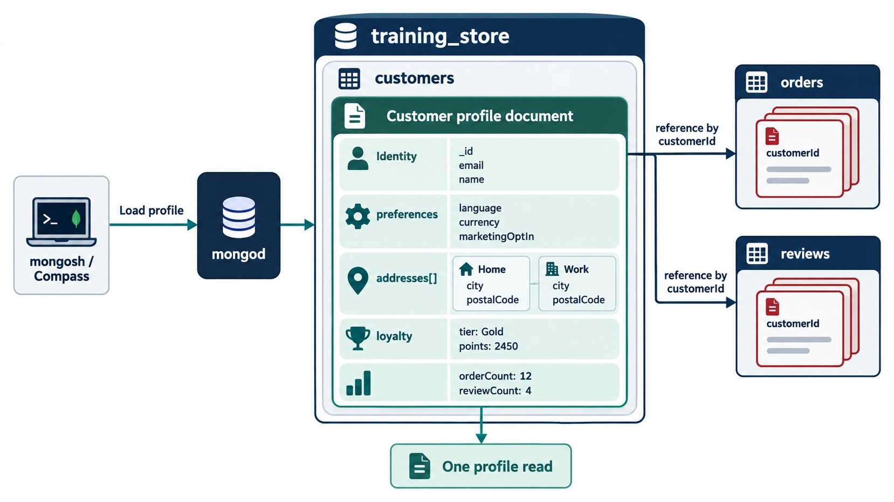
EMBEDDING: CUSTOMER PROFILES
Addresses belong to the customer and are read with the profile.
customers: C101 (trimmed)
{ customerNumber: "C101",
name: { first: "Aisha",
last: "Khan" },
addresses: [ {
type: "SHIPPING",
city: "Toronto", … } ] }
Advantages
One read, no join, atomic updates inside one document.
Limitations
Duplication, bigger documents — and never for unbounded data.
KEY TAKEAWAY Embed data that belongs to the parent, stays small and is read with it.
19
© 2026 by Innovation In Software Corporation
Notes:
KEY TALKING POINTS
------------------
- Why addresses are embedded
Addresses belong to the customer, a customer has only a few, they are displayed with the profile, and an address doesn't need to exist on its own.
- Advantages of embedding
One query returns the whole profile.
There is no join.
Updates inside one document are atomic, and the document matches the application object.
- Limitations
Embedding can duplicate shared information and make documents large.
It is wrong for unbounded arrays, and it makes independent updates of the embedded data less convenient.
- What it shows
A customer profile document with identity, preferences, an addresses array with a home and a work address, loyalty and activity counts.
Orders and reviews point back to it by customerId.
- How to read it
Everything inside the green card is embedded, so loading the profile is one read.
The arrows on the right are references from other collections.
- Diagram versus dataset
training_store's C101 is simpler: name, contact, one SHIPPING address, preferences and status.
It has no loyalty or activity counts.

Slide 20
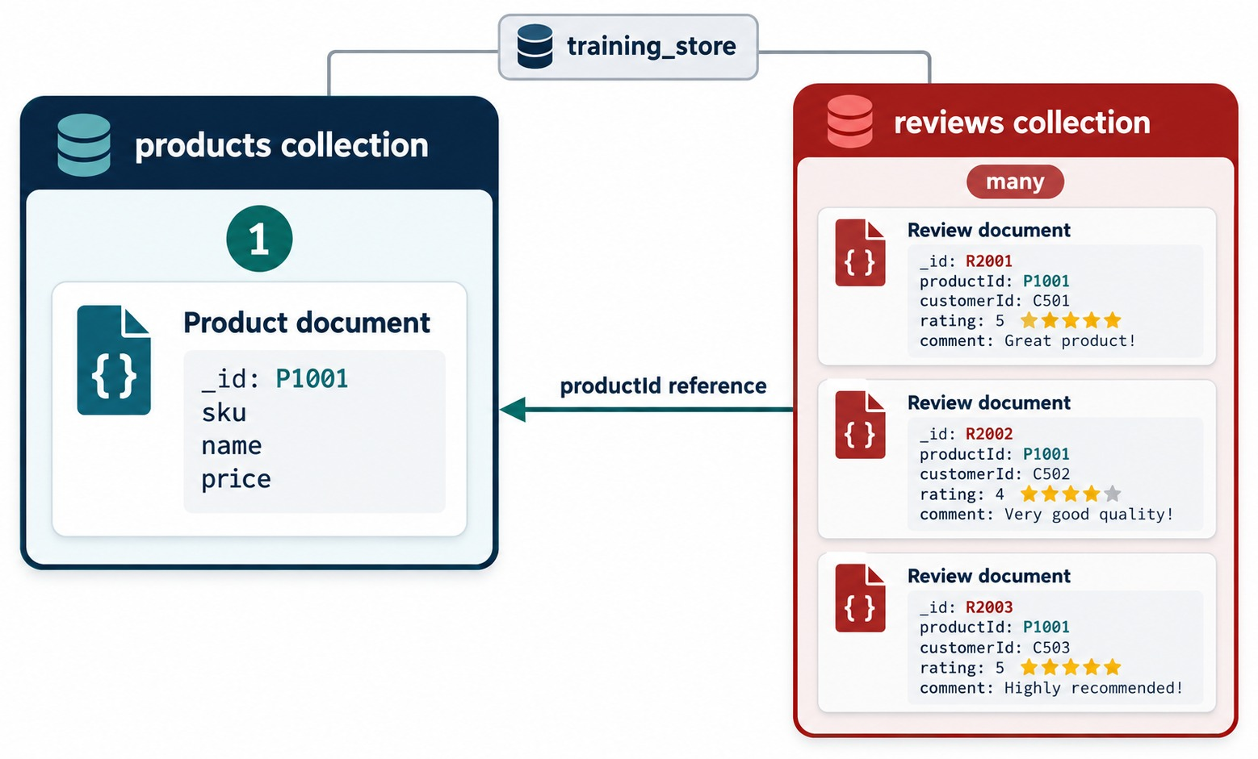
REFERENCING: PRODUCT REVIEWS
Each review points to its product and its author.
reviews: the L100 review (trimmed)
{ productId: ObjectId("…"),
sku: "L100",
customerId: ObjectId("…"),
rating: 5,
title: "Excellent for travel" }
Advantages
Small documents, independent growth, no large duplication.
Limitations
A second query or $lookup; multi-document changes may need a transaction.
KEY TAKEAWAY Reference data that is shared, changes on its own or grows without limit.
20
© 2026 by Innovation In Software Corporation
Notes:
KEY TALKING POINTS
------------------
- Referencing
Referencing keeps related data in separate collections and connects documents with identifiers.
Each review stores the productId of the product it belongs to, and the customerId of the person who wrote it.
- Advantages of referencing
It avoids large-scale duplication, lets data change independently, works for many-to-many relationships, handles large and growing relationships, and keeps each document small.
- Limitations
Combining the data needs a second query or a $lookup stage.
Application logic is more complex, and a change that spans several documents may need a transaction.
- What it shows
One product document, P1001, in the products collection and three review documents in the reviews collection.
Each review stores productId P1001, its own customerId, a rating and a comment.
- How to read it
The arrow is the productId reference: 1 product on the left, many reviews on the right.
- Diagram versus dataset
training_store reviews store the text in title and body rather than comment, and also copy the product's sku.

Slide 21
HOW TO CHOOSE BETWEEN THEM
Nine considerations from the modeling guide.
Consideration | Embed | Reference
Normally read together | Yes | Possibly
Small and bounded | Yes | Not required
Belongs to one parent | Yes | Possibly
Grows continuously | No | Yes
Shared by many records | No | Yes
Changes independently | Sometimes | Yes
One-query retrieval matters | Yes | Needs $lookup
Duplication would be large | No | Yes
Atomic update required | Strong choice | Transaction
Rule
Embed bounded data that belongs to the parent; reference independent, shared or unbounded data.
EXERCISE 3.3 Eight relationships to decide.
KEY TAKEAWAY Embed bounded data that belongs to the parent; reference independent, shared or unbounded data.
21
© 2026 by Innovation In Software Corporation
Notes:
KEY TALKING POINTS
------------------
- How to read the table
Each row is one question about the relationship.
Most rows point clearly one way; a few say sometimes or possibly, which is where judgement comes in.
- The strongest signals
Continuous growth and sharing across many records point to referencing.
Being read together, small and owned by one parent point to embedding.
- Atomicity
A write to one document is atomic.
If several related values must change together, embedding them gives that for free; referenced data may need a multi-document transaction.
- Changes independently
Sometimes appears under embed because a snapshot is embedded on purpose even though the source changes.
The order's copy of a product price is the classic example.

Slide 22
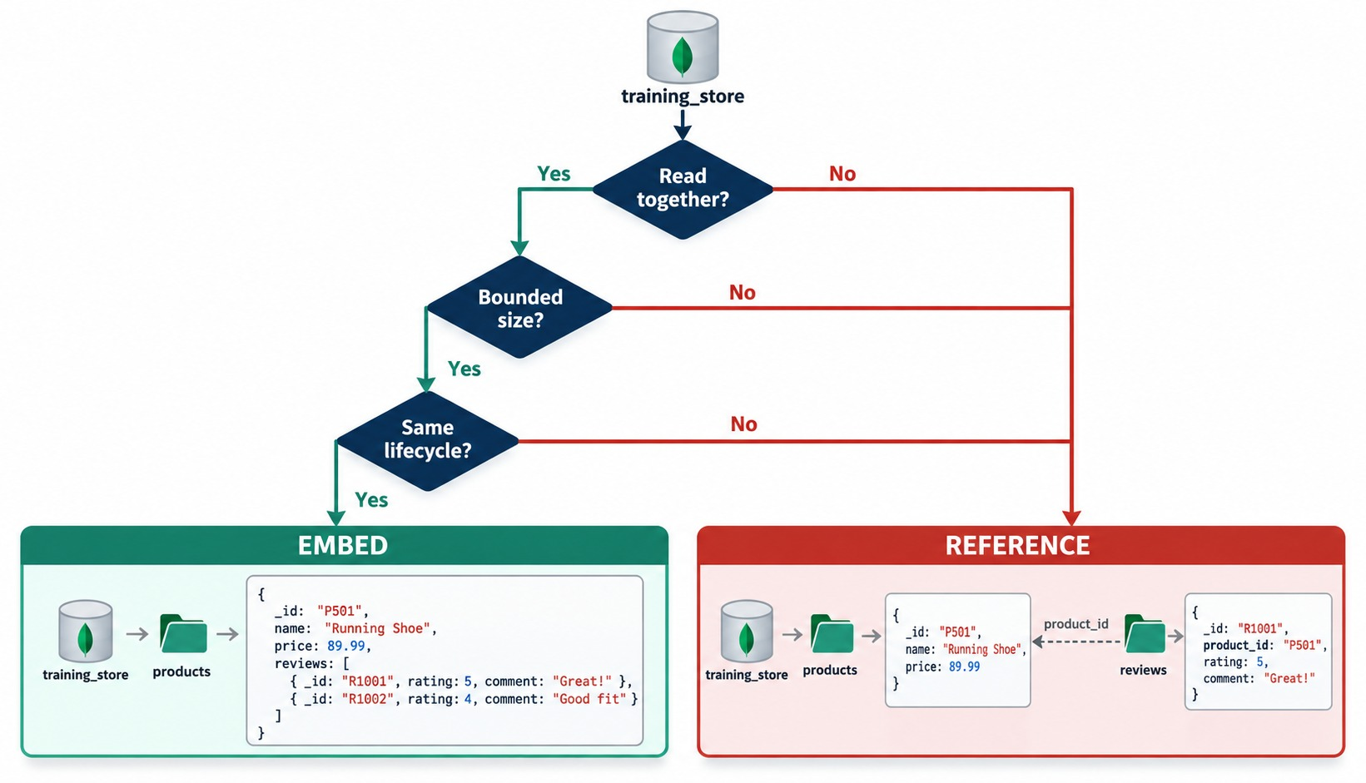
AN EMBEDDING DECISION TREE
Three questions — all yes means embed.
Read together?
Is it shown with the parent on the common page?
Bounded size?
Does it have a small, known maximum?
Same lifecycle?
Is it created and deleted with the parent?
REVIEWS Fail bounded size — so they are referenced.
KEY TAKEAWAY Embed only when the data is read together, bounded and shares the parent's lifecycle.
22
© 2026 by Innovation In Software Corporation
Notes:
KEY TALKING POINTS
------------------
- Three questions
Is the data read together with the parent?
Is its size bounded?
Does it share the parent's lifecycle, created and deleted with it?
- All three yes
Embed it.
Addresses on a customer and line items on an order pass all three.
- Any no
Reference it.
Reviews are read on the product page, but they are not bounded and they have their own lifecycle.
So training_store keeps them in their own collection.
- What it shows
A decision tree with three questions: read together, bounded size and same lifecycle.
Three yes answers lead to EMBED; any no leads to REFERENCE.
- How to read it
The two example boxes show both outcomes for product reviews: embedded in the product, or referenced from a separate reviews collection by product_id.
- Key point
The embed example only illustrates the shape.
Reviews fail the bounded-size question, which is why training_store references them.

Slide 23
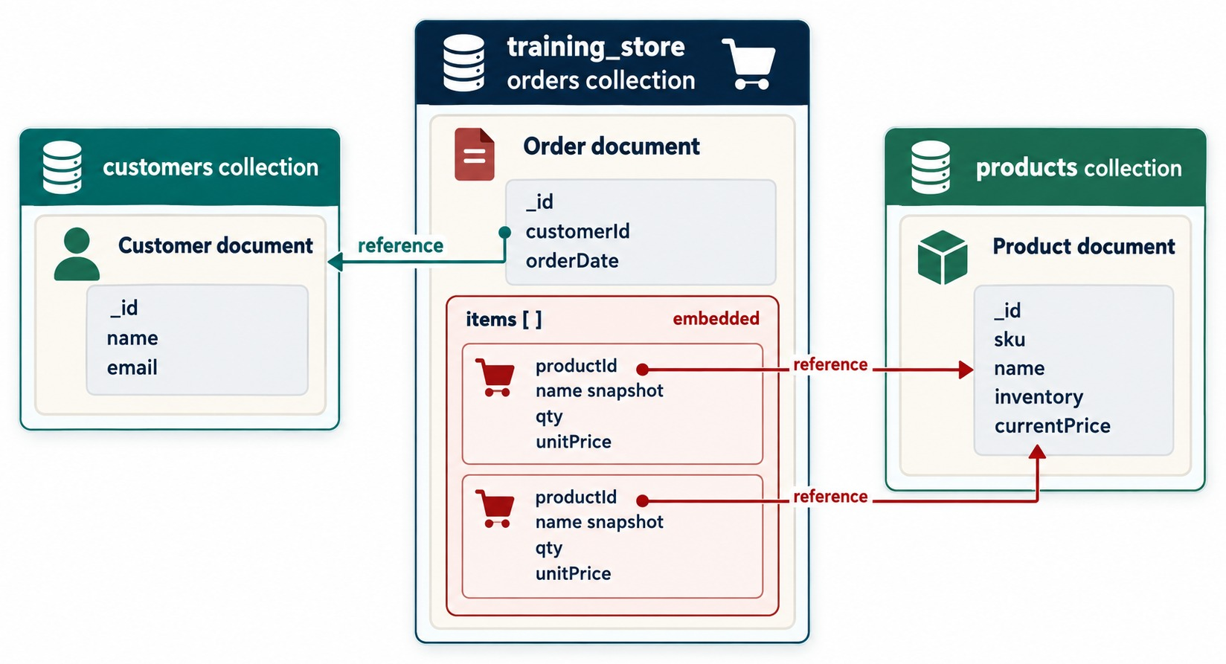
MODELING ORDERS: A HYBRID APPROACH
Reference the customer and products; embed items and the address.
orders: O5001 (trimmed)
{ orderNumber: "O5001",
customerId: ObjectId("…"),
items: [
{ productId: ObjectId("…"),
sku: "L100",
name: "Business Laptop",
quantity: 1,
unitPrice: Decimal128("1299.99") },
… ], // A410 × 2
shippingAddress: { city: "Toronto", … },
total: Decimal128("1514.17") }
Reference
customerId → the customer; productId → the catalog.
Embed
Line items and the shipping address, read with the order.
KEY TAKEAWAY One order document answers "show this order" — while customers and products keep changing on their own.
23
© 2026 by Innovation In Software Corporation
Notes:
KEY TALKING POINTS
------------------
- Orders mix both approaches
An order is the clearest example of a hybrid model.
It references the customer and each product, and it embeds the line items and the shipping address.
- Copied fields
Each line item also copies sku, name and unitPrice from the product.
The productId still points to the catalog, but the copies keep what the customer actually bought.
- Why this shape
The most common read is: show one order.
This shape answers it with one document, while customers and products keep changing independently.
- What it shows
An order document in the middle.
It references the customer document on the left through customerId, embeds an items array, and each item references a product document on the right through productId.
- How to read it
Each item carries a name snapshot, qty and unitPrice.
The product itself keeps sku, name, inventory and currentPrice.
- Diagram versus dataset
training_store orders use createdAt instead of orderDate and quantity instead of qty, and products keep their current price in price.
- The real O5001
After load.js, O5001 is Aisha Khan's order: one Business Laptop at 1299.99 and two Wireless Mice at 19.99, subtotal 1339.97, tax 174.20, total 1514.17.
Payment is PENDING and fulfillment is NEW.
- Lab 2, Step 4, builds a smaller O5001
In the hand-insert path, Lab 2, Step 4, creates O5001 with the laptop only, so its total is 1468.99.
Reloading load.js at the start of Day 2 replaces it with the full version.

Slide 24
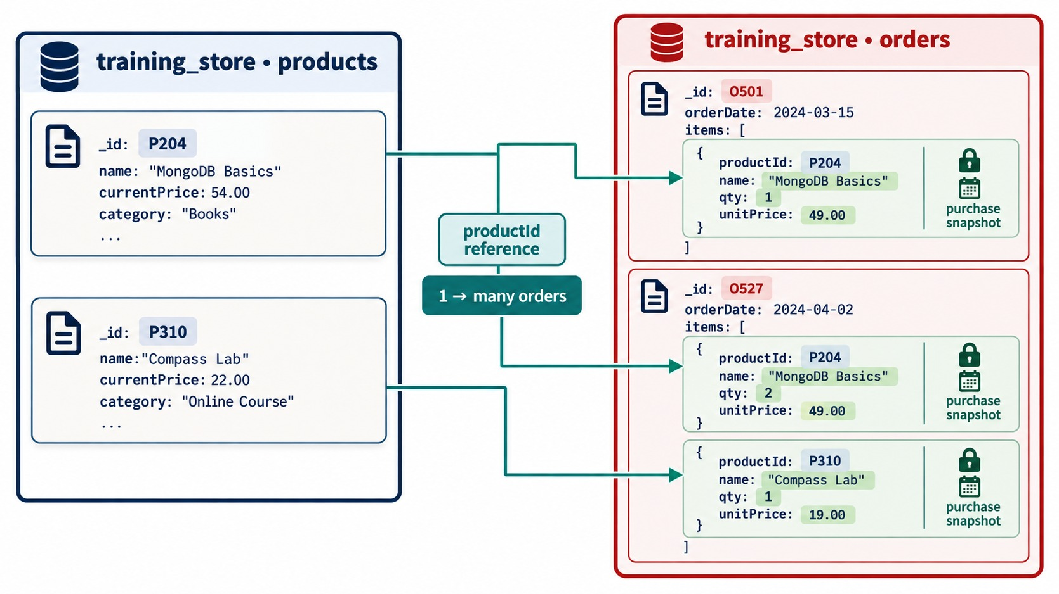
HISTORICAL SNAPSHOTS
The order keeps what the customer paid, not today's price.
Snapshot
unitPrice and name are copied at purchase — and never synced.
Current price
Lives only in products; the catalog can change freely.
In training_store
If L100's price changes, O5001 still shows 1299.99.
COPY WITH CARE Freeze history — don't copy data that must stay current.
KEY TAKEAWAY Duplication is deliberate when it preserves history — a snapshot should never follow the catalog.
24
© 2026 by Innovation In Software Corporation
Notes:
KEY TALKING POINTS
------------------
- Why copy product information
A product's name or price can change later.
An order must keep the values that applied when the purchase happened.
- Controlled duplication
If the catalog price changes, the historical order still shows the old price.
This deliberate copy is called a snapshot, or the historical pattern.
- Snapshot versus live copy
Don't copy data that must stay current, such as a customer's email, into thousands of documents.
Duplicate only the fields that should stay frozen as history.
- What it shows
Two products on the left, MongoDB Basics at a current price of 54.00 and Compass Lab at 22.00, and two orders on the right that bought them.
- How to read it
Each order item references the product by productId, but locks the name and unitPrice at purchase: 49.00 and 19.00, not today's prices.
- Key point
The reference says which product; the snapshot says what the customer paid.
- Customer data is different
training_store orders don't copy the customer's email or profile, because those must stay current.
They reference the customer and copy only the shipping address, which is part of the order's history.

Slide 25
PART 4: ANTI-PATTERNS AND SCHEMA PATTERNS
What goes wrong — and the proven fixes.
✓ Part 1
Documents and types
✓ Part 2
Access patterns
✓ Part 3
Embed or reference
Part 4
Patterns
Part 5
Validate and build
SO FAR
NEXT QUESTION
Which mistakes do first designs make — and which patterns solve common modeling problems?
✓
Embed bounded data that belongs to the parent
✓
Reference shared, independent or unbounded data
IN THIS PART
1
Collections copied from tables
✓
Snapshots preserve history on purpose
2
Inconsistent names and types
3
Seven schema patterns
4
Attribute, Subset and Computed up close
25
© 2026 by Innovation In Software Corporation
Notes:
KEY TALKING POINTS
------------------
- Why this part
A technically valid model can still perform badly.
We look at the mistakes first designs make, then at named patterns that experienced teams reuse.
- Link to the exercises
Exercise 3.6 corrects a flawed product document, and Exercise 3.7 matches requirements to the seven patterns.

Slide 26
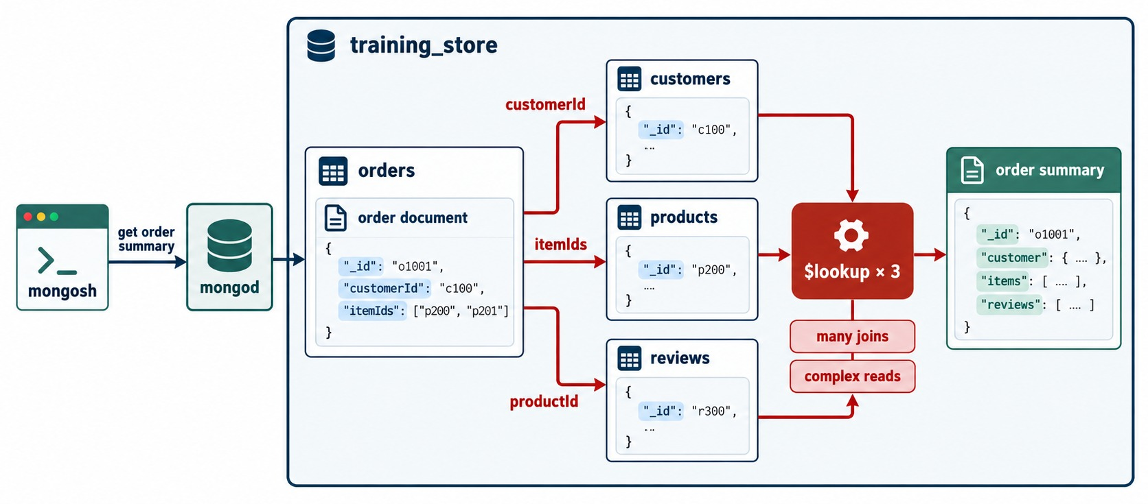
ANTI-PATTERN: COLLECTIONS COPIED FROM TABLES
One collection per table turns every page into joins.
The mistake
A collection for every small component; the app rebuilds each order.
The cost
$lookup × 3 — more round trips, more code, slower pages.
The fix
Embed what the page reads together; reference the rest.
TRAINING_STORE One O5001 document is one read.
KEY TAKEAWAY Don't translate tables into collections — model the documents the application reads.
26
© 2026 by Innovation In Software Corporation
Notes:
KEY TALKING POINTS
------------------
- Collections like tables
The most common first-design mistake is one collection for every relational table.
The application then rebuilds each object with several queries or $lookup stages.
- The cost
More round trips, more code and slower pages, for data that is always read together anyway.
- The fix
Start again from the access pattern.
Embed what the page reads together, and reference only what is shared, independent or unbounded.
- What it shows
An order document holding only a customerId and an itemIds array.
To show an order summary, mongod has to join customers, products and reviews with three $lookup stages.
- How to read it
The red arrows are the joins; the red labels name the cost: many joins, complex reads.
- Key point
This is a relational design with MongoDB syntax — it loses the benefit of documents.

Slide 27
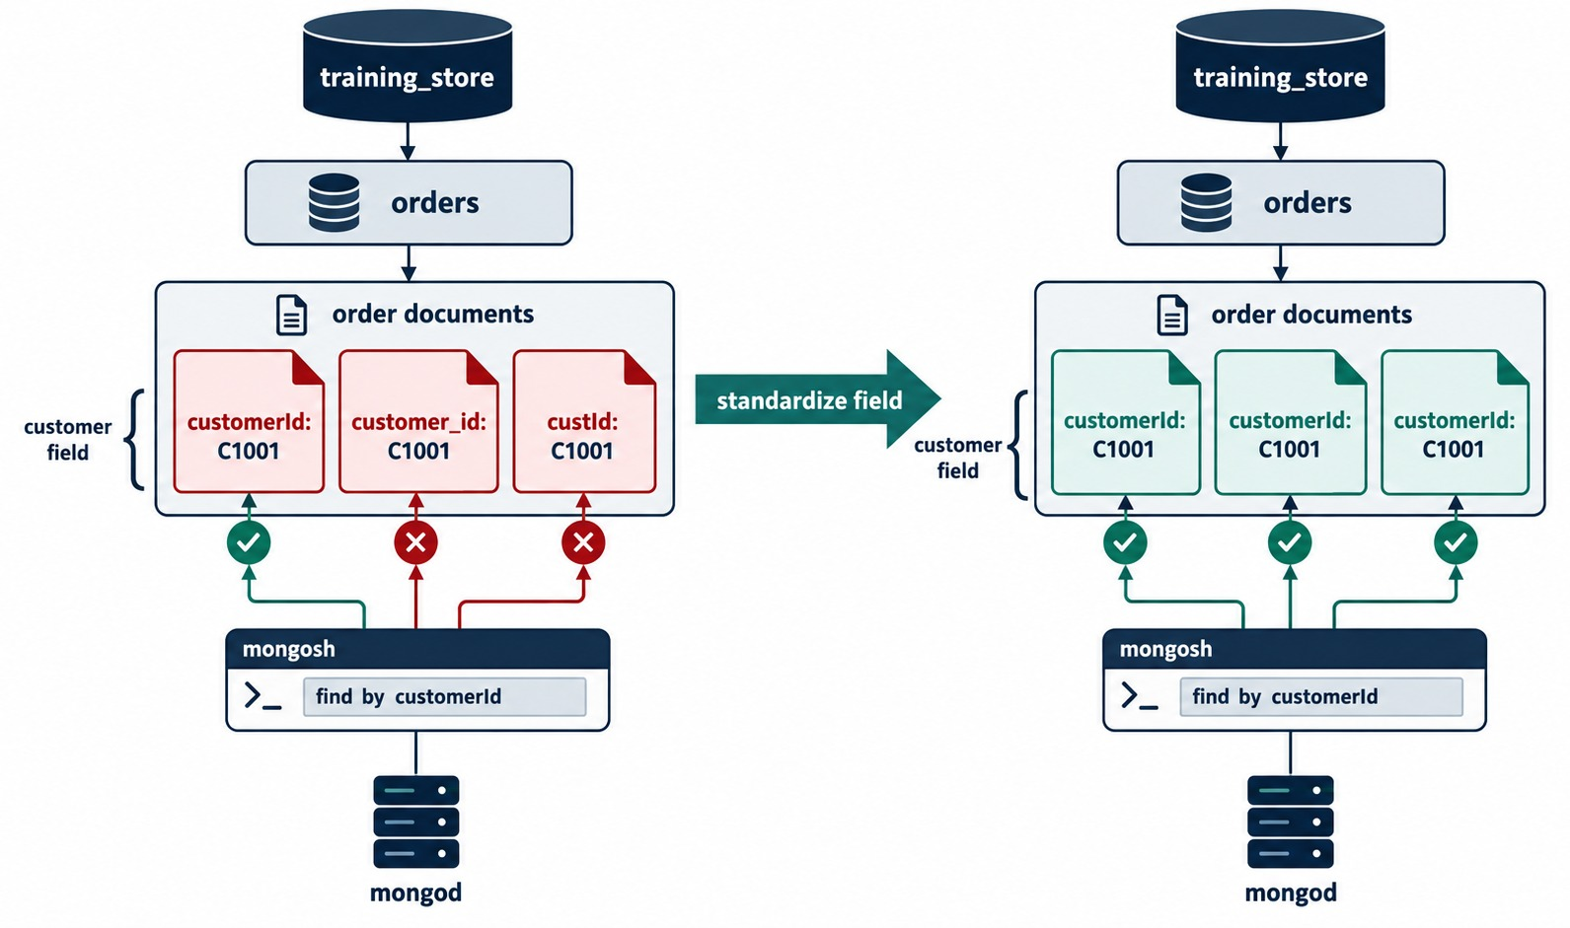
ANTI-PATTERN: INCONSISTENT NAMES AND TYPES
One field should have one name — and one type.
Names
customerId, customer_id, custId — a query on one misses the others.
✕
Types: three shapes, one field
{ price: 29.99 }
{ price: "29.99" }
{ price: { amount: 29.99 } }
The fix
One name, one structure per field — then enforce it with validation.
TRAINING_STORE camelCase everywhere: customerId, createdAt.
KEY TAKEAWAY Consistency is a correctness rule: queries match exact names and compare by type.
27
© 2026 by Innovation In Software Corporation
Notes:
KEY TALKING POINTS
------------------
- Inconsistent names
When one document says customerId, another customer_id and a third custId, a query on one name silently misses the others.
- Inconsistent types
The same happens with types: price as 29.99, as "29.99" and as { amount: 29.99 } in one collection breaks sorting, filtering and calculations.
- The fix
Choose one name and one structure for each field, apply it everywhere, and enforce it with validation.
training_store uses camelCase names such as customerId and createdAt throughout.
- What it shows
Three order documents that store the customer as customerId, customer_id and custId.
A find by customerId matches only the first.
- How to read it
Red crosses mark the documents the query misses.
After standardizing the field, all three show green ticks.
- Key point
Queries match exact field names, so one name per field is a correctness rule.
- More mistakes to watch
Two more from the guide.
Don't copy frequently changing shared data, such as a customer's current profile, into thousands of documents.
And don't design without the queries: a valid model can still be slow if it doesn't support the common queries and indexes.

Slide 28
SEVEN COMMON SCHEMA PATTERNS
Named solutions to recurring modeling problems.
Pattern | Use it when | Example
Attribute | Many optional, searchable fields | Product specifications
Bucket | Many small time-based events | Sensor readings per hour
Subset | The page needs only the hot few | Latest three reviews
Computed | The same calculation repeats | Stored average rating
Extended reference | A few fields read with the link | Customer name on an order
Outlier | A few documents are far larger | A viral product's reviews
Polymorphic | Different shapes, shared queries | Laptops, shoes, books
Every pattern costs
Faster reads usually mean extra writes or extra code.
Already here
products is polymorphic; order items use extended references.
EXERCISE 3.7 Match seven requirements to these patterns.
KEY TAKEAWAY Patterns are proven trade-offs — pick one only when its problem is really in your access patterns.
28
© 2026 by Innovation In Software Corporation
Notes:
KEY TALKING POINTS
------------------
- Attribute and Polymorphic
Attribute handles many optional fields that must be searchable.
Polymorphic keeps different shapes in one collection because the application queries them together, like our products.
- Bucket and Outlier
Bucket groups many small events, such as sensor readings, into one document per time window.
Outlier gives the rare very large case, like a product with an extreme number of reviews, special overflow handling so ordinary documents stay simple.
- Subset, Computed and Extended reference
Subset embeds only the hot part of a large relationship.
Computed stores a calculated result.
Extended reference copies a few frequently read fields next to the reference, as our order items copy sku and name, and as our reviews copy sku.
- Trade-offs
Every pattern makes some reads cheaper by making writes or code more complex.
Apply one only when its problem appears in the access patterns.

Slide 29
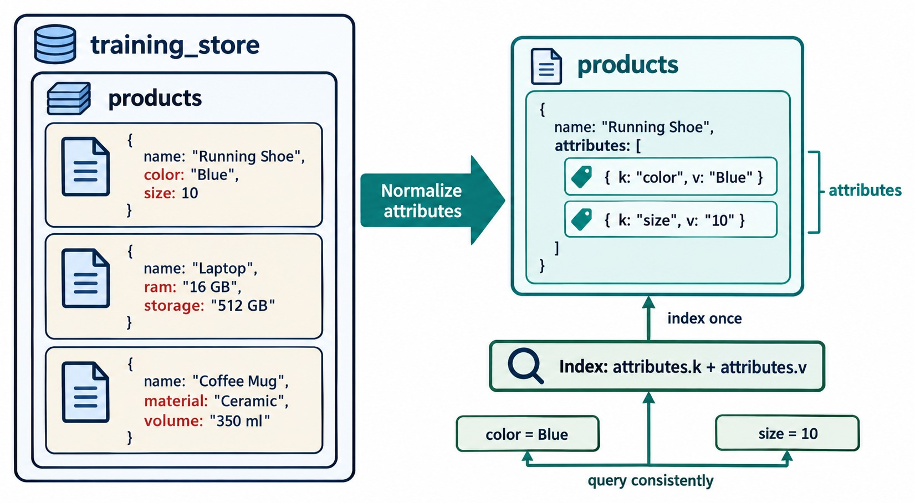
THE ATTRIBUTE PATTERN
Many optional attributes, one index.
The problem
Every searchable attribute would need its own index.
The pattern
Store { k, v } pairs; index attributes.k and attributes.v together.
training_store today
attributes is a plain object — fine for a few known fields.
TRADE-OFF Simpler indexing, less natural documents.
KEY TAKEAWAY Use the Attribute pattern when many optional fields must all be searchable.
29
© 2026 by Innovation In Software Corporation
Notes:
KEY TALKING POINTS
------------------
- The problem
Products have many optional attributes.
Searching on each one would need its own index.
- The pattern
The Attribute pattern stores them as an array of key-value pairs, { k, v }.
One compound index on attributes.k and attributes.v then serves every attribute search.
- training_store today
Our attributes field is a plain embedded object, which is simpler and fine while queries use a few known fields.
Switch to the pattern when attribute searches multiply.
- What it shows
Three products with different top-level attributes — color and size, ram and storage, material and volume — normalized into one attributes array of { k, v } pairs.
- How to read it
One index on attributes.k plus attributes.v then serves queries such as color = Blue or size = 10.
- Key point
The pattern trades a simple document shape for one index that covers every attribute.

Slide 30
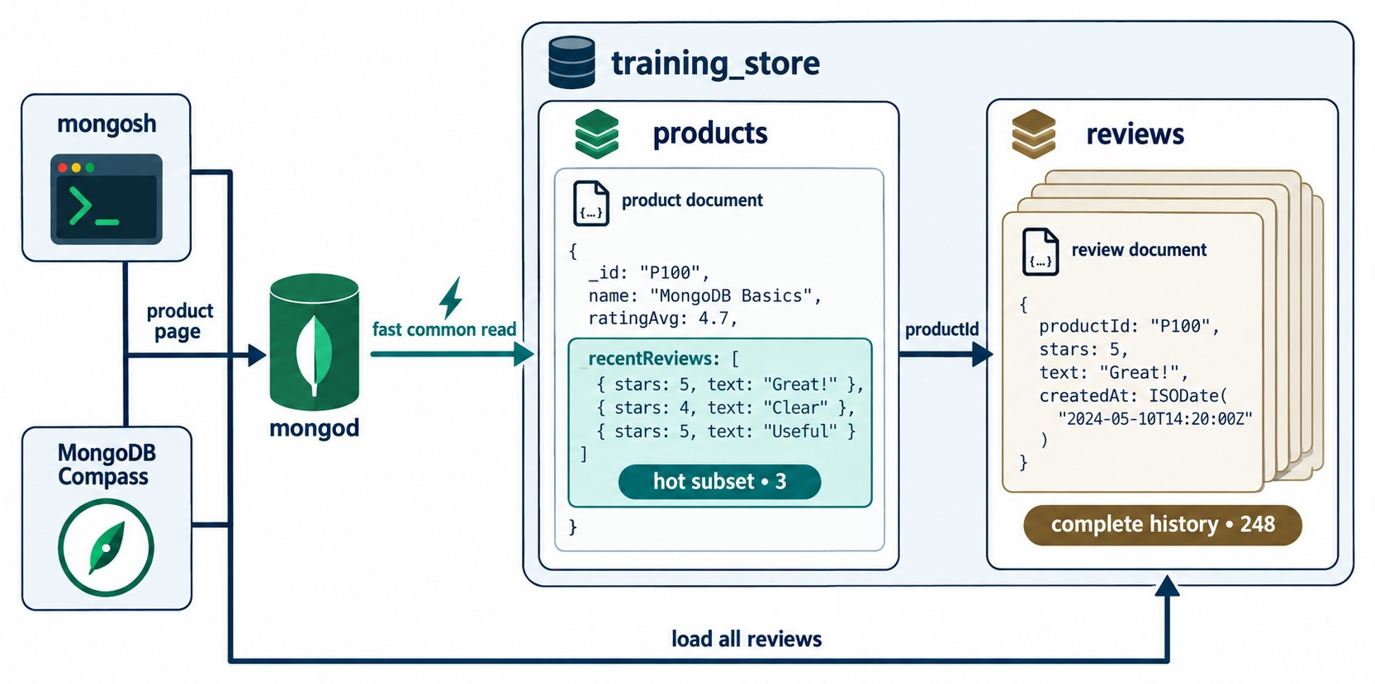
THE SUBSET PATTERN
Embed the hot few; keep the full history separate.
The problem
The product page needs three reviews, not all 248.
The pattern
Embed a small recentReviews array; keep every review in reviews.
Trade-off
A new review is written in two places.
TRAINING_STORE Not used yet — reviews live only in reviews.
KEY TAKEAWAY Subset keeps the common page to one read without embedding an unbounded array.
30
© 2026 by Innovation In Software Corporation
Notes:
KEY TALKING POINTS
------------------
- The problem
A product page shows a few recent reviews, but the product may have hundreds.
- The pattern
The Subset pattern embeds only the hot part, such as the three most recent reviews, and keeps the complete history in the reviews collection.
- Trade-off
The page loads in one read, but a new review is written in two places: the reviews collection and the product's small subset.
- What it shows
A product document with ratingAvg 4.7 and a recentReviews array of three, the hot subset.
The reviews collection holds the complete history of 248 reviews.
- How to read it
The product page uses the fast common read.
Load all reviews goes to the reviews collection by productId.
- Key point
Embed only the part the common page needs; reference the rest.

Slide 31
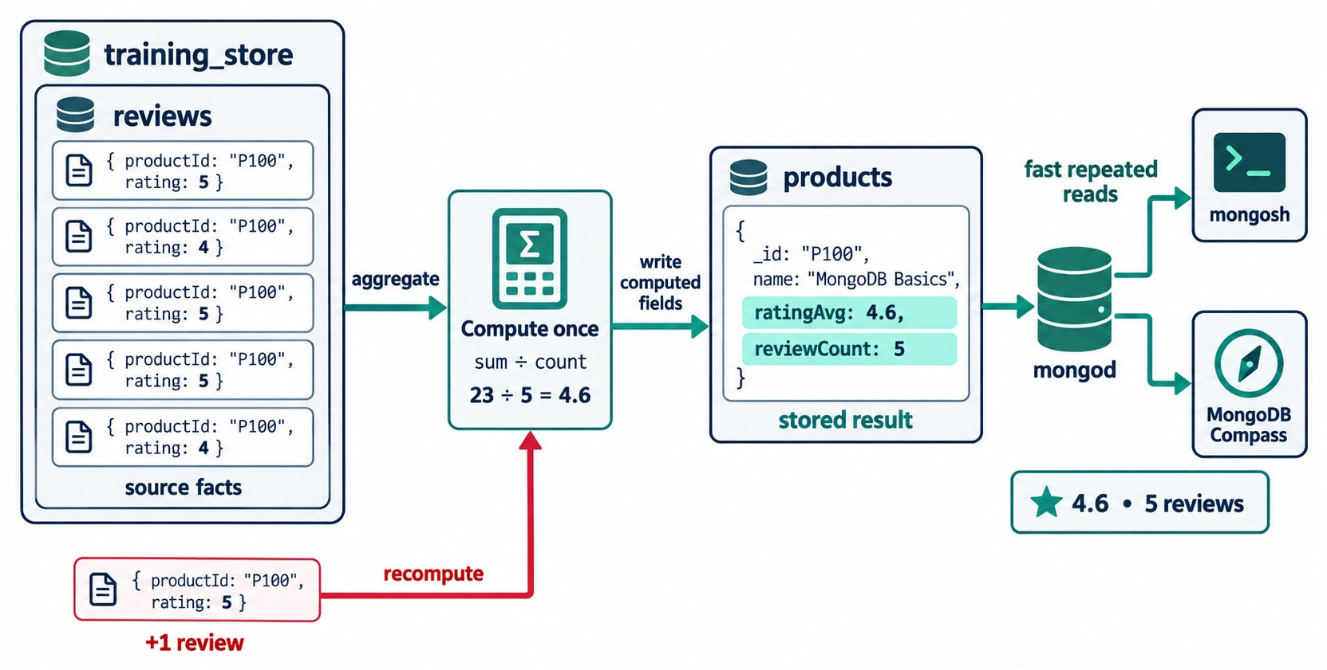
THE COMPUTED PATTERN
Calculate once, store the result, read it many times.
The problem
Averaging every review on every page view.
The pattern
Store ratingAvg and reviewCount on the product.
Trade-off
Recompute on each new review, or on a schedule.
MODULE 5 You'll compute averages with $group.
KEY TAKEAWAY Store a calculated value when it is read far more often than its inputs change.
31
© 2026 by Innovation In Software Corporation
Notes:
KEY TALKING POINTS
------------------
- The problem
Calculating the average rating from every review on every page view repeats the same work.
- The pattern
The Computed pattern calculates once and stores the result, such as ratingAvg and reviewCount on the product.
- Trade-off
Reads become fast, but the stored value must be recomputed when a review is added, either at write time or on a schedule.
- What it shows
Five review documents for product P100 are aggregated once: 23 ÷ 5 = 4.6.
The result is written to the product as ratingAvg 4.6 and reviewCount 5.
- How to read it
Green arrows are fast repeated reads.
The red arrow shows a new review triggering a recompute.
- Key point
Store a calculated value when it is read far more often than its inputs change.

Slide 32
PART 5: VALIDATE, EVOLVE AND BUILD
Enforce the model, plan for change, then build it.
✓ Part 1
Documents and types
✓ Part 2
Access patterns
✓ Part 3
Embed or reference
✓ Part 4
Patterns
Part 5
Validate and build
SO FAR
NEXT QUESTION
How do we enforce the model, change it safely — and build it in training_store?
✓
Avoid table-shaped collections and mixed types
✓
Seven patterns solve recurring problems
IN THIS PART
Every pattern is a trade-off
1
$jsonSchema validation
✓
2
Validation level and action
3
Evolving a schema
4
Querying nested fields and arrays
5
Joining references with $lookup
6
Indexes for the access patterns
32
© 2026 by Innovation In Software Corporation
Notes:
KEY TALKING POINTS
------------------
- Why this part
A flexible schema still needs guardrails.
We add validation, plan how the schema can change, and then build and query the model in the labs.
- Lab link
The slides in this part follow Steps 5 and 6 of Lab 2.
The full lab, labs/day-01/lab2/LAB-2-GUIDE.md, comes after the knowledge check and Exercises 3.1 to 3.9.

Slide 33
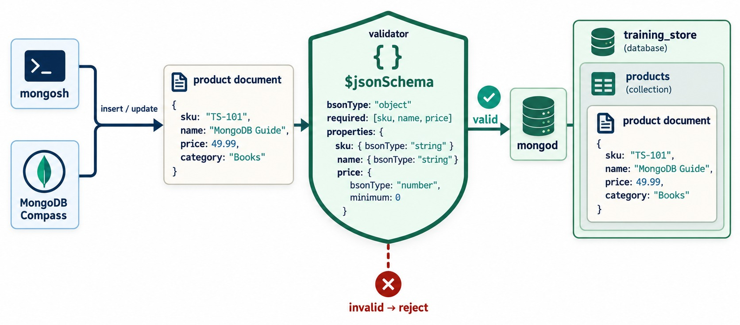
SCHEMA VALIDATION WITH $JSONSCHEMA
Flexible fields, enforced rules.
required
Fields every document must have.
bsonType
The type each field must hold: string, decimal, bool, date.
minimum
Range rules — price can't be negative.
LAB 2, STEP 6 Requires decimal for price — stricter than number.
KEY TAKEAWAY Validation lets the database reject documents that break the model's contract.
33
© 2026 by Innovation In Software Corporation
Notes:
KEY TALKING POINTS
------------------
- Flexible, not unplanned
MongoDB doesn't force one shape, but a collection can enforce rules with a validator.
The $jsonSchema operator is the usual way.
- The three building blocks
required lists the fields every document must have.
properties gives each field a bsonType.
Keywords such as minimum add range rules.
- When it runs
The validator checks inserts and updates.
A valid document is stored; an invalid one is rejected with an error that names the failing rule.
- What it shows
A product document passes through a $jsonSchema validator: bsonType object, required sku, name and price, with a type for each and price minimum 0.
- How to read it
Valid documents continue to mongod and the products collection; invalid ones are rejected.
- Diagram versus lab
The diagram uses bsonType number, which accepts any numeric type.
Lab 2, Step 6, is stricter: price must be decimal, the Decimal128 type.
- The Lab 2, Step 6 validator
Step 6 creates a separate validated_products collection that requires sku, name, category, price, active and createdAt.
price must be decimal with minimum 0, active must be bool and createdAt must be date.
Extra optional fields are still allowed.
- Why a separate collection
The main products collection keeps XBAD's string price for Module 4, so the lab tries validation on a new collection instead.

Slide 34
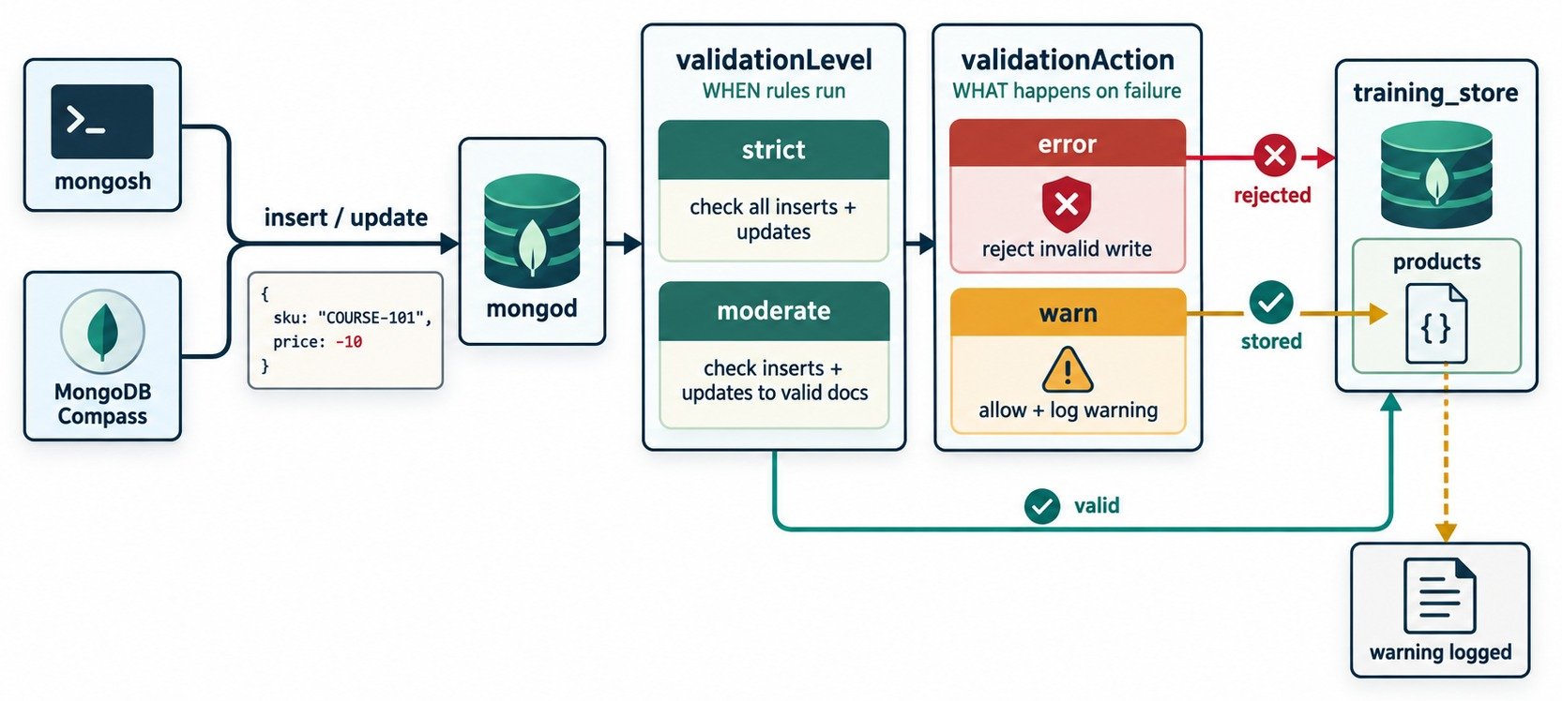
VALIDATION LEVEL AND ACTION
When rules run — and what a failure does.
validationLevel
strict checks every write; moderate skips already-invalid documents.
validationAction
error rejects the write; warn stores it and logs a warning.
Relax rules on old data
db.runCommand({
collMod: "validated_products",
validationLevel: "moderate",
validationAction: "warn" })
DEFAULT strict + error.
KEY TAKEAWAY Keep strict and error for new data; use moderate or warn only while old documents are fixed.
34
© 2026 by Innovation In Software Corporation
Notes:
KEY TALKING POINTS
------------------
- validationLevel
strict, the default, checks every insert and every update.
moderate checks inserts and updates to documents that are already valid, and leaves existing invalid documents alone.
- validationAction
error, the default, rejects an invalid write.
warn stores the write and records a warning in the log.
- When to relax
Use moderate and warn when you add rules to a collection that already holds old documents.
Fix the old data, then switch back to strict and error.
- What it shows
An insert with price -10 reaches mongod, which applies the validationLevel and then the validationAction.
- How to read it
validationLevel strict checks all inserts and updates; moderate checks inserts and updates to valid documents.
validationAction error rejects the write; warn stores it and logs a warning.
- Key point
Level decides when rules run; action decides what a failure does.

Slide 35
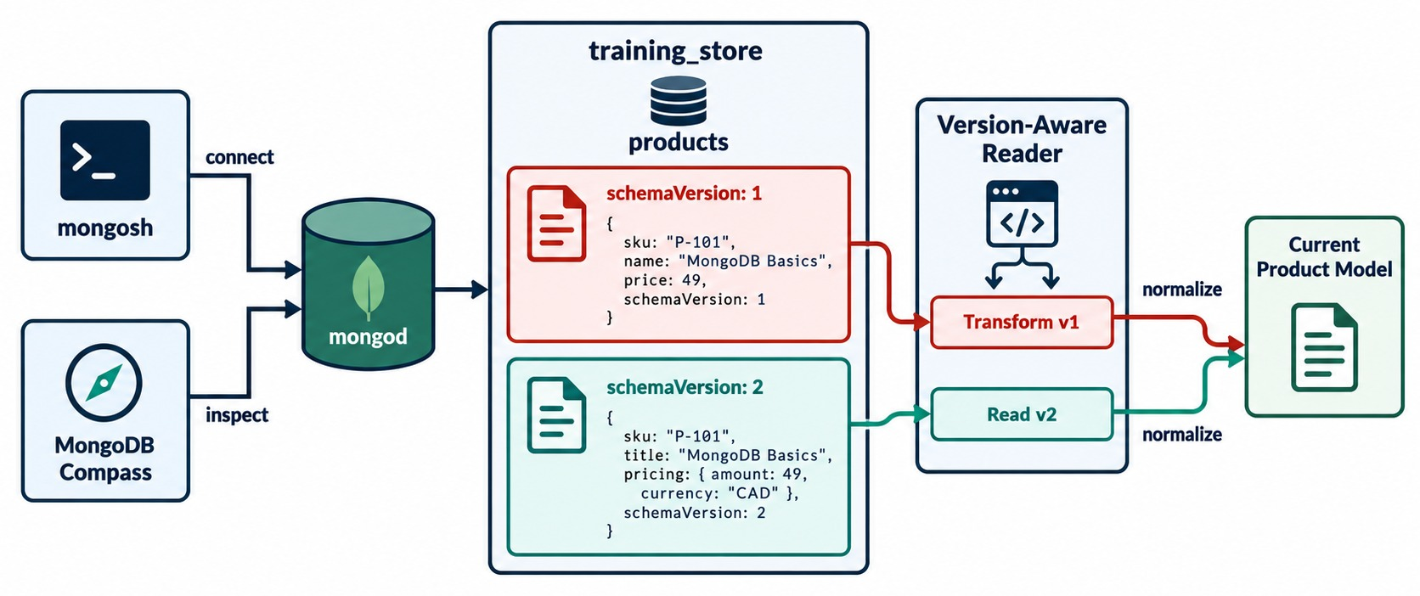
EVOLVING A SCHEMA SAFELY
Old and new shapes can coexist while you migrate.
Non-breaking first
Adding an optional field keeps old readers working.
Version the shape
schemaVersion tells the reader which shape it has.
Migrate in steps
Tolerant readers → new writes → backfill → require.
DEMO 3.6 v1 price becomes v2 pricing: { amount, currency }.
KEY TAKEAWAY Evolve a schema in steps — readers first, backfill later, validation last.
35
© 2026 by Innovation In Software Corporation
Notes:
KEY TALKING POINTS
------------------
- Schemas change
Requirements change, so document shapes change.
A new optional field is non-breaking.
Renaming or restructuring a field is breaking for old readers and writers.
- Version the shape
A schemaVersion field records which shape each document has.
The application reads both versions and normalizes them to one model.
- Migrate safely
Deploy readers that tolerate both shapes first.
Then write the new shape, backfill old documents in small batches, and only then tighten validation to require it.
- What it shows
The products collection holds schemaVersion 1 documents with name and price, and schemaVersion 2 documents with title and a pricing object of amount and currency.
- How to read it
A version-aware reader transforms v1, reads v2 and normalizes both into the current product model.
- Key point
Old and new documents can coexist while the migration runs.

Slide 36
QUERY NESTED FIELDS AND ARRAYS
Lab 2, Step 5: dot notation walks into documents and arrays.
Products
Customers and orders
db.products.find({ category: "LAPTOP" })
db.products.find(
{ "attributes.memoryGB": 16 })
db.products.find({ tags: "technology" })
db.customers.find(
{ "addresses.city": "Toronto" })
db.orders.find(
{ "items.sku": "L100" })
Hand-built core
After load.js
Arrays
L100 · L100 · B300 · C101 · O5001.
LAPTOP returns L100, L110, L190; items.sku finds four orders.
tags: "technology" matches any element of the array.
KEY TAKEAWAY Dot notation reaches into embedded documents and arrays of documents — always in quotes.
36
© 2026 by Innovation In Software Corporation
Notes:
KEY TALKING POINTS
------------------
- Products
category LAPTOP returns the laptop.
"attributes.memoryGB": 16 walks into the embedded attributes document and also returns L100.
tags: "technology" matches any element of the tags array, so it returns the book, B300.
- Customers and orders
"addresses.city": "Toronto" looks inside every element of the addresses array and returns Aisha Khan, C101.
"items.sku": "L100" returns every order with a laptop line.
- Two result sets
On the hand-built core from Lab 2, Steps 1-4, the results are L100, L100, B300, C101 and O5001.
After load.js, the LAPTOP query returns three products, L100, L110 and L190, and the items.sku query returns O5001, O6101, O6301 and O6401.
The other three queries return the same documents.
- Why the quotes
A dotted path is not a valid JavaScript identifier, so mongosh needs it as a quoted string.
Module 4 goes further with $elemMatch and array operators.

Slide 37
JOIN REFERENCED DATA WITH $LOOKUP
The cost of referencing: combining needs another query or a join.
Reviews for L100, with the product name
✓
Result (full load)
const l100 = db.products.findOne({ sku: "L100" })
db.reviews.aggregate([
{ $match: { productId: l100._id } },
{ $lookup: { from: "products",
localField: "productId",
foreignField: "_id", as: "product" } },
{ $unwind: "$product" },
{ $project: { _id: 0, rating: 1, title: 1,
productName: "$product.name" } }
])
[
{
rating: 5,
title: 'Excellent for travel',
productName: 'Business Laptop'
}
]
$lookup
Needs the full load
Shortcut
Joins each review to the product whose _id equals its productId.
The hand-built core has no reviews yet.
Reviews copy sku, so find({ sku: "L100" }) needs no join.
KEY TAKEAWAY Referenced data stays independent — combining it costs a $lookup or a second query.
37
© 2026 by Innovation In Software Corporation
Notes:
KEY TALKING POINTS
------------------
- Read the pipeline
The first line looks up the L100 product to get its _id.
$match keeps the reviews for that product.
$lookup adds a product array holding the matching product, $unwind turns that array into a single embedded document, and $project keeps rating, title and the product's name.
- The result
After load.js, L100 has one review: Aisha Khan's rating 5, titled Excellent for travel.
The product name comes from the products collection: Business Laptop.
- Dataset note
The content guide's version matches on a hard-coded mouseId and projects a comment field.
training_store reviews have no comment; their text is in title and body.
The hand-insert labs don't add reviews, so run this after load.js.
- The trade-off
This is the price of referencing.
training_store softens it by copying sku into each review, an extended reference, so the most common lookup needs no join.
Module 5 covers $lookup in depth.

Slide 38
INDEXES THAT FOLLOW THE ACCESS PATTERNS
Design them now — Module 6 creates and tests them.
✓
Already created by load.js
Planned from the access patterns
db.products.getIndexes()
// _id_, sku_unique
db.customers.getIndexes()
// _id_, customerNumber_unique,
// email_unique on contact.email
db.orders.getIndexes()
// _id_, orderNumber_unique
// browse by category and price
{ category: 1, price: 1 } // products
// a customer's order history
{ customerId: 1, createdAt: -1 } // orders
// a product's reviews, newest first
{ productId: 1, createdAt: -1 } // reviews
Unique keys
Pattern → index
Module 6
sku, customerNumber, orderNumber and email can't repeat.
Each planned index serves one row of the access table.
explain() will show each index being used.
KEY TAKEAWAY Every important access pattern should have an index to support it — plan them with the model.
38
© 2026 by Innovation In Software Corporation
Notes:
KEY TALKING POINTS
------------------
- What already exists
load.js creates four unique indexes: sku_unique on products, customerNumber_unique and email_unique on customers, and orderNumber_unique on orders.
Every collection also has the automatic _id index.
- What we plan
Browsing by category and price, a customer's order history newest first, and a product's reviews newest first each get a compound index.
We only design them here; Module 6 creates them and checks them with explain().
- Dataset note
The content guide indexes { email: 1 } and { customerId: 1, orderedAt: -1 }.
In training_store the email lives at contact.email and orders use createdAt, so the slide uses those field names.
- Don't re-run the unique ones
Creating the unique sku index again without its name would fail, because an index with the same key already exists under the name sku_unique.

Slide 39
EXERCISE: PREDICT THE NESTED QUERY RESULTS
Read each query and say what it returns — before you run it.
PRACTICE EXERCISE
10 MIN
SCENARIO
YOUR TASKS
EXPECTED OUTCOME
Run after load.js. Use the dataset facts: shoe sizes, accessory connections, customer countries and order items.
1
Predict each query's result
✓
sizes 11 → Trail Shoe (S210)
2
Name the embedded path it follows
USB-C → USB Hub, Docking Station
✓
db.products.find(
{ "attributes.sizes": 11 })
db.products.find(
{ "attributes.connection": "USB-C" })
db.customers.find(
{ "addresses.country": "USA" })
db.orders.countDocuments(
{ "items.sku": "A410" })
3
Say where an array is crossed
✓
USA → Luis (C204), Maya (C620)
4
Check on the instructor's screen
✓
A410 → 3 orders
✓
Arrays: sizes, addresses, items
KEY TAKEAWAY Dot notation follows the document's shape — arrays and embedded documents alike.
39
© 2026 by Innovation In Software Corporation
Notes:
KEY TALKING POINTS
------------------
- How to run it
Two minutes to write predictions, then run each query on the instructor screen after load.js.
- Shoe sizes
"attributes.sizes": 11 walks into attributes and then matches any element of the sizes array.
Only the Trail Shoe, S210, with sizes 8 to 11, has an 11.
- Connections and countries
Two accessories use USB-C: the USB Hub, A400, and the Docking Station, A500.
The keyboard and the mouse are Bluetooth.
Two customers ship to the USA: Luis Romero, C204, in Austin, and Maya Chen, C620, in San Francisco.
- Wireless Mouse orders
A410 appears in O5001, O6201 and O6305, so countDocuments returns 3.

Slide 40
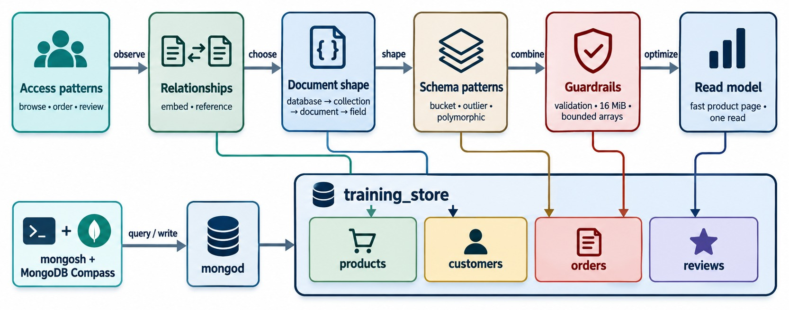
MODULE 3 AT A GLANCE
From access patterns to a read model, on one page.
KEY TAKEAWAY Model from the access patterns, embed what is bounded and owned, reference the rest — then enforce it.
40
© 2026 by Innovation In Software Corporation
Notes:
KEY TALKING POINTS
------------------
- Access patterns
Start from what the application does: browse, order, review.
- Relationships and shape
Embed bounded data that belongs to the parent; reference independent, shared or unbounded data.
- Patterns and guardrails
Schema patterns solve recurring problems.
Validation, the 16 MiB limit and bounded arrays keep the model healthy.
- The result
training_store: products, customers, orders and reviews, ready for Day 2.
- What it shows
Six boxes across the top: access patterns, relationships, document shape, schema patterns, guardrails and read model.
Each feeds the four training_store collections below.
- How to use it
Point to each box and ask the class for one training_store example before the knowledge check.
- Key point
Together these steps are the modeling method Module 4 now queries.

Slide 41
KNOWLEDGE CHECK
Answer in your own words — then compare with a partner.
What is the difference between a collection and a document?
Why are unbounded arrays dangerous?
1
6
What does BSON add to JSON?
What is the maximum size of one BSON document?
2
7
What three things does _id guarantee?
Why does an order copy the product price?
3
8
When is embedding appropriate?
What does schema validation enforce?
4
9
When is referencing appropriate?
Which pattern stores a calculated result?
5
10
41
© 2026 by Innovation In Software Corporation
Notes:
KEY TALKING POINTS
------------------
- 1. Collection and document
A document is one record of field-value pairs.
A collection is a group of related documents.
- 2. BSON
Binary JSON.
It adds types such as Date, Decimal128, ObjectId and Int32 that plain JSON doesn't have.
- 3. _id
It is unique within the collection, it always has an index, and it can't change after the insert.
- 4. Embedding
When the data is read with the parent, stays bounded and belongs to the parent — like addresses or order items.
- 5. Referencing
When the data is shared, changes independently or grows without limit — like orders per customer or reviews per product.
- 6. Unbounded arrays
The document keeps growing, updates get more expensive, and it can reach the size limit.
- 7. Size limit
16 MiB per BSON document.
- 8. Price on the order
To keep the price the customer actually paid.
It is a snapshot, so it must not follow later catalog changes.
- 9. Validation
Required fields, BSON types and value rules such as a minimum, checked on inserts and updates.
It doesn't design the model for you.
- 10. Calculated result
The Computed pattern.
For time-based measurements the answer would be Bucket, and for copied referenced fields, Extended reference.

Slide 42
EXERCISE 3.1 — IDENTIFY DOCUMENT COMPONENTS
Module 3 checkpoint A: label every part of a customer document.
OFFICIAL CHECKPOINT A
10 MIN
labs/day-01/exercises/exercise-3.1-identify-document-components.md
SCENARIO
YOUR TASKS
SOLUTION (AFTER DEBRIEF)
Pairs. Label the sample customer, then list candidate required fields.
1
Mark _id and say what it guarantees
✓
_id: unique in the collection
{ _id: ObjectId("..."),
customerNumber: "C101",
name: { first: "Aisha",
last: "Khan" },
email: "aisha@example.com",
tags: ["premium", "newsletter"],
active: true,
createdAt: ISODate("...") }
2
Mark the scalars and the embedded name
✓
Scalars: customerNumber, email
Label the array, Boolean and date
✓
name: embedded, first and last
3
4
List candidate required fields
✓
tags array · active · createdAt
✓
Required: _id, customerNumber, name, email, active, createdAt
KEY TAKEAWAY Naming each part of a document is the first step to designing one.
42
© 2026 by Innovation In Software Corporation
Notes:
KEY TALKING POINTS
------------------
- Official checkpoint
This is the official Exercise 3.1.
The worksheet is labs/day-01/exercises/exercise-3.1-identify-document-components.md; the answer key is labs/day-01/exercises/solution/exercise-3.1-identify-document-components.md.
No MongoDB is needed.
- Running it
Ten minutes in pairs.
Reveal the solution column after two pairs share their labels.
- Worksheet versus dataset
The worksheet's customer is a teaching sample.
The loaded C101 keeps email inside a contact object, has a status of ACTIVE instead of an active flag, and has no tags.
Both are valid designs; the labelling skill is the same.

Slide 43
EXERCISE 3.2 — DISCOVER APPLICATION ACCESS PATTERNS
Module 3 checkpoint B: turn requirements into access patterns.
OFFICIAL CHECKPOINT B
15 MIN
labs/day-01/exercises/exercise-3.2-discover-access-patterns.md
SCENARIO
YOUR TASKS
SOLUTION (AFTER DEBRIEF)
The store must support product search, product pages, customer profiles, order placement, order history, reviews and inventory display.
1
Name the three most frequent reads
✓
Product by SKU · order by number · profile
2
Write the data each returns together
Returned data is specific, not everything
✓
3
Fill four or more table rows
✓
Add order history and paginated reviews
4
Mark embed, reference or snapshot
Purchase-time price is a snapshot
✓
✓
At least one embed and one reference
KEY TAKEAWAY Access patterns turn vague requirements into concrete document shapes.
43
© 2026 by Innovation In Software Corporation
Notes:
KEY TALKING POINTS
------------------
- Official checkpoint
This is the official Exercise 3.2.
The worksheet is labs/day-01/exercises/exercise-3.2-discover-access-patterns.md; the answer key is labs/day-01/exercises/solution/exercise-3.2-discover-access-patterns.md.
- Table columns
Each row needs the access pattern, its frequency, the data returned together, and the modeling implication.
The worksheet starts two rows for them: find product by SKU and retrieve order.
- What to listen for
Returned together must be specific, such as items, totals, address and status, not just everything.
Compare their table with the training_store access-pattern slide from Part 2.

Slide 44
EXERCISE 3.3 — EMBED OR REFERENCE?
Module 3 checkpoint C: decide eight relationships and justify each.
OFFICIAL CHECKPOINT C
15 MIN
labs/day-01/exercises/exercise-3.3-embed-or-reference.md
SCENARIO
YOUR TASKS
SOLUTION (AFTER DEBRIEF)
Write Embed or Reference and a one-line reason: ownership, size or growth.
1
Decide relationships 1–4
✓
1 Embed · 2 Reference
2
Decide relationships 5–8
✓
3 Embed · 4 Reference
1 Primary contact information
2 Complete order history
3 Order line items
4 A product's millions of reviews
5 An employee's office address
6 Blog post tags
7 Purchase-time product price
8 Complete transaction history
3
Justify with bounded or unbounded
✓
5 Depends on reuse
Explain the one 'it depends'
✓
6 Embed · 7 Embed (snapshot)
4
✓
8 Reference
KEY TAKEAWAY Unbounded histories are referenced; owned, bounded data is embedded.
44
© 2026 by Innovation In Software Corporation
Notes:
KEY TALKING POINTS
------------------
- Official checkpoint
This is the official Exercise 3.3.
The worksheet is labs/day-01/exercises/exercise-3.3-embed-or-reference.md; the answer key is labs/day-01/exercises/solution/exercise-3.3-embed-or-reference.md.
- The answers
Contact information, line items and tags are embedded.
Order history, millions of reviews and a complete transaction history are referenced because they grow without limit.
The purchase-time price is embedded as a snapshot.
- The 'it depends'
An office address is embedded if each employee has their own, and referenced if many employees share the same office record that changes independently.

Slide 45
EXERCISE 3.4 — MODEL A PRODUCT CATALOG
Module 3 checkpoint D: three products, one consistent core.
OFFICIAL CHECKPOINT D
20 MIN
labs/day-01/exercises/exercise-3.4-model-a-product-catalog.md
SCENARIO
YOUR TASKS
SOLUTION (AFTER DEBRIEF)
Common fields: sku, name, description, category, price, active, creation date.
1
List core fields and BSON types
✓
sku string · price Decimal128
2
Decide: top level or attributes
active Boolean · createdAt Date
✓
Laptop processor, memory,
storage, screen size
Shoe size, color, material,
gender category
Book author, ISBN, publisher,
language
3
Write one laptop, shoe and book
✓
Type-specific data in attributes
4
Check names and types match
✓
Queryable by category and attributes.isbn
✓
No productPrice beside price
KEY TAKEAWAY A consistent core with nested attributes keeps a varied catalog queryable.
45
© 2026 by Innovation In Software Corporation
Notes:
KEY TALKING POINTS
------------------
- Official checkpoint
This is the official Exercise 3.4.
The worksheet is labs/day-01/exercises/exercise-3.4-model-a-product-catalog.md; the answer key is labs/day-01/exercises/solution/exercise-3.4-model-a-product-catalog.md.
MongoDB is optional; learners write documents in a scratch file.
- A model answer
training_store's L100, S200 and B300 are a good reference answer: the same core fields, with processor and memoryGB, sizes and material, or author and isbn under attributes.
The worksheet also asks for description, gender category and publisher, which training_store doesn't store.
- What to check
The same field names and types on all three, and no category-specific field required for every product.

Slide 46
EXERCISE 3.5 — MODEL AN ORDER DOCUMENT
Module 3 checkpoint E: one order aggregate, justified.
OFFICIAL CHECKPOINT E
20 MIN
labs/day-01/exercises/exercise-3.5-model-an-order-document.md
SCENARIO
YOUR TASKS
SOLUTION (AFTER DEBRIEF)
Find an order by number, show items and purchase-time prices, the shipping address used, payment and fulfillment status, and list a customer's orders.
1
Decide items, price, address, customer
✓
Items, prices, address: embedded
2
Mark the historical snapshots
✓
Customer: customerId reference
3
Write the order document
✓
Money as Decimal128
4
List the required fields
✓
One read by orderNumber
✓
Same shape as Lab 2, Step 4
KEY TAKEAWAY An order is a hybrid: reference the customer, embed the purchase facts.
46
© 2026 by Innovation In Software Corporation
Notes:
KEY TALKING POINTS
------------------
- Official checkpoint
This is the official Exercise 3.5.
The worksheet is labs/day-01/exercises/exercise-3.5-model-an-order-document.md; the answer key is labs/day-01/exercises/solution/exercise-3.5-model-an-order-document.md.
- Expected document
orderNumber, customerId, an items array with sku, name, quantity and unitPrice, a shippingAddress, paymentStatus and fulfillmentStatus, Decimal128 subtotal, tax and total, and createdAt.
- Justification
One read by order number returns everything the page shows.
A customer's orders are found by customerId.
Prices never silently follow the catalog.

Slide 47
EXERCISE 3.6 — FIND AND CORRECT SCHEMA ANTI-PATTERNS
Module 3 checkpoint F: fix a flawed product document.
OFFICIAL CHECKPOINT F
15 MIN
labs/day-01/exercises/exercise-3.6-correct-schema-anti-patterns.md
SCENARIO
YOUR TASKS
SOLUTION (AFTER DEBRIEF)
A teammate wrote this product document:
1
Name every problem you see
✓
String price, text Boolean
2
Fix the types
✓
Unbounded allReviews array
{
productId: "P1001",
price: "49.99",
isActive: "yes",
allReviews: [
// unlimited growth
],
created: "September 20, 2026"
}
3
Move the reviews out
✓
Display-text date
Choose an _id / sku convention
✓
Decimal128, true, a real Date
4
✓
Reviews in their own collection
KEY TAKEAWAY Most anti-patterns are wrong types or unbounded growth — both are easy to spot once you look.
47
© 2026 by Innovation In Software Corporation
Notes:
KEY TALKING POINTS
------------------
- Official checkpoint
This is the official Exercise 3.6.
The worksheet is labs/day-01/exercises/exercise-3.6-correct-schema-anti-patterns.md; the answer key is labs/day-01/exercises/solution/exercise-3.6-correct-schema-anti-patterns.md.
- The problems
The price is a string, the Boolean is the text yes, allReviews grows without limit, created is a display string rather than a date, and productId is used instead of a clear _id or sku convention.
- The corrected document
sku: "P1001" with an ObjectId _id, price: Decimal128("49.99"), active: true, createdAt as a real date, and no reviews array.
That is exactly the shape of training_store's Wireless Keyboard, P1001.

Slide 48
EXERCISE 3.7 — SELECT A SCHEMA DESIGN PATTERN
Module 3 checkpoint G: match seven requirements to patterns.
OFFICIAL CHECKPOINT G
15 MIN
labs/day-01/exercises/exercise-3.7-select-a-schema-pattern.md
SCENARIO
YOUR TASKS
SOLUTION (AFTER DEBRIEF)
Choose Attribute, Bucket, Subset, Computed, Extended reference, Outlier or Polymorphic.
1
Match requirements 1–4
✓
1 Bucket · 2 Subset
2
Match requirements 5–7
✓
3 Computed · 4 Attribute
1 Sensor readings grouped by hour
2 Latest three product reviews
3 Stored average rating
4 Dynamic product specifications
5 Customer name copied into order
6 Rare products, huge review volume
7 Many product types, one collection
3
Give one benefit and one cost
✓
5 Extended reference
Explain Bucket and Outlier
✓
6 Outlier · 7 Polymorphic
4
KEY TAKEAWAY Each pattern answers one recurring problem — name the problem first.
48
© 2026 by Innovation In Software Corporation
Notes:
KEY TALKING POINTS
------------------
- Official checkpoint
This is the official Exercise 3.7.
The worksheet is labs/day-01/exercises/exercise-3.7-select-a-schema-pattern.md; the answer key is labs/day-01/exercises/solution/exercise-3.7-select-a-schema-pattern.md.
- Bucket versus one document per event
Bucket stores an hour of readings in one document, so there are far fewer documents and index entries, at the cost of updating a growing bucket.
- Why Outlier exists
Most products have a few reviews.
Outlier keeps the normal design for them and adds overflow handling only for the rare product with a huge volume.

Slide 49
EXERCISE 3.8 — DESIGN COLLECTION VALIDATION
Module 3 checkpoint H: a $jsonSchema for products.
OFFICIAL CHECKPOINT H
15 MIN
labs/day-01/exercises/exercise-3.8-design-collection-validation.md
SCENARIO
YOUR TASKS
SOLUTION (AFTER DEBRIEF)
A valid product must contain these fields:
1
Write the required array
✓
Six required field names
2
Give each field a bsonType
✓
price: decimal, minimum 0
sku string
name string
category string
price decimal, not negative
active Boolean
createdAt date
3
Add minimum: 0 to price
✓
active: bool · createdAt: date
4
Wrap it in $jsonSchema
✓
bsonType: "object" at the top
✓
Extra fields still allowed
KEY TAKEAWAY A validator turns the model's contract into rules the database enforces.
49
© 2026 by Innovation In Software Corporation
Notes:
KEY TALKING POINTS
------------------
- Official checkpoint
This is the official Exercise 3.8.
The worksheet is labs/day-01/exercises/exercise-3.8-design-collection-validation.md; the answer key is labs/day-01/exercises/solution/exercise-3.8-design-collection-validation.md.
Learners may type the validator in a scratch file; running it comes in Lab 2, Step 6.
- Watch the type names
In $jsonSchema the BSON type names are decimal, bool and date, not Decimal128, Boolean and Date.
price must be decimal, not double or string.
- Level and action
Learners who know them can add validationLevel and validationAction; the defaults are strict and error.

Slide 50
EXERCISE 3.9 — DESIGN A SUPPORT-TICKET DATA MODEL
Module 3 checkpoint I: a complete design challenge.
OFFICIAL CHECKPOINT I
25 MIN
labs/day-01/exercises/exercise-3.9-support-ticket-challenge.md
SCENARIO
YOUR TASKS
SUGGESTED DIRECTION
Create tickets, assign agents, set status and priority, add comments and tags, show recent comments with the ticket, keep a complete audit history, and search by customer, agent, status and priority.
1
List access patterns and collections
✓
tickets, customers, agents, audit_events
2
Mark embedded, referenced, unbounded
✓
Embed: assignee, tags, recentComments
Draft one ticket with BSON types
✓
Full comments and audit: separate
3
4
List validation rules and indexes
✓
Indexes: customerId, agentId, status, priority
KEY TAKEAWAY The same method works for any application: patterns, relationships, growth, then rules.
50
© 2026 by Innovation In Software Corporation
Notes:
KEY TALKING POINTS
------------------
- Official checkpoint
This is the official Exercise 3.9, the practical challenge.
The worksheet is labs/day-01/exercises/exercise-3.9-support-ticket-challenge.md; the answer key is labs/day-01/exercises/solution/exercise-3.9-support-ticket-challenge.md.
Design only; don't create indexes.
- The ticket document
ticketNumber, customerId, an assignee summary, status, priority, tags, a bounded recentComments array and timestamps.
Validation requires those keys.
- What grows
The complete comment history and the audit trail grow without limit, so they live in their own collections, such as comments and audit_events.
Likely indexes are customerId, assignee.agentId, status and priority.

Slide 51
LAB 2 — CREATE AND POPULATE TRAINING_STORE
Day 1 hands-on: Steps 1–7 by hand, or the time-boxed load.js path.
OFFICIAL LAB
90 MIN
labs/day-01/lab2/LAB-2-GUIDE.md
SCENARIO
YOUR TASKS
EXPECTED COUNTS
Path A (50 min): the instructor loads the full dataset. Path B (90 min): type the core by hand.
1
Step 1 Create the four collections
✓
Path A: 13 · 6 · 17 · 6
2
Steps 2–3 Insert L100, S200, B300, C101
✓
Path B: 3 · 1 · 1 · 0
# Path A, in PowerShell
mongosh "mongodb://localhost:27017" `
.\datasets\training_store\load.js
✓
O5001 customerId = C101's _id
3
Step 4 Insert O5001 with references
✓
Invalid insert rejected
4
Step 5 Query nested fields and arrays
✓
XBAD's string price noted
5
Step 6 Validate · Step 7 Review
KEY TAKEAWAY By the end of Day 1, training_store exists with a model you can explain field by field.
51
© 2026 by Innovation In Software Corporation
Notes:
KEY TALKING POINTS
------------------
- Official lab
This is Day 1 Lab 2, labs/day-01/lab2/LAB-2-GUIDE.md.
The expected output of every step is in labs/day-01/lab2/solution/LAB-2-SOLUTION.md.
Path A takes about 50 minutes: load.js replaces Steps 1 to 4, then learners do Steps 5 to 7.
Path B, all seven steps by hand, takes about 90.
- Path A
Run load.js from the repository root in PowerShell, not inside mongosh.
The backtick ending the first line is PowerShell's line continuation, so both lines run as one command.
Counts are products 13, customers 6, orders 17 and reviews 6.
Then inspect L100, C101, O5001 and the L100 review.
- Path B
Step 1 creates the collections, Step 2 inserts L100, S200 and B300, Step 3 inserts C101, and Step 4 inserts O5001 using the customer's _id and the product's price.
Step 5 runs the nested queries, Step 6 creates validated_products and Step 7 reviews the model against a checklist.
- Counts in the order products, customers, orders, reviews
The hand-built core has 3 products, 1 customer, 1 order and no reviews.
Step 4's O5001 has only the laptop, total 1468.99; the load.js version also has two Wireless Mice, total 1514.17.
- Before Day 2
Whichever path was used, reload load.js at the start of Day 2 so Modules 4 and 5 have the full analytical data.

Slide 52
MODULE 3 SUMMARY AND WHAT'S NEXT
From document structure to a modeled, populated training_store.
YOU CAN NOW
NEXT: MODULE 4 — THE MONGODB QUERY LANGUAGE
Read a document's fields, nesting and _id
1
How do I filter, project and sort documents?
✓
Choose BSON types that match the meaning
2
How do I query arrays and embedded fields precisely?
✓
Turn requirements into access patterns
How do I update and delete documents safely?
✓
3
Embed or reference — and justify it
✓
Spot anti-patterns and pick a schema pattern
DAY 2 Reload training_store with load.js, and bring your Lab 2, Step 7 checklist.
✓
Validate, evolve and query the model
✓
KEY TAKEAWAY Day 1 ends with a designed database; Day 2 starts querying it.
52
© 2026 by Innovation In Software Corporation
Notes:
KEY TALKING POINTS
------------------
- Recap
We read documents field by field, chose BSON types, discovered access patterns, decided embed or reference with a snapshot where history matters, learned the anti-patterns and seven schema patterns, and added validation.
- End of Day 1
Day 1 took us from the NoSQL landscape, to a running MongoDB, to documents designed around access patterns.
training_store is ready for querying.
- Next module
Module 4 uses training_store to teach find and findOne, filters and operators, projection, array queries, sorting and counting, and safe inserts, updates and deletes.
- Before tomorrow
Reload load.js at the start of Day 2 and keep the same connection string.
Bring the Lab 2, Step 7 checklist and its one planned improvement.

