Slide 1
"Filters choose documents; projections choose fields."
MODULE 4
The MongoDB Query Language
Read, filter, shape, insert, update, upsert and delete training_store documents — and prove every write did what you meant.
Read and filter
Query operators
Nested fields and arrays
Insert, update, upsert
Delete and verify
MASTERING MONGODB • MODULE 4
Notes:
KEY TALKING POINTS
------------------
- What MQL is
The MongoDB Query Language, MQL, is how we read, filter, shape, insert, update and delete documents.
Its filters are themselves documents, shaped like the data they match.
- What this module does
Five parts: reading documents, query operators, nested fields and arrays, inserts and updates, and finally deletes, bulk writes and safe practice.
Everything runs on training_store.
- Where it sits
Module 4 opens Day 2, right after Module 3 designed the documents.
Module 5, aggregation, reuses today's filters and projections as pipeline stages.
REAL-WORLD EXAMPLES
-------------------
- An online store's product page is a findOne by SKU, its category page is a filtered, sorted and paged find, and checkout is a guarded update of stock.
This module covers all three.

Slide 2
LEARNING OBJECTIVES
What you will be able to do by the end of this module.
🎯
BY THE END OF THIS MODULE, YOU CAN
❓
SIX QUESTIONS THIS MODULE ANSWERS
1. Read documents with find() and findOne()
2. Shape results: project, sort, page, count
3. Combine comparison and logical operators
4. Query nested fields and arrays
5. Insert, update, upsert and replace
6. Delete safely and read write results
WHICH
documents does my filter match?
WHAT
fields should come back?
HOW
do operators combine?
WHEN
is $elemMatch required?
HOW
do I change only what I mean?
HOW
do I prove a write was right?
🗺️
MODULE ROADMAP
Filters
Shape results
Operators
Arrays
Insert, update
Upsert, replace
Delete, verify
KEY TAKEAWAY A good query starts from the real field names, values and BSON types in the documents.
2
© 2026 by Innovation In Software Corporation
Notes:
KEY TALKING POINTS
------------------
- By the end of this module
Walk through the six objectives on the left.
Learners should be able to read documents with find() and findOne(), shape results with projection, sort, paging and counts, combine operators, query nested fields and arrays, insert, update, upsert and replace documents, and delete safely while reading every write result.
- Six questions this module answers
Which documents does my filter match?
What fields should come back?
How do operators combine?
When is $elemMatch required?
How do I change only what I mean?
And how do I prove a write was right?
- Set the expectation
Precision is the skill: the right field name, the right case, the right BSON type.
The roadmap at the bottom shows the path through the module.

Slide 3
KEY TERMS FOR THIS MODULE
Plain definitions for the words we'll use most.
1
Query filter
2
Projection
A document that says which documents match, e.g. { category: "BOOK" }. {} matches every document.
The second find() argument: it chooses which fields come back, e.g. { name: 1, _id: 0 }.
3
Cursor
4
Dot notation
What find() returns: a pointer that hands back matching documents in batches, not all at once.
A quoted path into nested fields and arrays, such as "attributes.sizes" or "items.sku".
5
$elemMatch
6
Update operator
Requires one array element to meet every condition — not different elements for different conditions.
$set, $inc, $push and friends: change named fields in place instead of replacing the document.
7
Upsert
8
Write result
{ upsert: true }: update the match, or insert a new document when nothing matches the filter.
What every write returns: acknowledged, matchedCount, modifiedCount, insertedId, deletedCount.
KEY TAKEAWAY Agree on the words first — every later slide builds on them.
3
© 2026 by Innovation In Software Corporation
Notes:
KEY TALKING POINTS
------------------
- How to run this slide
Read each term once and give a quick example from the training_store sample database.
- Query filter
A document that says which documents match, e.g. { category: "BOOK" }.
{} matches every document.
- Projection
The second find() argument: it chooses which fields come back, e.g. { name: 1, _id: 0 }.
- Cursor
What find() returns: a pointer that hands back matching documents in batches, not all at once.
- Dot notation
A quoted path into nested fields and arrays, such as "attributes.sizes" or "items.sku".
- $elemMatch
Requires one array element to meet every condition — not different elements for different conditions.
- Update operator
$set, $inc, $push and friends: change named fields in place instead of replacing the document.
- Upsert
{ upsert: true }: update the match, or insert a new document when nothing matches the filter.
- Write result
What every write returns: acknowledged, matchedCount, modifiedCount, insertedId, deletedCount.

Slide 4
FULL FORMS USED IN THIS MODULE
Every abbreviation on these slides, spelled out.
BSON
Binary JSON
JSON
JavaScript Object Notation
USB
Universal Serial Bus
CRUD
Create, Read, Update, Delete
MQL
MongoDB Query Language
UTC
Coordinated Universal Time
ID
Identifier
SKU
Stock Keeping Unit
ISO
International Organization for Standardization (ISODate uses the ISO 8601 date format)
SQL
Structured Query Language
KEY TAKEAWAY When an abbreviation isn't clear, the full form is on this slide.
4
© 2026 by Innovation In Software Corporation
Notes:
KEY TALKING POINTS
------------------
- How to run this slide
Don't read every row.
Point out the few this module uses most, and say the full list is here for reference.
- Reference
BSON is Binary JSON; CRUD is Create, Read, Update, Delete; ID is Identifier; ISO is International Organization for Standardization (ISODate uses the ISO 8601 date format); JSON is JavaScript Object Notation; MQL is MongoDB Query Language; SKU is Stock Keeping Unit; SQL is Structured Query Language; USB is Universal Serial Bus; UTC is Coordinated Universal Time.

Slide 5
FROM MODULE 3 TO MODULE 4
Module 3 designed the documents. Now we read and change them.
MODULE 3 GAVE US
🧭
THE PATH THROUGH MODULE 4
Read: find, filters, projection, sort
✓
Documents shaped by access patterns
1
Part 1
✓
Items embedded, customers referenced
Comparison, logical and element operators
2
Part 2
✓
Decimal128 money, Date timestamps
Nested fields and arrays
✓
Four collections in training_store
3
Part 3
Insert, update, upsert and replace
4
Part 4
NOW Query and change that model with filters shaped like the documents.
Delete, bulk write and verify
5
Part 5
KEY TAKEAWAY The document design from Module 3 decides how every query in Module 4 is written.
5
© 2026 by Innovation In Software Corporation
Notes:
KEY TALKING POINTS
------------------
- Where we are
Module 4 opens Day 2.
On Day 1, Module 3 designed the training_store documents: products with category attributes, orders that embed their items and reference their customer, and reviews in their own collection.
- Why it matters now
Queries follow the document shape.
Because items are embedded, we query "items.sku" instead of joining.
Because prices are Decimal128, we compare with Decimal128 values.
- The path
Five parts: reading and shaping results, operators, nested fields and arrays, inserts and updates, and finally deletes, bulk writes and verification.
Day 2 Lab 3 practises all of it.
- Before class
Reload the dataset with mongosh and datasets/training_store/load.js so everyone sees the same counts.

Slide 6
THE TRAINING_STORE DATA WE QUERY
Counts, field names and the traps planted for this module.
🛒
FOUR COLLECTIONS ON A FRESH LOAD
PLANTED ON PURPOSE
customers
6 documents
products
13 documents
orders
17 documents
reviews
6 documents
!
XBAD: price is the string "49.99"
!
C204: phone is null; C515 has none
!
L190: inactive, tagged discontinued
🔑
FIELD NAMES TO QUERY — EXACTLY AS STORED
!
O5001: L100 × 1 and A410 × 2
!
No stock field on any product
products sku, name, category, price, tags, attributes, active
customers customerNumber, name.first, contact.email, addresses
orders orderNumber, customerId, items, paymentStatus,
fulfillmentStatus, total, createdAt
reviews sku, productId, customerId, rating, title, body
RELOAD Run load.js again before each lab so counts start fresh.
VALUES ARE UPPERCASE category "LAPTOP", status "ACTIVE", paymentStatus "PAID" — and there is no order field called status.
KEY TAKEAWAY Look at the real field names, values and types before writing a filter — MongoDB matches exactly what is stored.
6
© 2026 by Innovation In Software Corporation
Notes:
KEY TALKING POINTS
------------------
- The counts
On a fresh load: 6 customers, 13 products, 17 orders and 6 reviews.
13 orders are PAID.
These numbers come back in every exercise.
- Field names
Use the names exactly as stored: sku, category, price, tags, attributes; customerNumber and contact.email; orderNumber, items, paymentStatus and fulfillmentStatus.
Orders have no status field, and products have no stock field.
- Planted fixtures
The loader plants traps on purpose.
XBAD, Legacy Cable Pack, stores its price as a string.
C204's phone is null and C515 has no phone field.
L190 is inactive and tagged discontinued.
O5001 has L100 quantity 1 and A410 quantity 2 — the $elemMatch trap.
- About the guides
Some older examples say Electronics, ELEC-1001, stock or status Processing.
Those are generic; the lab guide and these slides use the real training_store fields.
- Demo 4.1
Run show collections and one findOne() per collection.
Ask the class to point at a nested object, an array and a Decimal128 before writing any filter.

Slide 7
PART 1: READING DOCUMENTS
find(), findOne() and the shape of a read query.
Part 1
Read documents
Part 2
Query operators
Part 3
Nested and arrays
Part 4
Insert and update
Part 5
Delete and verify
SO FAR
NEXT QUESTION
How do we ask for exactly the documents — and fields — we need?
✓
You know the module goals and key terms
✓
You know the fields and planted traps
IN THIS PART
1
Query filters
2
findOne() versus find()
3
Filter, projection, sort, limit
4
Projection rules
5
Sort, skip and limit for pages
6
Counting and distinct values
7
© 2026 by Innovation In Software Corporation
Notes:
KEY TALKING POINTS
------------------
- Where we start
Every operation in this module starts with a filter, so we begin with reading: which documents match, and what comes back.
- What this part answers
How filters work, when to use findOne() or find(), how to shape results with projection, sort, skip and limit, and how to count.

Slide 8
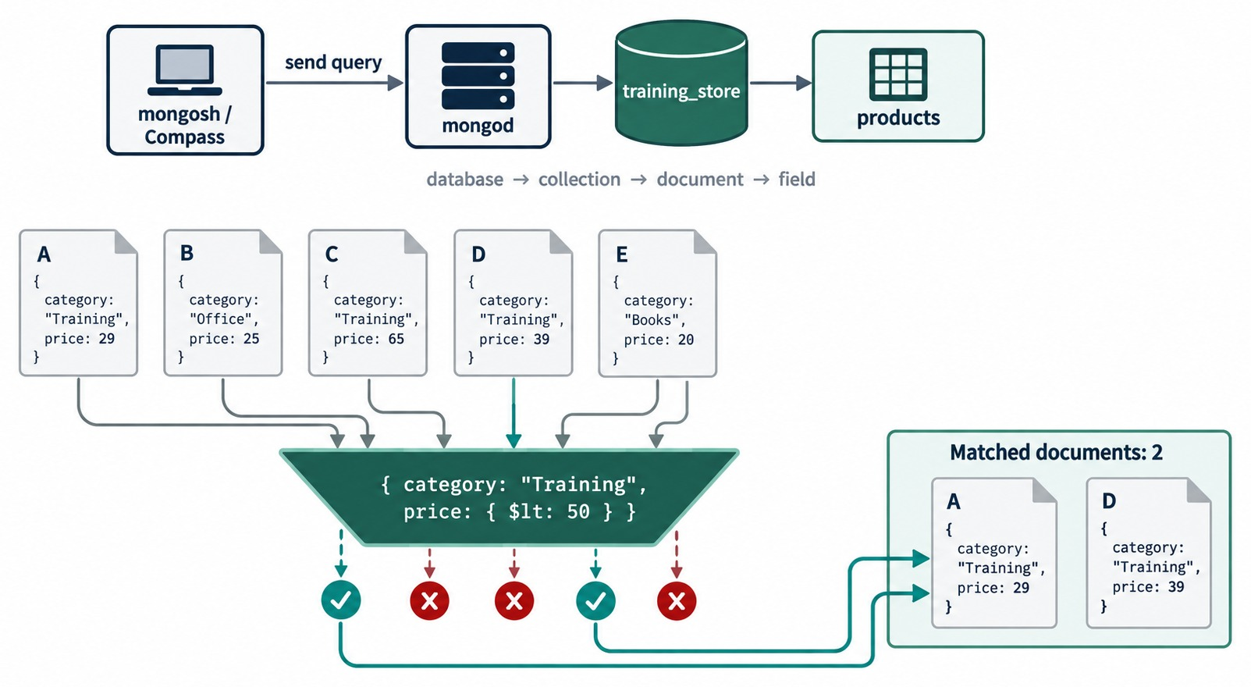
UNDERSTANDING QUERY FILTERS
The filter is a document; each document either matches or doesn't.
A document of conditions
{ field: value } pairs — every pair must be true.
Exact and case-sensitive
"LAPTOP" matches 3 products; "Laptop" matches none.
On training_store
db.products.find({
category: "BOOK",
price: { $lt:
Decimal128("50.00") }
})
// Query Cookbook (39.99)
KEY TAKEAWAY A filter is a document of conditions — a document matches only when every condition is true.
8
© 2026 by Innovation In Software Corporation
Notes:
KEY TALKING POINTS
------------------
- A filter is a document
Each field-value pair in the filter is a condition, and a document matches only when every condition is true.
That is an implicit AND.
- Exact and case-sensitive
Equality is exact.
category "LAPTOP" matches three products: L100, L110 and L190.
"Laptop" matches none, because the stored values are uppercase.
Field names are case-sensitive too.
- On training_store
BOOK with price below Decimal128 50.00 returns only Query Cookbook at 39.99.
MongoDB Fundamentals at 59.99 fails the price condition.
- Diagram data versus our data
The diagram uses simplified sample documents, not training_store.
Its categories, Training, Office and Books, are illustrations; ours are LAPTOP, SHOE, BOOK and ACCESSORY.
- What it shows
mongosh or Compass sends a query to mongod, which reads the products collection.
Five sample documents, A to E, pass through the filter { category: "Training", price: { $lt: 50 } }.
- How to read it
A green check means both conditions are true.
A (Training, 29) and D (Training, 39) match.
B is Office, C costs 65 and E is Books, so they get a red cross.
Matched documents: 2.
- Key point
Every condition in one filter document must be true for a document to match.

Slide 9
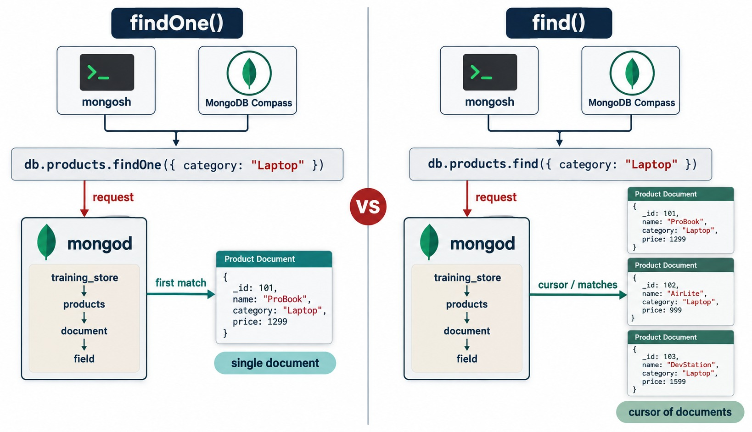
FINDONE() VS FIND()
One document or null — or a cursor over every match.
findOne()
Returns one document, or null when nothing matches.
find()
Returns a cursor; mongosh prints 20 at a time — type it for more.
By a unique field
db.products.findOne(
{ sku: "L100" })
// Business Laptop
TIP sku has a unique index, so one match is guaranteed.
KEY TAKEAWAY Use findOne() when you expect one document and find() when you expect a list.
9
© 2026 by Innovation In Software Corporation
Notes:
KEY TALKING POINTS
------------------
- findOne()
findOne() returns a single document, or null when nothing matches.
Use it with a unique field: findOne({ sku: "L100" }) returns the Business Laptop, and the sku_unique index guarantees there is only one.
- find()
find() returns a cursor, not an array.
mongosh prints the first 20 documents and you type it to see more.
An application driver fetches the rest in batches as it iterates.
- Look before you assume
findOne({ orderNumber: "O5001" }) does not return an embedded customer object.
In training_store, O5001 has a customerId reference, an embedded shippingAddress and an items array.
- Diagram data versus our data
The diagram uses simplified sample documents, not training_store.
It uses category "Laptop" and products such as ProBook; in training_store the value is "LAPTOP".
- What it shows
The same filter, { category: "Laptop" }, sent two ways.
findOne() returns the first match as a single document.
find() returns a cursor over all three matching documents.
- How to read it
Follow the arrows: request, then first match on the left, and cursor or matches on the right.
- Key point
Use findOne() for one document by a unique field; use find() when you expect a list.

Slide 10
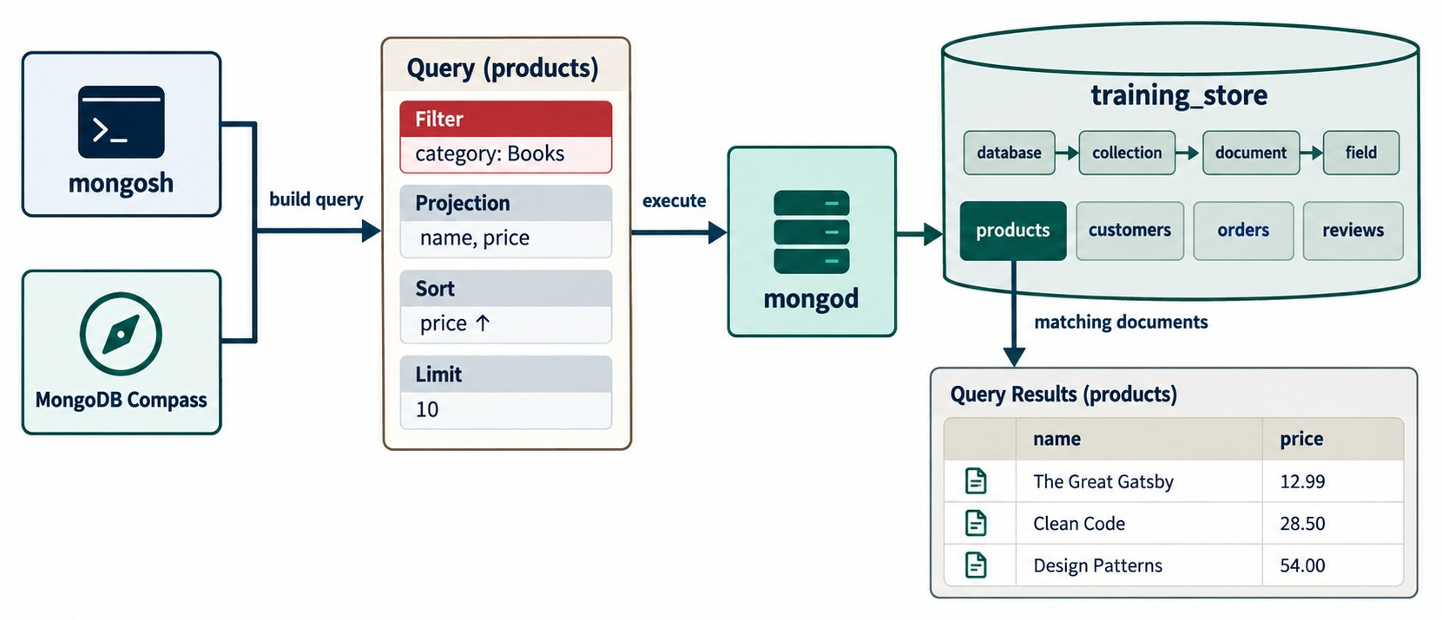
ANATOMY OF A READ QUERY
Filter, projection, sort and limit — the four questions of a read.
The same shape on training_store
db.products.find(
{ category: "BOOK" },
{ _id: 0, name: 1,
price: 1 }
).sort({ price: 1 })
.limit(10)
Result
Query Cookbook 39.99, then MongoDB Fundamentals 59.99.
Order of thought
Which documents, which fields, which order, how many?
KEY TAKEAWAY Build a read in four steps: filter the documents, project the fields, sort them, limit the count.
10
© 2026 by Innovation In Software Corporation
Notes:
KEY TALKING POINTS
------------------
- Four questions
Every read answers four questions: which documents, which fields, in which order, and how many.
Filter, projection, sort and limit.
- On training_store
find({ category: "BOOK" }, { _id: 0, name: 1, price: 1 }).sort({ price: 1 }).limit(10) returns Query Cookbook at 39.99, then MongoDB Fundamentals at 59.99.
There are only two books, so the limit is not reached.
- The order MongoDB applies
However you chain them, the server sorts first, then skips, then limits.
Writing limit before sort does not change the result.
- Diagram data versus our data
The diagram uses simplified sample documents, not training_store.
Its books, such as Clean Code, are not in our catalog.
- What it shows
A query on products built from four parts: filter category Books, projection name and price, sort price ascending, limit 10.
mongod runs it and returns a small table of names and prices.
- How to read it
Read the query card top to bottom.
Each part narrows or shapes what comes back from the products collection.
- Key point
Think in this order: which documents, which fields, which order, how many.
REAL-WORLD EXAMPLES
-------------------
- A category page on a shopping site is exactly this query: one category, the fields the card shows, sorted by price, twenty per page.

Slide 11
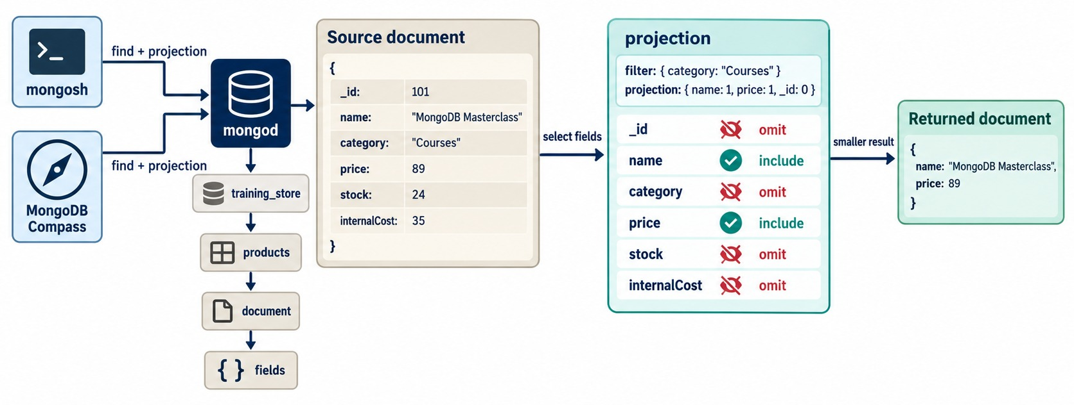
PROJECTION FUNDAMENTALS
The second argument of find() chooses the fields that come back.
Include
{ name: 1, price: 1 } — _id comes too unless you add _id: 0.
Exclude
{ attributes: 0, tags: 0 } — every other field comes back.
Don't mix
{ name: 1, tags: 0 } is an error; only _id may be mixed.
Nested paths work too
db.customers.find(
{ customerNumber: "C101" },
{ _id: 0, "name.first": 1 })
// { name: { first: "Aisha" } }
KEY TAKEAWAY Return only the fields the caller needs — projection shapes the result, never the stored document.
11
© 2026 by Innovation In Software Corporation
Notes:
KEY TALKING POINTS
------------------
- Inclusion
{ name: 1, price: 1 } returns name, price and _id.
_id is always included unless you add _id: 0.
- Exclusion
{ attributes: 0, tags: 0 } returns every other field.
Try it on L100.
- The mixing rule
{ name: 1, tags: 0 } is an error.
You choose inclusion or exclusion; _id is the only field that may be excluded in an inclusion projection.
- Nested paths
find({ customerNumber: "C101" }, { _id: 0, "name.first": 1 }) returns { name: { first: "Aisha" } }.
The nested shape is kept.
- Also available
items: { $elemMatch: { sku: "L100" } } in a projection returns only the matching line item, and $slice returns part of an array.
- Diagram data versus our data
The diagram uses simplified sample documents, not training_store.
Its Courses product with stock and internalCost is an illustration.
- What it shows
A source product with _id, name, category, price, stock and internalCost.
The filter { category: "Courses" } and the projection { name: 1, price: 1, _id: 0 } return only name and price.
- How to read it
The projection table marks name and price include and every other field, _id included, omit.
- Key point
Projection changes what comes back, never what is stored.

Slide 12
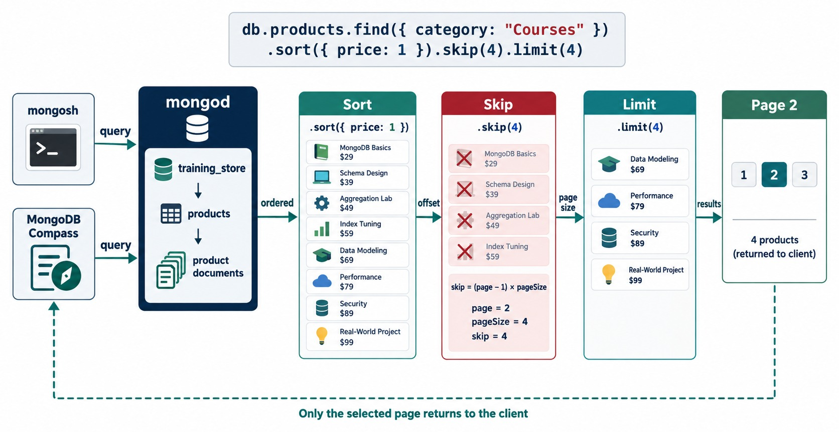
SORTING, SKIPPING AND LIMITING
sort() orders, skip() jumps, limit() caps — together they make a page.
sort()
1 ascending, -1 descending; add _id as a tie-breaker.
skip() and limit()
skip = (page − 1) × pageSize; limit = pageSize.
Page 2 of active products
db.products
.find({ active: true })
.sort({ price: 1, _id: 1 })
.skip(5).limit(5)
RESULT B300, S210, S200, A500, L100.
KEY TAKEAWAY Always sort before you page — without a stable order, pages can repeat or skip documents.
12
© 2026 by Innovation In Software Corporation
Notes:
KEY TALKING POINTS
------------------
- sort()
1 is ascending and -1 descending.
Several keys sort in order.
Add _id as a last key so documents with the same price always come back in the same order.
- Paging
skip is (page − 1) × pageSize and limit is the page size.
For page 2 of five active products sorted by price and _id, skip(5).limit(5) returns B300, S210, S200, A500 and L100.
- Mixed types
Page 3 returns L110 and then XBAD.
MongoDB sorts by BSON type first, and numbers come before strings, so XBAD's string price sorts after every Decimal128.
- At scale
skip() still walks past the skipped documents, so deep pages get slower.
A range filter on an indexed sort key scales better; Module 6 covers indexes.
- Diagram data versus our data
The diagram uses simplified sample documents, not training_store.
Its eight Courses products are illustrations.
- What it shows
Eight Courses products sorted by price, skip(4) removes the first four, limit(4) keeps the next four.
Page 2 of 3 returns four products.
- How to read it
The skip panel shows the formula: skip = (page − 1) × pageSize, so page 2 with a page size of 4 skips 4.
- Key point
Only the selected page travels back to the client.

Slide 13
COUNTING AND DISTINCT VALUES
How many documents match — and which values a field holds.
Count accurately
Estimate from metadata
Unique values
db.products
.countDocuments({})
// 13
db.products.countDocuments(
{ active: true })
// 12 — L190 is inactive
db.products
.estimatedDocumentCount()
// 13 — takes no filter
// legacy, avoid:
db.products.find().count()
db.products.distinct(
"category")
// [ "ACCESSORY", "BOOK",
// "LAPTOP", "SHOE" ]
db.products.distinct(
"attributes.connection",
{ category: "ACCESSORY" })
// [ "Bluetooth", "USB-C" ]
countDocuments()
estimatedDocumentCount()
distinct()
Exact count for a filter — your safety check.
Fast total from metadata, no filter.
Unique values; an optional filter narrows them.
KEY TAKEAWAY Count with countDocuments() before and after every change — it is the cheapest check you have.
13
© 2026 by Innovation In Software Corporation
Notes:
KEY TALKING POINTS
------------------
- countDocuments()
countDocuments({}) returns 13 and countDocuments({ active: true }) returns 12, because L190 is inactive.
It runs the filter, so the number is exact.
- estimatedDocumentCount()
Reads the collection's metadata, so it is fast but takes no filter.
It returns 13 here.
The older find().count() still appears in old examples; new code should use one of these two methods.
- distinct()
distinct("category") returns ACCESSORY, BOOK, LAPTOP and SHOE.
With a filter, distinct("attributes.connection", { category: "ACCESSORY" }) returns Bluetooth and USB-C.
On an array field, such as tags, each element counts as a separate value.
- Link to the labs
Lab 3 changes documents from step 8 on.
countDocuments({}) and countDocuments({ active: true }) — 13 and 12 on a fresh load — are the quickest way to prove the reload worked before you start.

Slide 14
EXERCISE: PREDICT THE SORTED RESULT
Read the query, write your answer, then run it.
PRACTICE EXERCISE
10 MIN
SCENARIO
YOUR TASKS
EXPECTED OUTCOME
The five accessories cost 19.99, 24.99, 49.99 and 249.99 — and XBAD, whose price is stored as the string "49.99".
1
Write the three SKUs you expect, in order
✓
XBAD first: strings sort after numbers
2
Say where XBAD lands, and why
✓
Then A500 (249.99) and P1001 (49.99)
db.products.find(
{ category: "ACCESSORY" },
{ _id: 0, sku: 1, price: 1 }
).sort({ price: -1 })
.limit(3)
3
Run it on the instructor's screen
✓
Add price: { $type: "decimal" }
4
Change the filter so only Decimal128 prices sort
Then A500, P1001, A400
✓
KEY TAKEAWAY Mixed BSON types sort by type first, then value — one bad document can top a price list.
14
© 2026 by Innovation In Software Corporation
Notes:
KEY TALKING POINTS
------------------
- How to run it
Two minutes to write a prediction, then run it on the instructor screen.
Most people predict A500 first.
- Why XBAD is first
MongoDB compares different BSON types in a fixed order, and numbers come before strings.
In a descending sort the string "49.99" therefore lands above every Decimal128 price.
- The rest of the answer
After XBAD come A500 at 249.99 and P1001 at 49.99.
The limit stops there, so A400 and A410 are not shown.
- The fix
Adding price: { $type: "decimal" } to the filter returns A500, P1001 and A400.
The real fix is to correct XBAD's price in the data.
The course leaves it as a string on purpose, so the same trap tops any descending price sort — L110 is only first once XBAD is filtered out.

Slide 15
PART 2: QUERY OPERATORS
Comparison, logical and element operators.
✓ Part 1
Read documents
Part 2
Query operators
Part 3
Nested and arrays
Part 4
Insert and update
Part 5
Delete and verify
SO FAR
NEXT QUESTION
How do we express ranges, lists, either-or and missing values?
✓
Filters are documents of conditions
✓
Projection, sort and limit shape the result
IN THIS PART
countDocuments() checks every step
1
Comparison operators and ranges
✓
2
$in and $nin
3
$and and $or
4
Building a filter step by step
5
$not and $nor
6
Missing, null and BSON type
7
Regular expressions and dates
15
© 2026 by Innovation In Software Corporation
Notes:
KEY TALKING POINTS
------------------
- Connecting the parts
Part 1 used equality and one $lt.
Part 2 adds the operators that real business questions need.
- Watch for
Two themes run through this part: the BSON type of the value you compare, and negative operators that also match missing fields.

Slide 16
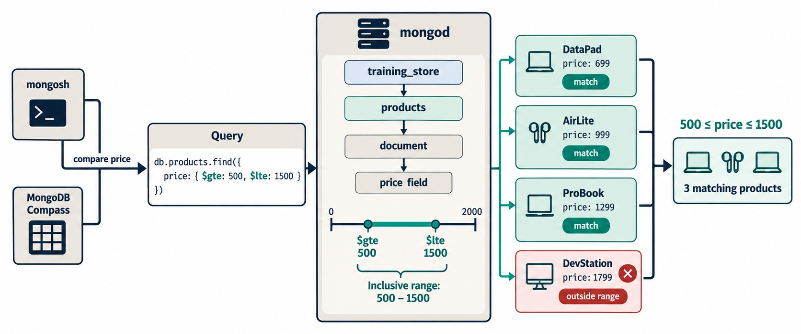
COMPARISON OPERATORS
$gt, $gte, $lt and $lte — inside the field they test.
Inside the field
{ price: { $gt: … } } — never { $gt: { price: … } }.
Money is Decimal128
Compare with Decimal128("100.00"); a string never matches a number.
A range
Two operators on one field; $gte and $lte include both ends.
ON TRAINING_STORE 50.00 to 500.00 returns L190, S200, S210, B300 and A500.
KEY TAKEAWAY Put comparison operators inside the field, and compare with the same BSON type that is stored.
16
© 2026 by Innovation In Software Corporation
Notes:
KEY TALKING POINTS
------------------
- Operator placement
Comparison operators sit inside the field they test: { price: { $gt: … } }.
{ $gt: { price: … } } is an error — one of the classic mistakes gathered near the end of the module.
- Decimal128
training_store stores money as Decimal128.
Compare with Decimal128("100.00") or NumberDecimal("100.00").
A string such as "100.00" never matches a number.
- A range
$gte 50.00 and $lte 500.00 on price returns L190 at 499.99, S200 at 129.99, S210 at 89.99, B300 at 59.99 and A500 at 249.99.
Both ends are inclusive.
- Dates compare too
The same operators work on Date fields such as createdAt, as a later slide shows.
- Diagram data versus our data
The diagram uses simplified sample documents, not training_store.
Its prices, such as DataPad at 699, are illustrations.
- What it shows
The query { price: { $gte: 500, $lte: 1500 } } on four sample products.
DataPad 699, AirLite 999 and ProBook 1299 match; DevStation 1799 is outside the range.
- How to read it
The number line shows an inclusive range from 500 to 1500.
Both ends count.
- Key point
Two operators on one field make a range.

Slide 17
COMPARISONS, $IN AND $NIN ON TRAINING_STORE
Real results — and the product that never shows up.
Above 100
Any value in a list
None of a list
db.products.find(
{ price: { $gt:
Decimal128("100.00") } },
{ _id: 0, sku: 1 })
// L100 L110 L190
// S200 A500
db.products.countDocuments({
category: { $in:
["LAPTOP", "BOOK"] } })
// 5
db.reviews.countDocuments(
{ rating: { $gte: 4 } })
// 5 of 6 reviews
db.products.find(
{ category: { $nin:
["LAPTOP", "SHOE"] } },
{ _id: 0, sku: 1 })
// B300 B310 P1001 A400
// A410 A500 XBAD
XBAD is missing above
$in
$nin and $ne
Its price is a string, so no numeric range sees it.
An OR on one field — shorter than $or.
Also match documents where the field is missing.
KEY TAKEAWAY Use $in and $nin for lists on one field — and remember that negative operators also match missing fields.
17
© 2026 by Innovation In Software Corporation
Notes:
KEY TALKING POINTS
------------------
- Above 100
Five products cost more than 100: L100, L110, L190, S200 and the Docking Station A500.
Exercise 4.1, step 1, expects all five — A500 at 249.99 is the one people forget.
- XBAD
Legacy Cable Pack stores price as the string "49.99".
Numeric comparisons only match values of a comparable type, so XBAD never appears in a Decimal128 range.
- $in
category $in LAPTOP and BOOK counts 5: three laptops and two books.
It is an OR on one field.
The five reviews rated 4 or 5 match $gte: 4; the 3-star P1001 review does not.
- $nin
Leaving out laptops and shoes keeps seven products: two books and five accessories, including XBAD.
$nin and $ne also match documents that do not have the field at all.
Add $exists: true when the field must be present.

Slide 18
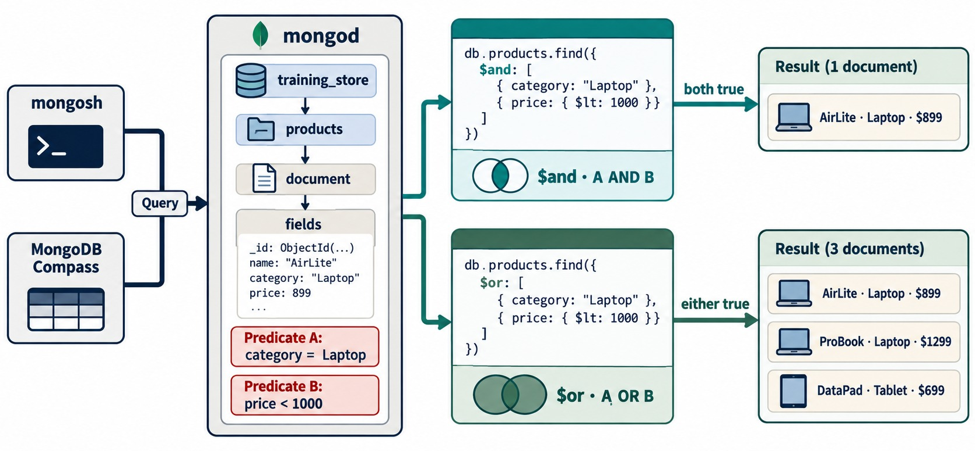
LOGICAL OPERATORS: $AND AND $OR
Both conditions true — or at least one.
AND
Commas mean AND; write $and only when a field or operator repeats.
$or
Any condition true. Same field? Use $in instead.
Two different fields: $or
db.orders.find({ $or: [
{ paymentStatus: "PENDING" },
{ fulfillmentStatus:
"PROCESSING" } ] })
// O5001 O6202 O6302 O6401 O6499
KEY TAKEAWAY Write AND with commas, OR with $or across fields, and $in when the alternatives share one field.
18
© 2026 by Innovation In Software Corporation
Notes:
KEY TALKING POINTS
------------------
- Implicit AND
Commas already mean AND: { active: true, category: "BOOK" }.
Most filters need nothing more.
- Explicit $and
Use $and when the same field or operator must appear twice, for example two separate $or clauses.
For a simple range, one field with $gte and $lte is shorter.
- $or on training_store
PENDING payment or PROCESSING fulfilment returns five orders: O5001, O6202, O6302, O6401 and O6499.
O6401 matches both conditions and appears once.
- Don't miss two orders
O6202 and O6302 are PAID but still PROCESSING, so the $or includes them alongside O5001, O6401 and O6499.
Active laptops or books returns L100, L110, B300 and B310.
When the alternatives share one field, $in is shorter than $or.
- Diagram data versus our data
The diagram uses simplified sample documents, not training_store.
Its AirLite, ProBook and DataPad products are illustrations.
- What it shows
Two queries with the same predicates: A is category Laptop, B is price below 1000.
$and returns 1 document, AirLite.
$or returns 3: AirLite, ProBook and DataPad.
- How to read it
The Venn symbols show the difference: the overlap for $and, both circles for $or.
- Key point
$or widens a result; $and narrows it.

Slide 19
BUILD A FILTER ONE CONDITION AT A TIME
Demo 4.2 on products: add one condition, count, and explain the number.
FILTER SO FAR
COUNT · WHO IS LEFT
Why one at a time
{}
13
Every product
When the result is wrong, you know which condition caused it.
{ category: "ACCESSORY" }
5
P1001, A400, A410, A500, XBAD
Count after each step
db.products.countDocuments({
category: "ACCESSORY" }) // 5
{ category: "ACCESSORY",
active: true }
5
All five accessories are active
Two drops explained
A500 costs 249.99. XBAD's price is the string "49.99", so a Decimal128 range skips it.
{ category: "ACCESSORY",
active: true,
price: { $lte:
Decimal128("100.00") } }
P1001, A400, A410
3
SURPRISED? Check the field name, case and BSON type first.
KEY TAKEAWAY Grow a filter one condition at a time and count after each step — every drop should have a reason.
19
© 2026 by Innovation In Software Corporation
Notes:
KEY TALKING POINTS
------------------
- Demo 4.2
Start with an empty filter and add one condition at a time.
Run countDocuments() after each step and explain the number before moving on.
- The counts
{} counts 13.
category ACCESSORY leaves 5: P1001, A400, A410, A500 and XBAD.
Adding active: true keeps all 5, because every accessory is active.
Adding price $lte Decimal128 100.00 leaves 3: P1001, A400 and A410.
- The two drops
A500, the Docking Station, costs 249.99, so the price rule removes it.
XBAD is removed for a different reason: its price is the string "49.99", and a Decimal128 comparison never matches a string.
- Why it matters
If one step drops to zero or drops the wrong documents, you know exactly which condition to check.
Usually it's a field name, a case or a type.

Slide 20
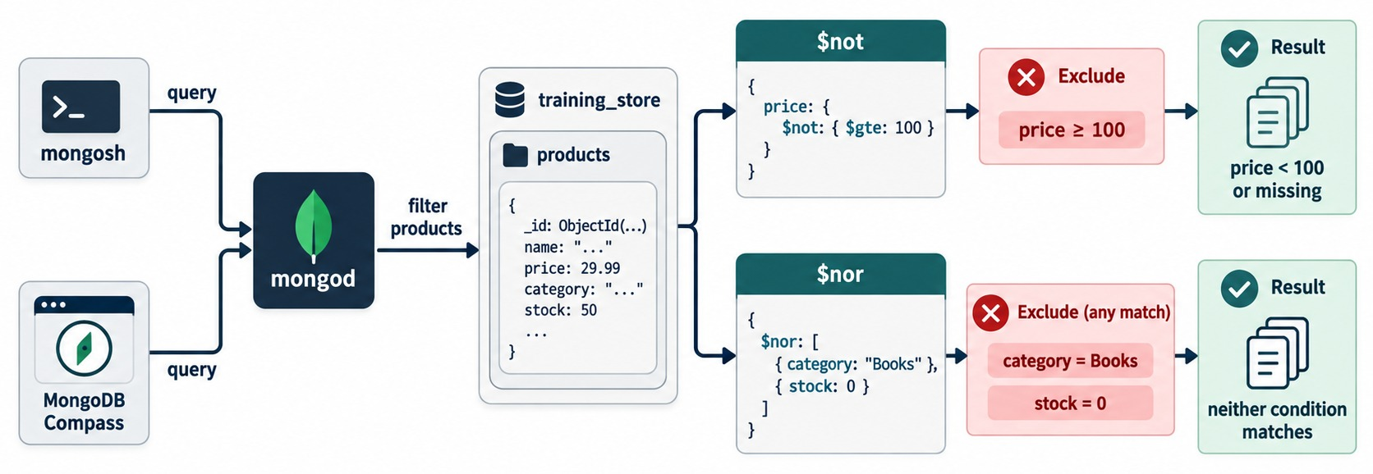
THE $NOT AND $NOR OPERATORS
Negate one expression — or reject every listed condition.
$not
Wraps an operator: { price: { $not: { $gt: … } } }. Missing or non-numeric prices pass too.
$nor
Keeps documents that fail every listed condition.
Prefer $ne
For a simple not-equal, $ne reads better than $not.
ON TRAINING_STORE $nor: [{ category: "BOOK" }, { active: false }] keeps 10 of 13 products.
KEY TAKEAWAY Negations over-match easily: $not, $nor, $ne and $nin all keep documents where the field is missing.
20
© 2026 by Innovation In Software Corporation
Notes:
KEY TALKING POINTS
------------------
- $not
$not wraps another operator expression for one field.
{ price: { $not: { $gt: Decimal128("100.00") } } } returns 8 products: the seven priced at 100 or less, plus XBAD, whose string price cannot be greater than a number.
- $nor
$nor keeps documents that fail every listed condition.
$nor: [{ category: "BOOK" }, { active: false }] removes the two books and L190, leaving 10 of 13.
- Missing fields
Negations also keep documents without the field.
Add $exists: true when the field must be present.
- Prefer $ne
For a simple not-equal, { category: { $ne: "BOOK" } } is clearer than $not.
- Diagram data versus our data
The diagram uses simplified sample documents, not training_store.
Its Books category and stock field are illustrations; our products have no stock field.
- What it shows
$not wraps { $gte: 100 } on price, so documents with price below 100 or no price at all remain.
$nor lists category Books and stock 0, and keeps only documents that match neither.
- How to read it
The red boxes show what each operator excludes; the green boxes show what remains.
- Key point
Negation also keeps documents where the field is missing.

Slide 21
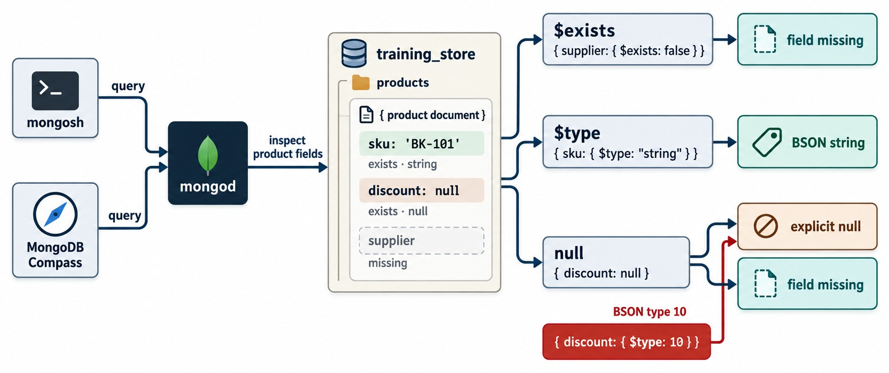
FIELD EXISTENCE, BSON TYPE AND NULL
Missing, explicit null and the wrong type are three different questions.
{ field: null }
Explicit null or missing: C204 and C515.
$type: "null"
Explicit null only: C204's phone.
$exists: false
Missing only: C515 has no phone field.
Find the planted type error
db.products.find(
{ price: { $type:
"string" } },
{ _id: 0, sku: 1 })
// { sku: "XBAD" }
KEY TAKEAWAY Ask exactly what you mean: $exists for presence, $type for the BSON type, null for null-or-missing.
21
© 2026 by Innovation In Software Corporation
Notes:
KEY TALKING POINTS
------------------
- Null or missing
{ "contact.phone": null } matches C204, whose phone is null, and C515, who has no phone field at all.
- Only explicit null
{ "contact.phone": { $type: "null" } } matches C204 only.
- Only missing
{ "contact.phone": { $exists: false } } matches C515 only.
Every other customer has a string phone.
- Wrong type
{ price: { $type: "string" } } finds XBAD, the planted type error.
$type: "decimal" matches the other 12 products.
- Diagram data versus our data
The diagram uses simplified sample documents, not training_store.
Its BK-101 product with a discount and a supplier is an illustration.
- What it shows
One product with sku as a string, discount set to null and no supplier field.
$exists: false finds the missing field, $type: "string" checks the type, and { discount: null } matches both explicit null and a missing field.
- How to read it
Follow the two arrows out of the null box.
The red box, $type: 10, is BSON type 10, null, and matches explicit null only.
- Key point
Ask exactly the question you mean: present, null, or of a given type.

Slide 22
REGULAR EXPRESSIONS AND DATE RANGES
Match text by pattern; match time with a start and an end.
Pattern match on a string
✓
Half-open date range
db.products.find(
{ name: { $regex: "^MongoDB" } },
{ _id: 0, name: 1 })
// MongoDB Fundamentals
db.products.countDocuments({
name: { $regex: "wireless",
$options: "i" } })
// 2 — Keyboard and Mouse
db.orders.find(
{ createdAt: {
$gte: ISODate("2026-09-19T00:00:00Z"),
$lt: ISODate("2026-09-20T00:00:00Z")
} },
{ _id: 0, orderNumber: 1 })
// O6402, O6499: every order
// placed on 19 September (UTC)
^ anchors
The i option
Half-open range
Starts with: precise, and can use an index.
Case-insensitive; unanchored patterns scan every value.
$gte the start, $lt the next day: no time-of-day gaps.
KEY TAKEAWAY Anchor regular expressions when you can, and query dates from an inclusive start to an exclusive end.
22
© 2026 by Innovation In Software Corporation
Notes:
KEY TALKING POINTS
------------------
- Anchored pattern
^MongoDB means the name starts with MongoDB.
Only MongoDB Fundamentals, B300, matches.
An anchored, case-sensitive prefix can use an index on the field.
- Case-insensitive search
"wireless" with the i option matches Wireless Keyboard and Wireless Mouse.
It looks anywhere in every name, so on a large collection it can be expensive.
Module 6 covers index design.
- Half-open date range
createdAt holds a Date with a time.
Start inclusive at midnight on 19 September and end exclusive at midnight on 20 September.
That returns O6402 at 09:15 and O6499 at 19:00.
- The common mistake
Writing $lte: ISODate("2026-09-19") as the end means midnight at the start of the day, so both orders would be missed.
The guide's date example uses an orderedAt field; training_store's field is createdAt.

Slide 23
EXERCISE: TURN A BUSINESS QUESTION INTO A FILTER
From a merchandising request to a working query.
PRACTICE EXERCISE
10 MIN
SCENARIO
YOUR TASKS
EXPECTED OUTCOME
Merchandising asks: which active products are on clearance or premium? They want the SKU and name only.
1
Choose the fields and operators
✓
active: true plus tags: { $in: [ … ] }
2
Write the filter and the projection
{ _id: 0, sku: 1, name: 1 }
✓
db.products.find(
{ /* your filter */ },
{ /* your projection */ }
)
L110, S290 and A500
3
Predict the SKUs before you run it
✓
Explain why L190 is not in the result
✓
L190 is clearance but inactive
4
KEY TAKEAWAY Translate each phrase of the request into one condition — then check the result against the data.
23
© 2026 by Innovation In Software Corporation
Notes:
KEY TALKING POINTS
------------------
- How to run it
Pairs, five minutes.
Ask one pair to type their query on the instructor screen.
- The answer
db.products.find({ active: true, tags: { $in: ["clearance", "premium"] } }, { _id: 0, sku: 1, name: 1 }).
An $or with two tag conditions is also correct; $in is shorter because both alternatives use the same field.
- The result
L110 Ultrabook and A500 Docking Station are premium; S290 Clearance Shoe is clearance.
This is Day 2 Lab 3, step 2.
- L190
The Refurbished Laptop is tagged clearance, but active is false, so the implicit AND removes it.
That is exactly what the business asked for.

Slide 24
PART 3: NESTED FIELDS AND ARRAYS
Query inside embedded documents and arrays.
✓ Part 1
Read documents
✓ Part 2
Query operators
Part 3
Nested and arrays
Part 4
Insert and update
Part 5
Delete and verify
SO FAR
NEXT QUESTION
How do we reach inside embedded documents and arrays — and match the right element?
✓
Comparison and logical operators
✓
Missing, null and type are different
IN THIS PART
✓
Negations also match missing fields
Dot notation for embedded fields
1
2
Contains, exact match, $all and $size
3
$elemMatch on arrays of documents
4
Practice: choose the array query
24
© 2026 by Innovation In Software Corporation
Notes:
KEY TALKING POINTS
------------------
- Why this part
Module 3 embedded attributes, addresses and order items.
Those are the fields business questions ask about most.
- What to watch
The O5001 order is built to show the difference between dot notation on an array and $elemMatch.
That difference is the most common array bug in real code.

Slide 25
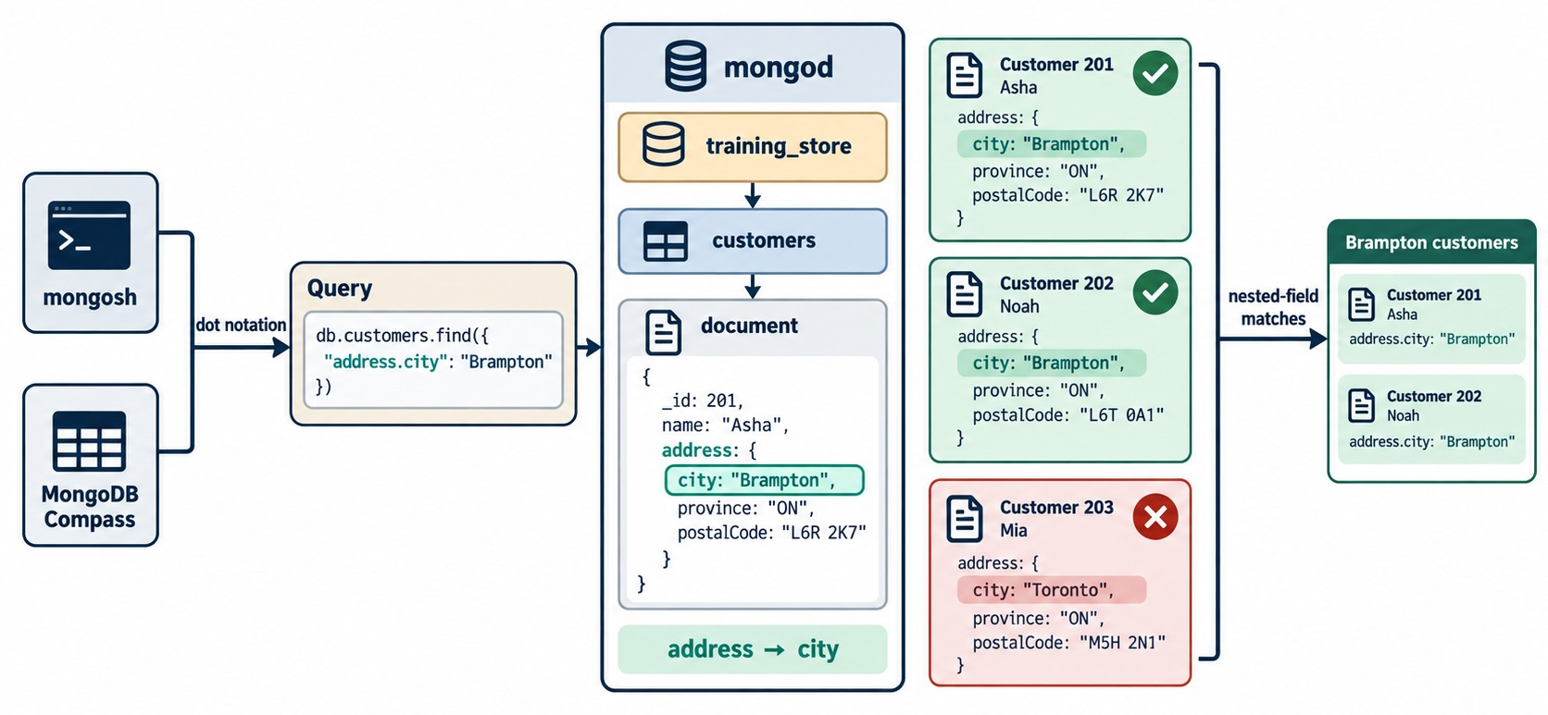
QUERYING NESTED FIELDS
Dot notation reaches inside embedded documents.
Quote the path
"attributes.memoryGB" — unquoted dots are a syntax error.
Through arrays too
"addresses.city" looks at every address in the array.
On training_store
db.customers.find(
{ "addresses.city": { $in:
["Toronto", "Montreal"] } },
{ _id: 0, customerNumber: 1 })
// C101, C412
KEY TAKEAWAY Dot notation reaches into embedded documents and arrays — quote the path and match the stored value exactly.
25
© 2026 by Innovation In Software Corporation
Notes:
KEY TALKING POINTS
------------------
- Quote the path
Dot notation must be quoted in mongosh: "attributes.memoryGB".
Without quotes it is a JavaScript syntax error, one of the classic query bugs.
- Embedded documents
{ "attributes.memoryGB": { $gte: 16 } } returns L100 with 16 GB and L110 with 32 GB.
L190 has 8 GB.
- Arrays of documents
customers keep addresses as an array.
"addresses.city" checks every address in the array.
$in Toronto and Montreal returns C101, Aisha Khan, and C412, Jordan Lee.
- Diagram data versus our data
The diagram uses simplified sample documents, not training_store.
It stores one address object; ours is an addresses array, and nobody in training_store lives in Brampton.
- What it shows
db.customers.find({ "address.city": "Brampton" }).
Customers 201 and 202 live in Brampton and match; customer 203 lives in Toronto and doesn't.
- How to read it
The highlighted city line in each customer is the field the dotted path reads: address, then city.
- Key point
Quote the dotted path and match the nested value exactly.

Slide 26
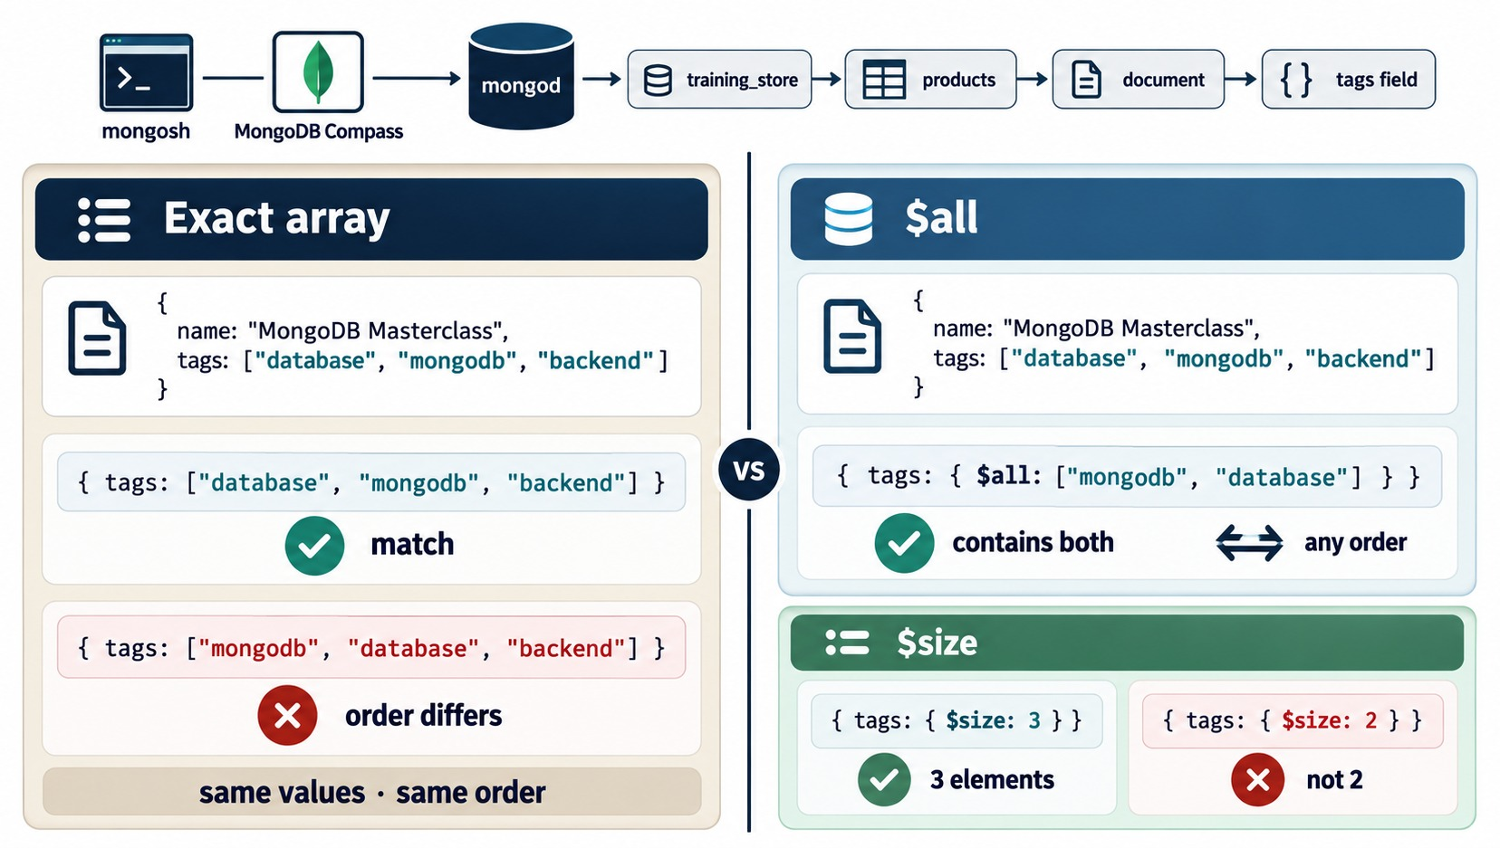
EXACT ARRAY MATCH VS $ALL VS $SIZE
Contains a value, equals the array, contains all, or has N elements.
Contains
{ tags: "wireless" } — any element: P1001, A410.
Exact array
["database", "technology"] → B300; reversed order finds nothing.
$all
All listed values, any order: ["office", "premium"] → A500.
$size
Exact length only: $size: 3 → L190. No "at least".
KEY TAKEAWAY Match one element by value and several with $all; use exact arrays or $size only when order or length matters.
26
© 2026 by Innovation In Software Corporation
Notes:
KEY TALKING POINTS
------------------
- Contains
{ tags: "wireless" } matches any document whose tags array contains that value: P1001 and A410.
- Exact array
{ tags: ["database", "technology"] } matches B300.
The same two values in the other order match nothing.
- $all
{ tags: { $all: ["office", "premium"] } } returns A500 in any order.
$all with database and technology returns B300.
- $size
$size matches an exact length.
$size: 3 returns L190; $size: 2 returns 11 of the 13 products.
There is no "at least" form.
- Diagram data versus our data
The diagram uses simplified sample documents, not training_store.
Its MongoDB Masterclass product and tags are illustrations.
- What it shows
One product with tags database, mongodb, backend.
The exact array matches; the same values in a different order don't.
$all with mongodb and database matches in any order.
$size: 3 matches; $size: 2 doesn't.
- How to read it
Left panel: exact array.
Right panels: $all at the top, $size below.
- Key point
Exact array match is rarely what you want; $all usually is.

Slide 27
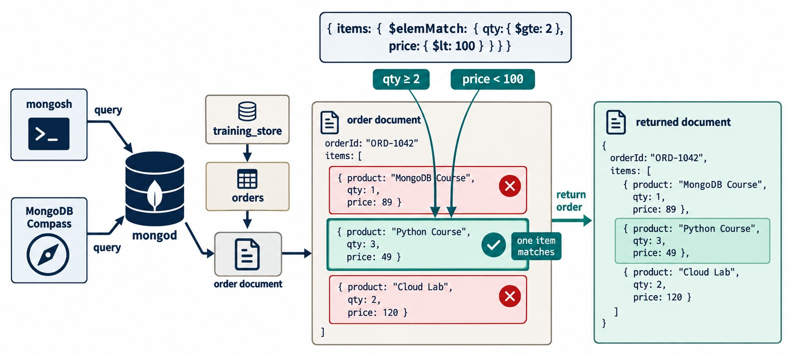
QUERYING ARRAYS OF DOCUMENTS WITH $ELEMMATCH
Every condition must be met by the same array element.
Without $elemMatch
"items.sku" and "items.quantity" can be met by different items.
The O5001 trap
L100 × 1 plus A410 × 2 — dot notation matches it; $elemMatch doesn't.
Same item, both conditions
db.orders.find({ items: {
$elemMatch: {
sku: "L100",
quantity: { $gte: 2 }
} } })
// only O6401 (L100 × 2)
KEY TAKEAWAY When several conditions must hold for the same array element, wrap them in $elemMatch.
27
© 2026 by Innovation In Software Corporation
Notes:
KEY TALKING POINTS
------------------
- The trap
With dot notation, "items.sku": "L100" and "items.quantity": { $gte: 2 } can be satisfied by different items.
O5001 has L100 quantity 1 and A410 quantity 2, so it matches.
- The fix
$elemMatch requires one element to pass both conditions.
It returns only O6401, Luis Romero's order for two laptops.
- Lab 3, step 6
$elemMatch with quantity $gte 2 and unitPrice below 50 returns O5001, O6201 and O6305.
O6302 and O6401 have quantity 2, but of expensive items, so they don't match.
- Diagram data versus our data
The diagram uses simplified sample documents, not training_store.
Its orderId, product and qty fields are illustrations; ours are orderNumber, sku and quantity.
- What it shows
An order with three items and the filter items: { $elemMatch: { qty: { $gte: 2 }, price: { $lt: 100 } } }.
Only the Python Course item, qty 3 at 49, meets both conditions, so the whole order is returned.
- How to read it
MongoDB Course fails qty and Cloud Lab fails price.
One item that passes both is enough to return the order.
- Key point
The filter selects the order; the returned document still has every item.
USE-CASE SCENARIO
-----------------
A support agent searches for orders where a customer bought at least two laptops.
Without $elemMatch the search also returns O5001, one laptop and two mice, and the agent contacts the wrong customer.

Slide 28
EXERCISE: CHOOSE THE RIGHT ARRAY QUERY
Four requests, four different array tools.
PRACTICE EXERCISE
10 MIN
SCENARIO
YOUR TASKS
EXPECTED OUTCOME
The store team sends four requests. Pick containment, dot notation, $all or $elemMatch for each.
1
Choose the operator for each request
✓
A "attributes.sizes": 9 → S200, S210, S290
2
Write each filter
✓
B items $elemMatch → O6401
A Shoes available in size 9
B Orders with L100 × 2 or more
C Customers in Toronto or Montreal
D Products tagged office AND premium
C "addresses.city" $in → C101, C412
3
Predict the matching documents
✓
4
Say which one dot notation gets wrong
✓
D tags $all → A500
✓
B: dot notation adds O5001
KEY TAKEAWAY Choose the array tool from the question: one value, all values, a nested path, or one element meeting several conditions.
28
© 2026 by Innovation In Software Corporation
Notes:
KEY TALKING POINTS
------------------
- How to run it
Individually for five minutes, then compare in pairs.
Run the four answers on the instructor screen.
- A and C
Containment through a dotted path: { "attributes.sizes": 9 } returns the three shoes.
{ "addresses.city": { $in: ["Toronto", "Montreal"] } } returns Aisha Khan, C101, and Jordan Lee, C412.
- B
{ items: { $elemMatch: { sku: "L100", quantity: { $gte: 2 } } } } returns only O6401, Luis Romero's order for two laptops.
The dot-notation version also returns O5001.
- D
{ tags: { $all: ["office", "premium"] } } returns only A500, the Docking Station.
{ tags: ["office", "premium"] } would be an exact array match and depends on order.

Slide 29
PART 4: INSERTS, UPDATES, UPSERTS AND REPLACE
Change documents — and only the fields you mean.
✓ Part 1
Read documents
✓ Part 2
Query operators
✓ Part 3
Nested and arrays
Part 4
Insert and update
Part 5
Delete and verify
SO FAR
NEXT QUESTION
How do we add and change documents without losing data we meant to keep?
✓
Filters find exactly the right documents
✓
Dot notation and $elemMatch reach inside
IN THIS PART
✓
Every read can be counted first
1
insertOne() and insertMany()
2
updateOne() and updateMany()
3
$set, $unset, $inc and $rename
4
Array updates and positional $
5
replaceOne() versus $set
6
Upserts with $setOnInsert
7
Reading write results
29
© 2026 by Innovation In Software Corporation
Notes:
KEY TALKING POINTS
------------------
- The link
Every update and delete starts with a filter.
Everything from Parts 1 to 3 now decides which documents a write touches.
- Test data
Use the SKUs the labs reserve: DEMO-1, DEMO-REP, DEMO-BULK and TEMP-100 for demos; A600 to A900 are created by the labs.
Never replace or delete L100.

Slide 30
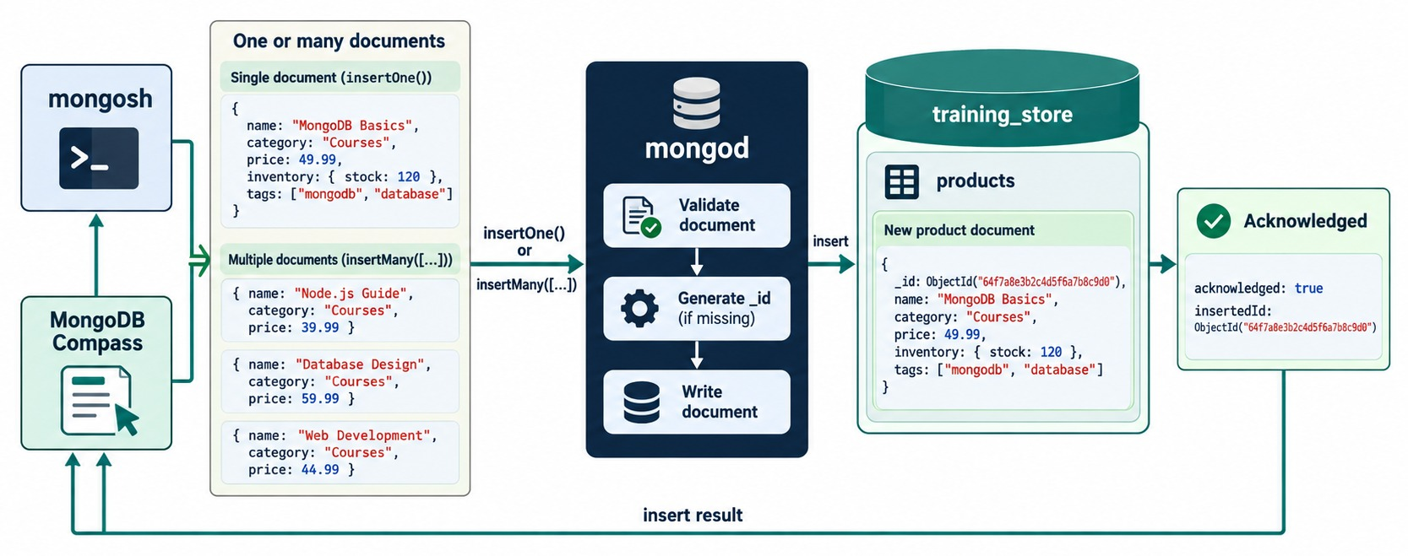
INSERTING DOCUMENTS
insertOne() or insertMany(); mongod adds _id when it is missing.
Demo 4.5
db.products.insertOne({
sku: "DEMO-1", name: "Demo Cable",
category: "ACCESSORY",
price: Decimal128("9.99"),
active: true })
// acknowledged: true,
// insertedId: ObjectId(…)
insertMany()
Returns insertedIds, one per document.
Unique sku
A second DEMO-1 fails with E11000 duplicate key.
VERIFY findOne({ sku: "DEMO-1" }), then delete it.
KEY TAKEAWAY Insert with real BSON types — Decimal128 for money, Date for time — and read the document back to verify.
30
© 2026 by Innovation In Software Corporation
Notes:
KEY TALKING POINTS
------------------
- insertOne()
Demo 4.5 inserts DEMO-1 and returns acknowledged: true and an insertedId.
mongod adds an ObjectId _id because the document has none.
- insertMany()
Takes an array and returns insertedIds, one ObjectId per document, keyed "0", "1" and so on.
Practise with free test SKUs such as A610, A611 and A612, which load.js does not create.
- Unique index
sku has the sku_unique index, so inserting an existing SKU fails with an E11000 duplicate key error.
If an exercise hits it, the SKU is left from an earlier run: reload the dataset.
- Types and verification
Write money as Decimal128 and times as Date.
Then read the document back with findOne({ sku: "DEMO-1" }) and delete the demo document afterwards.
- Diagram data versus our data
The diagram uses simplified sample documents, not training_store.
Its Courses products are illustrations.
- What it shows
One document, or an array of documents, goes to mongod, which validates it, generates _id if missing and writes it into products.
The client receives acknowledged: true and the insertedId.
- How to read it
Follow the arrows left to right, then the insert result back to the client.
- Key point
Check the acknowledgement and the new _id — then read the document back.

Slide 31
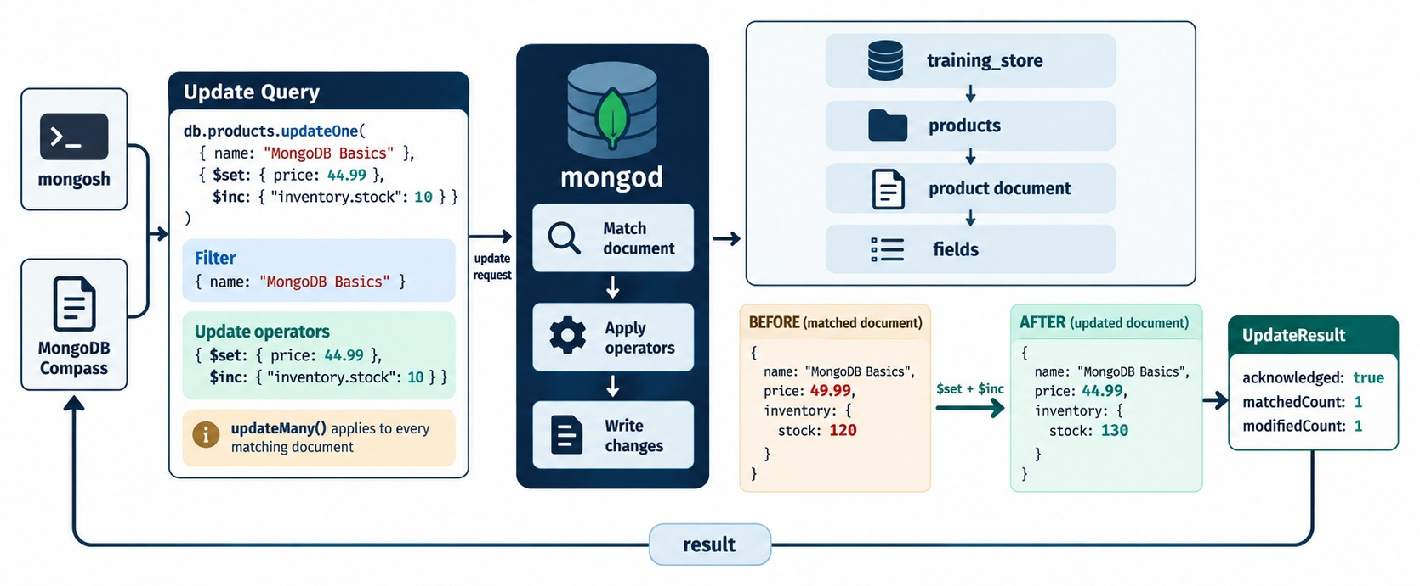
UPDATING DOCUMENTS
A filter, update operators and a write result.
Three parts
updateOne(filter, update, options): the filter picks, the operators change.
One or many
updateMany() changes every match — preview it with find() first.
Already true?
db.products.updateOne(
{ sku: "L100" },
{ $set: { active: true } })
// matchedCount: 1,
// modifiedCount: 0
WHY 0 L100 is already active: found, nothing to change.
KEY TAKEAWAY An update is a filter plus operators — the result says what was found and what actually changed.
31
© 2026 by Innovation In Software Corporation
Notes:
KEY TALKING POINTS
------------------
- Three parts
updateOne(filter, update, options).
The filter picks the document, the update operators say what changes, and options add things like upsert.
- updateOne() and updateMany()
updateOne() changes the first match; updateMany() changes every match.
Always preview an updateMany() filter with find() and countDocuments() first.
- Matched but not modified
L100 is already active, so $set active: true returns matchedCount 1 and modifiedCount 0.
The document was found, and it already had that value.
- Diagram data versus our data
The diagram uses simplified sample documents, not training_store.
Its MongoDB Basics product and inventory.stock field are illustrations.
- What it shows
db.products.updateOne() with filter { name: "MongoDB Basics" }, $set price 44.99 and $inc inventory.stock 10.
Before, the price is 49.99 and stock 120; after, 44.99 and 130.
matchedCount 1, modifiedCount 1.
- How to read it
mongod matches the document, applies the operators, then writes the change.
- Key point
The yellow note matters: updateMany() applies the same change to every match.

Slide 32
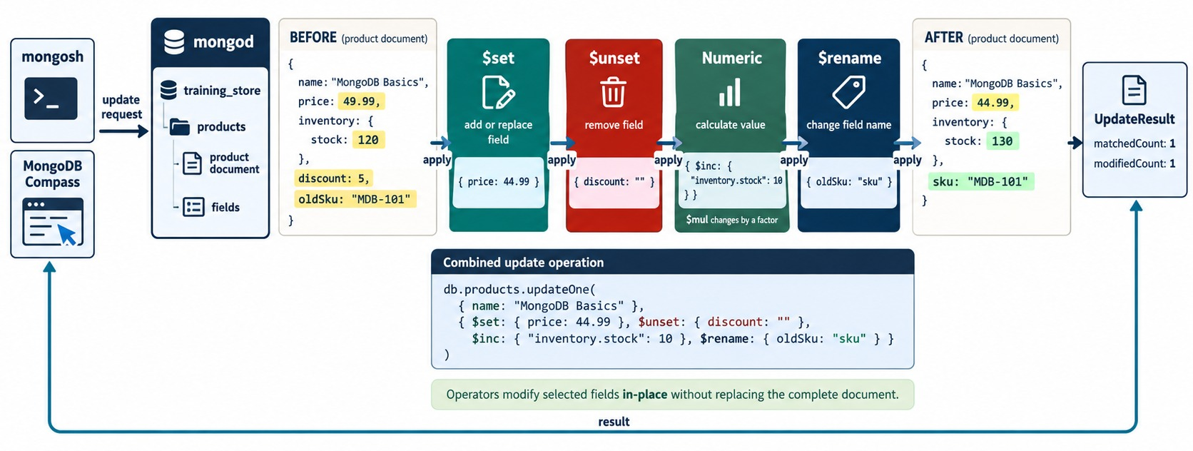
$SET, $UNSET, NUMERIC OPERATORS AND $RENAME
Four kinds of operator, one document, changed in place.
$set / $unset
Add or replace a field; remove one — A410's temporaryNote.
$inc / $mul
Change a number in place, atomically.
$min / $max
Change only if the new value is lower, or higher.
$rename
legacyName → catalogName on L190. Preview the filter first.
KEY TAKEAWAY Update operators change only the fields you name — the rest of the document stays as it was.
32
© 2026 by Innovation In Software Corporation
Notes:
KEY TALKING POINTS
------------------
- $set and $unset
$set adds a field or replaces its value.
$unset removes a field; the value you give it doesn't matter — for example, A410's temporaryNote.
- $inc and $mul
$inc adds to a number and $mul multiplies it, both on the server in one step.
For prices, keep the Decimal128 type in mind.
- $min and $max
$min changes the field only if the new value is lower; $max only if it is higher.
They are useful for lowest-price or high-water-mark fields.
- $rename
Renaming legacyName to catalogName with updateMany on { legacyName: { $exists: true } } matches only L190.
Preview the filter first: a rename touches every match.
- $currentDate
$currentDate: { updatedAt: true } stamps the server's current date.
- Diagram data versus our data
The diagram uses simplified sample documents, not training_store.
Its MongoDB Basics product with oldSku is an illustration.
- What it shows
One combined update on the MongoDB Basics product: $set price to 44.99, $unset discount, $inc inventory.stock by 10 and $rename oldSku to sku.
- How to read it
Compare BEFORE and AFTER.
The price changes, discount disappears, stock goes from 120 to 130 and oldSku becomes sku with the same value.
- Key point
Operators modify selected fields in place without replacing the whole document.

Slide 33
NESTED $SET AND A GUARDED $INC
Change one embedded field; decrement stock only when there is enough.
✓
Set one nested field
✓
Decrement only if stock allows
db.products.updateOne(
{ sku: "L100" },
{ $set: {
"attributes.warrantyYears": 2
} })
// memoryGB, processor … kept
// Lab 3 first sets stockQuantity: 18
db.products.updateOne(
{ sku: "A410",
stockQuantity: { $gte: 2 } },
{ $inc: { stockQuantity: -2 },
$currentDate: { updatedAt: true } })
// 18 → 16
Dotted path
Atomic
MATCHEDCOUNT: 0 Not enough stock — or no such SKU.
$set: { contact: { … } } would replace the object and lose phone.
Check and change happen in one single-document write.
KEY TAKEAWAY Set nested fields by their dotted path, and put the business rule in the filter so check and change are one write.
33
© 2026 by Innovation In Software Corporation
Notes:
KEY TALKING POINTS
------------------
- Nested $set
Setting "attributes.warrantyYears" adds one field inside attributes.
processor, memoryGB, storageGB and screenSizeInches stay.
- The trap it avoids
$set: { attributes: { warrantyYears: 2 } } would replace the whole attributes object.
Exercise 4.4 shows the same mistake with contact: C101 would lose her phone.
- Guarded $inc
Products have no stock field on a fresh load, so Lab 3 first sets stockQuantity to 18 on A410.
The update matches only while at least 2 remain, and $inc subtracts 2: 18 becomes 16.
- Why it is safe
The condition and the change are one single-document write, which MongoDB applies atomically.
Two buyers cannot both take the last unit.
Reading the value into the application and writing it back would allow that race.
- No stock field yet
On a fresh load L100 has no stockQuantity either.
$inc on a missing field creates it with the increment, so $inc: { stockQuantity: 5 } gives 5.
That is why Lab 3 sets A410's stockQuantity to 18 before the guarded decrement.

Slide 34
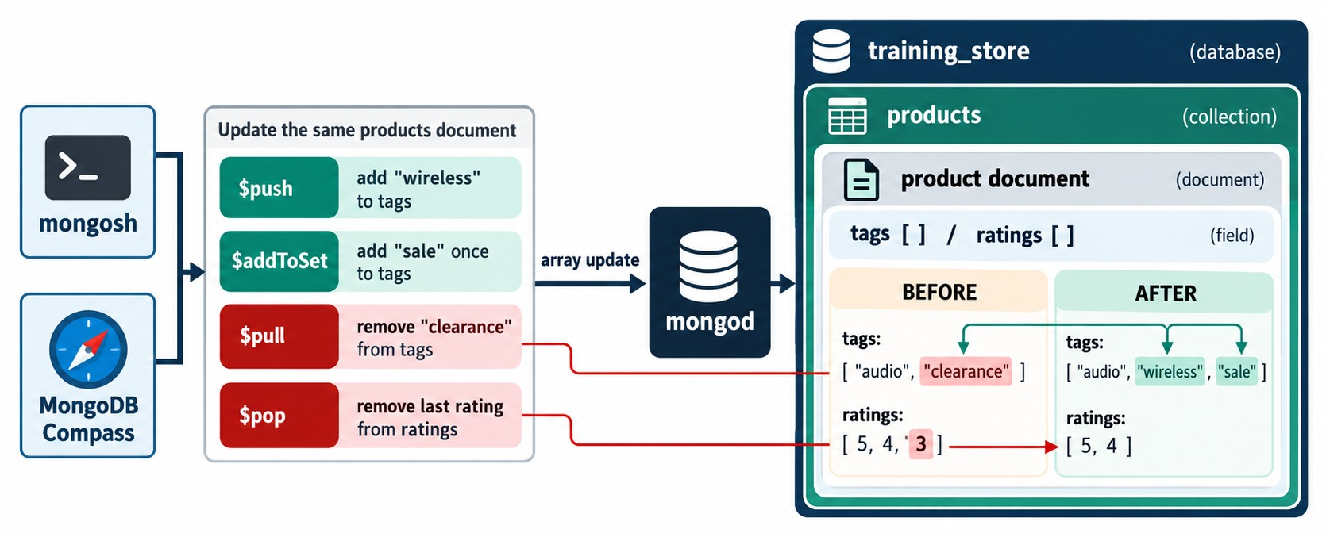
ARRAY UPDATE OPERATORS
$push, $addToSet, $pull and $pop change arrays without rewriting them.
$push
Appends — run it twice and the value is there twice.
$addToSet
Adds only if absent; $each adds several.
$pull / $pop
Remove by value or condition / from one end.
Lab 3: wireless stays once
db.products.updateOne(
{ sku: "A410" },
{ $addToSet: { tags: { $each:
["featured", "office", "wireless"]
} } })
KEY TAKEAWAY Use $addToSet when duplicates are wrong, $push when repeats and order matter, and $pull to remove by value.
34
© 2026 by Innovation In Software Corporation
Notes:
KEY TALKING POINTS
------------------
- $push
$push appends a value.
Run it twice and the value appears twice.
$each pushes several values, and $slice with $each keeps an array bounded, for example the last ten status changes.
- $addToSet
Lab 3 adds featured, office and wireless to A410 with $addToSet and $each.
wireless is already there, so it stays once.
The tags become wireless, accessories, featured, office.
- $pull and $pop
$pull removes every element that matches a value or condition; Lab 3 pulls discontinued from L190.
$pop removes the first (-1) or last (1) element and does not look at values.
- Diagram data versus our data
The diagram uses simplified sample documents, not training_store.
Its audio and clearance tags and its ratings array are illustrations.
- What it shows
Tags start as audio and clearance, ratings as 5, 4, 3.
After the updates, tags are audio, wireless, sale, and ratings are 5, 4.
- How to read it
$pull removed clearance, $push added wireless, $addToSet added sale once and $pop removed the last rating.
- One caution
Run these as separate updates.
One update may not both $push to and $pull from the same array; MongoDB reports a conflict.

Slide 35
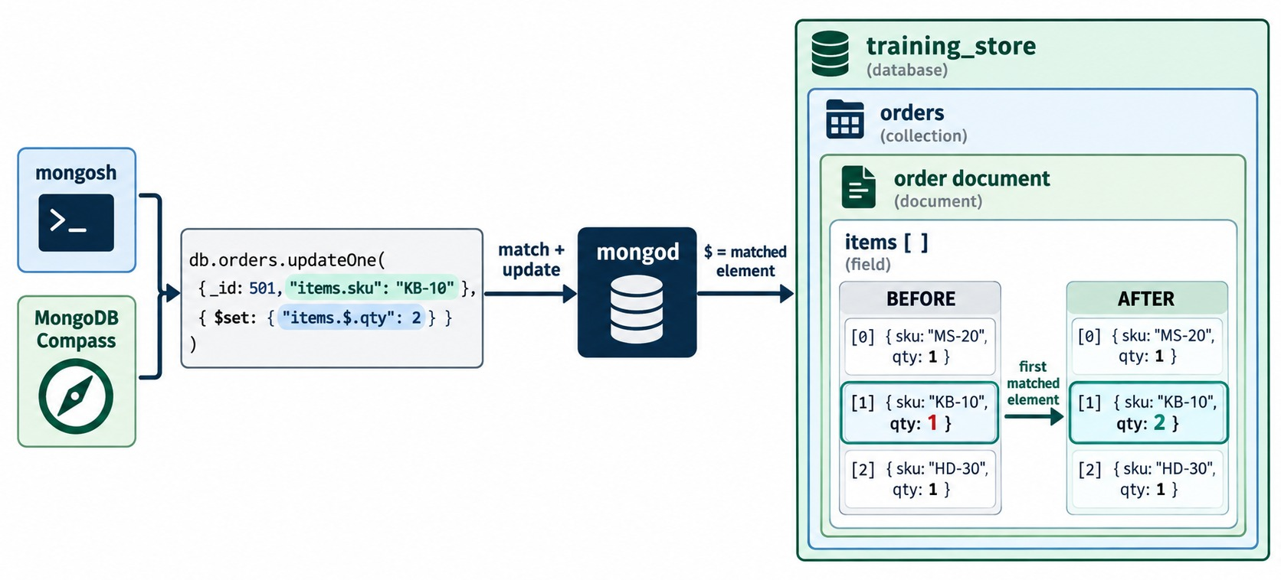
POSITIONAL ARRAY UPDATES
$ updates the element the filter matched.
$
The first element the filter matched: items.$.quantity.
$[]
Every element: items.$[].reviewed.
$[name] + arrayFilters
Only the elements that pass a condition.
On O5001
db.orders.updateOne(
{ orderNumber: "O5001",
"items.sku": "L100" },
{ $set: {
"items.$.quantity": 2 } })
// only the L100 line
KEY TAKEAWAY Put the array condition in the filter and use $ for the matched element — or $[] and arrayFilters for many.
35
© 2026 by Innovation In Software Corporation
Notes:
KEY TALKING POINTS
------------------
- Positional $
The filter must include the array condition, here "items.sku": "L100".
Then "items.$.quantity" means the first element that matched.
On O5001 only the L100 line changes, from 1 to 2.
- All elements
"items.$[].reviewed": false sets the field on every item of the order.
Try both on O5001, then reload.
- Filtered elements
"items.$[item].requiresReview" with arrayFilters: [{ "item.quantity": { $gte: 2 } }] changes only the lines with quantity 2 or more.
- Reload afterwards
These exercises change O5001.
Reload the dataset before labs that expect the original $elemMatch trap.
- Diagram data versus our data
The diagram uses simplified sample documents, not training_store.
Its order 501 and SKUs such as KB-10 are illustrations.
- What it shows
updateOne on order 501 with the filter "items.sku": "KB-10" and $set "items.$.qty": 2.
Only element 1, KB-10, changes from qty 1 to 2.
- How to read it
The $ stands for the first matched element.
Elements 0 and 2 are untouched.
- Key point
The array field must appear in the filter for $ to know which element.

Slide 36
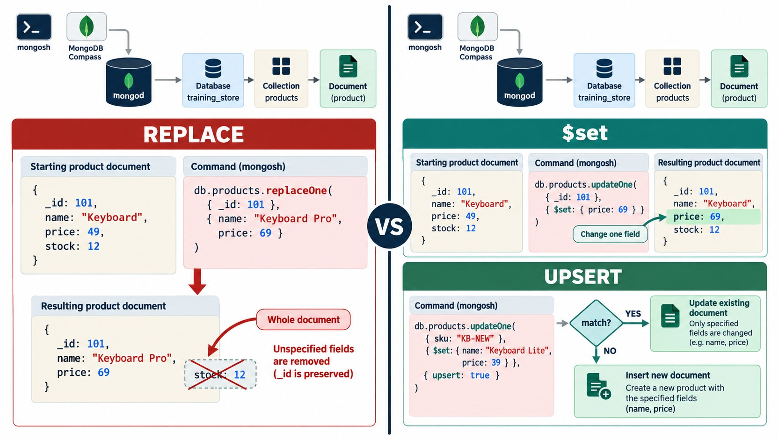
REPLACE VS $SET
replaceOne() rewrites the document; $set changes named fields.
replaceOne()
A new body for the whole document; only _id survives.
$set
Changes the named fields; the rest stays.
Practise on a copy
Use a test SKU such as DEMO-REP — never L100.
RULE Replace only when you mean to rewrite every field.
KEY TAKEAWAY replaceOne() rewrites the whole document; when only some fields should change, use update operators.
36
© 2026 by Innovation In Software Corporation
Notes:
KEY TALKING POINTS
------------------
- replaceOne()
replaceOne() swaps the whole body of the document.
Only _id is kept, and any field you leave out disappears.
- $set
$set changes only the named fields.
For almost every business change this is what you want.
- Practise safely
Demo 4.8 uses a test document such as DEMO-REP or TEMP-200.
Never practise replaceOne() on L100; later labs depend on it.
- Diagram data versus our data
The diagram uses simplified sample documents, not training_store.
Its Keyboard product with _id 101 is an illustration.
- What it shows
Left: replaceOne keeps _id 101 but drops stock, because the replacement lists only name and price.
Right: updateOne with $set changes price to 69 and keeps stock 12.
Below, a preview of upsert: match, or insert.
- How to read it
The red cross over stock: 12 is the whole lesson of replaceOne.
- Key point
Use update operators when only some fields should change.

Slide 37
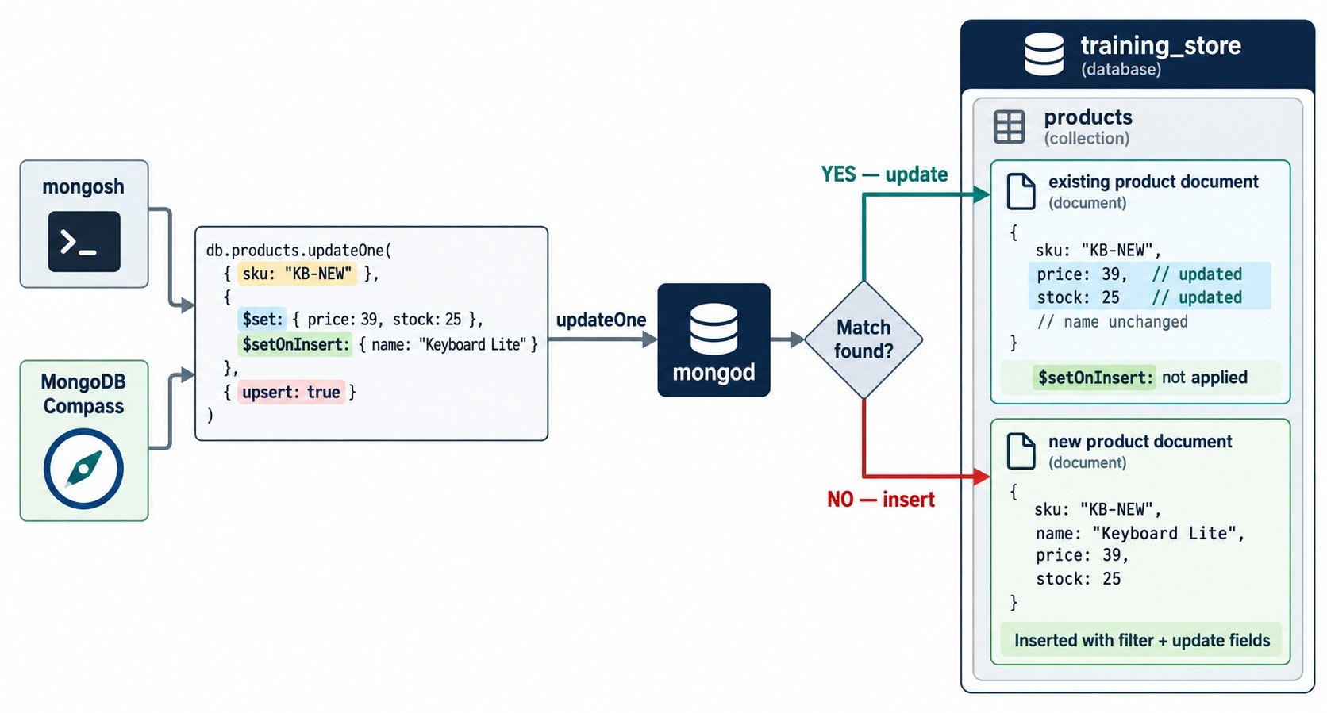
THE UPSERT PATTERN
One command: update if found, insert if not.
Exercise 4.3 (trimmed)
db.products.updateOne(
{ sku: "A700" },
{ $set: {
name: "Portable Charger",
updatedAt: new Date() },
$setOnInsert: {
createdAt: new Date() } },
{ upsert: true })
First run
No match: inserts A700; upsertedCount 1 and the new _id.
Second run
Matches: updatedAt changes, createdAt stays.
KEY TAKEAWAY An upsert updates when the filter matches and inserts when it doesn't — $setOnInsert applies only to the insert.
37
© 2026 by Innovation In Software Corporation
Notes:
KEY TALKING POINTS
------------------
- Upsert
{ upsert: true } means: update the match, or insert when nothing matches.
The inserted document combines the filter's equality fields and the update's fields.
- $setOnInsert
Fields in $setOnInsert are written only on the insert path, so createdAt is set once and never overwritten.
- Exercise 4.3
The first run inserts A700, Portable Charger, and returns the new _id.
The second run matches it: updatedAt changes and createdAt stays.
- Filter on a unique field
sku has a unique index.
An upsert on a non-unique field can update the wrong document or insert duplicates.
- Diagram data versus our data
The diagram uses simplified sample documents, not training_store.
Its KB-NEW Keyboard Lite is an illustration.
- What it shows
updateOne on sku KB-NEW with $set price and stock, $setOnInsert name and { upsert: true }.
If the SKU exists, price and stock change and $setOnInsert is not applied.
If not, a new document is inserted with the filter field plus every set field.
- How to read it
Follow the diamond: YES goes to update, NO goes to insert.
- Key point
$setOnInsert only acts on the insert path.

Slide 38
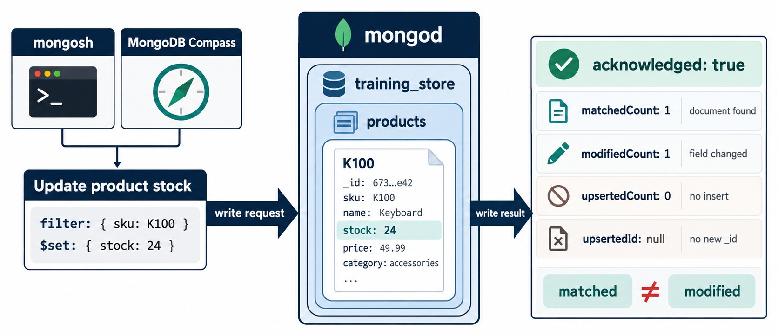
UNDERSTANDING WRITE RESULTS
Matched is not the same as modified.
acknowledged
The server accepted the write.
matchedCount / modifiedCount
Found / really changed; 1 and 0 means already right.
upsertedId / deletedCount
The new _id of an upsert; documents removed.
ON TRAINING_STORE updateMany({}, { $pull: { tags: "discontinued" } }) matches 13, modifies 1.
KEY TAKEAWAY Read every field of the write result — matched, modified, upserted and deleted each answer a different question.
38
© 2026 by Innovation In Software Corporation
Notes:
KEY TALKING POINTS
------------------
- The fields
acknowledged means the server accepted the write.
matchedCount is how many documents the filter found, modifiedCount how many really changed.
upsertedCount and the upserted _id appear when an upsert inserted.
- mongosh naming
mongosh prints the upserted _id as insertedId; drivers call it upsertedId.
It is null when nothing was inserted.
- Matched but not modified
updateMany({}, { $pull: { tags: "discontinued" } }) matches all 13 products but modifies only 1, L190.
The other 12 had nothing to pull.
- Deletes and bulk writes
deleteOne and deleteMany return deletedCount.
bulkWrite returns all the counts together.
- Diagram data versus our data
The diagram uses simplified sample documents, not training_store.
Its K100 Keyboard and stock field are illustrations.
- What it shows
A $set of stock 24 on product K100 and the write result: acknowledged true, matchedCount 1, modifiedCount 1, upsertedCount 0, upsertedId null.
- How to read it
Each row of the result answers one question: found, changed, inserted, new _id.
- Key point
Read the whole result, not just "acknowledged".

Slide 39
PART 5: DELETES, BULK WRITES AND SAFE PRACTICE
Remove data safely, batch writes, and fix queries that go wrong.
✓ Part 1
Read documents
✓ Part 2
Query operators
✓ Part 3
Nested and arrays
✓ Part 4
Insert and update
Part 5
Delete and verify
SO FAR
NEXT QUESTION
How do we delete and batch writes safely — and debug a query that returns the wrong thing?
✓
Insert with real BSON types
✓
Update operators change only named fields
IN THIS PART
✓
Upserts insert when nothing matches
deleteOne() and deleteMany()
1
✓
Write results show what really changed
2
Preview, count, then delete
3
bulkWrite(): many writes, one result
4
Troubleshooting an empty result
5
Common mistakes and safe habits
6
Module 4 at a glance
39
© 2026 by Innovation In Software Corporation
Notes:
KEY TALKING POINTS
------------------
- Why this part
A delete cannot be undone from the shell.
The habits in this part protect real data.
- Outcome
By the end, learners follow one routine for every risky write: preview, count, write, verify.

Slide 40
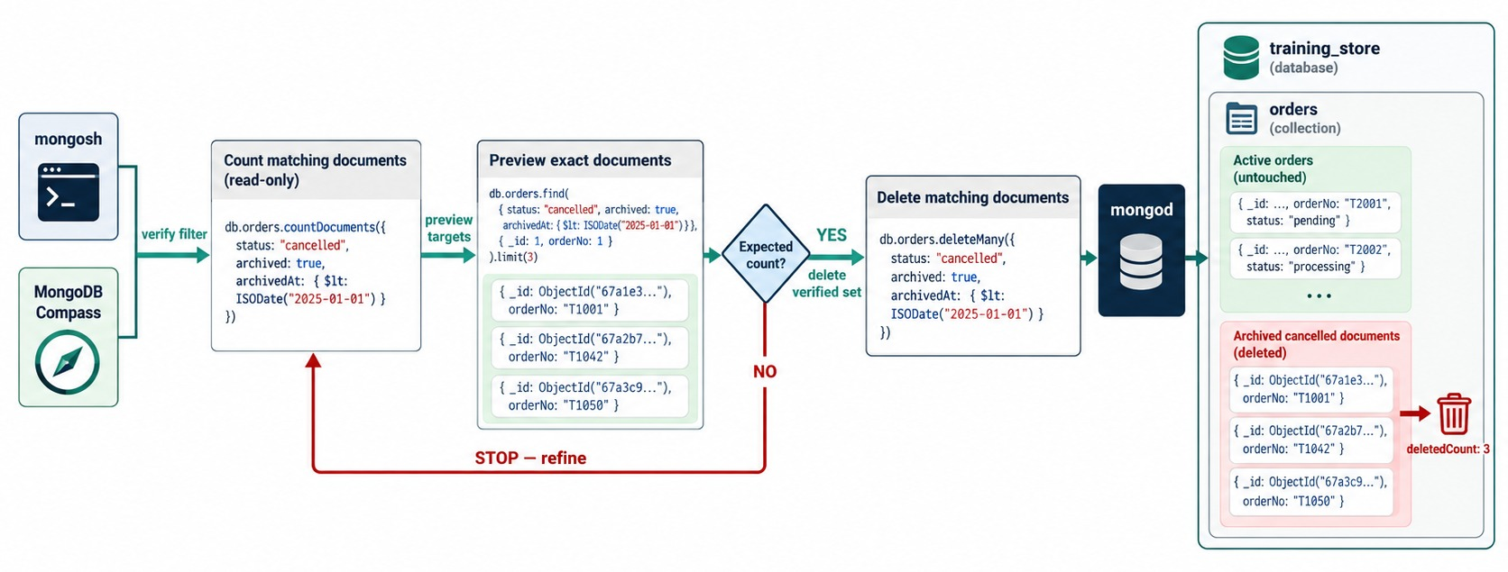
DELETING DOCUMENTS SAFELY
Count, preview, check — then delete the verified set.
Demo 4.9
const filter =
{ sku: "TEMP-100" }
db.products.find(filter)
db.products
.countDocuments(filter)
// 1
db.products.deleteOne(filter)
// deletedCount: 1
deleteOne / deleteMany
The first match, or every match.
NEVER deleteMany({}) removes every document.
KEY TAKEAWAY Delete with exactly the filter you previewed and counted — then compare deletedCount with that count.
40
© 2026 by Innovation In Software Corporation
Notes:
KEY TALKING POINTS
------------------
- The routine
Put the filter in a variable.
Preview with find(), count with countDocuments(), check the number, and only then delete with the same filter.
- Demo 4.9
Insert TEMP-100 first if needed.
The count is 1, deleteOne returns deletedCount: 1, and a final find confirms TEMP-100 is gone while L100 remains.
- deleteOne() and deleteMany()
deleteOne() removes the first match; deleteMany() removes every match.
deleteMany({}) empties the collection and is never the right answer in these labs.
- Soft delete
When deleted data may need to come back, many teams set a deletedAt field instead and filter it out of normal reads.
- Diagram data versus our data
The diagram uses simplified sample documents, not training_store.
Its cancelled and archived orders are illustrations; training_store orders use paymentStatus and fulfillmentStatus.
- What it shows
The filter status cancelled, archived true and archivedAt before 2025 is counted, previewed with find() and limit(3), checked against the expected count, and only then used by deleteMany().
deletedCount: 3.
- How to read it
The NO path loops back: stop and refine the filter.
Active orders are untouched.
- Key point
The delete uses exactly the filter you counted and previewed.

Slide 41
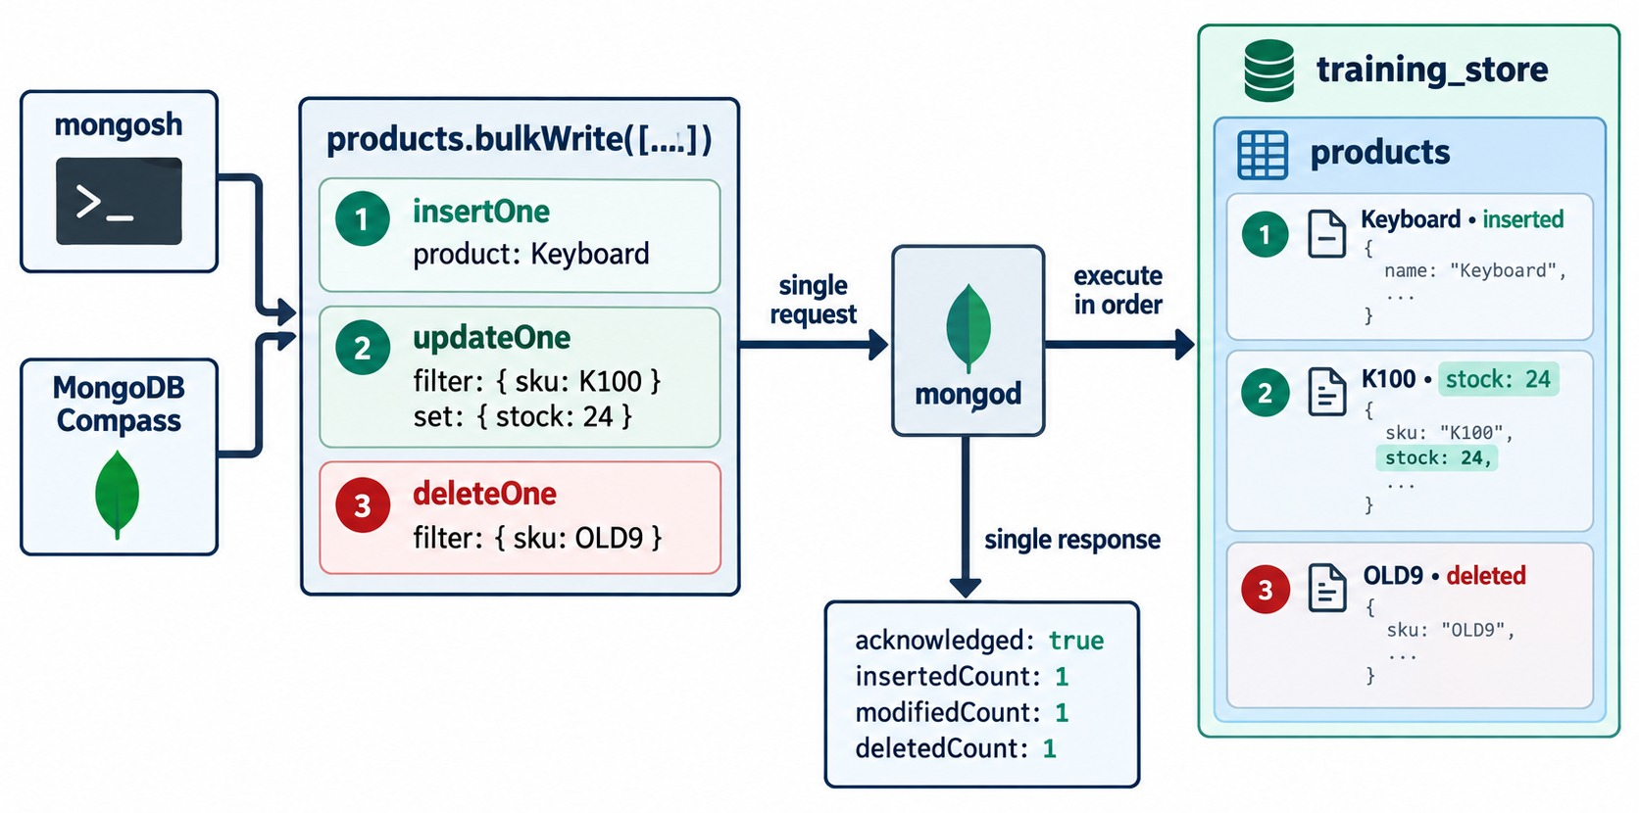
BULK WRITE OPERATIONS
Several writes in one request, one combined result.
Demo 4.10 (trimmed)
db.products.bulkWrite([
{ insertOne: { document:
{ sku: "DEMO-BULK" } } },
{ updateOne: {
filter: { sku: "DEMO-BULK" },
update: { $set:
{ active: false } } } },
{ deleteOne: { filter:
{ sku: "TEMP-100" } } } ])
Result
insertedCount 1, matchedCount 1, modifiedCount 1, deletedCount 0.
Ordered by default
Stops at the first error; ordered: false carries on.
KEY TAKEAWAY bulkWrite() sends many writes in one round trip — then read each count in the combined result.
41
© 2026 by Innovation In Software Corporation
Notes:
KEY TALKING POINTS
------------------
- One request
bulkWrite() sends several inserts, updates, replaces and deletes in one request and returns one combined result.
- Demo 4.10
Insert DEMO-BULK, update it to active: false, and delete TEMP-100.
The result is insertedCount 1, matchedCount 1, modifiedCount 1 and deletedCount 0.
TEMP-100 was already deleted in Demo 4.9, so 0 is a normal outcome.
- Ordered or not
By default operations run in order and stop at the first error.
With ordered: false, MongoDB attempts them all and reports every error.
- Not a transaction
Each operation is atomic on its own document, but the batch is not all-or-nothing.
Multi-document transactions are a separate feature.
- Diagram data versus our data
The diagram uses simplified sample documents, not training_store.
Its K100 and OLD9 products are illustrations.
- What it shows
products.bulkWrite with three operations: insertOne a Keyboard, updateOne sku K100 to stock 24, deleteOne sku OLD9.
The single response shows insertedCount 1, modifiedCount 1, deletedCount 1.
- How to read it
The numbered steps run in order, and the numbers match the documents on the right.
- Key point
Fewer round trips, one combined result.

Slide 42
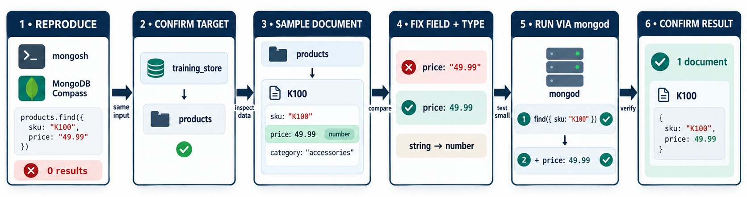
QUERY TROUBLESHOOTING WORKFLOW
Reproduce, confirm, sample, fix, test small, confirm.
Reproduce
Compare
Fix the type
RULE Test the smallest query first, then add one condition.
find({ price: "49.99" }) returns only XBAD — the broken one.
findOne({ sku: "P1001" }) shows a Decimal128 price.
{ price: Decimal128("49.99") } → P1001 only.
KEY TAKEAWAY When a query returns nothing — or the wrong thing — compare it field by field with a real document.
42
© 2026 by Innovation In Software Corporation
Notes:
KEY TALKING POINTS
------------------
- Reproduce
find({ price: "49.99" }) returns only XBAD, the one broken document, because the query compares a string.
- Compare with a real document
findOne({ sku: "P1001" }) shows price: Decimal128("49.99").
The stored type is Decimal128, not a string.
- Fix and test small
{ price: Decimal128("49.99") } returns P1001, the Wireless Keyboard.
Test the smallest query first, sku alone, then add one condition at a time.
- Common causes
A wrong field name, the wrong case, the wrong type or an unquoted path.
The next slide gathers seven of them.
- Diagram data versus our data
The diagram uses simplified sample documents, not training_store.
Its K100 product priced 49.99 is an illustration.
- What it shows
find({ sku: "K100", price: "49.99" }) returns 0 results.
A sample document shows price is a number, 49.99.
Changing the string to a number returns 1 document.
- How to read it
Six steps left to right.
Step 5 tests the smallest query first, sku alone, then adds the price.
- Key point
When a query returns nothing, compare it with a real document.

Slide 43
COMMON QUERY MISTAKES AND SAFE-WRITE HABITS
Seven classic query errors — and the habits that prevent write disasters.
MISCONCEPTION
REALITY
ANTI-PATTERNS TO AVOID
{ Category: "LAPTOP" }
Field names are case-sensitive: category
✕
updateMany({}) or deleteMany({})
✕
$set on a parent object instead of one path
{ price: { $gt: "100.00" } }
Compare money as Decimal128("100.00")
✕
$push where values must be unique
✕
skip() and limit() without sort()
✕
Writing without reading the result
{ attributes.memoryGB: 16 }
Quote dotted paths: "attributes.memoryGB"
REMEMBER Preview, count, write, then verify.
{ $gt: { price: … } }
Operator inside the field: { price: { $gt: … } }
updateOne(f, { featured: true })
Use an operator: { $set: { featured: true } }
KEY TAKEAWAY Most query bugs are a wrong name, case, type or path — most write disasters are an unchecked filter.
43
© 2026 by Innovation In Software Corporation
Notes:
KEY TALKING POINTS
------------------
- Why this slide
These are seven classic query errors and the write mistakes from Exercise 4.4, gathered in one place before the checks.
- Query mistakes
Category with a capital C matches nothing.
A string "100.00" compares only against strings: on training_store it returns XBAD alone, because "49.99" sorts after "100.00" as text.
An unquoted dotted path is a JavaScript syntax error.
An operator must sit inside its field.
- Update without an operator
updateOne(filter, { featured: true }) is rejected: the update document must use operators such as $set.
Replacing a document is what replaceOne() is for.
Mixing inclusion and exclusion in a projection is the seventh error.
- Anti-patterns
An empty filter on updateMany or deleteMany touches every document.
$set on a parent object drops its other fields.
$push creates duplicates.
Paging without a sort gives unstable pages.
And a write you never check is a write you cannot trust.

Slide 44
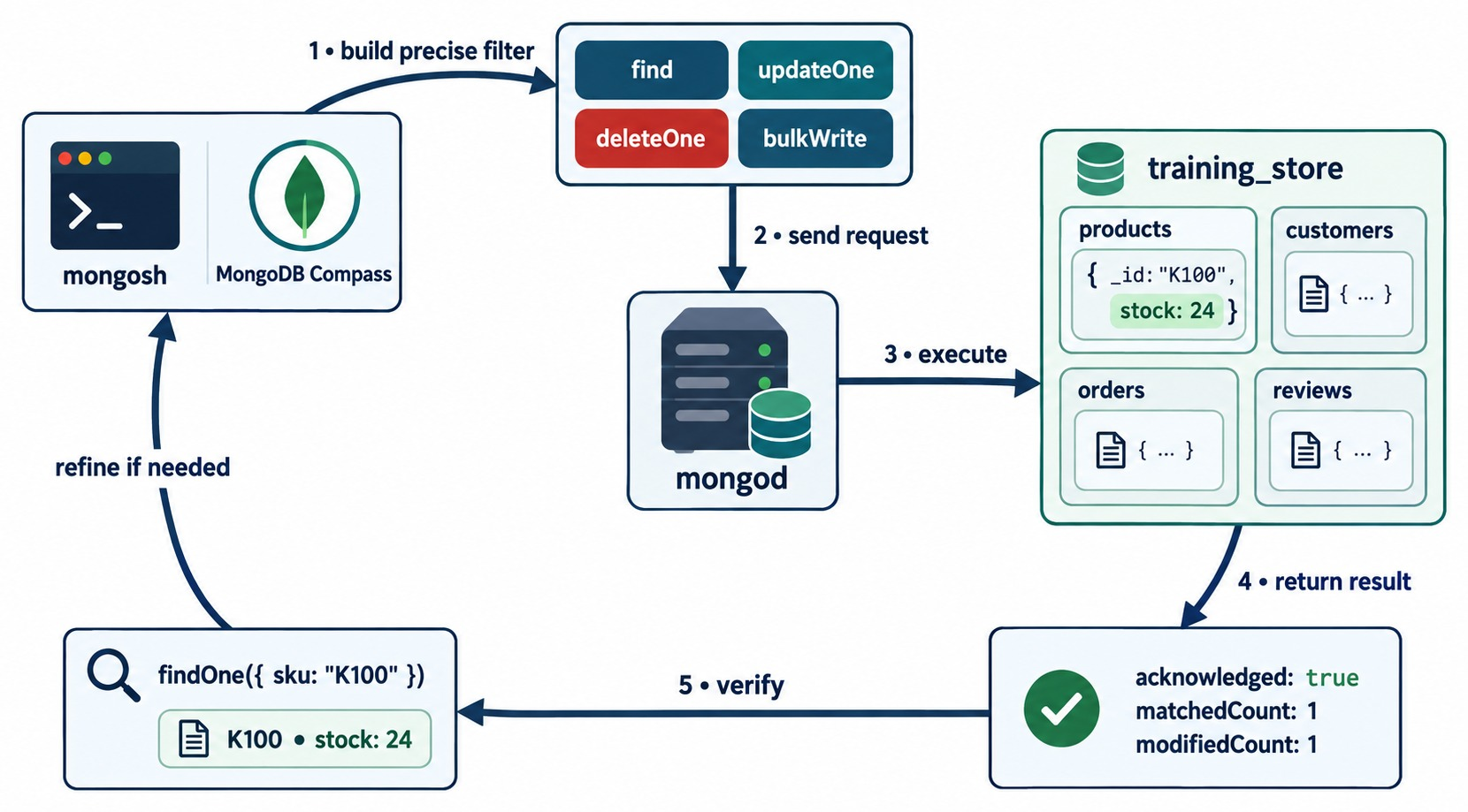
MODULE 4 AT A GLANCE
Build a precise filter, send it, execute, read the result, verify.
KEY TAKEAWAY Every query and every write follows one loop: precise filter, execute, read the result, verify.
44
© 2026 by Innovation In Software Corporation
Notes:
KEY TALKING POINTS
------------------
- Build a precise filter
find, updateOne, deleteOne and bulkWrite all start with a filter.
Parts 1 to 3 were about making it precise.
- Execute and read the result
mongod runs the command on training_store and returns a result: documents for a read, counts for a write.
- Verify, then refine
Check the result with findOne or countDocuments, and refine the filter when it doesn't match what you expected.
- What it shows
The loop: build a precise filter with find, updateOne, deleteOne or bulkWrite; send it to mongod; execute on training_store; return acknowledged, matchedCount and modifiedCount; verify with findOne.
- How to use it
Ask the class which part of the loop each Part of the module taught.
- A detail to notice
The product card writes _id: "K100" as shorthand.
In training_store, _id is an ObjectId and K100-style codes live in sku, which is what the findOne verifies.

Slide 45
KNOWLEDGE CHECK
Answer in your own words — then compare with a partner.
findOne() or find() — what does each return?
$push or $addToSet — what is the difference?
1
6
What does the filter {} match?
updateOne() with $set, or replaceOne()?
2
7
How do you query a nested field?
What does upsert: true do?
3
8
When is $elemMatch required?
matchedCount 1, modifiedCount 0 — meaning?
4
9
What is the projection mixing rule?
Why does XBAD miss every price range?
5
10
45
© 2026 by Innovation In Software Corporation
Notes:
KEY TALKING POINTS
------------------
- 1. findOne() and find()
findOne() returns one document or null.
find() returns a cursor over every match.
- 2. The empty filter
{} matches every document in the collection — 13 products.
That is why it is dangerous in updateMany and deleteMany.
- 3. Nested fields
With a quoted dotted path, such as "attributes.memoryGB" or "contact.email".
- 4. $elemMatch
When two or more conditions must be true for the same array element, as in the O5001 example.
- 5. Projection
Use inclusion or exclusion, not both.
_id is the only field you may exclude in an inclusion projection.
- 6. $push and $addToSet
$push always appends, so repeats are possible.
$addToSet adds a value only if it is not already there.
- 7. $set or replaceOne()
$set changes the named fields and keeps the rest.
replaceOne() replaces everything except _id.
- 8. Upsert
It updates the matching document, or inserts a new one built from the filter and the update when nothing matches.
- 9. Matched but not modified
The document was found but already had the requested values, so nothing changed.
- 10. XBAD
Its price is the string "49.99".
Numeric comparisons with Decimal128 only match numeric values, so it is skipped.

Slide 46
EXERCISE 4.1 — BUILD COMPARISON FILTERS
Module 4 checkpoint A: ranges and lists with Decimal128.
OFFICIAL CHECKPOINT A
15 MIN
labs/day-02/exercises/exercise-4.1-build-comparison-filters.md
SCENARIO
YOUR TASKS
SOLUTION (AFTER DEBRIEF)
Money in training_store is Decimal128 — except XBAD, planted with a string price.
1
Write 1 and 2 with Decimal128 values
✓
1 L100, L110, L190, S200, A500
2
Write 3 and 4 on orders and reviews
✓
2 L190, S200, S210, B300, A500
1 products: price > 100
2 products: 50 ≤ price ≤ 500
3 orders: total > 1000
4 reviews: rating ≥ 4
5 products: not LAPTOP or SHOE
Write 5 with $nin
✓
3 Six orders, O5001 to O6401
3
4
Explain why XBAD never appears in 1–2
✓
4 Five of the six reviews
✓
5 Seven products, XBAD included
KEY TAKEAWAY Compare values of the stored BSON type — Decimal128 for money — and check every result against the data.
46
© 2026 by Innovation In Software Corporation
Notes:
KEY TALKING POINTS
------------------
- Official checkpoint
This is the official Exercise 4.1, the first Module 4 checkpoint.
The worksheet is labs/day-02/exercises/exercise-4.1-build-comparison-filters.md; the answer key is in its solution folder.
Fifteen minutes in mongosh on a fresh load.
- Solutions 1 and 2
Above 100: L100, L110, L190, S200 and A500 — people often stop at the laptops and S200, but A500 at 249.99 also matches.
Between 50 and 500: L190 499.99, S200 129.99, S210 89.99, B300 59.99 and A500 249.99.
A400, at 24.99, is below the range and must not appear.
- Solutions 3 to 5
Orders over 1000: O5001, O6101, O6202, O6301, O6304 and O6401.
Five reviews have a rating of 4 or more.
$nin LAPTOP and SHOE leaves two books and five accessories, including XBAD.
- What to listen for
Everyone should use Decimal128("100.00"), not 100 or "100", and explain that XBAD is skipped because its price is a string.

Slide 47
EXERCISE 4.2 — QUERY ARRAYS OF DOCUMENTS
Module 4 checkpoint B: prove the O5001 $elemMatch trap.
OFFICIAL CHECKPOINT B
15 MIN
labs/day-02/exercises/exercise-4.2-query-arrays-of-documents.md
SCENARIO
YOUR TASKS
SOLUTION (AFTER DEBRIEF)
O5001 holds L100 × 1 and A410 × 2. Show why dot notation is not enough.
1
Run steps 1 and 2; list the orders
✓
1 O5001, O6101, O6301, O6401
2
Run steps 3 and 4 side by side
2 Six orders
1 "items.sku": "L100"
2 "items.quantity": { $gte: 2 }
3 $elemMatch: L100 and qty ≥ 2
4 1 and 2 with dot notation
5 addresses $elemMatch:
SHIPPING in Toronto
✓
3
Name the false positive and why
✓
3 O6401 only
4
Query addresses with $elemMatch
✓
4 O5001 and O6401
✓
5 C101
KEY TAKEAWAY Dot notation lets different elements satisfy different conditions; $elemMatch makes one element satisfy them all.
47
© 2026 by Innovation In Software Corporation
Notes:
KEY TALKING POINTS
------------------
- Official checkpoint
This is the official Exercise 4.2, the second checkpoint.
The worksheet is labs/day-02/exercises/exercise-4.2-query-arrays-of-documents.md.
- Steps 1 and 2
Four orders contain L100: O5001, O6101, O6301 and O6401.
O6301, a laptop and a USB Hub, is the one people miss.
Six orders have some item with quantity 2 or more: O5001, O6103, O6201, O6302, O6305 and O6401.
- Steps 3 and 4
$elemMatch returns only O6401, two laptops.
Dot notation also returns O5001, because its L100 line has quantity 1 and its A410 line has quantity 2 — different elements.
- Step 5
addresses with $elemMatch type SHIPPING and city Toronto returns C101, Aisha Khan.
Type values are uppercase in this dataset.

Slide 48
EXERCISE 4.3 — PERFORM AN UPSERT
Module 4 checkpoint C: the same upsert, run twice.
OFFICIAL CHECKPOINT C
10 MIN
labs/day-02/exercises/exercise-4.3-perform-an-upsert.md
SCENARIO
YOUR TASKS
SOLUTION (AFTER DEBRIEF)
A700 is not in the fresh dataset. Run one upsert twice and compare the write results.
1
Run the upsert; read the result
✓
Run 1: matched 0, upsertedCount 1
2
findOne A700; note createdAt
Run 2: matched 1, modified 1
✓
db.products.updateOne(
{ sku: "A700" },
{ $set: { name, category,
price, active, updatedAt },
$setOnInsert: { createdAt,
stockQuantity: 25 } },
{ upsert: true })
3
Run the same upsert again
✓
createdAt unchanged after run 2
4
Compare both results in two bullets
✓
The filter uses the unique sku
KEY TAKEAWAY Upsert on a unique field and put creation-only fields in $setOnInsert, so a rerun updates instead of duplicating.
48
© 2026 by Innovation In Software Corporation
Notes:
KEY TALKING POINTS
------------------
- Official checkpoint
This is the official Exercise 4.3, the third checkpoint.
The worksheet is labs/day-02/exercises/exercise-4.3-perform-an-upsert.md.
The full command sets name Portable Charger, category ACCESSORY, price Decimal128 39.99, active true and updatedAt.
- First run
Nothing matches sku A700, so MongoDB inserts a document from the filter and both operators.
The result shows matchedCount 0, modifiedCount 0, upsertedCount 1 and the new _id.
mongosh prints that _id as insertedId; drivers call it upsertedId.
- Second run
Now A700 matches.
matchedCount is 1, and modifiedCount is 1 because updatedAt gets a new date.
upsertedCount is 0.
createdAt and stockQuantity keep their first values.
- Why the unique field
sku has a unique index.
Upserting on a field that isn't unique could match the wrong document or insert duplicates.

Slide 49
EXERCISE 4.4 — CORRECT UNSAFE OPERATIONS
Module 4 checkpoint D: rewrite three dangerous writes. Don't run them.
OFFICIAL CHECKPOINT D
10 MIN
labs/day-02/exercises/exercise-4.4-correct-unsafe-operations.md
SCENARIO
YOUR TASKS
SOLUTION (AFTER DEBRIEF)
A teammate wants to run these. Rewrite each one instead.
1
Name what each command would damage
✓
1 All 13 products go inactive
db.products.updateMany({},
{ $set: { active: false } })
db.orders.deleteMany({})
db.customers.updateOne(
{ customerNumber: "C101" },
{ $set: { contact:
{ email: "new@example.com" } } })
2
Rewrite 1 with a precise filter
✓
Safer: { tags: "discontinued" }: 1
3
Rewrite 2 as find → count → delete
✓
2 All 17 orders are deleted
4
Rewrite 3 with a dotted path
3 C101 loses her phone
✓
✓
Use "contact.email" instead
KEY TAKEAWAY Name the blast radius before every write — an empty filter or a replaced parent object is rarely what you mean.
49
© 2026 by Innovation In Software Corporation
Notes:
KEY TALKING POINTS
------------------
- Official checkpoint
This is the official Exercise 4.4, the last checkpoint.
The worksheet is labs/day-02/exercises/exercise-4.4-correct-unsafe-operations.md.
Nobody runs the unsafe commands.
- Command 1
The empty filter makes all 13 products inactive.
Safer: preview { tags: "discontinued" }, count it — 1, L190 — then run updateMany with that filter.
- Command 2
deleteMany({}) removes all 17 orders.
Never use an empty delete filter.
Filter on the test orderNumber values, then find, countDocuments and deleteMany with the same filter.
- Command 3
$set on contact replaces the whole object, so C101's phone, +1-555-0100, is lost.
$set: { "contact.email": "new@example.com" } changes only the email.

Slide 50
LAB 3 — COMPLEX QUERIES AND UPDATES
Day 2 hands-on: filters, arrays and guarded writes on training_store.
OFFICIAL LAB
75 MIN
labs/day-02/lab3/LAB-3-GUIDE.md
SCENARIO
YOUR TASKS
EXPECTED RESULTS
Reload first. Steps 1–7 read, steps 8–12 write and verify, step 13 is the challenge.
1
1–4 Filters, ranges and $nin
✓
1 A410, A400, P1001
2
5–7 Cities, $elemMatch, PROCESSING
✓
6 O5001, O6201, O6305
# In PowerShell, from the repo root
mongosh "mongodb://localhost:27017" `
.\datasets\training_store\load.js
3
8–9 Guarded $inc, $addToSet on A410
✓
8 A410 stock 18 → 16
✓
11 Second ship matches 0
4
10–12 $pull, ship O6202, $rename
✓
13 A410, P1001, B310, B300
5
13 Challenge: one precise filter
KEY TAKEAWAY Lab 3 puts the whole module together: precise filters first, then writes guarded by the filter and verified by the result.
50
© 2026 by Innovation In Software Corporation
Notes:
KEY TALKING POINTS
------------------
- Official lab
This is Day 2 Lab 3, labs/day-02/lab3/LAB-3-GUIDE.md, about 60 to 75 minutes.
The expected output for every step is in labs/day-02/lab3/solution/LAB-3-SOLUTION.md, for instructors.
- Before you start
Reload load.js from the repository root in PowerShell, not inside mongosh, then use training_store.
The four checkpoints changed data — A700 exists after Exercise 4.3 — so a fresh load keeps the counts at 13 products, 6 customers, 17 orders and 6 reviews.
- Steps 1 to 7: reads
Step 1 returns A410, A400 and P1001; XBAD's string price keeps it out.
Step 2 returns L110, S290 and A500 but not the inactive L190.
Step 6's $elemMatch — quantity 2 or more and unitPrice below 50 on the same item — matches O5001, O6201 and O6305, not O6302 or O6401.
Step 7 uses fulfillmentStatus: O6401, O6302 and O6202.
- Steps 8 to 12: writes
A410 has no stock field, so step 8 sets stockQuantity to 18 and the guarded $inc takes it to 16.
Step 9's $addToSet keeps wireless once.
Step 10 matches 13 products and modifies 1, L190.
Step 11 ships O6202; the rerun matches 0.
Step 12 renames reviewText to body on a throwaway review.
- Step 13 and the debrief
The challenge returns A410, P1001, B310 and B300, sorted by category then price.
Ask who used $in versus $or, and who read matchedCount before trusting a write.

Slide 51
MODULE 4 SUMMARY AND WHAT'S NEXT
From precise filters to safe, verified writes.
YOU CAN NOW
NEXT: MODULE 5 — THE AGGREGATION FRAMEWORK
Read with find(), findOne() and precise filters
1
How does a filter become a $match stage?
✓
Project, sort, page, count and list distinct values
2
How does $group total the orders?
✓
Combine comparison, logical and element operators
How do stages chain into a pipeline?
✓
3
Query nested fields and arrays with $elemMatch
✓
Insert, update, upsert and replace documents
BRING ALONG Your Lab 3 queries — and reload load.js so the counts start fresh.
✓
Delete safely and read every write result
✓
KEY TAKEAWAY Module 5 reuses today's filters and projections as the first stages of an aggregation pipeline.
51
© 2026 by Innovation In Software Corporation
Notes:
KEY TALKING POINTS
------------------
- Recap
We read documents with filters, shaped results with projection, sort and limit, combined operators, queried nested fields and arrays, then inserted, updated, upserted, replaced and deleted — checking every write result.
- Day 2 Lab 3
The lab, labs/day-02/lab3/LAB-3-GUIDE.md, practises all of it on training_store: 13 steps ending in a challenge query that returns four SKUs — A410, P1001, B310 and B300.
- Next module
Module 5 builds aggregation pipelines.
$match uses the same filters we wrote today and $project uses the same projections; $group and accumulators are new.
- Reload
Today's labs change the data.
Reload load.js before Module 5 so everyone's totals match.

