Slide 1
"Each stage receives documents, transforms them and passes them on."
MODULE 5
The Aggregation Framework
Turn training_store documents into totals, rankings and reports — one pipeline stage at a time.
Pipelines
Filter and shape
Group
Arrays and joins
Reports
MASTERING MONGODB • MODULE 5
Notes:
KEY TALKING POINTS
------------------
- What aggregation is
The aggregation framework runs documents through a pipeline of stages.
Each stage receives documents, transforms them and passes the result to the next stage.
That is how MongoDB answers questions such as revenue per customer or the top five products.
- What this module does
We build pipelines on training_store: filter with $match, shape with $project and $set, summarize with $group, expand arrays with $unwind, join with $lookup and combine several reports with $facet.
We finish with stage order and performance.
- Where it sits in the course
Module 4 taught find() and updates.
This module is the second half of Day 2, and it leads into Day 2 Lab 4.
Module 6, on Day 3, makes these pipelines fast with indexes.
REAL-WORLD EXAMPLES
-------------------
- An online store's sales dashboard, a finance team's monthly revenue report and a product page's average rating can all be one aggregation pipeline each.

Slide 2
LEARNING OBJECTIVES
What you will be able to do by the end of this module.
🎯
BY THE END OF THIS MODULE, YOU CAN
❓
SIX QUESTIONS THIS MODULE ANSWERS
1. Explain how documents flow through a pipeline
2. Filter and reshape with $match, $project, $set
3. Summarize with $group and accumulators
4. Expand items with $unwind; join with $lookup
5. Build one report with several metrics
6. Order stages for correct, cheap pipelines
WHAT
is an aggregation pipeline?
HOW
do we filter and shape documents?
HOW
do we summarize many documents?
HOW
do we use arrays and other collections?
HOW
do we build one multi-metric report?
WHY
does stage order matter?
🗺️
MODULE ROADMAP
Pipelines
Filter
Shape
Group
Arrays + joins
Reports
Performance
KEY TAKEAWAY A pipeline answers questions no single stored document can — one stage at a time.
2
© 2026 by Innovation In Software Corporation
Notes:
KEY TALKING POINTS
------------------
- By the end of this module
Walk through the six objectives on the left.
Learners should be able to explain how documents flow through a pipeline, filter and reshape documents, and group them with accumulators.
They should be able to work with the items array and join collections, build one report with several metrics, and put the stages in an order that is both correct and cheap.
- Six questions this module answers
What is a pipeline?
How do we filter and shape documents?
How do we summarize them?
How do we use arrays and other collections?
How do we build one report with several metrics?
And why does stage order matter?
- Set the expectation
Every result on these slides comes from the real training_store data.
Learners can run each pipeline and get the same numbers.

Slide 3
KEY TERMS FOR THIS MODULE
Plain definitions for the words we'll use most.
1
Aggregation pipeline
2
Stage
An ordered array of stages that db.collection.aggregate() runs on a stream of documents.
One step such as $match, $group or $sort: it takes documents in and passes new documents on.
3
Field path
4
Expression
"$total" or "$items.quantity": the $ tells MongoDB to read a field's value, not the text.
A calculation evaluated per document, such as $multiply, $concat or $cond.
5
Grouping key
6
Accumulator
The _id of $group: every distinct value becomes one output document.
An operator that combines values across a group: $sum, $avg, $min, $max, $push.
7
$unwind
8
$lookup
Turns one document with an array into one document per array element.
A left outer join to another collection; the matches arrive as an array.
KEY TAKEAWAY Agree on the words first — every later slide builds on them.
3
© 2026 by Innovation In Software Corporation
Notes:
KEY TALKING POINTS
------------------
- How to run this slide
Read each term once and give a quick example from the training_store sample database.
- Aggregation pipeline
An ordered array of stages that db.collection.aggregate() runs on a stream of documents.
- Stage
One step such as $match, $group or $sort: it takes documents in and passes new documents on.
- Field path
"$total" or "$items.quantity": the $ tells MongoDB to read a field's value, not the text.
- Expression
A calculation evaluated per document, such as $multiply, $concat or $cond.
- Grouping key
The _id of $group: every distinct value becomes one output document.
- Accumulator
An operator that combines values across a group: $sum, $avg, $min, $max, $push.
- $unwind
Turns one document with an array into one document per array element.
- $lookup
A left outer join to another collection; the matches arrive as an array.

Slide 4
FULL FORMS USED IN THIS MODULE
Every abbreviation on these slides, spelled out.
API
Application Programming Interface
CRUD
Create, Read, Update, Delete
SKU
Stock Keeping Unit
BSON
Binary JSON
ID
Identifier
UTC
Coordinated Universal Time
KEY TAKEAWAY When an abbreviation isn't clear, the full form is on this slide.
4
© 2026 by Innovation In Software Corporation
Notes:
KEY TALKING POINTS
------------------
- How to run this slide
Don't read every row.
Point out the few this module uses most, and say the full list is here for reference.
- Reference
API is Application Programming Interface; BSON is Binary JSON; CRUD is Create, Read, Update, Delete; ID is Identifier; SKU is Stock Keeping Unit; UTC is Coordinated Universal Time.

Slide 5
FROM MODULE 4 TO MODULE 5
find() reads what is stored — aggregate() computes what isn't.
MODULE 4 GAVE US
🧭
OUR PATH THROUGH MODULE 5
How a pipeline works; why order matters
✓
find() filters with query operators
1
Part 1
✓
Projections pick the returned fields
Filter, reshape and compute fields
2
Part 2
✓
Dotted paths reach nested fields
Group and summarize with accumulators
3
Part 3
✓
sort() and limit() rank results
Expand items; join customers
4
Part 4
✓
Updates change stored documents
Dates, price bands and one report
NOW Answer questions find() can't: totals, rankings and joins.
5
Part 5
Stage order, cost and debugging
6
Part 6
KEY TAKEAWAY Module 4's filters become the first stage of every pipeline in Module 5.
5
© 2026 by Innovation In Software Corporation
Notes:
KEY TALKING POINTS
------------------
- Bridge from Module 4
Module 4 taught the query language: filters with comparison and logical operators, projections, dotted paths into nested fields and arrays, sort and limit, and updates.
- What changes now
find() can only return documents that are stored.
Questions like revenue per customer, the top five products or orders with customer names need new documents computed from the stored ones.
That is aggregation.
- Nothing is wasted
Every Module 4 filter works unchanged inside $match, and projections return as $project.
- Where this leads
The module ends in Day 2 Lab 4, one multi-stage pipeline.
Tomorrow, Module 6 makes these pipelines fast with indexes.

Slide 6
THE FIELDS EVERY PIPELINE USES
The real paths in training_store — and the traps the data is built to teach.
🛒
TRAINING_STORE AFTER A FRESH LOAD
TRAPS BUILT INTO THE DATA
customers
6 documents
products
13 documents
orders
17 documents
reviews
6 documents
!
No status field: use paymentStatus and fulfillmentStatus
!
No lineTotal: compute quantity × unitPrice
!
shippingFee is missing on 6 orders
🧾
ONE ORDER: THE PATHS WE AGGREGATE
!
XBAD's price is the string "49.99"
{ orderNumber: "O6301",
customerId: ObjectId("…"), // → customers._id
items: [ { sku: "L100", name: "Business Laptop",
quantity: 1,
unitPrice: Decimal128("1299.99") }, … ],
paymentStatus: "PAID",
fulfillmentStatus: "SHIPPED",
subtotal: …, tax: …, shippingFee: Decimal128("15.00"),
total: Decimal128("1512.23"),
createdAt: ISODate("2026-09-03T10:15:00Z") }
!
O6499's customerId matches no customer
MONEY Decimal128 — compare with Decimal128("1000.00").
Before Lab 4
Count each collection and write down these paths before any pipeline.
KEY TAKEAWAY A pipeline is only as correct as its field paths — check them against a real document first.
6
© 2026 by Innovation In Software Corporation
Notes:
KEY TALKING POINTS
------------------
- Reload first
Run datasets/training_store/load.js before class.
A fresh load has 6 customers, 13 products, 17 orders and 6 reviews, with 13 paid orders.
Some lab guides say 12 products; the loader adds a 13th, XBAD, on purpose.
- The order document
Orders keep two status fields, paymentStatus and fulfillmentStatus.
Each item stores sku, name, quantity and unitPrice.
Money is Decimal128 and createdAt is a Date.
customerId is a reference to the customer's _id.
- Traps on purpose
Many generic examples use status: "Shipped" and items.lineTotal.
Neither exists here, so those pipelines return nothing or zeros.
shippingFee is missing on O5001, O6201, O6202, O6304, O6402 and O6499.
XBAD stores its price as a string, and O6499 points to a customer that doesn't exist.
- Before Lab 4
Lab 4 starts with exactly this check, its Step 0: reload, count the collections, open one document of each kind and write down the field paths.

Slide 7
PART 1: HOW A PIPELINE WORKS
Documents in, stages in order, new documents out.
Part 1
Pipelines
Part 2
Filter and shape
Part 3
Group
Part 4
Arrays and joins
Part 5
Reports
Part 6
Performance
SO FAR
NEXT QUESTION
What does a pipeline do that find() can't — and why does the order of its stages matter?
✓
You know find(), projections and sort()
✓
You know the training_store field paths
IN THIS PART
1
Queries versus aggregation
2
How documents flow through stages
3
One pipeline, stage by stage
4
Why stage order matters
7
© 2026 by Innovation In Software Corporation
Notes:
KEY TALKING POINTS
------------------
- Where we start
We begin with the model: what a pipeline is, and how documents flow through it.
- What this part answers
By the end of Part 1, learners can read a short pipeline and say how many documents leave each stage, and what they look like.

Slide 8
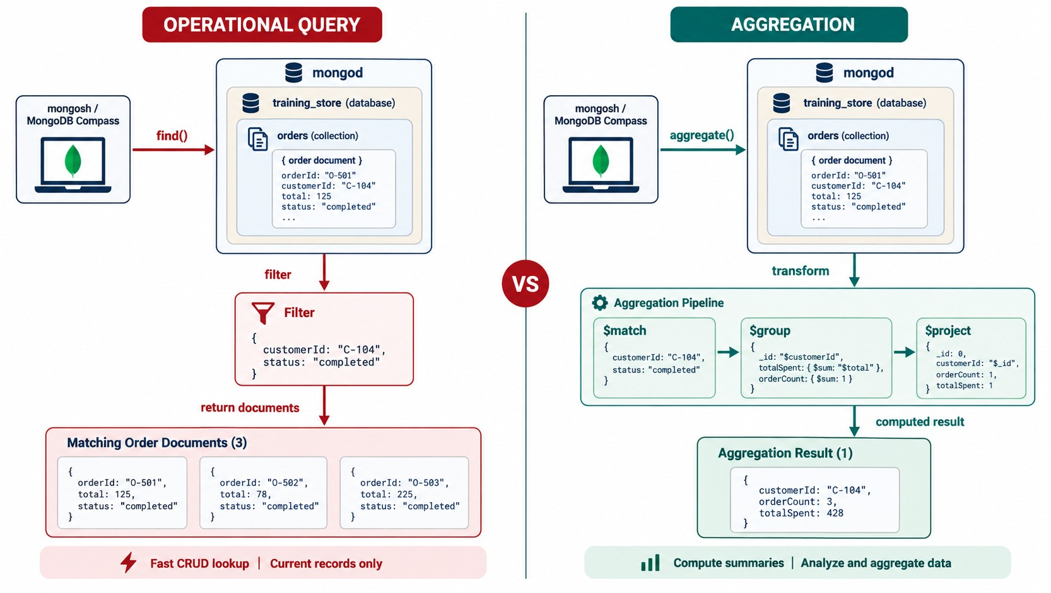
OPERATIONAL QUERIES VS. AGGREGATION
find() returns stored documents; aggregate() computes new ones.
find()
Returns the stored documents that match — everyday CRUD reads.
aggregate()
Computes new documents: counts, totals, averages, rankings, joins.
Our example
find() lists Aisha's paid orders; aggregate() says they total 3418.62.
RULE OF THUMB Not stored in one document? Aggregate.
KEY TAKEAWAY Use find() to retrieve documents and aggregate() to compute answers from them.
8
© 2026 by Innovation In Software Corporation
Notes:
KEY TALKING POINTS
------------------
- Two tools, two jobs
find() returns stored documents that match a filter.
It is the right tool for everyday reads: one order, a customer's orders, the books in the catalog.
- When to aggregate
Use aggregate() when the answer isn't stored in any single document: a count, a total, an average, a ranking or a join.
The pipeline computes new documents from the stored ones.
- In training_store
find() can list Aisha Khan's paid orders.
Only aggregate() can tell us that together they are worth 3418.62.
- What it shows
On the left, find() with a filter on customerId C-104 and status completed returns three matching order documents.
On the right, aggregate() runs $match, $group and $project and returns one computed result: C-104, three orders, totalSpent 428.
- How to read it
Compare the bottom bars: fast CRUD lookup of current records, versus computed summaries.
- About the data
The diagram uses a simplified status field and made-up customer numbers.
training_store orders have paymentStatus and fulfillmentStatus instead.
- Key point
find() gives back what is stored.
aggregate() gives back something new.

Slide 9
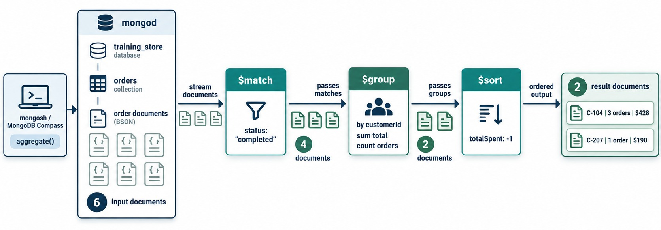
HOW DOCUMENTS MOVE THROUGH A PIPELINE
An array of stages; each stage's output is the next stage's input.
An array of stage documents
db.orders.aggregate([
{ $match: { … } },
{ $group: { … } },
{ $sort: { … } }
])
A stream
Stages run in array order; each sees only the last one's output.
Count and shape change
6 → 4 → 2: $match shrinks the stream, $group reshapes it.
READ-ONLY Stored orders never change.
KEY TAKEAWAY A pipeline is a stream: each stage transforms the documents and passes them on.
9
© 2026 by Innovation In Software Corporation
Notes:
KEY TALKING POINTS
------------------
- The syntax
aggregate() takes an array.
Each element is one stage document, such as { $match: … }.
MongoDB runs them in array order.
- A stream, not a table
Documents flow from stage to stage.
The output of one stage is the only input the next stage sees.
- Count and shape
Some stages change how many documents there are: $match, $group, $limit, $unwind.
Others change what each document looks like: $project, $set.
$group does both.
- Nothing is written
A normal pipeline doesn't change the stored documents.
Only the write stages $out and $merge save results.
- What it shows
mongosh or Compass calls aggregate() on the orders collection.
Six input documents stream into $match, four pass to $group by customerId, and $sort orders the two groups by totalSpent.
- How to read it
Follow the counts under each arrow: 6, 4, 2.
The two result documents are C-104 with three orders and C-207 with one.
- Key point
Each stage only sees what the previous stage passed on.

Slide 10
DEMO: ONE PIPELINE, STAGE BY STAGE
Paid revenue by fulfillment status — run it one stage at a time.
training_store.orders
17 documents
$match
paymentStatus: "PAID" → 13
$group
by fulfillmentStatus → 4
$sort
revenue: -1 → 4 ranked
⚙️
THE PIPELINE
📊
THE RESULT: 4 DOCUMENTS
db.orders.aggregate([
{ $match: { paymentStatus: "PAID" } },
{ $group: {
_id: "$fulfillmentStatus",
orders: { $sum: 1 },
revenue: { $sum: "$total" } } },
{ $sort: { revenue: -1 } }
])
_id | orders | revenue
SHIPPED | 6 | 3809.48
DELIVERED | 4 | 2788.42
PROCESSING | 2 | 2448.77
NEW | 1 | 71.77
Check: 6 + 4 + 2 + 1 = 13 paid orders.
KEY TAKEAWAY Run each stage on its own first — the counts tell you whether it did what you meant.
10
© 2026 by Innovation In Software Corporation
Notes:
KEY TALKING POINTS
------------------
- Demo 5.1
Type the pipeline in mongosh one stage at a time.
Run the $match alone first: 13 documents, the paid orders.
- Add $group
Append $group.
Seventeen orders became 13, and 13 become 4: one per fulfillmentStatus.
orders counts with $sum: 1, and revenue adds total.
- Add $sort
Append $sort on revenue, descending.
SHIPPED leads with six orders worth 3809.48, then DELIVERED 2788.42, PROCESSING 2448.77 and NEW 71.77.
- Decimal128 output
mongosh prints revenue as Decimal128('3809.48').
The slide shows the plain numbers.
- Check the sum
Six plus four plus two plus one is 13.
If the counts don't add up to the $match count, something is wrong.

Slide 11
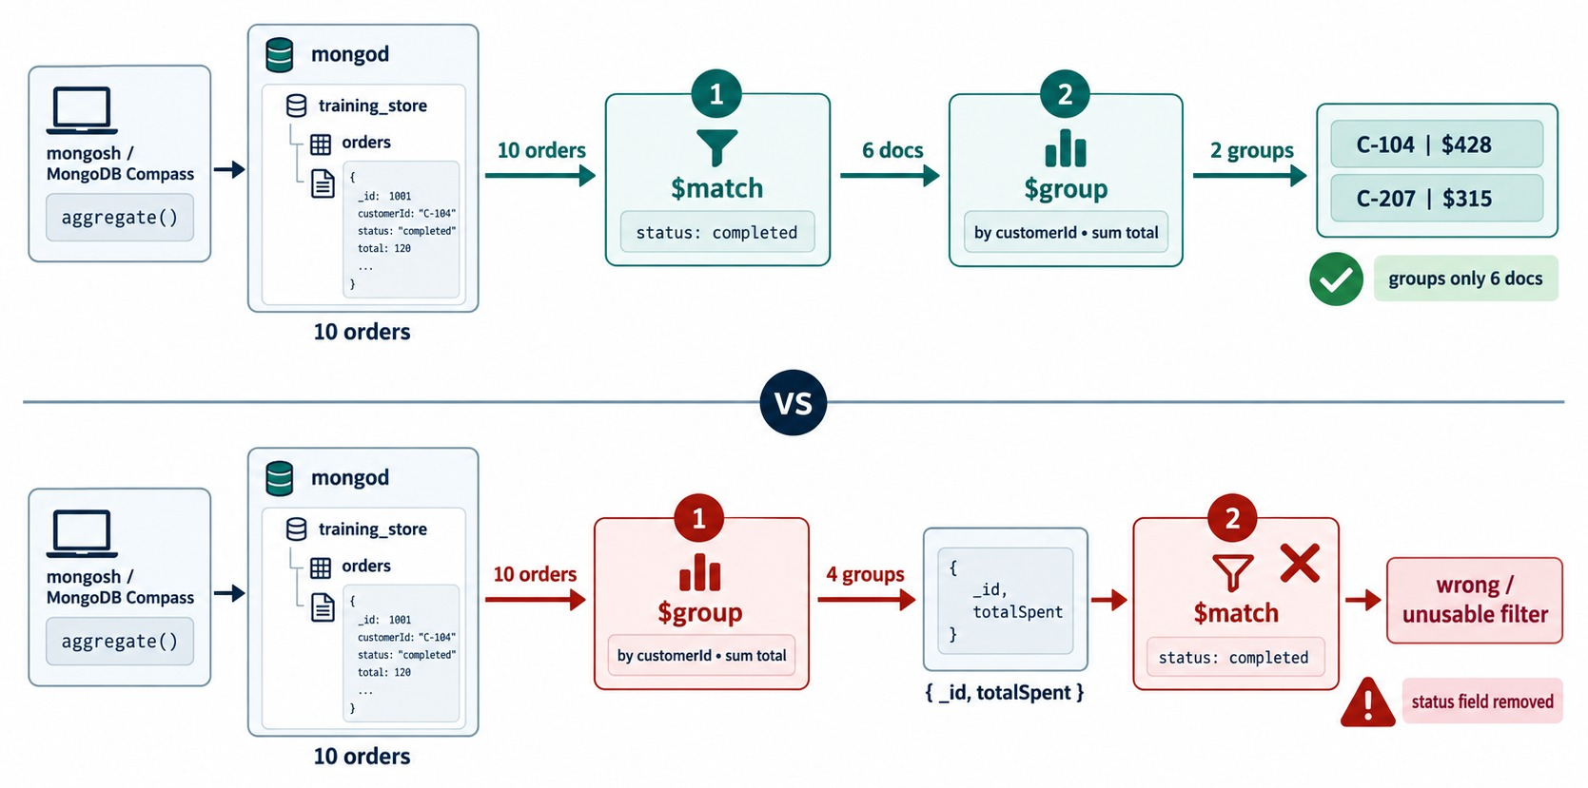
STAGE ORDER MATTERS
Match then group is a report; group then match returns nothing.
Match, then group
Keep PAID orders, then total them: paid revenue per customer.
Group, then match
$group keeps only _id and totals — paymentStatus is gone.
✕
Wrong order on training_store
{ $group: { _id: "$customerId",
spent: { $sum: "$total" } } },
{ $match: { paymentStatus: "PAID" } }
// → 0 documents
KEY TAKEAWAY Stage order is part of the question — filter on stored fields before $group removes them.
11
© 2026 by Innovation In Software Corporation
Notes:
KEY TALKING POINTS
------------------
- Order is meaning
Stages run in the order you write them.
Swap two stages and you may ask a different question, or no question at all.
- Group, then match
$group outputs only _id and the accumulator fields.
A $match on paymentStatus after it looks for a field that no longer exists, so it returns nothing.
On training_store this pipeline returns zero documents.
- The fix
Filter first, then group.
Every total is then paid revenue only.
- What it shows
Top row: ten orders, $match on status completed keeps six, and $group by customerId makes two groups.
Bottom row: $group runs first and outputs only _id and totalSpent, so the later $match has no status field to test.
- How to read it
Green is the correct order.
Red marks the wrong one: status field removed, wrong or unusable filter.
- Key point
Filter on stored fields before $group removes them.

Slide 12
PART 2: FILTER AND SHAPE
Choose the documents, then choose — or compute — their fields.
✓ Part 1
Pipelines
Part 2
Filter and shape
Part 3
Group
Part 4
Arrays and joins
Part 5
Reports
Part 6
Performance
SO FAR
NEXT QUESTION
How do we keep only the documents we need, and give them the shape the report needs?
✓
A pipeline is an ordered array of stages
✓
Each stage sees only the previous output
IN THIS PART
✓
Filter before $group removes fields
$match: filter the stream
1
2
$match on real fields and dates
3
$project: include, exclude, rename
4
Calculated fields and $set
5
$sort and $limit: top-N
12
© 2026 by Innovation In Software Corporation
Notes:
KEY TALKING POINTS
------------------
- Connecting the parts
Part 1 showed the stream.
Part 2 introduces the stages that almost every pipeline uses: $match, $project, $set, $sort and $limit.
- Watch for
Real field names, Decimal128 money and missing fields.
They are where most first pipelines go wrong.

Slide 13
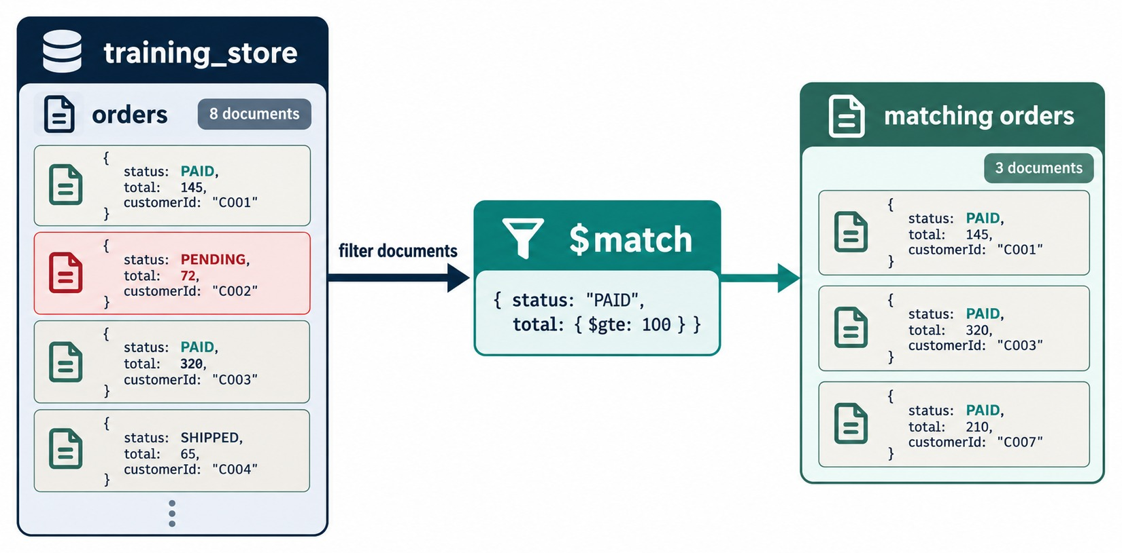
THE $MATCH STAGE
Keep only the documents that satisfy the filter.
Paid orders of 1000 or more
{ $match: {
paymentStatus: "PAID",
total: { $gte:
Decimal128("1000.00") }
} }
Result
4 orders: O6101, O6202, O6301 and O6304.
Put it first
Later stages then handle 4 documents, not 17.
SAME LANGUAGE Every Module 4 filter works here.
KEY TAKEAWAY $match filters with the find() query language — and belongs as early as possible.
13
© 2026 by Innovation In Software Corporation
Notes:
KEY TALKING POINTS
------------------
- $match filters
$match keeps the documents that satisfy a filter and drops the rest.
It uses exactly the query language from Module 4.
- Our high-value orders
paymentStatus PAID and total at least Decimal128 1000.00 match four orders: O6101, O6202, O6301 and O6304.
- Put it first
A selective $match at the start means every later stage works on fewer documents.
As the first stage it can also use an index, which is Module 6.
- What it shows
Eight orders enter $match with status PAID and total at least 100.
Three documents come out, with totals 145, 320 and 210.
- How to read it
The pending order and the shipped order are dropped.
Each remaining order meets both conditions.
- About the data
The diagram's status field stands for training_store's paymentStatus.
- Key point
$match uses the same filter language as find().

Slide 14
$MATCH ON REAL TRAINING_STORE FIELDS
Categories, a date range and a nested array path.
Active laptops and accessories
Reviews written in August
Customers in Ontario or Quebec
db.products.aggregate([
{ $match: {
active: true,
category: { $in:
["LAPTOP", "ACCESSORY"] }
} }
])
// 7 products (XBAD is one)
db.reviews.aggregate([
{ $match: { createdAt: {
$gte: ISODate("2026-08-01"),
$lt: ISODate("2026-09-01")
} } }
])
// 3 reviews: L110, B300, P1001
db.customers.aggregate([
{ $match: {
"addresses.province":
{ $in: ["Ontario", "Quebec"] }
} }
])
// 3 customers: C101, C412, C515
Same operators
Half-open dates
TRY IT Run each filter and check the count.
$in, ranges and dotted paths behave exactly as in find().
$gte the first day, $lt the next month — no gap, no overlap.
KEY TAKEAWAY $match speaks the query language you already know — use the real field paths and types.
14
© 2026 by Innovation In Software Corporation
Notes:
KEY TALKING POINTS
------------------
- Categories
Active laptops and accessories: L100, L110, P1001, A400, A410, A500 and XBAD.
L190 is a laptop but inactive, so it is filtered out.
- Dates
The half-open range, $gte the first of August and $lt the first of September, catches every August instant exactly once.
The August reviews are for L110, B300 and P1001.
- Nested arrays
addresses is an array of documents.
"addresses.province" matches if any address is in Ontario or Quebec: Aisha Khan (C101), Jordan Lee (C412) and Sam Okonkwo (C515), who is inactive but still matches.
- Try it
Have learners run these three filters, plus the paid and high-value filter from the last slide, and check each count.
The high-value filter must use Decimal128, not a plain number written as a string.

Slide 15
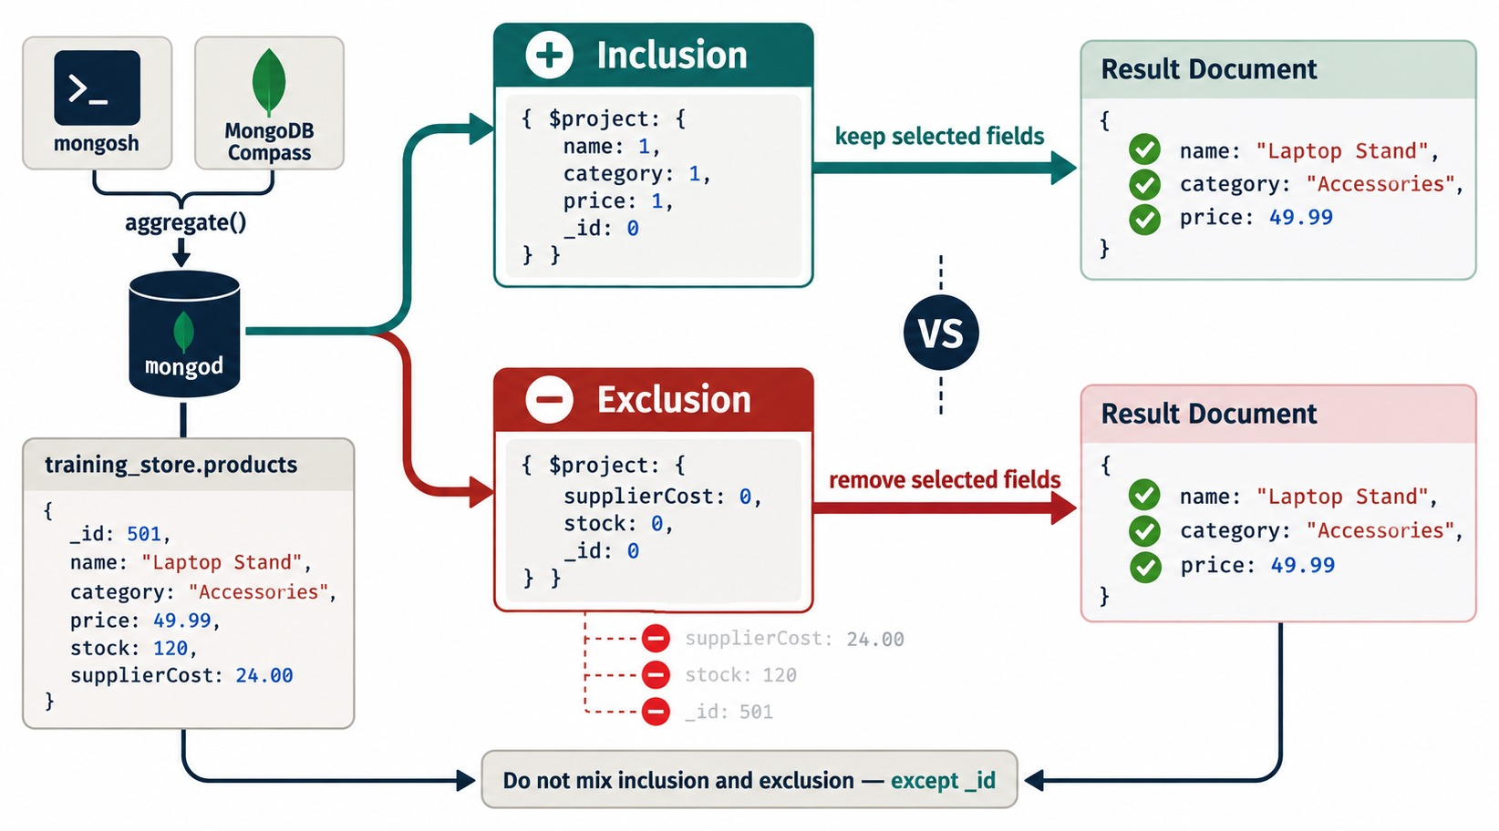
$PROJECT: INCLUDE, EXCLUDE, RENAME
Decide exactly which fields leave the stage.
Rename sku, keep two fields
db.products.aggregate([
{ $project: { _id: 0,
productCode: "$sku",
name: 1, price: 1 } }
])
1 or 0
1 keeps a field, 0 drops it — never both, except _id.
Rename
productCode: "$sku" copies the value under a new name.
OUTPUT ONLY Stored products are unchanged.
KEY TAKEAWAY $project decides the output shape: keep, drop, rename — the stored document stays the same.
15
© 2026 by Innovation In Software Corporation
Notes:
KEY TALKING POINTS
------------------
- $project controls the output shape
1 includes a field and 0 excludes it.
_id is included unless you set it to 0.
- Include or exclude — not both
A projection is either a list of fields to keep or a list of fields to drop.
The only field you may exclude in an inclusion projection is _id.
- Rename and compute
A new name with a $ path copies a value: productName: "$name".
An expression computes one.
Both change only the pipeline output, never the stored product.
- What it shows
One product, a Laptop Stand, projected two ways.
Inclusion keeps name, category and price.
Exclusion drops supplierCost, stock and _id.
Both give the same result document.
- How to read it
The banner at the bottom states the rule: do not mix inclusion and exclusion, except _id.
- Key point
Pick one style per projection; _id is the only exception.

Slide 16
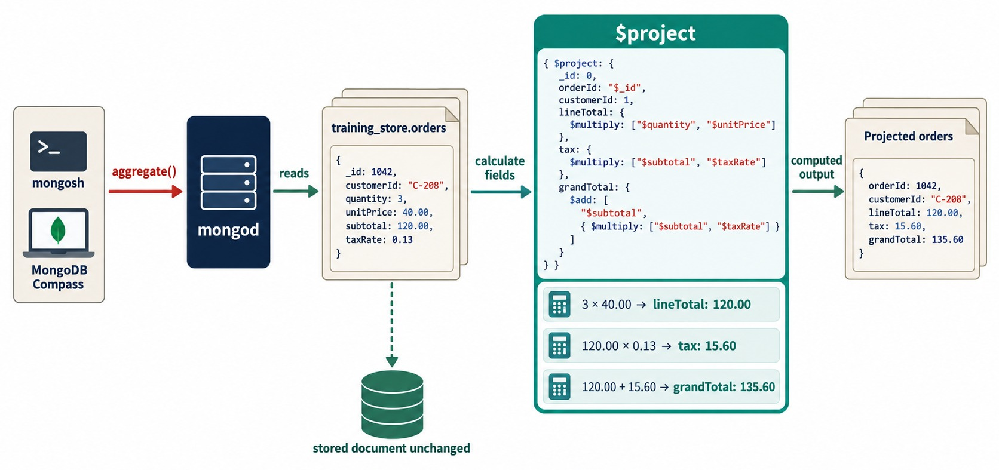
CALCULATED FIELDS
Expressions compute values that aren't stored.
Line revenue (after $unwind)
{ $set: { lineRevenue: {
$multiply: ["$items.quantity",
"$items.unitPrice"]
} } }
No lineTotal
training_store stores quantity and unitPrice — compute the line.
$project or $set
$project keeps only listed fields; $set adds fields and keeps the rest.
KEY TAKEAWAY Compute what the report needs with expressions — $set for helper fields, $project for the final shape.
16
© 2026 by Innovation In Software Corporation
Notes:
KEY TALKING POINTS
------------------
- Expressions per document
Arithmetic expressions run once for each document: $add, $subtract, $multiply, $divide and $round.
- Line revenue
training_store stores items.quantity and items.unitPrice.
There is no lineTotal field, so we compute it: quantity times unitPrice.
Guides that read items.lineTotal get null and a zero sum.
- $project or $set
$project returns only the fields you list.
$set, also called $addFields, adds or replaces fields and keeps everything else.
Use $set for helper fields in the middle of a pipeline, $project for the final shape.
- What it shows
An order with quantity 3, unitPrice 40.00, subtotal 120.00 and taxRate 0.13 goes through $project.
It outputs lineTotal 120.00, tax 15.60 and grandTotal 135.60.
- How to read it
Read the three calculator rows: 3 × 40.00, then 120.00 × 0.13, then 120.00 + 15.60.
The stored document stays unchanged.
- About the data
training_store has no taxRate field; it stores tax as an amount.
The line calculation, quantity times unitPrice, is exactly the one we use.
- Key point
Compute what isn't stored — the stored document never changes.

Slide 17
CALCULATED FIELDS YOU CAN CHECK
Rebuild each order's total — and survive a missing shippingFee.
Pipeline
✓
Result
db.orders.aggregate([
{ $match: { orderNumber:
{ $in: ["O6201", "O6301"] } } },
{ $set: { shipping: { $ifNull:
["$shippingFee", Decimal128("0.00")] } } },
{ $set: { checkTotal: { $add:
["$subtotal", "$tax", "$shipping"] } } },
{ $project: { _id: 0, orderNumber: 1,
total: 1, shipping: 1, checkTotal: 1 } }
])
{ orderNumber: "O6201",
total: Decimal128("79.07"),
shipping: Decimal128("0.00"),
checkTotal: Decimal128("79.07") }
{ orderNumber: "O6301",
total: Decimal128("1512.23"),
shipping: Decimal128("15.00"),
checkTotal: Decimal128("1512.23") }
$ifNull
$add
WHY CHECK checkTotal ≠ total means bad data — or a bad pipeline.
O6201 has no shippingFee, so 0.00 is used instead of null.
subtotal + tax + shipping rebuilds the stored total.
KEY TAKEAWAY Handle missing fields with $ifNull before calculating — one null turns the whole result into null.
17
© 2026 by Innovation In Software Corporation
Notes:
KEY TALKING POINTS
------------------
- The missing field
O6201 has no shippingFee at all.
$add with a missing value returns null, so without $ifNull, checkTotal would be null for O6201.
- $ifNull
$ifNull returns the first value that isn't null or missing, here Decimal128 0.00.
Six orders have no shippingFee: O5001, O6201, O6202, O6304, O6402 and O6499.
- The check
For O6301, 1324.98 plus 172.25 plus 15.00 is 1512.23, the stored total.
For O6201, 69.97 plus 9.10 plus 0.00 is 79.07.
- Field order
An inclusion $project keeps the input order, and $set appended shipping and checkTotal at the end.
That is why total prints before them.
- For fast finishers
Add the same shipping-safe total to every paid order, plus line revenue, full names, an order-size class and a reporting month.
Each one returns in a later part of this module.

Slide 18
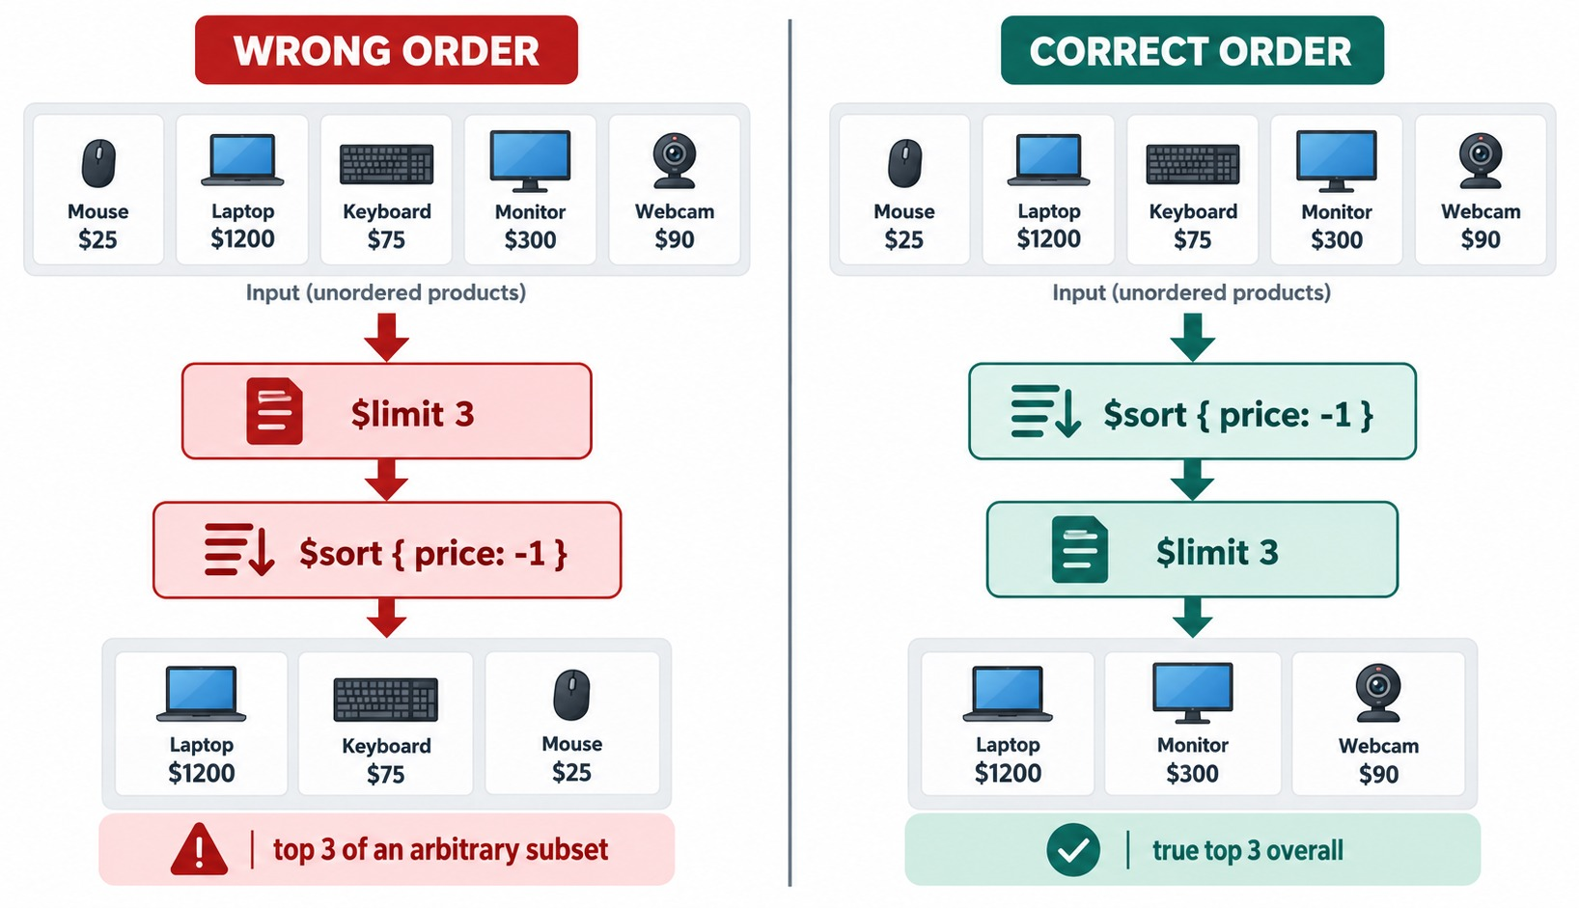
$SORT BEFORE $LIMIT
A top-N report sorts the whole stream, then keeps N.
Top three paid orders
{ $match: {
paymentStatus: "PAID" } },
{ $sort: { total: -1,
orderNumber: 1 } },
{ $limit: 3 }
Result
O6202 and O6304 tie at 2146.99; O6301 is third at 1512.23.
Tie-breaker
orderNumber makes the order repeatable.
$skip
$sort → $skip → $limit pages through results.
KEY TAKEAWAY Every top-N report is $sort, then $limit — with a tie-breaker when values can tie.
18
© 2026 by Innovation In Software Corporation
Notes:
KEY TALKING POINTS
------------------
- Top N needs sort first
$limit keeps the first N documents that reach it.
If they haven't been sorted yet, you get N arbitrary documents.
- Ties
O6202 and O6304 both total 2146.99.
Adding orderNumber as a second sort key makes the order repeatable.
- $skip
$sort, then $skip, then $limit pages through results.
Large skips get slow, so production code often pages by range instead.
- What it shows
Five products.
On the left, $limit 3 runs before $sort, so the result is Laptop, Keyboard and Mouse: the top 3 of an arbitrary subset.
On the right, $sort by price then $limit 3 gives Laptop, Monitor and Webcam: the true top 3.
- How to read it
Compare the two output rows.
The Monitor at 300 is missing from the wrong one.
- Key point
Every top-N report is $sort, then $limit.

Slide 19
EXERCISE: BUILD A SHOE PRICE LIST
Filter, shape, sort and limit — then predict the output.
PRACTICE EXERCISE
10 MIN
SCENARIO
YOUR TASKS
EXPECTED OUTCOME
Marketing wants the two most expensive active shoes: name and price only, highest price first.
training_store has three shoes: S200, S210 and S290.
1
Choose the four stages and their order
✓
$match → $project → $sort → $limit
2
Write the $match
✓
{ active: true, category: "SHOE" }
3
Write the $project
✓
{ _id: 0, name: 1, price: 1 }
4
Add $sort and $limit; predict the output
Running Shoe 129.99, then Trail Shoe 89.99
✓
KEY TAKEAWAY Filter first, shape the output, then sort before you limit.
19
© 2026 by Innovation In Software Corporation
Notes:
KEY TALKING POINTS
------------------
- How to run it
Pairs, five minutes to write it, then run it on the instructor screen.
- The stages
$match on active true and category SHOE, $project name and price without _id, $sort price descending, $limit 2.
- The answer
Running Shoe at 129.99, then Trail Shoe at 89.99.
The Clearance Shoe at 44.99 is third, so $limit drops it.
- A variation
Ask what happens if $project comes before $match.
The projection removes category and active, so the $match then finds nothing.
That is Part 1's lesson again.

Slide 20
PART 3: GROUP AND SUMMARIZE
Many documents in, one summary per key out.
✓ Part 1
Pipelines
✓ Part 2
Filter and shape
Part 3
Group
Part 4
Arrays and joins
Part 5
Reports
Part 6
Performance
SO FAR
NEXT QUESTION
How do we turn many documents into one summary per customer, status or category?
✓
$match keeps the documents you need
✓
$project and $set shape documents
IN THIS PART
✓
Top-N is $sort, then $limit
$group, _id and accumulators
1
2
Products by category
3
Grouping by several fields
4
What $group keeps — and loses
5
$count and $sortByCount
20
© 2026 by Innovation In Software Corporation
Notes:
KEY TALKING POINTS
------------------
- Connecting the parts
Part 2 worked on one document at a time.
$group is different: it combines many documents into one.
- Watch for
What _id means in the output, and which fields survive the stage.

Slide 21
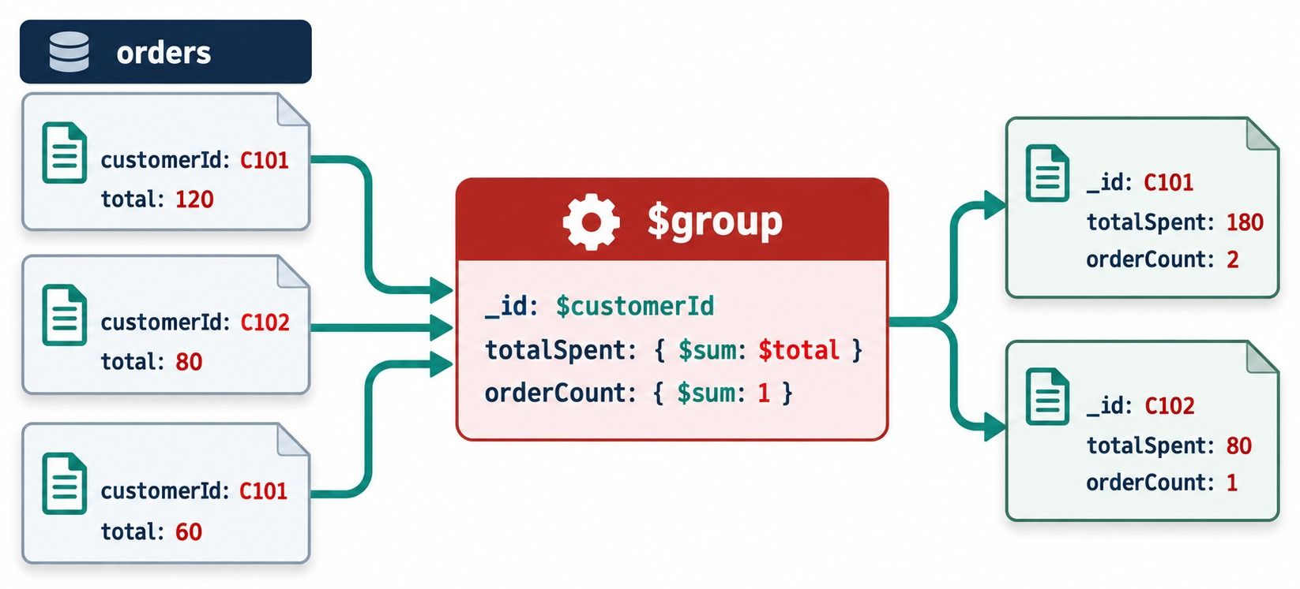
$GROUP: ONE DOCUMENT PER KEY
_id is the grouping key; every other field is an accumulator.
_id
"$customerId" — one output per distinct value; null means one group.
Accumulators
$sum, $avg, $min, $max, $first, $last, $push, $addToSet.
Count or total
$sum: 1 counts documents; $sum: "$total" adds values.
OUR DATA Aisha's 4 paid orders → spent 3418.62.
KEY TAKEAWAY $group turns many documents into one per key — _id names the key, accumulators compute the rest.
21
© 2026 by Innovation In Software Corporation
Notes:
KEY TALKING POINTS
------------------
- One output per key
$group collects documents with the same _id value into one output document.
_id: "$customerId" means one result per customer.
- Accumulators
Every other field in $group must be an accumulator: $sum, $avg, $min, $max, $first, $last, $push or $addToSet.
- Two kinds of $sum
$sum: 1 adds one per document, so it counts.
$sum: "$total" adds the field's values.
- _id: null
Use _id: null to put the whole input in one group, for a grand total.
- What it shows
Three orders: C101 with 120, C102 with 80 and C101 with 60.
$group by customerId sums total and counts orders.
The output is C101 with 180 and two orders, and C102 with 80 and one order.
- How to read it
Follow the two C101 arrows into the same group.
- Key point
_id is the grouping key; the other fields are accumulators.

Slide 22
PRODUCTS BY CATEGORY
Count, average, minimum and maximum price for active products.
Pipeline
✓
Result (rounded)
db.products.aggregate([
{ $match: { active: true } },
{ $group: {
_id: "$category",
productCount: { $sum: 1 },
averagePrice: { $avg: "$price" },
minimumPrice: { $min: "$price" },
maximumPrice: { $max: "$price" }
} },
{ $sort: { averagePrice: -1 } }
])
_id count averagePrice
LAPTOP 2 1599.99
SHOE 3 88.32
ACCESSORY 5 86.24
BOOK 2 49.99
L190 is inactive
So LAPTOP counts 2, not 3.
XBAD TRAP Price "49.99" is a string: $avg skips it, $max returns it.
KEY TAKEAWAY Accumulators summarize each group — and a wrongly typed value changes the answer quietly.
22
© 2026 by Innovation In Software Corporation
Notes:
KEY TALKING POINTS
------------------
- The pipeline
$match keeps the 12 active products.
$group makes one document per category with four accumulators.
$sort ranks categories by average price.
- The result
LAPTOP averages 1599.99 over two products, because L190 is inactive.
SHOE averages 88.32 over three.
ACCESSORY averages 86.24 and BOOK 49.99.
The exact SHOE average is 88.3233…; add $round in a $project for the report.
- The XBAD trap
ACCESSORY counts five products, because XBAD is active.
Its price is the string "49.99".
$avg and $sum ignore non-numbers, so the average uses four prices.
But $max compares by BSON type order, where strings rank above numbers, so ACCESSORY's maximumPrice is the string "49.99", not 249.99.
- Guide differences
Older guides expect ACCESSORY 4 and the order LAPTOP, ACCESSORY, SHOE, BOOK.
On a fresh load the counts are ACCESSORY 5 and the order is LAPTOP, SHOE, ACCESSORY, BOOK.
The fix for the data is to match price with $type: "decimal", or convert it with $toDecimal.

Slide 23
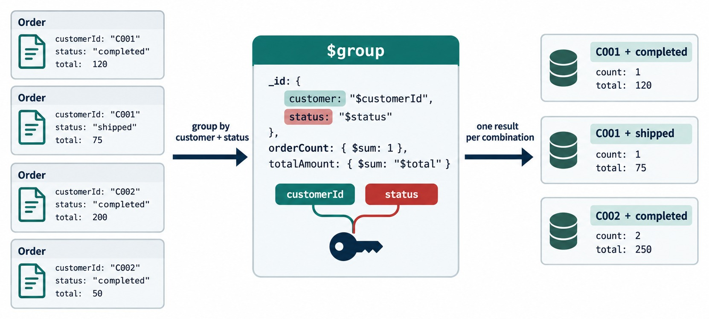
GROUPING BY SEVERAL FIELDS
A document as _id: one group per combination of values.
Payment × fulfillment
{ $group: {
_id: {
pay: "$paymentStatus",
ful: "$fulfillmentStatus" },
orders: { $sum: 1 },
revenue: { $sum: "$total" } } }
Result
7 groups; PAID + SHIPPED is largest: 6 orders, 3809.48.
Read _id in words
{ PENDING, NEW } = all pending, new orders: O5001, O6499.
KEY TAKEAWAY A compound _id groups by every combination — read it as a sentence about the orders it holds.
23
© 2026 by Innovation In Software Corporation
Notes:
KEY TALKING POINTS
------------------
- A compound key
_id can be a document.
Each unique combination of its fields becomes one group.
- Payment by fulfillment
Grouping training_store orders by paymentStatus and fulfillmentStatus gives seven combinations.
PAID and SHIPPED is the largest: six orders worth 3809.48.
- Read _id in words
The group with _id PENDING and NEW means all orders that are pending and new.
That is O5001 and O6499.
_id here is the grouping key, not an order's ObjectId.
- What it shows
Four orders grouped with _id: { customer, status }.
The result is three groups: C001 and completed, C001 and shipped, and C002 and completed with two orders totaling 250.
- How to read it
The key icon joins customerId and status into one grouping key.
- About the data
training_store has two status fields, so our version groups by paymentStatus and fulfillmentStatus.
- Key point
Every unique pair of values becomes its own summary document.

Slide 24
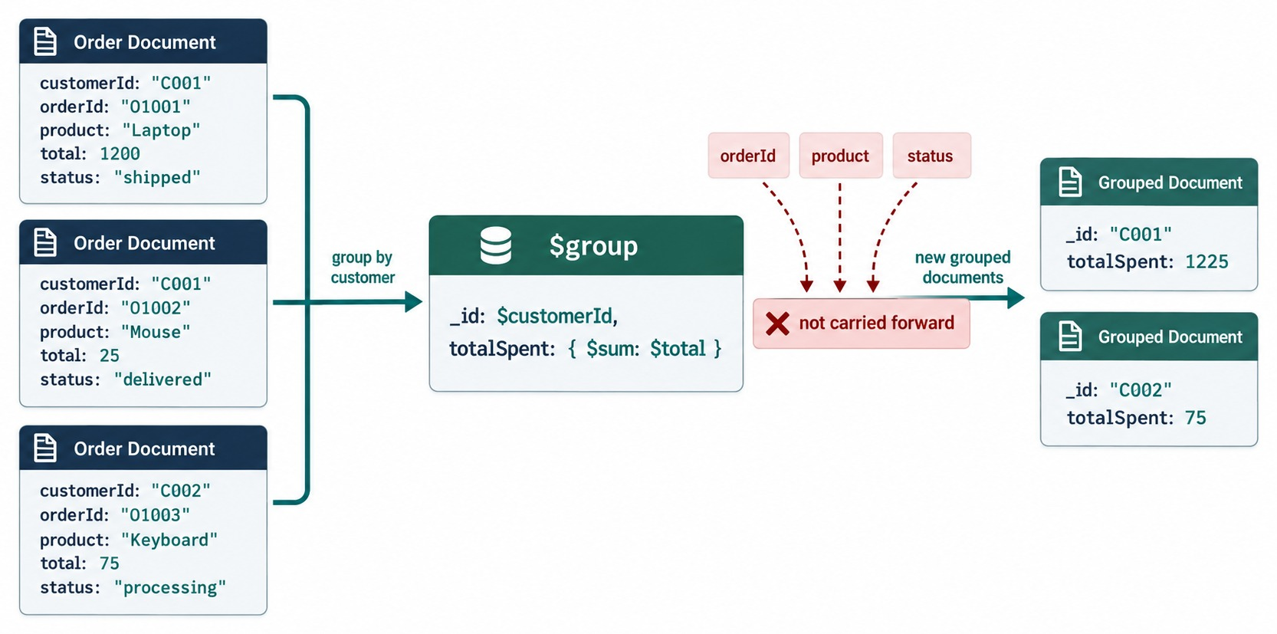
WHAT $GROUP KEEPS — AND LOSES
Only _id and the accumulators leave the stage.
Lost
orderNumber, items and fulfillmentStatus don't carry forward.
✓
Keep values with accumulators
{ $group: { _id: "$customerId",
spent: { $sum: "$total" },
orders: { $push: "$orderNumber" },
statuses: { $addToSet:
"$fulfillmentStatus" } } }
$first and $last
Sort first — then they pick a meaningful document.
KEY TAKEAWAY Anything a report needs after $group must be kept by an accumulator.
24
© 2026 by Innovation In Software Corporation
Notes:
KEY TALKING POINTS
------------------
- What survives $group
Only _id and the accumulator fields leave $group.
Every other field, such as orderNumber, items or fulfillmentStatus, is gone.
- Keep what you need
If the report needs a value, collect it with an accumulator.
$push keeps every value, $addToSet keeps unique values, and $first or $last keeps one.
- $first needs a $sort
Without a $sort before $group, first is whatever order the documents arrived in.
Sort first, then $first is meaningful.
- What it shows
Three orders with orderId, product, total and status.
$group by customer with totalSpent gives C001 1225 and C002 75.
- How to read it
The red tags orderId, product and status are not carried forward into the grouped documents.
- Key point
If the report needs a field, keep it with an accumulator.
- On our data
For Aisha Khan's paid orders, orders holds O6101, O6201, O6301 and O6306, and statuses holds SHIPPED and DELIVERED, each once.

Slide 25
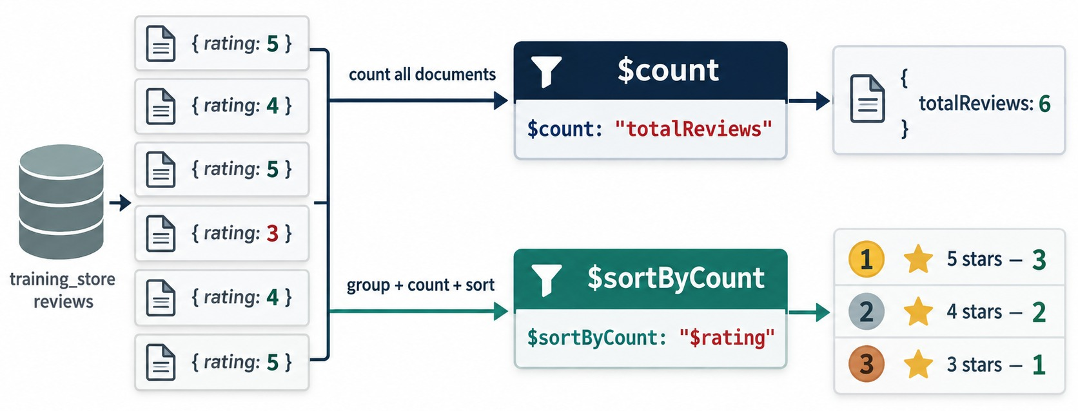
$COUNT AND $SORTBYCOUNT
Count the stream — or count and rank each value.
Reviews per rating
db.reviews.aggregate([
{ $sortByCount: "$rating" }
])
Result
5 stars: 3 · 4 stars: 2 · 3 stars: 1 — our six reviews.
$count
{ $count: "totalReviews" } → { totalReviews: 6 }
SHORTCUT $sortByCount = $group + $sum: 1 + $sort.
KEY TAKEAWAY $count counts what reaches it; $sortByCount counts and ranks each value in one stage.
25
© 2026 by Innovation In Software Corporation
Notes:
KEY TALKING POINTS
------------------
- $count
$count outputs one document holding the number of documents that reached it.
It counts the pipeline stream, not the whole collection.
- $sortByCount
$sortByCount groups by an expression, counts each group and sorts by the count, highest first.
It is shorthand for $group with $sum: 1 followed by $sort.
- The diagram is our data
training_store has six reviews: three 5-star, two 4-star and one 3-star.
- What it shows
Six reviews with ratings 5, 4, 5, 3, 4 and 5.
$count totalReviews returns 6.
$sortByCount on rating returns 5 stars 3, 4 stars 2 and 3 stars 1.
- How to read it
The upper path counts everything; the lower path groups, counts and sorts.
- Key point
These are exactly the six reviews in training_store.
- Guide difference
Exercise 5.2, the top-N checkpoint, runs $sortByCount on product category.
On a fresh load it returns ACCESSORY 5, then LAPTOP 3 and SHOE 3, then BOOK 2.
Older guides' ACCESSORY 4 predates the XBAD fixture.

Slide 26
EXERCISE: ORDERS BY PAYMENT STATUS
Group all orders — then check the counts add up.
PRACTICE EXERCISE
10 MIN
SCENARIO
YOUR TASKS
EXPECTED OUTCOME
Finance asks how many orders — and how much money — sit in each payment status.
Use all 17 orders, not only the paid ones.
1
Group by paymentStatus
✓
PAID: 13 orders, 9118.44
2
Count with $sum: 1; add total with $sum
✓
PENDING: 3 orders, 4488.39
✓
FAILED: 1 order, 45.19
3
Sort by revenue, highest first
✓
13 + 3 + 1 = 17 orders
4
Rename _id to paymentStatus in $project
KEY TAKEAWAY Check a grouped report by adding its counts back to the input count.
26
© 2026 by Innovation In Software Corporation
Notes:
KEY TALKING POINTS
------------------
- How to run it
Individually for five minutes, then compare.
No $match this time: the question is about every order.
- The pipeline
$group with _id "$paymentStatus", orders { $sum: 1 } and revenue { $sum: "$total" }; $sort revenue -1; $project with _id: 0 and paymentStatus: "$_id".
- The answer
PAID 13 orders worth 9118.44.
PENDING 3 orders worth 4488.39: O5001, O6401 and O6499.
FAILED 1 order worth 45.19: O6402.
- The habit
The counts add up to 17, the collection size.
That one check catches most mistakes in a $group.

Slide 27
PART 4: ARRAYS AND JOINS
Look inside the items array — and reach into other collections.
✓ Part 1
Pipelines
✓ Part 2
Filter and shape
✓ Part 3
Group
Part 4
Arrays and joins
Part 5
Reports
Part 6
Performance
SO FAR
NEXT QUESTION
How do we report on individual order lines, and add customer names that live in another collection?
✓
$group summarizes many documents per key
✓
Accumulators keep what the report needs
✓
Counts should add back up to the input
IN THIS PART
1
$unwind: one document per item
2
Product sales from order lines
3
The double-counting trap
4
$lookup: matched and unmatched
5
Customer spending with names
27
© 2026 by Innovation In Software Corporation
Notes:
KEY TALKING POINTS
------------------
- Why this part
An order embeds its items, and refers to its customer by id.
To report on products we open the array; to show names we join customers.
- Watch for
How many documents each stage produces.
$unwind multiplies them, and $lookup adds arrays.

Slide 28
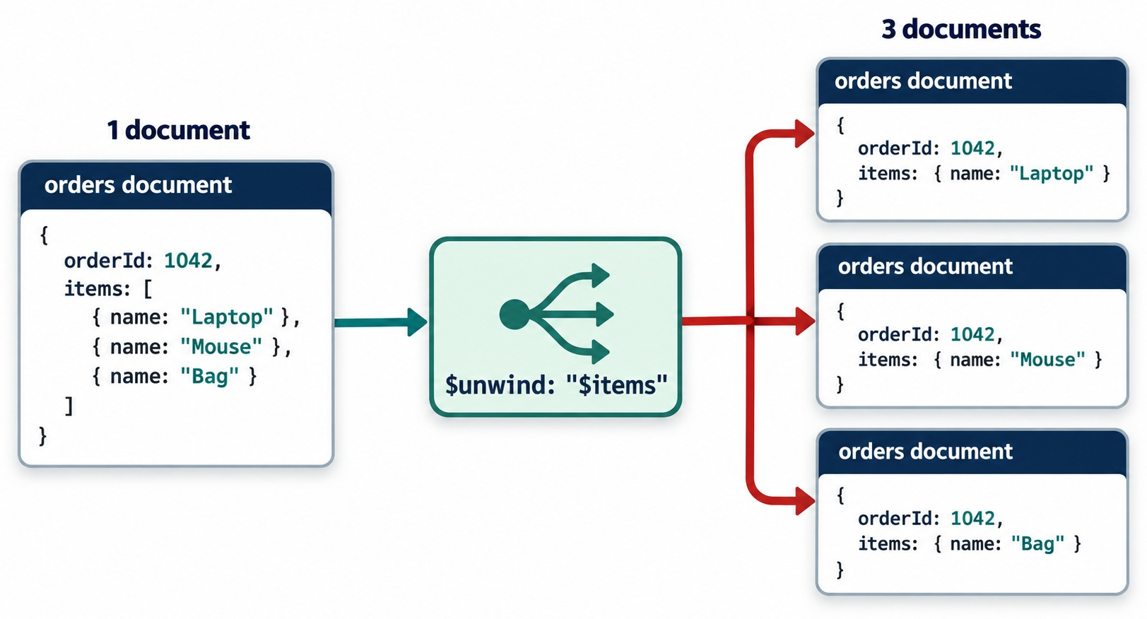
$UNWIND: ONE DOCUMENT PER ARRAY ELEMENT
An order with three items becomes three documents.
Our three-item order
db.orders.aggregate([
{ $match: { orderNumber: "O6303" } },
{ $unwind: "$items" }
])
Result
3 documents — items is now one object, not an array.
Scale
The 13 paid orders become 21 line documents.
OUTPUT ONLY Stored orders keep their arrays.
KEY TAKEAWAY $unwind turns each array element into its own document — filter first so it multiplies less.
28
© 2026 by Innovation In Software Corporation
Notes:
KEY TALKING POINTS
------------------
- One per element
$unwind outputs one copy of the document for each element of the array.
In each copy, the array field holds just that one element.
- Our three-item order
O6303 has three items: MongoDB Fundamentals, Query Cookbook and the Wireless Keyboard.
After $unwind it is three documents.
- Watch the size
The 13 paid orders become 21 line documents.
An order with 100 items becomes 100 documents, so filter before you unwind.
- What it shows
Order 1042 with items Laptop, Mouse and Bag goes through $unwind "$items".
Three order documents come out, each with a single item object.
- How to read it
In each output, items is one object, no longer an array.
- Key point
$unwind multiplies documents: one per array element.

Slide 29
PRODUCT SALES FROM ORDER LINES
Paid orders → lines → line revenue → one row per SKU.
Pipeline (Exercises 5.1 and 5.4)
✓
Result
db.orders.aggregate([
{ $match: { paymentStatus: "PAID" } },
{ $unwind: "$items" },
{ $set: { lineRevenue: { $multiply:
["$items.quantity", "$items.unitPrice"] } } },
{ $group: {
_id: "$items.sku",
unitsSold: { $sum: "$items.quantity" },
revenue: { $sum: "$lineRevenue" },
orderCount: { $sum: 1 } } },
{ $sort: { revenue: -1 } },
{ $limit: 5 }
])
_id units revenue orders
L110 2 3799.98 2
L100 2 2599.98 2
A500 2 499.98 2
S200 3 389.97 2
B300 3 179.97 2
orderCount
$sum: 1 counts lines — equal to orders here, as no order repeats a SKU.
ORDER Match → unwind → compute → group.
KEY TAKEAWAY Unwind after filtering, compute the line value, then group — that is the product-report pattern.
29
© 2026 by Innovation In Software Corporation
Notes:
KEY TALKING POINTS
------------------
- The pattern
Keep paid orders, open the items array, compute line revenue as quantity times unitPrice, then group by SKU.
It is the answer to Exercise 5.1 and the corrected pipeline of Exercise 5.4.
Lab 4 uses the same pattern, grouped by product category.
- The result
L110, the Ultrabook, leads with two units worth 3799.98.
L100 follows with 2599.98 and A500 with 499.98.
S200 and B300 complete the top five.
- Units versus revenue
Ranked by units instead, A410, the Wireless Mouse, leads with four.
The ranking depends on the metric.
- Why no lineTotal
The content guide groups on $items.lineTotal.
training_store has no such field, so that sum would be 0.
Compute it, as here.
- orderCount
$sum: 1 after $unwind counts lines.
No training_store order lists the same SKU twice, so it equals the number of orders.
In general, $addToSet the orderNumber and take $size.

Slide 30
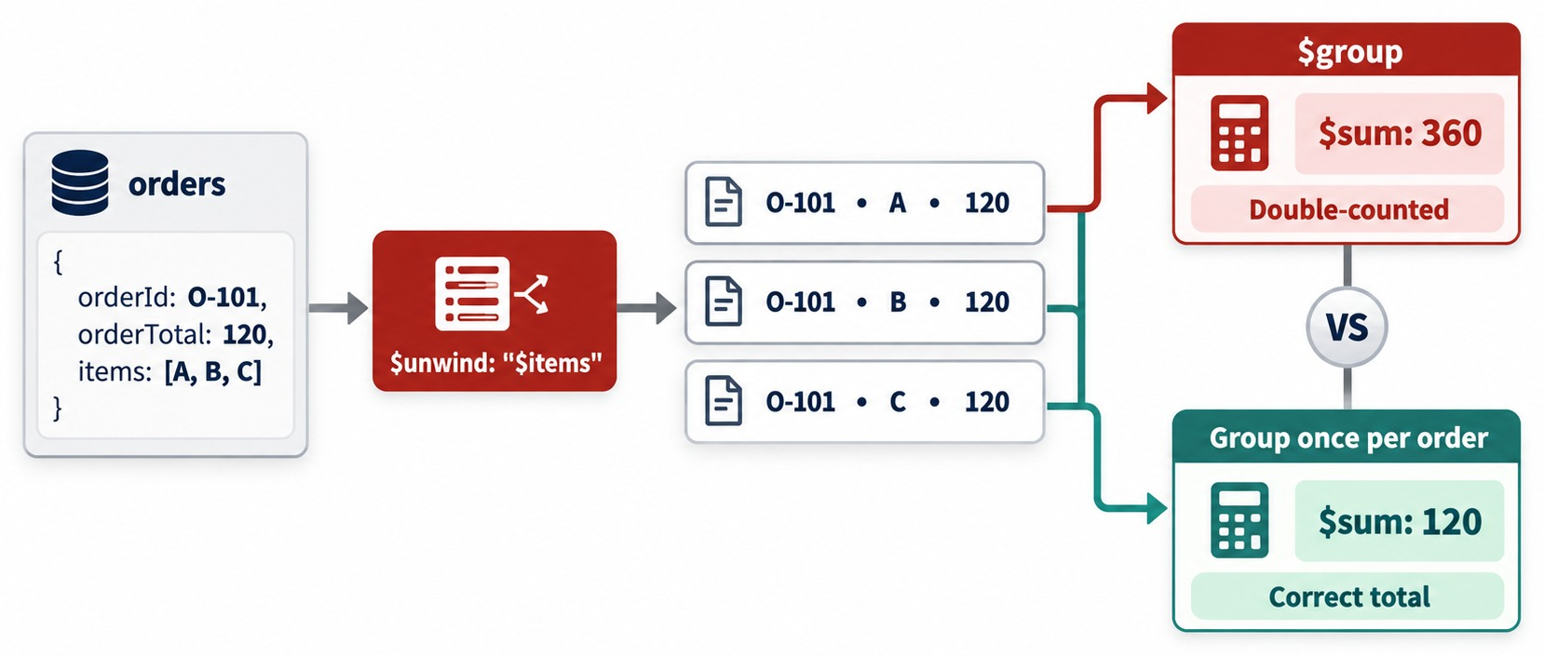
DOUBLE-COUNTING AFTER $UNWIND
Each line still carries the whole order's total.
The trap
O6303's total, 174.47, is summed three times — once per line.
On our data
Paid revenue is 9118.44; unwind first and it becomes 12119.25.
The rule
Sum order fields before $unwind; sum line values after it.
CHECK Known totals must not change.
KEY TAKEAWAY After $unwind, sum line values — never the order total that every line repeats.
30
© 2026 by Innovation In Software Corporation
Notes:
KEY TALKING POINTS
------------------
- The trap
After $unwind, every line document still carries the whole order's total.
Summing total then counts a two-item order twice and a three-item order three times.
- On our data
Paid revenue is 9118.44.
Unwinding first and summing total gives 12119.25: wrong by more than 3000.
- The rule
Sum order-level fields before $unwind.
Sum line-level values, quantity times unitPrice, after it.
- What it shows
Order O-101 with orderTotal 120 and three items is unwound into three documents, each still carrying 120.
$sum gives 360, double-counted.
Grouping once per order gives the correct 120.
- How to read it
Red is the wrong sum, green the correct total.
- Key point
Don't sum an order field after unwinding its lines.

Slide 31
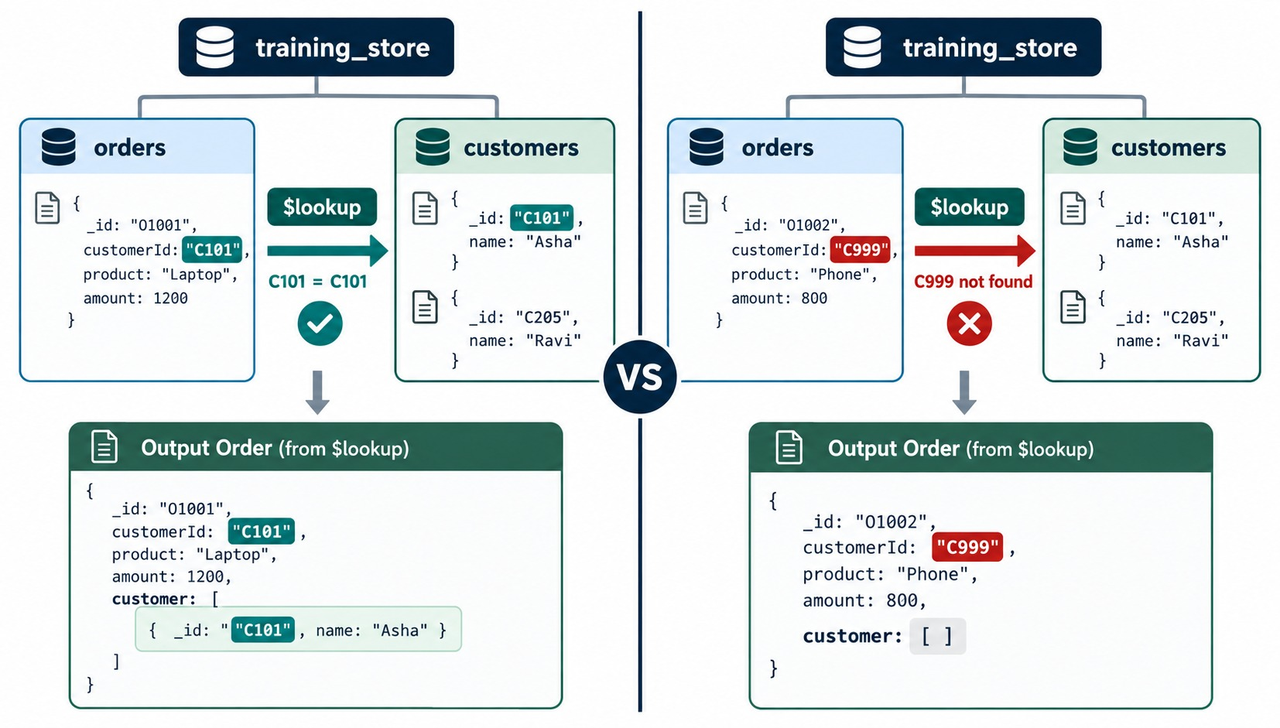
$LOOKUP: MATCHED AND UNMATCHED
Join another collection; the matches arrive as an array.
Orders → customers
{ $lookup: {
from: "customers",
localField: "customerId",
foreignField: "_id",
as: "customer" } }
Always an array
One match → [ {…} ]; no match → [ ].
O6499
Its customerId matches no one, so customer is [ ].
KEEP IT $unwind with preserveNullAndEmptyArrays: true.
KEY TAKEAWAY $lookup is a left outer join — it never drops an order, it just leaves the array empty.
31
© 2026 by Innovation In Software Corporation
Notes:
KEY TALKING POINTS
------------------
- A left outer join
$lookup adds the matching documents from another collection to each input document.
Input documents without a match are kept.
- Always an array
The as field is always an array: one element for one match, several for several, and empty for none.
- Our unmatched order
O6499's customerId matches no customer, so its customer array is empty.
A plain $unwind would drop it.
preserveNullAndEmptyArrays: true keeps it.
- What it shows
Left: order O1001 with customerId C101 finds customer Asha, so customer holds one document.
Right: order O1002 with customerId C999 finds nothing, so customer is an empty array.
- How to read it
Both orders stay in the output.
Only the customer array differs.
- About the data
The diagram stores string ids for readability.
In training_store, customerId holds the customer's ObjectId, and C101 is Aisha Khan.
- Key point
$lookup never drops an input document; an empty array means no match.

Slide 32
CUSTOMER SPENDING WITH NAMES
Group first, then join — five lookups instead of thirteen.
Pipeline
✓
Result
db.orders.aggregate([
{ $match: { paymentStatus: "PAID" } },
{ $group: { _id: "$customerId",
orders: { $sum: 1 },
spent: { $sum: "$total" } } },
{ $lookup: { from: "customers",
localField: "_id", foreignField: "_id",
as: "customer" } },
{ $unwind: "$customer" },
{ $project: { _id: 0, orders: 1, spent: 1,
name: { $concat: ["$customer.name.first",
" ", "$customer.name.last"] } } },
{ $sort: { spent: -1 } }
])
name orders spent
Aisha Khan 4 3418.62
Maya Chen 2 2497.97
Jordan Lee 2 2321.46
Luis Romero 3 668.04
Priya Patel 2 212.35
No Sam Okonkwo
C515's only order, O6402, failed payment.
JOIN LATE Look up after $group — one per customer.
KEY TAKEAWAY Group before you join — the lookup then runs once per customer, not once per order.
32
© 2026 by Innovation In Software Corporation
Notes:
KEY TALKING POINTS
------------------
- The pipeline
Match paid orders, group them by customerId, then look up each customer.
The $group _id is the customer's ObjectId, so localField is _id.
- The names
Customers store name.first and name.last, so the full name is a $concat of the two.
The content guide's $firstName and $lastName don't exist here; they would give null.
- The result
Aisha Khan spent 3418.62 over four paid orders: O6101, O6201, O6301 and O6306.
Maya Chen and Jordan Lee follow, each with one large laptop order.
- Why no O6499 problem here
O6499 is pending, so the $match already removed it.
Every grouped customerId finds a customer, and a plain $unwind is safe.
- Email
To add the email, project "$customer.contact.email"; the email is nested under contact.

Slide 33
EXERCISE: HOW BIG DOES THE STREAM GET?
Predict the document count after each stage.
PRACTICE EXERCISE
5 MIN
SCENARIO
YOUR TASKS
EXPECTED OUTCOME
Before building the product report, predict how many documents each stage passes on.
1
Predict the count after $match
✓
13 paid orders
2
Predict the count after $unwind
✓
{ lines: 21 }
db.orders.aggregate([
{ $match: { paymentStatus: "PAID" } },
{ $unwind: "$items" },
{ $count: "lines" }
])
3
Name the paid order with the most lines
✓
O6303 — three items
✓
26 lines, filtered back to 21: more work
4
What if $unwind came before $match?
KEY TAKEAWAY Know how many documents each stage emits — it is the first check of any pipeline.
33
© 2026 by Innovation In Software Corporation
Notes:
KEY TALKING POINTS
------------------
- How to run it
Two minutes to write predictions, then run it on the instructor screen.
- The counts
13 paid orders.
Six have one item, six have two and O6303 has three: 6 + 12 + 3 = 21 lines.
- The other order
All 17 orders hold 26 lines.
Unwinding first creates all 26 documents and then throws 5 away, the same result for more work.
- Why it matters
On a real store with millions of orders, that difference is the difference between a fast and a slow report.

Slide 34
PART 5: CONDITIONS, DATES AND REPORTS
Per-document decisions, calendar reports and several metrics at once.
✓ Part 1
Pipelines
✓ Part 2
Filter and shape
✓ Part 3
Group
✓ Part 4
Arrays and joins
Part 5
Reports
Part 6
Performance
SO FAR
NEXT QUESTION
How do we label, bucket and date-group documents — and return a whole dashboard from one call?
✓
$unwind opens the items array
✓
Sum line values, never repeated totals
IN THIS PART
✓
$lookup joins as an array — group first
$cond and $switch
1
2
Dates and time zones
3
Monthly paid sales
4
$bucket price bands
5
$facet: several reports at once
6
A paid-orders dashboard
34
© 2026 by Innovation In Software Corporation
Notes:
KEY TALKING POINTS
------------------
- Why this part
Real reports need labels, calendar periods and several metrics side by side.
These stages and expressions provide them.
- Watch for
Time zones in date grouping, and the one-document shape of $facet output.

Slide 35
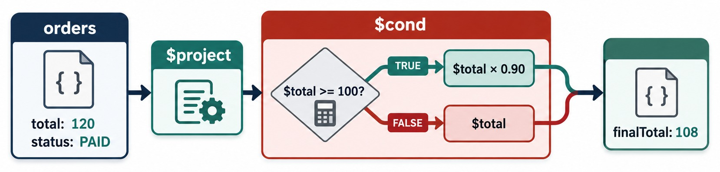
$COND: DECIDE PER DOCUMENT
If the condition is true use one value, otherwise the other.
Inside $set
Result
$switch
orderSize: { $cond: [
{ $gte: ["$total",
Decimal128("1000.00")] },
"HIGH_VALUE", "STANDARD" ] }
O6201 (79.07) → STANDARD; O6202 (2146.99) → HIGH_VALUE. Paid orders: 4 HIGH_VALUE, 9 STANDARD.
Several cases in order; the first true case wins, and default catches the rest.
KEY TAKEAWAY $cond and $switch put business rules into the pipeline — one decision per document.
35
© 2026 by Innovation In Software Corporation
Notes:
KEY TALKING POINTS
------------------
- $cond is if-then-else
$cond takes a condition, a value when true and a value when false.
It runs for each document.
- Order size
We label paid orders HIGH_VALUE when total is at least 1000.00, otherwise STANDARD.
O6201 at 79.07 is STANDARD; O6202 at 2146.99 is HIGH_VALUE.
- $switch for more branches
$switch checks cases in order and uses the first one that is true, with a default when none match.
It reads better than nested $cond.
- What it shows
An order with total 120 and status PAID goes through $project with $cond.
The test is total at least 100.
True gives total × 0.90, false gives total.
The result is finalTotal 108.
- How to read it
Follow the green TRUE path: 120 passes the test, so 10 percent comes off.
- Key point
$cond chooses a value for each document.
- The counts
Among the 13 paid orders, four are HIGH_VALUE: O6101, O6202, O6301 and O6304, together 7290.20.
The other nine are STANDARD.

Slide 36
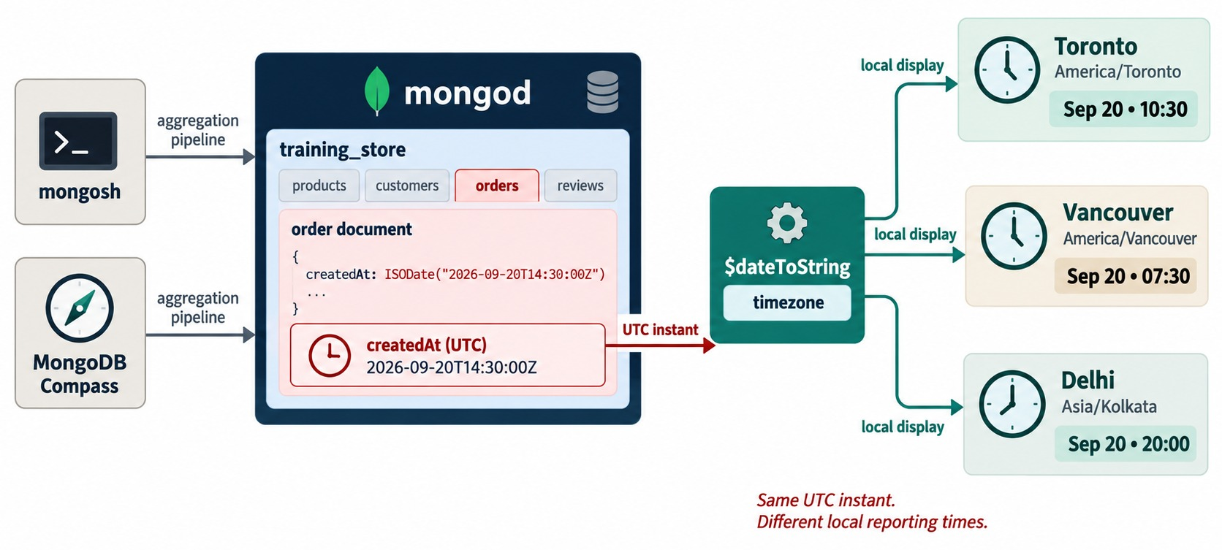
DATES AND TIME ZONES
Dates are stored in UTC; reports need a local calendar.
A month key
month: { $dateToString: {
format: "%Y-%m",
date: "$createdAt",
timezone: "America/Toronto"
} }
Our order
O5001's createdAt, 14:30 UTC, is 10:30 in Toronto.
Name the zone
Day and month boundaries depend on it.
ALSO $year, $month, $dateTrunc, $dateAdd.
KEY TAKEAWAY Store dates in UTC; state the time zone every time a report groups by day or month.
36
© 2026 by Innovation In Software Corporation
Notes:
KEY TALKING POINTS
------------------
- Dates are stored in UTC
createdAt is a BSON Date: one instant, stored in UTC.
- Reports need a local day
Grouping by day or month needs a time zone.
$dateToString, $dateTrunc and the other date operators accept a timezone option.
- The diagram is our data
2026-09-20T14:30Z is order O5001's createdAt.
It is 10:30 in Toronto, 07:30 in Vancouver and 20:00 in Delhi.
An order placed late in the evening can land in a different day, or month, depending on the zone.
- What it shows
An order's createdAt, 2026-09-20T14:30:00Z, goes through $dateToString with a timezone.
Toronto shows Sep 20 10:30, Vancouver 07:30 and Delhi 20:00.
- How to read it
The red note says it all: same UTC instant, different local reporting times.
- Key point
Name the time zone whenever a report groups by day or month.

Slide 37
MONTHLY PAID SALES
A month key, then one row per month in calendar order.
Pipeline
✓
Result
db.orders.aggregate([
{ $match: { paymentStatus: "PAID" } },
{ $set: { month: { $dateToString: {
format: "%Y-%m", date: "$createdAt",
timezone: "America/Toronto" } } } },
{ $group: { _id: "$month",
orders: { $sum: 1 },
revenue: { $sum: "$total" } } },
{ $sort: { _id: 1 } }
])
_id orders revenue
2026-07 3 1835.95
2026-08 4 2731.92
2026-09 6 4550.57
Sorts as text
"YYYY-MM" strings sort in calendar order.
O5001 excluded
Its payment is still PENDING.
CHECK 3 + 4 + 6 = 13 paid orders.
KEY TAKEAWAY A date expression builds the key, $group builds the rows, $sort puts them in calendar order.
37
© 2026 by Innovation In Software Corporation
Notes:
KEY TALKING POINTS
------------------
- The pipeline
Keep paid orders, build a YYYY-MM month key from createdAt in the Toronto time zone, group by it and sort ascending.
- The result
July has three paid orders worth 1835.95: O6101, O6102 and O6103.
August has four worth 2731.92, and September six worth 4550.57.
- Time zone
Without a timezone option, $dateToString uses UTC.
On this dataset no paid order is close to midnight at a month boundary, so UTC gives the same months.
Real data will differ.
- $dateTrunc
The content guide groups with $dateTrunc and unit month instead.
That returns a Date for the first of the month rather than a string; both work.

Slide 38
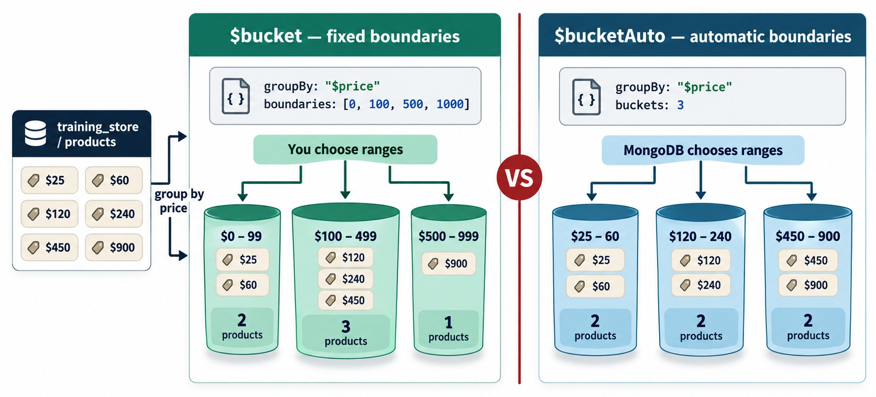
$BUCKET: PRICE BANDS
Group values into ranges the business defines.
Price bands on products
{ $bucket: {
groupBy: "$price",
boundaries: [0, 50, 100, 500, 2000],
default: "Other",
output: { count: { $sum: 1 } } } }
Result
0: 5 · 50: 2 · 100: 3 · 500: 2 · Other: 1
Boundaries
Lower bound in, upper bound out: 49.99 → the 0 band.
OTHER = XBAD A string price fits no band.
KEY TAKEAWAY $bucket turns a number into a business band — and default catches whatever doesn't fit.
38
© 2026 by Innovation In Software Corporation
Notes:
KEY TALKING POINTS
------------------
- Fixed bands
$bucket groups documents into ranges you choose with boundaries.
Each lower bound is included and each upper bound excluded.
- Our price bands
With boundaries 0, 50, 100, 500 and 2000, training_store has five products under 50, two from 50 to 100, three from 100 to 500 and two from 500 to 2000.
- The default bucket
Anything outside the boundaries, or of another type, goes to default.
XBAD's price is the string "49.99", so it lands in Other.
- $bucketAuto
$bucketAuto chooses the ranges for you, given a number of buckets.
- What it shows
Six prices, 25 to 900.
$bucket with boundaries 0, 100, 500 and 1000 gives groups of 2, 3 and 1.
$bucketAuto with three buckets gives three groups of two.
- How to read it
Left, you choose ranges; right, MongoDB balances them.
- Key point
Use $bucket when the business defines the bands.
- The bands on our data
Under 50: USB Hub, Wireless Mouse, Query Cookbook, Clearance Shoe and Wireless Keyboard.
50 to 100: Trail Shoe and MongoDB Fundamentals.
100 to 500: Refurbished Laptop, Running Shoe and Docking Station.
500 to 2000: the two laptops.
- Guide difference
Older guides expect four buckets.
A fresh load gives five, because XBAD's string price goes to the Other bucket.

Slide 39
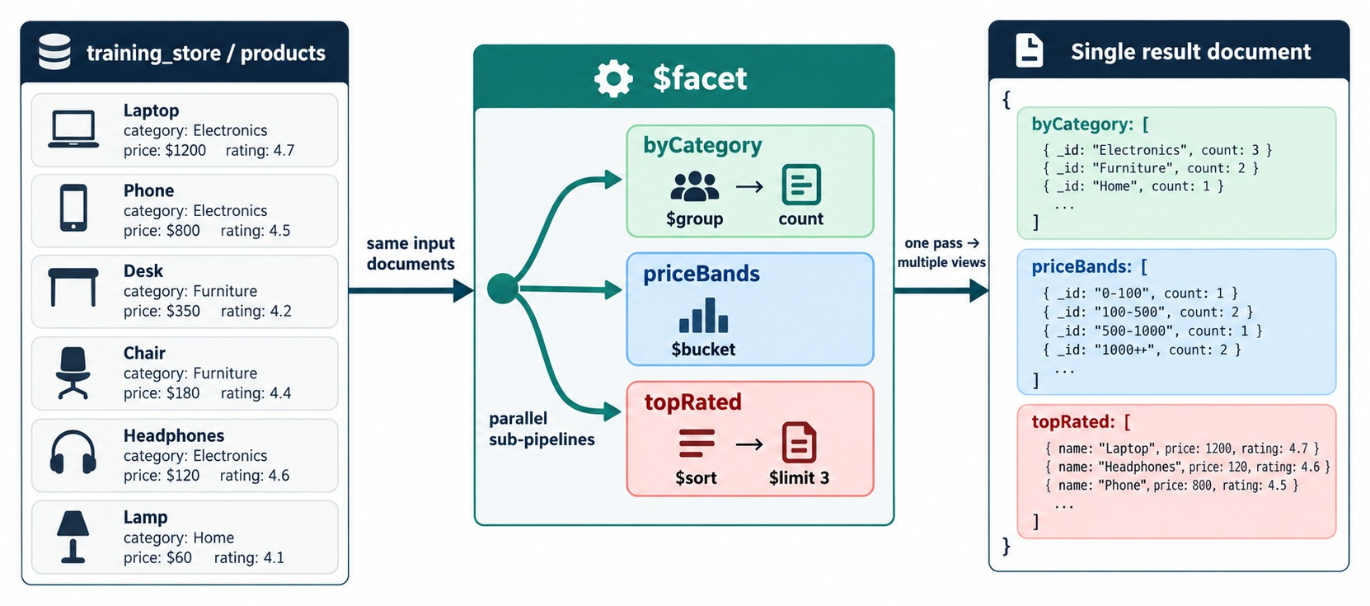
$FACET: SEVERAL REPORTS IN ONE PASS
Parallel sub-pipelines on the same input, one result document.
Same input
Every sub-pipeline sees the documents that reach $facet.
One document
Each facet name holds an array of results.
Use it for
Dashboards and API responses with several metrics.
FILTER FIRST One $match before $facet serves every facet.
KEY TAKEAWAY $facet returns a whole dashboard in one document — one array per sub-pipeline.
39
© 2026 by Innovation In Software Corporation
Notes:
KEY TALKING POINTS
------------------
- Several pipelines, one input
$facet runs several sub-pipelines on the same documents in one aggregate call.
- One result document
The output is a single document.
Each facet name is a field holding that sub-pipeline's results as an array.
- When to use it
Dashboards and API responses that need several metrics at once: totals, breakdowns and top-N lists.
- Filter before it
A $match before $facet runs once, and every facet benefits.
- What it shows
Products flow into $facet with three parallel sub-pipelines: byCategory with $group, priceBands with $bucket and topRated with $sort and $limit 3.
The output is a single result document with one array per facet.
- How to read it
Each coloured box in the result matches the sub-pipeline of the same colour.
- About the data
The diagram's products have ratings; in training_store ratings live in the reviews collection.
- Key point
$facet returns one document; each facet is an array.

Slide 40
A PAID-ORDERS DASHBOARD
Totals, a status breakdown and a high-value count in one call.
Pipeline (trimmed)
✓
Result: one document
db.orders.aggregate([
{ $match: { paymentStatus: "PAID" } },
{ $facet: {
totals: [ { $group: { _id: null,
orders: { $sum: 1 },
revenue: { $sum: "$total" } } } ],
byFulfillment: [
{ $sortByCount: "$fulfillmentStatus" } ],
highValue: [
{ $match: { total:
{ $gte: Decimal128("1000.00") } } },
{ $count: "orders" } ]
} }
])
{ totals: [ { _id: null,
orders: 13, revenue: 9118.44 } ],
byFulfillment: [
{ _id: "SHIPPED", count: 6 },
{ _id: "DELIVERED", count: 4 },
{ _id: "PROCESSING", count: 2 },
{ _id: "NEW", count: 1 } ],
highValue: [ { orders: 4 } ] }
ARRAYS Even one-row facets are arrays.
KEY TAKEAWAY Filter once, then let each facet answer its own question — the result is one document.
40
© 2026 by Innovation In Software Corporation
Notes:
KEY TALKING POINTS
------------------
- The pipeline
One $match keeps the 13 paid orders.
Then three facets run on those same 13 documents.
- The result
totals holds one document: 13 orders worth 9118.44.
byFulfillment ranks SHIPPED 6, DELIVERED 4, PROCESSING 2 and NEW 1.
highValue counts four orders of at least 1000.
- Reading the shape
The output is one document, and every facet is an array, even totals and highValue, which hold one element each.
Application code reads result.totals[0].revenue.
- Extending it
A fuller dashboard adds topCustomers and topProducts facets.
topProducts starts with L110, as in the product sales report.

Slide 41
PART 6: PERFORMANCE AND DEBUGGING
Right first, then cheap — and a method for finding what went wrong.
✓ Part 1
Pipelines
✓ Part 2
Filter and shape
✓ Part 3
Group
✓ Part 4
Arrays and joins
✓ Part 5
Reports
Part 6
Performance
SO FAR
NEXT QUESTION
How do we order stages so a pipeline stays correct and cheap — and find the stage that broke it?
✓
$cond, dates and $bucket label documents
✓
$facet returns several reports at once
IN THIS PART
✓
Every report was checked against the data
Early versus late $match
1
2
Build and verify one stage at a time
3
Common aggregation mistakes
41
© 2026 by Innovation In Software Corporation
Notes:
KEY TALKING POINTS
------------------
- Why this part
training_store is tiny, so every pipeline is fast here.
The habits in this part are what keep pipelines fast on real data.
- Link to Module 6
Module 6 adds indexes and explain plans.
This part explains why the first stage matters so much to them.

Slide 42
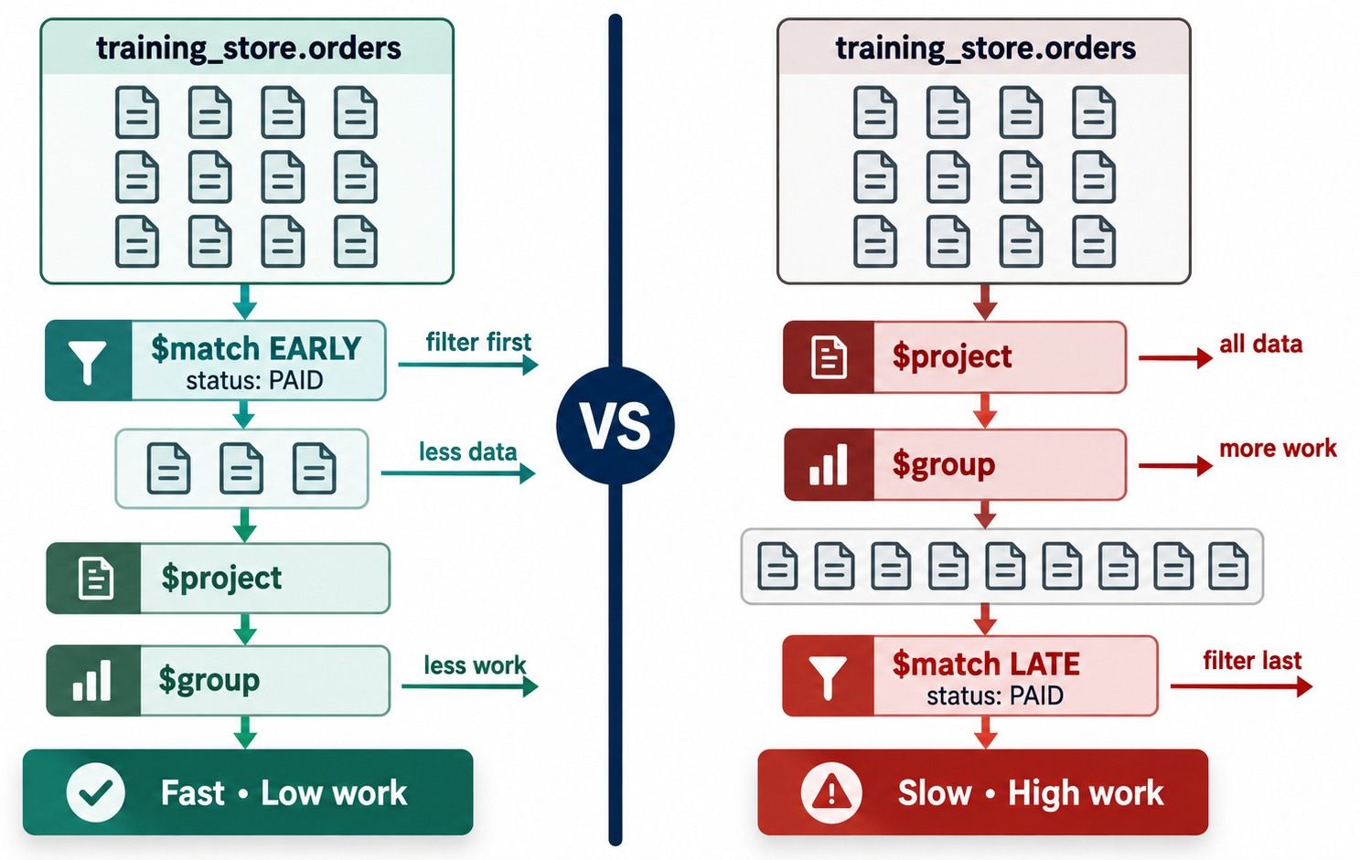
EARLY VS. LATE $MATCH
Filter first: fewer documents for every later stage.
Early
$match PAID first: 13 documents flow on, not 17.
Late can be wrong
After $group, the status field no longer exists.
Join late
$lookup after $group runs once per customer.
INDEX A first-stage $match can use one — Module 6.
KEY TAKEAWAY Filter as early as possible, and join after you have reduced the stream.
42
© 2026 by Innovation In Software Corporation
Notes:
KEY TALKING POINTS
------------------
- Early $match
Filtering first means every later stage handles fewer documents.
Here 13 paid orders flow on instead of 17.
- Late $match can be wrong too
In the diagram's late version, $match status runs after $group.
As we saw in Part 1, $group has already removed that field, so the pipeline is not only slow but also empty.
- The optimizer helps, a little
MongoDB moves some stages itself, such as a $match after a $sort.
It can't fix a pipeline whose meaning is wrong, so write the efficient order yourself.
- Indexes
A $match at the start can use an index, such as { paymentStatus: 1, createdAt: 1 }.
Module 6 covers this.
- What it shows
Left: $match status PAID runs first, then $project and $group — fast, low work.
Right: $project and $group handle all the data, and $match runs last — slow, high work.
- How to read it
Count the document icons between stages: fewer on the left.
- Key point
Put the most selective $match as early as possible.
- Applying it
To speed up a slow customer report: match paid orders first, group by customerId without unwinding, then look up customers and keep ACTIVE ones.
A supporting index later is { paymentStatus: 1, customerId: 1 }.
- Lab 4, Step 5
Lab 4's optional Step 5 runs explain("executionStats") on the report and checks that $match is first.
Comparing a late and an early $match on 17 orders, both plans may look alike, because the optimizer moves a $match ahead of a $sort.
Read the plan shape, not the milliseconds.

Slide 43
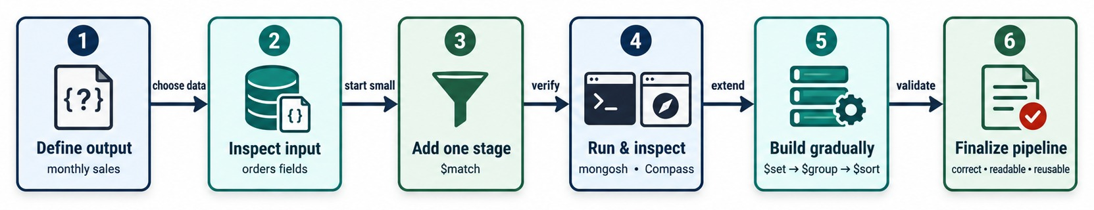
BUILD A PIPELINE ONE STAGE AT A TIME
Define the output, then add and check one stage at a time.
One stage at a time
Prove one number
Then inspect the plan
Run the first stage and check the count and one document; add the next, run again.
Add Aisha's paid orders by hand: 3418.62 must match the pipeline.
db.orders
.explain("executionStats")
.aggregate([ … ])
KEY TAKEAWAY Build incrementally and verify each stage — a wrong path shows up the moment you add it.
43
© 2026 by Innovation In Software Corporation
Notes:
KEY TALKING POINTS
------------------
- Start from the output
Write down the result you want first: its fields and roughly how many rows.
- One stage at a time
Run the first stage and look at the documents.
Add the next stage and run again.
A wrong field path or filter shows up the moment it is added.
- Prove one number
Check one result by hand.
Aisha Khan's four paid orders add up to 3418.62, which must match the pipeline.
- What it shows
Six steps: define the output, inspect the input, add one stage, run and inspect in mongosh or Compass, build gradually with $set, $group and $sort, and finalize a correct, readable, reusable pipeline.
- How to read it
Steps 3 to 5 repeat until the result is right.
- Key point
Never write a ten-stage pipeline in one go.
- Day 2 Lab 4
Lab 4 is built exactly this way: confirm the input set (10 paid orders that are shipped or delivered), add $unwind and line sales, then join products and group by category.
Step 4 proves one number with a second pipeline.

Slide 44
COMMON AGGREGATION MISTAKES
Why a pipeline returns nothing, too much or the wrong total.
MISCONCEPTION
REALITY
ANTI-PATTERNS TO AVOID
"total" and "$total" mean the same
Without $ it is the text "total", not the field
✕
status: "Shipped" — orders have no status field
✕
$items.lineTotal — compute quantity × unitPrice
$limit, then $sort gives a top N
Sort first — otherwise it is an arbitrary N
✕
$lookup on every order before filtering
✕
Unwinding just to sum order totals
✕
Money compared with strings, not Decimal128
Sum total after $unwind
Each order's total repeats on every line
REMEMBER Filter early, group before joining, verify each stage.
$match on paymentStatus after $group
$group dropped it — filter before grouping
$lookup returns one document
It returns an array — unwind it or take [0]
KEY TAKEAWAY Most broken pipelines have a wrong field path or a stage in the wrong place.
44
© 2026 by Innovation In Software Corporation
Notes:
KEY TALKING POINTS
------------------
- Why this slide
Before the checks, collect the mistakes that cause most broken pipelines.
Exercise 5.4 contains several of them at once.
- Field references
A $ turns a string into a field path.
"items.sku" as a group key is one constant, so everything lands in one group; "$items.sku" is the SKU.
- Order mistakes
$limit before $sort, $match after $group on a dropped field, and $unwind before summing order totals all give plausible but wrong answers.
They don't raise errors.
- Dataset traps
Generic examples use status and lineTotal.
training_store has paymentStatus, fulfillmentStatus, quantity and unitPrice.
Money is Decimal128, so compare it with Decimal128("1000.00").

Slide 45
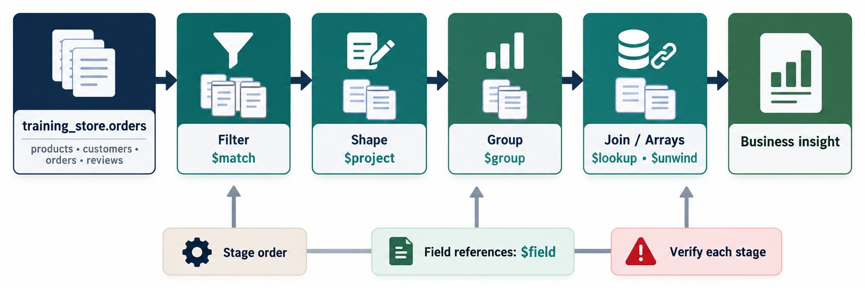
MODULE 5 AT A GLANCE
Filter, shape, group, join — and verify each stage.
KEY TAKEAWAY A pipeline is ordered transformations: filter, shape, group and join — then check the numbers.
45
© 2026 by Innovation In Software Corporation
Notes:
KEY TALKING POINTS
------------------
- Filter
$match first, with the real field names: paymentStatus and fulfillmentStatus.
- Shape
$project and $set rename fields and compute new ones, such as line revenue.
- Group
$group with accumulators turns many documents into one per key.
- Join and arrays
$unwind expands items; $lookup adds customer or product details as an array.
- Always
Keep stage order in mind, use $ for field references and verify each stage.
- What it shows
training_store orders flow through Filter ($match), Shape ($project), Group ($group) and Join or arrays ($lookup, $unwind) to business insight.
- How to use it
Point to each box and ask the class for the stage they would use for one question, before the knowledge check.
- Key point
Stage order, $ field references and checking each stage are what make a pipeline right.

Slide 46
KNOWLEDGE CHECK
Answer in your own words — then compare with a partner.
What does each pipeline stage receive and pass on?
When do you need $unwind?
1
6
Why can $group then $match on paymentStatus return nothing?
What does $lookup put in its as field?
2
7
How is $project different from $set?
Why must $sort come before $limit?
3
8
What does _id mean in a $group stage?
How do you handle a missing shippingFee?
4
9
What does $sum: 1 calculate?
What does a $facet stage return?
5
10
46
© 2026 by Innovation In Software Corporation
Notes:
KEY TALKING POINTS
------------------
- 1. Stages
Each stage receives the documents the previous stage output, transforms them and passes the result on.
- 2. Group then match
$group outputs only _id and accumulators, so paymentStatus no longer exists when $match runs.
Filter before grouping.
- 3. $project and $set
$project returns only the fields you list.
$set, or $addFields, adds or replaces fields and keeps the rest.
- 4. _id in $group
The grouping key.
Each distinct value becomes one output document; null puts everything in one group.
- 5. $sum: 1
It adds one per document, so it counts the documents in each group.
- 6. $unwind
When you need to work with individual array elements, such as grouping order items by SKU.
- 7. $lookup
An array of the matching documents from the other collection: empty when nothing matches, as for O6499.
- 8. Sort before limit
$limit keeps the first N documents it receives.
Unsorted, those are arbitrary, not the top N.
- 9. Missing values
$ifNull: ["$shippingFee", Decimal128("0.00")], so the calculation doesn't become null.
- 10. $facet
One document with one field per facet, each holding that sub-pipeline's results as an array.

Slide 47
EXERCISE 5.1 — ARRANGE PIPELINE STAGES
Module 5 checkpoint A: put six stages in the right order.
OFFICIAL CHECKPOINT A
10 MIN
labs/day-02/exercises/exercise-5.1-arrange-pipeline-stages.md
SCENARIO
YOUR TASKS
SOLUTION (AFTER DEBRIEF)
Top five products by line revenue from paid orders. Use each stage once. No MongoDB needed.
1
Propose an order for the six stages
✓
$match → $unwind → $set
✓
→ $group → $sort → $limit
2
Describe the documents after each one
$limit $unwind $sort
$match $group $set
✓
$unwind before grouping by SKU
3
Compare with the instructor's reveal
✓
$match after $group filters groups
4
Explain why $limit can't precede $sort
KEY TAKEAWAY The right order follows the data: filter, expand, compute, group, rank, cut.
47
© 2026 by Innovation In Software Corporation
Notes:
KEY TALKING POINTS
------------------
- Official checkpoint
This is the official Exercise 5.1.
The worksheet is labs/day-02/exercises/exercise-5.1-arrange-pipeline-stages.md; the answer key is in labs/day-02/exercises/solution/.
Pairs, on paper; no MongoDB is needed.
- The reveal
$match paid orders, $unwind items, $set lineRevenue, $group by SKU, $sort by revenue descending, $limit 5.
- What to listen for
$limit before $sort gives five arbitrary products.
$unwind must come before grouping by items.sku.
$set could also sit inside $group as a $sum of $multiply — a defensible variation.
- The follow-up question
A $match after $group would filter the grouped SKU rows, for example keeping products with revenue over 500.
That is a different, valid question.

Slide 48
EXERCISE 5.2 — BUILD A TOP-N REPORT
Module 5 checkpoint B: four rankings, each sorted before it is limited.
OFFICIAL CHECKPOINT B
15 MIN
labs/day-02/exercises/exercise-5.2-build-a-top-n-report.md
SCENARIO
YOUR TASKS
SOLUTION (AFTER DEBRIEF)
Build four top-N reports from training_store.
1
Match PAID; group spend by customerId
✓
C101 first: 3418.62
✓
O6202, O6304 (2146.99), O6301
1 Top 5 customers by paid spend
2 Top 3 paid orders by total
3 Top 3 SKUs by units sold
4 Products per category
{ $sortByCount: "$category" }
2
Sort total -1 with a tie-breaker
Unwind items; sum quantity by SKU
✓
A410 leads with 4 units
3
Rank categories with $sortByCount
✓
ACCESSORY 5, LAPTOP 3, SHOE 3, BOOK 2
4
KEY TAKEAWAY Every top-N is $sort then $limit — add a tie-breaker whenever values can tie.
48
© 2026 by Innovation In Software Corporation
Notes:
KEY TALKING POINTS
------------------
- Official checkpoint
This is the official Exercise 5.2.
The worksheet is labs/day-02/exercises/exercise-5.2-build-a-top-n-report.md.
- Customers and orders
C101, Aisha Khan, is the top paid spender with 3418.62.
The highest paid orders are O6202 and O6304 at 2146.99, then O6301 at 1512.23; orderNumber breaks the tie.
- Units
Sorted by unitsSold and then _id, A410 leads with 4 units, followed by A400 and B300 with 3.
P1001 and S200 also sold 3.
- A dataset note
The worksheet lists ACCESSORY 4.
On a fresh load $sortByCount returns ACCESSORY 5, because the XBAD fixture is an accessory, then LAPTOP 3 and SHOE 3, then BOOK 2.
The inactive L190 is counted, since there is no $match.

Slide 49
EXERCISE 5.3 — JOIN RELATED COLLECTIONS
Module 5 checkpoint C: add customer names, keep the unmatched order.
OFFICIAL CHECKPOINT C
20 MIN
labs/day-02/exercises/exercise-5.3-join-related-collections.md
SCENARIO
YOUR TASKS
SOLUTION (AFTER DEBRIEF)
List every order with its customer number and full name, largest total first.
1
Join orders to customers
✓
17 rows; O6401 first (2945.98)
2
Unwind, keeping empty matches
Names such as Aisha Khan
✓
{ $lookup: { from: "customers",
localField: "customerId",
foreignField: "_id",
as: "customer" } },
{ $unwind: { path: "$customer",
preserveNullAndEmptyArrays:
true } },
{ $project: … }, { $sort: … }
3
Project number and $concat name
O6499: no customerNumber
✓
4
Find the order with no customer
✓
Kept by preserveNullAndEmptyArrays
KEY TAKEAWAY $lookup returns an array — decide deliberately what happens when it is empty.
49
© 2026 by Innovation In Software Corporation
Notes:
KEY TALKING POINTS
------------------
- Official checkpoint
This is the official Exercise 5.3.
The worksheet is labs/day-02/exercises/exercise-5.3-join-related-collections.md.
- The projection
customerNumber: "$customer.customerNumber" and customerName: $concat of "$customer.name.first", a space and "$customer.name.last".
- The result
All 17 orders appear, sorted by total.
O6401, Luis Romero's pending 2945.98 order, is first.
O6499 has no customerNumber, and its customerName is null, because $concat of missing fields returns null.
- Without preserve
Remove preserveNullAndEmptyArrays and O6499 disappears: 16 rows.
Ask learners which behaviour a data-quality report needs.

Slide 50
EXERCISE 5.4 — CORRECT A BROKEN PIPELINE
Module 5 checkpoint D: find the defects, then rewrite and run it.
OFFICIAL CHECKPOINT D
15 MIN
labs/day-02/exercises/exercise-5.4-correct-a-broken-pipeline.md
SCENARIO
YOUR TASKS
SOLUTION (AFTER DEBRIEF)
This pipeline should report product revenue.
1
List at least five defects
✓
$limit first; no PAID filter
2
Name the symptom each one causes
"items.sku" lacks $: one group
{ $limit: 3 },
{ $group: { _id: "items.sku",
unitsSold: { $sum: "$quantity" },
revenue: { $sum: "$total" } } },
{ $sort: { revenue: -1 } },
{ $lookup: { from: "customers", … } },
{ $project: { sku:
"$customer.customerNumber" } }
✓
3
Rewrite: match, unwind, set, group, sort, limit
✓
No $unwind; quantity is under items
4
Run it and name the top SKU
total is not line revenue
✓
✓
No $lookup needed; L110 is first
KEY TAKEAWAY Debug a pipeline stage by stage: field paths first, then stage order.
50
© 2026 by Innovation In Software Corporation
Notes:
KEY TALKING POINTS
------------------
- Official checkpoint
This is the official Exercise 5.4.
The worksheet is labs/day-02/exercises/exercise-5.4-correct-a-broken-pipeline.md.
- The seven defects
$limit before any sort; no paid-order filter; "items.sku" without $, so every order falls in one group; quantity read from the top level instead of items; no $unwind before grouping by SKU; total is an order total, not line revenue; and the $lookup output is treated like an object.
- The correct core
Match PAID, unwind items, set lineRevenue as quantity times unitPrice, group by "$items.sku" with unitsSold and revenue, sort revenue descending, limit 5.
It returns L110 first with 3799.98.
- The lesson
A product revenue report needs no customer join at all.
Removing a stage is often the best fix.

Slide 51
LAB 4 — AGGREGATION PIPELINE
Day 2 hands-on: top product categories for completed paid sales.
OFFICIAL LAB
60 MIN
labs/day-02/lab4/LAB-4-GUIDE.md
SCENARIO
YOUR TASKS
EXPECTED RESULTS
Rank categories for PAID orders that are SHIPPED or DELIVERED. Reload load.js first.
1
0 Reload; count the collections
✓
13 · 6 · 17 · 6; 13 PAID
2
1 Count the completed paid orders
✓
10 orders, 18 lines
$match → $unwind → $set lineSales
→ $lookup products → $unwind
→ $group by category → $set
→ $match ≥ 50 → $sort → $limit
3
2 Unwind; compute lineSales
✓
quantity × unitPrice, Decimal128
4
3 Join products; group by category
✓
LAPTOP 4499.97; 4 categories
5
4 Prove one number; 5 explain
3 laptop units; $match first
✓
KEY TAKEAWAY One pipeline, built and checked stage by stage, turns 17 orders into a ranked category report.
51
© 2026 by Innovation In Software Corporation
Notes:
KEY TALKING POINTS
------------------
- Official lab
This is Day 2 Lab 4, labs/day-02/lab4/LAB-4-GUIDE.md, about 45 to 60 minutes.
The instructor answer key is labs/day-02/lab4/solution/LAB-4-SOLUTION.md.
It is the outline hands-on, building an aggregation pipeline.
- Before you start
Reload load.js from the repository root in PowerShell.
Lab 3 changed O6202 and A410, and the Module 4 labs added products, so without a reload the numbers drift.
Step 0 checks 13 products, 6 customers, 17 orders, 6 reviews and 13 paid orders.
- Steps 1 and 2
Step 1 counts the input: PAID and SHIPPED or DELIVERED gives 10 orders; O6202 and O6302 are still PROCESSING and O6305 is NEW.
Step 2 runs $match, $unwind and $set: 18 line documents, each with lineSales as quantity times unitPrice.
- Step 3, the report
Join each line to products on items.productId, group by product.category and rank.
LAPTOP 4499.97 from 3 units and 2 customers, ACCESSORY 744.91 from 9 units, SHOE 264.97 and BOOK 259.95.
All four clear 50, so $limit 5 returns four rows.
- Steps 4 and 5
Step 4 proves one number: laptop units from a second pipeline are 3, the same as LAPTOP totalUnitsSold.
Optional Step 5 runs explain and confirms the $match is the first stage.
- Debrief
Ask why the $match comes before $unwind, and why $lookup comes after it.
Then ask which index would help the first $match: that is where Module 6 begins.

Slide 52
MODULE 5 SUMMARY AND WHAT'S NEXT
From one $match to a multi-metric sales report.
YOU CAN NOW
NEXT: MODULE 6 — INDEXING AND QUERY PERFORMANCE
Explain how documents flow through a pipeline
1
Which index supports our first $match?
✓
Filter and shape with $match, $project, $set
2
How do I read explain("executionStats")?
✓
Summarize with $group and accumulators
When is a query covered by an index?
✓
3
Expand items with $unwind; join with $lookup
✓
Build monthly, banded and $facet reports
BRING ALONG Your Day 2 Lab 4 pipeline and the index you would add for its first $match.
✓
Order stages for correct, cheap pipelines
✓
KEY TAKEAWAY Module 6 makes these pipelines fast: the first $match is where an index pays off.
52
© 2026 by Innovation In Software Corporation
Notes:
KEY TALKING POINTS
------------------
- Recap
We moved from one $match to reports that group, unwind, join and facet, all on training_store with numbers we checked by hand.
- Day 2 Lab 4
Next is Day 2 Lab 4: top product categories for paid orders that are shipped or delivered.
It uses paymentStatus and fulfillmentStatus, computes line sales, and on a fresh load LAPTOP comes first with 4499.97.
- Next module
Module 6, on Day 3, covers index types, compound index order, covered queries and explain plans.
The first $match of each pipeline is where those indexes help, for example { paymentStatus: 1, createdAt: 1 }.
- Bring along
Keep the Lab 4 pipeline and one proposed index.
Module 6 tests them with explain.

