Slide 1
"Index the query shape, not every field."
MODULE 6
Indexing and Query Performance
How MongoDB finds documents, how to design indexes around real query shapes, and how to prove the result with explain().
COLLSCAN vs IXSCAN
Compound + ESR
Specialized indexes
explain() + covered
Costs + clean-up
MASTERING MONGODB • MODULE 6
Notes:
KEY TALKING POINTS
------------------
- Day 3 starts here
Day 2 taught us to ask questions of training_store: find, update and the aggregation pipeline.
Day 3 is about making those questions fast, then keeping the data available and scalable.
- What this module does
We see how MongoDB finds documents with and without an index, create and manage named indexes, design compound indexes with the ESR guideline, meet the specialized index types, and prove every decision with explain().
- The quote
Index the query shape, not every field.
An index is a trade: faster reads for one shape of query, paid for with storage and extra work on every write.
REAL-WORLD EXAMPLES
-------------------
- An online store's product page and order-history page run thousands of times an hour.
Two well-chosen compound indexes can keep both fast, while ten speculative single-field indexes slow down every checkout.

Slide 2
LEARNING OBJECTIVES
What you will be able to do by the end of this module.
🎯
BY THE END OF THIS MODULE, YOU CAN
❓
SIX QUESTIONS THIS MODULE ANSWERS
1. Explain how an index avoids a full scan
2. Create, list, hide and drop named indexes
3. Order compound fields with ESR
4. Choose multikey, unique, partial, sparse, TTL
5. Read explain() and build a covered query
6. Weigh selectivity, write cost and usage
WHY
does a query read every document?
HOW
do I create and manage indexes?
WHICH
field order goes in an index?
WHICH
index type fits the query?
WHAT
does explain() really tell me?
WHEN
is an index not worth its cost?
🗺️
MODULE ROADMAP
How indexes work
Manage
Compound + ESR
Specialized
explain()
Costs + mistakes
KEY TAKEAWAY Design indexes around the queries the application really runs — then prove them with explain().
2
© 2026 by Innovation In Software Corporation
Notes:
KEY TALKING POINTS
------------------
- By the end of this module
Walk through the six objectives on the left.
Learners explain how an index avoids a full scan, and manage named indexes.
They order compound fields with ESR and choose specialized types.
They read explain() output, build a covered query, and weigh selectivity, write cost and usage.
- Six questions
Why does a query read every document?
How do I create and manage indexes?
Which field order goes in an index?
Which index type fits the query?
What does explain() really tell me?
And when is an index not worth its cost?
- Set the expectation
training_store is tiny: 13 products and 17 orders.
Every query will feel instant, with or without an index.
So we judge a plan by its shape and its counts, keys and documents examined against documents returned, not by milliseconds.

Slide 3
KEY TERMS FOR THIS MODULE
Plain definitions for the words we'll use most.
1
Index
2
COLLSCAN and IXSCAN
A sorted structure of field values with pointers to documents, so MongoDB can skip the full scan.
Plan stages: read every document, or walk the matching keys of one index.
3
Compound index
4
ESR guideline
One index on several fields, sorted by the first field, then the next.
Order compound fields Equality first, then Sort, then Range — a starting point, not a law.
5
Multikey index
6
explain()
An index on an array field: one index key for each array value.
Shows the plan MongoDB chose and, with executionStats, the keys and documents it examined.
7
Covered query
8
Selectivity
Filter and returned fields all come from one index, so no document is fetched.
How small a share of the collection a condition matches — sku is high, active is low.
KEY TAKEAWAY Agree on the words first — every later slide builds on them.
3
© 2026 by Innovation In Software Corporation
Notes:
KEY TALKING POINTS
------------------
- How to run this slide
Read each term once and give a quick example from the training_store sample database.
- Index
A sorted structure of field values with pointers to documents, so MongoDB can skip the full scan.
- COLLSCAN and IXSCAN
Plan stages: read every document, or walk the matching keys of one index.
- Compound index
One index on several fields, sorted by the first field, then the next.
- ESR guideline
Order compound fields Equality first, then Sort, then Range — a starting point, not a law.
- Multikey index
An index on an array field: one index key for each array value.
- explain()
Shows the plan MongoDB chose and, with executionStats, the keys and documents it examined.
- Covered query
Filter and returned fields all come from one index, so no document is fetched.
- Selectivity
How small a share of the collection a condition matches — sku is high, active is low.

Slide 4
FULL FORMS USED IN THIS MODULE
Every abbreviation on these slides, spelled out.
COLLSCAN
Collection Scan
I/O
Input/Output
RAM
Random Access Memory
CPU
Central Processing Unit
IXSCAN
Index Scan
SKU
Stock Keeping Unit
ESR
Equality, Sort, Range
JSON
JavaScript Object Notation
TTL
Time To Live
KEY TAKEAWAY When an abbreviation isn't clear, the full form is on this slide.
4
© 2026 by Innovation In Software Corporation
Notes:
KEY TALKING POINTS
------------------
- How to run this slide
Don't read every row.
Point out the few this module uses most, and say the full list is here for reference.
- Reference
COLLSCAN is Collection Scan; CPU is Central Processing Unit; ESR is Equality, Sort, Range; I/O is Input/Output; IXSCAN is Index Scan; JSON is JavaScript Object Notation; RAM is Random Access Memory; SKU is Stock Keeping Unit; TTL is Time To Live.

Slide 5
FROM MODULE 5 TO MODULE 6
Day 2 taught us to ask questions — Day 3 makes them fast.
MODULE 5 GAVE US
🧭
OUR PATH THROUGH MODULE 6
See why a query reads every document
✓
Pipelines of $match, $group and $sort
1
Part 1
✓
Reports over orders and reviews
Create, list, hide and drop indexes
2
Part 2
✓
$lookup joins between collections
Order compound fields with ESR
3
Part 3
✓
Filter early to shrink the work
Pick a specialized index type
4
Part 4
✓
Results checked against real data
Read explain() and cover a query
NOW Index the query shapes Day 2 wrote — and prove each one with explain().
5
Part 5
Weigh selectivity, costs and mistakes
6
Part 6
KEY TAKEAWAY Module 5 asked the questions; Module 6 makes MongoDB answer them without reading every document.
5
© 2026 by Innovation In Software Corporation
Notes:
KEY TALKING POINTS
------------------
- Bridge from Module 5
In Module 5 we built pipelines over training_store: $match, $group, $sort, $lookup and more.
We learned to put $match early so later stages see fewer documents.
- The missing piece
An early $match or a find is only fast if MongoDB can locate the matching documents without reading them all.
That is what indexes do, and it is today's first module.
- The path
Six parts: how indexes work, managing them, compound indexes and ESR, specialized types, explain() and covered queries, and finally costs and mistakes.
Lab 5 at the end puts it all into practice.
- Same dataset
Reload training_store with load.js before the lab so earlier writes are gone.
Every example on these slides uses the freshly loaded data.

Slide 6
PART 1: HOW INDEXES WORK
Start with how MongoDB finds a document at all.
Part 1
How indexes work
Part 2
Manage indexes
Part 3
Compound + ESR
Part 4
Specialized types
Part 5
explain()
Part 6
Costs + mistakes
SO FAR
NEXT QUESTION
How does MongoDB find documents — and why does an index make it faster?
✓
Module 5 built pipelines over our data
✓
Every query so far ran without asking how
IN THIS PART
1
Why query performance matters
2
Collection scan versus index scan
3
What an index looks like inside
4
The _id index every collection has
6
© 2026 by Innovation In Software Corporation
Notes:
KEY TALKING POINTS
------------------
- Where we start
Until now we asked what a query returns.
Now we ask how MongoDB found it.
- What this part answers
We compare a collection scan with an index scan, look inside an index, and meet the one index every collection already has.

Slide 7
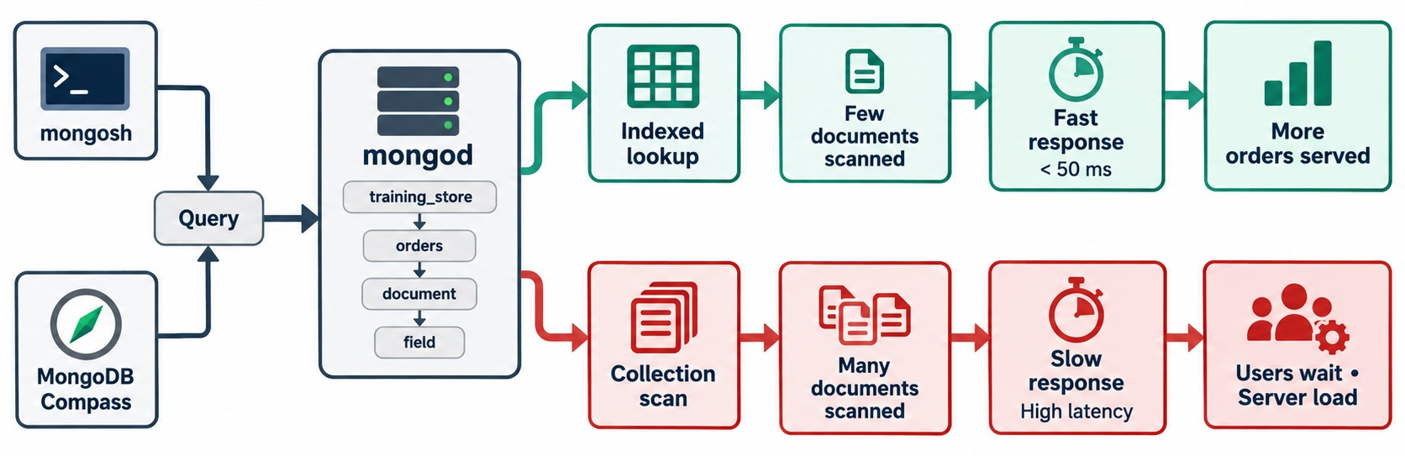
WHY QUERY PERFORMANCE MATTERS
The same query: an indexed lookup or a full collection scan.
Indexed lookup
Few documents read — fast, predictable responses.
Collection scan
Every document read — the cost grows with the collection.
At scale
Slow queries queue up: users wait and the server works harder.
OUR DATASET 13 products and 17 orders scan instantly — watch counts, not the clock.
KEY TAKEAWAY An index changes how much work a query does — the result stays the same.
7
© 2026 by Innovation In Software Corporation
Notes:
KEY TALKING POINTS
------------------
- Two paths for one query
When a query arrives, mongod either walks an index to the matching documents or reads every document in the collection and tests each one.
- Why it matters
A collection scan's cost grows with the collection.
On a million orders the red path means a million documents read for a handful of results, and every other request waits behind it.
- On our data
training_store is small enough that both paths finish in about a millisecond.
That is why Lab 5 asks you to record counts, not times.
- What it shows
mongosh and MongoDB Compass send a query to mongod for the orders collection in training_store.
The green path is an indexed lookup; the red path is a collection scan.
- How to read it
Follow each row left to right.
Indexed lookup, few documents scanned, fast response, more orders served.
Collection scan, many documents scanned, slow response, users wait and the server works harder.
- Key point
The query is the same on both rows.
Only the access path differs.
REAL-WORLD EXAMPLES
-------------------
- A customer-service screen that looks up orders by customer.
Without an index it slows down a little more every day as the orders collection grows, until the support team notices.

Slide 8
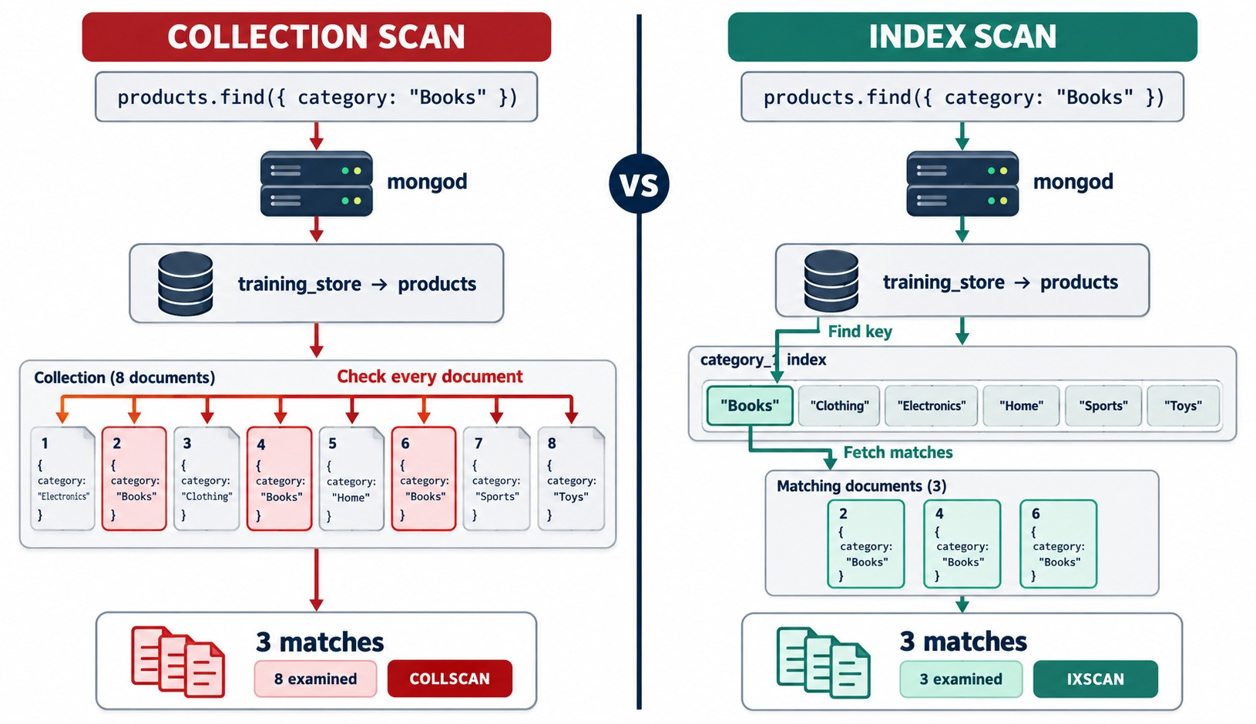
COLLECTION SCAN VS INDEX SCAN
Same query, same three matches — 8 documents examined versus 3.
COLLSCAN
Reads every document and tests the filter on each one.
IXSCAN
Finds the matching keys in the category index, then fetches only those documents.
The signal
Examined versus returned: 8 : 3 against 3 : 3.
IN TRAINING_STORE category is "BOOK": 2 of 13 products.
KEY TAKEAWAY Compare documents examined with documents returned — the closer they are, the better the plan.
8
© 2026 by Innovation In Software Corporation
Notes:
KEY TALKING POINTS
------------------
- COLLSCAN
A collection scan reads every document and applies the filter to each one.
It is the only option when no index matches the query.
- IXSCAN
An index scan looks up the value in a sorted index, reads only the matching keys, and then fetches just those documents.
- The number to watch
Compare documents examined with documents returned.
8 examined for 3 returned is waste; 3 for 3 is the ideal.
- On training_store
db.products.find({ category: "BOOK" }) on a fresh load is a COLLSCAN: 13 documents examined, 2 returned.
With a category index it becomes IXSCAN: 2 keys, 2 documents, 2 returned.
- What it shows
The same find on category Books, run twice against a small eight-document products collection: once as a collection scan and once through a category_1 index.
- How to read it
On the left, every one of the eight documents is checked: 3 matches, 8 examined, COLLSCAN.
On the right, the index finds the Books key and fetches only documents 2, 4 and 6: 3 matches, 3 examined, IXSCAN.
- About the data
The diagram uses a simplified collection with category names like Books and Electronics.
In training_store the categories are upper-case codes, LAPTOP, SHOE, BOOK and ACCESSORY, and there are 13 products, 2 of them books.

Slide 9
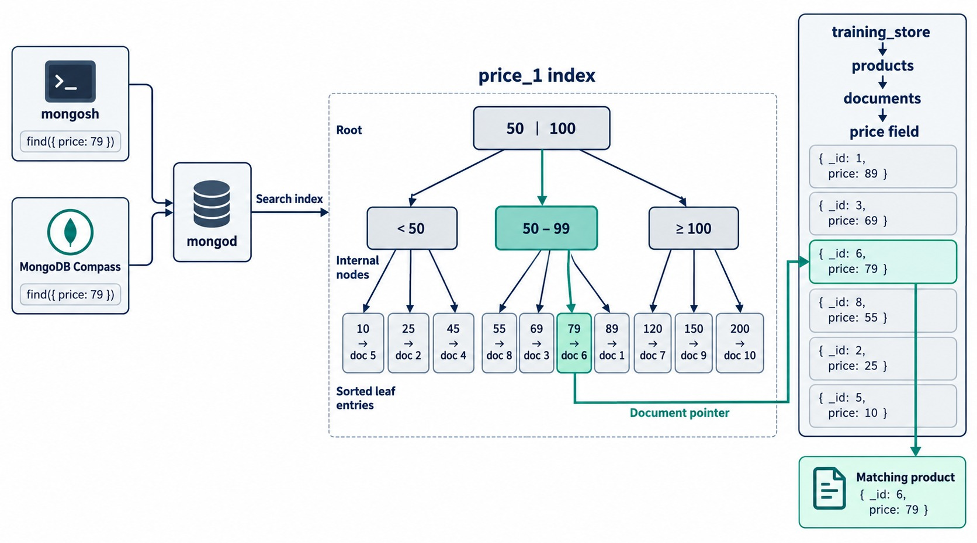
INSIDE AN INDEX: A SORTED TREE
An index is a B-tree of sorted keys, each pointing to a document.
Root and internal nodes
Split the key range: below 50, 50–99, 100 and above.
Sorted leaf entries
Each key points to its document: 79 → doc 6.
Why it's fast
A few steps down the tree instead of reading every document.
SORTED The same order also serves ranges and sorts.
KEY TAKEAWAY An index keeps values in sorted order with pointers to documents — so lookups, ranges and sorts need no full scan.
9
© 2026 by Innovation In Software Corporation
Notes:
KEY TALKING POINTS
------------------
- An ordered structure
An index stores the indexed values in sorted order, each with a pointer to its document.
MongoDB keeps it as a B-tree, so a lookup takes a few steps down the tree.
- Sorted is the superpower
Because keys are sorted, the same index answers equality, ranges such as price between 50 and 99, and sorts by price, without extra work.
- What it costs
The tree lives on disk and in memory, and every insert, update or delete of an indexed value has to update it.
We come back to that cost in Part 6.
- What it shows
A price_1 index drawn as a tree: a root that splits at 50 and 100, three internal nodes, and sorted leaf entries that each point to one product document.
- How to read it
Follow the green path for find price 79: root, then the 50 to 99 node, then the leaf 79, which points to doc 6.
The document pointer lands on the product with _id 6 and price 79.
- Key point
A few steps down a sorted tree replace a read of every document.

Slide 10
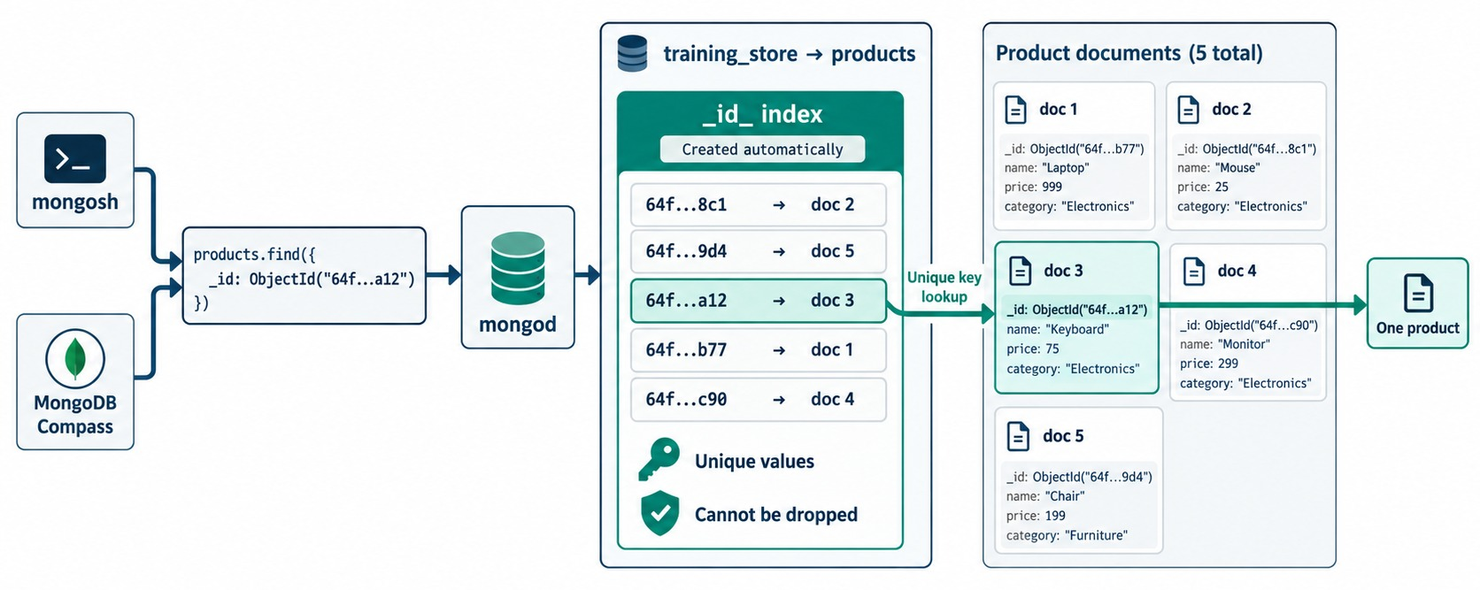
THE DEFAULT _ID INDEX
Every collection gets a unique index on _id — automatically.
Created for you
Named _id_; it exists before you create anything.
Unique
Two documents in one collection can't share an _id.
Can't be dropped
dropIndexes() removes every other index but keeps _id_.
Always an index scan
db.products.find({
_id: ObjectId("…")
})
KEY TAKEAWAY Lookups by _id are always indexed — every other query shape needs an index you design.
10
© 2026 by Innovation In Software Corporation
Notes:
KEY TALKING POINTS
------------------
- Always there
Every standard collection gets a unique index on _id, named _id_.
A lookup by _id is always an index scan.
- Unique and permanent
It prevents two documents from sharing an _id, and it cannot be dropped.
dropIndexes() removes every other index but keeps _id_.
- On training_store
Right after load.js, products has _id_ and sku_unique, customers has _id_, customerNumber_unique and email_unique, orders has _id_ and orderNumber_unique, and reviews has only _id_.
- A common surprise
Learners often expect each collection to show only the default _id_ index.
On a fresh load that isn't true: load.js also builds the four unique indexes listed here, and Lab 5, Step 6 asks learners to list them.
- What it shows
The products collection with its _id_ index, created automatically.
A find on one ObjectId goes to the index, finds the key ending a12 and jumps straight to doc 3, the Keyboard.
- How to read it
The two notes at the bottom of the index are the rules: unique values, and it cannot be dropped.
- About the data
The five products in the diagram are illustrative.
The rule is the same for all four training_store collections.

Slide 11
PART 2: MANAGE INDEXES
Create, list, hide and drop — by name.
✓ Part 1
How indexes work
Part 2
Manage indexes
Part 3
Compound + ESR
Part 4
Specialized types
Part 5
explain()
Part 6
Costs + mistakes
SO FAR
NEXT QUESTION
How do we create, inspect, hide and remove indexes safely?
✓
COLLSCAN reads every document; IXSCAN reads matching keys
✓
An index is a sorted tree of keys and pointers
IN THIS PART
1
What load.js already built
✓
Every collection has a unique _id index
2
Creating indexes with clear names
3
Listing and dropping indexes
4
Hiding an index to test a removal
11
© 2026 by Innovation In Software Corporation
Notes:
KEY TALKING POINTS
------------------
- Connecting the parts
Part 1 showed why indexes help.
Part 2 is the everyday toolkit for managing them.
- Watch for
Names.
The course uses idx_ for helper indexes, uq_ for unique rules and ttl_ for TTL indexes, so every explain() and $indexStats result is easy to read.

Slide 12
CREATE, LIST AND DROP NAMED INDEXES
On a fresh training_store — the output is what mongosh prints.
What load.js already built
✓
Create with a clear name
Drop by name — never _id_
db.products.getIndexes()
.map(i => i.name)
[ '_id_', 'sku_unique' ]
db.products.createIndex(
{ category: 1, price: 1 },
{ name:
"idx_products_category_price" }
)
idx_products_category_price
db.products.dropIndex(
"idx_products_category_price"
)
{ nIndexesWas: 3, ok: 1 }
Names
Several at once
dropIndexes()
idx_<collection>_<fields> — easy to spot in explain() and $indexStats.
createIndexes([ … ]) builds a list of index specifications in one command.
Removes all but _id_ — including unique rules like sku_unique.
KEY TAKEAWAY Name every index after its collection and fields — and list before you create or drop anything.
12
© 2026 by Innovation In Software Corporation
Notes:
KEY TALKING POINTS
------------------
- What is already there
load.js ends by creating four unique indexes: sku_unique on products, customerNumber_unique and email_unique on customers, and orderNumber_unique on orders.
So a fresh products collection lists _id_ and sku_unique.
- Create
createIndex takes the key specification and an options document.
The name option replaces the default category_1_price_1.
mongosh prints the index name when it succeeds.
- Several at once
The content source creates uq_products_sku, idx_products_category_price and idx_products_tags together with createIndexes.
On a fresh load the SKU entry fails, because sku_unique already covers the same key; Lab 5, Step 9 drops sku_unique first.
- Drop
dropIndex takes a name or the key specification.
nIndexesWas 3 counts _id_, sku_unique and the new index.
dropIndexes() with no argument removes every index except _id_, unique rules included, so confirm no query depends on them first.

Slide 13
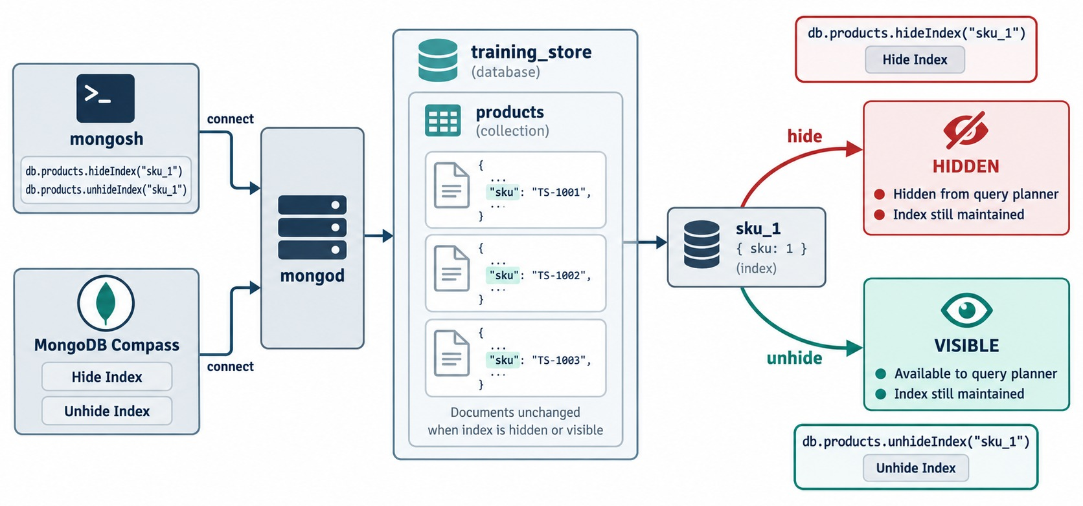
HIDE AN INDEX BEFORE YOU DROP IT
hideIndex() takes an index out of the planner's choices without deleting it.
Test a removal
db.products.hideIndex(
"idx_products_category_price")
// run the queries + explain()
db.products.unhideIndex(
"idx_products_category_price")
Hidden
The planner ignores it; every write still maintains it.
Visible again
unhideIndex() restores it at once — no rebuild.
UNIQUE STILL APPLIES A hidden unique index still blocks duplicates.
KEY TAKEAWAY Hide, measure, then drop — hiding is instant to undo, dropping means a rebuild.
13
© 2026 by Innovation In Software Corporation
Notes:
KEY TALKING POINTS
------------------
- Hide instead of drop
db.products.hideIndex(name) keeps the index on disk and up to date, but the query planner stops choosing it.
Run the important queries and their explain() while it is hidden.
- Undo in an instant
unhideIndex(name) makes it available again immediately.
Dropping and recreating would mean a full index rebuild.
- Hidden still costs
A hidden index is still maintained on every write and still takes storage.
A hidden unique index still rejects duplicates.
- In Lab 5, Step 13
Learners hide a non-unique helper index, idx_products_category_active_price, explain db.products.find({ category: "ACCESSORY" }) with queryPlanner, then unhide it.
They never hide _id_ or a unique rule, and never drop in the lab.
- What it shows
mongosh and Compass hide and unhide the sku_1 index on products.
Hidden, it is removed from the query planner's choices but still maintained.
Visible, it is available again.
The documents never change.
- How to read it
The red arrow is hideIndex, the green arrow is unhideIndex.
Both boxes say the index is still maintained, which is why hiding is instant to undo.
- About the data
In training_store the SKU index built by load.js is named sku_unique, not sku_1.
In Lab 5, Step 13 you hide a non-unique helper index, idx_products_category_active_price, instead: never a unique rule or _id_.

Slide 14
PART 3: COMPOUND INDEXES AND ESR
Real queries filter and sort on several fields.
✓ Part 1
How indexes work
✓ Part 2
Manage indexes
Part 3
Compound + ESR
Part 4
Specialized types
Part 5
explain()
Part 6
Costs + mistakes
SO FAR
NEXT QUESTION
Which fields go into one index — and in what order?
✓
Indexes are created, listed and dropped by name
✓
Hide first, measure, then drop
IN THIS PART
load.js already enforces a unique sku
1
Compound indexes
✓
2
Why field order matters
3
The prefix rule
4
Equality, Sort, Range
5
Order history before and after
6
Sort direction and reverse scans
7
Exercise: the fulfillment queue
14
© 2026 by Innovation In Software Corporation
Notes:
KEY TALKING POINTS
------------------
- Why this part
Real queries rarely use one field.
The order history filters by customer and sorts by date; the catalog filters by category and sorts by price.
- Outcome
By the end, learners can write a compound index for a query and defend its field order with ESR.

Slide 15
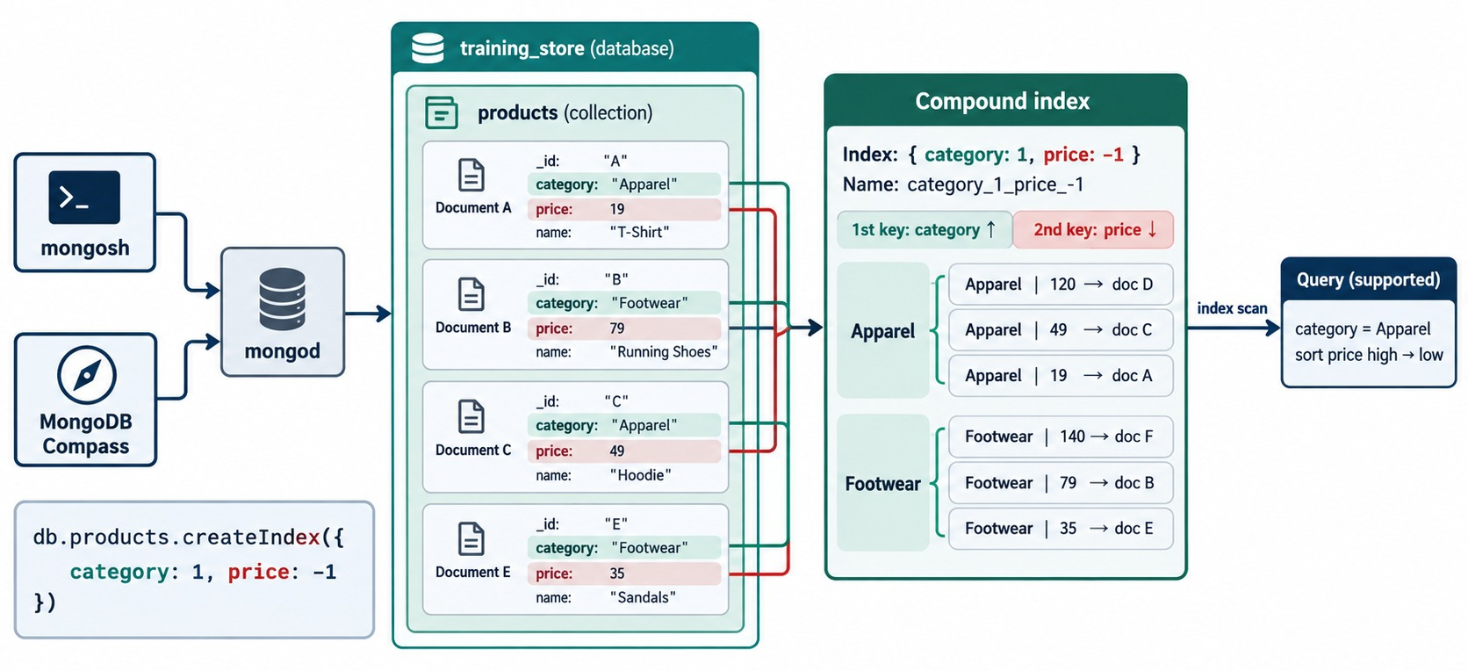
COMPOUND INDEXES
One index, several fields: sorted by category, then by price.
Sorted by the first key
All Apparel keys, then all Footwear keys.
Then by the second
Inside each category, price runs high to low because of price: -1.
Filter + sort
category = Apparel sorted by price is one run of keys.
DEFAULT NAME category_1_price_-1 — unless you set name.
KEY TAKEAWAY A compound index sorts by its first field, then the next — so one index can filter and sort at once.
15
© 2026 by Innovation In Software Corporation
Notes:
KEY TALKING POINTS
------------------
- Several fields, one index
A compound index is sorted by its first field, then by the second field within each value of the first, and so on.
- Filter and sort together
Because price is already in order inside each category, a query for one category sorted by price reads one run of keys and needs no SORT stage.
- Directions
category: 1 is ascending and price: -1 descending.
Direction matters when the index must serve a sort on more than one field.
- On training_store
The course's catalog index is { category: 1, price: 1 }, named idx_products_category_price.
It serves db.products.find({ category: "SHOE" }).sort({ price: 1 }): Clearance Shoe 44.99, Trail Shoe 89.99, Running Shoe 129.99.
- What it shows
The index { category: 1, price: -1 }, named category_1_price_-1, built from Apparel and Footwear products.
The keys are grouped by category and, inside each group, run from the highest price to the lowest.
- How to read it
The first key column is category, ascending; the second is price, descending.
The supported query on the right, category Apparel sorted by price high to low, is one continuous run of keys.
- About the data
Apparel and Footwear are illustrative.
In training_store the same idea is { category: 1, price: 1 } over LAPTOP, SHOE, BOOK and ACCESSORY.

Slide 16
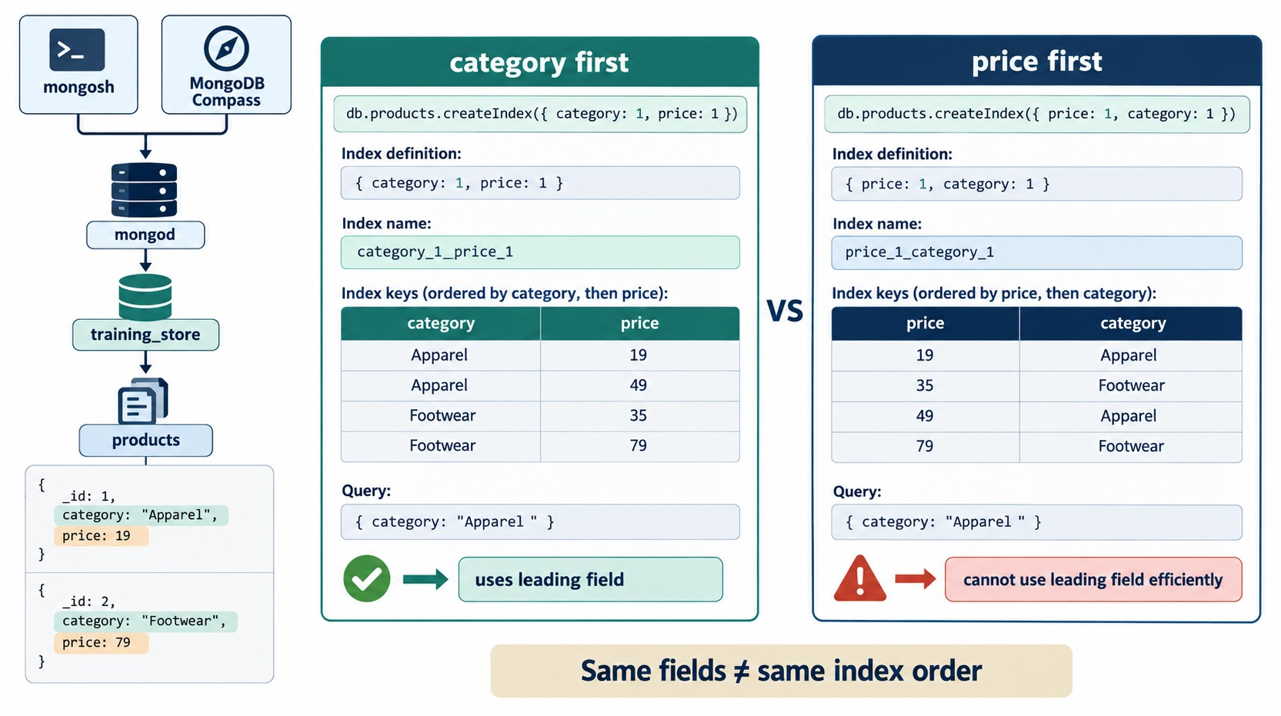
FIELD ORDER MATTERS
Same two fields, two different indexes.
category first
Keys grouped by category — a category query reads one block.
price first
Categories are scattered through the price order.
Our catalog
It always filters by category — so category leads.
SAME FIELDS ≠ SAME INDEX Choose the order from the query.
KEY TAKEAWAY { category: 1, price: 1 } and { price: 1, category: 1 } serve different queries — field order is a design decision.
16
© 2026 by Innovation In Software Corporation
Notes:
KEY TALKING POINTS
------------------
- Order is part of the design
{ category: 1, price: 1 } and { price: 1, category: 1 } contain the same fields but are different indexes with different key orders.
- Which queries each serves
Category first serves category equality, and category with a price range or sort.
Price first serves price ranges and price sorts across all categories.
- How to choose
Look at the queries the application actually runs.
Our catalog always filters by category, so category goes first.
- What it shows
Two indexes built from the same fields: category_1_price_1 on the left and price_1_category_1 on the right, each with its keys in order.
- How to read it
On the left, the Apparel keys sit together, so a category query reads one block and gets a green check.
On the right, Apparel keys are scattered through the price order, so the same query cannot use the leading field efficiently.
- Key point
The banner says it: same fields does not mean same index order.

Slide 17
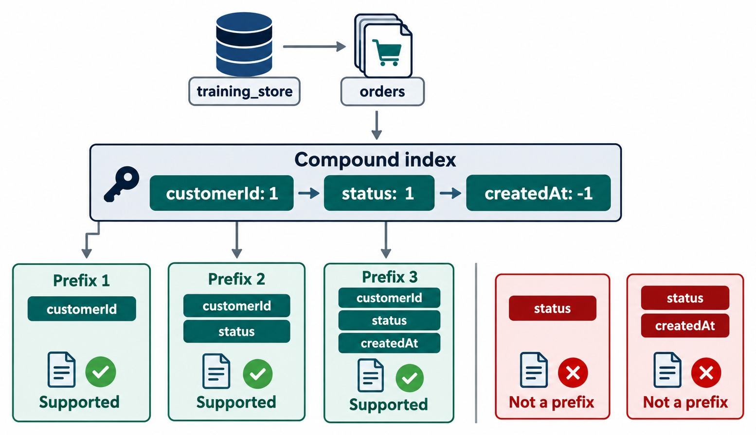
THE PREFIX RULE
A compound index serves queries on its leading fields.
Supported prefixes
customerId · customerId + status · all three.
Not a prefix
status alone, or status + createdAt, skips the first field.
In training_store
status stands for paymentStatus: { customerId, paymentStatus, createdAt }.
REDUNDANCY { customerId: 1 } adds little once this index exists.
KEY TAKEAWAY Queries can use a compound index through its leading fields — read the prefixes from the left.
17
© 2026 by Innovation In Software Corporation
Notes:
KEY TALKING POINTS
------------------
- Leading fields
A compound index can serve queries on any prefix of its fields, read from the left.
For three fields that is the first; the first two; and all three.
- Not a prefix
A query on the second field alone skips the first, so the matching keys are scattered through the index.
- Prefixes make indexes redundant
If { customerId: 1, paymentStatus: 1, createdAt: -1 } exists, a separate { customerId: 1 } index is usually redundant, because customerId is a prefix.
Check uniqueness, partial filters and collation before removing anything.
- Skipping a middle field
Filtering customerId and sorting createdAt without paymentStatus skips the middle field, so the index can't supply the sort and a SORT stage is likely.
- What it shows
The orders index { customerId: 1, status: 1, createdAt: -1 } and five query shapes.
Three are prefixes and supported; two skip customerId and are not prefixes.
- How to read it
Read the green boxes left to right: customerId; customerId and status; all three.
The red boxes, status alone and status with createdAt, start in the middle of the index.
- About the data
training_store orders have no plain status field.
The diagram's status stands for paymentStatus, so the training_store version is { customerId: 1, paymentStatus: 1, createdAt: -1 }.

Slide 18
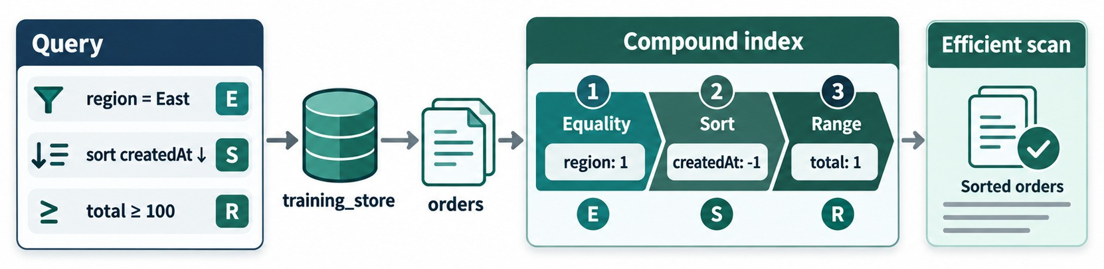
EQUALITY, SORT, RANGE (ESR)
A starting order for compound-index fields.
E — Equality
S — Sort
R — Range
A GUIDELINE Confirm with explain() — data can change the order.
Exact matches first: region = East.
Then the sort field in its direction: createdAt: -1.
Range conditions last: total ≥ 100.
KEY TAKEAWAY Equality, then Sort, then Range: the index narrows first, delivers the order next, and scans the range last.
18
© 2026 by Innovation In Software Corporation
Notes:
KEY TALKING POINTS
------------------
- Equality first
Exact-match fields go first.
They cut the index down to one contiguous block of keys.
- Then sort
The sort field comes next, in the sort direction, so the keys inside that block are already in the order the query wants.
- Range last
Range conditions such as $gte go last.
A range placed before the sort field would break the sort order and force a SORT stage.
- A guideline, not a law
On training_store: for one customer's PAID orders over a minimum total, customerId and paymentStatus are equality, createdAt is the sort, total is the range.
Selectivity and real explain() results make the final call.
- What it shows
A query on orders with an equality filter region = East, a sort on createdAt descending and a range total ≥ 100, mapped to the compound index region: 1, createdAt: -1, total: 1.
- How to read it
The E, S and R badges connect each query condition to its position in the index: 1 Equality, 2 Sort, 3 Range.
The result is an efficient scan of already sorted orders.
- About the data
training_store orders have no region field; region is the diagram's example of an equality condition.
In our data the equality fields are customerId, paymentStatus and fulfillmentStatus.

Slide 19
ORDER HISTORY: BEFORE AND AFTER THE INDEX
Lab 5, Steps 1–3: C101's orders, newest first (explain output trimmed).
✕
Before: no matching index
✓
After: idx_orders_customer_date
db.orders.find({ customerId: cid })
.sort({ createdAt: -1 })
.explain("executionStats")
winningPlan: SORT
inputStage: COLLSCAN
nReturned: 5
totalKeysExamined: 0
totalDocsExamined: 17
db.orders.createIndex(
{ customerId: 1, createdAt: -1 },
{ name: "idx_orders_customer_date" })
winningPlan: FETCH
inputStage: IXSCAN
nReturned: 5
totalKeysExamined: 5
totalDocsExamined: 5
cid
Before
After
db.customers.findOne({ customerNumber: "C101" })._id — never a copied ObjectId.
All 17 orders read, then sorted in memory by the SORT stage.
5 keys, 5 documents, 5 orders — the index order replaces SORT.
KEY TAKEAWAY Equality on customerId and a matching sort on createdAt turn 17 reads and a sort into 5 reads in order.
19
© 2026 by Innovation In Software Corporation
Notes:
KEY TALKING POINTS
------------------
- The query
Aisha Khan, C101, has five orders: O5001, O6306, O6301, O6201 and O6101, newest first.
Look up her _id with findOne on customerNumber and store it in cid.
- Before
On a fresh load, orders has only _id_ and orderNumber_unique, so the plan is a collection scan of all 17 orders plus a SORT stage.
On some versions you might instead see an _id index scan with a fetch and sort; either way the history index is missing.
- After
The index groups keys by customerId and orders each customer's keys by createdAt descending.
The plan becomes FETCH over IXSCAN on idx_orders_customer_date: 5 keys, 5 documents, 5 returned, and no SORT.
- Guide differences
The content source writes this query with orderedAt and a fixed ObjectId; our orders use createdAt, and that ObjectId is not in the dataset.
Older guides built the same key as idx_orders_customer_created; Lab 5 uses one name, idx_orders_customer_date, everywhere.
MongoDB can't hold two indexes with the same key under different names, so a second createIndex under another name fails with an index-options conflict.

Slide 20
WHICH SORTS CAN ONE INDEX SERVE?
Index { customerId: 1, createdAt: -1 }, filtering one customer.
Sort requested | Index walk | SORT stage?
{ createdAt: -1 } | Forward | No
{ createdAt: 1 } | Backward | No
{ customerId: -1, createdAt: 1 } | Full reverse | No
{ customerId: 1, createdAt: 1 } | Mixed directions | Yes
{ createdAt: -1 }, no customer filter | Not in date order | Yes
Same or full reverse
An index can be walked forwards or backwards — never half of each.
Mixed directions
Need an index built in that mix, such as { customerId: 1, createdAt: 1 }.
ONE FIELD For a single-field index, direction doesn't matter.
KEY TAKEAWAY One compound index serves its own sort order and the exact reverse — mixed directions need their own index.
20
© 2026 by Innovation In Software Corporation
Notes:
KEY TALKING POINTS
------------------
- Forward and backward
With customerId fixed by equality, the keys for that customer are already newest first.
Walking them backwards gives oldest first, so both date sorts need no SORT stage.
- Full reverse
{ customerId: -1, createdAt: 1 } flips both fields, which is the same index walked backwards.
- Mixed
{ customerId: 1, createdAt: 1 } flips only one field.
Neither walk produces that order, so MongoDB adds a SORT.
- No customer filter
Across all customers the keys are grouped by customer first, so they are not in global date order.
A sort on createdAt alone needs a different index, such as { createdAt: -1 }.

Slide 21
EXERCISE: INDEX THE FULFILLMENT QUEUE
Lab 5, Step 4: a query shape the history index can't serve.
PRACTICE EXERCISE
10 MIN
SCENARIO
YOUR TASKS
EXPECTED OUTCOME
Warehouse staff list PROCESSING orders, oldest first. idx_orders_customer_date already exists.
1
Label the equality and the sort field
✓
E: fulfillmentStatus · S: createdAt
2
Say why idx_orders_customer_date can't help
✓
Its leading field is customerId
db.orders.find(
{ fulfillmentStatus:
"PROCESSING" }
).sort({ createdAt: 1 })
Write the createIndex command, with a name
✓
{ fulfillmentStatus: 1, createdAt: 1 }
3
✓
Named idx_orders_fulfillment_date
4
Predict the results and the new plan
✓
O6202, O6302, O6401 — IXSCAN, no SORT
KEY TAKEAWAY Every important query shape needs an index that leads with its own equality fields.
21
© 2026 by Innovation In Software Corporation
Notes:
KEY TALKING POINTS
------------------
- How to run it
Pairs, five minutes, then compare.
If mongosh is open, run the explain before and after.
- Why the history index can't help
Its first field is customerId, and this query doesn't filter on customerId, so fulfillmentStatus is not a prefix.
- The answer
db.orders.createIndex({ fulfillmentStatus: 1, createdAt: 1 }, { name: "idx_orders_fulfillment_date" }).
Equality first, then the sort in its direction.
- The data
Three orders are PROCESSING on a fresh load: O6202 on 11 August, O6302 on 7 September and O6401 on 18 September.
Baseline: COLLSCAN, 17 documents examined, 3 returned, with a SORT.
- Guide difference
The content source writes this as status Processing with orderedAt and names the index idx_orders_status_date.
Our orders use fulfillmentStatus, upper-case values and createdAt, and Lab 5 names the index idx_orders_fulfillment_date.

Slide 22
PART 4: SPECIALIZED INDEX TYPES
Arrays, business rules, subsets and expiry.
✓ Part 1
How indexes work
✓ Part 2
Manage indexes
✓ Part 3
Compound + ESR
Part 4
Specialized types
Part 5
explain()
Part 6
Costs + mistakes
SO FAR
NEXT QUESTION
What if the field is an array, must be unique, or matters only for some documents?
✓
Compound indexes sort by the first field, then the next
✓
Queries use an index through its prefix
IN THIS PART
ESR: equality, then sort, then range
1
Multikey indexes on arrays
✓
2
Unique indexes
3
Partial indexes
4
Sparse indexes
5
TTL indexes
6
Text, wildcard, geospatial, hashed
7
Choosing the right type
22
© 2026 by Innovation In Software Corporation
Notes:
KEY TALKING POINTS
------------------
- Why this part
Plain and compound indexes cover most queries.
Some needs are special: arrays, uniqueness, optional fields, expiring data and word search.
- Watch for
Each type has a rule the query must follow to use it.
Partial indexes are the clearest example.

Slide 23
MULTIKEY INDEXES ON ARRAYS
One index key for every array value — real tags from training_store products.
🏷️
THREE PRODUCTS
IDX_PRODUCTS_TAGS
✓
Query
Wireless Keyboard
db.products.find(
{ tags: "wireless" })
sku: "P1001",
tags: [ "wireless",
"accessories" ]
accessories → P1001
accessories → A400
Result
accessories → A410
P1001 and A410 — 2 keys and 2 documents examined.
USB Hub
sku: "A400",
tags: [ "office",
"accessories" ]
… (26 keys in all)
office → A400
multikey: true
Set automatically once an indexed field holds an array.
Wireless Mouse
wireless → P1001
sku: "A410",
tags: [ "wireless",
"accessories" ]
wireless → A410
Arrays of documents
13 products → 26 index keys
{ "items.productId": 1 } finds orders that contain a product.
KEY TAKEAWAY Index an array field and MongoDB makes a multikey index — one key per value, so each array element is searchable.
23
© 2026 by Innovation In Software Corporation
Notes:
KEY TALKING POINTS
------------------
- One key per value
tags is an array.
When you index it, MongoDB adds one index key for each value in each document's array, and marks the index multikey: true automatically.
- Read the index
The Wireless Keyboard, P1001, contributes two keys, wireless and accessories.
The keys are sorted, so all the wireless keys sit together.
Across the 13 products the index holds 26 keys.
- The query
db.products.find({ tags: "wireless" }) walks the two wireless keys and returns P1001 and A410: 2 keys examined, 2 documents examined.
This is Lab 5, Step 5, with idx_products_tags.
- Arrays of documents and limits
An index on items.productId lets you find every order that contains one product.
Large arrays mean large indexes, and a compound index can't have two array fields in the same document.
- One more tag
Step 5 also queries tags technology: only B300, MongoDB Fundamentals, carries that tag, so it returns one book.

Slide 24
UNIQUE INDEXES ENFORCE BUSINESS RULES
A duplicate SKU is rejected by the database — not just by the application.
Rebuild with the course name
✕
A duplicate is rejected
Case-insensitive email
// load.js built sku_unique
db.products.dropIndex(
"sku_unique")
db.products.createIndex(
{ sku: 1 },
{ unique: true,
name: "uq_products_sku" })
db.products.insertOne({
sku: "L100",
name: "Duplicate SKU test"
})
MongoServerError: E11000
duplicate key error …
index: uq_products_sku
dup key: { sku: "L100" }
db.customers.createIndex(
{ "contact.email": 1 },
{ unique: true,
name:
"uq_customers_email_ci",
collation: { locale: "en",
strength: 2 } })
One key, one index
E11000
Collation
Two indexes can't share { sku: 1 } — drop sku_unique first.
The insert fails and nothing is written.
strength: 2 ignores case; queries must use the same collation.
KEY TAKEAWAY A unique index turns a business rule — one SKU, one email — into something the database guarantees.
24
© 2026 by Innovation In Software Corporation
Notes:
KEY TALKING POINTS
------------------
- Why unique
SKUs, customer numbers, order numbers and emails must never repeat.
A unique index makes the database reject the duplicate, whatever the application does.
- The rebuild
Lab 5, Step 9 wants the course name uq_products_sku, but load.js already built the same key as sku_unique.
MongoDB won't create a second index on { sku: 1 } with a different name, so drop sku_unique first.
customerNumber_unique and orderNumber_unique already enforce the other two identity rules, so the lab checks them rather than rebuilding them.
- The duplicate
Inserting another L100 fails with E11000 duplicate key error and names the index and the duplicate value.
The lab's insert has more fields; they are trimmed here.
- Case-insensitive email
priya@example.com and PRIYA@EXAMPLE.COM differ as strings.
An index with collation strength 2 compares them without case.
Our email lives at contact.email, not email as in the content source.
A query must specify the same collation to use this index.
- If creation fails
A unique build fails when duplicates already exist.
Find them with $group on the key and $match on a count above 1, clean them up, then build again.

Slide 25
PARTIAL INDEXES: INDEX ONLY WHAT YOU QUERY
Lab 5, Step 10: only active products enter this index.
Create it
With and without active: true
db.products.createIndex(
{ category: 1, price: 1 },
{
name: "idx_active_products_category_price",
partialFilterExpression: { active: true }
}
)
// 12 of 13 products are indexed:
// L190 is inactive
// can use the partial index
db.products.find({ category: "LAPTOP",
active: true,
price: { $lte: Decimal128("2000.00") } })
// → L100, L110
// can't: L190 would be missing
db.products.find({ category: "LAPTOP",
price: { $lte: Decimal128("2000.00") } })
Smaller
The query must match
vs sparse
Fewer keys to store and to update on every write.
Only queries that include active: true can use it.
Partial takes any filter; sparse only checks that a field exists.
KEY TAKEAWAY A partial index covers only the documents the application asks for — and only queries that ask the same can use it.
25
© 2026 by Innovation In Software Corporation
Notes:
KEY TALKING POINTS
------------------
- What it does
partialFilterExpression decides which documents get index keys.
Here only active products are indexed.
In training_store that is 12 of 13: the Refurbished Laptop, L190, is inactive.
- The rule
A query can use a partial index only if its filter guarantees the partial condition.
The first query includes active: true, so it can; it returns the Business Laptop and the Ultrabook.
- The second query
Without active: true the answer must include L190, which isn't in the index, so MongoDB can't use it for this query.
- Why bother
If nearly every catalog query asks for active products, the partial index is smaller and cheaper to maintain than a full one.
The content source's example uses category Electronics; our categories are LAPTOP, SHOE, BOOK and ACCESSORY.

Slide 26
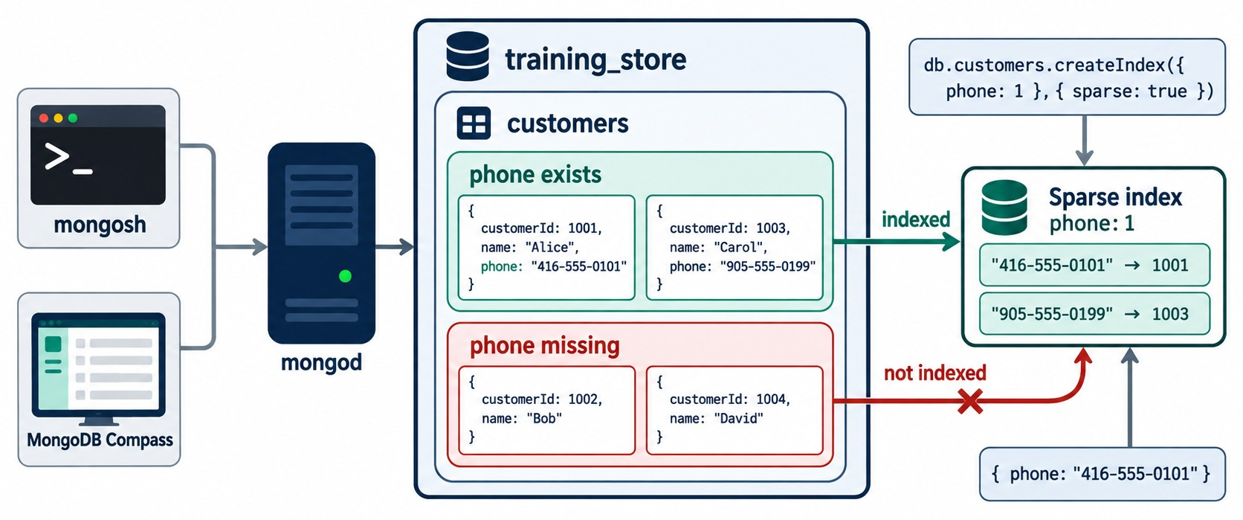
SPARSE INDEXES
Only documents that have the field get an index entry.
Field present
Indexed — Alice and Carol have a phone.
Field missing
No entry — Bob and David are skipped.
training_store twist
C204's phone is null: it exists, so it's indexed. C515 has none.
PREFER PARTIAL A partial filter on $exists says the same, explicitly.
KEY TAKEAWAY Sparse indexes skip documents without the field — partial indexes do the same job with a clearer rule.
26
© 2026 by Innovation In Software Corporation
Notes:
KEY TALKING POINTS
------------------
- Only documents with the field
A sparse index skips documents that don't have the indexed field.
It is smaller than a normal index on an optional field.
- Null is not missing
In training_store, Luis Romero, C204, has contact.phone set to null.
The field exists, so a sparse index includes him.
Sam Okonkwo, C515, has no phone field at all, so he is left out: 5 of the 6 customers are indexed.
- Careful with queries
Because some documents are missing from it, MongoDB won't use a sparse index for a query or sort that must see every document, unless you hint it.
- Prefer partial
A partial index with partialFilterExpression { "contact.phone": { $exists: true } } says the same thing more explicitly, and partial indexes can use any filter.
- What it shows
db.customers.createIndex({ phone: 1 }, { sparse: true }).
Alice and Carol have a phone, so they are indexed.
Bob and David have no phone field, so they are not indexed.
- How to read it
The green arrow is indexed and the red crossed arrow is not indexed.
The query for one phone number uses the two-entry sparse index.
- About the data
The four customers are illustrative, and training_store keeps phone inside contact, so the real path is contact.phone.

Slide 27
TTL INDEXES REMOVE EXPIRED DOCUMENTS
Lab 5, Step 10: a dedicated sessions collection — never orders.
Sessions that expire
✓
The TTL index
db.sessions.insertMany([
{ sessionId: "S1", user: "aisha",
expiresAt: new Date(
Date.now() + 60 * 60 * 1000) },
{ sessionId: "S-EXPIRED",
user: "temp",
expiresAt: new Date(
Date.now() - 60 * 1000) }
])
db.sessions.createIndex(
{ expiresAt: 1 },
{ expireAfterSeconds: 0,
name: "ttl_sessions_expires_at" })
// about 60 s later the TTL monitor
// deletes S-EXPIRED; S1 stays
expireAfterSeconds: 0
Not instant
Never for records you keep
Each document expires at its own expiresAt date.
A background task runs about every 60 seconds.
Orders, payments and audit data stay out of TTL.
KEY TAKEAWAY A TTL index deletes expired documents for you — use it only for data that is meant to disappear.
27
© 2026 by Innovation In Software Corporation
Notes:
KEY TALKING POINTS
------------------
- The setup
Lab 5, Step 10 creates a separate sessions collection with two documents: S1 expires in an hour, S-EXPIRED expired a minute ago.
- The index
A TTL index is a single-field index on a date field with expireAfterSeconds.
With 0, each document expires exactly at the date it stores.
Lab 5 names it ttl_sessions_expires_at; the content source spells it ttl_sessions_expiresAt.
We follow the lab.
- Asynchronous
Right after the insert both documents are there.
The TTL monitor runs about once a minute, so S-EXPIRED disappears some time later, not at an exact instant.
- Where it belongs
Sessions, verification codes and short-lived events.
Never orders, payments or anything you must keep for legal or audit reasons.

Slide 28
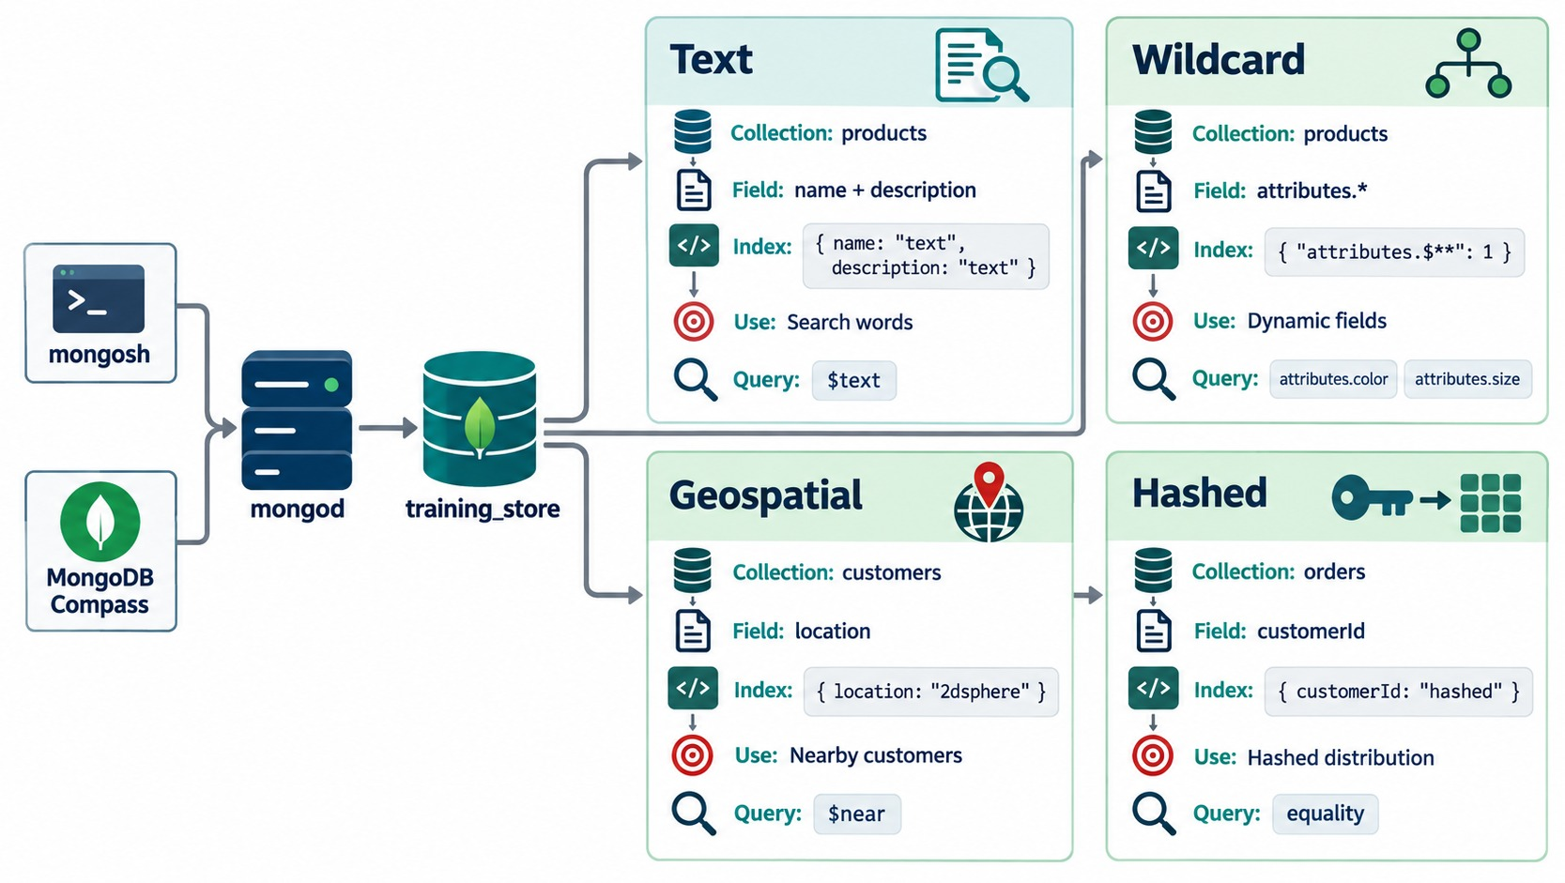
TEXT, WILDCARD, GEOSPATIAL AND HASHED
Four specialized types for four special query shapes.
Text
$text word search — on name, since our products have no description.
Wildcard
{ "attributes.$**": 1 } — our attributes differ by category.
Geospatial
2dsphere on GeoJSON points, longitude first; $near.
Hashed
Equality only; spreads values for hashed sharding — Module 7.
KEY TAKEAWAY Specialized indexes serve special query shapes — word search, dynamic fields, location and shard distribution.
28
© 2026 by Innovation In Software Corporation
Notes:
KEY TALKING POINTS
------------------
- Text
A text index supports word search with $text and a relevance score.
In training_store we would index name, since products have no description.
For autocomplete, fuzzy matching or synonyms, use a dedicated search product.
- Wildcard
{ "attributes.$**": 1 } indexes every path under attributes.
Our laptops have processor and memoryGB, shoes have color and material, books have author and isbn, so the paths vary.
It supports queries such as { "attributes.connection": "Bluetooth" }.
- Geospatial
A 2dsphere index supports $near and containment queries on GeoJSON points, stored longitude first.
A store-locator collection would use it.
- Hashed
A hashed index stores a hash of the value.
It supports equality only, not ranges or sorts, and exists mainly for hashed sharding, which Module 7 covers.
- What it shows
Four cards, one per type: text on products name plus description, wildcard on products attributes.$**, 2dsphere on a customers location field, and hashed on orders customerId.
- How to read it
Each card lists the collection, the field, the index definition, what it is used for and the query operator it serves: $text, dynamic attribute paths, $near and equality.
- About the data
Two cards are hypothetical for training_store: our products have no description field and our customers have no location.
The wildcard card matches our data exactly: products store category-specific fields under attributes.

Slide 29
CHOOSING THE RIGHT INDEX TYPE
Start from what the query must do.
The query must… | Index type | training_store example
Match or sort one field | Single-field | { sku: 1 }
Filter and sort on several | Compound | { customerId: 1, createdAt: -1 }
Forbid duplicates | Unique | sku, customerNumber, orderNumber
Match array values | Multikey | { tags: 1 }
Cover some documents only | Partial | active: true products
Skip a missing field | Sparse | contact.phone
Expire documents | TTL | sessions.expiresAt
Search words / dynamic paths | Text / Wildcard | name / attributes.$**
Location and sharding
2dsphere for coordinates; hashed for hashed shard keys.
One index, many shapes
A compound index often serves several queries through its prefix.
RULE Pick the type from the query, not from the field.
KEY TAKEAWAY Name the query's job first — the index type follows from it.
29
© 2026 by Innovation In Software Corporation
Notes:
KEY TALKING POINTS
------------------
- How to use the table
Read it left to right: what the query must do, the index type, and where training_store uses it.
- Combinations
Types combine.
idx_active_products_category_price is compound and partial; uq_products_sku is single-field and unique; idx_products_tags is single-field and multikey.
- Practice
Ask the class to match eight requirements to these types: unique SKU, active-only, an optional discountCode, session expiry, word search, attribute paths, nearby stores and a hashed tenantId.
Exercise 6.3 at the end of the module applies these types to ten workloads.

Slide 30
PART 5: EXPLAIN() AND COVERED QUERIES
Stop guessing — read the plan.
✓ Part 1
How indexes work
✓ Part 2
Manage indexes
✓ Part 3
Compound + ESR
✓ Part 4
Specialized types
Part 5
explain()
Part 6
Costs + mistakes
SO FAR
NEXT QUESTION
How do we prove an index works — and when can a query skip the documents entirely?
✓
Arrays get multikey indexes automatically
✓
Unique, partial, sparse and TTL add rules and limits
IN THIS PART
The query decides the index type
1
explain() verbosity modes
✓
2
Reading executionStats
3
Spotting a blocking sort
4
Covered queries
5
Proving coverage in mongosh
6
Exercise: diagnose three plans
30
© 2026 by Innovation In Software Corporation
Notes:
KEY TALKING POINTS
------------------
- Why this part
Every earlier slide claimed a plan.
This part shows how to check the claim yourself.
- Watch for
Three numbers read together: nReturned, totalKeysExamined and totalDocsExamined.
One stage to watch for: SORT.

Slide 31
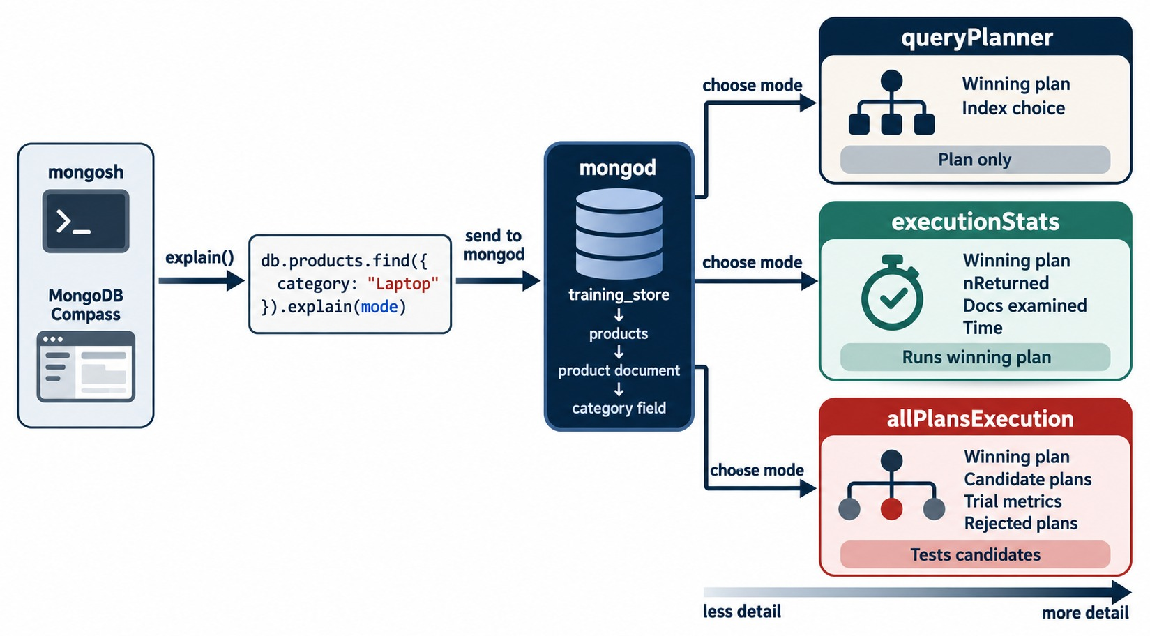
EXPLAIN(): THREE LEVELS OF DETAIL
queryPlanner, executionStats and allPlansExecution.
queryPlanner
The winning plan only — the query isn't run.
executionStats
Runs the winning plan: returned, keys and documents examined, time.
allPlansExecution
Adds the candidate plans the planner tried and rejected.
FOR TUNING explain("executionStats") — as in every lab.
KEY TAKEAWAY explain() shows the plan; executionStats shows what that plan actually cost.
31
© 2026 by Innovation In Software Corporation
Notes:
KEY TALKING POINTS
------------------
- queryPlanner
The default mode.
It shows the chosen plan without running the query, which is safe on a busy system.
- executionStats
Runs the winning plan and reports nReturned, totalKeysExamined, totalDocsExamined and executionTimeMillis.
This is the mode for tuning, and the one every Lab 5 step uses.
- allPlansExecution
Also reports the candidate plans the planner tried during plan selection and why they lost.
Use it when the planner picks an index you didn't expect.
- Two ways to write it
db.products.find(filter).explain("executionStats") or db.products.explain("executionStats").find(filter).
The second form also works for aggregate, as in Lab 5, Step 12.
- What it shows
One find on products, category Laptop, sent with explain(mode).
mongod returns one of three levels of detail.
- How to read it
Top to bottom is less to more detail.
queryPlanner gives the plan only.
executionStats runs the winning plan and reports nReturned, documents examined and time.
allPlansExecution also tests the candidate plans and shows the rejected ones.
- About the data
Laptop is written as LAPTOP in training_store, where three laptops exist: L100, L110 and L190.

Slide 32
READING EXECUTIONSTATS
Lab 5, Step 7: active accessories by price, with idx_products_category_active_price.
✓
The query and its plan (trimmed)
winningPlan
db.products.find(
{ category: "ACCESSORY", active: true }
).sort({ price: 1 }).explain("executionStats")
queryPlanner.winningPlan:
stage: "FETCH"
inputStage:
stage: "IXSCAN"
indexName: "idx_products_category_active_price"
executionStats:
nReturned: 5
totalKeysExamined: 5
totalDocsExamined: 5
FETCH over IXSCAN: keys first, then the matching documents. No SORT.
Keys : docs : returned
5 : 5 : 5 — nothing wasted.
Before the index
SORT over COLLSCAN: 0 keys, 13 documents, 5 returned.
XBAD Its price is the string "49.99" — it matches, and sorts after the numbers.
KEY TAKEAWAY Read the stage path first, then compare keys and documents examined with documents returned.
32
© 2026 by Innovation In Software Corporation
Notes:
KEY TALKING POINTS
------------------
- The index
Lab 5, Step 7 creates { category: 1, active: 1, price: 1 } as idx_products_category_active_price.
category and active are equality, price is the sort.
- Reading the plan
Read winningPlan from the inside out: IXSCAN walks the index, FETCH reads each document.
There is no SORT stage, because the keys are already in price order.
- The counts
Five keys, five documents, five returned: the Wireless Mouse, USB Hub, Wireless Keyboard, Docking Station, and the Legacy Cable Pack.
- A dataset trap
XBAD stores its price as the string "49.99", a Module 4 fixture.
It still matches category and active, and strings sort after numbers, so it comes last.
A range such as price ≤ 100 would skip it.
- The baseline
On a fresh load the same query is SORT over COLLSCAN: 0 keys, all 13 products examined, 5 returned.
Lab 5, Step 7 records that baseline first.
Older sample output shows 4 returned; on the live data it's 5, because XBAD counts.

Slide 33
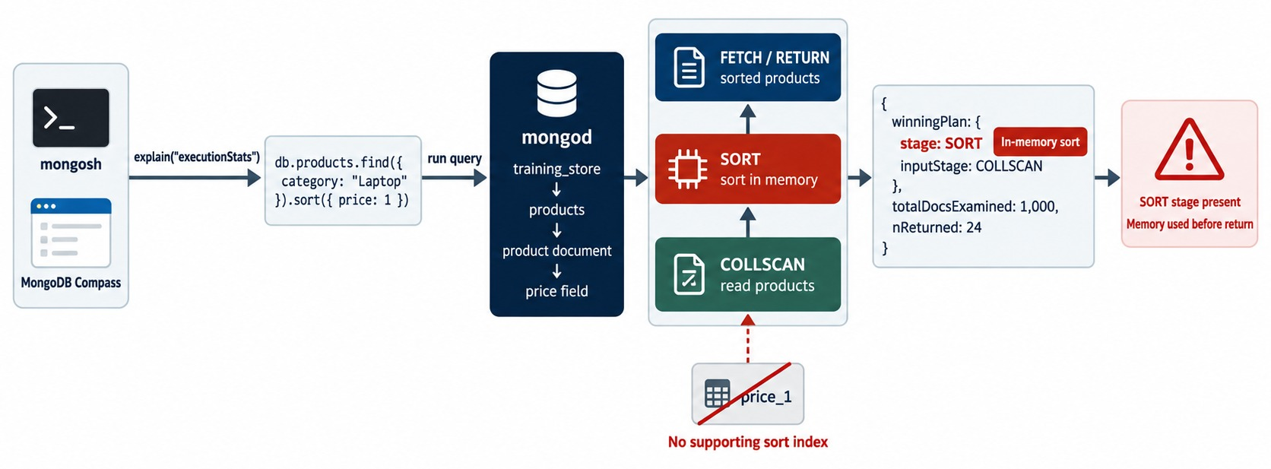
SPOTTING A BLOCKING SORT
A SORT stage means documents were sorted in memory.
The signal
stage: SORT above COLLSCAN or IXSCAN in winningPlan.
Why it hurts
Every match is held and sorted before the first result returns.
The fix
An index whose order matches the sort — after the equality fields.
MEMORY Large sorts use up to 100 MB, then spill to disk.
KEY TAKEAWAY A SORT stage is a missing or mis-ordered index — fix the index, not the query.
33
© 2026 by Innovation In Software Corporation
Notes:
KEY TALKING POINTS
------------------
- What SORT means
A SORT stage in the winning plan means no index supplied the order, so MongoDB collected the matching documents and sorted them in memory.
- Why it hurts
It is blocking: nothing is returned until every matching document has been read and sorted.
Big sorts use up to 100 MB of memory and then spill to disk.
- The fix
An index whose order matches the sort, after any equality fields.
Our order-history index removed SORT for exactly this reason.
- On training_store
Before the catalog index, active accessories sorted by price show SORT above COLLSCAN.
After { category: 1, active: 1, price: 1 }, the SORT stage is gone.
- What it shows
find category Laptop sorted by price, with no supporting index.
The plan reads with COLLSCAN, then a red SORT stage sorts in memory before the results go back.
- How to read it
The explain excerpt shows stage SORT with inputStage COLLSCAN and the warning In-memory sort.
The crossed-out price_1 box explains why: no index supplies the order.
- About the data
The counts, 1,000 examined and 24 returned, are from a larger illustrative catalog.
The pattern is what matters.

Slide 34
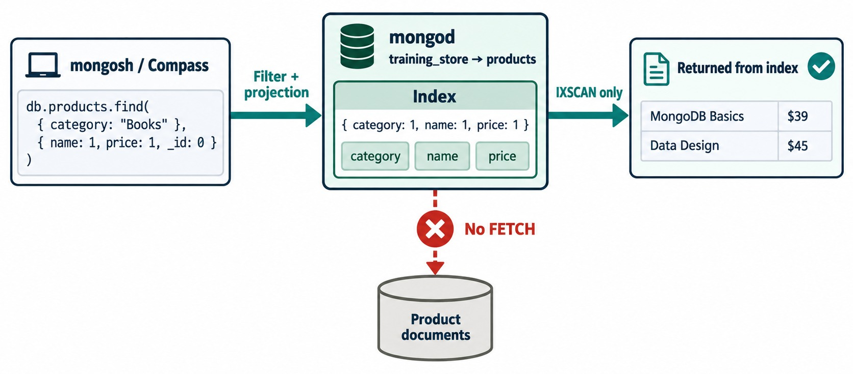
COVERED QUERIES
When the index holds every field the query needs, no document is read.
Filter in the index
category is the first key.
Output in the index
name and price are keys too.
_id excluded
_id isn't in the index, so the projection sets _id: 0.
THE SIGNAL IXSCAN with no FETCH; totalDocsExamined: 0.
KEY TAKEAWAY A covered query answers from the index alone — every filtered and returned field must be in it.
34
© 2026 by Innovation In Software Corporation
Notes:
KEY TALKING POINTS
------------------
- No document read
When the filter and every returned field are in one index, MongoDB answers from the index keys alone and skips the FETCH.
- Three conditions
The filter fields are indexed.
The returned fields are indexed.
And _id is excluded, or is itself part of the index.
- Why _id matters
_id is returned by default.
If it isn't in the index, MongoDB must fetch the document just to read it, and the query is no longer covered.
- Field order in the diagram
The diagram's index is { category: 1, name: 1, price: 1 }; Lab 5, Step 11 uses { category: 1, price: 1, name: 1 }.
Both cover this query: coverage needs the fields to be present, not in a particular order.
- What it shows
A find on category Books with the projection name 1, price 1, _id 0, served by the index { category: 1, name: 1, price: 1 }.
The results come from the index only: IXSCAN only, and a red cross marks no FETCH from the product documents.
- How to read it
Check the three index fields against the query: category is the filter, name and price are the output, and _id is switched off.
- About the data
The two books in the diagram are illustrative.
In training_store the books are MongoDB Fundamentals at 59.99 and Query Cookbook at 39.99, in category BOOK.

Slide 35
PROVING COVERAGE IN MONGOSH
Lab 5, Step 11: idx_products_category_price_name on the two books (trimmed).
✓
Covered
✕
Not covered
db.products.createIndex(
{ category: 1, price: 1, name: 1 },
{ name: "idx_products_category_price_name" })
db.products.find({ category: "BOOK" },
{ _id: 0, name: 1, price: 1 })
stage: PROJECTION_COVERED
inputStage: IXSCAN
totalDocsExamined: 0
// _id comes back by default
db.products.find({ category: "BOOK" },
{ name: 1, price: 1 })
// tags isn't in the index
db.products.find({ category: "BOOK" },
{ _id: 0, name: 1, tags: 1 })
stage: PROJECTION_SIMPLE
inputStage: FETCH
totalDocsExamined: 2
Three conditions
The result
Arrays
Filter indexed · output indexed · _id excluded or indexed.
Query Cookbook 39.99, then MongoDB Fundamentals 59.99.
A multikey field such as tags can't be covered.
KEY TAKEAWAY Confirm coverage with explain() — IXSCAN with no FETCH and zero documents examined.
35
© 2026 by Innovation In Software Corporation
Notes:
KEY TALKING POINTS
------------------
- The covered query
Filter on category, return name and price, and switch _id off.
All three fields are in idx_products_category_price_name, so the plan is PROJECTION_COVERED over IXSCAN: 2 keys, 0 documents, 2 returned.
- Results
The index is ordered by price inside BOOK, so the output is Query Cookbook at 39.99, then MongoDB Fundamentals at 59.99.
- Breaking coverage
Leaving _id on, or asking for tags, needs a field that isn't in the index.
The plan gains a FETCH and totalDocsExamined becomes 2.
- Field order
The index is { category, price, name }.
Coverage needs the fields to be present; their order still matters for which filters and sorts the index serves.

Slide 36
EXERCISE: DIAGNOSE THREE PLANS
Read the numbers, name the problem, propose the fix.
PRACTICE EXERCISE
10 MIN
SCENARIO
YOUR TASKS
EXPECTED OUTCOME
Three explain("executionStats") summaries on a fresh training_store. A: name "USB Hub". B: PROCESSING orders by date. C: tags "wireless".
1
Mark each plan targeted or wasteful
✓
A and B wasteful · C targeted
2
Propose a fix for A
✓
A: index name, or query by sku
A COLLSCAN
keys 0 · docs 13 · returned 1
B SORT ← COLLSCAN
keys 0 · docs 17 · returned 3
C FETCH ← IXSCAN idx_products_tags
keys 2 · docs 2 · returned 2
3
Propose a fix for B
✓
B: idx_orders_fulfillment_date
4
Say why C needs no change
B's SORT disappears with it
✓
✓
C: 2 : 2 : 2 already
KEY TAKEAWAY Read stage, keys, documents and returned together — any one alone can mislead.
36
© 2026 by Innovation In Software Corporation
Notes:
KEY TALKING POINTS
------------------
- How to run it
Individually for three minutes, then discuss.
Ask for the ratio of documents examined to returned for each plan.
- Plan A
13 products read for one USB Hub.
Either index name, if the application really searches by name, or change the query to use sku, which is already uniquely indexed.
- Plan B
All 17 orders read and sorted in memory for 3 results.
idx_orders_fulfillment_date gives an IXSCAN with 3 keys and no SORT.
- Plan C
Two keys, two documents, two results: the Wireless Keyboard and the Wireless Mouse.
It is already as good as it gets.
- One more case
Add a fourth plan out loud: an IXSCAN that examines 50,000 keys for 10 results.
Using an index doesn't make a plan efficient; the key order may be wrong or not selective.

Slide 37
PART 6: SELECTIVITY, COSTS AND COMMON MISTAKES
Every index is a trade-off.
✓ Part 1
How indexes work
✓ Part 2
Manage indexes
✓ Part 3
Compound + ESR
✓ Part 4
Specialized types
✓ Part 5
explain()
Part 6
Costs + mistakes
SO FAR
NEXT QUESTION
Is every index worth what it costs — and how do we keep the set healthy?
✓
explain("executionStats") proves what a query did
✓
A SORT stage means an in-memory sort
IN THIS PART
Covered queries skip the documents entirely
1
Index selectivity
✓
2
Write, storage and memory costs
3
Usage statistics with $indexStats
4
Changing indexes safely in production
5
Common indexing mistakes
6
An indexing strategy for training_store
37
© 2026 by Innovation In Software Corporation
Notes:
KEY TALKING POINTS
------------------
- Why this part
So far every index made a query faster.
Now we count what indexes cost and how to keep only the useful ones.
- Outcome
Learners can audit an index list and recommend retain, redesign or remove, with evidence.

Slide 38
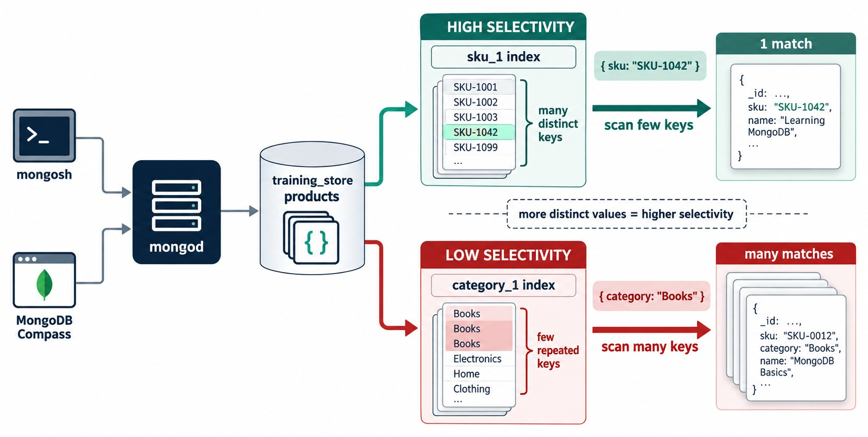
INDEX SELECTIVITY
The more distinct values, the fewer keys a lookup scans.
High
sku: 13 distinct values in 13 products — one key per lookup.
Low
active: 12 of 13 products are true — barely narrows the search.
Combine
Put low-selectivity fields in a compound or partial index.
MEASURE Selectivity comes from your data — check it with explain().
KEY TAKEAWAY An index narrows a search only as much as its values do — lead with fields that really narrow it.
38
© 2026 by Innovation In Software Corporation
Notes:
KEY TALKING POINTS
------------------
- Selective means narrow
A selective condition matches a small share of the collection.
sku is perfectly selective: 13 products, 13 distinct values.
- Low selectivity
active has two values, and 12 of our 13 products are true.
An index on active alone barely narrows the search.
- Use it inside something bigger
Put a low-selectivity field inside a compound index, as in { category: 1, active: 1, price: 1 }, or use it as a partial filter.
- Measure it
Selectivity is a property of your data, not of the field name.
Check it with counts and explain().
- What it shows
Two indexes on products.
sku_1 has many distinct keys, so the SKU lookup scans a few keys and returns one match.
category_1 has a few repeated keys, so a Books query scans many keys and returns many matches.
- How to read it
Green is high selectivity, red is low.
The dashed note in the middle is the rule: more distinct values means higher selectivity.
- Key point
An index narrows the search only as much as its values do.

Slide 39
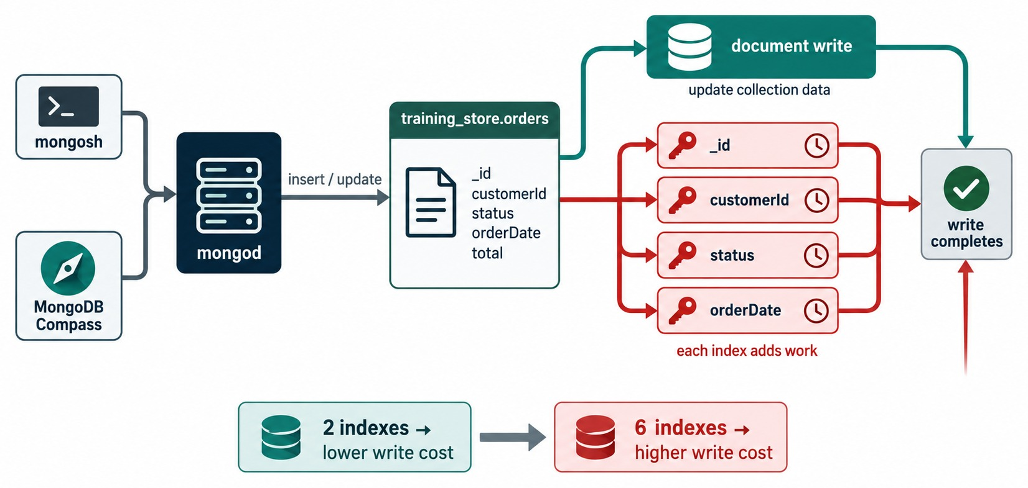
EVERY INDEX COSTS WRITES
Each insert or update also updates the indexes it touches.
Write path
One order insert updates the document, _id_, orderNumber_unique and every secondary index.
Storage and memory
Indexes take disk space and compete for RAM with the data.
Updates
Changing an indexed field rewrites its index keys.
BALANCE Keep indexes that serve real, frequent queries.
KEY TAKEAWAY Every index speeds some reads and slows every write — keep the ones that earn their cost.
39
© 2026 by Innovation In Software Corporation
Notes:
KEY TALKING POINTS
------------------
- Writes pay for reads
Every insert updates the collection and every index on it.
Every update to an indexed field rewrites that field's index keys.
Every delete removes keys from every index.
- On training_store
A new order already updates _id_ and orderNumber_unique.
After Lab 5 it also updates idx_orders_customer_date and idx_orders_fulfillment_date.
- Storage and memory
Indexes take disk space and compete with the documents for the storage engine's cache in RAM.
Indexes that fit in memory are fast; ones that don't cause disk reads.
- Operational cost
More indexes mean longer builds, more monitoring, more plan choices, and more data to back up and replicate.
- What it shows
An insert or update on training_store.orders writes the document and then updates each index: _id, customerId, status and orderDate.
Each adds work before the write completes.
- How to read it
The clocks on the red index boxes are the extra work.
The bottom bar compares two indexes, lower write cost, with six indexes, higher write cost.
- About the data
The diagram's orderDate and status are generic names.
training_store orders use createdAt, paymentStatus and fulfillmentStatus.

Slide 40
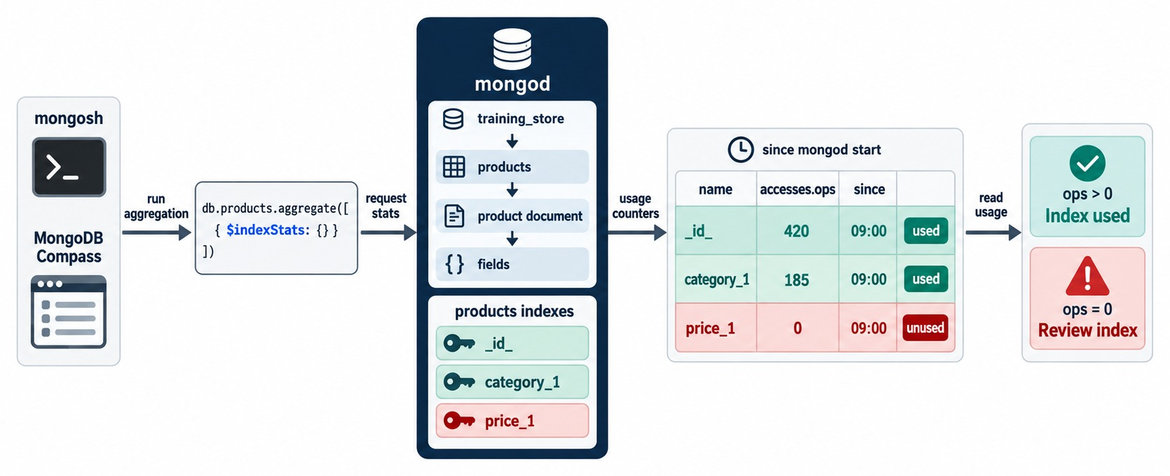
INDEX USAGE STATISTICS
$indexStats counts how often each index was used.
Usage per index
db.products.aggregate([
{ $indexStats: {} }
]).map(s => ({ name: s.name,
ops: s.accesses.ops }))
ops > 0
The planner is using the index.
ops = 0
Review it: hide, measure, then decide.
SINCE RESTART Counters reset when mongod restarts.
KEY TAKEAWAY $indexStats shows which indexes earn their keep — zero uses starts an investigation, not a drop.
40
© 2026 by Innovation In Software Corporation
Notes:
KEY TALKING POINTS
------------------
- Usage counters
$indexStats returns one document per index with accesses.ops, the number of times the planner used it, and accesses.since, when counting started.
- Read with care
The counters reset when mongod restarts and are per server.
On a replica set, check every member before deciding an index is unused.
- In the lab
Lab 5, Step 13 runs $indexStats on products and expects low or zero counts for some indexes, because the classroom server hasn't been running long.
- What it shows
db.products.aggregate([{ $indexStats: {} }]) returns usage counters since mongod started: _id_ with 420 operations, category_1 with 185, and price_1 with 0.
- How to read it
Green rows have ops greater than zero: index used.
The red row, price_1 with zero, is flagged review index.
- Key point
Zero uses is a reason to investigate, not an instruction to drop.

Slide 41
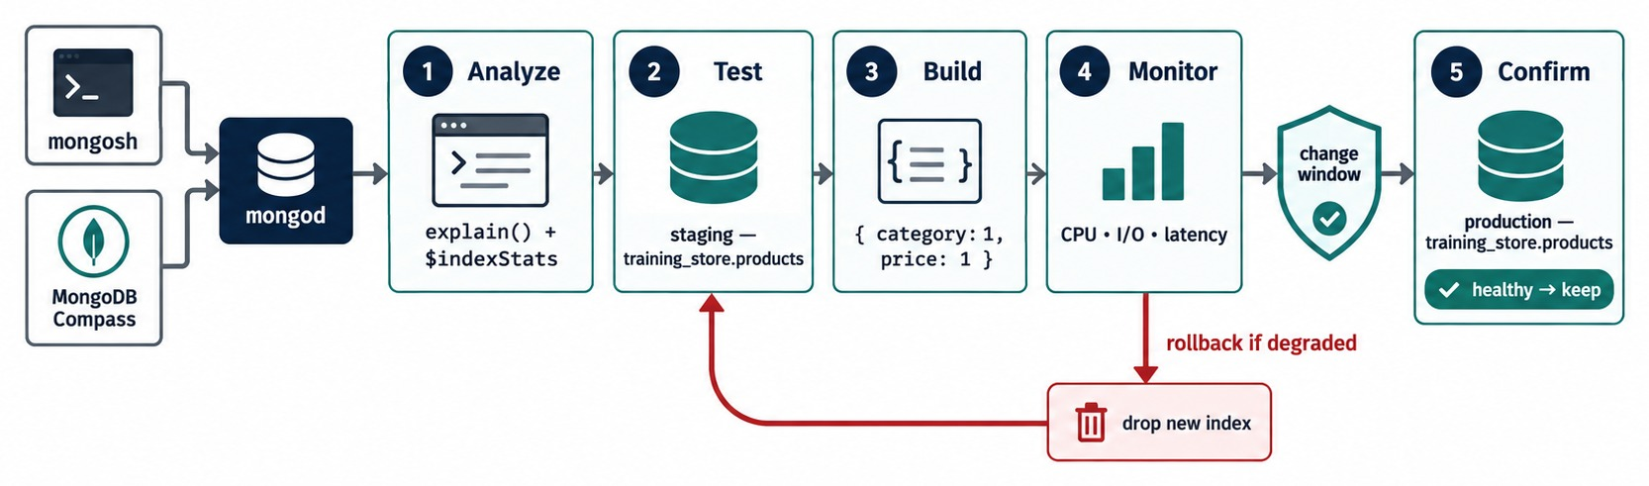
CHANGING INDEXES SAFELY IN PRODUCTION
Analyze, test, build, monitor, confirm — with a rollback ready.
Analyze and test
Build and monitor
Rollback
REMOVING Hide first; drop only when the queries stay healthy.
explain() and $indexStats; try it on staging data first.
Build in a change window; watch CPU, I/O and latency.
If it degrades, drop the new index — keep the createIndex command.
KEY TAKEAWAY Treat every index change as a production change: measured, monitored and reversible.
41
© 2026 by Innovation In Software Corporation
Notes:
KEY TALKING POINTS
------------------
- Treat it as a change
Adding or removing an index changes performance for every query on that collection.
Plan it like a code release.
- Before and after
Capture the explain() baseline and $indexStats first.
Build on staging with production-like data.
Watch CPU, I/O and latency after the production build.
- Rollback
Keep both commands ready.
For a new index, rollback is dropIndex by name; for a removal, hide first, and keep the original createIndex so it can be rebuilt.
- What it shows
Five steps for one index change: analyze with explain and $indexStats, test on staging, build { category: 1, price: 1 }, monitor CPU, I/O and latency, then confirm in production during a change window.
- How to read it
The red loop is the rollback: if monitoring shows degradation, drop the new index and return to testing.
- Key point
An index change is a production change.
It gets a plan and a rollback.
USE-CASE SCENARIO
-----------------
A team adds { category: 1, price: 1 } to speed up the catalog page.
They test it on staging, build it in the evening change window, and watch the dashboards for an hour.
Catalog latency drops and write latency is unchanged, so they keep it.

Slide 42
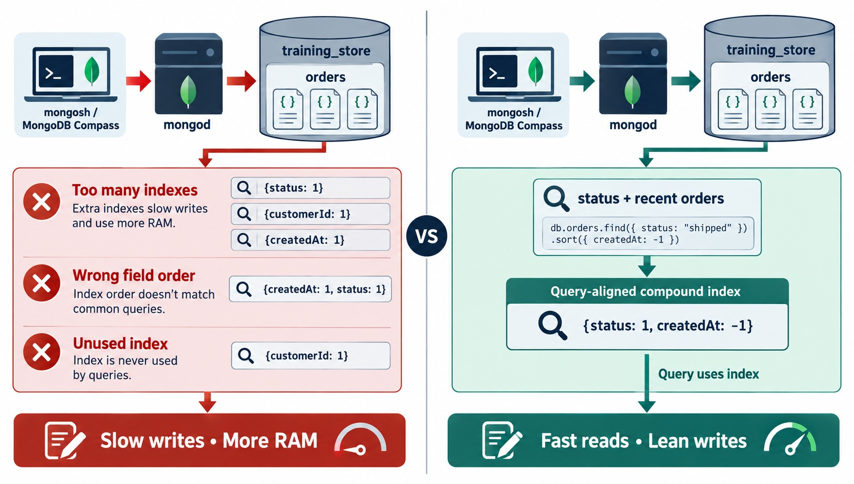
COMMON INDEXING MISTAKES
Too many, wrong order, never used — and the query-aligned fix.
Too many indexes
Every extra index slows writes and uses RAM.
Wrong field order
{ createdAt, status } can't serve status + newest first.
Unused indexes
$indexStats ops = 0 — review them.
Also avoid
hint() as a permanent fix · timing tiny data · trusting any IXSCAN.
KEY TAKEAWAY Index the real query shapes, in ESR order — and review what nothing uses.
42
© 2026 by Innovation In Software Corporation
Notes:
KEY TALKING POINTS
------------------
- Too many indexes
One index per field, just in case, slows every write and fills memory.
Index recurring query shapes instead.
- Wrong order
{ createdAt: 1, status: 1 } puts the range and sort field first.
For status equality with a date sort, equality must lead.
- Unused indexes
An index nobody uses is pure cost.
Find it with $indexStats, hide it, measure, then drop it.
- Three more
Using hint() as a permanent fix locks in a plan that ages badly.
Judging by time alone on tiny data proves nothing.
And an IXSCAN that examines 50,000 keys for 10 results is not efficient.
- What it shows
On the left, three mistakes on orders: too many single-field indexes, the wrong field order { createdAt: 1, status: 1 }, and an unused { customerId: 1 } index.
Result: slow writes and more RAM.
- How to read it
On the right, the fix for the real query, status shipped sorted by createdAt newest first: one query-aligned compound index { status: 1, createdAt: -1 }.
Result: fast reads and lean writes.
- About the data
In training_store the field is fulfillmentStatus and the value is upper case, SHIPPED.
The same index there is { fulfillmentStatus: 1, createdAt: -1 }.

Slide 43
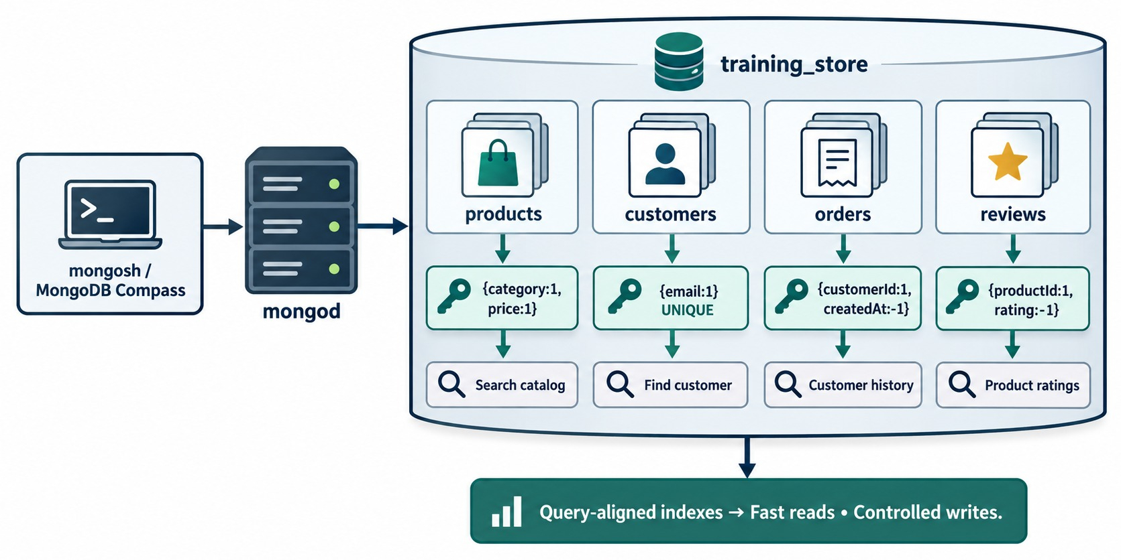
AN INDEXING STRATEGY FOR TRAINING_STORE
One index per important query shape — plus the integrity rules.
products
{ category: 1, price: 1 } for the catalog; unique sku.
customers
Unique contact.email — the diagram shortens it to email.
orders
{ customerId: 1, createdAt: -1 } for order history.
reviews
{ productId: 1, rating: -1 } for top ratings — or createdAt: -1 for newest.
KEY TAKEAWAY A small set of query-aligned indexes gives fast reads with controlled writes.
43
© 2026 by Innovation In Software Corporation
Notes:
KEY TALKING POINTS
------------------
- Start from the pages
The catalog page filters by category and sorts by price.
The login looks a customer up by email.
The account page lists orders newest first.
The product page shows reviews.
- The indexes
products { category: 1, price: 1 }, customers unique contact.email, orders { customerId: 1, createdAt: -1 } and reviews { productId: 1, rating: -1 }.
- Two review indexes
The diagram sorts a product's reviews by rating, for top-rated first.
The content source also recommends { productId: 1, createdAt: -1 }, named idx_reviews_product_date, for newest first.
Build the one the product page actually uses.
- Keep the integrity rules
The unique indexes on sku, customerNumber, orderNumber and email stay whatever else changes.
- What it shows
The four training_store collections, each with one query-aligned index and the query it serves: category and price for the catalog, unique email to find a customer, customerId and createdAt for order history, productId and rating for product ratings.
- How to read it
Read each column top to bottom: collection, index, query.
The banner sums it up: fast reads, controlled writes.
- About the data
The customer email lives at contact.email in training_store, and load.js already makes it unique as email_unique.

Slide 44
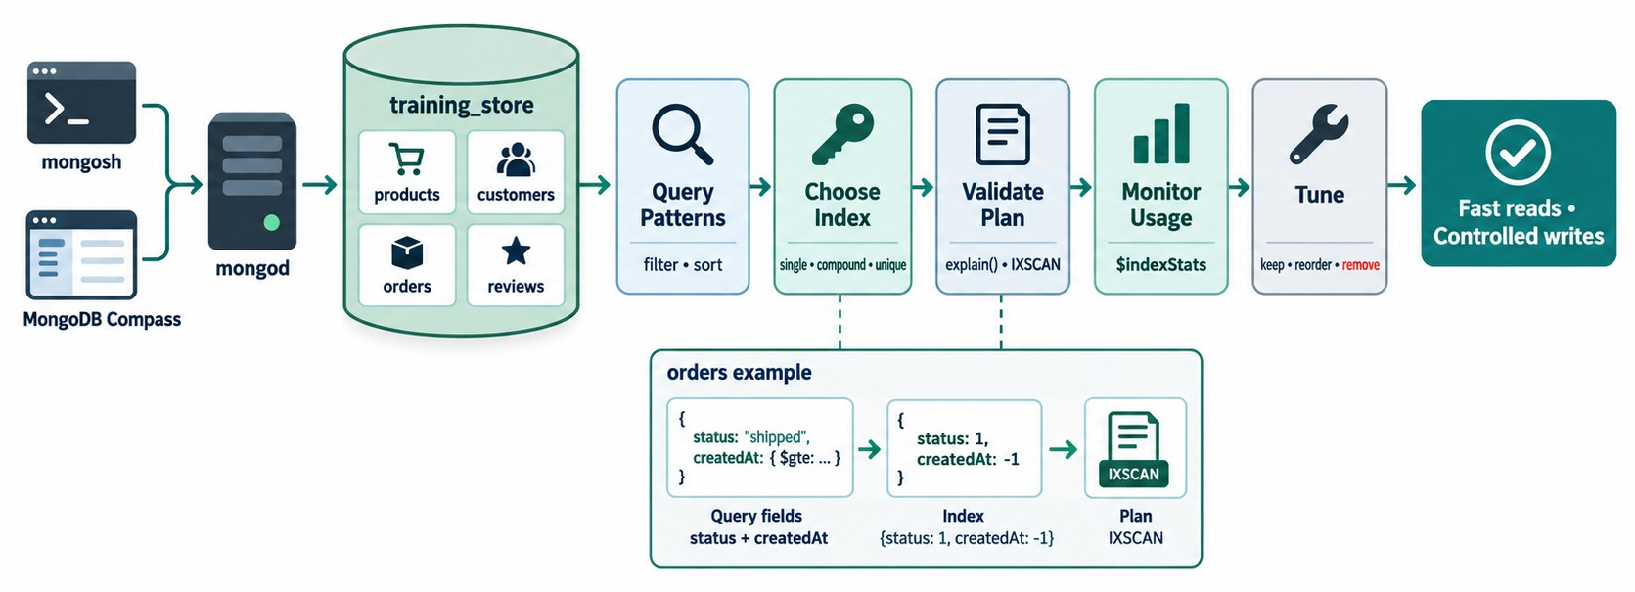
MODULE 6 AT A GLANCE
Query patterns → choose index → validate plan → monitor usage → tune.
KEY TAKEAWAY Start from the query, prove the index with explain(), and keep reviewing what the index set costs.
44
© 2026 by Innovation In Software Corporation
Notes:
KEY TALKING POINTS
------------------
- The workflow
Query patterns first: what does the application filter and sort on?
Then choose the index: single, compound or unique.
- Prove it
Validate the plan with explain(): IXSCAN, keys and documents close to returned, no SORT.
- Keep it healthy
Monitor usage with $indexStats, then tune: keep, reorder or remove.
The outcome is fast reads with controlled writes.
- What it shows
The whole module as one workflow on training_store: query patterns, choose the index, validate the plan, monitor usage, tune, and the outcome, fast reads with controlled writes.
- How to use it
Point to each step and ask the class which command belongs there: find and sort, createIndex, explain, $indexStats, hide or drop.
- About the data
The orders example uses status shipped.
In training_store that is fulfillmentStatus SHIPPED.

Slide 45
KNOWLEDGE CHECK
Answer in your own words — then compare with a partner.
What does a COLLSCAN stage tell you?
How is a partial index different from a sparse one?
1
6
Which index does every collection have?
Why should a TTL index never go on orders?
2
7
Why does field order matter in a compound index?
Which three explain() numbers do you compare?
3
8
What does ESR stand for, and what is it for?
What three conditions make a query covered?
4
9
What makes an index on tags multikey?
Why hide an index before dropping it?
5
10
45
© 2026 by Innovation In Software Corporation
Notes:
KEY TALKING POINTS
------------------
- 1. COLLSCAN
No usable index: MongoDB read every document in the collection and tested the filter on each one.
- 2. Every collection
The unique _id index, named _id_.
It can't be dropped.
- 3. Field order
The index is sorted by its first field, then the next.
{ category: 1, price: 1 } serves category queries; { price: 1, category: 1 } scatters each category through the price order.
Same fields, different index.
- 4. ESR
Equality, Sort, Range: a starting order for compound-index fields.
Check it with explain().
- 5. Multikey
tags is an array, so MongoDB stores one key per array value and sets multikey: true automatically.
- 6. Partial versus sparse
Partial indexes documents that match any filter expression.
Sparse only skips documents that lack the field.
- 7. TTL on orders
TTL deletes documents automatically.
Orders must be kept for business, legal and audit reasons.
- 8. explain() numbers
nReturned, totalKeysExamined and totalDocsExamined, together with the stage path, especially SORT.
- 9. Covered
Filter fields indexed, returned fields indexed, and _id excluded or indexed.
Confirm: IXSCAN with no FETCH.
- 10. Hide first
Hiding is instant to undo and keeps the index maintained.
Dropping means a full rebuild if a query turns out to need it.

Slide 46
EXERCISE 6.1 — APPLY EQUALITY–SORT–RANGE
Module 6 checkpoint A: three query shapes, three compound indexes.
OFFICIAL CHECKPOINT A
15 MIN
labs/day-03/exercises/exercise-6.1-apply-equality-sort-range.md
SCENARIO
YOUR TASKS
SOLUTION (AFTER DEBRIEF)
Label equality, sort and range in each shape, then propose one compound index per shape.
1
Label E, S and R in shape A
✓
A { category: 1, active: 1, price: 1 }
2
Label shape B — spot the shared field
B { customerId: 1, createdAt: -1 }
✓
A products: ACCESSORY, active,
price ≤ 100, sort by price
B orders: one customerId,
createdAt in a date range,
sort createdAt descending
C orders: paymentStatus PAID,
createdAt ≥ start, sort desc
3
Propose one index per shape
✓
C { paymentStatus: 1, createdAt: -1 }
4
Say why paymentStatus leads in C
Equality first partitions the keys
✓
✓
No index leads with a range
KEY TAKEAWAY ESR gives a strong first design — equality narrows, sort orders, range scans last.
46
© 2026 by Innovation In Software Corporation
Notes:
KEY TALKING POINTS
------------------
- Official checkpoint
This is the official Exercise 6.1.
The worksheet is labs/day-03/exercises/exercise-6.1-apply-equality-sort-range.md; the answer key is in its solution folder.
It is a discussion exercise; mongosh is optional.
- Shape A
category and active are equality, price is both the sort and the range.
{ category: 1, active: 1, price: 1 } is the same index Lab 5, Step 7 builds as idx_products_category_active_price.
On a fresh load it returns the Wireless Mouse, USB Hub and Wireless Keyboard; XBAD's string price is outside a numeric range.
- Shape B
customerId is equality; createdAt is both the sort and the range, so it appears once: { customerId: 1, createdAt: -1 }.
- Shape C
{ paymentStatus: 1, createdAt: -1 }.
paymentStatus has only a few values, but putting equality first means the date sort and range walk one status's keys instead of mixing statuses.
Lab 5, Step 12 builds it as idx_orders_payment_created.

Slide 47
EXERCISE 6.2 — IDENTIFY COVERED QUERIES
Module 6 checkpoint B: which projections can the index answer alone?
OFFICIAL CHECKPOINT B
15 MIN
labs/day-03/exercises/exercise-6.2-identify-covered-queries.md
SCENARIO
YOUR TASKS
SOLUTION (AFTER DEBRIEF)
The index { category: 1, price: 1, name: 1 } exists. Decide which queries can be covered.
1
Decide coverage for Q1
✓
Q1 may be covered
2
Decide coverage for Q2 and Q3
✓
Q2 not — tags needs a FETCH
Q1 find({ category: "BOOK" },
{ _id: 0, name: 1, price: 1 })
Q2 find({ category: "BOOK" },
{ _id: 0, name: 1, price: 1,
tags: 1 })
Q3 find({ category: "BOOK" },
{ name: 1 })
3
Write the three coverage conditions
✓
Q3 not — _id returns by default
Name the explain() signal to look for
✓
Filter, output, _id handled
4
✓
IXSCAN with no FETCH
KEY TAKEAWAY A covered query needs every filtered and returned field in the index — including the decision about _id.
47
© 2026 by Innovation In Software Corporation
Notes:
KEY TALKING POINTS
------------------
- Official checkpoint
This is the official Exercise 6.2.
The worksheet is labs/day-03/exercises/exercise-6.2-identify-covered-queries.md.
Lab 5, Step 11 lets learners test the answers in mongosh.
- Q1
Filter on category, output name and price, _id off: every field is in the index, so it can be covered.
- Q2 and Q3
Q2 asks for tags, which isn't in the index, so MongoDB must fetch the documents.
Q3 leaves _id on by default, and _id isn't in the index, so it fetches too.
- The rule and the signal
Filter fields indexed, returned fields indexed, _id excluded or indexed.
Confirm with explain: IXSCAN and no FETCH, PROJECTION_COVERED, and totalDocsExamined 0.

Slide 48
EXERCISE 6.3 — E-COMMERCE INDEX REVIEW
Module 6 checkpoint C: an index recommendation for ten workloads.
OFFICIAL CHECKPOINT C
30–45 MIN
labs/day-03/exercises/exercise-6.3-e-commerce-index-review.md
SCENARIO
YOUR TASKS
SOLUTION (AFTER DEBRIEF)
Recommend indexes for ten recurring training_store workloads.
1
Tabulate shape and index for all ten
✓
A ten-row table
✓
uq_products_sku, idx_products_tags
1 SKU lookup 6 order history
2 category browse 7 paid reporting
3 tag search 8 newest reviews
4 email lookup 9 session expiry
5 order number 10 dynamic attrs
2
Mark unique, multikey, partial, TTL, wildcard
✓
TTL on sessions · wildcard attributes
3
Give ESR roles and a cost note per compound
✓
Overlap: category vs category + active + price
4
Flag an overlap; plan validation and rollback
✓
Baseline → create → explain → rollback
KEY TAKEAWAY A good index plan names the query, the index, its cost and how to prove it — and how to undo it.
48
© 2026 by Innovation In Software Corporation
Notes:
KEY TALKING POINTS
------------------
- Official checkpoint
This is the official Exercise 6.3, the module's practical challenge.
The worksheet is labs/day-03/exercises/exercise-6.3-e-commerce-index-review.md.
Allow 30 to 45 minutes.
- Expected table
SKU: unique sku.
Category browse: { category: 1, active: 1, price: 1 }, or partial on active.
Tags: multikey.
Email: unique contact.email.
Order number: unique orderNumber.
History: { customerId: 1, createdAt: -1 }.
Paid reporting: { paymentStatus: 1, createdAt: -1 }.
Reviews: { productId: 1, createdAt: -1 }.
Sessions: TTL on expiresAt.
Attributes: wildcard attributes.$**.
- Overlap
A single { category: 1 } index overlaps with every category-leading compound.
Plan: hide it, measure, then decide.
- Validation
For the catalog and history indexes: baseline explain, createIndex, explain again, compare examined with returned and check that SORT is gone.
Rollback is dropIndex by name, with the createIndex command saved.

Slide 49
LAB 5 — INDEX AND EXPLAIN
Day 3 official lab: measure, index and measure again on a fresh training_store.
OFFICIAL LAB
40–50 MIN
labs/day-03/lab5/LAB-5-GUIDE.md
🧪
SIX CORE STEPS ON A FRESH LOAD
BEFORE YOU START
1
Baseline: C101's orders, newest first
explain → SORT + COLLSCAN
mongosh "mongodb://localhost:27017" `
.\datasets\training_store\load.js
use training_store
2
Create the history index
idx_orders_customer_date
3
Measure again
IXSCAN · 5 keys · 5 docs · no SORT
C101 Look it up by customerNumber — don't copy an ObjectId from a slide.
4
A new shape: PROCESSING orders
idx_orders_fulfillment_date
5
Multikey: tags = "wireless"
idx_products_tags
GO FURTHER Steps 7–13 add catalog, unique, partial, TTL, covered, aggregation and audit practice.
6
Inventory every index
getIndexes() on all four collections
KEY TAKEAWAY Record the plan shape and the counts before and after every index — that evidence is the lab.
49
© 2026 by Innovation In Software Corporation
Notes:
KEY TALKING POINTS
------------------
- Official lab
This is Day 3 Lab 5, labs/day-03/lab5/LAB-5-GUIDE.md; expected explain excerpts are in lab5/solution/LAB-5-SOLUTION.md.
Reload training_store first so Lab 3's writes are gone, then work through the six core steps.
- Steps 1 to 3
Baseline explain of C101's order history, create idx_orders_customer_date, and explain again.
Expect SORT over COLLSCAN before, IXSCAN with 5 keys and 5 documents after.
- Steps 4 and 5
The PROCESSING queue needs idx_orders_fulfillment_date: 3 orders.
The tags index is multikey; wireless matches P1001 and A410.
- Step 6
Inventory every index: products has sku_unique, customers has customerNumber_unique and email_unique, orders has orderNumber_unique, plus the three indexes created in Steps 2, 4 and 5.
Don't drop the unique identity indexes.
- Go further
Steps 7 to 13 fold in the extra module practice: the catalog index and its prefixes, a nested-field lookup, unique SKUs, partial and TTL indexes, a covered query, an aggregation, and a hide-and-test audit with $indexStats.
- Data notes
A fresh load has 13 products, including the XBAD fixture, and 17 orders.
Never copy the ObjectId shown in older slides; it isn't in this dataset.

Slide 50
MODULE 6 SUMMARY AND WHAT'S NEXT
From a collection scan to a small, proven set of indexes.
YOU CAN NOW
NEXT: MODULE 7 — REPLICATION AND SHARDING
Explain COLLSCAN, IXSCAN, FETCH and SORT
1
How do replica sets keep data available?
✓
Create, list, hide and drop named indexes
2
How does sharding split a collection?
✓
Order compound fields with ESR and prefixes
Why does a shard key need an index?
✓
3
Choose multikey, unique, partial, sparse and TTL
✓
Read explain() and build a covered query
BRING ALONG Your Lab 5 index inventory and the explain() numbers you recorded before and after each index.
✓
Weigh selectivity, write cost and index usage
✓
KEY TAKEAWAY Fast queries on one server come first — Module 7 keeps them available and spreads them across many.
50
© 2026 by Innovation In Software Corporation
Notes:
KEY TALKING POINTS
------------------
- Recap
We moved from collection scans to index scans, managed named indexes, designed compound indexes with ESR, used specialized types, read explain() and covered a query, and weighed what indexes cost.
- Next module
Module 7 answers the next Day 3 questions: how replica sets keep data available through a failure, and how sharding spreads a collection across servers.
- The link
Every sharded collection needs an index that supports its shard key, and hashed indexes, which we met today, support hashed sharding.
Good indexes still matter on every shard.

