Slide 1
"Replicate to stay online. Shard to grow."
MODULE 7
Introduction to Replication and Sharding
How replica sets keep training_store online through a failure — and how sharding lets its orders grow past one server.
Availability vs scale
Replica sets and failover
Read and write guarantees
Sharded clusters and keys
Routing and design
MASTERING MONGODB • MODULE 7
Notes:
KEY TALKING POINTS
------------------
- Two mechanisms, two problems
MongoDB uses two mechanisms for demanding production workloads.
Replication keeps several copies of the same data so the database stays available when a server fails.
Sharding splits a collection across several servers so it can grow past one machine.
- What this module does
We start by separating availability from scalability.
Then we look inside a replica set: the primary, the secondaries, the oplog, elections and failover.
Next come the read and write settings and what replication lag and rollback mean.
Finally we build a sharded cluster, choose a shard key for training_store orders and see how queries are routed.
- Where this sits in the course
This is the second module of Day 3.
Module 6 made single queries fast with indexes.
Module 7 keeps the whole database online and ready to grow, and Module 8 turns all of it into production practice.
- Lab safety
Failover and sharding commands run only on instructor-controlled, disposable infrastructure.
Say this now and repeat it whenever such a command appears.
REAL-WORLD EXAMPLES
-------------------
- An online store runs its database as a three-member replica set, so a failed server causes a pause of seconds, not an outage.
Years later, when order volume outgrows one replica set, it shards the orders collection.

Slide 2
LEARNING OBJECTIVES
What you will understand by the end of this module.
🎯
BY THE END OF THIS MODULE, YOU CAN
❓
SIX QUESTIONS THIS MODULE ANSWERS
1. Tell availability from scalability
2. Explain replica-set roles, the oplog, failover
3. Choose basic read and write settings
4. Describe the parts of a sharded cluster
5. Evaluate shard keys and query routing
6. Decide when to replicate, shard, or both
WHY
do we need copies and pieces?
HOW
does a replica set survive failure?
WHICH
member serves a read, and when?
WHAT
makes up a sharded cluster?
HOW
do we choose a shard key?
WHEN
do we replicate, shard, or both?
🗺️
MODULE ROADMAP
Availability
Replica sets
Failover
Guarantees
Shard keys
Routing
Design
KEY TAKEAWAY Replication keeps the data available; sharding distributes the data and the work.
2
© 2026 by Innovation In Software Corporation
Notes:
KEY TALKING POINTS
------------------
- By the end of this module
Walk through the six objectives on the left.
Learners should be able to tell availability from scalability, and explain the roles in a replica set, the oplog and failover.
They should be able to choose basic read and write settings and describe the parts of a sharded cluster.
They should also be able to evaluate a shard key and its query routing, and decide when to replicate, shard, or both.
- Six questions this module answers
Why do we need both copies and pieces?
How does a replica set survive a failure?
Which member serves a read, and when is a write safe?
What makes up a sharded cluster?
How do we choose a shard key?
And when should we replicate, shard, or both?
- The roadmap
The five parts at the bottom follow that order.
Official Exercises 7.1 to 7.4 come at the end, followed by the module's lab, Day 3 Lab 6.

Slide 3
KEY TERMS FOR THIS MODULE
Plain definitions for the words we'll use most.
1
Replica set
2
Oplog
A group of mongod servers holding the same data: one primary and its secondaries.
The operation log: a capped collection of every change, which secondaries copy and apply.
3
Election and failover
4
Write concern
When the primary is lost, a majority of voters elects a secondary as the new primary.
How many members must confirm a write before the application gets an answer.
5
Read preference and read concern
6
Sharded cluster
Which member serves a read — and which data it may return.
Shards hold the data, config servers hold the metadata, mongos routes every request.
7
Shard key
8
Chunk and balancer
The indexed field or fields that decide which shard stores each document.
A chunk is one range of shard-key values; the balancer moves ranges between shards.
KEY TAKEAWAY Agree on the words first — every later slide builds on them.
3
© 2026 by Innovation In Software Corporation
Notes:
KEY TALKING POINTS
------------------
- How to run this slide
Read each term once and give a quick example from the training_store sample database.
- Replica set
A group of mongod servers holding the same data: one primary and its secondaries.
- Oplog
The operation log: a capped collection of every change, which secondaries copy and apply.
- Election and failover
When the primary is lost, a majority of voters elects a secondary as the new primary.
- Write concern
How many members must confirm a write before the application gets an answer.
- Read preference and read concern
Which member serves a read — and which data it may return.
- Sharded cluster
Shards hold the data, config servers hold the metadata, mongos routes every request.
- Shard key
The indexed field or fields that decide which shard stores each document.
- Chunk and balancer
A chunk is one range of shard-key values; the balancer moves ranges between shards.

Slide 4
FULL FORMS USED IN THIS MODULE
Every abbreviation on these slides, spelled out.
CA
Canada (zone label)
EU
European Union (zone label)
RAM
Random Access Memory
COLLSCAN
Collection Scan
HA
High Availability
URI
Uniform Resource Identifier
CPU
Central Processing Unit
IXSCAN
Index Scan
US
United States (zone label)
ESR
Equality, Sort, Range
oplog
Operations log
KEY TAKEAWAY When an abbreviation isn't clear, the full form is on this slide.
4
© 2026 by Innovation In Software Corporation
Notes:
KEY TALKING POINTS
------------------
- How to run this slide
Don't read every row.
Point out the few this module uses most, and say the full list is here for reference.
- Reference
CA is Canada (zone label); COLLSCAN is Collection Scan; CPU is Central Processing Unit; ESR is Equality, Sort, Range; EU is European Union (zone label); HA is High Availability; IXSCAN is Index Scan; oplog is Operations log; RAM is Random Access Memory; URI is Uniform Resource Identifier; US is United States (zone label).

Slide 5
FROM MODULE 6 TO MODULE 7
Our queries are fast on one server — now keep the data online and ready to grow.
MODULE 6 GAVE US
🧭
OUR PATH THROUGH MODULE 7
1
Availability versus scalability
Part 1
✓
Indexes shaped like our queries
explain(): IXSCAN versus COLLSCAN
2
Replica sets, the oplog and elections
Part 2
✓
The ESR guideline for compound keys
3
Failover and what the application sees
Part 2
✓
{ customerId: 1, createdAt: -1 } for history
4
Read preference, read and write concern
Part 3
✓
Evidence before changing the design
5
Replication lag and rollback
Part 3
✓
NOW Survive a server failure — and plan how orders can outgrow one server.
6
Sharded clusters and shard keys
Part 4
7
Chunks, routing and the design decision
Part 5
KEY TAKEAWAY Module 6 made one server fast; Module 7 keeps training_store online and lets it grow.
5
© 2026 by Innovation In Software Corporation
Notes:
KEY TALKING POINTS
------------------
- Bridge from Module 6
In Module 6 we built indexes that match our query shapes and proved them with explain.
The customer-history index { customerId: 1, createdAt: -1 } made one customer's orders fast.
- The new question
A fast query doesn't help if the server is down, or if the orders collection no longer fits on one server.
This module answers both.
- The same example
We stay with training_store: 17 orders from 6 customers today.
The customerId field from Module 6 comes back as our main shard-key candidate.
- Lab safety
Failover and sharding commands run only on instructor-controlled, disposable infrastructure.
Never step down or shard a shared class cluster.

Slide 6
PART 1: AVAILABILITY AND SCALE
Two different problems — and two different mechanisms.
Part 1
Availability and scale
Part 2
Replica sets
Part 3
Guarantees and lag
Part 4
Shard keys
Part 5
Routing and design
SO FAR
NEXT QUESTION
What should happen when a server fails — and when the data outgrows one server?
✓
Indexes make single queries fast
✓
explain() shows the work each query does
IN THIS PART
✓
training_store runs on one server so far
Requirement to mechanism
1
2
Scaling up versus scaling out
3
Replication versus sharding
4
What neither mechanism does
6
© 2026 by Innovation In Software Corporation
Notes:
KEY TALKING POINTS
------------------
- Why start here
Replication and sharding are often confused.
We first separate the two problems: availability and scale.
- What this part covers
Which mechanism solves which requirement, vertical and horizontal scaling, and a side-by-side comparison.

Slide 7
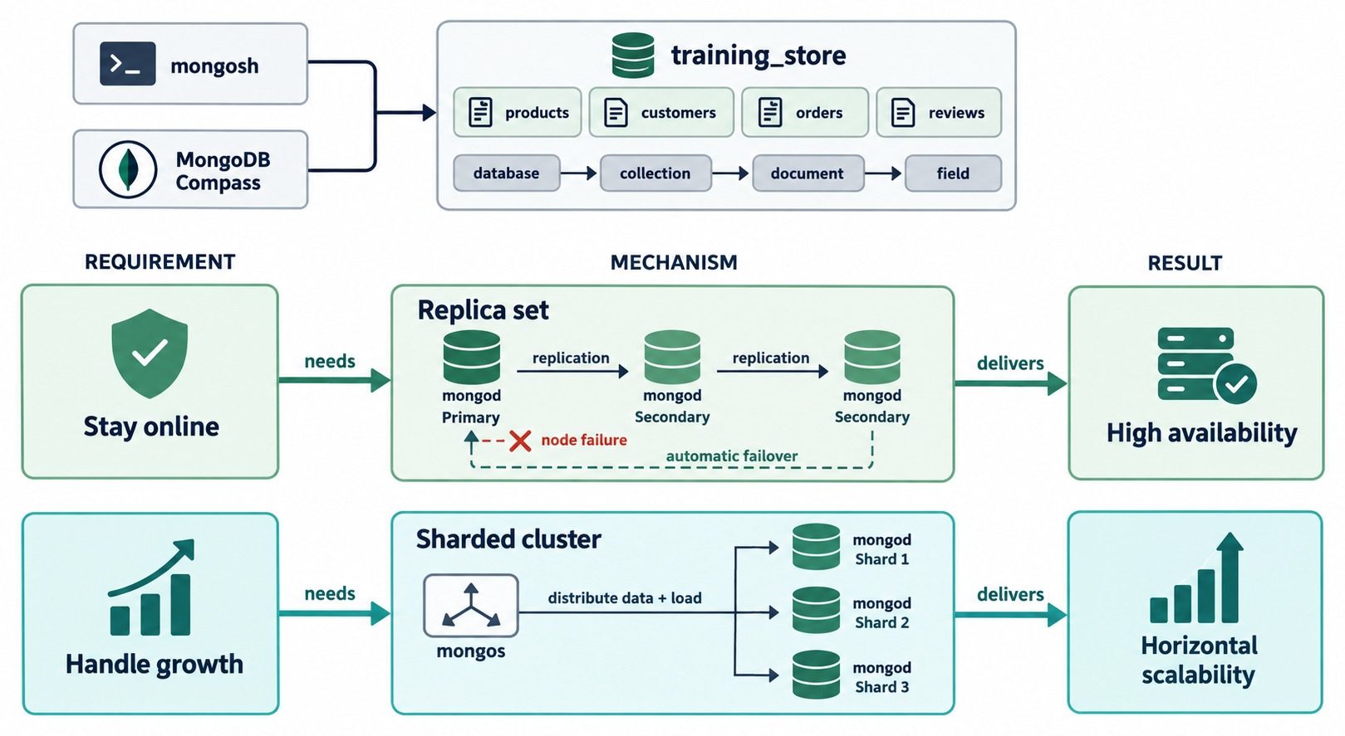
HIGH AVAILABILITY AND HORIZONTAL SCALABILITY
Stay online needs a replica set; handle growth needs a sharded cluster.
Stay online → replica set
Copies of the same data; if the primary fails, a secondary takes over.
Handle growth → sharded cluster
mongos spreads data and load across several shards.
Different problems
Copies add availability, not capacity. Shards add capacity, not copies.
SIMPLIFIED Each shard is drawn as one mongod; in production it is a replica set.
KEY TAKEAWAY Name the requirement first: staying online needs replication, growing needs sharding.
7
© 2026 by Innovation In Software Corporation
Notes:
KEY TALKING POINTS
------------------
- Start from the requirement
Don't start from a technology.
Start from what the business needs: stay online, or handle growth.
- Stay online
Staying online needs a replica set.
Several mongod servers keep the same data, and when a node fails, another member takes over automatically.
The result is high availability.
- Handle growth
Handling growth needs a sharded cluster.
mongos spreads the data and the load across shards.
The result is horizontal scalability.
- What it shows
mongosh and Compass use training_store.
Below, two rows: the requirement stay online needs a replica set and delivers high availability; the requirement handle growth needs a sharded cluster and delivers horizontal scalability.
- How to read it
Read each row left to right: requirement, mechanism, result.
In the replica set, the red node failure and the dashed automatic failover arrow show a secondary taking over.
- A simplification to point out
The sharded cluster draws each shard as one mongod and leaves out the config servers.
In production every shard is a replica set, as we'll see in Part 4.

Slide 8
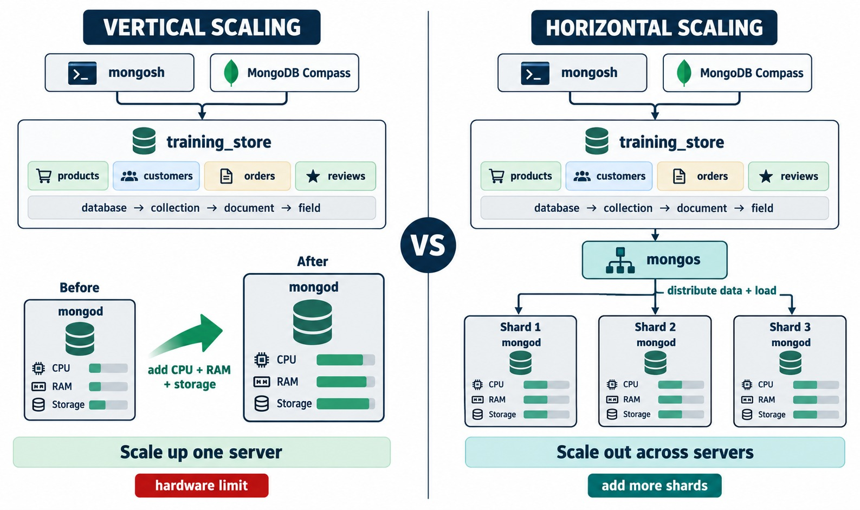
VERTICAL SCALING VS HORIZONTAL SCALING
Scale up one server — or scale out across servers.
Vertical: scale up
More CPU, RAM and storage on one server — simple, until the hardware limit.
Horizontal: scale out
Add shards behind mongos; each holds part of the data.
The cost of scaling out
More servers, routing, balancing and monitoring.
START SIMPLE Tune schema and indexes before you shard.
KEY TAKEAWAY Scale up while one server is enough; scale out when the data or the writes outgrow it.
8
© 2026 by Innovation In Software Corporation
Notes:
KEY TALKING POINTS
------------------
- Vertical scaling
Vertical scaling means a bigger server: more CPU, more memory, faster and larger storage.
It is simple and needs no data distribution.
But a server has a maximum size, large hardware is expensive, and maintenance affects the whole workload.
On its own, a bigger server also gives no high availability.
- Horizontal scaling
Horizontal scaling adds servers and spreads the work.
In MongoDB that is sharding: each shard holds part of the data, and each shard's CPU, memory and disk carry part of the load.
- Why growth happens
More users, larger data, more writes, more queries, larger indexes, analytics and new regions all add load.
- Advice
MongoDB recommends starting unsharded while the data and workload fit comfortably on one replica set.
Tune the schema and indexes from Modules 3 and 6 first.
- What it shows
On the left, one mongod before and after an upgrade: the CPU, RAM and storage bars grow, and the red label says hardware limit.
On the right, mongos distributes data and load to three shards, each with moderate CPU, RAM and storage use.
- How to read it
Compare the captions: scale up one server, or scale out across servers and add more shards.
- A simplification to point out
Again each shard is drawn as one mongod.
In production each shard is a replica set.

Slide 9
REPLICATION VERSUS SHARDING
What each mechanism delivers — and what neither does.
Requirement | Replication | Sharding
Keep several copies | Yes | Not by itself
Automatic failover | Yes | Per shard, via replication
Grow data capacity | Limited | Yes
Spread write load | Not normally | Yes
Survive one server failure | Yes | Only with replicated shards
Main objective | Availability | Capacity and throughput
Undo last week's delete | No — restore a backup | No — restore a backup
Replication
Every member holds the same data — redundancy, not more room.
Sharding
Each shard holds part of a collection — room and throughput.
TOGETHER Production clusters shard the data and replicate every shard.
KEY TAKEAWAY Replication copies the data; sharding divides it — and only a backup undoes a mistake.
9
© 2026 by Innovation In Software Corporation
Notes:
KEY TALKING POINTS
------------------
- How to read the table
Each row is one requirement.
The two columns say whether replication or sharding delivers it.
- The important distinction
Replication does not divide the data.
Every data-bearing member of a replica set holds a copy of the whole data set.
Sharding divides a collection's documents, so each shard stores only its own part.
- Failover in a sharded cluster
Sharding on its own gives no failover.
It gets failover because each shard is itself a replica set.
- The last row
Neither mechanism restores data that was deleted last week.
A deleteMany on the primary is replicated to every secondary within seconds.
Only a backup gives an independent recovery point.
Module 8 covers backup and restore.

Slide 10
PART 2: REPLICA SETS AND FAILOVER
How several copies of training_store stay in step — and take over.
✓ Part 1
Availability and scale
Part 2
Replica sets
Part 3
Guarantees and lag
Part 4
Shard keys
Part 5
Routing and design
SO FAR
NEXT QUESTION
How does a replica set keep every copy in step — and pick a new primary?
✓
Availability and scale are different problems
✓
Replication keeps copies for availability
IN THIS PART
Sharding divides data for capacity
1
Primary and secondary members
✓
2
The oplog
3
Elections and majority
4
Automatic failover
5
What the application sees
6
Checking replica-set health
7
Exercise: count the votes
10
© 2026 by Innovation In Software Corporation
Notes:
KEY TALKING POINTS
------------------
- Why this part
Replica sets are the foundation of MongoDB high availability, and every production shard is one.
We look inside one now.
- What to watch
Keep asking two questions: where do writes go, and who decides the new primary?
- Lab safety
Failover and sharding commands run only on instructor-controlled, disposable infrastructure.
Never step down or shard a shared class cluster.

Slide 11
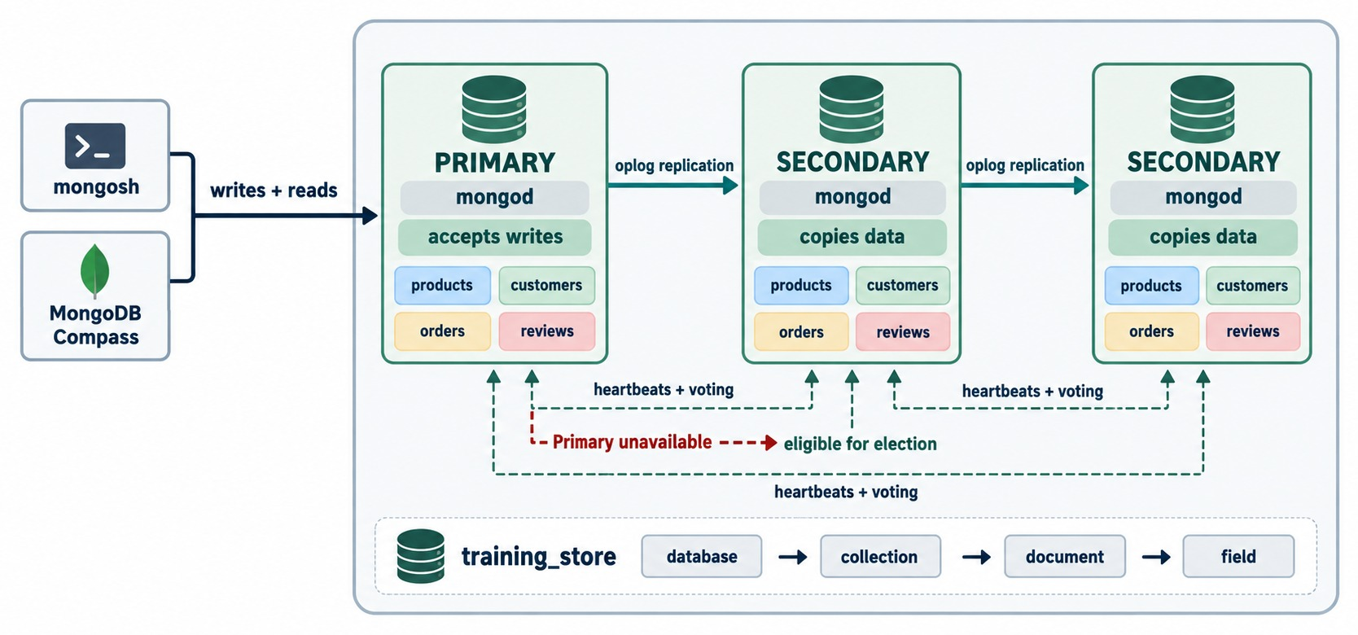
REPLICA-SET MEMBERS
One primary accepts writes; the secondaries copy the data.
Primary
The one member that accepts writes; by default it also serves reads.
Secondaries
Copy the primary's oplog and apply it — each keeps a full copy.
Heartbeats and votes
Members check each other every 2 seconds and vote in elections.
THREE MEMBERS The common minimum for automatic failover.
KEY TAKEAWAY A replica set has one writable primary; the secondaries keep full copies, ready to take over.
11
© 2026 by Innovation In Software Corporation
Notes:
KEY TALKING POINTS
------------------
- What a replica set is
A replica set is a group of mongod processes that maintain the same data set.
The common configuration is three data-bearing members.
- Primary and secondaries
The primary receives every write.
It applies the write, records it in its oplog and makes it available to the secondaries.
Secondaries copy those operations and apply them locally, so each one keeps a full copy of training_store.
- One writable primary
A replica set normally has one writable primary at a time.
Applications can't write to a secondary.
They can read from one only when a read preference allows it.
- Heartbeats
Members send each other heartbeats, every two seconds by default.
If the primary goes quiet for long enough, the eligible secondaries hold an election.
- What it shows
mongosh and Compass send writes and reads to the PRIMARY, which accepts writes.
Oplog replication arrows lead to two SECONDARY members, which copy data.
Each member holds products, customers, orders and reviews.
- How to read it
The dashed lines underneath are heartbeats and voting between all members.
The red line shows that when the primary is unavailable, a secondary is eligible for election.
- Key point
Every member holds the whole of training_store.
Copies add redundancy, not capacity.

Slide 12
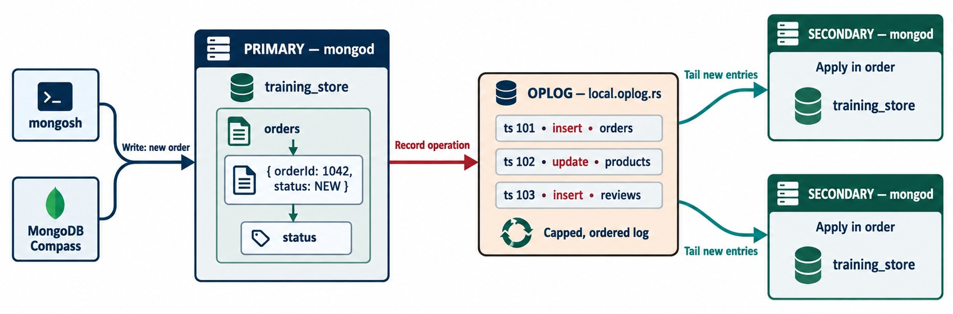
THE REPLICATION OPLOG
Every change is recorded once — and replayed on every secondary.
Record every change
The primary logs each insert, update and delete in local.oplog.rs.
Secondaries tail it
They pull new entries and apply them in order.
Capped
Fixed size: the oldest entries are overwritten — that span is the replication window.
TOO FAR BEHIND A member offline longer than the window needs a full resync.
KEY TAKEAWAY The oplog is the replication stream: secondaries replay it in order to stay in step.
12
© 2026 by Innovation In Software Corporation
Notes:
KEY TALKING POINTS
------------------
- What the oplog is
The operation log, or oplog, is a special capped collection, local.oplog.rs.
It records every data-changing operation: inserts, updates, deletes and certain administrative changes.
- The flow
A write reaches the primary.
The primary applies it and records it in the oplog.
Secondaries copy the new entries and apply them locally, in order.
- Asynchronous
Replication is asynchronous.
A secondary may lag behind the primary for a moment, and sometimes for longer.
- The replication window
The oplog has a fixed size.
When it is full, the oldest entries are overwritten.
The time span it still holds is the replication window.
A member offline for longer than the window can't catch up incrementally and needs a full resynchronization.
- What it shows
A new order is written on the primary.
The primary records the operation in the oplog, local.oplog.rs, whose entries ts 101, 102 and 103 are an insert into orders, an update to products and an insert into reviews.
Two secondaries tail the new entries and apply them in order.
- How to read it
Follow the red arrow into the capped, ordered log, then the teal arrows out to the secondaries.
- About the sample document
The diagram's { orderId: 1042, status: NEW } is simplified.
A real training_store order has an orderNumber such as O6305 and a fulfillmentStatus of NEW.

Slide 13
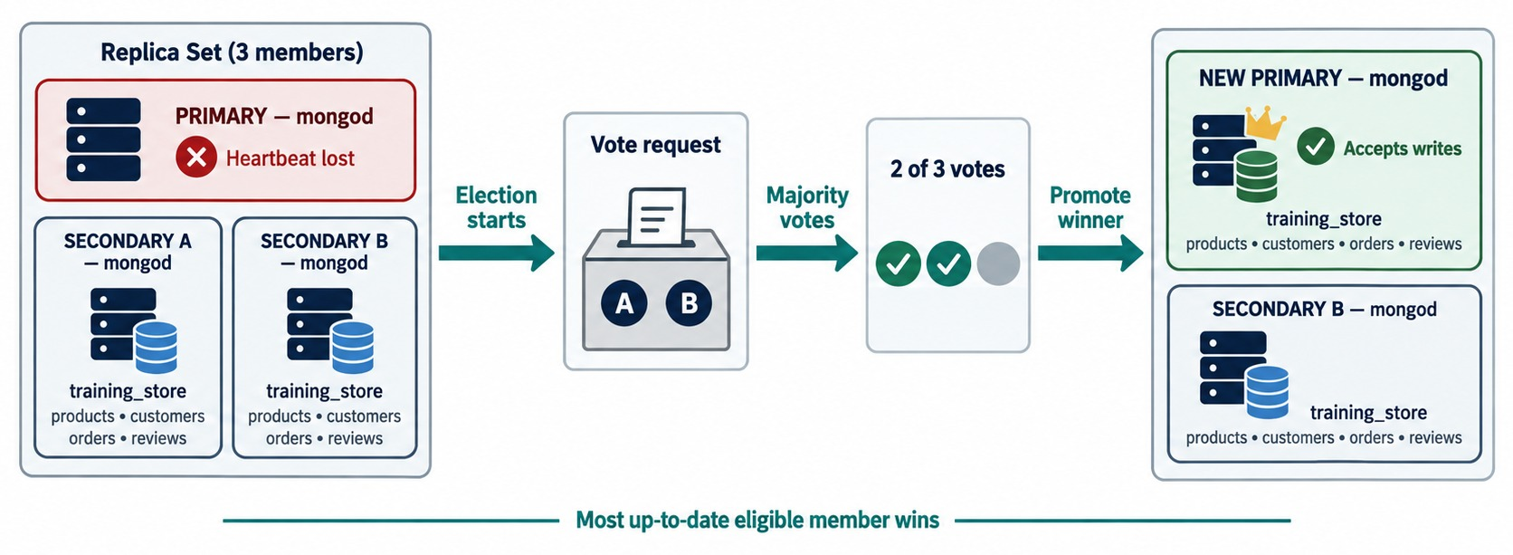
REPLICA-SET ELECTIONS
A candidate needs votes from a majority of voting members.
Trigger
The members stop hearing the primary's heartbeat.
Majority vote
Two of three votes win; the most up-to-date eligible member is chosen.
Why odd numbers are common
voters majority can lose
3 2 1
4 3 1
5 3 2
A FOURTH VOTER Adds cost, not failure tolerance.
KEY TAKEAWAY Elections need a majority of voters — so three or five members, not two or four.
13
© 2026 by Innovation In Software Corporation
Notes:
KEY TALKING POINTS
------------------
- When an election happens
If the primary becomes unreachable, the eligible voting members hold an election.
- Majority
A candidate must win votes from a majority of voting members.
Three voters need two votes, so the set survives the loss of one voter.
Five voters need three, so the set survives the loss of two.
- Why odd numbers
Four voters need three votes, so they tolerate only one failure, the same as three voters.
A fourth voter adds cost but no extra failure tolerance.
That is why odd numbers are common.
- Who wins
Priority and how up to date a member is both matter.
A member whose oplog is behind the others won't be elected ahead of a more current one.
- What it shows
A three-member set whose primary has lost its heartbeat.
The election starts, Secondaries A and B vote, two of three votes are cast, and the winner is promoted: it now accepts writes, and Secondary B stays a secondary.
- How to read it
Follow the arrows: election starts, majority votes, promote winner.
The line at the bottom says the most up-to-date eligible member wins.
- Key point
Two of three is a majority, so this set can lose one member and still elect a primary.

Slide 14
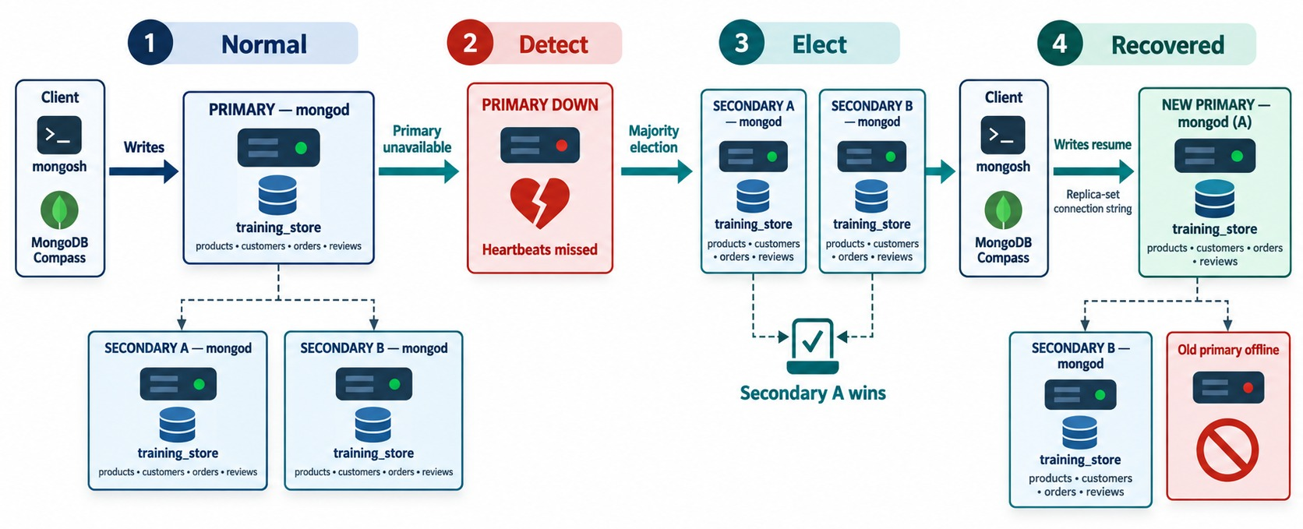
AUTOMATIC FAILOVER
Normal, detect, elect, recovered — without an operator.
1 Normal
Writes go to the primary; the secondaries copy.
2 Detect
Heartbeats are missed — about 10 seconds by default.
3 Elect
Secondary A wins the majority vote and becomes primary.
4 Recovered
Writes resume; the old primary rejoins as a secondary.
KEY TAKEAWAY Failover is automatic, but there is a short window with no primary and no writes.
14
© 2026 by Innovation In Software Corporation
Notes:
KEY TALKING POINTS
------------------
- The six steps
The members detect the failure.
An eligible secondary asks for an election.
A majority selects the new primary, and that member becomes primary.
Drivers discover the change.
Application operations resume after reconnection and server selection.
- A short write pause
There is normally a short period, often seconds, when writes can't complete because there is no primary.
By default a member waits about ten seconds without heartbeats before it calls an election.
- The old primary
When the old primary comes back, it rejoins as a secondary.
It does not reclaim the primary role just because it was primary before.
- Lab safety
The instructor can show this with rs.stepDown() on an instructor-controlled disposable replica set.
Never step down a shared class cluster.
- What it shows
Four stages.
Normal: the client writes to the primary.
Detect: the primary is down and heartbeats are missed.
Elect: Secondary A wins the majority election.
Recovered: writes resume on the new primary, mongod A, through the replica-set connection string.
- How to read it
At the end, Secondary B still copies data and the old primary is shown offline.
When it returns, it rejoins as a secondary.
- Key point
No operator had to act: detection, election and recovery are automatic.

Slide 15
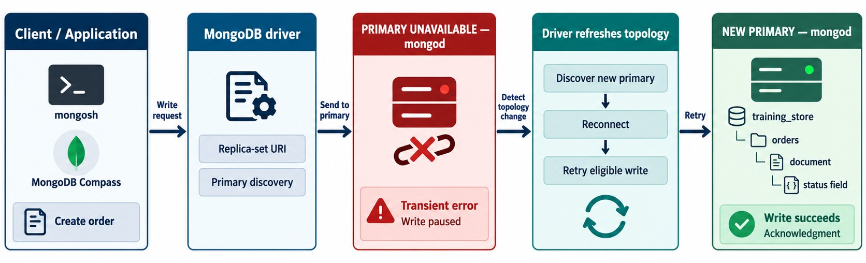
APPLICATION BEHAVIOR DURING FAILOVER
Transient error, topology refresh, retry.
Connect to the whole set
Transient error
Retryable writes
DESIGN FOR IT Idempotent operations and timeouts — never a pinned host.
mongodb://db1:27017,
db2:27017,db3:27017/
training_store
?replicaSet=trainingRS
Writes pause during the election; the driver sees a retryable error.
The driver retries an eligible write once, on the new primary.
KEY TAKEAWAY Use a replica-set connection string and retryable, idempotent operations — failover becomes a pause.
15
© 2026 by Innovation In Software Corporation
Notes:
KEY TALKING POINTS
------------------
- Give the driver the whole set
Applications should get several hosts or an SRV connection string, plus the replica set name.
The driver then discovers which member is primary and notices when that changes.
- What the application sees
During the election a write fails with a transient error.
The driver refreshes the topology, reconnects to the new primary and can retry an eligible write once.
- Design for it
Applications should still handle timeouts, retryable write failures, the risk of duplicate requests and transaction retries.
Idempotent operations make a retry safe.
- The anti-pattern
Connecting to one host without replica-set discovery weakens failover.
Nobody should have to restart the application by hand after an election.
- What it shows
An application creates an order.
The MongoDB driver, holding the replica-set URI and doing primary discovery, sends it to the primary.
The primary is unavailable, so the write gets a transient error and pauses.
The driver detects the topology change, discovers the new primary, reconnects and retries the eligible write, which succeeds and is acknowledged.
- How to read it
Left to right is time.
The red box is the only moment the application sees a problem.
- Key point
Failover is survivable when the driver knows the whole replica set and the write can be retried safely.

Slide 16
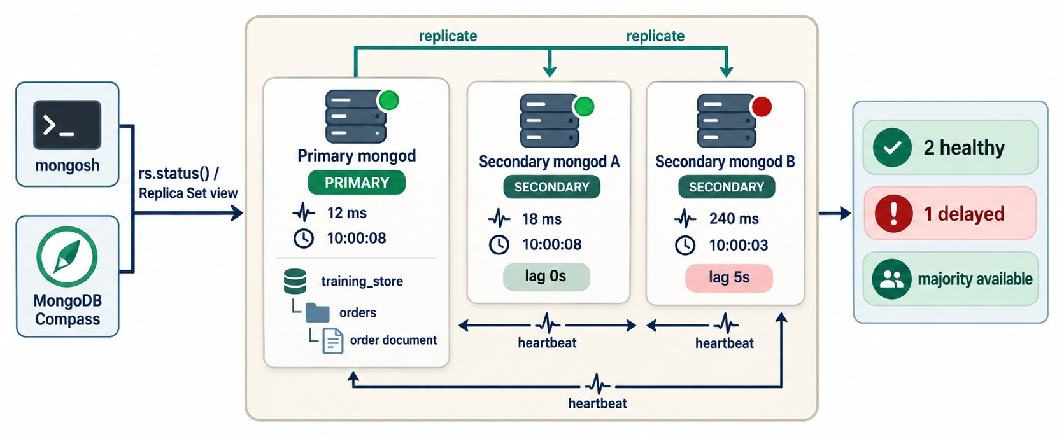
CHECKING REPLICA-SET HEALTH
What rs.status() tells you — and what to watch.
Check health in mongosh
rs.status()
rs.conf()
rs.printSecondaryReplicationInfo()
db.hello()
Read the states
One PRIMARY, the SECONDARY members, health: 1 on each reachable member.
Watch the lag
Secondary B is 5 s behind — healthy, but worth watching.
LAB 6 Steps 4–7: you'll write this health report on a real replica set.
KEY TAKEAWAY Measure replica-set health — the primary, the majority and the lag — don't guess it.
16
© 2026 by Innovation In Software Corporation
Notes:
KEY TALKING POINTS
------------------
- rs.status()
Connected to a replica-set member, rs.status() shows the set name, the current primary, the secondaries, each member's health and state, replication progress and election information.
- rs.conf() and db.hello()
rs.conf() shows the configuration, including votes and priority.
db.hello() says whether the connected server is writable: setName, isWritablePrimary and secondary.
- Lag
rs.printSecondaryReplicationInfo() shows how far behind each secondary is.
In a quiet training set it is usually zero to two seconds.
- Where to run it
Atlas clusters, including the free tier, are replica sets.
A local standalone mongod is not: rs.status() reports that it is not running with --replSet.
Switch to the instructor's replica-set URI for Lab 6, Steps 4 to 7.
- What it shows
mongosh and Compass look at the replica set through rs.status().
The primary reports 12 ms and 10:00:08.
Secondary A reports 18 ms, 10:00:08 and lag 0 s. Secondary B reports 240 ms, 10:00:03 and lag 5 s. The summary on the right: 2 healthy, 1 delayed, majority available.
- How to read it
Compare the timestamps: Secondary B has applied the oplog up to five seconds earlier than the primary.
Here delayed simply means lagging; it is not a configured delayed member.
- Key point
A lagging member is still healthy, and the majority is available, but the lag is worth watching.

Slide 17
EXERCISE: COUNT THE VOTES
Decide whether each replica set can still elect a primary.
PRACTICE EXERCISE
10 MIN
SCENARIO
YOUR TASKS
EXPECTED OUTCOME
Every member below is a voting, data-bearing member.
1
Work out the majority for each set
✓
A yes — 2 of 3 still vote
2
Say whether a primary can exist
✓
B no — 1 of 3: no writes
A 3 members, 1 down
B 3 members, 2 down
C 4 members, 2 down
D 5 members split 3 | 2
across two data centers;
the link between them fails
3
Say what happens to writes
✓
C no — needs 3 of 4
Explain why D is split 3 | 2
✓
D the 3-member side elects
4
✓
Odd voter counts decide cleanly
KEY TAKEAWAY A primary needs a reachable majority of voters — count them before you design.
17
© 2026 by Innovation In Software Corporation
Notes:
KEY TALKING POINTS
------------------
- How to run it
Pairs, five minutes, then take one answer per set.
Point back to the voters, majority, can-lose table on the elections slide.
- A and B
Three voters need two.
With one member down, two remain and a primary can be elected.
With two down, the survivor stays SECONDARY: writes fail, and reads only work with a secondary read preference.
- C
Four voters need three.
With two down only two remain, so there is no primary.
Four members tolerate one failure, the same as three.
- D
With five voters split three and two, the side with three still has a majority and keeps or elects the primary.
The side with two can't.
That is why teams place a majority of voters, or a tie-breaking member, in a third location.

Slide 18
PART 3: READ AND WRITE GUARANTEES, LAG AND ROLLBACK
Choose where reads go and when a write counts as safe.
✓ Part 1
Availability and scale
✓ Part 2
Replica sets
Part 3
Guarantees and lag
Part 4
Shard keys
Part 5
Routing and design
SO FAR
NEXT QUESTION
Which member should serve a read — and when is a write really safe?
✓
Writes go to one primary
✓
Secondaries replay the oplog
IN THIS PART
✓
A majority elects a new primary
1
Read preference
2
Write concern
3
Read concern
4
The three settings in mongosh
5
Replication lag
6
Rollback
7
Exercise: what did the customer see?
18
© 2026 by Innovation In Software Corporation
Notes:
KEY TALKING POINTS
------------------
- Why this part
Replication is asynchronous.
The settings in this part decide how much that matters for each operation.
- Three knobs
Read preference, read concern and write concern are three different settings.
By the end, learners should be able to say what each one controls.

Slide 19
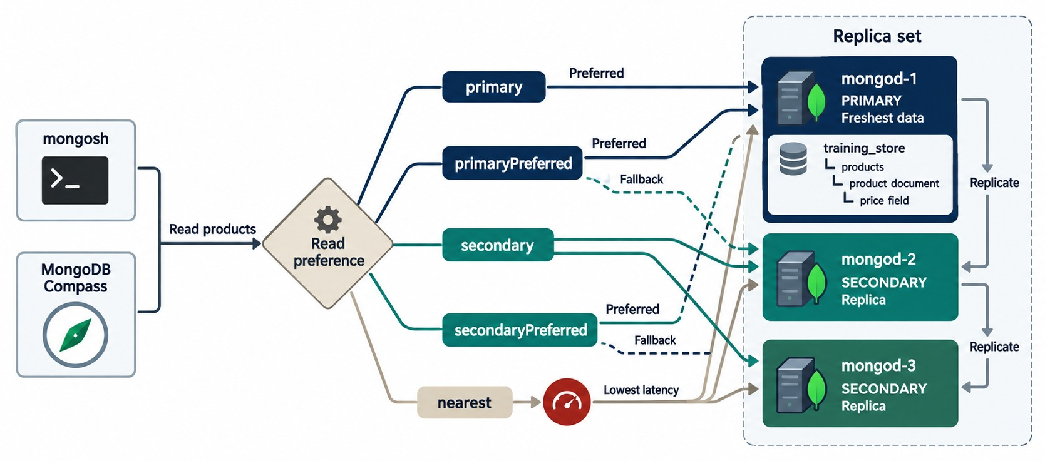
READ PREFERENCES
Five modes decide which members may serve a read.
primary (default)
Freshest data — the application reads its own writes.
The Preferred modes
primaryPreferred and secondaryPreferred prefer one side, then fall back.
secondary, nearest
Any eligible secondary, or the lowest-latency member — may be stale.
NOT FREE SCALING Secondary reads can lag and compete with replication.
KEY TAKEAWAY Read from the primary by default; read from secondaries only where stale data is acceptable.
19
© 2026 by Innovation In Software Corporation
Notes:
KEY TALKING POINTS
------------------
- What read preference decides
Read preference decides which members may serve a read.
- The five modes
primary, the default, reads only from the primary.
primaryPreferred uses the primary and falls back to a secondary.
secondary reads only from eligible secondaries.
secondaryPreferred prefers a secondary and falls back to the primary.
nearest picks among eligible members partly by network latency.
- Why primary is the default
Reading from the primary gives the simplest read-after-write behavior.
An application sees its own write straight away.
- The secondary-read trade-off
Secondary reads can move load off the primary, serve distant users and help reporting.
But they may return data that is behind the primary, and they compete with replication for the secondary's resources.
They are a conscious decision, not free scaling.
- What it shows
A read of products goes through the read preference.
primary and primaryPreferred point to mongod-1, the primary with the freshest data; primaryPreferred can fall back to a secondary.
secondary goes to mongod-2 or mongod-3; secondaryPreferred prefers them and can fall back to the primary.
nearest picks the lowest-latency member.
- How to read it
Solid lines are the preferred targets, dashed lines the fallbacks.
- Key point
Only the primary is guaranteed to have the freshest data.

Slide 20
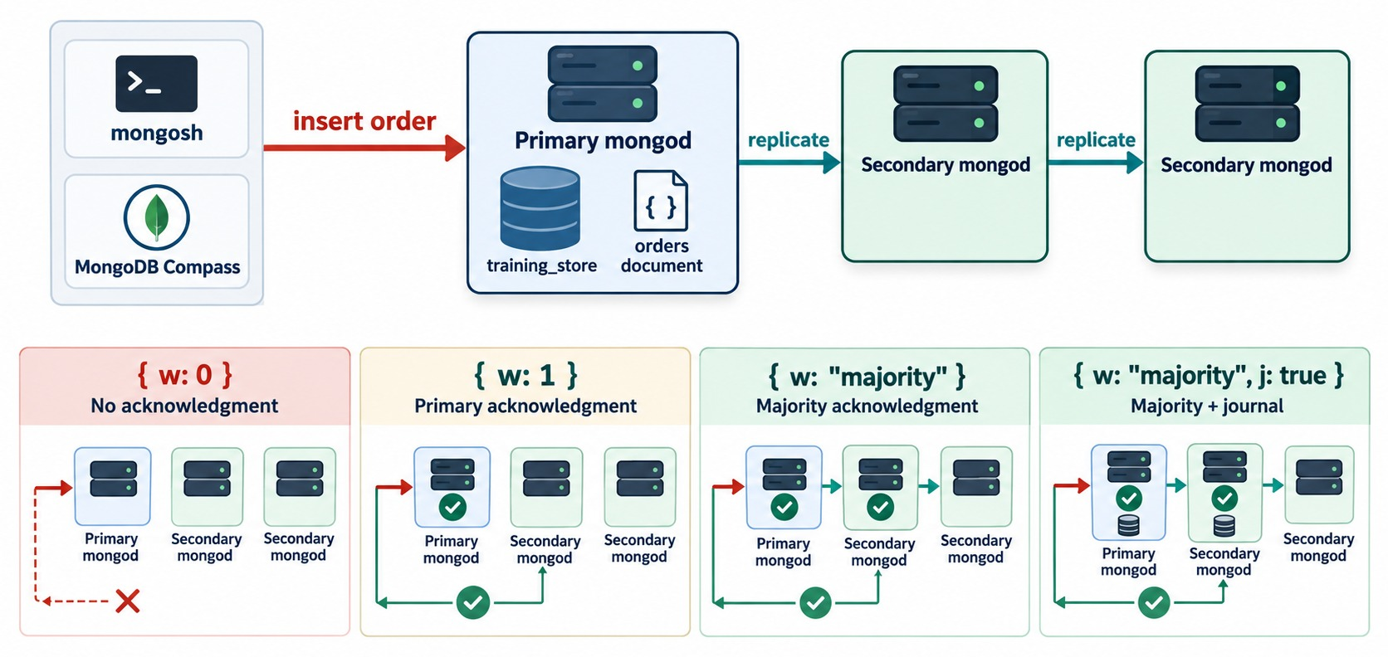
WRITE CONCERN
How many members must have a write before you get an answer.
w: 0
No acknowledgment — errors go unseen.
w: 1
The primary has it — lost if the primary fails before replicating.
w: "majority"
A majority has it — it survives a failover.
j: true
Also wait for the on-disk journal.
KEY TAKEAWAY Stronger write concern costs some latency and buys durability — match it to the operation.
20
© 2026 by Innovation In Software Corporation
Notes:
KEY TALKING POINTS
------------------
- What write concern controls
Write concern controls how much acknowledgment the application asks for before a write counts as done.
- The levels
w: 0 asks for no acknowledgment at all.
w: 1 means the primary accepted the write.
w: majority means a majority of data-bearing voting members have it.
Adding j: true also waits for the write to reach the on-disk journal.
- The trade-off
Stronger acknowledgment gives better durability but can add latency.
Since MongoDB 5.0 the default for most replica sets is majority.
- Match it to the operation
A shopping-cart preference, a completed payment, an inventory deduction, an audit record and a temporary analytics event can each deserve a different setting.
- What it shows
An insert of an orders document on the primary, replicated to two secondaries.
Below, four panels.
w: 0 has no acknowledgment.
w: 1 is acknowledged by the primary.
w: majority is acknowledged after the primary and one secondary have it.
w: majority with j: true also has both members write the journal.
- How to read it
Count the green checks in each panel: none, one, two, and two with a disk icon.
- Key point
In a three-member set, majority means two members.

Slide 21
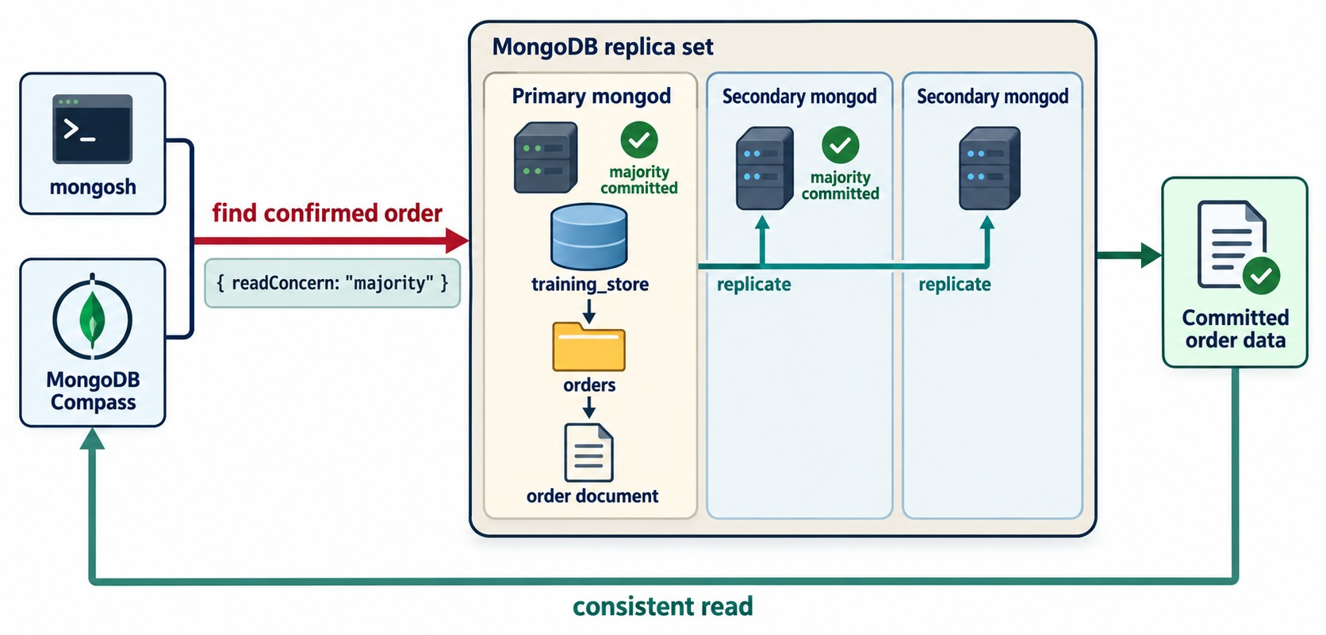
READ CONCERN
Which data a read may return.
local (default)
The member's newest data — it could still roll back.
majority
Only data a majority has — it will not roll back.
snapshot, linearizable
Transactions, and the strongest single-document reads.
DIFFERENT QUESTION Read preference picks the member; read concern the guarantee.
KEY TAKEAWAY Read preference chooses where a read runs; read concern chooses what it may return.
21
© 2026 by Innovation In Software Corporation
Notes:
KEY TALKING POINTS
------------------
- What read concern controls
Read concern controls the consistency and isolation of the data a read returns.
- The levels
local, the default, returns the member's newest data, which could later be rolled back.
available is similar and matters mainly on sharded clusters.
majority returns only data a majority has acknowledged.
linearizable gives the strongest single-document guarantee, and snapshot is used by transactions.
- Two different questions
Read preference answers: which member may serve the read?
Read concern answers: what visibility or consistency guarantee should the read have?
Learners often mix them up, so ask them to say both questions aloud.
- What it shows
mongosh asks to find a confirmed order with readConcern majority.
In the replica set, the primary and one secondary are marked majority committed.
The result is committed order data and a consistent read.
- How to read it
The check marks show which members already have the data.
Two of three is enough for a majority read.
- Key point
A majority read only returns data that can't be rolled back.

Slide 22
THE THREE SETTINGS ON TRAINING_STORE
Write concern, read concern and read preference in mongosh.
Write concern: confirm a payment
Read concern: committed data
Read preference: a report
db.orders.updateOne(
{ orderNumber: "O6401" },
{ $set: { paymentStatus: "PAID" } },
{ writeConcern: {
w: "majority",
wtimeout: 5000 } }
)
db.orders.find(
{ paymentStatus: "PAID" }
).readConcern("majority")
db.getMongo()
.setReadPref(
"secondaryPreferred")
db.orders.countDocuments(
{ fulfillmentStatus:
"SHIPPED" })
Write concern
Read concern
Read preference
How many members confirm the write before the answer.
Local data, or only majority-committed data.
Which member serves it — this report may lag.
KEY TAKEAWAY Three different settings: who confirms a write, what a read returns, and where it runs.
22
© 2026 by Innovation In Software Corporation
Notes:
KEY TALKING POINTS
------------------
- Write concern
Order O6401 is Luis Romero's pending order for two Business Laptops, total 2945.98.
Confirming the payment with w majority means the application only hears success once a majority has the change.
wtimeout stops it from waiting forever.
- Don't change the shared data
This update is an example.
Don't run it on the shared training_store: later labs expect O6401's paymentStatus to be PENDING.
To practise write concerns, the instructor uses a scratch collection, repl_lab, and deletes the probes afterwards.
- Read concern
readConcern majority returns only paid orders that a majority has acknowledged.
On a fresh load that is 13 orders.
- Read preference
setReadPref secondaryPreferred sends this shell's reads to a secondary when one is available.
The count of SHIPPED orders, 6 on a fresh load, may be slightly behind the primary.
db.hello() on each connection shows which member answered.

Slide 23
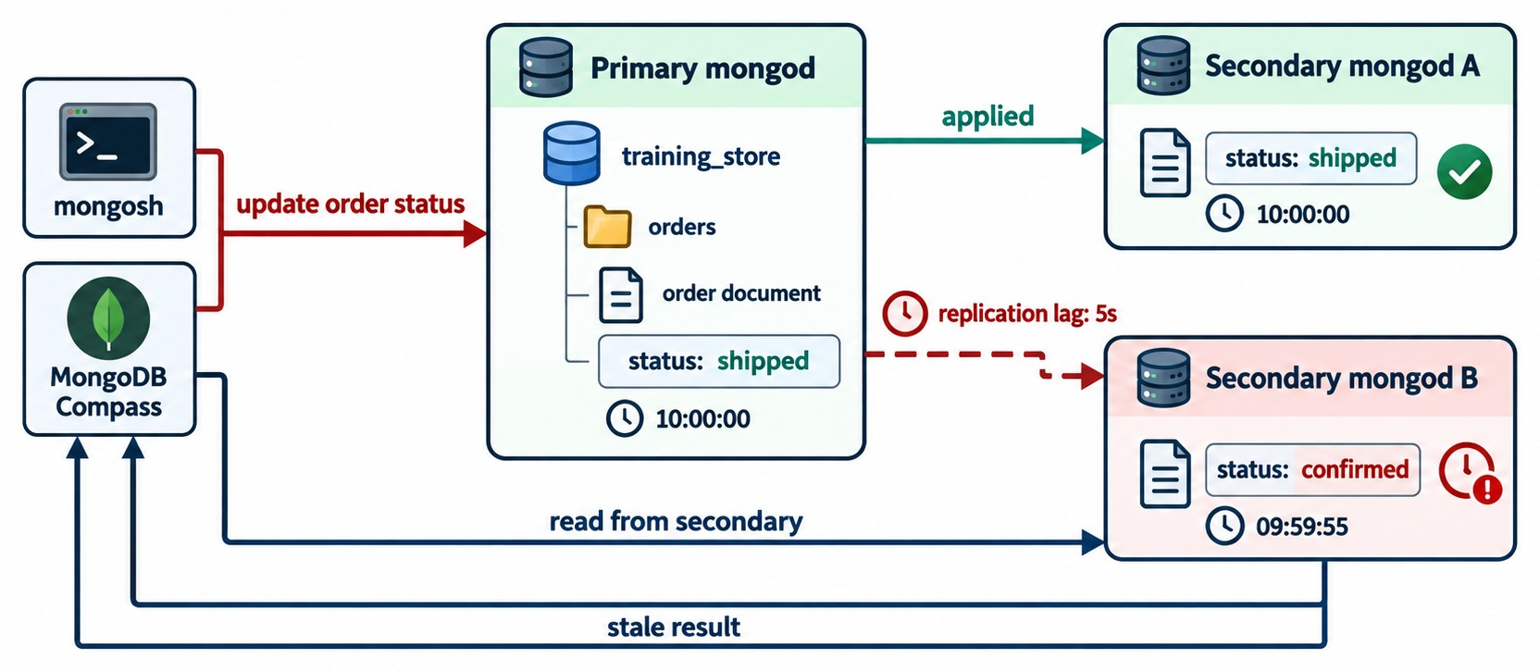
REPLICATION LAG
A lagging secondary returns stale data.
What it is
How far a secondary's applied oplog trails the primary — 5 s here.
Stale read
The secondary still says confirmed; the primary says shipped.
Common causes
Slow disk, busy secondary, slow network, write bursts, long operations.
First checks
Member optimes and lag — then the secondary's CPU and disk.
KEY TAKEAWAY Small lag is normal; growing lag means stale reads and slower failover — measure it.
23
© 2026 by Innovation In Software Corporation
Notes:
KEY TALKING POINTS
------------------
- What lag is
Replication lag is how far a secondary's applied oplog trails the primary.
A little lag is normal.
Growing lag is a warning.
- Why it matters
A read from a lagging secondary returns stale data.
Lag also stretches a failover, because an up-to-date member must be elected, and a member that falls outside the oplog window needs a full resync.
- Common causes
Slow or saturated disks, heavy reporting on the secondary, network congestion, write bursts faster than the secondary can apply, long operations and a small oplog window.
- First checks
Run rs.printSecondaryReplicationInfo() and compare member optimes in rs.status().
Then look at the secondary's CPU, disk and current operations before you think about rebuilding anything.
- What it shows
An update sets an order's status to shipped on the primary at 10:00:00.
Secondary A has applied it.
Secondary B lags by five seconds and still shows confirmed at 09:59:55.
Compass reads from the secondary and gets a stale result.
- How to read it
Compare the three status boxes and their clocks.
- About the field
The diagram's status field stands for fulfillmentStatus in training_store, whose values are upper case, such as SHIPPED.

Slide 24
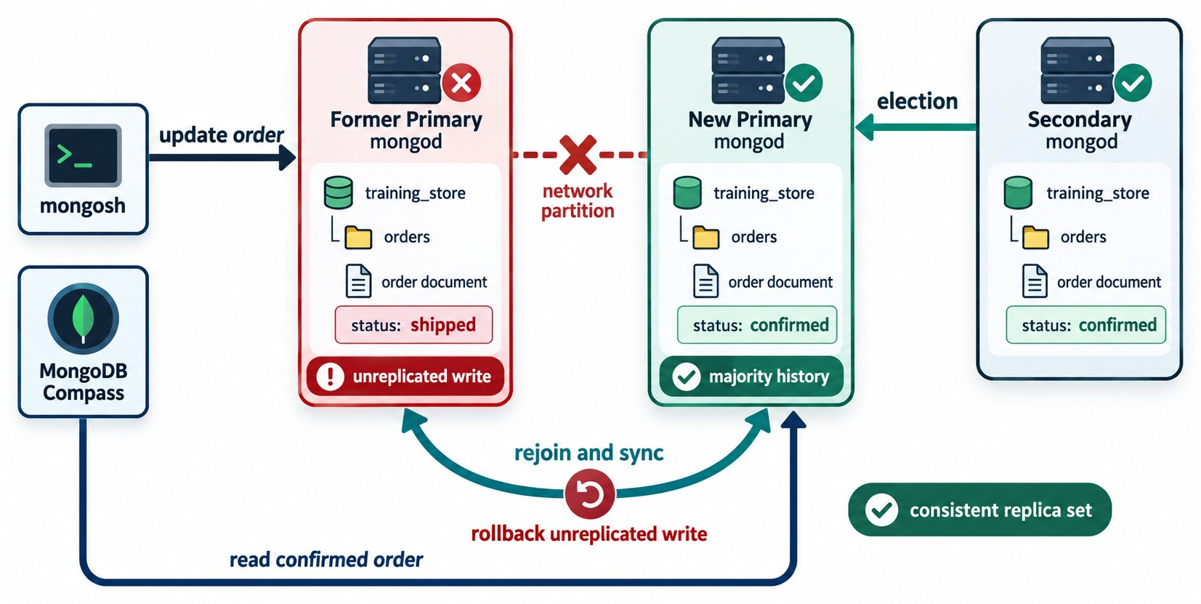
ROLLBACK
A write the majority never saw is undone.
Unreplicated write
The old primary accepted shipped with w: 1, then lost its network.
The majority moves on
The other two members elect a primary that never saw it.
Rollback
The old primary rejoins, undoes the write and saves it to a rollback file.
PREVENTION w: "majority" writes are not rolled back.
KEY TAKEAWAY Only majority-acknowledged writes survive a failover — use them for anything that matters.
24
© 2026 by Innovation In Software Corporation
Notes:
KEY TALKING POINTS
------------------
- How a rollback starts
The primary accepts a write with w: 1 and acknowledges it.
Before any secondary copies it, the primary is cut off by a network partition.
- The majority moves on
The other two members still form a majority.
They elect a new primary that never saw that write.
- The rollback
When the old primary rejoins, its history no longer matches the majority.
It rolls back the unreplicated write, saves it to a rollback file for an operator to review, and syncs from the new primary.
- Prevention
A write acknowledged with w: majority has reached a majority, so it is not rolled back.
Reads with read concern majority never return data that could be rolled back.
- What it shows
The former primary accepted an update to shipped, but a network partition cut it off: an unreplicated write.
The other two members held an election; the new primary and the secondary both have confirmed, the majority history.
When the former primary rejoins and syncs, it rolls back the unreplicated write, and the replica set is consistent again.
- How to read it
Follow the red partition, the green election arrow, then the curved rejoin and sync arrows.
- Key point
Reads of the confirmed order go to the majority history.

Slide 25
EXERCISE: WHAT DID THE CUSTOMER SEE?
Replay a failover during Luis Romero's payment.
PRACTICE EXERCISE
10 MIN
SCENARIO
YOUR TASKS
EXPECTED OUTCOME
O6401 is PENDING. The payment service sets paymentStatus to PAID with w: 1. The status page reads with secondaryPreferred.
1
State paymentStatus on the new primary
✓
PENDING — it never got PAID
✓
Rolled back, saved to a file
2
Say what happens to the PAID write
10:00:00 PAID written on primary
10:00:00 acknowledged (w: 1)
10:00:01 primary partitioned
10:00:12 secondary elected
10:00:30 old primary rejoins
Say what the status page showed
✓
PENDING: stale, then wrong
3
Pick the settings you would change
✓
Payment: w: "majority"
4
✓
Status page: primary reads
KEY TAKEAWAY w: 1 can lose an acknowledged write; majority writes plus primary reads keep the customer's view true.
25
© 2026 by Innovation In Software Corporation
Notes:
KEY TALKING POINTS
------------------
- How to run it
Give pairs five minutes.
It is a thought experiment on the diagrams from this part; nobody runs it on the shared cluster.
- The new primary
The PAID update reached only the old primary.
The elected secondary never saw it, so on the new primary O6401 is still PENDING.
- The rollback
When the old primary rejoins, it rolls the PAID write back and saves it to a rollback file.
The payment service was told the write succeeded, so someone now has to reconcile it by hand.
- The status page
With secondaryPreferred, the page may have shown PENDING even while the old primary had PAID, because of lag.
After the rollback, PENDING is the true state, but the customer was told the payment went through.
- The fix
Write payments with w majority, so success is only reported once the write can't be rolled back.
Read the order status from the primary, or with read concern majority, right after a payment.
Exercise 7.2 practises exactly these choices.

Slide 26
PART 4: SHARDED CLUSTERS AND SHARD KEYS
Split orders across servers — and choose the key that splits them.
✓ Part 1
Availability and scale
✓ Part 2
Replica sets
✓ Part 3
Guarantees and lag
Part 4
Shard keys
Part 5
Routing and design
SO FAR
NEXT QUESTION
How is a collection split across shards — and which field should split it?
✓
Replica sets survive a server failure
✓
Settings trade freshness for load and latency
IN THIS PART
Majority writes survive failover
1
Sharded-cluster components
✓
2
Shards as replica sets
3
Cardinality and frequency
4
Monotonic keys
5
Ranged sharding
6
Hashed and zoned sharding
7
Candidate keys for orders
26
© 2026 by Innovation In Software Corporation
Notes:
KEY TALKING POINTS
------------------
- Why this part
When orders outgrow one replica set, we shard.
The most important sharding decision is the shard key, and it is hard to change later.
- Our running candidate
Keep Module 6's customer-history query in mind: find one customer's orders, newest first.
A good shard key should keep that query on one shard.
- Lab safety
Failover and sharding commands run only on instructor-controlled, disposable infrastructure.
Never step down or shard a shared class cluster.

Slide 27
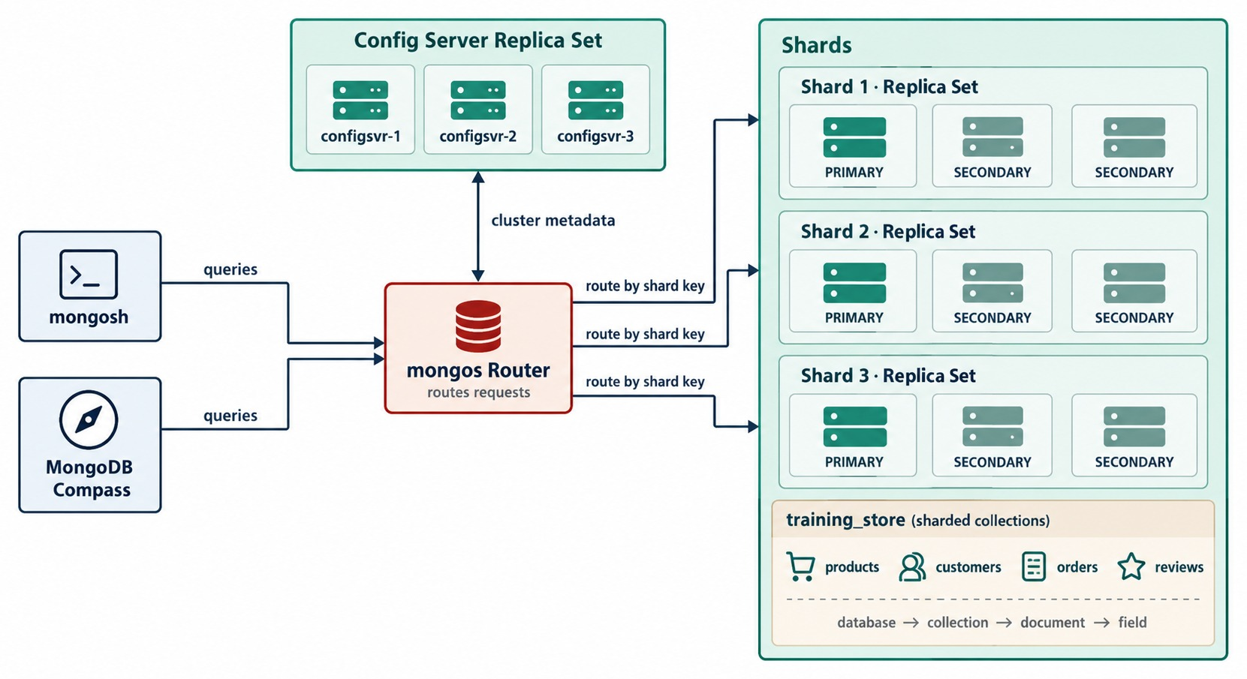
SHARDED-CLUSTER COMPONENTS
mongos routers, a config server replica set and replica-set shards.
mongos
The router applications connect to; it stores no collection data.
Config server replica set
Holds the metadata: which ranges live on which shard.
Shards
Each is a replica set holding part of the sharded data.
ONLY SHARDED COLLECTIONS SPLIT The rest stay on one shard.
KEY TAKEAWAY Applications talk to mongos; config servers hold the map; shards hold the data.
27
© 2026 by Innovation In Software Corporation
Notes:
KEY TALKING POINTS
------------------
- Three components
A sharded cluster has shards, config servers and mongos query routers.
- mongos
Applications connect to mongos, not directly to shards.
mongos reads the cluster metadata, finds the shard or shards that hold the data, sends the operation there, combines results and returns them.
It does not store the application data itself.
Production clusters usually run several mongos processes.
- Config servers
The config servers store the metadata: sharded collections, shard membership, shard-key ranges and data distribution.
They run as their own replica set, because the cluster can't route without them.
- Shards
Each shard stores part of the sharded data.
In production each shard is a replica set, so replication gives availability inside every shard.
- What it shows
mongosh and Compass send queries to the mongos router, which routes them by shard key to three shards.
Each shard is a replica set with a primary and two secondaries.
The config server replica set, configsvr-1 to configsvr-3, exchanges cluster metadata with mongos.
- A label to correct
The box under the shards lists all four collections as sharded collections.
In our design only orders is sharded; products, customers and reviews stay unsharded on the primary shard.
- Key point
Applications only ever talk to mongos.

Slide 28
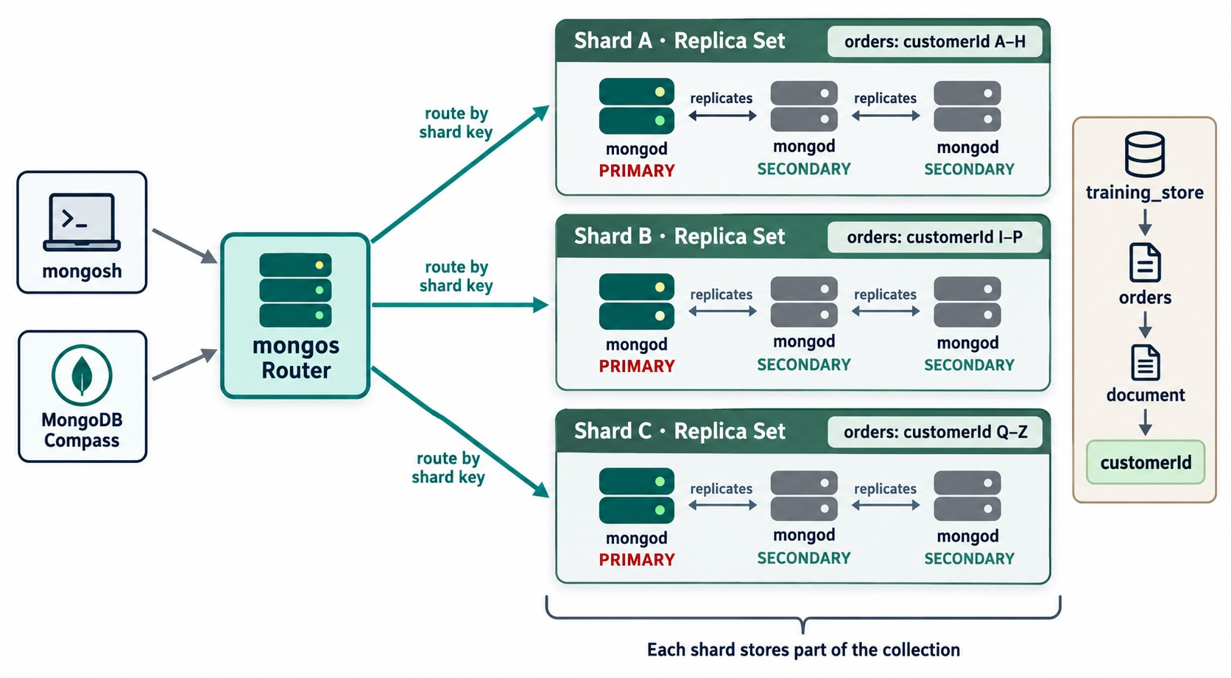
SHARDS
Each shard is a replica set holding part of the collection.
Part of the collection
Each shard owns its own ranges of orders — here by customerId.
A replica set per shard
A primary and two secondaries, with its own elections.
Illustrative labels
A–H, I–P, Q–Z stand in for ranges; our customerId is an ObjectId.
NEVER A SINGLE MONGOD An unreplicated shard is a single point of failure.
KEY TAKEAWAY Sharding distributes the data between shards; replication keeps each shard available.
28
© 2026 by Innovation In Software Corporation
Notes:
KEY TALKING POINTS
------------------
- A shard holds part of the data
Each shard stores only its assigned part of a sharded collection.
Here the orders collection is divided by customerId ranges.
- A shard is a replica set
Each shard has a primary and two secondaries, with its own elections and failover.
If a shard were a single unreplicated server, it would be a single point of failure for its data.
- Sharding plus replication
Sharding distributes the data between shards.
Replication provides availability within each shard.
A production cluster needs both.
- What it shows
mongosh and Compass connect to the mongos router, which routes by shard key to Shard A, B and C. Each is a replica set of a primary and two secondaries.
The labels say Shard A holds orders for customerId A–H, Shard B I–P and Shard C Q–Z.
- How to read it
The bracket at the bottom: each shard stores part of the collection.
The panel on the right shows the path training_store, orders, document, customerId.
- About the labels
The letter ranges are illustrative.
In training_store, customerId is an ObjectId reference to a customer; the readable code, such as C101, is the customer's customerNumber.

Slide 29
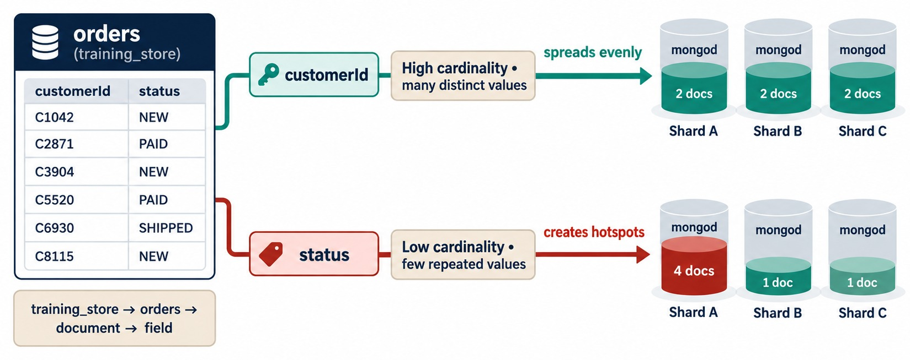
CARDINALITY AND FREQUENCY
Many distinct values spread evenly; a few values create hotspots.
customerId: high
Many distinct values — many split points, an even spread.
status: low
A handful of values — each one is a bucket that can't split.
Frequency matters too
One huge customer can still make one range hot.
TRAINING_STORE fulfillmentStatus has only four values.
KEY TAKEAWAY Choose a shard key with many values that occur evenly — never a status field.
29
© 2026 by Innovation In Software Corporation
Notes:
KEY TALKING POINTS
------------------
- What makes a good shard key
A strong key has high cardinality and even value frequency, does not grow in one direction, matches the common queries, spreads the writes, and keeps working as the data grows.
- Cardinality
Cardinality is the number of distinct key values.
A status field has only a few, and all documents with the same value must sit in the same range, so a very large collection can't be divided.
- Frequency
Frequency is how often each value occurs.
Even with many customers, one customer with fifty million orders makes one oversized, heavily used range.
- In training_store
fulfillmentStatus has four values: NEW, PROCESSING, SHIPPED and DELIVERED.
paymentStatus has three: PAID, PENDING and FAILED.
Neither can be a shard key on its own.
customerId, a reference to one of many customers, has high cardinality.
- What it shows
A sample of orders with a customerId and a status.
Sharding on customerId, with high cardinality, spreads evenly: two documents on each shard.
Sharding on status, with low cardinality, creates a hotspot: four documents on Shard A, one each on B and C.
- How to read it
Compare the two rows of cylinders.
The document counts are illustrative; the point is that each status value is one bucket that can't be split.
- Key point
A key with a few values can never be divided into many ranges.

Slide 30
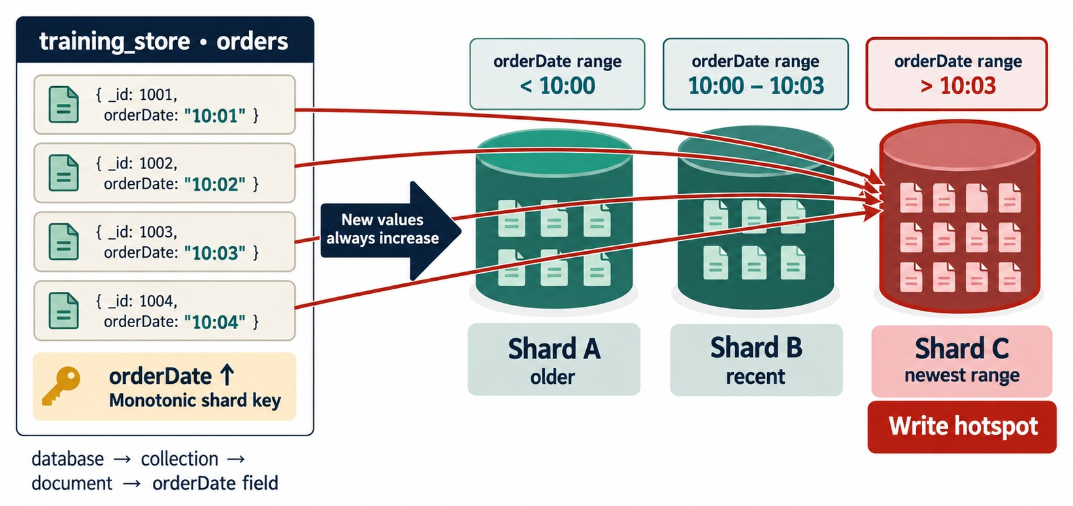
MONOTONIC SHARD KEYS
Always-increasing values pile into the newest range.
Always increasing
createdAt, sequential order numbers, ObjectId-based _id.
Ranged key → hotspot
Every new order lands in the top range, on one shard.
Fixes
Hash the value, or lead with a high-cardinality field such as customerId.
DIAGRAM FIELD orderDate stands for our createdAt.
KEY TAKEAWAY A monotonic ranged key sends every new write to one shard — hash it or lead with another field.
30
© 2026 by Innovation In Software Corporation
Notes:
KEY TALKING POINTS
------------------
- Monotonic values
A monotonically increasing value keeps growing: timestamps, sequential order numbers, auto-incrementing identifiers.
ObjectId values also start with a timestamp, so they grow over time too.
- The hotspot
With ranged sharding, every new value is the largest so far.
All new inserts land in the top range, on one shard, while the others sit idle for writes.
- The fixes
A hashed key spreads such values evenly but loses efficient range targeting.
A compound key that leads with a high-cardinality field, such as customerId, spreads writes across customers.
- Decide from the workload
It depends on whether the workload needs even write distribution, efficient range reads, customer locality or time locality.
- What it shows
Four orders with orderDate 10:01, 10:02, 10:03 and 10:04 and a monotonic orderDate shard key.
The ranges are below 10:00 on Shard A, 10:00 to 10:03 on Shard B, and above 10:03 on Shard C. The red arrows send every new order to Shard C, the newest range, marked as the write hotspot.
- How to read it
New values always increase, so all red arrows end at the same shard.
- About the field
orderDate stands for createdAt in training_store.
The _id values are simplified; ours are ObjectIds.

Slide 31
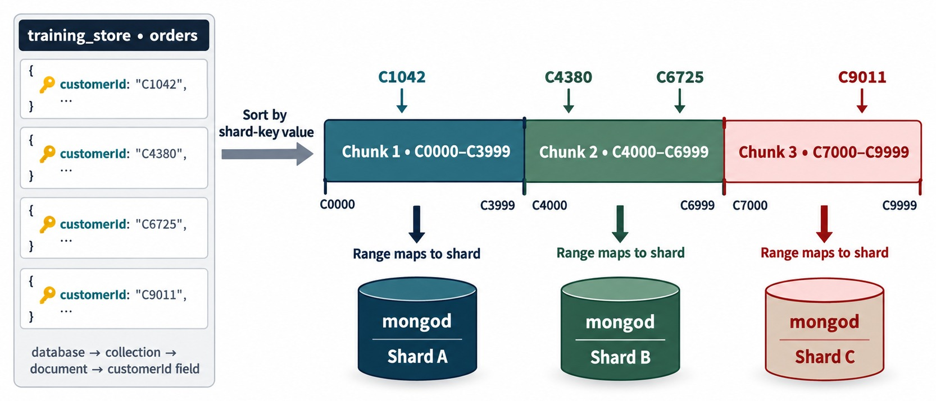
RANGED SHARDING
Sorted shard-key values cut into contiguous ranges.
Contiguous ranges
Sorted values are cut into ranges; each range lives on one shard.
Good for ranges
One customer's orders, or a date span, stay on few shards.
Risk
A monotonic key sends all new writes to the last range.
A ranged compound key
{ customerId: 1, createdAt: 1 }
KEY TAKEAWAY Ranged sharding keeps neighbours together — great for range queries, risky for rising keys.
31
© 2026 by Innovation In Software Corporation
Notes:
KEY TALKING POINTS
------------------
- Ranged sharding
Ranged sharding orders the shard-key values and cuts them into contiguous ranges.
Each range lives on one shard.
- Benefits
Range queries are efficient, related key values stay near each other, and a query for one customer or one time range can target the relevant shards.
- Risk
If new values always increase, new writes concentrate in the last range.
That is the monotonic hotspot from the previous slide.
- What it shows
Orders with customerId C1042, C4380, C6725 and C9011 are sorted by shard-key value into three chunks: C0000–C3999 on Shard A, C4000–C6999 on Shard B and C7000–C9999 on Shard C.
- How to read it
Follow each value down to its range and then to its shard.
C4380 and C6725 share Chunk 2.
- About the labels
The C-numbers are readable stand-ins for customerId, which is an ObjectId in training_store.

Slide 32
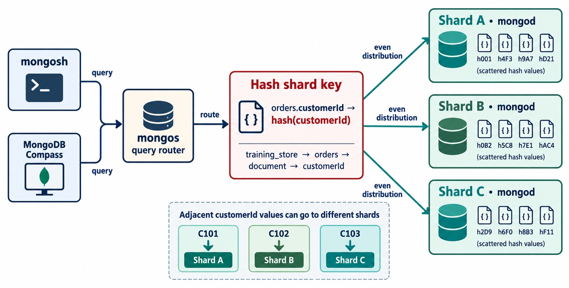
HASHED SHARDING
Hash the value, then distribute the hash ranges.
Hash first
MongoDB hashes customerId and ranges the hash values.
Even spread
Neighbours C101, C102 and C103 land on different shards.
Trade-off
Equality finds stay targeted; range queries on the field scatter.
A hashed key
{ customerId: "hashed" }
KEY TAKEAWAY Hashed sharding spreads writes evenly — and gives up efficient range queries on that field.
32
© 2026 by Innovation In Software Corporation
Notes:
KEY TALKING POINTS
------------------
- Hashed sharding
Hashed sharding computes a hash of the shard-key value and distributes ranges of hash values across the shards.
- Benefits
It usually gives a more even distribution, spreads monotonically increasing identifiers and reduces write concentration.
- Trade-off
The hash is not ordered like the original value.
An equality query on customerId can still be targeted, because mongos can hash the value.
But a range query on the original values may have to contact every shard.
- What it shows
mongos routes through a hash shard key, hash(customerId).
The hashed values, such as h001 and h4F3, are scattered evenly over Shards A, B and C. The panel below shows adjacent customers C101, C102 and C103 going to three different shards.
- How to read it
Each shard holds a mix of hash values, not a neat run of customers.
- Key point
Neighbours in the original order end up apart, which spreads writes but breaks range locality.

Slide 33
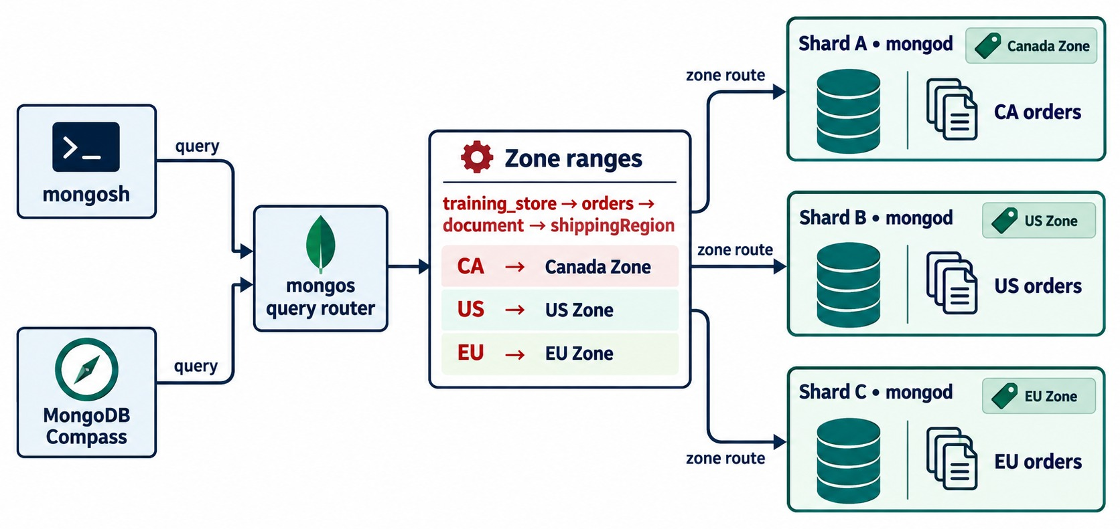
ZONED SHARDING
Zone ranges pin chosen data to chosen shards.
Pin ranges to shards
Canadian orders stay on the Canada-zone shard.
Why
Data residency, and keeping data near its users.
Needs a key prefix
We'd add a region field and lead the shard key with it.
WATCH THE SKEW A popular zone means hot shards.
KEY TAKEAWAY Zones place data deliberately — for residency or locality — but can concentrate load.
33
© 2026 by Innovation In Software Corporation
Notes:
KEY TALKING POINTS
------------------
- What zones do
Zoned sharding ties ranges of the shard key to chosen shards.
Here Canadian orders stay on Shard A, US orders on Shard B and EU orders on Shard C.
- Why teams use zones
The main reasons are data residency rules and keeping data close to the users who read it.
- What it needs
The zone field must be part of the shard key, normally its first field, for example shippingRegion followed by customerId.
training_store has no shippingRegion field today; its orders store shippingAddress.country as Canada or USA.
You would add a region field before zoning on it.
- The catch
Zones are not a free locality win.
If 90 percent of users are in one region, that zone's shards take 90 percent of the load.
For residency, also compare zones with separate regional clusters.
- What it shows
Queries go through mongos to the zone ranges on training_store.orders by shippingRegion: CA to the Canada zone on Shard A, US to the US zone on Shard B and EU to the EU zone on Shard C.
- How to read it
Each shard carries a zone tag and holds only that region's orders.
- About the field
shippingRegion is not in training_store; our orders have shippingAddress.country Canada or USA.

Slide 34
COMPARING CANDIDATE SHARD KEYS FOR ORDERS
Six candidates for training_store.orders — five on real fields, one what-if.
Candidate | Strength | Concern
{ fulfillmentStatus: 1 } | Status queries | 4 values: low cardinality
{ createdAt: 1 } | Date-range queries | Monotonic: write hotspot
{ customerId: 1 } | Customer history | A huge customer concentrates
{ customerId: "hashed" } | Even write spread | Ranges scatter
{ customerId: 1, createdAt: 1 } | History + date range | Depends on customer skew
{ region: 1, customerId: 1 } | Regional placement | Needs a new region field
Our pick to test
{ customerId: 1, createdAt: 1 } — it matches Module 6's history query.
Validate it
Test with production-like data and traffic before you choose.
NO UNIVERSAL KEY Choose from the workload.
KEY TAKEAWAY No shard key is universally right — score each candidate against the real workload.
34
© 2026 by Innovation In Software Corporation
Notes:
KEY TALKING POINTS
------------------
- How to read the table
Each row is one candidate for training_store.orders, with what it helps and what worries us.
- The weak candidates
fulfillmentStatus has four values, so it can never make more than four ranges.
createdAt has many values, but every new order is the newest, so ranged sharding on it makes a write hotspot.
- The customer candidates
customerId targets one customer's history but a very large customer can concentrate data.
Hashed customerId spreads writes evenly, and equality lookups are still targeted, but ranges on customerId scatter.
- The compound candidates
{ customerId: 1, createdAt: 1 } keeps each customer's orders together in date order, so the history query and a customer's date range are targeted.
A region-first key allows zones, but our orders have no region field; we would have to add one.
- Link to Exercise 7.3
Checkpoint C scores these candidates on seven criteria.
The worksheet adds a tenantId candidate, which training_store doesn't have; treat it as a what-if for multi-tenant platforms.

Slide 35
SHARDING A COLLECTION — INSTRUCTOR DEMONSTRATION
Run through mongos, on a disposable cluster only.
Ranged compound key
Or a hashed key
Inspect the result
// disposable lab cluster only
db.orders.createIndex(
{ customerId: 1, createdAt: 1 })
sh.shardCollection(
"training_store.orders",
{ customerId: 1, createdAt: 1 })
sh.shardCollection(
"training_store.orders",
{ customerId: "hashed" })
sh.status()
db.orders
.getShardDistribution()
Through mongos
Index first
Disposable only
Sharding commands run on a mongos connection.
The shard key needs a supporting index.
Never shard the shared class cluster.
KEY TAKEAWAY Shard with a supporting index, through mongos, on a disposable cluster — then inspect the result.
35
© 2026 by Innovation In Software Corporation
Notes:
KEY TALKING POINTS
------------------
- What the commands do
createIndex builds the index that supports the shard key.
sh.shardCollection shards training_store.orders on that key.
sh.status shows shards, sharded collections, keys and ranges, and getShardDistribution shows how much data each shard holds.
- Choose one key
The second block is an alternative, not a second step.
A collection has one shard key; changing it later needs resharding.
- Safety
Failover and sharding commands run only on instructor-controlled, disposable infrastructure.
Never step down or shard a shared class cluster.
- A hands-on demonstration
On the disposable cluster, use a scratch namespace, training_shard.orders_lab, with the same key { customerId: 1, createdAt: 1 }.
Older versions also need sh.enableSharding on the database first; follow the instructor's exact commands.
Atlas free-tier clusters are replica sets, not sharded clusters, so learners without a mongos URI follow the demonstration.

Slide 36
PART 5: DISTRIBUTION, ROUTING AND DESIGN
How ranges move, how queries find them — and when to shard at all.
✓ Part 1
Availability and scale
✓ Part 2
Replica sets
✓ Part 3
Guarantees and lag
✓ Part 4
Shard keys
Part 5
Routing and design
SO FAR
NEXT QUESTION
How do ranges stay balanced and queries find them — and when should we shard?
✓
mongos, config servers and replica-set shards
✓
A good key: many values, even use, not monotonic
IN THIS PART
1
Chunks
✓
Ranged, hashed and zoned sharding
2
The balancer
3
Targeted queries
4
Targeted versus scatter-gather
5
Replication and sharding together
6
The deployment decision
7
Misconceptions and anti-patterns
36
© 2026 by Innovation In Software Corporation
Notes:
KEY TALKING POINTS
------------------
- Why this part
The shard key decides placement.
Now we see how placement stays balanced, how mongos uses it to route queries, and how to decide whether to shard at all.
- Outcome
By the end, learners should be able to sketch a production architecture for training_store and defend it.

Slide 37
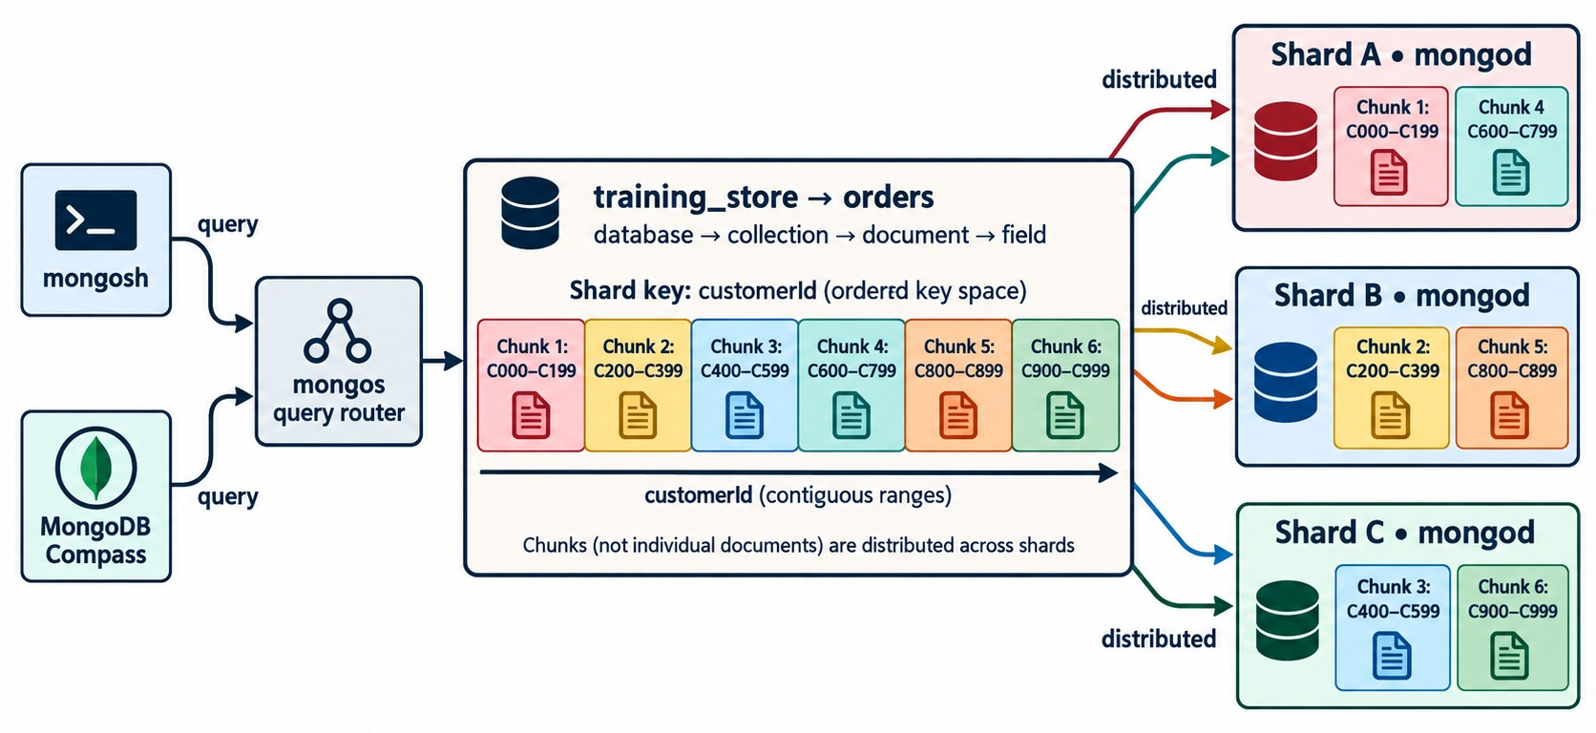
CHUNKS AND DATA DISTRIBUTION
The key space is cut into ranges; ranges are spread over shards.
Chunks are ranges
Each non-overlapping range of the key lives on one shard.
Not documents
MongoDB moves whole ranges, never single documents.
Metadata
The config servers record which shard owns each range.
TRAINING DATA Tiny data sets often sit in one range.
KEY TAKEAWAY Data is placed and moved range by range — the chunk map is what mongos routes with.
37
© 2026 by Innovation In Software Corporation
Notes:
KEY TALKING POINTS
------------------
- Chunks
MongoDB divides the shard-key space into non-overlapping ranges, usually called chunks.
Each range belongs to exactly one shard.
- Ranges, not documents
MongoDB moves whole ranges between shards, not individual documents.
Here Shard A owns chunks 1 and 4, Shard B chunks 2 and 5, and Shard C chunks 3 and 6.
- Metadata
The config servers record which shard owns each range.
That map is what mongos uses to route.
- Training data
A tiny training data set may sit in one range on one shard.
That is expected, not a fault.
- What it shows
The orders collection, sharded on customerId, is divided into six chunks from C000–C199 to C900–C999.
Shard A holds chunks 1 and 4, Shard B chunks 2 and 5, and Shard C chunks 3 and 6.
- How to read it
The line under the chunks says customerId in contiguous ranges; the note says chunks, not individual documents, are distributed.
- Key point
Placement is decided range by range.

Slide 38
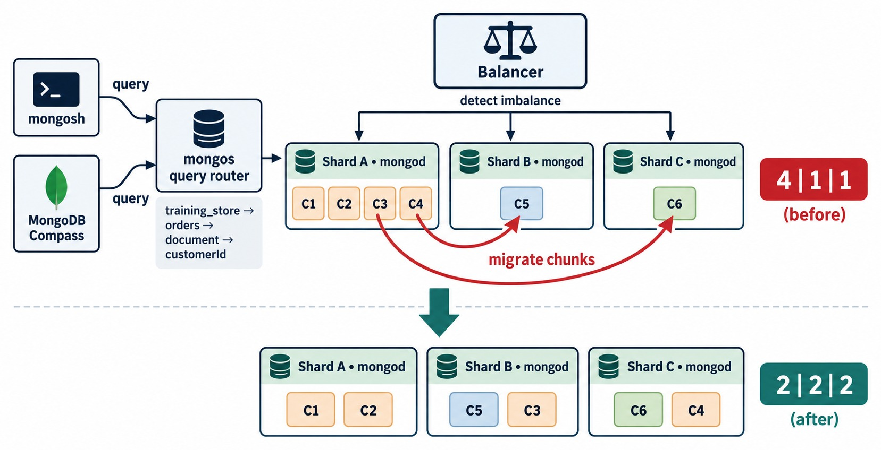
THE BALANCER
Detect imbalance, migrate ranges, even out the shards.
Detect imbalance
Shard A holds four chunks; Shards B and C hold one each.
Migrate ranges
C3 moves to Shard B, C4 to Shard C — two chunks each.
Costs resources
Migrations use network, disk and CPU — monitor them.
MODERN VERSIONS Balance by data size, not chunk count.
KEY TAKEAWAY The balancer evens out the shards automatically — but migrations have a cost, so watch them.
38
© 2026 by Innovation In Software Corporation
Notes:
KEY TALKING POINTS
------------------
- The balancer
The balancer is a background process that watches the distribution.
When one shard holds far more than the others, it moves ranges to even them out.
- Reading the diagram
Before: Shard A has four chunks, B and C one each.
The balancer migrates C3 to Shard B and C4 to Shard C, so each shard ends with two.
- Migrations cost resources
A migration copies the range, catches up on recent writes, commits the new owner in the metadata and deletes the old copy.
That uses network, disk and CPU, so production teams monitor migrations and can schedule a balancing window.
- Modern versions
Since MongoDB 6.0 the balancer compares the amount of data on each shard, not just the number of chunks.
The diagram counts chunks to keep the idea simple.
- What it shows
The balancer detects that Shard A holds C1 to C4 while Shard B holds only C5 and Shard C only C6: 4, 1, 1.
It migrates C3 to Shard B and C4 to Shard C. After balancing each shard has two chunks: 2, 2, 2.
- How to read it
Follow the red migrate-chunks arrows, then read the after row.
- Key point
Queries keep working while ranges move; mongos follows the updated metadata.

Slide 39
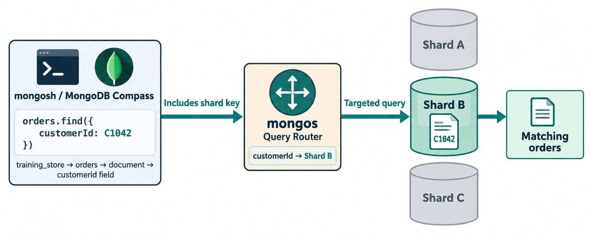
TARGETED QUERIES
A query that includes the shard key goes to one shard.
Includes the shard key
find({ customerId: … }) names the key.
mongos routes
The chunk map says Shard B — only Shard B works.
The fastest shape
Shards A and C stay free for other queries.
VALUE SHOWN C1042 is illustrative; ours is an ObjectId.
KEY TAKEAWAY Put the shard key in your hot-path queries so mongos can target one shard.
39
© 2026 by Innovation In Software Corporation
Notes:
KEY TALKING POINTS
------------------
- Targeted query
A query that includes the shard key, or its leading field, can be routed to one shard or a small set of shards.
- How mongos decides
mongos looks up the value in the chunk map from the config servers.
Here that value lives on Shard B, so only Shard B does the work.
- Why it matters
MongoDB notes that the fastest sharded queries are generally routed to a single shard using shard-key information.
Shards A and C stay free for other work.
- What it shows
mongosh or Compass runs orders.find({ customerId: C1042 }).
The query includes the shard key, so mongos maps customerId to Shard B and sends a targeted query there.
Shards A and C are grey and idle.
Shard B returns the matching orders.
- How to read it
Only one path is coloured: client, mongos, Shard B, result.
- About the value
C1042 is illustrative.
In training_store you would look up the customer's _id first, as the next slide shows.

Slide 40
TARGETED OR SCATTER-GATHER ON TRAINING_STORE?
Assume orders is sharded on { customerId: 1, createdAt: 1 }.
✓
Targeted: shard-key prefix
✕
Scatter-gather: no shard key
Check it with explain
const c = db.customers.findOne(
{ customerNumber: "C101" })
db.orders
.find({ customerId: c._id })
.sort({ createdAt: -1 })
db.orders.find(
{ fulfillmentStatus:
"PROCESSING" })
db.orders.find(
{ _id: someOrderId })
db.orders
.find({ customerId: c._id })
.explain()
// winningPlan lists
// the shards used
Targeted
Scatter-gather
Not always wrong
mongos sends it to the shard owning that customer's range.
Every shard runs it; mongos merges the results.
Fine for rare reports — costly in the hot path.
KEY TAKEAWAY Queries with the shard-key prefix are targeted; the rest ask every shard — keep those rare.
40
© 2026 by Innovation In Software Corporation
Notes:
KEY TALKING POINTS
------------------
- The targeted query
We look up Aisha Khan, customer C101, and use her _id.
The filter names the leading field of the shard key, so mongos can send it to the shard that owns her range.
On a fresh load she has 5 orders.
- The scatter-gather queries
fulfillmentStatus is not in the shard key, so every shard must search.
Three orders are PROCESSING on a fresh load: O6202, O6302 and O6401.
A lookup by _id alone also scatters, because _id is not part of this shard key.
- Proving it
On a sharded cluster, explain shows which shards took part; the instructor can compare a targeted plan with a scatter-gather one on the disposable cluster.
On our replica set there is only one place the data can be, so the difference doesn't appear.
- Not always wrong
A monthly report may scatter and that's fine.
Frequent, high-volume scatter-gather in the hot path means the shard key doesn't match the workload.

Slide 41
REPLICATION AND SHARDING TOGETHER
A production-style cluster: orders sharded, every shard a replica set.
Application (driver)
Sharding splits orders
Its ranges are spread over three shards; mongos routes each request by shard key.
mongos 1
query router
mongos 2
query router
metadata
Config server
replica set
Replication protects each shard
SHARD A · PRIMARY SHARD
SHARD B
SHARD C
Every shard is its own replica set — P is the primary, S a secondary.
P
S
S
P
S
S
P
S
S
If a Shard B server fails
replica set · own elections
replica set · own elections
replica set · own elections
Shard B elects a new primary; Shards A and C keep serving.
orders ranges 1 · 4
orders ranges 2 · 5
orders ranges 3 · 6
Unsharded: products,
customers and reviews
on the primary shard
PRIMARY SHARD Unsharded collections live on one shard, not on all.
KEY TAKEAWAY Sharding distributes the data; replication protects every shard — production clusters need both.
41
© 2026 by Innovation In Software Corporation
Notes:
KEY TALKING POINTS
------------------
- The production picture
Applications talk to mongos routers, usually more than one.
The routers read metadata from the config server replica set.
The data lives on three shards, and every shard is a three-member replica set.
- What is sharded and what is not
Only the orders collection is sharded here.
Its ranges are spread over all three shards.
products, customers and reviews stay unsharded, and unsharded collections live on one shard, the database's primary shard.
They are not copied to every shard.
- A server fails in Shard B
The Shard B replica set elects another primary.
Shards A and C keep working, and mongos updates its routing as the topology changes.
The application keeps using the cluster, apart from the short failover pause for Shard B's ranges.
- Why draw it ourselves
Some generated diagrams show every collection on every shard, or each shard as one mongod.
Both are wrong for production, so this slide draws the architecture correctly.

Slide 42
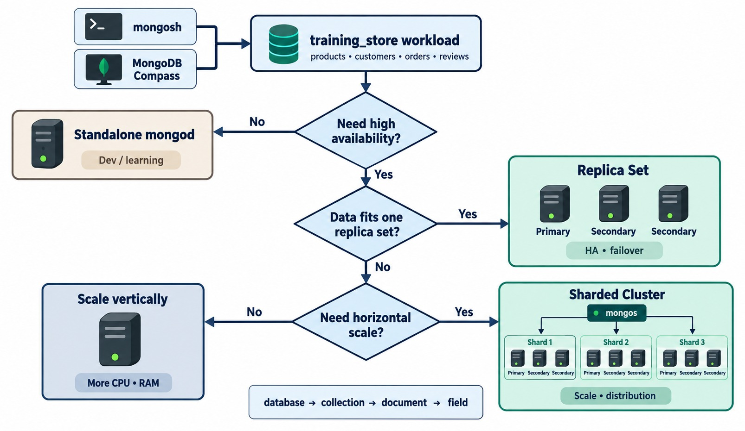
DEPLOYMENT DECISION FRAMEWORK
Standalone, replica set, scale up — or shard.
Development or learning
A standalone mongod is enough.
Production
Start with a replica set of at least three members.
Outgrown one replica set?
Scale up first; shard when one set can't hold the data or writes.
SHARD WITH EVIDENCE Fix schema and indexes first.
KEY TAKEAWAY Replicate every production deployment; shard only when measurements show you must.
42
© 2026 by Innovation In Software Corporation
Notes:
KEY TALKING POINTS
------------------
- Walk the questions
Does the workload need high availability?
If not, as in development and learning, a standalone mongod is enough.
If it does, does the data fit one replica set?
Then a replica set is the answer.
- When one replica set is not enough
If it doesn't fit, either scale the replica set's servers up, or shard.
The scale-vertically box still means a replica set, just on bigger servers.
- Shard with evidence
Shard when measurements show that one replica set can't hold the data or the writes.
Fix the schema and the indexes first; sharding a badly indexed collection spreads the problem.
- Which collection
In training_store, orders grows fastest, so it is the first shard candidate.
products and customers usually stay unsharded for a long time.
- What it shows
A flowchart for the training_store workload.
No need for high availability leads to a standalone mongod for development and learning.
Data that fits one replica set leads to a replica set.
Data that doesn't fit leads to the last question: no need for horizontal scale means scale vertically; yes means a sharded cluster whose shards are all replica sets.
- How to read it
Start at the top and answer each diamond in turn.
- Key point
Each step adds cost and operations work, so only take the next step when the previous one is not enough.

Slide 43
MISCONCEPTIONS AND ANTI-PATTERNS
Beliefs that lead first distributed designs into trouble.
MISCONCEPTION
REALITY
ANTI-PATTERNS TO AVOID
A replica set spreads writes over its members
All writes go to the primary; the secondaries copy them
✕
Connecting to one host, not the set
✕
Two or four voters instead of three or five
Secondary reads always make apps faster
They may be stale and compete with replication
✕
Sharding on fulfillmentStatus
✕
A ranged key on createdAt
✕
Sharding before fixing indexes
Sharding speeds up every query
Queries without the shard key ask every shard
REMEMBER Replicate to stay online, shard to grow, back up to recover.
Replication is a backup
A deleteMany is replicated too — keep real backups
The shard key is just another index
It decides placement and routing — and is hard to change
KEY TAKEAWAY Most distributed-design problems come from mixing up availability, scale and recovery.
43
© 2026 by Innovation In Software Corporation
Notes:
KEY TALKING POINTS
------------------
- Why this slide
Before the checks, clear away the beliefs that cause the most trouble.
- Writes and reads
A replica set does not spread writes: every write goes to the primary.
Secondary reads can help reporting, but they may be stale and they compete with replication work.
- Sharding
Sharding doesn't speed up every query: a query without the shard key may contact every shard.
More shards also mean more servers, routing, monitoring and balancing.
And the shard key is not just an index: it decides where data lives and how queries are routed.
- Backups
If someone runs db.orders.deleteMany({}), the delete is replicated to every secondary.
Replication also copies application bugs, bad updates and malicious deletes.
Resilience means replication, plus backups, plus tested restores — Module 8 covers the last two.

Slide 44
KNOWLEDGE CHECK
Answer in your own words — then compare with a partner.
What is the main purpose of replication? Of sharding?
What does mongos do? What do config servers store?
1
6
What does the oplog do?
Why is fulfillmentStatus a poor shard key?
2
7
What starts an election, and why is a majority needed?
Why can a ranged key on createdAt create a hotspot?
3
8
What is replication lag, and why does it matter?
Targeted versus scatter-gather: what is the difference?
4
9
Read preference, read concern, write concern: what does each control?
Is replication a replacement for backups?
5
10
44
© 2026 by Innovation In Software Corporation
Notes:
KEY TALKING POINTS
------------------
- 1. Purpose
Replication keeps copies of the same data for high availability and automatic failover.
Sharding divides data across servers for capacity and write throughput.
- 2. Oplog
It is a capped collection that records every data change on the primary.
Secondaries copy the entries and apply them in order.
- 3. Elections
Members stop receiving the primary's heartbeats.
A candidate needs votes from a majority of voting members, so only one side of a split can ever elect a primary.
- 4. Lag
How far a secondary's applied oplog trails the primary.
It causes stale secondary reads, and a member that falls outside the oplog window needs a full resync.
- 5. Three settings
Read preference chooses which member serves a read.
Read concern chooses which data it may return.
Write concern chooses how many members must acknowledge a write.
- 6. mongos and config servers
mongos routes every application request to the right shards and merges results.
The config servers store the cluster metadata: sharded collections, shard-key ranges and their shards.
- 7. fulfillmentStatus
It has only four values, so it can make at most four ranges, and most writes go to the NEW range.
- 8. createdAt
Every new order has the largest createdAt so far, so every insert lands in the last range, on one shard.
- 9. Routing
A targeted query includes the shard key or its prefix, so mongos sends it to one or a few shards.
A scatter-gather query goes to every shard and mongos merges the results.
- 10. Backups
No. Replication copies deletes and mistakes to every member.
Only backups and tested restores recover from them.

Slide 45
EXERCISE 7.1 — REPLICATION OR SHARDING?
Module 7 checkpoint A: match each requirement to its mechanism.
OFFICIAL CHECKPOINT A
10 MIN
labs/day-03/exercises/exercise-7.1-replication-or-sharding.md
SCENARIO
YOUR TASKS
SOLUTION (AFTER DEBRIEF)
Write Replication, Sharding, Both or Neither yet for each requirement.
1
Classify requirements 1–3
✓
1 Replication · 2 Sharding
2
Classify requirements 4–6
✓
3 Replication · 4 Sharding
1 Survive one server failure
2 Increase total data capacity
3 Elect a replacement primary
4 Distribute write load
5 A local development database
6 Production availability + scale
3
Explain why secondaries add no capacity
✓
5 Neither yet: standalone
✓
6 Both: sharded replica sets
4
Compare with Lab 6: last week's delete
✓
Same data on each member
KEY TAKEAWAY Copies give availability, shards give capacity — and development needs neither yet.
45
© 2026 by Innovation In Software Corporation
Notes:
KEY TALKING POINTS
------------------
- Official checkpoint
This is the official Exercise 7.1.
The worksheet is labs/day-03/exercises/exercise-7.1-replication-or-sharding.md.
It is classroom discussion; learners may look at training_store or rs.status() to test ideas.
- Running it
Seven minutes in pairs, then a three-minute debrief.
Reveal the solution column only after the groups share.
- The borderline case
Copying data to secondaries does not increase capacity: each member stores the same logical data set.
Extra members add redundancy, not a larger working set.
- Link to Lab 6
Day 3 Lab 6, Step 1, adds one more row: recover an order deleted last week.
The answer is a backup, because replication and sharding both copy or keep the delete.

Slide 46
EXERCISE 7.2 — SELECT READ AND WRITE SETTINGS
Module 7 checkpoint B: choose settings per business operation.
OFFICIAL CHECKPOINT B
20 MIN
labs/day-03/exercises/exercise-7.2-select-read-and-write-settings.md
SCENARIO
YOUR TASKS
SOLUTION (AFTER DEBRIEF)
For each operation choose a read preference, a read concern and a write concern.
1
Set the two money paths
✓
Payment: primary + majority
2
State what you refuse to trade away
✓
Reconciliation: same bias
Payment confirmation
Financial reconciliation
Product-catalog browsing
Customer order status
Operational reporting
Noncritical analytics
✓
Catalog: primaryPreferred ok
3
Set catalog, status and reporting
One sentence on staleness for each
✓
Status: primary after payment
4
✓
Analytics: secondaryPreferred
KEY TAKEAWAY Money paths get primary reads and majority writes; staleness is accepted only where it's harmless.
46
© 2026 by Innovation In Software Corporation
Notes:
KEY TALKING POINTS
------------------
- Official checkpoint
This is the official Exercise 7.2.
The worksheet is labs/day-03/exercises/exercise-7.2-select-read-and-write-settings.md.
- Money paths
Payment confirmation reads from the primary, or primaryPreferred only with a documented reason, writes with w majority, and reads with majority, or snapshot inside a transaction.
Reconciliation has the same bias: never read unpaid state from a lagging secondary.
- The other four
Catalog browsing can use primaryPreferred or nearest with local reads.
Order status should read from the primary, or with majority, right after a customer pays.
Reporting and analytics can use secondaryPreferred if minutes of delay are acceptable and the secondary has capacity.
- What to listen for
The three settings are not interchangeable, and staleness is accepted explicitly, never by accident.

Slide 47
EXERCISE 7.3 — EVALUATE SHARD-KEY CANDIDATES
Module 7 checkpoint C: score keys for training_store.orders.
OFFICIAL CHECKPOINT C
20 MIN
labs/day-03/exercises/exercise-7.3-evaluate-shard-key-candidates.md
SCENARIO
YOUR TASKS
SOLUTION (AFTER DEBRIEF)
Score each candidate 1–5 on cardinality, distribution, write scale, targeting, hotspot risk, locality and growth. tenantId is a what-if: training_store has none.
1
Score all six candidates
✓
paymentStatus: rejected
2
Reject the low-cardinality key
✓
createdAt: write hotspot
3
Flag the monotonic key
✓
Hashed: even, no ranges
{ paymentStatus: 1 }
{ createdAt: 1 }
{ customerId: 1 }
{ customerId: "hashed" }
{ tenantId: 1, orderNumber: 1 }
{ customerId: 1, createdAt: 1 }
Recommend one; name two risks
✓
Pick customerId + createdAt
4
✓
Risks: big customers, reports
KEY TAKEAWAY A defensible shard key matches the hot query — and still names the risks you'll monitor.
47
© 2026 by Innovation In Software Corporation
Notes:
KEY TALKING POINTS
------------------
- Official checkpoint
This is the official Exercise 7.3.
The worksheet is labs/day-03/exercises/exercise-7.3-evaluate-shard-key-candidates.md.
Use training_store.orders as the mental model: few statuses, many customers, dates that only increase.
- Expected scores
paymentStatus has three values: low cardinality, a hotspot and poor targeting.
Ranged createdAt is a monotonic write hotspot.
customerId targets history but may suffer customer skew.
Hashed customerId gives even writes and weak range locality.
- The compound keys
{ customerId: 1, createdAt: 1 } targets history queries, and ranged writes per customer are usually fine.
The tenantId key only works if queries lead with the tenant; training_store has no tenantId, so treat it as a what-if.
Its second field is the real orderNumber, such as O6401.
- The recommendation
{ customerId: 1, createdAt: 1 } or hashed customerId, depending on whether date ranges across customers matter.
Risks to monitor: very large customers and scatter-gather global reports.

Slide 48
EXERCISE 7.4 — TARGETED OR SCATTER-GATHER?
Module 7 checkpoint D: classify five queries by their routing.
OFFICIAL CHECKPOINT D
15 MIN
labs/day-03/exercises/exercise-7.4-targeted-or-scatter-gather.md
SCENARIO
YOUR TASKS
SOLUTION (AFTER DEBRIEF)
Shard key: { customerId: 1, createdAt: 1 }. c is customer C101.
1
Classify queries A and B
✓
A, B targeted: key prefix
2
Classify queries C and D
✓
C scatter-gather
A { customerId: c._id }
B { customerId: c._id,
createdAt: { $gte: start } }
C { paymentStatus: "PAID" }
D { createdAt: { $gte: start } }
E D again, key hashed customerId
3
Classify E under the hashed key
✓
D many shards or all
Fix a slow monthly revenue report
✓
E scatter-gather
4
✓
Pre-aggregate, don't re-key
KEY TAKEAWAY The leading shard-key field decides routing — reports without it need a different design, not a new key.
48
© 2026 by Innovation In Software Corporation
Notes:
KEY TALKING POINTS
------------------
- Official checkpoint
This is the official Exercise 7.4.
The worksheet is labs/day-03/exercises/exercise-7.4-targeted-or-scatter-gather.md.
As on the slide, c holds C101's customer document, so c._id is the ObjectId stored in orders.customerId.
- A to E
A is targeted: one or a few chunks for that customer.
B is a targeted range inside the customer prefix.
C is scatter-gather: paymentStatus is not in the key.
D usually touches many shards, depending on how dates map.
E, a createdAt range under a hashed customerId key, is scatter-gather.
- The redesign
If monthly global revenue must be fast, don't pick a shard key that hurts the order path.
Pre-aggregate the report, run it on an analytics node, or accept scatter-gather for a rare job.
- Link to Lab 6
Day 3 Lab 6, Step 3, repeats this with fulfillmentStatus and an _id-only lookup, both scatter-gather.

Slide 49
LAB 6 — REPLICATION AND SHARDING
Day 3 hands-on: choose the mechanism, reason about shard keys, check a replica set.
OFFICIAL LAB
40 MIN
labs/day-03/lab6/LAB-6-GUIDE.md
SCENARIO
YOUR TASKS
EXPECTED OUTCOME
Steps 1–3 work on paper. Steps 4–7 need the instructor's replica-set or Atlas URI; a standalone mongod is not a replica set.
1
1 Mechanism for six requirements
✓
Last week's delete: a backup
2
2–3 Shard keys and query routing
fulfillmentStatus rejected
✓
use training_store
rs.status()
rs.conf()
db.hello()
rs.printSecondaryReplicationInfo()
3
4 Confirm a replica set
✓
Status-only query scatters
4
5–6 Record members, votes and lag
✓
One PRIMARY, health: 1
5
7 Write a short health report
✓
Lag measured, often 0–2 s
KEY TAKEAWAY Name the mechanism, defend the shard key, and report health as measured — not assumed.
49
© 2026 by Innovation In Software Corporation
Notes:
KEY TALKING POINTS
------------------
- Official lab
This is Day 3 Lab 6, Replication and Sharding.
The guide is labs/day-03/lab6/LAB-6-GUIDE.md.
Allow 30 to 40 minutes.
Steps 1 to 3 are reasoning on training_store.orders; Steps 4 to 7 inspect a real replica set.
- Steps 1 to 3
Step 1 repeats Exercise 7.1 and adds last week's deleted order: the answer is a backup.
Step 2 rejects fulfillmentStatus, flags createdAt and prefers { customerId: 1, createdAt: 1 }.
Step 3 classifies customer history as targeted and the fulfillmentStatus and _id-only lookups as scatter-gather.
On a fresh load 3 orders are PROCESSING: O6202, O6302 and O6401.
- Environment
Atlas clusters are replica sets; a local standalone mongod is not.
If rs.status() says the server is not running with --replSet, stop and switch to the instructor's URI.
These commands only read status, so they are safe on a shared cluster; nobody steps anything down.
Failover and sharding commands run only on instructor-controlled, disposable infrastructure.
Never step down or shard a shared class cluster.
- Steps 4 to 6: what to record
The set name, the primary host, the secondary hosts, each member's votes and priority, any arbiter, what db.hello() says about the connected member, and the lag of each secondary, even when it is zero.
- Step 7: the report
One short paragraph: is there a primary, is a majority reachable, is the lag a concern, and is there any configuration smell, such as an arbiter carrying durability or priority 0 on the only nearby member.

Slide 50
MODULE 7 SUMMARY AND WHAT'S NEXT
From one replica set to a sharded cluster.
YOU CAN NOW
NEXT: MODULE 8 — BEST PRACTICES
Tell availability from scalability
1
What will we actually run in production?
✓
Explain the primary, secondaries, oplog and elections
2
How do we secure, back up and restore it?
✓
Choose read preference, read and write concern
How do we monitor and troubleshoot it?
✓
3
Explain replication lag and rollback
✓
Evaluate shard keys and query routing
BRING ALONG Your Lab 6 health report and answers, and your shard-key scores from Exercise 7.3.
✓
Decide when to replicate, shard, or both
✓
KEY TAKEAWAY Module 8 turns replication, sharding and backups into a production checklist.
50
© 2026 by Innovation In Software Corporation
Notes:
KEY TALKING POINTS
------------------
- Recap
We separated availability from scale, looked inside a replica set, chose read and write settings, saw lag and rollback, and designed a sharded cluster with a shard key for training_store orders.
- Next module
Module 8 consolidates the course: sustainable modeling, query and index optimization, security, backup and recovery, monitoring, troubleshooting and deployment readiness.
- Day 3 labs
Day 3 Lab 6, Replication and Sharding, is this module's hands-on lab: the reasoning steps plus the replica-set health check.
Failover and sharding commands run only on instructor-controlled, disposable infrastructure.
Never step down or shard a shared class cluster.
- Bring along
Keep the Lab 6 health report and answers and the Exercise 7.3 scores.
Module 8's production-readiness review builds on them.

