Slide 1
"Production-ready is proven, not assumed."
MODULE 8
MongoDB Best Practices, Security, and Troubleshooting
Model, tune, secure, recover and diagnose training_store — and decide whether it is ready for production.
Data modeling
Performance
Security
Backup and recovery
Troubleshooting
MASTERING MONGODB • MODULE 8
Notes:
KEY TALKING POINTS
------------------
- The last module
This is the final module of the course.
We stop learning new MongoDB features and start asking whether a MongoDB solution is safe to run for real.
- Production-ready is a claim you prove
A database that accepts queries is only functional.
Production-ready means the model holds up, queries are measured, access is locked down, restores are tested and someone can diagnose problems.
- Same dataset
Everything uses training_store: 6 customers, 13 products, 17 orders and 6 reviews.
By the end we decide whether it could go live — and why not yet.
REAL-WORLD EXAMPLES
-------------------
- Many real outages are not exotic bugs.
They are a missing index after a release, an expired certificate, a disk that filled up, or a backup nobody had ever restored.

Slide 2
LEARNING OBJECTIVES
What you will be able to do by the end of this module.
🎯
BY THE END OF THIS MODULE, YOU CAN
❓
SIX QUESTIONS THIS MODULE ANSWERS
1. Apply modeling, validation and evolution rules
2. Tune queries, pipelines and indexes with explain
3. Secure access with auth, roles, TLS, network
4. Plan backups and prove restores (RPO, RTO)
5. Monitor health and troubleshoot by layer
6. Judge training_store's production readiness
IS
the model safe to grow?
HOW
do we prove it is fast?
WHO
may do what — and from where?
CAN
we recover from a mistake?
WHAT
is wrong right now?
ARE
we ready to go live?
🗺️
MODULE ROADMAP
Model
Validate
Tune
Secure
Recover
Diagnose
Go-live?
KEY TAKEAWAY Production-ready is a claim you prove with evidence — not a feeling you have.
2
© 2026 by Innovation In Software Corporation
Notes:
KEY TALKING POINTS
------------------
- By the end of this module
Learners can apply modeling, validation and schema-evolution rules, and tune queries, pipelines and indexes with explain evidence.
They can secure access with authentication, least privilege, TLS and network limits, and plan backups against RPO and RTO.
They can monitor health, troubleshoot by layer, and judge production readiness.
- Six questions
Is the model safe to grow?
How do we prove it is fast?
Who may do what?
Can we recover?
What is wrong right now?
Are we ready to go live?
- How the module runs
Five parts, three short practice exercises, a knowledge check, three official checkpoints — Exercises 8.1 to 8.3 — and Lab 7, which closes the course.

Slide 3
KEY TERMS FOR THIS MODULE
Plain definitions for the words we'll use most.
1
Schema validation
2
Query shape
$jsonSchema rules the server checks on every insert and update — required fields, types, enums.
A query's filter, sort and projection. Indexes are designed around shapes, not single queries.
3
ESR rule
4
Least privilege
Order compound-index keys Equality first, then Sort, then Range.
Give each identity only the actions and collections its job needs — nothing more.
5
TLS
6
RPO and RTO
Transport Layer Security: encrypts traffic between clients, servers and cluster members.
How much data you may lose, and how long recovery may take — both are time targets.
7
Restore test
8
Runbook
Proving a backup by restoring it to an isolated target and checking counts, samples and indexes.
Written steps for one alert: checks, fixes, escalation, rollback and verification.
KEY TAKEAWAY Agree on the words first — every later slide builds on them.
3
© 2026 by Innovation In Software Corporation
Notes:
KEY TALKING POINTS
------------------
- How to run this slide
Read each term once and give a quick example from the training_store sample database.
- Schema validation
$jsonSchema rules the server checks on every insert and update — required fields, types, enums.
- Query shape
A query's filter, sort and projection.
Indexes are designed around shapes, not single queries.
- ESR rule
Order compound-index keys Equality first, then Sort, then Range.
- Least privilege
Give each identity only the actions and collections its job needs — nothing more.
- TLS
Transport Layer Security: encrypts traffic between clients, servers and cluster members.
- RPO and RTO
How much data you may lose, and how long recovery may take — both are time targets.
- Restore test
Proving a backup by restoring it to an isolated target and checking counts, samples and indexes.
- Runbook
Written steps for one alert: checks, fixes, escalation, rollback and verification.

Slide 4
FULL FORMS USED IN THIS MODULE
Every abbreviation on these slides, spelled out.
BSON
Binary JSON
ID
Identifier
RTO
Recovery Time Objective
COLLSCAN
Collection Scan
IP
Internet Protocol
TLS
Transport Layer Security
CPU
Central Processing Unit
IXSCAN
Index Scan
URI
Uniform Resource Identifier
DBA
Database Administrator
RBAC
Role-Based Access Control
UTC
Coordinated Universal Time
ESR
Equality, Sort, Range
RPO
Recovery Point Objective
KEY TAKEAWAY When an abbreviation isn't clear, the full form is on this slide.
4
© 2026 by Innovation In Software Corporation
Notes:
KEY TALKING POINTS
------------------
- How to run this slide
Don't read every row.
Point out the few this module uses most, and say the full list is here for reference.
- Reference
BSON is Binary JSON; COLLSCAN is Collection Scan; CPU is Central Processing Unit; DBA is Database Administrator; ESR is Equality, Sort, Range; ID is Identifier; IP is Internet Protocol; IXSCAN is Index Scan; RBAC is Role-Based Access Control; RPO is Recovery Point Objective; RTO is Recovery Time Objective; TLS is Transport Layer Security; URI is Uniform Resource Identifier; UTC is Coordinated Universal Time.

Slide 5
FROM MODULE 7 TO MODULE 8
The cluster stays up and scales — now make it safe to run for real.
MODULE 7 GAVE US
🧭
OUR PATH THROUGH MODULE 8
Model and validate documents
✓
Replica sets: primary and secondaries
1
Part 1
✓
Elections and automatic failover
Query, pipeline and index habits
2
Part 2
✓
Read and write concerns
Authentication, roles, TLS, network
3
Part 3
✓
Shard keys, chunks and mongos
Backups, RPO, RTO and restore tests
4
Part 4
✓
Targeted versus scatter-gather
Metrics and troubleshooting by layer
NOW Put the practices around it: model, tune, secure, back up, monitor and diagnose.
5
Part 5
Production-readiness review
6
Part 5
KEY TAKEAWAY Module 7 kept training_store available; Module 8 makes it correct, secure and recoverable.
5
© 2026 by Innovation In Software Corporation
Notes:
KEY TALKING POINTS
------------------
- Bridge from Module 7
Module 7 gave us a replica set for availability and sharding for scale.
Both are necessary for production, but neither makes the data correct, secure or recoverable on its own.
- The path
We review the data model, measure performance, lock down access, prove we can recover, and learn a method for diagnosing problems.
The module ends with a readiness review of training_store.
- The last module
This is the final module of the course.
The closing slides look back over all eight modules.

Slide 6
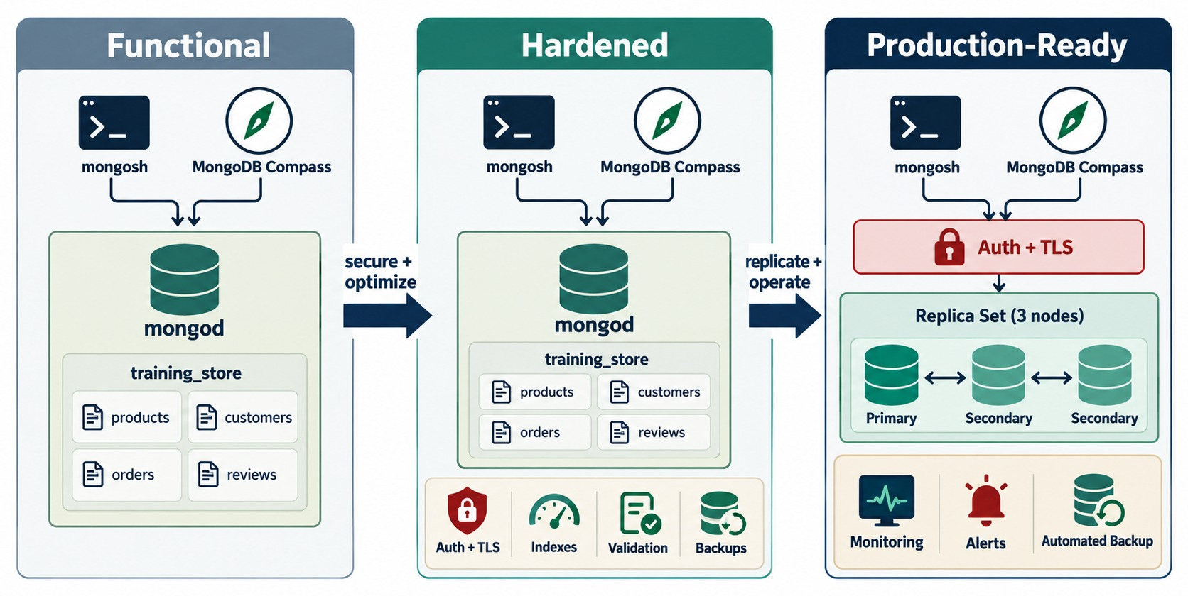
FROM FUNCTIONAL TO PRODUCTION-READY
What changes between “it works” and “we can run it”.
Functional
One mongod, no security — where our class instance is today.
Hardened
Auth + TLS, indexes, validation and backups.
Production-ready
A replica set with monitoring, alerts and automated backup.
SAME DATA The four collections never change — the controls do.
KEY TAKEAWAY Production-ready is the same data with proven controls around it.
6
© 2026 by Innovation In Software Corporation
Notes:
KEY TALKING POINTS
------------------
- Three stages
Functional: mongosh and Compass talk to one mongod with the four training_store collections.
It works, and that is all.
Hardened: authentication and TLS, indexes, validation and backups are added.
Production-ready: a three-member replica set behind authentication and TLS, with monitoring, alerts and automated backups.
- Where training_store is today
Our class instance is firmly in the first column.
No authentication, one server, no validator, no tested restore.
That is fine for learning — and the reason Lab 7 ends with not ready.
- Module 7 link
The replica set in the third column is exactly what Module 7 built.
Replication gives availability; this module adds everything around it.
- What it shows
Three columns.
Functional: clients and one mongod with training_store.
Hardened: the same server plus Auth + TLS, indexes, validation and backups.
Production-ready: Auth + TLS in front of a three-member replica set, with monitoring, alerts and automated backup.
- How to read it
Follow the arrows: secure and optimize, then replicate and operate.
- Key point
Each step adds controls around the same data; the collections don't change.

Slide 7
PART 1: DATA-MODELING GUIDELINES
Flexible schema, governed by explicit rules.
Part 1
Data model
Part 2
Performance
Part 3
Security
Part 4
Backup & recovery
Part 5
Operate & diagnose
SO FAR
NEXT QUESTION
Will this document model still hold up as data, features and teams grow?
✓
You modeled training_store in Module 3
✓
You queried, aggregated and indexed it
IN THIS PART
✓
You replicated and sharded it
Embed or reference: document boundaries
1
2
Consistent field names and BSON types
3
Historical snapshots
4
Schema validation
5
Planning schema evolution
7
© 2026 by Innovation In Software Corporation
Notes:
KEY TALKING POINTS
------------------
- Why start with the model
Most performance and correctness problems start in the document design.
An index can't fix an unbounded array.
- What this part does
We review training_store's model against six rules and find the real defects the loader left in it on purpose.

Slide 8
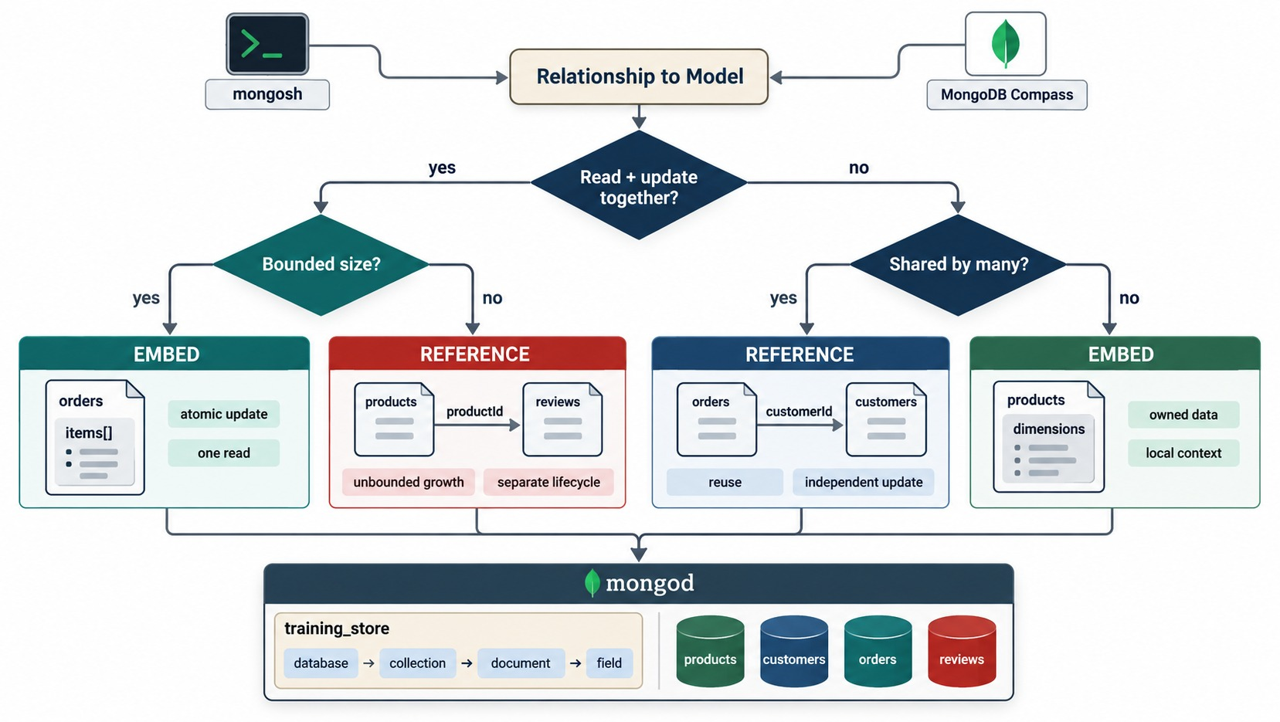
CHOOSE DOCUMENT BOUNDARIES CAREFULLY
Embed bounded, owned data — reference shared or unbounded data.
Embed
Order items and the shipping address: read with the order, bounded, owned.
Reference
Customers are shared; reviews grow without limit.
ANTI-PATTERN Every review inside its product — an unbounded array.
KEY TAKEAWAY Embed what belongs to one parent and stays bounded; reference the rest.
8
© 2026 by Innovation In Software Corporation
Notes:
KEY TALKING POINTS
------------------
- Two questions
First: is the data read and updated together with its parent?
If yes, is it bounded?
Bounded and owned data is embedded — order items in an order.
If it grows without limit, reference it — reviews point to a product.
- The other branch
If the data is not read together, ask whether many documents share it.
Shared data such as a customer is referenced by customerId.
Owned local detail such as product dimensions can still be embedded.
- training_store already follows this
Orders embed items and a shippingAddress snapshot.
They reference the customer with customerId.
Reviews live in their own collection and carry productId and customerId.
- The anti-pattern to name
Putting every review inside its product.
A popular product's document would grow without limit and approach the 16 MB document limit, and every product read would drag the reviews along.
- What it shows
A decision tree: read and updated together?
Then bounded size?
Otherwise shared by many?
Each leaf is EMBED or REFERENCE with a training_store example.
- How to read it
Left branch: order items embed; reviews are referenced because they grow without limit.
Right branch: customers are referenced because they are shared; product dimensions embed because they are owned.
- Key point
Embed bounded, owned data.
Reference shared, independent or unbounded data.

Slide 9
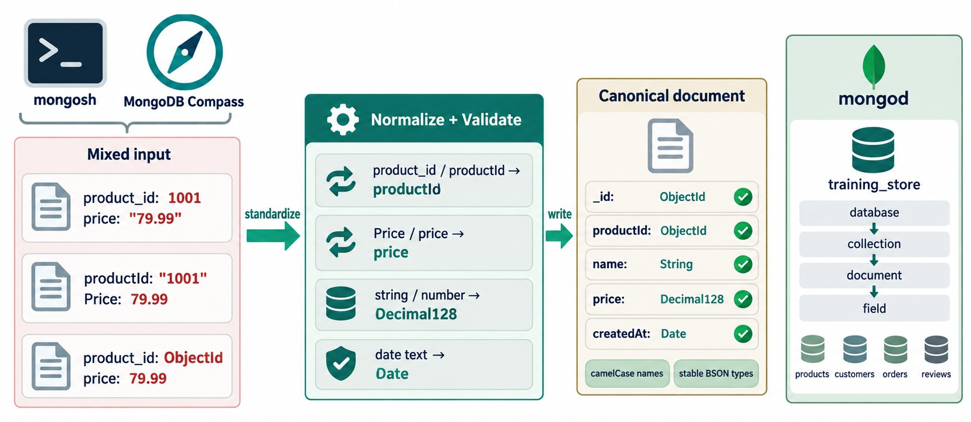
USE CONSISTENT FIELD NAMES AND TYPES
One name and one BSON type per concept.
Names
camelCase, one spelling: productId — never product_id or prodId.
Types
Decimal128 for money, Date for time, ObjectId for references.
IN OUR DATA XBAD stores price as the string "49.99".
KEY TAKEAWAY A field with two spellings or two types quietly breaks queries, sorts and indexes.
9
© 2026 by Innovation In Software Corporation
Notes:
KEY TALKING POINTS
------------------
- Mixed input
The left panel shows the same idea written three ways: product_id or productId, Price or price, and the price as a string, a number or with an ObjectId key.
Queries on one spelling silently miss the others.
- Normalize, then validate
Pick one name per concept in camelCase and one BSON type per field: ObjectId for references, Decimal128 for money, Date for timestamps.
- training_store has real drift
Product XBAD, the Legacy Cable Pack, stores price as the string '49.99'.
The other 12 products use Decimal128.
A range query on price never matches XBAD, and a sort puts it in the wrong place.
- Stray fields too
L190 carries legacyName and A410 carries temporaryNote.
Neither is part of the product model — they are leftovers to clean up.
- What it shows
Three product documents with different names and types are standardized, normalized and validated, then written as one canonical shape: _id ObjectId, productId ObjectId, name String, price Decimal128, createdAt Date.
- How to read it
Left: the drift.
Middle: the four fixes.
Right: camelCase names and stable BSON types.
- Key point
One name and one type per concept, enforced by validation.

Slide 10
FIND THE DRIFT IN TRAINING_STORE
Three queries that expose type and naming problems.
Prices stored with the wrong type
Fields outside the model
db.products.find(
{ price: { $type: "string" } },
{ _id: 0, sku: 1, price: 1 }
)
// { sku: 'XBAD', price: '49.99' }
db.products.countDocuments(
{ price: { $type: "decimal" } })
// 12
db.products.find(
{ $or: [
{ legacyName: { $exists: true } },
{ temporaryNote: { $exists: true } }
] },
{ _id: 0, sku: 1 }
)
// { sku: 'L190' }, { sku: 'A410' }
$type
$exists
FIX PLAN Migrate XBAD to Decimal128, then validate.
Finds values whose BSON type differs from the rule.
Finds stray fields left by old code or manual edits.
KEY TAKEAWAY Measure the drift before you fix it — $type and $exists turn a hunch into a list.
10
© 2026 by Innovation In Software Corporation
Notes:
KEY TALKING POINTS
------------------
- Wrong type
Twelve products store price as Decimal128.
XBAD, the Legacy Cable Pack, stores the string '49.99'.
A query such as price less than 50 never matches it, and a price sort puts it after every number, because BSON sorts numbers before strings.
- Stray fields
L190, the Refurbished Laptop, has a legacyName.
A410, the Wireless Mouse, has a temporaryNote that says remove after review.
Neither field belongs to the product model.
- The fix
Lab 7 counts XBAD's string price as not-ready evidence.
Convert the value with $toDecimal in a small, verified update, add a validator so it can't happen again, and remove the stray fields once nothing reads them.
- Don't change the shared class data
Other modules' labs rely on these defects, so demonstrate the fix on training_store_ops or reload with load.js afterwards.

Slide 11
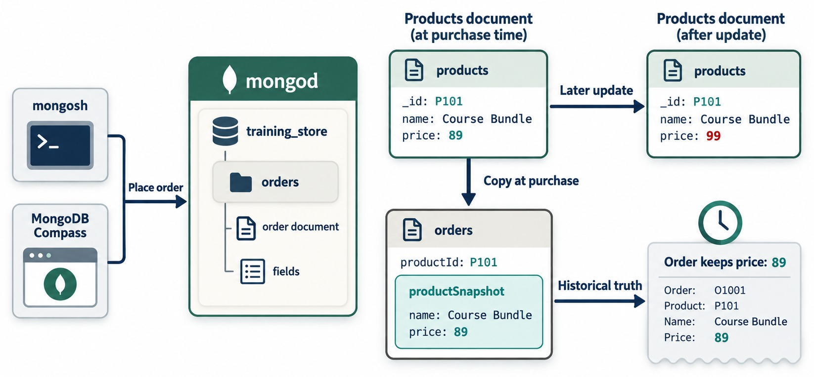
PRESERVE HISTORICAL SNAPSHOTS
The order keeps what the customer actually paid.
Copy at purchase
The name and price are copied into the order.
Later update
The product's price changes; the order doesn't.
In training_store
Each item keeps sku, name, quantity and unitPrice.
INTENTIONAL Snapshot duplication records history — it isn't a bug.
KEY TAKEAWAY Copy the values that must stay historically true into the order at the moment it is placed.
11
© 2026 by Innovation In Software Corporation
Notes:
KEY TALKING POINTS
------------------
- Copy at purchase
When the order is placed, the product's name and price are copied into the order.
Later the product's price changes from 89 to 99, but the order still says 89.
- Intentional duplication
This is not inconsistency.
It is the historical truth of what the customer paid.
- In training_store
The loader's snap() function copies productId, sku, name, quantity and unitPrice into each order item.
For example, O6102 keeps the Running Shoe at 129.99 and the Wireless Keyboard at 49.99, even though the keyboard now has a discountPrice of 39.99.
The diagram's Course Bundle P101 is a generic example.
- What it shows
Product P101, Course Bundle, costs 89 at purchase.
The order copies the name and price into a productSnapshot.
Later the product price becomes 99, but the order still keeps 89.
- How to read it
Copy at purchase, later update, historical truth.
- Key point
Snapshot duplication is deliberate: it records what happened.

Slide 12
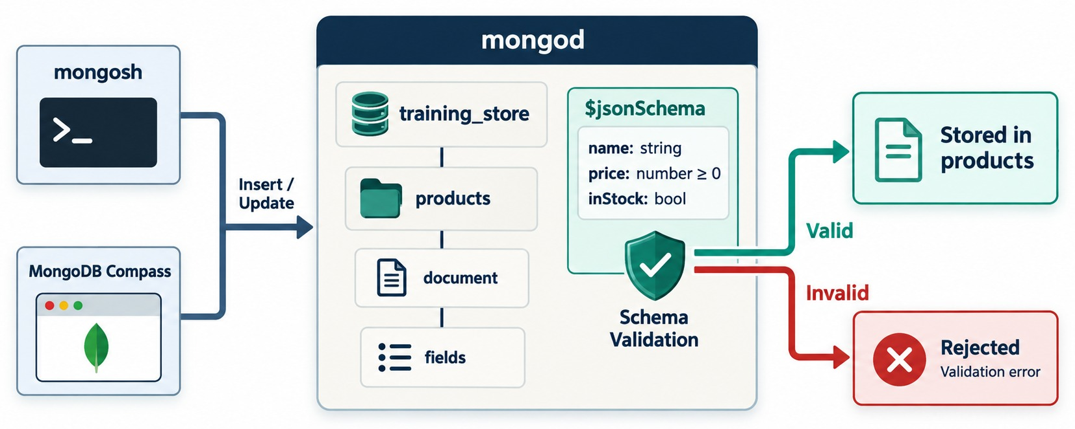
APPLY SCHEMA VALIDATION
The flexible model can still refuse bad data.
Required
Fields that must exist, e.g. orderNumber and total.
Types and enums
total must be decimal; paymentStatus one of three values.
Rejected
An invalid write fails with code 121, Document failed validation.
NOT A REPLACEMENT Keep validating in the application too.
KEY TAKEAWAY Schema validation turns the rules the model depends on into rules the database enforces.
12
© 2026 by Innovation In Software Corporation
Notes:
KEY TALKING POINTS
------------------
- What validation does
mongod checks every insert and update against the collection's $jsonSchema.
A valid document is stored; an invalid one is rejected with a validation error, code 121.
- Read the diagram's rule
It requires name as a string, price as a number of zero or more, and a boolean flag.
In $jsonSchema, bsonType number accepts int, long, double and Decimal128, so our Decimal128 prices pass it.
training_store calls its flag active; inStock is the diagram's generic name.
- Cover what matters
A validator does not have to list every field.
Required fields, types, enums and ranges are enough.
It complements application validation; it doesn't replace it.
- What it shows
Inserts and updates from mongosh and Compass reach mongod, where a $jsonSchema rule on products checks the document.
Valid documents are stored; invalid ones are rejected with a validation error.
- How to read it
Green path valid, red path invalid.
- Key point
A flexible schema can still refuse bad data at the database.

Slide 13
A VALIDATOR ON A SCRATCH COLLECTION
Lab 7, Step 3 — training_store_ops, so the class orders stay untouched.
✓
Create the collection with $jsonSchema
Prove accept and reject
use training_store_ops
db.createCollection("orders_validated", {
validator: { $jsonSchema: {
bsonType: "object",
required: ["orderNumber", "total",
"paymentStatus"],
properties: {
orderNumber: { bsonType: "string" },
total: { bsonType: "decimal" },
paymentStatus: {
enum: ["PAID", "PENDING", "FAILED"] }
} } },
validationAction: "error"
})
db.orders_validated.insertOne({
orderNumber: "OPS-1",
total: Decimal128("10.00"),
paymentStatus: "PAID" })
// acknowledged: true
db.orders_validated.insertOne({
orderNumber: "OPS-BAD",
total: "10.00",
paymentStatus: "PAID" })
// MongoServerError:
// Document failed validation
KEY TAKEAWAY Test a validator with one good document and one bad one before you trust it.
13
© 2026 by Innovation In Software Corporation
Notes:
KEY TALKING POINTS
------------------
- Why a scratch database
Lab 7, Step 3 builds the validator on training_store_ops.orders_validated.
The class orders collection stays loadable for everyone else.
- The rule
Three fields are required.
orderNumber must be a string, total must be a Decimal128, and paymentStatus must be PAID, PENDING or FAILED — the three values training_store really uses.
- The two inserts
OPS-1 is accepted.
OPS-BAD is rejected because total is the string '10.00'.
The error is code 121, and mongosh shows which rule failed in the details.
- Decimal128 or NumberDecimal
The lab guide writes NumberDecimal.
In mongosh it is the same constructor as Decimal128, which this deck uses everywhere.
- Going further
A fuller validator adds customerId as objectId, items as an array with at least one element, fulfillmentStatus as an enum and createdAt as a date.

Slide 14
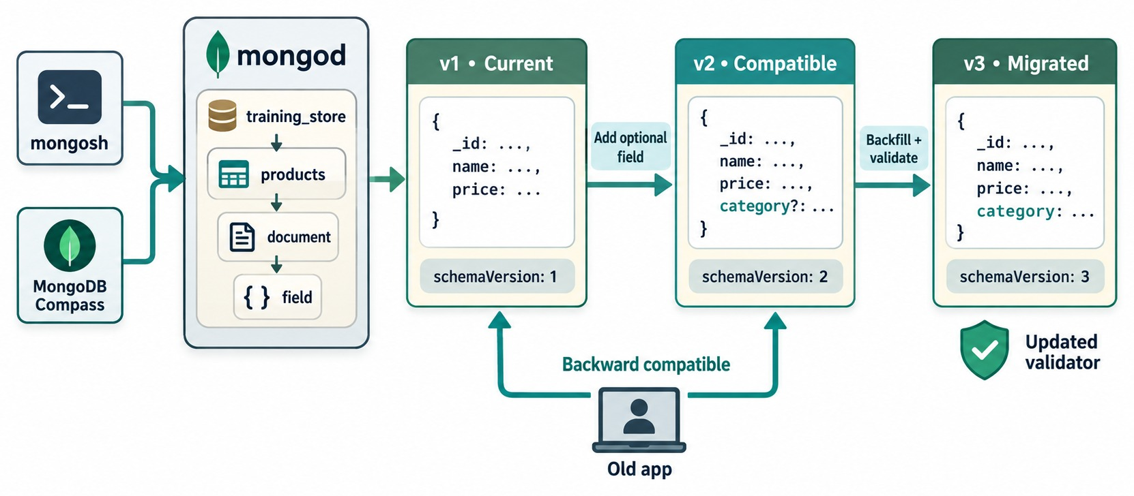
PLAN FOR SCHEMA EVOLUTION
Change the shape in compatible steps.
MIGRATION ORDER
✓
Support both shapes in the app
✓
Start writing the new shape
✓
Migrate old documents in batches
✓
Measure progress and failures
✓
Tighten validation, remove old code
AVOID One huge untested updateMany on production.
KEY TAKEAWAY Evolve the schema in backward-compatible steps and tighten the validator last.
14
© 2026 by Innovation In Software Corporation
Notes:
KEY TALKING POINTS
------------------
- Versions side by side
Version 1 has name and price.
Version 2 adds an optional category, so old and new documents are both valid.
Version 3 backfills category everywhere and then tightens the validator.
- Old app keeps working
The arrows from the old app show backward compatibility: it can still read v1 and v2 documents while the migration runs.
- The safe order
Teach the application both shapes, write the new shape, migrate in controlled batches, measure, tighten validation, and only then remove the old code path.
Never run one huge untested updateMany on production.
- What it shows
Three document versions with schemaVersion 1, 2 and 3.
Version 2 adds an optional category; version 3 backfills it and updates the validator.
- How to read it
The old app still reads v1 and v2: that is backward compatibility during the migration.
- Key point
Evolve in compatible steps; tighten validation last.

Slide 15
EXERCISE: PREDICT THE VALIDATOR'S VERDICT
Accepted or rejected? Decide before you run each insert.
PRACTICE EXERCISE
10 MIN
SCENARIO
YOUR TASKS
EXPECTED OUTCOME
orders_validated requires orderNumber (string), total (decimal) and paymentStatus (PAID, PENDING or FAILED).
1
Mark each insert accepted or rejected
✓
A accepted
✓
B rejected: enum
2
Name the rule each rejection breaks
A {orderNumber:"OPS-2",
total:Decimal128("24.99"),
paymentStatus:"PENDING"}
B {orderNumber:"OPS-3",
total:Decimal128("5.00"),
paymentStatus:"PAID_NOW"}
C {total:Decimal128("5.00"),
paymentStatus:"PAID"}
D {orderNumber:"OPS-4",
total:9.99, paymentStatus:"PAID"}
✓
C rejected: required
3
Say whether an extra field such as note is allowed
✓
D rejected: 9.99 is a double
4
Run them on training_store_ops to check
✓
Extra fields pass — no additionalProperties rule
KEY TAKEAWAY A validator enforces only the rules you wrote — know exactly which ones those are.
15
© 2026 by Innovation In Software Corporation
Notes:
KEY TALKING POINTS
------------------
- How to run it
Pairs, five minutes to predict, then run the four inserts on the scratch collection from the previous slide.
- A and B
A satisfies all three rules.
B fails the enum: PAID_NOW is not one of the allowed values.
- C and D
C has no orderNumber, so it fails required.
D fails the type rule: the literal 9.99 is a double, not a Decimal128, even though it looks like money.
- Extra fields
The validator lists properties but doesn't set additionalProperties to false, so a document with an extra note field is accepted.
That is usually what you want while a schema evolves.

Slide 16
PART 2: PERFORMANCE HABITS
Observe → measure → diagnose → change → measure again.
✓ Part 1
Data model
Part 2
Performance
Part 3
Security
Part 4
Backup & recovery
Part 5
Operate & diagnose
SO FAR
NEXT QUESTION
How do we prove a query or a report is fast — and still correct?
✓
Documents are bounded and consistently typed
✓
Snapshots are intentional
IN THIS PART
Validation protects the essentials
1
Filter, project, sort and limit
✓
2
Reduce pipeline input early
3
Validate aggregation results
4
ESR compound indexes
5
Reading explain plans
16
© 2026 by Innovation In Software Corporation
Notes:
KEY TALKING POINTS
------------------
- Evidence first
Performance work follows evidence.
Don't start by creating many speculative indexes.
- Small data, real lessons
On 17 orders every query is fast.
We watch the plan shape and the examined counts, which are what change at production volume.

Slide 17
ASK ONLY FOR WHAT THE PAGE NEEDS
A catalog page: filter, project, sort and limit.
✕
Anti-pattern: return everything
✓
Better: one bounded, shaped query
db.products.find({})
// all 13 products, every field,
// including attributes
db.products.find(
{ category: "LAPTOP", active: true },
{ _id: 0, sku: 1, name: 1, price: 1 }
).sort({ price: 1 }).limit(20)
// L100 Business Laptop 1299.99
// L110 Ultrabook 1899.99
Filter
Project
Limit
Selective predicates; L190 is inactive and drops out.
Return three fields, not attributes.
Bound every user-facing list; paginate by range.
KEY TAKEAWAY Every user-facing query should be filtered, projected, sorted and limited.
17
© 2026 by Innovation In Software Corporation
Notes:
KEY TALKING POINTS
------------------
- The anti-pattern
find with an empty filter returns every product with every field.
On 13 documents it is harmless.
On a real catalog it moves megabytes over the network for one page.
- The better query
This is Lab 7, Step 1.
Only active laptops match: the Business Laptop at 1299.99 and the Ultrabook at 1899.99.
The Refurbished Laptop, L190, is inactive.
Prices print as Decimal128 values.
- Candidate index
Equality on category and active, then the price sort: category 1, active 1, price 1.
Lab 7 asks learners to propose it without dropping existing indexes.
- Pagination
For deep pages, prefer range pagination — the next page starts after the last price and _id seen — over large skip values, which still read every skipped document.

Slide 18
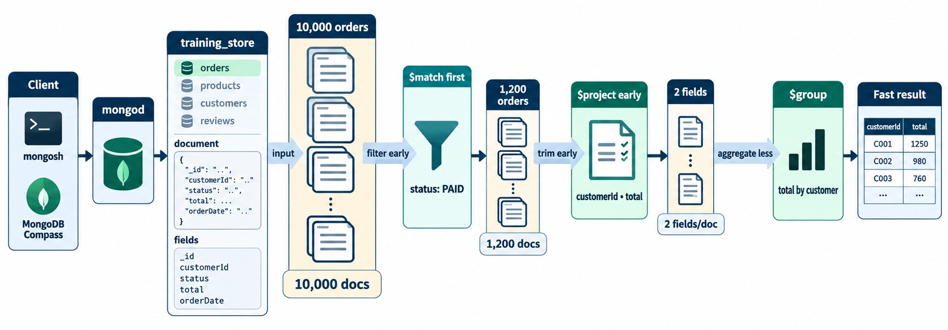
REDUCE PIPELINE INPUT EARLY
$match and $project before the expensive stages.
$match first
Keep only paid orders; an early $match can use an index.
$project early
Carry only the fields later stages need.
In training_store
The field is paymentStatus: 13 of 17 orders are PAID.
SCALE The diagram's 10,000 orders are illustrative.
KEY TAKEAWAY Filter and trim at the start of the pipeline, so every later stage has less to do.
18
© 2026 by Innovation In Software Corporation
Notes:
KEY TALKING POINTS
------------------
- Shrink the stream first
The pipeline starts with many orders and many fields.
$match keeps only the paid orders, $project keeps only the two fields the report needs, and $group then works on far less data.
- The numbers are illustrative
The diagram shows 10,000 orders reduced to 1,200.
Our class dataset has 17 orders, 13 of them paid, so timings will barely move.
What matters is the shape of the plan.
- Field name
The diagram's status is a generic name.
In training_store the payment state is paymentStatus and the order date is createdAt.
- Indexes help only at the start
A $match at the start of the pipeline can use an index.
After $unwind or $group, the documents are new and no index applies.
- What it shows
10,000 orders enter; $match keeps 1,200 paid orders; $project keeps two fields; $group totals by customer.
- How to read it
Each box shows how much data flows to the next stage.
- Key point
Less input to $unwind and $group means less work everywhere after.

Slide 19
MONTHLY PAID REVENUE — BUILT SAFELY
Lab 7, Step 2: group whole orders, not unwound items.
✓
Pipeline
Result
db.orders.aggregate([
{ $match: { paymentStatus: "PAID" } },
{ $group: {
_id: { $dateToString: {
format: "%Y-%m",
date: "$createdAt" } },
orderCount: { $sum: 1 },
revenue: { $sum: "$total" } } },
{ $sort: { _id: 1 } }
])
{ _id: '2026-07', orderCount: 3,
revenue: Decimal128('1835.95') }
{ _id: '2026-08', orderCount: 4,
revenue: Decimal128('2731.92') }
{ _id: '2026-09', orderCount: 6,
revenue: Decimal128('4550.57') }
$match first
Group whole orders
Months in UTC
Only the 13 paid orders enter the pipeline.
total is summed once per order.
$dateToString uses UTC unless you pass a timezone.
KEY TAKEAWAY Put $match first and sum order-level fields before any $unwind.
19
© 2026 by Innovation In Software Corporation
Notes:
KEY TALKING POINTS
------------------
- The pipeline
$match keeps the 13 paid orders.
$group turns createdAt into a year-month string and counts and sums per month.
$sort puts the months in order.
- The result
July has 3 orders for 1835.95, August 4 for 2731.92 and September 6 for 4550.57.
Together that is 13 orders and 9118.44.
- Why not the guide's version
The content guide filters on status and orderedAt and sums items.lineTotal.
training_store has none of those fields; it has paymentStatus, createdAt and items with quantity and unitPrice.
Line revenue would be quantity times unitPrice with $multiply.
- Time zones
Month boundaries are in UTC.
If the business reports in Toronto time, pass a timezone to $dateToString, or orders near midnight move month.

Slide 20
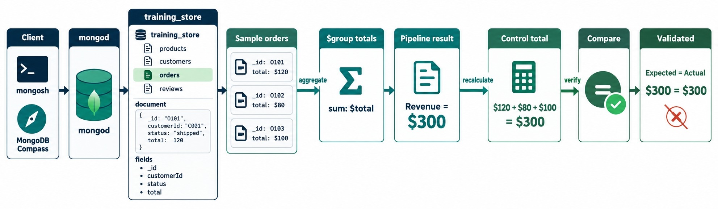
VALIDATE AGGREGATION CALCULATIONS
A fast report can still be wrong.
Control total
The $unwind trap
Our numbers
RULE Check every report against an independent control.
countDocuments({ paymentStatus: "PAID" }) → 13 orders.
Unwind items, then sum $total: 13 orders become 21 rows.
True revenue 9118.44 — the unwound sum says 12119.25.
KEY TAKEAWAY Verify a pipeline's totals against an independent control before anyone trusts the report.
20
© 2026 by Innovation In Software Corporation
Notes:
KEY TALKING POINTS
------------------
- Check the answer, not only the speed
The pipeline says revenue is 300.
A control total, calculated separately, also says 300.
Only when both agree is the report validated.
- The $unwind trap in our data
Unwinding items and then summing the order total counts each order once per item.
For paid orders the true revenue is 9118.44, but the unwound version reports 12119.25, because 13 orders become 21 item rows.
- A simple control
countDocuments with paymentStatus PAID returns 13.
If the pipeline's orderCount doesn't also add up to 13, something is double counted or filtered wrongly.
- What it shows
Three sample orders totalling 120, 80 and 100.
The $group result says 300; a separate control total also says 300; the report is validated.
- How to read it
Aggregate, recalculate, compare, then validate.
- Key point
A fast report that is wrong is still wrong.

Slide 21
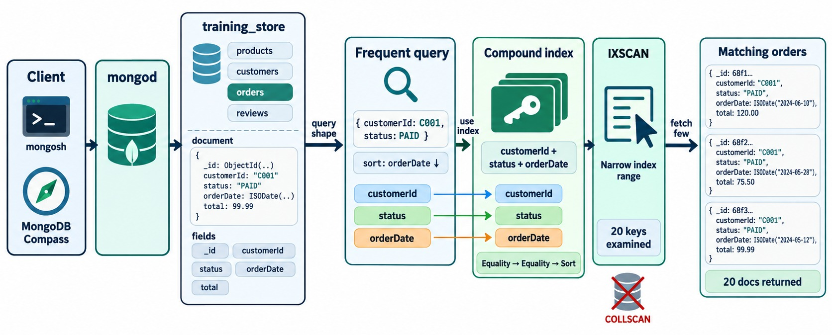
INDEXING BEST PRACTICES
Equality, then Sort, then Range — built from the real query shape.
The same shape in training_store
db.orders.createIndex({
customerId: 1,
paymentStatus: 1,
createdAt: -1 })
ESR
Equality fields first, the sort next, range fields last.
Each index costs
Disk, cache and extra work on every write.
BEFORE DROPPING Hide the index, monitor, then drop.
KEY TAKEAWAY Build each compound index from a real query shape, in ESR order, and know what it costs.
21
© 2026 by Innovation In Software Corporation
Notes:
KEY TALKING POINTS
------------------
- From query to index
The frequent query filters on a customer and a payment state and sorts by date.
The compound index lists the two equality fields first and the sort field last: equality, equality, sort.
- The payoff
IXSCAN walks a narrow index range, examines about as many keys as it returns, and avoids a collection scan and an in-memory sort.
- Map it to training_store
The diagram uses generic names: status, orderDate and a string customer code.
Our fields are customerId, an ObjectId, paymentStatus and createdAt, so the index is customerId 1, paymentStatus 1, createdAt -1 — the one Exercise 8.1 recommends.
- Every index has a cost
Each index uses disk and cache and slows every insert, update and delete.
Name the query an index serves before creating it, and hide an index to test before dropping it.
- What it shows
The frequent query filters by customerId and status and sorts by orderDate.
The compound index customerId + status + orderDate follows Equality, Equality, Sort.
IXSCAN examines 20 keys and returns 20 documents; no COLLSCAN.
- How to read it
The coloured arrows map each query field to its index position.
- Key point
Design indexes around the query shapes the application really runs.

Slide 22
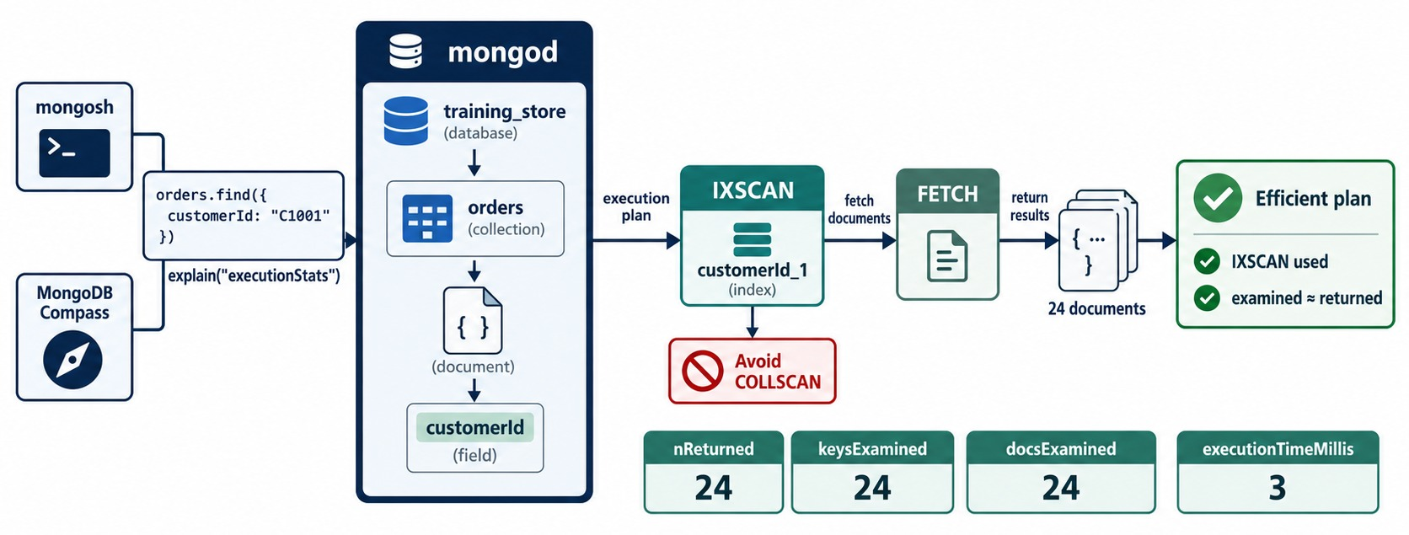
REVIEW EXPLAIN PLANS
explain("executionStats") is the evidence behind every index.
C101's paid history
db.orders.find({
customerId: c101,
paymentStatus: "PAID" })
.sort({ createdAt: -1 })
.explain("executionStats")
No index
COLLSCAN: 17 documents examined, 4 returned, plus a SORT.
ESR index
IXSCAN: 4 keys, 4 documents, no SORT stage.
KEY TAKEAWAY Compare examined with returned — a large gap means a missing or unsuitable index.
22
© 2026 by Innovation In Software Corporation
Notes:
KEY TALKING POINTS
------------------
- Four numbers to read
nReturned, totalKeysExamined, totalDocsExamined and executionTimeMillis.
In the diagram all three counts are 24: the plan examined exactly what it returned.
- Plan stages
IXSCAN reads the index, FETCH loads the documents.
COLLSCAN means every document was read.
A SORT stage means an in-memory sort that an index could have avoided.
- Our dataset
Before an index, C101's paid-order history is a COLLSCAN that examines all 17 orders to return 4.
With the ESR index it examines 4 keys and 4 documents, with no SORT stage.
- A scan is not always wrong
On a tiny collection, or when most documents are returned anyway, a collection scan can be the right plan.
- What it shows
orders.find by customerId with explain('executionStats').
The winning plan is IXSCAN on customerId_1, then FETCH, returning 24 documents.
nReturned, keysExamined and docsExamined are all 24; executionTimeMillis is 3.
- How to read it
Examined roughly equal to returned is an efficient plan.
- Key point
explain() is the evidence behind every index decision.
- Getting c101
const c101 = db.customers.findOne({ customerNumber: "C101" })._id.
customerId is an ObjectId in training_store, not the string C101.

Slide 23
EXERCISE: DESIGN THE INDEX FOR EACH SHAPE
Three real training_store queries — one compound index each.
PRACTICE EXERCISE
15 MIN
SCENARIO
YOUR TASKS
EXPECTED OUTCOME
Write the index for each shape, label each key E, S or R, then confirm with explain.
1
Write an index for each shape
✓
1 { category, active, price }
2
Label every key E, S or R
2 { customerId: 1, createdAt: -1 }
✓
1 Catalog: category "LAPTOP",
active true, sort price asc
2 History: customerId = c101,
sort createdAt desc
3 Report: paymentStatus "PAID",
createdAt in September
3
Check the plan with explain()
✓
3 { paymentStatus, createdAt }
4
Name the extra cost of each index
✓
IXSCAN and no SORT stage
✓
Each slows inserts and updates
KEY TAKEAWAY An index is designed for a query shape — write the shape down first.
23
© 2026 by Innovation In Software Corporation
Notes:
KEY TALKING POINTS
------------------
- How to run it
Individually for eight minutes, then compare.
Run explain on the instructor screen for at least one shape.
- Shapes 1 and 2
Catalog: two equality fields, then the sort — category 1, active 1, price 1.
History: equality on customerId, then the sort on createdAt descending.
- Shape 3
Equality on paymentStatus, then the date range: paymentStatus 1, createdAt 1.
createdAt -1 works equally well, because an index range can be scanned in either direction.
- Overlap
If the history index also includes paymentStatus, as in Exercise 8.1, the two order indexes overlap.
Keep both only if both shapes are hot; otherwise hide one and monitor.

Slide 24
PART 3: SECURITY
Authentication, authorization, TLS and network exposure.
✓ Part 1
Data model
✓ Part 2
Performance
Part 3
Security
Part 4
Backup & recovery
Part 5
Operate & diagnose
SO FAR
NEXT QUESTION
Who can reach the database, who are they, and what may they do?
✓
The model is bounded and validated
✓
Queries are shaped and indexed
IN THIS PART
✓
Results are checked for correctness
Security in layers
1
2
Authentication
3
Least-privilege roles
4
Network exposure and TLS
5
Configuration and credentials
24
© 2026 by Innovation In Software Corporation
Notes:
KEY TALKING POINTS
------------------
- Why now
A correct, fast database that anyone can reach is not production-ready.
This part locks it down.
- Safety in class
Don't enable authentication on the shared class instance.
We design users and roles, and demonstrate only on a disposable environment.
Never show a real password on screen.

Slide 25
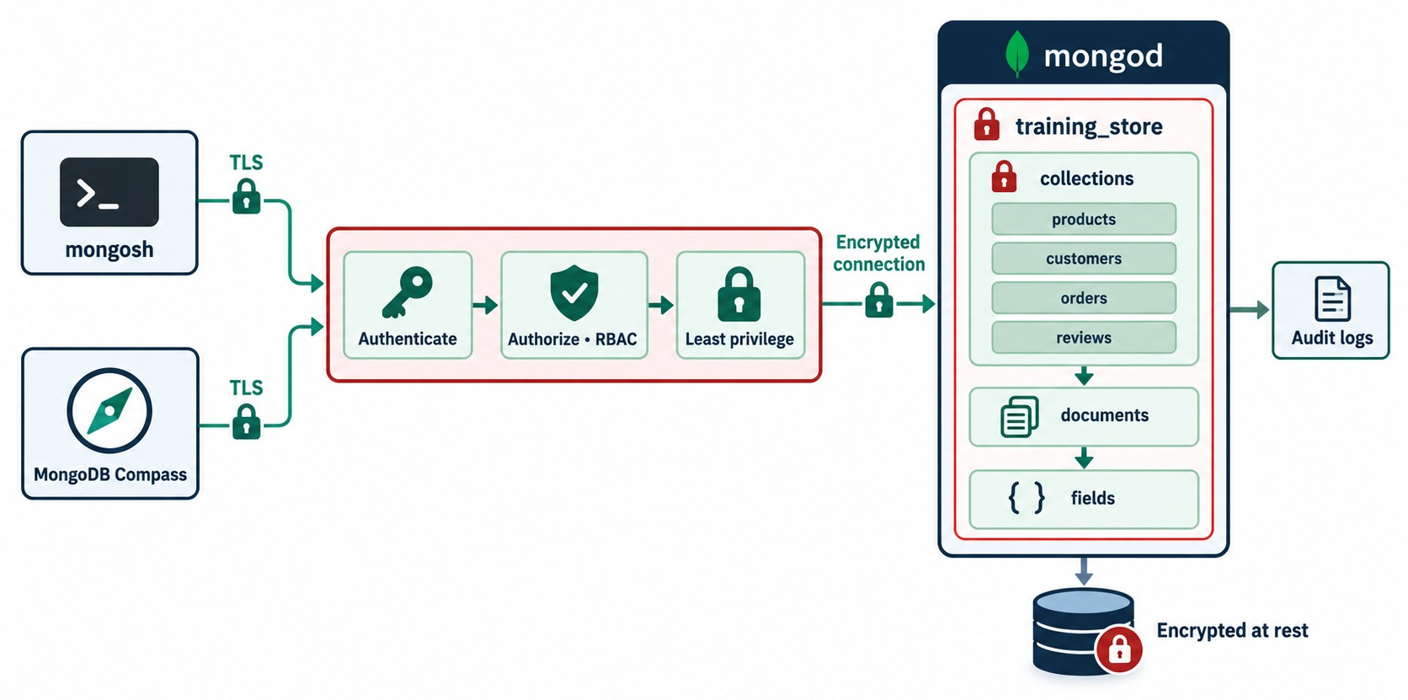
MONGODB SECURITY PRINCIPLES
Every request passes several controls.
In transit
TLS from every client and between members.
Identity and rights
Authenticate, authorize with roles, least privilege.
At rest and after
Encrypted storage; audit logs of security events.
DEFENSE IN DEPTH If one layer fails, the others still hold.
KEY TAKEAWAY Layer the controls, so one mistake never exposes everything.
25
© 2026 by Innovation In Software Corporation
Notes:
KEY TALKING POINTS
------------------
- Layers, not a single switch
Traffic is encrypted with TLS.
Then every connection is authenticated, authorized through roles, and limited to least privilege.
Data files are encrypted at rest, and security events go to audit logs.
- Why layers
If one control fails — a leaked password, a misconfigured firewall — the others still limit the damage.
- Our class instance
The training instance runs without authentication on localhost.
That is acceptable only because it is a disposable learning environment on one machine.
- What it shows
Clients connect over TLS, pass through authenticate, authorize with RBAC and least privilege, and reach training_store over an encrypted connection.
The data is encrypted at rest and activity goes to audit logs.
- How to read it
Left to right is the path of every request.
- Key point
Security is layered: no single control is enough.

Slide 26
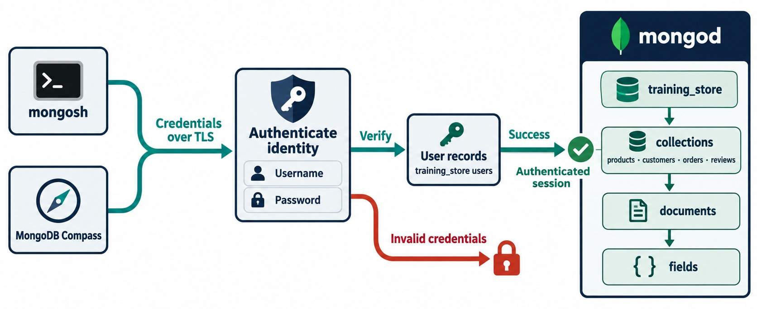
AUTHENTICATION
Who is connecting?
Turn on access control
# mongod.conf
security:
authorization: enabled
First user first
Create an administrator before enforcing it.
Identity, not location
A trusted network is not proof of identity.
KEY TAKEAWAY Enable access control, so every connection must prove who it is.
26
© 2026 by Innovation In Software Corporation
Notes:
KEY TALKING POINTS
------------------
- Who is connecting?
Authentication proves identity.
mongosh or Compass sends a username and password over TLS; mongod checks them against its user records.
- Success and failure
Valid credentials give an authenticated session on training_store.
Invalid credentials are refused before any data is touched.
- Turning it on
On a self-managed server, security.authorization: enabled in mongod.conf switches access control on.
Create the first administrative user before enforcing it, following the documented procedure.
- Never trust location alone
Being on the same network is not proof of identity.
- What it shows
Credentials go over TLS to authenticate the identity.
mongod verifies them against its user records.
Success opens an authenticated session; invalid credentials are locked out.
- How to read it
Green path success, red path refusal.
- Key point
No valid identity, no access.

Slide 27
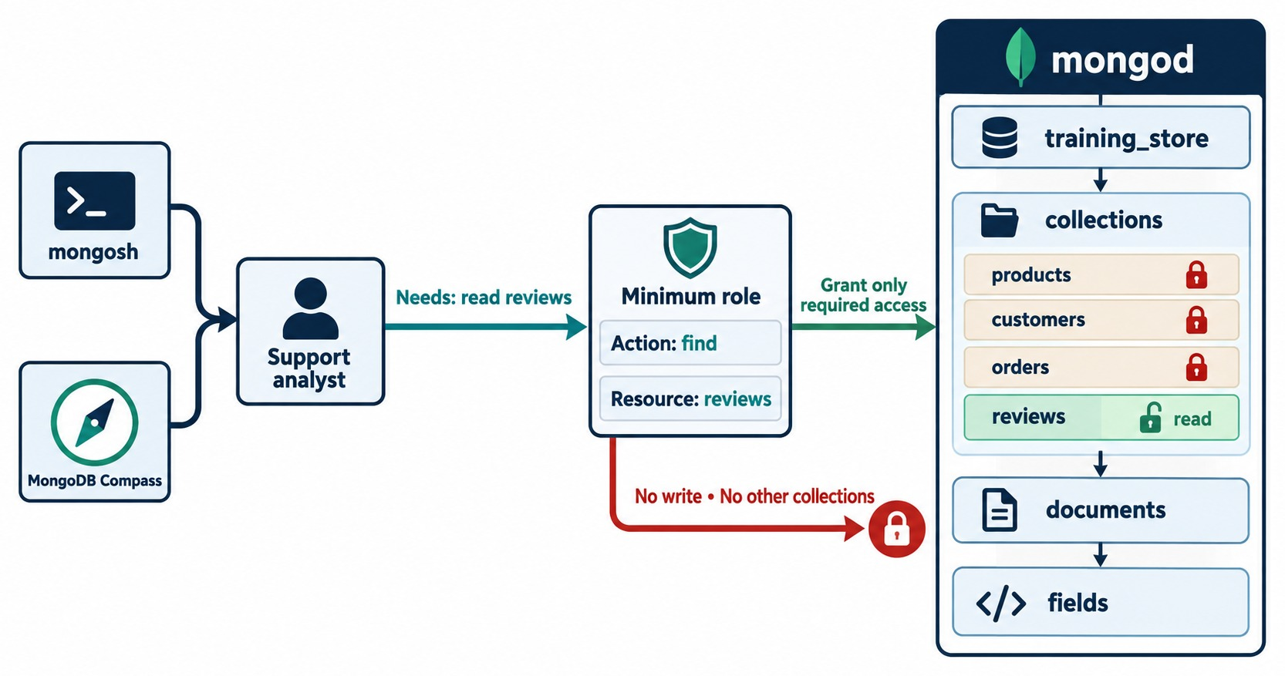
PRINCIPLE OF LEAST PRIVILEGE
Grant only the access each job requires.
Application
readWrite on training_store — never clusterAdmin.
Reporting
read only.
Support
find on reviews, as in the diagram.
Operations
Monitoring, backup and DBA each get their own identity.
KEY TAKEAWAY Give every identity its own account and only the privileges its job needs.
27
© 2026 by Innovation In Software Corporation
Notes:
KEY TALKING POINTS
------------------
- Grant only what the job needs
The support analyst needs to read reviews.
The minimum role allows the find action on the reviews collection only.
Products, customers and orders stay locked, and there is no write at all.
- Blast radius
If this analyst's credentials leak, the attacker can read reviews — nothing else.
That is the point of least privilege.
- Separate identities
The application, reporting, support, monitoring, backup and the DBA each get their own user and role.
Exercise 8.2 builds exactly this matrix.
- What it shows
A support analyst needs to read reviews.
The minimum role grants find on reviews only.
Products, customers and orders stay locked; there is no write and no access to other collections.
- How to read it
One green unlocked row; everything else is locked.
- Key point
Least privilege limits the damage any one identity can do.

Slide 28
USERS AND ROLES — SKETCHED, NOT RUN
Placeholder names, prompted passwords; a disposable instance only.
✓
Application and reporting users
✓
A custom role: read reviews only
use training_store
db.createUser({
user: "trainingStoreApp",
pwd: passwordPrompt(),
roles: [{ role: "readWrite",
db: "training_store" }]
})
db.createUser({
user: "reportUser",
pwd: passwordPrompt(),
roles: [{ role: "read",
db: "training_store" }]
})
db.createRole({
role: "reviewReader",
privileges: [{
resource: { db: "training_store",
collection: "reviews" },
actions: ["find"]
}],
roles: []
})
passwordPrompt()
Built-in roles
Custom roles
The password is typed, never stored in the script or history.
readWrite and read cover most services.
Narrow a role to single collections and actions.
KEY TAKEAWAY Create one identity per job, with the smallest role that works, and never type a real password into a script.
28
© 2026 by Innovation In Software Corporation
Notes:
KEY TALKING POINTS
------------------
- Don't run this in class
Exercise 8.2 is design only: don't enable authentication on the shared class database.
Show these commands on a disposable instance if you demonstrate them.
- The two users
trainingStoreApp can read and write training_store and nothing else.
reportUser can only read.
Neither can create users, drop databases or touch other databases.
- The custom role
reviewReader allows only find on the reviews collection.
It is the support analyst from the least-privilege diagram.
Grant it with db.grantRolesToUser.
- Passwords
passwordPrompt() asks for the password interactively, so it never appears in the script, in shell history or in a screenshot.

Slide 29
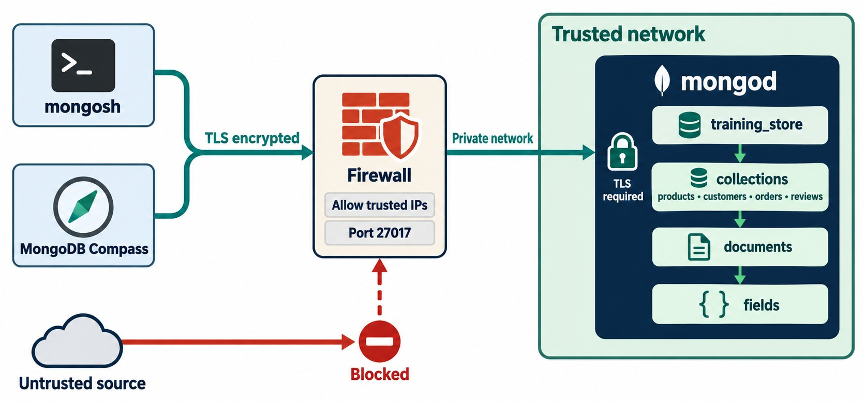
NETWORK SECURITY
Make the database unreachable to anyone who shouldn't reach it.
Firewall
Allow trusted IPs on 27017; block everything else.
Private network
mongod lives on a private subnet, never the public internet.
bindIp
Listen only on localhost and the private address clients use.
ATLAS IP access lists and private endpoints.
KEY TAKEAWAY Don't expose port 27017 broadly — restrict who can reach mongod before anyone tries to log in.
29
© 2026 by Innovation In Software Corporation
Notes:
KEY TALKING POINTS
------------------
- The network path
Clients connect over TLS to a firewall that allows only trusted IP addresses on port 27017.
Behind it, mongod sits on a private network and requires TLS itself.
- Untrusted sources are blocked
Traffic from the internet never reaches mongod.
Never expose port 27017 broadly to the public internet.
- bindIp
bindIp controls which network interfaces mongod listens on.
List localhost plus the specific private address the application uses.
Binding to every interface on a reachable host, with authentication off, is how databases end up exposed.
- Managed option
On MongoDB Atlas the same idea is an IP access list or a private endpoint.
- What it shows
mongosh and Compass connect over TLS to a firewall that allows trusted IPs on port 27017.
mongod lives in a trusted network and requires TLS.
An untrusted source is blocked.
- How to read it
Only the green path reaches the database.
- Key point
Unreachable is the strongest protection.

Slide 30
SECURE CONFIGURATION AND CONNECTION STRINGS
A hardened mongod.conf — and the anti-pattern it replaces.
✓
Hardened (sketch)
✕
Anti-pattern — never ship this
net:
port: 27017
bindIp: 127.0.0.1,10.0.1.15
tls:
mode: requireTLS
certificateKeyFile: /etc/mongo/server.pem
CAFile: /etc/mongo/ca.pem
security:
authorization: enabled
net:
bindIp: 0.0.0.0 # every interface
# no security section:
# access control off, no TLS
// URI with a password in source code
mongodb://admin:<password>@db:27017/
Listen narrowly
TLS everywhere
Secrets
Localhost plus one private address.
Validate certificates; never disable checks.
Load the URI from a secret store at runtime.
KEY TAKEAWAY Bind narrowly, require TLS and authentication, and keep credentials out of code and configuration files.
30
© 2026 by Innovation In Software Corporation
Notes:
KEY TALKING POINTS
------------------
- The hardened file
mongod listens on localhost and one private address, 10.0.1.15 in this sketch.
requireTLS refuses unencrypted connections, and authorization enabled turns on access control.
The paths and the address are placeholders.
- The anti-pattern
Binding to every interface on a reachable host with no security section means anyone who can reach the port can read or delete everything.
This is shown only as a warning — never use it.
- Connection strings
Treat a connection string as a secret.
The application should read it from a secret manager or protected environment variable, with its own least-privilege user, never the admin account.
- Client side
Production clients connect with tls=true, validate the server certificate against a trusted certificate authority, and rotate certificates before they expire.

Slide 31
SECURITY MISCONCEPTIONS AND ANTI-PATTERNS
Beliefs that leave real databases exposed.
MISCONCEPTION
REALITY
ANTI-PATTERNS TO AVOID
It's on our network, so it's safe
Authenticate every connection — location isn't identity
✕
Port 27017 open to the internet
✕
One shared administrator account
✕
Passwords in code, Git or screenshots
The app needs admin to be safe
Least privilege: readWrite on its own database
✕
Unencrypted backup files
✕
Production data copied into development
TLS is only for the internet
Encrypt inside the data center and between members too
REMEMBER Unreachable, authenticated, least privilege, encrypted.
Encryption replaces password hashing
Hash application passwords; encrypt sensitive fields
Fix not-authorized by granting root
Grant the one missing privilege
KEY TAKEAWAY Most breaches come from simple gaps — exposure, shared accounts and leaked credentials.
31
© 2026 by Innovation In Software Corporation
Notes:
KEY TALKING POINTS
------------------
- Why this slide
Before we move on, clear away the beliefs that cause the most common real incidents.
- Network and identity
Being inside the network doesn't prove identity.
Every connection authenticates, and each service uses its own least-privilege user.
- Encryption
TLS protects traffic everywhere, not only on the internet.
Encryption at rest protects files and backups.
Application passwords are hashed, never just encrypted.
- Anti-patterns
Look for these six risks in any review: a public endpoint, a shared administrator, secrets in source control, no TLS, unprotected backups and production data in development.

Slide 32
PART 4: BACKUPS AND RECOVERY
Replication keeps you running. Backups let you go back.
✓ Part 1
Data model
✓ Part 2
Performance
✓ Part 3
Security
Part 4
Backup & recovery
Part 5
Operate & diagnose
SO FAR
NEXT QUESTION
If someone deletes the orders tonight, what do we lose — and how long until we are back?
✓
Access is authenticated and least-privilege
✓
Traffic is encrypted; the network is closed
IN THIS PART
1
Replication versus backup
✓
Credentials live outside the code
2
Recovery objectives: RPO and RTO
3
Restore testing
32
© 2026 by Innovation In Software Corporation
Notes:
KEY TALKING POINTS
------------------
- The question
Security reduces the chance of damage; recovery limits its cost.
Mistakes and bad releases still happen.
- The lab
Lab 7, Step 4 dumps training_store and restores it into an isolated database, training_store_restore.

Slide 33
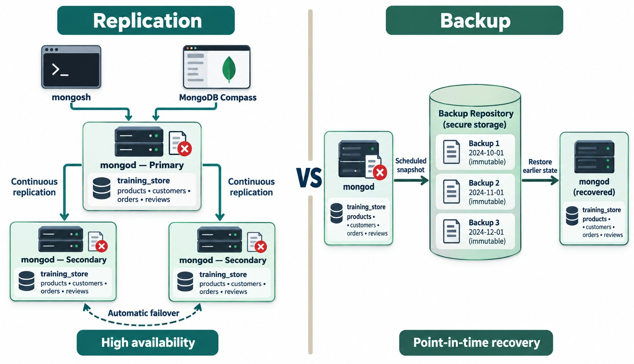
REPLICATION VS. BACKUP
Two different capabilities — you need both.
An accidental delete
db.orders.deleteMany({})
// replicated to every member
Replication
Copies every change, good or bad, in seconds.
Backup
Immutable copies from before the mistake.
RULE Replication is not a backup.
KEY TAKEAWAY Replication protects availability; only an independent backup protects you from a bad change.
33
© 2026 by Innovation In Software Corporation
Notes:
KEY TALKING POINTS
------------------
- Replication
The primary copies every change to the secondaries continuously.
If the primary fails, a secondary is elected.
That is high availability.
- Why it's not a backup
The red marks show the problem: a bad change on the primary is replicated too.
Run db.orders.deleteMany({}) and every member loses the orders within seconds.
- Backup
Backups are separate, immutable copies taken on a schedule.
They let you restore an earlier state — the state before the mistake.
- You need both
Replication for staying up, backups for going back.
- What it shows
Left: a primary replicating continuously to two secondaries with automatic failover; a bad change is replicated to all three.
Right: scheduled immutable backups in a repository, used to restore an earlier state.
- How to read it
The red marks on the left are the same damaged data on every member.
- Key point
Replication keeps you running; backups let you go back.

Slide 34
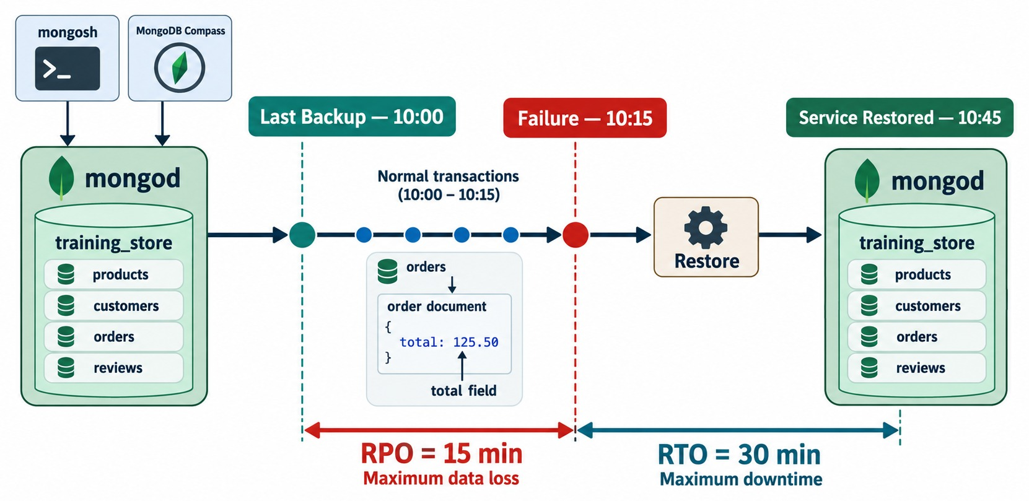
RECOVERY POINT AND RECOVERY TIME OBJECTIVES
How much data you may lose, and how long you may be down.
RPO = 15 min
Changes since the 10:00 backup are at risk.
RTO = 30 min
Service restored at 10:45 after a 10:15 failure.
Set per data set
Orders and payments tight; reviews more tolerant.
EXERCISE 8.3 You'll set these for training_store.
KEY TAKEAWAY RPO and RTO are business targets in minutes — choose the backup method that meets them.
34
© 2026 by Innovation In Software Corporation
Notes:
KEY TALKING POINTS
------------------
- Read the timeline
The last backup ran at 10:00.
The failure happened at 10:15.
Service was restored at 10:45.
- RPO
Recovery Point Objective: how much data you may lose.
Here, the orders placed between 10:00 and 10:15 are at risk, so the RPO is 15 minutes.
- RTO
Recovery Time Objective: how long recovery may take.
From 10:15 to 10:45 is 30 minutes.
- Business decides
Orders and payments usually need the tightest RPO, often minutes with point-in-time recovery.
Reviews can usually tolerate more.
- What it shows
A timeline.
The last backup is at 10:00, the failure at 10:15, and service is restored at 10:45.
RPO is 15 minutes of possible data loss; RTO is 30 minutes of downtime.
- How to read it
RPO looks back from the failure; RTO looks forward to recovery.
- Key point
Both are business targets measured in time.

Slide 35
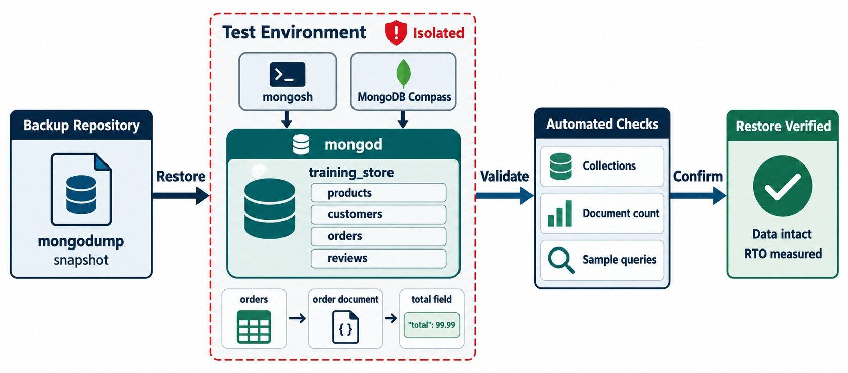
RESTORE TESTING
A backup is proven only by a restore.
Lab 7, Step 4
mongodump --uri="mongodb://localhost:27017"
--db=training_store --out=<dir>
mongorestore --uri="mongodb://localhost:27017"
--db=training_store_restore --drop
<dir>/training_store
Verify
17 orders, 13 products, a sample order and its indexes.
NEVER Restore over training_store itself.
KEY TAKEAWAY Schedule restore tests into an isolated target, and measure the time against the RTO.
35
© 2026 by Innovation In Software Corporation
Notes:
KEY TALKING POINTS
------------------
- Restore somewhere safe
The backup is restored into an isolated test environment, never over the live database.
- Automated checks
Check that the collections exist, the document counts match, and sample queries return the expected documents.
Then record how long it took, so the RTO is measured, not guessed.
- Lab 7, Step 4
Learners dump training_store and restore it into training_store_restore.
They compare counts — 17 orders and 13 products — find one recorded order number, and check getIndexes().
- What it shows
A mongodump snapshot is restored into an isolated test environment.
Automated checks confirm collections, document counts and sample queries.
The restore is verified: data intact, RTO measured.
- How to read it
Restore, validate, confirm.
- Key point
A backup is only proven when a restore has worked.
- The commands
mongodump writes a logical BSON copy of training_store.
mongorestore loads it into training_store_restore; --drop replaces that restore database only.
Then compare countDocuments in both databases.

Slide 36
PART 5: OPERATE AND DIAGNOSE
Monitor the right signals and troubleshoot from evidence.
✓ Part 1
Data model
✓ Part 2
Performance
✓ Part 3
Security
✓ Part 4
Backup & recovery
Part 5
Operate & diagnose
SO FAR
NEXT QUESTION
Something is wrong in production — how do we find out what, and fix only that?
✓
Replication is not a backup
✓
RPO and RTO are time targets
IN THIS PART
✓
Restores are tested, not assumed
Metrics that matter
1
2
A troubleshooting method
3
Common errors by layer
4
A slow-search investigation
5
Safe error handling
6
The production-readiness checklist
36
© 2026 by Innovation In Software Corporation
Notes:
KEY TALKING POINTS
------------------
- Why this part
Production systems fail in ordinary ways.
The skill is to notice early and to diagnose from evidence instead of guessing.
- How it ends
The part closes with the readiness checklist that Lab 7 uses to score training_store.

Slide 37
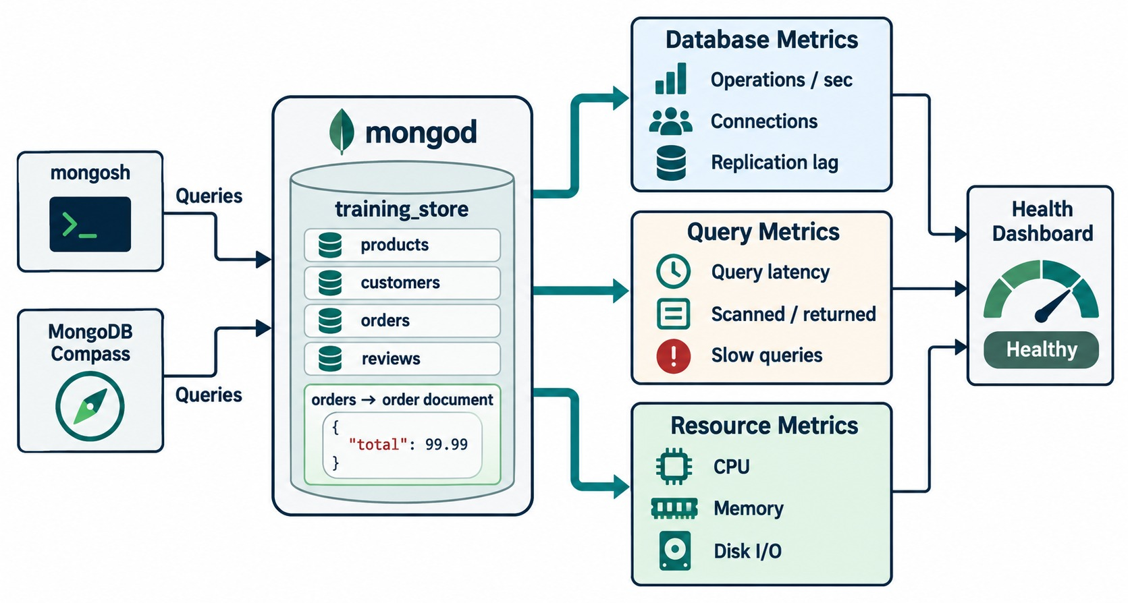
DATABASE, QUERY, AND RESOURCE METRICS
Three groups of signals — one health view.
Sample slow operations
db.setProfilingLevel(1,
{ slowms: 200, sampleRate: 0.2 })
db.system.profile.find()
.sort({ ts: -1 }).limit(5)
db.setProfilingLevel(0)
Also watch
Disk space, oplog window, backup status, authentication failures.
PROFILER Adds overhead — enable it deliberately.
KEY TAKEAWAY Monitor query evidence and replication, not only CPU — slow queries show up there first.
37
© 2026 by Innovation In Software Corporation
Notes:
KEY TALKING POINTS
------------------
- Three groups of metrics
Database metrics: operations per second, connections and replication lag.
Query metrics: latency, documents scanned versus returned, and slow queries.
Resource metrics: CPU, memory and disk I/O.
- One health view
All three feed one dashboard.
A slow query shows up as latency and scanned documents before it shows up as CPU.
- The profiler
db.setProfilingLevel(1) with slowms 200 and sampleRate 0.2 records a sample of operations slower than 200 milliseconds into system.profile.
The profiler adds overhead, so turn it on deliberately and back off with db.setProfilingLevel(0).
- What it shows
Database metrics: operations per second, connections, replication lag.
Query metrics: query latency, scanned versus returned, slow queries.
Resource metrics: CPU, memory, disk I/O.
- How to read it
All three groups feed the health dashboard on the right.
- Key point
Watch the query metrics, not only CPU.

Slide 38
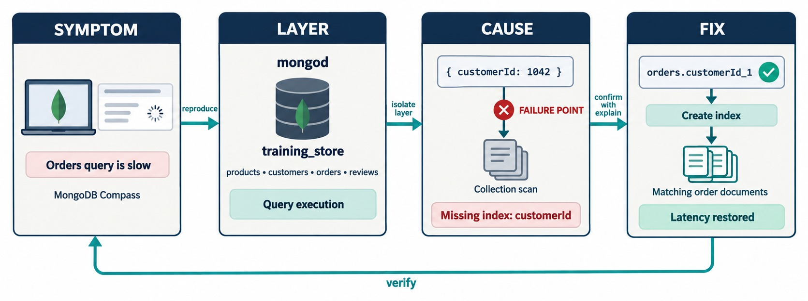
TROUBLESHOOTING METHODOLOGY
Symptom → scope → evidence → layer → cause → fix → verify.
Precise symptom
Not “MongoDB is slow” but “order history went from 100 ms to 2.5 s”.
Scope and evidence
One query or all? Logs, explain, metrics, recent changes.
Smallest safe fix
One index, one role, one setting — then verify.
LOOP Re-run the same test after every fix.
KEY TAKEAWAY Troubleshoot from evidence, one layer at a time, and verify with the same test.
38
© 2026 by Innovation In Software Corporation
Notes:
KEY TALKING POINTS
------------------
- Four boxes
Symptom: the orders query is slow.
Layer: the problem is in query execution inside mongod.
Cause: the filter on customerId has no index, so it scans the collection.
Fix: create the customerId index and latency returns to normal.
- The verify loop
The arrow back to the symptom matters most.
Repeat the same test and compare latency, keys and documents examined.
- The full framework
The content guide adds two steps: scope — one query or all, one instance or every instance — and evidence: logs, explain, metrics and recent changes.
- Smallest safe fix
Add a targeted index, bound a query, correct a connection string, or fix one role.
Not: restart everything, or grant root.
- What it shows
The orders query is slow.
The layer is query execution in mongod.
The cause is a collection scan for customerId: a missing index.
The fix creates orders.customerId_1 and latency is restored.
- How to read it
Reproduce, isolate the layer, confirm with explain, then verify from the symptom again.
- Key point
Evidence first, then the smallest safe fix.

Slide 39
COMMON PROBLEMS, BY LAYER
The error message usually names the layer.
Symptom | Likely layer | First check
Connection refused | Process, network | mongod up? host, port, firewall
Authentication failed | Security | user, password, authSource
not authorized | Security: roles | user's roles on that collection
E11000 duplicate key | Index | which unique index
Document failed validation | Schema | missing field, type, enum
Slow query | Query, index | explain: COLLSCAN, SORT
Lag or no primary | Replication | rs.status(), majority
Every shard contacted | Sharding | shard key in the filter?
Authenticated ≠ authorized
Wrong authSource fails login; a missing role fails the command.
Never
Grant root, disable auth or bind to every interface to make an error go away.
EXERCISE Name the layer for five real messages.
KEY TAKEAWAY Read the error, name the layer, then check that layer first.
39
© 2026 by Innovation In Software Corporation
Notes:
KEY TALKING POINTS
------------------
- Process and network
Connection refused means nothing is listening where the client points: mongod is stopped, the host or port is wrong, a firewall or container port blocks it, or bindIp doesn't include that interface.
The fix is the correct interface — never every interface.
- Security
Authentication failed is about identity: check the user, the password and authSource.
A user created in admin needs authSource=admin in the URI.
not authorized means login worked but a role is missing.
- Data rules
E11000 comes from a unique index.
In training_store, inserting a second customer with aisha@example.com violates email_unique.
Code 121 is a validator rejection.
- Cluster
For lag or no primary, run rs.status() and db.hello(): look for a lost majority, an election or an undersized oplog.
A query that contacts every shard is missing the shard key.

Slide 40
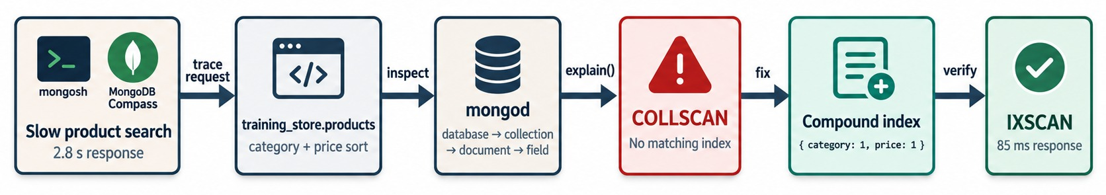
SLOW APPLICATION INVESTIGATION
Follow the user's request down to the plan.
Trace
Explain
Fix and verify
SAME INDEX The one Module 1 showed in mongosh.
The slow search filters by category and sorts by price.
COLLSCAN — no index matches the shape.
{ category: 1, price: 1 } → IXSCAN, 85 ms.
KEY TAKEAWAY Start from the request the user felt, and verify with the same request.
40
© 2026 by Innovation In Software Corporation
Notes:
KEY TALKING POINTS
------------------
- Follow one request
Product search takes 2.8 seconds.
The trace shows a query on training_store.products that filters by category and sorts by price.
- Explain, fix, verify
explain() shows COLLSCAN — no matching index.
A compound index on category and price supports both the filter and the sort, and the plan becomes IXSCAN at 85 milliseconds.
- Matches our data
This is the same category-and-price index Module 1 showed in mongosh.
For the active-only catalog page, Lab 7 suggests category, active, price.
- What it shows
A slow product search is traced to training_store.products with a category filter and a price sort.
explain() shows COLLSCAN; a compound index on category and price makes it IXSCAN at 85 ms.
- How to read it
Trace, inspect, explain, fix, verify.
- Key point
Start from the request the user felt, not from the server.

Slide 41
HANDLE ERRORS SAFELY
Business messages, repeatable writes and bounded waits.
Expected conflict → safe message
✓
Guarded, repeatable transition
db.customers.insertOne({
customerNumber: "C999",
contact: { email: "aisha@example.com" }
})
// MongoServerError: E11000 duplicate
// key error ... index: email_unique
// user sees: "An account already
// exists for that email."
db.orders.updateOne(
{ orderNumber: "O6302",
fulfillmentStatus: "PROCESSING" },
{ $set: { fulfillmentStatus: "SHIPPED" },
$currentDate: { shippedAt: true } }
)
// 1st run: modifiedCount 1
// 2nd run: matchedCount 0
db.orders.find({ fulfillmentStatus:
"PROCESSING" }).maxTimeMS(3000)
Log internally
Idempotent
Timeouts
The raw error, securely, with a request ID.
A retry can't ship the order twice.
No operation waits forever.
KEY TAKEAWAY Turn database errors into safe messages, and design writes that are safe to retry.
41
© 2026 by Innovation In Software Corporation
Notes:
KEY TALKING POINTS
------------------
- Duplicate key
customers has a unique index, email_unique, on contact.email.
Aisha Khan already uses aisha@example.com, so this insert fails with E11000.
The content guide calls the index uq_customers_email; in training_store it is email_unique.
- What the user sees
Log the full error internally, without credentials or complete documents.
Show the user a business message, never the stack trace, host names or collection names.
- Guarded update
O6302 is PROCESSING in the loaded data.
The filter includes the current state, so the first run ships it and a retry matches nothing.
Run it only on a copy, or reload with load.js afterwards.
- Timeouts
maxTimeMS(3000) stops this query after three seconds.
Configure server-selection, connection and socket timeouts in the driver too, and choose values from the workload.

Slide 42
EXERCISE: WHICH LAYER IS IT?
Five messages from the training_store application.
PRACTICE EXERCISE
10 MIN
SCENARIO
YOUR TASKS
EXPECTED OUTCOME
Name the layer and the first check for each message.
1
Name the layer for A–E
✓
A process or network: is mongod up?
2
Write the first check or command
B identity: authSource and user
A connect ECONNREFUSED
127.0.0.1:27017
B Authentication failed
(user trainingStoreApp)
C not authorized on training_store
to execute command { find:
"orders" }
D E11000 ... index: email_unique
E Document failed validation
✓
3
Say what you would not do
✓
C roles: grant only find on orders
4
Pick one to add to a runbook
✓
D business conflict: safe message
✓
E schema: which rule failed
KEY TAKEAWAY The message names the layer — read it before you change anything.
42
© 2026 by Innovation In Software Corporation
Notes:
KEY TALKING POINTS
------------------
- How to run it
Pairs for five minutes, then go round the room, one message per pair.
- A and B
A: nothing is listening on localhost 27017.
Check that mongod is running and the port is right, then connect and run db.hello().
B: check the user name, the password source and authSource.
- C
Login worked; the role is missing.
Grant find on orders or a read role — never root.
- D and E
D is a duplicate email: an expected business outcome, shown to the user as a friendly message.
E is a validator rejection, code 121: read the details to see which rule failed.
- What not to do
Don't disable authentication, grant root, or bind to every interface to make an error disappear.

Slide 43
PRODUCTION-READINESS CHECKLIST
Six areas — each needs evidence, not assumptions.
DATA MODEL
QUERIES AND AGGREGATION
INDEXES
✓
Arrays bounded; snapshots intentional
✓
Filtered, projected, limited
✓
Each index serves a named shape
✓
One name and one BSON type per field
✓
$match first; no $unwind double count
✓
ESR order confirmed with explain
✓
Validator plus a migration plan
✓
Results checked against a control
✓
Redundant keys hidden, then dropped
SECURITY
AVAILABILITY AND RECOVERY
OPERATIONS
✓
Authentication on; least privilege
✓
Replica set; failover tested
✓
Metrics, slow queries, alerts
✓
TLS; private network; no public 27017
✓
Backups separate from replication
✓
Runbooks with owners
✓
Secrets in a manager, not in code
✓
Restore tested against RPO and RTO
✓
Changes reviewed with explain
KEY TAKEAWAY Go live only when every area has evidence — a single “not ready” area blocks the launch.
43
© 2026 by Innovation In Software Corporation
Notes:
KEY TALKING POINTS
------------------
- How to use it
This is the checklist Lab 7, Step 5 uses.
For each area, ask for evidence: an explain output, a restore log, a role list, an alert rule.
- Model, queries, indexes
Bounded arrays, consistent types, a validator and a migration plan.
Queries filtered and limited, pipelines checked against a control.
Every index tied to a query shape and confirmed with explain.
- Security and recovery
Authentication and least privilege, TLS, a closed network, secrets outside code.
A replica set with tested failover, backups separate from replication, and a restore measured against RPO and RTO.
- Operations
Metrics and alerts with owners, runbooks for the critical alerts, and changes reviewed with explain before release.
- training_store today
Against this list our class instance is not ready: no authentication, one server, XBAD's string price, no validator and no tested restore.
That is the expected answer in Lab 7.

Slide 44
KNOWLEDGE CHECK
Answer in your own words — then compare with a partner.
Why design documents around access patterns?
Examined ≫ returned — what does it suggest?
1
6
When should related data be referenced?
Why is replication not a backup?
2
7
What does schema validation add?
What do RPO and RTO measure?
3
8
Why can $unwind over-count revenue?
Authentication vs. authorization?
4
9
What does the ESR rule say?
How do you start on a slow endpoint?
5
10
44
© 2026 by Innovation In Software Corporation
Notes:
KEY TALKING POINTS
------------------
- 1. Access patterns
Store together what the application reads and updates together, so common operations need one read.
- 2. Reference
When the data is shared, changes independently, is queried on its own or grows without limit — like reviews.
- 3. Validation
The database enforces required fields, types, enums and ranges, and rejects bad writes with code 121.
- 4. $unwind
Each order becomes one row per item, so summing the order total counts it several times: 12119.25 instead of 9118.44 for paid orders.
- 5. ESR
In a compound index, put equality fields first, then the sort field, then range fields.
- 6. Examined versus returned
A missing or unsuitable index: the plan reads many more keys or documents than it returns.
- 7. Replication
It copies every change, including mistakes such as deleteMany, to every member within seconds.
- 8. RPO and RTO
RPO is how much data may be lost; RTO is how long recovery may take.
Both are measured in time.
- 9. Authentication and authorization
Authentication proves who you are; authorization decides what you may do.
- 10. Slow endpoint
Define the symptom precisely, scope it, collect evidence — the query shape and its explain, logs and recent changes — then fix the layer at fault and verify.

Slide 45
EXERCISE 8.1 — REVIEW A QUERY AND PROJECTION
Module 8 checkpoint A: from find({}) to a bounded, indexed query.
OFFICIAL CHECKPOINT A
15 MIN
labs/day-03/exercises/exercise-8.1-review-a-query-and-projection.md
SCENARIO
YOUR TASKS
SOLUTION (AFTER DEBRIEF)
The app needs C101's paid orders, newest first, ten at a time: orderNumber, fulfillmentStatus, total and createdAt. Today it runs:
1
Add a selective filter
✓
customerId: c101, paymentStatus: "PAID"
2
Project the four fields
{ _id: 0, orderNumber: 1, … }
✓
db.orders.find({})
3
Sort newest first and limit to ten
✓
.sort({ createdAt: -1 }).limit(10)
4
Name a compound index, labelled E or S
✓
{ customerId: 1, paymentStatus: 1, createdAt: -1 }
✓
4 orders: O6306, O6301, O6201, O6101
KEY TAKEAWAY A production query is selective, shaped, ordered, bounded — and backed by an index.
45
© 2026 by Innovation In Software Corporation
Notes:
KEY TALKING POINTS
------------------
- Official checkpoint
This is the official Exercise 8.1.
The worksheet is labs/day-03/exercises/exercise-8.1-review-a-query-and-projection.md.
Lab 7, Step 1 applies the same habits to the catalog query.
- The customer id
customerId is an ObjectId, so first run const c101 = db.customers.findOne({ customerNumber: "C101" })._id.
- The answer
Filter on customerId and paymentStatus PAID; project orderNumber, fulfillmentStatus, total and createdAt with _id 0; sort createdAt descending; limit 10.
It returns Aisha Khan's four paid orders: O6306, O6301, O6201 and O6101.
Her pending order O5001 is excluded.
- The index
customerId 1, paymentStatus 1, createdAt -1: equality, equality, sort.
Don't lead with createdAt.

Slide 46
EXERCISE 8.2 — DESIGN LEAST-PRIVILEGE ROLES
Module 8 checkpoint B: a permit / deny matrix for six identities.
OFFICIAL CHECKPOINT B
20 MIN
labs/day-03/exercises/exercise-8.2-design-least-privilege-roles.md
SCENARIO
YOUR TASKS
SOLUTION (AFTER DEBRIEF)
For each identity, list one permitted and one prohibited operation on training_store.
1
Fill the permit / deny matrix
✓
App: readWrite, never userAdmin
2
Choose a role for each identity
Reporting: read only
✓
1 Application service
2 Reporting service
3 Support engineer
4 Monitoring service
5 Backup service
6 Database administrator
3
Explain why the app never uses clusterAdmin
Support: limited read, never drop
✓
4
Use placeholder names only
✓
Monitoring: clusterMonitor, no writes
✓
Backup: backup role; DBA: separate identity
KEY TAKEAWAY Least privilege limits the blast radius of any stolen credential.
46
© 2026 by Innovation In Software Corporation
Notes:
KEY TALKING POINTS
------------------
- Official checkpoint
This is the official Exercise 8.2.
The worksheet is labs/day-03/exercises/exercise-8.2-design-least-privilege-roles.md.
It is a design exercise; no authentication is enabled.
- The matrix
The application reads and writes its collections but can't administer users.
Reporting reads approved collections but can't update.
Support reads, perhaps with limited personal data, but can't drop.
Monitoring gets clusterMonitor-style rights and no data writes.
Backup gets backup privileges, not arbitrary deletes.
The DBA has administration under change control and is never used by the application.
- The anti-pattern
If the application used a cluster administrator, one stolen application credential would inherit every privilege.
Least privilege limits the blast radius and makes audit trails meaningful.

Slide 47
EXERCISE 8.3 — DEFINE RPO AND RTO
Module 8 checkpoint C: recovery targets for each part of the store.
OFFICIAL CHECKPOINT C
15 MIN
labs/day-03/exercises/exercise-8.3-define-rpo-and-rto.md
SCENARIO
YOUR TASKS
SOLUTION (AFTER DEBRIEF)
Treat training_store as a small retailer, not a global bank.
1
Write RPO and RTO for each data set
✓
Orders, payments: RPO in minutes
Data sets to plan:
product catalog
customer profiles
orders
payments
reviews
2
Pick a backup frequency that meets each RPO
✓
Catalog: longer RPO is acceptable
Describe how you would prove an orders restore
✓
Reviews: the most tolerant
3
✓
Checkout RTO shorter than reviews
✓
Prove it: counts, O5001, indexes, a read
KEY TAKEAWAY A backup job that succeeded is not a recovery plan — a measured restore is.
47
© 2026 by Innovation In Software Corporation
Notes:
KEY TALKING POINTS
------------------
- Official checkpoint
This is the official Exercise 8.3.
The worksheet is labs/day-03/exercises/exercise-8.3-define-rpo-and-rto.md.
- Objectives
Orders and payments usually get the tightest RPO, in minutes, with tested point-in-time recovery.
The catalog can often tolerate a longer RPO because it can be rebuilt.
Reviews are the most tolerant.
Checkout's RTO should be shorter than the RTO for reviews.
- Proving an orders restore
Compare countDocuments with the pre-restore note — 17 on a fresh load.
Find O5001 and check a paid total.
Run getIndexes().
Confirm the application can read an order.
Backup success alone is not enough.

Slide 48
LAB 7 — PRODUCTION READINESS
The course's final lab: treat training_store as a go-live candidate.
OFFICIAL LAB 7
60 MIN
labs/day-03/lab7/LAB-7-GUIDE.md
SCENARIO
YOUR TASKS
EXPECTED RESULTS
Reload first if Day 2–3 writes remain. Never restore over training_store.
1
Filter, project, sort, limit, explain
✓
Two active laptops returned
✓
Three months: July to September
1 Stop the catalog collection scan
2 Monthly paid-order pipeline
3 Validator on training_store_ops
4 Restore to training_store_restore
5 Score go-live with evidence
2
Build the pipeline with $match first
✓
OPS-BAD rejected
3
Prove one accepted and one rejected insert
✓
13 products in both databases
4
Restore and compare product counts
✓
Not ready — with named evidence
5
Classify: ready, conditional or not ready
KEY TAKEAWAY Lab 7 turns the whole course into one production-readiness review.
48
© 2026 by Innovation In Software Corporation
Notes:
KEY TALKING POINTS
------------------
- Official lab
This is Lab 7, the Day 3 lab: labs/day-03/lab7/LAB-7-GUIDE.md.
It takes 45 to 60 minutes.
Expected outputs for every step are in labs/day-03/lab7/solution/LAB-7-SOLUTION.md.
- Steps 1 to 3
Step 1 rewrites the catalog query and proposes category 1, active 1, price 1 without dropping existing indexes.
Step 2 is the monthly pipeline from Part 2.
Step 3 is the validator on training_store_ops.orders_validated.
- Step 4
Dump training_store and restore into training_store_restore.
Both databases show 13 products.
If the classroom image has no Database Tools, use the Exercise 8.3 restore-proof answer instead.
- Step 5
The defensible answer is not ready.
Evidence includes XBAD's string price, no authentication in class, tiny data, no stock field, and no restore tested in the learner's own environment.
Conditions for go-live: typed money, authentication and TLS, a restore drill, least-privilege roles and explain on real volume.

Slide 49
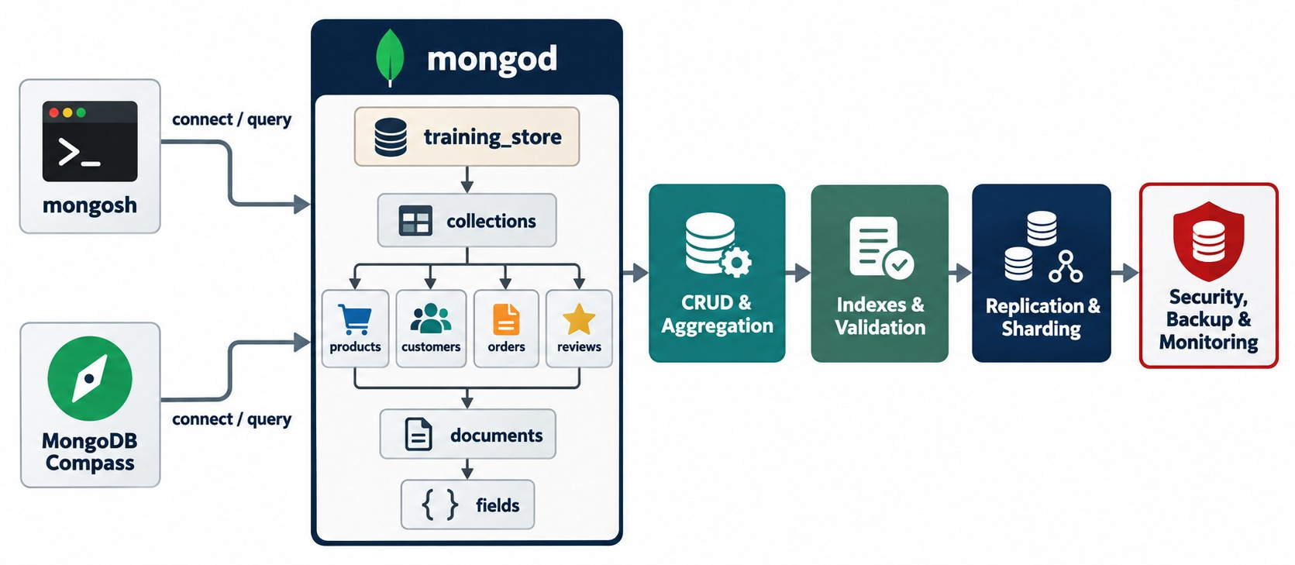
THE COURSE AT A GLANCE
One database, eight modules, one layer at a time.
KEY TAKEAWAY Every module added one layer to the same training_store database.
49
© 2026 by Innovation In Software Corporation
Notes:
KEY TALKING POINTS
------------------
- The whole course in one picture
mongosh and Compass connect to mongod, which holds training_store, its four collections, documents and fields.
- The path we took
CRUD and aggregation on Day 2.
Indexes and validation, replication and sharding on Day 3.
And finally security, backup and monitoring in this module.
- Ask the room
Ask learners which box they would find hardest to get right in their own systems — and why.
- What it shows
mongosh and Compass connect to mongod and training_store; the course moves through CRUD and aggregation, indexes and validation, replication and sharding, and security, backup and monitoring.
- How to use it
Point to each block and ask the class what they can now do with it.
- Key point
Each module added one layer to the same database.

Slide 50
COURSE SUMMARY AND NEXT STEPS
From why NoSQL exists to running MongoDB securely and reliably.
YOU CAN NOW
NEXT: APPLY IT TO YOUR OWN SYSTEMS
Choose a data model and design documents
1
Which query will you explain first?
✓
Install, connect and load MongoDB
2
When will you test a restore?
✓
Query, update and aggregate documents
Which alert needs a runbook?
✓
3
Index from query shapes and explain
✓
Replicate for availability; shard for scale
TAKE WITH YOU The readiness checklist, your Lab 7 scorecard and one action for next week.
✓
Secure, back up, monitor and troubleshoot
✓
KEY TAKEAWAY Model around access patterns, measure before tuning, secure by default and prove every recovery.
50
© 2026 by Innovation In Software Corporation
Notes:
KEY TALKING POINTS
------------------
- Recap
Across eight modules we chose a data model, set up MongoDB, designed documents, queried and aggregated them, indexed with evidence, replicated and sharded, and finally learned to run it securely and reliably — all on training_store.
- The ten principles
Model around how the application uses data.
Embed bounded data that belongs together; reference shared or unbounded data.
Keep names and types consistent.
Design indexes around real query shapes.
Measure before and after.
Filter early in pipelines.
Apply authentication, authorization, TLS and network limits.
Treat replication, sharding and backups as different capabilities.
Troubleshoot from evidence.
- Next steps
Ask each participant for one action: a schema or validation change, a query to explain, a security control to verify, a restore test to schedule, or an alert that needs a runbook.
Recommend the current MongoDB security checklist and operations documentation for their version.
- Close
Thank the group, take final questions, and collect feedback.

