Slide 1
"AI doesn't replace business architecture — it works through it."
CAPSTONE
Putting It
All Together
From business requirement to a production microservices platform.
End-to-end Spring Boot
REST and event integration
Data and resilience
Security and authentication
Automated testing
CI/CD and containers
OpenShift and observability
Copilot + MCP
SPRING BOOT MICROSERVICES BOOTCAMP • CAPSTONE
Notes:
KEY TALKING POINTS
------------------
- Connecting everything
This capstone connects the whole course.
Earlier modules covered design, Spring Boot, messaging, data, resilience, DevOps, OpenShift, Copilot, agentic AI, MCP and security one at a time.
- The new question
Now we ask: how do all these pieces work together in one production-style system?
- The lifecycle
Business requirement, architecture, code, test, secure, build, containerize, deploy, observe, improve.
- What it's really about
The capstone is about the whole engineering system, not just whether one REST endpoint works.

Slide 2
CAPSTONE OBJECTIVES AND DELIVERABLES
What teams must build, deploy, secure and demonstrate.
BUILD
PROTECT
DELIVER
OPERATE
ACCELERATE
Spring Boot microservices
OAuth2 / OIDC
Git workflow
Health checks
GitHub Copilot
REST APIs
Authorization
Automated tests
Logs
MCP-enabled AI integration
SQL persistence
Secrets management
CI/CD
Metrics
Event integration
Containers
Traces
OpenShift
EVALUATE EVERY DIMENSION
Architecture
Functionality
Reliability
Security
Automation
Deployment
Observability
AI integration
“It works on my laptop”
Built, tested, secured, deployed, observed and operated — repeatably
✕
✓
KEY TAKEAWAY Grade the whole engineering system — not just whether the code compiles.
2
© 2026 by Innovation In Software Corporation
Notes:
KEY TALKING POINTS
------------------
- Five groups of deliverables
Build: Spring Boot microservices, REST APIs, SQL persistence and event integration.
Protect: OAuth2 and OIDC, authorization and secrets management.
Deliver: Git workflow, automated tests, CI/CD, containers and OpenShift.
Operate: health checks, logs, metrics and traces.
Accelerate: GitHub Copilot and MCP-enabled AI integration.
- Grade more than compiling
Don't grade the capstone only on whether the application compiles.
Evaluate architecture, functionality, reliability, security, automation, deployment, observability and AI integration.
- Not production-ready yet
A team with beautiful Java code that can't deploy or diagnose it doesn't yet have a production-ready platform.
- The real goal
'It works on my laptop' is not the goal.
The goal is a system that can be built, tested, secured, deployed, observed and operated repeatably.

Slide 3
KEY TERMS FOR THE CAPSTONE
Plain definitions for the words we'll use most.
1
Service boundary
2
Synchronous integration
The line around what a service owns — its capability, its API and its data.
A call that waits for an answer, such as a REST request.
3
Asynchronous integration
4
Transactional outbox
Publishing an event that other services process later.
Saving an event in the same transaction as the data, then publishing it.
5
Safe fallback
6
Rollback
A defined outcome when a dependency fails — pending or HOLD, never an invented success.
Returning a deployment to its previous working version.
7
Human review
8
Production readiness
A person decides every HOLD before any money moves.
Evidence that a system is secure, observable, recoverable and correct under failure.
KEY TAKEAWAY Agree on the words first — every later slide builds on them.
3
© 2026 by Innovation In Software Corporation
Notes:
KEY TALKING POINTS
------------------
- How to run this slide
Read each term once and give a quick example from the order platform or the banking lab.
- Service boundary
The line around what a service owns — its capability, its API and its data.
- Synchronous integration
A call that waits for an answer, such as a REST request.
- Asynchronous integration
Publishing an event that other services process later.
- Transactional outbox
Saving an event in the same transaction as the data, then publishing it.
- Safe fallback
A defined outcome when a dependency fails — pending or HOLD, never an invented success.
- Rollback
Returning a deployment to its previous working version.
- Human review
A person decides every HOLD before any money moves.
- Production readiness
Evidence that a system is secure, observable, recoverable and correct under failure.

Slide 4
FULL FORMS USED IN THE CAPSTONE
Every abbreviation on these slides, spelled out.
AI
Artificial Intelligence
HTTP
HyperText Transfer Protocol
OIDC
OpenID Connect
API
Application Programming Interface
HTTPS
HyperText Transfer Protocol Secure
PR
Pull Request
CD
Continuous Delivery / Deployment
ID
Identifier
REST
Representational State Transfer
CI
Continuous Integration
JPA
Jakarta Persistence API
SHA
Secure Hash Algorithm
CI/CD
Continuous Integration / Continuous Delivery
JWT
JSON Web Token
SKU
Stock Keeping Unit
DB
Database
MCP
Model Context Protocol
SQL
Structured Query Language
DLQ
Dead-Letter Queue
OAuth
Open Authorization
HMAC
Hash-based Message Authentication Code
OCI
Open Container Initiative
KEY TAKEAWAY When an abbreviation isn't clear, the full form is on this slide.
4
© 2026 by Innovation In Software Corporation
Notes:
KEY TALKING POINTS
------------------
- How to run this slide
Don't read every row.
Point out the few this module uses most, and say the full list is here for reference.
- Reference
AI is Artificial Intelligence; API is Application Programming Interface; CD is Continuous Delivery / Deployment; CI is Continuous Integration; CI/CD is Continuous Integration / Continuous Delivery; DB is Database; DLQ is Dead-Letter Queue; HMAC is Hash-based Message Authentication Code; HTTP is HyperText Transfer Protocol; HTTPS is HyperText Transfer Protocol Secure; ID is Identifier; JPA is Jakarta Persistence API; JWT is JSON Web Token; MCP is Model Context Protocol; OAuth is Open Authorization; OCI is Open Container Initiative; OIDC is OpenID Connect; PR is Pull Request; REST is Representational State Transfer; SHA is Secure Hash Algorithm; SKU is Stock Keeping Unit; SQL is Structured Query Language.

Slide 5
FROM MODULE 12 TO THE CAPSTONE
Twelve modules, one platform — now make every piece work together.
MODULES 1–12 GAVE US
🧭
OUR PATH THROUGH THE CAPSTONE
1
Scenario, architecture and contracts
Part 1
✓
Service boundaries and REST APIs
Data, events and resilience
2
Order Service and integrations
Part 2
✓
Pipelines, images and OpenShift
3
Data and resilience
Part 2
✓
Copilot, agents and MCP
4
Security, secrets and tests
Part 3
✓
Security, secrets and audit
5
Git, CI/CD and OpenShift
Part 4
✓
NOW Design, build, deliver and demonstrate one production-ready platform.
6
Observability and AI
Part 5
7
The demo and readiness review
Part 5
KEY TAKEAWAY The Capstone isn't a new topic — it's every module working together.
5
© 2026 by Innovation In Software Corporation
Notes:
KEY TALKING POINTS
------------------
- Bridge from Module 12
Module 12 secured every identity and boundary.
The Capstone connects that work with everything that came before.
- The path
Design, build, protect and test, deliver, then operate and demonstrate.
- Two examples
The slides use the order platform.
The official demo uses the banking Account, Transaction and Risk Assessment services from Labs 1–5.

Slide 6
PART 1: DESIGN THE PLATFORM
Scenario, architecture, boundaries and contracts — before any code.
Part 1
Design
Part 2
Build
Part 3
Protect and test
Part 4
Deliver
Part 5
Operate and demo
SO FAR
NEXT QUESTION
What should the platform look like before anyone writes a controller?
✓
Twelve modules of techniques
✓
Labs 1–5 built banking services
IN THIS PART
✓
Each piece tested on its own
The business scenario
1
2
Target architecture
3
Boundaries — with an exercise
4
REST and event contracts — in code
6
© 2026 by Innovation In Software Corporation
Notes:
KEY TALKING POINTS
------------------
- Why start here
Teams that start with controllers often build a distributed monolith.
Design comes first.
- What this part covers
The scenario, the target architecture, service boundaries and the contracts between services.

Slide 7
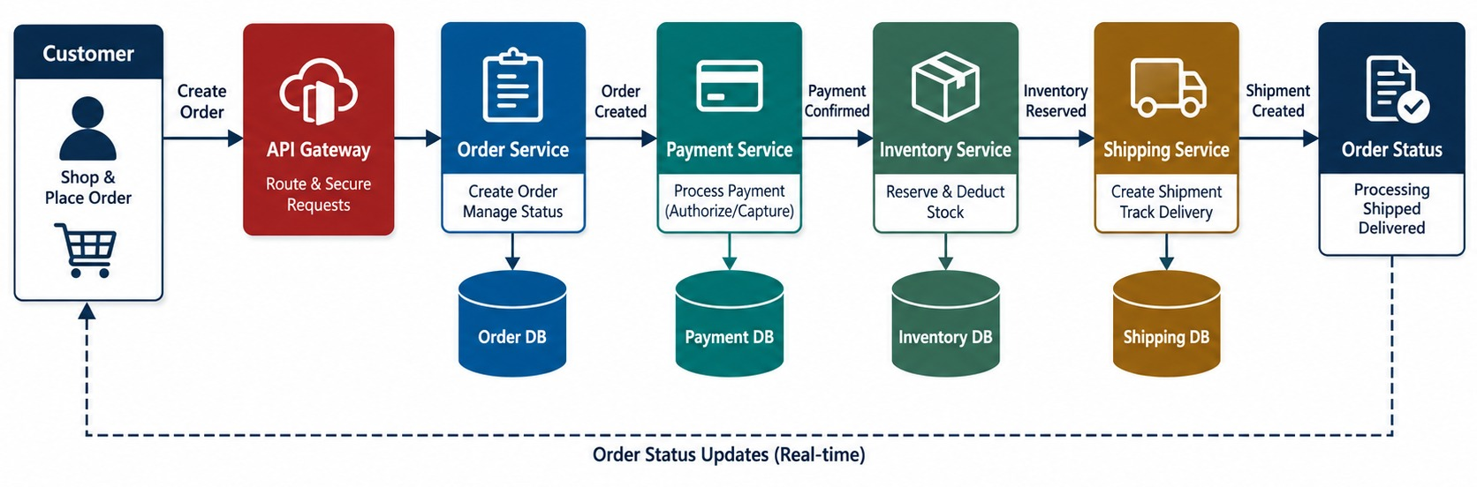
CAPSTONE BUSINESS SCENARIO
An e-commerce order processing platform.
THE CUSTOMER STORY
→
Customer places an order
→
Payment is authorized
→
Stock is reserved
→
The order ships
→
The customer sees the status
ASK What happens when payment fails?
KEY TAKEAWAY One simple business process touches almost every topic in the course.
7
© 2026 by Innovation In Software Corporation
Notes:
KEY TALKING POINTS
------------------
- The scenario
The platform is an e-commerce order processing system with Order, Payment, Inventory and Shipping services.
Customers can create, view and cancel eligible orders.
The platform processes payment, reserves inventory, arranges shipping and tracks status.
- A simple customer story
A customer places an order with two products.
The platform must create the order, process payment, reserve inventory, arrange shipping, and let the customer track the order.
- Questions that drive the design
Ask learners: what happens if Payment is down?
What if payment succeeds but inventory fails?
How do we secure cancellation, and how does Shipping learn about the order?
How do we deploy a new Order Service version, and how do we find where a failure happened?
- Almost every topic
This apparently simple process touches almost every topic from the course.
- What the diagram shows
A customer places an order; payment, inventory, shipping and the order status follow.
- Key point
One business process touches almost every course topic.

Slide 8
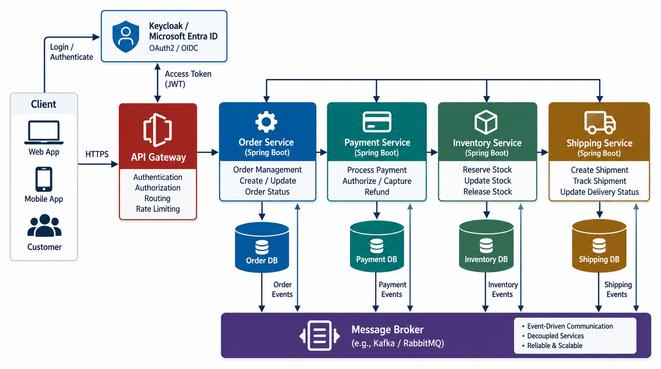
TARGET END-TO-END ARCHITECTURE
The complete architecture — before any implementation.
Capabilities first
Order, payment, inventory, shipping — then APIs.
Around the system
Gateway, identity, broker, pipeline, OpenShift, monitoring.
AVOID A distributed monolith: services that must deploy together.
KEY TAKEAWAY Start from capabilities and boundaries — the architecture comes before the controllers.
8
© 2026 by Innovation In Software Corporation
Notes:
KEY TALKING POINTS
------------------
- The target architecture
The customer uses a web or API client, which goes through the API gateway to the Order, Payment and Inventory services.
Each service has its own database.
Order publishes domain events to a message broker, and Inventory and Shipping consume them.
- Around the whole system
Security, CI/CD, OpenShift, observability and AI assistance surround the architecture.
- Don't start with controllers
Don't begin by coding controllers.
Start from business capability, then service boundary, then contract, then implementation.
- Avoid a distributed monolith
Order Service must not become Order plus Payment plus Inventory plus Shipping plus everything else.
Otherwise we've rebuilt a distributed monolith, meaning a monolith spread across the network.
- What the diagram shows
Clients, a gateway, Order, Payment, Inventory and Shipping services, a broker, databases, security, observability and OpenShift.
- Key point
Design capabilities and boundaries before code.

Slide 9
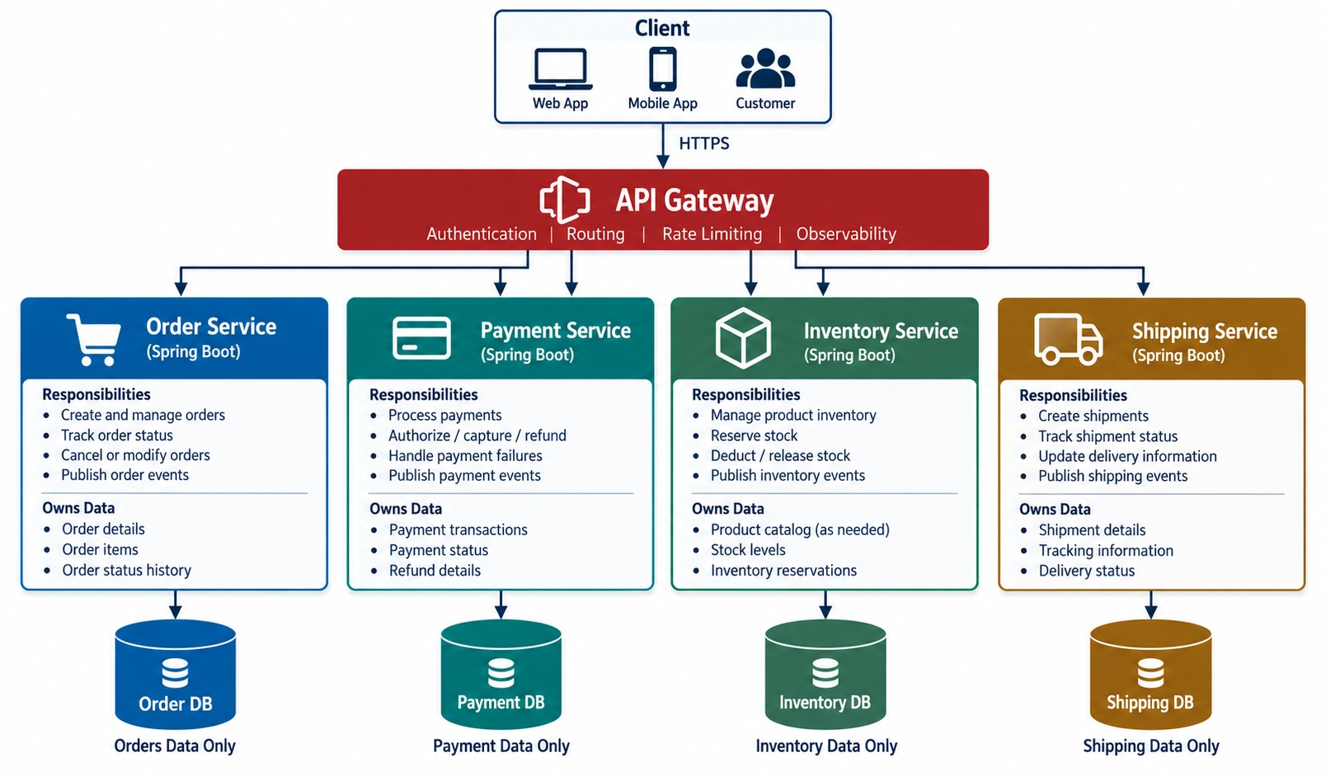
MICROSERVICE BOUNDARIES AND RESPONSIBILITIES
Order, Payment, Inventory and Shipping.
Order
Order lifecycle and its rules.
Payment
Authorizations, captures and refunds.
Inventory
Stock levels and reservations.
Shipping
Shipments and tracking.
KEY TAKEAWAY Clear ownership of capability and data keeps each service autonomous.
9
© 2026 by Innovation In Software Corporation
Notes:
KEY TALKING POINTS
------------------
- Clear ownership
Order owns the order lifecycle.
Payment owns payment processing.
Inventory owns stock and reservations.
Shipping owns the shipment lifecycle.
Each service owns its business capability and its data.
- Order and Payment
Order Service creates, gets and cancels orders, and tracks order status.
Payment Service creates, checks and refunds payments.
- Inventory and Shipping
Inventory Service checks stock, reserves stock and releases reservations.
Shipping Service creates, tracks and updates shipments.
- Preserve autonomy
Order Service must not update the payment table, and Payment must not update the order table.
That preserves each service's autonomy.
- What the diagram shows
Order, Payment, Inventory and Shipping, each with its own capability, APIs, events and data.
- Key point
Clear ownership keeps each service autonomous.

Slide 10
EXERCISE: DRAW THE SERVICE BOUNDARIES
Assign each capability and table to exactly one owner.
PRACTICE EXERCISE
10 MIN
SCENARIO
YOUR TASKS
EXPECTED OUTCOME
A team's first design has these pieces:
1
Give every table one owning service
✓
Order, Payment, Inventory, Shipping each own theirs
orders, order_items tables
payments, refunds tables
stock_levels, reservations tables
shipments table
Order Service reads stock_levels
Shipping updates orders.status
2
Find the two boundary violations
✓
Order → Inventory API or reservation
3
Replace each with an API call or event
✓
Shipping publishes ShipmentDispatched
✓
Order Service updates its own status
KEY TAKEAWAY One owner per table — other services ask through APIs or react to events.
10
© 2026 by Innovation In Software Corporation
Notes:
KEY TALKING POINTS
------------------
- Ownership
Each group of tables belongs to one service, which alone reads and writes it.
- The violations
Order Service reading stock and Shipping updating order status both reach into another service's data.
- The fixes
Order Service calls the Inventory API.
Shipping publishes an event, and Order Service updates its own status.

Slide 11
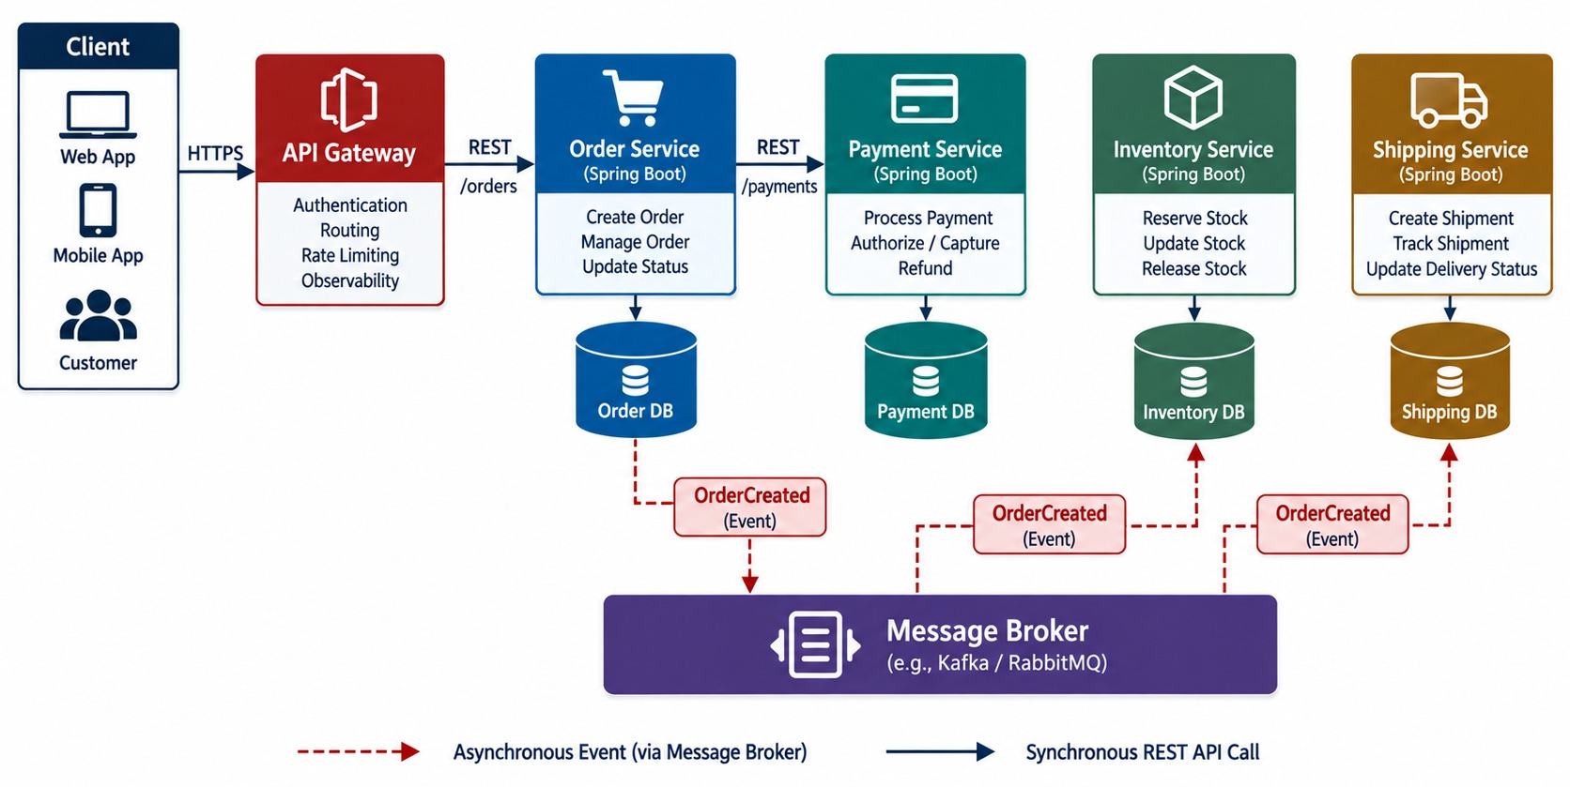
API AND EVENT CONTRACT DESIGN
REST endpoints and domain events.
REST — NEEDS AN ANSWER NOW
POST /orders
GET /orders/{id}
POST /payments
EVENTS — OTHERS REACT
OrderCreated
PaymentCompleted
ShipmentDispatched
KEY TAKEAWAY Design REST and event contracts deliberately — both are public APIs.
11
© 2026 by Innovation In Software Corporation
Notes:
KEY TALKING POINTS
------------------
- REST APIs
Order Service exposes POST /orders, GET /orders/{id} and PATCH /orders/{id}/cancel.
Payment Service exposes POST /payments and GET /payments/{id}.
There are also GET /inventory/{sku} and GET /shipments/{id}.
- Domain events
The events are OrderCreated, OrderCancelled, PaymentCompleted, PaymentFailed, InventoryReserved and ShipmentCreated.
- Sync or async
Use synchronous calls when the caller needs an immediate answer, like Order waiting for a payment result.
Use asynchronous events for loose coupling and independent processing.
For example, OrderCreated goes to the broker and on to Inventory and Shipping.
- Events are APIs too
An event shouldn't be an uncontrolled dump of an internal entity.
A good OrderCreated event carries eventType, orderId, customerId and a timestamp.
Event contracts need versioning and compatibility planning, just like APIs.
- What the diagram shows
Synchronous REST calls next to asynchronous domain events such as OrderCreated and PaymentCompleted.
- Key point
REST and events are both public contracts.

Slide 12
A REST CONTRACT AND AN EVENT CONTRACT
Both are versioned, documented and owned — consumers depend on them.
openapi.yaml (excerpt)
✓
OrderCreated v1
paths:
/api/v1/orders:
post:
operationId: createOrder
parameters:
- in: header
name: Idempotency-Key
required: true
requestBody:
content:
application/json:
schema: { $ref: '#/components/schemas/CreateOrder' }
responses:
'201': { description: Order created }
'400': { description: Validation failed }
'409': { description: Duplicate request }
{
"eventId": "evt-7c21",
"eventType": "OrderCreated",
"eventVersion": 1,
"occurredAt": "2026-09-18T14:02:11Z",
"correlationId": "c-41af",
"data": {
"orderId": "ORD-1045",
"customerId": "CUST-0007",
"total": { "amount": "84.50", "currency": "USD" },
"items": [ { "sku": "SKU-221", "qty": 2 } ]
}
}
Idempotency-Key
eventId
eventVersion
A retried POST can't create two orders.
Consumers use it to ignore duplicates.
Add fields safely; never break consumers.
KEY TAKEAWAY Version and document both contracts — and put idempotency into them from the start.
12
© 2026 by Innovation In Software Corporation
Notes:
KEY TALKING POINTS
------------------
- The REST contract
createOrder requires an Idempotency-Key and documents the success, validation and duplicate responses.
- The event contract
OrderCreated carries an event ID, type, version, time and correlation ID, plus only the data consumers need.
- Money
The amount is a string with a currency, so no floating-point rounding.
- Evolution
Adding optional fields is safe.
Removing or renaming fields needs a new version.

Slide 13
PART 2: BUILD THE SERVICES
Order Service, its integrations, its data and its failure handling.
✓ Part 1
Design
Part 2
Build
Part 3
Protect and test
Part 4
Deliver
Part 5
Operate and demo
SO FAR
NEXT QUESTION
How do we build services that stay correct when their neighbours fail?
✓
One business process drives the design
✓
Four services own their capabilities
IN THIS PART
✓
REST and event contracts are defined
Service architecture and Order Service
1
2
Order lifecycle rules — in code
3
Sync and async integration
4
Resilience — in code
5
Data, failures — and an exercise
13
© 2026 by Innovation In Software Corporation
Notes:
KEY TALKING POINTS
------------------
- Why this part
This is where Modules 2 to 6 come together inside real services.
- What comes next
Internal layers, the order lifecycle, calls and events, owned data and resilience.

Slide 14
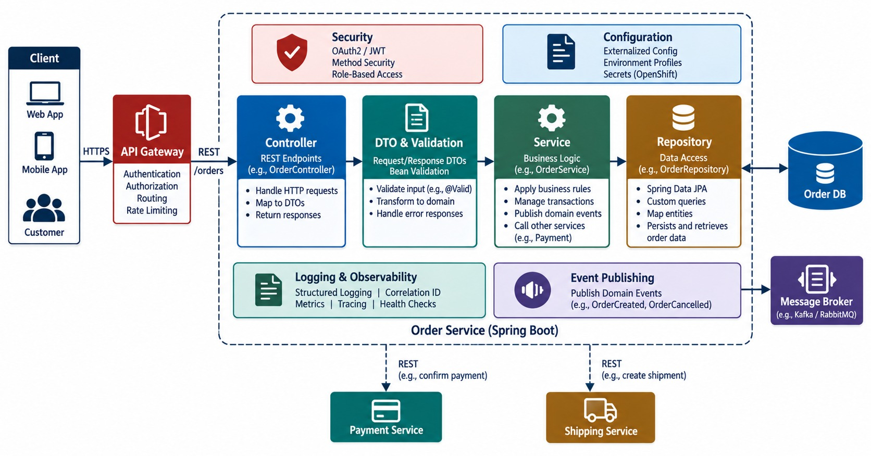
SPRING BOOT SERVICE ARCHITECTURE
Controller → service → repository → database.
Controller
HTTP, validation and DTOs — no business logic.
Service
Business rules and transactions.
Repository
Persistence only.
ACROSS EVERY LAYER
Security
Logging
Errors
Metrics
KEY TAKEAWAY Clean layers inside every service keep code testable and maintainable.
14
© 2026 by Innovation In Software Corporation
Notes:
KEY TALKING POINTS
------------------
- Clean internal layers
Each microservice should have a clean internal architecture.
An HTTP request goes to the controller, then DTOs and validation, then the service and business logic, then the repository and database.
- Cross-cutting concerns
Security, exception handling, logging and configuration apply across all the layers.
- Who does what
In Order Service, OrderController handles HTTP concerns.
OrderService holds the business rules.
OrderRepository handles persistence.
- Keep them separate
Don't put the whole application inside OrderController.
Separate responsibilities keep the service testable and maintainable.
- What the diagram shows
Controller, service, repository and database, with validation, security, logging and error handling across them.
- Key point
Clean internal layers keep services testable.

Slide 15
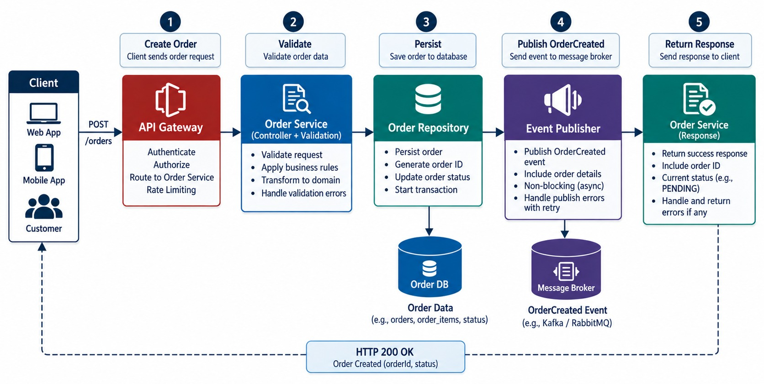
BUILDING THE ORDER MICROSERVICE
The core service implementation.
ORDER STATES
→
CREATED
→
PAYMENT_PENDING
→
PAID
→
SHIPPED
Cancellation
Allowed before shipping; a paid order also needs a refund.
PRINCIPLE Only Order Service changes an order.
KEY TAKEAWAY Order Service owns the order lifecycle and its business rules.
15
© 2026 by Innovation In Software Corporation
Notes:
KEY TALKING POINTS
------------------
- The primary implementation
Use Order Service as the main capstone implementation.
Its endpoints are POST /orders, GET /orders/{id} and PATCH /orders/{id}/cancel, built as controller, service, repository and database.
- Creating an order
Receive the CreateOrderRequest and validate it.
Create the order, persist it, and publish OrderCreated.
Then return the OrderResponse.
- Order states
Order states are CREATED, PAID, CONFIRMED, CANCELLED and SHIPPED.
- Cancellation rules
A CREATED order can be cancelled.
A CONFIRMED order may be cancellable.
A SHIPPED order can't be cancelled, and a CANCELLED order is already cancelled.
- A critical principle
Business rules belong in the service, not in the UI, the agent, the MCP server or the API gateway.
- What the diagram shows
An order moving from CREATED through PAYMENT_PENDING and PAID to SHIPPED, or to CANCELLED.
- Key point
Order Service owns the lifecycle and its rules.

Slide 16
ORDER LIFECYCLE RULES IN CODE
The entity guards its states; the service saves the order and its event together.
Order.java
✓
OrderService.java
public void markPaid(String paymentId) {
requireStatus(PAYMENT_PENDING);
this.paymentId = paymentId;
this.status = PAID;
}
public void cancel(String reason) {
if (status == SHIPPED || status == CANCELLED)
throw new InvalidOrderStateException(id, status);
this.refundRequired = (status == PAID);
this.status = CANCELLED;
this.cancelReason = reason;
}
@Transactional
public OrderResponse create(CreateOrder cmd, String idempotencyKey) {
return orders.findByIdempotencyKey(idempotencyKey)
.map(OrderResponse::from) // retried request
.orElseGet(() -> {
Order order = orders.save(Order.create(cmd, idempotencyKey));
outbox.save(OutboxEvent.orderCreated(order)); // same transaction
return OrderResponse.from(order);
});
}
// a relay publishes outbox rows to the broker
Guarded states
Idempotent create
Outbox
Illegal transitions fail loudly.
A retried request returns the same order.
The order and its event commit together.
KEY TAKEAWAY Put state rules in the entity, and save each change with its event in one transaction.
16
© 2026 by Innovation In Software Corporation
Notes:
KEY TALKING POINTS
------------------
- The entity
Order refuses illegal transitions, such as cancelling a shipped order, and records when a refund is needed.
- Idempotency
If the same Idempotency-Key arrives twice, the service returns the existing order instead of creating another.
- The outbox
The order row and the OrderCreated outbox row commit in one local transaction.
A relay publishes the event afterwards, so no event is lost and none is invented.
- Module links
This combines Module 3's layers, Module 4's events and Module 5's local transactions.

Slide 17
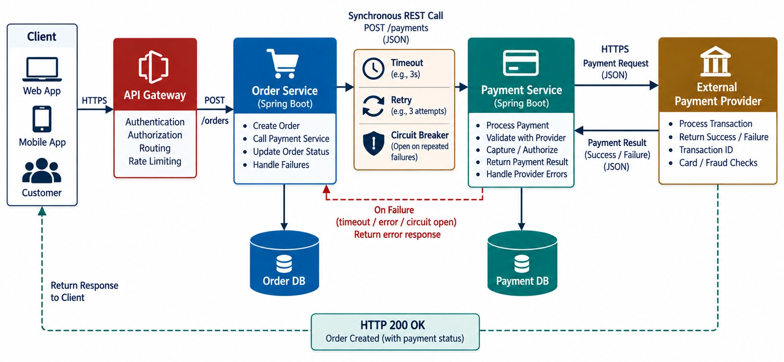
SYNCHRONOUS SERVICE INTEGRATION
Order → Payment REST call.
POSSIBLE OUTCOMES
?
Authorized
?
Declined
?
Timed out
?
Unavailable
Never wait forever
Connect and read timeouts on every call.
TIMED OUT ≠ FAILED The payment may have succeeded.
KEY TAKEAWAY Synchronous calls need timeouts, safe retries and circuit breakers.
17
© 2026 by Innovation In Software Corporation
Notes:
KEY TALKING POINTS
------------------
- A synchronous call
Suppose confirming an order needs immediate payment authorization.
The client calls Order Service, which calls POST /payments on Payment Service.
Payment calls the payment provider, and the result returns to Order Service.
- Possible outcomes
The outcome might be success, declined, a timeout, or the service being unavailable.
- Never wait forever
Don't let Order Service wait forever.
Configure an explicit timeout.
Protect the call with timeouts, retries where safe, a circuit breaker and authentication.
- Deliberate retries
Retries must be deliberate.
Don't blindly retry a payment creation unless the API guarantees idempotency, meaning a repeat does no extra harm.
This connects directly to Module 6.
- What the diagram shows
Order Service calling Payment Service with a timeout, retry and circuit breaker, and each possible outcome.
- Key point
Synchronous calls need bounded waits.

Slide 18
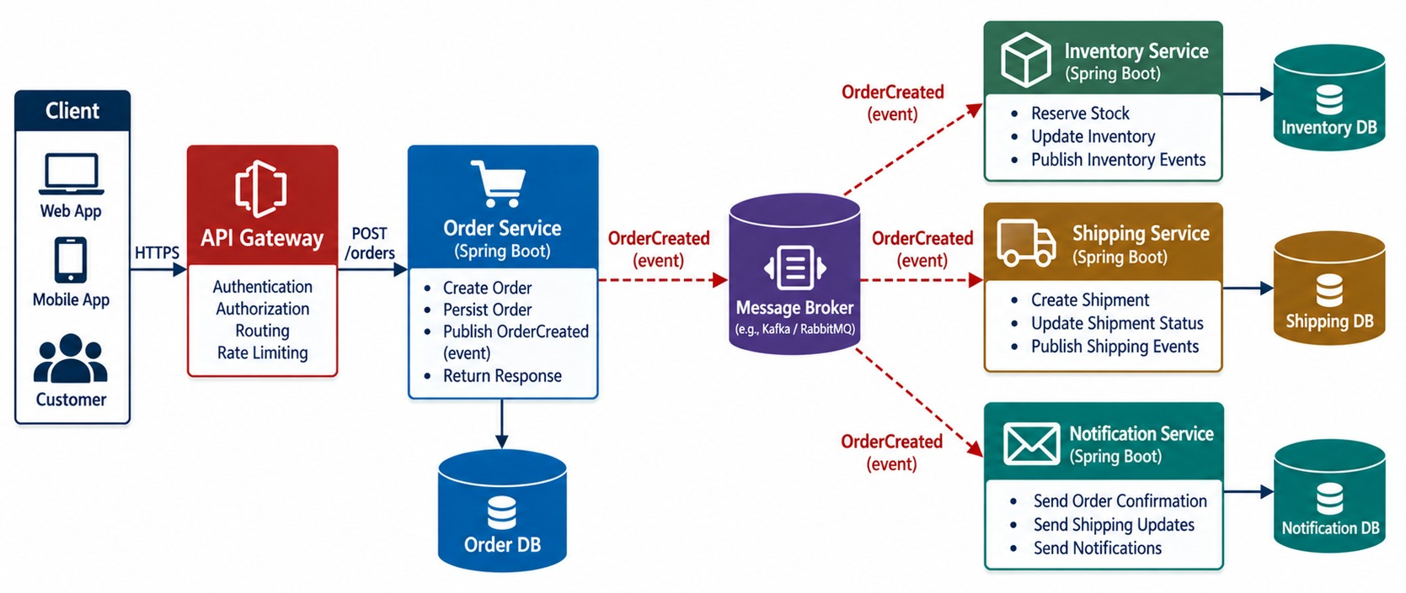
ASYNCHRONOUS EVENT INTEGRATION
OrderCreated → broker → Inventory and Shipping.
Gives
Loose coupling, independent scaling, room for new consumers.
Costs
Eventual consistency, duplicates and harder tracing.
CONSUMERS must be idempotent.
KEY TAKEAWAY Events decouple services — so consumers must handle duplicates and eventual consistency.
18
© 2026 by Innovation In Software Corporation
Notes:
KEY TALKING POINTS
------------------
- Publishing an event
When Order Service publishes OrderCreated, it doesn't need to know every consumer.
Inventory may reserve stock, Shipping may prepare fulfillment, and Notification may send a confirmation.
- Room to grow
Later, a new analytics service could subscribe without any change to Order Service.
- What it gives
This gives loose coupling, independent evolution and independent scaling.
- What it costs
It also introduces eventual consistency, meaning data catches up over time, plus duplicate delivery and ordering concerns.
It adds schema evolution and failure handling too.
So consumers should tolerate duplicate delivery where appropriate.
- What the diagram shows
Order Service publishing OrderCreated to a broker, consumed independently by Inventory and Shipping.
- Key point
Events decouple services; consumers handle duplicates.

Slide 19
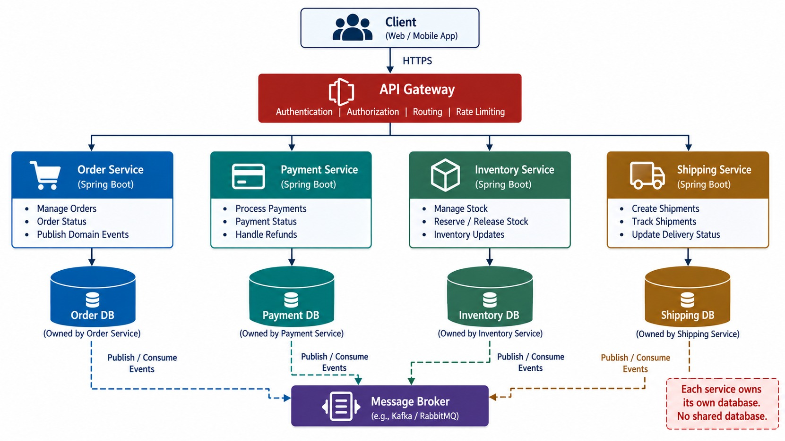
DATA PERSISTENCE AND SERVICE-OWNED DATABASES
JPA/SQL and database-per-service.
Tempting shortcut
Order Service joins the inventory tables directly.
Service-owned data
Ask the Inventory API, or keep a local copy from events.
TRANSACTIONS Local per service; sagas across services.
KEY TAKEAWAY Each service owns its database — share data through APIs and events, never tables.
19
© 2026 by Innovation In Software Corporation
Notes:
KEY TALKING POINTS
------------------
- Service-owned data
Order Service has the Order DB, Payment the Payment DB, Inventory the Inventory DB, and Shipping the Shipping DB.
No service owns another service's tables.
- The tempting shortcut
A tempting shortcut is one giant database shared by all services.
That creates strong coupling.
- Getting another service's data
If Payment needs order information, it should use an API or an event.
It should never run SELECT * directly against the Order Service tables.
- Transaction boundaries
A local Order transaction can use @Transactional.
But a transaction spanning Order, Payment and Inventory is a distributed workflow.
Don't pretend one local database transaction covers the whole system.
- What the diagram shows
Each service with its own database, sharing data only through APIs and events.
- Key point
Share data through contracts, never tables.

Slide 20
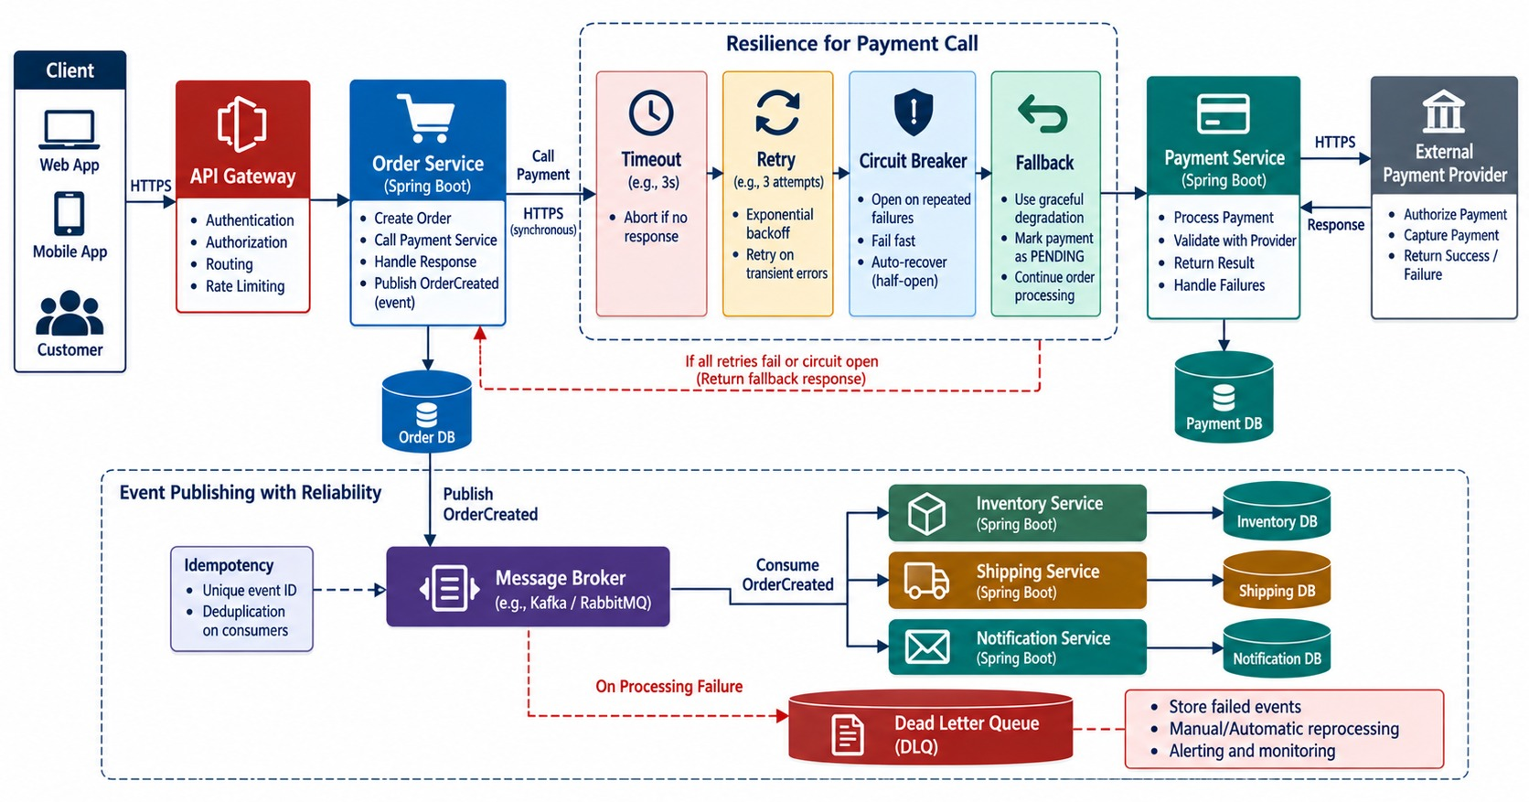
RESILIENCE AND FAILURE HANDLING
Timeout, retry, circuit breaker and idempotency.
THE TOOLKIT
Timeout
Retry + backoff
Circuit breaker
Idempotency
Dead-letter queue
Bulkhead
RULE Only retry what's safe to repeat.
KEY TAKEAWAY Design for failure: bound waits, retry carefully, fail fast and isolate bad messages.
20
© 2026 by Innovation In Software Corporation
Notes:
KEY TALKING POINTS
------------------
- A realistic failure
Suppose the Payment Service becomes unavailable.
Without resilience, payment is slow and Order threads wait, so connections pile up.
Order Service becomes unhealthy, and the whole system fails.
- With resilience
A timeout stops the waiting, and a controlled retry happens only if it's safe.
The circuit breaker opens, and the service fails fast instead of hanging.
- Event consumers
For events: a message is processed and fails.
It's retried, and if it still fails it goes to a dead-letter queue, or DLQ, for later handling.
- Also
Use idempotency, dead-letter handling and graceful degradation, meaning the system keeps partly working.
- The key message
Production systems are designed around failure, not around the assumption that every dependency always works.
- What the diagram shows
A failing dependency handled with timeouts, retries, a circuit breaker, idempotency and a dead-letter queue.
- Key point
Design every call and consumer for failure.

Slide 21
RESILIENT CALLS AND IDEMPOTENT CONSUMERS
Bound the synchronous call; make the event consumer safe to run twice.
PaymentClient.java
✓
InventoryListener.java
@CircuitBreaker(name = "payment", fallbackMethod = "pending")
@Retry(name = "payment")
public PaymentResult authorize(Order order) {
return paymentApi.post()
.uri("/api/v1/payments")
.header("Idempotency-Key", "pay-" + order.id())
.body(PaymentRequest.from(order))
.retrieve()
.body(PaymentResult.class);
}
PaymentResult pending(Order order, Throwable cause) {
return PaymentResult.unknown(order.id()); // never "approved"
}
@KafkaListener(topics = "orders.events", groupId = "inventory-service")
@Transactional
public void on(OrderCreated event) {
if (processed.existsById(event.eventId())) {
log.info("Duplicate ignored eventId={}", event.eventId());
return;
}
reservations.reserve(event.data().orderId(), event.data().items());
processed.save(new ProcessedEvent(event.eventId()));
}
# resilience4j.timelimiter.instances.payment.timeout-duration: 2s
# resilience4j.retry.instances.payment.max-attempts: 3
Same key on retry
Fallback
Processed events
Payment Service charges once.
Unknown, then reconcile — never invent success.
A redelivery changes nothing.
KEY TAKEAWAY Retry only with idempotency, fall back to "unknown" — never to "approved".
21
© 2026 by Innovation In Software Corporation
Notes:
KEY TALKING POINTS
------------------
- The call
The retry reuses the same Idempotency-Key, so Payment Service won't charge twice.
The circuit breaker stops calls to a failing service.
- The fallback
When payment can't be confirmed, the result is unknown and the order stays PAYMENT_PENDING for reconciliation.
We never invent a successful financial outcome.
- The consumer
The processed-event check and the reservation commit in one transaction, so a redelivered event is ignored.
- Lab link
Lab 5 does the same: a duplicate event creates no second assessment, and a model timeout becomes HOLD.

Slide 22
EXERCISE: TRACE A FAILED PAYMENT
Decide what the platform does at each step of a bad afternoon.
PRACTICE EXERCISE
12 MIN
SCENARIO
YOUR TASKS
EXPECTED OUTCOME
ORD-1045 is created. Then:
1
Give the order's state after each step
✓
1 PAYMENT_PENDING — timeout
1 Payment call times out after 2s
2 Retry succeeds — or did it charge twice?
3 Payment Service goes down for 5 minutes
4 OrderCreated is delivered twice
5 A poison message keeps failing
✓
2 One charge — same Idempotency-Key
2
Name the control that protects it
Say what the customer sees
✓
3 Circuit opens; status unknown
3
✓
4 One reservation — processed events
✓
5 Dead-letter queue + alert
KEY TAKEAWAY Every failure has a designed outcome — and none of them is a made-up success.
22
© 2026 by Innovation In Software Corporation
Notes:
KEY TALKING POINTS
------------------
- Timeouts and retries
The order stays PAYMENT_PENDING.
The retry reuses the idempotency key, so the customer is charged once.
- Outages
The circuit breaker fails fast.
The customer sees that payment is being confirmed, not a false success.
- Messages
Duplicate events are ignored.
A poison message moves to the dead-letter queue and raises an alert.

Slide 23
PART 3: PROTECT AND TEST
Security, configuration and tests — built in, not bolted on.
✓ Part 1
Design
✓ Part 2
Build
Part 3
Protect and test
Part 4
Deliver
Part 5
Operate and demo
SO FAR
NEXT QUESTION
How do we know the platform is secure — and still correct after every change?
✓
Clean layers and a guarded lifecycle
✓
Calls bounded; consumers idempotent
IN THIS PART
✓
Each service owns its data
API security and authentication
1
2
Secrets and configuration
3
Automated testing strategy
23
© 2026 by Innovation In Software Corporation
Notes:
KEY TALKING POINTS
------------------
- Why this part
Security and testing added at the end are always incomplete.
They belong in every service from day one.
- What comes next
Token validation, runtime configuration and a layered test strategy.

Slide 24
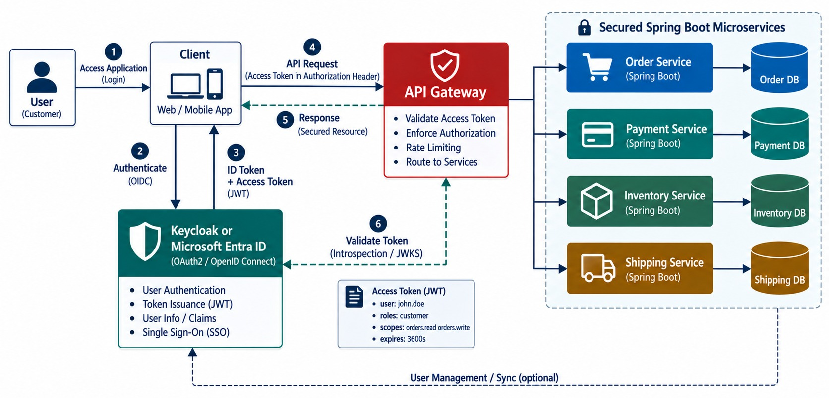
API SECURITY AND AUTHENTICATION
OAuth2/OIDC with Keycloak or Microsoft Entra ID.
Authenticate
Every service validates issuer, audience and expiry.
Authorize
Scopes per endpoint — orders.write, payments.authorize.
Resource checks
This customer may see only their orders.
LAB 3 HMAC JWTs from issue-jwt.py.
KEY TAKEAWAY Validate tokens and authorize each resource — in every service, from day one.
24
© 2026 by Innovation In Software Corporation
Notes:
KEY TALKING POINTS
------------------
- Secure from the start
Secure the capstone from the beginning; don't bolt security on at the end.
The user authenticates with Keycloak or Microsoft Entra ID through OAuth2 and OIDC.
The access token goes through the API gateway and Spring Security to the microservice.
- Two questions
Authentication asks: who is calling?
Authorization asks: what may they do?
Permissions include orders.read, orders.write and payment.refund.
- Examples
A customer can view their own orders and cancel their own eligible orders.
Payment support may issue permitted refunds.
- Resource-level checks
Order Service must validate the token and check authorization against the resource.
A valid access token doesn't automatically grant access to every order ID.
- What the diagram shows
A user signing in through the identity provider, and the gateway and every service validating the token.
- Key point
Every service validates and authorizes.

Slide 25
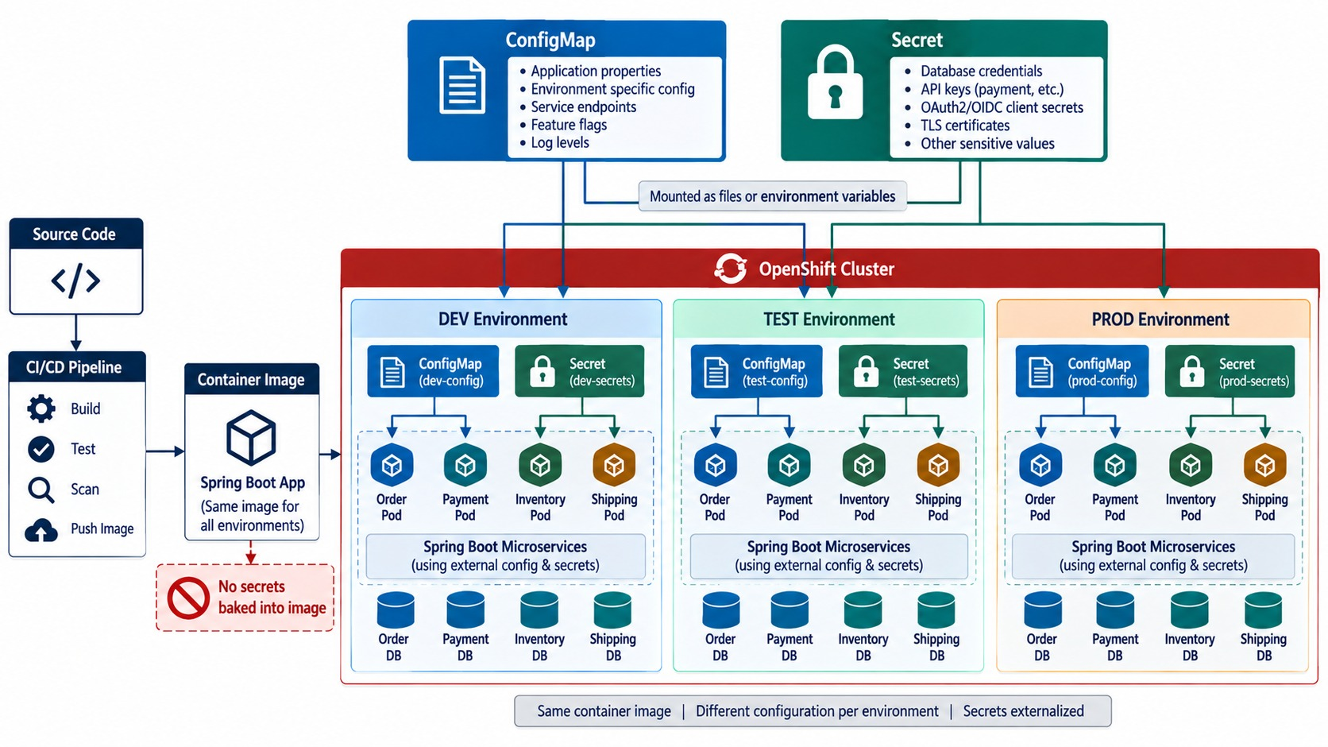
SECRETS AND CONFIGURATION MANAGEMENT
External configuration, OpenShift Secrets and profiles.
ConfigMap
URLs, topics, feature flags.
Secret
DB passwords, client secrets, API keys.
NEVER
✕
Secrets in Git or images
✕
Rebuilding per environment
KEY TAKEAWAY One image, many environments — configuration and secrets arrive at runtime.
25
© 2026 by Innovation In Software Corporation
Notes:
KEY TALKING POINTS
------------------
- ConfigMaps and Secrets
A ConfigMap holds non-sensitive configuration, like PAYMENT_SERVICE_URL, LOG_LEVEL or a feature flag.
A Secret holds sensitive values, like DB_PASSWORD, OAUTH_CLIENT_SECRET or an API key.
Both are supplied to the Spring Boot container at runtime.
- One image, many environments
Build one image, like order-service 1.0.0, and configure it differently for DEV, TEST and PROD without rebuilding.
- Never
Never hard-code credentials, commit secrets, or bake secrets into the image.
- Connections
This connects Twelve-Factor principles, Spring profiles, OpenShift and security.
- What the diagram shows
One image receiving ConfigMaps, Secrets and profiles per environment at runtime.
- Key point
One image, many environments.

Slide 26
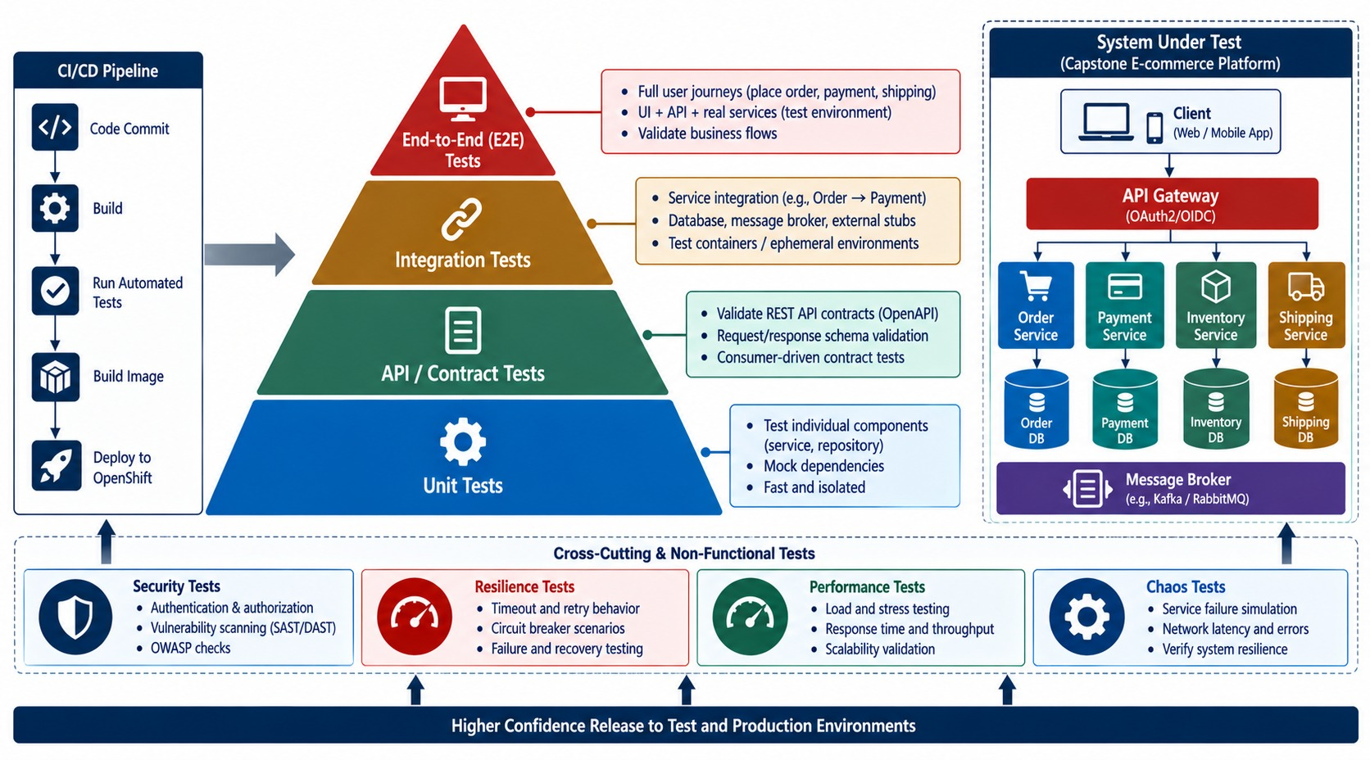
AUTOMATED TESTING STRATEGY
Unit, API, integration, contract and resilience tests.
Unit
Order state rules and policy logic.
Integration
Testcontainers with real Postgres and Kafka.
Contract
Consumers and providers agree on APIs and events.
Security and resilience
401/403 cases, timeouts, duplicates.
KEY TAKEAWAY Automate tests at every layer so problems surface before deployment.
26
© 2026 by Innovation In Software Corporation
Notes:
KEY TALKING POINTS
------------------
- Not just manual testing
Don't rely only on manual Postman testing.
Use a layered strategy: many unit tests, contract and API tests, integration tests, and a few end-to-end tests.
- Examples
Unit-test OrderService, API-test POST /orders, and integration-test the repository with the database.
Resilience tests simulate a payment timeout.
Event tests check that OrderCreated is published.
- Security tests
A call with no token is rejected, and so is one with the wrong scope.
A call with the correct permission is allowed.
- The goal
The goal is fast feedback before deployment.
- What the diagram shows
Unit, API, integration, contract, security and resilience tests layered in the pipeline.
- Key point
Catch problems before deployment.

Slide 27
PART 4: DELIVER TO OPENSHIFT
From a pull request to running, scalable pods.
✓ Part 1
Design
✓ Part 2
Build
✓ Part 3
Protect and test
Part 4
Deliver
Part 5
Operate and demo
SO FAR
NEXT QUESTION
How does a reviewed change reach production safely — and roll back if it doesn't?
✓
Tokens validated in every service
✓
Secrets arrive at runtime
IN THIS PART
✓
Tests cover rules, data and failures
Git workflow and PR gates
1
2
CI/CD — in code
3
Containers and OpenShift
4
Scaling, health and rollouts
5
Exercise: missing risk assessments
27
© 2026 by Innovation In Software Corporation
Notes:
KEY TALKING POINTS
------------------
- Why this part
Delivery turns code into a running platform.
Modules 7 and 8 come together here.
- What comes next
Pull request gates, the pipeline, images, OpenShift objects, rollouts and a troubleshooting exercise.

Slide 28
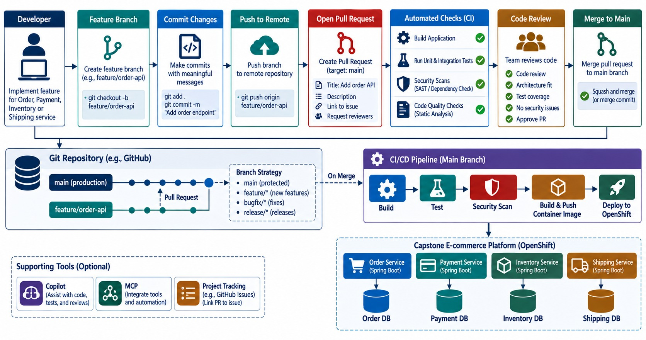
GIT WORKFLOW AND PULL REQUEST QUALITY GATES
Branching, review and automated checks.
BEFORE MERGING
✓
Build and tests pass
✓
Scans clean
✓
One approving review
✓
Contracts unchanged or versioned
AI CODE TOO Copilot changes pass the same gates.
KEY TAKEAWAY Every change — human or AI-written — passes the same automated and human gates.
28
© 2026 by Innovation In Software Corporation
Notes:
KEY TALKING POINTS
------------------
- Git is a workflow
Git isn't just backup storage; it's part of the engineering workflow.
Work on a feature branch, commit, push, and open a pull request.
- Automated validation
A pull request is a chance for automated checks: build, tests and security checks.
Then comes code review, then merge.
- Before merging
Does it compile?
Do tests pass?
Were any secrets committed?
Is there a critical dependency issue?
Did someone review it?
- AI code too
Don't rely entirely on Copilot-generated code.
AI-generated code goes through the same review, testing, security and quality gates as human-written code.
- What the diagram shows
A feature branch, pull request, automated checks, review and merge to main.
- Key point
Every change passes the same gates.

Slide 29
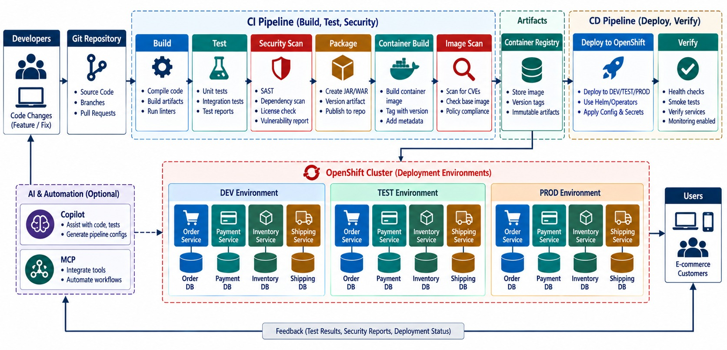
CI/CD PIPELINE INTEGRATION
GitHub Actions / Jenkins → build → test → scan → image → deploy.
Stop conditions
Failing tests, critical vulnerabilities, leaked secrets.
Build once
The same image digest moves from dev to prod.
VENDOR matters less than the gates.
KEY TAKEAWAY Automate the path from commit to deployment — and promote one versioned artifact.
29
© 2026 by Innovation In Software Corporation
Notes:
KEY TALKING POINTS
------------------
- The pipeline
A push or merge triggers CI.
It builds, then runs unit tests, integration tests and security scans.
Then it packages, builds the container, scans the image, pushes to the registry, deploys and verifies.
- The vendor matters less
Use GitHub Actions, Jenkins or both.
The important idea is a source change going through an automated, repeatable delivery process.
- Stop conditions
A failed test should stop the pipeline.
A critical security policy may stop it too.
Never deploy arbitrary source code directly to production.
- Build once, promote
Produce a versioned artifact, like order-service 1.4.2.
Then build once and promote that same artifact through every environment.
- What the diagram shows
Commit, build, test, scan, image, registry and deploy stages with gates between them.
- Key point
Build once and promote one artifact.

Slide 30
THE CAPSTONE PIPELINE IN ONE VIEW
Test, build one image, deploy it by digest — and know how to undo it.
.github/workflows/order-service.yml
✕
When the rollout goes wrong
jobs:
build:
runs-on: ubuntu-latest
steps:
- uses: actions/checkout@v4
- uses: actions/setup-java@v4
with: { distribution: temurin, java-version: '21' }
- run: mvn -B verify # unit + Testcontainers
- uses: aquasecurity/trivy-action@0.28.0
with: { scan-type: fs, severity: CRITICAL, exit-code: '1' }
- run: |
podman build -t $IMAGE:${{ github.sha }} .
podman push --digestfile digest $IMAGE:${{ github.sha }}
- run: |
oc set image deploy/order-service \
order-service=$IMAGE@$(cat digest)
oc rollout status deploy/order-service --timeout=180s
oc rollout status deploy/order-service
# error: deployment exceeded its progress deadline
oc get pods -l app=order-service
oc logs deploy/order-service --tail=50
oc rollout undo deploy/order-service
oc rollout status deploy/order-service
# then: fix forward through a new PR
Commit SHA tag
Deploy by digest
Rollback
Traceable back to the change.
Exactly the image that was scanned.
Practised — Lab 4's oc rollout undo.
KEY TAKEAWAY Gate on tests and scans, deploy one image by digest, and practise the rollback.
30
© 2026 by Innovation In Software Corporation
Notes:
KEY TALKING POINTS
------------------
- The pipeline
Build and test with Maven, scan, build and push one image, then deploy that exact digest and wait for the rollout.
- Gates
A failing test or a critical vulnerability stops the job before any image is deployed.
- Rollback
If the rollout doesn't complete, inspect pods and logs, undo to the previous version, then fix forward through a new pull request.
- Lab link
Lab 4 uses oc rollout undo as the recovery evidence for the capstone demo.

Slide 31
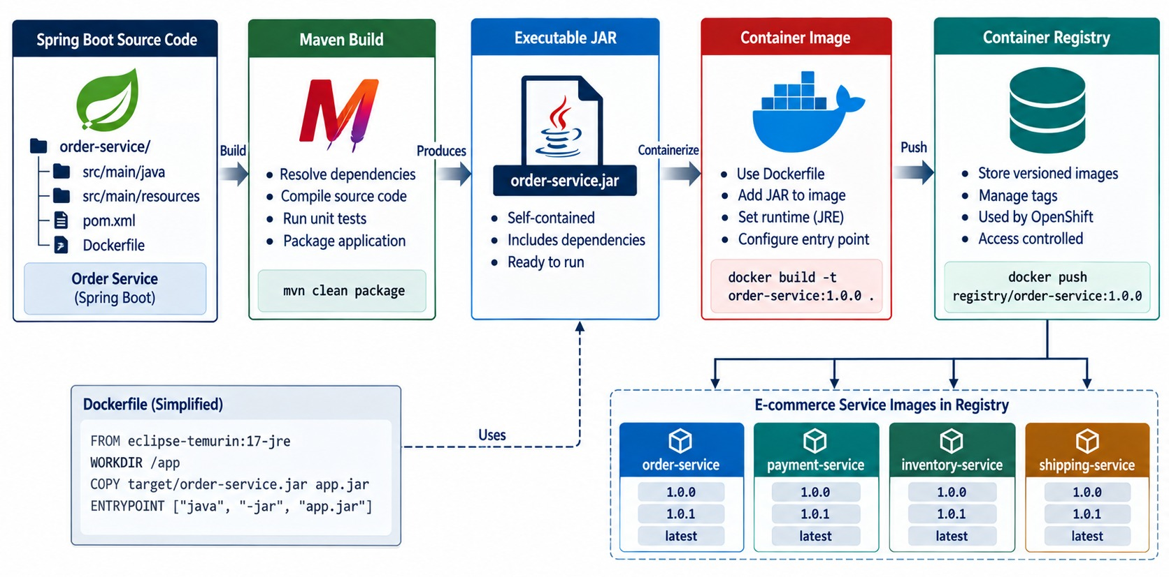
CONTAINERIZING THE MICROSERVICES
Docker/OCI images, tagging and the registry.
EVERY IMAGE
✓
Multi-stage build
✓
Non-root user
✓
Versioned tag, no :latest
✓
Scanned before push
✓
No secrets inside
IMAGE VS CONTAINER Template vs running instance.
KEY TAKEAWAY Every service ships as a versioned, scanned, secret-free container image.
31
© 2026 by Innovation In Software Corporation
Notes:
KEY TALKING POINTS
------------------
- From code to image
Spring Boot code goes through the Maven build to a JAR.
The container build turns it into an OCI image, which is pushed to the registry.
OCI is the open standard format for container images.
- The Dockerfile
The Dockerfile starts from eclipse-temurin 21 JRE, sets the working directory, copies the JAR, and runs it with java -jar.
- One image per service
Each microservice becomes its own image: order-service, payment-service, inventory-service and shipping-service, each versioned.
- Good practices
Use a trusted base image, keep the runtime image small, and run as non-root where possible.
Never embed secrets.
Version, scan, and make builds reproducible.
- Image versus container
A container image is not the running application.
The image is the immutable package; OpenShift creates running containers from it.
- What the diagram shows
Source built into a versioned, scanned image, pushed to a registry and pulled by OpenShift.
- Key point
Every service ships as a versioned image.

Slide 32
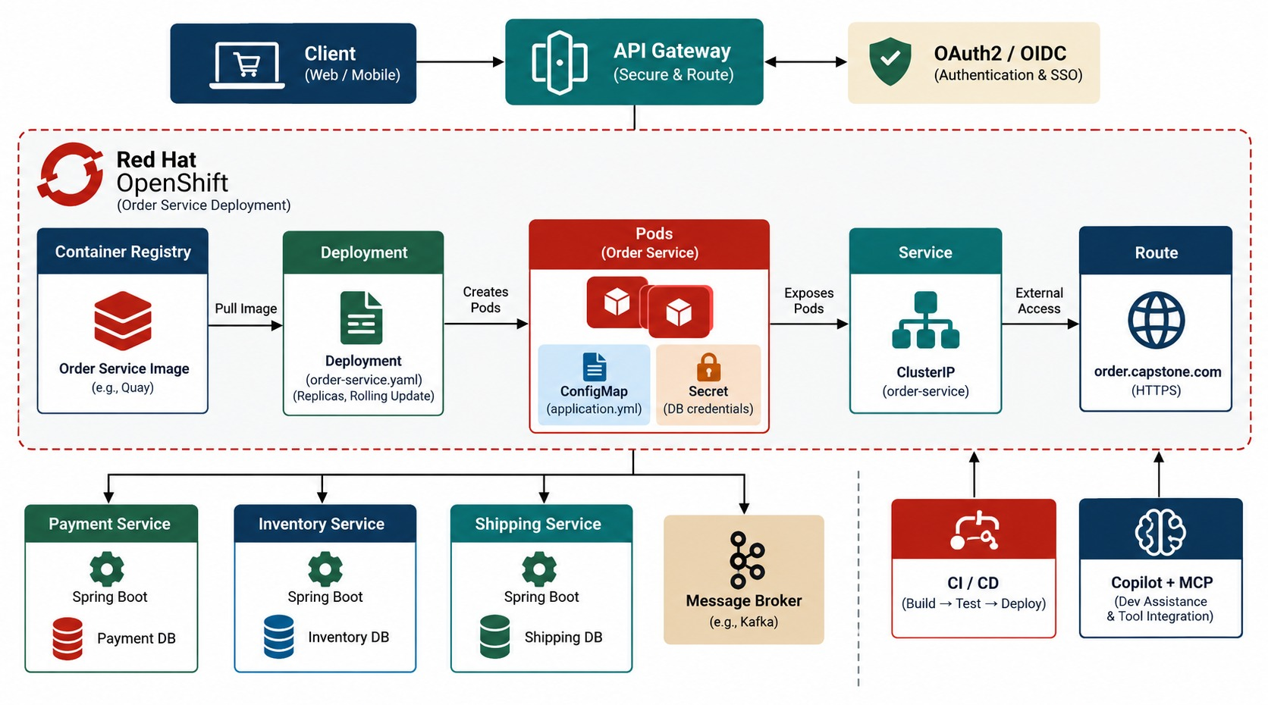
DEPLOYING TO OPENSHIFT
Deployment, Service, Route, ConfigMap and Secret.
Deployment
Runs the pods with probes and resources.
Service
Stable internal address for other services.
Route
External HTTPS — only for public entry points.
INTERNAL ONLY Payment and Inventory need no Route.
KEY TAKEAWAY OpenShift runs each service as Deployment → Pods → Service, exposing only what must be public.
32
© 2026 by Innovation In Software Corporation
Notes:
KEY TALKING POINTS
------------------
- From registry to client
The image registry feeds OpenShift.
A Deployment creates pods, a Service fronts them, and a Route exposes them to clients.
ConfigMaps, Secrets and ServiceAccounts support the deployment.
- The objects
A Deployment describes the desired workload, and a Pod runs the container.
A Service gives stable internal network access.
A Route gives external access when it's needed.
- Traffic path
Traffic goes client, route, service, then the Order pods.
- Don't expose everything
Don't expose every microservice externally.
Often only the API gateway is reachable from outside, and the backend services stay internal.
- What the diagram shows
Deployment, Pods, Service, Route, ConfigMap and Secret for each service in a project.
- Key point
Expose only what must be public.

Slide 33
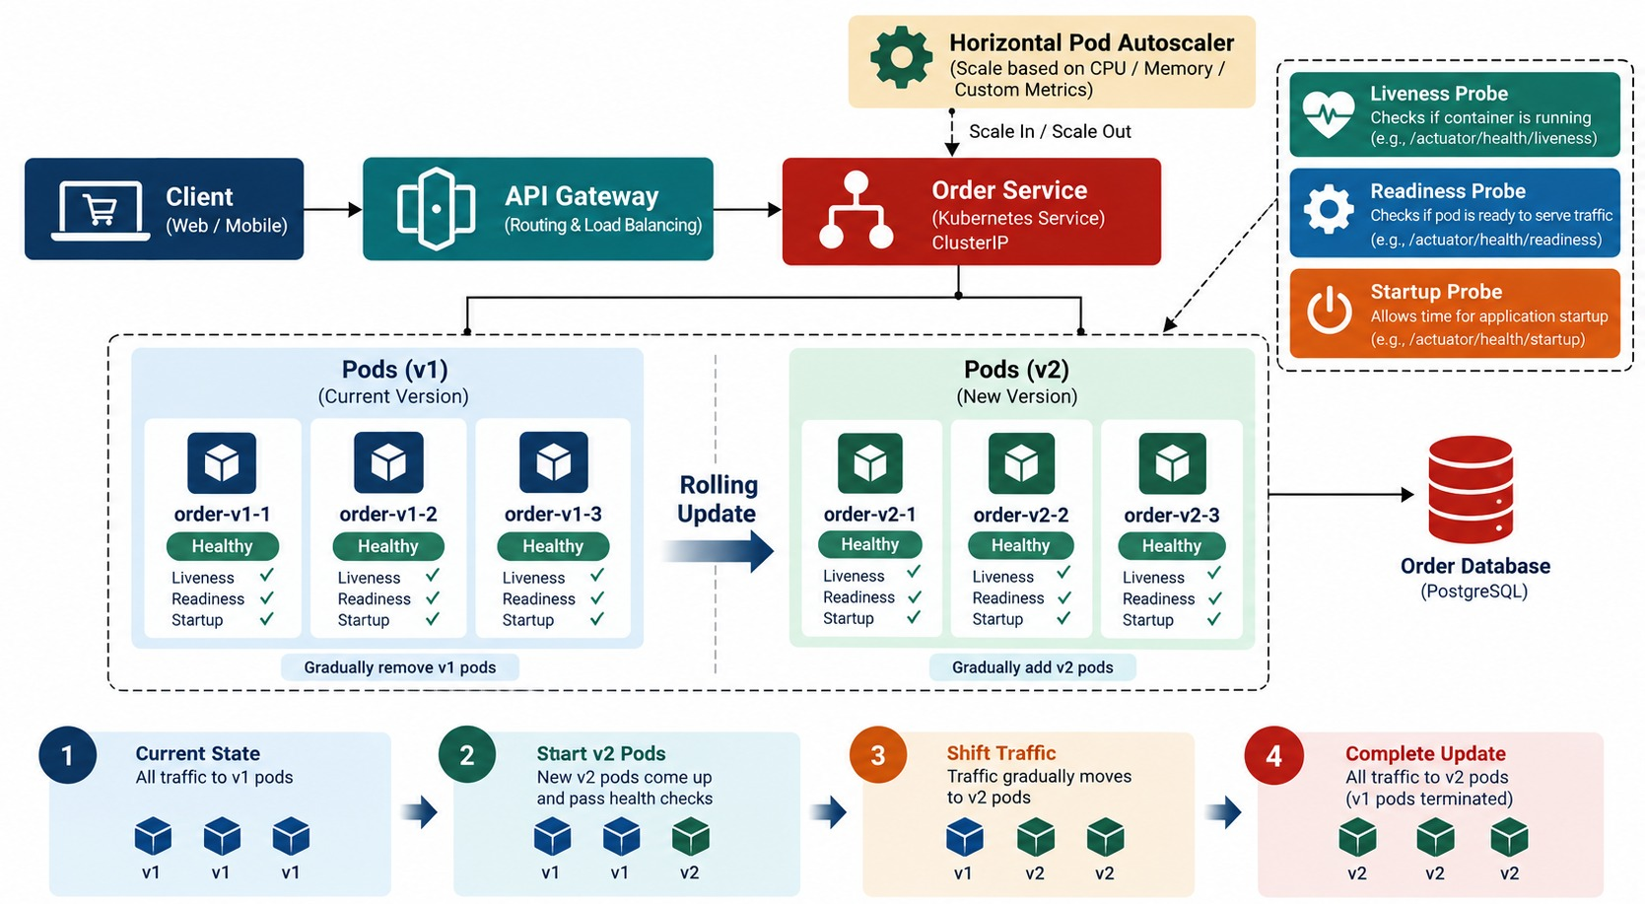
SCALING, HEALTH CHECKS, AND ROLLOUTS
Readiness and liveness, replicas and rolling updates.
Readiness
No traffic until the pod can serve.
Liveness
Restart a stuck pod.
Rolling update
New pods ready before old ones stop.
RECOVERY oc rollout undo restores the last version.
KEY TAKEAWAY Replicas add capacity, probes guard traffic, rolling updates replace versions safely.
33
© 2026 by Innovation In Software Corporation
Notes:
KEY TALKING POINTS
------------------
- Scaling
If Order Service is stateless at the instance level, going from one replica to three adds capacity and availability.
The Service spreads traffic across the pods.
- Health probes
The startup probe asks whether initialization has finished.
The readiness probe asks whether this pod should receive traffic.
The liveness probe asks whether the app is healthy enough to keep running.
- Rolling updates
During a rolling update, OpenShift gradually replaces version 1 pods with version 2.
- Recovery
If the new release fails, the deployment strategy should support recovery or rollback.
- What the diagram shows
Replicas behind a Service, readiness and liveness probes, and pods replaced version by version.
- Key point
Probes guard traffic during rollouts.

Slide 34
EXERCISE: WHY ARE RISK ASSESSMENTS MISSING?
Troubleshoot the deployed banking platform in a sensible order.
PRACTICE EXERCISE
10 MIN
SCENARIO
YOUR TASKS
EXPECTED OUTCOME
On OpenShift, transactions are submitted successfully, but GET /api/v1/assessments/{transactionId} returns 404 for every new one.
1
Choose which service to check first
✓
Was TransactionSubmitted published?
2
List the checks in order
✓
Broker reachable; consumer group risk-assessment-service
3
Name the evidence that confirms each
✓
Risk pod Ready; logs show errors?
✓
ConfigMap topic and Secret values set
✓
401/403 on the lookup call?
KEY TAKEAWAY Follow the event: published, delivered, consumed, stored — then check config and access.
34
© 2026 by Innovation In Software Corporation
Notes:
KEY TALKING POINTS
------------------
- Start at the source
Confirm Transaction Service published the event, with the correlation ID from its logs.
- Follow the path
Check the broker, the consumer group, the Risk Assessment pod's readiness and its logs.
- Configuration and access
A wrong topic in the ConfigMap, a missing Secret, or a 401 or 403 on the lookup can each look like missing data.

Slide 35
PART 5: OPERATE, ACCELERATE AND DEMONSTRATE
Observability, AI working through the platform, and the final demo.
✓ Part 1
Design
✓ Part 2
Build
✓ Part 3
Protect and test
✓ Part 4
Deliver
Part 5
Operate and demo
SO FAR
NEXT QUESTION
Can we see, explain and prove how the platform behaves — including when it fails?
✓
Every change passes PR and pipeline gates
✓
One image deployed by digest
IN THIS PART
✓
Probes, rollouts and rollback in place
Observability and monitoring
1
2
Copilot and agentic AI with MCP
3
The demo — in commands
4
Official capstone demonstration
5
Readiness review and the full architecture
35
© 2026 by Innovation In Software Corporation
Notes:
KEY TALKING POINTS
------------------
- Why this part
Production readiness means you can observe the system, use AI safely and demonstrate the result.
- What comes next
Signals, AI patterns, the demo commands, the official demonstration and a readiness review.

Slide 36
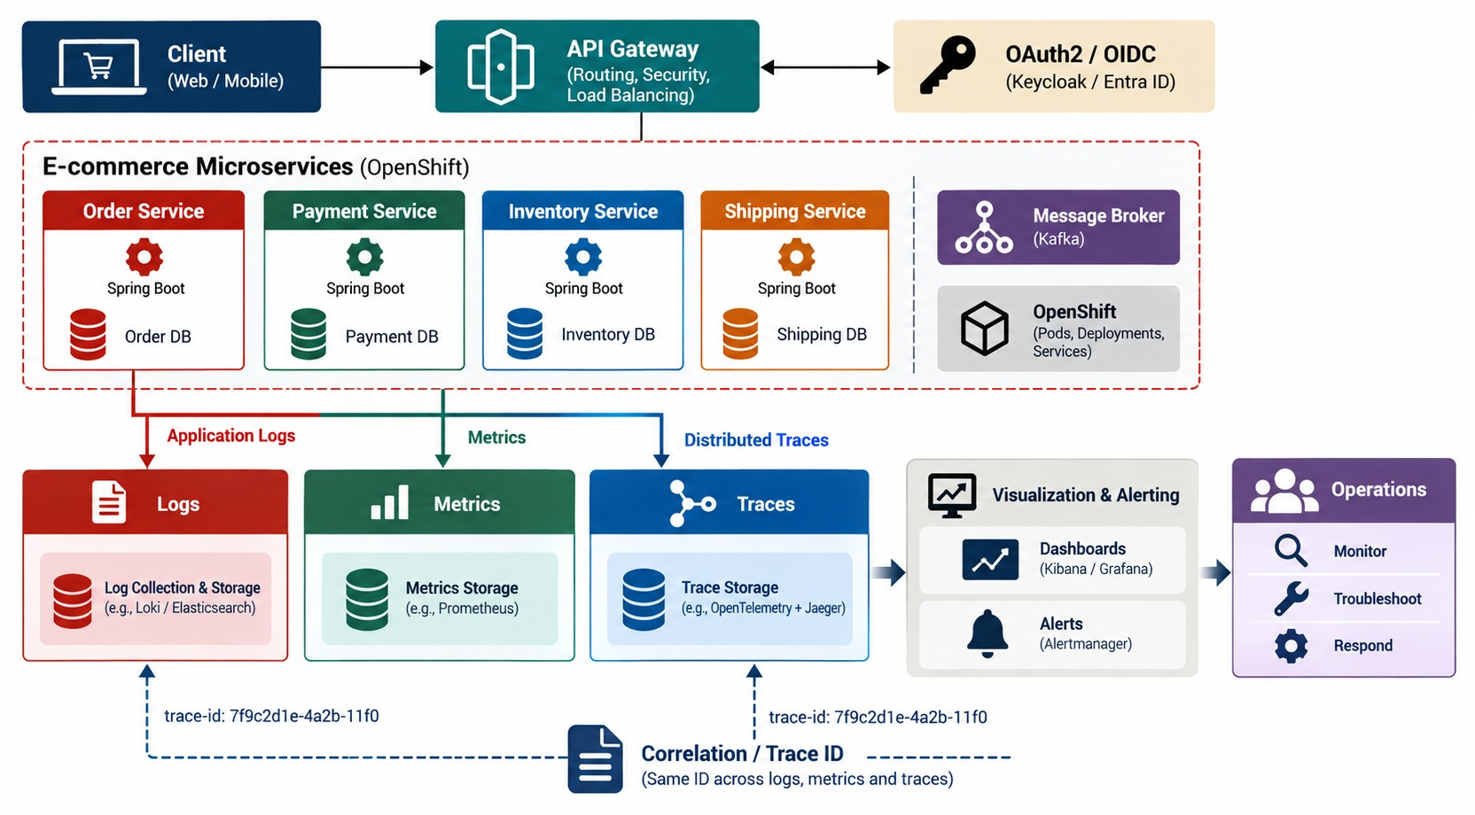
OBSERVABILITY AND MONITORING
Logs, metrics, traces, dashboards and alerts.
Metrics find it
Error rate on POST /orders jumps.
Traces locate it
The payment span takes 2 seconds.
Logs explain it
Timeouts, with the correlation ID.
ALERT ON HOLD backlog and DLQ depth too.
KEY TAKEAWAY Follow one request end to end — metrics find it, traces locate it, logs explain it.
36
© 2026 by Innovation In Software Corporation
Notes:
KEY TALKING POINTS
------------------
- Three signals
Logs tell you what happened.
Metrics tell you how healthy things are.
Traces tell you where the time went.
Add health checks, dashboards, alerts and correlation IDs.
- Monitoring versus observability
Monitoring asks: is something wrong?
Observability helps answer: why is it wrong?
- An example
Checkout takes eight seconds, and metrics show high latency.
The trace shows the gateway at 20 milliseconds, Order at 60, Payment at 7,600, and Inventory at 80.
Now we know to investigate Payment.
- Follow the request
Logs with the same correlation or trace ID show what happened.
The system should let you follow a request from the customer through the gateway, Order and Payment to the database.
- What the diagram shows
Logs, metrics and traces from every service flowing to dashboards and alerts.
- Key point
Follow one request end to end.

Slide 37
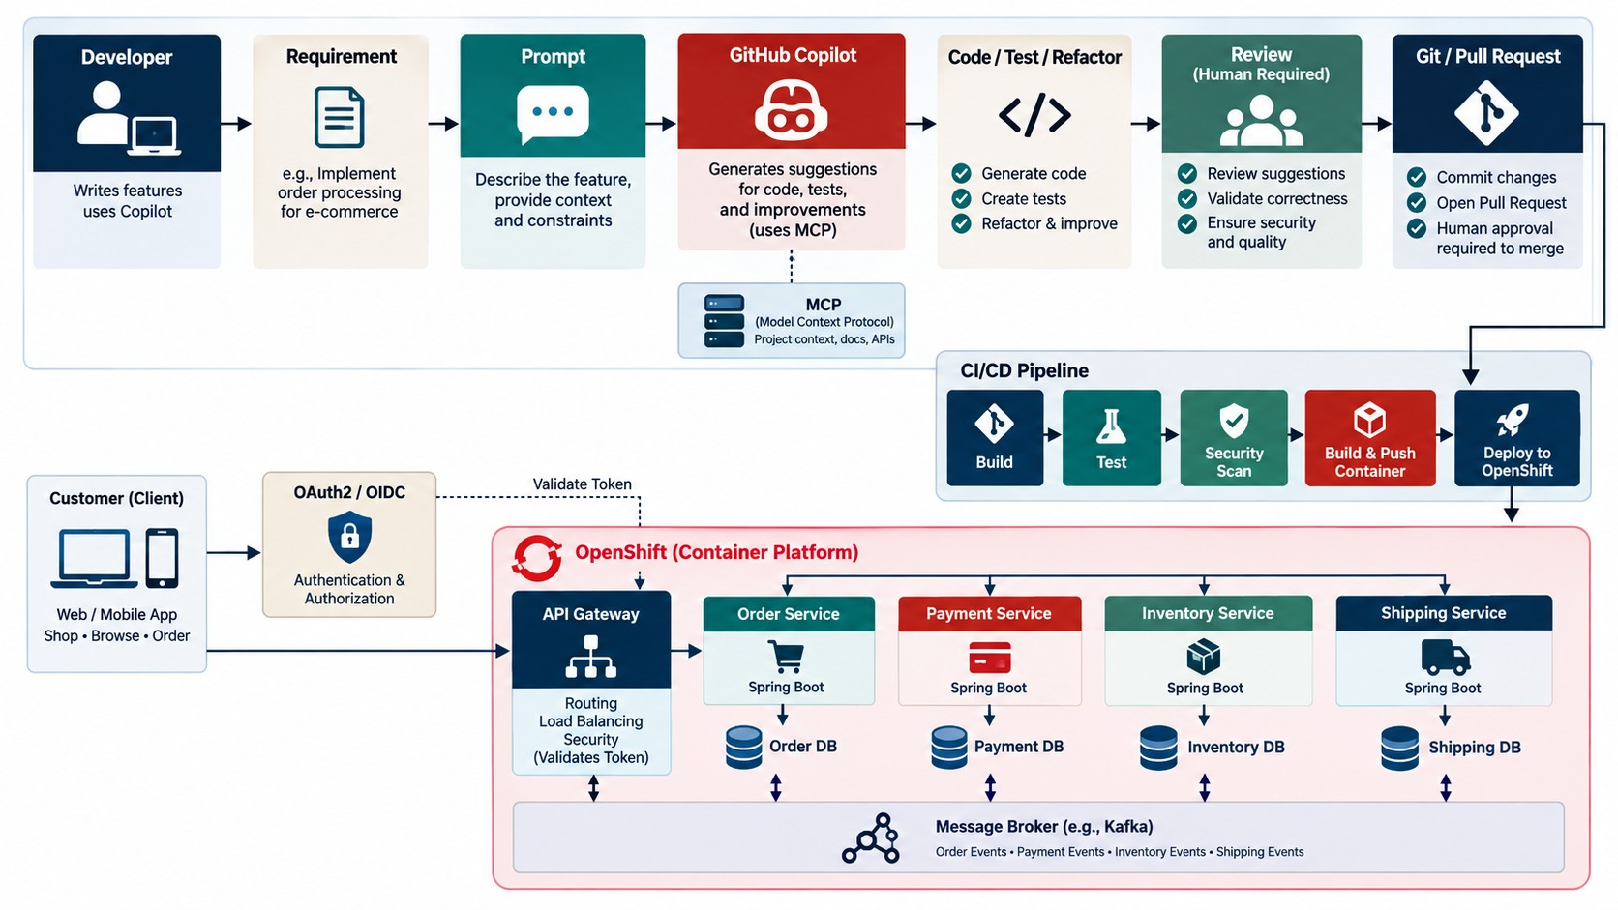
AI-ASSISTED DEVELOPMENT WITH GITHUB COPILOT
Generate, test, refactor and troubleshoot.
GOOD USES
Draft code
Write tests
Refactor
Explain errors
After it generates
Review, test and scan like any other change.
BOUNDARY The developer owns the result.
KEY TAKEAWAY Use Copilot across the capstone — and review, test and secure everything it writes.
37
© 2026 by Innovation In Software Corporation
Notes:
KEY TALKING POINTS
------------------
- The right boundary
Use Copilot throughout the capstone, but show the right responsibility boundary.
The developer turns a requirement into a good prompt, and Copilot produces code, tests or refactoring.
Then come developer review, automated tests, security checks, Git and a pull request.
- A good prompt
For example: implement a Spring Boot 3 REST controller for the existing OrderService, with GET /orders/{id} and POST /orders.
Use DTOs, Bean Validation, constructor injection and existing exception conventions, and keep persistence logic out of the controller.
That's far better than 'build my microservice'.
- After it generates
Inspect the code, understand it, compile it and test it.
Do a security review, then accept, modify or reject it.
- Uses
Copilot helps with boilerplate, controllers, DTOs, tests, refactoring, documentation and troubleshooting.
- The principle
Copilot accelerates engineering work; it doesn't remove engineering accountability.
- What the diagram shows
Prompt, generate, review, test, refactor and merge through the normal pipeline.
- Key point
AI output gets the same review and tests.

Slide 38
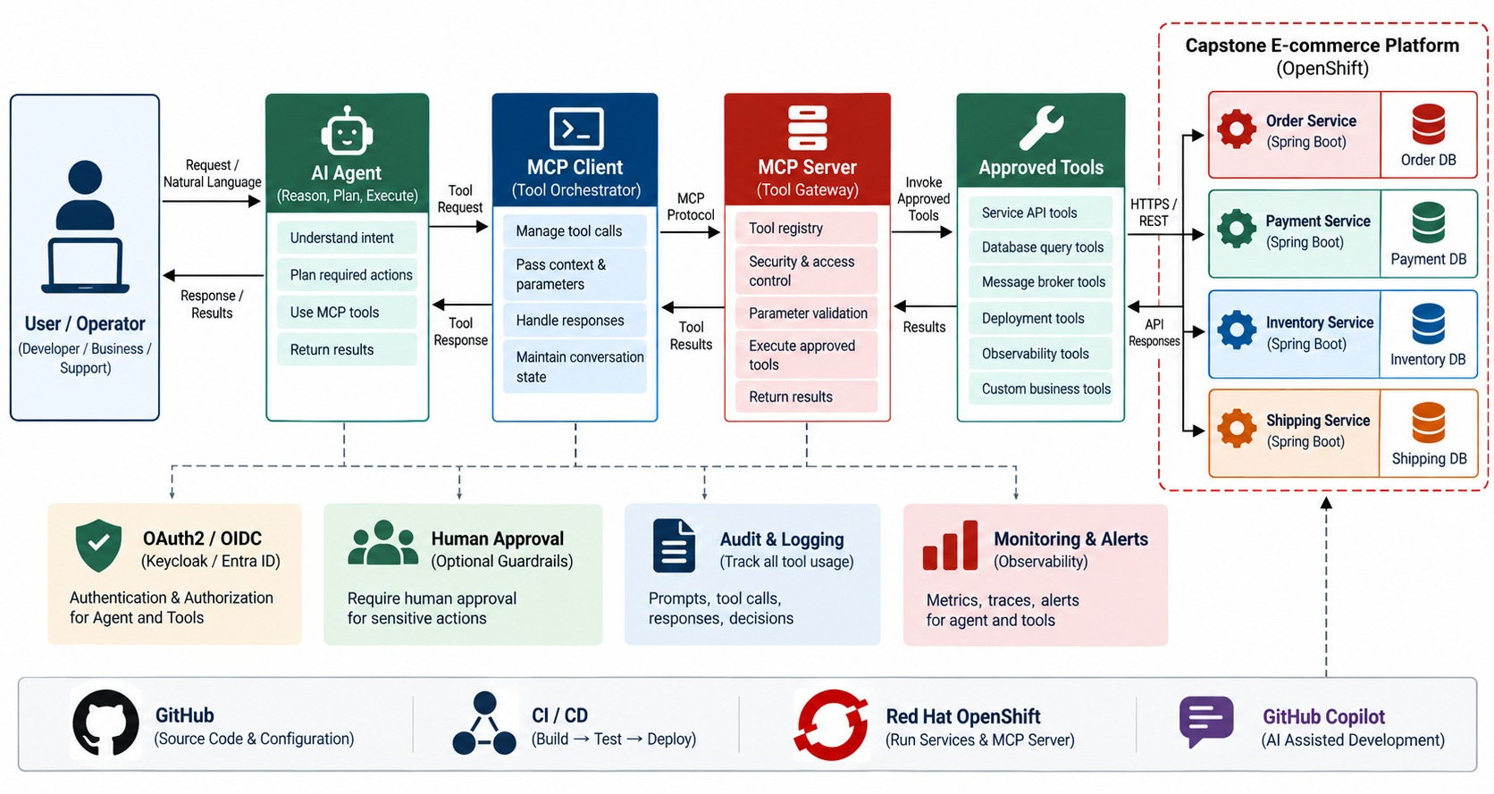
AGENTIC AI AND MCP INTEGRATION
Agent → MCP → backend microservice tools.
Example request
“Why is order ORD-1045 still pending?”
Tools
get_order, get_payment — read-only; refunds need approval.
NEVER
✕
Direct database access
✕
Superuser tokens
KEY TAKEAWAY Agents reach microservices only through MCP tools and APIs — never their databases.
38
© 2026 by Innovation In Software Corporation
Notes:
KEY TALKING POINTS
------------------
- Combining Modules 10 and 11
The user or operator talks to the AI agent, which uses the MCP client and server.
Tools like getOrder, cancelOrder and getPayment go through the API gateway to the Spring Boot services.
- An example request
The user says: check order 1001; if it hasn't shipped, cancel it and tell me whether a refund is needed.
The agent calls getOrder and sees it's not shipped.
It calls cancelOrder, then getPaymentForOrder.
If the payment was captured, it explains or requests an approved refund.
- No direct database access
MCP standardizes access to the tools.
But the agent must not directly change the Order or Payment databases.
It goes agent, MCP, approved tool, API, microservice and business rules.
- Security still applies
A sensitive tool like refundPayment may need stronger authorization or human approval.
- What the diagram shows
An agent calling MCP tools that invoke microservice APIs under the user's identity, never their databases.
- Key point
Agents act only through governed tools.

Slide 39
THE CAPSTONE DEMO IN COMMANDS
Lab 5's script: prove the decisions locally, then prove the platform on OpenShift.
Risk decisions (PowerShell, labs/day-05/lab5)
✓
OpenShift evidence and recovery
$OPS = python tools\issue-jwt.py ops
$REVIEWER = python tools\issue-jwt.py reviewer
.\tools\publish-event.ps1 -File tools\events\approve.json
.\tools\publish-event.ps1 -File tools\events\approve.json # duplicate
.\tools\publish-event.ps1 -File tools\events\timeout.json # HOLD
.\tools\publish-event.ps1 -File tools\events\hold.json
curl.exe -s -H "Authorization: Bearer $OPS" `
"http://localhost:8083/api/v1/assessments?disposition=HOLD"
# review TXN-B2C3D4E5 with $REVIEWER -> 200
# same POST with $OPS -> 403
$PROJECT = oc project -q
oc -n $PROJECT rollout status deploy/risk-assessment-service
$RISK = oc -n $PROJECT get route risk-assessment-service `
-o jsonpath="{.spec.host}"
curl.exe -s https://$RISK/actuator/health/readiness # 200
# Lab 4 recovery
oc -n $PROJECT rollout undo deploy/account-service
oc -n $PROJECT rollout status deploy/account-service
Duplicate
Timeout
Evidence
Logs show it ignored — still one row.
HOLD MODEL_UNAVAILABLE — never APPROVE.
Route readiness 200, then a working rollback.
KEY TAKEAWAY Show the happy path, the failures and the recovery — each with evidence on screen.
39
© 2026 by Innovation In Software Corporation
Notes:
KEY TALKING POINTS
------------------
- Local decisions
Publish approve.json twice to show one row, timeout.json to show HOLD with MODEL_UNAVAILABLE, and hold.json for the review.
- Human review
The reviewer token completes the HOLD with 200.
The same request with the ops token is 403.
- OpenShift
Show the rollout is complete and the Route readiness endpoint returns 200, then Lab 4's rollout undo as recovery.
- Logs
Logs show transactionId and correlationId, but never Authorization headers or API keys.

Slide 40
CAPSTONE DEMONSTRATION — DAY 5
Official checkpoint: demonstrate Labs 1–5 as one working platform.
OFFICIAL CAPSTONE DEMO
30 MIN
labs/day-05/lab5/LAB-5-GUIDE.md
SCENARIO
YOUR TASKS
EXPECTED OUTCOME
Teams demonstrate the banking Account, Transaction and Risk Assessment services. Do not run TEKsystems Lab 13.
1
Successful transaction → APPROVE
✓
All six demos with visible evidence
2
Duplicate event → still one row
Synthetic, secret-free logs
✓
3
Model timeout → HOLD, never APPROVE
✓
Each step explained by its module
4
Human review: reviewer 200, ops 403
✓
No invented financial outcome
5
OpenShift Route readiness 200
6
Rollback: oc rollout undo
KEY TAKEAWAY Six demos, each with evidence: success, duplicate, HOLD, review, OpenShift, recovery.
40
© 2026 by Innovation In Software Corporation
Notes:
KEY TALKING POINTS
------------------
- Official checkpoint
Module 13 has no numbered exercise.
Run the Day 5 capstone demonstration from the Lab 5 guide.
- Required demos
A successful transaction, a duplicate event, a model timeout or failure giving HOLD, human review, OpenShift Route evidence and rollback or recovery.
- Scope
Use the Labs 1–5 banking services.
Don't run TEKsystems Lab 13 with Customer, Notification, Redis or Jenkins.
- Timing
Adjust the time to the number of teams.

Slide 41
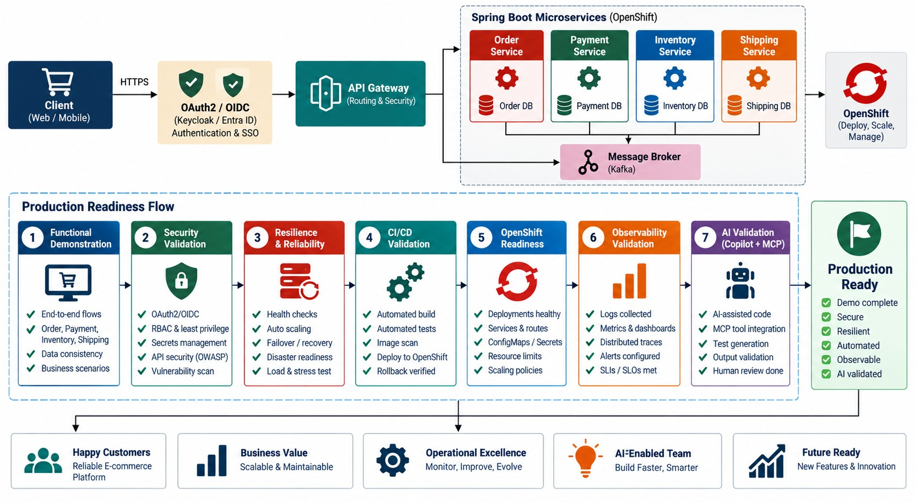
CAPSTONE DEMO AND PRODUCTION READINESS REVIEW
Demonstrate the story, then decide: is it ready?
READINESS QUESTIONS
✓
Correct under failure
✓
Secured and audited
✓
Delivered by pipeline
✓
Observable and recoverable
✓
AI kept under control
FINAL QUESTION Would you run this with real money?
KEY TAKEAWAY Demonstrate the whole engineering story — from order to operations — not one endpoint.
41
© 2026 by Innovation In Software Corporation
Notes:
KEY TALKING POINTS
------------------
- The final demo
Teams create an order, process payment, publish an event, reserve inventory and create a shipment.
They observe the request and demonstrate failure handling and security.
They show CI/CD, the OpenShift deployment, and Copilot or MCP.
- Tell the whole story
Don't make the demo just 'POST /orders returns 201'.
Show resilience by briefly making a dependency unavailable.
Show security: without a token the call is rejected; with correct authorization it's accepted.
- Delivery and operations
Show commit, pipeline, tests, image and deployment.
Show pods, services, routes and health in OpenShift.
Follow one request through logs, metrics and a trace.
- AI
Use Copilot for a controlled engineering task, or use an MCP-enabled agent to inspect a backend capability.
- Readiness and the final question
Check architecture, tests, security, resilience, deployment, observability and documentation.
The final question: could another engineering team understand, deploy, operate, troubleshoot and safely evolve this system?
- What the diagram shows
The demo path from a successful request through failure, review, deployment evidence and recovery to a readiness decision.
- Key point
Demonstrate the whole engineering story.

Slide 42
EXERCISE: PRODUCTION READINESS REVIEW
A team says their platform is ready. Review the evidence.
PRACTICE EXERCISE
10 MIN
SCENARIO
YOUR TASKS
EXPECTED OUTCOME
The team's readiness checklist:
1
Mark each item: ready, risky or blocking
✓
:latest → versioned tag and digest
✓ mvn verify passes
✓ Image pushed as :latest
✓ Route readiness returns 200
✓ JWT scopes on every endpoint
DB password in the ConfigMap
No alert on the HOLD backlog
Rollback never tried
2
Give the fix for each gap
✓
Password → Secret, then rotate
3
Decide: go or no-go
✓
Alert on HOLD backlog and DLQ
✓
Rehearse oc rollout undo
✓
No-go until the blockers are fixed
KEY TAKEAWAY Ready means secure, traceable, observable and recoverable — not just "it starts".
42
© 2026 by Innovation In Software Corporation
Notes:
KEY TALKING POINTS
------------------
- Blocking
A password in a ConfigMap is exposed to anyone who can read configuration.
It must move to a Secret and be rotated.
- Risky
The :latest tag makes deployments untraceable, and an untested rollback may fail when needed.
- Operations
Without an alert, a growing HOLD backlog means customers wait with nobody noticing.
- Decision
No-go until the blockers are fixed.
Readiness is decided with evidence.

Slide 43
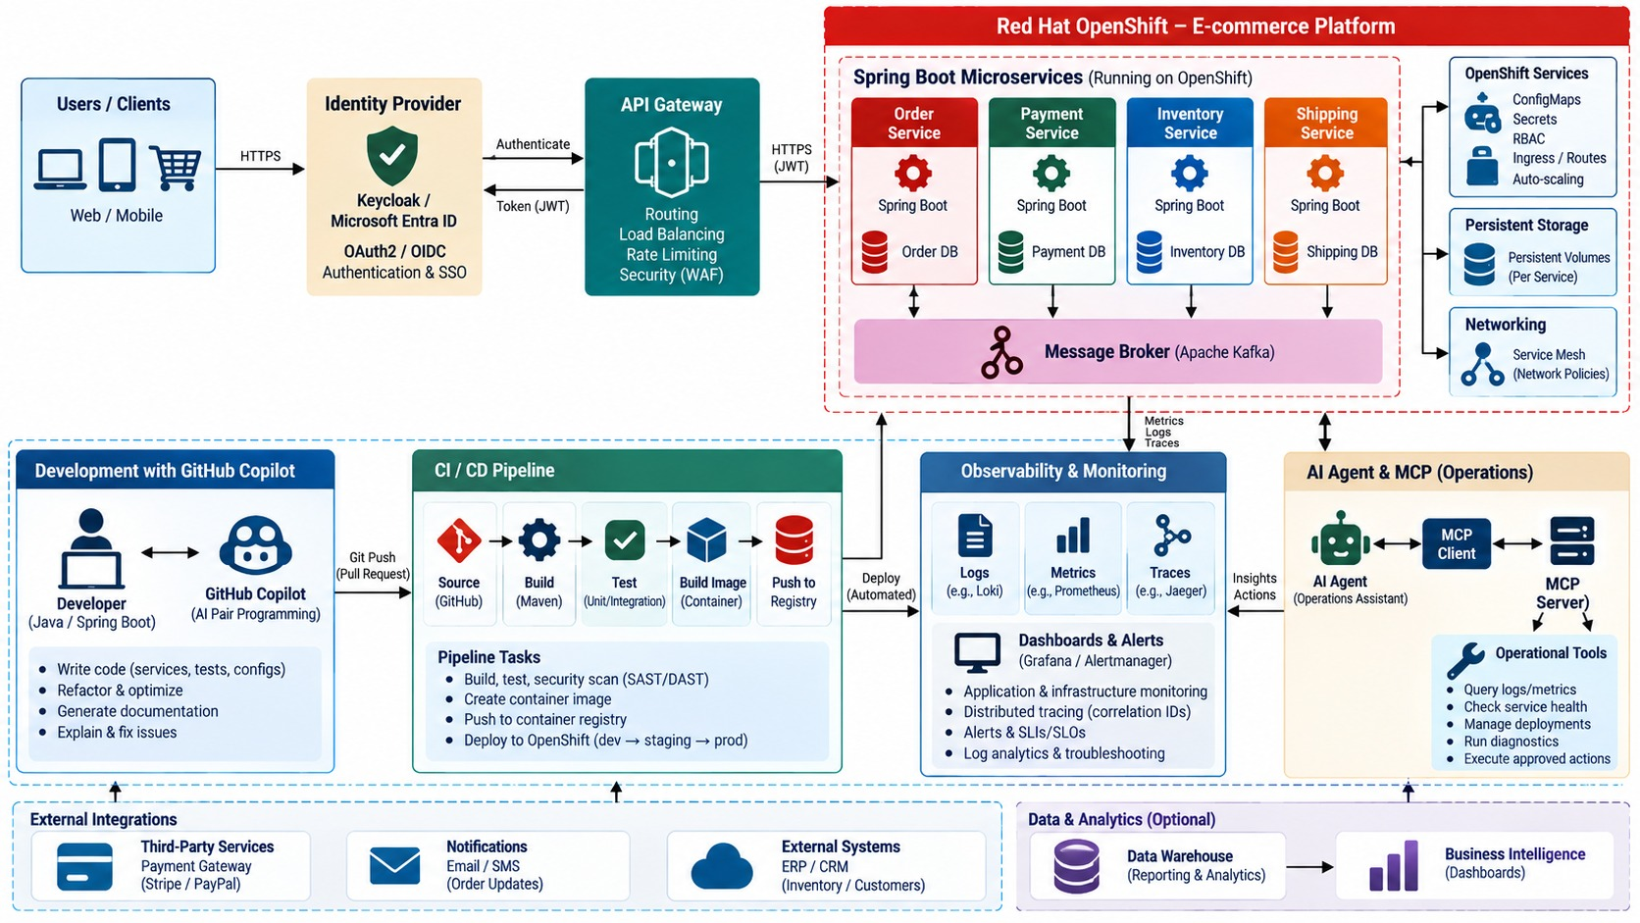
COMPLETE END-TO-END PRODUCTION ARCHITECTURE
Every module combined in one production platform.
Customer request path
Gateway, identity, services, events, data.
Software delivery path
Git, pipeline, registry, OpenShift.
Operations path
Probes, logs, metrics, traces, alerts.
Two AI patterns
Copilot for developers; agents through MCP.
KEY TAKEAWAY Production microservices = clear boundaries, security, automation and operations — with AI working through them.
43
© 2026 by Innovation In Software Corporation
Notes:
KEY TALKING POINTS
------------------
- Customer request path
The customer authenticates with Keycloak or Entra ID and gets an access token.
The request goes through the API gateway to Order Service, then to Payment, Inventory and Shipping.
The customer sees one business experience, even though many services work behind it.
- Software delivery path
The developer works with Copilot, then Git, a pull request, CI/CD, tests and security scans.
The code becomes a container image in the registry and runs on OpenShift.
This answers: how does source code safely become a running production workload?
- Operations path
A running service produces logs, metrics and traces.
Those feed dashboards and alerts, and an engineer diagnoses and improves.
Deployment isn't the end; production feedback returns to engineering.
- Two AI patterns
Copilot assists the developer with code, tests and refactoring.
Agent plus MCP gives controlled AI access to runtime capabilities through approved tools and APIs.
Neither bypasses security, business rules, testing, authorization or audit.
- The final message
AI does not replace business architecture; AI works through it.
Production microservices engineering means clear business boundaries.
Services must be independently developed, integrated, secured, tested, delivered, deployed, scaled, observed and safely evolved.
- What the diagram shows
The customer request path, software delivery path, operations path and AI patterns combined in one production platform.
- Key point
Every module works together in production.

Slide 44
CAPSTONE MISCONCEPTIONS AND ANTI-PATTERNS
Beliefs and habits that stop a working demo from being a production platform.
MISCONCEPTION
REALITY
ANTI-PATTERNS TO AVOID
It runs, so it's done
Deployed, observable and recoverable
✕
A distributed monolith
✕
:latest images in production
✕
Secrets in ConfigMaps
A shared database is simpler
Share through APIs and events
✕
Auto-approving on model failure
✕
Demoing only the happy path
✕
Rollback never rehearsed
Retries fix failures
Only with idempotency and limits
REMEMBER Prove it with evidence — including failure and recovery.
AI wrote the tests, so it's tested
Review every generated assertion
Agents can query the database
Only through MCP tools and APIs
KEY TAKEAWAY Production-ready means correct under failure, secure, automated and observable.
44
© 2026 by Innovation In Software Corporation
Notes:
KEY TALKING POINTS
------------------
- Why this slide
Before the knowledge check, clear away the beliefs that turn a good demo into a fragile system.
- Design and failure
Shared databases couple services, and retries without idempotency create duplicate charges.
- AI
Generated tests need review, and agents act only through governed tools.
- Anti-patterns
Distributed monoliths, :latest images, secrets in ConfigMaps, auto-approval on model failure, happy-path demos and untested rollbacks.

Slide 45
KNOWLEDGE CHECK (1 OF 2)
Design, data and resilience — answer in your own words.
Why should each microservice own its data?
What could Redis add to the platform?
1
5
When should services communicate through REST?
How do timeouts and circuit breakers help?
2
6
When should services communicate through events?
What does CI validate before deployment?
3
7
Why prefer local transactions over distributed ones?
4
45
© 2026 by Innovation In Software Corporation
Notes:
KEY TALKING POINTS
------------------
- 1. Data ownership
It supports independent schema evolution and service autonomy.
- 2. REST
For immediate request-response interactions.
- 3. Events
When other services can react asynchronously.
- 4. Local transactions
They preserve autonomy and avoid distributed coordination complexity.
- 5. Redis
It can cache selected read-heavy or short-lived data.
Lecture only in this course.
- 6. Timeouts and circuit breakers
Timeouts prevent indefinite waiting; circuit breakers stop repeated calls to failing dependencies.
- 7. CI
Build, tests, quality checks and packaging.

Slide 46
KNOWLEDGE CHECK (2 OF 2)
Delivery, security, AI and operations.
Why are container images useful for OpenShift?
How can Copilot help without replacing review?
1
5
OpenShift Service vs. Route?
What does MCP provide for AI agents?
2
6
How does Spring Security protect APIs?
Which signals are needed for production readiness?
3
7
Why must secrets be externalized?
4
46
© 2026 by Innovation In Software Corporation
Notes:
KEY TALKING POINTS
------------------
- 8. Images
Consistent, portable runtime packaging.
- 9. Service vs. Route
A Service provides internal access; a Route exposes external HTTP or HTTPS access.
- 10. Spring Security
It validates tokens and enforces authorization rules.
- 11. Secrets
They must be protected, rotated, and kept out of source code and images.
- 12. Copilot
It drafts code, tests and docs, but developers must review and test the output.
- 13. MCP
Controlled tools and resources for AI clients.
- 14. Signals
Health checks, logs, metrics, traces, events and deployment status.
- Practical scenario
If new risk assessments don't appear, follow the event from Transaction Service through the broker to Risk Assessment, then check logs, probes, configuration and authorization.

Slide 47
COURSE SUMMARY AND NEXT STEPS
From one Spring Boot service to a secure, observable, AI-assisted platform on OpenShift.
YOU CAN NOW
NEXT: BRING IT BACK TO YOUR TEAM
Design service boundaries, APIs and events
1
Which service would you harden first?
✓
Build resilient, secure Spring Boot services
2
Which pipeline gate is missing today?
✓
Deliver them through CI/CD to OpenShift
Where could an agent help safely?
✓
3
Observe, troubleshoot and recover them
✓
Use Copilot, agents and MCP under control
TAKE WITH YOU Your labs repo, the readiness checklist and the demo script.
✓
KEY TAKEAWAY Clear boundaries, built-in security, automation and observability — with AI working through them.
47
© 2026 by Innovation In Software Corporation
Notes:
KEY TALKING POINTS
------------------
- Recap
Across twelve modules and the capstone we designed, built, secured, delivered, operated and demonstrated a microservices platform.
- Next
Ask each participant to pick one improvement to take back to their team this week.
- Close
Thank the group, collect feedback and share the labs repository and materials.

