Slide 1
"Microservices are not simply small REST APIs."
MODULE 1
Microservices Fundamentals
From monoliths to distributed services — the principles, tradeoffs and practices that make them work.
From monoliths to distributed services
Microservices principles
Benefits and tradeoffs
Twelve-Factor App
Microservices + DevOps
SPRING BOOT MICROSERVICES BOOTCAMP • MODULE 1
Notes:
KEY TALKING POINTS
------------------
- Microservices are an architecture approach
Start by saying that microservices are a way to design a system.
They are not a Java feature.
They are not a Spring Boot feature either.
A microservices application splits a large business system into several smaller services.
Each service usually covers one business capability.
Each one can change and deploy with some independence.
- What really matters
Microservices are not simply small REST APIs.
The important ideas are service boundaries, autonomy and independent deployment.
Data ownership, resilience and automated operations matter just as much.
- Where the course goes next
Tell learners that Spring Boot, containers and OpenShift come later.
They are the tools we use to build and run these ideas.
REAL-WORLD EXAMPLES
-------------------
- An e-commerce platform might have a Customer Service, Product Service and Order Service.
It might also have an Inventory Service, Payment Service and Shipping Service.
Each service has one clear responsibility.

Slide 2
LEARNING OBJECTIVES
What you will understand by the end of this module.
🎯
BY THE END OF THIS MODULE, YOU CAN
❓
SIX QUESTIONS THIS MODULE ANSWERS
1. Explain monolithic architecture limitations
2. Describe microservices principles
3. Identify benefits and tradeoffs
4. Choose between monoliths and microservices
5. Explain Twelve-Factor App principles
6. Connect microservices with DevOps
WHY
did microservices become popular?
WHAT
exactly is a microservice?
HOW
should services be separated?
WHAT PROBLEMS
do microservices solve?
WHAT NEW PROBLEMS
do they introduce?
HOW
do DevOps, containers and OpenShift support them?
🗺️
MODULE ROADMAP
Monolith
Why microservices
Principles
Tradeoffs
Decision
Twelve-Factor
DevOps
KEY TAKEAWAY Choosing microservices is an architecture decision — not automatically a modernization decision.
2
© 2026 by Innovation In Software Corporation
Notes:
KEY TALKING POINTS
------------------
- By the end of this module
Walk through the six objectives on the left.
Learners should be able to explain the limits of a monolith.
They should be able to describe microservices principles, benefits and tradeoffs.
They should be able to choose between a monolith and microservices.
They should also be able to explain Twelve-Factor principles and connect microservices with DevOps.
- Six questions this module answers
Why did microservices become popular?
What exactly is a microservice?
How should services be separated?
What problems do microservices solve?
What new problems do they introduce?
How do DevOps, containers and OpenShift support them?
- Set the expectation
Choosing microservices is an architecture decision.
It is not automatically a modernization decision.
The roadmap at the bottom shows the path: monolith, why microservices, principles, tradeoffs, decision, Twelve-Factor and DevOps.

Slide 3
KEY TERMS FOR THIS MODULE
Plain definitions for the words we'll use most.
1
Monolith
2
Microservice
One deployable application where every feature shares one codebase and usually one database.
A small, independently deployable service built around one business capability.
3
Business capability
4
Independent deployment
Something the business does, such as taking payments, that one service owns end to end.
Releasing one service without redeploying or coordinating the others.
5
Fault isolation
6
Decentralized data ownership
Designing so a failure in one service doesn't take the rest of the system down.
Each service owns its data; others reach it only through that service's API or events.
7
Twelve-Factor App
8
Modular monolith
Twelve practices for cloud-ready apps, such as config in the environment and stateless processes.
One deployable app split into strict internal modules — often a step before microservices.
KEY TAKEAWAY Agree on the words first — every later slide builds on them.
3
© 2026 by Innovation In Software Corporation
Notes:
KEY TALKING POINTS
------------------
- How to run this slide
Read each term once and give a quick example from the order platform or the banking lab.
- Monolith
One deployable application where every feature shares one codebase and usually one database.
- Microservice
A small, independently deployable service built around one business capability.
- Business capability
Something the business does, such as taking payments, that one service owns end to end.
- Independent deployment
Releasing one service without redeploying or coordinating the others.
- Fault isolation
Designing so a failure in one service doesn't take the rest of the system down.
- Decentralized data ownership
Each service owns its data; others reach it only through that service's API or events.
- Twelve-Factor App
Twelve practices for cloud-ready apps, such as config in the environment and stateless processes.
- Modular monolith
One deployable app split into strict internal modules — often a step before microservices.

Slide 4
FULL FORMS USED IN THIS MODULE
Every abbreviation on these slides, spelled out.
API
Application Programming Interface
ESB
Enterprise Service Bus
SRE
Site Reliability Engineering
CI
Continuous Integration
HTTP
HyperText Transfer Protocol
UI
User Interface
CI/CD
Continuous Integration / Continuous Delivery
MVP
Minimum Viable Product
URL
Uniform Resource Locator
DB
Database
REST
Representational State Transfer
DDD
Domain-Driven Design
SOA
Service-Oriented Architecture
KEY TAKEAWAY When an abbreviation isn't clear, the full form is on this slide.
4
© 2026 by Innovation In Software Corporation
Notes:
KEY TALKING POINTS
------------------
- How to run this slide
Don't read every row.
Point out the few this module uses most, and say the full list is here for reference.
- Reference
API is Application Programming Interface; CI is Continuous Integration; CI/CD is Continuous Integration / Continuous Delivery; DB is Database; DDD is Domain-Driven Design; ESB is Enterprise Service Bus; HTTP is HyperText Transfer Protocol; MVP is Minimum Viable Product; REST is Representational State Transfer; SOA is Service-Oriented Architecture; SRE is Site Reliability Engineering; UI is User Interface; URL is Uniform Resource Locator.

Slide 5
ONE STORY THROUGH THE MODULE
An e-commerce order platform — and the banking lab you will build.
🛒
THE E-COMMERCE ORDER PLATFORM
YOUR LAB: BANKING
Customer
Catalog
Order
Payment
Inventory
Shipping
Lab 1 builds an Account Service for the course's banking platform. Every idea you see on the order platform applies there too.
🧾
ONE CHECKOUT, STEP BY STEP
Customer places order
Order is created
Payment is charged
Stock is reserved
Shipment is booked
LAB SCOPE
Account
THE MODULE'S QUESTION Should all of this live in one application — or in separate services? And what does each choice cost?
Transaction
Risk Assessment
KEY TAKEAWAY The same order platform runs through every slide, so each new idea builds on the last.
5
© 2026 by Innovation In Software Corporation
Notes:
KEY TALKING POINTS
------------------
- Why a running example
Instead of jumping between unrelated examples, we follow one e-commerce order platform through the whole module.
- The platform
It has six business capabilities: Customer, Catalog, Order, Payment, Inventory and Shipping.
A checkout touches most of them.
- The question
Should all of this live in one application, or in separate services?
Every part of the module helps answer that.
- Link to the lab
In Lab 1 you build an Account Service for the course's banking platform.
The same ideas apply there.

Slide 6
PART 1: WHY MONOLITHS STRUGGLE
Start with the architecture most systems begin with.
Part 1
Why monoliths struggle
Part 2
What microservices are
Part 3
Costs and decisions
Part 4
Cloud-native and DevOps
SO FAR
NEXT QUESTION
Why do successful monolithic applications become hard to change and scale?
✓
You know the goals of this module
✓
You met the e-commerce order platform
IN THIS PART
1
How application architecture evolved
2
SOA versus microservices
3
What a monolith really is
4
Where monoliths start to hurt
5
The scaling problem
6
© 2026 by Innovation In Software Corporation
Notes:
KEY TALKING POINTS
------------------
- Where we start
Most systems begin as one application, and that is often the right choice.
- What this part answers
We look at how architecture evolved, then at exactly where a growing monolith starts to hurt.

Slide 7
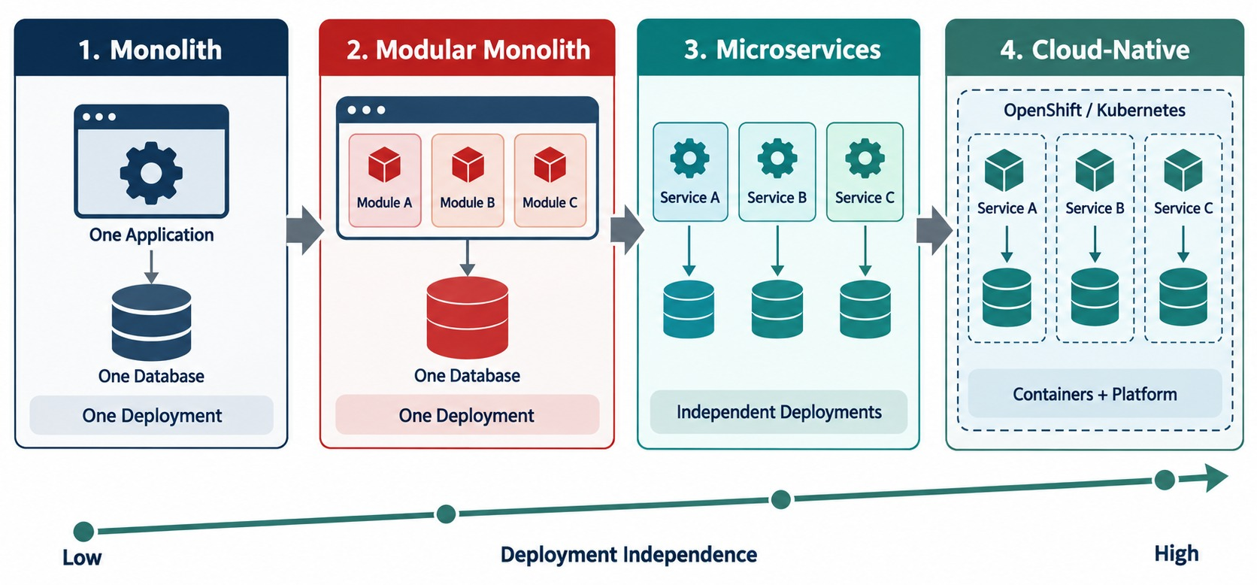
EVOLUTION OF APPLICATION ARCHITECTURE
Monolith → modular monolith → microservices → cloud-native.
Delivery evolved too
Manual deploys became CI/CD, servers became containers, static infrastructure became OpenShift.
NOT A LADDER A well-designed monolith can beat badly designed microservices.
KEY TAKEAWAY Architecture evolves as systems, teams and delivery needs grow — not simply because a newer style exists.
7
© 2026 by Innovation In Software Corporation
Notes:
KEY TALKING POINTS
------------------
- How architecture evolved
Applications traditionally started as monoliths.
A monolith packages many capabilities into one deployable unit.
As applications grow, teams often add better internal modules.
That gives a modular monolith.
- From modular monolith to microservices
Some organizations have large systems, many teams and a need for independent deployment.
They may then extract selected capabilities into microservices.
- Cloud-native practices
Cloud-native practices support this architecture.
They include containers, CI/CD and infrastructure automation.
They also include dynamic scaling, observability and Kubernetes or OpenShift.
The bottom row shows the same shift in delivery: manual deployments to CI/CD, servers to containers, and static infrastructure to Kubernetes and OpenShift.
- Important clarification
This diagram shows architectural options and a common evolution.
It is not a mandatory maturity ladder.
A well-designed monolith can be better than badly designed microservices.
- What it shows
The journey from a monolith, to a modular monolith, to microservices, to cloud-native systems.
- How to read it
Move left to right.
Each step gives teams more freedom to deploy and scale parts of the system on their own.
- Key point
This is an evolution, not a race.
Each step adds independence, and also adds complexity.

Slide 8
SOA VS. MICROSERVICES
Both reuse services — but they differ in scope, integration and ownership.
Aspect | Service-Oriented Architecture | Microservices
Scope | Enterprise-wide integration | One business capability
Integration | Central ESB routes and transforms | Lightweight REST, gRPC, events
Data | Often shared enterprise databases | Each service owns its data
Governance | Central standards and control | Team autonomy with guardrails
Deployment | Services often released together | Independently deployable
Change | Coordinated and slower | Isolated and faster
What they share
Both expose capabilities through service interfaces for reuse.
The key difference
SOA centralizes integration; microservices decentralize ownership.
WHY IT MATTERS A central ESB can become the new monolith.
KEY TAKEAWAY SOA focused on enterprise integration and reuse; microservices focus on independent delivery of business capabilities.
8
© 2026 by Innovation In Software Corporation
Notes:
KEY TALKING POINTS
------------------
- Why compare
Learners who know SOA often ask whether microservices are just SOA again.
They share ideas, but the goals differ.
- Scope and integration
SOA connected large enterprise systems through a central service bus.
Microservices keep integration lightweight.
- Data and ownership
SOA services often shared databases.
A microservice owns its data and one team owns the service.
- The lesson
If all traffic and logic flows through one central bus, that bus becomes a new bottleneck.

Slide 9
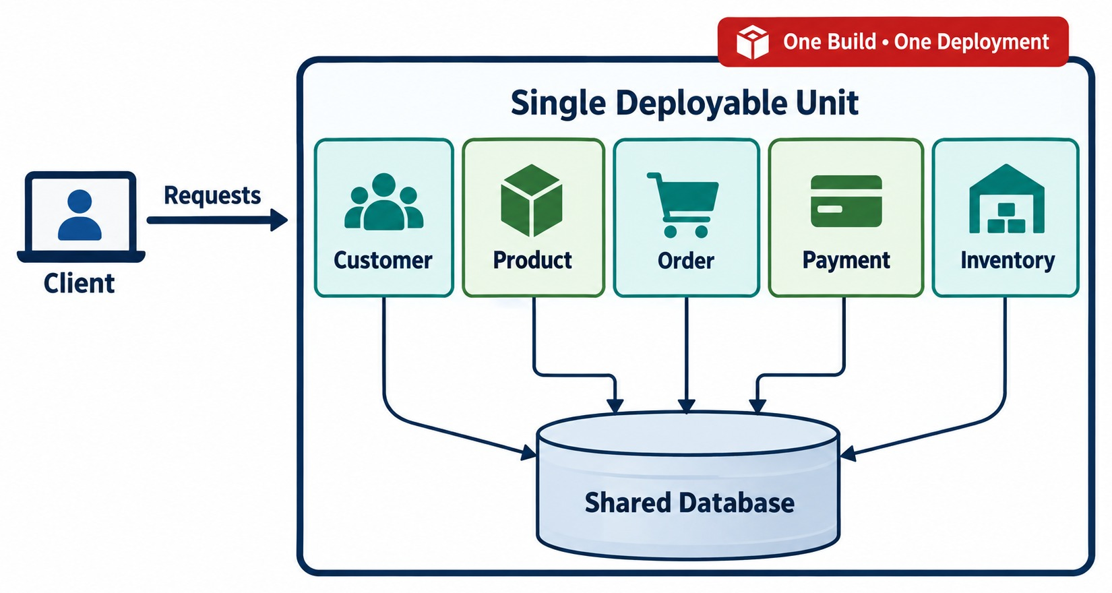
UNDERSTANDING MONOLITHIC ARCHITECTURE
One application, one deployment unit, one shared database.
One artifact
CustomerController OrderController
PaymentController InventoryController
→ commerce.jar
One unit
Everything builds, tests and deploys together and shares one database.
NOT BAD DESIGN A clean, modular monolith is often the right start.
KEY TAKEAWAY One application, one deployment unit — and monolithic does not automatically mean bad design.
9
© 2026 by Innovation In Software Corporation
Notes:
KEY TALKING POINTS
------------------
- One application, one deployment unit
Suppose we build an e-commerce application with Spring Boot.
Inside one application we might have CustomerController, ProductController and OrderController.
We might also have PaymentController and InventoryController.
- Modules still ship together
These parts can still be split into packages or modules.
But they build one deployable application, for example commerce.jar.
When we release, the whole artifact is usually deployed together.
All modules also share one database.
- Monolithic does not mean bad design
A monolith can be clean, modular and scalable.
It can be the right choice.
Problems usually appear when the application and the organization grow.
At some point one deployment unit no longer supports that growth comfortably.
- What it shows
A client sends requests to one large application.
Customer, Product, Order, Payment and Inventory all live inside it.
- One unit
Everything is built and deployed together as a single unit, and all modules share one database.
- Key point
This is simple to start with, but every change and every release involves the whole application.
REAL-WORLD EXAMPLES
-------------------
- An online store built as one Spring Boot application produces a single commerce.jar.
A change to the product catalog and a change to payments go out in the same release.

Slide 10
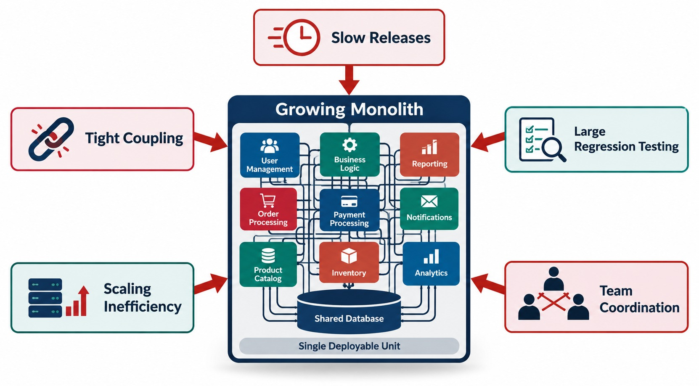
PROBLEMS WITH MONOLITHIC ARCHITECTURES
Coupling, deployment risk, scaling and a growing codebase.
As it grows
More features, a larger codebase, more dependencies — and slower, riskier releases.
100 developers, one app
A small payment change still means build all, test all, deploy all.
DEPLOYMENT COUPLING Every change waits for one shared release.
KEY TAKEAWAY A monolith is not automatically tightly coupled inside — good modular design greatly reduces these problems.
10
© 2026 by Innovation In Software Corporation
Notes:
KEY TALKING POINTS
------------------
- As the application grows
Follow the chain on the left.
More features mean a larger codebase.
A larger codebase brings more dependencies.
More dependencies need more coordination.
The result is slower and riskier releases.
- Key challenges
The main challenges are tight coupling and a large deployment unit.
Scaling can be inefficient.
Testing cycles get longer.
Teams spend more time coordinating with each other.
- Deployment coupling
A small payment change may still mean building the entire application.
Then you run broad regression testing.
Then you package and deploy the whole application.
This is called deployment coupling.
- An important distinction
A monolith does not have to be tightly coupled inside.
Good modular architecture can greatly reduce these problems.
- What it shows
A growing monolith in the center, surrounded by its problems.
- The challenges
The problems are tight coupling, slow releases, large regression testing, inefficient scaling and heavy team coordination.
- Key point
These problems grow with the size of the application and the number of teams working on it.
USE-CASE SCENARIO
-----------------
Imagine 100 developers working on one large enterprise application.
One team changes payments.
Another team changes inventory.
A third team changes customer management.
All of these changes end up in the same application and the same release process.
So every team waits for the others before anything reaches production.

Slide 11
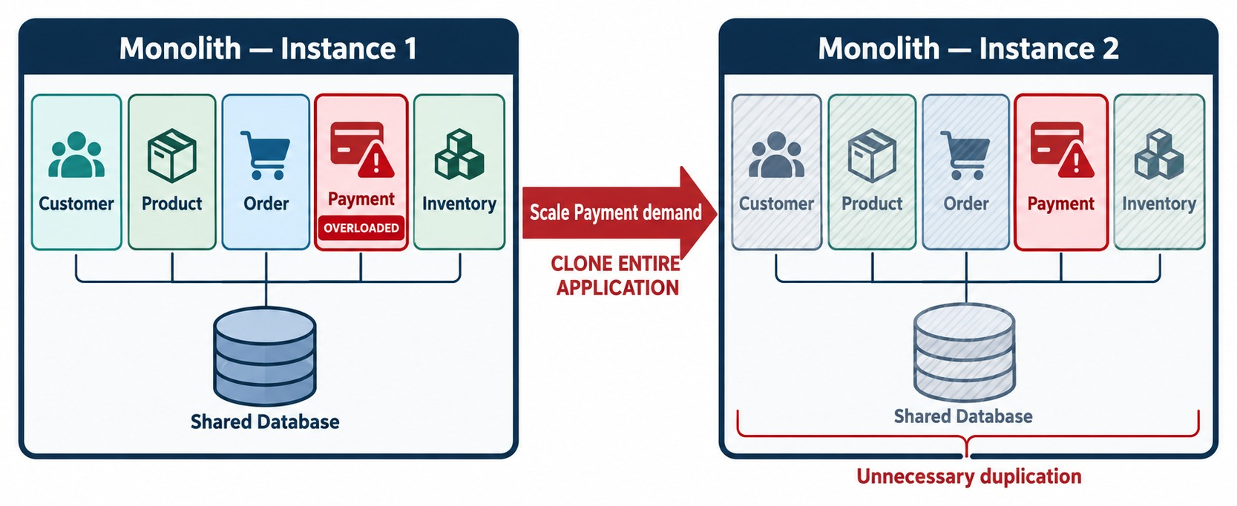
SCALING CHALLENGES IN A MONOLITH
Payment is overloaded, so the whole application is copied.
Load by capability
Payment runs at 95% while Customer, Product and Inventory sit at 20–40%.
Monolith
Adding Payment capacity means copying every capability.
Microservices
Run ten Payment instances and two Customer instances.
FAIR POINT Monoliths scale horizontally too — just not per capability.
KEY TAKEAWAY Monoliths can scale horizontally too — the microservices advantage is fine-grained scaling by service.
11
© 2026 by Innovation In Software Corporation
Notes:
KEY TALKING POINTS
------------------
- Load is uneven
Look at the load on the left.
Payment is at 95 percent.
Customer, Product, Order and Inventory are much lower.
- Monolith: scale everything
With a monolithic deployment, scaling may mean running more copies of the entire application.
So you also copy Customer, Product, Order and Inventory functionality.
You do that even though Payment is the real bottleneck.
- Microservices: scale by service
Microservices can let each service scale on its own.
For example, Customer and Product run two instances each.
Order runs four, Inventory runs three, and Payment runs ten.
This is called independent scalability.
- Be precise
Modern infrastructure can also scale a monolith horizontally.
So the real microservices advantage is fine-grained scaling by service.
- What it shows
Only the Payment part is overloaded.
- The problem
To add Payment capacity, you must copy the entire monolith, including parts that don't need more capacity.
- Key point
That wastes resources.
Microservices let you scale only the part that is under pressure.

Slide 12
PART 2: WHAT MICROSERVICES ARE
From the pain of one big application to independent services.
✓ Part 1
Why monoliths struggle
Part 2
What microservices are
Part 3
Costs and decisions
Part 4
Cloud-native and DevOps
SO FAR
NEXT QUESTION
What changes when we split capabilities into independently deployable services?
✓
Monoliths are simple to start with
✓
As they grow, releases, teams and scaling become coupled
IN THIS PART
Scaling one hot capability means copying everything
1
The definition of a microservice
✓
2
The architecture at a glance
3
Local calls become network calls
4
The core principles
5
Capabilities, deployment and data ownership
6
Synchronous and asynchronous communication
12
© 2026 by Innovation In Software Corporation
Notes:
KEY TALKING POINTS
------------------
- Connecting the parts
Part 1 showed the pain.
Part 2 shows the alternative and what really changes.
- Watch for
Pay attention to data ownership and communication.
Those two decide whether services are truly independent.

Slide 13
WHAT ARE MICROSERVICES?
The definition and the fundamental idea.
“A system composed of independently deployable services aligned with business capabilities.”
Customer Service
+
Order Service
+
Payment Service
+
Inventory Service
SERVICE
BUSINESS CAPABILITY
INDEPENDENTLY DEPLOYABLE
AUTONOMOUS
A separately running application or process that provides a capability through a defined interface.
The service represents meaningful business functionality.
Ideally, changing one service doesn't require rebuilding and redeploying every other service.
A service controls its implementation and typically its data boundary.
KEY TAKEAWAY A Payment Service owns payment behavior — it is not a generic collection of unrelated functions.
13
© 2026 by Innovation In Software Corporation
Notes:
KEY TALKING POINTS
------------------
- The definition
Read the definition at the top.
Microservices architecture is a system made of independently deployable services.
Those services are aligned with business capabilities.
Then break the definition into its parts.
- Service and business capability
A service is a separately running application or process.
It provides a capability through a defined interface.
A business capability means the service represents meaningful business functionality.
- Independently deployable and autonomous
Independently deployable means changing one service should not require rebuilding and redeploying every other service.
Autonomous means a service controls its own implementation.
It usually controls its own data boundary too.
REAL-WORLD EXAMPLES
-------------------
- A Payment Service should own payment-related behavior.
It should not turn into a generic collection of unrelated functions.

Slide 14
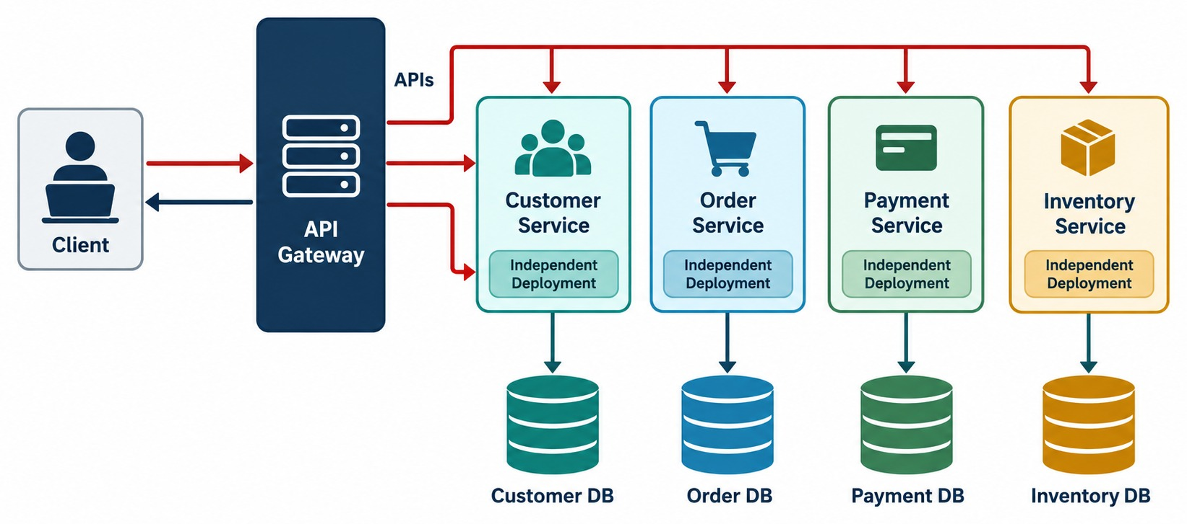
MICROSERVICES ARCHITECTURE OVERVIEW
Clients reach independent services through an API gateway.
API gateway
One entry point that routes each request to the right service.
Independent services
Customer, Order, Payment and Inventory run and deploy on their own.
Owned data
Each service keeps its own database — no shared tables.
KEY TAKEAWAY Clients reach independent services through a gateway, and each service owns its data.
14
© 2026 by Innovation In Software Corporation
Notes:
KEY TALKING POINTS
------------------
- What it shows
A client talks to an API gateway, which routes to the Customer, Order, Payment and Inventory services.
- Service-owned data
Each service owns its own data store instead of sharing one database.
- Key point
Each service is a separate, independently deployable part of the system.

Slide 15
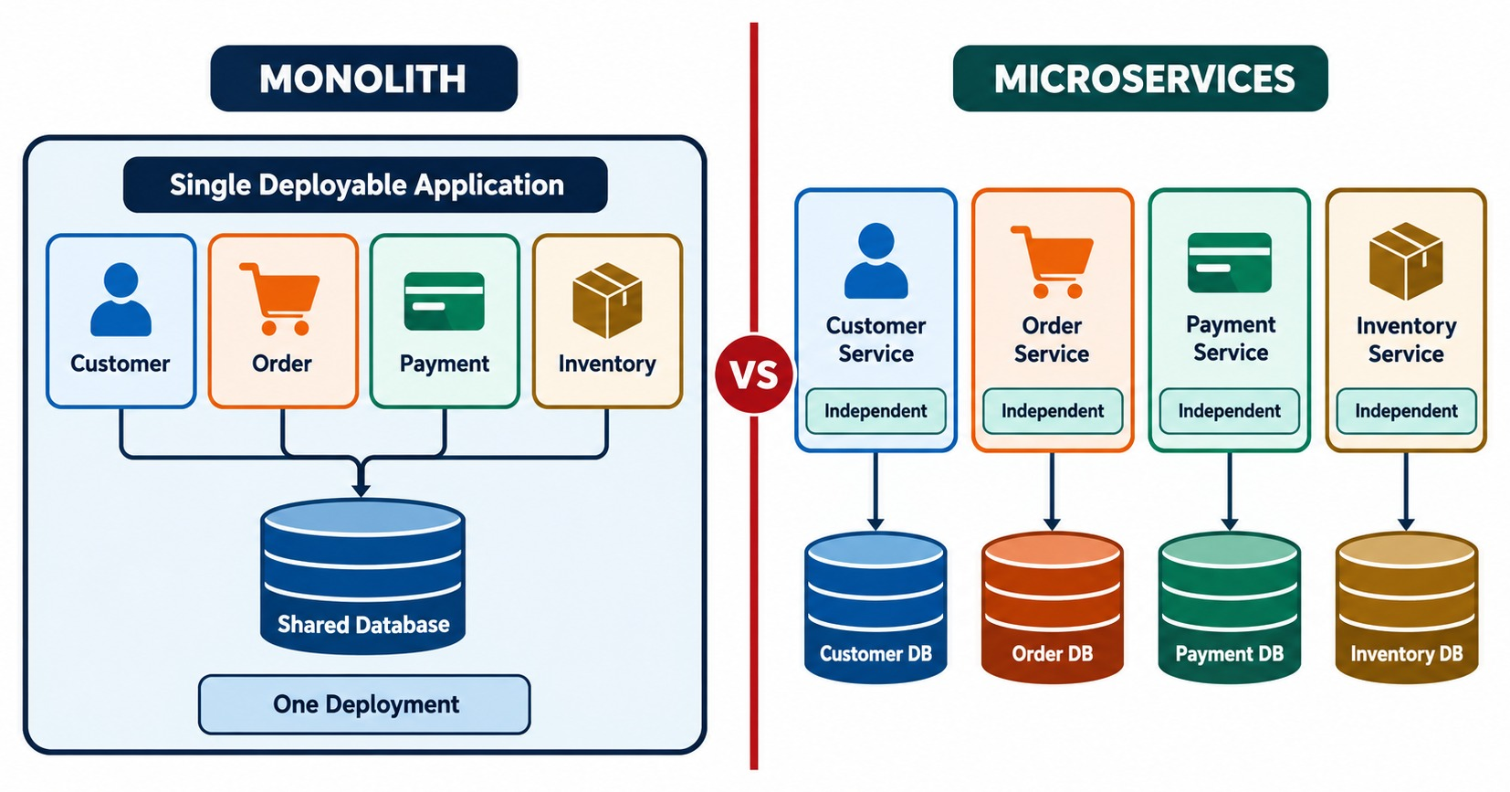
MONOLITH VS. MICROSERVICES ARCHITECTURE
The same capabilities — in one process, or across the network.
Monolith: local call
paymentService.charge(order);
Microservices: remote call
paymentClient.charge(order); // HTTP
THE NETWORK ADDS
Latency
Timeouts
Partial failure
Security
API contracts
Versioning
KEY TAKEAWAY Crossing the network boundary changes everything: latency, security, timeouts and partial failures.
15
© 2026 by Innovation In Software Corporation
Notes:
KEY TALKING POINTS
------------------
- Inside a monolith
This is an important visual.
In a monolith, modules usually call each other inside the same process.
For example, the code simply calls paymentService.processPayment().
- With microservices
With microservices, the Order Service calls the Payment Service across the network.
That boundary changes everything.
- What the network boundary adds
Now you must think about network latency, authentication and authorization.
You must handle timeouts, retries and partial failures.
You also need clear API contracts and you must plan for service availability.
This is why distributed architecture adds operational complexity.
- What it shows
On one side, one deployable application with a shared database.
On the other, independently deployable services.
- How to compare
Compare how each side is deployed, scaled and changed.
- Key point
Microservices trade simplicity for independence.
Neither side is always better.

Slide 16
FROM A LOCAL CALL TO A REMOTE CALL
The same checkout step, before and after the split.
Monolith — one transaction
Microservices — calls cross the network
@Transactional
public Order placeOrder(Cart cart) {
Order order = orders.save(Order.from(cart));
inventory.reserve(cart.items()); // local
payments.charge(order); // local
return order; // one commit
}
public Order placeOrder(Cart cart) {
Order order = orders.save(Order.pending(cart));
inventoryClient.reserve(order.id(), cart.items());
paymentClient.charge(order.id(), order.total());
return order; // no single transaction now
}
What you lose
What you gain
What you need
One database transaction no longer covers order, stock and payment.
Payment and Inventory deploy and scale on their own.
Timeouts, retries and a plan for partial failure — Part 3.
KEY TAKEAWAY A method call becomes a network call — great for independence, but it changes consistency and failure handling.
16
© 2026 by Innovation In Software Corporation
Notes:
KEY TALKING POINTS
------------------
- Read the monolith version
Everything runs in one process.
The @Transactional annotation wraps the order, the stock reservation and the charge in one database transaction, so they all succeed or all roll back.
- Read the microservices version
Inventory and Payment are now separate services called over HTTP.
The order is saved as pending first.
- What changed
There is no single transaction across services any more.
If the charge fails after stock was reserved, we need a plan to undo or retry.
- Why it's still worth it
Payment and Inventory can now be released and scaled independently.
Part 3 shows how to handle the failures.

Slide 17
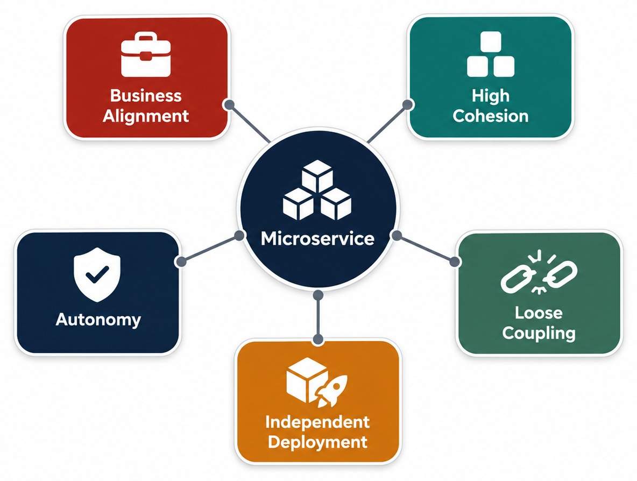
CORE PRINCIPLES OF MICROSERVICES
Five principles that matter more than making services small.
EACH IN ONE LINE
✓
Business alignment: follow business domains
✓
High cohesion: related behavior stays together
✓
Loose coupling: know contracts, not internals
✓
Autonomy: a service controls its own behavior
✓
Independent deployment: release without coordination
NOT ABOUT SIZE A small service can still break every principle.
KEY TAKEAWAY These principles are more important than simply making services small.
17
© 2026 by Innovation In Software Corporation
Notes:
KEY TALKING POINTS
------------------
- Business alignment
Service boundaries should match business domains.
They should not follow arbitrary technical layers.
- High cohesion
Functionality that belongs together should stay together in the same service.
- Loose coupling
One service should know as little as possible about another service's internal implementation.
- Service autonomy
Each service should control its own behavior and its own boundaries.
- Independent deployment
A service should ideally be releasable without coordinating a deployment of the entire system.
- The key message
These principles are more important than simply making services small.
- What it shows
A microservice in the center, surrounded by five principles.
- The principles
The principles are business alignment, high cohesion, loose coupling, autonomy and independent deployment.
- Key point
Small size alone doesn't make a microservice.
These principles do.

Slide 18
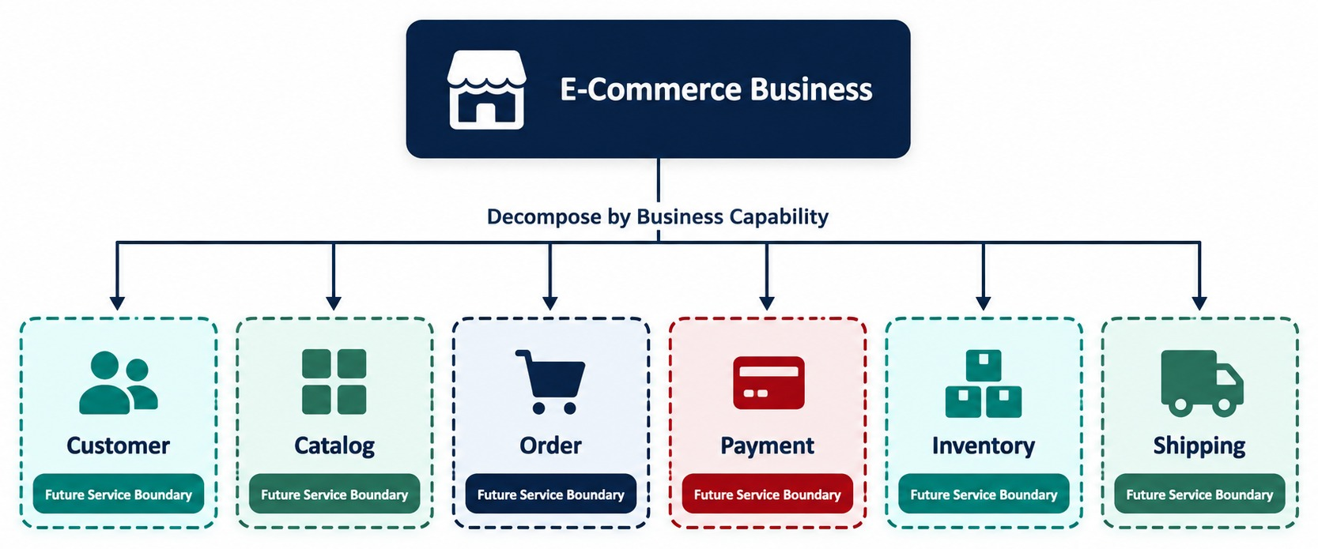
DESIGNING AROUND BUSINESS CAPABILITIES
Cut services by what the business does, not by technical layer.
AVOID TECHNICAL-LAYER SERVICES
✕
UI service
✕
Business-logic service
✕
Database service
Order Service owns
Create, update and cancel orders, and order status.
Payment Service owns
Authorize, capture and refund payments.
KEY TAKEAWAY Draw boundaries around business domains, not technical layers — later this leads to DDD and bounded contexts.
18
© 2026 by Innovation In Software Corporation
Notes:
KEY TALKING POINTS
------------------
- Avoid technical layers as services
This distinction is fundamental.
Traditional applications are often organized by technical layers.
Those layers are presentation, business, persistence and database.
Do not turn those layers into a UI Service, Controller Service, Business Logic Service and Database Service.
- Prefer business capabilities
Microservice boundaries should generally reflect business domains.
For an online store, that means Customer, Order, Payment, Inventory and Shipping.
- Ownership examples
The Order Service owns creating, updating and cancelling orders, plus order status.
The Payment Service owns authorizing, capturing and refunding payments.
- What comes later
Later in the course, this connects to Domain-Driven Design and bounded contexts.
- What it shows
An e-commerce business broken into capabilities: Customer, Catalog, Order, Payment, Inventory and Shipping.
- How to use it
Each capability is a strong candidate for its own service boundary.
- Key point
Design services around what the business does, not around technical layers.

Slide 19
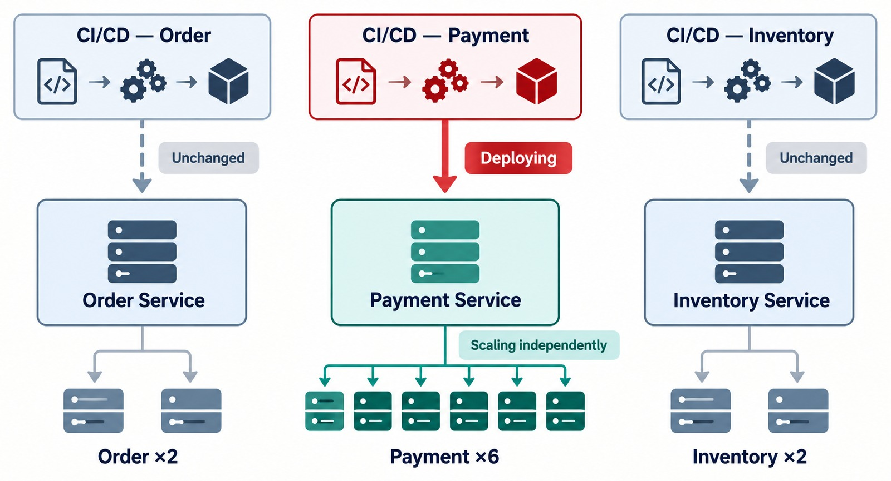
INDEPENDENT DEPLOYMENT AND SCALING
Deploy and scale one service without redeploying the others.
One pipeline per service
Git commit → CI → tests → image → registry → OpenShift.
Only Payment changes
Payment ships a fix while Customer, Order and Inventory keep running.
NEEDS AUTOMATION Independence works only with automated tests and deployment.
KEY TAKEAWAY Change Payment Service, then build, test, deploy and scale it — without redeploying unrelated services.
19
© 2026 by Innovation In Software Corporation
Notes:
KEY TALKING POINTS
------------------
- A strong reason to adopt microservices
Independent deployment is one of the strongest reasons organizations adopt microservices.
You change the Payment Service, then build, test, deploy and scale it.
You do not redeploy unrelated services.
- The delivery pipeline
Follow the pipeline at the top.
A Git commit starts the CI pipeline.
Automated tests run.
The pipeline builds a container image and pushes it to a registry.
Then the new version is deployed to OpenShift.
- Connect it to DevOps
Only the Payment Service changes.
The other services keep running.
But this independence is practical only when testing, deployment and infrastructure operations are heavily automated.
- What it shows
Each service has its own delivery pipeline and its own number of running copies, or replicas.
- Example
Payment can be deployed or scaled without touching Order or Inventory.
- Key point
Independence lets each team release and scale at its own pace.
REAL-WORLD EXAMPLES
-------------------
- Developers fix a bug in the Payment Service.
The fix goes through the pipeline and reaches OpenShift on its own.
Customer, Product, Order and Inventory keep serving users the whole time.

Slide 20
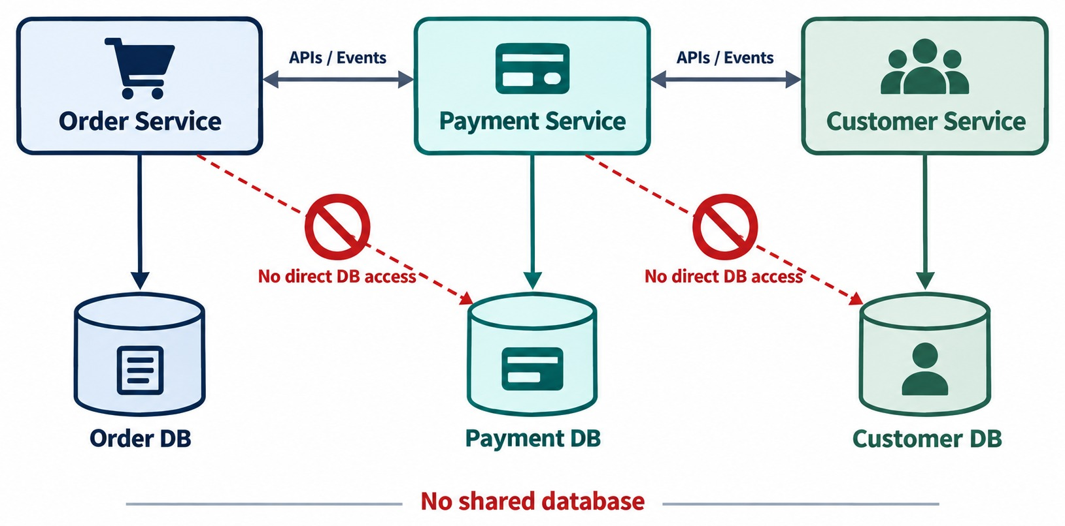
DECENTRALIZED DATA OWNERSHIP
Database-per-service and clear data boundaries.
AVOID
✕
One shared database for every service
✕
Reading or writing another service's tables
PREFER
✓
Each service owns its data
✓
Share data through APIs or events
THE BIG CHALLENGE Keeping data consistent across services — covered in the data module.
KEY TAKEAWAY Each service owns its data — if services share tables, the database becomes a coupling mechanism.
20
© 2026 by Innovation In Software Corporation
Notes:
KEY TALKING POINTS
------------------
- The database boundary
This is one of the most misunderstood microservices concepts.
If all services change the same tables directly, the database becomes a coupling mechanism.
- Avoid a shared database
For example, the Order Service should not directly change the Payment Service's tables.
- Prefer data ownership
Each service owns its own data.
The Order Service talks to the Payment Service through an API or an event.
The Payment Service then updates its own payment data.
The Payment Service owns its data contract.
- The big challenge
This raises a major question.
How do we keep data consistent when one business transaction crosses several services?
Mention that later modules cover eventual consistency, saga patterns, events and transaction boundaries.
Do not go deeply into them yet.
- What it shows
Order Service owns the Order DB, Payment owns the Payment DB, and Customer owns the Customer DB.
- How data is shared
Services share data through APIs or events.
They never reach directly into another service's database.
- Key point
Owning your data keeps services loosely coupled.

Slide 21
OWNING DATA IN CODE
Ask the owner — through its API or an event — instead of touching its database.
✕
Writes another service's table
✓
Calls the owner's API
✓
Publishes an event
// Order Service reaching into
// Inventory's database
inventoryRepository
.decrementStock(sku, qty);
inventoryClient.reserve(
new Reservation(orderId,
sku, qty));
events.publish(new OrderPlaced(
orderId, customerId,
items, total));
Why
API or event?
Inventory keeps control of its own rules, schema and changes.
Need an answer now → call the API. Others react later → publish an event.
KEY TAKEAWAY Services change each other's data only by asking the owner — never by touching its tables.
21
© 2026 by Innovation In Software Corporation
Notes:
KEY TALKING POINTS
------------------
- The bad version
Order Service writes straight into Inventory's database.
If Inventory renames a column or adds a rule, Order breaks without warning.
- Calling the API
Order asks Inventory to reserve stock.
Inventory checks its own rules and answers.
- Publishing an event
Order announces that an order was placed.
Inventory, Shipping and Notification each react in their own way.
- How to choose
If Order needs the answer before it can continue, call the API.
If others can react later, publish an event.

Slide 22
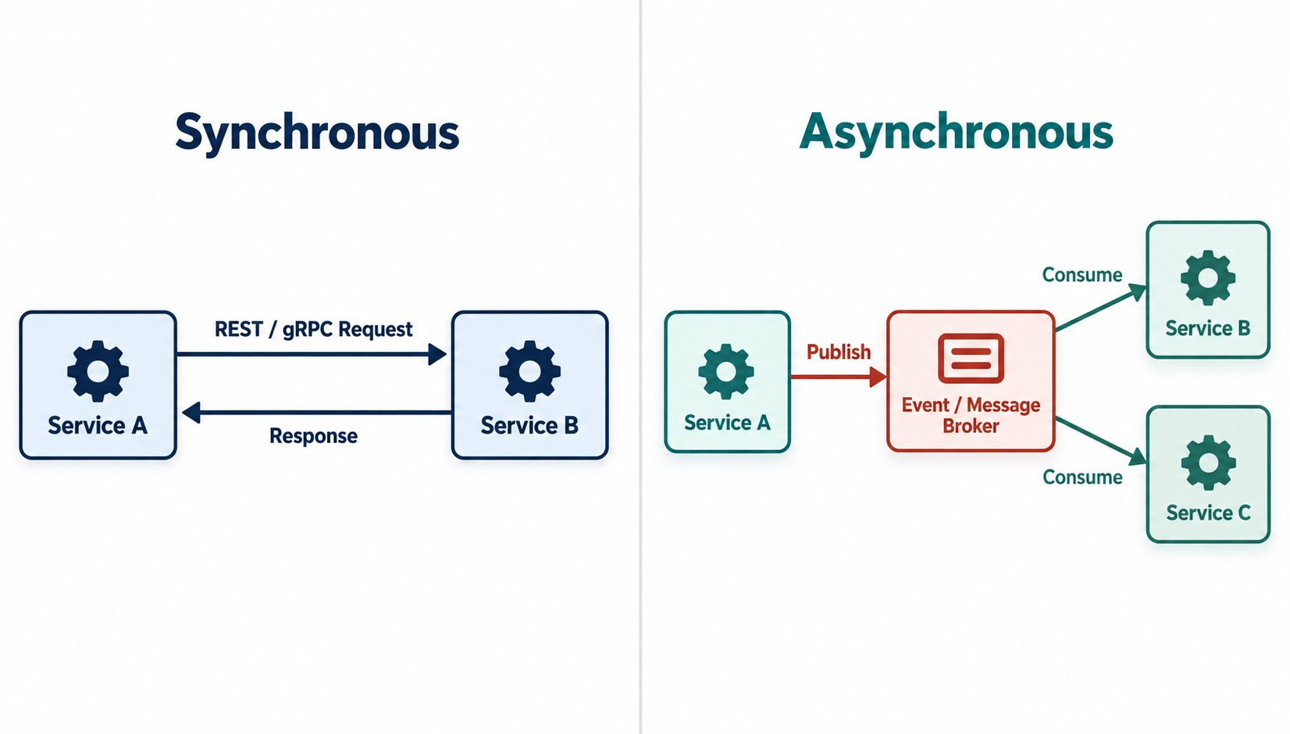
MICROSERVICE COMMUNICATION PATTERNS
REST, gRPC, messaging and events.
COMMON OPTIONS
REST
gRPC
Events
Messaging
Synchronous
The caller sends a request and waits for the reply.
Asynchronous
The producer publishes and moves on; consumers react later.
KEY TAKEAWAY Services must communicate — choose request/response or events based on what each interaction needs.
22
© 2026 by Innovation In Software Corporation
Notes:
KEY TALKING POINTS
------------------
- Services need to communicate
There are two major communication models.
Walk through each side of the slide.
- Synchronous
In synchronous communication, the caller waits for a response.
For example, Order calls Payment and waits for the answer.
Typical technologies are REST over HTTP and gRPC.
- Asynchronous
In asynchronous communication, the producer publishes information.
It does not wait for an immediate response from every consumer.
For example, an OrderCreated event goes to a message broker.
Inventory and Payment each pick it up.
- The tradeoff
Asynchronous messaging can reduce temporal coupling, which means services do not have to be available at the same moment.
But it adds complexity around messaging, eventual consistency and event processing.
- What it shows
On one side, a synchronous path using REST or gRPC.
On the other, an asynchronous path using events and a message broker.
- When to use each
Use synchronous calls when you need an immediate answer.
Use events when services can react independently.
- Key point
Most real systems use both patterns.

Slide 23
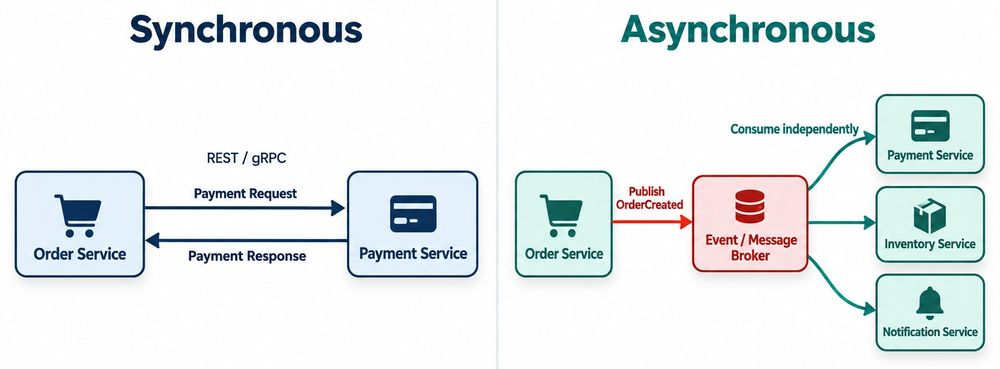
SYNCHRONOUS VS. ASYNCHRONOUS COMMUNICATION
The same order flow — once as a request, once as events.
Checkout: synchronous
Order asks Payment and waits for the result.
After acceptance: events
OrderCreated lets Inventory, Notification and Analytics react on their own.
USE BOTH Most systems combine request/response and events.
KEY TAKEAWAY Neither approach is universally better — most enterprise microservice architectures use a combination.
23
© 2026 by Innovation In Software Corporation
Notes:
KEY TALKING POINTS
------------------
- Compare the two
Synchronous calls give an immediate response and an easier mental model.
But they create a runtime dependency and can spread failures.
Asynchronous messages give better decoupling and independent consumers.
Processing then happens eventually.
Typical tools are REST and gRPC on one side, Kafka and RabbitMQ on the other.
- A practical example
A customer places an order.
Some steps need an immediate response, so the client calls the Order Service directly.
After the order is accepted, downstream work can happen through events.
An OrderCreated event reaches Inventory, Payment, Notification and Analytics.
- Use both
Neither approach is always better.
Most enterprise microservice architectures use a combination.
- What it shows
The same business flow drawn two ways.
- The two versions
Synchronous: Order calls Payment and waits for the reply.
Asynchronous: Order publishes OrderCreated to a broker, and Payment, Inventory and Notification react.
- Key point
Events reduce coupling, but results appear over time instead of immediately.

Slide 24
KEY CHARACTERISTICS OF MICROSERVICES
Small, autonomous, independently deployable — and observable.
✅
A WELL-DESIGNED MICROSERVICE IS
🔍
WHY OBSERVABLE MATTERS
Business focused
Loosely coupled
In a monolith you might read one application's logs. With 50 services, one request may travel through:
🏢
🔗
🎯
Highly cohesive
🚀
Independently deployable
Gateway
Distributed systems need
Order
Logs
📈
Independently scalable
🔍
Observable
Inventory
Metrics
🛡️
Resilient
🤖
Automation friendly
Payment
Traces
Notification
KEY TAKEAWAY Finding where a request failed across many services is hard — distributed systems need logs, metrics and traces.
24
© 2026 by Innovation In Software Corporation
Notes:
KEY TALKING POINTS
------------------
- A well-designed microservice
A well-designed microservice is business focused, loosely coupled and highly cohesive.
It is independently deployable and independently scalable.
It is observable, resilient and automation friendly.
- Focus on observable
In a monolith, debugging may mean reading one application's logs.
With 50 services, one customer request might travel through a gateway, Order, Inventory, Payment and Notification.
Finding where something failed becomes difficult.
- Logs, metrics and traces
That is why distributed systems need logs, metrics and traces.
This slide introduces observability early.
Do not teach the whole topic yet.

Slide 25
PART 3: COSTS AND DECISIONS
Independence has a price. Decide when it's worth paying.
✓ Part 1
Why monoliths struggle
✓ Part 2
What microservices are
Part 3
Costs and decisions
Part 4
Cloud-native and DevOps
SO FAR
NEXT QUESTION
What does this independence cost — and when is it worth paying?
✓
A microservice owns one business capability
✓
Services deploy, scale and store data independently
IN THIS PART
1
The benefits you can get
✓
They talk through APIs and events
2
Distributed-system challenges
3
Designing for failure, in code
4
Misconceptions and anti-patterns
5
Monolith or microservices?
6
The modular monolith
25
© 2026 by Innovation In Software Corporation
Notes:
KEY TALKING POINTS
------------------
- The honest part
So far microservices sound great.
This part is about what they cost and when not to use them.
- Outcome
By the end, learners should be able to argue for a monolith, a modular monolith or microservices in a given situation.

Slide 26
BENEFITS OF MICROSERVICES
Agility, scalability, autonomy and fault isolation.
🚀
📈
👥
🧱
🧰
Independent Delivery
Independent Scaling
Team Autonomy
Fault Isolation
Technology Flexibility
Teams can release services at different cadences.
High-demand services can receive more resources.
Different teams can own specific business capabilities.
Properly designed, a failure may stay confined to one service.
Different services can potentially use different technologies.
POTENTIAL, NOT GUARANTEED Poor service boundaries can produce a distributed system that is harder to maintain than the original monolith.
KEY TAKEAWAY These are potential benefits, not automatic guarantees — they depend on good boundaries and engineering.
26
© 2026 by Innovation In Software Corporation
Notes:
KEY TALKING POINTS
------------------
- Independent delivery
Teams can release their services at different cadences.
- Independent scaling
High-demand services can receive more resources.
- Team autonomy
Different teams can own specific business capabilities.
- Fault isolation
When services are designed properly, a failure may stay confined to one service.
- Technology flexibility
Different services can potentially use different technologies.
- Explain each benefit with caution
These are potential benefits, not automatic guarantees.
Poor service boundaries can produce a distributed system that is harder to maintain than the original monolith.

Slide 27
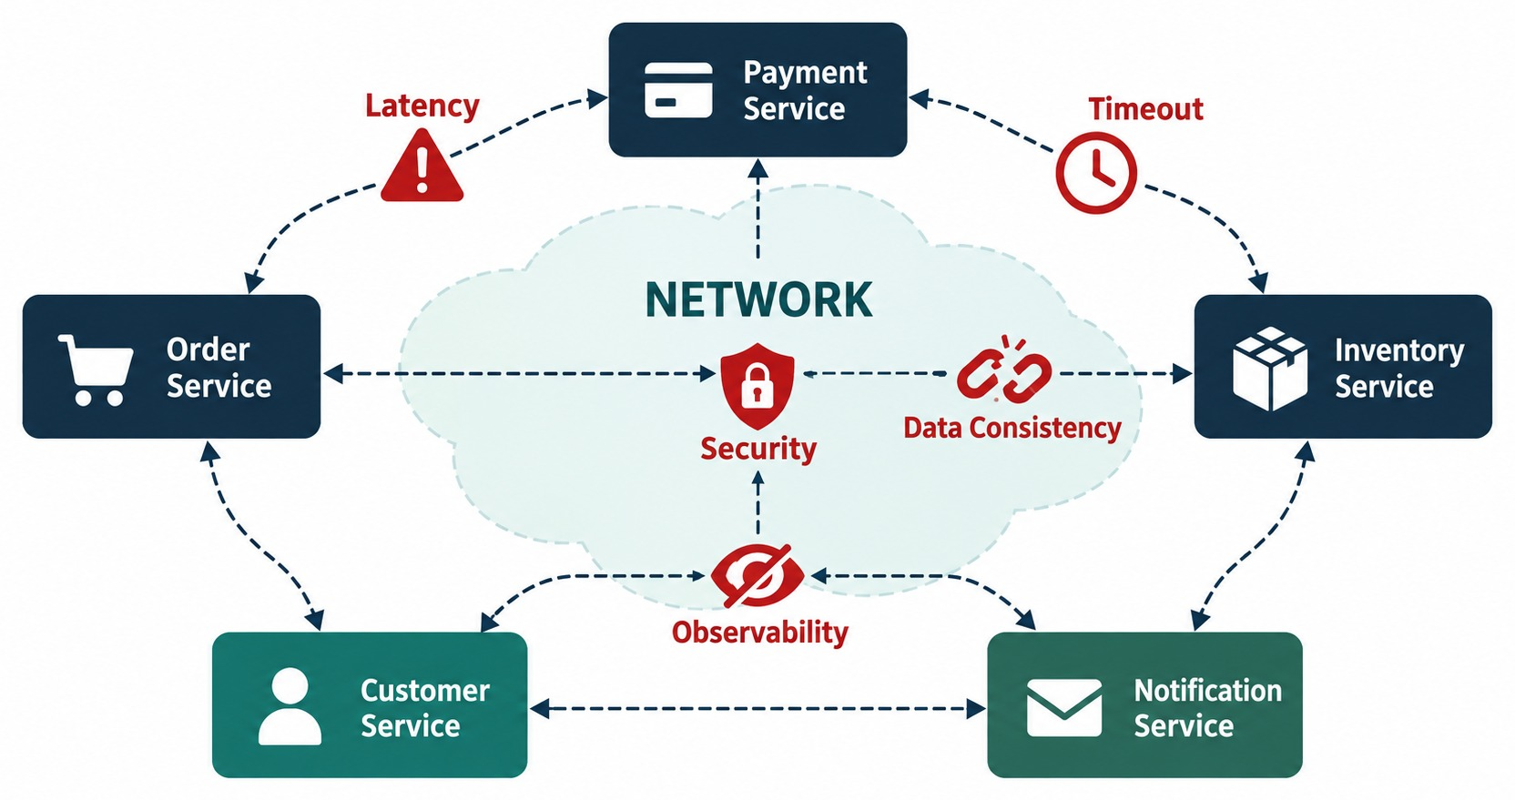
MICROSERVICES TRADEOFFS AND CHALLENGES
Network, consistency, observability, security and operations.
A REMOTE SERVICE COULD
✕
Be unavailable or slow
✕
Return an error
✕
Process the request but lose the reply
✕
Run a different API version
YOU INHERIT
Network failures
Data consistency
Security
Observability
KEY TAKEAWAY Microservices therefore require more mature engineering practices.
27
© 2026 by Innovation In Software Corporation
Notes:
KEY TALKING POINTS
------------------
- One of the most important slides
You gain independence, but you inherit distributed-system complexity.
Moving from a local object.method() call to an HTTP request over the network changes many assumptions.
- What you inherit
You now face network failures and data consistency problems.
You must handle security and observability.
You need service discovery.
Deployment gets more complex and operations cost more.
- The remote service could
The remote service could be unavailable.
It could respond slowly or return an error.
It could process the request but lose the response.
It could change its API or have a different version deployed.
- The consequence
So microservices require more mature engineering practices.
- What it shows
Several services connected over a network, with the places where things can go wrong.
- The failure points
The failure points are latency, timeouts, security, data consistency and observability.
- Key point
Every network call is a possible point of failure that the design has to handle.

Slide 28
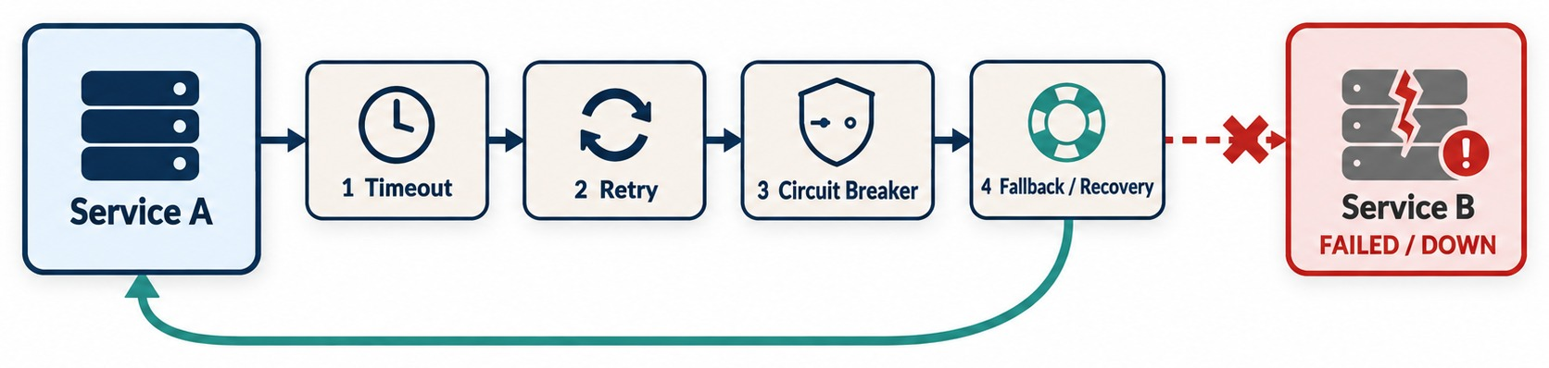
DESIGNING FOR FAILURE
Timeouts, retries, circuit breakers, fallbacks and health checks.
Timeout
Retry
Circuit breaker
Fallback
Health checks
Don't wait forever for a slow service.
Retry only safe, temporary failures — with limits.
Stop calling a failing dependency for a while.
Return a safe alternative, e.g. mark the order pending.
Tell the platform whether an instance is healthy.
KEY TAKEAWAY Timeouts, controlled retries, circuit breakers, fallbacks and health checks stop one failure from spreading.
28
© 2026 by Innovation In Software Corporation
Notes:
KEY TALKING POINTS
------------------
- Assume failures occur
Distributed systems must assume that failures happen.
In the diagram, Service A calls Service B across the network, and Service B has failed.
- Timeout and retry
A timeout means you do not wait forever.
A retry means you try again, but only for selected temporary failures.
- Circuit breaker and fallback
A circuit breaker temporarily stops sending requests to an unhealthy dependency.
A fallback provides an alternative behavior when that is appropriate.
- Health checks
Health checks let the platform know whether an application instance is healthy.
- Retries must be controlled
Blind retries can make an outage worse by adding more traffic.
Also think about idempotency, which means repeating a request has the same effect as doing it once.
Use backoff and retry limits too.
- What it shows
Service A calls Service B, and Service B fails.
- The response
The protection is layered: a timeout, then a retry, then a circuit breaker, then a fallback or recovery.
- Key point
Design for failure, so one failing service doesn't take down the others.

Slide 29
DESIGNING FOR FAILURE IN CODE
Checkout keeps working when Payment Service is slow or down.
1 Put a timeout on the client
✓
2 Fall back instead of failing the order
var factory = new SimpleClientHttpRequestFactory();
factory.setConnectTimeout(Duration.ofSeconds(1));
factory.setReadTimeout(Duration.ofSeconds(2));
RestClient payments = RestClient.builder()
.baseUrl("http://payment-service")
.requestFactory(factory)
.build();
public OrderResult checkout(Order order) {
try {
payments.post().uri("/payments")
.body(PaymentRequest.of(order))
.retrieve().toBodilessEntity();
return OrderResult.confirmed(order.id());
} catch (RestClientException ex) {
log.warn("Payment unavailable for {}", order.id());
return OrderResult.pendingPayment(order.id());
}
}
Timeout
Fallback
LATER IN THE COURSE Resilience4j adds retries and circuit breakers.
A slow Payment Service can't hold Order's threads forever.
The order is kept as PENDING_PAYMENT instead of failing.
KEY TAKEAWAY Bound every remote call with a timeout, and decide what the business does when it fails.
29
© 2026 by Innovation In Software Corporation
Notes:
KEY TALKING POINTS
------------------
- Step 1: the timeout
The client gives up after one second to connect and two seconds to read.
Without this, a hung Payment Service can tie up every Order thread.
- Step 2: the fallback
If the payment call fails, we don't crash the checkout.
We keep the order as pending payment and log a warning.
- A business decision
Whether to reject, retry or keep the order pending is a business choice.
The code just makes that choice explicit.
- What comes later
Resilience4j adds retries with backoff and circuit breakers.
We cover it in the resilience module.

Slide 30
EXERCISE: CHECKOUT WHEN PAYMENT IS DOWN
Decide how the order platform should behave during a partial failure.
PRACTICE EXERCISE
10 MIN
SCENARIO
YOUR TASKS
EXPECTED OUTCOME
A customer checks out a $180 order. Order Service calls Payment Service, but Payment has been timing out for three minutes.
1
Choose: reject, retry, keep pending, or queue for later
✓
Don't blindly retry the charge — it could double-charge
2
Say what the customer sees
✓
Keep the order as PENDING_PAYMENT and tell the customer
3
Decide what happens to the reserved stock
✓
Retry in the background; release stock after a time limit
4
Name the signal that alerts the team
✓
Alert on payment error rate and latency
KEY TAKEAWAY Failure handling is a business decision, not only a technical one.
30
© 2026 by Innovation In Software Corporation
Notes:
KEY TALKING POINTS
------------------
- How to run it
Give pairs five minutes, then compare answers.
There is no single right answer, but there are unsafe ones.
- Unsafe answers
Blindly retrying the charge can charge the customer twice.
Approving without payment loses money.
- A good answer
Keep the order pending, tell the customer payment is being confirmed, retry in the background, and release stock if payment never succeeds.
- Operations
The owning team should get an alert when the payment error rate or latency rises.

Slide 31
MISCONCEPTIONS AND ANTI-PATTERNS
Common beliefs that lead teams into trouble.
MISCONCEPTION
REALITY
ANTI-PATTERNS TO AVOID
Microservices are always faster
Poorly designed ones are slower than a good monolith
✕
Too many tiny services
✕
One shared database
✕
Synchronous, chatty calls everywhere
They're just small services
They're defined by business boundaries, not size
✕
Services that must deploy together
✕
Big-bang rewrite
✕
No logs, metrics or traces
Splitting is just moving code
Data, teams, testing and operations change too
REMEMBER Microservices amplify good design — and bad design.
Every service needs new tech
Too much variety makes support harder
Microservices = cloud + DevOps
They're an architecture; cloud and DevOps enable it
KEY TAKEAWAY Microservices amplify both good and bad design — avoid these traps from the start.
31
© 2026 by Innovation In Software Corporation
Notes:
KEY TALKING POINTS
------------------
- Why this slide
Before deciding when to use microservices, clear away the myths.
- Speed and size
Microservices aren't automatically faster, and they're not defined by being small.
They're defined by business boundaries.
- It's not just code
Splitting a system changes data, testing, team structure and operations, not only the codebase.
- Anti-patterns
Watch for a shared database, chatty synchronous calls, services that must deploy together, big-bang rewrites and missing observability.

Slide 32
WHEN TO USE MICROSERVICES VS. A MONOLITH
Practical architecture decision criteria.
CONSIDER MICROSERVICES WHEN
CONSIDER A MONOLITH WHEN
✓
Multiple autonomous teams
✓
Small team
✓
Clear domain boundaries
✓
New / MVP application
✓
Independent releases required
✓
Uncertain domain
✓
Different scaling requirements
✓
Simple deployment
✓
Mature CI/CD and operations
✓
Limited operational complexity desired
ASK FIRST — don't start with “Microservices are modern, so we should use microservices.”
1
2
3
4
5
Do teams need independent deployment?
Are domain boundaries sufficiently understood?
Do capabilities have very different scaling needs?
Can the organization operate distributed systems effectively?
Does the added complexity solve a meaningful problem?
KEY TAKEAWAY Start from business and engineering requirements — if the answers are no, a monolith may be the better choice.
32
© 2026 by Innovation In Software Corporation
Notes:
KEY TALKING POINTS
------------------
- Consider microservices when
You have multiple autonomous teams and clear domain boundaries.
Independent releases are required.
Capabilities have different scaling needs.
And you have mature CI/CD and operations.
- Consider a monolith when
You have a small team or a new MVP application.
The domain is still uncertain.
You want simple deployment and limited operational complexity.
- Start from requirements
Tell learners not to start with the idea that microservices are modern, so we should use them.
Start with business and engineering requirements instead.
- Ask these questions
Do teams need independent deployment?
Are domain boundaries understood well enough?
Do different capabilities have very different scaling needs?
Can the organization run distributed systems effectively?
Does the extra complexity solve a meaningful problem?
If not, a monolith may be the better choice.

Slide 33
EXERCISE: MONOLITH OR MICROSERVICES?
Apply the decision criteria to four situations.
PRACTICE EXERCISE
10 MIN
SCENARIO
YOUR TASKS
EXPECTED DIRECTION
A: an internal tool for five staff to approve supply requests.
B: a checkout platform with seasonal spikes and six product teams.
C: a brand-new subscription product whose rules change weekly.
D: fraud scoring that changes daily and needs its own scaling.
1
Pick monolith, modular monolith or microservices for each
✓
A → Monolith
✓
B → Microservices
2
Justify it with team size, domain clarity and scaling needs
✓
C → Modular monolith first
3
Name one risk of your choice
✓
D → A separate microservice
KEY TAKEAWAY The skill is explaining why — not just picking a label.
33
© 2026 by Innovation In Software Corporation
Notes:
KEY TALKING POINTS
------------------
- A: internal tool
Small team, simple domain, low traffic.
A monolith is faster to build and cheaper to run.
- B: checkout platform
Many teams, different scaling needs and frequent releases point to microservices.
- C: new product
The domain is still unclear.
Splitting now risks wrong boundaries, so start with a modular monolith.
- D: fraud scoring
It changes often and scales differently, so a separate service makes sense.

Slide 34
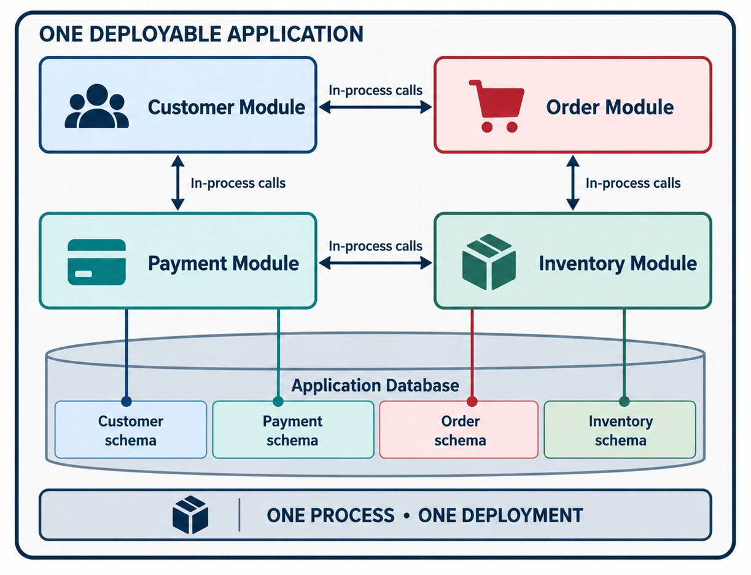
THE MODULAR MONOLITH ALTERNATIVE
Strong module boundaries inside one deployable application.
Start here
Customer, Order, Payment and Inventory as strong modules in one application.
Evolve when needed
Extract a module only when it truly needs its own deployment or scaling.
AVOID PREMATURE DISTRIBUTION Keep one deployment until distribution solves a real problem.
KEY TAKEAWAY A modular monolith is an excellent option — microservices should not always be the starting point.
34
© 2026 by Innovation In Software Corporation
Notes:
KEY TALKING POINTS
------------------
- An excellent option
A modular monolith is an excellent architectural option.
It keeps one deployment unit.
At the same time, it sets strong boundaries between internal modules.
- How to evolve
For a new system, you might start with Customer, Order, Payment and Inventory as modules.
As the business and the organization mature, some capability may genuinely need independent deployment or scaling.
That capability can then be extracted into its own service.
- Avoid premature distribution
This approach avoids premature distribution.
You only pay the cost of microservices when there is a real need.
- What it shows
One deployable application, with strongly separated Customer, Order, Payment and Inventory modules inside.
- Why it matters
You get clear boundaries without the cost of running a distributed system.
- Key point
A modular monolith is often a sensible first step, and it can be split into services later.

Slide 35
PART 4: CLOUD-NATIVE AND DEVOPS
From architecture choices to services that run well on OpenShift.
✓ Part 1
Why monoliths struggle
✓ Part 2
What microservices are
✓ Part 3
Costs and decisions
Part 4
Cloud-native and DevOps
SO FAR
NEXT QUESTION
How do we build services that run well in containers and on OpenShift?
✓
Microservices trade simplicity for independence
✓
Design for failure from day one
IN THIS PART
Choose microservices only when the need is real
1
The Twelve-Factor App
✓
2
Twelve-Factor in Spring Boot code
3
Twelve-Factor on OpenShift
4
Conway's Law and team ownership
5
Microservices in DevOps teams
6
The end-to-end delivery path
35
© 2026 by Innovation In Software Corporation
Notes:
KEY TALKING POINTS
------------------
- Why this part
A good architecture still needs services that are easy to configure, deploy and operate.
- What to watch
Look for how each Twelve-Factor idea shows up in Spring Boot code and on OpenShift.

Slide 36
INTRODUCTION TO THE TWELVE-FACTOR APP
Its purpose and why it matters for cloud-native systems.
📐
A METHODOLOGY FOR APPLICATIONS THAT ARE
🔧
CONFIG
Portable
Scalable
✕
✓
password = "admin123";
Configuration kept outside the code
📦
📈
Deployable
Cloud-Friendly
🔧
LOGS
🚀
🌐
✕
✓
Important logs only in a local server file
Log streams the platform can collect
Originally designed for modern software-as-a-service applications — its principles map well to cloud-native systems and microservices.
A NATURAL CONNECTION TO
Containers
OpenShift
KEY TAKEAWAY Twelve-Factor practices make applications portable, scalable and easy to deploy — a natural fit for OpenShift.
36
© 2026 by Innovation In Software Corporation
Notes:
KEY TALKING POINTS
------------------
- What it is
The Twelve-Factor App is a methodology.
It is a collection of practices originally designed for modern software-as-a-service applications.
It helps build applications that are portable, scalable, deployable and cloud-friendly.
- Why it matters here
Its principles map well to cloud-native systems and microservices.
- Config example
Do not put a database password inside Java source code, like password equals admin123.
Configuration should be kept outside the code.
- Logs example
Do not write important application logs only to a local server file.
Applications should produce log streams that the runtime or platform can collect.
This creates a natural connection to containers and OpenShift.

Slide 37
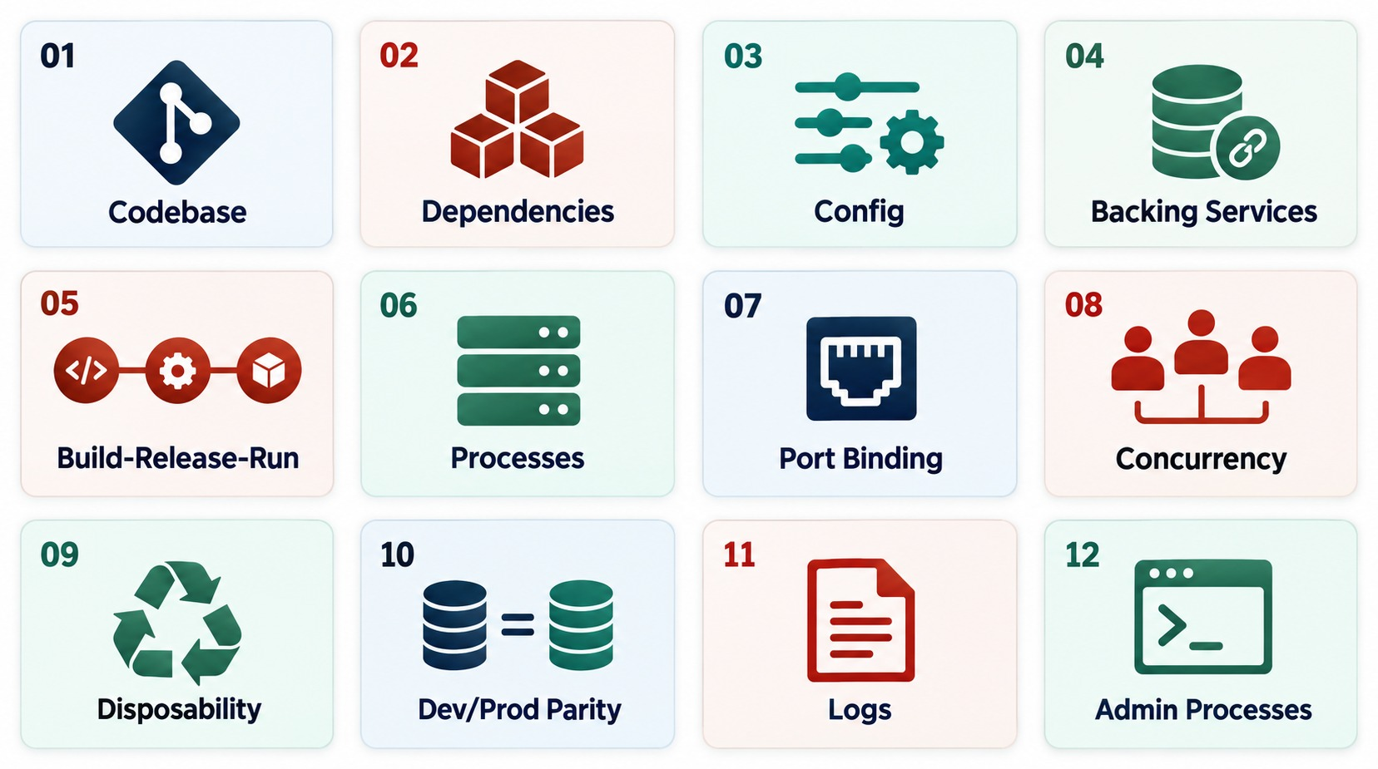
THE TWELVE FACTORS AT A GLANCE
All twelve principles, grouped by where they apply.
Code and build
1 Codebase · 2 Dependencies · 5 Build, release, run
Configuration
3 Config · 4 Backing services
Runtime
6 Processes · 7 Port binding · 8 Concurrency · 9 Disposability
Operations
10 Dev/prod parity · 11 Logs · 12 Admin processes
KEY TAKEAWAY This is the overview — don't spend equal time on every factor.
37
© 2026 by Innovation In Software Corporation
Notes:
KEY TALKING POINTS
------------------
- Codebase, dependencies, config
Codebase means one codebase under version control, with multiple deployments.
Dependencies means you declare application dependencies explicitly.
Config means environment-specific configuration stays outside the code.
- Backing services, build release run, processes
Backing services means databases, queues, caches and external services are treated as attached resources.
Build, release, run means these lifecycle stages stay separate.
Processes means applications run as stateless processes where practical.
- Port binding, concurrency, disposability
Port binding means applications expose services through ports.
Concurrency means you scale by adding processes or instances.
Disposability means instances start quickly and shut down gracefully.
- Dev/prod parity, logs, admin processes
Dev/prod parity means you keep unnecessary differences between environments small.
Logs means logs are treated as event streams.
Admin processes means administrative tasks run as controlled one-off processes.
- Pacing
This slide is the overview.
Do not spend equal time on every factor.
- What it shows
All twelve factors grouped visually, instead of in a long text list.
- The factors
Codebase, dependencies, config, backing services, build-release-run, processes, port binding, concurrency, disposability, dev/prod parity, logs and admin processes.
- Key point
Together they describe how to build apps that run well in the cloud.

Slide 38
TWELVE-FACTOR IN A SPRING BOOT SERVICE
Config, backing services, port binding and logs — in real code.
✕
Hard-coded (breaks factors 3 and 4)
✓
application.yml (from env)
✓
Code reads config, logs to stdout
private String dbPassword =
"Prod@123";
private String paymentUrl =
"https://prod-pay.shop.com";
server:
port: ${PORT:8080}
spring:
datasource:
url: ${DB_URL}
username: ${DB_USER}
password: ${DB_PASSWORD}
payment:
service-url: ${PAYMENT_URL}
@Value("${payment.service-url}")
private String paymentUrl;
log.info("Order {} created for {}",
orderId, customerId);
Config (3)
Backing services (4)
Port and logs (7, 11)
One image runs in dev, test and prod with different values.
The database is an attached resource found through config.
Bind to the given port; write logs to stdout for the platform.
KEY TAKEAWAY Keep configuration outside the code so one build runs everywhere.
38
© 2026 by Innovation In Software Corporation
Notes:
KEY TALKING POINTS
------------------
- The bad version
A password and a production URL are written into the code.
Anyone with the code sees the secret, and the build only works in production.
- application.yml
Each value comes from an environment variable.
PORT falls back to 8080 when it isn't set.
- In the code
The @Value annotation reads the setting, and logging goes to standard output where OpenShift collects it.
- The payoff
The same container image runs in every environment; only the environment values change.

Slide 39
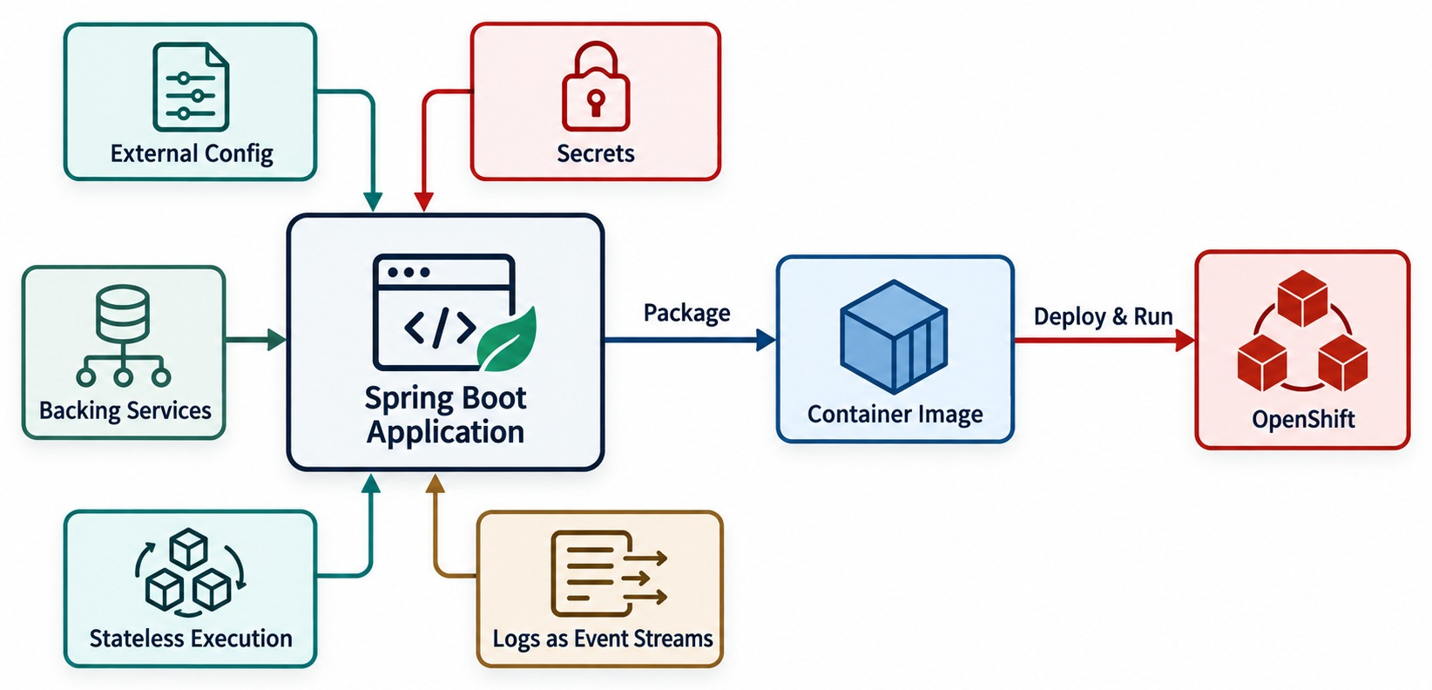
TWELVE-FACTOR IN SPRING BOOT AND OPENSHIFT
External config, stateless processes and logs — packaged and run on OpenShift.
Config
ConfigMaps and Secrets supply environment values.
Processes
Stateless pods; durable data lives in backing services.
Disposability
Pods start fast and shut down gracefully.
Logs
The platform collects the stdout stream.
KEY TAKEAWAY Twelve-Factor principles help applications deploy and run consistently across modern environments.
39
© 2026 by Innovation In Software Corporation
Notes:
KEY TALKING POINTS
------------------
- Connect theory to the tools
Now connect the Twelve-Factor ideas to technologies learners will actually use.
Follow the diagram from Spring Boot, through external config, stateless processes and logs, into a container on OpenShift.
- Config
Spring Boot configuration can come from environment variables and external configuration.
OpenShift can provide ConfigMaps and Secrets.
- Processes and port binding
Containerized services should not rely on local, temporary state for durable business data.
Spring Boot commonly exposes an HTTP port through its embedded web server.
- Disposability and logs
Containers should start and stop predictably.
Applications can write logs to standard output.
The platform and logging stack then collect them.
- Key message
Twelve-Factor principles make applications easier to deploy and run consistently across modern environments.
- What it shows
A Spring Boot app connected to external config, secrets, backing services, stateless execution and logs.
- The path
The app is packaged as a container and runs on OpenShift.
- Key point
This is how the Twelve-Factor ideas look in the stack we use in this course.

Slide 40
EXERCISE: SPOT THE TWELVE-FACTOR VIOLATIONS
Find what stops this service from running well on OpenShift.
PRACTICE EXERCISE
10 MIN
SCENARIO
YOUR TASKS
EXPECTED OUTCOME
A teammate wrote this part of Order Service:
1
Find each violation
✓
Password in code → Config (3)
2
Name the factor it breaks
Production URL in code → Config and backing services (3, 4)
public class OrderService {
String dbPassword = "Prod@123";
String payUrl =
"https://prod-pay.shop.com";
Map<String, Cart> carts =
new HashMap<>();
void save(Order o) {
writeFile("/var/log/orders.log", o);
}
}
✓
3
Rewrite it the Twelve-Factor way
✓
Carts kept in memory → Processes (6)
✓
Local log file → Logs (11)
KEY TAKEAWAY Most Twelve-Factor problems are visible in a few lines of code.
40
© 2026 by Innovation In Software Corporation
Notes:
KEY TALKING POINTS
------------------
- Secrets and URLs
The password and the production URL belong in environment variables, OpenShift ConfigMaps and Secrets.
- In-memory carts
A cart kept in one pod's memory is lost on restart and invisible to other pods.
Store it in a database or cache.
- Log files
Inside a container, a local log file disappears with the pod.
Log to standard output instead.
- Discussion
Ask which violation would hurt first in production.
Usually the hard-coded secret or the in-memory state.

Slide 41
CONWAY'S LAW AND TEAM OWNERSHIP
Team structure shapes service boundaries.
“Organizations design systems that mirror their own communication structures.” — Melvin Conway
Stream-aligned team
Owns one service end to end — e.g. the Order team.
HOW TEAMS ARE ORGANIZED
THE ARCHITECTURE YOU GET
Platform team
Siloed teams: UI, backend, database
Layered services that must change together
Provides the paved road: pipelines, OpenShift, observability.
Partly aligned teams
Inconsistent, blurry service boundaries
Enabling team
Coaches teams through new practices, then steps back.
Teams aligned to business capabilities
Loosely coupled, independently deployable services
INVERSE CONWAY Shape teams around the architecture you want.
KEY TAKEAWAY Align teams to business capabilities, and services will follow those boundaries.
41
© 2026 by Innovation In Software Corporation
Notes:
KEY TALKING POINTS
------------------
- Conway's Law
Systems end up mirroring how the teams that build them communicate.
- Siloed teams
If you have a UI team, a backend team and a database team, you tend to get layered services that must change together.
- Aligned teams
If each team owns a business capability, such as Order or Payment, you tend to get loosely coupled services.
- Team types
Stream-aligned teams own services, platform teams provide the paved road, and enabling teams coach.
Shape teams around the architecture you want.

Slide 42
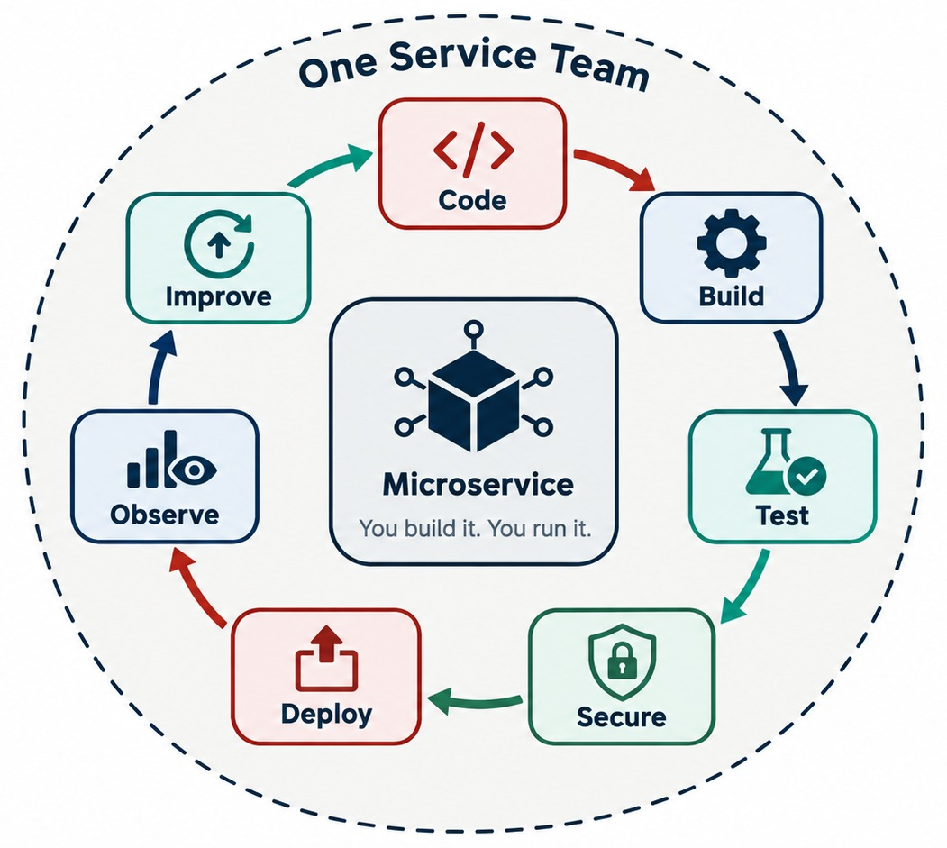
HOW MICROSERVICES FIT MODERN DEVOPS TEAMS
One team owns the loop from code to improvement.
TRADITIONAL HANDOFFS
✕
Developer hands off to testing
✕
Testing hands off to release and operations
Order Service team owns
Code, tests, pipeline, deployment, security, monitoring and production support.
SHARED HELP Platform and SRE teams may provide infrastructure and tooling.
KEY TAKEAWAY Ownership models differ — platform and SRE teams may provide shared infrastructure and operations.
42
© 2026 by Innovation In Software Corporation
Notes:
KEY TALKING POINTS
------------------
- Traditional handoffs
Traditional organizations often had strong handoffs.
Work passed from developers to a testing team, then a release team, then an operations team.
- Modern DevOps
Modern DevOps tries to reduce these handoffs.
It uses collaboration, automation and shared ownership.
One product or service team builds, runs and improves its microservice.
- What a service team owns
For example, a team might own the Order Service.
It is responsible for development, testing, the pipeline and deployment.
It also handles security considerations, monitoring and production reliability.
This is the idea of you build it, you run it.
- Ownership models differ
The exact ownership model differs between organizations.
Platform teams and SRE teams may provide shared infrastructure and operational capabilities.
The strip at the bottom shows the supporting capabilities: Git, CI/CD, security, deployment and observability.
- What it shows
A service team owning a continuous loop: code, build, test, secure, deploy, observe and improve.
- Ownership
The same team builds the service, runs it, and learns from how it behaves in production.
- Key point
In DevOps, you build it, you run it.

Slide 43
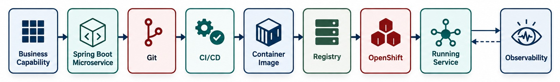
THE END-TO-END DELIVERY PATH
From business capability to a running, observed service on OpenShift.
Architecture
Spring Boot
Containers and CI/CD
OpenShift
Divides the business into independently evolvable services.
Builds each service.
Package each service and automate its delivery.
Schedules, scales, secures and observes the running service.
KEY TAKEAWAY Microservices, Spring Boot, containers and OpenShift are different layers that work together.
43
© 2026 by Innovation In Software Corporation
Notes:
KEY TALKING POINTS
------------------
- The full chain
Finish Module 1 by connecting everything.
We start with a business capability, such as Payment.
We implement it as a microservice, the Payment Service.
In this course, we build it with Spring Boot.
- From code to platform
The Spring Boot application becomes a container image.
CI/CD automates build, test, scan, package and deploy.
The image is stored in a registry and deployed onto OpenShift.
- What OpenShift provides
OpenShift provides capabilities for running containerized workloads.
These include scheduling, networking, configuration and secrets.
They also include health management and scaling.
- Final message
Spring Boot helps us build the service.
Containers package the service.
CI/CD automates its delivery.
OpenShift provides a platform for deploying and operating containerized workloads.
Microservices architecture decides how we divide the business system into independently evolvable services.
- Why this distinction matters
Learners often confuse microservices, Spring Boot, containers and OpenShift as if they were the same thing.
They are different layers that work together.
- What it shows
The full path: business capability, Spring Boot microservice, Git, CI/CD, container image, registry, OpenShift, running service and observability.
- Feedback
Observability feeds what we learn back into the next change.
- Key point
This path connects Module 1 to the rest of the course.
USE-CASE SCENARIO
-----------------
Walk the chain once more, end to end.
A business requirement defines a service boundary.
That boundary becomes a microservice, built as a Spring Boot application.
The application is packaged in a container.
CI/CD delivers it to OpenShift.
From there, the team handles production operations.

Slide 44
KNOWLEDGE CHECK
Answer in your own words — then compare with a partner.
What is a microservice?
Why is data ownership important?
1
6
Why do organizations adopt microservices?
What is a partial failure in a distributed system?
2
7
What is one major limitation of a monolith?
What is fault isolation?
3
8
Are monoliths always bad? Why or why not?
Why do microservices need DevOps automation?
4
9
What does independent deployment mean?
Name one Twelve-Factor principle that matters for Spring Boot.
5
10
44
© 2026 by Innovation In Software Corporation
Notes:
KEY TALKING POINTS
------------------
- 1. Microservice
An independently deployable service focused on one business capability.
- 2. Why adopt
To develop, deploy and scale parts of the system independently and change faster.
- 3. Monolith limitation
Even a small change often means rebuilding, retesting and redeploying the whole application.
- 4. Always bad?
No. Monoliths suit small teams, simple domains and simpler operations.
- 5. Independent deployment
A service can be released without redeploying unrelated services.
- 6. Data ownership
It keeps services autonomous and stops the database becoming a coupling point.
- 7. Partial failure
One service, network call, database or broker fails while the rest keeps running.
- 8. Fault isolation
A failure in one service doesn't necessarily stop the whole system.
- 9. DevOps automation
More deployable units need automated build, test, deployment, monitoring and rollback.
- 10. Twelve-Factor
Examples: externalized configuration, stateless processes, or logs as event streams.

Slide 45
EXERCISE 1.1 — ANALYZE A MONOLITHIC BANKING APPLICATION
Module 1 checkpoint A: spot coupling and candidate boundaries.
OFFICIAL CHECKPOINT A
15 MIN
labs/day-01/exercises/exercise-1.1-analyze-monolith.md
SCENARIO
YOUR TASKS
EXPECTED OUTCOME
The course's banking monolith handles customer profiles, accounts, transactions, loans, fraud checks, reporting and notifications in one deployable application.
Apply what you learned on the order platform to this system.
1
List the major business capabilities in the monolith
✓
A short list of coupling problems
2
Mark tightly coupled areas and modules that change often or carry high traffic
✓
One justified first extract: Account Service
✓
Lab 1 builds Account Service after Modules 1–3
3
Mark where failure should be isolated so money movement is not taken down by reporting
✓
Design only — no code in this checkpoint
4
Name the first extraction candidate and say why
KEY TAKEAWAY A short list of coupling problems and one justified first extract: Account Service.
45
© 2026 by Innovation In Software Corporation
Notes:
KEY TALKING POINTS
------------------
- Official checkpoint
This is the official OUTLINE.md checkpoint for Module 1.
Use the worksheet in labs/day-01/exercises.
- Running it
Fifteen minutes, design only.
Groups list capabilities, mark coupling and high-change areas, and mark failure isolation.
- Expected answer
The first extraction is Account Service.
It has clear ownership of accounts and is what Lab 1 builds.
- Scope
Keep the scope to Account, Transaction and Risk Assessment.
Don't add extra services.

Slide 46
MODULE 1 SUMMARY AND WHAT'S NEXT
From why microservices exist to how they run.
YOU CAN NOW EXPLAIN
NEXT: MODULE 2 — MICROSERVICES DESIGN
✓
Why monoliths struggle to change and scale
1
Where exactly should service boundaries go?
✓
What makes a service a microservice
How should service APIs be designed?
2
✓
How services own data and communicate
3
How should services communicate — and where does state live?
✓
What independence costs — and how to design for failure
✓
When a monolith or modular monolith is the better choice
BRING ALONG The order platform, the five principles and your Exercise 1.1 notes.
✓
Twelve-Factor habits and DevOps ownership
KEY TAKEAWAY Module 2 turns these principles into concrete service boundaries, APIs and communication choices.
46
© 2026 by Innovation In Software Corporation
Notes:
KEY TALKING POINTS
------------------
- Recap
We moved from monolith problems, to what microservices are, to what they cost, to how they run on OpenShift with DevOps teams.
- Next module
Module 2 answers the design questions: where boundaries go, how APIs look, how services communicate and where state lives.

