Slide 1
"Good microservices design starts with business boundaries — not REST controllers."
MODULE 2
Microservices Design
From business domains to well-designed, independently evolving services.
Service boundaries
Loose coupling & high cohesion
RESTful API design
Integration patterns
Service communication
Stateless vs. stateful
SPRING BOOT MICROSERVICES BOOTCAMP • MODULE 2
Notes:
KEY TALKING POINTS
------------------
- From concepts to design
Module 1 answered what microservices are and why organizations use them.
Module 2 answers a harder question.
How should we divide a system into services, and how should those services interact?
- Many apps is not the same as good design
Creating five Spring Boot applications does not automatically give you a good microservices architecture.
The hard part is deciding what belongs in each service and what data it owns.
You also decide how it exposes functionality, how it communicates, and how independently it can change.
- The risk
Poor boundaries can turn microservices into a distributed monolith.
We will see exactly what that means on slide 12.
- One storyline
The whole module uses one e-commerce and order-processing example.
We evolve that same architecture from slide to slide.

Slide 2
LEARNING OBJECTIVES
Define boundaries, design REST APIs, choose communication and understand state.
🎯
BY THE END OF THIS MODULE, YOU CAN
❓
THREE MAJOR DESIGN QUESTIONS
1. Identify appropriate service boundaries
2. Apply loose coupling and high cohesion
3. Explain bounded contexts
4. Design RESTful APIs
5. Compare API and messaging integration
6. Select communication strategies
7. Explain stateless and stateful services
1
Where should we create service boundaries?
Should Payment be part of Order Service — or its own service?
2
How should services communicate?
REST? gRPC? Messaging? Events?
WHY IT MATTERS These answers decide whether the architecture really supports independent deployment and scaling.
3
Where should state live?
With several Order Service instances, can any instance handle the next request?
KEY TAKEAWAY Boundaries, communication and state decide whether services can really deploy and scale independently.
2
© 2026 by Innovation In Software Corporation
Notes:
KEY TALKING POINTS
------------------
- By the end of this module
Learners should be able to identify good service boundaries.
They should apply loose coupling and high cohesion, and explain bounded contexts.
They should design RESTful APIs and compare API and messaging integration.
They should select communication strategies and explain stateless and stateful services.
- Question 1: where are the boundaries?
For example, should Payment be part of the Order Service, or its own service?
- Question 2: how do services communicate?
Should we use REST, gRPC, messaging or events?
- Question 3: where does state live?
If several instances of the Order Service are running, can any instance process the next request?
- Why these questions matter
The answers decide whether the architecture really supports independent deployment and scaling.

Slide 3
KEY TERMS FOR THIS MODULE
Plain definitions for the words we'll use most.
1
Bounded context
2
Loose coupling
A boundary inside which one domain model and its words have one exact meaning.
Services can change and deploy without forcing changes in other services.
3
High cohesion
4
Strangler fig
Everything a service contains belongs to the same business purpose.
Replacing a monolith gradually by moving features, one by one, to new services.
5
Resource
6
Idempotency
A thing an API exposes, such as an order, named with a noun in the URL.
Repeating the same request has the same effect as sending it once.
7
API contract
8
Stateless service
The agreed request, response and error format that consumers depend on.
A service that keeps no client session in memory, so any instance can handle any request.
KEY TAKEAWAY Agree on the words first — every later slide builds on them.
3
© 2026 by Innovation In Software Corporation
Notes:
KEY TALKING POINTS
------------------
- How to run this slide
Read each term once and give a quick example from the order platform or the banking lab.
- Bounded context
A boundary inside which one domain model and its words have one exact meaning.
- Loose coupling
Services can change and deploy without forcing changes in other services.
- High cohesion
Everything a service contains belongs to the same business purpose.
- Strangler fig
Replacing a monolith gradually by moving features, one by one, to new services.
- Resource
A thing an API exposes, such as an order, named with a noun in the URL.
- Idempotency
Repeating the same request has the same effect as sending it once.
- API contract
The agreed request, response and error format that consumers depend on.
- Stateless service
A service that keeps no client session in memory, so any instance can handle any request.

Slide 4
FULL FORMS USED IN THIS MODULE
Every abbreviation on these slides, spelled out.
API
Application Programming Interface
HTTPS
HyperText Transfer Protocol Secure
RPC
Remote Procedure Call
BFF
Backend for Frontend
ID
Identifier
SQL
Structured Query Language
CRUD
Create, Read, Update, Delete
JPA
Jakarta Persistence API
TLS
Transport Layer Security
DDD
Domain-Driven Design
JSON
JavaScript Object Notation
URI
Uniform Resource Identifier
DTO
Data Transfer Object
JVM
Java Virtual Machine
URL
Uniform Resource Locator
HTTP
HyperText Transfer Protocol
REST
Representational State Transfer
KEY TAKEAWAY When an abbreviation isn't clear, the full form is on this slide.
4
© 2026 by Innovation In Software Corporation
Notes:
KEY TALKING POINTS
------------------
- How to run this slide
Don't read every row.
Point out the few this module uses most, and say the full list is here for reference.
- Reference
API is Application Programming Interface; BFF is Backend for Frontend; CRUD is Create, Read, Update, Delete; DDD is Domain-Driven Design; DTO is Data Transfer Object; HTTP is HyperText Transfer Protocol; HTTPS is HyperText Transfer Protocol Secure; ID is Identifier; JPA is Jakarta Persistence API; JSON is JavaScript Object Notation; JVM is Java Virtual Machine; REST is Representational State Transfer; RPC is Remote Procedure Call; SQL is Structured Query Language; TLS is Transport Layer Security; URI is Uniform Resource Identifier; URL is Uniform Resource Locator.

Slide 5
FROM MODULE 1 TO MODULE 2
Principles are in place — now we design.
MODULE 1 GAVE US
🧭
THE SEVEN-STEP DESIGN PATH
1
Understand the business requirement
Part 1
✓
Why monoliths struggle to change and scale
What makes a service a microservice
2
Identify business capabilities
Part 1
✓
Data ownership and API / event communication
3
Define the domain and bounded contexts
Part 1
✓
The cost of distribution and designing for failure
4
Identify service boundaries
Part 1
✓
Twelve-Factor and DevOps habits
5
Design responsibilities and API contracts
Part 2
✓
NOW Turn those principles into concrete design decisions.
6
Choose communication and state strategy
Parts 3–4
7
Validate and refine the design
Exercise 1.2
KEY TAKEAWAY Design moves from business requirements to boundaries, contracts, communication and state — in that order.
5
© 2026 by Innovation In Software Corporation
Notes:
KEY TALKING POINTS
------------------
- Bridge from Module 1
Module 1 explained why microservices exist and what they cost.
Module 2 is about making concrete design decisions.
- The seven-step path
Understand the requirement, find capabilities, define bounded contexts, pick boundaries, design contracts, choose communication and state, then validate.
- How the module follows it
Part 1 covers steps 1–4, Part 2 covers contracts, Parts 3 and 4 cover communication and state, and Exercise 1.2 validates the design.

Slide 6
PART 1: FINDING SERVICE BOUNDARIES
Boundaries decide almost everything that follows.
Part 1
Service boundaries
Part 2
REST API design
Part 3
Service communication
Part 4
State and the blueprint
SO FAR
NEXT QUESTION
Where exactly should one service end and the next begin?
✓
Microservices own business capabilities
✓
They deploy, scale and store data independently
IN THIS PART
Independence costs network calls and failure handling
1
From business domain to candidate services
✓
2
What makes a good boundary — and the right size
3
Coupling and cohesion
4
Domain-Driven Design and bounded contexts
5
Decomposition, with an exercise
6
Migrating safely and avoiding the distributed monolith
6
© 2026 by Innovation In Software Corporation
Notes:
KEY TALKING POINTS
------------------
- Why boundaries first
APIs, communication and data all depend on where the boundaries are.
Get them wrong and everything downstream is harder.
- What this part covers
We go from the business domain to candidate services, test them with coupling and cohesion, and refine them with Domain-Driven Design.

Slide 7
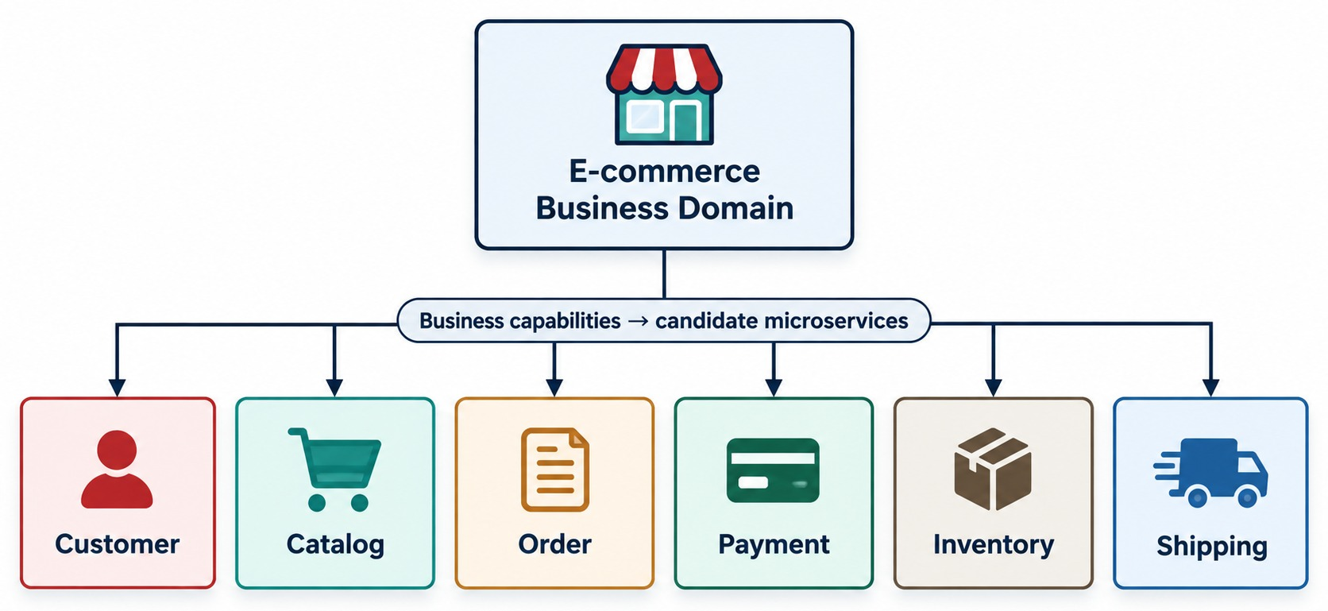
FROM BUSINESS DOMAIN TO MICROSERVICES
How business capabilities become candidate services.
What the business does
Manage customers and products, create orders, take payments, manage stock and ship.
Capabilities → candidates
Order Management → Order Service; Payment Processing → Payment Service.
CANDIDATES, NOT FINAL Domain analysis, teams and change patterns decide.
KEY TAKEAWAY Start with the business domain — not with “how many services should we create?”
7
© 2026 by Innovation In Software Corporation
Notes:
KEY TALKING POINTS
------------------
- Start with the business
Do not begin by asking how many services we should create.
Begin with the business domain.
- What the business does
Suppose we are designing an e-commerce platform.
The business manages customers and maintains products.
It creates orders, processes payments, manages inventory and ships products.
- Capabilities become candidates
These business capabilities become candidates for service boundaries.
Order management becomes the Order Service.
Payment processing becomes the Payment Service.
Inventory management becomes the Inventory Service.
- Candidates, not final answers
Stress that these are candidate boundaries.
Domain analysis, organizational needs and change patterns decide the final architecture.
- What it shows
The e-commerce business domain broken into Customer, Catalog, Order, Payment, Inventory and Shipping.
- How to read it
Start with the whole business at the top, then follow it down to the individual capabilities.
- Key point
Each business capability is a strong candidate for its own service.

Slide 8
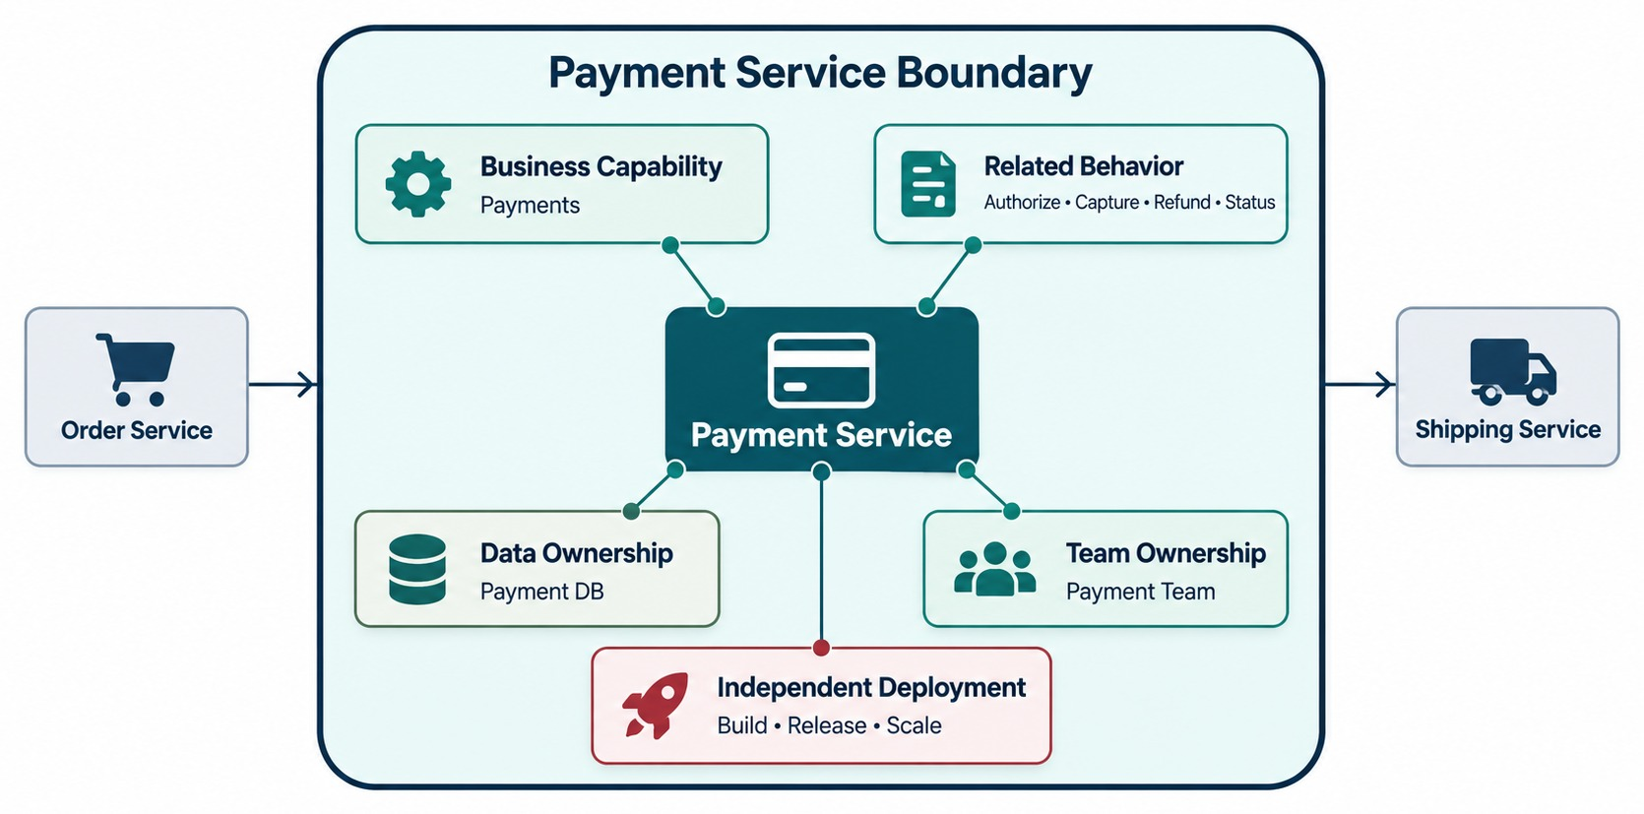
WHAT MAKES A GOOD MICROSERVICE BOUNDARY?
Business ownership, data ownership, change patterns and autonomy.
PAYMENT SERVICE: GOOD FIT
✓
Authorize payment
✓
Capture payment
✓
Refund payment
✓
Payment status
Doesn't belong
Update shipping address → Shipping, not Payment.
ASK What changes together? It belongs together.
KEY TAKEAWAY Things that change together belong together; things that must evolve independently may need separate boundaries.
8
© 2026 by Innovation In Software Corporation
Notes:
KEY TALKING POINTS
------------------
- What a boundary is
A service boundary defines what belongs inside a service and what stays outside it.
Walk around the six factors on the diagram: business capability, data ownership and change together.
Then team ownership, independent deployment and minimal dependencies.
- A good fit
Take the Payment Service.
Authorize payment, capture payment, refund payment and payment status naturally belong together.
- A questionable fit
Putting update shipping address inside the Payment Service would be questionable.
Shipping information belongs to another business capability.
- The key question
Ask: what functionality changes together?
Things that often change together usually belong together.
Things that need to evolve independently may need separate boundaries.
- What it shows
A single service boundary, and everything that belongs inside it.
- What's inside
One business capability, the behavior that goes with it, the data it owns, the team that owns it, and its own deployment.
- Key point
A good boundary lets one team change and deploy the service on its own.

Slide 9
RIGHT-SIZING A SERVICE
Not too fine, not too coarse — sized to one capability and one team.
TOO FINE-GRAINED
RIGHT-SIZED
TOO COARSE-GRAINED
•
Chatty network calls
✓
One business capability
•
Many unrelated capabilities
•
High operational overhead
✓
Owned by one team
•
Teams block each other
•
One table = one service
✓
Deploys independently
•
A distributed monolith
ASK FOR EVERY SERVICE
WARNING SIGNS OF POOR BOUNDARIES
?
Which business capability does it own?
✕
One feature needs changes in many services
?
Which data does it own?
✕
Services share tables
?
Which team owns it?
✕
Services can't deploy on their own
?
How often does it change — and scale?
✕
The same business rule lives in several services
KEY TAKEAWAY Right-sized services balance independent deployment against the cost of running many small services.
9
© 2026 by Innovation In Software Corporation
Notes:
KEY TALKING POINTS
------------------
- The spectrum
Too fine-grained services talk constantly over the network.
Too coarse-grained ones become a distributed monolith.
- Right-sized
A right-sized service owns one business capability, is owned by one team, and deploys on its own.
- Four questions
Ask which capability and data it owns, which team owns it, and how often it changes and scales.
- Warning signs
One feature touching many services, shared tables, services that can't deploy alone, and duplicated business rules.

Slide 10
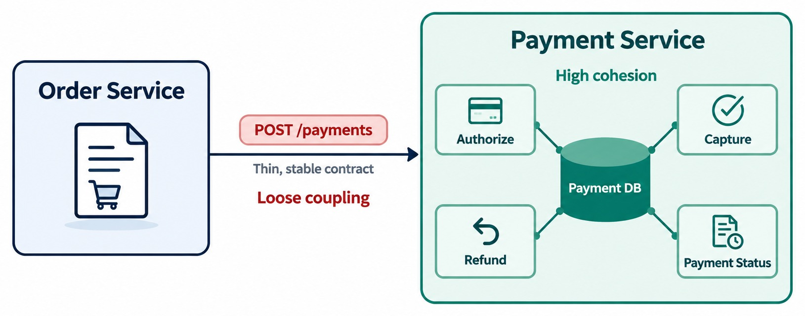
LOOSE COUPLING AND HIGH COHESION
Two fundamental characteristics of well-designed services.
High cohesion — inside
Authorize, capture, refund and status all live in Payment Service.
ORDER DOESN'T NEED TO KNOW
✕
Payment's tables
✕
Its Java classes
✕
Its internal algorithms
RULE Cohesive inside, loosely coupled between.
KEY TAKEAWAY Keep related payment behavior together, and let other services depend only on its contract.
10
© 2026 by Innovation In Software Corporation
Notes:
KEY TALKING POINTS
------------------
- Two foundational principles
Loose coupling and high cohesion are two foundational design principles for microservices.
- High cohesion
Related responsibilities stay together.
The Payment Service holds closely related payment functionality: authorize, capture, refund and payment status.
- Loose coupling
Services should know as little as possible about each other's internals.
The Order Service should only know that the Payment Service provides a payment operation through a contract.
It should not need to know Payment's tables, internal Java classes, repository implementation or internal algorithms.
- The combination we want
High cohesion inside the service.
Loose coupling between services.
- What it shows
Payment Service keeps its related logic together, which is high cohesion.
- Between services
Order and Payment talk only through a clean, agreed contract, which is loose coupling.
- Key point
Keep related things together inside a service, and keep services loosely connected.

Slide 11
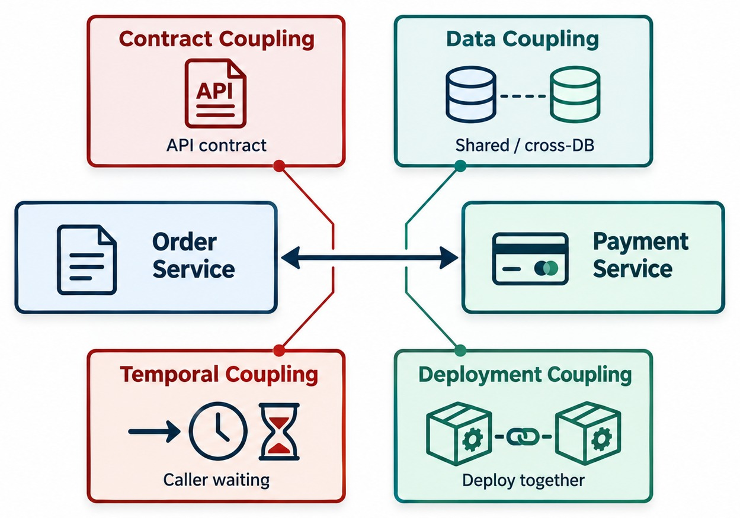
UNDERSTANDING COUPLING BETWEEN SERVICES
Contract, data, temporal and deployment coupling.
Contract
Depends on another service's API shape.
Data
Several services depend on one schema.
Temporal
Service B must be up when A calls.
Deployment
Changing A forces B to redeploy.
THE GOAL Intentional, manageable coupling — not zero.
KEY TAKEAWAY Know which kind of coupling you are creating — and keep it intentional and manageable.
11
© 2026 by Innovation In Software Corporation
Notes:
KEY TALKING POINTS
------------------
- Not all coupling is the same
Walk through the four kinds of coupling on the slide.
- Contract coupling
One service depends on the structure of another service's API.
- Data coupling
Several services depend directly on the same database schema.
- Temporal coupling
Service A needs Service B to be available at exactly the same time.
For example, Order calls Payment, which calls Inventory, which calls Shipping.
If every service must respond before the order completes, their availability is tightly linked.
- Deployment coupling
Changing Service A forces Service B to be redeployed.
- The realistic goal
The goal is not zero coupling.
That is unrealistic.
The goal is coupling that is intentional and manageable.
- What it shows
Four kinds of coupling around services that interact.
- The four types
Contract coupling depends on the API shape.
Data coupling depends on shared data.
Temporal coupling needs the other service to be up at the same time.
Deployment coupling means releasing services together.
- Key point
Some coupling is unavoidable, so aim to keep each kind as low as practical.

Slide 12
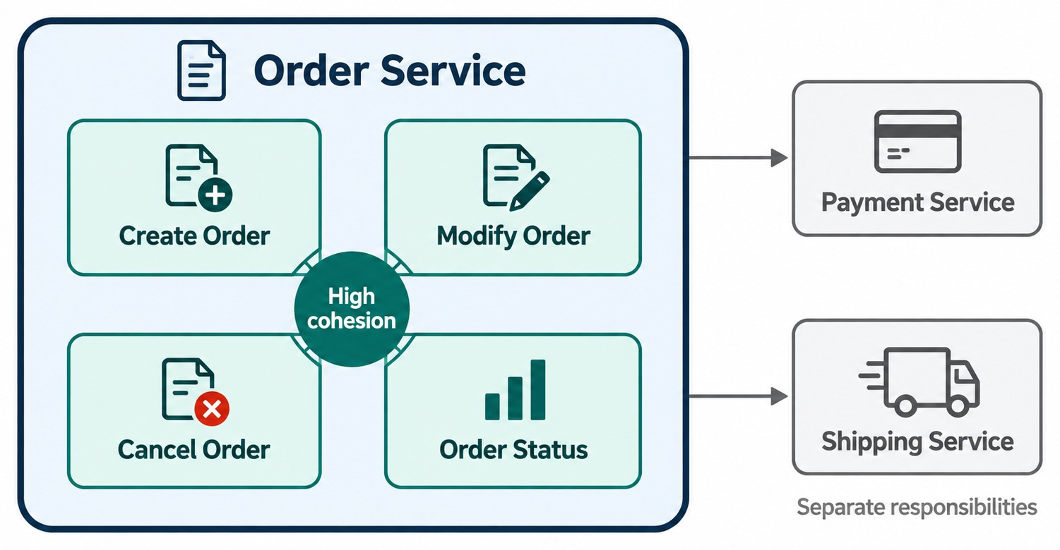
HIGH COHESION WITHIN A SERVICE
Keep closely related business behavior and data together.
Order Service owns
Create, modify, cancel and track orders.
Shared business logic
Pricing or eligibility rules in a shared library force services to release together.
Safe to share
Technical utilities: logging, tracing, HTTP client wrappers.
QUICK TEST Describe the service in one short sentence.
KEY TAKEAWAY A service should have one clear business purpose.
12
© 2026 by Innovation In Software Corporation
Notes:
KEY TALKING POINTS
------------------
- What belongs to Order
Ask what naturally belongs to the Order domain.
Creating an order, adding and removing items, calculating the total, cancelling and tracking status clearly belong together.
- What belongs elsewhere
Processing a credit card payment is a different business concern, so it belongs in the Payment Service.
Shipping belongs in the Shipping Service.
- Low cohesion
Low cohesion produces services that become random collections of unrelated functionality.
- A quick test
A service should have a clear business purpose.
If you cannot describe what a service does in a short sentence, its boundary may be poorly defined.
- What it shows
Order Service contains Create Order, Modify Order, Cancel Order and Order Status.
- What stays outside
Payment and Shipping logic live in their own services, not inside Order.
- Key point
A service should own one closely related set of behavior.
- Shared business logic
A library full of business rules looks like reuse, but every service using it must release together when a rule changes.
Keep rules inside the owning service; share only technical utilities.

Slide 13
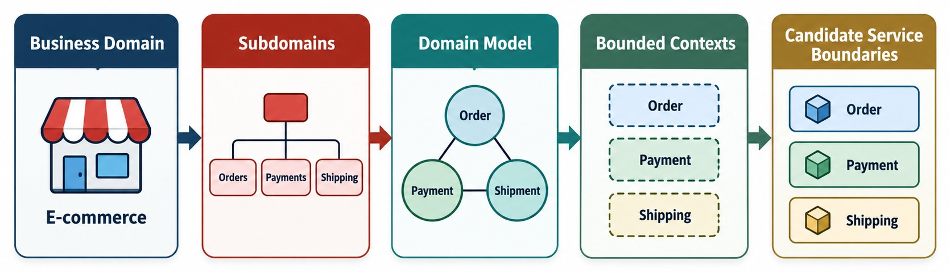
INTRODUCTION TO DOMAIN-DRIVEN DESIGN
Domain, subdomains, domain model, bounded contexts and candidate services.
Domain
Subdomains
Ubiquitous language
Bounded context
The business area — here, e-commerce.
Core: invest most. Supporting: build simply. Generic: buy or reuse.
One vocabulary shared by developers and business experts.
Where a model and its terms have one meaning.
KEY TAKEAWAY Use just enough DDD to find good service boundaries — starting from a shared business language.
13
© 2026 by Innovation In Software Corporation
Notes:
KEY TALKING POINTS
------------------
- Just enough DDD
Introduce Domain-Driven Design only as deeply as we need for microservices.
Follow the flow from the real business down to service boundaries.
- Domain and subdomains
A domain is the business area we are solving problems for, for example e-commerce.
Subdomains might include ordering, payments, inventory and shipping.
- Ubiquitous language
DDD encourages developers and business experts to share one vocabulary.
This is called ubiquitous language.
For example, the word Order should have one clear meaning inside the Ordering context.
- Why it matters here
That shared, precise language becomes important when we identify microservice boundaries.
- What it shows
The steps Domain-Driven Design takes, from the business down to service boundaries.
- The steps
Start with the business domain, split it into subdomains, and build a domain model.
Then define bounded contexts and turn them into candidate service boundaries.
- Key point
Service boundaries should come from understanding the business, not from guesswork.
- Three kinds of subdomain
Core subdomains are what make the business different, so invest heavily.
Supporting ones are needed but not special.
Generic ones, like email sending, are best bought or reused.

Slide 14
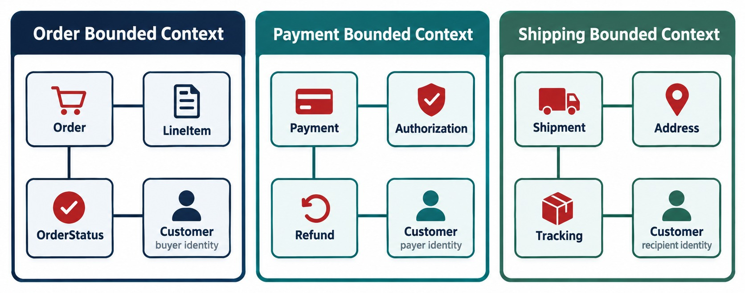
BOUNDED CONTEXTS
Clear model and responsibility boundaries.
Same word, different model
“Customer” is an ID and shipping address in Ordering, but name, email and preferences in Customer Management.
Own concepts
Order: line items, status. Payment: refunds, authorizations.
BIG SHIFT No single enterprise-wide object model.
KEY TAKEAWAY Inside each bounded context, the model and its terms have one clear meaning.
14
© 2026 by Innovation In Software Corporation
Notes:
KEY TALKING POINTS
------------------
- What a bounded context is
A bounded context sets a boundary.
Inside it, a domain model and its terms have one specific meaning.
The slide shows three: Order, Payment and Shipping, each with its own terms.
- Same word, different model
Customer can mean different things in different contexts.
For Ordering, a customer ID and shipping address may be enough.
For Customer Management, name, email, preferences and account status matter.
- A big shift
The contexts do not need identical Customer models.
This is a major change from designing one universal enterprise object model.
- What it shows
Separate bounded contexts for Order, Payment and Shipping.
- Own concepts
Each context has its own terms and model.
The same word can mean different things in different contexts.
- Key point
A bounded context is a clear boundary where one model and one language apply.

Slide 15
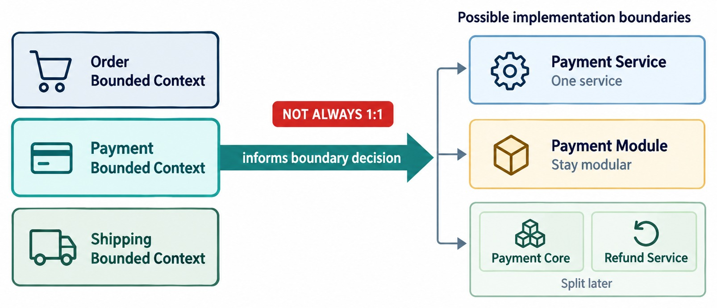
BOUNDED CONTEXT → SERVICE BOUNDARY
Contexts inform candidate services — without a strict 1:1 rule.
Bounded context
A domain modeling boundary.
Microservice
An architecture and deployment boundary.
POSSIBLE OUTCOMES
✓
Often: one context → one service
✓
Large context → several services
✓
Or stay a module for now
KEY TAKEAWAY Let the business model inform the architecture — not blindly dictate the number of deployments.
15
© 2026 by Innovation In Software Corporation
Notes:
KEY TALKING POINTS
------------------
- Follow the flow
The business domain gives us bounded contexts.
A bounded context suggests a candidate service boundary.
That service talks to other services through APIs and events.
- An important qualification
A bounded context is a domain modeling boundary.
A microservice is an architectural and deployment boundary.
They often line up, but not always one to one.
- Examples
The Payment context becoming the Payment Service could be a good fit.
But a large bounded context may eventually need several deployable services.
- The message
The business model should inform the architecture.
It should not blindly dictate the number of deployments.
- What it shows
A bounded context guiding where a microservice boundary could be.
- Not always 1:1
One context might become one service, several services, or share a service, depending on the situation.
- Key point
Use bounded contexts as a strong guide, not a strict rule.

Slide 16
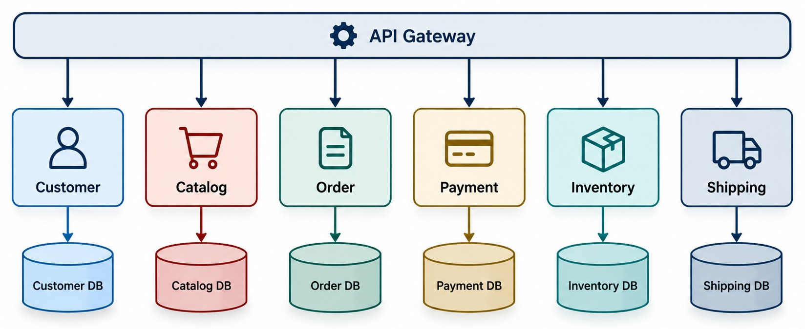
SERVICE DECOMPOSITION WITH OWNED DATA
Six capabilities behind one gateway, each with its own database.
Customer · Catalog
Profiles and preferences; product information.
Order · Payment
Order lifecycle; authorize, capture and refund.
Inventory · Shipping
Stock and reservations; shipments and tracking.
KEY TAKEAWAY Breaking down the business produces candidate services with clear responsibilities.
16
© 2026 by Innovation In Software Corporation
Notes:
KEY TALKING POINTS
------------------
- Walk the responsibilities
The Customer Service owns customer profiles, contact information and preferences.
The Catalog Service owns product information, descriptions and metadata.
The Order Service owns creating orders, the order lifecycle and order status.
- Services connected to Order
The Payment Service owns authorization, capture and refunds.
The Inventory Service owns stock availability, reservations and inventory adjustments.
The Shipping Service owns shipment creation and delivery tracking.
- The takeaway
Now learners can see how breaking down the business produces candidate services.
- What it shows
Customer, Catalog, Order, Payment, Inventory and Shipping as clearly separate capabilities.
- How to use it
This is the same e-commerce example we use throughout the module.
- Key point
Clear separation makes ownership and independent change possible.

Slide 17
EXERCISE: GROUP FEATURES INTO SERVICES
Practice bounded contexts and high cohesion on the order platform.
PRACTICE EXERCISE
10 MIN
SCENARIO
YOUR TASKS
EXPECTED OUTCOME
The order platform needs these features:
open a customer account · view a product · add to cart · place an order · charge a card · refund a payment · reserve stock · print a shipping label · email a receipt · flag a suspicious order
1
Group the features into services
✓
Customer, Catalog, Order, Payment, Inventory, Shipping
2
Name the data each service owns
Notification owns receipt emails
✓
3
Pick one feature that could go either way — and decide
✓
Fraud checks: separate if they change often
✓
Every service owns its own data
KEY TAKEAWAY Group features by business capability and the data they change together.
17
© 2026 by Innovation In Software Corporation
Notes:
KEY TALKING POINTS
------------------
- Expected grouping
Customer: accounts.
Catalog: products.
Order: cart and orders.
Payment: charges and refunds.
Inventory: stock.
Shipping: labels.
- Judgment calls
Is the cart part of Order?
Usually yes.
Receipt emails fit a Notification capability.
Fraud checks may be their own service if they change often.
- What to listen for
Good answers justify groupings by business capability and owned data, not by technical layer.

Slide 18
DECOMPOSING A MONOLITH: THE STRANGLER FIG
Replace a monolith one capability at a time — safely.
1 Put a gateway in front
2 Build the new service beside it
3 Route that traffic to it
4 Retire the old code
Stages 1–2
Stage 3
Stage 4
The gateway sends everything to the monolith while the new Order Service is built and tested beside it.
The gateway routes /orders to Order Service. Everything else still goes to the monolith.
Order code is removed from the monolith. Repeat for the next capability.
WHY IT WORKS
Where to start
✓
The monolith keeps serving traffic the whole time
A low-risk, high-value seam with clear data ownership — in the lab, Account Service.
✓
Every step is small and reversible
✓
Each capability is validated on real traffic
AVOID A big-bang rewrite that switches everything at once.
KEY TAKEAWAY Migrate one capability at a time while the monolith keeps running — never all at once.
18
© 2026 by Innovation In Software Corporation
Notes:
KEY TALKING POINTS
------------------
- The idea
Like a strangler fig growing around a tree, new services gradually take over from the monolith.
- Four stages
Put a gateway in front, build the new service beside the monolith, route that capability's traffic to it, then remove the old code.
- Why it's safe
The monolith keeps serving traffic, and each step can be undone if something goes wrong.
- Where to start
Pick a low-risk, high-value capability with clear data ownership.
In the course lab that is Account Service.

Slide 19
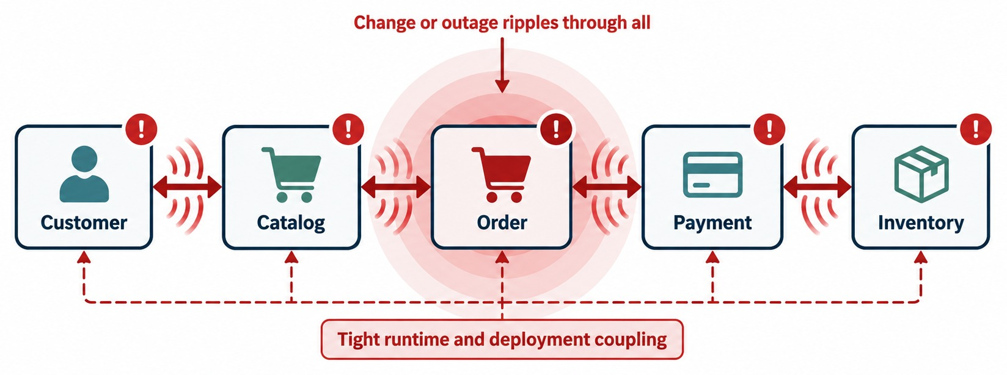
AVOIDING THE DISTRIBUTED MONOLITH
How excessive dependencies defeat microservice independence.
WARNING SIGNS
!
Services must deploy together
!
Excessive synchronous calls
!
Shared database tables
!
Services know each other's internals
LOOKS LIKE MICROSERVICES …but behaves like one tightly coupled system.
KEY TAKEAWAY Microservices are about independent evolution — not simply separate processes.
19
© 2026 by Innovation In Software Corporation
Notes:
KEY TALKING POINTS
------------------
- It looks like microservices
This design has several applications, so it looks like microservices.
But one request needs five mandatory synchronous calls, from Service A all the way to Service E.
- It behaves like a monolith
A change in A forces changes in B and C. Then A, B and C must be deployed together.
Operationally, they behave like one tightly coupled system.
This is called a distributed monolith.
- Warning signs
Services must deploy together.
There are too many synchronous calls.
Services share database tables.
One business operation crosses many services.
Changes keep affecting several services.
Services know each other's internal details.
- The message
Microservices are about independent evolution, not just separate processes.
- What it shows
Service A calls B, which calls C, then D, then E, in one long chain.
- The problem
If one service in the chain is slow or down, everything fails, and services must often be released together.
- Key point
This is a distributed monolith: all the cost of microservices, without the independence.

Slide 20
EXERCISE: SPOT THE TIGHT COUPLING
Mark each design good or bad — and fix the bad ones.
PRACTICE EXERCISE
10 MIN
SCENARIO
YOUR TASKS
EXPECTED OUTCOME
1. Order Service updates the Inventory database directly.
2. Order Service calls Inventory's API to reserve stock.
3. Notification polls the Order database every 5 seconds.
4. Order publishes OrderPlaced; Notification reacts.
5. Order and Payment share a pricing-rules library and must release together.
1
Mark each design good or bad
✓
1 Bad: data coupling → call the API
2
Name the type of coupling for each bad one
2 Good: contract only
✓
Suggest a better design
✓
3 Bad: data coupling → consume events
3
✓
4 Good: loose, asynchronous
✓
5 Bad: deployment coupling → rules stay with the owner
KEY TAKEAWAY Services should never own each other's databases or internal logic.
20
© 2026 by Innovation In Software Corporation
Notes:
KEY TALKING POINTS
------------------
- Designs 1 and 3
Both reach into another service's database.
That's data coupling; use the owner's API or events instead.
- Designs 2 and 4
Both depend only on a contract, either an API or an event, so they are loosely coupled.
- Design 5
A shared business-rules library forces both services to release together.
Keep the rule in the service that owns it.

Slide 21
PART 2: DESIGNING REST APIS
The contract is what other teams depend on.
✓ Part 1
Service boundaries
Part 2
REST API design
Part 3
Service communication
Part 4
State and the blueprint
SO FAR
NEXT QUESTION
What should the contract between a service and its callers look like?
✓
Boundaries follow business capabilities
✓
Coupling is intentional; cohesion is high
IN THIS PART
✓
Bounded contexts guide where services split
REST in microservices
1
2
Resources and URIs
3
HTTP methods and idempotency
4
Status codes and a Spring Boot controller
5
DTOs, validation and errors
6
Versioning, OpenAPI and API security
21
© 2026 by Innovation In Software Corporation
Notes:
KEY TALKING POINTS
------------------
- From boundaries to contracts
Once a boundary is clear, the API is how the rest of the system sees the service.
- What to watch
Look for how each design choice affects consumers who depend on the contract.

Slide 22
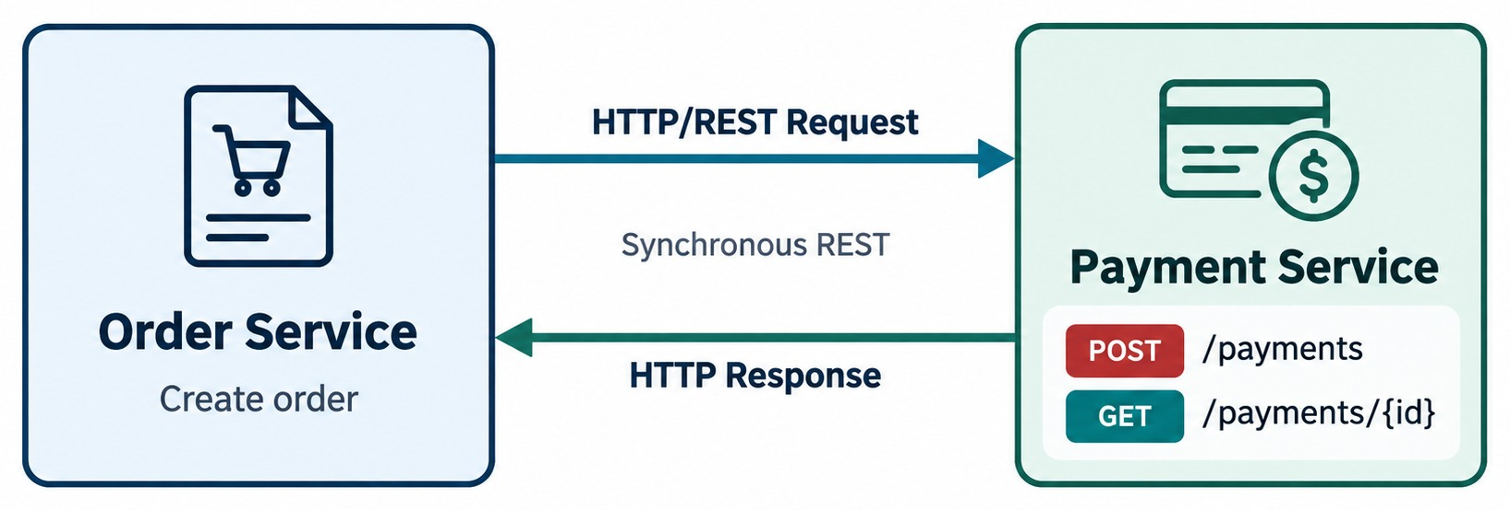
RESTFUL APIS IN MICROSERVICES
REST as a synchronous service communication mechanism.
REST BUILDING BLOCKS
Resources
HTTP methods
Representations
Stateless requests
Payment Service contract
POST /payments
GET /payments/{id}
REST ≠ MICROSERVICES Neither implies the other.
KEY TAKEAWAY REST is one common mechanism for synchronous service communication.
22
© 2026 by Innovation In Software Corporation
Notes:
KEY TALKING POINTS
------------------
- REST in microservices
REST is one common way for microservices to communicate synchronously.
In the diagram, the Order Service calls the Payment Service over HTTP.
For example, POST /payments creates a payment and GET /payments/{id} reads one.
- Resources
REST models business concepts as resources, such as /orders, /customers, /products and /payments.
Clients work with them using standard HTTP semantics.
- REST is not the same as microservices
A microservice does not have to use REST.
And a REST API is not automatically a microservice.
- What it shows
Order Service calling Payment Service over HTTP using REST.
- Endpoints
The call uses resource-based endpoints, like a payments resource, instead of action names.
- Key point
REST is a simple, widely understood way for services to talk synchronously.

Slide 23
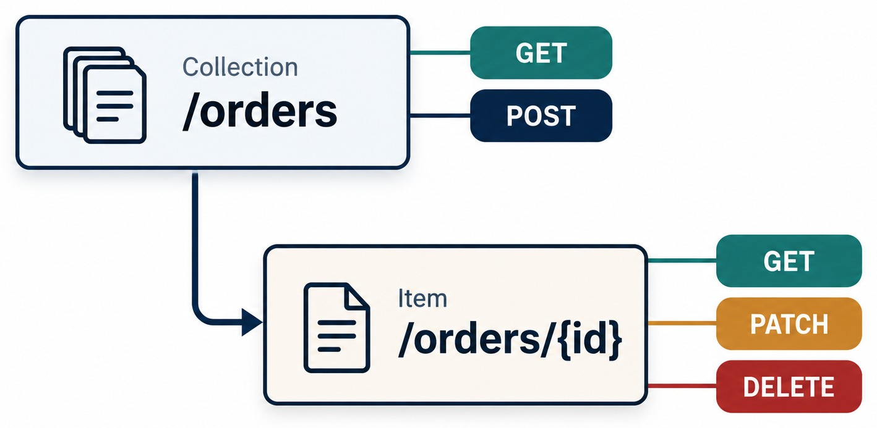
RESOURCE-ORIENTED API DESIGN
Resources, URIs and nouns: /orders, /customers, /products.
AVOID RPC-STYLE URLS
✕
/getAllOrders
✕
/createNewOrder
✕
/deleteOrderById
Read it as
GET /orders/123 — retrieve the representation of order 123.
BE PRAGMATIC Action endpoints can fit; resources are the default.
KEY TAKEAWAY Name resources with nouns and let the HTTP method express the action.
23
© 2026 by Innovation In Software Corporation
Notes:
KEY TALKING POINTS
------------------
- Prefer resources and HTTP semantics
REST APIs should generally focus on resources and HTTP methods.
Use nouns like /orders, /payments and /customers.
Do not turn every operation into a verb in the URL.
- Avoid endpoint sprawl
Avoid RPC-style endpoints like /getAllOrders, /createNewOrder and /deleteOrderById.
RPC means remote procedure call, where each URL is named like a method.
- Read an endpoint aloud
GET /orders/123 means: retrieve the representation of order 123.
- Be pragmatic
Real enterprise APIs can include action-style operations where that makes sense.
But resource-oriented design is a strong default.
- What it shows
The /orders collection and a single /orders/{id} resource.
- Methods
GET reads, POST creates, PATCH updates part of a resource, and DELETE removes it.
- Key point
Design URLs around nouns (resources), and let HTTP methods express the action.

Slide 24
HTTP METHODS AND CRUD SEMANTICS
GET, POST, PUT, PATCH and DELETE — used with the correct intent.
HTTP Method | Typical Purpose | Example
GET | Retrieve | GET /orders/123
POST | Create / process | POST /orders
PUT | Replace | PUT /customers/123
PATCH | Partial update | PATCH /orders/123
DELETE | Remove | DELETE /orders/123
IDEMPOTENCY
PUT /customers/123
#1
Same result
PUT /customers/123
#2
Repeating the same PUT has the same intended effect as doing it once.
This matters when retries happen in distributed systems.
GET should not change application state as its intended effect.
KEY TAKEAWAY Use each HTTP method for its intended meaning — idempotency matters once retries happen.
24
© 2026 by Innovation In Software Corporation
Notes:
KEY TALKING POINTS
------------------
- Semantics, not just CRUD
Explain what each method means rather than memorizing CRUD.
GET retrieves information and should not change application state as its intended effect.
POST commonly creates a resource or starts processing defined by the target resource.
- PUT, PATCH and DELETE
PUT generally replaces the state of a resource at a known URI.
PATCH partially changes a resource.
DELETE asks for a resource to be removed.
- Idempotency
Introduce idempotency.
Repeating PUT /customers/123 with the same data should have the same intended effect as doing it once.
This matters when retries happen in distributed systems.

Slide 25
SAFE OPERATIONS AND IDEMPOTENCY KEYS
Which requests can be retried safely — and how to make POST retry-safe.
Method | Safe? | Idempotent?
GET | Yes | Yes
PUT | No | Yes
DELETE | No | Yes
PATCH | No | Not by default
POST | No | No
✓
Retry-safe order creation
POST /orders
Idempotency-Key: 7f3a-checkout-001
→ 201 Created (first request)
→ 200 OK, same order (retry)
How it works
The server stores the key with the result and returns the original response for repeats.
WHY A double-tap must not create two orders or two charges.
KEY TAKEAWAY Safe methods never change state; idempotency keys make retries of POST safe.
25
© 2026 by Innovation In Software Corporation
Notes:
KEY TALKING POINTS
------------------
- Safe
A safe method doesn't change server state.
GET is safe, so it can be cached and retried freely.
- Idempotent
Repeating an idempotent request has the same effect as doing it once.
PUT and DELETE are idempotent; POST is not.
- Idempotency keys
The client sends a unique Idempotency-Key header.
If the server has seen the key, it returns the original result instead of creating a new order.
- Why it matters
Networks drop responses and users double-tap.
Without a key, a retry can create two orders or charge twice.

Slide 26
HTTP STATUS CODES AND API RESPONSES
2xx, 4xx and 5xx — with consistent response and error design.
2XX SUCCESS
4XX CLIENT / REQUEST PROBLEM
5XX SERVER-SIDE FAILURE
CONSISTENT ERROR RESPONSE
200
OK
400
Bad Request
500
Internal Server Error
Error code
201
Created
401
Unauthorized
503
Service Unavailable
Message
204
No Content
403
Forbidden
Timestamp
404
Not Found
Correlation / trace ID
409
Conflict
Relevant details
EXAMPLES
Clients shouldn't reverse-engineer failures from arbitrary strings.
Order created
201 Created
Order doesn't exist
404 Not Found
Invalid input
400 Bad Request
KEY TAKEAWAY Status codes and a consistent error model are part of the API contract.
26
© 2026 by Innovation In Software Corporation
Notes:
KEY TALKING POINTS
------------------
- Status codes are part of the contract
An API contract is more than the JSON payload.
HTTP status codes tell the client the outcome of a request.
- The three families
2xx means success.
4xx means a problem with the client's request.
5xx means a failure on the server side.
- Examples
Creating an order successfully returns 201 Created.
Asking for an order that does not exist returns 404 Not Found.
Sending invalid input returns 400 Bad Request.
- Consistent error responses
A consistent error response can include an error code, a message, a timestamp, a correlation or trace ID, and relevant details.
Clients should not have to reverse-engineer failures from arbitrary strings.

Slide 27
A SPRING BOOT REST CONTROLLER
Order Service exposes /orders — and the controller stays thin.
OrderController.java
Resource URL
@RestController
@RequestMapping("/orders")
public class OrderController {
private final OrderService orders; // injected
@GetMapping("/{id}")
public OrderResponse get(@PathVariable String id) {
return orders.find(id);
}
@PostMapping
public ResponseEntity<OrderResponse> create(
@Valid @RequestBody CreateOrderRequest req) {
OrderResponse created = orders.create(req);
return ResponseEntity
.created(URI.create("/orders/" + created.id()))
.body(created);
}
}
@RequestMapping("/orders") names the resource.
GET by id
@GetMapping("/{id}") reads one order.
201 + Location
POST returns 201 Created and where to find the new order.
THIN CONTROLLER Business rules live in OrderService.
KEY TAKEAWAY Controllers map HTTP to the service layer — URLs, methods and status codes, nothing more.
27
© 2026 by Innovation In Software Corporation
Notes:
KEY TALKING POINTS
------------------
- The resource
@RestController and @RequestMapping("/orders") make this class handle the orders resource.
- Reading
@GetMapping("/{id}") handles GET /orders/123 and returns the order as JSON.
- Creating
@PostMapping handles POST /orders.
It returns 201 Created with a Location header pointing at the new order.
- Keep it thin
The controller only translates HTTP.
Business rules belong in OrderService, which is easier to test.

Slide 28
DESIGNING STABLE MICROSERVICE API CONTRACTS
DTOs, validation, compatibility, versioning — and no implementation leakage.
Internal Domain Model
AVOID
PROTECT THE CONTRACT
Database Entity
JSON
✕
✓
DTOs
DTO
✓
Validation
PREFER
Entity / Domain Model
Mapping
API DTO
✓
Compatibility
API Contract
✓
Versioning strategy
Consumer
The DTO becomes the external contract.
✓
Clear error models
⚡
BACKWARD COMPATIBILITY: ONE RENAME, FIVE CONSUMERS
customerName
fullLegalCustomerName
✕
✕
✕
✕
✕
C1
C2
C3
C4
C5
could all break
KEY TAKEAWAY The DTO is the external contract — evolve it carefully so consumers keep working.
28
© 2026 by Innovation In Software Corporation
Notes:
KEY TALKING POINTS
------------------
- Don't expose internals
A common mistake is exposing internal persistence or domain structures directly as the public API.
Turning a database entity straight into JSON couples your storage design to every consumer.
- Use a DTO
Instead, map the entity or domain model to an API DTO.
DTO means data transfer object.
The DTO becomes the external contract that consumers rely on.
- Protect the contract
Protect it with DTOs, validation, compatibility, a versioning strategy and clear error models.
- Backward compatibility
Suppose five consumers use an API.
Renaming customerName to fullLegalCustomerName could break all of them.
So API evolution needs careful contract management.

Slide 29
DTOS, VALIDATION AND CONSISTENT ERRORS
The request, the response and the error body are all part of the contract.
Request DTO with validation
✓
Response DTO — no entity leaks
✓
400 error body — one shape
public record CreateOrderRequest(
@NotBlank String customerId,
@NotEmpty List<@Valid Item> items,
@NotBlank String currency) {}
public record Item(
@NotBlank String sku,
@Positive int quantity) {}
public record OrderResponse(
String id,
String status,
BigDecimal total,
Instant createdAt) {}
{
"timestamp": "2026-09-14T10:15Z",
"status": 400,
"errorCode": "VALIDATION_FAILED",
"message": "items must not be empty",
"path": "/orders",
"correlationId": "a1b2c3d4"
}
Validate at the edge
Hide internals
Traceable errors
@Valid rejects bad input with 400 before business logic runs.
Responses expose only what clients need — never JPA entities.
A correlation ID links the error to logs across services.
KEY TAKEAWAY DTOs, validation and one error format keep the contract stable and easy to use.
29
© 2026 by Innovation In Software Corporation
Notes:
KEY TALKING POINTS
------------------
- Request DTO
A Java record describes exactly what a client may send.
Annotations like @NotBlank and @Positive are checked automatically when the controller uses @Valid.
- Response DTO
The response record shows only what clients need.
The database entity stays private, so it can change without breaking consumers.
- Error body
Every service returns errors in the same shape: timestamp, status, error code, message, path and correlation ID.
- Why the correlation ID
It lets a support engineer find the matching log lines across every service the request touched.

Slide 30
API VERSIONING AND OPENAPI
Evolve contracts without breaking consumers — and publish them.
SAFE — BACKWARD COMPATIBLE
OpenAPI — the contract, kept with the code
✓
Add an optional field
openapi: 3.0.3
info:
title: Order API
version: 1.2.0
paths:
/v1/orders/{id}:
get:
summary: Get one order
responses:
'200': { description: The order }
'404': { description: Not found }
✓
Add a new endpoint
✓
Add an enum value clients can ignore
BREAKING — NEEDS A NEW VERSION
✕
Remove or rename a field
✕
Change a field's type or meaning
✕
Make an optional field required
RULE Version only breaking changes, and announce deprecation dates.
VERSIONING STYLES
/v1/orders
?version=2
Accept-Version: 2
Media type
KEY TAKEAWAY Evolve APIs with backward-compatible changes, version the breaking ones, and publish the contract as OpenAPI.
30
© 2026 by Innovation In Software Corporation
Notes:
KEY TALKING POINTS
------------------
- Safe changes
Adding optional fields, new endpoints or enum values that old clients can ignore doesn't break anyone.
- Breaking changes
Removing or renaming fields, changing meaning, or making a field required breaks consumers, so it needs a new version.
- Versioning styles
URI path versioning like /v1/orders is the clearest.
Query, header and media-type versioning also work.
- OpenAPI
An OpenAPI file documents endpoints, schemas and status codes.
Keep it in the repository, versioned with the code, and check it in CI.

Slide 31
REST API SECURITY AND ANTI-PATTERNS
Protect every call — and fix the design mistakes teams repeat.
SECURE BY DESIGN
ANTI-PATTERNS TO FIX
✓
Authenticate every request
✕
Verbs in URLs: /getOrders
✓
Authorize per resource — no guessable IDs
✕
Always returning 200 OK
✓
Validate all input, headers and parameters
✕
Exposing database structure
✓
HTTPS everywhere (TLS 1.2+)
✕
No pagination on large collections
✓
Return only the data clients need
✕
GET requests that change data
✓
Rate-limit to prevent abuse
✕
Inconsistent names and error formats
NEVER Return stack traces, SQL or secrets in an error response.
Paginate, filter and sort large lists
GET /orders?status=PAID&page=2&size=20
&sort=createdAt,desc
KEY TAKEAWAY Authenticate, authorize and validate every call — and fix each anti-pattern with a resource-oriented design.
31
© 2026 by Innovation In Software Corporation
Notes:
KEY TALKING POINTS
------------------
- Secure by design
Authenticate every request and authorize access to each resource, so no one can read another customer's order by guessing an ID.
- Validate and limit
Validate all input, use HTTPS everywhere, return only needed data, and rate-limit to prevent abuse.
- Anti-patterns
Verbs in URLs, always returning 200, exposing table structure, unbounded lists, and GET requests that change data.
- Pagination
Large collections should support page, size, filter and sort parameters instead of returning everything.

Slide 32
PART 3: HOW SERVICES COMMUNICATE
A great API is only half the story — how we call it matters too.
✓ Part 1
Service boundaries
✓ Part 2
REST API design
Part 3
Service communication
Part 4
State and the blueprint
SO FAR
NEXT QUESTION
Should services call each other directly — or react to events?
✓
Resources, methods and status codes form the contract
✓
DTOs, validation and errors keep it stable
IN THIS PART
Idempotency makes retries safe
1
Synchronous communication
✓
2
Asynchronous messaging and events
3
API versus messaging — with code
4
Communication strategies
5
Gateway, composition, BFF and choreography
6
Avoiding chatty communication
32
© 2026 by Innovation In Software Corporation
Notes:
KEY TALKING POINTS
------------------
- From contract to conversation
Part 2 designed the contract.
Part 3 decides how and when services use it.
- Key decision
For every interaction, ask whether the caller truly needs an answer right now.

Slide 33
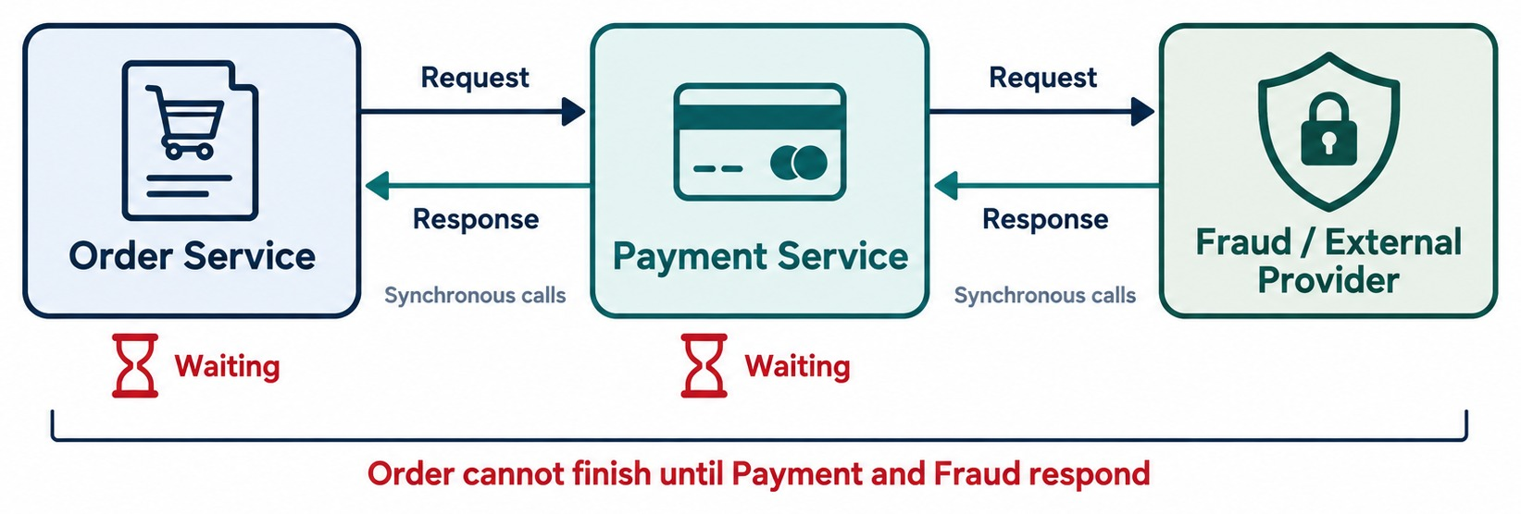
SYNCHRONOUS SERVICE COMMUNICATION
Request/response with REST or gRPC — and the dependencies it creates.
BENEFITS
✓
Simple mental model
✓
Immediate result
CHALLENGES
✕
Temporal coupling
✕
Latency adds up
✕
Failures propagate
ASK THE ROOM What happens to Order if Payment takes 30 seconds?
KEY TAKEAWAY The caller waits — so its latency and availability depend on every service downstream.
33
© 2026 by Innovation In Software Corporation
Notes:
KEY TALKING POINTS
------------------
- Request, wait, response
Synchronous communication means the caller waits for the downstream operation to respond.
The Order Service sends a request, the Payment Service processes it, and the Order Service waits for the answer.
The diagram shows the chain can grow: Payment may call a Fraud Service too.
- Benefits
It has a simple mental model.
You get an immediate result.
Request and response semantics are straightforward.
- Challenges
It creates temporal coupling.
It adds network latency.
Failures can spread, and dependency chains get longer.
- Ask the room
What happens to the Order Service if the Payment Service takes 30 seconds to respond?
This connects back to the resilience discussion in Module 1.
- What it shows
Order calls Payment, which calls a fraud check or external provider.
- Waiting
Each caller waits for the next response before it can continue.
- Key point
Long synchronous chains add latency and make failures spread.

Slide 34
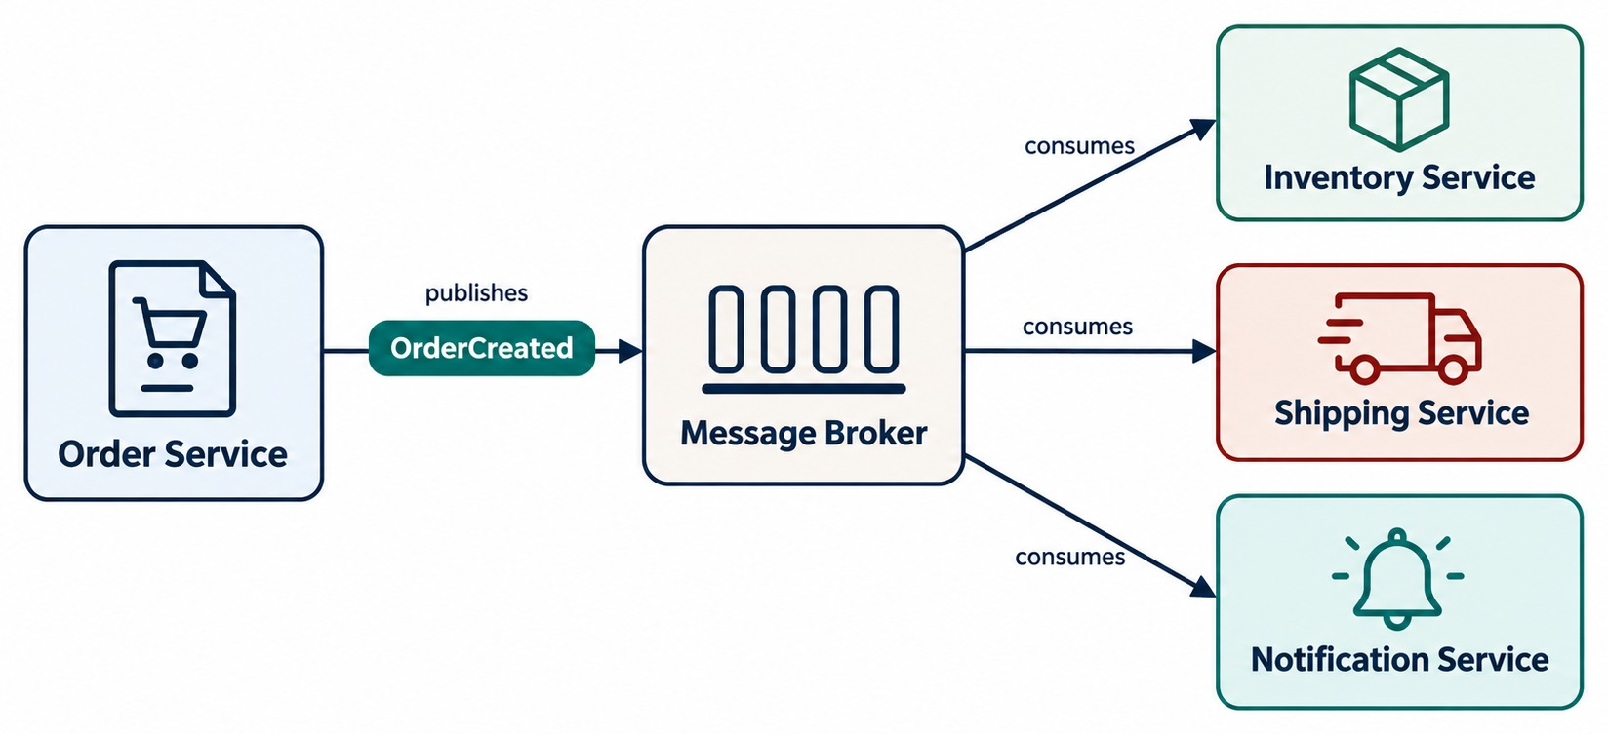
ASYNCHRONOUS MESSAGING AND EVENTS
Event-driven communication through brokers such as Kafka or RabbitMQ.
Command
Asks for something to happen: ReserveInventory.
Event
States a fact, in past tense: OrderCreated.
CONSUMERS MUST
✓
Handle duplicate messages safely
✓
Send repeated failures to a dead-letter queue
KEY TAKEAWAY The producer publishes and moves on — consumers react independently.
34
© 2026 by Innovation In Software Corporation
Notes:
KEY TALKING POINTS
------------------
- Publish and move on
With asynchronous communication, the producer does not wait for every consumer to finish.
The Order Service publishes OrderCreated to a message broker.
- Consumers react independently
Several consumers can react on their own.
Inventory might reserve stock.
Notification might send a confirmation.
Analytics might update metrics.
- Command versus event
A command expresses an intention, for example ReserveInventory.
An event says that something has already happened, for example OrderCreated.
This distinction helps later when we discuss event-driven architecture.
- What it shows
Order Service publishes an OrderCreated event to a message broker.
- Consumers
Inventory, Shipping and Notification each receive the event and react on their own.
- Key point
Order Service doesn't wait for or even know about each consumer.

Slide 35
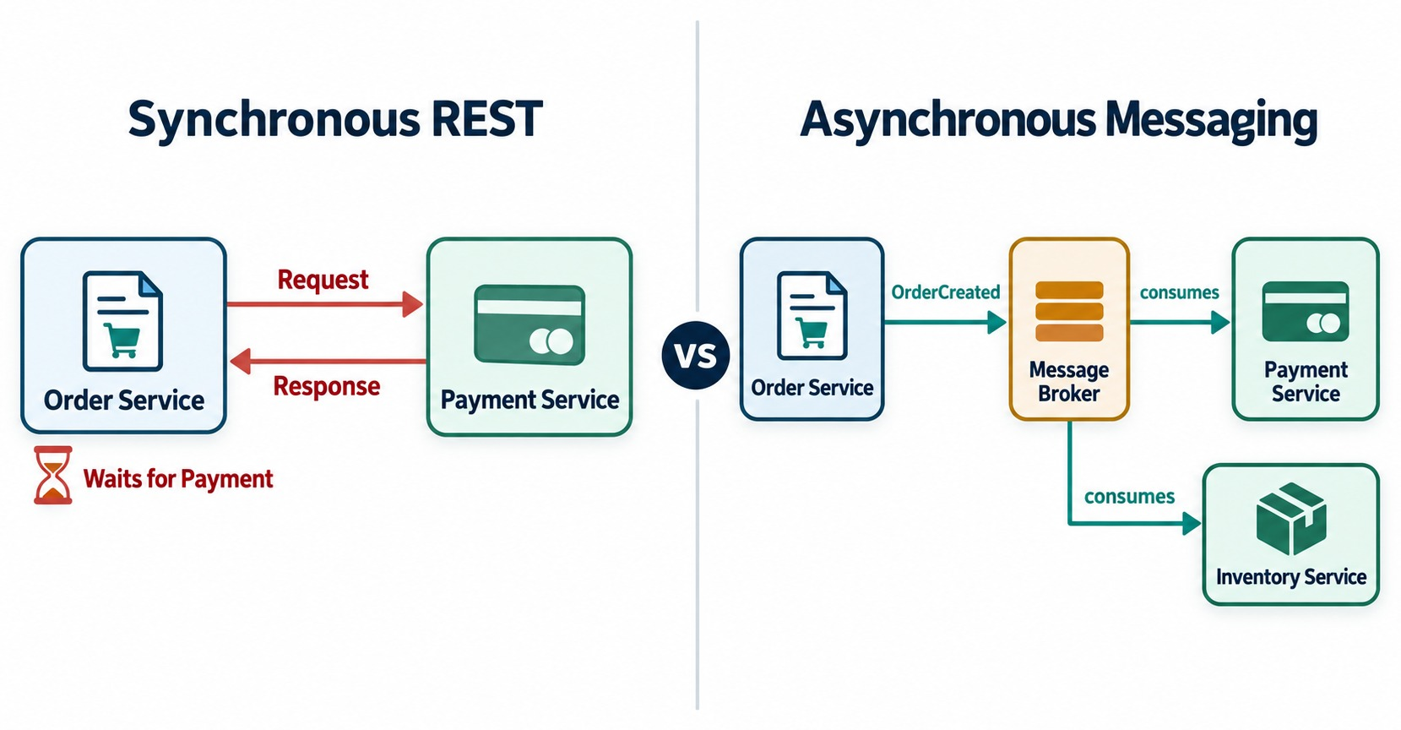
API VS. MESSAGING INTEGRATION PATTERNS
When request/response fits — and when events fit better.
Use REST when
The caller needs an answer now — e.g. GET /products/123.
Use messaging when
Work can happen later or many services react — e.g. OrderCreated.
NOT A COMPETITION Most real systems use both.
KEY TAKEAWAY Choose request/response for immediate answers and events for independent work.
35
© 2026 by Innovation In Software Corporation
Notes:
KEY TALKING POINTS
------------------
- Compare them fairly
REST and APIs give request and response with an immediate result, but a direct dependency.
Messaging and events are asynchronous, more decoupled, and processed eventually.
REST suits simple workflows, while messaging suits distributed workflows.
- When to use REST
Use synchronous communication when the caller genuinely needs an immediate response.
For example, GET /products/123.
- When to use messaging
Use asynchronous communication when work can happen independently.
For example, OrderCreated can trigger sending a confirmation, updating analytics and starting fulfillment.
- Not a competition
Do not teach that messaging is better than REST.
Teach when each is appropriate.
Many real microservice systems use both.
- What it shows
Two integration styles side by side.
- The comparison
REST request/response gives an immediate answer.
Publish/subscribe lets many services react independently.
- Key point
Choose based on whether the caller truly needs an immediate answer.

Slide 36
A BOUNDED CALL AND A PUBLISHED EVENT
One order flow: ask Inventory now, tell everyone else later.
Synchronous: ask Inventory before accepting
✓
Asynchronous: publish OrderCreated
Availability stock = inventory.get()
.uri("/inventory/{sku}", sku)
.retrieve()
.body(Availability.class);
if (!stock.inStock()) {
throw new OutOfStockException(sku);
}
// RestClient built with a timeout (Module 1)
@Service
public class OrderService {
private final StreamBridge bridge;
public OrderResponse place(Order order) {
orders.save(order);
bridge.send("orderCreated-out-0",
new OrderCreated(order.id(),
order.customerId(), order.total()));
return OrderResponse.from(order);
}
}
Sync
Async
Event payload
Order needs stock availability before it accepts the order.
Payment, Notification and Analytics react to OrderCreated.
Carry IDs and facts — not the whole internal entity.
KEY TAKEAWAY Ask synchronously only when you need the answer now; publish events for everything that can happen later.
36
© 2026 by Innovation In Software Corporation
Notes:
KEY TALKING POINTS
------------------
- The synchronous call
Order asks Inventory whether the item is in stock.
It needs the answer before accepting the order, so a REST call fits.
The client has a timeout.
- The event
After saving the order, Order Service publishes OrderCreated through Spring Cloud Stream's StreamBridge and returns immediately.
- Who listens
Payment, Notification and Analytics each consume the event on their own.
Order doesn't know or wait for them.
- Event design
Put IDs and key facts in the event, not the whole internal entity, so consumers don't couple to internals.

Slide 37
EXERCISE: REST OR MESSAGING?
Choose the communication style for each step of the order flow.
PRACTICE EXERCISE
10 MIN
SCENARIO
YOUR TASKS
EXPECTED OUTCOME
1. Check stock before accepting an order
2. Send the order confirmation email
3. Record an audit entry after payment
4. Show the current order status on screen
5. Tell Analytics an order was placed
6. Get a fraud score before charging the card
1
Choose REST or an event for each step
✓
1, 4, 6 → REST: an answer is needed now
2
Give the reason in a few words
✓
2, 3, 5 → Event: work can happen later
3
Name one failure each choice must handle
✓
REST must handle timeouts and fallbacks
✓
Events must handle duplicates and dead letters
KEY TAKEAWAY Immediate decision → REST; background reaction or many listeners → messaging.
37
© 2026 by Innovation In Software Corporation
Notes:
KEY TALKING POINTS
------------------
- REST steps
Stock check, current status and fraud score all feed an immediate decision or screen, so they use REST.
- Event steps
Emails, audit entries and analytics can happen a moment later, and several services may care, so they use events.
- Failure handling
REST calls need timeouts and fallbacks.
Event consumers must cope with duplicate messages and send repeated failures to a dead-letter queue.

Slide 38
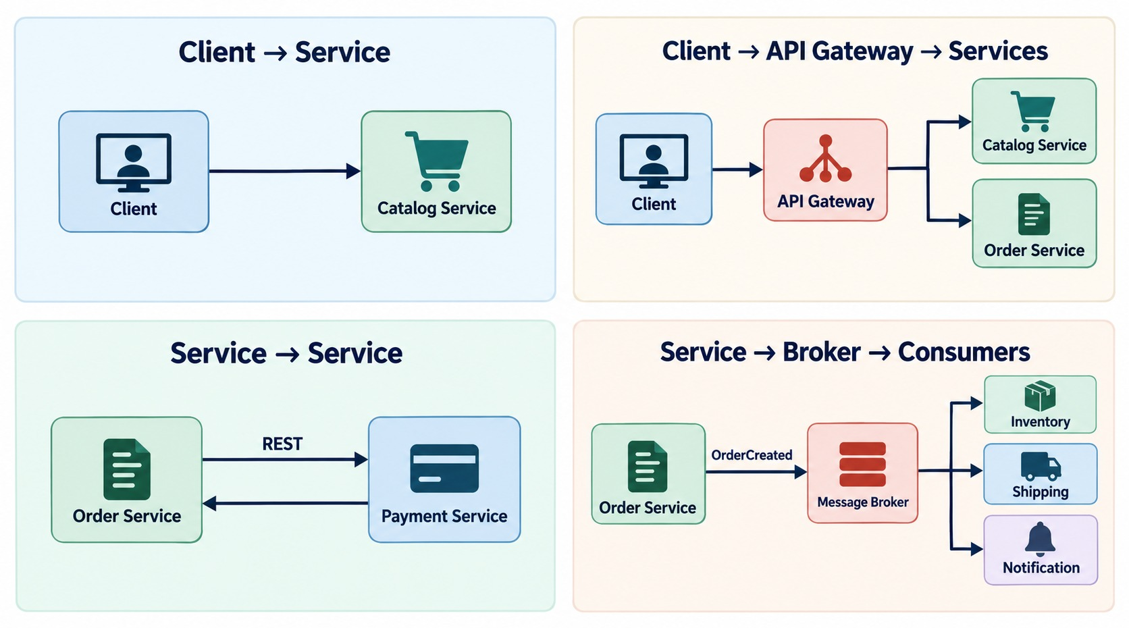
SERVICE COMMUNICATION STRATEGIES
Direct calls, API gateway, messaging and event-driven interactions.
Direct
Simple, but creates a direct dependency.
API gateway
One controlled entry point for web and mobile.
Service to service
Fits internal calls — adds runtime dependencies.
Messaging and events
Many consumers react without the producer knowing them.
KEY TAKEAWAY There's no universal strategy — deliberately choose one for each interaction.
38
© 2026 by Innovation In Software Corporation
Notes:
KEY TALKING POINTS
------------------
- No universal strategy
There is no single communication strategy that fits everything.
Walk through the four patterns on the slide.
- Direct calls
Direct service communication can suit internal interactions.
But it creates direct dependencies.
- API gateway
An API gateway gives external clients, like a mobile app or web app, one controlled entry point to the services.
- Messaging and events
Messaging allows asynchronous integration.
Events let many consumers respond without the producer knowing all of them.
- Choose deliberately
The architecture should deliberately choose the right strategy for each interaction.
- What it shows
Four ways services communicate.
- The four
A client calls a service directly, or a client goes through an API gateway.
Services also call each other, or send events through a broker to consumers.
- Key point
Real systems combine these strategies depending on the need.

Slide 39
API GATEWAY, COMPOSITION AND BFF
Keep clients simple — and stop them calling every service directly.
API GATEWAY
API COMPOSITION
BACKEND FOR FRONTEND
Web and mobile clients
Client: one request
Web BFF · Mobile BFF
API gateway
Order-view composer
Responses shaped per client
Order · Payment · Catalog
Order + Payment + Shipping
Shared domain services
Routing
Authentication
Result
Result
Rate limiting
TLS
One combined order view, fetched in parallel.
Mobile gets a small payload; web gets the full view.
SERVICE DISCOVERY Callers use a logical name such as http://payment-service — OpenShift routes the call to a healthy pod.
KEY TAKEAWAY Gateways, composition and BFFs give each client one simple, well-shaped entry point.
39
© 2026 by Innovation In Software Corporation
Notes:
KEY TALKING POINTS
------------------
- API gateway
A single entry point for external clients.
It routes requests and handles cross-cutting concerns like authentication, rate limiting and TLS.
- API composition
A composer calls several services, often in parallel, and merges the results, so the client makes one call for an order view.
- Backend for frontend
Each client type gets its own small backend that shapes responses for it, like a light payload for mobile.
- Service discovery
Instances come and go, so callers use a logical service name.
OpenShift routes it to a healthy pod.

Slide 40
ORCHESTRATION VS. CHOREOGRAPHY
Two ways to coordinate a workflow that spans several services.
ORCHESTRATION — CENTRAL CONTROL
CHOREOGRAPHY — SERVICES REACT
Order saga orchestrator
Order publishes OrderCreated
commands
Payment publishes PaymentCompleted
Payment
Inventory
Shipping
Inventory publishes StockReserved
STRENGTHS
STRENGTHS
✓
The whole flow is visible in one place
✓
No central coordinator
✓
Easier to monitor and debug
✓
Services evolve independently
WATCH OUT
WATCH OUT
✕
The orchestrator can become a bottleneck
✕
The end-to-end flow is harder to trace
KEY TAKEAWAY Orchestration gives control and visibility; choreography gives independence — choose per workflow.
40
© 2026 by Innovation In Software Corporation
Notes:
KEY TALKING POINTS
------------------
- Orchestration
One coordinator, sometimes called a saga orchestrator, tells Payment, Inventory and Shipping what to do, step by step.
- Its trade-off
The flow is easy to see and monitor, but the coordinator can become a bottleneck.
- Choreography
Each service reacts to events and publishes its own.
Order publishes OrderCreated, Payment reacts and publishes PaymentCompleted, and so on.
- Its trade-off
There's no central point of control, but tracing the whole flow is harder.
The data module covers sagas in depth.

Slide 41
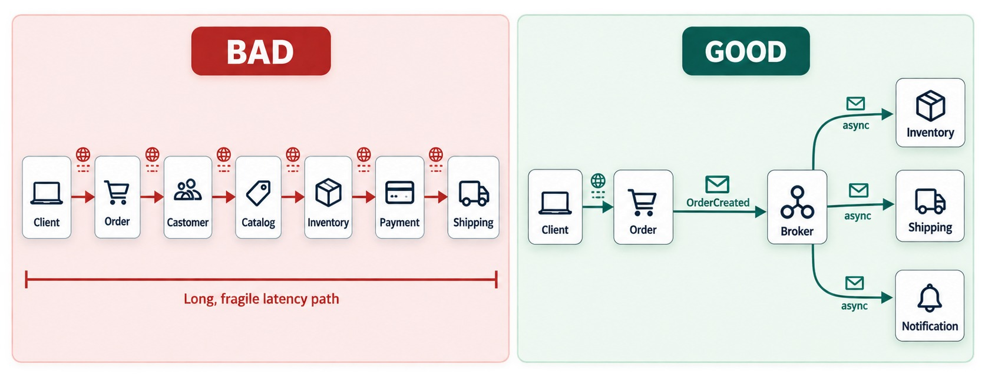
AVOIDING CHATTY SERVICE COMMUNICATION
Reduce excessive service-to-service calls and dependency chains.
EVERY NETWORK CALL ADDS
✕
Latency
✕
Serialization and authentication
✕
Another chance to fail
Better
Fewer, coarse-grained calls, plus events and well-drawn boundaries.
WHY In one JVM 20 calls are cheap; over a network they hurt.
KEY TAKEAWAY Don't design service APIs like local method calls — every network hop has a cost.
41
© 2026 by Innovation In Software Corporation
Notes:
KEY TALKING POINTS
------------------
- Don't design APIs like local methods
A common mistake is designing service APIs like local Java methods.
Inside one JVM, many small method calls are cheap.
- Every network call costs
Across a network, every call adds latency and serialization.
It adds authentication, the chance of network failure, and more load downstream.
- Chatty communication
Suppose one request needs 20 synchronous service calls.
Overall reliability and latency can suffer badly.
This is called chatty communication.
- The fix
Use fewer, coarse-grained interactions.
Use events where they fit.
Above all, design good service boundaries so services do not need to talk so much.
- What it shows
The bad version is a long chain of many small network calls.
- The better version
The good version uses fewer, more meaningful calls, and asynchronous events for the rest.
- Key point
Every network call adds latency and a chance to fail, so avoid chatty designs.

Slide 42
PART 4: WHERE STATE LIVES
The last design question before the blueprint.
✓ Part 1
Service boundaries
✓ Part 2
REST API design
✓ Part 3
Service communication
Part 4
State and the blueprint
SO FAR
NEXT QUESTION
Where should state live, so any instance can serve any request?
✓
Choose REST when an answer is needed now
✓
Publish events for work that can happen later
IN THIS PART
Keep calls coarse, bounded and few
1
Stateless versus stateful services
✓
2
Scaling stateless instances
3
Stateless design in code — with an exercise
4
The complete design blueprint
42
© 2026 by Innovation In Software Corporation
Notes:
KEY TALKING POINTS
------------------
- Why state matters
OpenShift runs several copies of each service and replaces pods freely.
That only works if pods don't hold important state.
- What comes next
After state, we put every design decision together in one blueprint.

Slide 43
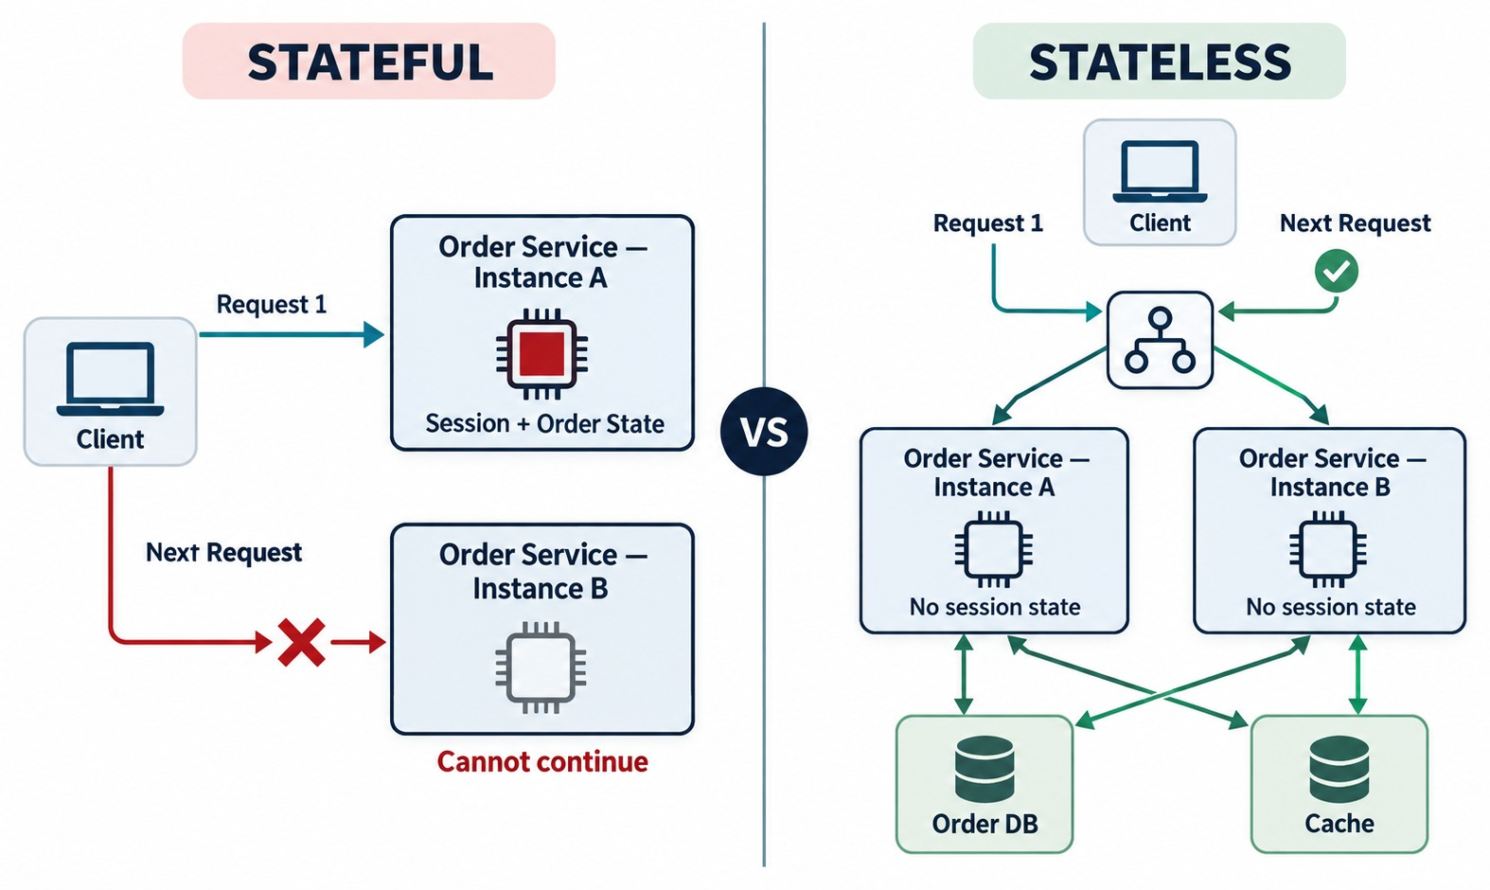
STATELESS VS. STATEFUL SERVICES
Processing state versus persistent business state.
Stateless instance
Keeps no session state between requests — any pod can serve.
Stateful component
Databases, brokers and caches hold durable state.
STATELESS ≠ NO DATABASE The question is where state lives.
KEY TAKEAWAY A stateless instance doesn't rely on locally kept session state — durable state lives outside it.
43
© 2026 by Innovation In Software Corporation
Notes:
KEY TALKING POINTS
------------------
- A common misunderstanding
Stateless does not mean no database.
- Stateless
A stateless instance does not depend on conversation or session state kept locally to handle the next request.
So request 1 can go to Pod A, request 2 to Pod B, and request 3 to Pod C. That works when the needed state is in an external store or comes with the request.
- Stateful
A stateful service may depend on state tied to one particular instance or a stable identity.
Then the next request may depend on reaching that same instance.
- State is not always bad
Some workloads genuinely need stateful behavior.
The goal is not to claim state is always bad.
- What it shows
A comparison of stateless and stateful services.
- The difference
A stateful service keeps session data in its own memory.
A stateless service keeps it outside, in a database or cache.
- Key point
Stateless services are much easier to scale and replace.

Slide 44
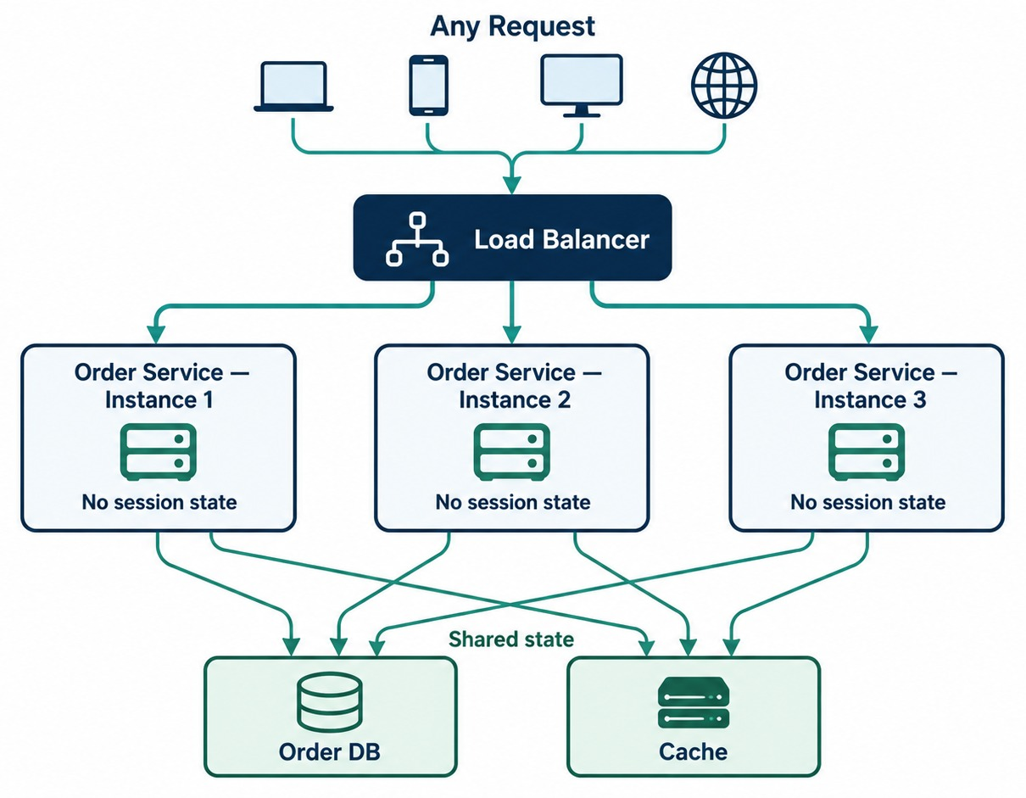
DESIGNING STATELESS MICROSERVICES
Externalized state, horizontal scaling and container-friendly design.
WHY EXTERNALIZE STATE
✓
Requests spread across pods
✓
Pods restart and move
✓
Scaling and recovery stay easy
Where state goes
PostgreSQL for durable data, a shared cache for sessions, tokens for identity.
CACHES ARE FINE Correctness must not depend on one instance.
KEY TAKEAWAY Keep instances replaceable — so OpenShift can scale and recover Order Service freely.
44
© 2026 by Innovation In Software Corporation
Notes:
KEY TALKING POINTS
------------------
- An OpenShift connection
Suppose three instances of the Order Service are running.
A load balancer spreads requests across them.
- The problem with local state
If critical session or business state lives only in Pod 1's memory, another pod may not have what it needs.
- Externalize durable state
Durable business state belongs in backing systems such as PostgreSQL, Redis or other persistence services.
That makes horizontal scaling, replacement and recovery easier.
- Caches are still fine
Local caches and temporary in-memory data can still exist.
The real question is whether correctness depends on one short-lived instance holding the only copy of required state.
- What it shows
A load balancer spreading requests across several identical service instances.
- Where state lives
State is kept outside the instances, in an external database and cache.
- Key point
Because any instance can handle any request, you can add or remove instances freely.

Slide 45
STATELESS DESIGN IN CODE
Keep durable state out of the pod's memory.
✕
Lost on restart — different in every pod
✓
State lives in a backing service
@Service
public class CartService {
private final Map<String, Cart> carts =
new HashMap<>();
public void addItem(String cartId, Item item) {
carts.computeIfAbsent(cartId, Cart::new)
.add(item);
}
}
@Service
public class CartService {
private final CartRepository carts;
public void addItem(String cartId, Item item) {
Cart cart = carts.findById(cartId)
.orElseGet(() -> new Cart(cartId));
cart.add(item);
carts.save(cart); // database or cache
}
}
Bad
Good
Identity
A restart loses the carts, and pod B can't see pod A's map.
Every pod uses the same store, so any pod can serve any request.
Carry who the user is in a token, not in server session memory.
KEY TAKEAWAY Application pods stay stateless; durable state belongs in databases, caches and tokens.
45
© 2026 by Innovation In Software Corporation
Notes:
KEY TALKING POINTS
------------------
- The bad version
Carts are kept in a HashMap inside the service.
If the pod restarts, they're gone, and with three pods each has its own different map.
- The good version
Carts are read from and saved to a repository backed by a database or shared cache, so every pod sees the same data.
- Identity
Instead of server-side session memory, the client sends a token on each request that says who the user is.

Slide 46
EXERCISE: STATELESS OR STATEFUL?
Classify the parts of the order platform.
PRACTICE EXERCISE
8 MIN
SCENARIO
YOUR TASKS
EXPECTED OUTCOME
• Order Service pod
• PostgreSQL order database
• Kafka broker
• Shared cart cache
• In-memory HashMap of pending payments
• Fraud-scoring REST API
1
Label each one stateless or stateful
✓
Stateless: Order Service pod, fraud-scoring API
2
Which scale horizontally with no extra work?
✓
Stateful: PostgreSQL, Kafka, cart cache
Which is risky inside a container — and why?
✓
Risky: the in-memory HashMap — lost on restart
3
✓
Fix: store pending payments in the database
KEY TAKEAWAY Scale the stateless tier freely; protect and back up the stateful components.
46
© 2026 by Innovation In Software Corporation
Notes:
KEY TALKING POINTS
------------------
- Stateless
The Order Service pod and the fraud-scoring API keep nothing important between requests, so they scale by adding replicas.
- Stateful
PostgreSQL, Kafka and the shared cache hold durable state.
They need backups, monitoring and careful scaling.
- The risky one
An in-memory HashMap of pending payments disappears when the pod restarts, and each pod has a different copy.

Slide 47
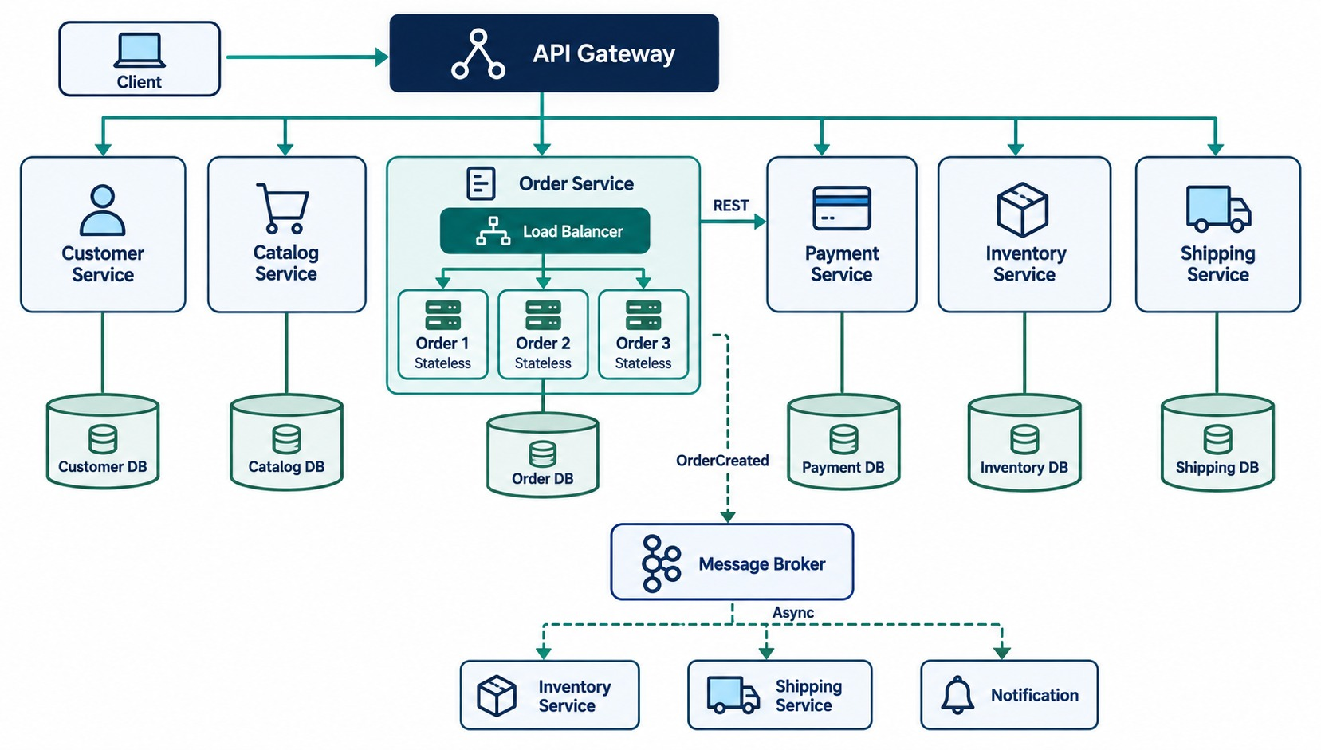
PUTTING IT TOGETHER — MICROSERVICES DESIGN BLUEPRINT
Boundaries, APIs, messaging, data ownership and stateless instances.
THE DESIGN SEQUENCE
✓
Business domain
✓
Bounded context
✓
Service boundary
✓
Cohesion and loose coupling
✓
API contract
✓
Communication strategy
✓
Data and state ownership
EVERY BOX comes from a part of this module.
KEY TAKEAWAY Good microservices design starts with business boundaries — not REST controllers.
47
© 2026 by Innovation In Software Corporation
Notes:
KEY TALKING POINTS
------------------
- Boundaries and cohesion
Use this blueprint to connect every Module 2 idea.
Customer, Catalog, Order, Payment, Inventory and Shipping are separate business capabilities.
Payment functionality stays in the Payment Service, and order functionality stays in the Order Service.
- Loose coupling and REST
Services interact through defined contracts, not each other's internals.
Where an immediate response is needed, the Order Service calls the Payment Service through a REST API.
- Messaging and events
Where downstream work can be asynchronous, the Order Service publishes OrderCreated to a message broker.
Inventory and Shipping consume it.
- Data and state
Each service owns its own data, so there is no random database access across services.
Instances stay replaceable and horizontally scalable, with durable state kept outside them.
- The design sequence
Read the sequence on the right, top to bottom.
Business domain, bounded context, service boundary, cohesion and coupling, API contract, communication strategy, data and state ownership.
The result is a scalable microservice.
- Final message
Good microservices design starts with business boundaries, not REST controllers.
Next module, we move from design into Spring Boot implementation.
- What it shows
The complete design: an API gateway, service boundaries, REST calls, messaging, service-owned data and stateless instances.
- How to use it
Walk through it as a recap.
Every piece comes from an earlier slide in this module.
- Key point
Good design combines clear boundaries, the right communication style and independent data.

Slide 48
KNOWLEDGE CHECK
Answer in your own words — then compare with a partner.
What is a REST resource?
What is loose coupling?
1
6
Why should URIs use nouns instead of verbs?
What is high cohesion?
2
7
Which HTTP method usually creates a resource?
What is a bounded context?
3
8
Which status code means a resource was created?
When should messaging be used instead of REST?
4
9
Why should APIs use DTOs?
What does an OpenAPI document describe?
5
10
48
© 2026 by Innovation In Software Corporation
Notes:
KEY TALKING POINTS
------------------
- 1. REST resource
A business object or concept exposed through an API, like an order.
- 2. Nouns in URIs
The URI identifies the resource; the HTTP method expresses the action.
- 3. Creating
POST.
- 4. Created
201 Created.
- 5. DTOs
They protect internal models, control the payload, support validation and avoid exposing sensitive fields.
- 6. Loose coupling
Services depend on each other as little as practical — on contracts, not internals.
- 7. High cohesion
A service contains closely related responsibilities.
- 8. Bounded context
A boundary where a domain model and its terms have one specific meaning.
- 9. Messaging
When work can happen asynchronously or several services need to react to an event.
- 10. OpenAPI
Endpoints, schemas, status codes, parameters and security requirements.

Slide 49
EXERCISE 1.2 — DESIGN ACCOUNT SERVICE APIS AND BOUNDARIES
Module 2 checkpoint B: REST resources, status transitions and an OpenAPI sketch.
OFFICIAL CHECKPOINT B
15 MIN
labs/day-01/exercises/exercise-1.2-account-apis.md
SCENARIO
YOUR TASKS
EXPECTED OUTCOME
In Lab 1 you build the banking Account Service. Before coding, sketch its API.
Resource: an account. Status machine: PENDING → ACTIVE → FROZEN or CLOSED.
1
Sketch POST, GET and PATCH plus activate, freeze and close — no DELETE
✓
A one-page Account API sketch
✓
Lab 1 can implement it without changing URLs
2
Model the statuses: freezing a PENDING account is 409; FROZEN can be activated; retries return 200
✓
Use this contract in Lab 1
List the 400, 404 and 409 cases; note OpenAPI and Actuator as Lab 1 deliverables
✓
No Customer or Notification services
3
4
Draw the bounded context: Account owns accounts only — not transactions or risk scores
KEY TAKEAWAY A one-page Account API sketch that Lab 1 can implement without changing URLs tomorrow.
49
© 2026 by Innovation In Software Corporation
Notes:
KEY TALKING POINTS
------------------
- Official checkpoint
This is the official OUTLINE.md checkpoint for Module 2.
Use the worksheet in labs/day-01/exercises.
- The API
The account is the resource: POST to create, GET to read, PATCH to update, and action endpoints to activate, freeze and close.
Accounts are never deleted.
- Status rules
PENDING goes to ACTIVE, then to FROZEN or CLOSED.
Freezing a pending account returns 409 Conflict.
Repeating the same action returns 200.
- Scope
Account owns accounts only.
Transactions and risk scores belong to other contexts.
Don't add Customer or Notification services.

Slide 50
MODULE 2 SUMMARY AND WHAT'S NEXT
From boundaries to a complete design blueprint.
YOU CAN NOW
NEXT: MODULE 3 — SPRING BOOT DEVELOPMENT
✓
Find boundaries from capabilities and bounded contexts
1
How do we build the Account Service in Spring Boot?
✓
Keep coupling low and cohesion high
2
How are controllers, services and repositories organized?
✓
Design resource-oriented REST APIs with stable contracts
How do we configure, validate and document it?
3
✓
Choose REST or messaging for each interaction
✓
Keep services stateless and state in backing services
BRING ALONG Your Exercise 1.2 Account API sketch — Lab 1 implements it.
KEY TAKEAWAY Module 3 turns this design into a working Spring Boot service.
50
© 2026 by Innovation In Software Corporation
Notes:
KEY TALKING POINTS
------------------
- Recap
We found boundaries, designed REST contracts, chose communication styles and decided where state lives.
- Next module
Module 3 builds the Account Service in Spring Boot: controllers, services, repositories, configuration, validation and documentation.

