Slide 1
"Spring Boot turns our microservice design into a runnable application."
MODULE 3
Spring Boot Microservices
Development
From service design to a running Java microservice.
Spring Boot architecture
Application lifecycle
Auto-configuration
REST API development
Dependency Injection
Configuration & profiles
Build and run
SPRING BOOT MICROSERVICES BOOTCAMP • MODULE 3
Notes:
KEY TALKING POINTS
------------------
- From design to implementation
Modules 1 and 2 covered why microservices exist and how we design their boundaries.
Now we move into implementation.
- One service to build
Our architecture has Customer, Catalog, Order, Payment, Inventory and Shipping services.
In this module we focus on implementing the Order Service with Spring Boot.
- The journey
We go from the service design to a Spring Boot project.
Then we add a REST controller, a business service and a repository.
Then configuration, a build, and finally a running microservice.
- Set expectations
Spring Boot does not create a good microservice architecture by itself.
It gives us a productive framework to implement the boundaries we already designed.

Slide 2
LEARNING OBJECTIVES
Architecture, lifecycle, auto-configuration, REST, DI, profiles and running services.
🎯
BY THE END OF THIS MODULE, YOU CAN
🧭
THREE SECTIONS
1. Explain Spring Boot architecture
2. Describe application startup
3. Understand auto-configuration
4. Manage dependencies
5. Build REST APIs
6. Apply Dependency Injection
7. Externalize configuration
8. Use Spring profiles
9. Build and run a microservice
1
Understand what Spring Boot does
Spring Framework
Spring Boot
Auto-Config
Running App
2
Build a real REST API
Client
Controller
Service
Repository
3
Make it portable across environments
Same App
DEV
TEST
PROD
KEY TAKEAWAY Understand what Spring Boot does, build a real API, then make it run in any environment.
2
© 2026 by Innovation In Software Corporation
Notes:
KEY TALKING POINTS
------------------
- By the end of this module
Learners should be able to explain Spring Boot architecture and describe application startup.
They should understand auto-configuration and manage dependencies.
They should build REST APIs and apply dependency injection.
They should externalize configuration, use Spring profiles, and build and run a microservice.
- Section 1: what Spring Boot does for us
We go from the Spring Framework, to Spring Boot, to auto-configuration, to a running application.
- Section 2: build a real REST API
A client calls a controller.
The controller calls a service, and the service calls a repository.
- Section 3: portable across environments
The same application runs in DEV, TEST and PROD.
This matters a lot later, when we deploy the same application into containers and OpenShift.

Slide 3
KEY TERMS FOR THIS MODULE
Plain definitions for the words we'll use most.
1
Auto-configuration
2
Starter
Spring Boot sets up beans automatically based on the libraries on the classpath.
A dependency bundle, such as spring-boot-starter-web, that brings one feature and its libraries.
3
Bean
4
Dependency injection
An object that the Spring container creates and manages.
Spring gives a class the objects it needs, usually through its constructor.
5
Controller
6
Data transfer object
The layer that maps HTTP requests to Java methods and returns the responses.
A simple object that carries API request or response data, separate from the database entity.
7
Profile
8
Actuator
A named set of configuration, such as local or prod, switched on per environment.
Built-in endpoints that report the health, info and metrics of a running service.
KEY TAKEAWAY Agree on the words first — every later slide builds on them.
3
© 2026 by Innovation In Software Corporation
Notes:
KEY TALKING POINTS
------------------
- How to run this slide
Read each term once and give a quick example from the order platform or the banking lab.
- Auto-configuration
Spring Boot sets up beans automatically based on the libraries on the classpath.
- Starter
A dependency bundle, such as spring-boot-starter-web, that brings one feature and its libraries.
- Bean
An object that the Spring container creates and manages.
- Dependency injection
Spring gives a class the objects it needs, usually through its constructor.
- Controller
The layer that maps HTTP requests to Java methods and returns the responses.
- Data transfer object
A simple object that carries API request or response data, separate from the database entity.
- Profile
A named set of configuration, such as local or prod, switched on per environment.
- Actuator
Built-in endpoints that report the health, info and metrics of a running service.

Slide 4
FULL FORMS USED IN THIS MODULE
Every abbreviation on these slides, spelled out.
API
Application Programming Interface
IDE
Integrated Development Environment
PII
Personally Identifiable Information
DB
Database
JAR
Java ARchive
REST
Representational State Transfer
DDL
Data Definition Language
JPA
Jakarta Persistence API
SLF4J
Simple Logging Facade for Java
DI
Dependency Injection
JSON
JavaScript Object Notation
SQL
Structured Query Language
DTO
Data Transfer Object
JVM
Java Virtual Machine
URL
Uniform Resource Locator
HTTP
HyperText Transfer Protocol
MVC
Model-View-Controller
YAML
YAML Ain't Markup Language
KEY TAKEAWAY When an abbreviation isn't clear, the full form is on this slide.
4
© 2026 by Innovation In Software Corporation
Notes:
KEY TALKING POINTS
------------------
- How to run this slide
Don't read every row.
Point out the few this module uses most, and say the full list is here for reference.
- Reference
API is Application Programming Interface; DB is Database; DDL is Data Definition Language; DI is Dependency Injection; DTO is Data Transfer Object; HTTP is HyperText Transfer Protocol; IDE is Integrated Development Environment; JAR is Java ARchive; JPA is Jakarta Persistence API; JSON is JavaScript Object Notation; JVM is Java Virtual Machine; MVC is Model-View-Controller; PII is Personally Identifiable Information; REST is Representational State Transfer; SLF4J is Simple Logging Facade for Java; SQL is Structured Query Language; URL is Uniform Resource Locator; YAML is YAML Ain't Markup Language.

Slide 5
FROM MODULE 2 TO MODULE 3
The design is ready — this module turns it into a running Spring Boot service.
MODULE 2 GAVE US
🧭
OUR PATH THROUGH MODULE 3
1
Generate the project and see how it starts
Part 1
✓
Service boundaries from business capabilities
Resource-oriented REST contracts
2
Auto-configuration and starters
Part 1
✓
DTOs, validation and one error format
3
Controller, DTOs and validation
Part 2
✓
Stateless, replaceable instances
4
Errors, service and repository code
Part 2
✓
A design blueprint for Order Service
5
Wire it with dependency injection
Part 2
✓
NOW Build it — Order Service in the slides, Account Service in Lab 1.
6
Externalize config and use profiles
Part 3
7
Build, run and troubleshoot one JAR
Part 3
KEY TAKEAWAY Module 2 decided what to build; Module 3 turns each decision into Spring Boot code.
5
© 2026 by Innovation In Software Corporation
Notes:
KEY TALKING POINTS
------------------
- Bridge from Module 2
Module 2 was about design: boundaries, REST contracts, communication and state.
Now we implement those decisions.
- Where each decision lives
A boundary becomes one project, resources become @RestController mappings, contracts become records, errors go to @RestControllerAdvice, and configuration moves to YAML and profiles.
We meet every one of them in this module.
- Two examples
The slides use the e-commerce Order Service.
Lab 1 and Exercise 1.3 use the banking Account Service, with the same layers.
- Set expectations
Spring Boot makes implementation fast, but it doesn't choose boundaries or contracts for us.

Slide 6
PART 1: WHAT SPRING BOOT DOES FOR US
Before writing endpoints, understand the framework underneath them.
Part 1
What Spring Boot does
Part 2
Build the Order API
Part 3
Portable and running
SO FAR
NEXT QUESTION
What does Spring Boot actually do when we build and start a service?
✓
Service boundaries come from business capabilities
✓
REST contracts use resources, methods and DTOs
IN THIS PART
1
Why Spring Boot, and how it relates to Spring
✓
Instances stay stateless; configuration lives outside
2
Layered architecture and creating the project
3
The entry point, @SpringBootApplication and startup
4
Auto-configuration, in a picture and in code
5
Starters and dependency management
6
Exercise: choose the starters
6
© 2026 by Innovation In Software Corporation
Notes:
KEY TALKING POINTS
------------------
- Why start here
When something goes wrong later, knowing what Boot does underneath tells you where to look.
- What this part covers
What Boot adds to Spring, how a project is laid out, how it starts, and how auto-configuration and starters work.

Slide 7
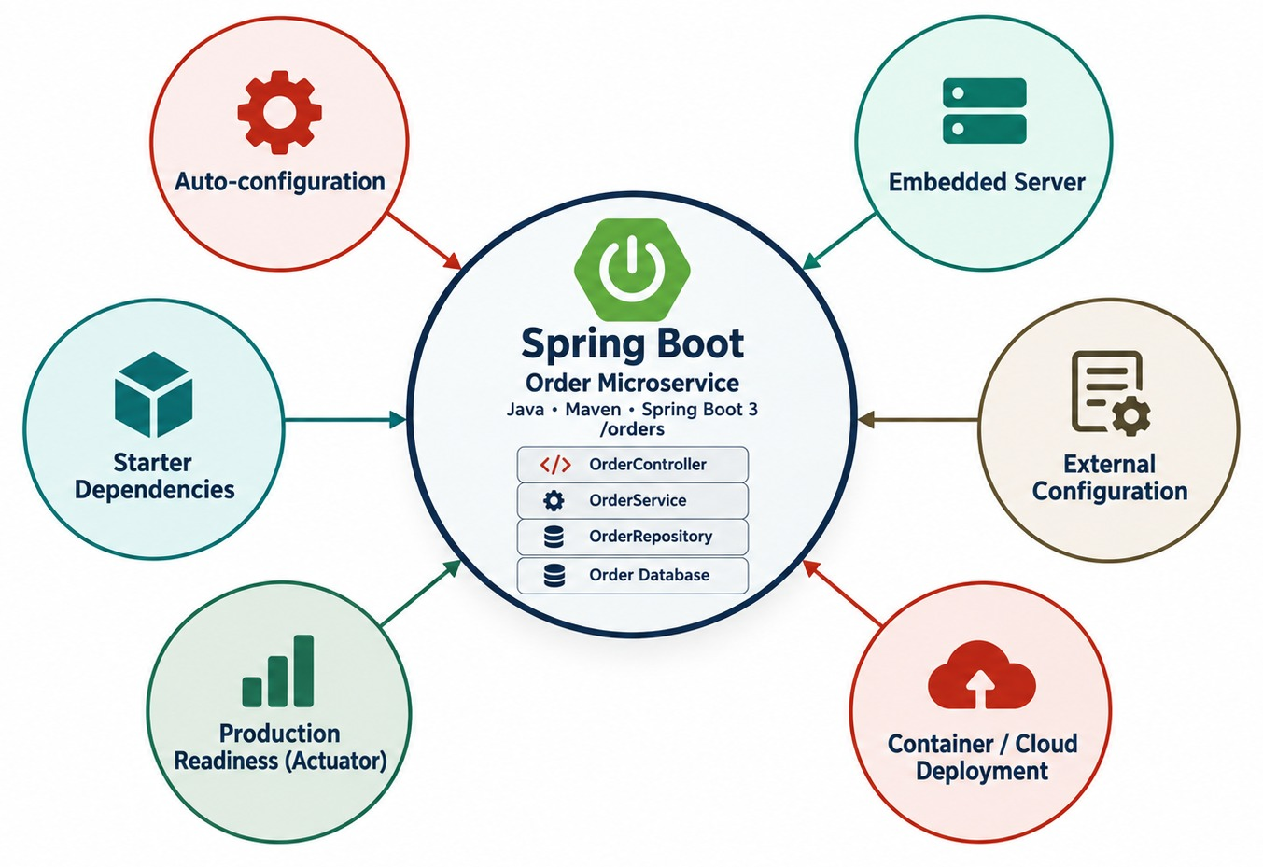
WHY SPRING BOOT FOR MICROSERVICES?
Why Spring Boot is so common for Java microservices.
LESS SETUP, FASTER START
✓
Sensible defaults you can override
✓
Minutes from idea to running API
✓
Same model locally and on OpenShift
One command to run
java -jar order-service.jar
WHY IT FITS Each service builds, runs and deploys on its own.
KEY TAKEAWAY Spring Boot's defaults and embedded server make independent services quick to build and run.
7
© 2026 by Innovation In Software Corporation
Notes:
KEY TALKING POINTS
------------------
- Less setup
Traditional Spring applications needed a lot more explicit setup.
Spring Boot reduces that with convention over configuration and sensible defaults.
Walk around the seven benefits in the diagram.
- Starters and auto-configuration
For a REST application, we add spring-boot-starter-web.
Spring Boot can then configure much of the basic web infrastructure automatically.
- Embedded server
It can provide an embedded server.
With the traditional Spring MVC web starter, that is typically Tomcat.
So we do not need to install the application into a separately managed application server.
- Run it anywhere
We can simply run java -jar order-service.jar, and the application starts its own web server.
That makes Spring Boot very convenient for independently deployable services.
- What it shows
Spring Boot in the middle, surrounded by auto-configuration, the embedded server, starters, external configuration, production readiness and cloud deployment.
- How to read it
Each outer circle is one thing Boot gives an Order Service without extra setup.
- Key point
Together these features let one small service be built, configured and run on its own.

Slide 8
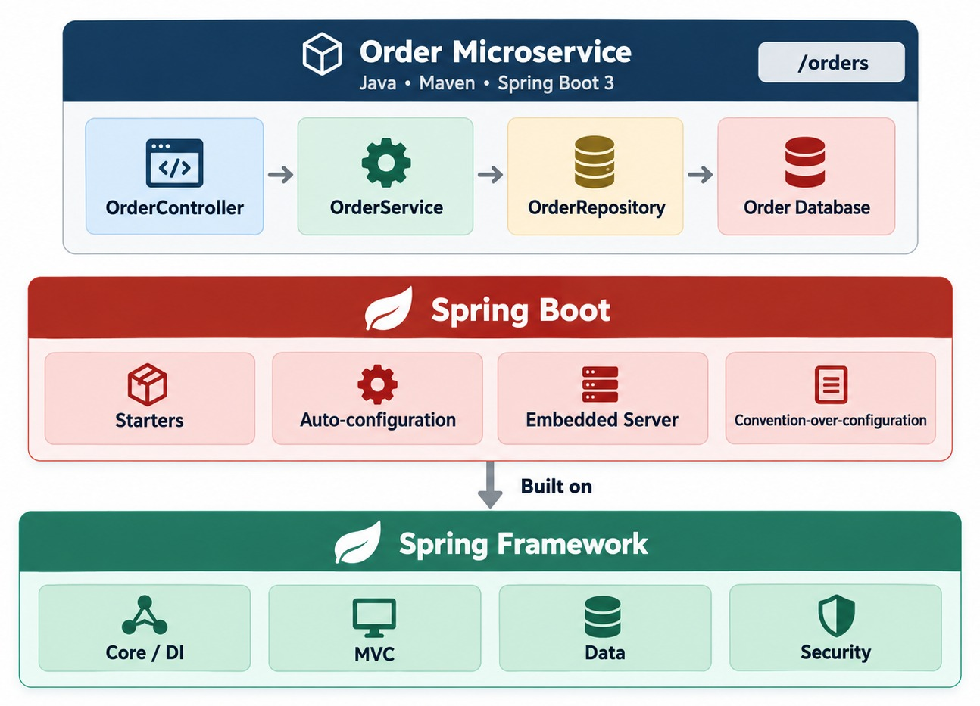
SPRING FRAMEWORK VS. SPRING BOOT
What Spring Boot adds on top of the Spring Framework.
MYTH Spring Boot replaced Spring. It builds on it.
Spring
Provides the capabilities: DI, web, data access, transactions, security.
Spring Boot
Provides conventions and automation to assemble them quickly.
SAME CORE, MORE MODULES
Spring Data
Spring Security
Spring Cloud
Spring Kafka
KEY TAKEAWAY Spring Boot didn't replace Spring — it makes Spring's capabilities easier to configure, package and run.
8
© 2026 by Innovation In Software Corporation
Notes:
KEY TALKING POINTS
------------------
- A common misconception
Some people think Spring Boot replaced the Spring Framework.
It did not.
Spring Boot is built on top of the Spring ecosystem.
- What Spring provides
Spring provides dependency injection and inversion of control, called IoC.
It also provides MVC, transaction management, data integration and security integration.
- What Spring Boot adds
Spring Boot makes those capabilities easier to configure, package and operate.
It adds auto-configuration, starter dependencies, embedded server support and operational conventions.
- One sentence to remember
Spring provides the capabilities.
Spring Boot provides conventions and automation for assembling applications with them.
- What it shows
The Spring Framework at the bottom with Core and DI, MVC, Data and Security.
Spring Boot sits on top with starters, auto-configuration, the embedded server and conventions.
- How to read it
Read it bottom-up.
The framework provides the capabilities; Boot assembles them for you.
- Key point
Spring Boot is built on Spring.
It did not replace it.

Slide 9
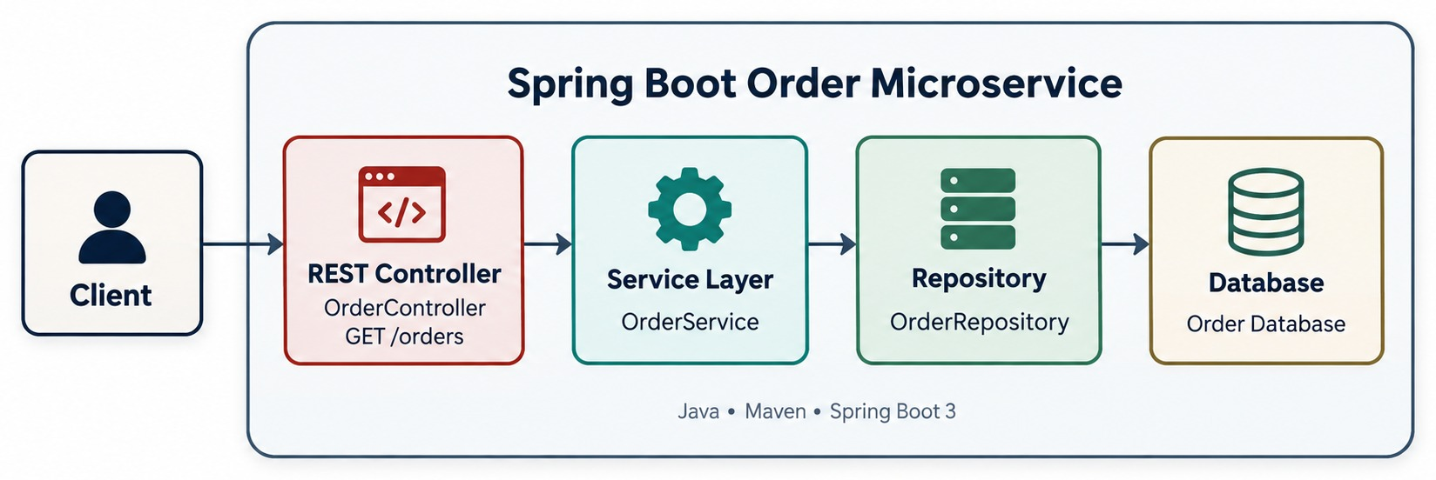
SPRING BOOT LAYERED ARCHITECTURE
Controller → Service → Repository → Database, each with one job.
Controller
Service
Repository
COMMON MISTAKES
HTTP only: map the URL, read input, return a status. GET /orders/1001
Business rules and workflow: createOrder(), cancelOrder(), calculateTotal()
Persistence access: save(), findById(), findAll()
✕
Business logic in controllers
✕
Entities returned from APIs
✕
SQL next to HTTP code
KEY TAKEAWAY Keep responsibilities separate — controllers shouldn't mix business logic and database access.
9
© 2026 by Innovation In Software Corporation
Notes:
KEY TALKING POINTS
------------------
- A common structure
Spring Boot does not force every application into exactly this layered structure.
But it is a common and useful one.
- Controller
The controller layer handles HTTP and API concerns, for example GET /orders/1001 or POST /orders.
- Service
The service layer contains business behavior, such as createOrder, cancelOrder and calculateTotal.
- Repository and database
The repository layer handles persistence, with operations like save, findById and findAll.
The database stores durable business data.
- Separate responsibilities
Controllers should not become the place where all business logic and database work are mixed together.
- What it shows
One Spring Boot Order Service with three layers between the client and the database.
- How to read it
Follow a request left to right: the controller receives it, the service decides, the repository reads or writes data.
- Key point
Each layer has one job.
That keeps the service easy to test and change.

Slide 10
CREATING THE PROJECT WITH SPRING INITIALIZR
start.spring.io generates a ready-to-run project with the dependencies you pick.
Setting | Order Service
Project | Maven
Language | Java
Spring Boot | Current stable 3.x
Group | com.example
Artifact | order-service
Packaging | Jar
Java | 17 or 21
DEPENDENCIES TO SELECT
Spring Web
Validation
Spring Data JPA
PostgreSQL Driver
Actuator
DevTools (dev only)
Or from the command line
curl https://start.spring.io/starter.zip \
-d dependencies=web,validation,data-jpa,postgresql,actuator \
-d javaVersion=21 -d artifactId=order-service \
-o order-service.zip
What you get
pom.xml, the main class, application.properties, a first test and the Maven wrapper (mvnw).
RULE Select only what this service needs — add more when a requirement appears.
KEY TAKEAWAY Spring Initializr gives every service the same clean start — with only the dependencies it needs.
10
© 2026 by Innovation In Software Corporation
Notes:
KEY TALKING POINTS
------------------
- What Initializr is
A project generator at start.spring.io.
It's also built into IntelliJ, VS Code and Eclipse.
- Settings
Maven, Java, a current stable Spring Boot 3 release, group com.example, artifact order-service, Jar packaging, and Java 17 or 21.
- Dependencies
Spring Web for REST, Validation for request checks, Spring Data JPA and the PostgreSQL driver for data, and Actuator for health endpoints.
DevTools helps only in local development.
- Common mistakes
Adding every dependency just in case, unclear package names, and putting several services in one project.

Slide 11
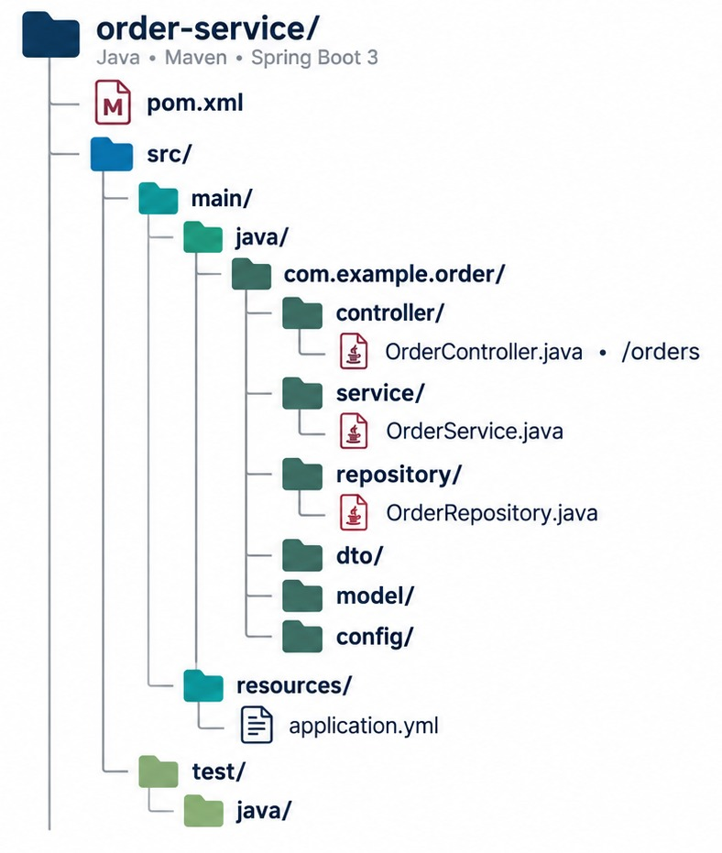
ANATOMY OF A SPRING BOOT PROJECT
Where code, configuration and tests live.
pom.xml
The build file: parent version, starters and plugins. Gradle projects use build.gradle instead.
src/main/resources
application.yml and profile files — configuration stays out of Java code.
src/test/java
Tests mirror the main packages, so OrderServiceTest sits beside OrderService.
GROWING SERVICE? Group by feature — orders/, returns/ — each with its own layers. Packages alone don't create boundaries.
KEY TAKEAWAY Know where code, configuration and tests live — then give each package a clear responsibility.
11
© 2026 by Innovation In Software Corporation
Notes:
KEY TALKING POINTS
------------------
- Walk the project
src/main/java holds the production Java source code.
src/main/resources holds configuration and other resources.
src/test holds the tests.
pom.xml is the Maven project descriptor when you use Maven.
- A practical package structure
A practical set of packages is controller, service, repository, dto, model, exception and config.
- Packages are not boundaries
Package structure alone does not create architectural boundaries.
What matters is the responsibilities you give those classes.
- What it shows
The folders a new Order Service project contains: pom.xml, src/main/java, resources and test.
- How to read it
Java code lives under com.example.order in controller, service, repository, dto, model and config packages.
application.yml lives in resources.
- Key point
Knowing where things live makes every Spring Boot project easy to navigate.
- Feature-oriented packages
In a small service, layer packages are fine.
As it grows, group by feature, such as orders and returns, each with its own controller, service and repository.

Slide 12
THE APPLICATION ENTRY POINT
main() starts Java; SpringApplication.run() starts Spring.
OrderApplication.java
main()
package com.example.order;
@SpringBootApplication
public class OrderApplication {
public static void main(String[] args) {
SpringApplication.run(OrderApplication.class, args);
}
}
A plain Java entry point. The JVM starts here.
SpringApplication.run()
Prepares the environment, creates the ApplicationContext, wires the beans and starts Tomcat.
The package line
✓
What the console shows
com.example.order is where component scanning starts — see the next slide.
:: Spring Boot :: (v3.5.0)
Starting OrderApplication using Java 21
No active profile set, falling back to "default"
Tomcat initialized with port 8080 (http)
Started OrderApplication in 2.41 seconds
KEEP IT EMPTY No business logic in the main class.
KEY TAKEAWAY main() hands control to SpringApplication.run(), which boots the whole application.
12
© 2026 by Innovation In Software Corporation
Notes:
KEY TALKING POINTS
------------------
- The entry point
Every standalone Spring Boot application usually has an entry point.
Java starts running at public static void main.
- Bootstrapping Spring
Then SpringApplication.run bootstraps the Spring application.
- What Spring Boot prepares
Spring Boot prepares the application environment and the Spring ApplicationContext.
It registers bean definitions and applies auto-configuration.
For a web application, it also sets up the web infrastructure.
- Ready
Eventually, the application is ready to receive requests.
- Read the console
The startup log follows the same steps: the Boot version, the active profile, Tomcat starting on port 8080, and finally the Started line.
- No active profile
The default-profile line matters later.
It tells you which configuration the service actually loaded.

Slide 13
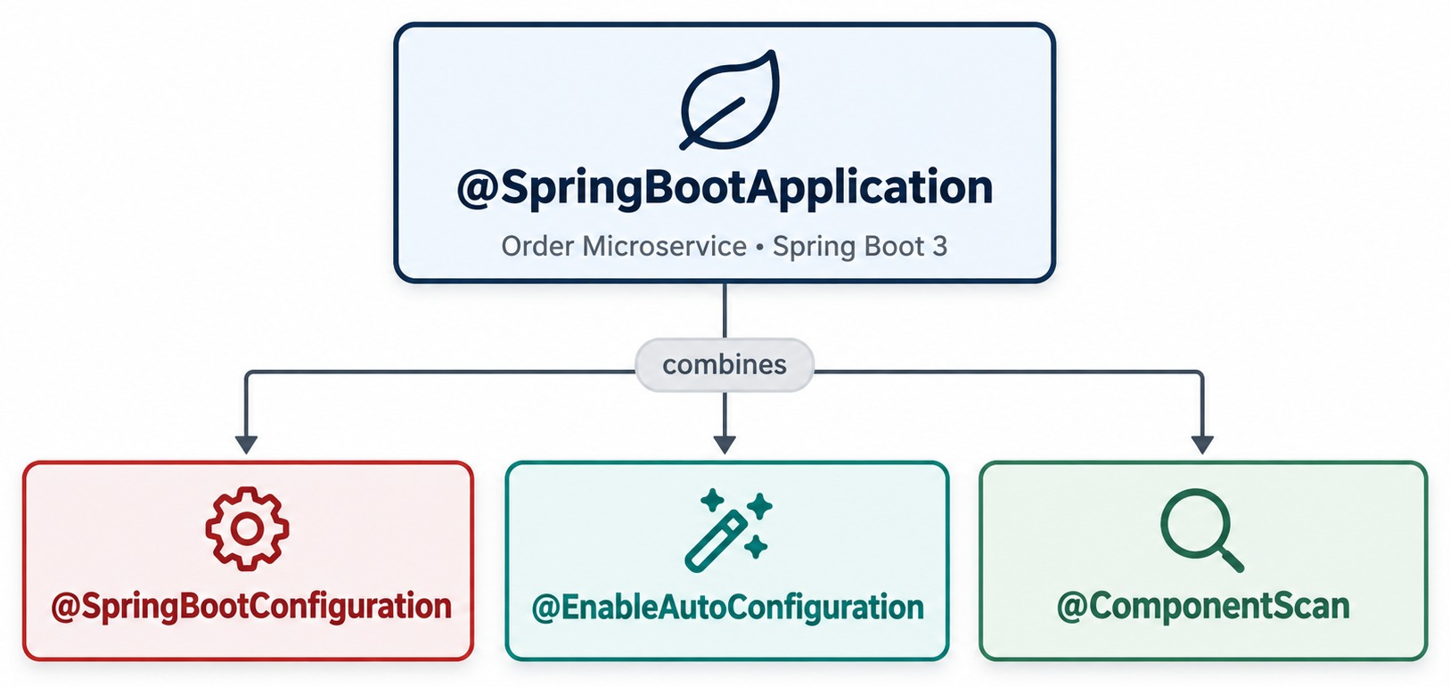
UNDERSTANDING @SPRINGBOOTAPPLICATION
Three annotations in one — and what each one does.
@SpringBootConfiguration
This class can declare @Bean methods.
@EnableAutoConfiguration
Boot configures infrastructure from what's on the classpath.
@ComponentScan
Finds components in this package and every package below.
PACKAGE MATTERS com.example.order.web is scanned; com.example.shared is not.
KEY TAKEAWAY Component scanning starts from the main class — so its package location matters.
13
© 2026 by Innovation In Software Corporation
Notes:
KEY TALKING POINTS
------------------
- A convenience annotation
@SpringBootApplication combines several important pieces of Spring Boot functionality in one annotation.
- Configuration
Through @SpringBootConfiguration, a specialized @Configuration, the application class takes part in Spring configuration.
- Auto-configuration
@EnableAutoConfiguration tells Spring Boot to examine the environment and the classpath.
It then tries to configure suitable infrastructure automatically.
- Component scanning
@ComponentScan makes Spring search the right packages for managed components.
Examples are classes marked @RestController, @Service, @Repository and @Component.
- Why location matters
This is why the location of the main application class and the package structure matter.
- What it shows
@SpringBootApplication split into @SpringBootConfiguration, @EnableAutoConfiguration and @ComponentScan.
- Key point
One annotation on the main class switches on configuration, auto-configuration and component scanning.

Slide 14
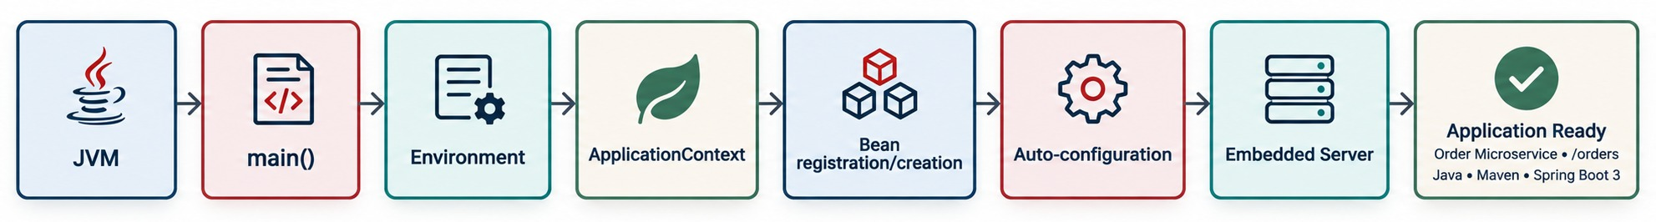
SPRING BOOT STARTUP LIFECYCLE
JVM → environment → ApplicationContext → beans → server → ready.
✓
The line you want to see
Why learn it
Shutdown
Started OrderApplication in 2.41 seconds
It's your map when a service won't start — Part 3 uses it to troubleshoot.
The context closes and releases connections and threads. server.shutdown=graceful finishes in-flight requests first.
KEY TAKEAWAY Knowing each startup step tells you where to look when an application won't start.
14
© 2026 by Innovation In Software Corporation
Notes:
KEY TALKING POINTS
------------------
- What happens when you click Run
This slide explains what happens between clicking Run and seeing the log line Started OrderApplication.
- Row one
Java starts the JVM and calls main.
SpringApplication.run bootstraps Spring.
Configuration is loaded and the environment is prepared.
Then an ApplicationContext is created.
- Row two
Spring discovers bean definitions.
Auto-configuration adds more configuration.
Beans are created and wired together.
For a web application, the embedded web server starts.
Finally, the application is ready to process traffic.
- Why it matters
This lifecycle becomes important later, when we troubleshoot startup failures.
- What it shows
Eight steps: JVM, main(), environment, ApplicationContext, bean registration and creation, auto-configuration, embedded server, and application ready.
- How to read it
Left to right is the order things happen in the startup log.
- Key point
If startup fails, find the step where it stopped.
That tells you where to look.
- Shutdown
Stopping matters too.
Spring closes the context and releases database connections, thread pools and consumers.
With graceful shutdown it finishes in-flight requests first, which OpenShift rolling updates rely on.

Slide 15
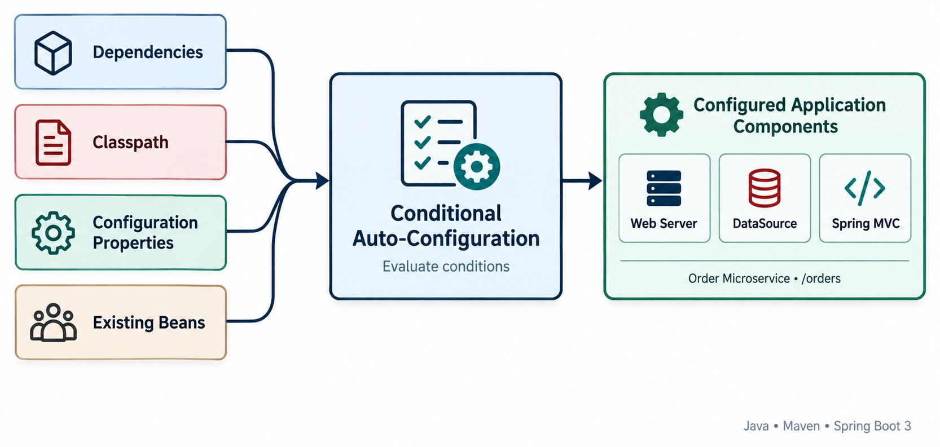
SPRING BOOT AUTO-CONFIGURATION
Configuration decided by the classpath, properties and existing beans.
BOOT ASKS
?
Is the library on the classpath?
?
Is it a web application?
?
Did you define this bean already?
?
Does a property turn it on or off?
Example
Add spring-boot-starter-web and you get Spring MVC, Tomcat and Jackson JSON.
IT BACKS OFF Define your own bean and Boot's default steps aside.
KEY TAKEAWAY Auto-configuration is conditional — and it backs away when you define your own configuration.
15
© 2026 by Innovation In Software Corporation
Notes:
KEY TALKING POINTS
------------------
- Not random
Auto-configuration does not mean Spring Boot randomly creates everything.
It is mostly conditional configuration.
- The inputs
Spring Boot looks at your dependencies, the classpath, your configuration properties and the beans you already defined.
- The questions it asks
Conceptually, it asks: is this class or library available?
Is this application type relevant?
Has the developer already defined a bean?
Does a property turn this behavior on or off?
Configuration is applied based on the answers.
- Why dependencies matter
That is why adding a dependency can change application behavior a lot.
For example, spring-boot-starter-web brings Spring MVC infrastructure, embedded web server support and JSON support.
- It backs away
In many common cases, auto-configuration is designed to back away when you provide your own configuration.
- What it shows
Four inputs, dependencies, the classpath, configuration properties and existing beans, feed a set of conditions.
- The result
When the conditions match, Boot creates components such as the web server, the DataSource and Spring MVC.
- Key point
Auto-configuration is a set of rules, not magic.

Slide 16
AUTO-CONFIGURATION IN CODE
Conditions decide; your own bean wins; the report shows every decision.
Inside Spring Boot (simplified)
✓
Your bean wins
See every decision
@AutoConfiguration
@ConditionalOnClass(ObjectMapper.class)
public class JacksonConfig {
@Bean
@ConditionalOnMissingBean
ObjectMapper objectMapper() {
return new ObjectMapper();
}
}
@Configuration
public class JsonConfig {
@Bean
ObjectMapper objectMapper() {
return JsonMapper.builder()
.findAndAddModules()
.build();
}
}
# application.yml
debug: true
# or when starting
java -jar order-service.jar --debug
# the log then shows:
# CONDITIONS EVALUATION REPORT
# Positive matches: ...
# Negative matches: ...
@ConditionalOnClass
@ConditionalOnMissingBean
@ConditionalOnProperty
Only if the library is on the classpath.
Only if you haven't defined one yourself.
Only if a property turns it on.
KEY TAKEAWAY Auto-configuration is a set of conditions — define your own bean and Boot's default steps aside.
16
© 2026 by Innovation In Software Corporation
Notes:
KEY TALKING POINTS
------------------
- Inside Boot
This is a simplified version of Boot's Jackson setup.
It runs only when Jackson is on the classpath, and only if no ObjectMapper bean exists yet.
- Your bean wins
When we declare our own ObjectMapper, the missing-bean condition fails, so Boot's default is skipped.
- See the decisions
Set debug to true, or start with --debug.
The conditions evaluation report lists what was configured and why the rest was not.
- When to use it
Use the report when something is configured unexpectedly, or not configured at all.

Slide 17
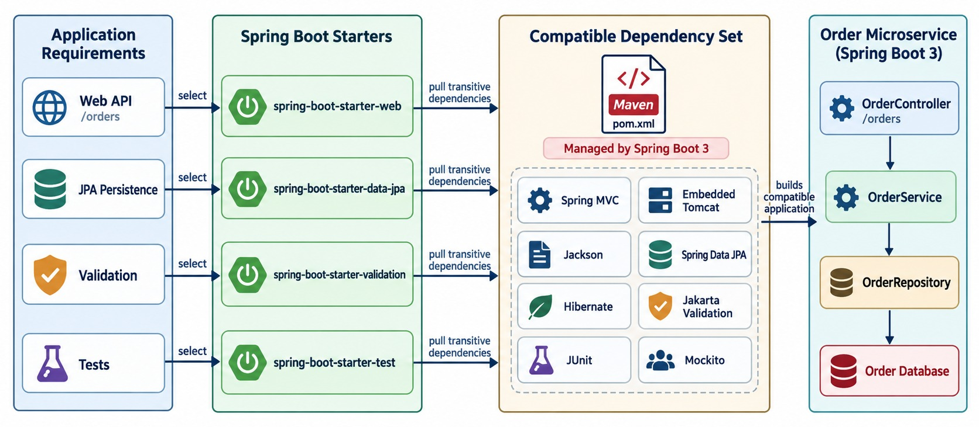
STARTERS AND DEPENDENCY MANAGEMENT
spring-boot-starter-* and compatible dependency versions.
Starter
A curated group of libraries for one capability.
pom.xml
<parent>
<groupId>org.springframework.boot</groupId>
<artifactId>spring-boot-starter-parent</artifactId>
<version>3.5.0</version>
</parent>
<dependency>
<groupId>org.springframework.boot</groupId>
<artifactId>spring-boot-starter-web</artifactId>
<!-- no version: managed by the parent -->
</dependency>
CAUTION Override a managed version only when you understand the compatibility risk.
KEY TAKEAWAY Starters bring the right libraries; Boot's dependency management keeps their versions compatible.
17
© 2026 by Innovation In Software Corporation
Notes:
KEY TALKING POINTS
------------------
- Without starters
Without dependency grouping, developers would have to find and coordinate many individual libraries themselves.
- Starters
Spring Boot starters are curated groups of dependencies for common capabilities.
Examples are spring-boot-starter-web, data-jpa, validation and test.
Adding spring-boot-starter-web brings in what a typical Spring MVC web application needs.
- Dependency management
Spring Boot's dependency management also helps keep library versions compatible with each other.
- A rule of thumb
Avoid manually overriding dependency versions.
Only do it when you have a clear reason and understand the compatibility impact.
- What it shows
Application needs on the left, the starter chosen for each, and the libraries each starter pulls in.
- How to read it
Web API selects starter-web, which brings Spring MVC, Jackson and embedded Tomcat.
Spring Boot manages all the versions.
- Key point
Pick a starter per capability and let Boot keep the versions compatible.
- The parent
The version is set once, on the starter parent.
The starters below it have no version, because Boot manages a compatible set.

Slide 18
EXERCISE: CHOOSE THE STARTERS
Pick exactly what the Order Service needs — and nothing more.
PRACTICE EXERCISE
10 MIN
SCENARIO
YOUR TASKS
EXPECTED OUTCOME
Order Service needs:
• a REST API for /orders
• orders saved in PostgreSQL
• request validation
• a health endpoint for OpenShift
• unit and slice tests
A teammate also wants Spring Security, Kafka and Redis “just in case”.
1
Pick a starter for each need
✓
web → MVC, Tomcat, Jackson
2
Name one thing each starter auto-configures
✓
data-jpa + PostgreSQL driver → DataSource, repositories
3
Decide what to do with the “just in case” dependencies
validation → Bean Validation; actuator → /actuator/health
✓
✓
test → JUnit, Mockito, AssertJ
✓
Leave the rest out until a requirement needs it
KEY TAKEAWAY Every starter switches on auto-configuration — add one only when the service needs it.
18
© 2026 by Innovation In Software Corporation
Notes:
KEY TALKING POINTS
------------------
- Expected starters
spring-boot-starter-web, data-jpa with the PostgreSQL driver, validation, actuator and test.
- What each configures
Web gives Spring MVC, Tomcat and Jackson.
Data JPA gives a DataSource, Hibernate and repositories.
Actuator gives health endpoints.
- Just in case
Security, Kafka and Redis each add auto-configuration, startup time and attack surface.
Security even locks every endpoint by default.
Add them when a requirement appears.

Slide 19
PART 2: BUILDING THE ORDER API
From a running application to working endpoints.
✓ Part 1
What Spring Boot does
Part 2
Build the Order API
Part 3
Portable and running
SO FAR
NEXT QUESTION
How do we turn the Order API contract into working Spring code?
✓
Boot adds starters, auto-configuration and a server to Spring
✓
@SpringBootApplication scans from the main class package
IN THIS PART
1
The Order Service case study
✓
Startup follows a fixed, readable lifecycle
2
Request flow, mappings and request data
3
DTOs, validation and error handling
4
Service and repository code
5
Dependency injection and beans
6
Exercises: refactor and fix the wiring
19
© 2026 by Innovation In Software Corporation
Notes:
KEY TALKING POINTS
------------------
- From framework to features
Part 1 explained what Boot does.
Part 2 builds the Order API layer by layer.
- How to follow
We follow one request inward: controller, request data, DTOs, validation and errors, then the service and repository, then how Spring wires them.

Slide 20
OUR CASE STUDY: THE ORDER SERVICE
What it does, the files we write, and the API it exposes.
ORDER SERVICE DOES
FILES WE WILL WRITE
POTENTIAL API
✓
Create an order
OrderController
POST
/orders
✓
Retrieve an order
HTTP in, HTTP out
✓
Update an order
GET
/orders
Cancel an order
CreateOrderRequest · OrderResponse
✓
GET
/orders/{id}
The API contract
OrderService
PATCH
/orders/{id}
FROM MODULE 2 It implements the Order capability and the API contract we designed.
Business rules
DELETE
/orders/{id}
OrderRepository
Data access
LAB 1 You build the same layers for the banking Account Service.
GlobalExceptionHandler
One error format
KEY TAKEAWAY One Order Service — controller, service and repository — carries us through the module.
20
© 2026 by Innovation In Software Corporation
Notes:
KEY TALKING POINTS
------------------
- From theory to code
Now we move from framework theory to implementation.
Our microservice represents the Order business capability we identified in Module 2.
- What it does
The Order Service creates, retrieves, updates and cancels orders.
- A possible API
The API could be POST /orders, GET /orders, GET /orders/{id}, PATCH /orders/{id} and DELETE /orders/{id}.
- Inside the service
Internally, the OrderController calls the OrderService, which calls the OrderRepository.
We use this example for the rest of the module.
- Files we write
OrderController handles HTTP.
The request and response records are the contract.
OrderService holds the rules, OrderRepository the data access, and GlobalExceptionHandler the error format.
- Lab link
Lab 1 builds the same layers for the banking Account Service.

Slide 21
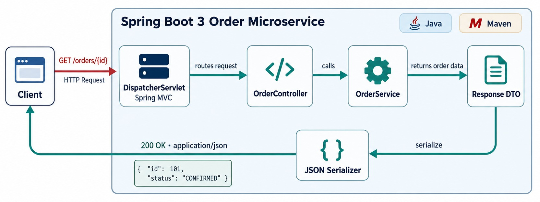
REST REQUEST–RESPONSE FLOW
@RestController and @RequestMapping — request in, JSON out.
SPRING MVC DOES FOR YOU
✓
Routes the URL to one controller method
✓
Converts path, query and body into Java types
✓
Serializes the return value to JSON
✓
Turns exceptions into error responses
DispatcherServlet
Spring MVC's front controller finds the matching method; Jackson turns the return value into JSON.
THIN CONTROLLER Map HTTP, then delegate to the service.
KEY TAKEAWAY The controller maps the HTTP request, then delegates the business work to the service layer.
21
© 2026 by Innovation In Software Corporation
Notes:
KEY TALKING POINTS
------------------
- @RestController
@RestController tells Spring that this class handles web requests.
Return values are generally written to the HTTP response body, usually as JSON.
- Mappings
@RequestMapping with /orders sets the base path.
@GetMapping with /{id} maps a GET request.
- Follow a request
For GET /orders/101, Spring extracts 101 and passes it to the id parameter.
The method returns an OrderDto, which goes back to the client as JSON.
- Delegate
The controller then hands the business work to the service layer.
- What it shows
A GET request going through DispatcherServlet to OrderController and OrderService, then back through the JSON serializer.
- How to read it
Follow the top arrows in, then the bottom arrow out as a 200 OK JSON response.
- Key point
Spring MVC does the HTTP plumbing.
Your code only handles the business request.

Slide 22
MAPPING HTTP OPERATIONS
@GetMapping, @PostMapping, @PutMapping, @PatchMapping, @DeleteMapping.
HTTP | Spring | Example
GET | @GetMapping | /orders/101
POST | @PostMapping | /orders
PUT | @PutMapping | /orders/101
PATCH | @PatchMapping | /orders/101
DELETE | @DeleteMapping | /orders/101
@RestController
@RequestMapping("/orders")
class OrderController {
@GetMapping("/{id}") // retrieve
@PostMapping // create
@PutMapping("/{id}") // replace
@PatchMapping("/{id}") // partial
@DeleteMapping("/{id}") // delete
}
DESIGN CAME FIRST Spring annotations implement the HTTP contract — they don't decide what a good contract is.
KEY TAKEAWAY Each mapping annotation implements the REST contract we designed in Module 2.
22
© 2026 by Innovation In Software Corporation
Notes:
KEY TALKING POINTS
------------------
- Connect to Module 2
Connect this table directly to the REST design from Module 2.
Use @GetMapping for retrieval and @PostMapping for creation.
Use @PutMapping for full replacement, @PatchMapping for partial updates, and @DeleteMapping for deletion.
- Design comes first
Spring annotations implement the HTTP contract.
They do not decide what a good API contract should be.
That design decision came first.

Slide 23
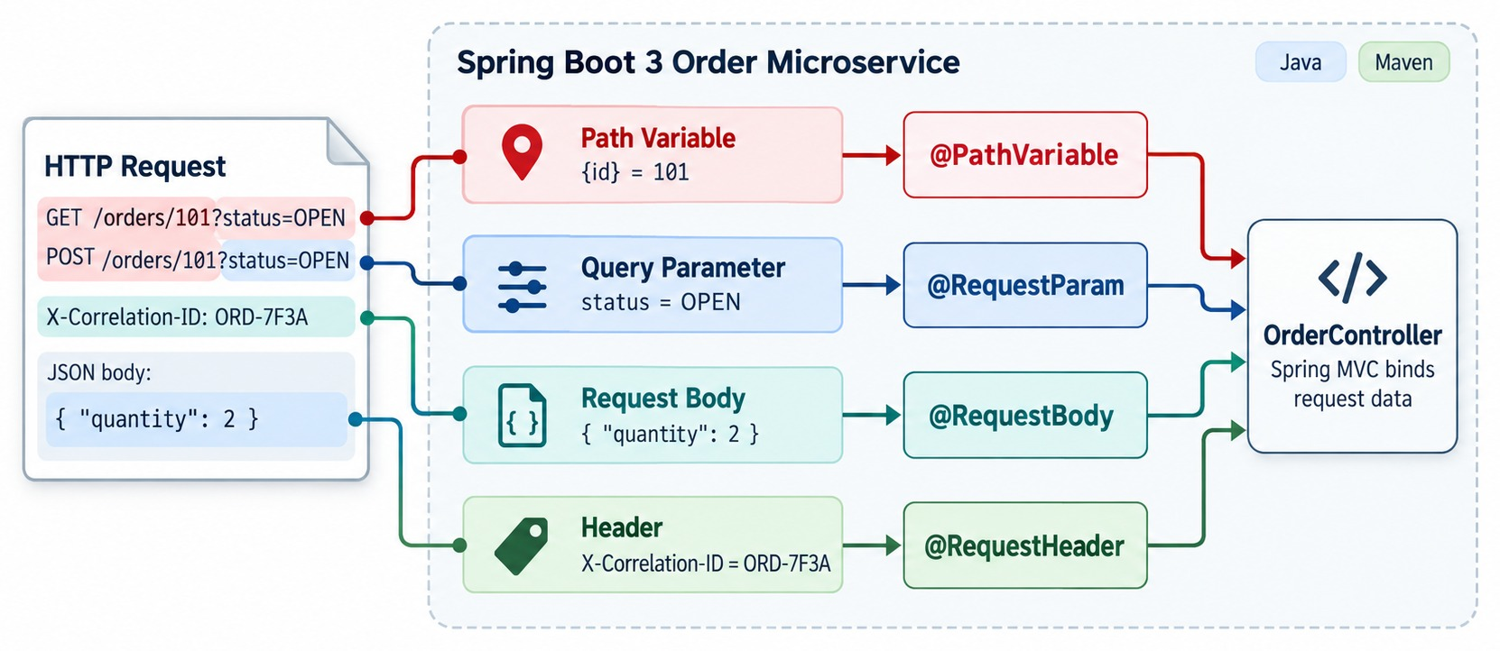
WORKING WITH REQUEST DATA
@PathVariable, @RequestParam, @RequestBody and @RequestHeader.
One method, three sources
@GetMapping("/{id}")
OrderResponse get(
@PathVariable Long id,
@RequestParam(required = false)
String status,
@RequestHeader("X-Correlation-Id")
String correlationId) { ... }
Type conversion
Spring turns "101" into a Long. A value it can't convert returns 400.
OPTIONAL VALUES Use required = false or a defaultValue.
KEY TAKEAWAY Spring maps each part of the HTTP request into Java method parameters — including JSON bodies.
23
© 2026 by Innovation In Software Corporation
Notes:
KEY TALKING POINTS
------------------
- Mapping the request
Spring maps different parts of an HTTP request into Java method parameters.
- Path variables
For /orders/101, @PathVariable gives the method the id 101.
- Query parameters
For GET /orders?status=CREATED, @RequestParam gives the method the status value.
- Request body
For POST /orders with JSON, @RequestBody turns the JSON into a CreateOrderRequest Java object.
This is called deserialization.
- Headers
@RequestHeader reads values from the HTTP headers.
- What it shows
One HTTP request split into a path variable, a query parameter, a request body and a header.
- How to read it
Each part is matched to @PathVariable, @RequestParam, @RequestBody or @RequestHeader, and arrives in OrderController as a method parameter.
- Key point
Spring binds request data for you.
You just declare what you need.

Slide 24
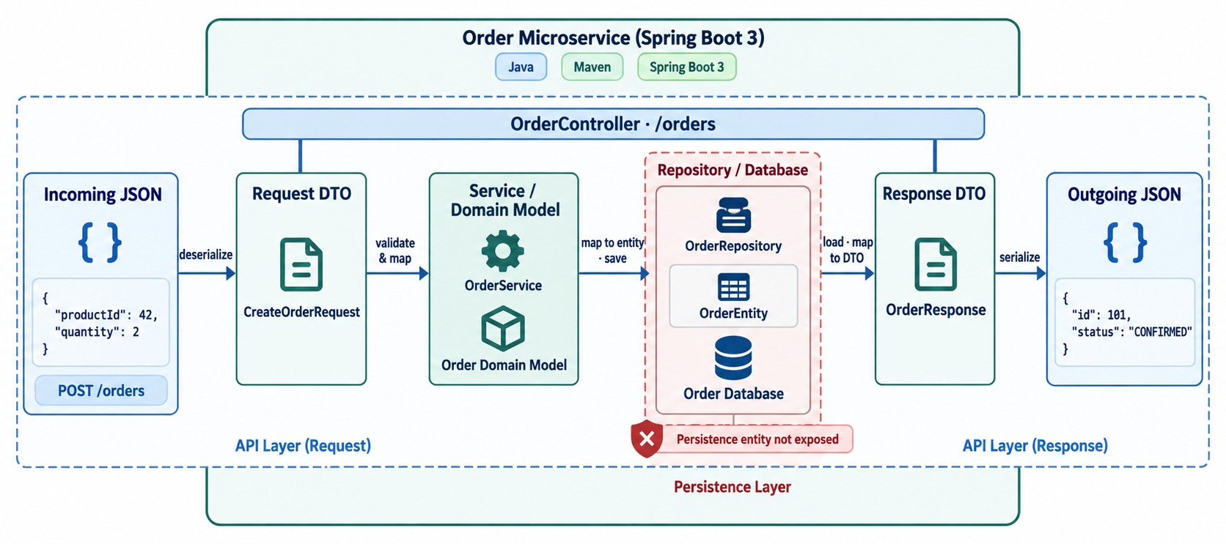
DTOS AND API RESPONSES
Request and response DTOs keep the entity inside the service.
NEVER LEAVES THE SERVICE
✕
internalProcessingCode
✕
databaseVersion
✕
Audit fields
✓
Map entity → DTO in one place
public record OrderResponse(
Long id, String status,
BigDecimal total) {
static OrderResponse from(Order o) {
return new OrderResponse(o.getId(),
o.getStatus().name(), o.getTotal());
}
}
MORE CONTROL ResponseEntity<T> sets status, headers and body.
KEY TAKEAWAY Don't expose entities — DTOs give clients exactly the contract they need.
24
© 2026 by Innovation In Software Corporation
Notes:
KEY TALKING POINTS
------------------
- Follow the data
Incoming JSON becomes a request DTO.
The business layer works with the domain or persistence model.
The result becomes a response DTO, which goes out as JSON.
- Don't expose entities
Do not automatically expose database entities as your API contract.
Our persistence entity has id, customerId, internalProcessingCode, databaseVersion and createdAt.
But the client may only need orderId, customerId, status and total.
- DTOs define the contract
A DTO lets us define the external contract separately from storage.
A Java record like OrderResponse is a simple way to write one.
- ResponseEntity
Use ResponseEntity when you need explicit control over the status code, headers and response body.
- What it shows
Incoming JSON becomes a request DTO, goes through the service and repository, and returns as a response DTO and JSON.
- How to read it
The red box marks the persistence entity.
It never leaves the service.
- Key point
DTOs protect the API contract from internal changes.
- One mapping place
A static from() method on the DTO, or a mapper such as MapStruct.
Pick one approach and use it everywhere.

Slide 25
VALIDATION AND ERROR HANDLING
Bean Validation, @Valid, consistent errors and @RestControllerAdvice.
Client Request
CONSTRAIN THE REQUEST DTO
KEY TOOLS
public record CreateOrderRequest(
@NotNull Long customerId,
@NotEmpty List<OrderItemRequest> items) {
}
@Valid
Validation
@NotNull
TRIGGER VALIDATION IN THE CONTROLLER
@NotBlank
Valid
Invalid
@PostMapping
public ResponseEntity<OrderResponse> create(
@Valid @RequestBody
CreateOrderRequest request) { ... }
@Size
Service
400 Error
@Positive
GOOD ERROR RESPONSE
@RestControllerAdvice
CENTRALIZE @RestControllerAdvice + @ExceptionHandler give consistent API errors.
errorCode · message · timestamp · path · traceId
@ExceptionHandler
KEY TAKEAWAY Never trust incoming requests — validate them, and return consistent errors from one place.
25
© 2026 by Innovation In Software Corporation
Notes:
KEY TALKING POINTS
------------------
- Never trust input
Never assume incoming requests are valid.
Follow the diagram: valid requests go on to the service, and invalid ones get a 400 error.
- Bean Validation
Put constraints on the request DTO, such as @NotNull on customerId and @NotEmpty on items.
Then add @Valid next to @RequestBody in the controller so Spring checks them.
- Central error handling
Do not repeat exception logic in every controller.
Use @RestControllerAdvice with @ExceptionHandler methods to produce consistent API errors.
- A good error response
A good error response can include an errorCode, a message, a timestamp, the path and a traceId.

Slide 26
CENTRALIZED ERROR HANDLING
One handler turns exceptions into the error format clients rely on.
Throw a meaningful exception
✓
Handle it in one place
What the client receives
public class OrderNotFoundException
extends RuntimeException {
public OrderNotFoundException(
Long id) {
super("Order " + id
+ " was not found");
}
}
@RestControllerAdvice
class GlobalExceptionHandler {
@ExceptionHandler(
OrderNotFoundException.class)
@ResponseStatus(HttpStatus.NOT_FOUND)
ErrorResponse notFound(
OrderNotFoundException ex,
HttpServletRequest req) {
return ErrorResponse.of(
"ORDER_NOT_FOUND",
ex.getMessage(),
req.getRequestURI());
}
}
HTTP/1.1 404 Not Found
{
"code": "ORDER_NOT_FOUND",
"message": "Order 999 was not found",
"timestamp": "2026-09-14T10:15:30Z",
"path": "/orders/999"
}
One place
Right status
Safe messages
No try/catch copied into every controller.
Validation 400, not found 404, conflict 409.
Log details inside; never return stack traces.
KEY TAKEAWAY Throw meaningful exceptions and map them once — every endpoint then returns the same error shape.
26
© 2026 by Innovation In Software Corporation
Notes:
KEY TALKING POINTS
------------------
- The exception
The service throws OrderNotFoundException with a clear message when an order doesn't exist.
- The handler
@RestControllerAdvice applies to all controllers.
The @ExceptionHandler method turns this exception into a 404 with our ErrorResponse.
- The result
Clients get code, message, timestamp and path.
This is the error body we designed in Module 2.
- Mapping
Validation failures map to 400, missing resources to 404, and illegal state changes to 409.
Unexpected errors return 500 with a safe message and are logged in full.

Slide 27
SERVICE AND REPOSITORY LAYERS IN CODE
Rules and transactions in the service; persistence in the repository.
OrderService.java
✓
OrderRepository.java
@Service
public class OrderService {
private final OrderRepository orders; // injected
@Transactional
public OrderResponse cancel(Long id) {
Order order = orders.findById(id)
.orElseThrow(() -> new OrderNotFoundException(id));
order.cancel(); // rule: only CREATED orders
return OrderResponse.from(order);
}
}
public interface OrderRepository
extends JpaRepository<Order, Long> {
List<Order> findByCustomerId(String customerId);
long countByCustomerIdAndStatus(
String customerId, OrderStatus status);
}
// Spring Data writes the implementation:
// save, findById, findAll, deleteById, count
Service
Repository
NEVER Call a repository straight from a controller.
Owns business rules and the transaction boundary.
Persistence only. Method names become queries.
KEY TAKEAWAY Services decide and repositories store — keep business rules out of both controllers and repositories.
27
© 2026 by Innovation In Software Corporation
Notes:
KEY TALKING POINTS
------------------
- The service
OrderService holds the rules.
cancel() loads the order, lets the domain object apply the rule, and returns a DTO.
- Transactions
@Transactional sits on the service method, because one business operation should be one transaction.
- The repository
OrderRepository is only an interface.
Spring Data generates the implementation, including queries from method names like findByCustomerId.
- Going deeper
Entities, mappings and data ownership come back in the data module.

Slide 28
EXERCISE: REFACTOR A FAT CONTROLLER
Move each responsibility to the layer where it belongs.
PRACTICE EXERCISE
12 MIN
SCENARIO
YOUR TASKS
EXPECTED OUTCOME
A teammate wrote this controller method:
1
Label each line: controller, validation, service, repository or logging
✓
Empty items → @NotEmpty on the DTO → 400
@PostMapping("/orders")
Order create(@RequestBody Order o) {
if (o.getItems().isEmpty())
return null;
int open = jdbc.queryForObject(
"select count(*) from orders"
+ " where customer_id = ?",
Integer.class, o.getCustomerId());
if (open > 5)
throw new RuntimeException("limit");
o.setStatus("CREATED");
System.out.println("Saved " + o);
return orderRepository.save(o);
}
✓
Open-order limit → service rule → 409
2
Rewrite the signature with a request DTO, @Valid and a 201 response
✓
Count query → repository method
3
Name the exception and status code for each failure
✓
Status CREATED → service or domain
✓
println → log.info with orderId only
KEY TAKEAWAY A thin controller, a rule-owning service and a query-only repository are easier to test and change.
28
© 2026 by Innovation In Software Corporation
Notes:
KEY TALKING POINTS
------------------
- What's wrong
The method mixes HTTP, validation, a business rule, SQL and console logging, and it takes and returns the entity.
- Expected refactor
The controller takes a CreateOrderRequest with @Valid and returns 201.
The service checks the open-order limit and sets the status.
The repository offers countByCustomerIdAndStatus.
- Errors
Empty items fail validation with 400.
The limit throws a domain exception the handler maps to 409.
Returning null is never an answer.

Slide 29
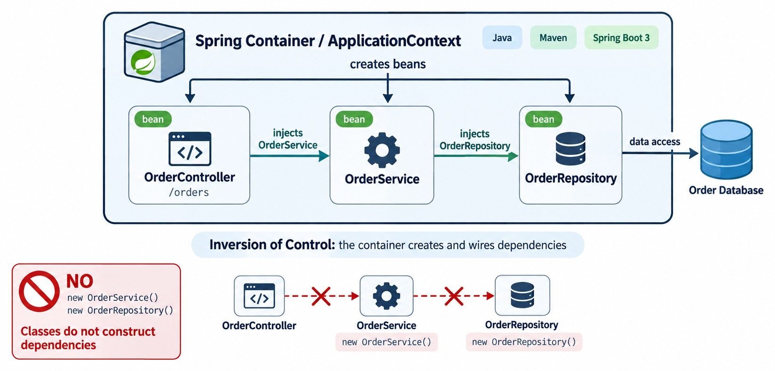
DEPENDENCY INJECTION IN SPRING BOOT
The container builds the objects; classes only declare what they need.
INJECTION STYLES
✓
Constructor — preferred
✓
Setter — optional dependencies
✕
Field @Autowired — avoid
✓
Unit test without Spring
var repo = mock(OrderRepository.class);
var service = new OrderService(repo);
ONE CONSTRUCTOR? No @Autowired needed.
KEY TAKEAWAY A class declares what it needs, not how to build it — use constructor injection by default.
29
© 2026 by Innovation In Software Corporation
Notes:
KEY TALKING POINTS
------------------
- Fundamental to Spring
Dependency injection is fundamental to Spring.
In the diagram, the controller needs the service, and the service needs the repository.
The Spring container creates and connects them.
- Without DI
Without dependency injection, code builds its own dependencies with new.
That ties object construction tightly to the application code.
- With Spring
With Spring, OrderService simply asks for an OrderRepository in its constructor.
Spring creates the managed components and passes in the dependency.
- The idea
The class declares what it needs.
It does not control how that dependency is built.
Recommend constructor injection as the normal default, not field injection.
- What it shows
The Spring container creating OrderController, OrderService and OrderRepository and injecting each into the next.
- The contrast
The red NO box shows the old way: classes calling new on their own dependencies.
- Key point
Inversion of control means the container, not your class, builds the object graph.
- Injection styles
Constructor injection makes dependencies explicit and final.
Setter injection suits optional ones.
Field injection hides dependencies and makes tests harder.

Slide 30
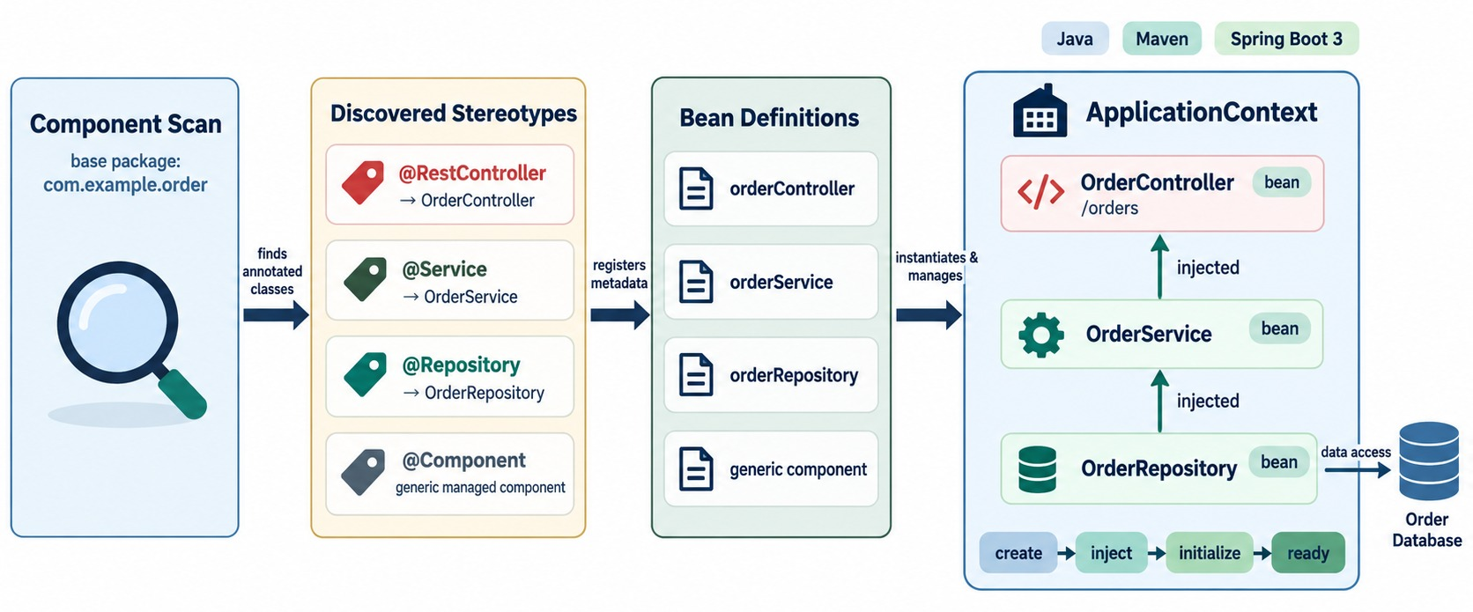
COMPONENT SCANNING AND BEAN MANAGEMENT
Stereotype annotations, @Bean methods and the ApplicationContext.
A bean
An object the container creates and manages. One shared instance by default (singleton).
Declare a bean explicitly
@Configuration
class ClientConfig {
@Bean
RestClient paymentClient(
RestClient.Builder b) {
return b.baseUrl("http://payment")
.build();
}
}
USE @BEAN FOR classes you can't annotate, like library clients.
KEY TAKEAWAY Stereotype annotations and @Bean methods put objects under the Spring container's management.
30
© 2026 by Innovation In Software Corporation
Notes:
KEY TALKING POINTS
------------------
- What a bean is
A bean is an object managed by the Spring container.
- Stereotype annotations
Common stereotype annotations are @Component, @Service, @Repository, @Controller and @RestController.
Spring finds these classes through component scanning and registers them in the ApplicationContext.
- Explicit beans
You can also create beans explicitly with a @Bean method inside a @Configuration class.
This is especially useful for objects from third-party libraries, or when construction needs explicit configuration.
- What it shows
Component scanning finds stereotype annotations, registers bean definitions, then the ApplicationContext creates and injects the beans.
- How to read it
Left to right: discover, register, create.
At the bottom: create, inject, initialize, ready.
- Key point
Only classes that scanning finds become beans.
- Bean scopes
Beans are singletons by default: one shared instance.
Prototype, request and session scopes exist, but services rarely need them.

Slide 31
EXERCISE: WHY WON'T IT WIRE?
Read the startup error and fix the wiring.
PRACTICE EXERCISE
10 MIN
SCENARIO
YOUR TASKS
EXPECTED OUTCOME
Startup fails: “Parameter 0 of constructor in OrderController required a bean of type OrderService that could not be found.”
1
Find two reasons OrderService is not a bean
✓
No @Service annotation
✓
com.example.services is outside the scanned package
2
Fix them, and replace the field injection
package com.example.order;
@SpringBootApplication
public class OrderApplication { }
package com.example.services;
public class OrderService { }
package com.example.order.web;
@RestController
public class OrderController {
@Autowired
private OrderService service;
}
✓
Move it under com.example.order and add @Service
3
Say which startup step failed
✓
Use a final field and a constructor
✓
Failed while creating beans — before Tomcat starts
KEY TAKEAWAY A missing bean is almost always a missing annotation or a class outside the scanned package.
31
© 2026 by Innovation In Software Corporation
Notes:
KEY TALKING POINTS
------------------
- Reason one
OrderService has no stereotype annotation, so scanning ignores it.
- Reason two
Even with @Service, com.example.services is outside com.example.order, where scanning starts.
- The fix
Move it to com.example.order.service, add @Service, and inject it through a constructor into a final field.
- Lifecycle link
The failure happens while creating beans, so the embedded server never starts.

Slide 32
PART 3: PORTABLE AND RUNNING
A working API is not finished until it runs anywhere and tells you how it's doing.
✓ Part 1
What Spring Boot does
✓ Part 2
Build the Order API
Part 3
Portable and running
SO FAR
NEXT QUESTION
How does one JAR run in dev, test and production — and how do we know it's healthy?
✓
Controllers map HTTP and stay thin
✓
DTOs, validation and one handler form the contract
IN THIS PART
Spring creates and injects every bean
1
Externalized and type-safe configuration
✓
2
Profiles and environments
3
Exercise: which value wins?
4
From source to a running service
5
Troubleshooting startup, and logging
6
The complete picture
32
© 2026 by Innovation In Software Corporation
Notes:
KEY TALKING POINTS
------------------
- Why this part
The same service must run on a laptop, in test and in production without being rebuilt.
- What comes next
Configuration, profiles, the build, what to do when startup fails, logging, and finally the whole picture.

Slide 33
EXTERNALIZED CONFIGURATION
application.yml, environment variables and configuration precedence.
APPLICATION
AVOID — HARD-CODED IN JAVA
String databaseUrl =
"jdbc:postgresql://prod-server/orders";
application.yml
Environment Variables
Command-line / other external config
PREFER — EXTERNALIZED VALUES
EXAMPLE APPLICATION.YML
spring:
datasource:
url: ${DB_URL}
username: ${DB_USER}
password: ${DB_PASSWORD}
spring:
application:
name: order-service
server:
port: 8080
Same artifact, different environments
→ Twelve-Factor “Config” from Module 1
KEY TAKEAWAY Keep configuration out of Java code so the same artifact runs in every environment.
33
© 2026 by Innovation In Software Corporation
Notes:
KEY TALKING POINTS
------------------
- Don't hard-code configuration
Configuration should not be hard-coded in Java classes.
A hard-coded production database URL ties the binary to one environment.
- Configuration sources
Spring Boot can read configuration from application.yml, environment variables, and command-line or other external sources.
- Externalize it
Instead, reference values like DB_URL, DB_USER and DB_PASSWORD in the configuration.
Now the same application artifact runs in different environments with different values.
- Twelve-Factor
Connect this back to the Twelve-Factor App principles from Module 1.

Slide 34
TYPE-SAFE CONFIGURATION
@ConfigurationProperties binds a whole group of settings to one Java type.
application.yml
✓
OrderProperties.java
Enable it, then inject it
orders:
max-items-per-order: 50
payment:
base-url: ${PAYMENT_URL}
timeout: 2s
@Validated
@ConfigurationProperties("orders")
public record OrderProperties(
@Min(1) int maxItemsPerOrder,
@Valid Payment payment) {
public record Payment(
@NotBlank String baseUrl,
Duration timeout) {}
}
@SpringBootApplication
@ConfigurationPropertiesScan
public class OrderApplication { }
@Service
class OrderService {
OrderService(OrderProperties p) {
this.maxItems =
p.maxItemsPerOrder();
}
}
vs. @Value
Fail fast
From the environment
One typed object instead of scattered strings.
A bad value stops startup and names the field.
ORDERS_MAXITEMSPERORDER=20 overrides the YAML.
KEY TAKEAWAY Group related settings in a validated properties type — misconfiguration then fails at startup, not in production.
34
© 2026 by Innovation In Software Corporation
Notes:
KEY TALKING POINTS
------------------
- The YAML
Order settings live under one orders prefix.
The payment URL comes from an environment variable.
- The record
@ConfigurationProperties binds the prefix to a record.
Durations like 2s convert automatically.
- Fail fast
With @Validated, a missing URL or a zero item limit stops startup with a clear message naming the field.
- Relaxed binding
Spring maps ORDERS_MAXITEMSPERORDER to orders.max-items-per-order, so the platform can override any value.

Slide 35
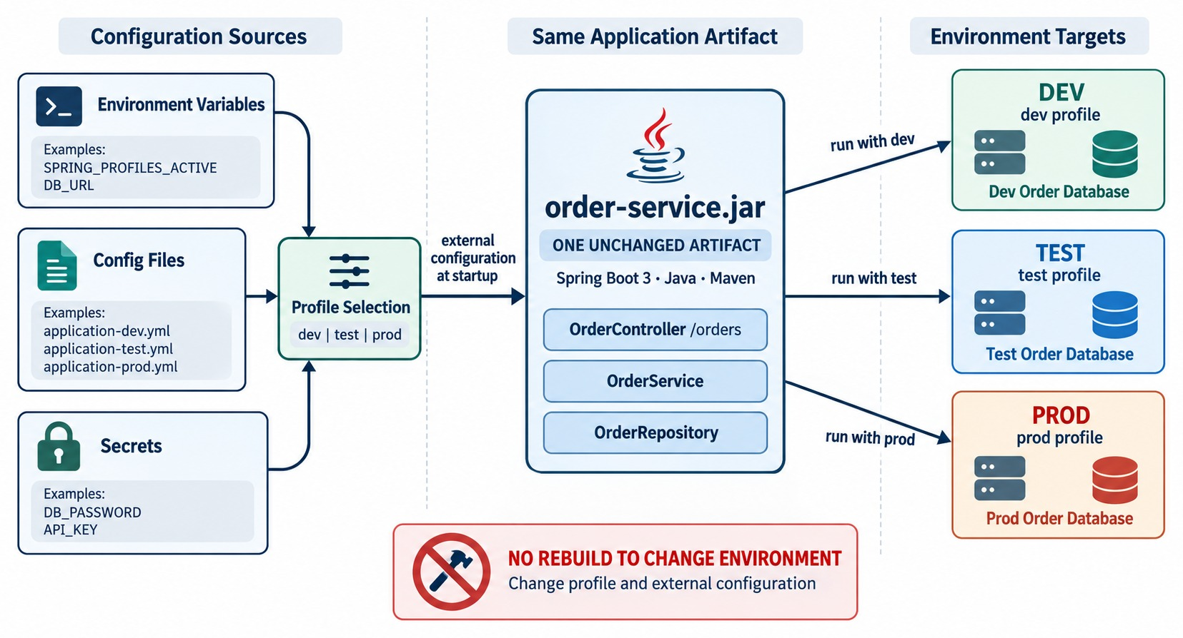
PROFILES: ONE ARTIFACT, MANY ENVIRONMENTS
dev, test and prod configuration — with secrets supplied by the platform.
Base file plus overrides
application.yml # shared
application-dev.yml
application-prod.yml
Choose the profile at runtime
java -jar order-service.jar \
--spring.profiles.active=prod
# on OpenShift
SPRING_PROFILES_ACTIVE=prod
SECRETS Never in YAML. The platform injects DB_PASSWORD at runtime.
KEY TAKEAWAY Build once — profiles, environment variables and secrets adapt the same JAR to each environment.
35
© 2026 by Innovation In Software Corporation
Notes:
KEY TALKING POINTS
------------------
- Don't hard-code configuration
Configuration should not be hard-coded in Java classes.
A hard-coded production database URL ties the binary to one environment.
- Configuration sources
Spring Boot can read configuration from application.yml, environment variables, and command-line or other external sources.
- Externalize it
Instead, reference values like DB_URL, DB_USER and DB_PASSWORD in the configuration.
Now the same application artifact runs in different environments with different values.
- Twelve-Factor
Connect this back to the Twelve-Factor App principles from Module 1.
- What it shows
Environment variables, config files and secrets feed profile selection for one order-service.jar.
- How to read it
The same JAR runs with the dev, test or prod profile and connects to that environment's database.
- Key point
No rebuild to change environment.
Only the profile and external configuration change.
- Different environments, different config
Development might use a local database and debug-friendly settings.
Testing uses test infrastructure and test-specific integrations.
Production uses production endpoints and infrastructure settings.
- Spring profiles
Spring profiles let configuration, or even beans, change based on the active environment.
Each profile can have its own file, such as application-dev.yml, application-test.yml and application-prod.yml.
- Choosing the profile
You can set spring.profiles.active to dev.
But for production, do not hard-code the active production profile into the artifact.
The deployment environment should usually select the right profile and configuration.
- Build once
The ideal principle is: build once, then configure for the target environment.
- Avoid separate builds
Avoid compiling a DEV version, a TEST version and a PROD version.
Prefer one artifact with different external configuration.
- Why it matters for containers
This becomes extremely important with containers.
Later, the same container image runs on OpenShift in DEV, TEST and PROD.
The image stays the same, and each environment supplies its own configuration.
- Configuration versus secrets
Configuration means non-sensitive operational values.
Secrets mean passwords, API keys, tokens, certificates and similar sensitive material.

Slide 36
EXERCISE: WHICH VALUE WINS?
Predict the configuration Spring Boot actually uses.
PRACTICE EXERCISE
10 MIN
SCENARIO
YOUR TASKS
EXPECTED OUTCOME
Order Service is started three ways:
A: no profile
B: prod profile
C: prod profile, env SERVER_PORT=9090 and command-line server.port=7070
1
Give the port and item limit for A, B and C
✓
A: 8080 and 50
✓
B: 8081 and 20
2
Rank the sources from highest to lowest priority
✓
C: 7070 and 20 — command line wins
# application.yml
server.port: 8080
orders.max-items-per-order: 50
# application-prod.yml
server.port: 8081
orders.max-items-per-order: 20
3
Decide where the database password should come from
✓
Command line > env vars > profile file > application.yml
✓
Password: a platform secret, never a file
KEY TAKEAWAY Command line beats environment variables, which beat profile files, which beat application.yml.
36
© 2026 by Innovation In Software Corporation
Notes:
KEY TALKING POINTS
------------------
- Run A
No profile is active, so only application.yml applies: port 8080 and 50 items.
- Run B
The prod profile file overrides the base file: port 8081 and 20 items.
- Run C
The command-line argument beats the environment variable, so the port is 7070.
The item limit is still 20.
- Secrets
The database password comes from an OpenShift secret exposed as an environment variable.
It never goes in a YAML file.

Slide 37
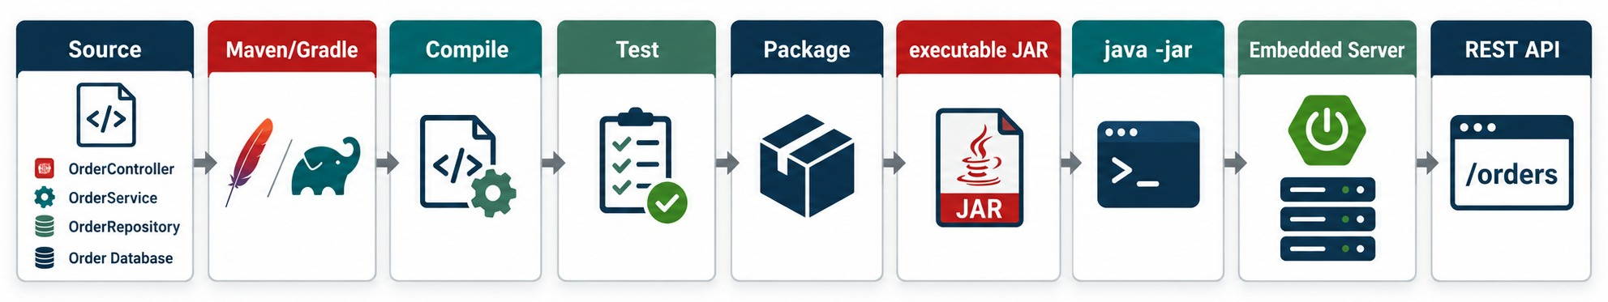
FROM SOURCE TO A RUNNING SERVICE
Build one executable JAR, start it, call it.
1 Build
2 Run
✓
3 Call
./mvnw clean package
# compiles, runs tests, packages
java -jar target/order-service.jar
# dev loop: ./mvnw spring-boot:run
curl localhost:8080/orders/101
# or Postman, IDE HTTP client
KEY TAKEAWAY A build tool compiles, tests and packages one executable JAR — java -jar starts the server and the API.
37
© 2026 by Innovation In Software Corporation
Notes:
KEY TALKING POINTS
------------------
- What gets deployed
We do not deploy the source project directly.
A build tool runs the build lifecycle.
- The Maven build
With Maven, we run ./mvnw clean package.
It compiles the source and the tests, runs the tests, and packages the application.
- The executable JAR
Spring Boot applications are commonly packaged as executable JARs, like target/order-service.jar.
The JAR contains what is needed to launch the application with its runtime dependencies.
- What's next
This JAR later becomes the input to our containerization process.
- What it shows
Source, Maven or Gradle, compile, test, package, executable JAR, java -jar, embedded server, and the /orders API.
- Key point
One build produces one JAR.
Running it starts the server and the API.
- Start the service
When we run java -jar target/order-service.jar, the JVM starts and Spring Boot initializes.
The ApplicationContext is created and the beans are wired.
The web server starts, typically on port 8080.
- Call it
Now the application can receive HTTP requests, for example GET http://localhost:8080/orders/101.
- Follow the request
The request goes to OrderController, then OrderService, then OrderRepository and the database.
The response comes back the same way.
- Tools
For testing and demos, learners can call the API with curl, Postman or an IDE HTTP client.

Slide 38
WHEN THE SERVICE WON'T START
Match the log message to the startup step, then check the likely cause.
Symptom in the log | Startup step | Check first
Port 8080 was already in use | Embedded server | Stop the other process or change server.port
No qualifying bean of type OrderService | Create beans | @Service present? Inside the scanned package?
Could not resolve placeholder 'DB_URL' | Prepare environment | Variable set? Right profile active?
Connection refused: localhost:5432 | Create beans (DataSource) | Database running? URL correct?
Binding to target OrderProperties failed | Prepare environment | Is the value valid for its type?
✓
Is it healthy?
curl localhost:8080/actuator/health
{"status":"UP"}
Read from the top
The first error is the cause. Later errors are usually side effects.
WRONG PROFILE? Look for “The following profiles are active” near the top.
KEY TAKEAWAY Find the failing startup step in the log — it points straight at the cause.
38
© 2026 by Innovation In Software Corporation
Notes:
KEY TALKING POINTS
------------------
- Use the lifecycle
Each symptom belongs to a step from the startup lifecycle.
Knowing the step narrows the search.
- Common failures
A port already in use, a missing bean, a missing environment variable, a database that isn't running, and invalid property values.
- Read the log from the top
The first exception is usually the real cause.
What follows is often fallout.
- Health
Once it starts, /actuator/health should report UP.
OpenShift probes use the same endpoint later.

Slide 39
LOGGING THAT HELPS IN PRODUCTION
SLF4J with Logback: clear messages, useful IDs, no sensitive data.
✕
Avoid
✓
Prefer
System.out.println("Order: " + order);
log.info("Creating order " + request);
log.info("Card {} charged", cardNumber);
log.error("Failed");
private static final Logger log =
LoggerFactory.getLogger(OrderService.class);
log.info("Order created orderId={} status={}",
order.getId(), order.getStatus());
log.warn("Order {} rejected: item limit", id);
log.error("Payment call failed orderId={}", id, ex);
Parameterized
Never log
Levels by profile
Placeholders with IDs — never whole objects or bodies.
Card numbers, emails, tokens or request bodies.
DEBUG locally; INFO and WARN in production.
KEY TAKEAWAY Log events with IDs at the right level — and never log sensitive customer data.
39
© 2026 by Innovation In Software Corporation
Notes:
KEY TALKING POINTS
------------------
- What to avoid
System.out bypasses the logging system.
Concatenating a request logs personal data.
A bare Failed message helps no one.
- What to prefer
One logger per class.
Parameterized messages with the order ID and status.
Pass the exception last so the stack trace is kept.
- Levels
INFO for normal events, WARN for recoverable problems, ERROR for failures.
Use DEBUG locally and set levels per profile.
- Banking link
Exercise 1.3 asks you to confirm Lab 1 logs only accountId and status.

Slide 40
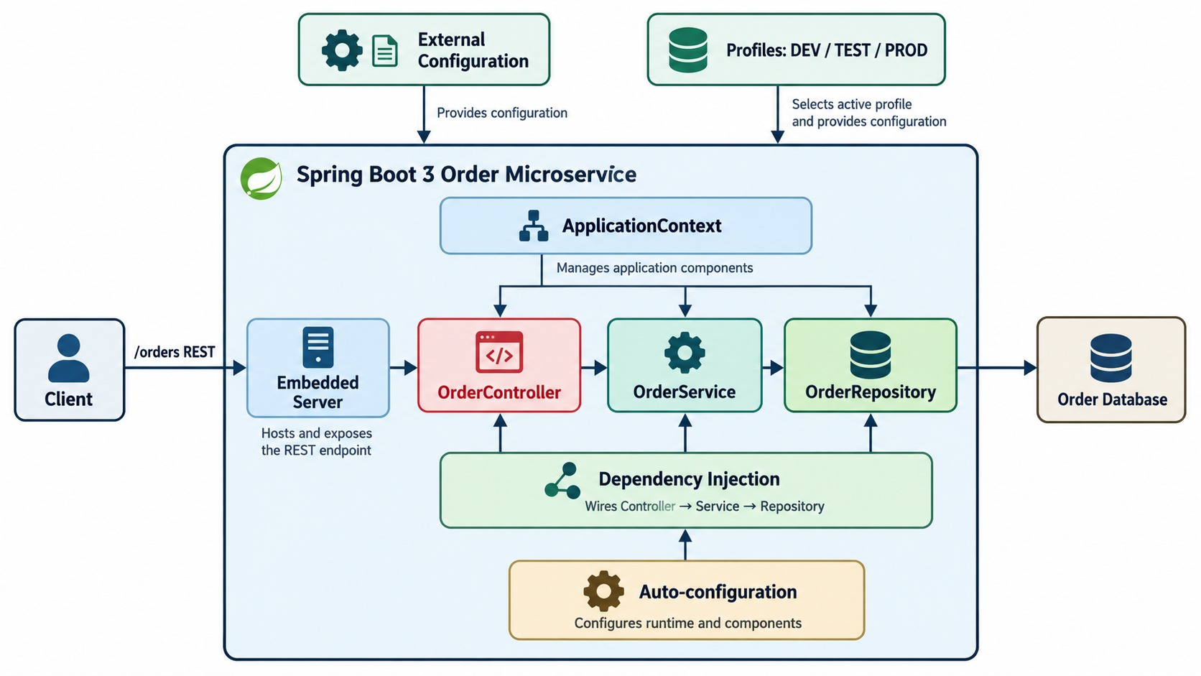
SPRING BOOT MICROSERVICE — END TO END
The layers, plus the runtime mechanisms that make them work.
THE FULL JOURNEY
✓
App starts; configuration loads
✓
Beans are created and injected
✓
Tomcat starts on the port
✓
POST /orders reaches the controller
✓
Service applies rules; repository saves
✓
JSON response returns
COMPARE The layered view showed only the layers. This adds the runtime around them.
KEY TAKEAWAY Spring Boot turns our microservice design into a runnable application.
40
© 2026 by Innovation In Software Corporation
Notes:
KEY TALKING POINTS
------------------
- Startup
Use this slide to rebuild the whole module.
The application starts in main with SpringApplication.run.
Spring loads configuration, and the active environment decides which configuration applies.
- Beans and dependencies
Spring discovers components like OrderController, OrderService and OrderRepository.
It manages them in the ApplicationContext and injects their dependencies.
Then the embedded web server starts listening for HTTP traffic.
- A request arrives
A client sends POST /orders with JSON.
The controller maps the endpoint, accepts the input, triggers validation and hands off the business work.
The OrderService runs the business logic, and the OrderRepository handles persistence.
- The response
The response travels back up through the repository, service and controller.
It reaches the client as JSON.
- Final message
Spring Boot turns our microservice design into a runnable application.
Controllers expose REST APIs, services hold business behavior and repositories handle persistence.
Dependency injection connects them, and external configuration lets the same app run in any environment.
- What comes next
Next we move to production concerns.
These are service-to-service communication, persistence, resilience, observability, containers, CI/CD and OpenShift deployment.
- What it shows
The Order Service layers inside the Spring Boot runtime: ApplicationContext, dependency injection, auto-configuration, the embedded server, external configuration and profiles.
- How it differs from the layered view
The earlier diagram showed only the layers.
This one adds everything Spring Boot does around them.
- Key point
Every mechanism in this picture was one part of the module.

Slide 41
SPRING BOOT MISCONCEPTIONS AND ANTI-PATTERNS
Beliefs and habits that make Spring Boot services hard to run and change.
MISCONCEPTION
REALITY
ANTI-PATTERNS TO AVOID
Spring Boot is magic
It follows conditions you can inspect with --debug
✕
Business logic in controllers
✕
Returning JPA entities from APIs
✕
One giant service class
Boot replaced the Spring Framework
It builds on Spring and configures it for you
✕
Hard-coded URLs and passwords
✕
System.out instead of a logger
✕
Adding starters “just in case”
The defaults are production-ready
Review pools, timeouts, logging and security
REMEMBER Spring Boot speeds up good design — it doesn't create it.
@Autowired fields are fine
Constructor injection is explicit and testable
Profiles are the place for secrets
Secrets come from the platform, not YAML
KEY TAKEAWAY Treat Spring Boot as transparent rules you control — and keep each layer's job clean.
41
© 2026 by Innovation In Software Corporation
Notes:
KEY TALKING POINTS
------------------
- Why this slide
Before the knowledge check, clear away the beliefs that cause most Spring Boot problems in real teams.
- Not magic
Auto-configuration is a set of conditions.
The --debug report shows exactly what was configured and why.
- Defaults
Defaults get a service running, but production needs deliberate pool sizes, timeouts, log levels and security.
- Injection and secrets
Constructor injection makes dependencies visible and testable.
Profiles change configuration, but passwords still come from the platform.
- Anti-patterns
Fat controllers, exposed entities, god services, hard-coded values, System.out and unneeded starters all make a service harder to change.

Slide 42
KNOWLEDGE CHECK
Answer in your own words — then compare with a partner.
What does Spring Boot add to traditional Spring setup?
application.yml vs. application-prod.yml?
1
6
Which layer holds business rules?
Why keep passwords out of config files?
2
7
Why should controllers stay thin?
Which annotation triggers request-body validation?
3
8
What is the repository layer for?
Why centralize exception handling?
4
9
Why prefer constructor injection over field injection?
Why package the service as an executable JAR?
5
10
42
© 2026 by Innovation In Software Corporation
Notes:
KEY TALKING POINTS
------------------
- 1. What Boot adds
Defaults, starters, auto-configuration, an embedded server and production-ready features, with far less manual setup.
- 2. Business rules
The service layer.
- 3. Thin controllers
They handle HTTP only.
Business logic belongs in services, where it's easier to test.
- 4. Repository
Persistence and data access.
- 5. Constructor injection
Dependencies are explicit and final, can't be missing, and tests can pass in mocks.
- 6. Base vs. profile file
application.yml holds shared settings; application-prod.yml overrides them for production.
- 7. Passwords
Files end up in Git and images.
Secrets come from the platform or a secret manager.
- 8. Validation
@Valid on the @RequestBody parameter.
- 9. Central handling
One consistent error format and no duplicated error code in every controller.
- 10. Executable JAR
It runs anywhere with java -jar and its embedded server, and becomes the input to the container image.

Slide 43
EXERCISE 1.3 — SCAFFOLD ACCOUNT ENDPOINTS AND VALIDATION
Module 3 checkpoint C: controllers, DTOs and validation rules.
OFFICIAL CHECKPOINT C
15 MIN
labs/day-01/exercises/exercise-1.3-scaffold-account.md
SCENARIO
YOUR TASKS
EXPECTED OUTCOME
Lab 1 builds the banking Account Service (starter on port 8081). Before coding, map this module to the starter project.
Scope: Account, Transaction and Risk Assessment only — no extra services.
1
Open labs/day-01/lab1/starter; find the controller, service, DTO and validation TODOs
✓
You can point at every starter file Lab 1 completes
✓
Layer names match the lab
2
Name the layers: Controller → Service → Repository → PostgreSQL (Flyway, not Hibernate DDL)
✓
Validation rules are ready to code
List the rules: customerId CUST- plus four digits, nickname length, legal status change; accountId is generated
✓
Don't skip ahead into Lab 2
3
4
Logs: accountId and status only — no bodies or PII. Copilot may explain TODOs; review first
KEY TAKEAWAY You can point at the starter files Lab 1 will complete — without skipping ahead to Lab 2.
43
© 2026 by Innovation In Software Corporation
Notes:
KEY TALKING POINTS
------------------
- Official checkpoint
This is the official OUTLINE.md checkpoint for Module 3.
Use the worksheet in labs/day-01/exercises.
- Starter files
Learners find the TODOs in the controller, service, DTO and validation classes of the Lab 1 starter.
- Layers and rules
The layers match this module, with Flyway managing the schema.
Validation covers the customer ID format, nickname length and legal status changes.
- Logging
Logs use accountId and status only, never request bodies or personal data.

Slide 44
MODULE 3 SUMMARY AND WHAT'S NEXT
From a Spring Boot project to a running, configurable service.
YOU CAN NOW
NEXT: MODULE 4 — MICROSERVICES INTEGRATION
✓
Explain what Spring Boot adds on top of Spring
1
How do services talk without waiting on each other?
✓
Follow startup, auto-configuration and component scanning
2
When do we use queues, pub/sub and events?
✓
Build a thin controller with DTOs, validation and errors
How do we make message consumers reliable?
3
✓
Wire services and repositories with constructor injection
✓
Configure, build and run one JAR in every environment
BRING ALONG Your Lab 1 Account Service, running on port 8081.
KEY TAKEAWAY Module 4 connects services like this one through messaging and events.
44
© 2026 by Innovation In Software Corporation
Notes:
KEY TALKING POINTS
------------------
- Recap
We saw what Spring Boot does, built the Order API layer by layer, and made one JAR run in every environment.
- Next module
Module 4 is about integration: asynchronous messaging, brokers, events and reliable consumers.

