Slide 1
"Sending a message is easy — building a reliable distributed workflow is harder."
MODULE 4
Microservices Integration
Connecting independent services through messaging and events.
Asynchronous communication
Messaging fundamentals
Message brokers
Event-driven architecture
Reliable message processing
Integration pattern selection
SPRING BOOT MICROSERVICES BOOTCAMP • MODULE 4
Notes:
KEY TALKING POINTS
------------------
- Where we are
In Module 2 we designed service boundaries: Order, Payment, Inventory and Shipping.
In Module 3 we built one service with Spring Boot.
Now the question is: how do independently deployed services work together to complete a business process?
- Option one: synchronous REST
Order could call Payment, which calls Inventory, which calls Shipping, all over REST.
But that creates runtime dependencies between them.
- Option two: asynchronous messaging
Order can publish an OrderCreated event to a message broker instead.
Payment, Inventory and Notification each pick it up.
This module focuses mainly on this second approach.

Slide 2
LEARNING OBJECTIVES
Messaging concepts, brokers, events, reliability and integration decisions.
🎯
BY THE END OF THIS MODULE, YOU CAN
🧭
THREE PARTS
1. Explain asynchronous messaging
2. Describe message-broker architecture
3. Compare queues and pub/sub
4. Explain event-driven architecture
5. Distinguish commands and events
6. Compare choreography and orchestration
7. Design reliable consumers
8. Handle retries and failures
9. Select appropriate integration patterns
1
Messaging fundamentals
Producer
Broker
Consumer
2
Event-driven architecture
Business Event
Multiple services react
3
Production reliability
Duplicates
Retries
Failures
Ordering
Schema evolution
Eventual consistency
KEY TAKEAWAY Sending a message is easy — building a reliable distributed business workflow is the real skill.
2
© 2026 by Innovation In Software Corporation
Notes:
KEY TALKING POINTS
------------------
- By the end of this module
Learners should be able to explain asynchronous messaging and message-broker architecture.
They should compare queues and publish/subscribe, and explain event-driven architecture.
They should tell commands from events, and compare choreography with orchestration.
They should design reliable consumers, handle retries and failures, and choose the right integration pattern.
- Three parts
Part one is messaging fundamentals: producer, broker, consumer.
Part two is event-driven architecture: a business event that several services react to.
Part three is production reliability: duplicates, retries, failures, ordering, schema evolution and eventual consistency.
- Why part three matters most
Sending a message is easy.
Building a reliable distributed business workflow is much harder.

Slide 3
KEY TERMS FOR THIS MODULE
Plain definitions for the words we'll use most.
1
Message broker
2
Event
Middleware, such as Kafka, that receives, stores and delivers messages between services.
A record that something already happened, such as OrderCreated.
3
Command
4
Publish/subscribe
A request asking one specific service to do something, such as ReserveStock.
One published message is delivered to every interested subscriber.
5
Choreography
6
Idempotent consumer
Services react to each other's events, with no central coordinator.
A consumer that safely ignores a message it has already processed.
7
Dead-letter topic
8
Transactional outbox
Where messages that keep failing are moved so they don't block the rest.
Saving an event in the same database transaction as the data, then publishing it.
KEY TAKEAWAY Agree on the words first — every later slide builds on them.
3
© 2026 by Innovation In Software Corporation
Notes:
KEY TALKING POINTS
------------------
- How to run this slide
Read each term once and give a quick example from the order platform or the banking lab.
- Message broker
Middleware, such as Kafka, that receives, stores and delivers messages between services.
- Event
A record that something already happened, such as OrderCreated.
- Command
A request asking one specific service to do something, such as ReserveStock.
- Publish/subscribe
One published message is delivered to every interested subscriber.
- Choreography
Services react to each other's events, with no central coordinator.
- Idempotent consumer
A consumer that safely ignores a message it has already processed.
- Dead-letter topic
Where messages that keep failing are moved so they don't block the rest.
- Transactional outbox
Saving an event in the same database transaction as the data, then publishing it.

Slide 4
FULL FORMS USED IN THIS MODULE
Every abbreviation on these slides, spelled out.
API
Application Programming Interface
DLT
Dead-Letter Topic
JSON
JavaScript Object Notation
CDC
Change Data Capture
HTTP
HyperText Transfer Protocol
REST
Representational State Transfer
DB
Database
ID
Identifier
SNS
Simple Notification Service
DLQ
Dead-Letter Queue
JAR
Java ARchive
SQS
Simple Queue Service
KEY TAKEAWAY When an abbreviation isn't clear, the full form is on this slide.
4
© 2026 by Innovation In Software Corporation
Notes:
KEY TALKING POINTS
------------------
- How to run this slide
Don't read every row.
Point out the few this module uses most, and say the full list is here for reference.
- Reference
API is Application Programming Interface; CDC is Change Data Capture; DB is Database; DLQ is Dead-Letter Queue; DLT is Dead-Letter Topic; HTTP is HyperText Transfer Protocol; ID is Identifier; JAR is Java ARchive; JSON is JavaScript Object Notation; REST is Representational State Transfer; SNS is Simple Notification Service; SQS is Simple Queue Service.

Slide 5
FROM MODULE 3 TO MODULE 4
One well-built service is ready — this module makes services work together.
MODULE 3 GAVE US
🧭
OUR PATH THROUGH MODULE 4
1
Why services must integrate
Part 1
✓
A Spring Boot service with a thin REST API
Business rules in the service layer
2
Choose synchronous or asynchronous
Part 1
✓
Configuration outside the JAR
3
Brokers, queues and topics
Part 1
✓
Consistent errors and useful logs
4
Design events, producers and consumers
Part 2
✓
One stateless, runnable JAR
5
Coordinate workflows across services
Part 2
✓
NOW Connect Order to Payment, Inventory and Shipping — and build Lab 2.
6
Survive duplicates, retries and reordering
Part 3
7
Contracts, the outbox and choosing a pattern
Part 3
KEY TAKEAWAY Module 3 built one service; Module 4 makes independent services work together reliably.
5
© 2026 by Innovation In Software Corporation
Notes:
KEY TALKING POINTS
------------------
- Bridge from Module 3
We can now build one clean Spring Boot service.
Real business processes need several services to cooperate.
- What integration adds
Each skill from Module 3 grows into an integration concern: calls become timeouts, logs become correlation IDs, errors become retries and dead letters.
- Two examples
The slides follow an e-commerce order.
Lab 2 builds the banking Transaction Service, which checks Account Service over REST and publishes TransactionSubmitted to Kafka.

Slide 6
PART 1: MESSAGING FUNDAMENTALS
How services talk without waiting on each other.
Part 1
Messaging fundamentals
Part 2
Event-driven architecture
Part 3
Production reliability
SO FAR
NEXT QUESTION
Each service works on its own — how do they work together without becoming tangled?
✓
One Spring Boot service with a clean REST API
✓
Configuration lives outside the JAR
IN THIS PART
Consistent errors and useful logs
1
Why services must integrate
✓
2
Synchronous vs. asynchronous
3
Messaging and its moving parts
4
What a broker adds
5
Exercise: when a service is down
6
Queues vs. publish/subscribe
6
© 2026 by Innovation In Software Corporation
Notes:
KEY TALKING POINTS
------------------
- Why start here
Before designing events, learners need the vocabulary: synchronous, asynchronous, producer, broker, consumer, queue and topic.
- What this part covers
Why integration is needed, the two communication styles, how messaging works, and the difference between queues and publish/subscribe.

Slide 7
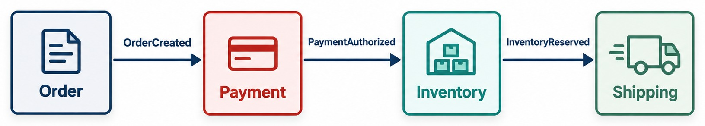
WHY MICROSERVICES NEED INTEGRATION
Independent services still exchange information and coordinate workflows.
ONE ORDER MAY NEED
WHAT MAKES IT HARD
DON'T COLLAPSE IT Moving it all back into Order Service erases the boundaries.
✓
Payment authorization
!
Latency and timeouts
✓
Inventory reservation
!
A service that's down
✓
Shipping
!
Duplicate messages
✓
Customer notification
!
Changing contracts
KEY TAKEAWAY Real business processes span services — so services must integrate through well-defined mechanisms.
7
© 2026 by Innovation In Software Corporation
Notes:
KEY TALKING POINTS
------------------
- Real processes cross services
Microservices own separate business capabilities.
But most real business operations span several of them.
- Placing an order
The Order Service can create an order.
But finishing the process may need payment authorization, inventory reservation and shipping.
It may also need a customer notification and analytics updates.
- Don't collapse the boundaries
We do not want to put all of this back into the Order Service, because then we lose our service boundaries.
Instead, services integrate through well-defined communication mechanisms.
- The design challenge
Keep services autonomous, while still letting them collaborate.
- What it shows
Four independent services that still form one business workflow, linked by the events between them.
- Key point
Independent capabilities still have to collaborate to finish one order.
- What makes it hard
Every integration faces latency, services that are unavailable, duplicate messages and contracts that change.
The rest of the module answers each of these.

Slide 8
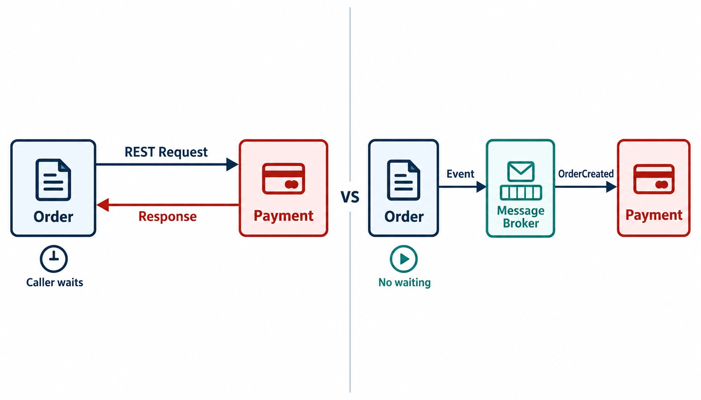
SYNCHRONOUS VS. ASYNCHRONOUS COMMUNICATION
Request and response compared with message- and event-based communication.
Use synchronous when
The caller needs an answer now — for example, checking stock before accepting an order.
Use asynchronous when
Work can finish later or many services react — for example, the confirmation email.
IF YOU CALL SYNCHRONOUSLY
✓
Set a timeout on every call
✓
Avoid long call chains
DECIDE BY the business interaction, not the technology.
KEY TAKEAWAY Synchronous means request, wait, response; asynchronous means produce and continue.
8
© 2026 by Innovation In Software Corporation
Notes:
KEY TALKING POINTS
------------------
- Synchronous
With synchronous communication, the caller waits.
The Order Service asks the Payment Service: can you process this payment?
Payment answers right away with success or failure.
The pattern is request, wait, response.
- Asynchronous
With asynchronous communication, the Order Service sends or publishes information and carries on.
For example, it publishes OrderCreated, and the Payment Service consumes it later.
The pattern is produce, continue, and the consumer processes it in its own time.
- Neither is always better
The business interaction decides which model is appropriate.
- What it shows
On the left, Order sends a REST request to Payment and waits for the response.
On the right, Order publishes an event to a broker and doesn't wait.
- How to read it
Look at the icons under Order: caller waits on the left, no waiting on the right.
- Key point
The difference is whether the caller waits for the other service.
- Chained calls
If Order calls Payment, which calls Fraud, which calls a bank, the slowest or least available service sets the pace for all of them.

Slide 9
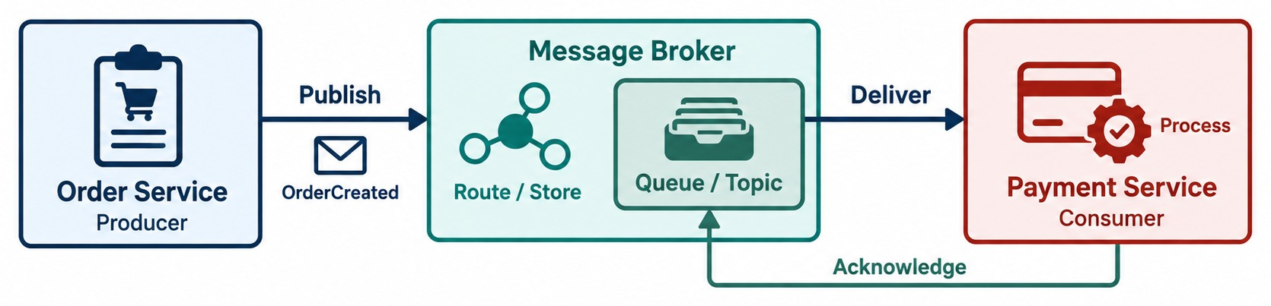
MESSAGING: THE PARTS AND THE LIFECYCLE
Producer, message, broker, destination and consumer — from publish to acknowledge.
Producer
Message
Broker and destination
Consumer
Acknowledge
Creates and sends the message — Order Service.
The information — OrderCreated for order 1001.
Kafka, RabbitMQ or a cloud service; a queue or a topic.
Receives and processes it — Payment Service.
Records success. No acknowledgment means redelivery.
KEY TAKEAWAY A broker sits between producers and consumers, so they don't need point-to-point knowledge of each other.
9
© 2026 by Innovation In Software Corporation
Notes:
KEY TALKING POINTS
------------------
- Produce and send
First, the Order Service creates a message.
Then it sends or publishes it to a broker destination.
Depending on the technology, that could be a queue, a topic, an exchange or a Kafka topic.
- The broker handles it
Depending on the broker and its configuration, it may persist, route, buffer, deliver or redeliver the message.
- Process and acknowledge
The consumer performs the business operation.
Then an acknowledgment or offset records the progress.
Different technologies track success differently.
This is how the system decides whether to deliver a message again or treat it as processed.
- What it shows
Order Service publishes OrderCreated to a broker.
The broker routes or stores it in a queue or topic and delivers it to Payment Service.
- How to read it
Follow publish, route and store, deliver, process, then the acknowledge arrow back to the broker.
- Key point
The acknowledgment tells the broker the message is done.
Without it, the message comes back.
- Producer
The producer creates and sends a message.
In our example, that is the Order Service.
- Message
The message holds the information being communicated.
For example: OrderCreated, order ID 1001, customer ID 500.
- Broker
The broker is infrastructure that accepts messages, and routes or stores them according to its model and configuration.
Examples are Apache Kafka, RabbitMQ and cloud-managed messaging systems.
- Destination and consumer
The destination is where the message goes, such as a queue or a topic.
The consumer receives and processes messages, for example the Inventory Service.
- Why a broker
The broker sits in the middle, so producers do not always need direct point-to-point knowledge of consumers.

Slide 10
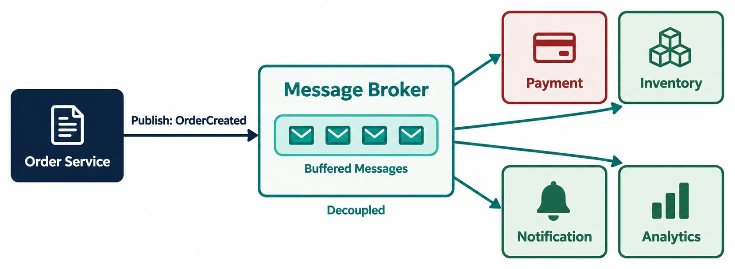
MESSAGE BROKERS IN MICROSERVICES
Routing, buffering, decoupling and delivery.
WHAT A BROKER PROVIDES
Routing
Buffering
Durability
Redelivery
Load distribution
Decoupling
Common brokers
Apache Kafka, RabbitMQ, ActiveMQ, Amazon SQS and SNS, Azure Service Bus, Google Pub/Sub.
BUFFERING Inventory down? Messages wait. An HTTP caller would fail now.
KEY TAKEAWAY A broker lets Order publish once, while consumers receive and process independently.
10
© 2026 by Innovation In Software Corporation
Notes:
KEY TALKING POINTS
------------------
- Without a broker
Without a broker, the Order Service talks directly to Payment, Inventory, Notification and Analytics.
It must know about and call every one of them.
- With a broker
With a broker, the Order Service publishes one event and does not call every consumer directly.
This reduces certain kinds of coupling.
- What a broker provides
Brokers can provide routing, buffering, decoupling and delivery.
They can also provide durability, retry or redelivery, and load distribution.
- Buffering in practice
Suppose the Inventory Service stops for a while.
Depending on the broker and configuration, messages can stay in the broker.
When Inventory comes back, it continues processing.
With a synchronous HTTP call, the caller would hit the unavailable service immediately.
- What it shows
Order Service publishes once.
The broker buffers the messages and delivers them to Payment, Inventory, Notification and Analytics.
- Key point
The broker decouples Order from every consumer, and buffers work when a consumer is busy or down.

Slide 11
EXERCISE: WHEN NOTIFICATION IS DOWN
Compare a REST call and an event when one service fails.
PRACTICE EXERCISE
10 MIN
SCENARIO
YOUR TASKS
EXPECTED OUTCOME
Notification Service is down for 10 minutes during a sale.
Version A: after saving, Order calls POST /notifications over REST.
Version B: after saving, Order publishes OrderCreated; Notification consumes it.
1
Trace one order through A and B while Notification is down
✓
A: the call times out — fail the order or skip the email
2
Say what the customer sees in each version
✓
A: an error, or a missing email
3
Say what happens when Notification comes back
B: the order succeeds; the event waits in the broker
✓
✓
B: Notification catches up when it recovers
✓
B still needs idempotency and lag monitoring
KEY TAKEAWAY A broker turns a failing dependency into delayed work instead of a failed order.
11
© 2026 by Innovation In Software Corporation
Notes:
KEY TALKING POINTS
------------------
- Version A
The REST call blocks until it times out.
Order must either fail the customer's order or skip the email and lose it.
- Version B
Order saves and publishes, and the customer gets a confirmation.
The event waits in the broker until Notification is back.
- The catch
When Notification recovers it may see some events again, so it must be idempotent.
Someone should also watch how far behind it is.

Slide 12
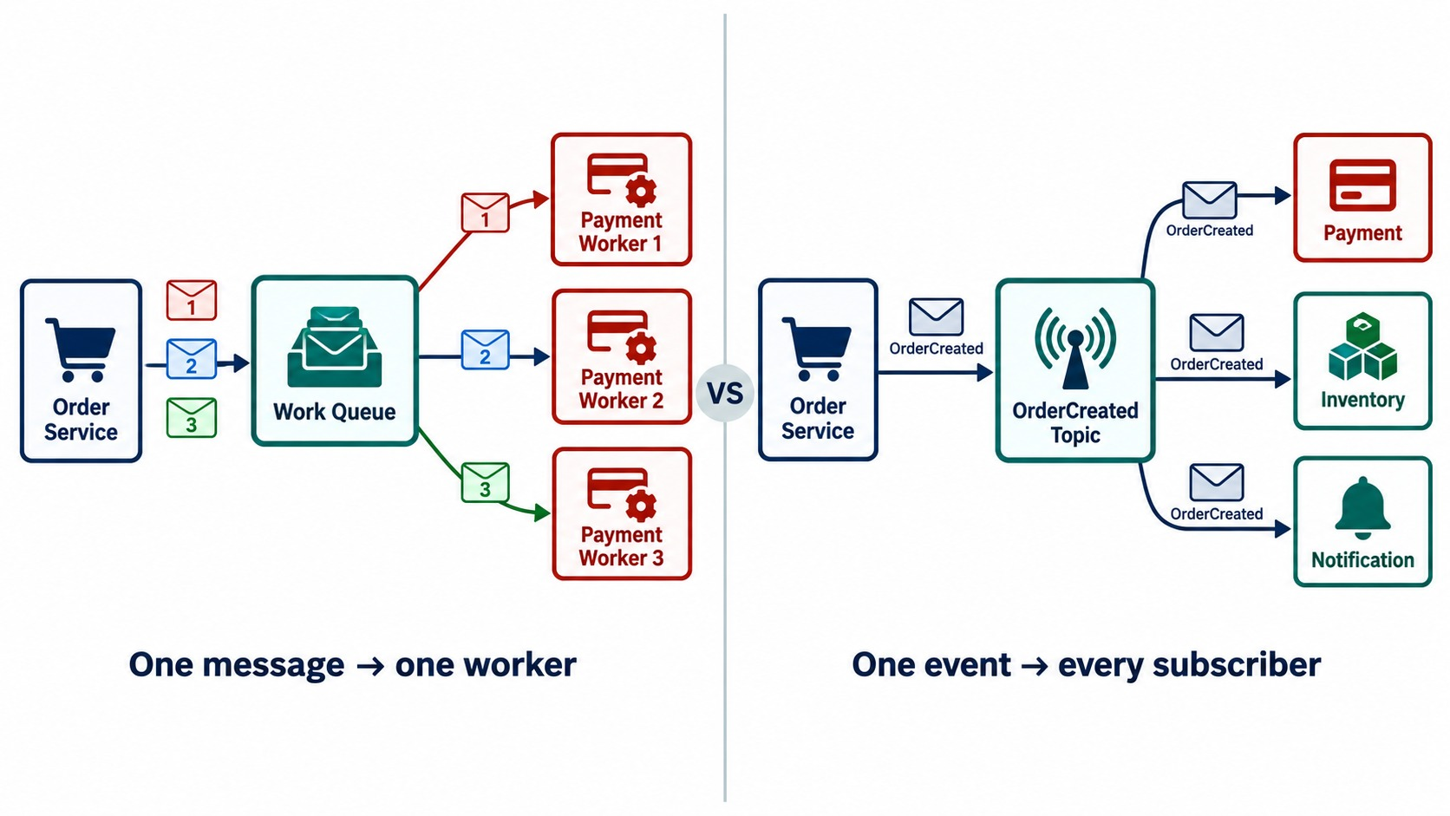
QUEUE VS. PUBLISH/SUBSCRIBE
Competing consumers versus multiple independent subscribers.
Queue — work distribution
GenerateInvoice jobs shared across workers. Add workers to go faster.
Topic — event distribution
OrderCreated to every subscriber. Add subscribers without touching Order.
Kafka consumer groups
Instances in one group share the work; each group gets every event.
TECHNOLOGIES DIFFER Kafka: topics and groups. RabbitMQ: exchanges and queues.
KEY TAKEAWAY Queues distribute work to one consumer; pub/sub distributes events to many — and technologies differ.
12
© 2026 by Innovation In Software Corporation
Notes:
KEY TALKING POINTS
------------------
- Different problems
Queues and publish/subscribe solve different problems.
- Queue, or competing consumers
Suppose we have a GenerateInvoice job and three worker instances.
Typically, only one worker processes a particular queued job.
This is useful for work distribution.
- Publish/subscribe
Suppose we publish OrderCreated.
Payment, Inventory, Notification and Analytics may all need it, and each has its own reason to react.
This is useful for event distribution.
- A word of caution
Do not imply that every messaging technology implements these patterns in the same way.
- What it shows
On the left, a work queue gives each message to one of three payment workers.
On the right, a topic gives the same OrderCreated event to every subscriber.
- Key point
Queues share work.
Topics share events.
- Consumer groups
In Kafka, three instances of Notification Service in one group split the events between them.
Audit Service, in its own group, still receives every event.

Slide 13
PART 2: EVENT-DRIVEN ARCHITECTURE
From sending messages to designing around business events.
✓ Part 1
Messaging fundamentals
Part 2
Event-driven architecture
Part 3
Production reliability
SO FAR
NEXT QUESTION
How do we design a system around business events — and who controls the workflow?
✓
Sync waits; async produces and continues
✓
A broker routes, buffers and redelivers
IN THIS PART
✓
Queues share work; topics share events
Business events and event-driven architecture
1
2
Commands, events and messages
3
An event-driven order, step by step
4
Producers and consumers — with Kafka code
5
Choreography, and when to orchestrate
6
Exercise: command or event?
13
© 2026 by Innovation In Software Corporation
Notes:
KEY TALKING POINTS
------------------
- From plumbing to design
Part 1 was about how messages move.
Part 2 is about what the messages mean and how a workflow is built from them.
- Key question
Who controls a workflow that spans services: nobody, with choreography, or one coordinator, with orchestration?

Slide 14
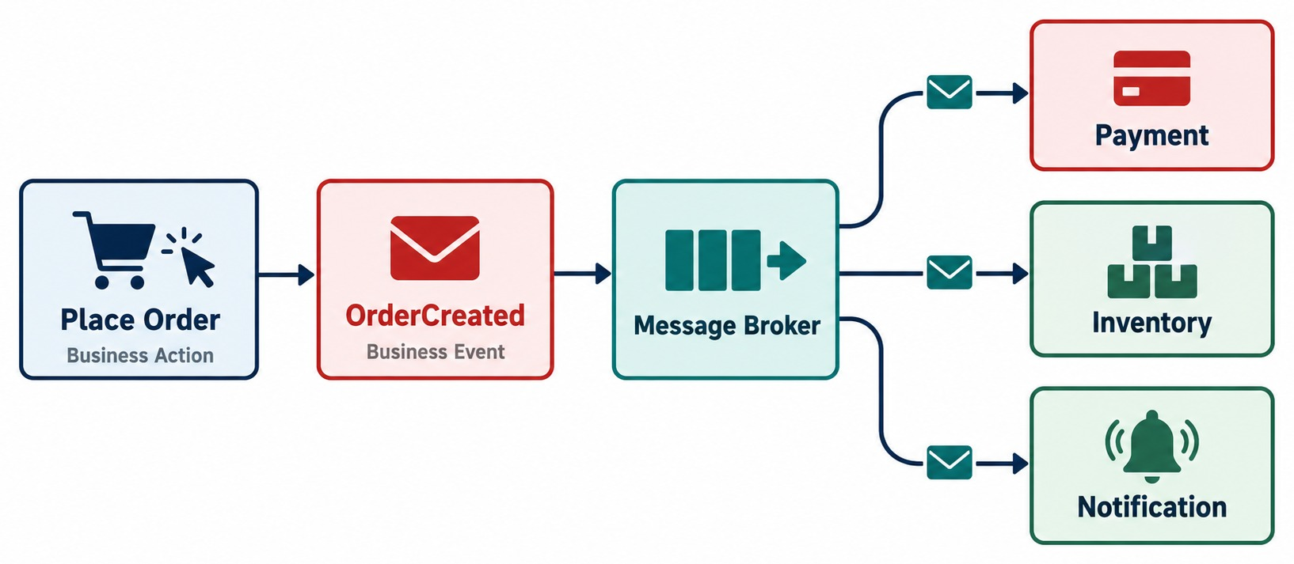
INTRODUCTION TO EVENT-DRIVEN ARCHITECTURE
Services react to business events instead of relying only on direct calls.
FACTS, IN THE PAST TENSE
OrderCreated
PaymentAuthorized
PaymentFailed
InventoryReserved
OrderCancelled
ShipmentCreated
AVOID
✕
DataChanged — too vague
✕
PostPayment — sounds like a command
CONSUMERS DECIDE how — and whether — to react.
KEY TAKEAWAY An event is a fact that already happened — consumers choose how to react to it.
14
© 2026 by Innovation In Software Corporation
Notes:
KEY TALKING POINTS
------------------
- What an event is
An event represents something meaningful that has already happened.
A business action, like creating an order, produces a business event: OrderCreated.
- Past-tense names
Examples are OrderCreated, PaymentAuthorized, PaymentFailed, InventoryReserved, OrderCancelled and ShipmentCreated.
Events are usually named in the past tense because they are facts.
OrderCreated simply means an order has been created.
- Consumers decide
Consumers react to that fact.
The producer does not tell each consumer what to do.
That is the key difference between event notification and tightly controlled service calls.
- What it shows
A customer places an order, which produces the OrderCreated event.
The broker delivers it to Payment, Inventory and Notification.
- Key point
The event describes what happened.
Each service decides how to react.

Slide 15
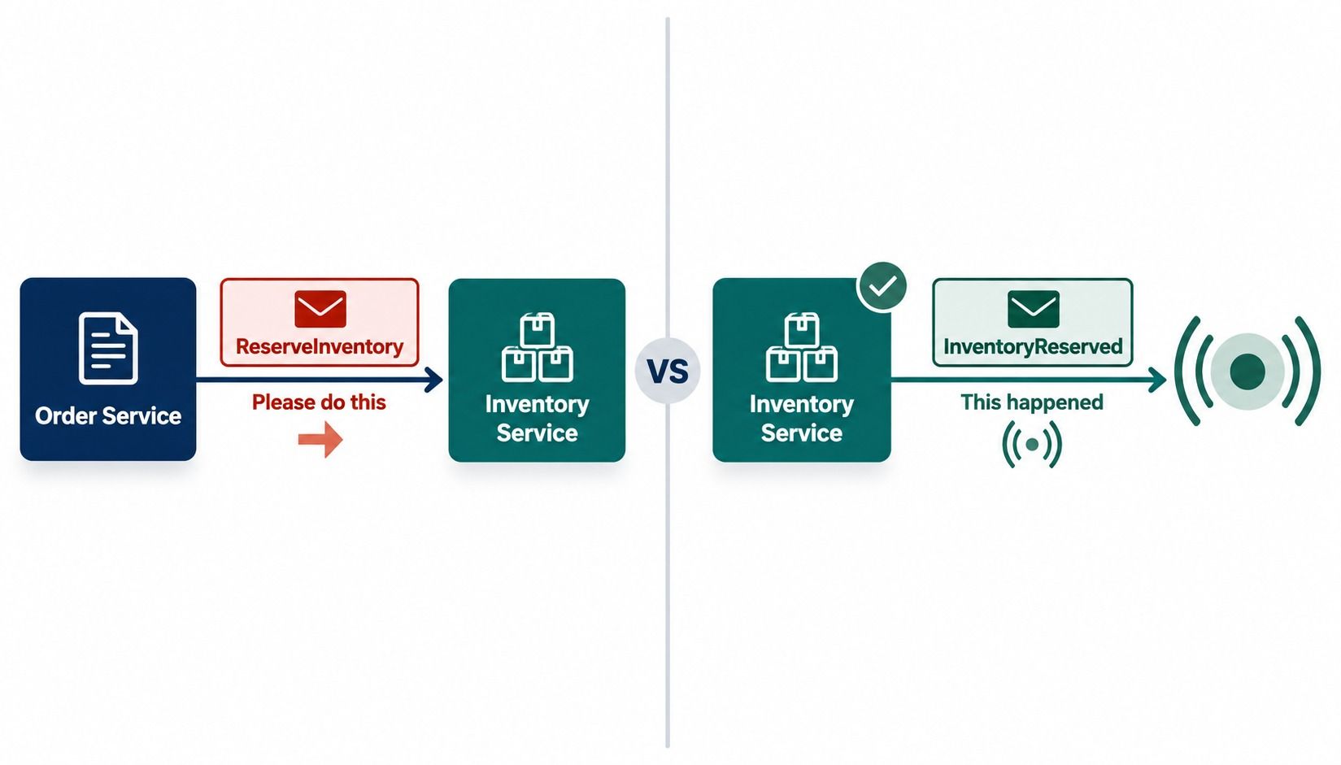
COMMANDS, EVENTS, AND MESSAGES
Intent versus facts — and the envelope that carries them.
Command
ProcessPayment, ReserveInventory, ShipOrder. Intent; usually one handler; it can be refused.
Event
PaymentProcessed, InventoryReserved, OrderShipped. A fact; many may care; never changed.
Notification
Informs or alerts; no action is required.
MESSAGE the envelope that carries any of them.
KEY TAKEAWAY Commands ask for action, events report facts, and messages carry either one.
15
© 2026 by Innovation In Software Corporation
Notes:
KEY TALKING POINTS
------------------
- People mix these up
Learners often use command, event and message as if they mean the same thing.
Explain the difference.
- Command
A command asks for an action.
ReserveInventory means: please reserve this inventory.
There is usually one intended handler.
- Event
An event reports a fact.
InventoryReserved means: inventory has been reserved.
Many services may care about it.
- Message
A message is the broader transport idea.
A command or an event can be carried as a message.
- Why it matters
This distinction helps architects think about intent and coupling, not just Kafka topics or RabbitMQ queues.
- What it shows
On the left, Order sends the ReserveInventory command to Inventory.
On the right, Inventory announces InventoryReserved to anyone listening.
- Key point
A command asks one service to act.
An event reports a fact that many services may care about.
- Notifications
A third kind of message only informs, like a status alert to a user interface.
Nobody has to act on it.

Slide 16
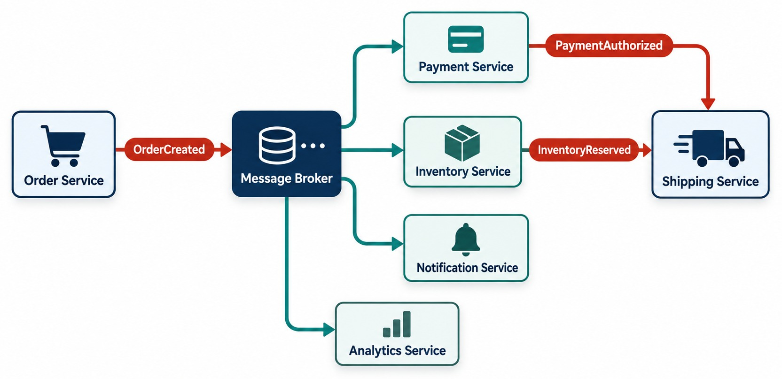
EVENT-DRIVEN ORDER PROCESSING EXAMPLE
OrderCreated → Payment, Inventory and Notification → Shipping.
WALK THROUGH ONE ORDER
✓
POST /orders creates the order
✓
Order publishes OrderCreated
✓
Payment, Inventory and Notification react
✓
They publish PaymentAuthorized and InventoryReserved
✓
Shipping starts when both have arrived
CAUTION Publishing events doesn't make the workflow correct by itself.
KEY TAKEAWAY Business rules define the workflow — events carry it from one service to the next.
16
© 2026 by Innovation In Software Corporation
Notes:
KEY TALKING POINTS
------------------
- Walk through one order
The customer submits POST /orders.
The Order Service creates the order and publishes OrderCreated.
- Consumers react
The Payment Service processes the payment.
The Inventory Service handles inventory.
The Notification Service may send a confirmation.
- New events
Next come events like PaymentAuthorized and InventoryReserved.
Shipping can begin once its required business conditions are met.
- An important caution
The exact workflow depends on business rules.
Publishing events does not automatically coordinate a correct transaction.
- What it shows
OrderCreated reaches Payment, Inventory, Notification and Analytics.
Payment and Inventory then publish their own events, which Shipping waits for.
- Key point
One business action starts a chain of events across several services.

Slide 17
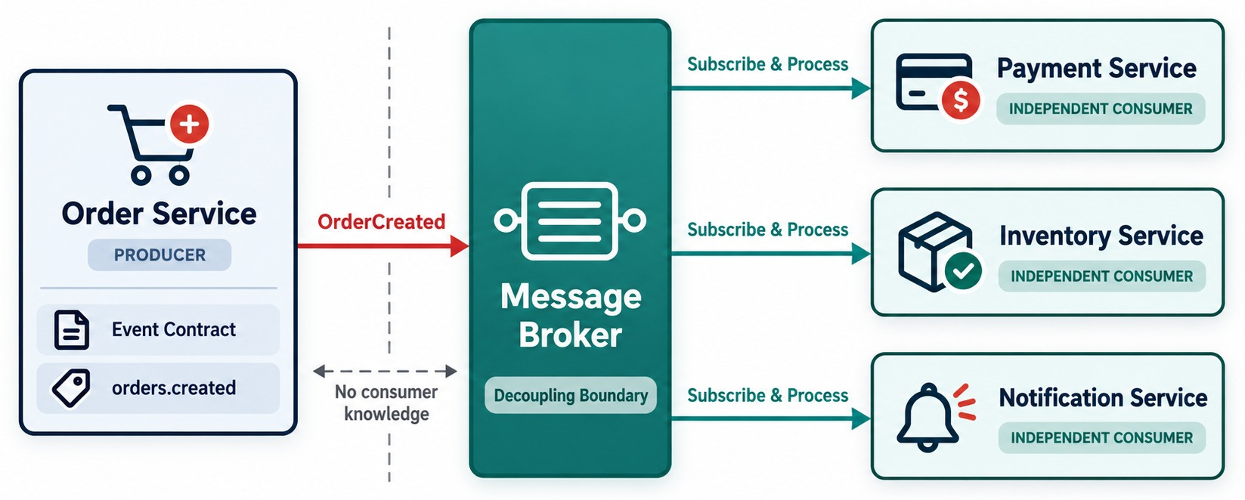
EVENT PRODUCER AND CONSUMER DESIGN
Clear responsibilities — and no unnecessary knowledge of each other.
✕
Avoid in Order Service
if (inventoryServiceExists) ...
if (analyticsServiceExists) ...
Extensibility
Add Analytics as a new subscriber — no change to Order Service.
NOT ZERO COUPLING Everyone still depends on the event contract.
KEY TAKEAWAY Producers publish facts and move on; consumers decide for themselves whether to react.
17
© 2026 by Innovation In Software Corporation
Notes:
KEY TALKING POINTS
------------------
- Disciplined producers and consumers
Good event-driven architecture needs disciplined producers and consumers.
Each side owns its own logic, with the broker between them.
- Producers don't track consumers
When the Order Service publishes OrderCreated, it should not contain code that checks whether Inventory, Analytics or Notification exist.
Those consumers decide for themselves whether they care about OrderCreated.
- Consumer extensibility
Later, an Analytics Service can subscribe without anyone changing the Order Service just to call it.
This is called consumer extensibility.
- Not zero coupling
Services are still coupled to the event contract.
Event-driven does not mean zero coupling.
- What it shows
Order Service knows only the event contract and the orders.created destination.
The dashed line marks that it has no knowledge of consumers.
- Key point
Consumers subscribe and process independently, so new ones can be added without changing the producer.

Slide 18
PRODUCING AND CONSUMING WITH SPRING FOR APACHE KAFKA
KafkaTemplate publishes; @KafkaListener consumes.
Order Service — producer
✓
Payment Service — consumer
@Service
public class OrderService {
private final KafkaTemplate<String, OrderCreated> kafka;
public OrderResponse place(CreateOrderRequest req) {
Order order = orders.save(Order.from(req));
kafka.send("orders.created",
order.getId().toString(), OrderCreated.from(order));
return OrderResponse.from(order);
}
}
@Component
public class OrderCreatedListener {
@KafkaListener(topics = "orders.created",
groupId = "payment-service")
public void on(OrderCreated event) {
payments.authorize(event.orderId(), event.total());
}
}
Key = orderId
groupId
GAP Saved but not sent? The outbox in Part 3 fixes it.
Events for one order land in one partition, in order.
Payment instances share the work; other groups get every event.
KEY TAKEAWAY Publish the event after the business change, keyed by the entity — consumers subscribe by topic and group.
18
© 2026 by Innovation In Software Corporation
Notes:
KEY TALKING POINTS
------------------
- The producer
Order Service saves the order, then sends OrderCreated to the orders.created topic.
The order ID is the message key.
- Why the key matters
Kafka sends messages with the same key to the same partition, so all events for one order stay in order.
- The consumer
@KafkaListener subscribes to the topic in the payment-service group.
Extra instances in that group share partitions; other groups still get every event.
- Configuration
spring.kafka.bootstrap-servers and the JSON serializers come from application.yml, with the broker address supplied per environment.
- The gap
If the save succeeds and the send fails, the event is lost.
We solve that with the transactional outbox in Part 3.

Slide 19
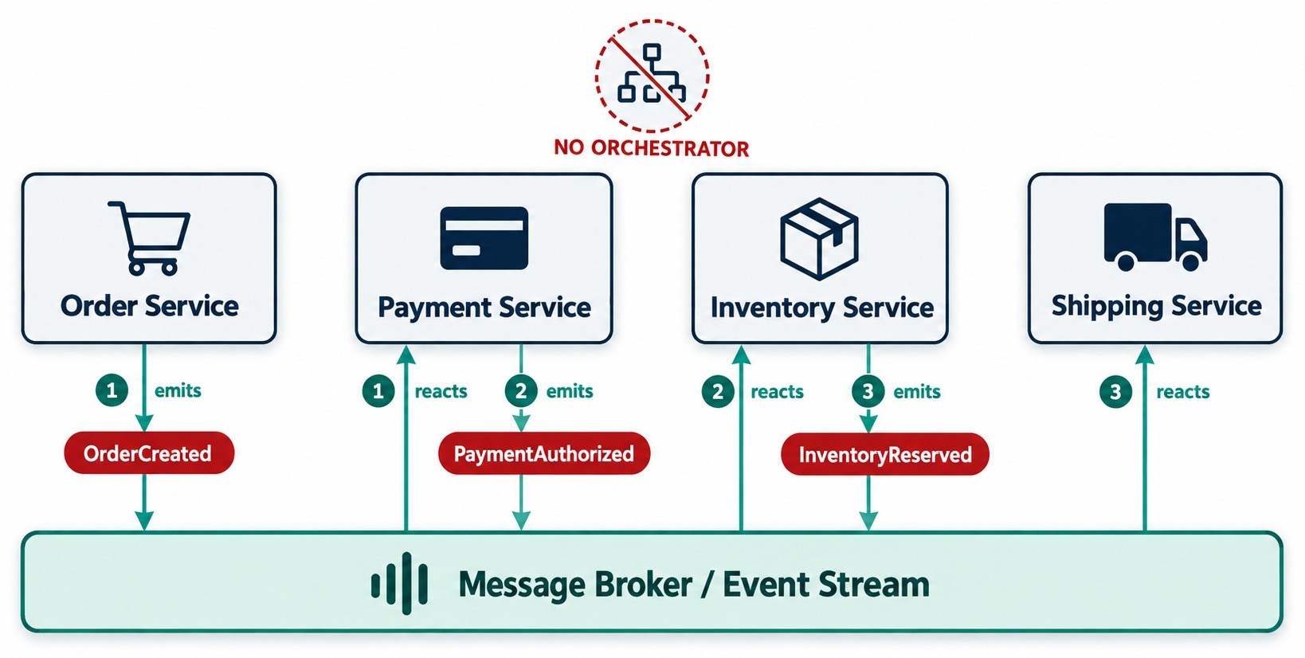
EVENT CHOREOGRAPHY
Services react to events without a central workflow controller.
BENEFITS
✓
Decentralized
✓
Services stay autonomous
✓
No central workflow dependency
CHALLENGES
✕
The whole flow is hard to see
✕
Troubleshooting takes longer
✕
Long event chains get fragile
LIKE A DANCE each service responds to the others' signals.
KEY TAKEAWAY In choreography, each service reacts and publishes the next event — nobody controls the whole flow.
19
© 2026 by Innovation In Software Corporation
Notes:
KEY TALKING POINTS
------------------
- How choreography works
In choreography, services react to events and publish new events.
No single central component commands every step.
- Think of a dance
Each participant knows how to respond to signals from the others.
Order publishes OrderCreated, and Payment reacts.
Payment publishes PaymentAuthorized, and Inventory reacts.
Inventory publishes InventoryReserved, and Shipping reacts.
- Benefits
It is decentralized and gives services autonomy.
It also reduces dependence on one central workflow component.
- Challenges
The workflow is harder to see, and troubleshooting can be harder.
The business flow gets spread across many services, and event chains can become hard to manage.
- What it shows
Order emits OrderCreated, Payment reacts and emits PaymentAuthorized, Inventory reacts and emits InventoryReserved, and Shipping reacts.
- How to read it
Follow the numbers: each service reacts to one event and emits the next.
The crossed-out icon means there is no central controller.
- Key point
The workflow emerges from the events rather than from one coordinating service.

Slide 20
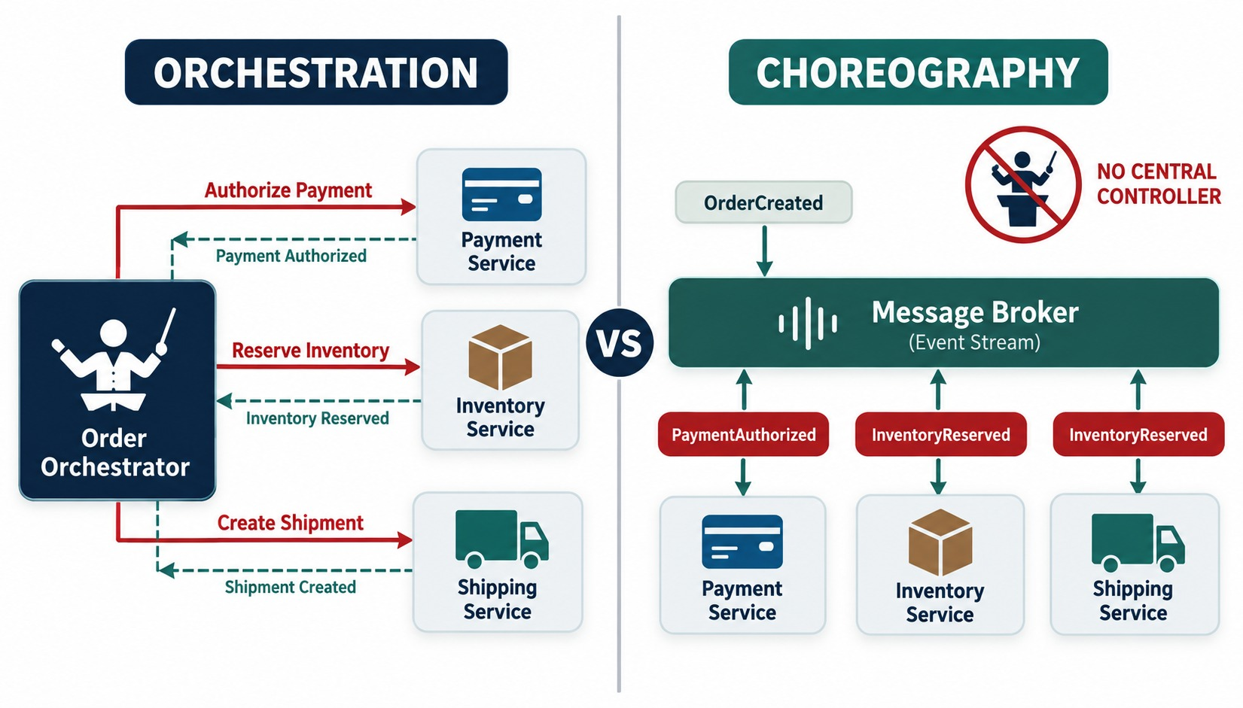
ORCHESTRATION OR CHOREOGRAPHY: HOW TO CHOOSE
A central coordinator versus a decentralized event-driven workflow.
Choose orchestration when
Many steps, branching decisions, compensation, and a need to see the whole flow in one place.
Choose choreography when
Few steps, independent reactions, and teams that must evolve separately.
MIX THEM Orchestrate the core order saga; choreograph side reactions like email and analytics.
KEY TAKEAWAY Neither is universally better — choose by workflow complexity and organizational needs.
20
© 2026 by Innovation In Software Corporation
Notes:
KEY TALKING POINTS
------------------
- Orchestration
A central coordinator manages the workflow.
Conceptually, it calls Payment, waits, calls Inventory, waits, then calls Shipping.
The orchestrator knows the whole process.
- Orchestration trade-offs
The workflow is explicit and easier to picture in one place, with decision logic centralized.
But the coordinator becomes important infrastructure and business logic.
Poor design can over-centralize the services.
- Choreography trade-offs
Services react to events, which is more decentralized and can reduce direct dependencies.
But complex workflows can become hard to understand.
- How to choose
The right choice depends on how complex the workflow is and what the organization needs.
- What it shows
On the left, an Order Orchestrator tells Payment, Inventory and Shipping what to do and hears back from each.
On the right, services react to events on a shared broker.
- Key point
Orchestration puts the workflow in one place; choreography spreads it across services.
- Building on Module 2
Module 2 introduced both styles.
Here the question is how to choose, and most real systems mix them.

Slide 21
EXERCISE: COMMAND OR EVENT?
Sort message names from a design review — and fix the weak ones.
PRACTICE EXERCISE
10 MIN
SCENARIO
YOUR TASKS
EXPECTED OUTCOME
The team proposed these message names:
1
Label each one a command or an event
✓
Commands: ChargeCard, SendWelcomeEmail, ReserveStock
ChargeCard
CardCharged
SendWelcomeEmail
AccountOpened
ReserveStock
StockReserved
DataChanged
OrderShipped
2
For two events, name the services that might react
✓
Events: CardCharged, AccountOpened, StockReserved, OrderShipped
3
Rename anything vague — and say what's wrong with it
AccountOpened → Notification, Analytics
✓
✓
DataChanged is vague → CustomerAddressChanged
KEY TAKEAWAY Commands are imperative requests to one handler; events are specific past-tense facts for anyone.
21
© 2026 by Innovation In Software Corporation
Notes:
KEY TALKING POINTS
------------------
- Commands
ChargeCard, SendWelcomeEmail and ReserveStock ask one service to do something, so they are commands.
- Events
CardCharged, AccountOpened, StockReserved and OrderShipped report facts in the past tense.
- DataChanged
It says nothing about which business fact happened.
A specific name like CustomerAddressChanged lets consumers decide whether they care.
- Consumers
AccountOpened might go to Notification for a welcome email and to Analytics.
OrderShipped might go to Notification and Loyalty.

Slide 22
PART 3: PRODUCTION RELIABILITY
Sending a message is easy; processing it correctly under failure is the real work.
✓ Part 1
Messaging fundamentals
✓ Part 2
Event-driven architecture
Part 3
Production reliability
SO FAR
NEXT QUESTION
Messages get lost, duplicated, delayed and reordered — how do we stay correct?
✓
Events are past-tense business facts
✓
Producers publish; consumers subscribe independently
IN THIS PART
Choreography or orchestration, chosen per workflow
1
Delivery guarantees
✓
2
Idempotent consumers, retries and dead letters
3
Exercise 2.3: idempotency and DLT
4
Eventual consistency and the outbox
5
Event contracts and Exercise 2.2
6
Kafka vs. RabbitMQ, choosing, the full picture
22
© 2026 by Innovation In Software Corporation
Notes:
KEY TALKING POINTS
------------------
- Why this part
Every failure mode here happens in production: lost messages, duplicates, retries that never stop, and events that arrive out of order.
- How it connects to the lab
Lab 2 uses exactly these techniques: a processed_events table, a dead-letter topic and a correlation ID on every event.

Slide 23
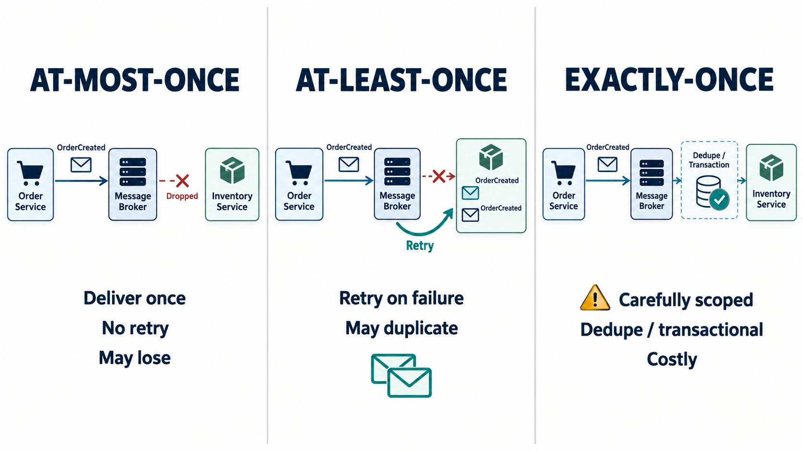
MESSAGE DELIVERY SEMANTICS
At-most-once, at-least-once — and what “exactly-once” really claims.
At-most-once
No duplicates, but messages may be lost. Fine for metrics — never for payments.
At-least-once
Nothing lost, but duplicates happen. The usual choice for orders and payments.
Exactly-once
Scoped to the broker, such as Kafka transactions — not to emails or external APIs.
ASK Exactly once where — and under what failure?
KEY TAKEAWAY At-least-once delivery is common — so consumers must be ready for duplicates.
23
© 2026 by Innovation In Software Corporation
Notes:
KEY TALKING POINTS
------------------
- A critical production idea
Delivery semantics describe how many times a message may be delivered.
- At-most-once
A message is not intentionally redelivered after uncertain processing.
So a message can be lost, but the delivery approach avoids duplicates.
- At-least-once
The infrastructure tries hard to make sure the message is processed, which can mean redelivery.
So a message may be delivered twice.
Consumers therefore need duplicate-safe behavior.
- Exactly-once
Be careful with this term.
Some platforms offer exactly-once capabilities within specific boundaries.
But exactly-once business effects across databases, external APIs and distributed systems need careful design.
Always ask: exactly once where, and under what failure model?
- What it shows
Three flows.
At-most-once drops a message and never retries.
At-least-once retries and may deliver twice.
Exactly-once needs deduplication or transactions.
- Key point
Every guarantee is a trade-off between loss, duplicates and cost.
- Why duplicates happen
A consumer processes a message, then crashes or times out before the acknowledgment reaches the broker.
The broker delivers it again.

Slide 24
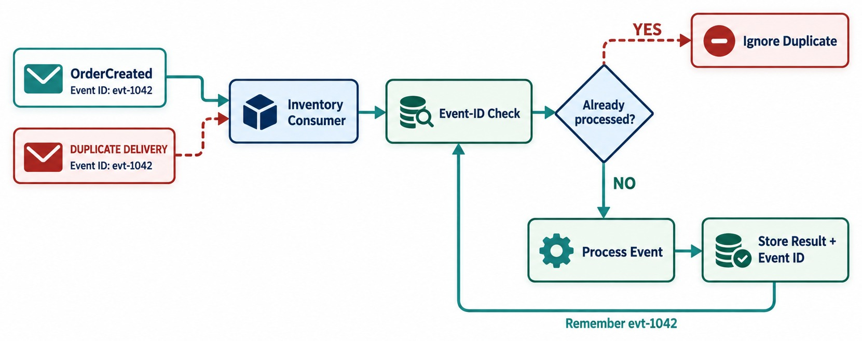
IDEMPOTENT MESSAGE CONSUMERS
Handle duplicate delivery without duplicating the business effect.
✕
Not idempotent
balance = balance.add(event.amount());
TECHNIQUES
Processed event IDs
Unique business keys
Upserts
State checks
DB constraints
RULE A redelivered payment must never charge twice.
KEY TAKEAWAY A redelivered payment message must never charge the customer twice.
24
© 2026 by Innovation In Software Corporation
Notes:
KEY TALKING POINTS
------------------
- What idempotency means
Idempotency means that repeating the same logical operation does not create an extra business effect.
- The payment problem
Payment is a great example.
Take order 1001 for 200 dollars.
A consumer processes the payment, then crashes before it records or confirms that the message is done.
The broker may deliver the message again.
Without protection, the customer could be charged 200 dollars twice.
- The idempotent design
The good design checks: have we already processed event E100?
If yes, ignore it.
If no, process it once.
- Techniques
You can use idempotency keys or stored processed event IDs.
You can also use unique business constraints, transactional techniques, or carefully designed upserts and state transitions.
This is one of the most important ideas in reliable messaging.
- What it shows
OrderCreated arrives twice with the same event ID.
The consumer checks whether it already processed that ID.
- How to read it
Yes means ignore the duplicate.
No means process the event and store the result together with the event ID.
- Key point
Remembering processed IDs turns at-least-once delivery into a correct, once-only effect.

Slide 25
AN IDEMPOTENT CONSUMER IN CODE
Remember every processed event ID in the same transaction as the business change.
✓
PaymentListener.java
processed_events table
@KafkaListener(topics = "orders.created",
groupId = "payment-service")
@Transactional
public void on(OrderCreated event) {
if (processed.existsById(event.eventId())) {
log.info("Duplicate ignored eventId={}", event.eventId());
return;
}
payments.record(event.orderId(), event.total());
processed.save(new ProcessedEvent(event.eventId()));
}
CREATE TABLE processed_events (
event_id VARCHAR(64) PRIMARY KEY,
processed_at TIMESTAMP NOT NULL
DEFAULT CURRENT_TIMESTAMP
);
-- The primary key rejects a second insert,
-- even when two consumers race.
One transaction
Primary key
Lab 2
The payment row and the processed ID commit together.
The database enforces “once”, even under a race.
processed_events keyed by event_id — the same pattern.
KEY TAKEAWAY Check, act and record the event ID in one transaction — duplicates then become harmless no-ops.
25
© 2026 by Innovation In Software Corporation
Notes:
KEY TALKING POINTS
------------------
- The check
Before doing anything, the listener looks up the event ID.
If it was already processed, it logs and returns.
- Act and record
The payment record and the processed event row are saved in the same transaction, so either both exist or neither does.
- Races
If two instances handle the same event at once, the primary key makes one insert fail.
That transaction rolls back, and on redelivery the check finds the ID.
- External calls
This protects database changes.
Calls to outside systems, like a card network, also need an idempotency key on that call.

Slide 26
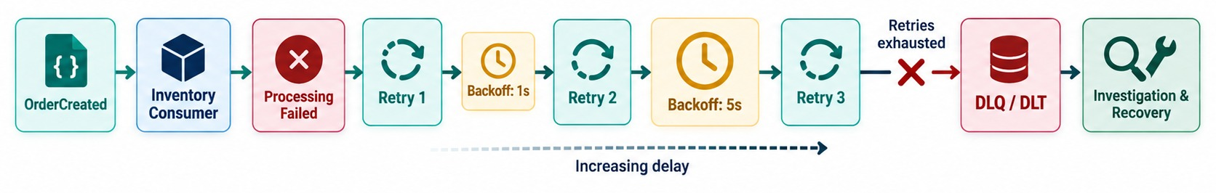
RETRIES AND DEAD-LETTER HANDLING
Transient failure → retry with backoff → dead letter → investigation and recovery.
Transient failure
Persistent failure
After the dead letter
The database is briefly down. Retrying with backoff may well succeed.
Bad structure or a rule that always rejects. Send it to the dead-letter topic — don't loop.
Alert, inspect, fix, then replay on purpose. Never invent a success.
KEY TAKEAWAY Retry transient failures with backoff; send what still fails to a dead-letter destination.
26
© 2026 by Innovation In Software Corporation
Notes:
KEY TALKING POINTS
------------------
- Not all failures are equal
Follow the flow: the consumer fails, retries with backoff, and fails again.
Then the message goes to a dead-letter queue or topic for investigation and recovery.
- Transient failures
A database that is temporarily unavailable is a transient failure.
Retrying later may succeed.
- Persistent or business failures
An invalid event structure, a missing required value, or a business rule that always rejects the operation will not be fixed by retrying.
- Backoff and dead letters
Use backoff, which means waiting longer between retries, so you do not keep hammering a failing dependency.
Once the retry policy is used up, route the message to a dead-letter destination for investigation or controlled recovery.
- Poison messages
A poison message is a message that fails processing again and again.
- What it shows
A failed message is retried three times with increasing delays.
When retries are exhausted it goes to the DLQ or DLT for investigation and recovery.
- Key point
Retries are limited, and failures are parked safely instead of blocking the queue.
- Poison messages
A message that fails every time would block everything behind it.
A retry limit plus a dead-letter topic moves it aside.

Slide 27
RETRIES AND DEAD LETTERS IN SPRING KAFKA
One error-handler bean: back off, give up, publish to the .DLT topic.
✓
KafkaErrorConfig.java
What lands on the dead-letter topic
@Bean
DefaultErrorHandler errors(KafkaTemplate<?, ?> template) {
var recoverer = new DeadLetterPublishingRecoverer(template);
var backoff = new ExponentialBackOffWithMaxRetries(3);
backoff.setInitialInterval(1_000); // 1s, 2s, 4s
backoff.setMultiplier(2.0);
var handler = new DefaultErrorHandler(recoverer, backoff);
handler.addNotRetryableExceptions(
IllegalArgumentException.class); // bad data
return handler;
}
Topic: orders.created.DLT
Headers added by Spring Kafka:
kafka_dlt-original-topic orders.created
kafka_dlt-original-offset 4182
kafka_dlt-exception-message
Invalid total: -20.00
Next: alert on DLT depth,
fix the cause, replay on purpose
Backoff
Not retryable
Lab 2
1s, 2s, 4s — a struggling dependency gets time to recover.
Bad data skips the retries and goes straight to the DLT.
Poison messages land on transactions.submitted.DLT.
KEY TAKEAWAY Limit retries with backoff, skip retries for bad data, and park failures on a dead-letter topic.
27
© 2026 by Innovation In Software Corporation
Notes:
KEY TALKING POINTS
------------------
- The error handler
Spring Boot plugs a DefaultErrorHandler bean into every @KafkaListener.
It retries a failed record, then hands it to the recoverer.
- Backoff
Three retries starting at one second and doubling each time: one, two, then four seconds.
- Not retryable
Some failures will never succeed, such as invalid data.
Those skip the retries and go straight to the dead-letter topic.
- The dead-letter topic
The recoverer publishes to the original topic name plus .DLT, with headers saying where the record came from and why it failed.
Unreadable JSON also needs the ErrorHandlingDeserializer.

Slide 28
EXERCISE 2.3 — DESIGN IDEMPOTENCY AND DLQ BEHAVIOUR
Day 2 checkpoint C: duplicate detection and failure routing.
OFFICIAL CHECKPOINT C
10 MIN
labs/day-02/exercises/exercise-2.3-idempotency-dlq.md
SCENARIO
YOUR TASKS
EXPECTED OUTCOME
Lab 2's Transaction Service consumes TransactionSubmitted from the transactions.submitted topic.
Design what happens to duplicates and poison messages before you code them.
1
Same eventId twice: the second consume is a no-op (event_id already in processed_events)
✓
Duplicate eventId → no-op
✓
Poison message → transactions.submitted.DLT
2
Poison or unreadable JSON: retry, then dead-letter — never loop forever
✓
A DLT message never becomes a success
A dead-lettered message must not invent a successful money-movement outcome
✓
A second consumer group fits without changes
3
4
Lab 5 Risk Assessment will consume the same topic — design for that
KEY TAKEAWAY You can explain duplicate detection and dead-letter routing before you code them.
28
© 2026 by Innovation In Software Corporation
Notes:
KEY TALKING POINTS
------------------
- Official checkpoint
This is an official OUTLINE.md checkpoint for Day 2.
Use the worksheet in labs/day-02/exercises.
- Duplicates
The consumer stores each event_id in processed_events.
A second delivery finds it and does nothing.
- Poison messages
After two retries, Lab 2 sends unreadable or invalid messages to transactions.submitted.DLT.
The transaction must not be marked as successful.
- Looking ahead
Risk Assessment in Lab 5 will read the same topic in its own consumer group, so the event must stay general enough for both.

Slide 29
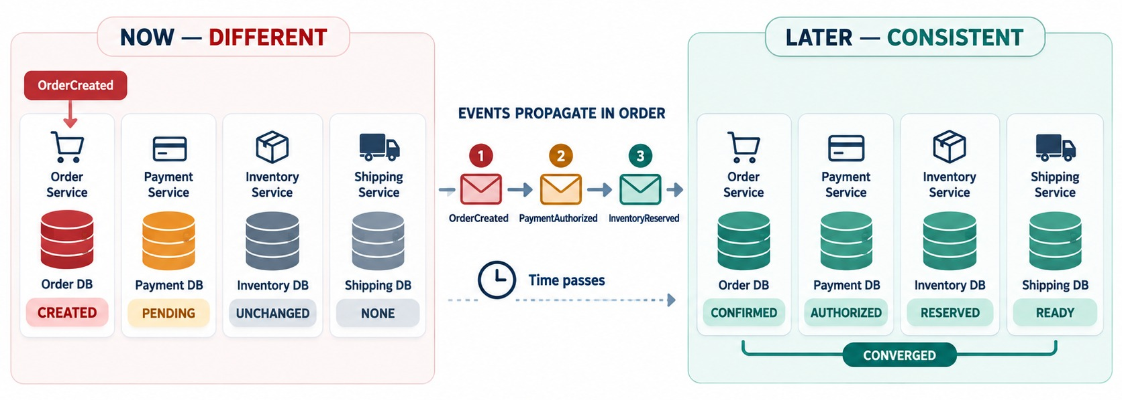
ORDERING AND EVENT CONSISTENCY
Event ordering, eventual consistency and stale state.
Out of order
OrderCancelled can arrive before OrderCreated. Consumers must cope.
Kafka ordering
Guaranteed within a partition only — so key events by orderId.
DESIGNED, NOT HOPED FOR Plan for stale views, compensation and reconciliation.
KEY TAKEAWAY Services converge over time — so design for stale views and out-of-order events.
29
© 2026 by Innovation In Software Corporation
Notes:
KEY TALKING POINTS
------------------
- Services update at different times
Distributed services do not all update at the same instant.
At one moment, the Order Service may already know the order is PAID.
Inventory is still PROCESSING, and Shipping has not started.
- Eventual consistency
As the events propagate, the system converges.
This is called eventual consistency.
- It is designed, not magic
Eventual consistency does not mean the data somehow becomes correct on its own.
It needs deliberate design for workflows, failures, compensation and reconciliation.
- Event ordering
Imagine a consumer receives OrderCancelled before it processes OrderCreated.
Ordering guarantees depend on the broker, the partitioning or routing strategy and the application design, and they have a specific scope.
Consumers must understand the guarantees they actually get, especially when they scale out.
- What it shows
Right now, Order is CREATED, Payment PENDING, Inventory unchanged and Shipping empty.
As the events arrive in order, all four converge.
- Key point
For a while the services disagree.
The design must make that window safe.

Slide 30
SAVE AND PUBLISH SAFELY: THE TRANSACTIONAL OUTBOX
A database commit and a broker send can't be one atomic step — unless you use an outbox.
✕
Dual write — the event can be lost
✓
Outbox — one local transaction
public OrderResponse place(CreateOrderRequest req) {
Order order = orders.save(Order.from(req)); // commits
// crash or broker outage here:
// the order exists, but no OrderCreated event
kafka.send("orders.created", OrderCreated.from(order));
return OrderResponse.from(order);
}
@Transactional
public OrderResponse place(CreateOrderRequest req) {
Order order = orders.save(Order.from(req));
outbox.save(OutboxEvent.of("orders.created",
order.getId(), OrderCreated.from(order)));
return OrderResponse.from(order);
} // both rows commit, or neither does
Relay
At-least-once
In the labs
A scheduler or CDC tool such as Debezium publishes new outbox rows.
The relay may send twice — consumers stay idempotent.
Lab 2 saves, then publishes. The outbox is the production hardening step.
KEY TAKEAWAY Write the business change and the event in one local transaction — a relay publishes it afterwards.
30
© 2026 by Innovation In Software Corporation
Notes:
KEY TALKING POINTS
------------------
- The problem
Saving to the database and sending to Kafka are two separate systems.
If the service crashes between them, the order exists but nobody hears about it.
- The outbox
Instead of sending directly, the service writes the event into an outbox table in the same transaction as the order.
- The relay
A separate job, or a change-data-capture tool like Debezium, reads new outbox rows, publishes them and marks them as sent.
- Trade-off
The relay can publish an event twice, which is fine because consumers are idempotent.
Lab 2 keeps the simpler save-then-publish flow.

Slide 31
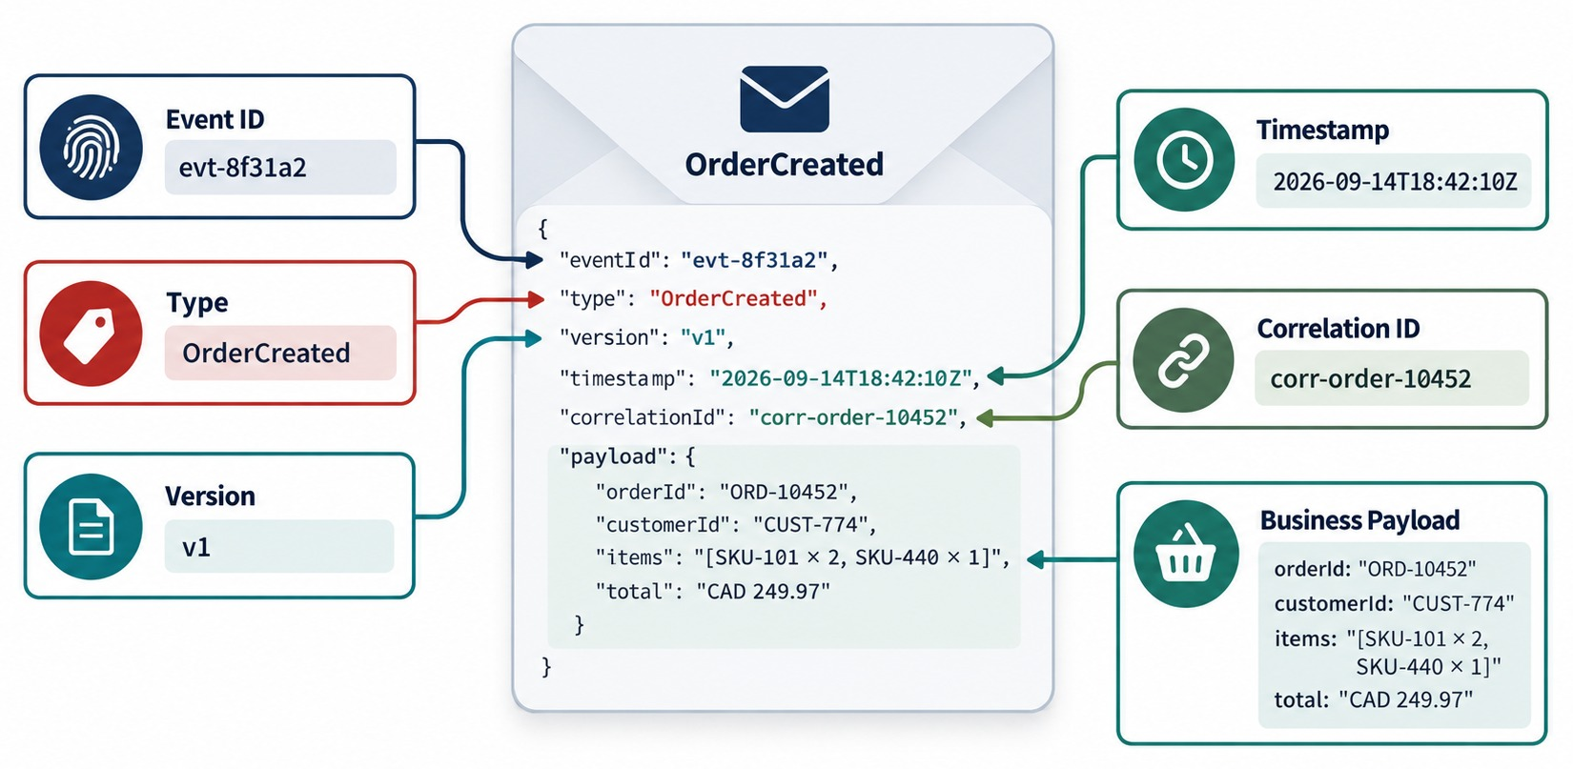
EVENT SCHEMA AND CONTRACT DESIGN
Payloads, IDs, timestamps, metadata, versioning and compatibility.
COMPATIBLE CHANGES
✓
Add an optional field
✓
Add a field with a default
BREAKING CHANGES
✕
Remove or rename a field
✕
Change a field's type
Thin or full event?
Thin events carry IDs and consumers call back; full events carry the data they need.
NEVER INCLUDE card numbers, SSNs, passwords or tokens.
KEY TAKEAWAY Once other services consume an event, its schema is a distributed contract — evolve it carefully.
31
© 2026 by Innovation In Software Corporation
Notes:
KEY TALKING POINTS
------------------
- Events are contracts
Once other services consume an event, its schema becomes a contract.
If Inventory expects orderId and the Order Service removes or renames it, Inventory may break.
- Identity, type and version
An event ID gives a unique identity, which helps with tracing and idempotency.
The event type says what happened.
The version says which contract version this is.
- Time, correlation and business data
The timestamp says when it happened.
A correlation or trace ID shows which request or workflow produced it.
Business identifiers include the order ID and customer ID.
- Evolve carefully
Prefer backward-compatible changes wherever practical.
- What it shows
An OrderCreated event with its event ID, type, version, timestamp, correlation ID and business payload labelled.
- Key point
Metadata makes events traceable and versionable; the payload carries only what consumers need.
- Notification or state transfer
A thin event notification carries identifiers, and consumers call back for details.
Event-carried state transfer includes the data, which lowers coupling but duplicates data.

Slide 32
EXERCISE 2.2 — SKETCH THE TRANSACTIONSUBMITTED FLOW
Day 2 checkpoint B: producer, consumer and correlation ID.
OFFICIAL CHECKPOINT B
10 MIN
labs/day-02/exercises/exercise-2.2-event-flow.md
SCENARIO
YOUR TASKS
EXPECTED OUTCOME
Lab 2 builds the banking Transaction Service on port 8082. A client POSTs a transaction, and Account Service confirms the account is ACTIVE over REST.
Scope: Account, Transaction and Risk Assessment only.
1
After a valid REST create: persist RECEIVED, then publish TransactionSubmitted
✓
A sequence sketch: REST → DB → Kafka → consumer
✓
The correlation ID on every hop
2
Envelope: eventType, eventVersion, eventId, correlationId, occurredAt, payload
✓
All six envelope fields
Copy X-Correlation-Id from the HTTP request onto the event and into logs
✓
Only TransactionSubmitted in Lab 2
3
4
Lab 2 implements TransactionSubmitted only; Approved, HeldForReview and Declined come later; RISK_ASSESSED is internal
KEY TAKEAWAY A sequence sketch from REST to DB to Kafka to consumer, with the correlation ID on every hop.
32
© 2026 by Innovation In Software Corporation
Notes:
KEY TALKING POINTS
------------------
- Official checkpoint
This is an official OUTLINE.md checkpoint for Day 2.
Use the worksheet in labs/day-02/exercises.
- The flow
The REST request is validated, the transaction is saved as RECEIVED, and then TransactionSubmitted is published.
A consumer later marks it SUBMITTED.
- The envelope
It uses the same fields as the contract anatomy diagram: type, version, ID, correlation ID, time and payload.
- Correlation
The X-Correlation-Id header travels onto the event and into every log line, so one request can be traced end to end.

Slide 33
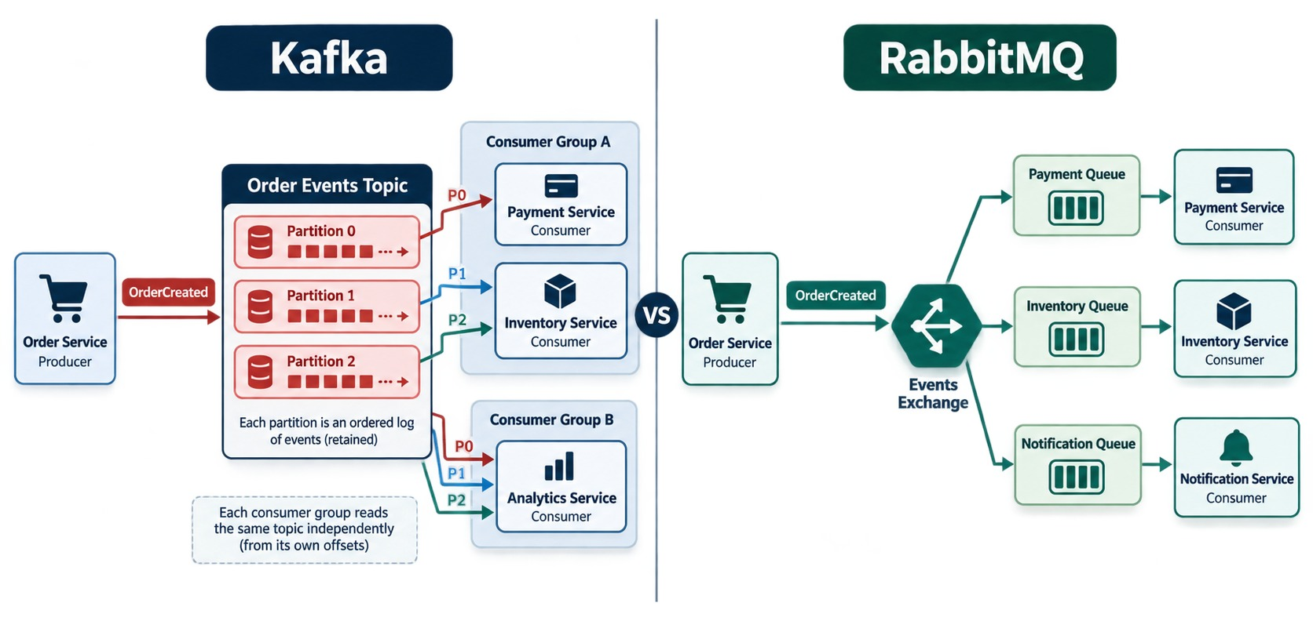
KAFKA VS. RABBITMQ — CONCEPTUAL COMPARISON
An event-streaming log platform versus message-broker and queue patterns.
Apache Kafka
A durable, replayable log. Topics with partitions; consumer groups track offsets. Event streams at high throughput.
RabbitMQ
A message broker. Exchanges route to queues; consumers acknowledge. Work queues and flexible routing.
In Spring
KafkaTemplate with @KafkaListener; RabbitTemplate with @RabbitListener.
ASK which model you need — not which is better.
KEY TAKEAWAY Kafka isn't simply a faster RabbitMQ — their architectures and usage models differ.
33
© 2026 by Innovation In Software Corporation
Notes:
KEY TALKING POINTS
------------------
- Ask the right question
Do not present this as which one is better.
Ask what communication model the system needs.
- Kafka
Think of Kafka as events going into a topic, stored in durable, ordered partitions.
Consumers track their position, called an offset, and can replay retained events.
Common uses are event streaming, data pipelines, event-driven architectures and high-throughput event distribution.
- RabbitMQ
Think of RabbitMQ as producer, exchange, queue, consumer.
It offers rich routing and queue-based messaging patterns.
Common uses are work queues, routing, task distribution and traditional asynchronous messaging.
- Not a faster RabbitMQ
Avoid teaching that Kafka is simply a faster RabbitMQ.
Their architectures and usage models differ.
Many organizations use either one, or both, depending on requirements.
- Kafka side
Order events go to a topic with three partitions.
Each consumer group reads the same topic independently from its own offsets.
- RabbitMQ side
Order events go to an exchange that routes copies into a payment, inventory and notification queue.
- Key point
Kafka keeps a replayable log; RabbitMQ routes messages into queues.
- In this course
The labs use Kafka, with Docker Compose locally and AMQ Streams on OpenShift later.

Slide 34
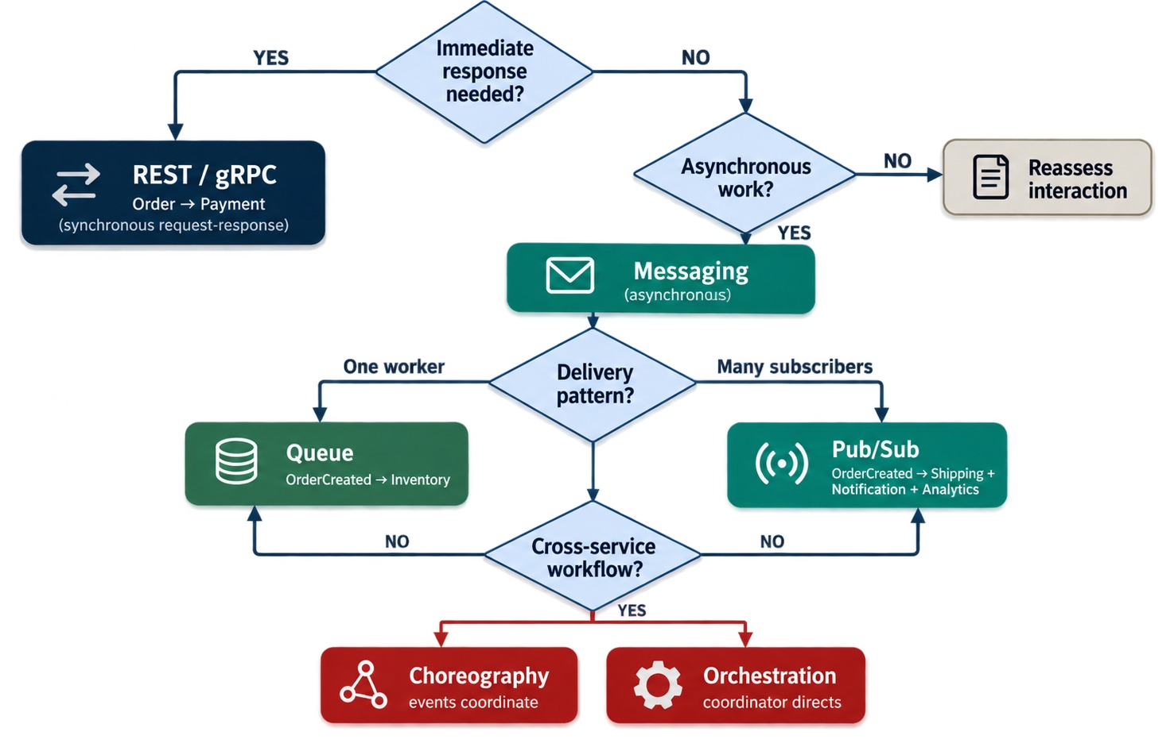
CHOOSING AN INTEGRATION PATTERN
When to use REST, queues, pub/sub, events, orchestration — or a combination.
Get customer details
Needs an answer now → REST
Generate an invoice
One worker, in the background → queue
OrderCreated
Many consumers → publish/subscribe
Order saga with refunds
Controlled steps and compensation → orchestration
MOST SYSTEMS combine several patterns.
KEY TAKEAWAY Choose by business semantics, reliability and coupling — not by technology popularity.
34
© 2026 by Innovation In Software Corporation
Notes:
KEY TALKING POINTS
------------------
- Turn the module into a decision
First ask: does the caller need an immediate result?
If yes, REST or gRPC.
If no, can the work happen asynchronously?
If yes, use messaging or events.
- Examples
Getting customer details with GET /customers/100 needs an immediate response, so REST may fit.
Generating an invoice can happen in the background, so a queue may fit.
OrderCreated matters to Payment, Inventory, Notification and Analytics, so publish/subscribe or event streaming may fit.
- Complex workflows
If a process has many decisions, compensations and dependencies, orchestration may give clearer control.
- The principle
Choose the communication model based on business meaning, reliability needs and coupling.
Do not choose it because a technology is popular.
- What it shows
Immediate response leads to REST or gRPC.
Asynchronous work leads to messaging, then queue or pub/sub, then choreography or orchestration for cross-service workflows.
- Key point
Answer the questions in order and the pattern follows.

Slide 35
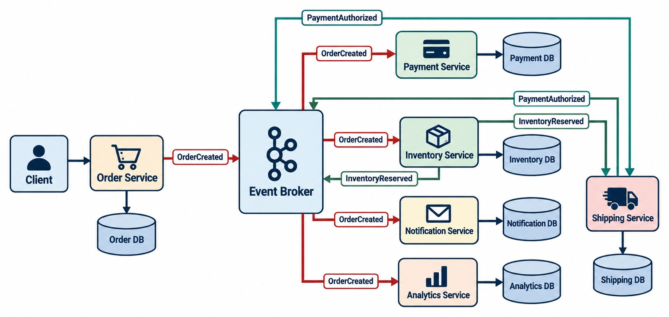
END-TO-END EVENT-DRIVEN MICROSERVICES ARCHITECTURE
Order → Broker → Payment, Inventory, Notification → Shipping — each with its own data.
PRODUCTION RELIABILITY
Acknowledgments
Idempotency
Retries + backoff
Dead-letter topics
Schema versioning
Outbox
Correlation IDs
Consumer-lag alerts
Watch in production
Consumer lag, dead-letter depth, retry counts and end-to-end latency.
EVERYTHING HERE came from this module.
KEY TAKEAWAY Events let services collaborate without being simultaneously available — if you design for reliability.
35
© 2026 by Innovation In Software Corporation
Notes:
KEY TALKING POINTS
------------------
- Start of the process
Use this slide to rebuild the module.
The client sends POST /orders.
The Order Service creates the order in its own database and publishes OrderCreated.
- Decoupled consumers
The broker decouples producers from consumers, so Order does not call every service synchronously.
Payment, Inventory and Notification react independently.
- New events
Consumers can publish new business events, like PaymentAuthorized and InventoryReserved.
The workflow continues, and Shipping starts once its business conditions are met.
- Each service owns its state
Order, Payment, Inventory and Shipping each have their own database.
So we do not rely on one shared distributed transaction to make the whole workflow atomic.
- Reliability surrounds it
In production you also need acknowledgments, idempotency, retries and backoff.
You need dead-letter handling, schema management, tracing and monitoring.
- Final message
Messaging changes how services collaborate, not just how data moves.
You gain decoupling and asynchronous scalability.
But you must explicitly handle duplicates, retries, failures, ordering, contracts and eventual consistency.
- What it shows
A client calls Order Service, which saves to its database and publishes OrderCreated.
The broker feeds Payment, Inventory, Notification and Analytics, each with its own database.
- How to read it
Follow PaymentAuthorized and InventoryReserved back through the broker to Shipping.
- Key point
Every idea in the module appears here: events, broker, independent consumers and owned data.
- Observability
Consumer lag is how far a consumer is behind the newest events.
Rising lag, a growing dead-letter topic or climbing retries are early warnings.

Slide 36
EVENT-DRIVEN MISCONCEPTIONS AND ANTI-PATTERNS
Beliefs and habits that make messaging systems fragile.
MISCONCEPTION
REALITY
ANTI-PATTERNS TO AVOID
Events remove all coupling
Everyone still depends on the event contract
✕
Publishing before the transaction commits
✕
Vague events like DataChanged
The broker delivers exactly once
Expect duplicates — make consumers idempotent
✕
Ignoring duplicate deliveries
✕
Retrying poison messages forever
✕
Card numbers or tokens in payloads
Messaging makes everything faster
It adds latency and eventual consistency
✕
No lag or dead-letter monitoring
REMEMBER Events decouple timing, not responsibility — every message needs an owner.
Events always arrive in order
Order holds only within a partition or queue
Going async fixes a poor design
Badly bounded services stay chatty
KEY TAKEAWAY Messaging only helps when contracts, duplicates, failures and monitoring are designed in from the start.
36
© 2026 by Innovation In Software Corporation
Notes:
KEY TALKING POINTS
------------------
- Why this slide
Before the knowledge check, clear away the beliefs that cause most messaging incidents.
- Coupling and delivery
Events remove timing coupling, not contract coupling.
And brokers usually guarantee at-least-once delivery, so duplicates are normal.
- Speed and order
Asynchronous work finishes later, not faster.
Ordering is only guaranteed within a Kafka partition or a single queue.
- Anti-patterns
Publishing before commit, vague event names, ignored duplicates, endless retries, sensitive payloads and no monitoring are the usual causes of trouble.

Slide 37
KNOWLEDGE CHECK
Answer in your own words — then compare with a partner.
Synchronous vs. asynchronous — the main difference?
What role does a message broker play?
1
6
When is a REST call appropriate between services?
What is a dead-letter queue for?
2
7
Why are long chains of synchronous calls risky?
Why must event consumers be idempotent?
3
8
What is an event?
What is consumer lag in Kafka?
4
9
Why name events in the past tense?
Why should services avoid sharing databases?
5
10
37
© 2026 by Innovation In Software Corporation
Notes:
KEY TALKING POINTS
------------------
- 1. Sync vs. async
Synchronous waits for a response; asynchronous sends a message and continues.
- 2. REST
When the caller needs an immediate answer, such as a simple query or a validation.
- 3. Call chains
One slow or failed service delays or breaks the whole chain.
- 4. Event
A message describing a business fact that already happened.
- 5. Past tense
It makes clear the fact is complete, like AccountOpened.
- 6. Broker
It receives messages from producers and delivers them to consumers through queues, topics and routing.
- 7. Dead-letter queue
It holds messages that still failed after retries, so they can be inspected and reprocessed.
- 8. Idempotency
Messages may be redelivered, so processing twice must not cause a wrong result.
- 9. Consumer lag
The gap between the newest events and the events a consumer has processed.
- 10. Shared databases
They create tight coupling and weaken service ownership.
- Practical scenario
A customer opens a checking account.
Account Service publishes AccountOpened; Notification and Analytics consume it; the welcome email never blocks the API; failures retry, then dead-letter.

Slide 38
MODULE 4 SUMMARY AND WHAT'S NEXT
From synchronous calls to a reliable event-driven workflow.
YOU CAN NOW
NEXT: MODULE 5 — MICROSERVICES AND DATA
✓
Choose synchronous or asynchronous for each interaction
1
How does each service own and persist its data?
✓
Explain brokers, queues, topics and consumer groups
2
How do we keep a workflow correct across databases?
✓
Design events, producers and consumers that stay decoupled
When does caching help — and when does it hurt?
3
✓
Pick choreography or orchestration for a workflow
✓
Build idempotent consumers with retries and dead letters
BRING ALONG Your Lab 2 Transaction Service and its TransactionSubmitted flow.
KEY TAKEAWAY Module 5 looks inside each service's data — ownership, transactions and caching.
38
© 2026 by Innovation In Software Corporation
Notes:
KEY TALKING POINTS
------------------
- Recap
We compared communication styles, learned how brokers and events work, designed event-driven workflows, and made consumers reliable.
- Next module
Module 5 is about data: each service owning its persistence, transactions across services with sagas, and caching.

