Slide 1
"Each microservice should control its own persistence boundary."
MODULE 5
Microservices and Data
Managing persistence, transactions, consistency and caching.
SQL integration with Spring Boot
Data ownership
Persistence patterns
Local transactions
Distributed transactions
Saga pattern
Redis caching
SPRING BOOT MICROSERVICES BOOTCAMP • MODULE 5
Notes:
KEY TALKING POINTS
------------------
- Where we are
So far we have answered four questions.
Module 1: why microservices.
Module 2: how to design them.
Module 3: how to build them.
Module 4: how they communicate.
Now we ask another critical question: how do microservices manage data?
- From one database to many
In a monolith, one application often uses one database.
With microservices, the Order, Payment and Inventory services may each have their own database.
- The trade-off
This improves autonomy.
But it brings new challenges around consistency, transactions and data access.

Slide 2
LEARNING OBJECTIVES
SQL integration, persistence patterns, transaction strategies and Redis caching.
🎯
BY THE END OF THIS MODULE, YOU CAN
🧭
FOUR PARTS
1. Integrate Spring Boot with SQL
2. Explain service-owned data
3. Use Spring Data JPA repositories
4. Understand persistence patterns
5. Implement local transactions
6. Explain distributed transaction challenges
7. Describe Saga patterns
8. Understand compensating transactions
9. Explain Redis caching
10. Design cache expiration and invalidation
1
SQL persistence
Spring Boot
Repository
SQL Database
2
Data ownership
Microservice
Owns its data
3
Transactions
Local ACID transaction
vs.
Distributed business transaction
4
Caching
Application
Redis
Database
KEY TAKEAWAY Data is where moving from a monolith to microservices changes architecture the most.
2
© 2026 by Innovation In Software Corporation
Notes:
KEY TALKING POINTS
------------------
- By the end of this module
Learners should be able to integrate Spring Boot with SQL, explain service-owned data and use Spring Data JPA repositories.
They should understand persistence patterns and implement local transactions.
They should explain distributed transaction challenges, Sagas and compensating transactions.
They should also explain Redis caching and design cache expiration and invalidation.
- Four parts
Part one is SQL persistence: Spring Boot, a repository and a SQL database.
Part two is data ownership: each microservice owns its data.
Part three is transactions: local ACID transactions versus distributed business transactions.
Part four is caching: the application, Redis and the database.
- Why this module matters
Data is one of the areas where moving from a monolith to microservices changes the architecture the most.

Slide 3
KEY TERMS FOR THIS MODULE
Plain definitions for the words we'll use most.
1
Database per service
2
Flyway migration
Each service owns its own database; no other service reads its tables.
A versioned SQL script that changes the database schema in a controlled order.
3
Entity
4
Repository
A Java class mapped to a database table with JPA.
An interface that loads and saves entities without hand-written SQL.
5
Local transaction
6
Optimistic locking
Changes in one service's database that either all commit or all roll back.
Detecting, with a version column, that someone changed a row since you read it.
7
Saga
8
Cache-aside
A sequence of local transactions across services, with compensating steps if one fails.
Check the cache first; on a miss, load from the database and store the result.
KEY TAKEAWAY Agree on the words first — every later slide builds on them.
3
© 2026 by Innovation In Software Corporation
Notes:
KEY TALKING POINTS
------------------
- How to run this slide
Read each term once and give a quick example from the order platform or the banking lab.
- Database per service
Each service owns its own database; no other service reads its tables.
- Flyway migration
A versioned SQL script that changes the database schema in a controlled order.
- Entity
A Java class mapped to a database table with JPA.
- Repository
An interface that loads and saves entities without hand-written SQL.
- Local transaction
Changes in one service's database that either all commit or all roll back.
- Optimistic locking
Detecting, with a version column, that someone changed a row since you read it.
- Saga
A sequence of local transactions across services, with compensating steps if one fails.
- Cache-aside
Check the cache first; on a miss, load from the database and store the result.

Slide 4
FULL FORMS USED IN THIS MODULE
Every abbreviation on these slides, spelled out.
ACID
Atomicity, Consistency, Isolation, Durability
ID
Identifier
SQL
Structured Query Language
API
Application Programming Interface
JDBC
Java Database Connectivity
TTL
Time To Live
ATM
Automated Teller Machine
JPA
Jakarta Persistence API
URL
Uniform Resource Locator
CRUD
Create, Read, Update, Delete
JSON
JavaScript Object Notation
YAML
YAML Ain't Markup Language
DB
Database
ORM
Object-Relational Mapping
DTO
Data Transfer Object
REST
Representational State Transfer
KEY TAKEAWAY When an abbreviation isn't clear, the full form is on this slide.
4
© 2026 by Innovation In Software Corporation
Notes:
KEY TALKING POINTS
------------------
- How to run this slide
Don't read every row.
Point out the few this module uses most, and say the full list is here for reference.
- Reference
ACID is Atomicity, Consistency, Isolation, Durability; API is Application Programming Interface; ATM is Automated Teller Machine; CRUD is Create, Read, Update, Delete; DB is Database; DTO is Data Transfer Object; ID is Identifier; JDBC is Java Database Connectivity; JPA is Jakarta Persistence API; JSON is JavaScript Object Notation; ORM is Object-Relational Mapping; REST is Representational State Transfer; SQL is Structured Query Language; TTL is Time To Live; URL is Uniform Resource Locator; YAML is YAML Ain't Markup Language.

Slide 5
FROM MODULE 4 TO MODULE 5
Services now talk to each other — this module is about the data behind each one.
MODULE 4 GAVE US
🧭
OUR PATH THROUGH MODULE 5
1
Persist an order with Spring Data JPA
Part 1
✓
REST and events between services
Brokers, topics and consumer groups
2
Configure the DataSource and migrations
Part 1
✓
Idempotent consumers and dead letters
3
Keep each service's data private
Part 2
✓
Choreography and orchestration
4
Get data you don't own
Part 2
✓
The transactional outbox
5
Commit locally; coordinate with Sagas
Part 3
✓
NOW Give each service its own data — and keep the business outcome correct.
6
Compensate when a step fails
Part 3
7
Cache reads with Redis, safely
Part 4
KEY TAKEAWAY Module 4 connected services; Module 5 makes each one own its data and stay correct.
5
© 2026 by Innovation In Software Corporation
Notes:
KEY TALKING POINTS
------------------
- Bridge from Module 4
Module 4 connected services with REST and events.
Every one of those services has data behind it, and that data now lives in separate databases.
- The path
We persist data in one service, draw ownership lines, replace shared transactions with Sagas, and finish with caching.
- Two examples
The slides follow the e-commerce Order Service.
Exercise 2.1 and Lab 2 use the banking Account and Transaction services.

Slide 6
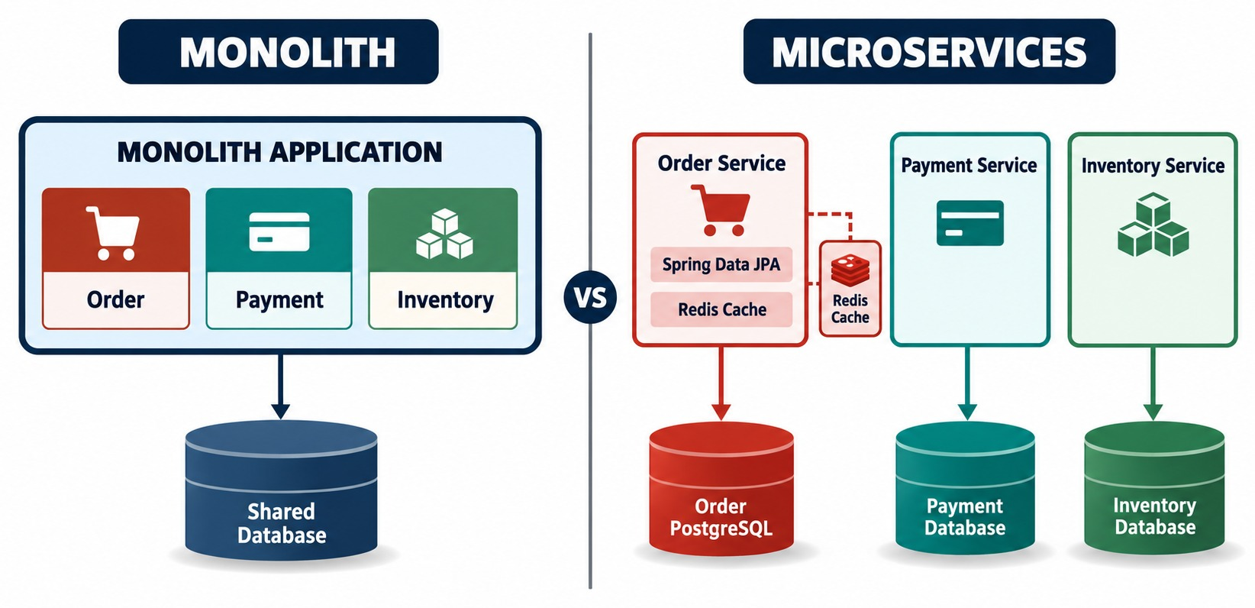
WHY DATA MANAGEMENT CHANGES WITH MICROSERVICES
From one shared database toward independently owned service data.
NOW YOU MUST HANDLE
!
Distributed state
!
Eventual consistency
!
Cross-service workflows
!
Failure recovery
One business operation
Placing an order may now touch the Order, Payment and Inventory databases.
FOUR WORDS Ownership, autonomy, consistency, distribution.
KEY TAKEAWAY Microservices gain autonomy, but one business operation may now cross several databases.
6
© 2026 by Innovation In Software Corporation
Notes:
KEY TALKING POINTS
------------------
- The monolith
A monolithic application usually works against one database.
It can begin a transaction, insert the order, update payment, update inventory and commit.
The database transaction manager provides atomicity, which means all or nothing.
- Microservices
Microservices change this, because different business capabilities own different data.
Order Service uses the Order DB, Payment Service the Payment DB, and Inventory Service the Inventory DB.
Now a single business operation may cross several databases.
- What you now have to handle
We gain service autonomy.
But we must explicitly deal with distributed state, eventual consistency and cross-service workflows.
We also need failure recovery, data duplication and clear transaction boundaries.
- What it shows
On the left, one monolith with Order, Payment and Inventory modules sharing one database.
On the right, three services, each with its own database.
- Key point
The data moves apart with the services — and so do the transactions.
- Bridge from Module 4
Module 4 connected services with events.
Now we look at the data behind each service, and what happens when one operation touches several databases.

Slide 7
PART 1: SQL PERSISTENCE WITH SPRING BOOT
Before sharing data across services, store it well inside one.
Part 1
SQL persistence
Part 2
Data ownership
Part 3
Transactions
Part 4
Caching
SO FAR
NEXT QUESTION
How does a Spring Boot service store and read its own data correctly?
✓
Services integrate through REST and events
✓
Consumers are idempotent; failures dead-letter
IN THIS PART
An outbox publishes events safely
1
The persistence stack: JDBC, JPA, Hibernate, Spring Data
✓
2
DataSource configuration and Flyway migrations
3
Mapping entities — and references across services
4
Repositories and the end-to-end flow
5
Exercise: spot the persistence problems
7
© 2026 by Innovation In Software Corporation
Notes:
KEY TALKING POINTS
------------------
- Why start here
Every later topic, from ownership to Sagas, assumes one service can persist its data cleanly.
- What this part covers
The Spring Data JPA stack, configuration and migrations, entity mapping, repositories, and one request from JSON to SQL.

Slide 8
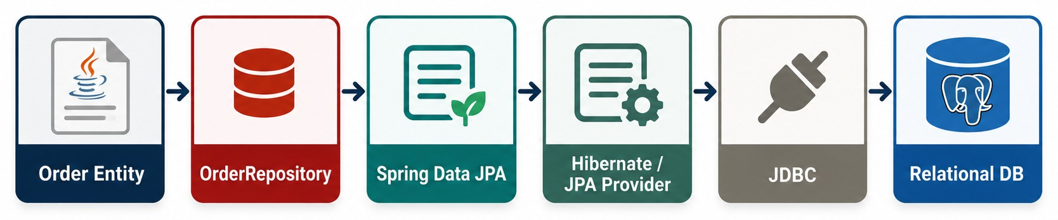
SPRING BOOT SQL INTEGRATION ARCHITECTURE
Entity → repository → Spring Data JPA → Hibernate → JDBC → SQL database.
JDBC
JPA
Hibernate
Spring Data JPA
The low-level Java API that talks to the database.
The specification for mapping Java objects to tables.
The JPA implementation Spring Boot uses by default.
Generates repository implementations at runtime.
KEY TAKEAWAY JDBC talks to the database, JPA and Hibernate map objects, and Spring Data removes the plumbing.
8
© 2026 by Innovation In Software Corporation
Notes:
KEY TALKING POINTS
------------------
- Separate the technologies
Walk down the stack and name each piece clearly.
- JDBC and JPA
JDBC is the low-level Java API for connecting to databases.
JPA is a Java persistence specification for ORM-style persistence.
ORM means object-relational mapping.
- Hibernate and Spring Data JPA
Hibernate is a widely used JPA implementation.
Spring Data JPA adds repository abstractions and integrates persistence neatly with Spring.
- Less plumbing
Instead of writing CRUD plumbing for every entity, developers define an interface like OrderRepository extending JpaRepository.
Spring Data creates the implementation at runtime.
- What it shows
The chain from the Order entity through OrderRepository, Spring Data JPA, Hibernate as the JPA provider, and JDBC to the relational database.
- Key point
Each layer hides the one below it, so application code works with entities and repositories.
- Connect to Module 3
In Module 3 we had controller, service and repository.
Now we complete the path all the way to the database.
- Each layer's job
The controller handles HTTP.
The service handles business behavior.
The repository handles persistence access.
- Below the repository
Spring Data JPA reduces repository boilerplate.
The JPA implementation turns persistence operations into SQL through JDBC.
The relational database stores the durable business state.
- Our example
POST /orders goes to OrderController, then OrderService, then OrderRepository, and finally PostgreSQL.

Slide 9
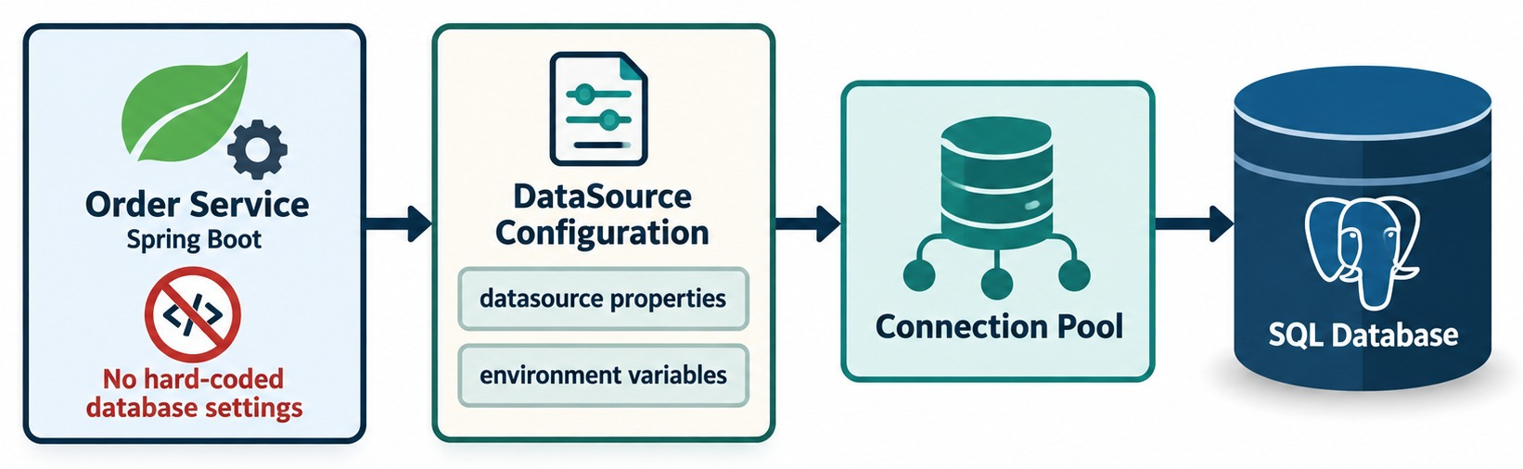
CONFIGURING A SQL DATASOURCE
Spring Boot datasource configuration and connection properties.
✓
application.yml
TYPICAL VALUES
Connection pool
SECRETS From the environment — later, OpenShift Secrets.
spring:
datasource:
url: ${DB_URL}
username: ${DB_USER}
password: ${DB_PASSWORD}
✓
JDBC URL
HikariCP reuses connections instead of opening one per request.
✓
Username and password
✓
Driver
✓
Pool settings
KEY TAKEAWAY Never commit database credentials — reference them and let the environment supply them.
9
© 2026 by Innovation In Software Corporation
Notes:
KEY TALKING POINTS
------------------
- Connection details
A Spring Boot application needs to know how to connect to its database.
Typical values are the JDBC URL, username, password, driver and connection pool settings.
- Never hard-code secrets
Do not teach learners to hard-code a production password in the configuration.
Use a placeholder like DB_PASSWORD, and let the deployment environment supply the secret.
This connects back to external configuration and secrets in Module 3.
Later, it maps to OpenShift Secrets and ConfigMaps.
- ddl-auto: validate
Setting Hibernate's ddl-auto to validate checks that the entities match the schema, without changing the schema.
- Connection pooling
Applications normally reuse a pool of database connections.
They do not open a brand-new physical connection for every request.
- What it shows
Order Service takes its datasource properties and environment variables, builds a connection pool, and reaches the SQL database through it.
- Key point
No database settings are hard-coded; the pool reuses connections.

Slide 10
SCHEMA MIGRATIONS WITH FLYWAY
Versioned SQL files own the schema; Hibernate only checks it.
db/migration/V1__create_orders.sql
✓
application.yml
CREATE TABLE orders (
id BIGSERIAL PRIMARY KEY,
customer_id VARCHAR(20) NOT NULL,
status VARCHAR(20) NOT NULL,
total NUMERIC(12, 2) NOT NULL,
version BIGINT NOT NULL DEFAULT 0,
created_at TIMESTAMP NOT NULL DEFAULT now()
);
CREATE INDEX idx_orders_customer ON orders (customer_id);
spring:
jpa:
hibernate:
ddl-auto: validate # Flyway owns the schema
flyway:
locations: classpath:db/migration # the default
datasource:
hikari:
maximum-pool-size: 10
connection-timeout: 3000 # milliseconds
Versioned
validate
Never edit
V1, V2 … run once, in order, recorded in flyway_schema_history.
Hibernate checks the entities match — it never changes tables.
an applied migration. Add V2 instead.
KEY TAKEAWAY Let Flyway create and evolve the schema; let Hibernate validate it — never ddl-auto: update in production.
10
© 2026 by Innovation In Software Corporation
Notes:
KEY TALKING POINTS
------------------
- The migration
Each SQL file has a version number.
Flyway runs new files once, in order, and records them in the flyway_schema_history table.
- validate, not update
Hibernate only checks that entities match the tables.
Letting Hibernate change a production schema is risky and untraceable.
- Pool settings
HikariCP is Spring Boot's default pool.
Size it to what the database can handle, and fail fast when no connection is free.
- In the labs
Labs 1 and 2 use Flyway, not Hibernate DDL, so this is exactly the pattern learners will run.

Slide 11
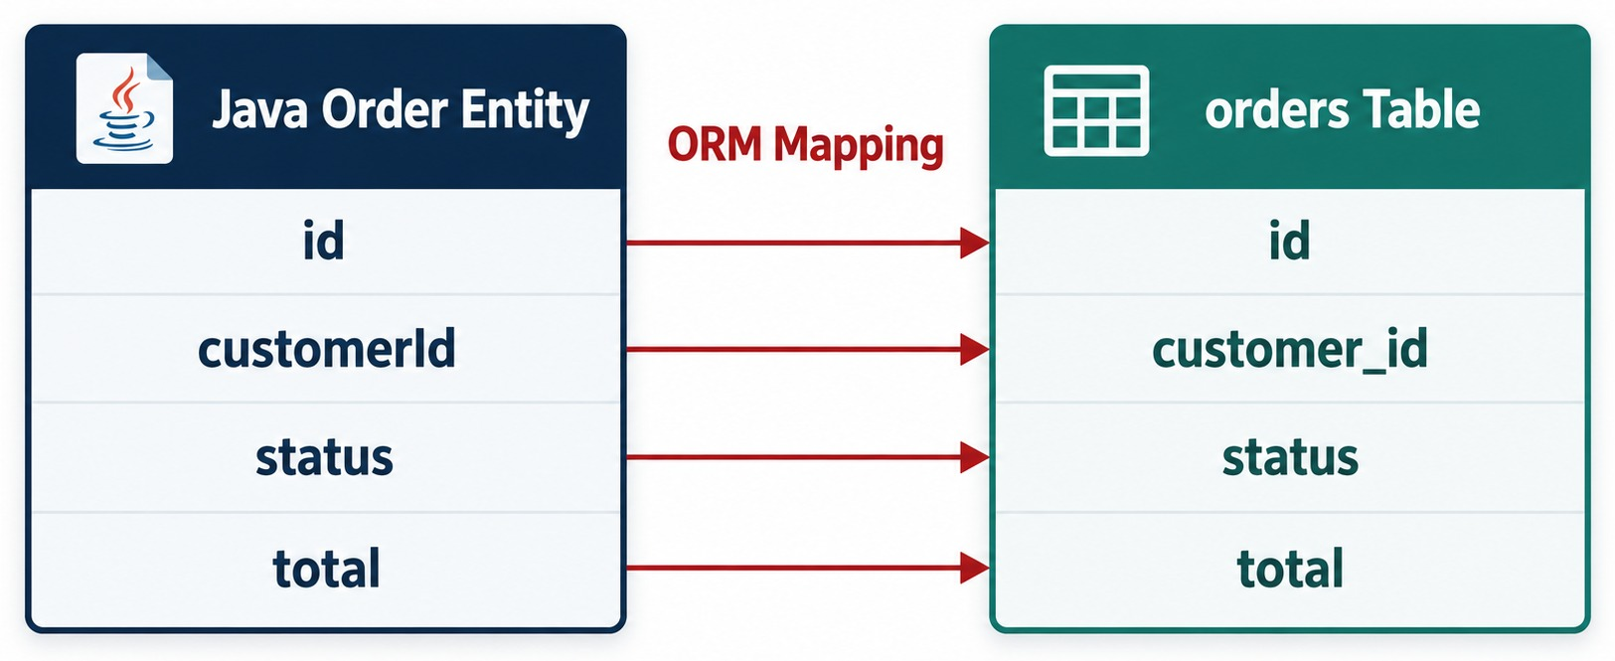
MAPPING JAVA OBJECTS TO RELATIONAL DATA
@Entity, @Id, columns, tables and object-relational mapping.
Order.java
@Entity
@Table(name = "orders")
public class Order {
@Id @GeneratedValue
private Long id;
private String customerId;
private String status;
private BigDecimal total;
}
Naming
Spring Boot maps customerId to customer_id automatically.
ORM ≠ NO SQL You still need keys, indexes and query awareness.
KEY TAKEAWAY ORM maps Java objects to tables — production developers understand both models.
11
© 2026 by Innovation In Software Corporation
Notes:
KEY TALKING POINTS
------------------
- Object-relational mapping
Object-relational mapping connects Java objects to relational tables.
Here the Order class maps to the orders table.
Its fields map to columns, for example customerId maps to customer_id.
- The annotations
@Entity marks a persistent entity.
@Table can name the matching table.
@Id marks the primary key, and @GeneratedValue sets how IDs are generated.
- You still need SQL
ORM does not remove the need to understand SQL.
Developers still need to understand tables, keys, relationships, indexes, query behavior, transactions and performance.
A production Spring developer understands both the Java object model and the relational data model.
- What it shows
The Java Order entity on the left and the orders table on the right, with id, customerId, status and total mapped across.
- Key point
customerId becomes customer_id — the mapping handles naming, types and keys.

Slide 12
RELATIONSHIPS INSIDE A SERVICE, IDS ACROSS SERVICES
Map what shares a lifecycle and a database; reference everything else by ID.
✓
Inside Order Service — map it
✕
Across services — don't map it
@Entity
@Table(name = "orders")
public class Order {
@Id @GeneratedValue
private Long id;
@OneToMany(mappedBy = "order", cascade = CascadeType.ALL,
orphanRemoval = true)
private List<OrderItem> items = new ArrayList<>();
private String customerId; // owned by Customer Service
}
@Entity
public class Order {
@ManyToOne // Customer lives in
private Customer customer; // another service's DB
@ManyToOne // a join into
private Payment payment; // Payment's tables
}
Inside one service
Across services
LAZY by default
Order and OrderItem share a lifecycle and a database — map them.
Store only the ID; call Customer Service when you need details.
Load collections only when needed — watch for N+1 queries.
KEY TAKEAWAY JPA relationships stop at the service boundary — across it, keep an ID and use the owner's API or events.
12
© 2026 by Innovation In Software Corporation
Notes:
KEY TALKING POINTS
------------------
- Inside the boundary
OrderItem belongs to Order.
They live in the same database and change together, so a one-to-many relationship is right.
- Across the boundary
Customer and Payment are owned by other services.
Mapping them with @ManyToOne would need their tables in Order's database.
- What to store
Keep customerId as a plain value.
When the order screen needs the customer's name, call Customer Service or keep a local read model.
- N+1 queries
Loading 100 orders and then touching each one's items can run 101 queries.
Fetch joins, entity graphs or DTO projections avoid it.

Slide 13
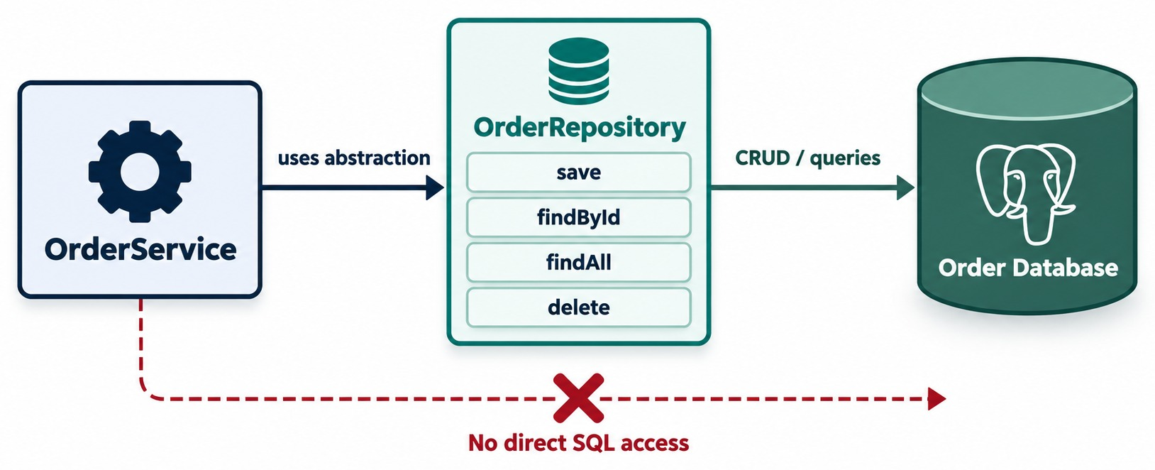
REPOSITORY PATTERN WITH SPRING DATA JPA
JpaRepository, CRUD operations and query abstraction.
DERIVED QUERY METHODS
findByStatus
findByCustomerId
existsByIdAndStatus
countByCustomerId
When a name gets too long
@Query("select o from Order o "
+ "where o.total > :min")
List<Order> bigOrders(
@Param("min") BigDecimal min);
KEEP IT CLEAN Queries in the repository; business rules in the service.
KEY TAKEAWAY Repositories give CRUD and derived queries — business logic stays in the service.
13
© 2026 by Innovation In Software Corporation
Notes:
KEY TALKING POINTS
------------------
- A persistence abstraction
The repository gives us a persistence abstraction.
We do not mix SQL into the OrderController.
Instead the controller calls OrderService, which calls OrderRepository.
- CRUD for free
Spring Data JPA provides common operations automatically: save, findById, findAll, delete and existsById.
- Derived queries
It can also build some queries from method names.
For example, findByStatus with CREATED becomes a query on the status property.
For more complex needs, you can write explicit queries or use other persistence approaches.
- Keep responsibilities clear
Do not put all your business logic into repository query methods.
The repository's job is persistence access.
- What it shows
OrderService uses OrderRepository, which offers save, findById, findAll and delete and talks to the database.
- Key point
The crossed-out dashed line means the service never runs SQL directly.

Slide 14
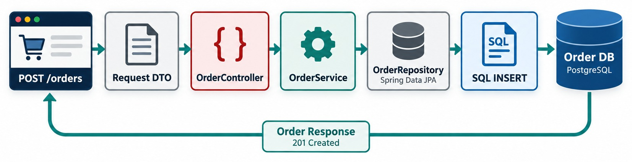
END-TO-END PERSISTENCE FLOW
REST request → controller → service → repository → SQL → response.
Request body
✓
The key line
CONNECTS REST from Module 3 with SQL persistence from this module.
{
"customerId": "CUST-501",
"total": 199.99
}
Order saved = orders.save(order);
// INSERT INTO orders (...) VALUES (...)
KEY TAKEAWAY One request travels from JSON to a SQL INSERT and back as a 201 Created response.
14
© 2026 by Innovation In Software Corporation
Notes:
KEY TALKING POINTS
------------------
- The request
The client sends POST /orders with JSON, for example customerId 501 and total 199.99.
Spring converts the JSON into the request DTO.
- Through the layers
The controller hands off to the Order Service.
The service does business validation and creates the Order entity.
The repository calls orderRepository.save(order).
- Down to the database
JPA and Hibernate generate the SQL INSERT, which runs against PostgreSQL.
- The response
After the save succeeds, the application returns an OrderResponse DTO with 201 Created.
This connects REST from Module 3 to SQL persistence in Module 5.
- What it shows
The request becomes a DTO, passes through the controller, service and repository, turns into a SQL INSERT on Order DB, and returns as an order response.
- Key point
Every layer from Module 3 and this module appears in one request.

Slide 15
EXERCISE: SPOT THE PERSISTENCE PROBLEMS
Review a pull request for Order Service.
PRACTICE EXERCISE
12 MIN
SCENARIO
YOUR TASKS
EXPECTED OUTCOME
The pull request contains:
1
Find at least four problems
✓
ddl-auto update → Flyway + validate
# application.yml
spring.jpa.hibernate.ddl-auto: update
spring.datasource.password: Prod#2026
@ManyToOne
private Customer customer;
@GetMapping("/orders")
List<Order> all() {
return orders.findAll();
}
2
Say why each one hurts in production
✓
Password in YAML → environment secret
3
Propose a fix for each
✓
@ManyToOne Customer → store customerId
✓
Returns entities → return DTOs
✓
findAll, no paging → Pageable
KEY TAKEAWAY Schema by migration, secrets from the environment, IDs across services, DTOs out, and pages for lists.
15
© 2026 by Innovation In Software Corporation
Notes:
KEY TALKING POINTS
------------------
- Schema and secrets
Hibernate should not alter a production schema, and a password must never be committed.
Use Flyway with validate, and environment variables.
- Cross-service mapping
Customer belongs to another service, so Order stores only customerId.
- The endpoint
It returns entities, exposing internals, and loads every order at once.
Return DTOs and accept a Pageable.
- Bonus
If the DTO mapping touches each order's items, the list may also cause N+1 queries.

Slide 16
PART 2: DATA OWNERSHIP
Each service's data is private — like its code.
✓ Part 1
SQL persistence
Part 2
Data ownership
Part 3
Transactions
Part 4
Caching
SO FAR
NEXT QUESTION
Who is allowed to touch which data — and how do others get it?
✓
Spring Data JPA maps entities and generates repositories
✓
Flyway owns the schema; secrets come from the environment
IN THIS PART
1
Database per service — and its trade-offs
✓
One request becomes SQL and a DTO
2
Why shared database access is dangerous
3
Getting data you don't own
4
Polyglot persistence
5
Exercise 2.1: map data ownership
16
© 2026 by Innovation In Software Corporation
Notes:
KEY TALKING POINTS
------------------
- From one service to many
Part 1 was about persisting data inside a service.
Part 2 is about the lines between services.
- Key question
If Payment needs order data, what may it do: call an API, consume an event, or query Order's tables?
Only the first two.

Slide 17
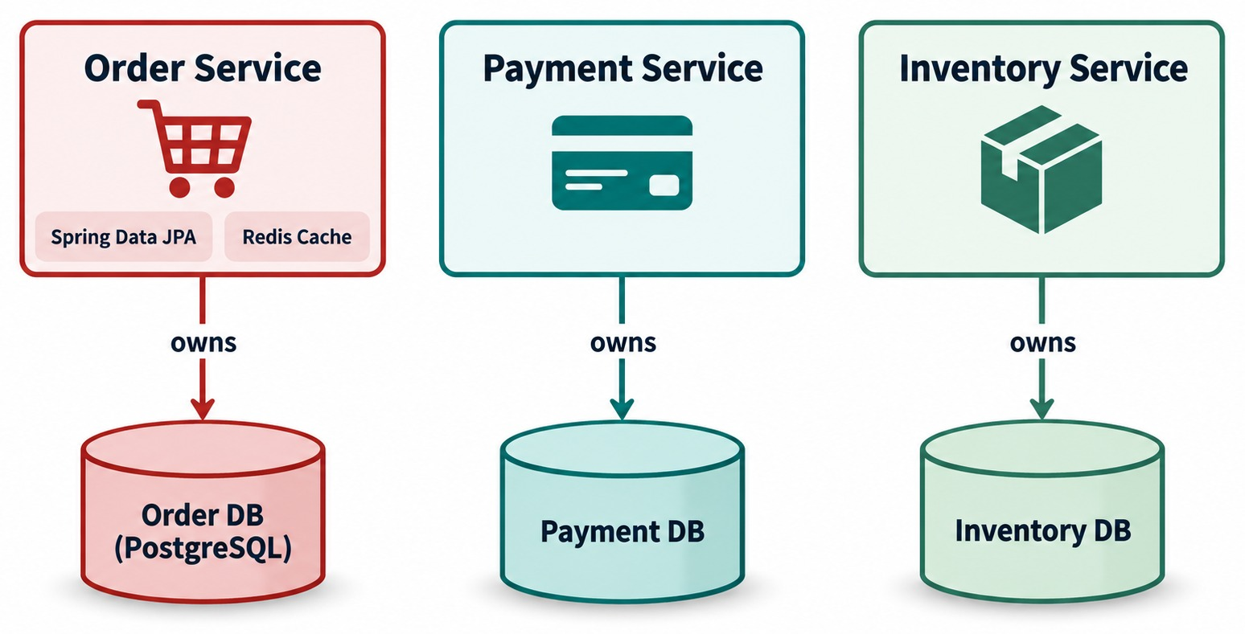
DATABASE PER SERVICE PATTERN
Each microservice owns and controls its persistence boundary.
YOU GAIN
✓
Independent schema changes
✓
Independent deployment
✓
Clear ownership
YOU GIVE UP
✕
Easy cross-table joins
✕
One ACID transaction for everything
OWNERSHIP, NOT SERVERS Separate schemas on one server can still work.
KEY TAKEAWAY A service owns its data — others go through its API or events, never its tables.
17
© 2026 by Innovation In Software Corporation
Notes:
KEY TALKING POINTS
------------------
- Ownership
The database per service pattern sets up data ownership.
The Order Service owns its schema and its persistence decisions.
- What not to do
The Payment Service should not run an UPDATE statement against the Order Service's tables to set an order to PAID.
- What to do instead
Payment communicates through an approved contract, an API or an event, such as PaymentAuthorized.
The Order Service receives that information and updates its own state.
- An important clarification
Database per service is mainly about ownership and access boundaries.
It does not necessarily mean one physical database server per service.
Separate schemas, separate databases, clusters or other isolation approaches can all work, depending on requirements.
- What it shows
Order, Payment and Inventory services, each with an arrow labelled owns to its own database.
- Key point
Only the owning service reads or writes its database directly.
- Why shared looks attractive
A shared database looks attractive because it is simple.
Cross-table joins and local ACID transactions are easy.
- The hidden cost
But now every service may depend on the same schema.
Suppose the Order Service changes orders.customer_id to another structure.
If the Payment Service reads that table directly, it may break unexpectedly.
- With service ownership
With ownership, Order uses the Order DB and Payment uses the Payment DB.
Payment depends on an API or event contract, not on Order's physical schema.
- The trade-off
Queries and transactions that span services become harder.

Slide 18
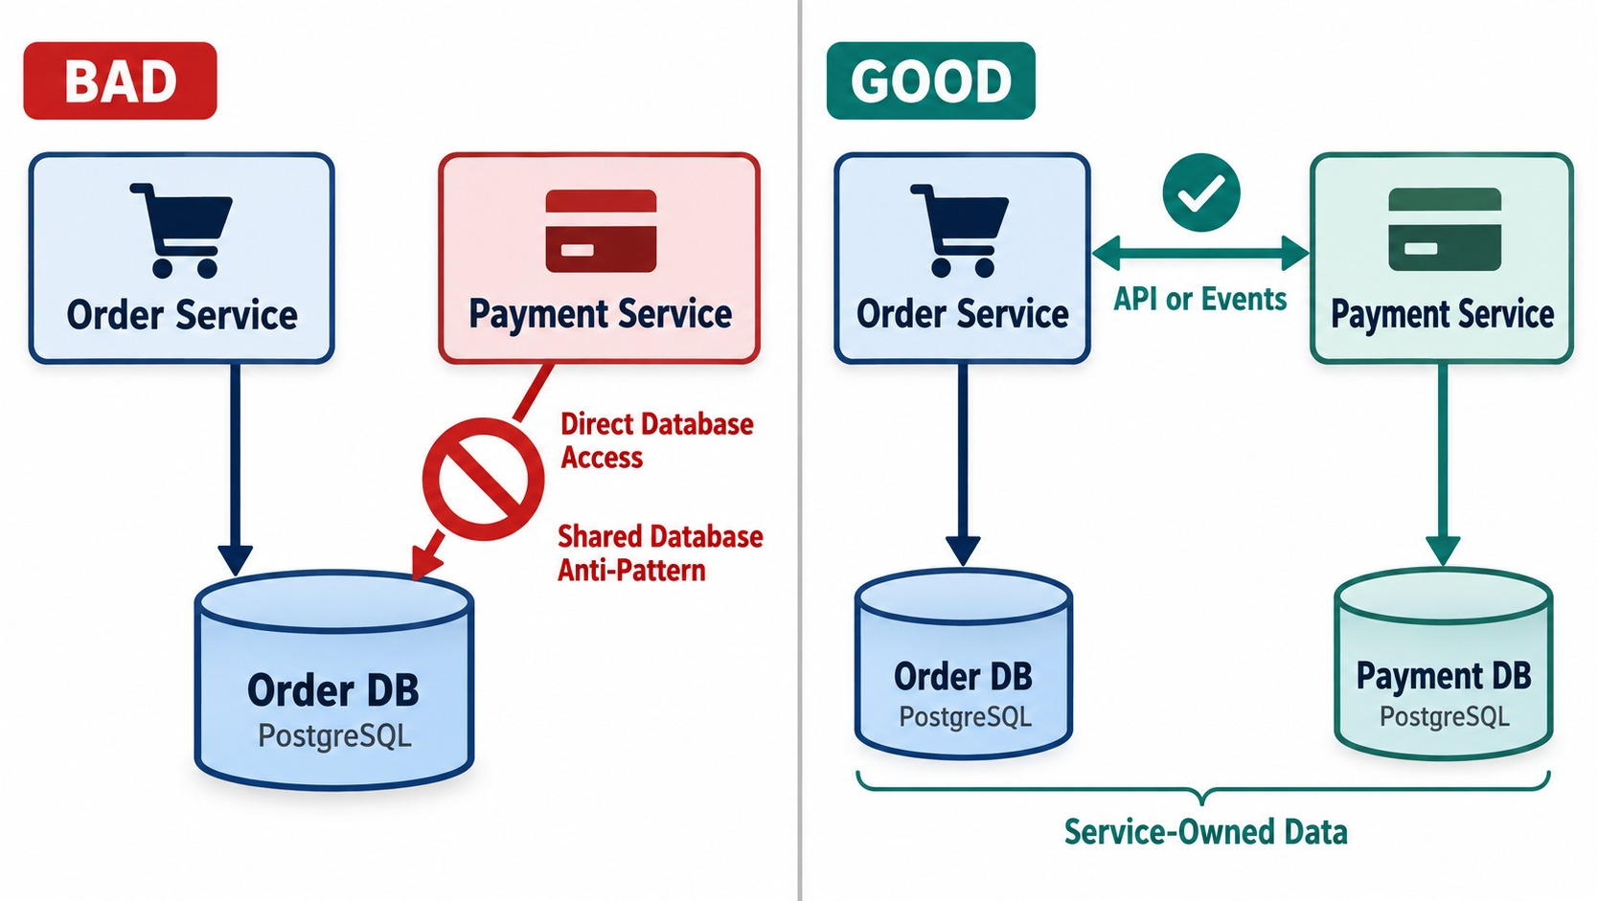
WHY SHARED DATABASE ACCESS IS DANGEROUS
One service reading or writing another service's tables creates coupling.
✕
Payment writes Order's table
UPDATE orders
SET status = 'PAID'
WHERE id = 1001; -- run by Payment
PAYMENT NOW DEPENDS ON
!
Order's table structure
!
Valid status values
!
Every future schema change
BETTER Payment publishes PaymentAuthorized; Order updates its own row.
KEY TAKEAWAY Data ownership is part of the microservice contract boundary.
18
© 2026 by Innovation In Software Corporation
Notes:
KEY TALKING POINTS
------------------
- A bad example
Suppose the Payment Service directly changes orders.status in the Order database.
- What Payment now has to know
Payment now needs to know Order's table structure, valid status values, constraints and business rules.
It also has to keep up with every schema change.
And it bypasses the Order Service's business logic.
- The database becomes the API
The database effectively becomes the integration API.
That is dangerous, because it creates tight data coupling.
- The better way
Payment communicates PaymentAuthorized to the Order Service.
Order decides how its own state should change.
Data ownership is part of the microservice contract boundary.
- Bad side
Payment Service reaches directly into Order DB — the shared database anti-pattern.
- Good side
Order and Payment talk through APIs or events, and each keeps its own database.
- Key point
Service-owned data keeps the database from becoming a hidden integration API.

Slide 19
GETTING DATA YOU DON'T OWN
API calls, API composition and event-built read models — never a cross-service join.
Approach | How it works | Trade-off
REST API call | Ask the owner at request time | Fresh, but a runtime dependency
API composition | Combine several owners' APIs | Many calls per request
Read model (CQRS) | A local copy built from events | Fast, but eventually consistent
Shared table or join | Query another service's database | ✕ Breaks ownership — never
✓
Order keeps a local customer view
@KafkaListener(topics = "customer.events")
void on(CustomerUpdated e) {
views.save(new CustomerView(
e.customerId(), e.name()));
}
RULE Copy only the fields you need; the owner stays the source of truth.
KEY TAKEAWAY Get other services' data through their APIs or their events — the owner stays the source of truth.
19
© 2026 by Innovation In Software Corporation
Notes:
KEY TALKING POINTS
------------------
- More than choosing PostgreSQL
Microservices data architecture involves several patterns, not just picking a database.
- Database per service and repository
Database per service defines ownership.
The repository pattern separates application logic from persistence access.
- Polyglot persistence
Polyglot persistence lets different services choose different data technologies, where that is justified.
- Replication through events
A service can keep a local copy of information that another service owns.
For example, Customer Service publishes CustomerUpdated, and Order Service updates its local customer view.
This can reduce synchronous calls, but it introduces eventual consistency.
- API call
Simplest and freshest, but the caller depends on the owner being up.
- API composition
A composer calls several services and merges the results, for example for a customer dashboard.
- Read model
Order Service consumes CustomerUpdated events and keeps a small local view.
Reads are fast and local, but slightly behind.
This is the read side of CQRS.
- Never
Joining into another service's tables recreates the shared database.

Slide 20
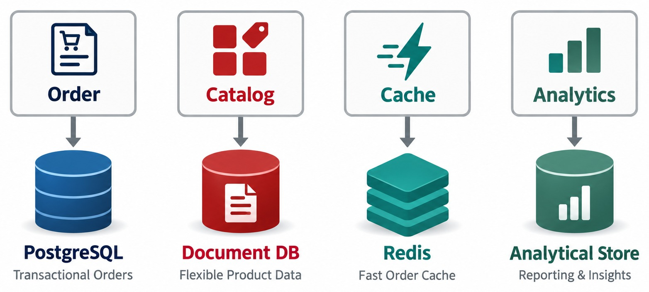
POLYGLOT PERSISTENCE
Services choose SQL, document, key-value or other stores based on requirements.
EVERY NEW STORE NEEDS
Operations skills
Monitoring
Backups
Security patching
Disaster recovery
Developer expertise
In this course
Every lab service uses PostgreSQL. Redis and document stores are lecture-only.
RULE Add a technology only when the benefit justifies the cost.
KEY TAKEAWAY Pick the right store per service — but only when the benefit outweighs the operational cost.
20
© 2026 by Innovation In Software Corporation
Notes:
KEY TALKING POINTS
------------------
- Pick storage per service
One advantage of independent services is choosing storage based on each service's needs.
An Order Service may benefit from relational transactions.
A Catalog Service may have flexible product structures that suit a document model.
Redis may suit low-latency cache access, and analytics may need a different storage architecture.
- The operational cost
Warn learners that polyglot persistence has an operational cost.
Every new technology adds operational knowledge, monitoring, backups, security, patching, disaster recovery and developer expertise.
- The rule
Use the right tool when the benefit justifies the complexity.
Do not add a technology just because microservices allow it.
- What it shows
Order on PostgreSQL, Catalog on a document database, a cache on Redis, and Analytics on an analytical store.
- Key point
Each store is chosen for how its data is used.

Slide 21
EXERCISE 2.1 — MAP ACCOUNT VS. TRANSACTION DATA
Day 2 checkpoint A: separate databases and no cross-service tables.
OFFICIAL CHECKPOINT A
10 MIN
labs/day-02/exercises/exercise-2.1-data-ownership.md
SCENARIO
YOUR TASKS
EXPECTED OUTCOME
Day 2 splits the banking platform into Account Service (Lab 1) and Transaction Service (Lab 2).
Scope: Account, Transaction and Risk Assessment only.
1
Account table lives only in account_db; transaction table only in transaction_db
✓
A two-column ownership map
✓
Zero shared tables
2
Transaction stores accountId as a reference, not a cross-service foreign key
✓
accountId kept as a plain reference
✓
Eligibility checked over REST
3
Eligibility is a REST GET to Account Service, not a SQL join
4
Redis is lecture-only — not part of this capstone
KEY TAKEAWAY A two-column ownership map with zero shared tables.
21
© 2026 by Innovation In Software Corporation
Notes:
KEY TALKING POINTS
------------------
- Official checkpoint
This is an official OUTLINE.md checkpoint for Day 2.
Use the worksheet in labs/day-02/exercises.
- Two databases
Account data stays in account_db and transaction data in transaction_db.
Lab 2 runs transaction_db on host port 5434.
- References, not joins
Transaction keeps accountId as a value.
To check eligibility it calls GET on Account Service; it never joins account_db.
- Scope
Redis appears in this module's lectures only; the capstone does not install it.

Slide 22
PART 3: TRANSACTIONS AND SAGAS
All-or-nothing inside a service; coordinated steps across services.
✓ Part 1
SQL persistence
✓ Part 2
Data ownership
Part 3
Transactions
Part 4
Caching
SO FAR
NEXT QUESTION
If one order touches three databases, how do we keep the business outcome correct?
✓
Each service owns its database
✓
Others use APIs, events or read models
IN THIS PART
✓
Extra stores only when justified
Local transactions and optimistic locking
1
2
The distributed transaction problem
3
Why ACID stops at the service boundary
4
Sagas: choreography and orchestration
5
Compensating transactions, in code
6
Exercise: design the compensation
22
© 2026 by Innovation In Software Corporation
Notes:
KEY TALKING POINTS
------------------
- Why this part
Data ownership removes the single shared transaction.
This part shows what replaces it.
- How it builds
We start with transactions inside one service, see why they can't span services, then build Sagas and compensation.

Slide 23
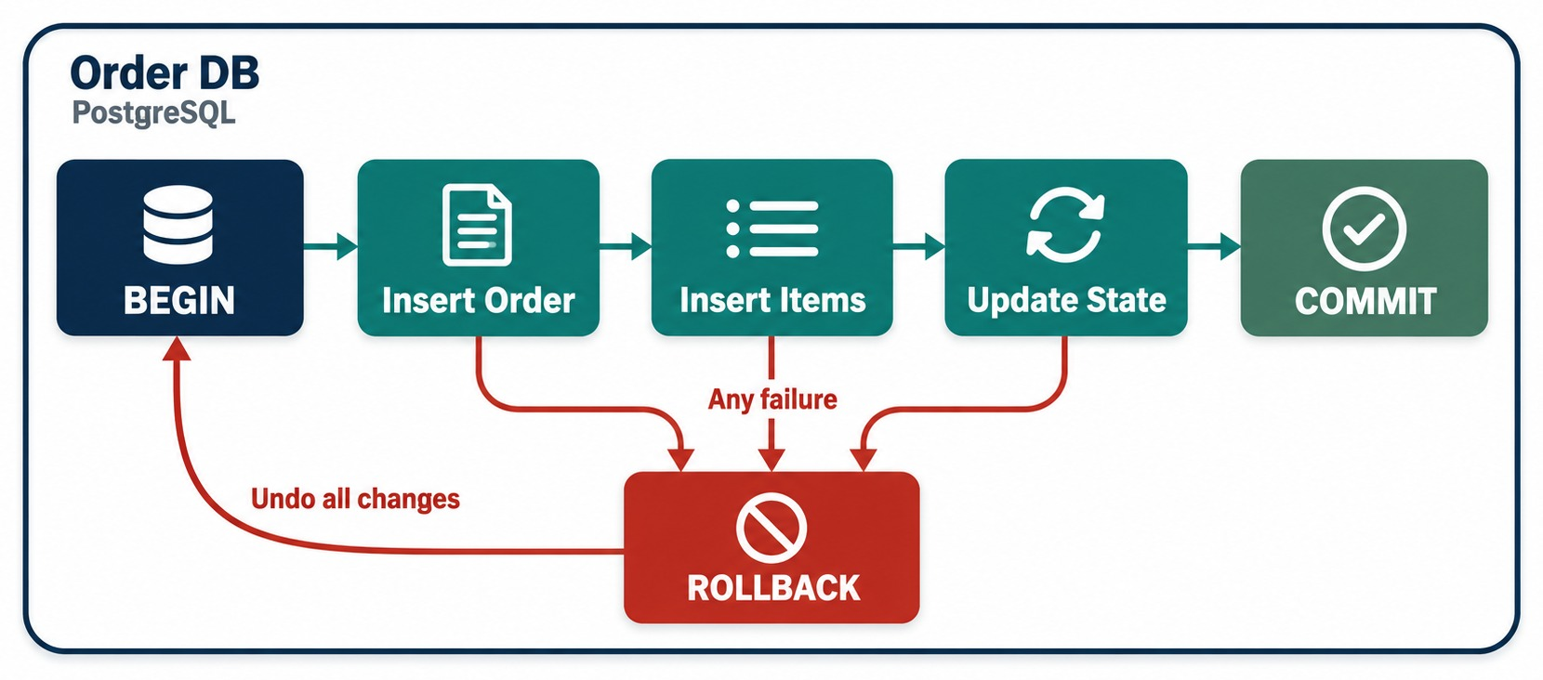
LOCAL TRANSACTIONS WITH @TRANSACTIONAL
Atomic operations inside a single Spring Boot service and database.
✓
One service, one database
@Transactional
public void create(CreateOrderRequest r) {
Order order = orders.save(Order.from(r));
items.saveAll(OrderItem.from(r, order));
}
RULES OF THUMB
✓
Put it on service methods
✓
Keep it short
✓
No remote calls inside
ROLLBACK RULE Runtime exceptions roll back by default; checked ones don't.
KEY TAKEAWAY @Transactional makes a service's local changes all-or-nothing.
23
© 2026 by Innovation In Software Corporation
Notes:
KEY TALKING POINTS
------------------
- Local transactions still matter
Inside one service and one database, traditional database transactions are still extremely useful.
- An example
Creating an order may mean inserting the order, inserting its items and updating related local state.
We do not want only part of that committed.
- @Transactional
@Transactional lets Spring manage a transaction around the method.
If everything succeeds, it commits.
If an applicable failure happens, it rolls back.
- A caution
Transaction behavior depends on configuration and on which exceptions are thrown.
Learners should not assume every exception behaves the same way.
- The key idea
Local ACID transactions remain valuable inside microservices.
- What it shows
Inside Order DB: begin, insert the order, insert items, update state, commit.
Any failure goes to ROLLBACK, which undoes all changes.
- Key point
Inside one database, all-or-nothing is easy.

Slide 24
CONCURRENT UPDATES: OPTIMISTIC LOCKING
Two users change the same order — only one update may win.
Order.java
✓
Service and error handler
@Entity
public class Order {
@Id @GeneratedValue
private Long id;
@Version
private long version; // checked on every update
private String status;
}
@Transactional
public OrderResponse cancel(Long id) {
Order order = orders.findById(id)
.orElseThrow(() -> new OrderNotFoundException(id));
order.cancel();
return OrderResponse.from(order);
} // UPDATE ... WHERE id = ? AND version = ?
@ExceptionHandler(ObjectOptimisticLockingFailureException.class)
@ResponseStatus(HttpStatus.CONFLICT)
ErrorResponse conflict() { ... } // 409: reload, retry
@Version
Conflict
Response
Hibernate adds the version to every UPDATE's WHERE clause.
If someone changed the row first, the update matches nothing.
Return 409 and let the client reload — no lost updates.
KEY TAKEAWAY A @Version column turns silent lost updates into a clear 409 Conflict.
24
© 2026 by Innovation In Software Corporation
Notes:
KEY TALKING POINTS
------------------
- The problem
Two requests load the same order.
Both change it and save.
Without protection, the second save silently overwrites the first.
- @Version
Hibernate reads the version and adds it to the UPDATE's WHERE clause, then increments it.
If the version changed meanwhile, zero rows update.
- Handling it
Spring throws ObjectOptimisticLockingFailureException.
Map it to 409 so the client reloads and tries again.
- Pessimistic locking
Locking the row up front also works, but it reduces concurrency and risks deadlocks.
Prefer optimistic locking for typical web traffic.

Slide 25
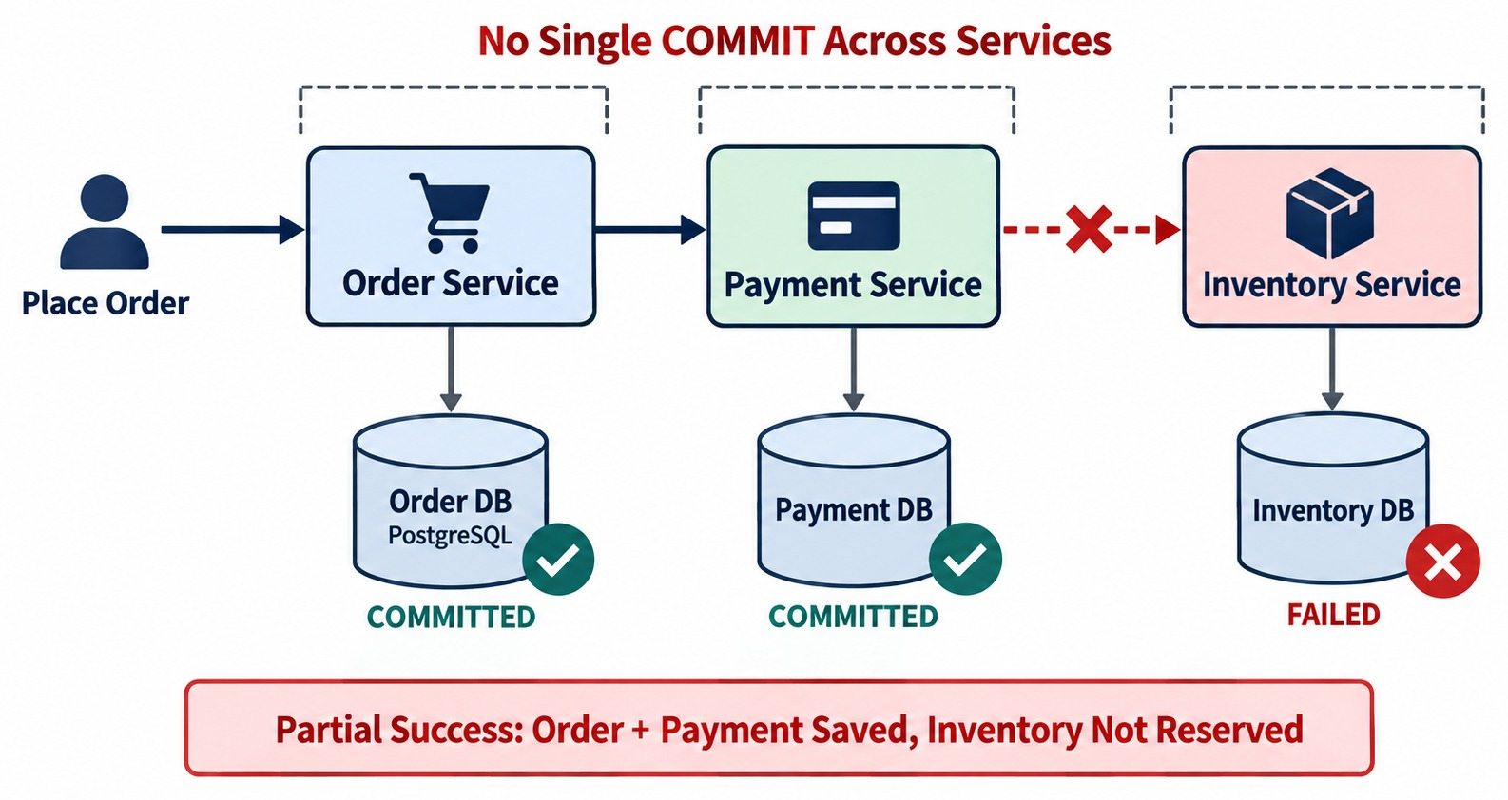
THE DISTRIBUTED TRANSACTION PROBLEM
One business operation spanning Order, Payment and Inventory databases.
WHY IT'S HARD
!
No single transaction manager
!
Networks fail mid-way
!
Payment providers can't roll back
Two-phase commit?
A coordinator locks every participant until all agree. It blocks, scales poorly and breaks on network splits.
THE QUESTION Who commits or undoes the whole business operation?
KEY TAKEAWAY When one business operation spans several databases, no single local transaction can undo it all.
25
© 2026 by Innovation In Software Corporation
Notes:
KEY TALKING POINTS
------------------
- A bigger scope
Now widen the scope.
Placing an order means creating the order, charging the payment and reserving inventory.
Each of these belongs to a different service and a different database.
- Partial failure
Imagine the order is created and the payment is charged, but the inventory reservation fails.
What happens now?
- No simple rollback
We cannot just tell the Order Service's local transaction to roll back everything.
The Payment Service may already have committed its own transaction.
It may even have called an external payment provider.
- The core challenge
This is the fundamental distributed transaction problem: who commits or rolls back the whole business operation?
- What it shows
Placing an order commits in Order DB and Payment DB, then fails in Inventory DB.
- Key point
The result is partial success: order and payment saved, inventory not reserved — and no single transaction can undo it.
- Two-phase commit
2PC asks every participant to prepare, then commit.
If the coordinator fails in between, participants stay locked.
That's why microservices usually avoid it.

Slide 26
WHY TRADITIONAL ACID TRANSACTIONS DON'T SPAN MICROSERVICES EASILY
Local transaction boundary versus distributed business workflow.
INSIDE ONE SERVICE
ACROSS SERVICES
A
Atomicity
Order Service
Order DB
All or nothing within the transaction
+
Consistency
Payment DB
C
@Transactional
+
Preserves defined database rules
Inventory DB
+
Isolation
Network
I
Order DB
+
Controls concurrent transactions
Independent processes
D
Durability
Atomic local transaction
Distributed business workflow
Committed data survives failures
One large technical transaction → a sequence of local transactions coordinated as a business workflow → Saga
KEY TAKEAWAY ACID works inside one database; across services we coordinate local transactions instead.
26
© 2026 by Innovation In Software Corporation
Notes:
KEY TALKING POINTS
------------------
- ACID
Atomicity means all or nothing within the transaction.
Consistency means the transaction keeps the database's defined rules.
Isolation means concurrent transactions are controlled according to the chosen isolation level.
Durability means committed data survives failures, within the database's guarantees.
- Works inside one database
These guarantees work very well inside one database transaction, like the Order Service with @Transactional on the Order DB.
- Microservices add boundaries
But microservices deliberately introduce multiple databases, multiple processes and network boundaries.
They also bring independent deployments and independent failures.
- The shift
So the design moves away from one large technical transaction.
It moves toward a sequence of local transactions coordinated as a business workflow.
That leads directly to the Saga pattern.

Slide 27
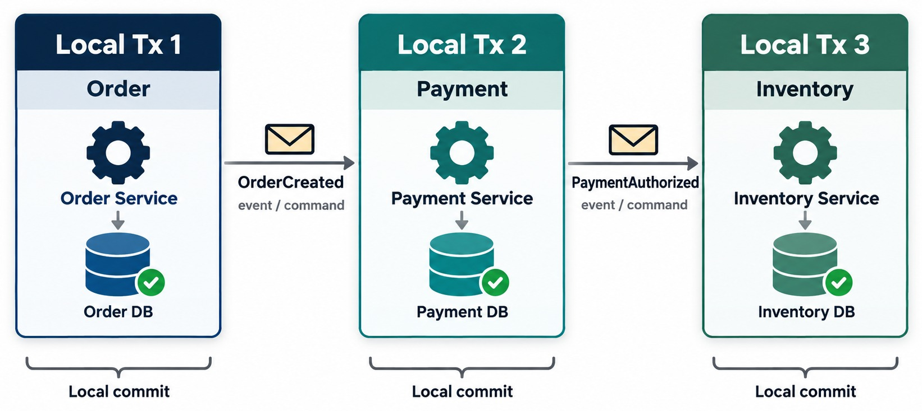
SAGA PATTERN
A sequence of local transactions coordinated through commands or events.
Saga =
A sequence of local transactions + coordination + compensation.
Between steps
Each commit publishes an event or sends a command that starts the next step.
Visible in-between states
Others may see an order as PENDING — design screens and rules for it.
NOT ACID A Saga coordinates small transactions — it never makes one big one.
KEY TAKEAWAY A Saga breaks one distributed business transaction into local transactions that each commit.
27
© 2026 by Innovation In Software Corporation
Notes:
KEY TALKING POINTS
------------------
- Smaller local transactions
A Saga breaks a distributed business transaction into smaller local transactions.
- The three steps
Transaction 1: the Order Service creates the order and commits to the Order DB.
Transaction 2: the Payment Service processes the payment and commits to the Payment DB.
Transaction 3: the Inventory Service reserves inventory and commits to the Inventory DB.
- Coordination and compensation
Steps communicate through commands or events.
If a later step fails, the system runs compensating business operations.
- What a Saga is not
A Saga does not create one ACID transaction across every service.
It coordinates local transactions to maintain business consistency.
- What it shows
Three local transactions in Order, Payment and Inventory, each with its own local commit, linked by OrderCreated and PaymentAuthorized.
- Key point
A saga is a chain of small commits, not one big transaction.
- No isolation
Unlike a database transaction, a Saga's intermediate states are visible.
An order can be PENDING while payment is still running, so status values must say so.

Slide 28
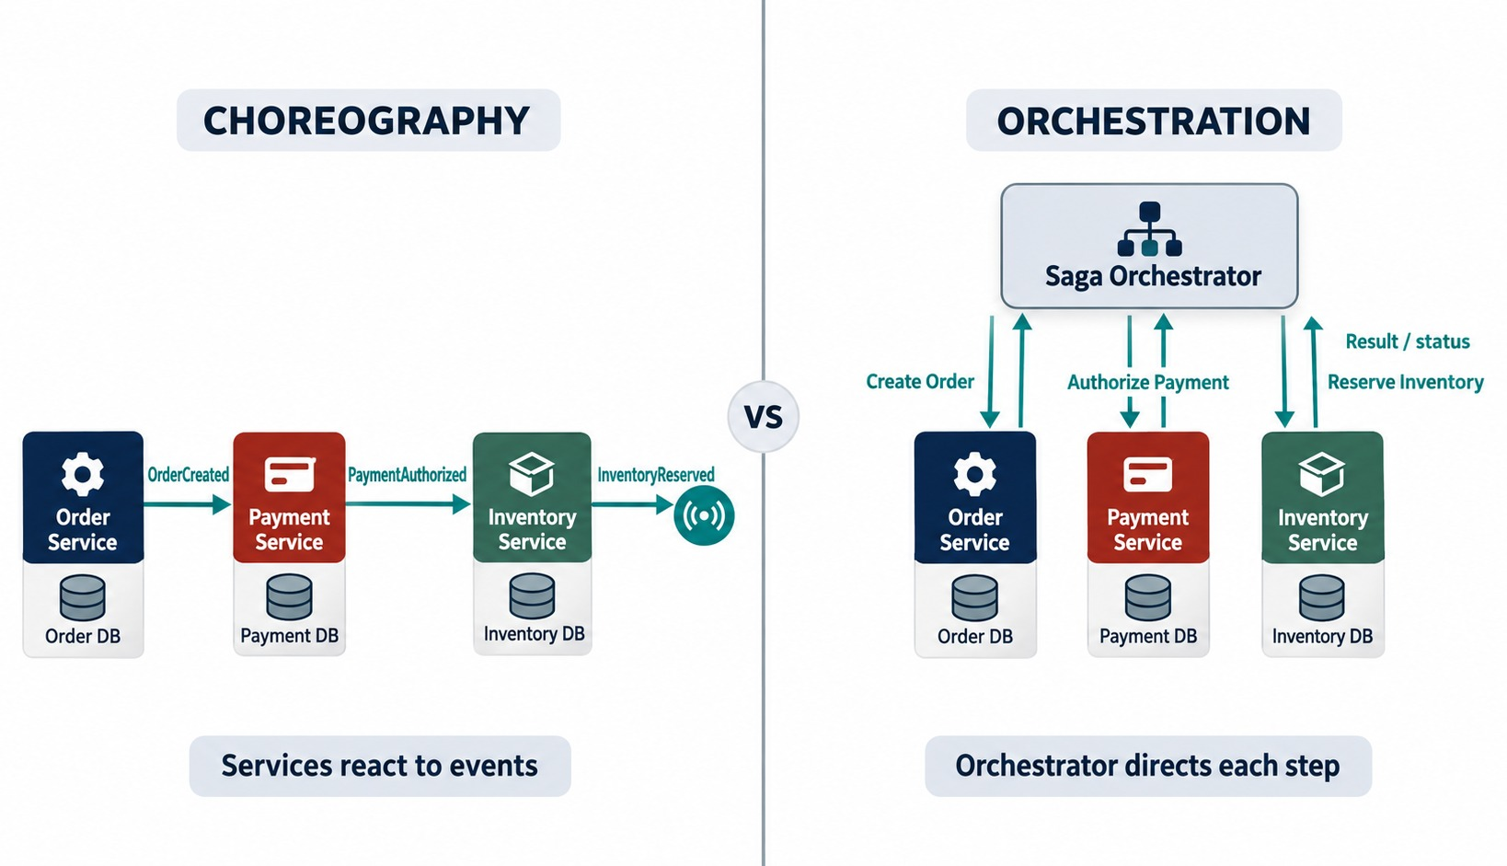
SAGA CHOREOGRAPHY VS. SAGA ORCHESTRATION
Events trigger each local transaction, or an orchestrator commands them.
Choreography saga
Each local commit publishes the event that triggers the next step. Suits a few steps.
Orchestration saga
An orchestrator sends commands and stores saga state. Suits many steps and compensation.
EITHER WAY
✓
Store saga state durably
✓
Make every step idempotent
✓
Trace with a correlation ID
FROM MODULE 4 Same styles — now each step is a local transaction.
KEY TAKEAWAY Choreography chains local transactions through events; orchestration commands them from one place.
28
© 2026 by Innovation In Software Corporation
Notes:
KEY TALKING POINTS
------------------
- Familiar from Module 4
This should feel familiar.
In choreography, each service reacts to events.
Order publishes OrderCreated, Payment reacts and publishes PaymentAuthorized, Inventory reacts and publishes InventoryReserved, and Shipping reacts.
- A different perspective
In Module 4 we studied event-driven integration.
Here we ask how these events can coordinate a multi-service business transaction while each service commits locally.
- Benefits
It is decentralized and fits event-driven systems.
There is no central workflow controller.
- Challenges
The whole Saga is harder to see, and failure paths get complex.
Debugging is harder, and event chains can become complicated.
- Choreography
Order, Payment and Inventory each react to the previous event and publish the next.
- Orchestration
A Saga Orchestrator sends create order, authorize payment and reserve inventory, and receives each result.
- Key point
The same local transactions, coordinated two different ways.
- Familiar from Module 4
This should feel familiar.
In choreography, each service reacts to events.
Order publishes OrderCreated, Payment reacts and publishes PaymentAuthorized, Inventory reacts and publishes InventoryReserved, and Shipping reacts.
- A different perspective
In Module 4 we studied event-driven integration.
Here we ask how these events can coordinate a multi-service business transaction while each service commits locally.
- Benefits
It is decentralized and fits event-driven systems.
There is no central workflow controller.
- Challenges
The whole Saga is harder to see, and failure paths get complex.
Debugging is harder, and event chains can become complicated.
- One component knows the workflow
In orchestration, a Saga orchestrator knows the workflow.
It issues commands such as CreateOrder, ProcessPayment and ReserveInventory, and reacts to the results.
- Handling failure
If inventory fails, the orchestrator decides the compensation sequence.
For example, InventoryReservationFailed leads to RefundPayment, then CancelOrder.
- Benefits
The workflow is explicit and easier to visualize.
There is one central place for complex decisions.
- Challenges
The orchestrator becomes an important component.
If poorly designed, it collects too much business logic.
It must itself be resilient and observable.

Slide 29
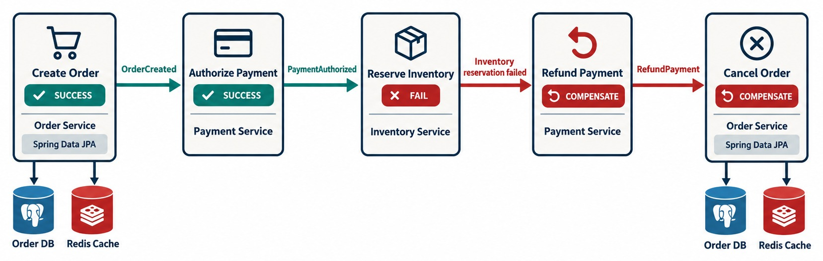
COMPENSATING TRANSACTIONS AND FAILURE RECOVERY
Undo completed business actions when a later step fails.
EVERY STEP NEEDS ITS UNDO
✓
Charge $200 → refund $200
✓
Create order → cancel order
✓
Reserve stock → release stock
Refund ≠ rollback
It's a new business transaction, with its own record and audit trail.
COMPENSATIONS FAIL TOO Retry them, make them idempotent, alert on failure.
KEY TAKEAWAY Sagas don't roll back committed work — they run compensating business actions.
29
© 2026 by Innovation In Software Corporation
Notes:
KEY TALKING POINTS
------------------
- One of the most important slides
A Saga does not roll back transactions that were already committed.
Instead, we run business actions that compensate for them.
- Examples
The original action charged the customer 200 dollars, so the compensation refunds 200 dollars.
The original action created an order, so the compensation cancels the order.
A refund is not a database rollback.
It is a new business transaction.
- Business logic, not a technical undo
Compensation is business logic.
It is not necessarily the technical opposite of the original database operation.
- Compensations can fail too
Production systems need retry policies, idempotency, audit trails and monitoring.
They also need manual recovery procedures for exceptional cases.
Connect this back to reliable messaging in Module 4.
- What it shows
Create order and authorize payment succeed, reserve inventory fails, so the saga refunds the payment and cancels the order.
- Key point
Compensations run in reverse and are new business actions, not rollbacks.

Slide 30
COMPENSATION IN CODE
Inventory failed: Order asks for a refund, Payment refunds exactly once.
Order Service — start compensating
✓
Payment Service — compensate once
@KafkaListener(topics = "inventory.reservation-failed",
groupId = "order-service")
@Transactional
public void on(InventoryReservationFailed e) {
Order order = orders.findById(e.orderId()).orElseThrow();
if (order.isCancelled()) return; // idempotent
order.markCancelling();
outbox.save(OutboxEvent.of("payments.refund-requested",
order.getId(),
new RefundPayment(order.getId(), order.getTotal())));
}
@KafkaListener(topics = "payments.refund-requested",
groupId = "payment-service")
@Transactional
public void on(RefundPayment cmd) {
if (refunds.existsByOrderId(cmd.orderId())) return;
refunds.save(Refund.of(cmd.orderId(), cmd.amount()));
outbox.save(OutboxEvent.of("payments.refunded",
cmd.orderId(), new PaymentRefunded(cmd.orderId())));
}
Command, then event
Idempotent both sides
Outbox
Order asks for a refund; Payment reports PaymentRefunded.
A repeated message never refunds or cancels twice.
State change and message commit together — from Module 4.
KEY TAKEAWAY Compensation is ordinary, idempotent business code — triggered by a failure event and published through the outbox.
30
© 2026 by Innovation In Software Corporation
Notes:
KEY TALKING POINTS
------------------
- Order Service
When inventory reservation fails, Order marks the order as cancelling and writes a RefundPayment command to its outbox, in one local transaction.
- Payment Service
It checks whether this order was already refunded.
If not, it records the refund and publishes PaymentRefunded through its own outbox.
- Closing the loop
Order consumes PaymentRefunded and marks the order CANCELLED.
- Why idempotency
Messages can arrive twice.
Without the checks, a customer could be refunded twice.

Slide 31
EXERCISE: DESIGN THE COMPENSATION
A late step fails — decide how the saga recovers.
PRACTICE EXERCISE
12 MIN
SCENARIO
YOUR TASKS
EXPECTED OUTCOME
The order saga runs:
Create Order → Authorize Payment → Reserve Inventory → Create Shipment
Shipping rejects the address after payment and inventory both succeeded.
1
List the compensations, in order
✓
Release the reserved inventory
2
Mark which steps must be idempotent — and why
Refund or void the payment
✓
Say what the customer sees at each stage
✓
Mark the order CANCELLED — or ask for a new address
3
✓
Every compensation is idempotent
✓
Customer sees PENDING, then a clear notice
KEY TAKEAWAY Compensate in reverse order, make every step idempotent, and keep the customer informed.
31
© 2026 by Innovation In Software Corporation
Notes:
KEY TALKING POINTS
------------------
- Reverse order
Undo the most recent completed step first: release inventory, then refund the payment, then close the order.
- A business choice
Instead of cancelling, the business may pause the saga and ask the customer for a valid address.
Compensation isn't always the only answer.
- Idempotency
Every step and every compensation can receive the same message twice, so each checks whether it already ran.
- Customer view
The order shows PENDING during the saga, then either CONFIRMED or a clear failure message with the refund.

Slide 32
PART 4: CACHING WITH REDIS
Faster reads — at the cost of a second copy of the data.
✓ Part 1
SQL persistence
✓ Part 2
Data ownership
✓ Part 3
Transactions
Part 4
Caching
SO FAR
NEXT QUESTION
Reads are slow and repeated — how do we speed them up without serving wrong data?
✓
Local transactions inside one service
✓
Sagas coordinate steps across services
IN THIS PART
✓
Compensations undo committed work
Redis as an external cache
1
2
The cache-aside pattern
3
Expiration and invalidation
4
Caching in Spring Boot, in code
5
Exercise: what should we cache?
6
The complete data architecture
32
© 2026 by Innovation In Software Corporation
Notes:
KEY TALKING POINTS
------------------
- Why caching now
Once data is split across services, reads can get slow.
Caching helps, but it adds another copy to keep consistent.
- Course scope
Redis is taught here but not installed in the labs.

Slide 33
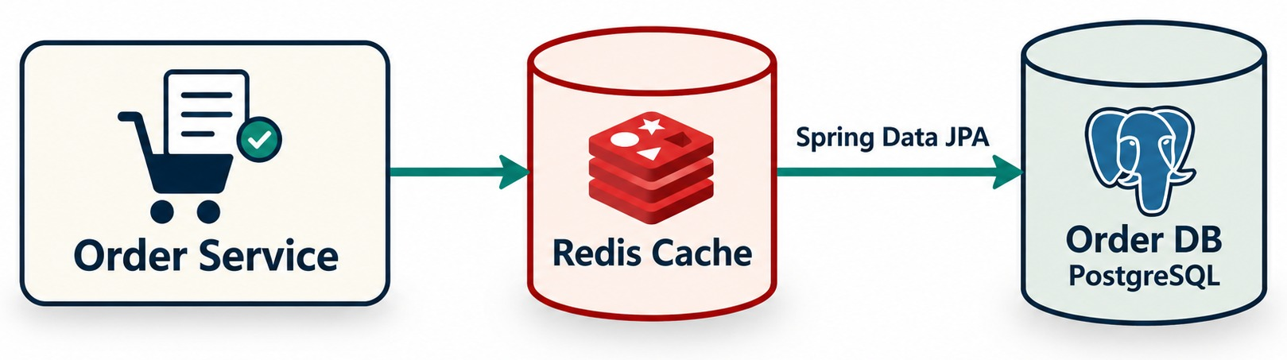
INTRODUCTION TO REDIS CACHING
Redis as an external in-memory store for frequently accessed data.
WHAT REDIS IS HERE
Good candidates
WARNING A cache is a second copy of data — a consistency problem.
In-memory
Key-value
Product details, reference data, dashboard summaries — read often, change rarely.
Shared by all pods
Not the system of record
KEY TAKEAWAY Redis speeds up repeated reads — but every cache is a second copy to keep consistent.
33
© 2026 by Innovation In Software Corporation
Notes:
KEY TALKING POINTS
------------------
- Not every request needs the database
Not every request should cause an expensive database query.
Suppose clients often request GET /products/1001, and product data changes rarely.
- What Redis is
A cache stores frequently used data close to the application.
Redis is an in-memory data platform, commonly used for caching and other purposes.
It works as an external key-value store.
- Benefits
Caching can improve response latency, reduce database load and help read-heavy workloads scale.
- The catch
A cache is another copy of the data.
That immediately creates a consistency problem.
- What it shows
Order Service reads through a Redis cache that sits in front of Order DB on PostgreSQL.
- Key point
Redis is a fast copy; PostgreSQL stays the source of truth.

Slide 34
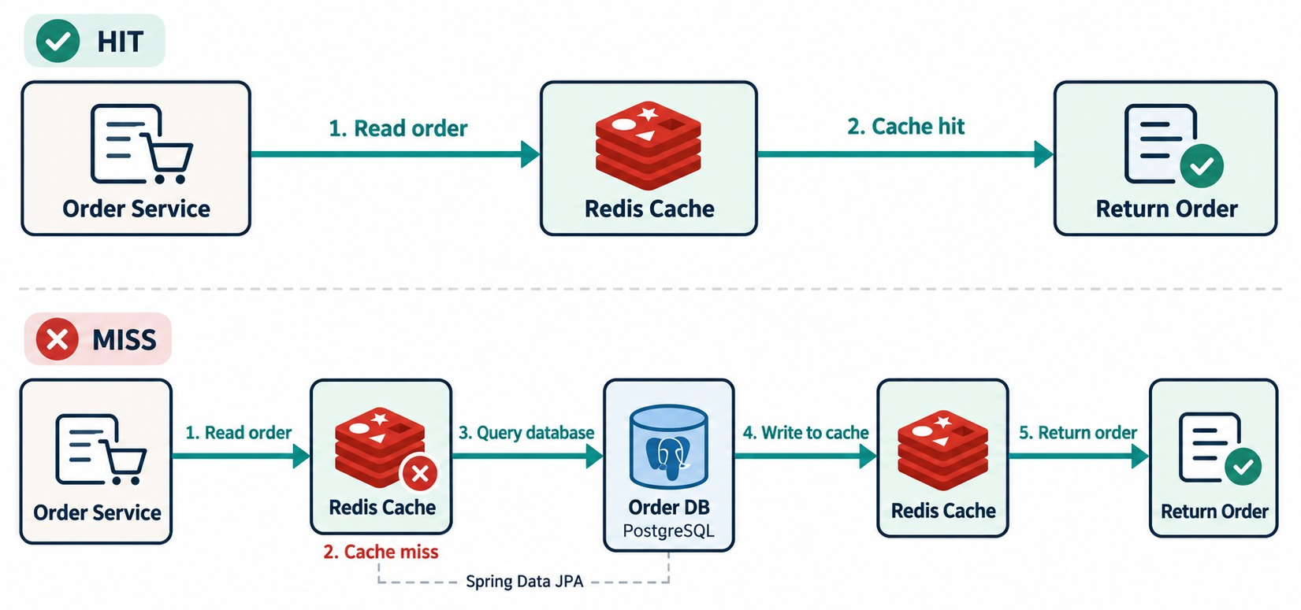
CACHE-ASIDE PATTERN
Cache → miss → database → populate cache → next request hits.
What's stored
Key: order:1001
Value: {"id":1001,"status":"PAID"}
TTL: 600 seconds
Key design
Namespace by entity — order:1001, customer:501:profile. Cache DTOs, not entity graphs.
Cache down?
Fall back to the database — the service must still work.
OWNER The application decides what to cache and when.
KEY TAKEAWAY Check the cache first; on a miss, read the database and populate the cache for next time.
34
© 2026 by Innovation In Software Corporation
Notes:
KEY TALKING POINTS
------------------
- A common pattern
Cache-aside is one of the most common caching patterns.
Suppose we need product 1001.
- Hit
The application checks Redis for the key product:1001.
If it is there, that is a hit.
Redis returns the data, and no database query is needed.
- Miss
If it is not there, that is a miss.
The application reads from the database, stores the result in Redis, and returns the response.
The next request can then be served from the cache.
- Who owns the logic
The application is responsible for the cache-aside logic, although frameworks can hide parts of it.
- Hit
Order Service reads Redis, gets the order and returns it.
- Miss
Redis has no entry, so the service queries Order DB, writes the result to Redis, and returns it.
- Key point
The application manages the cache around its database reads.

Slide 35
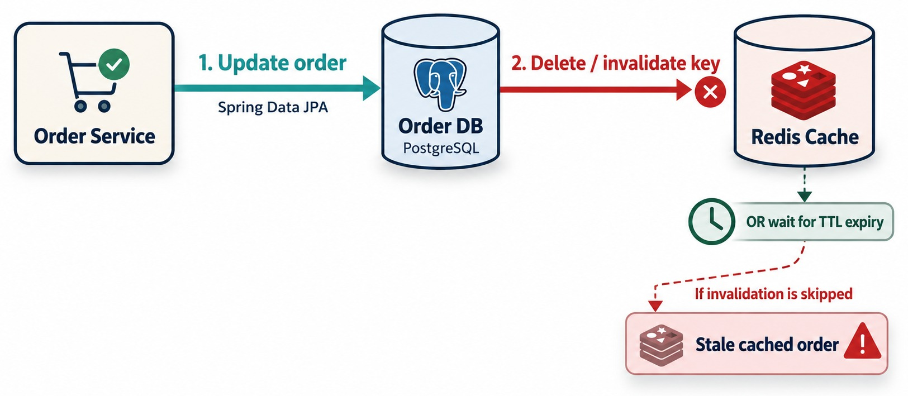
CACHE EXPIRATION, INVALIDATION AND CONSISTENCY
TTL, stale data, invalidation and cache/database consistency.
Long TTL
More cache hits, but staler data.
Short TTL
Fresher data, but more database traffic.
MATCH TTL TO THE DATA
Status: short
Profile: moderate
Products: long
Balances: don't
RULE Every cached read needs a matching evict on write.
KEY TAKEAWAY Caching improves performance by accepting extra state-management complexity.
35
© 2026 by Innovation In Software Corporation
Notes:
KEY TALKING POINTS
------------------
- Stale data
Caching is easy until the underlying data changes.
Redis says order 1001 is PROCESSING, but the database now says SHIPPED.
Redis still has the old value.
This is stale cache data.
- TTL
TTL means time to live.
You set the cache entry to expire after some seconds or minutes, so it eventually disappears.
- Invalidation
With explicit invalidation, you delete the cache entry when the record changes, and the next read repopulates it.
With event-driven invalidation, a service reacts to an event like OrderUpdated and invalidates or refreshes the cached copy.
- The trade-off
A long TTL gives a better hit rate, but data may be staler.
A short TTL gives fresher data, but more database traffic.
There is no universal TTL.
It depends on business requirements.
- What it shows
Order Service updates the order in the database, then deletes the cache key.
A TTL is the fallback.
- The warning
If invalidation is skipped, Redis keeps serving a stale cached order.
- Key point
Every write path needs an invalidation plan.
- Stampede
When a popular key expires, many requests can hit the database at once.
Locking the recomputation or refreshing early prevents it.

Slide 36
CACHING IN SPRING BOOT
@Cacheable for cache-aside, @CacheEvict for invalidation, a TTL as the safety net.
✓
OrderService.java
Enable Redis caching
@Cacheable(cacheNames = "orders", key = "#id")
public OrderResponse find(Long id) {
return orders.findById(id)
.map(OrderResponse::from)
.orElseThrow(() -> new OrderNotFoundException(id));
}
@CacheEvict(cacheNames = "orders", key = "#id")
@Transactional
public OrderResponse cancel(Long id) { ... }
@SpringBootApplication
@EnableCaching
public class OrderApplication { }
# application.yml
spring:
data:
redis:
host: ${REDIS_HOST}
cache:
type: redis
redis:
time-to-live: 10m
@Cacheable
@CacheEvict
Transactions
Checks Redis first; on a miss runs the method and stores the result.
Removes the entry when the order changes.
Eviction can run before commit — a short TTL limits the stale window.
KEY TAKEAWAY Cache the read, evict on the write, and keep a TTL as the safety net.
36
© 2026 by Innovation In Software Corporation
Notes:
KEY TALKING POINTS
------------------
- Enable it
Add spring-boot-starter-data-redis, put @EnableCaching on the application, and point spring.data.redis.host at the Redis server.
- @Cacheable
Spring checks the orders cache for the ID.
On a hit it skips the method; on a miss it runs it and stores the DTO.
- @CacheEvict
After cancel succeeds, the cached entry is removed so the next read reloads it.
- Safety nets
A default TTL of ten minutes limits damage from any missed eviction.
Cached objects need a serializer, such as JSON.

Slide 37
EXERCISE: WHAT SHOULD WE CACHE?
Choose a caching strategy for each kind of data.
PRACTICE EXERCISE
10 MIN
SCENARIO
YOUR TASKS
EXPECTED OUTCOME
Decide the strategy for each item:
1
Cache it — or not?
✓
Catalog, branch list: cache, long TTL
Product catalog page
Order status for tracking
Account balance
Exchange rates
Fraud decision
Branch and ATM list
Customer dashboard summary
2
If yes, choose a TTL and an invalidation trigger
✓
Exchange rates: cache for minutes
3
Name one item where stale data causes real harm
✓
Dashboard, order status: short TTL + evict on change
✓
Balance, fraud decision: don't cache
✓
A stale balance → a wrong spending decision
KEY TAKEAWAY Cache what is read often and tolerates staleness; never cache what must be exact right now.
37
© 2026 by Innovation In Software Corporation
Notes:
KEY TALKING POINTS
------------------
- Easy wins
The product catalog and branch list change rarely, so long TTLs are safe.
- Short-lived
Exchange rates, order status and dashboards change, so use short TTLs and evict when the data changes.
- Don't cache
Balances and fraud decisions must be exact now.
A stale value can approve a payment that should fail.
- Discussion
Ask learners what the business impact of five minutes of staleness would be for each item.

Slide 38
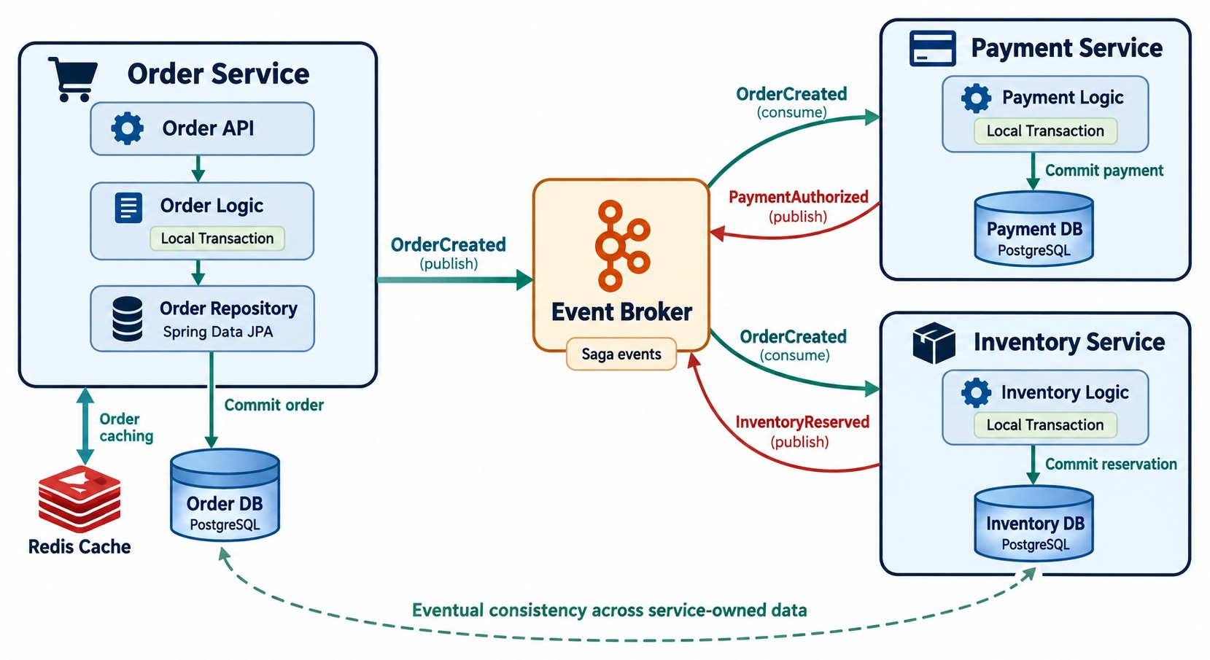
END-TO-END MICROSERVICES DATA ARCHITECTURE
Service-owned SQL databases, local transactions, events and Sagas, and Redis caching.
EVERYTHING IN ONE PICTURE
✓
Service-owned databases
✓
Local transactions
✓
Saga events through the broker
✓
Eventual consistency
✓
Redis for fast reads
Read it
Follow OrderCreated out, and PaymentAuthorized and InventoryReserved back.
REMEMBER The database is the source of truth — not the cache, not the broker.
KEY TAKEAWAY Own your data, commit locally, coordinate with Sagas, and cache with care.
38
© 2026 by Innovation In Software Corporation
Notes:
KEY TALKING POINTS
------------------
- Ownership and local persistence
Use this slide to rebuild the module.
Each service owns its data: Order, Payment, Inventory and Shipping each have their own database.
Inside a service, Spring Boot goes from controller to service to repository, then through JPA to the SQL database.
- Local transactions
@Transactional gives atomic transaction management inside one local persistence boundary.
- Saga across services
The business workflow spans Order, Payment, Inventory and Shipping, but they do not share one local transaction.
A Saga coordinates them, with each participant doing a local transaction linked by events or commands.
- Compensation and eventual consistency
If payment succeeds but inventory fails, we refund the payment and cancel the order.
Services may briefly see different states while events and compensations propagate.
- Redis
Redis improves read performance.
A hit returns quickly, and a miss goes to the database.
Expiration and invalidation must be designed carefully.
- Final message
Microservices need explicit data ownership, with local transactions for each service's own data.
Cross-service business transactions are coordinated with patterns like Sagas.
Redis can speed up reads, but it adds consistency, expiration and invalidation concerns.
- What it shows
Order Service with its local transaction, Order DB and Redis cache publishes OrderCreated.
Payment and Inventory commit locally and publish their results through the broker.
- How to read it
The dashed line at the bottom marks eventual consistency across the service-owned databases.
- Key point
Every data idea in the module fits together in this one architecture.

Slide 39
DATA MISCONCEPTIONS AND ANTI-PATTERNS
Beliefs and habits that quietly couple services through their data.
MISCONCEPTION
REALITY
ANTI-PATTERNS TO AVOID
Database per service means a server each
It means ownership — schemas can share a server
✕
One database shared by services
✕
@ManyToOne into another service's data
✕
ddl-auto: update in production
Microservices can't use transactions
Local ACID transactions still work inside a service
✕
Returning entities from APIs
✕
Two-phase commit by default
✕
Caching balances without invalidation
A Saga rolls back like a database
It runs new, compensating business actions
REMEMBER Data is the hardest coupling — own a store, not a shared schema.
ORM means you don't need SQL
Keys, indexes and N+1 queries still matter
The cache is the source of truth
The database is; the cache is a copy
KEY TAKEAWAY Keep data owned, transactions local, compensations explicit and caches honest.
39
© 2026 by Innovation In Software Corporation
Notes:
KEY TALKING POINTS
------------------
- Why this slide
Before the knowledge check, clear away the beliefs that recreate a distributed monolith through data.
- Ownership and transactions
Database per service is about who may access the data, not about servers.
And local transactions are still the right tool inside one service.
- Sagas and ORM
A Saga never rolls back committed work; it compensates.
ORM still needs good keys, indexes and awareness of N+1 queries.
- Anti-patterns
Shared databases, cross-service mappings, Hibernate-managed production schemas, exposed entities, 2PC by default and stale cached balances.

Slide 40
KNOWLEDGE CHECK
Answer in your own words — then compare with a partner.
Why should each service own its database or schema?
Why are distributed transactions hard?
1
6
What does Spring Data JPA provide?
What is a saga?
2
7
Why avoid JPA relationships across service boundaries?
What is eventual consistency?
3
8
What is the repository pattern for?
When is Redis useful?
4
9
Where does @Transactional usually belong?
Why should large list APIs use pagination?
5
10
40
© 2026 by Innovation In Software Corporation
Notes:
KEY TALKING POINTS
------------------
- 1. Ownership
It allows independent schema changes, deployments and service autonomy.
- 2. Spring Data JPA
Repository abstractions that remove persistence boilerplate.
- 3. Cross-service relationships
They create database coupling and break service ownership.
- 4. Repository pattern
It separates persistence access from business logic.
- 5. @Transactional
In the service layer, where business operations are coordinated.
- 6. Distributed transactions
They need coordination across services and databases, which adds coupling and operational risk.
- 7. Saga
A sequence of local transactions across services, with compensation for failures.
- 8. Eventual consistency
Services become consistent after a delay rather than instantly.
- 9. Redis
For fast access to frequently read or short-lived data.
- 10. Pagination
It stops huge result sets from overloading the database, service, network and client.
- Practical scenario
Account Service publishes AccountOpened and Reporting updates its dashboard.
Account owns the data; reporting is eventually consistent; if Reporting is down it catches up later; Account never writes Reporting's database.

Slide 41
MODULE 5 SUMMARY AND WHAT'S NEXT
From one service's SQL tables to a consistent, cached, multi-service data design.
YOU CAN NOW
NEXT: MODULE 6 — RESILIENT, HIGH-PERFORMANCE SERVICES
✓
Persist data with Spring Data JPA, Flyway and a pooled DataSource
1
What happens when a dependency slows down?
✓
Keep each service's data private — share through APIs and events
2
How do timeouts, retries and circuit breakers work together?
✓
Use local transactions and optimistic locking inside a service
How do we find and fix performance bottlenecks?
3
✓
Coordinate cross-service work with Sagas and compensation
✓
Cache reads with Redis, with TTLs and invalidation
BRING ALONG Your Lab 2 Transaction Service and its own transaction_db.
KEY TAKEAWAY Module 6 keeps these services responsive when dependencies slow down or fail.
41
© 2026 by Innovation In Software Corporation
Notes:
KEY TALKING POINTS
------------------
- Recap
We persisted data with Spring Data JPA, drew ownership boundaries, replaced shared transactions with Sagas, and added caching.
- Next module
Module 6 is about resilience and performance: timeouts, retries, circuit breakers and finding bottlenecks.

