Slide 1
"Failures are expected — design them to be contained, observable and recoverable."
MODULE 6
Resilient and High-Performance
Microservices
Designing distributed services that stay responsive, observable and recoverable.
Designing for failure
Timeouts and retries
Circuit breakers
Bulkheads
Observability
SLAs, SLOs and SLIs
Continuous testing
SPRING BOOT MICROSERVICES BOOTCAMP • MODULE 6
Notes:
KEY TALKING POINTS
------------------
- More arrows, more risk
Microservices add network boundaries and independent runtime parts.
Order may call Payment, which calls an external payment provider.
Order may also call Inventory, which uses its own database.
Every arrow adds a possible source of latency, timeouts, unavailability, resource exhaustion and partial failure.
- The real objective
The goal is not to build a system that never fails.
The goal is a system where individual failures are expected, contained, observable and recoverable.
- Link to Module 5
In Module 5, a Saga kept business data consistent after a failure.
Module 6 asks how the services themselves stay healthy and responsive while failures happen.

Slide 2
LEARNING OBJECTIVES
Failure handling, observability, reliability targets and resilience testing.
🎯
BY THE END OF THIS MODULE, YOU CAN
🧭
FOUR SECTIONS
1. Explain failure in distributed systems
2. Configure appropriate timeouts
3. Apply safe retry strategies
4. Explain exponential backoff and jitter
5. Implement circuit-breaker concepts
6. Apply bulkhead isolation
7. Design graceful degradation
8. Use logs, metrics and traces
9. Distinguish SLI, SLO and SLA
10. Continuously test resilience
1
Failure handling
Timeout
Retry
Circuit Breaker
Bulkhead
Fallback
2
Observability
Logs
Metrics
Traces
3
Reliability targets
SLI
SLO
SLA
4
Validation
Test
Measure
Fail
Recover
Improve
KEY TAKEAWAY Learn the individual patterns — and how they work together in production.
2
© 2026 by Innovation In Software Corporation
Notes:
KEY TALKING POINTS
------------------
- By the end of this module
Learners should be able to explain failure in distributed systems and configure sensible timeouts.
They should apply safe retries, with exponential backoff and jitter.
They should use circuit breakers, bulkheads and graceful degradation.
They should use logs, metrics and traces, tell SLI, SLO and SLA apart, and test resilience continuously.
- Four sections
One: failure handling with timeouts, retries, circuit breakers, bulkheads and fallbacks.
Two: observability with logs, metrics and traces.
Three: reliability targets, from SLI to SLO to SLA.
Four: validation, a loop of test, measure, fail, recover and improve.
- The bigger picture
Learners should understand not just each pattern, but how they work together in a production architecture.

Slide 3
KEY TERMS FOR THIS MODULE
Plain definitions for the words we'll use most.
1
Timeout
2
Retry with backoff
The longest a call may wait before it gives up.
Trying a failed call again after growing, slightly randomized delays.
3
Circuit breaker
4
Bulkhead
Stops calling a failing dependency for a while, so calls fail fast.
Limits what one dependency can use, so it can't exhaust the whole service.
5
Fallback
6
Correlation ID
A safe response when a dependency fails — never an invented success.
One identifier carried through every service and log line for a single request.
7
Liveness and readiness
8
Service level objective
Liveness means restart me; readiness means don't send me traffic yet.
The reliability target a team commits to, such as 99.9% successful requests.
KEY TAKEAWAY Agree on the words first — every later slide builds on them.
3
© 2026 by Innovation In Software Corporation
Notes:
KEY TALKING POINTS
------------------
- How to run this slide
Read each term once and give a quick example from the order platform or the banking lab.
- Timeout
The longest a call may wait before it gives up.
- Retry with backoff
Trying a failed call again after growing, slightly randomized delays.
- Circuit breaker
Stops calling a failing dependency for a while, so calls fail fast.
- Bulkhead
Limits what one dependency can use, so it can't exhaust the whole service.
- Fallback
A safe response when a dependency fails — never an invented success.
- Correlation ID
One identifier carried through every service and log line for a single request.
- Liveness and readiness
Liveness means restart me; readiness means don't send me traffic yet.
- Service level objective
The reliability target a team commits to, such as 99.9% successful requests.

Slide 4
FULL FORMS USED IN THIS MODULE
Every abbreviation on these slides, spelled out.
API
Application Programming Interface
GC
Garbage Collection
SLA
Service Level Agreement
CI
Continuous Integration
HTTP
HyperText Transfer Protocol
SLI
Service Level Indicator
CI/CD
Continuous Integration / Continuous Delivery
ID
Identifier
SLO
Service Level Objective
CPU
Central Processing Unit
JSON
JavaScript Object Notation
UUID
Universally Unique Identifier
DB
Database
JVM
Java Virtual Machine
DNS
Domain Name System
MDC
Mapped Diagnostic Context
KEY TAKEAWAY When an abbreviation isn't clear, the full form is on this slide.
4
© 2026 by Innovation In Software Corporation
Notes:
KEY TALKING POINTS
------------------
- How to run this slide
Don't read every row.
Point out the few this module uses most, and say the full list is here for reference.
- Reference
API is Application Programming Interface; CI is Continuous Integration; CI/CD is Continuous Integration / Continuous Delivery; CPU is Central Processing Unit; DB is Database; DNS is Domain Name System; GC is Garbage Collection; HTTP is HyperText Transfer Protocol; ID is Identifier; JSON is JavaScript Object Notation; JVM is Java Virtual Machine; MDC is Mapped Diagnostic Context; SLA is Service Level Agreement; SLI is Service Level Indicator; SLO is Service Level Objective; UUID is Universally Unique Identifier.

Slide 5
FROM MODULE 5 TO MODULE 6
Services own their data and talk over the network — now keep them standing when calls fail.
MODULE 5 GAVE US
🧭
OUR PATH THROUGH MODULE 6
1
Why failure is normal — and spreads
Part 1
✓
Service-owned data and local transactions
Sagas and compensation across services
2
Timeouts, retries and idempotency
Part 1
✓
Idempotent consumers and the outbox
3
Circuit breakers, bulkheads, fallbacks
Part 1
✓
Redis caching with TTLs
4
Logs, metrics and traces
Part 2
✓
Many services calling each other
5
Health checks, SLOs and capacity
Part 3
✓
NOW Keep them responsive when those calls get slow or fail.
6
Test failure before it happens
Part 4
7
The complete resilient architecture
Part 4
KEY TAKEAWAY Module 5 split the data; Module 6 keeps the whole system responsive when parts of it fail.
5
© 2026 by Innovation In Software Corporation
Notes:
KEY TALKING POINTS
------------------
- Bridge from Module 5
Every Saga step, event and cached read from Module 5 depends on network calls.
This module is about what happens when those calls are slow or fail.
- The path
First we contain failures, then we make them observable, then we set reliability targets, and finally we test that it all works.
- Two examples
The slides follow Order and Payment.
Exercise 3.1 and Lab 3 harden the banking Transaction Service's call to Account Service.

Slide 6
PART 1: FAILURE HANDLING
Contain failures so one slow dependency can't take everything down.
Part 1
Failure handling
Part 2
Observability
Part 3
Reliability targets
Part 4
Validation
SO FAR
NEXT QUESTION
A dependency is slow or down — how do we stop it taking our service down too?
✓
Services own their data and commit locally
✓
Sagas and events coordinate across services
IN THIS PART
Every cross-service step is a network call
1
Why failure is normal — and how it cascades
✓
2
Designing for failure
3
Timeouts and timeout budgets
4
Retries, backoff, jitter and idempotency
5
Circuit breakers and bulkheads — in code
6
Combining patterns and degrading gracefully
6
© 2026 by Innovation In Software Corporation
Notes:
KEY TALKING POINTS
------------------
- Why start here
Most microservice outages are not crashes; they are slow dependencies that exhaust their callers.
- What this part covers
The failure problem, then each pattern — timeouts, retries, circuit breakers, bulkheads and fallbacks — and how they combine.

Slide 7
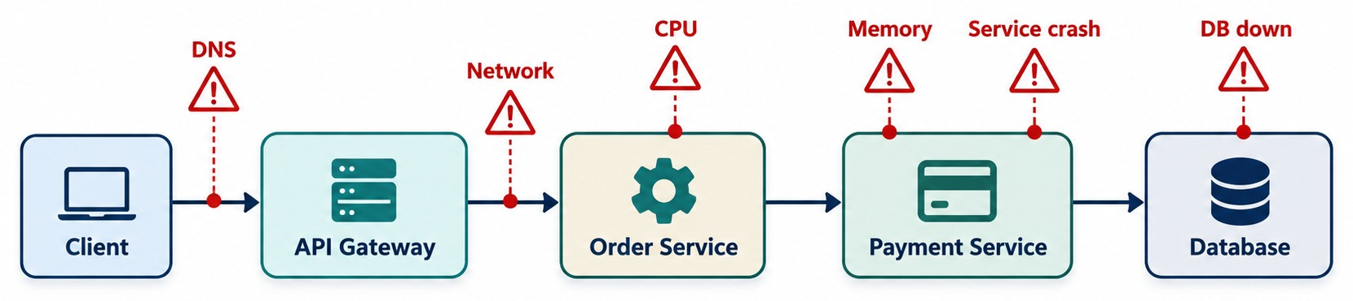
WHY FAILURE IS NORMAL IN DISTRIBUTED SYSTEMS
Networks, dependencies, pods, databases, APIs and infrastructure fail independently.
A “simple” call
…REALLY DOES ALL OF THIS
REMEMBER Every remote dependency can fail independently.
paymentService.processPayment();
✓
Resolve DNS, open a connection
✓
Serialize and send
✓
Remote work and its dependencies
✓
Response back, deserialize
KEY TAKEAWAY Remote calls are neither instantaneous nor guaranteed to succeed.
7
© 2026 by Innovation In Software Corporation
Notes:
KEY TALKING POINTS
------------------
- A call that looks simple
A local Java call like paymentService.processPayment() looks simple.
But if Payment is another microservice, a lot more happens.
- What actually happens
The request is serialized, and the destination is resolved.
A connection is opened or reused, and the request crosses the network.
The remote service processes it and may call its own dependency.
Then the response travels back and is deserialized.
Failures can happen at almost every one of these steps.
- Real examples
A Payment pod restarts, or a DNS lookup fails, or the network slows down.
A database connection pool runs out, or an external provider returns 503.
CPU saturates, a request queue grows, or a certificate or configuration problem blocks communication.
- The starting assumption
Distributed system design begins by assuming remote calls are neither instant nor guaranteed to succeed.
- What it shows
Client, API Gateway, Order Service, Payment Service and Database in a row, with warning markers for DNS, network, CPU, memory, a service crash and the database going down.
- Key point
One request crosses many independent failure points.

Slide 8
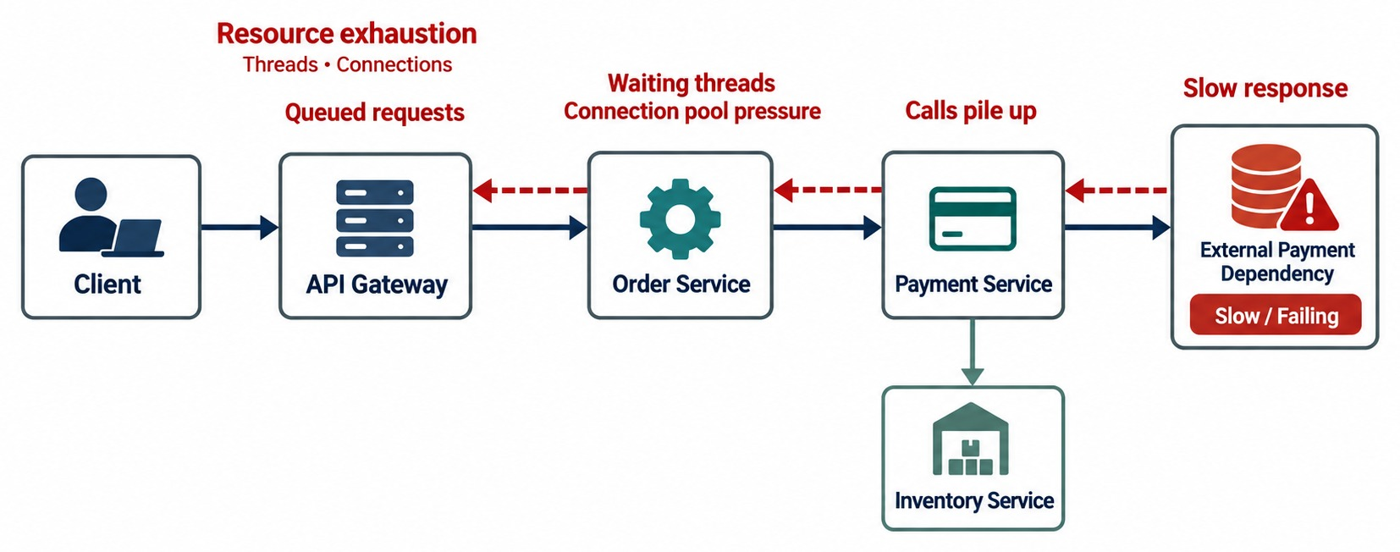
FAILURE PROPAGATION IN MICROSERVICES
One slow or failing service spreading latency and failure to its callers.
Normally → suddenly
Payment answers in 200 ms — until its provider makes it 30 seconds.
USERS EXPERIENCE
!
Slow responses
!
Timeouts
!
503 errors
CASCADING FAILURE Order Service was healthy — it just kept waiting.
KEY TAKEAWAY One slow dependency can drag down every service that waits on it.
8
© 2026 by Innovation In Software Corporation
Notes:
KEY TALKING POINTS
------------------
- Small problem, big impact
A small dependency problem can become a large system problem.
- How it spreads
Suppose the external provider normally answers in 200 milliseconds, but suddenly takes 30 seconds.
The Payment Service waits, and its request-handling resources pile up.
The Order Service is waiting for Payment, so its resources pile up too.
The API gateway gathers more pending requests.
- What users see
Eventually users get slow responses, timeouts and 503 errors.
This happens even though the Order Service was healthy at the start.
This is called a cascading failure.
- Why patterns exist
Resilience patterns exist largely to break this chain.
- What it shows
The external payment dependency slows down.
Calls pile up in Payment, threads wait in Order, requests queue at the gateway, and resources run out.
- How to read it
Follow the red dashed arrows from right to left — that's the failure travelling back to the client.
- Key point
The failure spreads to services that were healthy.

Slide 9
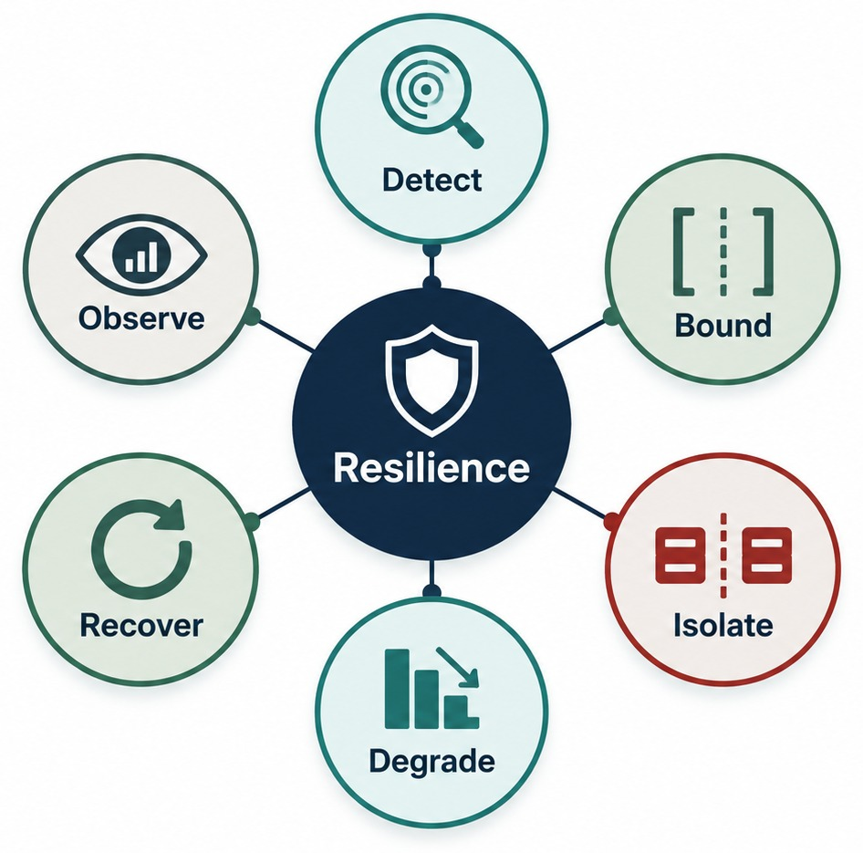
DESIGNING FOR FAILURE
Fail fast, isolate failures, degrade gracefully, recover and stay observable.
THE RESILIENCE MINDSET
✓
Prevent what you can
✓
Contain what you can't prevent
✓
Recover from what occurs
✓
Learn from what happened
BUILDING BLOCKS
Timeouts
Retries
Circuit breakers
Bulkheads
Rate limits
Fallbacks
MINDSET Assume failure will happen, then limit its impact.
KEY TAKEAWAY Assume failure will happen — then deliberately limit its impact.
9
© 2026 by Innovation In Software Corporation
Notes:
KEY TALKING POINTS
------------------
- Assume failure
A resilient architecture assumes failure will happen and deliberately limits its impact.
Walk around the seven principles in the diagram.
- Bound waiting, fail fast, retry carefully
Do not wait forever for a dependency.
If a dependency is known to be down, do not waste resources calling it again and again.
Some temporary failures go away, so retry with care.
- Isolate, degrade, recover, observe
A failure in one dependency should not consume every resource.
Keep useful functionality where you can.
Return to normal when the dependency recovers.
And give operators the evidence to explain what happened.
- The mindset
Prevent what you can, contain what you cannot prevent, recover from what occurs, and learn from what happened.
- What it shows
Resilience in the centre with six practices around it: detect, bound, isolate, degrade, recover and observe.
- Key point
Resilience is a set of deliberate practices, not one library.

Slide 10
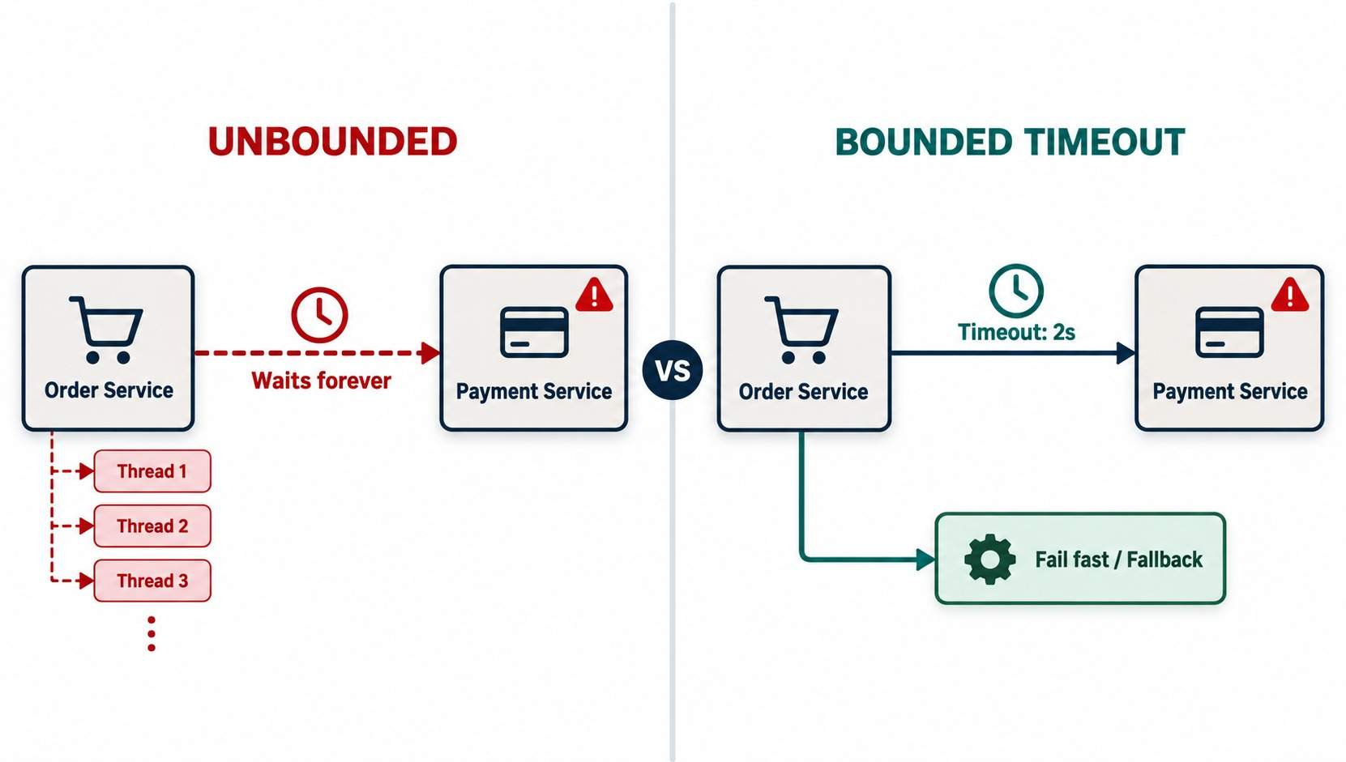
TIMEOUTS — STOP WAITING FOREVER
Every remote call needs a bounded wait time.
AFTER A TIMEOUT, THE CALLER DECIDES
✓
Return an error
✓
Retry — if it's safe
✓
Use a fallback
✓
Start async recovery
EVERY REMOTE CALL NEEDS ONE
HTTP calls
DB queries
Broker operations
Cache calls
RULE Timeouts turn unbounded waiting into controlled failure.
KEY TAKEAWAY Timeouts convert unbounded waiting into controlled failure.
10
© 2026 by Innovation In Software Corporation
Notes:
KEY TALKING POINTS
------------------
- An upper bound on waiting
A timeout puts an upper limit on how long a caller waits.
Suppose Payment normally responds in 100 to 300 milliseconds.
If it takes 30 seconds, should the Order Service keep holding resources?
Usually, no.
- Without timeouts
A slow dependency leads to waiting requests.
Resources pile up, and threads or connections run out.
- With a timeout
The caller gets control back and can decide what to do.
It can return an error, retry, use a fallback, or start asynchronous recovery.
- The key message
Timeouts turn unbounded waiting into controlled failure.
- Unbounded side
Order Service waits forever on a failing Payment Service, and threads pile up.
- Bounded side
With a 2-second timeout, Order stops waiting and takes a fail-fast or fallback path.
- Key point
A timeout turns an endless wait into a decision.

Slide 11
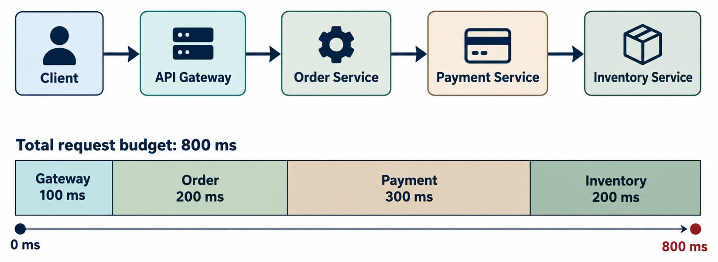
CHOOSING APPROPRIATE TIMEOUT VALUES
Connection vs. read timeouts, downstream latency, SLAs and user expectations.
Connection timeout
How long to wait to establish a connection.
Read timeout
How long to wait for the response once connected.
THE TRADE-OFF
!
Too long: failures detected slowly
!
Too short: healthy slow calls cut off
BUDGET Downstream timeouts must fit inside the user's target.
KEY TAKEAWAY A timeout comes from latency budgets and real behavior — not a number copied from elsewhere.
11
© 2026 by Innovation In Software Corporation
Notes:
KEY TALKING POINTS
------------------
- Not a random number
A timeout should not be a number copied from another application.
- Latency budgets
Suppose the overall checkout target is p95 under 2 seconds.
Order cannot give every downstream service a 5-second timeout.
Each timeout has to fit inside the end-to-end objective.
- Two kinds of timeout
A connection timeout is how long we wait to establish a connection.
A request, read or response timeout is how long we wait for the operation itself.
- What to consider
Consider the normal latency distribution, expected load and network overhead.
Also consider the business requirement and how the downstream service behaves.
- Too long or too short
Too long, and failures are detected slowly while resources stay occupied.
Too short, and healthy but slower requests get cut off by mistake.
- What it shows
The request path through the gateway, Order, Payment and Inventory, with the 800 ms budget divided between them.
- Key point
Each hop's timeout must fit inside the user's overall budget.

Slide 12
TIMEOUTS IN SPRING BOOT
Socket timeouts on the HTTP client, plus a time limit on the whole operation.
application.yml
✓
FraudClient.java
# Spring Boot 3.4+: auto-configured RestClient.Builder
spring:
http:
client:
connect-timeout: 2s
read-timeout: 3s
resilience4j:
timelimiter:
instances:
fraudCheck:
timeout-duration: 800ms
@TimeLimiter(name = "fraudCheck", fallbackMethod = "reviewLater")
public CompletableFuture<FraudDecision> check(Payment p) {
return CompletableFuture.supplyAsync(() -> fraud.check(p));
}
private CompletableFuture<FraudDecision> reviewLater(
Payment p, TimeoutException ex) {
return CompletableFuture.completedFuture(
FraudDecision.pendingReview(p.id()));
}
Socket timeouts
Time limit
Fallback
Connect 2 s, read 3 s — Lab 3's values for the Account call.
Bounds the whole operation, including any queueing.
PENDING_REVIEW — never an automatic approval.
KEY TAKEAWAY Set client timeouts on every call, and bound slow operations with a time limit and a safe fallback.
12
© 2026 by Innovation In Software Corporation
Notes:
KEY TALKING POINTS
------------------
- Client timeouts
Spring Boot 3.4 can configure connect and read timeouts for the auto-configured RestClient builder.
Lab 3 uses 2 seconds to connect and 3 seconds to read.
- TimeLimiter
Resilience4j's TimeLimiter bounds an asynchronous operation.
It needs a CompletableFuture and throws TimeoutException when the limit passes.
- The fallback
If the fraud check takes longer than 800 ms, the payment goes to manual review.
It is never approved automatically.
- Both layers
A time limit doesn't close the socket, so keep the client timeouts too.

Slide 13
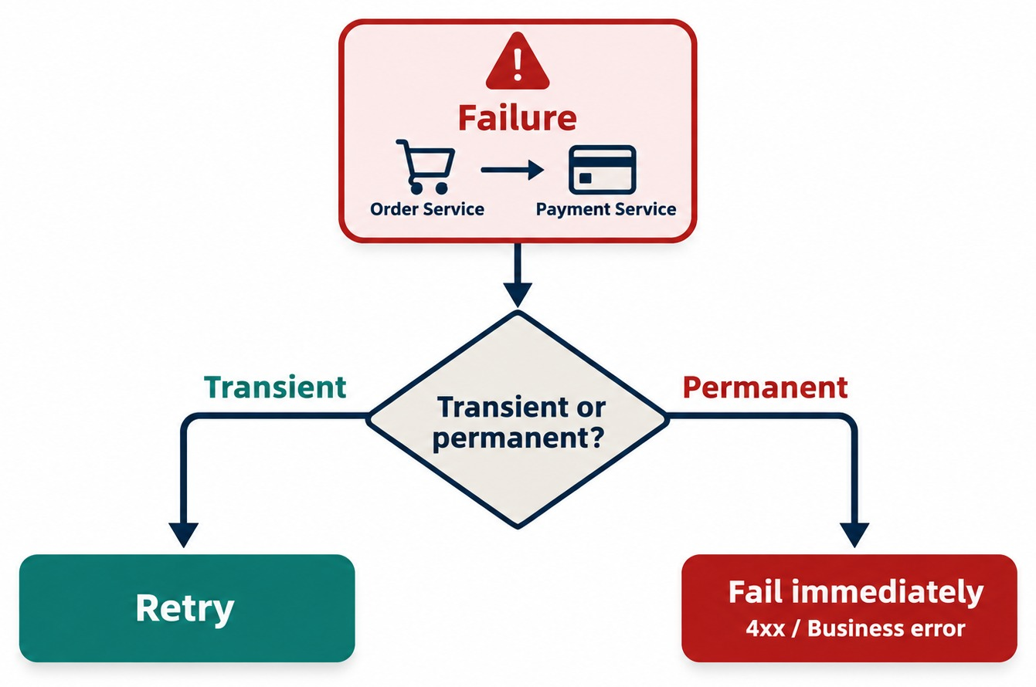
RETRIES — WHEN THEY HELP AND WHEN THEY HURT
Transient versus permanent failures — retry only the right operations.
RETRY MAY HELP
✓
503 Service Unavailable
✓
Connection reset
✓
429 with Retry-After
RETRY WON'T FIX
✕
400 Bad Request
✕
401 or 403
✕
Business-rule rejection
Retries add traffic
10,000 failures × 3 immediate retries = 30,000 extra calls on a struggling service.
RULE Retry selectively, not automatically.
KEY TAKEAWAY Retries help with transient faults — and hurt when used blindly.
13
© 2026 by Innovation In Software Corporation
Notes:
KEY TALKING POINTS
------------------
- What a retry is
A retry means the first attempt failed, so we try again.
It helps when the failure may be temporary, for example attempt one gets a 503 and attempt two succeeds.
- When retry won't help
Retrying invalid input just returns 400 again and again.
It does not make the request valid.
The same goes for unauthorized requests and business-rule rejections.
- Retries add traffic
Imagine 10,000 clients calling a struggling service.
If every failed request retries immediately three times, that could mean tens of thousands of extra attempts.
Retries can make an outage worse.
- The rule
Retry selectively, not automatically.
- What it shows
A failure between Order and Payment reaches one question: transient or permanent?
- Key point
Transient failures may be retried; 4xx and business errors fail immediately.

Slide 14
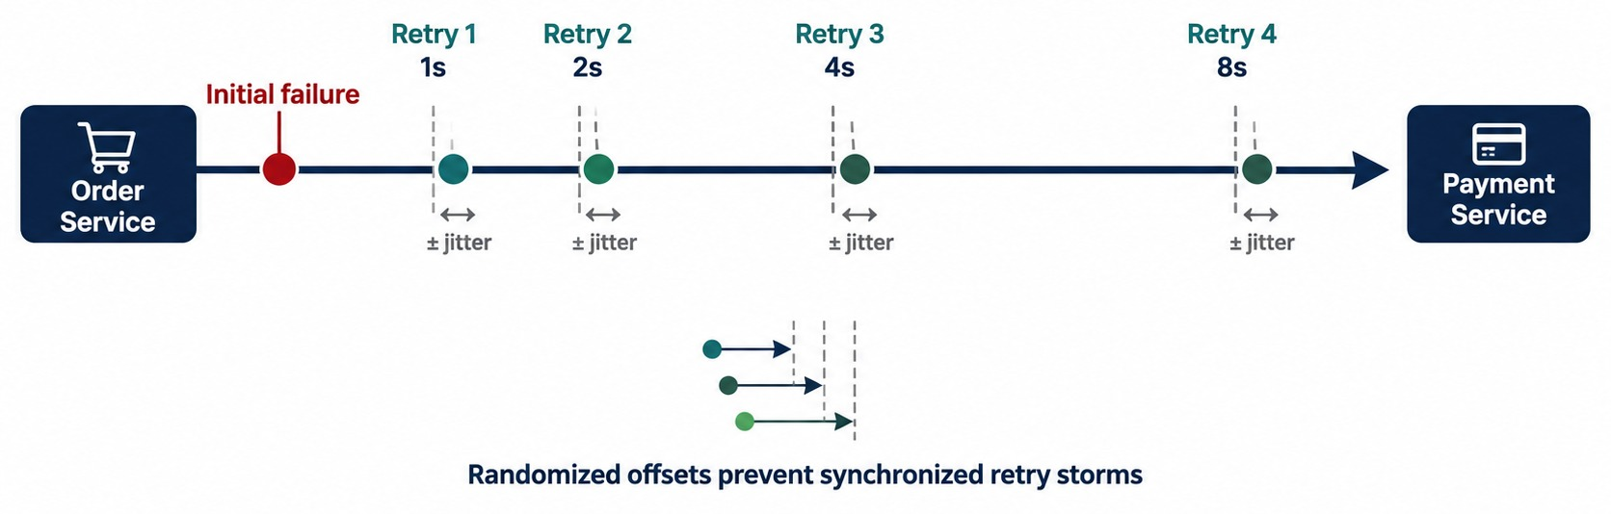
RETRY WITH BACKOFF AND JITTER
Exponential backoff — and avoiding synchronized retry storms.
Without jitter
Thousands of clients retry at exactly 1 second — a synchronized storm.
Always cap it
Limit the attempts and the total wait, inside the latency budget.
FORMULA delay = base × 2ⁿ, plus a random offset.
KEY TAKEAWAY Backoff slows retries down; jitter stops everyone retrying at the same moment.
14
© 2026 by Innovation In Software Corporation
Notes:
KEY TALKING POINTS
------------------
- Retry storms
If hundreds of clients fail at the same moment and all retry exactly one second later, they create a traffic spike.
This is called a retry storm, or a synchronized retry wave.
- Exponential backoff
Exponential backoff increases the wait between attempts.
Conceptually: 100, 200, 400, then 800 milliseconds.
Do not present these exact values as universal recommendations.
- Jitter
Jitter adds some randomness to each delay.
Instead of every client retrying at exactly 400 milliseconds, they retry at slightly different times.
This spreads the traffic out and breaks the synchronization.
- What it shows
After the first failure, retries wait 1, 2, 4 and 8 seconds, each with a small random jitter.
- Key point
Growing gaps give the dependency time; randomness prevents synchronized retry storms.

Slide 15
RETRY WITH BACKOFF IN RESILIENCE4J
Retry only transient failures on safe reads — with backoff, jitter and a fallback.
application.yml
✓
ExchangeRateService.java
resilience4j:
retry:
instances:
exchangeRates:
max-attempts: 3
wait-duration: 500ms
enable-exponential-backoff: true
exponential-backoff-multiplier: 2
enable-randomized-wait: true
randomized-wait-factor: 0.5
retry-exceptions:
- org.springframework.web.client.ResourceAccessException
ignore-exceptions:
- org.springframework.web.client.HttpClientErrorException
@Retry(name = "exchangeRates", fallbackMethod = "lastKnownRate")
public BigDecimal usdToEur() {
return rateClient.getRate("USD", "EUR"); // a safe read
}
private BigDecimal lastKnownRate(Throwable ex) {
return rateCache.lastKnown("USD", "EUR");
}
Backoff + jitter
Only transient errors
Reads only
500 ms, then about 1 s — each randomized by ±50%.
Timeouts and resets retry; 4xx client errors don't.
Writes need an idempotency key before any retry.
KEY TAKEAWAY Configure retries per dependency: few attempts, growing randomized waits, and only for errors that can recover.
15
© 2026 by Innovation In Software Corporation
Notes:
KEY TALKING POINTS
------------------
- The configuration
Three attempts in total, starting at 500 ms and doubling, with up to 50% random variation so clients don't retry together.
- Which errors
ResourceAccessException covers timeouts and connection problems, so it retries.
Client errors such as 400 are ignored because a retry won't fix them.
- The fallback
If every attempt fails, the last known exchange rate from the cache is used — acceptable for a quote, but the business must agree.
- Money movement
Never put a retry like this on a transfer or payment without an idempotency key.

Slide 16
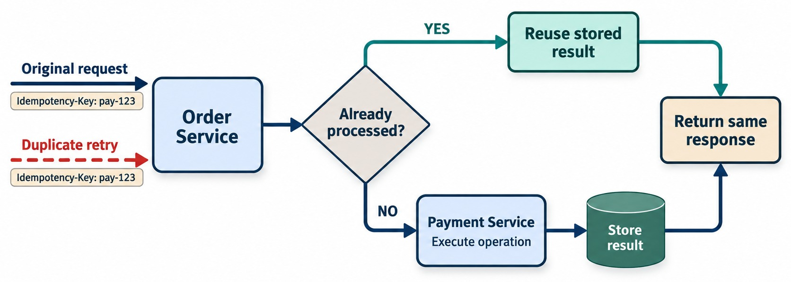
IDEMPOTENCY AND SAFE RETRIES
Retrying GET vs. payment and order operations — idempotency keys.
The client sends a key
POST /payments
Idempotency-Key: pay-123
Server side
Store the key and the result in the same transaction; a repeat returns the stored response.
THINK BUSINESS EFFECT A timeout doesn't tell you whether the charge happened.
KEY TAKEAWAY Retry only when repeating the operation can't create a second business effect.
16
© 2026 by Innovation In Software Corporation
Notes:
KEY TALKING POINTS
------------------
- Think about the business effect
Retries must consider the business effect, not just the HTTP call.
Retrying GET /orders/1001 is generally safe, because it only reads.
- The risky case
Suppose POST /payments charges a customer 500 dollars.
The provider charges the card successfully, but the network fails before our service gets the response.
We see a timeout.
Did the payment happen?
We do not know.
Retrying blindly could charge the customer twice.
- Idempotency keys
A safer design sends an idempotency key, such as PAY-ORDER-1001.
The receiver remembers that logical operation.
A repeated request with the same key is recognized as the same business action and not processed again.
- Link to Module 4
This connects directly to the idempotent consumers from Module 4.
- What it shows
An original request and a duplicate retry carry the same Idempotency-Key.
Order Service checks whether it was already processed.
- How to read it
Yes reuses the stored result.
No executes the operation, stores the result and returns it.
- Key point
Both paths return the same response, so the retry is safe.

Slide 17
EXERCISE: RETRY OR NOT?
Decide how each failed call should be handled.
PRACTICE EXERCISE
10 MIN
SCENARIO
YOUR TASKS
EXPECTED OUTCOME
Six calls just failed:
1
Decide: retry or fail fast
✓
1, 5: retry with backoff and jitter
1 GET exchange rate → 503
2 POST transfer → timeout, no key
3 POST transfer → timeout, with key
4 PUT profile → 400 validation
5 GET balance → connection reset
6 POST payment → 429, Retry-After: 2
2
For retries, choose attempts and backoff
✓
2: don't retry — check the transfer's status first
3
Say which case needs an idempotency key — and why
✓
3: retry safely with the same key
✓
4: fail fast — the request must change
✓
6: wait 2 s, then retry once
KEY TAKEAWAY Retry transient failures on safe or keyed operations — and fail fast on everything else.
17
© 2026 by Innovation In Software Corporation
Notes:
KEY TALKING POINTS
------------------
- Reads
The exchange rate and balance lookups are safe reads with transient errors, so they retry with backoff.
- The unkeyed transfer
A timeout doesn't say whether the transfer happened.
Retrying could move money twice, so check its status instead.
- The keyed transfer
With the same idempotency key, the server returns the original result if it already ran.
- 400 and 429
A validation error needs a different request.
A 429 tells you when to try again, so respect Retry-After.

Slide 18
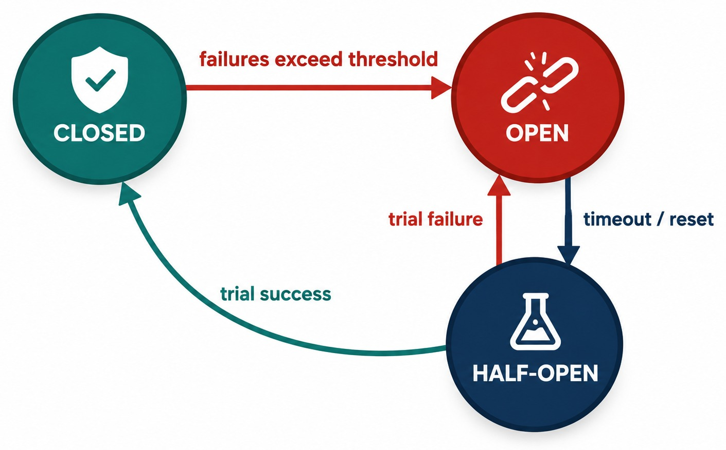
CIRCUIT BREAKER PATTERN
Closed → Open → Half-Open → Closed.
Closed
Calls flow; failures are counted over a sliding window.
Open
Calls fail fast for the configured wait duration.
Half-open
A few trial calls decide: close again or reopen.
LIKE A FUSE BOX It stops continued failure from spreading.
KEY TAKEAWAY Fail fast instead of repeatedly calling a dependency that is already failing.
18
© 2026 by Innovation In Software Corporation
Notes:
KEY TALKING POINTS
------------------
- What it protects
A circuit breaker protects the caller from repeatedly calling a dependency that is already failing.
- Closed
Closed is the normal state.
Requests flow to the dependency, and failures are counted.
- Open
When the failure criteria are reached, the breaker opens.
Instead of making another expensive call, requests fail fast.
- Half-open
After a wait interval, limited trial traffic is allowed through.
If the dependency has recovered, the breaker closes.
If it is still failing, it opens again.
- The analogy
Like an electrical circuit breaker, it stops continued failure from damaging the wider system.
- What it shows
Closed moves to open when failures exceed a threshold.
After the wait, open moves to half-open.
A trial success closes it; a trial failure reopens it.
- Key point
The breaker stops calls while a dependency is failing, then tests recovery carefully.

Slide 19
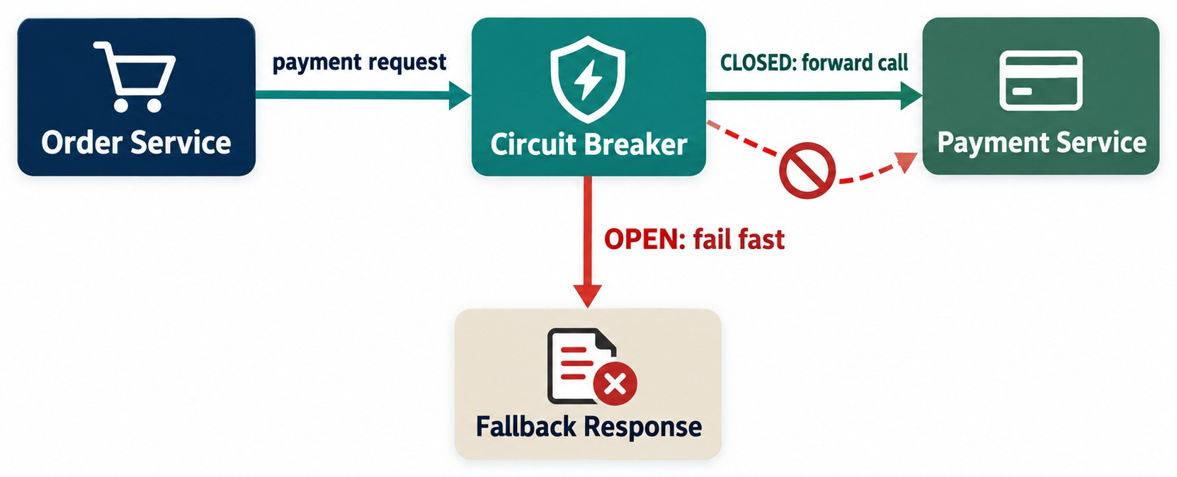
CIRCUIT BREAKER IN A MICROSERVICE CALL
Order Service → Payment Service with a failure threshold and fallback.
It protects the caller
It doesn't repair Payment Service — it keeps Order responsive.
SAFE FALLBACKS
✓
PAYMENT_PENDING
✓
A clear 503 with a retry hint
NEVER
✕
“Payment successful”
CRITERIA Failure rate and slow-call rate over a sliding window.
KEY TAKEAWAY When Payment is unhealthy, the breaker keeps Order responsive with a controlled response.
19
© 2026 by Innovation In Software Corporation
Notes:
KEY TALKING POINTS
------------------
- Normal operation
Apply the pattern to our Order Service.
Normally, Order calls Payment through a closed circuit breaker, and calls are allowed.
- When Payment fails
Payment starts failing repeatedly.
The breaker detects this according to its configured criteria and opens.
Later requests do not wait for Payment to fail.
They get a controlled response quickly.
- Business behavior
For example, the order can be marked PAYMENT_PENDING instead of bringing down the whole order system.
- An important point
A circuit breaker does not repair the Payment Service.
It protects the caller while Payment is unhealthy.
- What it shows
Order Service sends a payment request through a circuit breaker.
When closed, the call goes to Payment Service; when open, it returns a fallback response.
- Key point
An open breaker answers immediately instead of waiting on a failing service.

Slide 20
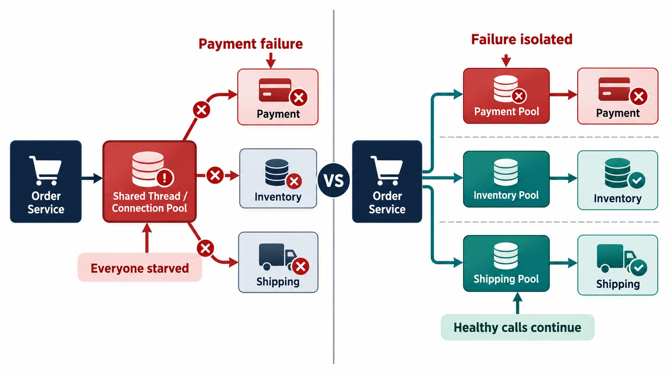
BULKHEAD PATTERN
Isolate resources so one failing dependency can't exhaust everything.
BULKHEADS CAN ISOLATE
Thread pools
Connection pools
Concurrency limits
Queues
Semaphore or thread pool
A semaphore caps concurrent calls cheaply; a thread pool fully separates blocking work.
Rate limiting
A related guard: cap requests per period and answer 429.
LIKE A SHIP One flooded compartment doesn't sink the vessel.
KEY TAKEAWAY A failing dependency should use only its allocated capacity — not the whole service.
20
© 2026 by Innovation In Software Corporation
Notes:
KEY TALKING POINTS
------------------
- The ship analogy
The name comes from ships.
A ship is split into compartments, so flooding in one section does not necessarily sink the whole vessel.
- Without isolation
Suppose the Payment Service becomes extremely slow.
If Payment, Inventory and Shipping calls all share one limited resource pool, Payment requests can use it all up.
Then Inventory and Shipping are affected too.
- With bulkheads
Bulkheads give each dependency its own resources: Payment uses pool A, Inventory pool B, Shipping pool C. You can isolate thread pools, connection pools, concurrency limits, queues and worker pools.
- The goal
A failure in one dependency should only use up its own allocated capacity, not the whole service.
- Shared pool
Payment fails and exhausts the shared thread and connection pool, so Inventory and Shipping fail too.
- Separate pools
Payment only exhausts its own pool, and Inventory and Shipping calls continue.
- Key point
Isolate resources so one failing dependency can't starve the others.
- Rate limiting
Rate limiting caps how many requests are accepted per period, often at the gateway.
Excess requests get 429 Too Many Requests.

Slide 21
CIRCUIT BREAKER AND BULKHEAD WITH RESILIENCE4J
Lab 3's breaker on the Account call — and a safe 503 when it opens.
application.yml
✓
AccountClient.java
resilience4j:
circuitbreaker:
instances:
accountService:
sliding-window-size: 10
minimum-number-of-calls: 4
failure-rate-threshold: 50
wait-duration-in-open-state: 10s
permitted-number-of-calls-in-half-open-state: 2
ignore-exceptions:
- com.example.AccountConflictException # 409
bulkhead:
instances:
accountService:
max-concurrent-calls: 20
@CircuitBreaker(name = "accountService",
fallbackMethod = "unavailable")
@Bulkhead(name = "accountService") // concept only in the labs
public Account requireActiveAccount(String accountId) {
return accountApi.get(accountId);
}
private Account unavailable(String id, CallNotPermittedException e) {
throw new AccountServiceUnavailableException(); // → 503
}
private Account unavailable(String id, ResourceAccessException e) {
throw new AccountServiceUnavailableException(); // → 503
}
Lab 3 values
Fallback
Bulkhead
At least 4 calls, 50% failing, open for 10 s — a 409 never trips it.
503 ACCOUNT_SERVICE_UNAVAILABLE — never a fake ACTIVE account.
Shown for completeness; the labs keep it conceptual.
KEY TAKEAWAY Open the breaker on real dependency failures, ignore business conflicts, and fail with a clear 503.
21
© 2026 by Innovation In Software Corporation
Notes:
KEY TALKING POINTS
------------------
- The breaker
After at least four calls, if half of them fail, the breaker opens for ten seconds.
Two trial calls then decide whether it closes.
- Ignored exceptions
A 409 conflict is a business answer, not a dependency failure, so it must not count towards opening the breaker.
- Fallbacks
Resilience4j picks the fallback that matches the exception.
An open breaker or a timeout becomes a 503; other errors propagate normally.
- Bulkhead
The bulkhead annotation caps concurrent calls.
Exercise 3.1 keeps bulkheads and rate limiting conceptual — no extra libraries in the lab.

Slide 22
EXERCISE 3.1 — CONFIGURE TIMEOUT AND CIRCUIT BREAKER
Day 3 checkpoint A: Resilience4j on the Account dependency.
OFFICIAL CHECKPOINT A
10 MIN
labs/day-03/exercises/exercise-3.1-timeout-circuit-breaker.md
SCENARIO
YOUR TASKS
EXPECTED OUTCOME
Lab 3 hardens the banking Transaction Service. Before accepting money movement, it calls Account Service through AccountClient.requireActiveAccount.
Scope: Account, Transaction and Risk Assessment only.
1
Find the RestClient timeouts (connect 2 s, read 3 s) in the Lab 3 Transaction starter
✓
Timeouts located in the starter
✓
Breaker settings you can explain
2
Circuit breaker: 4 failed calls at 50% open it; wait 10 s; later calls fail fast. A 409 does not trip it
✓
503 fallback with no Kafka event
✓
Never a fake ACTIVE account
3
Safe fallback: POST /api/v1/transactions returns 503 ACCOUNT_SERVICE_UNAVAILABLE — no Kafka event
4
Bulkhead and rate limiting stay conceptual — no extra libraries
KEY TAKEAWAY The fallback rule: never invent a successful financial outcome.
22
© 2026 by Innovation In Software Corporation
Notes:
KEY TALKING POINTS
------------------
- Official checkpoint
This is the official OUTLINE.md checkpoint for Module 6.
Use the worksheet in labs/day-03/exercises.
- Timeouts
Learners find the connect and read timeouts on the RestClient that calls Account Service.
- Breaker and fallback
The breaker opens on repeated failures, not on 409 business conflicts.
When it's open, the API returns 503 and publishes no TransactionSubmitted event.
- The rule
Never pretend an account is ACTIVE or a transaction succeeded when the dependency is down.

Slide 23
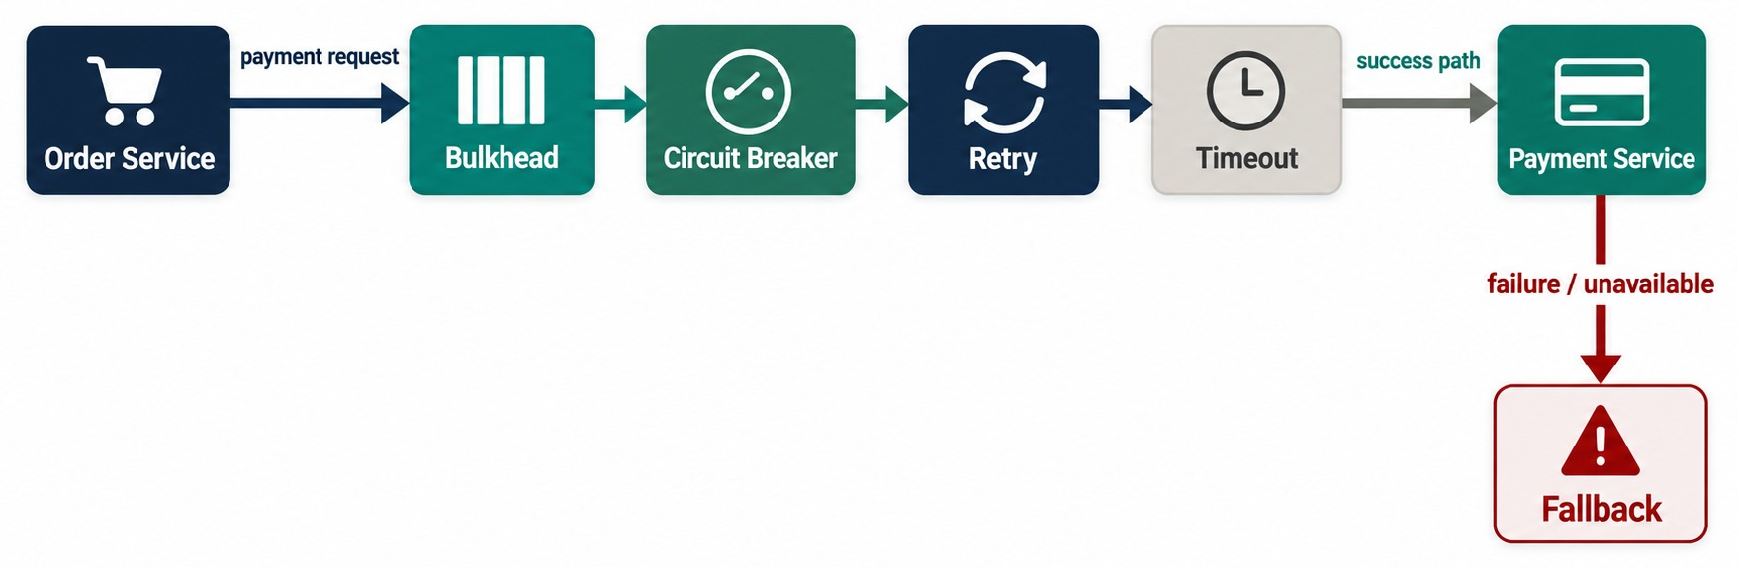
COMBINING RESILIENCE PATTERNS
Timeout + retry + circuit breaker + bulkhead + fallback.
EACH LAYER'S JOB
✓
Bulkhead: isolate resources
✓
Circuit breaker: fail fast
✓
Retry: handle transient faults
✓
Timeout: bound each attempt
✓
Fallback: stay useful
Composition matters
3 retries × a 2 s timeout = 6 s — far beyond a 2 s budget.
ORDER Libraries differ — Resilience4j applies Retry outermost by default.
KEY TAKEAWAY Design the whole resilience policy together — patterns interact.
23
© 2026 by Innovation In Software Corporation
Notes:
KEY TALKING POINTS
------------------
- Patterns work together
Real production systems rarely use just one resilience pattern.
Suppose Order calls Payment.
- Each pattern's job
The timeout means Payment does not get unlimited time.
A retry may be justified for a temporary network failure.
The circuit breaker makes repeated failures fail fast.
The bulkhead stops Payment traffic from consuming all of Order's resources.
The fallback decides what useful behavior remains.
- Composition matters
Retries, timeouts and breakers can interact in unexpected ways.
For example, three retries, each with a 2-second timeout, could use far more of the caller's latency budget than intended.
- Design it as one policy
The exact order depends on the client library and the operation.
Design the whole resilience policy together.
- What it shows
A payment request passes through a bulkhead, a circuit breaker, retry and a timeout before reaching Payment Service.
Failure goes to a fallback.
- Key point
The patterns are layers of one policy and must be tuned together.
- Default order
With the Resilience4j Spring Boot annotations, Retry wraps the circuit breaker, which wraps the rate limiter, time limiter and bulkhead.
The aspect order can be changed in configuration.

Slide 24
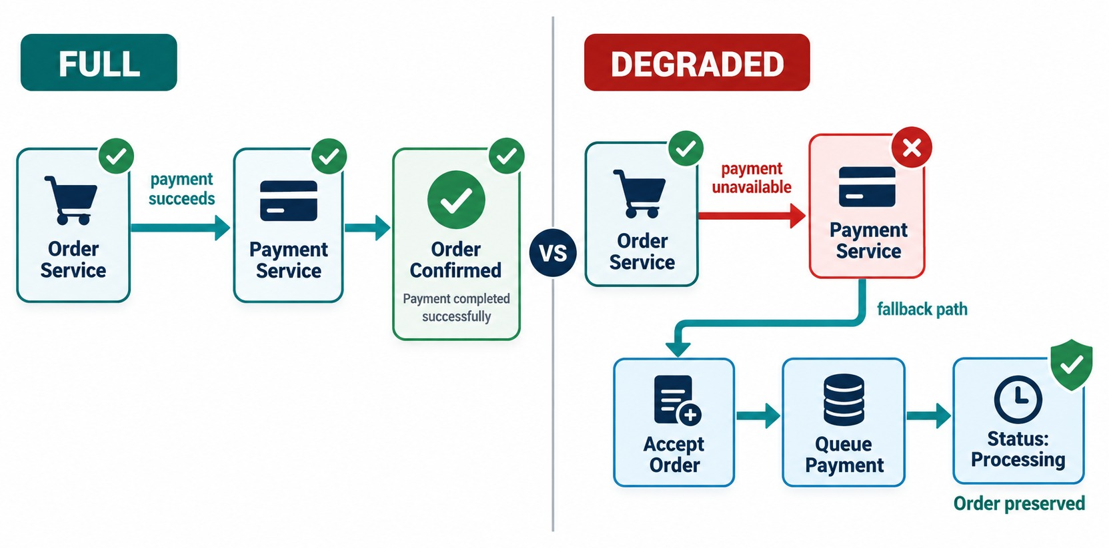
GRACEFUL DEGRADATION AND FALLBACKS
Partial functionality, cached data, default responses and reduced features.
NON-CRITICAL: DEGRADE
✓
Recommendations down → hide them
✓
Catalog down → acceptable cached data
✓
Notifications down → queue for later
CRITICAL: STAY CORRECT
!
Payment down → PENDING, or reject cleanly
Load shedding
When saturated, reject low-priority work early to protect the critical path.
BUSINESS DECISION Agree fallback behavior with the business, not only in config.
KEY TAKEAWAY Degrade gracefully where you can — but never trade away business correctness.
24
© 2026 by Innovation In Software Corporation
Notes:
KEY TALKING POINTS
------------------
- What a fallback really is
A fallback is not fake data, and it is not returning success anyway.
It means defining useful behavior when a dependency is unavailable.
- Non-critical features
If recommendations fail, checkout should probably still work, so we hide recommendations.
If the live catalog lookup fails, we may use acceptable cached data.
If notifications fail, we can queue them for later.
That is graceful degradation.
- Critical features
If payment authorization is mandatory, we must not say payment succeeded when Payment is down.
The fallback must keep business correctness, for example marking the payment PAYMENT_PENDING, or rejecting the transaction cleanly.
- Whose decision
Fallback behavior is a business decision, not just a technical setting.
- Full
The payment succeeds and the order is confirmed.
- Degraded
Payment is unavailable, so the fallback accepts the order, queues the payment and shows Processing.
The order is preserved.
- Key point
Reduced functionality, but nothing false is promised.
- Load shedding
A saturated service can reject lower-priority requests early, before they consume threads, so its most important traffic keeps working.

Slide 25
PART 2: OBSERVABILITY
You can't fix what you can't see.
✓ Part 1
Failure handling
Part 2
Observability
Part 3
Reliability targets
Part 4
Validation
SO FAR
NEXT QUESTION
When something still goes wrong in production, how do we see what — and why?
✓
Timeouts bound waiting; retries are selective and keyed
✓
Breakers fail fast; bulkheads isolate
IN THIS PART
Fallbacks degrade without faking success
1
Observability vs. monitoring
✓
2
Logs, metrics and traces
3
Structured logs and correlation IDs — in code
4
Metrics and health signals — in code
5
Distributed tracing
6
Exercise: diagnose a slow dependency
25
© 2026 by Innovation In Software Corporation
Notes:
KEY TALKING POINTS
------------------
- Why this part
Resilience patterns contain failures, but teams still need to see them, understand them and fix the cause.
- What comes next
Monitoring versus observability, the three pillars, then correlation IDs, metrics and traces in Spring Boot.

Slide 26
OBSERVABILITY VS. MONITORING
Monitoring says something is wrong; observability helps explain why.
MONITORING
OBSERVABILITY
Known questions
Dashboards / Alerts
System evidence
Investigate the unknown
Understand WHY
Is the error rate high?
Which service?
Which dependency?
Is CPU saturated?
Which requests?
Which region / pod?
Is the service available?
Which code path?
What changed?
FROM ALERT TO EXPLANATION
Alert: checkout p95 latency > target
We know something is wrong
Collect logs, metrics, traces
Understand why
KEY TAKEAWAY Monitoring answers known questions; observability lets you investigate new ones.
26
© 2026 by Innovation In Software Corporation
Notes:
KEY TALKING POINTS
------------------
- Monitoring
Monitoring is extremely important.
It answers known questions through dashboards and alerts.
Is the error rate high?
Is CPU saturated?
Is the service available?
- From alert to investigation
Monitoring may alert that checkout p95 latency is above target.
Now we know something is wrong.
- Observability
Observability helps us investigate why.
Which service, which dependency, which requests, which region or pod, which code path, and what changed?
- Why it matters in microservices
In distributed systems, operators need enough telemetry to reconstruct behavior across many services.
That is why we collect logs, metrics and traces.

Slide 27
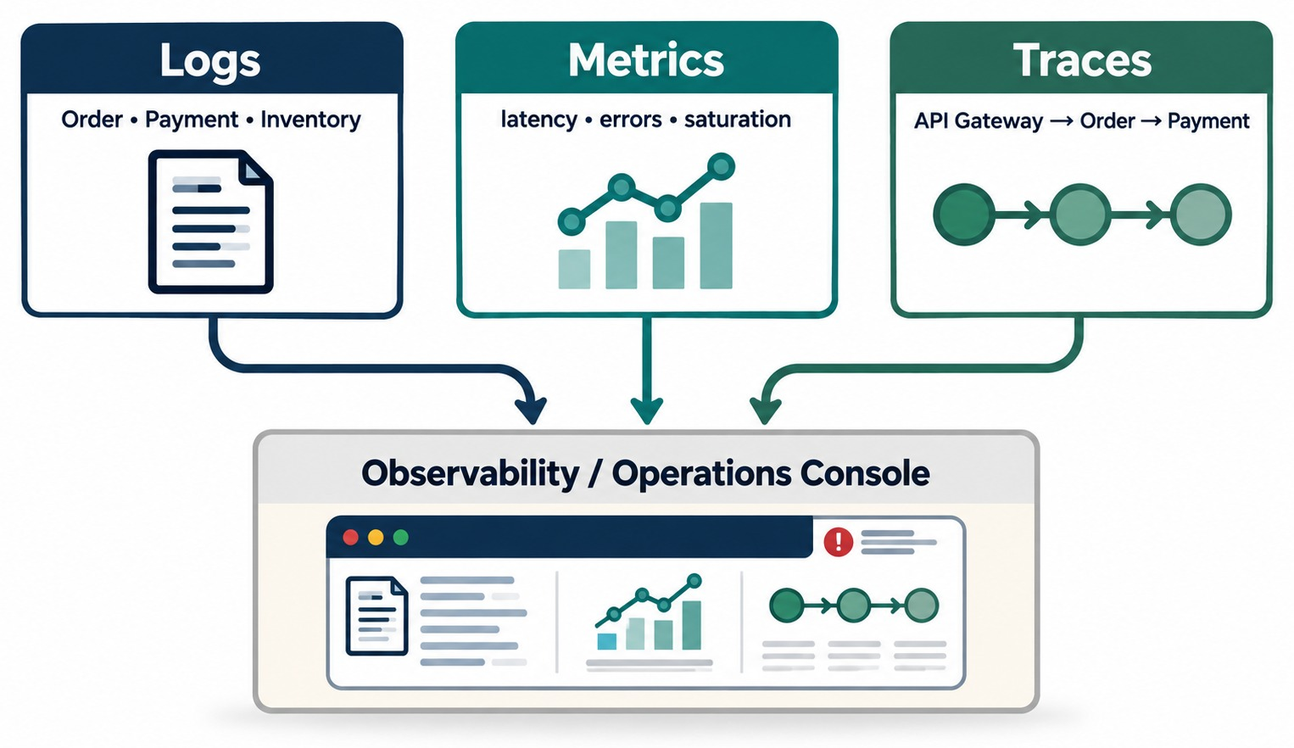
THE THREE PILLARS OF OBSERVABILITY
Logs, metrics and traces.
USE THEM TOGETHER
✓
Metric: checkout latency rose
✓
Trace: Payment took 90% of the time
✓
Logs: explain the Payment failure
OpenTelemetry
One vendor-neutral standard for all three; Micrometer bridges it in Spring Boot.
RULE No single pillar answers every question.
KEY TAKEAWAY Logs, metrics and traces complement each other — use all three together.
27
© 2026 by Innovation In Software Corporation
Notes:
KEY TALKING POINTS
------------------
- Logs
Logs are individual records that describe events.
For example: payment request failed for order 1001.
They answer the question: what happened?
- Metrics
Metrics are numbers measured over time, such as request rate, error rate, latency, CPU, memory and queue depth.
They answer: how much, and how often?
- Traces
Traces follow one request across distributed components, from the gateway to Order, Payment and the external provider.
They answer: where did the request travel, and where did time or failure happen?
- They work together
A metric may show that latency increased.
A trace may show Payment used 90 percent of the request time.
Logs may explain why Payment failed.
- What it shows
Logs from each service, metrics for latency, errors and saturation, and traces across the gateway, Order and Payment all flow into one observability console.
- Key point
Each pillar answers a different question; together they explain an incident.

Slide 28
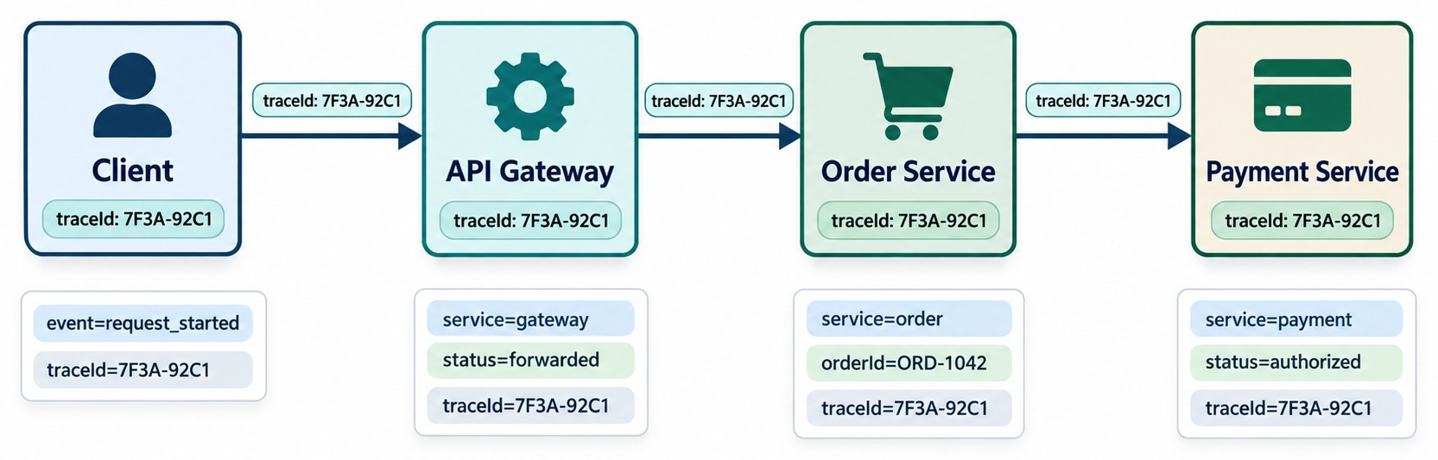
STRUCTURED LOGGING AND CORRELATION IDS
Consistent logs with service, request, trace ID, severity and context.
✕
Avoid
ERROR: Something failed
SEARCHABLE FIELDS
service
traceId
orderId
level
NEVER LOG passwords, tokens, card or account numbers.
KEY TAKEAWAY Structured fields and a shared trace ID turn scattered logs into a searchable story.
28
© 2026 by Innovation In Software Corporation
Notes:
KEY TALKING POINTS
------------------
- Unhelpful logs
A log line that says 'ERROR: Something failed' is not much use in a system with hundreds of service instances.
- Structured logging
Structured logging adds searchable fields.
For example: service is payment-service, order ID is ORD-1001, trace ID is abc-123, and level is ERROR.
- Correlation IDs
A correlation or trace ID links together all activity for the same request or workflow.
The same ID appears in the gateway, Order and Payment logs.
Now operators can follow one business request across several services.
- Protect sensitive data
Remind learners never to log passwords, access tokens, payment secrets or unnecessary sensitive data.
- What it shows
The same traceId travels from the client through the gateway, Order and Payment.
Each service logs structured fields with it.
- Key point
Search one ID and see the request's whole journey.

Slide 29
CORRELATION IDS IN SPRING BOOT
Accept or create an ID, put it in every log line, and pass it on.
✓
CorrelationIdFilter.java
Log it and pass it on
@Component
public class CorrelationIdFilter extends OncePerRequestFilter {
@Override
protected void doFilterInternal(HttpServletRequest req,
HttpServletResponse res, FilterChain chain)
throws ServletException, IOException {
String id = Optional.ofNullable(req.getHeader("X-Correlation-Id"))
.orElseGet(() -> UUID.randomUUID().toString());
MDC.put("correlationId", id);
res.setHeader("X-Correlation-Id", id);
try { chain.doFilter(req, res); }
finally { MDC.remove("correlationId"); }
}
}
# application.yml — Spring Boot 3.4+
logging:
structured:
format:
console: ecs # JSON logs to stdout
// calling the next service
accountApi.get()
.uri("/accounts/{id}", id)
.header("X-Correlation-Id", MDC.get("correlationId"))
.retrieve()
.body(Account.class);
MDC
Structured
Tracing
Every log line on this request thread includes the ID.
JSON fields that log platforms can search and filter.
Micrometer Tracing adds and propagates traceId automatically.
KEY TAKEAWAY One ID, accepted at the edge, written into every log and passed to every downstream call.
29
© 2026 by Innovation In Software Corporation
Notes:
KEY TALKING POINTS
------------------
- The filter
It reads X-Correlation-Id or creates one, stores it in the MDC, echoes it in the response, and always clears it afterwards.
- Structured logs
Spring Boot 3.4 can write JSON logs with one property, so every field is searchable.
- Propagation
Outgoing calls carry the same header, so the next service logs the same ID.
- Tracing does more
With Micrometer Tracing on the classpath, trace and span IDs are added to logs and propagated automatically.
Lab 2 already carries X-Correlation-Id onto events.

Slide 30
METRICS AND HEALTH MONITORING
Latency, error rate, throughput, saturation, JVM and dependency metrics.
TRAFFIC
LATENCY
ERRORS
SATURATION
How much work arrives?
How long does work take?
How often does work fail?
How close to resource limits?
Requests / second
p50
5xx rate
Thread / DB pool usage
Messages / second
p95
Failed payment %
CPU · memory
p99
Queue backlog
ALSO WATCH
DON'T BE FOOLED Low CPU isn't healthy if the DB connection pool is exhausted.
CPU
Memory
JVM
GC
Thread pools
Connection pools
Queue depth
Dependency latency
KEY TAKEAWAY Traffic, latency, errors and saturation show how a service is really behaving.
30
© 2026 by Innovation In Software Corporation
Notes:
KEY TALKING POINTS
------------------
- Four core signals
Metrics give quantitative visibility.
Traffic is how much work arrives, such as requests or messages per second.
Latency is how long work takes, shown as p50, p95 and p99.
Errors are how often work fails, like the 5xx rate or failed payment percentage.
- Saturation
Saturation is how close the system is to its resource limits.
Examples are thread pool usage, database connection pool usage, CPU, memory and queue backlog.
- Beyond infrastructure
Do not monitor only infrastructure.
A service can have low CPU and still be unusable because its database connection pool is exhausted.
Also watch JVM, garbage collection and dependency latency.

Slide 31
METRICS WITH MICROMETER AND ACTUATOR
Count business outcomes, time dependencies, and expose them for scraping.
✓
PaymentService.java
application.yml
@Service
class PaymentService {
private final Counter failed;
private final Timer latency;
PaymentService(MeterRegistry registry) {
failed = registry.counter("payments.failed");
latency = Timer.builder("payments.latency")
.publishPercentiles(0.95, 0.99)
.register(registry);
}
PaymentResult charge(Order order) {
return latency.record(() -> doCharge(order));
}
}
management:
endpoints:
web:
exposure:
include: health, metrics, prometheus
# with micrometer-registry-prometheus:
# GET /actuator/prometheus
# payments_latency_seconds{quantile="0.95"}
Business metrics
Percentiles
Built in
Failed payments matter more than CPU.
p95 and p99 show the tail users actually feel.
Resilience4j publishes breaker state and retry counts too.
KEY TAKEAWAY Measure the golden signals and the business outcome — then expose them for dashboards and alerts.
31
© 2026 by Innovation In Software Corporation
Notes:
KEY TALKING POINTS
------------------
- Counters and timers
A counter records how many payments failed.
A timer records how long each charge took and publishes p95 and p99.
- Exposure
Actuator exposes health, metrics and a Prometheus endpoint for scraping.
- Free metrics
Spring Boot already records HTTP server requests, JVM, pools and, with Resilience4j, circuit breaker states and retry calls.
- Alert on symptoms
Alert on error rate and latency that users feel, not only on CPU.

Slide 32
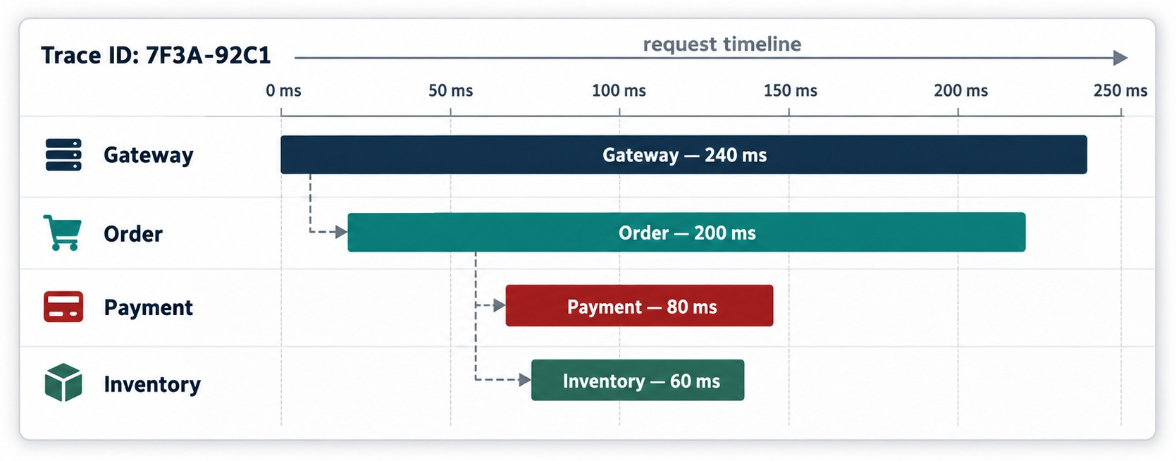
DISTRIBUTED TRACING ACROSS MICROSERVICES
Client → Order → Payment → Inventory — one trace spanning services.
Trace vs. span
A trace is the whole request; a span is one timed operation inside it.
TRACING HELPS WITH
Latency analysis
Failure propagation
Dependency mapping
Cross-service debugging
SPRING BOOT Micrometer Tracing adds and propagates trace IDs automatically.
KEY TAKEAWAY Traces break one request into spans, so the slow service is obvious.
32
© 2026 by Innovation In Software Corporation
Notes:
KEY TALKING POINTS
------------------
- The problem
In a monolith, a profiler or the application logs may show slow code.
In microservices, one user request can cross many processes.
Suppose POST /orders takes 900 milliseconds.
Where did the time go?
- Spans
Distributed tracing breaks the request into spans, all under one trace ID.
Here the gateway took 20 milliseconds, Order 100, Payment 650 and Inventory 80.
Payment is clearly the place to investigate.
- What tracing is good for
Tracing is especially useful for latency analysis, understanding how failures spread, mapping dependencies and debugging across services.
It connects naturally to correlation IDs.
- What it shows
Trace 7F3A-92C1 on a timeline: the gateway span is 240 ms, containing Order at 200 ms, which calls Payment at 80 ms and Inventory at 60 ms.
- Key point
Nested spans show where the time actually went.

Slide 33
EXERCISE: DIAGNOSE A SLOW DEPENDENCY
Use the signals to find the cause — and choose the fix.
PRACTICE EXERCISE
12 MIN
SCENARIO
YOUR TASKS
EXPECTED OUTCOME
Since 10:05, checkout p95 is 4.8 s and 3% of requests fail with 5xx.
Transaction Service calls Fraud Detection during payment. Fraud Detection is slow and starting to time out.
1
Which signal do you check first — and what will it show?
✓
Trace: the fraud span dominates the latency
2
Choose timeout, retry and circuit-breaker settings
✓
Timeout inside the budget; no blind retries on the write
3
Pick a business-safe fallback
A circuit breaker on the fraud call
✓
4
List the metrics, logs and trace fields you need
✓
Fallback: PENDING_REVIEW — never auto-approve
✓
Fraud p95, timeouts, breaker state; traceId in logs
KEY TAKEAWAY Let the signals locate the problem, then contain it with patterns that keep money movement correct.
33
© 2026 by Innovation In Software Corporation
Notes:
KEY TALKING POINTS
------------------
- Find it
Metrics show the symptom.
A trace of a slow checkout shows the fraud span taking most of the time.
Logs with the same traceId show the timeouts.
- Contain it
Give the fraud call a timeout inside the budget, don't retry the payment write blindly, and add a circuit breaker so callers fail fast.
- Fallback
Hold the payment for review.
Approving without a fraud check would be inventing a safe outcome.
- Keep watching
Track fraud latency, timeout count, breaker state and the number of payments pending review.

Slide 34
PART 3: RELIABILITY TARGETS
Decide what “healthy enough” means — then measure it.
✓ Part 1
Failure handling
✓ Part 2
Observability
Part 3
Reliability targets
Part 4
Validation
SO FAR
NEXT QUESTION
How healthy is healthy enough — and how do we prove it?
✓
Logs, metrics and traces work together
✓
One correlation ID follows every request
IN THIS PART
✓
Micrometer and Actuator expose the signals
Liveness and readiness
1
2
SLIs, SLOs, SLAs and error budgets
3
Performance and capacity indicators
4
Exercise: define SLOs for banking APIs
34
© 2026 by Innovation In Software Corporation
Notes:
KEY TALKING POINTS
------------------
- From signals to targets
Observability gives us numbers.
Reliability targets say which numbers matter and what values are good enough.
- What comes next
Health probes, SLI/SLO/SLA with error budgets, and the performance indicators behind them.

Slide 35
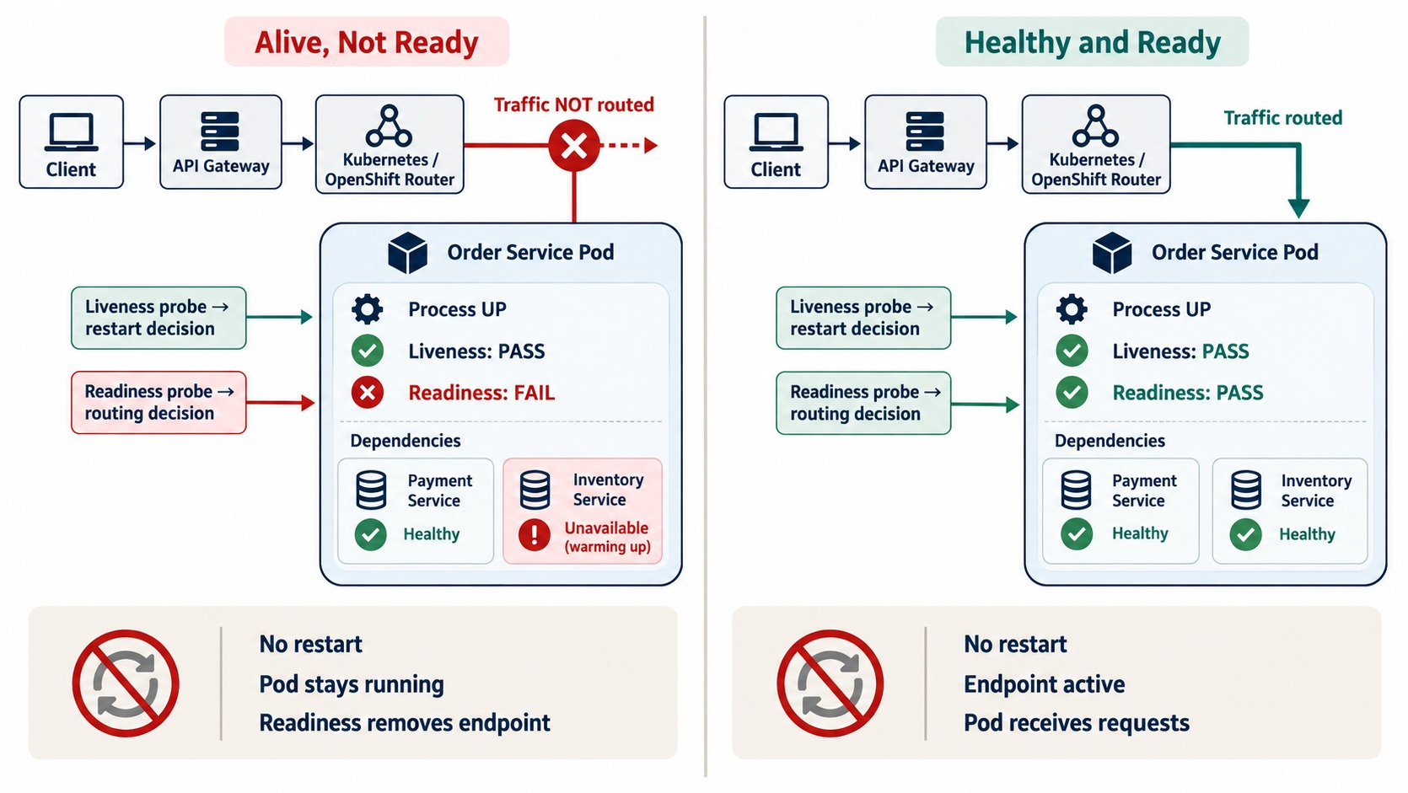
HEALTH CHECKS AND READINESS/LIVENESS
Process alive versus service ready to receive traffic.
✓
Spring Boot Actuator
management:
endpoint:
health:
probes:
enabled: true
# /actuator/health/liveness
# /actuator/health/readiness
KEEP CHECKS HONEST
✓
Liveness: the app itself only
✓
Readiness: may include required dependencies
WARNING A liveness check that calls a dependency causes restart storms.
KEY TAKEAWAY Liveness decides restarts; readiness decides traffic — OpenShift uses both.
35
© 2026 by Innovation In Software Corporation
Notes:
KEY TALKING POINTS
------------------
- Important for OpenShift
These ideas are important for OpenShift and Kubernetes.
- Liveness
Liveness asks: is this process healthy enough to keep running?
If it is stuck and cannot recover, the platform may restart the container.
- Readiness
Readiness asks: should this instance receive requests right now?
Picture a running pod whose application is still starting and whose required resources are not ready.
The process is alive, but it is not ready for traffic.
So liveness passes, readiness fails, and the platform does not route traffic to it until it is ready.
- An operational warning
Do not make health checks so aggressive, or so tied to dependencies, that a temporary downstream problem causes a storm of unnecessary restarts.
- Alive, not ready
The pod process is up and liveness passes, but readiness fails because Inventory is still warming up.
The router sends no traffic, and there is no restart.
- Healthy and ready
Both probes pass, the endpoint is active and the pod receives requests.
- Key point
Liveness drives restarts; readiness drives routing.
- In Spring Boot
Actuator exposes liveness and readiness groups.
They are enabled automatically on Kubernetes and OpenShift, and the container module wires them to probes.

Slide 36
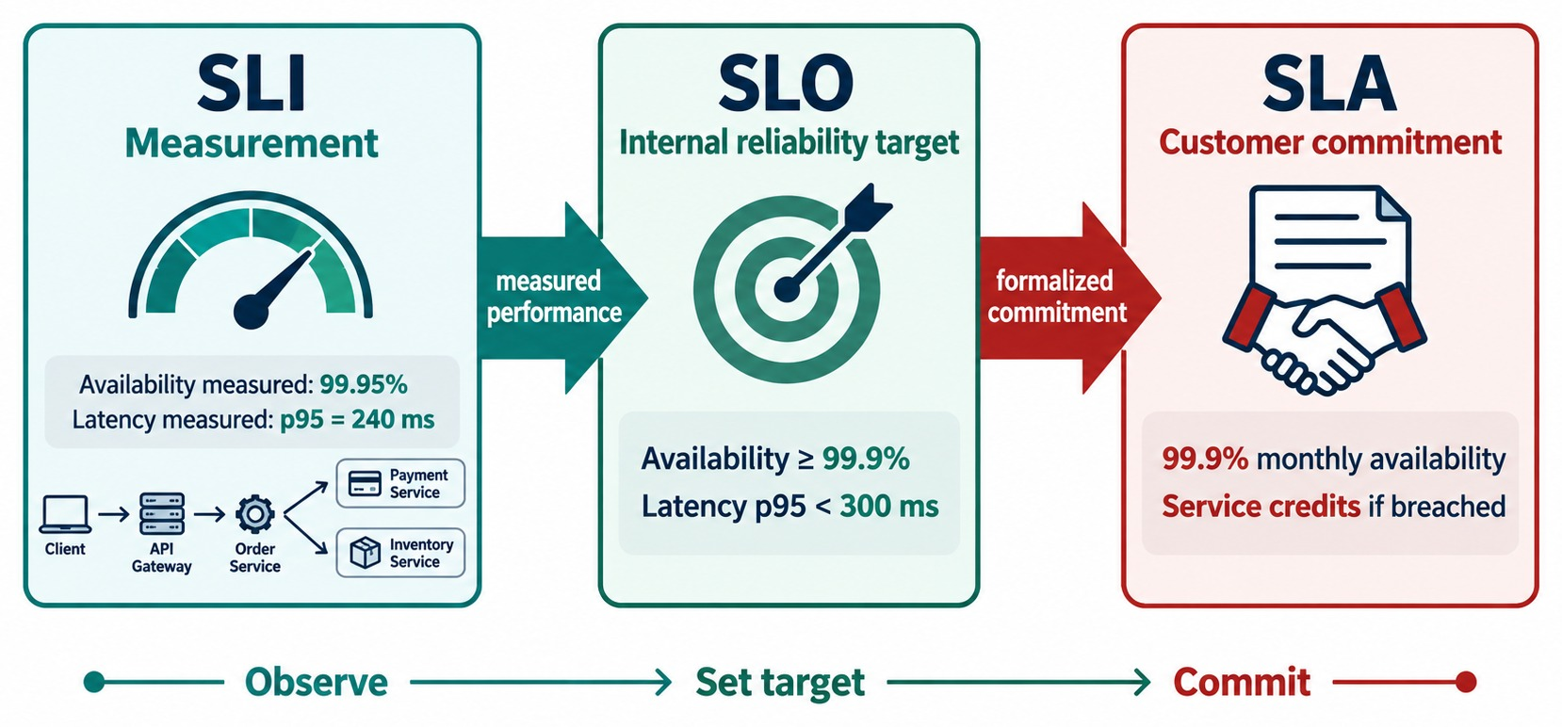
SERVICE-LEVEL AGREEMENTS, SLOS AND SLIS
SLA vs. SLO vs. SLI — availability and latency targets.
Error budget
A 99.9% monthly SLO allows about 43 minutes of failure.
USE IT TO DECIDE
✓
Budget left: ship features
✓
Budget spent: freeze and fix reliability
NOT EVERY SERVICE Payments deserve stricter targets than promotions.
KEY TAKEAWAY Measure with SLIs, aim with SLOs, and commit with SLAs.
36
© 2026 by Innovation In Software Corporation
Notes:
KEY TALKING POINTS
------------------
- Related but different
These three terms are related, but they are not interchangeable.
- SLI
A service level indicator is a measurement, such as availability, latency, error rate or the ratio of successful requests.
- SLO
A service level objective is the target for an indicator.
For example, 99.95 percent monthly availability, or 95 percent of eligible requests under 300 milliseconds.
- SLA
A service level agreement is a formal commitment between a provider and a customer or business party.
It may carry consequences if the commitment is not met.
- Easy to remember
SLI is the measure.
SLO is the target.
SLA is the commitment.
- What it shows
The SLI measures 99.95% availability and a 240 ms p95.
The SLO sets an internal target of 99.9% and p95 under 300 ms. The SLA commits 99.9% monthly with service credits if breached.
- Key point
Observe, set a target, then commit — each step builds on the last.
- Error budgets
If the SLO is 99.9% over a 30-day month, 0.1% — about 43 minutes — may fail.
While budget remains, teams can release; when it's spent, they focus on reliability.

Slide 37
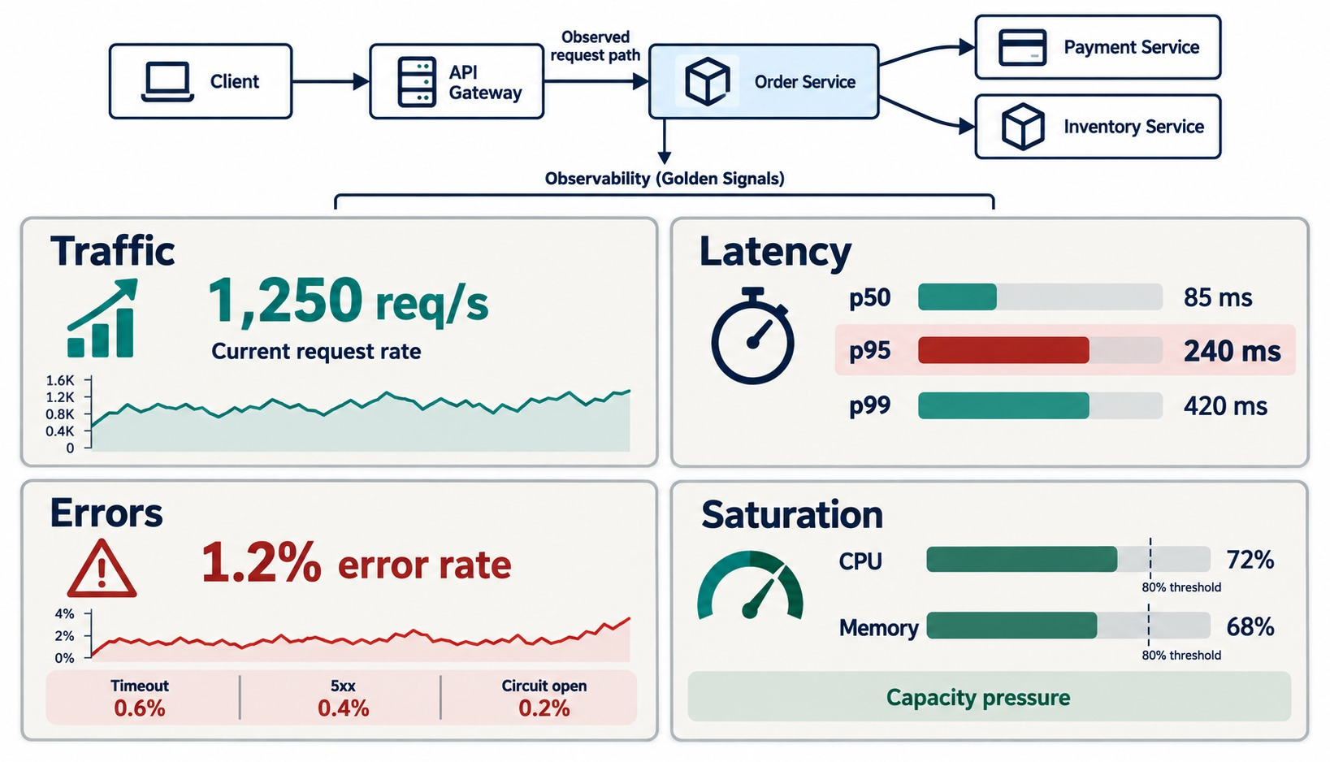
PERFORMANCE AND CAPACITY INDICATORS
p95/p99 latency, throughput, saturation, concurrency and resource use.
Averages hide the tail
An average of 200 ms can hide a p99 of 8 s.
Context matters
1,250 requests per second means little without latency and errors at that load.
LOAD TEST TYPES
Stress
Spike
Soak
Scalability
HEADROOM Plan capacity before saturation, not after.
KEY TAKEAWAY Performance is multidimensional — watch the tail, not just the average.
37
© 2026 by Innovation In Software Corporation
Notes:
KEY TALKING POINTS
------------------
- Averages hide problems
Average latency alone is not enough.
An average of 200 milliseconds sounds good.
But if p95 is 1.5 seconds and p99 is 8 seconds, a meaningful group of users is having a poor experience.
- Percentiles
p95 means 95 percent of measured requests finished at or below that latency.
p99 means 99 percent did.
- Throughput in context
1,000 requests per second means little unless you also know the latency and error rate at that load.
- Many dimensions
Also watch concurrency, CPU, memory, connections and queue depth.
Performance combines load, latency, errors and resource consumption.
- What it shows
Traffic at 1,250 requests per second, latency p50 85 ms, p95 240 ms and p99 420 ms, a 1.2% error rate, and CPU and memory approaching their thresholds.
- Key point
Read the signals together — saturation explains rising latency.
- Load test types
Stress finds the breaking point, spike checks sudden bursts, soak runs for hours to catch leaks, and scalability measures gains from more resources.

Slide 38
EXERCISE: DEFINE SLOS FOR BANKING APIS
Turn “reliable enough” into numbers you can measure.
PRACTICE EXERCISE
10 MIN
SCENARIO
YOUR TASKS
EXPECTED OUTCOME
Set reliability targets for these APIs:
1
Pick one SLI per API
✓
Balance: 99.9%, p95 < 300 ms
2
Set an SLO — availability and p95 latency
Transfer: 99.95%, no duplicate transfers
Account balance API
Transfer API
Fraud check API
Statement download
Rewards lookup
✓
3
Rank them by strictness and explain why
✓
Fraud check: p95 < 700 ms
✓
Statements: p95 < 3 s
✓
Rewards: 99.5% — least critical
KEY TAKEAWAY Strict targets where money moves; relaxed ones where a delay only annoys.
38
© 2026 by Innovation In Software Corporation
Notes:
KEY TALKING POINTS
------------------
- SLIs
For example: successful balance responses divided by all balance requests, or the p95 of transfer latency.
- Ranking
Transfers and balances are critical and customer-facing.
Statements and rewards can tolerate more delay and failure.
- Beyond numbers
Transfer's target includes correctness: no duplicate transfers, which ties back to idempotency.
- Discussion
Ask what each target would cost to meet, and what the error budget would allow each month.

Slide 39
PART 4: CONTINUOUS VALIDATION
A resilience setting nobody tested is only a hope.
✓ Part 1
Failure handling
✓ Part 2
Observability
✓ Part 3
Reliability targets
Part 4
Validation
SO FAR
NEXT QUESTION
How do we know the resilience we designed actually works — before customers find out?
✓
Liveness restarts; readiness routes traffic
✓
SLIs measure, SLOs target, SLAs commit
IN THIS PART
Watch p95, p99, errors and saturation
1
The continuous testing pipeline
✓
2
Testing a timeout fallback — in code
3
Exercise: plan a failure experiment
4
The complete resilient architecture
5
Misconceptions and anti-patterns
39
© 2026 by Innovation In Software Corporation
Notes:
KEY TALKING POINTS
------------------
- Why this part
Timeouts, breakers and fallbacks often fail in production because nobody exercised them.
- What comes next
The testing pipeline, a real fallback test, a planned failure experiment, and the whole architecture.

Slide 40
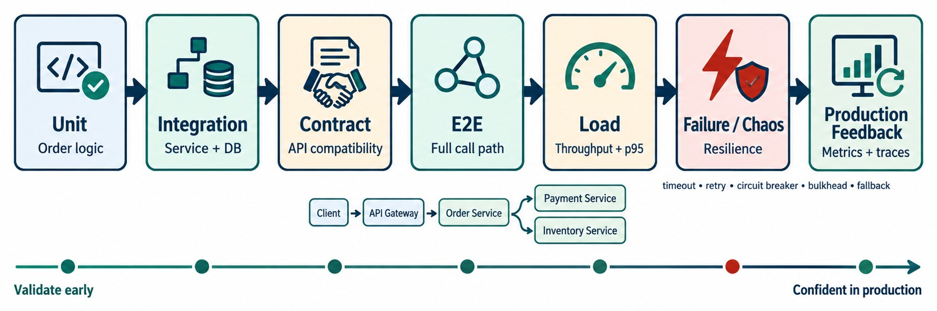
CONTINUOUS TESTING AND RESILIENCE VALIDATION
Unit, integration, contract, load, failure, chaos and deployment validation.
SIMULATE
Timeout
503
Slow dependency
DB unavailable
Pod restart
VERIFY
✓
The timeout fires
✓
Retries stay bounded
✓
The circuit opens
✓
The fallback is safe
✓
The service recovers
QUALITY GATE Fail the build when p95 or error thresholds break.
KEY TAKEAWAY A resilience mechanism never exercised under failure is only an unverified assumption.
40
© 2026 by Innovation In Software Corporation
Notes:
KEY TALKING POINTS
------------------
- More than a 200 response
Testing cannot stop at checking that a controller returns 200.
Unit tests check isolated business logic.
Integration tests check real interactions with the database, message broker or HTTP client.
Contract tests check that service, API and event expectations stay compatible.
- Workflows and load
End-to-end tests check important business workflows.
Load tests show how the system behaves under expected and higher traffic.
- Resilience testing
Deliberately simulate a timeout, a 503, a slow dependency, an unavailable database, a connection failure or a pod restart.
Then verify the timeout works, retries are bounded, the circuit opens, the fallback works, resources stay isolated and the system recovers.
- Chaos testing
Controlled chaos testing introduces planned failures to check your assumptions about how the system behaves.
- The key message
A resilience mechanism that has never been exercised under failure is only an unverified assumption.
- What it shows
Unit, integration, contract, end-to-end, load, failure and chaos tests, then production feedback from metrics and traces.
- Key point
Validate early and keep validating until you're confident in production.

Slide 41
TESTING A TIMEOUT FALLBACK
Make the dependency slow in a test — then assert the business rule.
✓
TransactionResilienceTest.java
…and nothing was published
@Test
void slowAccountServiceReturns503() {
wireMock.stubFor(get(urlPathMatching("/accounts/.*"))
.willReturn(aResponse()
.withFixedDelay(5_000) // beyond the 3 s read timeout
.withStatus(200)));
mockMvc.perform(post("/api/v1/transactions")
.contentType(APPLICATION_JSON)
.content(validRequestJson()))
.andExpect(status().isServiceUnavailable())
.andExpect(jsonPath("$.code")
.value("ACCOUNT_SERVICE_UNAVAILABLE"));
}
@MockitoBean
KafkaTemplate<String, TransactionSubmitted> kafka;
@Test
void noEventWhenAccountServiceIsDown() {
// same slow stub, same request as above
submitTransaction();
verify(kafka, never())
.send(eq("transactions.submitted"), any(), any());
}
Slow, not down
Assert the rule
Run in CI
A delay past the read timeout is the realistic failure.
503 and no TransactionSubmitted — never a fake success.
Every build proves the fallback still works.
KEY TAKEAWAY Inject the failure in a test and assert the business outcome — every build, not once.
41
© 2026 by Innovation In Software Corporation
Notes:
KEY TALKING POINTS
------------------
- The stub
WireMock stands in for Account Service and delays its answer for five seconds, longer than the three-second read timeout.
- The assertion
The API must return 503 with ACCOUNT_SERVICE_UNAVAILABLE, not hang and not succeed.
- No side effects
The second test checks that no TransactionSubmitted event was published while the dependency was down.
- Testing module
Exercise 3.3 in the testing module adds tests like these to the lab.

Slide 42
EXERCISE: PLAN A FAILURE EXPERIMENT
Prove a resilience claim safely, before production proves it for you.
PRACTICE EXERCISE
10 MIN
SCENARIO
YOUR TASKS
EXPECTED OUTCOME
Your team claims Order Service survives a slow Payment Service. You will test it in staging this afternoon.
1
Write the hypothesis you want to prove
✓
Checkout p95 stays under 2 s; orders go PENDING
2
Choose the fault to inject and limit its blast radius
✓
Add 3 s latency to 10% of Payment calls
List what you'll measure — and when you'll stop
✓
Watch p95, errors, breaker state, pending orders
3
✓
Abort if the error rate passes 2%
✓
Record results, fix, and rerun
KEY TAKEAWAY Chaos engineering is a controlled experiment: hypothesis, small blast radius, clear stop rule.
42
© 2026 by Innovation In Software Corporation
Notes:
KEY TALKING POINTS
------------------
- Hypothesis
State what should happen in measurable terms, for example p95 under two seconds and orders marked pending instead of failing.
- Blast radius
Start small: a fraction of calls, in staging, for a limited time.
- Stop rule
Decide in advance which signal ends the experiment, so nobody improvises during an incident.
- Learn
Whatever breaks becomes a fix and a new automated test.

Slide 43
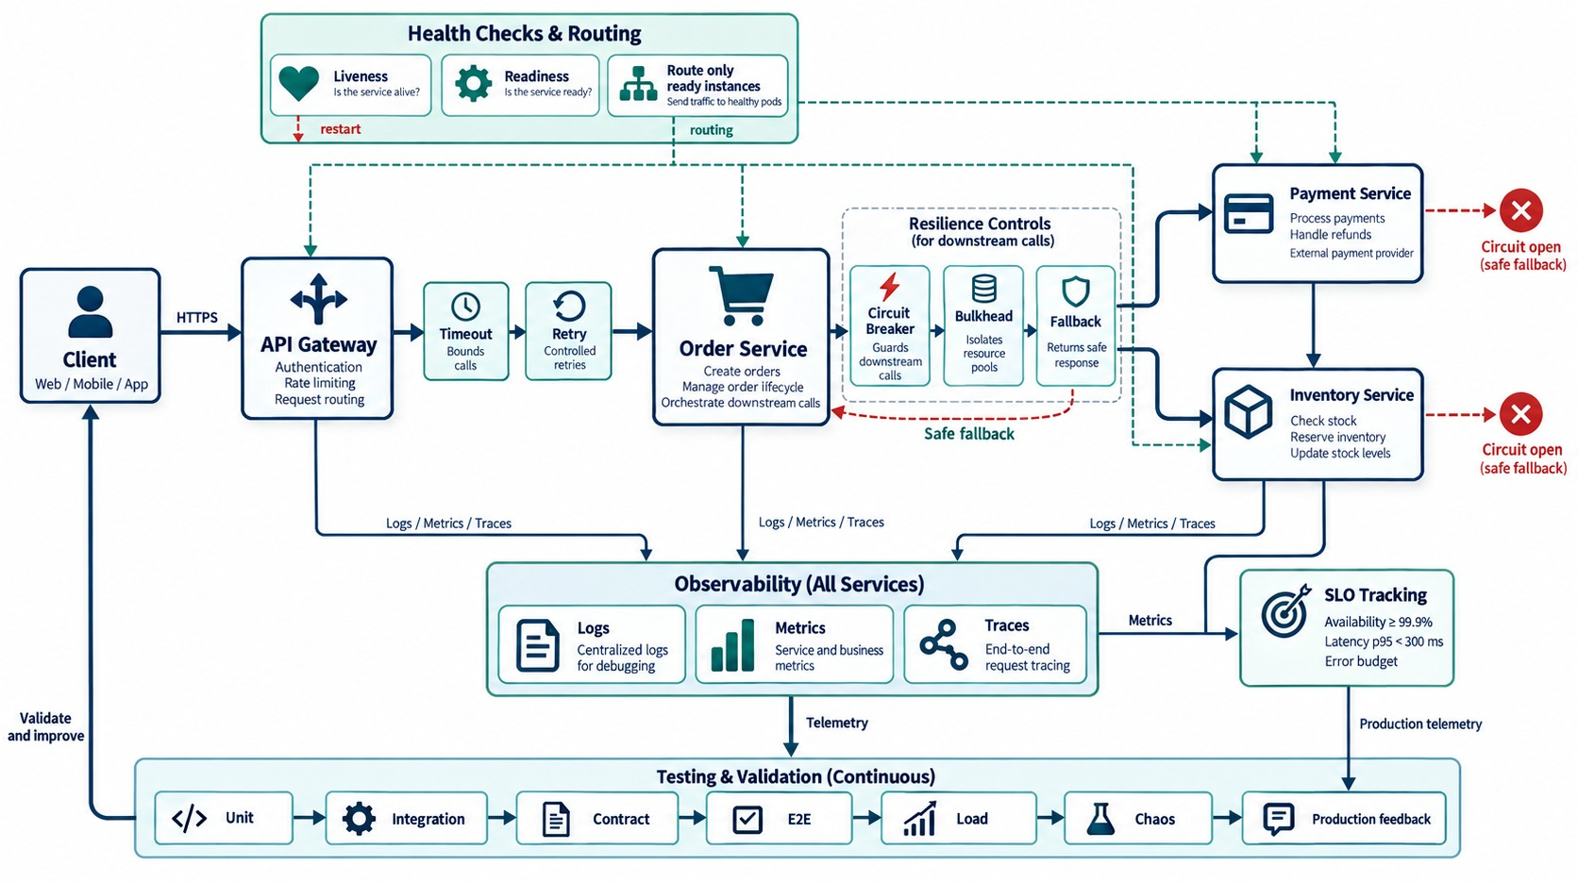
END-TO-END RESILIENT MICROSERVICES ARCHITECTURE
Resilience patterns, observability, health checks, SLOs and testing feedback.
EVERY PART OF THE MODULE
✓
Gateway: timeout, retry, rate limit
✓
Order: breaker, bulkhead, fallback
✓
Probes route only to ready pods
✓
Logs, metrics and traces from every service
✓
SLOs and error budgets from telemetry
✓
Tests from unit to chaos feed back
REMEMBER Contain, observe, measure — then keep validating.
KEY TAKEAWAY Contain failures, make them observable, measure reliability — and keep testing it.
43
© 2026 by Innovation In Software Corporation
Notes:
KEY TALKING POINTS
------------------
- Failure boundaries
Use this architecture to rebuild the module.
Order calls Payment and Inventory over the network, and each call is a failure boundary.
- The client-side patterns
Timeouts stop requests from waiting forever.
Retries, with backoff and jitter, handle selected temporary failures, but must be bounded and safe.
Circuit breakers fail fast when a dependency is unhealthy.
Bulkheads stop a Payment problem from consuming Inventory's resources.
Fallbacks keep reduced but correct functionality.
- Observability
Logs explain individual events.
Metrics show how often, how slow, how many errors and how saturated.
Traces connect a request across the gateway, Order and Payment, so operators find where latency or failure started.
- Health and reliability targets
Liveness and readiness let OpenShift and Kubernetes make the right runtime decisions.
SLIs measure reliability, SLOs set targets, and SLAs express formal commitments.
- Continuous validation
Do not assume the circuit breaker, retries, fallback, autoscaling or recovery work.
Test those behaviors, observe and improve.
- Final message
Resilient microservices assume networks, dependencies and infrastructure will sometimes fail.
They bound waiting, retry carefully, fail fast, contain resource exhaustion and keep useful behavior.
They make failures observable, measure reliability, and test that it all really works.
- What it shows
A client calls the API Gateway, which applies timeouts and retries before Order Service.
Order protects its Payment and Inventory calls with a circuit breaker, bulkhead and fallback.
- How to read it
Health checks at the top route traffic only to ready pods.
Logs, metrics and traces flow down to observability, metrics feed SLO tracking, and continuous testing at the bottom loops back to improve the system.
- Key point
Resilience isn't one pattern — it's contained failures, visible behavior, measured targets and constant validation working together.

Slide 44
RESILIENCE MISCONCEPTIONS AND ANTI-PATTERNS
Beliefs and habits that turn small failures into outages.
MISCONCEPTION
REALITY
ANTI-PATTERNS TO AVOID
Retries make services more reliable
Blind retries amplify outages
✕
No timeout on remote calls
✕
Retrying non-idempotent writes
✕
Retries at every layer
Longer timeouts are safer
They hold threads and hide failures
✕
Liveness checks that call dependencies
✕
Alerting on CPU but not on errors
✕
Resilience never tested under failure
A circuit breaker fixes the dependency
It only protects the caller
REMEMBER Budget latency, then test it — before an incident does.
A fallback may return success
Never invent a financial outcome
Average latency tells the story
p95 and p99 are what users feel
KEY TAKEAWAY Resilience comes from bounded, deliberate and tested behavior — not from adding more retries.
44
© 2026 by Innovation In Software Corporation
Notes:
KEY TALKING POINTS
------------------
- Why this slide
Before the knowledge check, clear away the beliefs behind most resilience incidents.
- Retries and timeouts
Unbounded retries multiply load on a struggling service, and long timeouts keep threads busy while hiding the problem.
- Breakers and fallbacks
A breaker protects the caller, not the dependency.
And a fallback must never report a payment or transfer as successful.
- Anti-patterns
Missing timeouts, retrying writes, stacking retries in every layer, dependency-coupled liveness checks, CPU-only alerts and untested fallbacks.

Slide 45
KNOWLEDGE CHECK
Answer in your own words — then compare with a partner.
Why design microservices for failure?
What does the bulkhead pattern protect?
1
6
What problem does a timeout solve?
Which HTTP status signals rate limiting?
2
7
When is a retry appropriate?
Why are correlation IDs important?
3
8
Why can retries be dangerous?
What are the four golden signals?
4
9
What are the three circuit breaker states?
What's the difference between a trace and a span?
5
10
45
© 2026 by Innovation In Software Corporation
Notes:
KEY TALKING POINTS
------------------
- 1. Design for failure
Services depend on networks, databases, brokers and other services that fail or slow down.
- 2. Timeout
It stops a service waiting indefinitely for a dependency.
- 3. Retry
For temporary failures, when the operation is safe to repeat.
- 4. Danger
Retries can overload a struggling dependency or repeat non-idempotent operations.
- 5. States
Closed, open and half-open.
- 6. Bulkhead
Service resources, by isolating workflows or dependencies.
- 7. Rate limiting
429 Too Many Requests.
- 8. Correlation IDs
They connect logs, events and traces across services.
- 9. Golden signals
Latency, traffic, errors and saturation.
- 10. Trace vs. span
A trace is the whole request journey; a span is one operation within it.
- Practical scenario
Transaction Service calls a slow Fraud Detection Service: set a timeout inside the budget, don't retry the write blindly, add a breaker, hold payments for review, and track fraud latency, timeouts and breaker state.

Slide 46
MODULE 6 SUMMARY AND WHAT'S NEXT
From fragile call chains to contained, observable and tested services.
YOU CAN NOW
NEXT: MODULE 7 — DEVOPS AND CI/CD
✓
Bound every remote call with a timeout inside a budget
1
How does a code change reach production safely?
✓
Retry safely with backoff, jitter and idempotency
2
What belongs in a microservices CI/CD pipeline?
✓
Protect callers with circuit breakers, bulkheads and fallbacks
How do we deploy without downtime — and roll back?
3
✓
Diagnose incidents with logs, metrics and traces
✓
Set SLOs and prove resilience with failure tests
BRING ALONG Your Lab 3 Transaction Service with its timeouts and circuit breaker.
KEY TAKEAWAY Module 7 automates getting these services to production safely.
46
© 2026 by Innovation In Software Corporation
Notes:
KEY TALKING POINTS
------------------
- Recap
We contained failures with timeouts, retries, breakers, bulkheads and fallbacks, made them observable, set reliability targets and tested them.
- Next module
Module 7 is DevOps and CI/CD: pipelines, automated quality gates and safe deployments.

