Slide 1
"What we tested is what we deploy."
MODULE 7
DevOps and CI/CD for
Microservices
From source-code change to a secure, tested production deployment.
DevOps lifecycle
Git workflows
Continuous Integration
Continuous Delivery
GitHub and Jenkins
Automated testing
Blue/Green and Canary
Authentication and security
SPRING BOOT MICROSERVICES BOOTCAMP • MODULE 7
Notes:
KEY TALKING POINTS
------------------
- A new question
Until now we focused on building the application: design, Spring Boot, REST APIs, messaging, data and resilience.
Production software also needs a reliable answer to one question: how does a developer's code safely reach production?
- The manual way
A manual process looks like this.
The developer builds on a laptop, copies the JAR, logs in to a server over SSH, replaces the application and restarts it.
That is hard to reproduce, hard to audit, and hard to scale across dozens of microservices.
- The goal
Instead we want a repeatable flow.
Code goes into version control, then an automated build, automated tests and security checks.
Then we package, deploy, observe, and feed what we learn back in.
That is the focus of Module 7.

Slide 2
LEARNING OBJECTIVES
Git workflows, CI/CD, testing, GitHub/Jenkins, deployment strategies and security.
🎯
BY THE END OF THIS MODULE, YOU CAN
🧭
FOUR AREAS
1. Explain the DevOps lifecycle
2. Apply Git workflows
3. Explain CI, continuous delivery and deployment
4. Design a CI/CD pipeline
5. Understand GitHub Actions and Jenkins
6. Automate software testing
7. Build and promote immutable artifacts
8. Explain Blue/Green and Canary deployment
9. Understand authentication and authorization
10. Integrate security checks into CI/CD
1
Source control & collaboration
Git
Branch
Commit
PR
Merge
2
CI/CD
Build
Test
Scan
Package
Publish
Deploy
3
Release strategies
Blue/Green
Canary
4
Security
Authentication
Authorization
Secrets
Scanning
KEY TAKEAWAY Make delivery repeatable, automated, testable, secure and observable.
2
© 2026 by Innovation In Software Corporation
Notes:
KEY TALKING POINTS
------------------
- By the end of this module
Learners should be able to explain the DevOps lifecycle and apply Git workflows.
They should explain CI, continuous delivery and continuous deployment, and design a CI/CD pipeline.
They should understand GitHub Actions and Jenkins, automate testing, and build and promote immutable artifacts.
They should explain Blue/Green and Canary deployment, the basics of authentication and authorization, and security checks in CI/CD.
- Four areas
Source control and collaboration: Git, branch, commit, pull request, merge.
CI/CD: build, test, scan, package, publish, deploy.
Release strategies: Blue/Green and Canary.
Security: authentication, authorization, secrets and security scanning.
- The objective
Make delivery repeatable, automated, testable, secure and observable.

Slide 3
KEY TERMS FOR THIS MODULE
Plain definitions for the words we'll use most.
1
Continuous integration
2
Continuous delivery
Merging small changes often, with an automated build and tests on every change.
Every change stays releasable; the production release is a deliberate step.
3
Continuous deployment
4
Pull request
Every change that passes the pipeline goes to production automatically.
A proposed change that is reviewed and checked before it's merged.
5
Quality gate
6
Build once, promote
A pipeline check, such as tests or a scan, that must pass before moving on.
Build one image, then move that exact artifact through every environment.
7
Blue/green deployment
8
Canary deployment
Two identical environments; traffic switches from old to new all at once.
Sending a small share of traffic to the new version before everyone gets it.
KEY TAKEAWAY Agree on the words first — every later slide builds on them.
3
© 2026 by Innovation In Software Corporation
Notes:
KEY TALKING POINTS
------------------
- How to run this slide
Read each term once and give a quick example from the order platform or the banking lab.
- Continuous integration
Merging small changes often, with an automated build and tests on every change.
- Continuous delivery
Every change stays releasable; the production release is a deliberate step.
- Continuous deployment
Every change that passes the pipeline goes to production automatically.
- Pull request
A proposed change that is reviewed and checked before it's merged.
- Quality gate
A pipeline check, such as tests or a scan, that must pass before moving on.
- Build once, promote
Build one image, then move that exact artifact through every environment.
- Blue/green deployment
Two identical environments; traffic switches from old to new all at once.
- Canary deployment
Sending a small share of traffic to the new version before everyone gets it.

Slide 4
FULL FORMS USED IN THIS MODULE
Every abbreviation on these slides, spelled out.
API
Application Programming Interface
JWT
JSON Web Token
SAST
Static Application Security Testing
CD
Continuous Delivery / Deployment
MFA
Multi-Factor Authentication
SBOM
Software Bill of Materials
CI
Continuous Integration
OAuth
Open Authorization
SHA
Secure Hash Algorithm
CI/CD
Continuous Integration / Continuous Delivery
OIDC
OpenID Connect
SSO
Single Sign-On
CVE
Common Vulnerabilities and Exposures
PR
Pull Request
YAML
YAML Ain't Markup Language
DB
Database
REST
Representational State Transfer
KEY TAKEAWAY When an abbreviation isn't clear, the full form is on this slide.
4
© 2026 by Innovation In Software Corporation
Notes:
KEY TALKING POINTS
------------------
- How to run this slide
Don't read every row.
Point out the few this module uses most, and say the full list is here for reference.
- Reference
API is Application Programming Interface; CD is Continuous Delivery / Deployment; CI is Continuous Integration; CI/CD is Continuous Integration / Continuous Delivery; CVE is Common Vulnerabilities and Exposures; DB is Database; JWT is JSON Web Token; MFA is Multi-Factor Authentication; OAuth is Open Authorization; OIDC is OpenID Connect; PR is Pull Request; REST is Representational State Transfer; SAST is Static Application Security Testing; SBOM is Software Bill of Materials; SHA is Secure Hash Algorithm; SSO is Single Sign-On; YAML is YAML Ain't Markup Language.

Slide 5
FROM MODULE 6 TO MODULE 7
Our services are resilient and observable — now deliver every change safely.
MODULES 1–6 GAVE US
🧭
OUR PATH THROUGH MODULE 7
1
DevOps culture and the delivery lifecycle
Part 1
✓
Well-bounded Spring Boot services
REST and event contracts
2
Git workflows and pull-request gates
Part 1
✓
Service-owned data and Sagas
3
CI, continuous delivery and pipelines
Part 2
✓
Resilience patterns and failure tests
4
GitHub Actions, Jenkins and testing
Part 2
✓
Logs, metrics, traces and SLOs
5
Build once, promote the same image
Part 2
✓
NOW Automate how every change is reviewed, tested, secured and released.
6
Blue/Green and canary releases
Part 3
7
Security in the pipeline
Part 4
KEY TAKEAWAY Modules 1–6 built good services; Module 7 makes delivering them repeatable, automated and safe.
5
© 2026 by Innovation In Software Corporation
Notes:
KEY TALKING POINTS
------------------
- Bridge from Module 6
We can now build services that survive failure and tell us how they behave.
This module is about getting every change into production safely.
- The path
Source control first, then CI/CD pipelines and testing, then release strategies, and finally security inside the pipeline.
- Two examples
The slides follow the Order Service.
Exercises 3.3 and 4.3 and Lab 4 use the banking Account and Transaction services.

Slide 6
PART 1: SOURCE CONTROL AND COLLABORATION
Everything we deliver starts as a reviewed change in Git.
Part 1
Source control
Part 2
CI/CD
Part 3
Release strategies
Part 4
Security
SO FAR
NEXT QUESTION
How do many teams change many services every day without breaking each other?
✓
Services deploy independently
✓
Tests prove resilience and fallbacks
IN THIS PART
✓
Observability shows how releases behave
What DevOps means for microservices
1
2
The DevOps and delivery lifecycles
3
Git as the source of truth
4
Team workflows and branching models
5
Exercise: design a branching workflow
6
Pull requests and quality gates
6
© 2026 by Innovation In Software Corporation
Notes:
KEY TALKING POINTS
------------------
- Why start here
Pipelines, tests and deployments all start from a change in Git.
If the workflow is weak, automation just ships problems faster.
- What this part covers
DevOps culture, the delivery lifecycle, Git workflows and the pull-request gates that protect main.

Slide 7
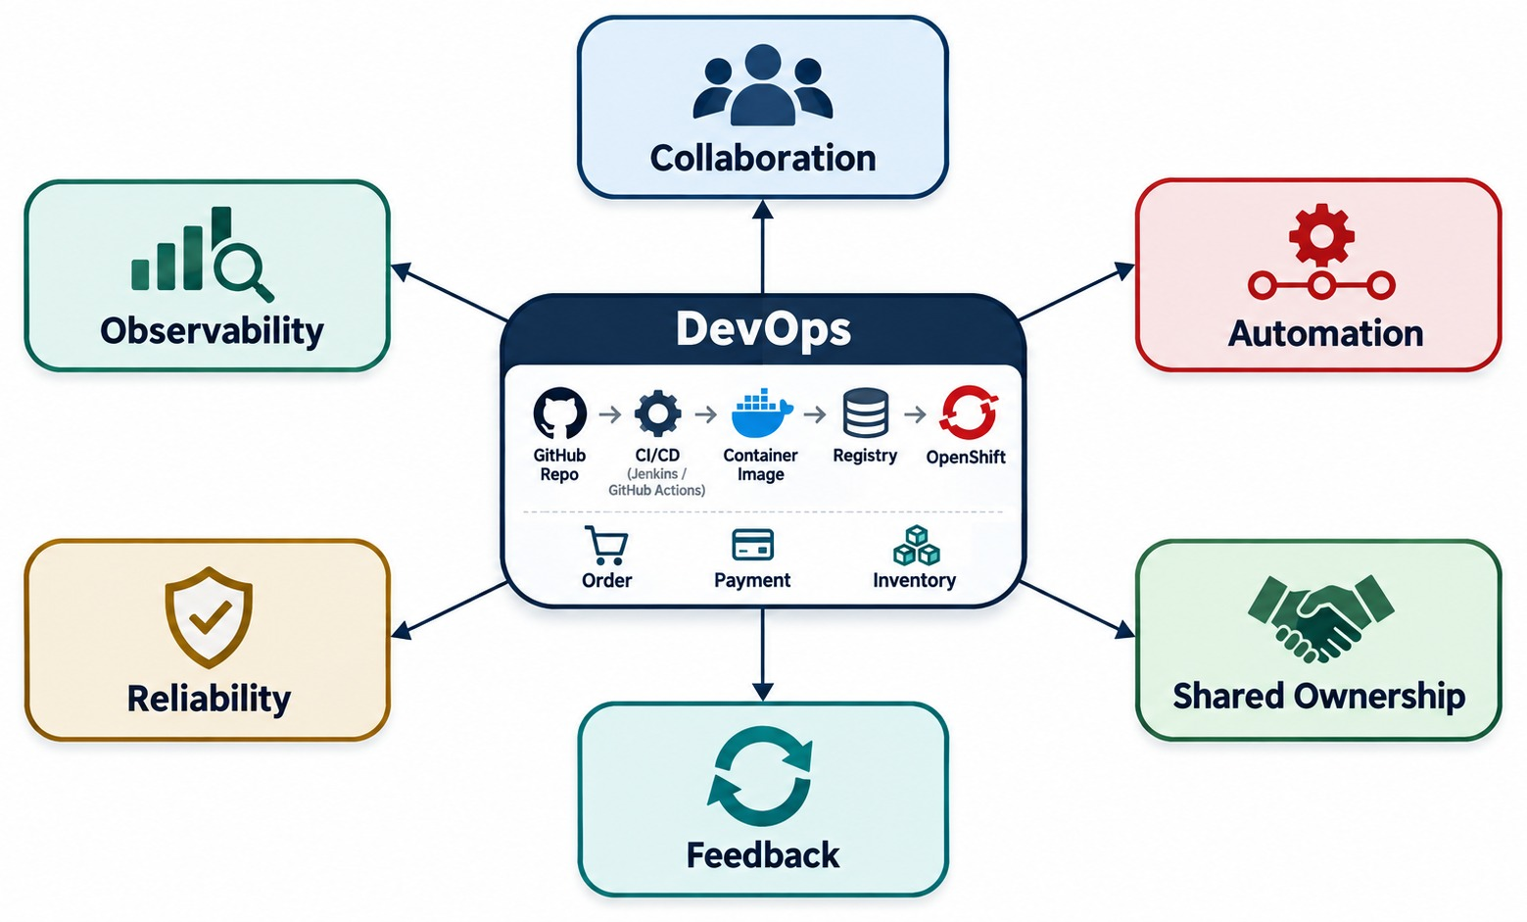
WHAT DEVOPS MEANS FOR MICROSERVICES
Collaboration, automation, ownership, rapid feedback and reliable releases.
WHAT DEVOPS IS NOT
✕
Hand code over the wall to operations
✕
Buy a tool and call it DevOps
✕
Release once a quarter
You build it, you run it
The team that owns Order Service also owns its pipeline, alerts and releases.
WHY IT MATTERS Dozens of services deploying independently need automation.
KEY TAKEAWAY DevOps is culture, practices and automation — essential when many services deploy independently.
7
© 2026 by Innovation In Software Corporation
Notes:
KEY TALKING POINTS
------------------
- What DevOps is not
DevOps is not the same as Jenkins.
It is also not simply Docker plus Kubernetes.
- What DevOps is
DevOps combines culture, practices, automation, feedback and ownership.
Walk around the diagram: collaboration, automation, continuous feedback, shared ownership, fast delivery, reliability and observability.
- From handoff to loop
The traditional handoff is a developer saying the code is finished, and operations being told to deploy it.
DevOps encourages a continuous lifecycle instead: develop, deliver, operate, observe and improve, then repeat.
- Why it matters for microservices
This matters especially with microservices, because we may have many independently deployable applications.
- What the diagram shows
DevOps in the centre, connected to collaboration, automation, shared ownership, feedback, reliability and observability.
- Key point
DevOps is a culture and set of practices — the tools only support them.

Slide 8
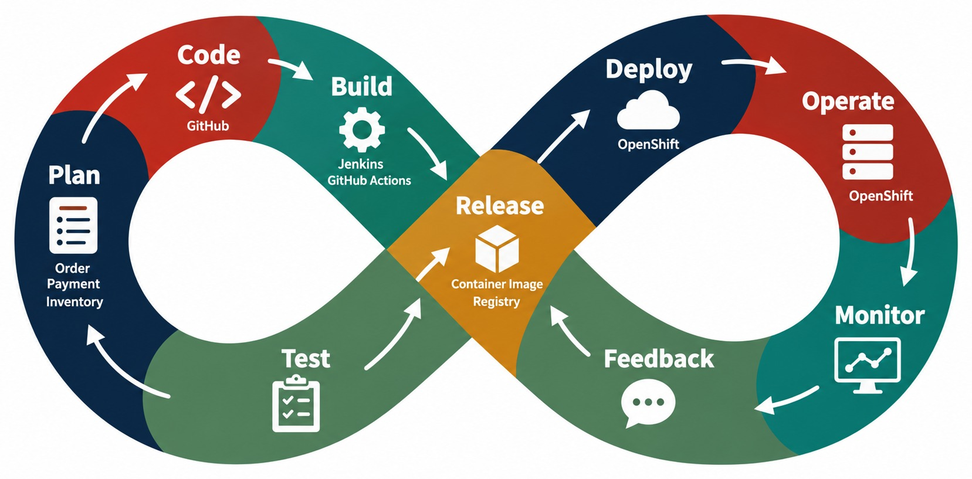
THE DEVOPS LIFECYCLE
Plan → Code → Build → Test → Release → Deploy → Operate → Monitor → Feedback.
Left loop — deliver
Plan, code, build and test turn an idea into a validated change.
Right loop — run
Release, deploy, operate and monitor keep it healthy in production.
FEEDBACK THAT DRIVES PLANNING
Error rate
Latency
Incidents
User feedback
A LOOP not a one-way pipeline.
KEY TAKEAWAY DevOps is a loop, not a one-way pipeline.
8
© 2026 by Innovation In Software Corporation
Notes:
KEY TALKING POINTS
------------------
- Plan, code, build
Plan defines business requirements, user stories, technical work and acceptance criteria.
Code is where we develop the change.
Build compiles and packages it.
For Spring Boot, Java source goes through Maven to become a JAR.
- Test, release, deploy
Test runs automated tests.
Release creates a versioned release candidate, or artifact.
Deploy places the application into an environment.
- Operate, monitor, feedback
Operate means running the service.
Monitor means watching logs, metrics, traces, health and business indicators.
Feedback uses what we learn in development and production to improve the next change.
- The key point
DevOps is a loop, not a one-way pipeline.
- What the diagram shows
The loop of plan, code, build, test, release, deploy, operate, monitor and feedback.
- Key point
What we learn in production flows straight back into planning.

Slide 9
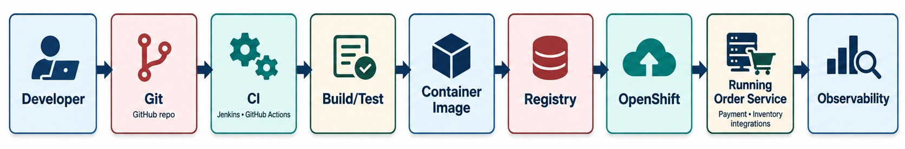
MICROSERVICES DELIVERY LIFECYCLE
Code change → Git → CI → container → registry → deployment → monitoring.
WHAT CI RUNS FOR ORDER SERVICE
After deployment
PER SERVICE Each service has its own pipeline and release cadence.
✓
Compile and unit test
Readiness, smoke tests and dashboards confirm the release is healthy.
✓
Integration and contract tests
✓
Security scans
✓
Build and tag the image
KEY TAKEAWAY Every Order Service change follows the same automated path from commit to feedback.
9
© 2026 by Innovation In Software Corporation
Notes:
KEY TALKING POINTS
------------------
- Apply it to Order Service
Now apply DevOps to our Order Service.
A developer changes OrderService.java and commits the change.
GitHub stores the version-controlled source, and the CI system starts.
- What CI runs
It may run compile, unit tests, integration tests, static analysis and security checks.
- From JAR to OpenShift
If everything passes, the Spring Boot JAR becomes a container image.
The image goes to a container registry, and then to OpenShift.
- After deployment
Once it is deployed, telemetry tells us whether the release is healthy.
This slide sets up the architecture for the rest of Module 7.
- What the diagram shows
A developer's change moving through Git, CI, build and test, a container image, the registry, OpenShift, the running service and observability.
- Key point
Every service change follows the same automated path.

Slide 10
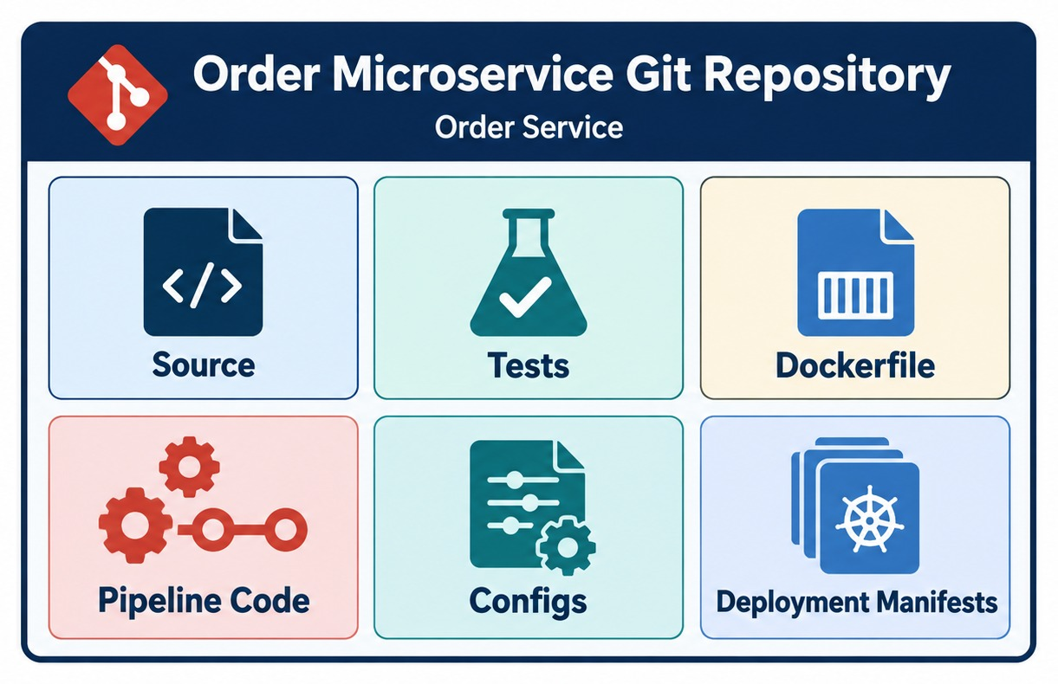
GIT AS THE SOURCE OF TRUTH
Source code, configuration, pipeline definitions, infrastructure and history.
One repository, whole recipe
order-service/
├── src/main/java/…
├── src/test/java/…
├── Containerfile
├── .github/workflows/ci.yml
├── Jenkinsfile
└── deploy/openshift/*.yaml
WHAT YOU GET
✓
Review
✓
Audit history
✓
Rollback
✓
Reproducible builds
NEVER IN GIT passwords, tokens or keys.
KEY TAKEAWAY Git holds the code, tests, pipeline and deployment definitions — the whole delivery recipe.
10
© 2026 by Innovation In Software Corporation
Notes:
KEY TALKING POINTS
------------------
- More than Java files
Git should contain much more than .java files.
A typical microservice repository has src, pom.xml, a Dockerfile and a Jenkinsfile.
It also has a .github/workflows folder, deployment files and a README.
- Benefits
Version control gives us history, auditability, collaboration and the ability to roll back.
It also gives us review, and it triggers automation.
- Pipeline as code
If a pipeline definition changes, that change goes through code review too.
This leads to the idea of pipeline as code.
- What the diagram shows
One repository holding source, tests, the Dockerfile, pipeline code, configuration and deployment manifests.
- Key point
If it isn't in Git, it can't be reviewed, versioned or rebuilt.

Slide 11
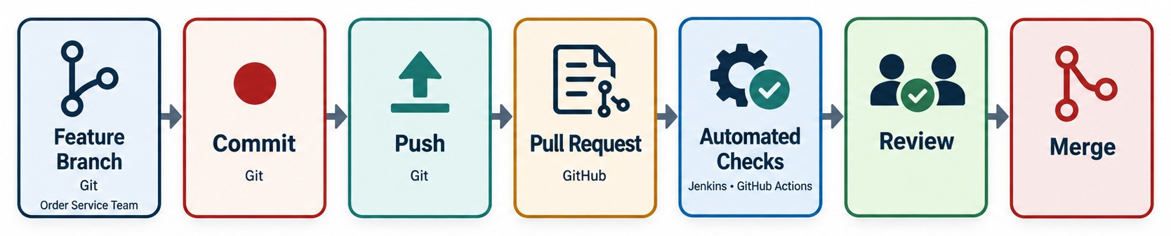
GIT WORKFLOW FOR A MICROSERVICE TEAM
Branch → commit → push → pull request → review → merge.
An example change
Branch names
RULE Main is always releasable.
git switch -c feature/payment-limit-rule
git commit -m "feat: reject orders above limit"
git push -u origin feature/payment-limit-rule
# open a PR against main
feature/…, bugfix/…, hotfix/… — link each change to a work item.
KEY TAKEAWAY Branch, commit, push, open a PR, pass checks and review — then merge.
11
© 2026 by Innovation In Software Corporation
Notes:
KEY TALKING POINTS
------------------
- An example change
Suppose a developer is adding an order cancellation API.
They create a branch, for example feature/order-cancellation.
- The flow
They edit, commit and push, then open a pull request.
The pull request is a controlled collaboration point.
- Before merging
The build must pass, tests must pass, security checks must pass, and a reviewer must approve.
Then the change merges into the main integration branch.
- The key point
A Git workflow is not only about storing code.
It creates the trigger and the governance model for automation.
- What the diagram shows
A feature branch, commit, push, pull request, automated checks, review and merge.
- Key point
Nothing reaches main without checks and a review.

Slide 12
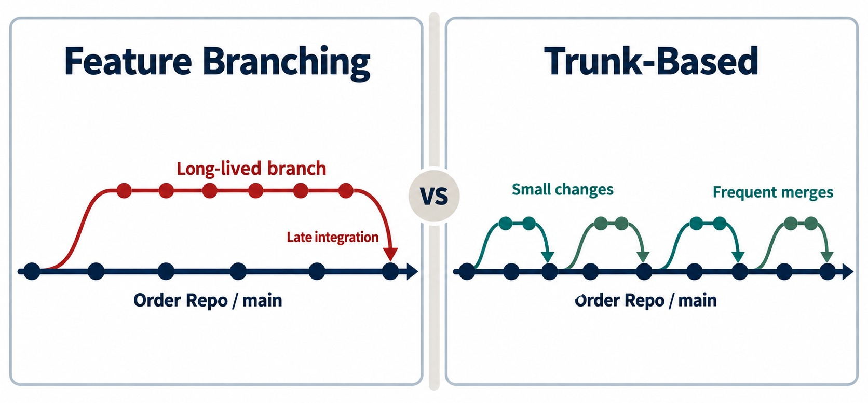
TRUNK-BASED DEVELOPMENT VS. FEATURE BRANCHING
Two common Git collaboration models and their trade-offs.
Feature branching
Isolated work, but long-lived branches drift and merges get painful.
Trunk-based
Small changes merged at least daily; feature flags hide unfinished work.
REAL LESSON Integrate small batches often, whichever model you pick.
KEY TAKEAWAY Choose a workflow that supports frequent, safe integration — not large unvalidated batches.
12
© 2026 by Innovation In Software Corporation
Notes:
KEY TALKING POINTS
------------------
- Feature branching
Feature branching gives developers an isolated work area.
But long-lived branches cause large merge conflicts, large pull requests and delayed integration.
- Trunk-based development
Trunk-based development emphasizes small changes and short-lived branches, where branches are used at all.
It relies on frequent integration and strong automated testing.
- The real lesson
No single Git strategy is right for everyone.
The workflow should support frequent, safe integration and avoid large batches of unvalidated change.
- What the diagram shows
A long-lived feature branch next to frequent, small integrations into trunk.
- Key point
The smaller and more frequent the merge, the less painful it is.
- Feature flags
Trunk-based teams merge unfinished work behind a flag, so main stays releasable while the feature is still being built.

Slide 13
EXERCISE: DESIGN A BRANCHING WORKFLOW
Agree how the Order Service team moves changes to production.
PRACTICE EXERCISE
10 MIN
SCENARIO
YOUR TASKS
EXPECTED OUTCOME
Six developers own Order Service. They release several times a week and must be able to ship an urgent fix within an hour.
Today some branches live for three weeks and merges break main.
1
Choose trunk-based or short-lived feature branches — and justify it
✓
Short-lived branches merged within 1–2 days
2
Name the branch types and naming rules
✓
feature/, bugfix/, hotfix/ with a work-item link
List what must pass before a PR can merge
✓
Build, tests, scan and one approval to merge
3
✓
Hotfix branch from main, same gates, fast review
4
Describe the path for an urgent production fix
✓
Feature flags for unfinished work
KEY TAKEAWAY A good workflow keeps branches short, gates every merge and still allows a fast, safe hotfix.
13
© 2026 by Innovation In Software Corporation
Notes:
KEY TALKING POINTS
------------------
- The problem
Three-week branches drift from main, so merges become large and risky.
- A good answer
Short-lived branches or trunk-based development, with protected main and required checks.
- Hotfixes
An urgent fix still goes through the pipeline.
The review is faster, not skipped.

Slide 14
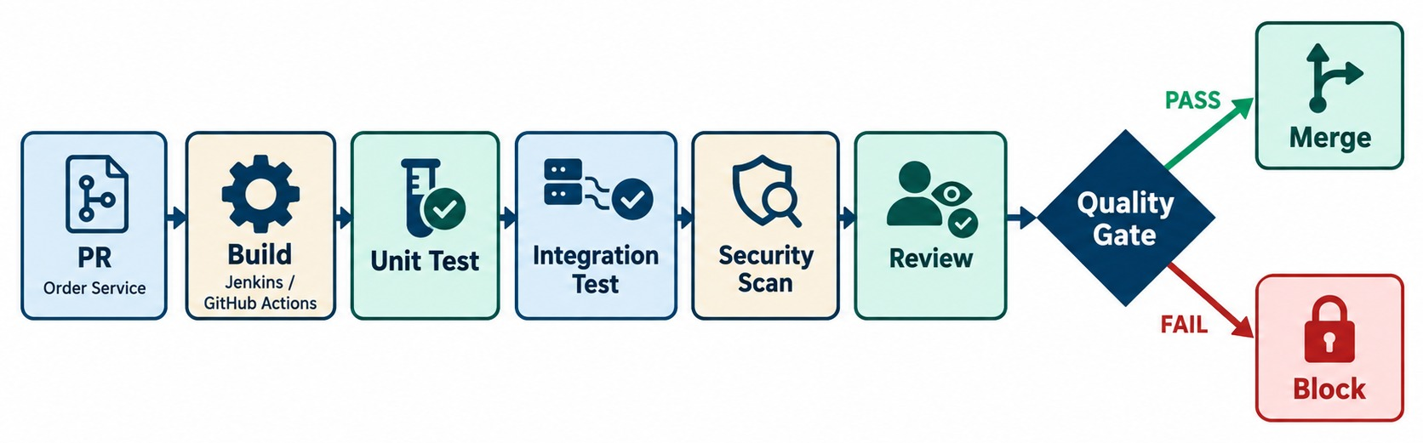
PULL REQUESTS AND AUTOMATED QUALITY GATES
Reviews, tests, linting, security checks and merge controls.
BRANCH PROTECTION ON MAIN
When a check fails
FAST FEEDBACK Keep PR checks under about ten minutes.
✓
At least one approval
The merge button stays disabled; the author fixes and pushes again.
✓
All required checks green
✓
No CRITICAL vulnerabilities
✓
Branch up to date
KEY TAKEAWAY Pull requests gate quality before code reaches main — fast feedback is cheap feedback.
14
© 2026 by Innovation In Software Corporation
Notes:
KEY TALKING POINTS
------------------
- A place to enforce quality
A pull request is a good place to enforce quality before code reaches the main branch.
When a developer opens a PR, automation starts right away.
- When checks fail
If unit tests fail, the PR shows the failure.
If a serious security issue is found, the merge may be blocked, depending on organizational policy.
- Fast feedback
The objective is fast feedback.
Finding a defect minutes after a commit is far cheaper than finding it after a production deployment.
- What the diagram shows
A pull request going through build, unit tests, integration tests, a security scan and review, ending in merge or block.
- Key point
Any failing gate blocks the merge automatically.

Slide 15
PART 2: CI/CD PIPELINES
Turn every merge into a tested, versioned, deployable artifact.
✓ Part 1
Source control
Part 2
CI/CD
Part 3
Release strategies
Part 4
Security
SO FAR
NEXT QUESTION
What should happen automatically between a merge and a running release?
✓
DevOps is a feedback loop
✓
Git holds the whole delivery recipe
IN THIS PART
✓
Pull requests gate every change
Continuous integration, delivery and deployment
1
2
Pipeline architecture
3
GitHub Actions and Jenkins — in code
4
Automated testing across the pipeline
5
Exercise 3.3: security and resilience tests
6
Build once, promote — and Exercise 4.3
15
© 2026 by Innovation In Software Corporation
Notes:
KEY TALKING POINTS
------------------
- From change to artifact
Part 1 got a reviewed change into main.
Part 2 turns it into an artifact we trust enough to deploy.
- What comes next
CI and CD definitions, the pipeline stages, two tools, tests at each stage, and promotion of one immutable image.

Slide 16
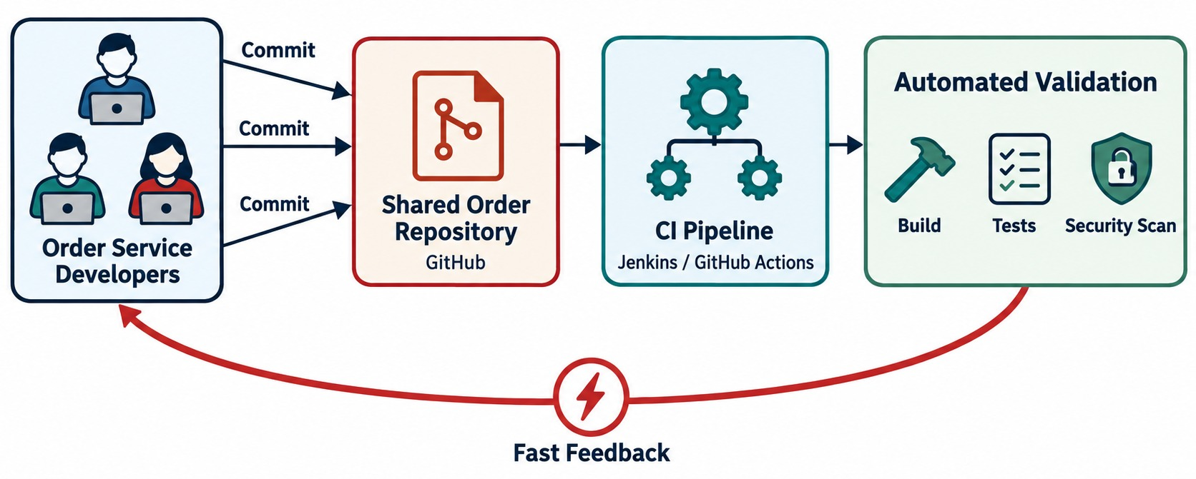
WHAT IS CONTINUOUS INTEGRATION?
Frequent integration with automated build and test feedback.
The classic problem
Weeks of separate work, then an “integration phase” full of surprises.
THE CI HABIT
✓
Merge small changes daily
✓
Every push builds and tests
✓
Fix a broken build first
A PRACTICE not just “we have Jenkins.”
KEY TAKEAWAY CI is a practice of frequent, validated integration — not just “we have Jenkins.”
16
© 2026 by Innovation In Software Corporation
Notes:
KEY TALKING POINTS
------------------
- The classic problem
Continuous Integration solves a classic problem.
Developers work separately for weeks, then everyone tries to merge at once.
The result is integration chaos.
- The CI habit
CI encourages a small change, integrated quickly, validated automatically, with fast feedback.
- For Order Service
A git push starts CI, which runs mvn test and reports the build result.
A failed build should become visible quickly.
- A practice, not a tool
CI does not mean we have Jenkins.
It means the team's practice and automation consistently validate integrated changes.
- What the diagram shows
Several developers pushing to a shared repository, triggering a CI pipeline that validates and feeds results back.
- Key point
Integrate often and let automation tell you quickly when something breaks.

Slide 17
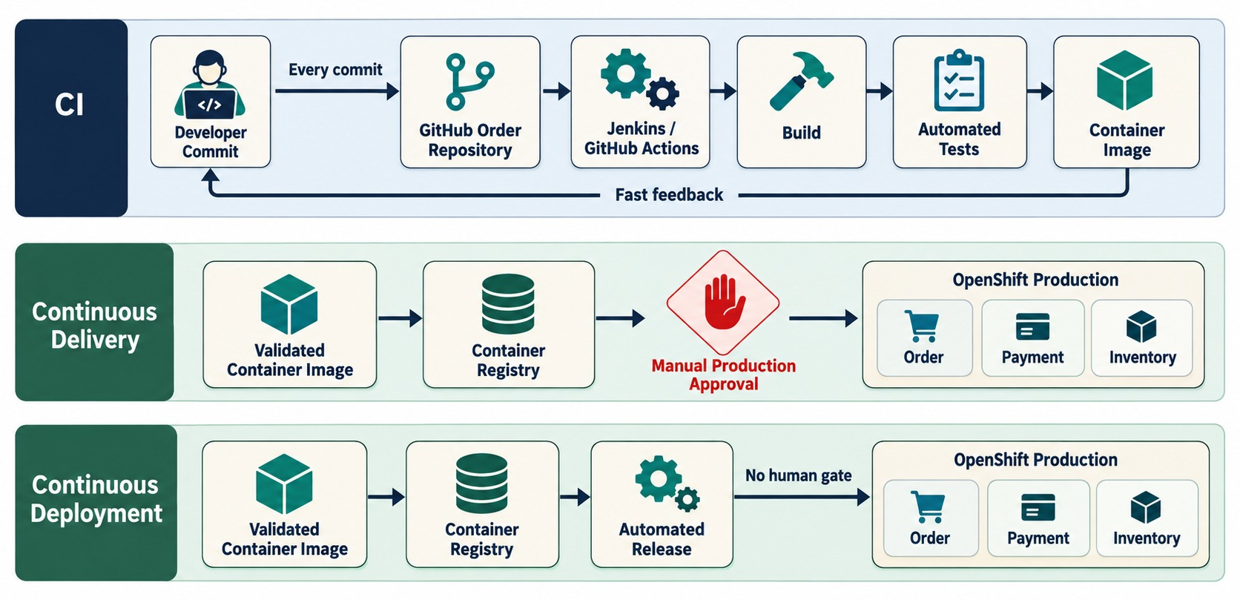
WHAT IS CONTINUOUS DELIVERY AND DEPLOYMENT?
CI vs. continuous delivery vs. continuous deployment.
Continuous delivery
Every change is releasable; a person approves the production step.
Continuous deployment
Every change that passes all gates goes to production automatically.
THREE QUESTIONS
?
Can we release any time?
?
Who approves production?
?
What evidence do we need?
KEY TAKEAWAY Delivery keeps software releasable; deployment releases validated changes automatically.
17
© 2026 by Innovation In Software Corporation
Notes:
KEY TALKING POINTS
------------------
- Often confused
These three terms are often confused.
- Continuous integration and delivery
Continuous integration automatically integrates and validates code.
Continuous delivery keeps the software ready to release.
Production may still need a manual approval, a change window or a business approval.
- Continuous deployment
In continuous deployment, changes that pass the defined automated gates go to production automatically.
- Three questions
CI asks: can we integrate safely?
Delivery asks: can we release safely?
Deployment asks: do validated changes reach production automatically?
Many enterprises practice continuous delivery without fully automatic production deployment.
- What the diagram shows
Three layers, showing where a manual production approval exists and where release is fully automated.
- Key point
Delivery keeps software releasable; deployment releases it automatically.

Slide 18
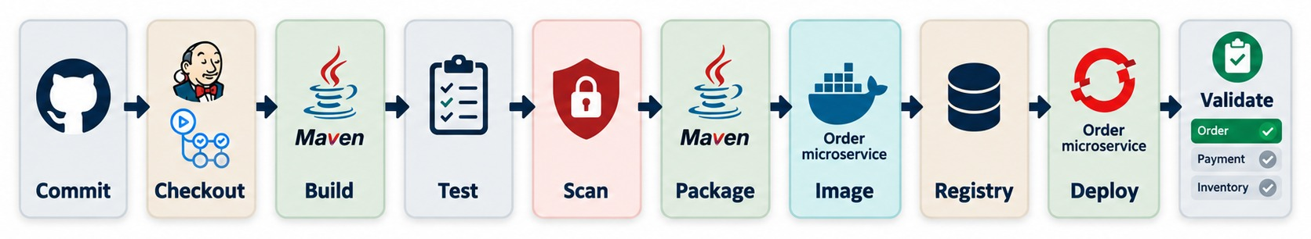
CI/CD PIPELINE ARCHITECTURE
Commit → build → test → scan → package → publish → deploy.
EVIDENCE EACH RUN LEAVES
Stop conditions
BACKBONE Every other slide in this module plugs into this.
Test results
Coverage
Failed tests, CRITICAL vulnerabilities or failed smoke checks end the run.
Scan report
SBOM
Image digest
Deploy log
KEY TAKEAWAY This pipeline is the backbone for the rest of Module 7.
18
© 2026 by Innovation In Software Corporation
Notes:
KEY TALKING POINTS
------------------
- The core pipeline
This is the core pipeline.
Checkout gets the exact source revision.
Compile builds the Java source.
Unit tests check isolated behavior, and integration tests check interactions with other components.
- Scan and package
Scanning looks for quality and security problems.
Packaging creates the application artifact, order-service.jar.
The container build creates a deployable image, and the image scan checks its contents against security policy.
- Registry, deploy, validate
The registry stores the versioned image.
Deploy releases it to the target environment.
Smoke and health tests confirm the service works, and then we observe it.
- The most important idea
Every stage either increases confidence in the release, or prepares the exact artifact for deployment.
- What the diagram shows
Commit, checkout, build, test, scan, package, image, registry, deploy and validate.
- Key point
Each stage produces evidence and can stop the release.

Slide 19
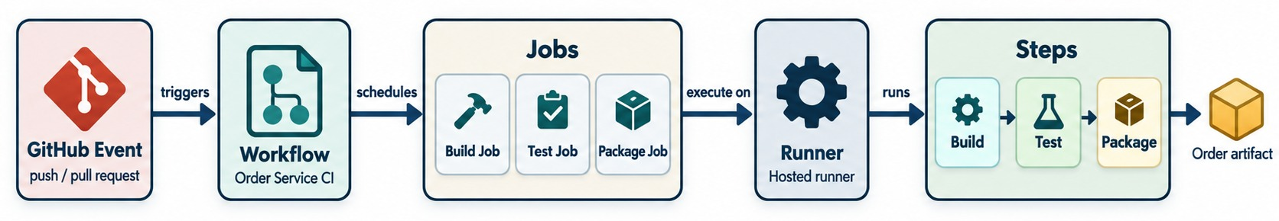
GITHUB ACTIONS FOR MICROSERVICES CI/CD
Workflow triggers, jobs, runners and build/test/package stages.
Workflow
Triggers
Runners
KEY IDEA The pipeline lives next to the code it builds.
A YAML file in .github/workflows, versioned with the code.
pull_request, push, tags or a manual workflow_dispatch.
GitHub-hosted or self-hosted inside the bank's network.
KEY TAKEAWAY A Git event triggers automatic validation — defined right next to the code.
19
© 2026 by Innovation In Software Corporation
Notes:
KEY TALKING POINTS
------------------
- Automation next to the code
GitHub Actions lets workflow automation live alongside the repository.
Workflow definitions live under .github/workflows.
- Four concepts
The event is what starts the workflow, such as a push, a pull request or a manual trigger.
The workflow is the complete automation definition.
A job is a collection of steps.
The runner is the compute environment that executes the job.
- The example
The example workflow runs on pull requests and on pushes to main.
It checks out the code, sets up Java and runs ./mvnw verify.
- The key idea
A Git event triggers automatic validation.
- What the diagram shows
A GitHub event triggering a workflow, whose jobs run on runners as ordered steps.
- Key point
Event → workflow → job → runner → steps, all defined in the repository.

Slide 20
A GITHUB ACTIONS WORKFLOW FOR ORDER SERVICE
Build and test every PR; on main, build, push and tag the image with the commit.
✓
.github/workflows/ci.yml
Two jobs
name: order-service-ci
on:
pull_request: { branches: [ main ] }
push: { branches: [ main ] }
jobs:
build-test:
runs-on: ubuntu-latest
steps:
- uses: actions/checkout@v4
- uses: actions/setup-java@v4
with: { distribution: temurin, java-version: 21, cache: maven }
- run: ./mvnw -B verify # unit + integration tests
image:
needs: build-test
if: github.ref == 'refs/heads/main'
runs-on: ubuntu-latest
permissions: { contents: read, packages: write }
steps:
- uses: actions/checkout@v4
- uses: docker/login-action@v3
with: { registry: ghcr.io, username: "${{ github.actor }}",
password: "${{ secrets.GITHUB_TOKEN }}" }
- run: docker build -t ghcr.io/example/order-service:${{ github.sha }} .
- run: docker push ghcr.io/example/order-service:${{ github.sha }}
PRs only build and test; main also publishes an image.
Traceable tag
The commit SHA links the image back to the source.
Least privilege
The job may read code and write packages — nothing more.
SECRETS From the secrets store — never typed into YAML.
KEY TAKEAWAY Keep the pipeline in the repository: test every PR, and publish a traceable image only from main.
20
© 2026 by Innovation In Software Corporation
Notes:
KEY TALKING POINTS
------------------
- Triggers
The workflow runs for pull requests into main and for pushes to main.
- build-test
It checks out the code, sets up Java 21 with a Maven cache, and runs verify, which includes unit and integration tests.
- image
Only after tests pass on main does the second job build the container and push it, tagged with the commit SHA.
- Permissions and secrets
The job gets only the permissions it needs, and the registry login uses the built-in token, not a password in the file.

Slide 21
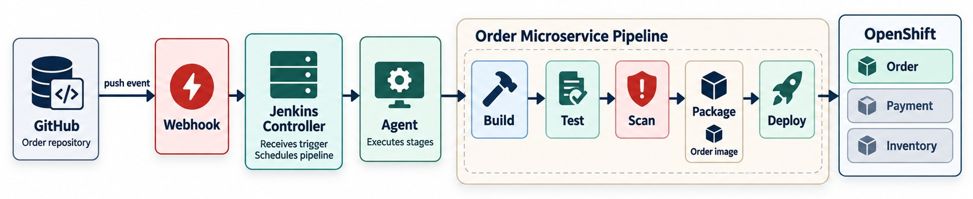
JENKINS PIPELINE FOR MICROSERVICES
Controller and agents, Jenkinsfile, stages, artifacts and deployment.
Controller
Agents
Jenkinsfile
IN THE LABS Jenkins is awareness only — nothing to install.
Schedules pipelines, stores configuration and credentials.
Run the build steps, often inside the bank's network.
Pipeline as code, reviewed in the same PR as the app.
KEY TAKEAWAY A Jenkinsfile keeps delivery logic versioned and reviewed with the application.
21
© 2026 by Innovation In Software Corporation
Notes:
KEY TALKING POINTS
------------------
- Jenkins in the enterprise
Jenkins is widely used for enterprise automation.
Instead of configuring every build by hand in a UI, teams define pipelines as code in a Jenkinsfile.
- The Jenkinsfile
The example Jenkinsfile has stages for build, test, scan, package and deploy.
- Controller and agents
The Jenkins controller coordinates the work.
Agents, or executors, carry out the pipeline tasks, depending on how Jenkins is set up.
- Why pipeline as code
It gives versioning, review, reproducibility, auditability and consistency.
- What the diagram shows
GitHub sending a webhook to the Jenkins controller, which runs build, test, scan, package and deploy on agents.
- Key point
The controller orchestrates; agents do the work.

Slide 22
A DECLARATIVE JENKINSFILE
Stages, test reports, stored credentials and a production approval.
✓
Jenkinsfile
Test reports
pipeline {
agent { label 'maven-jdk21' }
environment { IMAGE = "registry.bank.local/orders/order-service:${GIT_COMMIT}" }
stages {
stage('Build & test') {
steps { sh './mvnw -B verify' }
post { always { junit 'target/surefire-reports/*.xml' } }
}
stage('Image') {
when { branch 'main' }
steps {
withCredentials([string(credentialsId: 'registry-token', variable: 'TOKEN')]) {
sh 'echo "$TOKEN" | podman login registry.bank.local -u ci --password-stdin'
sh 'podman build -t "$IMAGE" . && podman push "$IMAGE"'
}
}
}
stage('Promote to prod') {
when { branch 'main' }
steps {
input message: 'Promote this image to production?'
sh './deploy.sh prod "$IMAGE"'
}
}
}
}
junit publishes results even when tests fail.
Credentials
withCredentials injects the token and masks it in logs.
Approval
input pauses for a human — continuous delivery.
SAME IMAGE The image built once is the one promoted.
KEY TAKEAWAY A Jenkinsfile expresses the same pipeline — with stored credentials and an explicit production approval.
22
© 2026 by Innovation In Software Corporation
Notes:
KEY TALKING POINTS
------------------
- Agent
The pipeline runs on an agent labelled with Maven and JDK 21.
- Build and test
verify runs the tests, and the post block always publishes the JUnit reports.
- Credentials
The registry token comes from Jenkins' credentials store and is masked in the console output.
- Approval
The input step waits for a person before production, which is continuous delivery rather than deployment.

Slide 23
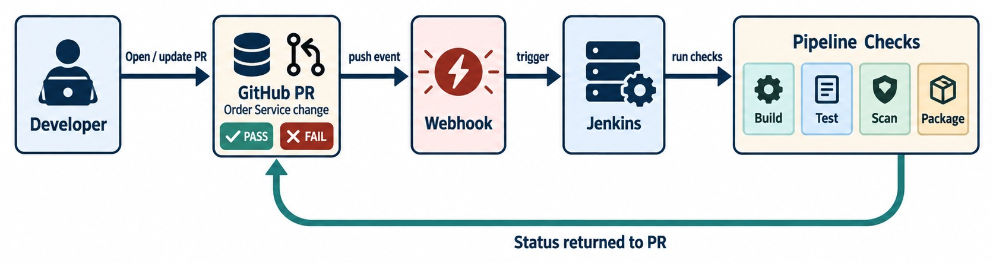
GITHUB AND JENKINS TOGETHER
A GitHub PR triggers a Jenkins pipeline, which reports status back.
GitHub
Jenkins
The link
RESULT Reviewers see pipeline results right in the PR.
Repository, pull requests, reviews and branch protection.
Runs the pipeline on internal agents with internal credentials.
A webhook starts the build; a commit status marks the PR green or red.
KEY TAKEAWAY GitHub for collaboration, Jenkins for execution — they work together.
23
© 2026 by Innovation In Software Corporation
Notes:
KEY TALKING POINTS
------------------
- Not alternatives
GitHub and Jenkins are not necessarily competing choices.
- Who does what
An enterprise may use GitHub for repository hosting, pull requests, code review and branch policies.
It may use Jenkins for build automation, testing, packaging and deployment workflows.
- How they connect
A developer opens a pull request, and GitHub triggers Jenkins through a webhook.
Jenkins compiles, tests and scans.
Then it reports success or failure back to the pull request.
- The result
Only successful changes may be eligible to merge.
- What the diagram shows
A developer opening a pull request, a webhook triggering Jenkins, and the check status returning to the PR.
- Key point
GitHub hosts collaboration; Jenkins runs the pipeline and reports back.

Slide 24
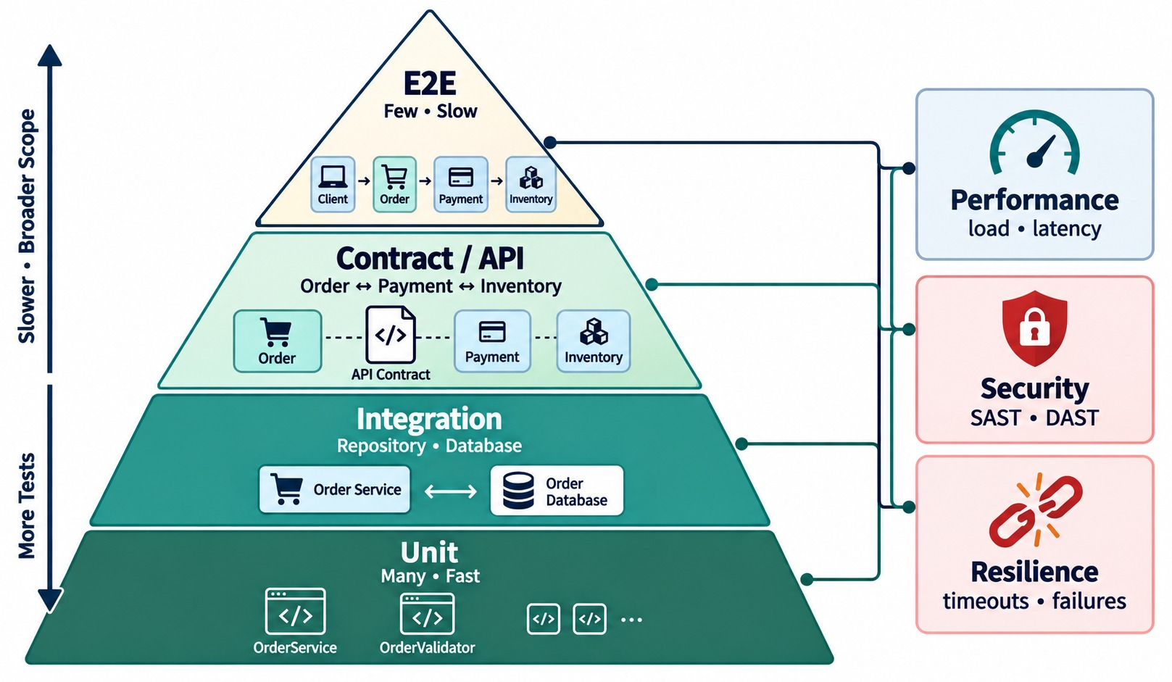
AUTOMATED TESTING STRATEGY
Unit, integration, contract, API, end-to-end, performance and security.
EACH LAYER CATCHES
✓
Unit: logic bugs
✓
Integration: wiring bugs
✓
Contract: compatibility bugs
✓
Smoke: deployment bugs
✓
Security: dangerous exposure
AVOID one giant, slow, flaky end-to-end suite.
KEY TAKEAWAY Don't rely on one giant end-to-end suite — layer your tests.
24
© 2026 by Innovation In Software Corporation
Notes:
KEY TALKING POINTS
------------------
- Use layers
A CI/CD pipeline should not depend on one giant end-to-end test suite.
Use different test layers.
- Unit and integration
Unit tests are fast and isolated, for example the order total calculation or the order cancellation rule.
Integration tests check interaction with the database, messaging, the Spring context and external interfaces.
- Contract, API and end-to-end
Contract tests check that service interfaces stay compatible, which is especially important for microservices.
API tests validate REST endpoints.
End-to-end tests validate key workflows, such as placing an order through payment, inventory and shipping.
- Non-functional tests
Also consider performance, security and resilience testing.
- What the diagram shows
Unit tests at the base, then integration, contract and API, with end-to-end at the top; performance, security and resilience alongside.
- Key point
Many fast tests at the bottom, few slow ones at the top.

Slide 25
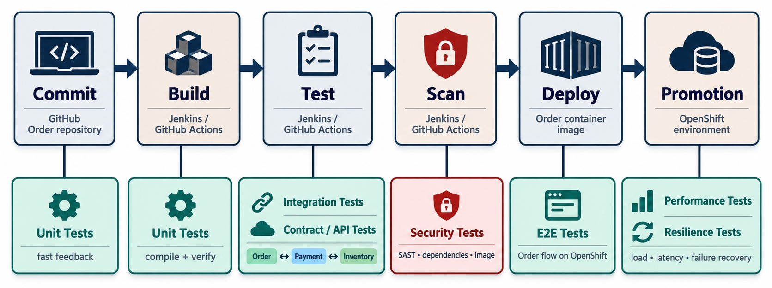
TESTING IN THE CI/CD PIPELINE
Map each test type to the right pipeline stage.
On every PR
Unit, slice and contract tests — minutes.
After merge
Integration with Testcontainers, image and security scans.
After deploy
Smoke, API and performance checks before promotion.
PRINCIPLE Fail early and cheaply; spend minutes, not hours.
KEY TAKEAWAY Run cheap tests first and slower tests later — balance speed, coverage and confidence.
25
© 2026 by Innovation In Software Corporation
Notes:
KEY TALKING POINTS
------------------
- Right test, right stage
Not every test should run at the same stage.
The pipeline should give fast feedback early.
- Stop early
A unit test failure should stop the pipeline before we spend resources building and deploying artifacts we do not need.
- Early and later stages
Early stages run compilation, unit tests and static checks.
Later stages run integration, contract, API, end-to-end and performance tests, plus deployment validation.
- The principle
Fail fast on cheap checks, and gain stronger confidence with later checks.
Pipeline design balances speed, coverage and confidence.
- What the diagram shows
Each test type mapped to the commit, build, test, deploy and promotion stages.
- Key point
Cheap tests run first; expensive ones run later, before promotion.

Slide 26
TESTS THE PIPELINE RUNS
A security slice test and a real-database integration test — every build.
✓
AccountSecurityTest.java
AccountPersistenceTest.java
@WebMvcTest(AccountController.class)
@Import(SecurityConfig.class)
class AccountSecurityTest {
@Autowired MockMvc mvc;
@MockitoBean AccountService accounts;
@Test void noTokenIs401() throws Exception {
mvc.perform(get("/api/v1/accounts/ACC-1"))
.andExpect(status().isUnauthorized());
}
@Test void wrongScopeIs403() throws Exception {
mvc.perform(get("/api/v1/accounts/ACC-1")
.with(jwt().authorities(
new SimpleGrantedAuthority("SCOPE_transactions.read"))))
.andExpect(status().isForbidden());
}
}
@DataJpaTest
@Testcontainers
@AutoConfigureTestDatabase(replace = NONE)
class AccountPersistenceTest {
@Container @ServiceConnection
static PostgreSQLContainer<?> db =
new PostgreSQLContainer<>("postgres:16");
@Autowired AccountRepository repo;
@Test void savesAndReadsAccount() {
repo.save(Account.pending("CUST-0001"));
assertThat(repo.findAll()).hasSize(1);
}
}
Security slice
Testcontainers
In CI
Proves 401 without a token and 403 with the wrong scope.
A real Postgres 16 — Flyway migrations run for real.
Runners need Docker; both tests gate the merge.
KEY TAKEAWAY Automate the tests that protect security rules and real persistence — and let them block the merge.
26
© 2026 by Innovation In Software Corporation
Notes:
KEY TALKING POINTS
------------------
- The security test
A web slice test loads the controller and security configuration.
It checks that no token gives 401 and a token with the wrong scope gives 403.
- The persistence test
@DataJpaTest with a Testcontainers Postgres 16 database runs the real Flyway migrations.
@ServiceConnection wires the connection details automatically.
- In the pipeline
Both run in mvn verify.
The CI runner needs Docker for the container.
- Official exercise
These are exactly the tests Exercise 3.3 asks for.

Slide 27
EXERCISE 3.3 — ADD SECURITY AND RESILIENCE TESTS
Day 3 checkpoint C: unit tests plus one integration test.
OFFICIAL CHECKPOINT C
10 MIN
labs/day-03/exercises/exercise-3.3-security-resilience-tests.md
SCENARIO
YOUR TASKS
EXPECTED OUTCOME
Lab 3 secured and hardened the banking Account and Transaction services. Now the pipeline must prove those rules on every build.
Scope: Account, Transaction and Risk Assessment only.
1
Unit-test 401 and 403 on a protected Account or Transaction endpoint
✓
A short test list Lab 3 can tick
2
Unit-test circuit open → 503 fallback — no fake ACTIVE account
✓
Security rules covered
✓
The fallback rule covered
3
Name AccountPersistenceTest — Testcontainers Postgres 16; Docker must run for mvn test
✓
One real-database integration test
4
Testcontainers is required for that integration test, not optional
KEY TAKEAWAY A short test list that proves security and the fallback rule on every build.
27
© 2026 by Innovation In Software Corporation
Notes:
KEY TALKING POINTS
------------------
- Official checkpoint
This is the official OUTLINE.md checkpoint.
Use the worksheet in labs/day-03/exercises.
- Security and resilience
Tests prove 401 without a token, 403 with the wrong scope, and a 503 when the circuit is open.
- Integration
AccountPersistenceTest uses Testcontainers with Postgres 16, so Docker must be running.

Slide 28
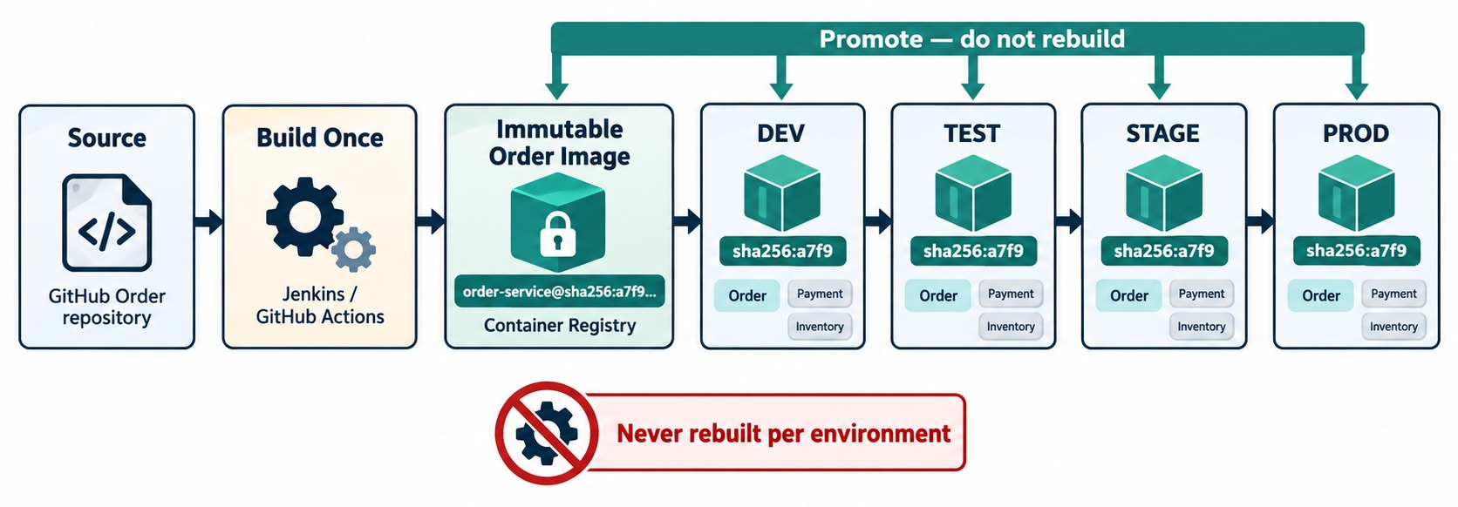
BUILD ONCE, PROMOTE THE SAME ARTIFACT
One immutable artifact promoted through DEV → TEST → STAGE → PROD.
THE DANGEROUS MODEL
✕
Rebuild per environment
✕
Different dependencies each time
✕
“Worked in test” means nothing
What changes between environments
Only ConfigMaps, Secrets and replica counts — never the image.
PROMOTE BY DIGEST sha256:… guarantees the exact same bytes.
KEY TAKEAWAY What we tested is what we deploy — same artifact, different external configuration.
28
© 2026 by Innovation In Software Corporation
Notes:
KEY TALKING POINTS
------------------
- A dangerous model
A dangerous model builds a separate DEV version, TEST version and PROD version.
Then production is not necessarily running the artifact you tested.
- Build once, promote
Instead, build once to create one artifact, for example order-service:1.7.0.
Promote that same artifact from DEV to TEST to STAGE to PROD.
- Differences come from outside
Environment differences should come from external configuration and secrets.
This connects to externalized configuration, profiles and environment variables from Module 3.
Later it maps to OpenShift ConfigMaps and Secrets.
- The principle
What we tested is what we deploy.
- What the diagram shows
Source built once into one immutable image, promoted through DEV, TEST, STAGE and PROD.
- Key point
The artifact never changes between environments — only its configuration does.

Slide 29
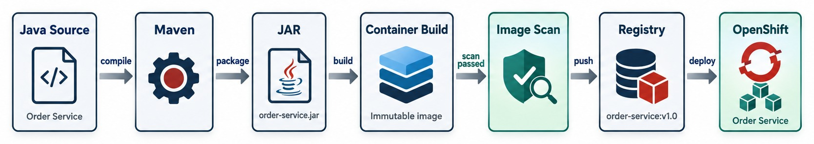
CONTAINER IMAGE AND REGISTRY FLOW
Source → build image → tag → scan → registry → deployment.
✓
A traceable tag
AVOID
Traceability
MODULE 8 goes deeper into images and registries.
registry.bank.local/orders/order-service:1.4.0-a13f92c
✕
latest alone — which build is this?
Tag → pipeline run → commit → pull request → work item.
KEY TAKEAWAY Versioned, scanned images in a registry make every production release traceable.
29
© 2026 by Innovation In Software Corporation
Notes:
KEY TALKING POINTS
------------------
- Packaging the image
The CI pipeline produces the application.
Then a container build packages the application, its runtime requirements and image metadata into a deployable image.
- Tags and the registry
The image gets an identifiable version tag, such as order-service:1.7.0 or the commit SHA.
The registry stores images in a controlled way.
Then OpenShift pulls the selected image.
- Traceability
If production fails, we should be able to answer: which source commit, which pipeline, which image, which version and which deployment?
- Avoid latest alone
Do not make production depend only on a changeable tag like latest.
It is not precise enough for release traceability.
- What the diagram shows
Java source, Maven, the JAR, the container build, an image scan, the registry and OpenShift.
- Key point
Only scanned, versioned images reach the registry and the cluster.

Slide 30
PROMOTE THE SAME IMAGE
Tag once in CI, then move the same digest from environment to environment.
CI — build and record the digest
✓
Promotion — no rebuild
VERSION=1.4.0
SHA=$(git rev-parse --short HEAD)
IMAGE=registry.bank.local/orders/order-service
podman build -t $IMAGE:$VERSION-$SHA .
podman push --digestfile digest.txt $IMAGE:$VERSION-$SHA
# digest.txt → sha256:9f2c… (store with the run)
DIGEST=$(cat digest.txt)
# TEST
oc -n orders-test set image deployment/order-service \
order-service=$IMAGE@$DIGEST
oc -n orders-test rollout status deployment/order-service
# PROD — after approval, the very same digest
oc -n orders-prod set image deployment/order-service \
order-service=$IMAGE@$DIGEST
Version + SHA
Digest
Config outside
Readable for humans, traceable to the commit.
A tag can be moved; a digest cannot.
Each namespace has its own ConfigMap and Secret.
KEY TAKEAWAY Build and tag once, then promote the exact digest — never rebuild for production.
30
© 2026 by Innovation In Software Corporation
Notes:
KEY TALKING POINTS
------------------
- Build
CI builds one image tagged with the version and short commit SHA, and saves the digest the registry returns.
- Promote
Each environment points its Deployment at the same image digest.
Nothing is rebuilt.
- Why the digest
Tags are mutable pointers.
A sha256 digest identifies exactly the bytes that were tested.
- In the labs
Lab 4 tags images 1.0.0 and rolls a version forward and back on OpenShift.

Slide 31
EXERCISE 4.3 — TRACE A PIPELINE STAGE OWNERSHIP MAP
Day 4 checkpoint C: who owns scan, SBOM, sign and promote.
OFFICIAL CHECKPOINT C
15 MIN
labs/day-04/lab4/starter/pipeline/OWNERSHIP.md
SCENARIO
YOUR TASKS
EXPECTED OUTCOME
Lab 4 walks a prepared pipeline for the Account and Transaction services: checkout, compile, test, scan, image, SBOM, sign, deploy, smoke and approval.
1
Open OWNERSHIP.md and fill who owns scan, SBOM, sign and promote
✓
A completed ownership map
✓
Each stage's failure meaning understood
2
A CRITICAL CVE fails the gate; the SBOM is the ingredients list; unsigned images must not run
✓
Compare with the solution OWNERSHIP.md
3
Participants execute and verify — they don't manage signing keys
Fill it before run-pipeline-locally.ps1
✓
4
GitOps is conceptual — don't install Jenkins or GitHub Actions runners
KEY TAKEAWAY Every pipeline stage has an owner and a clear meaning when it fails.
31
© 2026 by Innovation In Software Corporation
Notes:
KEY TALKING POINTS
------------------
- Official checkpoint
This is the official OUTLINE.md checkpoint.
The worksheet is the starter OWNERSHIP.md in Lab 4.
- The gates
A CRITICAL vulnerability blocks promotion, the SBOM proves what shipped, and an unsigned image must not run.
- Scope
Learners run and verify the pipeline.
Signing keys are a platform concern, and Jenkins is awareness only.

Slide 32
PART 3: RELEASE STRATEGIES
Deploying is not the same as exposing every user to the change.
✓ Part 1
Source control
✓ Part 2
CI/CD
Part 3
Release strategies
Part 4
Security
SO FAR
NEXT QUESTION
How do we release a new version without risking every customer at once?
✓
CI proves each change; CD keeps it releasable
✓
Tests run at the right pipeline stage
IN THIS PART
One image is promoted everywhere
1
Blue/Green deployment
✓
2
Canary deployment
3
Choosing between them
4
Traffic switching on OpenShift — in code
5
Exercise: choose a release strategy
32
© 2026 by Innovation In Software Corporation
Notes:
KEY TALKING POINTS
------------------
- Why this part
Even a well-tested release can fail under real traffic.
Release strategies limit the damage and make rollback fast.
- What comes next
Blue/Green, canary, how to choose, and how OpenShift Routes split traffic.

Slide 33
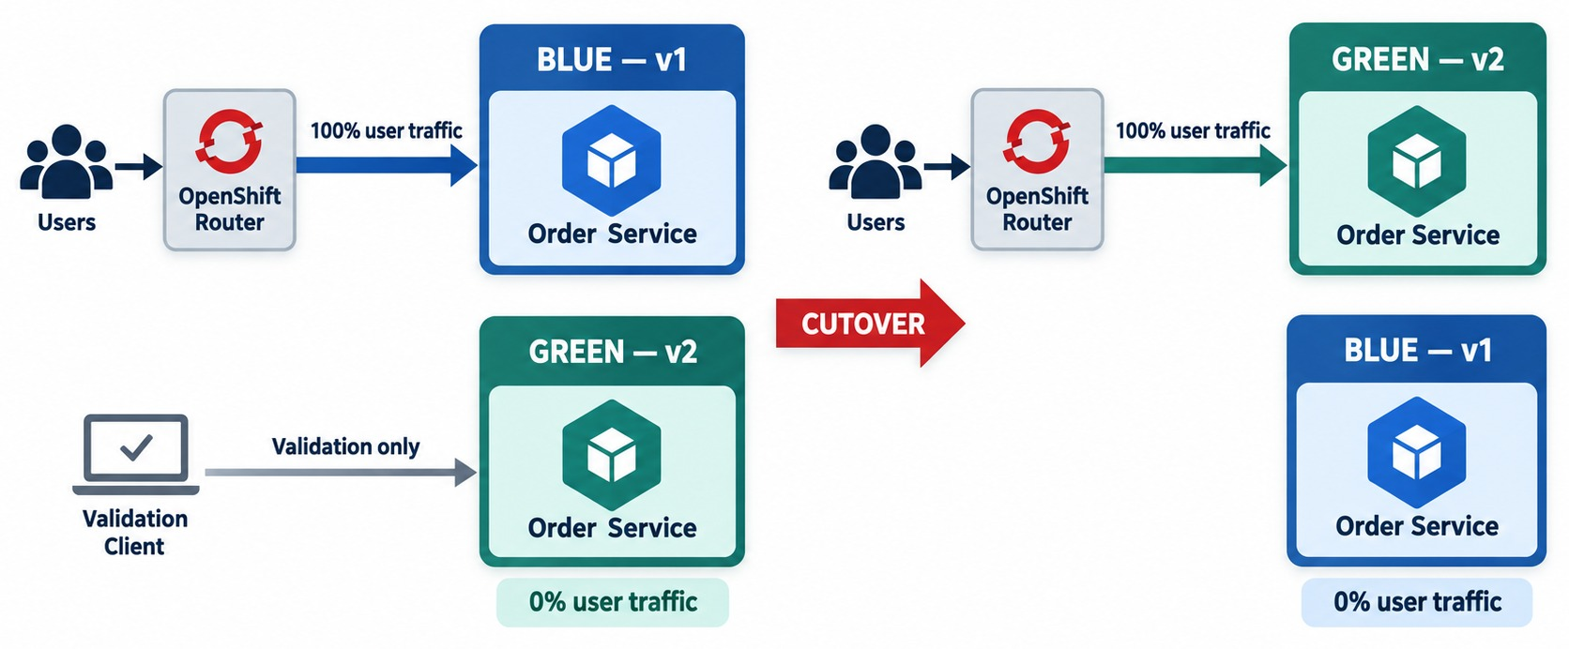
BLUE/GREEN DEPLOYMENT
Two production environments — traffic switched between Blue and Green.
ADVANTAGES
✓
Instant cutover
✓
Instant rollback
✓
Test in production before exposure
TRADE-OFFS
!
Double capacity during release
!
Schema must suit both versions
DATA Use expand-and-contract migrations.
KEY TAKEAWAY Blue/Green switches all traffic at once — and can switch it back quickly.
33
© 2026 by Innovation In Software Corporation
Notes:
KEY TALKING POINTS
------------------
- Two versions
Blue/Green keeps two environments, or deployment versions.
Suppose Blue is version 1 and Green is version 2.
Production traffic currently goes to Blue.
- Cutover
Deploy and validate Green.
When Green is ready, switch traffic to Green.
If serious problems appear and Blue is still suitable, switch traffic back to Blue.
So rollback can be fast.
- Advantages
It gives a controlled cutover, fast rollback and validation before cutover.
- Trade-offs
It needs extra capacity for a while.
Database and schema compatibility still matter, and stateful changes can complicate rollback.
Rolling back a deployment does not automatically undo incompatible database changes.
- What the diagram shows
The router sending all traffic to Blue while Green is validated, then switching traffic to Green.
- Key point
Cut over in one step — and switch back just as fast.
- Database changes
Both versions share the database during the switch, so migrations must be backward compatible: add first, remove later.

Slide 34
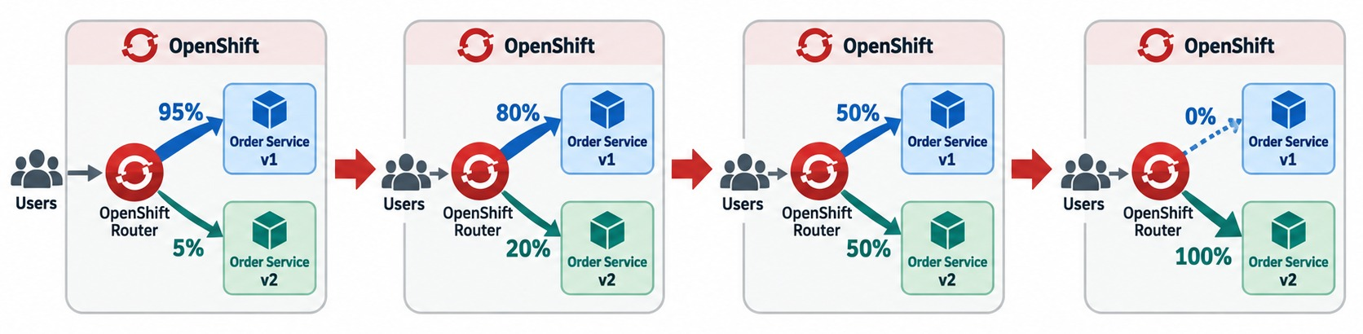
CANARY DEPLOYMENT
Gradually shift a small percentage of traffic to the new version.
WATCH AT EACH STEP
Automatic rollback
NEEDS good observability — Module 6.
Error rate
p95 latency
If a signal crosses its threshold, return all traffic to v1.
Failed payments
Saturation
KEY TAKEAWAY Canary exposes a new release gradually — and depends on good observability.
34
© 2026 by Innovation In Software Corporation
Notes:
KEY TALKING POINTS
------------------
- Limited exposure first
Canary deployment sends a small amount of traffic to the new version first.
For example, 95 percent goes to version 1 and 5 percent to version 2.
- Grow or roll back
Watch the new release.
If it is healthy, increase its share to 20 percent, then 50, then 100.
If it is unhealthy, drop it from 5 percent back to 0.
- Blast radius
This limits the blast radius of a bad release, meaning how many users a defect can affect.
- Depends on observability
Canary deployment depends heavily on Module 6.
Without metrics, logs, traces and health indicators, how would we know the canary is healthy?
Deployment strategy and observability must work together.
- What the diagram shows
The router splitting traffic between v1 and v2 at 95/5, 80/20, 50/50 and finally 0/100.
- Key point
Increase exposure only while the signals stay healthy.

Slide 35
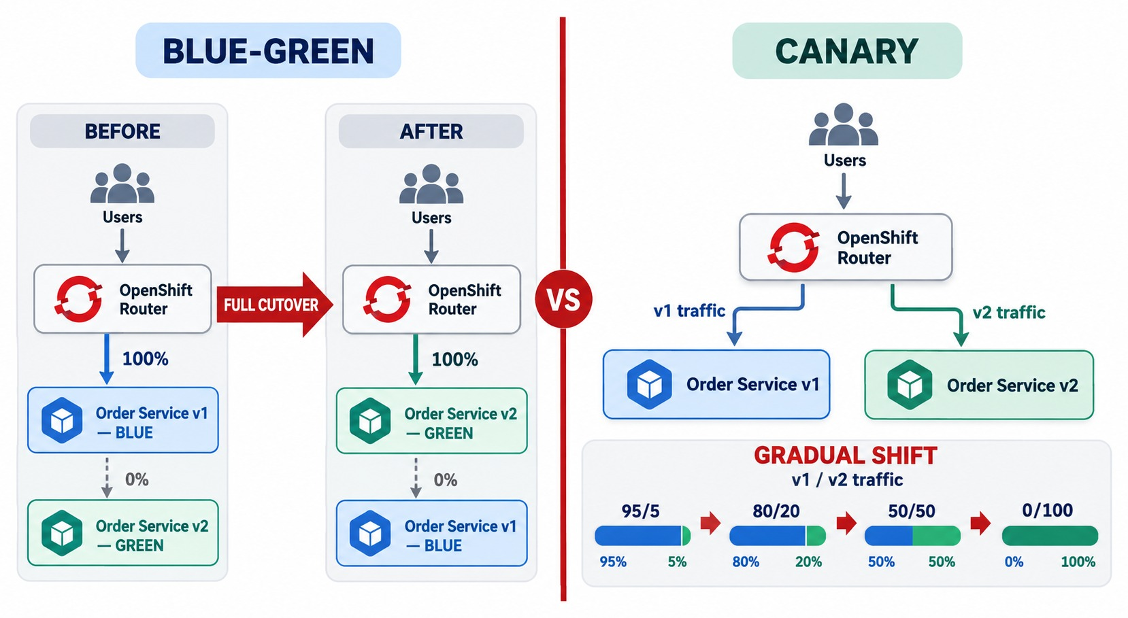
BLUE/GREEN VS. CANARY DEPLOYMENT
Risk, rollback, infrastructure cost, traffic control and use cases.
Choose Blue/Green
Fast, all-or-nothing releases with an instant rollback path.
Choose canary
Risky changes where real-traffic evidence should drive exposure.
Consider
Infrastructure cost, data compatibility and how good your metrics are.
BOTH need automated health checks.
KEY TAKEAWAY Blue/Green changes where all traffic goes; Canary changes how much goes to the new release.
35
© 2026 by Innovation In Software Corporation
Notes:
KEY TALKING POINTS
------------------
- A simple distinction
Blue/Green asks: which environment receives production traffic?
Canary asks: what percentage of production traffic goes to the new version?
- When to use each
Blue/Green is useful when you want a controlled switch between environments.
Canary is useful when you want gradual exposure.
- What to consider
Neither solves every release problem.
Consider stateful workloads, database migrations, backward compatibility and session handling.
Also consider cost, traffic-routing capability, monitoring quality and release risk.
- What the diagram shows
The two release models side by side: full cutover versus gradual traffic shifting.
- Key point
Blue/Green changes where traffic goes; canary changes how much goes to the new version.

Slide 36
SWITCHING TRAFFIC WITH OPENSHIFT ROUTES
The same Route can cut over all traffic — or split it by weight.
Blue/Green — switch the backend
✓
Canary — weighted backends
apiVersion: route.openshift.io/v1
kind: Route
metadata:
name: order-service
spec:
to:
kind: Service
name: order-service-green # was -blue
tls:
termination: edge
# roll back:
# oc patch route order-service \
# -p '{"spec":{"to":{"name":"order-service-blue"}}}'
apiVersion: route.openshift.io/v1
kind: Route
metadata:
name: order-service
spec:
to:
kind: Service
name: order-service-v1
weight: 95
alternateBackends:
- kind: Service
name: order-service-v2
weight: 5
tls:
termination: edge
Blue/Green
Canary
Automate it
Change one field; change it back to roll back.
Raise v2's weight step by step: 5, 20, 50, 100.
Tools such as Argo Rollouts drive the steps from metrics.
KEY TAKEAWAY Routes give both strategies: repoint the whole backend, or shift traffic by weight.
36
© 2026 by Innovation In Software Corporation
Notes:
KEY TALKING POINTS
------------------
- Blue/Green
Two Services, blue and green, sit behind one Route.
Changing the Route's target moves all traffic at once, and patching it back rolls back.
- Canary
alternateBackends split traffic by weight.
Start v2 at 5% and increase while the metrics stay healthy.
- Automation
Progressive delivery tools can adjust weights automatically based on error rate and latency.
- In the labs
Lab 4 practises a rolling update and oc rollout undo; these strategies are lecture.

Slide 37
EXERCISE: CHOOSE A RELEASE STRATEGY
Pick Blue/Green, canary or a rolling update for each release.
PRACTICE EXERCISE
10 MIN
SCENARIO
YOUR TASKS
EXPECTED OUTCOME
Four releases are planned this month:
1
Choose a strategy for each release
✓
A: canary — watch failed payments and latency
A Payment Service: new fraud-check call
B Order Service: fix a typo in an error message
C Inventory Service: rename a DB column
D Transfer API: new routing to a partner bank
2
Name the signals that would stop the rollout
✓
B: rolling update — low risk
3
Describe the rollback — including data
✓
C: expand-and-contract first, then Blue/Green
✓
D: canary to a small share, with approval
✓
Rollback: repoint the Route; schema stays compatible
KEY TAKEAWAY Match the release strategy to the risk — and plan the data rollback before the traffic rollback.
37
© 2026 by Innovation In Software Corporation
Notes:
KEY TALKING POINTS
------------------
- Risky logic
The fraud call and partner routing affect money movement, so expose them gradually with canary.
- Low risk
A typo fix can use a normal rolling update with readiness checks.
- Schema changes
Renaming a column breaks the old version.
Add the new column first, migrate, then remove the old one later.

Slide 38
PART 4: SECURITY IN THE PIPELINE
Whoever controls the pipeline can change production.
✓ Part 1
Source control
✓ Part 2
CI/CD
✓ Part 3
Release strategies
Part 4
Security
SO FAR
NEXT QUESTION
How do we make sure only trusted, secure changes reach production?
✓
Blue/Green cuts over and back fast
✓
Canary grows exposure on healthy signals
IN THIS PART
✓
Routes switch or split traffic
Authentication and authorization basics
1
2
DevSecOps scanning and policy gates
3
Securing a workflow — in code
4
Exercise: find the pipeline security problems
5
The complete delivery architecture
38
© 2026 by Innovation In Software Corporation
Notes:
KEY TALKING POINTS
------------------
- Why this part
A pipeline holds registry tokens and deployment rights.
If it's compromised, production is too.
- What comes next
Identity basics, security scanning in the pipeline, a hardened workflow and the full picture.
Module 12 goes deeper.

Slide 39
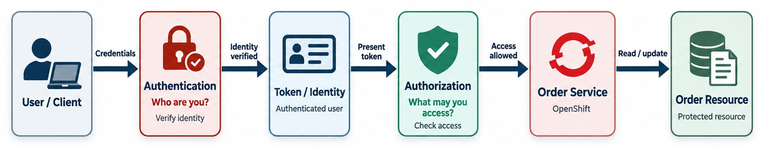
AUTHENTICATION AND SECURITY BASICS
Identity, authentication, authorization, tokens, secrets and least privilege.
For people
For pipelines
For services
MODULE 12 covers OAuth2, OIDC and JWT in depth.
SSO and MFA for Git, CI and cluster access.
Short-lived tokens with only the permissions each job needs.
OAuth2 tokens or workload identity — not network trust.
KEY TAKEAWAY Authentication proves who you are; authorization decides what you may do.
39
© 2026 by Innovation In Software Corporation
Notes:
KEY TALKING POINTS
------------------
- Keep it foundational
Keep this slide foundational, because security could be a whole course.
- Authentication and authorization
Authentication verifies identity: who is making this request?
Authorization decides permissions: can this identity cancel order 1001?
They are not the same.
Being authenticated does not mean being authorized for everything.
- Tokens
Tokens can carry or reference identity and claims that services use.
Microservices must validate the right security context.
They must not trust arbitrary information that a client sends.
- Least privilege
Give each service only the access it needs.
The Order Service should not automatically get admin access to every system.
- Secrets
Protect passwords, API keys, tokens, certificates, private keys and database credentials.
Never commit secrets into Git.
- What the diagram shows
A user or client authenticating, receiving a token, being authorized and reaching the microservice and resource.
- Key point
Identity first, then permission — at every hop.

Slide 40
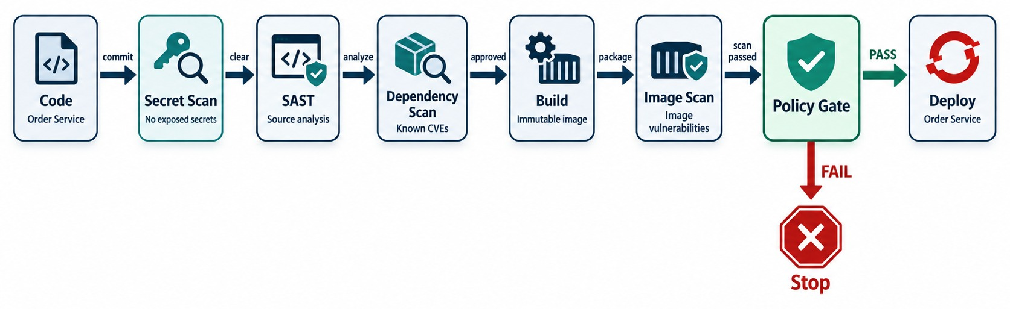
DEVSECOPS IN THE PIPELINE
SAST, dependency scanning, secrets scanning, image scanning and policy gates.
TYPICAL TOOLS
Policy gate
SHIFT LEFT A leaked secret found in the PR is cheap to fix.
Gitleaks
SonarQube
No CRITICAL CVEs, an SBOM attached and a valid signature — or no deploy.
Dependency-Check
Trivy
Syft (SBOM)
Cosign
KEY TAKEAWAY Security becomes part of the normal engineering and delivery workflow.
40
© 2026 by Innovation In Software Corporation
Notes:
KEY TALKING POINTS
------------------
- The old way
Traditionally, teams built everything, and only near release did they do a security review.
The problem is that security issues are discovered late.
- Security throughout
DevSecOps brings security feedback earlier and throughout delivery.
Secret scanning detects credentials committed by accident.
SAST, static application security testing, analyzes code for possible security issues.
Dependency scanning checks third-party libraries for known vulnerabilities and policy concerns.
- Images and gates
Image scanning inspects container packages and layers for known vulnerabilities and configuration concerns.
Policy gates decide whether a release may move forward.
For example, a critical prohibited vulnerability stops the pipeline.
- It doesn't end at deployment
Runtime monitoring continues after deployment.
Security becomes part of the normal engineering and delivery workflow.
- What the diagram shows
Code, secret scan, SAST, dependency scan, build, image scan, policy gate and deploy.
- Key point
Security checks run in the pipeline, not after release.

Slide 41
SECURITY SCANS IN A WORKFLOW
Secrets, dependencies and the image are scanned — and CRITICAL findings stop the run.
✓
.github/workflows/security.yml (excerpt)
Secret scan
jobs:
scan:
runs-on: ubuntu-latest
permissions: { contents: read }
steps:
- uses: actions/checkout@v4
with: { fetch-depth: 0 }
- name: Secret scan
uses: gitleaks/gitleaks-action@v2
- name: Dependency and image scan
uses: aquasecurity/trivy-action@0.28.0
with:
image-ref: registry.bank.local/orders/order-service:${{ github.sha }}
severity: CRITICAL
exit-code: '1' # fail the job
- name: SBOM
run: syft registry.bank.local/orders/order-service:${{ github.sha }} \
-o spdx-json > sbom.spdx.json
Blocks the PR if a key or password was committed.
Gate
exit-code 1 fails the job on any CRITICAL finding.
SBOM
The ingredients list you need when a new CVE appears.
PIN VERSIONS Pin actions to a version or commit.
KEY TAKEAWAY Scan secrets, dependencies and images in every run — and let CRITICAL findings block the release.
41
© 2026 by Innovation In Software Corporation
Notes:
KEY TALKING POINTS
------------------
- Secret scanning
Gitleaks checks the whole history for committed keys and passwords.
- Image scanning
Trivy scans the built image.
With severity CRITICAL and exit code 1, any critical vulnerability fails the job.
- SBOM
Syft writes a software bill of materials, so the team can answer what shipped when a new vulnerability is announced.
- Supply chain
Pin third-party actions to a version or commit, and give jobs only the permissions they need.

Slide 42
EXERCISE: FIND THE PIPELINE SECURITY PROBLEMS
Review a pipeline change before it merges.
PRACTICE EXERCISE
12 MIN
SCENARIO
YOUR TASKS
EXPECTED OUTCOME
A teammate proposes this deploy job:
1
Find at least five problems
✓
write-all → least-privilege permissions
deploy:
runs-on: ubuntu-latest
permissions: write-all
env:
DB_PASSWORD: SuperSecret123
steps:
- uses: some-user/deploy-action@main
- run: docker build -t order:latest .
- run: echo $DB_PASSWORD
- run: ./deploy.sh prod order:latest
2
Explain the risk of each
✓
Password in YAML → secrets store
3
Rewrite the job safely
✓
Unpinned third-party action → pin to a commit
✓
latest, rebuilt → promote the scanned digest
✓
Echoing a secret; no scan or approval gate
KEY TAKEAWAY Treat pipeline code like production code: least privilege, no secrets, pinned dependencies and gates.
42
© 2026 by Innovation In Software Corporation
Notes:
KEY TALKING POINTS
------------------
- Permissions and secrets
write-all gives the job far more rights than it needs, and the password is committed and echoed into logs.
- Supply chain
An action on @main from an unknown author can change at any time.
Pin it to a reviewed commit.
- Artifact
Building latest in the deploy job means production runs something no test saw.
Promote the scanned digest after approval.

Slide 43
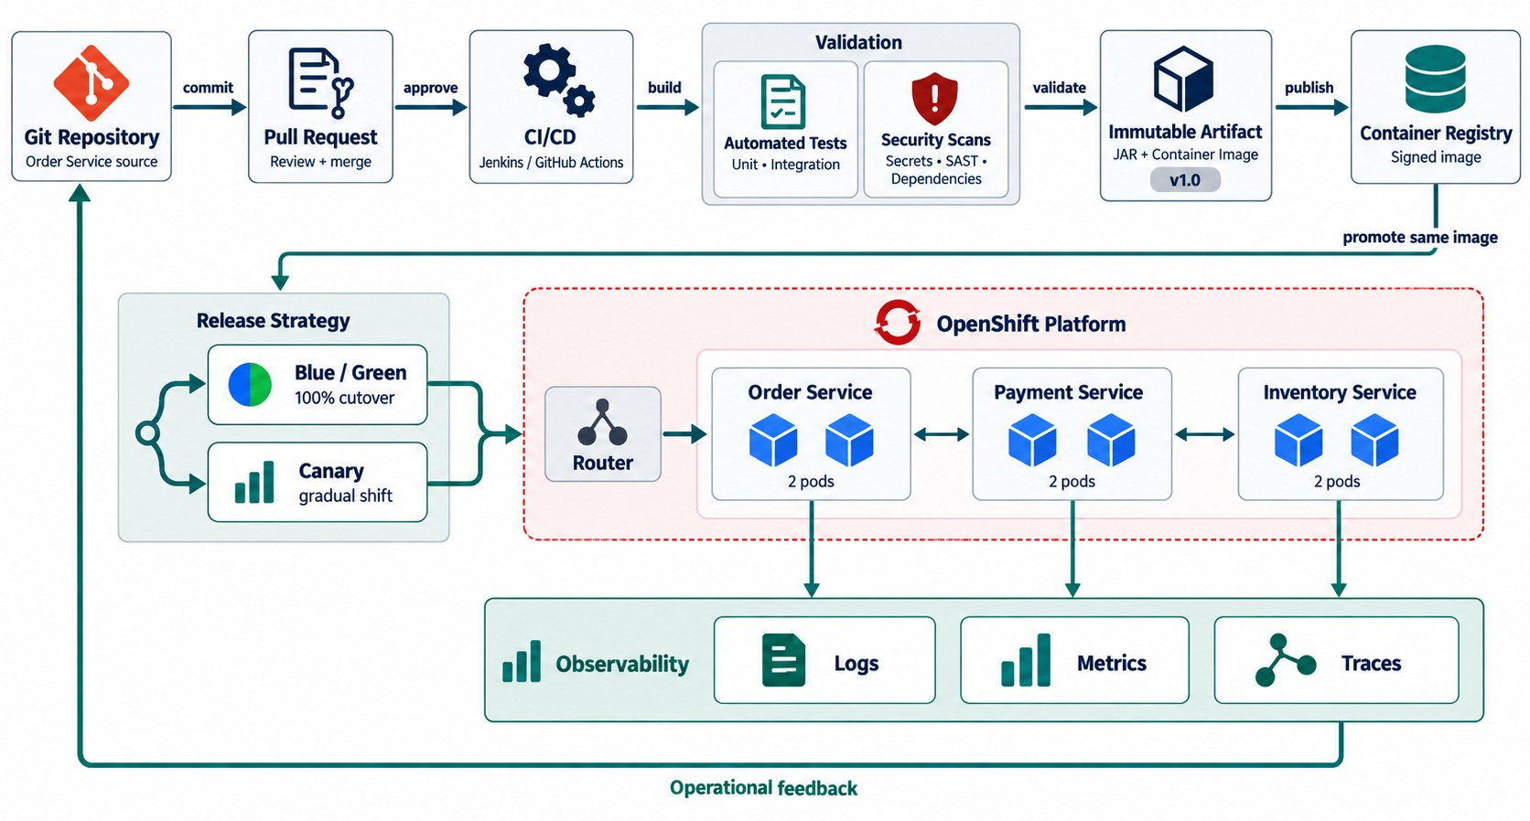
END-TO-END MICROSERVICES DEVOPS DELIVERY ARCHITECTURE
Git → PR → CI/CD → tests and security → registry → deployment strategy → observability.
EVERY PART OF THE MODULE
✓
Git and pull requests gate changes
✓
CI tests and scans every build
✓
One signed image is promoted
✓
Blue/Green or canary on OpenShift
✓
Logs, metrics and traces feed back
REMEMBER What we tested is what we deploy.
KEY TAKEAWAY DevOps turns microservice delivery into a repeatable, measurable feedback loop.
43
© 2026 by Innovation In Software Corporation
Notes:
KEY TALKING POINTS
------------------
- Change and review
Use this slide to tell the whole delivery story.
A developer builds an order cancellation feature on a branch and commits it.
GitHub governs the change through a push and a pull request.
The PR triggers compile, unit and integration tests, code quality and security checks.
- Humans and automation
Automation catches many problems.
Reviewers also check design, maintainability, business correctness and architectural impact.
Only an acceptable change is merged.
- Artifact and image
CI/CD builds the Spring Boot JAR with Maven, then a versioned container image.
The image is scanned, then stored in the registry, for example as order-service:1.7.0.
Now we can trace the Git commit to the pipeline, the artifact and the image.
- Deploy and validate
Choose Blue/Green or Canary, depending on the release.
OpenShift runs the application.
Success is not just a container that started.
Is it ready, are requests succeeding, is latency acceptable, are errors rising, and are business operations working?
- Close the loop
Observe with logs, metrics and traces from Module 6.
Production behavior feeds the next engineering cycle: deploy, observe, learn, improve and commit again.
- Final message
DevOps makes microservice delivery a repeatable, measurable engineering process.
Git controls change, CI validates it, and tests and security checks create quality gates.
Immutable artifacts give traceability, safe release strategies reduce risk, and observability closes the feedback loop.
- What the diagram shows
Git, pull requests, CI/CD with tests and security, image, registry, Blue/Green or canary, OpenShift and observability feeding back.
- Key point
The whole module in one picture: a repeatable, measurable delivery loop.

Slide 44
DEVOPS MISCONCEPTIONS AND ANTI-PATTERNS
Beliefs and habits that make delivery slow, fragile or unsafe.
MISCONCEPTION
REALITY
ANTI-PATTERNS TO AVOID
DevOps is a tool or a team
It's shared ownership, practices and automation
✕
Long-lived feature branches
✕
Manual, undocumented deployments
✕
Deploying latest
CI means we have a build server
CI means integrating small changes daily
✕
Secrets in pipeline YAML
✕
Skipping tests to meet a deadline
✕
No rollback plan
More tests always mean more safety
Fast, reliable layers beat one slow suite
REMEMBER Pipeline = evidence. Main = always releasable.
Rebuild the image for production
Promote the exact tested digest
Security reviews happen before go-live
Security runs in every pipeline
KEY TAKEAWAY Good delivery is small changes, automated evidence and a rehearsed rollback — every time.
44
© 2026 by Innovation In Software Corporation
Notes:
KEY TALKING POINTS
------------------
- Why this slide
Before the knowledge check, clear away the beliefs behind most delivery failures.
- Culture and CI
DevOps isn't a team you hire or a tool you buy, and CI isn't a server — it's the habit of integrating small changes often.
- Artifacts and security
Rebuilding for production ships untested bytes.
Security checks belong in every run, not a final review.
- Anti-patterns
Long branches, manual deploys, latest tags, secrets in YAML, skipped tests and no rollback plan.

Slide 45
KNOWLEDGE CHECK
Answer in your own words — then compare with a partner.
What is the purpose of DevOps?
Continuous delivery vs. continuous deployment?
1
6
Why are short-lived feature branches useful?
Why run automated tests before merge?
2
7
What is a pull request for?
What does static code analysis detect?
3
8
What is a Jenkinsfile?
How does Blue/Green support rollback?
4
9
What does a CI pipeline validate?
How does canary deployment reduce risk?
5
10
45
© 2026 by Innovation In Software Corporation
Notes:
KEY TALKING POINTS
------------------
- 1. DevOps
It improves delivery through collaboration, automation, feedback and shared responsibility.
- 2. Short-lived branches
They reduce merge conflicts and speed up review.
- 3. Pull request
It proposes a change for review, automated checks and a controlled merge.
- 4. Jenkinsfile
A Jenkins pipeline defined as code.
- 5. CI
That code builds, tests pass, quality checks succeed and the artifact can be created.
- 6. Delivery vs. deployment
Delivery prepares releasable changes with an approval; deployment releases them to production automatically.
- 7. Tests before merge
They catch defects early and protect shared branches.
- 8. Static analysis
Quality, maintainability, security and dependency issues, without running the app.
- 9. Blue/Green
The previous environment stays available, so traffic can switch back.
- 10. Canary
Only a small share of traffic reaches the new version first.
- Practical scenario
Transaction Service calls a new fraud API: short-lived branch, unit and contract tests plus scans in CI, canary release, and only least-privilege pipeline credentials.

Slide 46
MODULE 7 SUMMARY AND WHAT'S NEXT
From a reviewed commit to a safe, observable production release.
YOU CAN NOW
NEXT: MODULE 8 — CONTAINERIZATION WITH OPENSHIFT
Run a Git workflow with pull-request quality gates
1
What exactly is inside a container image?
✓
Explain CI, continuous delivery and continuous deployment
2
How does OpenShift run, expose and scale a service?
✓
Read a GitHub Actions workflow and a Jenkinsfile
How do probes, config and rollouts work on the platform?
✓
3
Build once and promote the same image
✓
Choose Blue/Green or canary and gate on security scans
BRING ALONG Your Lab 3 services — Lab 4 containerizes and deploys them.
✓
KEY TAKEAWAY Module 8 looks inside the images this pipeline builds — and the platform that runs them.
46
© 2026 by Innovation In Software Corporation
Notes:
KEY TALKING POINTS
------------------
- Recap
We connected Git, pull requests, CI/CD pipelines, testing, image promotion, release strategies and pipeline security into one delivery loop.
- Next module
Module 8 is containerization and Red Hat OpenShift: images, registries, Deployments, Services, Routes, probes and scaling.

