Slide 1
"The container packages the application; OpenShift manages it at scale."
MODULE 8
Containerization with
Red Hat OpenShift
Packaging, deploying, scaling and operating Spring Boot microservices.
Containers vs. virtual machines
Building container images
Container registries
OpenShift architecture
Deploying microservices
Configuration and secrets
Health checks
Scaling and management
SPRING BOOT MICROSERVICES BOOTCAMP • MODULE 8
Notes:
KEY TALKING POINTS
------------------
- Where does it run?
Modules 1 to 7 covered designing, building, integrating, securing, testing and delivering microservices.
Now ask: once the CI/CD pipeline has created our Spring Boot application, where does it run?
- The traditional way
Traditionally, you copy the JAR to a server, install Java, configure the operating system and start the application.
That approach creates differences between environments.
- A new deployment unit
Containerization changes the deployment unit.
The Spring Boot application, its runtime and its dependencies become one container image.
Then OpenShift manages the running containers.
- The main idea
We go from application, to container image, to registry, to OpenShift, then pods, services and routes, with scaling, health and operations around them.
The container packages the application, and OpenShift manages it at scale.

Slide 2
LEARNING OBJECTIVES
Containers vs. VMs, images, registries, OpenShift concepts, deployment and scaling.
🎯
BY THE END OF THIS MODULE, YOU CAN
🧭
FOUR SECTIONS
1. Compare containers and virtual machines
2. Explain container images and containers
3. Build a Spring Boot container image
4. Apply container build best practices
5. Explain container registries
6. Describe OpenShift architecture
7. Identify key OpenShift objects
8. Deploy a microservice to OpenShift
9. Externalize configuration and secrets
10. Configure application health checks
11. Scale applications
12. Understand rolling updates and resources
1
Container fundamentals
Containers vs VMs
Images
Running containers
2
Building & distributing
JAR
Container Build
Image
Registry
3
OpenShift architecture
Cluster
Control Plane
Worker Nodes
Pods
4
Running applications
Deployment
Pods
Service
Route
Scale/Health
KEY TAKEAWAY Follow the full path from Spring Boot source to a production workload on OpenShift.
2
© 2026 by Innovation In Software Corporation
Notes:
KEY TALKING POINTS
------------------
- By the end of this module
Learners should be able to compare containers and virtual machines, and explain images and containers.
They should build a Spring Boot container image, apply build best practices and explain registries.
They should describe OpenShift architecture, key objects, and how to deploy a microservice.
They should externalize configuration and secrets, configure health checks, scale applications, and understand rolling updates and resources.
- Four sections
Section 1 is container fundamentals: containers versus VMs, images and running containers.
Section 2 is building and distributing: JAR, container build, image, registry.
Section 3 is OpenShift architecture: cluster, control plane, worker nodes, pods.
Section 4 is running applications: deployment, pods, service, route, then scaling, health and updates.
- The destination
By the end, learners understand the full path from Spring Boot source to a production workload on OpenShift.

Slide 3
KEY TERMS FOR THIS MODULE
Plain definitions for the words we'll use most.
1
Container image
2
Container
A read-only package of the application, its runtime and its dependencies.
A running instance of an image, isolated from other processes.
3
Multi-stage build
4
Registry
Build in one stage, then copy only the result into a small runtime image.
A server that stores and distributes container images.
5
Pod
6
Deployment
The smallest unit OpenShift runs — one or more containers sharing a network.
Keeps the desired number of pods running and manages rolling updates.
7
Service and Route
8
ConfigMap and Secret
A Service gives pods a stable internal address; a Route exposes it outside the cluster.
Objects that inject configuration and sensitive values into pods at runtime.
KEY TAKEAWAY Agree on the words first — every later slide builds on them.
3
© 2026 by Innovation In Software Corporation
Notes:
KEY TALKING POINTS
------------------
- How to run this slide
Read each term once and give a quick example from the order platform or the banking lab.
- Container image
A read-only package of the application, its runtime and its dependencies.
- Container
A running instance of an image, isolated from other processes.
- Multi-stage build
Build in one stage, then copy only the result into a small runtime image.
- Registry
A server that stores and distributes container images.
- Pod
The smallest unit OpenShift runs — one or more containers sharing a network.
- Deployment
Keeps the desired number of pods running and manages rolling updates.
- Service and Route
A Service gives pods a stable internal address; a Route exposes it outside the cluster.
- ConfigMap and Secret
Objects that inject configuration and sensitive values into pods at runtime.

Slide 4
FULL FORMS USED IN THIS MODULE
Every abbreviation on these slides, spelled out.
AI
Artificial Intelligence
HTTP
HyperText Transfer Protocol
JWT
JSON Web Token
API
Application Programming Interface
HTTPS
HyperText Transfer Protocol Secure
OOM
Out Of Memory
CI
Continuous Integration
ID
Identifier
OS
Operating System
CI/CD
Continuous Integration / Continuous Delivery
IP
Internet Protocol
SBOM
Software Bill of Materials
CPU
Central Processing Unit
JAR
Java ARchive
TLS
Transport Layer Security
CVE
Common Vulnerabilities and Exposures
JDBC
Java Database Connectivity
UBI
Universal Base Image
DB
Database
JDK
Java Development Kit
URL
Uniform Resource Locator
HPA
Horizontal Pod Autoscaler
JRE
Java Runtime Environment
YAML
YAML Ain't Markup Language
KEY TAKEAWAY When an abbreviation isn't clear, the full form is on this slide.
4
© 2026 by Innovation In Software Corporation
Notes:
KEY TALKING POINTS
------------------
- How to run this slide
Don't read every row.
Point out the few this module uses most, and say the full list is here for reference.
- Reference
AI is Artificial Intelligence; API is Application Programming Interface; CI is Continuous Integration; CI/CD is Continuous Integration / Continuous Delivery; CPU is Central Processing Unit; CVE is Common Vulnerabilities and Exposures; DB is Database; HPA is Horizontal Pod Autoscaler; HTTP is HyperText Transfer Protocol; HTTPS is HyperText Transfer Protocol Secure; ID is Identifier; IP is Internet Protocol; JAR is Java ARchive; JDBC is Java Database Connectivity; JDK is Java Development Kit; JRE is Java Runtime Environment; JWT is JSON Web Token; OOM is Out Of Memory; OS is Operating System; SBOM is Software Bill of Materials; TLS is Transport Layer Security; UBI is Universal Base Image; URL is Uniform Resource Locator; YAML is YAML Ain't Markup Language.

Slide 5
FROM MODULE 7 TO MODULE 8
The pipeline produces a tested image — now look inside it and the platform that runs it.
MODULE 7 GAVE US
🧭
OUR PATH THROUGH MODULE 8
1
Containers, VMs and images
Part 1
✓
Git workflows and pull-request gates
CI/CD pipelines with tests and scans
2
Build a secure Spring Boot image
Part 2
✓
Build once, promote the same image
3
Tag, push and scan in a registry
Part 2
✓
Blue/Green and canary releases
4
OpenShift architecture and objects
Part 3
✓
Security in the pipeline
5
Deploy with config, secrets and probes
Part 4
✓
NOW Package each service as an image and run it reliably on OpenShift.
6
Scale, roll out and set resources
Part 4
7
Troubleshoot and see the whole picture
Part 4
KEY TAKEAWAY Module 7 automated the delivery; Module 8 is what gets delivered — and where it runs.
5
© 2026 by Innovation In Software Corporation
Notes:
KEY TALKING POINTS
------------------
- Bridge from Module 7
The pipeline ends by pushing an image and deploying it.
This module explains what that image is and how OpenShift runs it.
- The path
Container basics, building and distributing images, OpenShift architecture, then running, configuring, scaling and troubleshooting applications.
- Two examples
The slides use Order Service.
Exercises 4.2 and 4.1 and Lab 4 use the banking Account and Transaction services.

Slide 6
PART 1: CONTAINER FUNDAMENTALS
What a container really is — and why microservices need one.
Part 1
Container fundamentals
Part 2
Build & distribute
Part 3
OpenShift architecture
Part 4
Running applications
SO FAR
NEXT QUESTION
What exactly is this “image” the pipeline builds — and why use containers at all?
✓
CI builds and tests every change
✓
The pipeline publishes a versioned image
IN THIS PART
✓
Releases promote that same image
Why containers for microservices
1
2
Containers vs. virtual machines
3
How containers work
4
Images vs. running containers
5
Anatomy of an image
6
© 2026 by Innovation In Software Corporation
Notes:
KEY TALKING POINTS
------------------
- Why start here
Everything on OpenShift runs as containers, so learners need a clear mental model before touching YAML.
- What this part covers
The problem containers solve, how they differ from VMs, how they isolate processes, and how images are built from layers.

Slide 7
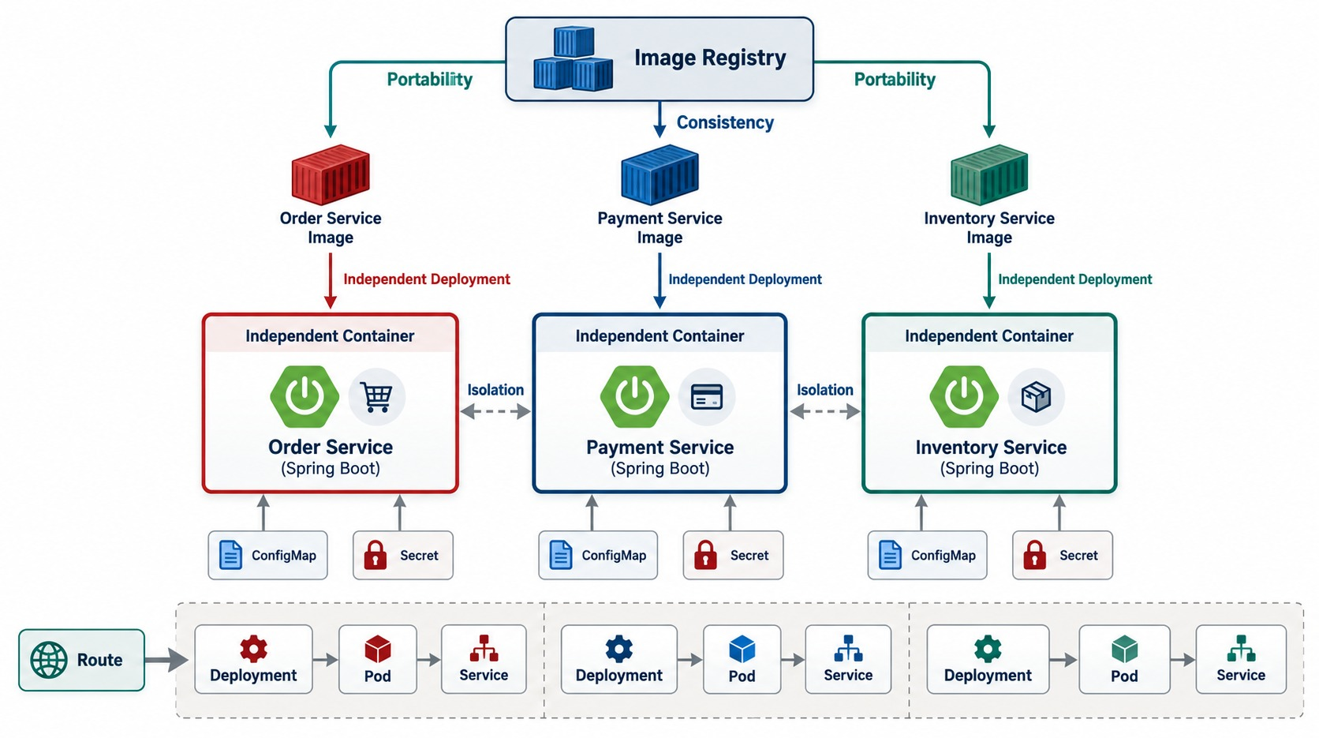
WHY CONTAINERS FOR MICROSERVICES?
Portability, isolation, consistency, fast startup and independent deployment.
“Works on my machine”
Different JDKs, libraries and OS settings make environments drift.
WHAT A CONTAINER PACKAGES
✓
The JRE and dependencies
✓
The application JAR
✓
Startup command and defaults
FITS MICROSERVICES Each service versions, deploys and scales alone.
KEY TAKEAWAY Containers let each microservice be packaged, versioned, deployed and scaled independently.
7
© 2026 by Innovation In Software Corporation
Notes:
KEY TALKING POINTS
------------------
- Many services, many needs
Microservices usually mean many independently deployable services, like Order, Payment, Inventory and Shipping.
Each may need a specific Java runtime, libraries, configuration and startup commands.
- Environments drift
Without containers, environments differ.
The developer's laptop has Java 21, but the test server has Java 17, or a dependency is missing.
- What a container packages
Containers package the application code, runtime, libraries and startup command into an image.
The same image can then run in DEV, TEST, STAGE and PROD.
This supports Module 7's principle: build once, promote the same artifact.
- Why they suit microservices
Each service can be packaged, versioned, deployed and scaled independently.
- What the diagram shows
Several microservices each packaged in their own container, highlighting portability, consistency, isolation and independent deployment.
- Key point
Each service ships and runs as its own self-contained unit.

Slide 8
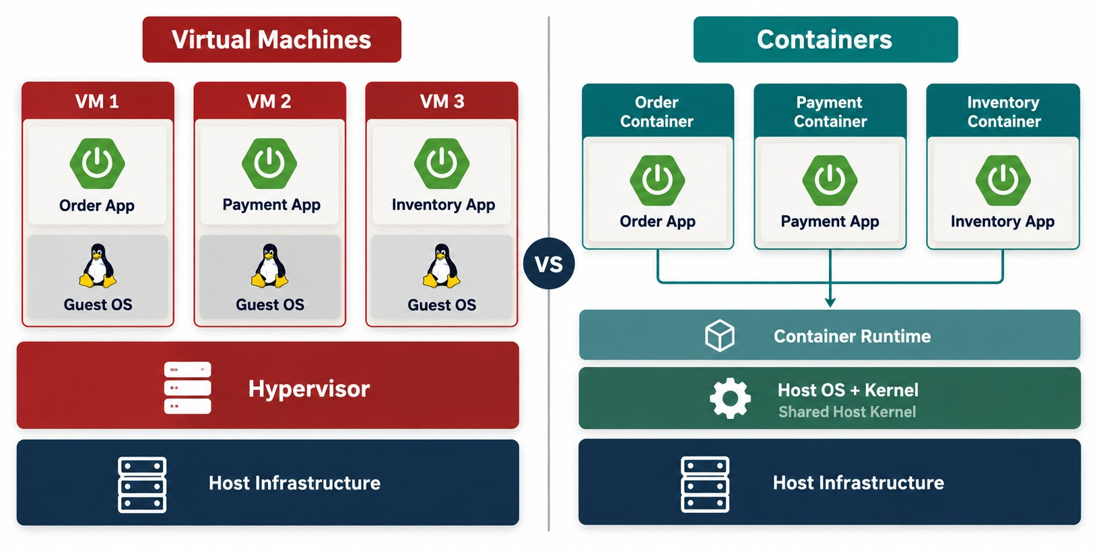
CONTAINERS VS. VIRTUAL MACHINES
Architecture, startup, resource overhead and isolation.
Virtual machine
Full guest OS; boots in minutes; strong isolation; gigabytes.
Container
Shares the host kernel; starts in seconds; megabytes.
NOT A REPLACEMENT OpenShift worker nodes are often VMs running containers.
KEY TAKEAWAY VMs virtualize hardware; containers isolate processes on a shared kernel — and they coexist.
8
© 2026 by Innovation In Software Corporation
Notes:
KEY TALKING POINTS
------------------
- Different layers of isolation
Virtual machines and containers isolate at different layers.
A VM virtualizes hardware, and each VM usually contains the application, libraries and a full guest operating system.
- Containers share the kernel
Containers isolate processes while sharing the host operating system's kernel.
A container holds the application and its required user-space dependencies, but not its own kernel.
That usually makes containers faster to start, more lightweight and higher density.
- Not a replacement
Containers do not replace virtual machines.
A very common architecture is physical hardware, then virtual machines, then OpenShift worker nodes, then containers.
VMs and containers often work together.
- What the diagram shows
Virtual machines each carrying a guest operating system, next to containers sharing the host kernel.
- Key point
VMs virtualize hardware; containers isolate processes.

Slide 9
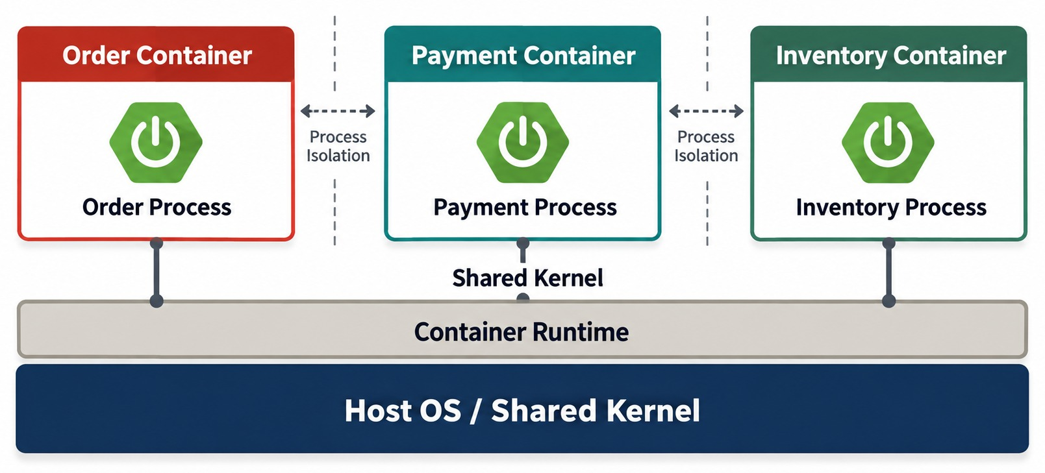
HOW CONTAINERS WORK
Application and dependencies sharing the host kernel with process isolation.
WHAT MAKES THE ISOLATION
Namespaces
cgroups
Layered filesystem
Own network
Namespaces
Give each container its own view of processes, files and network.
cgroups
Limit how much CPU and memory each container may use.
ENOUGH DEPTH You don't manage these directly on OpenShift.
KEY TAKEAWAY A container is an isolated process — with its own view of files, network and resources.
9
© 2026 by Innovation In Software Corporation
Notes:
KEY TALKING POINTS
------------------
- An isolated process
A container is basically an isolated process, or group of processes.
When we run the Order Service container, it behaves as if it has its own environment.
- Four kinds of isolation
Process isolation keeps processes in one container separate from another.
Filesystem isolation gives each container its own view of files, based on its image.
Network isolation gives containers their own network interfaces and addresses.
Resource isolation lets CPU and memory be limited.
- Enough depth for this course
Under the hood, container runtimes use Linux features such as namespaces and resource controls.
Learners don't need deep kernel internals.
The main idea: containers isolate applications while sharing the underlying kernel.
- What the diagram shows
One host kernel running isolated containers for the Order, Payment and Inventory services.
- Key point
Containers are isolated processes on a shared kernel.

Slide 10
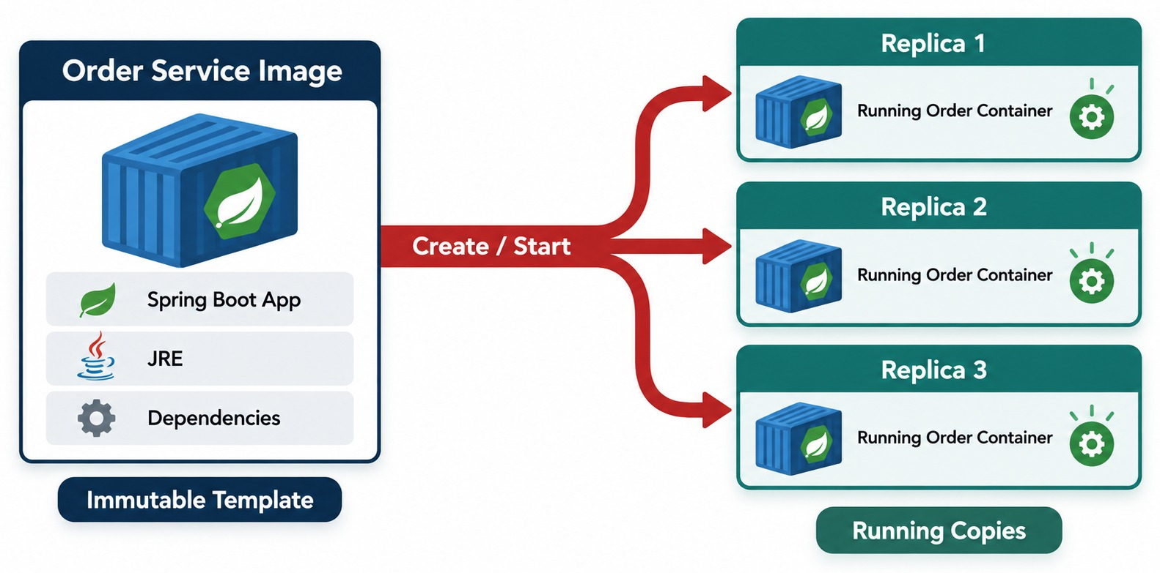
CONTAINER IMAGE VS. RUNNING CONTAINER
An immutable image template versus running instances.
Image
Read-only, versioned, stored in a registry.
Container
A running instance with its own writable layer — lost when it stops.
LINK TO SCALING Three replicas = three containers from one image.
KEY TAKEAWAY One image can create many identical running containers.
10
© 2026 by Innovation In Software Corporation
Notes:
KEY TALKING POINTS
------------------
- A fundamental distinction
A container image is not the running application.
Think of the image, order-service:1.0, as a template that holds the packaged application.
- Running it
When the platform starts the image, it creates a running container.
One image can produce many containers, for example three pods all running the same version.
- The link to scaling
This is exactly how horizontal scaling works in OpenShift.
If traffic rises from one instance to three, OpenShift does not need three images.
It launches three running instances from the same image.
- What the diagram shows
One image starting several identical running containers.
- Key point
The image is the template; containers are its running instances.

Slide 11
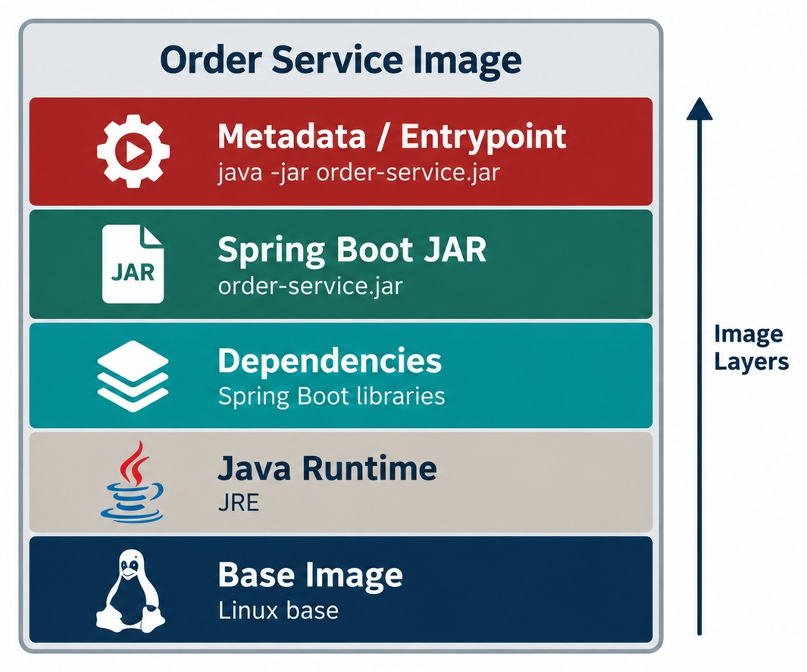
ANATOMY OF A CONTAINER IMAGE
Base image, runtime, application JAR, config defaults, metadata and layers.
Why layers matter
Change only your code and only the top layer is rebuilt and pushed.
Order layers well
Put rarely changing things first: base, JRE, dependencies, then the app.
KEEP IT SMALL No build tools, caches or test files in the final image.
KEY TAKEAWAY Layered images reuse unchanged layers — so only what changed gets rebuilt and moved.
11
© 2026 by Innovation In Software Corporation
Notes:
KEY TALKING POINTS
------------------
- Built in layers
Container images are usually built in layers.
The base image provides a minimal operating-system user space.
The Java runtime provides the JVM.
The application layer holds order-service.jar.
Metadata defines how it starts, such as java -jar app.jar.
- Why layers matter
Unchanged layers can often be reused during builds and distribution.
If only the JAR changes, the lower layers may not need to be rebuilt or transferred.
That improves build efficiency, registry storage and distribution speed.
- Keep it small
Smaller, simpler runtime images are generally easier to scan, transfer, maintain and secure.
- What the diagram shows
Layers stacked from the base image, Java runtime and dependencies up to the Spring Boot JAR and the entrypoint metadata.
- Key point
Unchanged layers are reused, so rebuilds and pulls stay fast.

Slide 12
PART 2: BUILDING AND DISTRIBUTING IMAGES
From a Spring Boot JAR to a trusted image in a registry.
✓ Part 1
Container fundamentals
Part 2
Build & distribute
Part 3
OpenShift architecture
Part 4
Running applications
SO FAR
NEXT QUESTION
How do we build a small, secure image — and get it safely to the cluster?
✓
Containers isolate processes on a shared kernel
✓
One image runs as many containers
IN THIS PART
Images are built from reusable layers
1
The Spring Boot build flow
✓
2
A multi-stage, non-root Containerfile — in code
3
Good vs. bad images
4
Exercise 4.2: containerize Account Service
5
Tags, registries and scanning
6
Exercise: review a Containerfile
12
© 2026 by Innovation In Software Corporation
Notes:
KEY TALKING POINTS
------------------
- From idea to artifact
Part 1 explained containers.
Part 2 builds one for a Spring Boot service and distributes it.
- What comes next
The build flow, a real Containerfile, image best practices, tagging, registries and scanning.

Slide 13
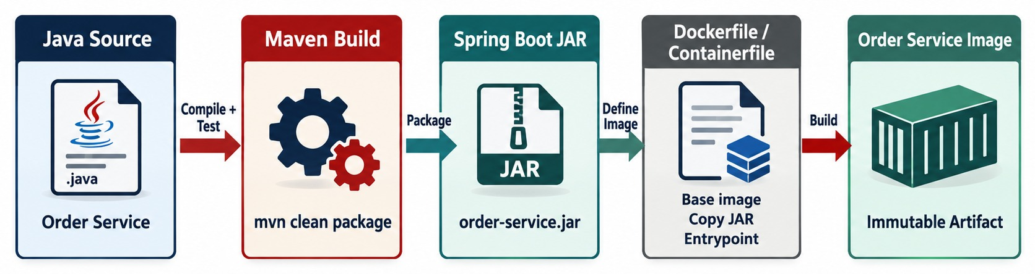
BUILDING A SPRING BOOT CONTAINER
JAR → Dockerfile/Containerfile → build → image.
Build and run locally
Docker or Podman
BASE IMAGES Use trusted, maintained images such as UBI or Temurin.
./mvnw -B package
podman build -t order-service:1.0.0 .
podman run -p 8080:8080 order-service:1.0.0
Same Containerfile syntax; Podman is common in Red Hat environments.
KEY TAKEAWAY Build the JAR, describe the image, then build it into a versioned container image.
13
© 2026 by Innovation In Software Corporation
Notes:
KEY TALKING POINTS
------------------
- Build the application first
The application build comes first.
Running ./mvnw clean package produces target/order-service.jar.
Then a Containerfile or Dockerfile tells the build tool how to build the image.
- Line by line
FROM selects a base runtime image.
WORKDIR sets the working directory.
COPY copies the application JAR into the image.
ENTRYPOINT defines how the application starts.
- The result
The output is an image like order-service:1.0.
- Choose base images carefully
The exact base image should follow your organization's security and platform standards.
Do not pick one casually.
Teach the process, not a specific base image as a universal rule.
- What the diagram shows
Java source built by Maven into a JAR, then a Containerfile turning it into an image.
- Key point
Build the application, then package it into an image.

Slide 14
A MULTI-STAGE, NON-ROOT CONTAINERFILE
Compile in a builder stage; ship only the JRE and the JAR, running as a normal user.
✓
Containerfile
Two stages
# ---- build stage ----
FROM eclipse-temurin:21-jdk AS build
WORKDIR /src
COPY mvnw pom.xml ./
COPY .mvn .mvn
RUN ./mvnw -B dependency:go-offline # cached layer
COPY src src
RUN ./mvnw -B package -DskipTests
# ---- runtime stage ----
FROM eclipse-temurin:21-jre
RUN useradd --uid 1001 --gid 0 md287
WORKDIR /app
COPY --from=build --chown=1001:0 /src/target/*.jar app.jar
USER 1001
EXPOSE 8080
ENTRYPOINT ["java", "-XX:MaxRAMPercentage=75", "-jar", "app.jar"]
Maven and the JDK stay in the builder — not in production.
Dependency layer
Unchanged dependencies are reused on every rebuild.
Non-root
USER 1001, group 0 — fits OpenShift's random UIDs.
TESTS ran earlier in CI, so the image build skips them.
KEY TAKEAWAY Build in one stage, run in another — as a non-root user with only what the service needs.
14
© 2026 by Innovation In Software Corporation
Notes:
KEY TALKING POINTS
------------------
- Build stage
The JDK image downloads dependencies in their own layer, then compiles and packages the JAR.
- Runtime stage
Only the JRE and the JAR are copied into the final image, so it's smaller and has fewer vulnerabilities.
- Non-root
The app runs as user 1001 in group 0.
OpenShift assigns a random UID but keeps group 0, so the files stay readable.
- Memory
MaxRAMPercentage lets the JVM size its heap from the container's memory limit.

Slide 15
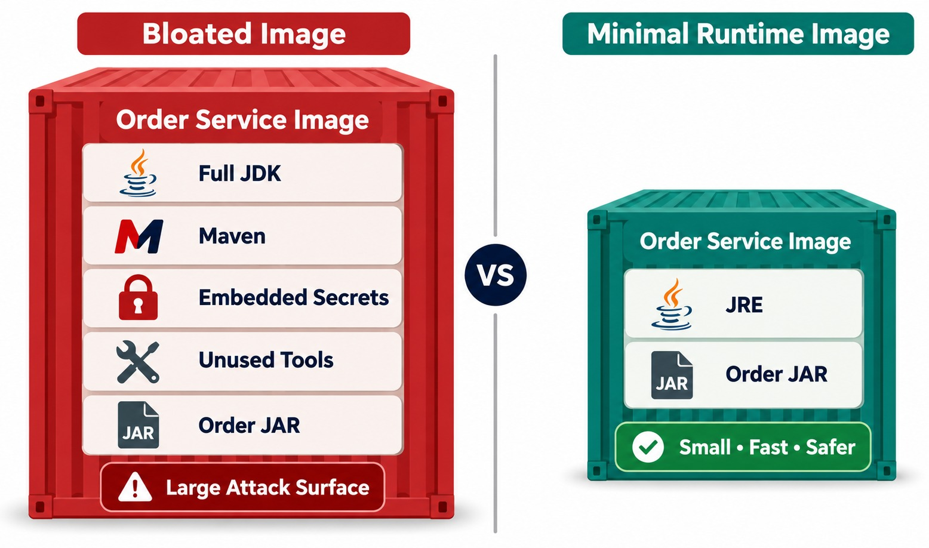
CONTAINER BUILD BEST PRACTICES
Minimal base image, non-root, reproducible builds, small layers, secrets outside.
NEVER SHIP
✕
Maven, JDK and source code
✕
Passwords in ENV or files
✕
Running as root
✕
:latest base image
ALWAYS
✓
Pinned, trusted base image
✓
Non-root user
✓
Only the runtime and JAR
IMAGES REMEMBER A secret in any layer stays in the image.
KEY TAKEAWAY Ship only what the application needs to run — and never ship secrets.
15
© 2026 by Innovation In Software Corporation
Notes:
KEY TALKING POINTS
------------------
- Part of the supply chain
A container image becomes part of your production software supply chain, so its quality matters.
- Trusted and small
Use maintained, approved base images.
Keep the runtime image small.
A bad image includes Maven, source code, debug tools, caches and temporary files.
A better image has just the runtime, the application and the libraries it needs.
- No secrets in images
Never bake values like database passwords, API keys or private keys into an image.
Anyone with access to the image may be able to inspect its contents.
- Least privilege and scanning
Run as non-root, so the application has only the permissions it needs.
Make builds reproducible, so the same inputs give predictable results.
Scan images for known vulnerabilities and policy violations, which connects to Module 7 DevSecOps.
- What the diagram shows
A bloated image with build tools and secrets next to a minimal runtime image with only what the service needs.
- Key point
Smaller images are faster, cheaper and safer.

Slide 16
EXERCISE 4.2 — CONTAINERIZE ACCOUNT SERVICE
Day 4 checkpoint B: a secure, non-root image.
OFFICIAL CHECKPOINT B
10 MIN
labs/day-04/exercises/exercise-4.2-containerize-account.md
SCENARIO
YOUR TASKS
EXPECTED OUTCOME
Lab 4 ships the banking Account and Transaction services from Lab 3 as container images, then runs them with Docker Compose and on OpenShift.
1
Multi-stage build: Maven compile in the builder, JRE runtime in the final image
✓
Explain why the runtime user isn't root
✓
Say what stays in the builder stage
2
USER md287 (non-root); OpenShift also sets runAsNonRoot: true
✓
Tag md287/account-service:1.0.0
3
Immutable tag 1.0.0 — not :latest
✓
Ready before running docker build
4
Build from the Lab 3 solution context — don't recopy Java trees
KEY TAKEAWAY You can explain why the runtime user is not root before you run docker build.
16
© 2026 by Innovation In Software Corporation
Notes:
KEY TALKING POINTS
------------------
- Official checkpoint
This is the official OUTLINE.md checkpoint.
Use the worksheet in labs/day-04/exercises.
- The image
A multi-stage Containerfile keeps Maven out of the runtime image, and USER md287 means a compromised process isn't root.
- The tag
An immutable 1.0.0 tag makes the deployment traceable and rollback possible.

Slide 17
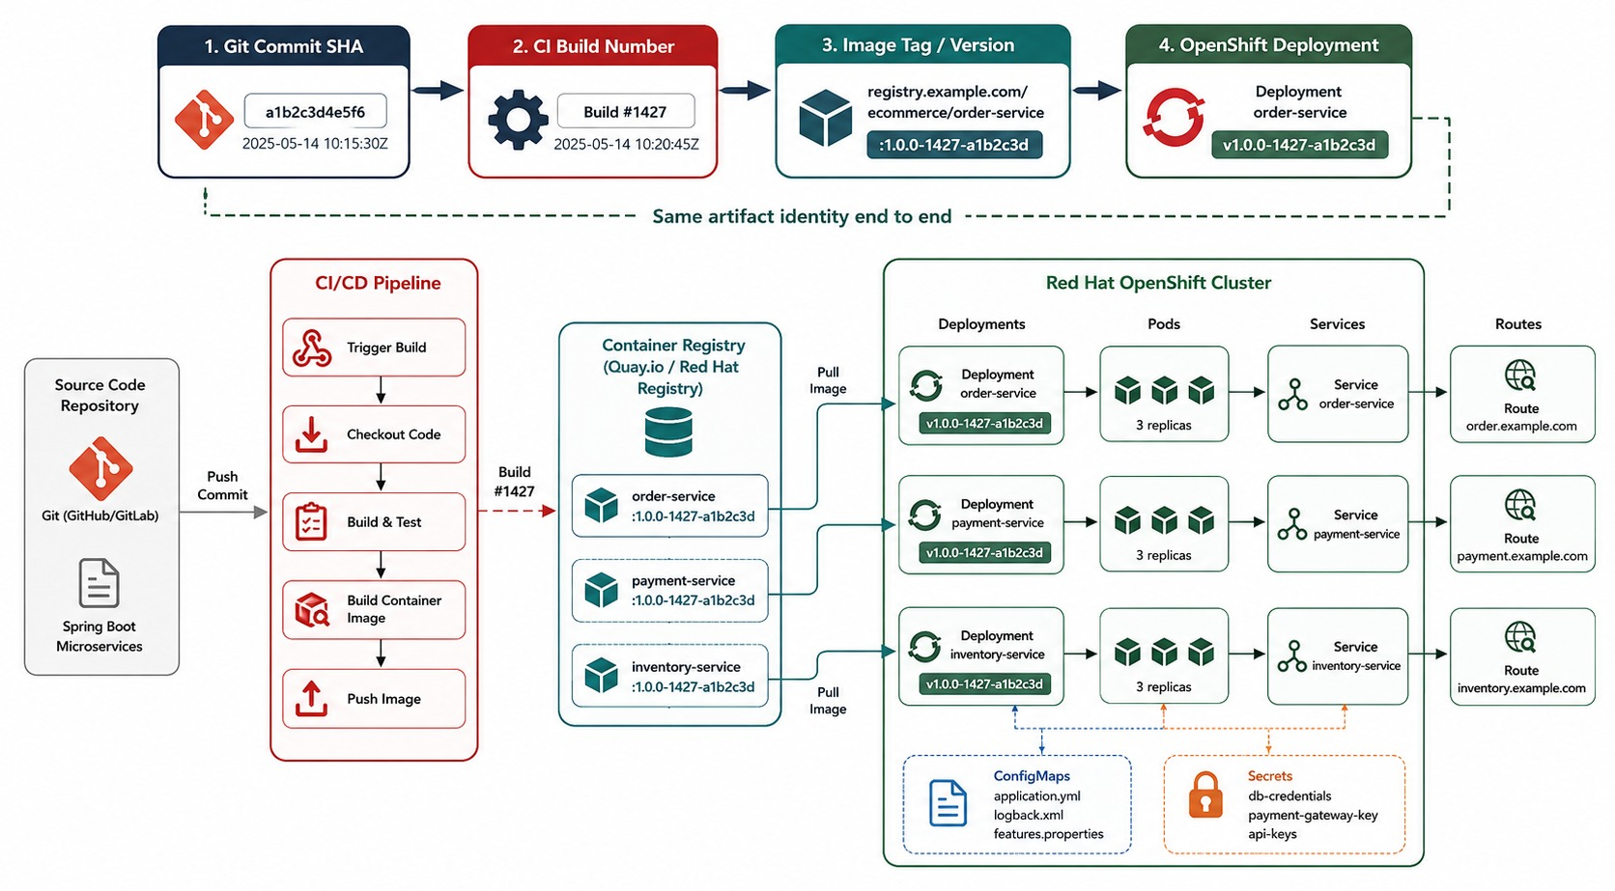
CONTAINER IMAGE TAGGING AND VERSIONING
Semantic versions, commit SHAs and immutable references.
✓
Good references
account-service:1.0.0
account-service:1.4.0-a13f92c
account-service@sha256:9f2c…
WEAK
✕
:latest — which version is running?
ENABLES audits, incident analysis and exact rollback.
KEY TAKEAWAY Map every running deployment to an exact image and source revision.
17
© 2026 by Innovation In Software Corporation
Notes:
KEY TALKING POINTS
------------------
- Traceable deployments
A deployment must be traceable.
If someone asks what version is running in production, the answer should not be 'probably latest'.
- Why latest alone is weak
Using only the latest tag is ambiguous, because the content it points to can change.
- Better identifiers
Use identifiers that trace back to a release, such as order-service:2.3.1, or a Git commit SHA like a8f42c9.
Organizations use different conventions.
The principle is that the running deployment maps clearly to an exact image and source revision.
- What it enables
Traceability helps with auditing, rollback, incident investigation and comparing releases.
- What the diagram shows
A Git commit flowing through a CI build to an image tag and an OpenShift deployment.
- Key point
Every running pod traces back to an exact commit.

Slide 18
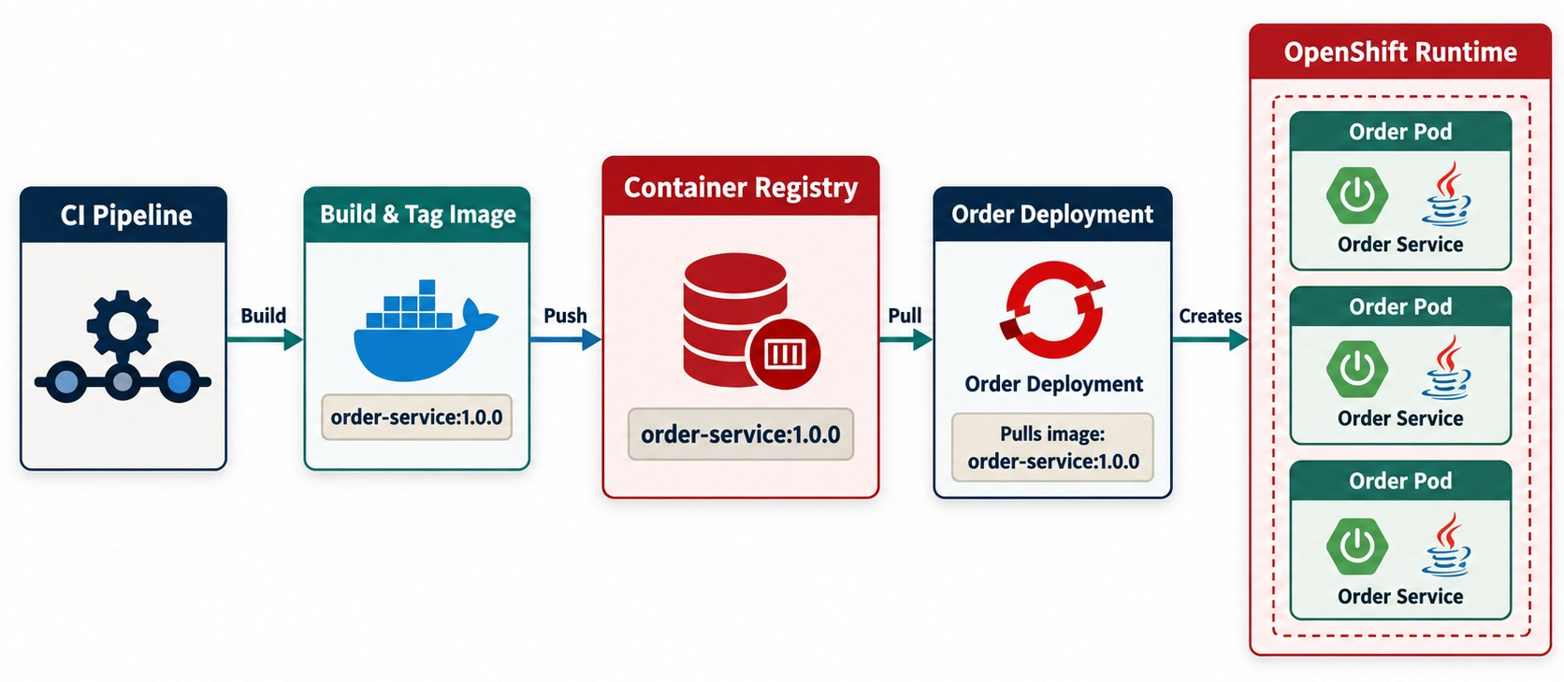
CONTAINER REGISTRIES
Build → tag → push → registry → pull.
Push to a registry
IMG=quay.io/md287/account-service:1.0.0
podman login quay.io
podman tag account-service:1.0.0 $IMG
podman push $IMG
Name anatomy
registry / namespace / image : tag
EXAMPLES
Quay
OpenShift internal
GHCR
ACR / ECR
KEY TAKEAWAY A registry stores and distributes the images OpenShift pulls to run pods.
18
© 2026 by Innovation In Software Corporation
Notes:
KEY TALKING POINTS
------------------
- What a registry does
A container registry stores and distributes container images.
Think of it as the repository for deployable container artifacts.
- The flow
The CI pipeline builds, tags and pushes an image such as order-service:1.0.0 to the registry.
OpenShift later pulls that image to create running pods.
- Examples
Examples include Red Hat Quay, the OpenShift integrated registry, GitHub Container Registry, Docker Hub and cloud-provider registries.
- Why it matters
Build once, store centrally, and deploy wherever authorized.
If the registry or permissions are misconfigured, OpenShift may fail to start a pod because it cannot pull the image.
- What the diagram shows
CI building and tagging an image, pushing it to the registry, and OpenShift pulling it to run pods.
- Key point
The registry is the hand-off between CI and the cluster.

Slide 19
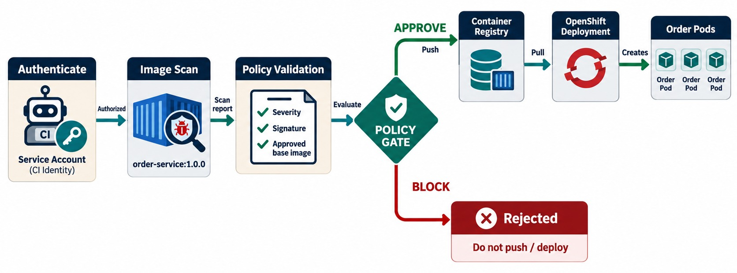
REGISTRY SECURITY AND IMAGE SCANNING
Authentication, access control, vulnerability scanning and trusted images.
BEFORE PRODUCTION
✓
Authenticated push and pull
✓
Scanned for CVEs
✓
Signed (for example, Cosign)
✓
SBOM attached
Policy gate
A CRITICAL CVE or a missing signature blocks the deploy.
RULE Only signed images from approved registries run in prod.
KEY TAKEAWAY A registry is a security boundary — authenticate, authorize, scan and gate.
19
© 2026 by Innovation In Software Corporation
Notes:
KEY TALKING POINTS
------------------
- A security boundary
Registries are not just file stores.
They are security boundaries.
- Authentication and authorization
Authentication decides who can push, pull, delete or manage images.
Authorization gives teams the right permissions.
For example, developers push to a development repository, and the production platform pulls approved releases.
- Vulnerability scanning
Images can contain vulnerable operating-system packages, runtime components or libraries.
Scanning finds known issues.
- Policy gates
Organizations can set policies.
For example, a critical vulnerability blocks deployment, or only approved base images are allowed.
This connects directly to Module 7's security pipeline.
- What the diagram shows
Authentication, scanning and policy validation deciding whether an image is approved or blocked.
- Key point
Only authenticated, scanned, policy-compliant images get deployed.

Slide 20
EXERCISE: REVIEW A CONTAINERFILE
Find what makes this image slow, large and unsafe.
PRACTICE EXERCISE
10 MIN
SCENARIO
YOUR TASKS
EXPECTED OUTCOME
A teammate wrote:
1
Find at least five problems
✓
:latest base → pin a version
FROM maven:latest
COPY . /app
WORKDIR /app
ENV DB_PASSWORD=Secret123
RUN mvn package
EXPOSE 8080
CMD mvn spring-boot:run
2
Explain the risk of each
✓
Maven and source in runtime → multi-stage
3
Sketch the improved Containerfile
✓
Password baked in → Secret at runtime
✓
Runs as root → USER 1001
✓
COPY . breaks caching → copy pom first
KEY TAKEAWAY Pin the base, build in stages, run as non-root, and keep secrets out of every layer.
20
© 2026 by Innovation In Software Corporation
Notes:
KEY TALKING POINTS
------------------
- Size and speed
The Maven image with source and build output is huge, and copying everything first means any change invalidates the dependency layer.
- Security
The password is stored in the image history, the process runs as root, and latest can change without notice.
- Runtime
Running mvn spring-boot:run in production recompiles at startup.
Run the packaged JAR instead.

Slide 21
PART 3: OPENSHIFT ARCHITECTURE
The platform that runs, heals and exposes our containers.
✓ Part 1
Container fundamentals
✓ Part 2
Build & distribute
Part 3
OpenShift architecture
Part 4
Running applications
SO FAR
NEXT QUESTION
Once the image is in the registry, what runs it — and how?
✓
Multi-stage, non-root images
✓
Immutable tags trace to commits
IN THIS PART
✓
Registries scan and gate images
What Red Hat OpenShift is
1
2
Cluster architecture
3
Core objects and how they relate
4
Route → Service → Pods
21
© 2026 by Innovation In Software Corporation
Notes:
KEY TALKING POINTS
------------------
- Why this part
Before deploying, learners need to know which objects they will create and what the platform does with them.
- What comes next
OpenShift versus Kubernetes, the control plane and workers, and the objects that carry traffic.

Slide 22
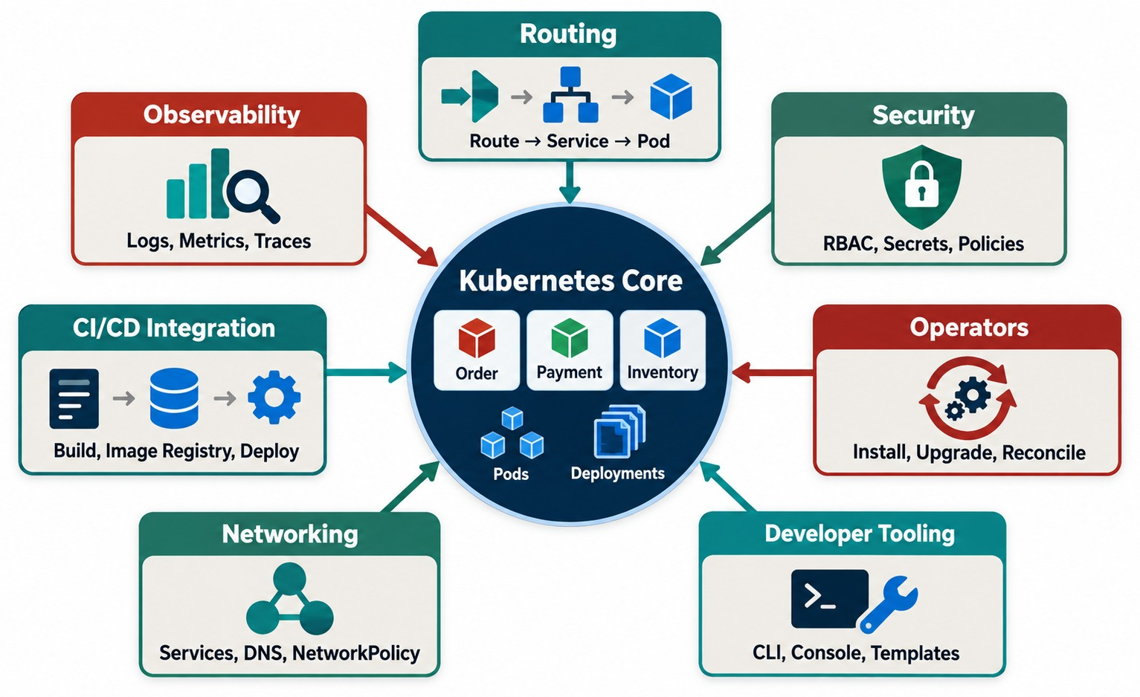
WHAT IS RED HAT OPENSHIFT?
An enterprise Kubernetes platform with developer, security, routing and operations capabilities.
Kubernetes gives
Scheduling, self-healing, Services and declarative Deployments.
OpenShift adds
Routes, a web console, security defaults, builds, a registry and operators.
SAME WORLD Kubernetes YAML and kubectl skills carry over.
KEY TAKEAWAY OpenShift packages and extends Kubernetes into an enterprise application platform.
22
© 2026 by Innovation In Software Corporation
Notes:
KEY TALKING POINTS
------------------
- Built around Kubernetes
OpenShift is built around Kubernetes.
Think of it as Kubernetes concepts plus enterprise platform capabilities.
- What it provides
OpenShift handles scheduling workloads, managing containers, service discovery, networking and routing.
It also covers scaling, security controls, configuration, lifecycle management and platform operations.
- A useful distinction
Kubernetes provides the core container orchestration model.
OpenShift packages and extends that model into an enterprise application platform.
- Not a different world
Don't teach OpenShift as unrelated to Kubernetes.
The key Kubernetes ideas, such as pods, deployments, services and namespaces, stay central.
- What the diagram shows
Kubernetes at the core, surrounded by routing, security, operators, developer tooling, networking, CI/CD integration and observability.
- Key point
OpenShift is Kubernetes plus the enterprise platform around it.

Slide 23
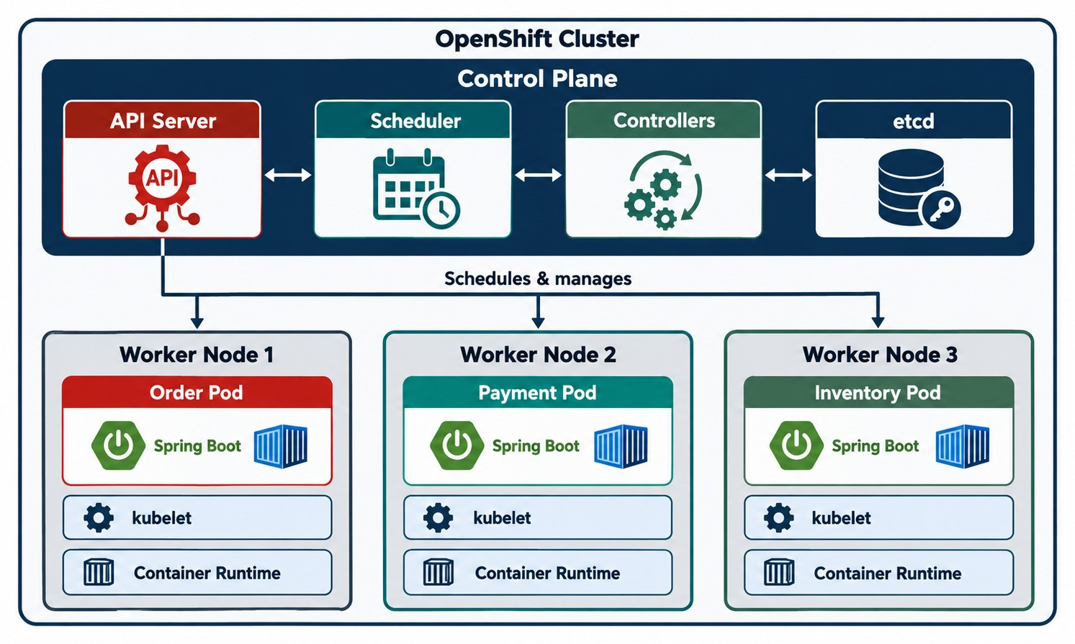
OPENSHIFT ARCHITECTURE OVERVIEW
Control plane, worker nodes, API server, scheduler, etcd and operators.
API server
Every oc command and console action goes through it.
Scheduler
Places pods on nodes with enough requested resources.
etcd
Stores the desired state of every object.
RECONCILIATION Controllers keep moving actual state toward desired.
KEY TAKEAWAY OpenShift continuously reconciles actual state toward desired state.
23
© 2026 by Innovation In Software Corporation
Notes:
KEY TALKING POINTS
------------------
- Two parts
An OpenShift cluster has a control plane, which makes cluster decisions and stores cluster state.
It also has worker nodes, which run the application workloads.
- API server and scheduler
The API server is the central entry point for cluster operations.
When you run oc get pods, you are talking to the platform API.
The scheduler decides which eligible worker node runs a new pod.
- Controllers and etcd
Controllers keep comparing desired state with actual state and try to bring them together.
If three replicas are desired but only two exist, the controller creates another pod.
etcd stores important cluster state.
- The key principle
OpenShift continuously reconciles actual state toward desired state.
- What the diagram shows
The control plane with API server, scheduler, controllers and etcd, connected to worker nodes running pods.
- Key point
The control plane decides; worker nodes run the workloads.

Slide 24
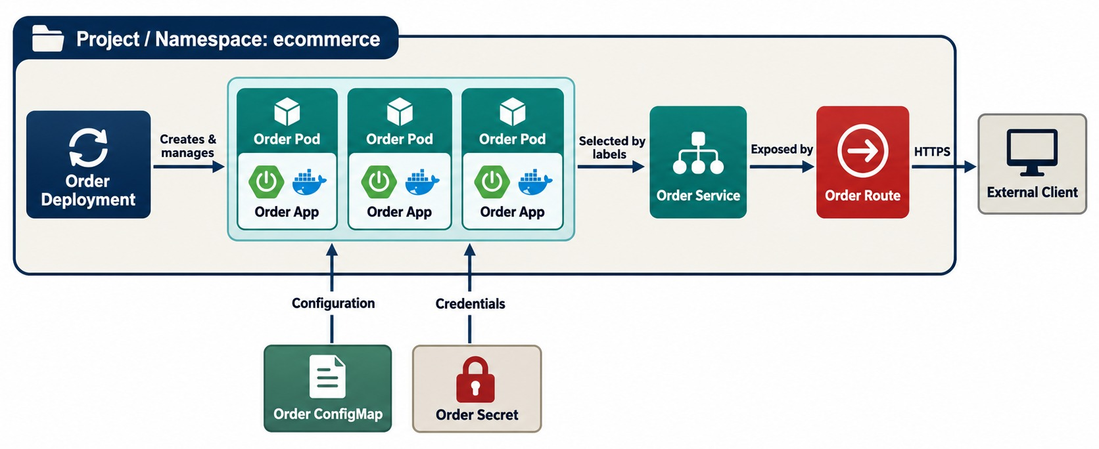
CORE OPENSHIFT OBJECTS
Project/namespace, pod, deployment, service, route, ConfigMap and secret.
Project
Namespace plus access control for a team or environment.
Deployment → Pods
Desired replicas of one image; pods are replaceable.
Service → Route
Stable internal name; optional external HTTPS URL.
CONFIG ConfigMaps and Secrets feed pods at runtime.
KEY TAKEAWAY Seven core objects describe where an app lives, how it runs, and how traffic and config reach it.
24
© 2026 by Innovation In Software Corporation
Notes:
KEY TALKING POINTS
------------------
- Project and deployment
A project, or namespace, groups and isolates resources, for example order-platform-dev, test and prod.
A deployment defines how the application should run, such as image order-service:1.0 with three replicas.
- Pod
A pod is the smallest runtime unit in Kubernetes and OpenShift.
It holds one or more closely related containers.
In this course, most examples use one main application container per pod.
- Service and route
A service gives a group of pods a stable network endpoint.
A route exposes a service outside the cluster.
- ConfigMap and secret
A ConfigMap stores non-sensitive configuration.
A secret stores sensitive configuration such as credentials or tokens.
- What the diagram shows
A project containing a Deployment, its pods, a Service and a Route, with a ConfigMap and Secret feeding the pods.
- Key point
A few objects describe where an app lives, how it runs and how traffic reaches it.

Slide 25
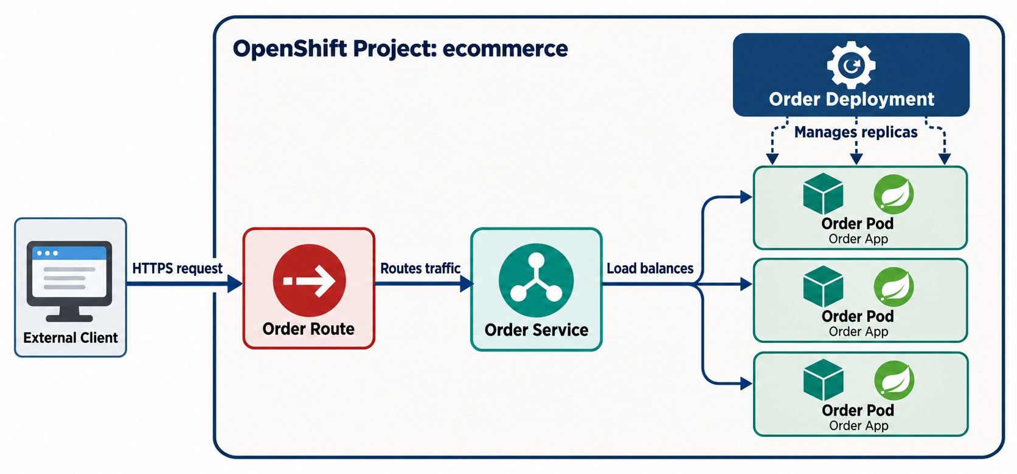
POD, DEPLOYMENT, SERVICE, AND ROUTE
How traffic reaches Spring Boot pods.
Inside the cluster — the Service name
http://account-service:8080
✓
Outside — through the Route
https://account-service-md287.apps.example.com
SELECTORS The Service finds pods by label, not by IP.
KEY TAKEAWAY Route → Service → Pods carries traffic, while the Deployment manages the pods.
25
© 2026 by Innovation In Software Corporation
Notes:
KEY TALKING POINTS
------------------
- One of the most important diagrams
Start from the bottom.
The deployment says: I want three Order Service replicas.
OpenShift makes sure three pods exist, all running the Order Service image.
- The service
Pods can be temporary, and their identities and addresses may change.
The service gives them a stable internal endpoint.
Callers use order-service instead of knowing each pod's IP address.
- The route
When external access is needed, the route gives external HTTP or HTTPS access to the service.
- The mental model
Traffic flows route, then service, then pods.
Separately, the deployment manages the pods.
- What the diagram shows
An external client reaching a Route, then a Service, then several pods managed by a Deployment.
- Key point
Route → Service → Pods carries traffic; the Deployment manages the pods.

Slide 26
PART 4: RUNNING APPLICATIONS
Deploy, configure, check, scale, update — and troubleshoot.
✓ Part 1
Container fundamentals
✓ Part 2
Build & distribute
✓ Part 3
OpenShift architecture
Part 4
Running applications
SO FAR
NEXT QUESTION
How do we run a Spring Boot service on OpenShift so it stays healthy under change and load?
✓
OpenShift reconciles desired state
✓
Deployments manage replaceable pods
IN THIS PART
✓
Services and Routes carry traffic
Deploying — with YAML
1
2
ConfigMaps and Secrets — with YAML
3
Probes — and Exercise 4.1
4
Scaling, rolling updates and resources
5
Troubleshooting — with an exercise
6
The complete picture
26
© 2026 by Innovation In Software Corporation
Notes:
KEY TALKING POINTS
------------------
- Why this part
This is what Lab 4 does: apply manifests, prove probes, roll forward and roll back.
- What comes next
Deployment YAML, configuration and secrets, probes, scaling, updates, resources and a troubleshooting method.

Slide 27
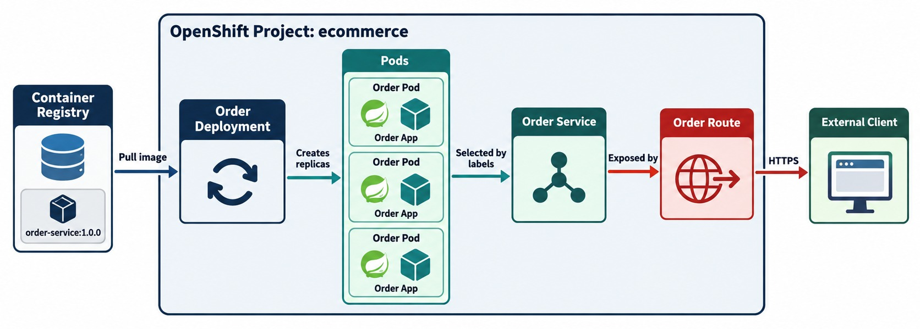
DEPLOYING A MICROSERVICE TO OPENSHIFT
Image → Deployment → Pods → Service → Route.
Apply and watch
oc apply -f openshift/
oc get pods -w
oc get route account-service
What OpenShift does
Pulls the image, schedules pods, runs probes, then routes traffic.
DECLARATIVE Change the YAML in Git; reapply — don't edit live.
KEY TAKEAWAY Declare the image and replicas; OpenShift schedules, starts, checks and exposes the pods.
27
© 2026 by Innovation In Software Corporation
Notes:
KEY TALKING POINTS
------------------
- Starting point
Suppose Module 7 produced registry.example.com/order-service:1.0.
Now the OpenShift deployment begins.
- The steps
First, create a deployment that references the image, with three replicas.
OpenShift schedules pods onto worker nodes, and the nodes pull the image from the registry.
The containers start, and health probes decide when the pods are ready.
A service gives the pods a stable identity, and a route may expose the application externally.
- The key idea
The CI/CD pipeline does not run the JAR on a server.
It declares the desired workload to the platform.
- What the diagram shows
A registry image becoming a Deployment, pods, a Service and a Route reached by a client.
- Key point
Declare what should run; OpenShift makes it so.

Slide 28
DEPLOYMENT, SERVICE AND ROUTE
Three manifests take Account Service from image to HTTPS URL.
10-account.yaml (Deployment)
✓
Service and Route
apiVersion: apps/v1
kind: Deployment
metadata: { name: account-service }
spec:
replicas: 2
selector: { matchLabels: { app: account-service } }
template:
metadata: { labels: { app: account-service } }
spec:
securityContext: { runAsNonRoot: true }
containers:
- name: account-service
image: <registry>/md287/account-service:1.0.0
ports: [ { containerPort: 8080 } ]
envFrom:
- configMapRef: { name: account-config }
- secretRef: { name: account-secret }
apiVersion: v1
kind: Service
metadata: { name: account-service }
spec:
selector: { app: account-service }
ports: [ { port: 8080, targetPort: 8080 } ]
---
apiVersion: route.openshift.io/v1
kind: Route
metadata: { name: account-service }
spec:
to: { kind: Service, name: account-service }
port: { targetPort: 8080 }
tls: { termination: edge }
Labels
envFrom
Route
app: account-service ties the Service to the pods.
Config and secrets arrive as environment variables.
Edge TLS — HTTPS outside, plain HTTP to the pod.
KEY TAKEAWAY A Deployment runs the pods, a Service names them, and a Route exposes only what must be public.
28
© 2026 by Innovation In Software Corporation
Notes:
KEY TALKING POINTS
------------------
- Deployment
Two replicas of the immutable 1.0.0 image, with runAsNonRoot enforced by the platform.
- Config and secrets
envFrom turns every ConfigMap and Secret key into an environment variable the Spring Boot app can read.
- Service
The selector matches the pod label, so traffic reaches whichever pods are ready.
- Route
Edge termination serves HTTPS on the platform's certificate.
Internal services such as databases get no Route at all.

Slide 29
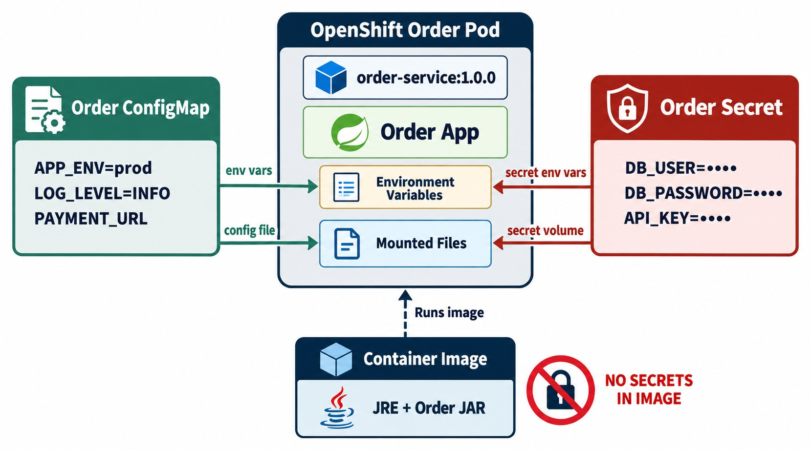
CONFIGURATION AND SECRETS IN OPENSHIFT
ConfigMaps, secrets, environment variables and mounted files.
ConfigMap
JDBC URL, Kafka bootstrap servers, feature flags.
Secret
DB password, JWT signing secret, API keys — tightly restricted.
Spring binding
SPRING_DATASOURCE_URL maps to spring.datasource.url automatically.
NOTE Secrets are base64 — restrict who can read them.
KEY TAKEAWAY Same image + environment-specific ConfigMaps and secrets — for DEV, TEST and PROD.
29
© 2026 by Innovation In Software Corporation
Notes:
KEY TALKING POINTS
------------------
- One image everywhere
We want one image to move through every environment.
The bad model builds separate dev, test and prod images just because configuration differs.
The better model uses one image, order-service:1.0, with different external configuration.
- ConfigMaps
Use a ConfigMap for non-sensitive values, such as log level, the payment service URL or a feature flag.
- Secrets
Use a secret for sensitive values, such as a database password, API token or private key.
- How Spring Boot gets them
Spring Boot can receive these as environment variables, mounted configuration files or other external configuration sources.
This connects directly to externalized configuration in Module 3.
- What the diagram shows
A pod receiving settings from a ConfigMap and credentials from a Secret.
- Key point
Same image everywhere; configuration and secrets arrive at runtime.

Slide 30
CONFIGMAP AND SECRET FOR ACCOUNT SERVICE
Non-sensitive settings in a ConfigMap; credentials in a Secret — never in the image.
ConfigMap
✓
Secret
apiVersion: v1
kind: ConfigMap
metadata: { name: account-config }
data:
SPRING_PROFILES_ACTIVE: openshift
SPRING_DATASOURCE_URL: jdbc:postgresql://account-db:5432/account_db
SPRING_KAFKA_BOOTSTRAP_SERVERS: kafka:19092
apiVersion: v1
kind: Secret
metadata: { name: account-secret }
type: Opaque
stringData:
SPRING_DATASOURCE_USERNAME: account_app
SPRING_DATASOURCE_PASSWORD: <from the vault>
MD287_JWT_SECRET: <from the vault>
# apply from a secure source — not from Git
Relaxed binding
Per environment
Secrets in Git?
Environment names map to Spring properties.
Each project gets its own values; the image is unchanged.
No — use a vault, sealed or external secrets.
KEY TAKEAWAY Change behavior per environment with ConfigMaps and Secrets — the image stays exactly the same.
30
© 2026 by Innovation In Software Corporation
Notes:
KEY TALKING POINTS
------------------
- ConfigMap
It holds the profile, the JDBC URL and the Kafka address — exactly what Lab 4 puts there.
No password.
- Secret
Credentials and the JWT signing secret live in a Secret, applied from a secure source rather than committed to Git.
- Binding
Spring Boot's relaxed binding turns SPRING_DATASOURCE_URL into spring.datasource.url.
- Module 12
Secret stores, rotation and access control are covered in depth in Module 12.

Slide 31
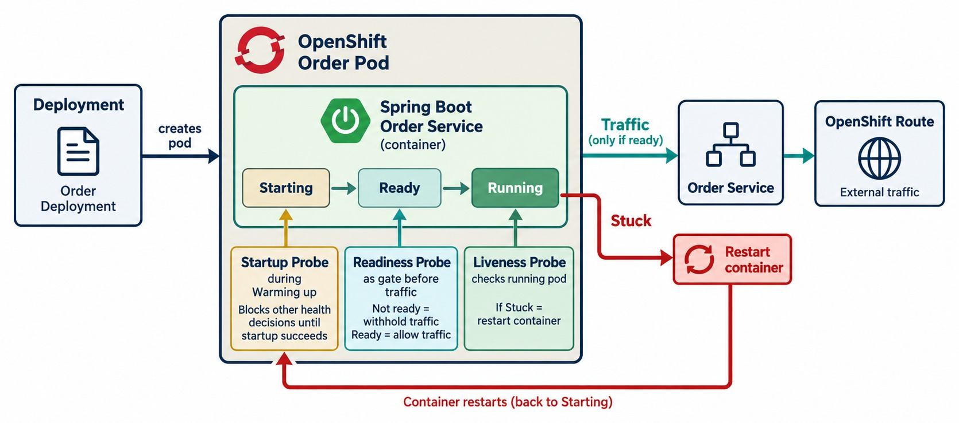
HEALTH CHECKS IN OPENSHIFT
Startup, readiness and liveness probes.
Startup
Gives Spring Boot time to boot before other probes start.
Readiness
Fails → the pod is removed from the Service, not restarted.
Liveness
Fails repeatedly → OpenShift restarts the container.
WARNING Never make liveness depend on the database.
KEY TAKEAWAY Probes tell OpenShift when a pod has started, can take traffic, or needs a restart.
31
© 2026 by Innovation In Software Corporation
Notes:
KEY TALKING POINTS
------------------
- Link to Module 6
Connect this back to health checks in Module 6.
- Startup probe
A startup probe suits applications that take time to initialize.
It asks whether startup has finished, so the platform does not treat a slow starter as broken too early.
- Readiness probe
A readiness probe asks whether this pod should receive traffic.
An application can be running while its database initialization is still incomplete.
Then liveness is fine but readiness is false, so the service avoids sending it normal traffic.
- Liveness probe
A liveness probe asks whether the application is healthy enough to keep running.
If it stays unhealthy according to its settings, the platform can restart the container.
- A warning
Bad probe settings can make an outage worse.
If every temporary database slowdown makes every pod fail liveness, the platform may keep restarting healthy processes.
- What the diagram shows
A pod lifecycle with a startup probe, a readiness gate before traffic, and a liveness check that triggers recovery.
- Key point
Three probes, three decisions: started, ready, still alive.

Slide 32
PROBES BACKED BY SPRING BOOT ACTUATOR
Actuator's health groups become OpenShift's startup, readiness and liveness checks.
application.yml
✓
Container probes
management:
endpoint:
health:
probes:
enabled: true
endpoints:
web:
exposure:
include: health, info, metrics
# /actuator/health/liveness
# /actuator/health/readiness
startupProbe:
httpGet: { path: /actuator/health/liveness, port: 8080 }
periodSeconds: 5
failureThreshold: 30 # up to 150 s to boot
readinessProbe:
httpGet: { path: /actuator/health/readiness, port: 8080 }
periodSeconds: 10
livenessProbe:
httpGet: { path: /actuator/health/liveness, port: 8080 }
periodSeconds: 15
failureThreshold: 3
Startup
Readiness
Security
Holds off liveness until the app has booted.
Controls whether the Service sends traffic.
Health stays public; metrics still need a JWT.
KEY TAKEAWAY Let Actuator report health and OpenShift act on it — start, route, or restart.
32
© 2026 by Innovation In Software Corporation
Notes:
KEY TALKING POINTS
------------------
- Actuator
With probes enabled, Actuator exposes separate liveness and readiness health groups.
- Startup probe
It allows up to 150 seconds for startup.
Until it passes, the liveness probe can't restart a slowly booting pod.
- Readiness and liveness
Readiness failing removes the pod from traffic; liveness failing three times restarts it.
- Lab 4
Health endpoints stay public for the platform, while /actuator/metrics still requires a JWT.

Slide 33
EXERCISE 4.1 — ADD HEALTH PROBES AND CORRELATION LOGGING
Day 4 checkpoint A: operability basics.
OFFICIAL CHECKPOINT A
10 MIN
labs/day-04/exercises/exercise-4.1-probes-correlation.md
SCENARIO
YOUR TASKS
EXPECTED OUTCOME
Lab 4 runs Account and Transaction services with Docker Compose, then deploys them to OpenShift with the same probes.
1
Liveness vs. readiness vs. startup — which Actuator paths, and why startup exists
✓
Tell liveness from readiness
✓
Explain why startup probes exist
2
X-Correlation-Id on the request must appear as correlationId= in logs
✓
Find a correlationId in a log line
3
Health stays public; /actuator/metrics still needs a JWT
✓
Know which endpoints need a token
4
Tracing (OpenTelemetry) is a demonstration — no Jaeger to stand up
KEY TAKEAWAY You can tell liveness from readiness and find a correlation ID in a log line.
33
© 2026 by Innovation In Software Corporation
Notes:
KEY TALKING POINTS
------------------
- Official checkpoint
This is the official OUTLINE.md checkpoint.
Use the worksheet in labs/day-04/exercises.
- Probes
Liveness and readiness use the Actuator health groups; startup gives Spring time to boot before liveness can restart it.
- Correlation
The X-Correlation-Id header from Module 6 appears as correlationId= in every log line.

Slide 34
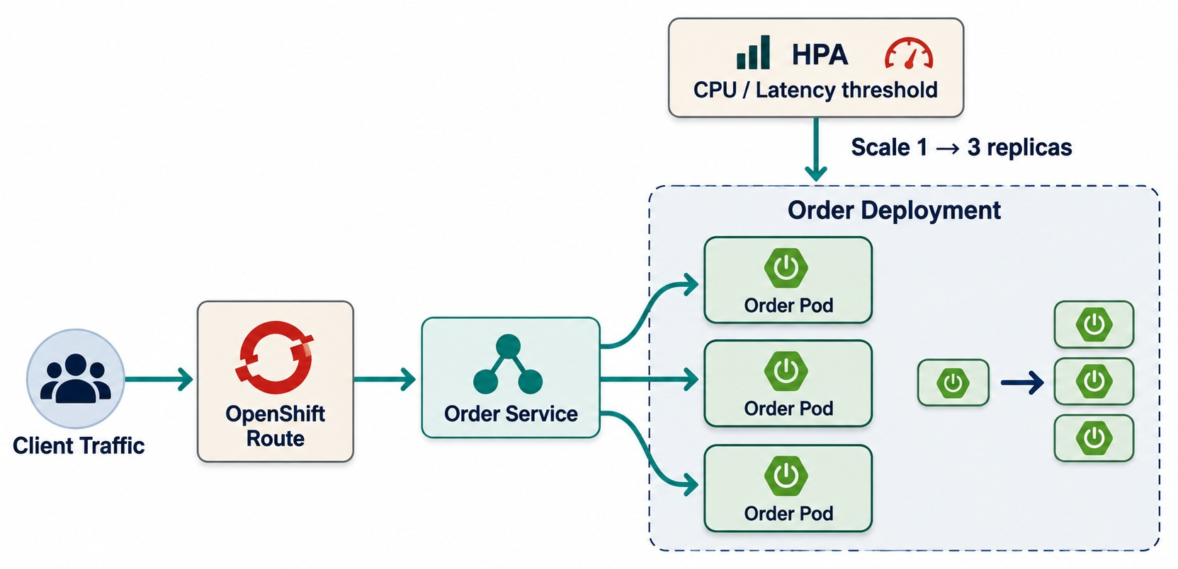
SCALING APPLICATIONS IN OPENSHIFT
Replica scaling and horizontal scaling concepts.
Manual and automatic
oc scale deploy/account-service \
--replicas=4
oc autoscale deploy/account-service \
--min=2 --max=8 --cpu-percent=70
CHECK BEFORE SCALING OUT
!
Stateless pods
!
Database connection limits
!
Downstream capacity
HPA needs CPU requests set to calculate utilization.
KEY TAKEAWAY Scale out by adding replicas — but check stateless design and downstream capacity.
34
© 2026 by Innovation In Software Corporation
Notes:
KEY TALKING POINTS
------------------
- More instances
OpenShift can run many instances of the same application.
If the Order Service has one replica and needs more capacity, change it to three.
OpenShift creates more pods from the same image, and the service spreads traffic across them.
- Stateless scales best
This works best for stateless services, which connects back to Module 2.
If critical session state lives only in Pod A's memory, sending the next request to Pod B may break behavior.
- Autoscaling
Horizontal autoscaling works like this: demand rises, an observed metric crosses a threshold, and replicas increase.
- The whole chain
Scaling the service tier does not automatically scale the database, external APIs or the message broker.
Capacity planning must consider the whole dependency chain.
- What the diagram shows
One pod scaling out to several replicas behind a Service, with an autoscaling trigger.
- Key point
Add replicas behind the same Service to handle more load.

Slide 35
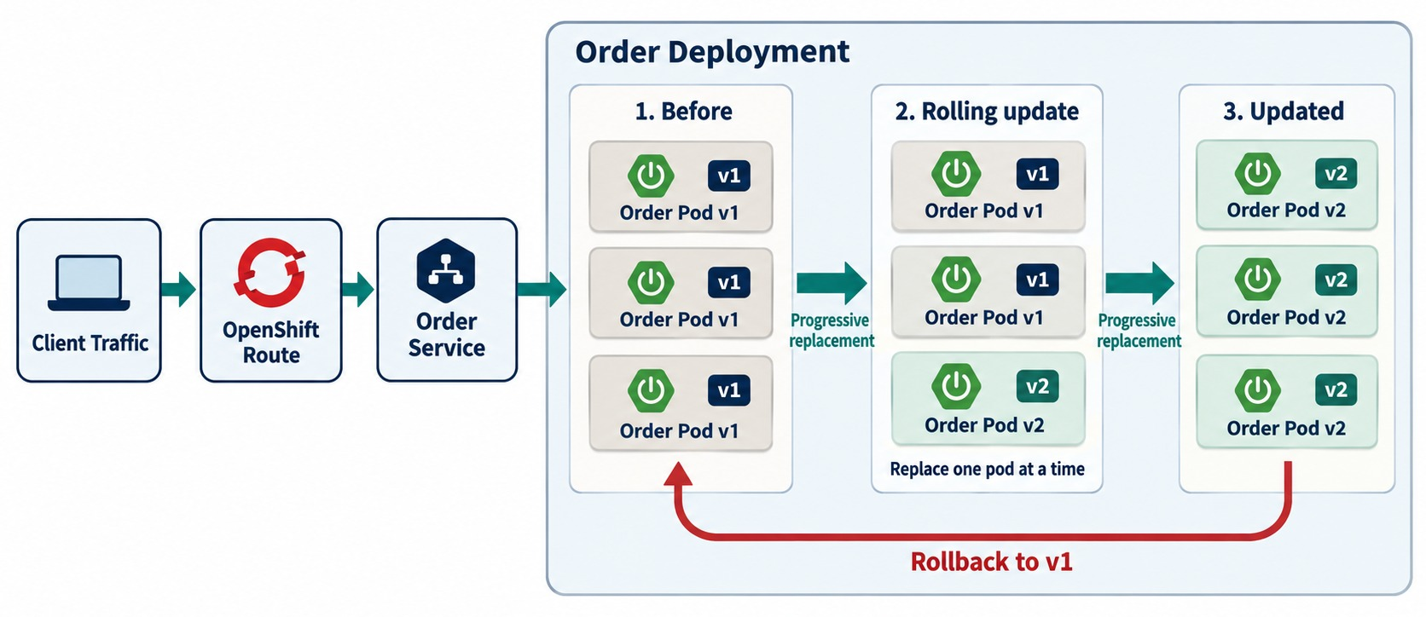
ROLLING UPDATES AND ROLLBACKS
Progressive pod replacement, readiness gates and reverting failed releases.
Roll forward, then back
oc set image deploy/account-service \
account-service=$IMG:1.0.1
oc rollout status deploy/account-service
oc rollout undo deploy/account-service
Readiness gate
Old pods keep serving until new ones are ready.
LIMIT Rollback restores the image — not the database schema.
KEY TAKEAWAY Rolling updates replace pods gradually; readiness keeps traffic safe during the rollout.
35
© 2026 by Innovation In Software Corporation
Notes:
KEY TALKING POINTS
------------------
- Progressive replacement
A rolling update gradually replaces old instances with new ones.
Say we move from order-service:1.0 to 1.1.
Instead of stopping all version 1 pods first, the platform replaces them one at a time.
- Readiness protects traffic
A new version 2 pod should not receive production traffic until it is ready.
That keeps the service available during the deployment.
- Rollback
If version 2 shows serious problems, rolling back to version 1 may be possible.
- An important limit
Rolling back the application does not automatically reverse database changes.
If version 2 made an incompatible schema change, rolling back only the image might not restore compatibility.
That is why backward-compatible schema evolution matters.
- What the diagram shows
Version 1 pods progressively replaced by version 2 pods, with a rollback path.
- Key point
Readiness gates each new pod; rollback restores the previous version.

Slide 36
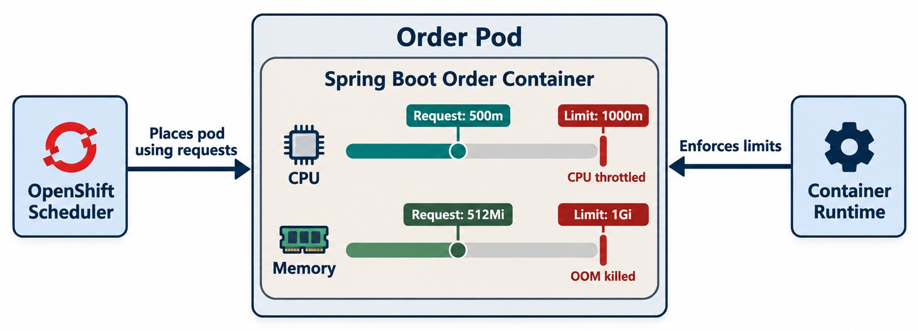
MANAGING RESOURCES AND APPLICATION LIMITS
CPU and memory requests and limits, scheduling and stability.
A starting point
resources:
requests: { cpu: 250m, memory: 512Mi }
limits: { cpu: "1", memory: 1Gi }
Over the memory limit
The container is OOM-killed and restarted.
Over the CPU limit
The container is throttled — slower, not killed.
MEASURE FIRST Set values from real usage, then adjust.
KEY TAKEAWAY Requests guide scheduling, limits cap usage — both should come from measurement.
36
© 2026 by Innovation In Software Corporation
Notes:
KEY TALKING POINTS
------------------
- Resources aren't unlimited
Applications should not act as if cluster resources are unlimited.
- Requests
Resource requests describe what the workload needs for scheduling.
The scheduler uses them to choose a node.
For example, the Order Service might request 500m of CPU, which is half a core, and 512Mi of memory.
- Limits
Resource limits set upper boundaries.
If a container uses too much memory for its configured limit, it may be terminated.
CPU may be throttled, depending on configuration.
- Why it matters
Without sensible settings, one service can consume too much capacity.
Scheduling gets less predictable, autoscaling less meaningful, and cost planning harder.
But arbitrary, aggressive limits can also cause instability.
- Measure first
Measure application behavior before setting production values.
This connects to the saturation and performance metrics in Module 6.
- What the diagram shows
A container with CPU and memory requests and limits, and what the scheduler and runtime do with each.
- Key point
Requests drive scheduling; limits cap usage.

Slide 37
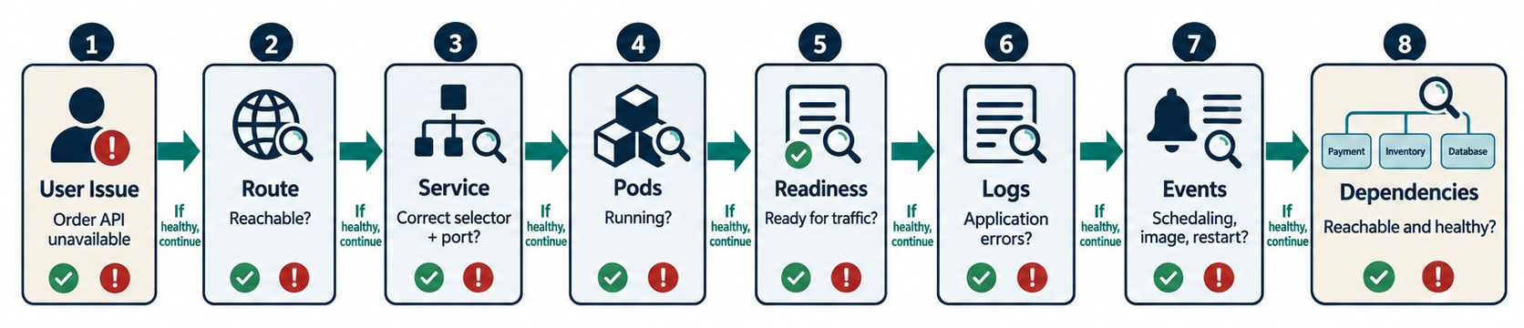
OBSERVING AND MANAGING APPLICATIONS
Logs, events, status, metrics and troubleshooting.
Walk the path
COMMON STATES
RULE Read events and logs before restarting anything.
oc get route,svc,endpoints
oc get pods
oc describe pod <pod> # events
oc logs <pod> --previous
ImagePullBackOff
CrashLoopBackOff
OOMKilled
0/2 ready
KEY TAKEAWAY Troubleshoot systematically along the traffic path, not by restarting first.
37
© 2026 by Innovation In Software Corporation
Notes:
KEY TALKING POINTS
------------------
- Be systematic
Suppose a user reports that the Order API is unavailable.
Do not restart the application straight away.
Follow the request path.
- Route, service, pods
First, check that the route exists and points to the right service.
Next, check that the service selects the right pods.
Then check that the pods are running, and that they are ready.
A pod can be running but not ready.
- Logs and events
Check logs for application failures.
Check platform events, which may show a failed image pull, a scheduling problem, a probe failure or a resource issue.
- Dependencies
OpenShift itself may be healthy while, for example, the database is unavailable.
Troubleshoot layer by layer instead of guessing.
- What the diagram shows
A user issue traced through the Route, Service, pods, readiness, logs, events and dependencies.
- Key point
Follow the traffic path in order instead of guessing.

Slide 38
EXERCISE: WHY CAN'T USERS REACH THE API?
Troubleshoot a deployed service along the traffic path.
PRACTICE EXERCISE
10 MIN
SCENARIO
YOUR TASKS
EXPECTED OUTCOME
Account Service is deployed. oc get pods shows the pod Running, but users get an error from the Route URL.
1
List what to check, in order
✓
Route → Service → endpoints → pod readiness
2
Explain what 0/1 and <none> tell you
0/1: running but not ready; no endpoints
✓
$ oc get pods
account-service-7c9d 0/1 Running 0 4m
$ oc get endpoints account-service
account-service <none>
3
Name two likely causes and their fixes
✓
Readiness failing — a DB or config issue
✓
Or the Service selector doesn't match the labels
✓
Check describe events and logs
KEY TAKEAWAY Running isn't ready: follow Route, Service, endpoints, readiness, events and logs — in that order.
38
© 2026 by Innovation In Software Corporation
Notes:
KEY TALKING POINTS
------------------
- The clue
The pod is Running but 0 of 1 containers are ready, and the Service has no endpoints, so the Route has nowhere to send traffic.
- Likely causes
Readiness fails because the database URL or secret is wrong, or the Service selector doesn't match the pod labels.
- How to confirm
oc describe pod shows probe failures in events; oc logs shows the underlying exception.

Slide 39
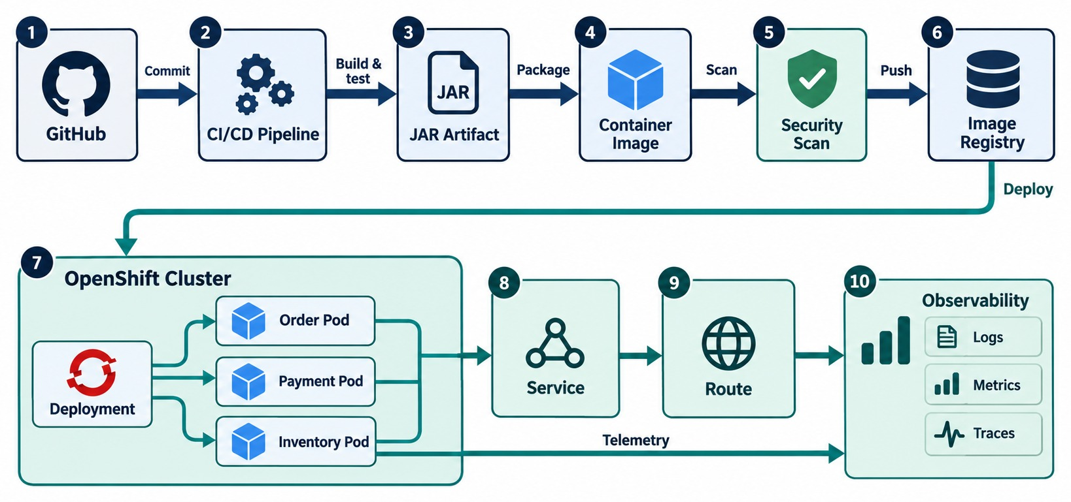
OPENSHIFT MICROSERVICES DEPLOYMENT WORKFLOW
Git → CI/CD → registry → OpenShift → service and route → monitoring.
Module 7 half
Git, CI, tests, scans, image, SBOM, signature and registry.
Module 8 half
Deployment, pods, probes, Service, Route, scaling and rollout.
LAB 4 walks this workflow on the classroom cluster.
KEY TAKEAWAY Git and CI/CD produce the release; OpenShift runs it; observability feeds back.
39
© 2026 by Innovation In Software Corporation
Notes:
KEY TALKING POINTS
------------------
- Connecting Modules 7 and 8
Module 7 ended with Git, CI/CD, a container image and the registry.
Module 8 continues from the registry into OpenShift, then the deployment, pods, service and route.
- The lifecycle
A developer changes code, and Git stores the change.
CI validates it, the build creates a Spring Boot JAR, and the container build creates the image.
Security checks validate the image, and the registry stores it.
- Running it
OpenShift deploys it, and health checks decide when it is ready.
The service gives internal access, and the route exposes it externally.
Observability validates how it behaves at runtime, and feedback reaches the engineering team.
- Two halves of one story
Module 7 explained how the delivery pipeline creates the release.
Module 8 explains where and how that release runs.
- What the diagram shows
GitHub and CI/CD producing a JAR and a scanned image in the registry, deployed to OpenShift pods, Service and Route, with observability.
- Key point
CI/CD produces the release; OpenShift runs it; observability feeds back.

Slide 40
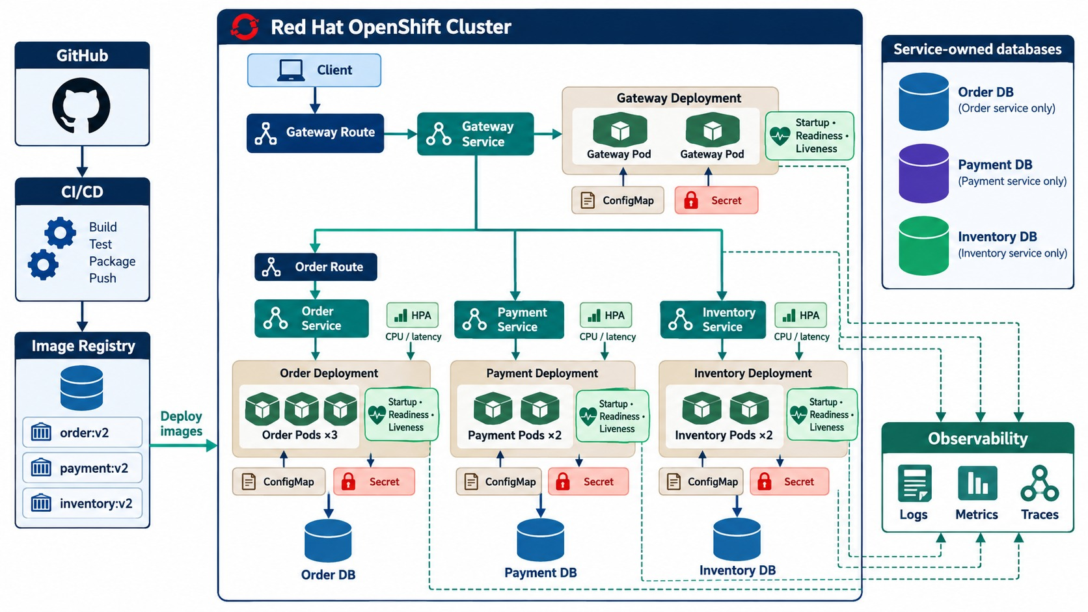
END-TO-END SPRING BOOT MICROSERVICES ON OPENSHIFT
Containers, registry, OpenShift, scaling, config, health and routing together.
EVERY PART OF THE MODULE
✓
Non-root images from the registry
✓
Deployments with replicas and resources
✓
ConfigMaps and Secrets per environment
✓
Startup, readiness and liveness probes
✓
Services inside, Routes only at the edge
REMEMBER Same image everywhere; the platform does the rest.
KEY TAKEAWAY Containers package the service; OpenShift runs, scales, updates and manages it reliably.
40
© 2026 by Innovation In Software Corporation
Notes:
KEY TALKING POINTS
------------------
- From code to images
Use this slide to rebuild the module.
Developers write the Order, Payment and Inventory services.
CI/CD builds each one with Maven into a JAR, and then into a container image.
The images are stored in a registry for controlled distribution.
- Deployments and pods
OpenShift deployments reference those images and declare the desired state, such as three Order Service replicas.
OpenShift schedules the pods, possibly across several worker nodes.
- Networking and configuration
Services give stable networking, so Order does not need to know the IP address of each Payment pod.
Routes provide controlled external access.
ConfigMaps and secrets keep configuration outside the image, so the same image runs in DEV, TEST and PROD.
- Health, scale and updates
Startup, readiness and liveness probes protect traffic and recovery.
Scaling changes capacity, for example from 3 to 6 pods, without rebuilding.
Resource controls protect cluster stability, and rolling updates replace versions progressively.
- Final message
Containers package Spring Boot microservices into consistent, portable images, and registries distribute them.
OpenShift schedules pods, keeps replicas running, and provides service networking and routes.
It injects configuration, checks health, manages resources, and supports scaling and rolling updates.
- What the diagram shows
Gateway, Order, Payment and Inventory services running as replicated pods with Routes, Services, Deployments, ConfigMaps, Secrets, probes, scaling, databases and the delivery flow.
- Key point
The whole module in one platform picture.

Slide 41
CONTAINER AND OPENSHIFT MISCONCEPTIONS
Beliefs and habits that make platform deployments fragile or unsafe.
MISCONCEPTION
REALITY
ANTI-PATTERNS TO AVOID
Containers are lightweight VMs
They're isolated processes on a shared kernel
✕
Root user in the image
✕
Secrets baked into layers
✕
No resource requests or limits
latest is fine for deployments
Immutable tags make releases traceable
✕
Liveness checks that call the database
✕
A Route for every internal service
✕
Editing live objects instead of Git
Running means healthy
Only readiness means it can take traffic
REMEMBER Same image, external config, honest probes.
Secrets are encrypted by default
Base64 isn't encryption — restrict access
Rollback also restores the data
It restores the image, not the schema
KEY TAKEAWAY Reliable platforms come from immutable images, runtime config and probes that tell the truth.
41
© 2026 by Innovation In Software Corporation
Notes:
KEY TALKING POINTS
------------------
- Why this slide
Before the knowledge check, clear away the beliefs behind most failed deployments.
- Images
Containers aren't VMs, and a latest tag hides which version is running.
- Health and data
A running pod may still be unready, Secrets are only encoded, and rolling back an image doesn't undo a migration.
- Anti-patterns
Root images, baked-in secrets, no limits, dependency-coupled liveness, over-exposed Routes and hand-edited live objects.

Slide 42
KNOWLEDGE CHECK
Answer in your own words — then compare with a partner.
Container image vs. container?
What is an OpenShift project?
1
6
Why are containers useful for microservices?
What does a Deployment manage?
2
7
What is a Dockerfile or Containerfile for?
Service vs. Route?
3
8
Why should image tags be traceable?
When use a Secret instead of a ConfigMap?
4
9
What is a container registry?
Why are readiness probes important?
5
10
42
© 2026 by Innovation In Software Corporation
Notes:
KEY TALKING POINTS
------------------
- 1. Image vs. container
An image is a packaged template; a container is a running instance of it.
- 2. Why containers
Consistent, portable, lightweight packaging and runtime behavior.
- 3. Containerfile
The instructions for building an image.
- 4. Traceable tags
They show exactly which version is deployed.
- 5. Registry
It stores and distributes container images.
- 6. Project
It organizes related resources and access control.
- 7. Deployment
Pods, replicas, the image and rollouts.
- 8. Service vs. Route
A Service gives internal access; a Route exposes a Service externally over HTTP or HTTPS.
- 9. Secret
For sensitive values such as passwords, tokens and keys.
- 10. Readiness
It stops traffic reaching pods that can't serve requests yet.
- Practical scenario
Pod running but unreachable: check the Deployment, the Service selector, the Route target, readiness, then events and logs.

Slide 43
MODULE 8 SUMMARY AND WHAT'S NEXT
From a Spring Boot JAR to a healthy, scalable service on OpenShift.
YOU CAN NOW
NEXT: MODULE 9 — GITHUB COPILOT FOR SPRING BOOT
Explain containers, images and how they differ from VMs
1
How can AI speed up Spring Boot development safely?
✓
Write a multi-stage, non-root Containerfile
2
What makes a good prompt for backend code?
✓
Tag, push and gate images in a registry
Who stays responsible for AI-generated code?
✓
3
Deploy with Deployments, Services, Routes, ConfigMaps and Secrets
✓
Use probes, scaling, rollouts and a troubleshooting path
BRING ALONG Your Lab 4 services and manifests — they're the context for Copilot.
✓
KEY TAKEAWAY Module 9 uses AI to build these services faster — without lowering the bar.
43
© 2026 by Innovation In Software Corporation
Notes:
KEY TALKING POINTS
------------------
- Recap
We built secure images, distributed them through registries, and ran them on OpenShift with configuration, probes, scaling and rollouts.
- Next module
Module 9 introduces GitHub Copilot for Spring Boot development, with review and testing still in human hands.

