Slide 1
"Copilot is an engineering accelerator, not an engineering authority."
MODULE 9
GitHub Copilot for
Spring Boot Development
AI-assisted development from requirement to tested microservice.
Copilot fundamentals
Backend prompting
Spring Boot code generation
Controllers and services
AI-assisted testing
Refactoring and quality
Enterprise guardrails
Hands-on microservice
SPRING BOOT MICROSERVICES BOOTCAMP • MODULE 9
Notes:
KEY TALKING POINTS
------------------
- Adding AI to the process
This module adds AI help to the development process from the earlier modules.
Until now the flow was: requirement, microservice design, Spring Boot development, testing, Git, CI/CD, container, OpenShift.
- Where Copilot fits
Now we add Copilot.
The flow becomes: requirement, developer analysis, GitHub Copilot, candidate code, developer review, tests, and then the existing delivery pipeline.
- The key word is candidate
Copilot can speed up code generation, boilerplate, tests, documentation, explanations, refactoring and troubleshooting.
But it does not remove the need for architecture, business requirements, code review, testing, security, CI/CD or production checks.
- Opening line
AI changes how quickly we can build software.
It does not remove the engineering work needed to make that software correct.

Slide 2
LEARNING OBJECTIVES
Prompting, code generation, tests, refactoring and enterprise best practices.
🎯
BY THE END OF THIS MODULE, YOU CAN
🧭
FOUR SECTIONS
1. Explain where GitHub Copilot fits
2. Write effective backend prompts
3. Provide useful project context
4. Generate controllers and services
5. Generate DTOs, repositories and validation
6. Create tests with AI assistance
7. Identify missing test scenarios
8. Refactor existing code
9. Use Copilot for troubleshooting
10. Apply enterprise AI guardrails
11. Build a microservice iteratively
1
AI-assisted fundamentals
Copilot
Developer
Project context
2
AI-assisted implementation
DTO
Controller
Service
Repository
Validation
3
AI-assisted quality
Tests
Code review
Refactoring
Troubleshooting
THE GOAL Not who generates the most code — who builds correct, secure software faster.
4
Enterprise governance
Security
Human review
CI/CD
Policies
Production
KEY TAKEAWAY Use AI to produce correct, maintainable, secure software more efficiently.
2
© 2026 by Innovation In Software Corporation
Notes:
KEY TALKING POINTS
------------------
- By the end of this module
Learners should be able to explain where Copilot fits and write good backend prompts with useful project context.
They should generate controllers, services, DTOs, repositories and validation, and create tests with AI help.
They should find missing test cases, refactor code, use Copilot for troubleshooting, apply enterprise guardrails, and build a microservice step by step.
- Four sections
Section 1 is AI-assisted development basics: Copilot, the developer and project context.
Section 2 is AI-assisted implementation: DTO, controller, service, repository and validation.
Section 3 is AI-assisted quality: tests, code review, refactoring and troubleshooting.
Section 4 is enterprise governance: security, human review, CI/CD, policies and production controls.
- The real goal
The goal is not to see who can generate the most code.
It is to see who can use AI to produce correct, maintainable, secure software more efficiently.

Slide 3
KEY TERMS FOR THIS MODULE
Plain definitions for the words we'll use most.
1
GitHub Copilot
2
Prompt
An AI coding assistant in the editor that suggests code, tests and explanations.
The instruction and context you give the AI to get a result.
3
Context
4
Custom instructions
The files, code and rules the AI can see when it answers.
A repository file of team conventions that Copilot applies to every chat.
5
Hallucination
6
Human in the loop
Confident AI output that is wrong, such as a method or library that doesn't exist.
A person reviews and approves AI output before it's used.
7
Refactoring
8
Guardrails
Improving the structure of code without changing what it does.
Rules and controls that limit what AI tools may see, generate or change.
KEY TAKEAWAY Agree on the words first — every later slide builds on them.
3
© 2026 by Innovation In Software Corporation
Notes:
KEY TALKING POINTS
------------------
- How to run this slide
Read each term once and give a quick example from the order platform or the banking lab.
- GitHub Copilot
An AI coding assistant in the editor that suggests code, tests and explanations.
- Prompt
The instruction and context you give the AI to get a result.
- Context
The files, code and rules the AI can see when it answers.
- Custom instructions
A repository file of team conventions that Copilot applies to every chat.
- Hallucination
Confident AI output that is wrong, such as a method or library that doesn't exist.
- Human in the loop
A person reviews and approves AI output before it's used.
- Refactoring
Improving the structure of code without changing what it does.
- Guardrails
Rules and controls that limit what AI tools may see, generate or change.

Slide 4
FULL FORMS USED IN THIS MODULE
Every abbreviation on these slides, spelled out.
AI
Artificial Intelligence
DTO
Data Transfer Object
REST
Representational State Transfer
API
Application Programming Interface
HTTP
HyperText Transfer Protocol
SQL
Structured Query Language
CI
Continuous Integration
JPA
Jakarta Persistence API
URI
Uniform Resource Identifier
CI/CD
Continuous Integration / Continuous Delivery
JSON
JavaScript Object Notation
YAML
YAML Ain't Markup Language
DB
Database
PR
Pull Request
KEY TAKEAWAY When an abbreviation isn't clear, the full form is on this slide.
4
© 2026 by Innovation In Software Corporation
Notes:
KEY TALKING POINTS
------------------
- How to run this slide
Don't read every row.
Point out the few this module uses most, and say the full list is here for reference.
- Reference
AI is Artificial Intelligence; API is Application Programming Interface; CI is Continuous Integration; CI/CD is Continuous Integration / Continuous Delivery; DB is Database; DTO is Data Transfer Object; HTTP is HyperText Transfer Protocol; JPA is Jakarta Persistence API; JSON is JavaScript Object Notation; PR is Pull Request; REST is Representational State Transfer; SQL is Structured Query Language; URI is Uniform Resource Identifier; YAML is YAML Ain't Markup Language.

Slide 5
FROM MODULE 8 TO MODULE 9
We know how to design, build, ship and run services — now build them faster with AI.
MODULES 1–8 GAVE US
🧭
OUR PATH THROUGH MODULE 9
1
What Copilot is and how it fits
Part 1
✓
Service design and REST contracts
Layered Spring Boot services
2
Prompts that give real context
Part 1
✓
Data, messaging and resilience patterns
3
Generate controllers, services and DTOs
Part 2
✓
Pipelines with tests and scans
4
Persistence and error handling
Part 2
✓
Containers running on OpenShift
5
Tests, refactoring and review
Part 3
✓
NOW Use GitHub Copilot to go faster — without lowering the bar.
6
Troubleshooting with Copilot
Part 3
7
Security, governance and responsibility
Part 4
KEY TAKEAWAY Everything from Modules 1–8 still applies — Copilot helps you apply it faster.
5
© 2026 by Innovation In Software Corporation
Notes:
KEY TALKING POINTS
------------------
- Bridge from Module 8
Learners can now design, build, test and ship services.
Copilot changes how fast they write the code, not what good code looks like.
- The path
Fundamentals and prompting, generating each Spring Boot layer, testing and reviewing with AI, then enterprise guardrails.
- Two examples
The slides build Order Service.
Exercise 5.2 and Lab 5 use Copilot on the banking Risk Assessment policy rules.

Slide 6
PART 1: AI-ASSISTED FUNDAMENTALS
Before generating code, understand the assistant and how to talk to it.
Part 1
AI-assisted fundamentals
Part 2
AI-assisted implementation
Part 3
AI-assisted quality
Part 4
Enterprise governance
SO FAR
NEXT QUESTION
What can Copilot actually do for a backend developer — and how do we ask it well?
✓
We know what good Spring Boot code looks like
✓
Pipelines test and scan every change
IN THIS PART
Architecture decisions are already made
1
What Copilot is — and isn't
✓
2
The AI-assisted workflow
3
Copilot across a Spring Boot project
4
Prompting fundamentals and structure
5
Repository instructions — in code
6
Exercise: improve a weak prompt
6
© 2026 by Innovation In Software Corporation
Notes:
KEY TALKING POINTS
------------------
- Why start here
Most poor AI output comes from vague prompts and missing context, not from the tool.
- What this part covers
Copilot's role, the workflow loop, prompt structure and how to give it your project's conventions.

Slide 7
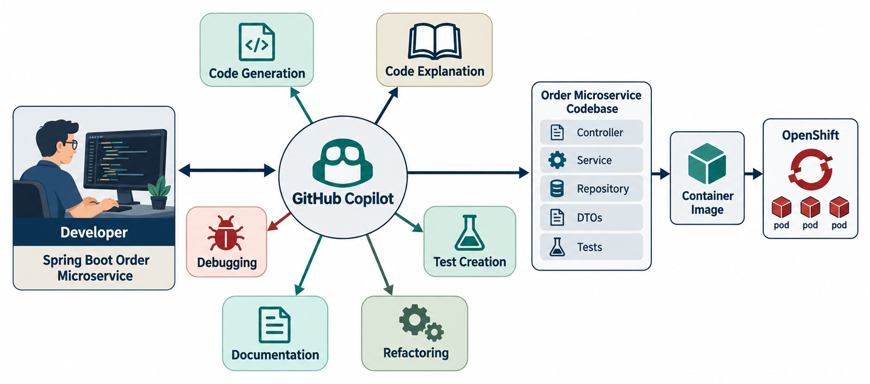
WHAT IS GITHUB COPILOT?
AI coding assistant capabilities and where it fits in the development workflow.
WAYS TO USE IT
Inline suggestions
Chat
Agent mode
Code review
Explain code
Generate tests
WHAT IT IS NOT
✕
Not an architect
✕
Not a security reviewer
✕
Not accountable for defects
RULE Every suggestion is a candidate to review.
KEY TAKEAWAY Copilot assists the developer — the developer stays responsible for correctness.
7
© 2026 by Innovation In Software Corporation
Notes:
KEY TALKING POINTS
------------------
- What it is
GitHub Copilot is an AI tool that helps with software development.
It can suggest, generate, explain, test and refactor code, and help with documentation, debugging and questions.
- How the workflow changes
Traditionally the developer writes code, searches documentation, writes tests and debugs.
With Copilot, the developer defines the intent, Copilot assists, and the developer checks the result.
- What it works from
Copilot works from plain-language instructions, existing code, comments, open files, errors and stack traces, and project conventions.
You might ask it: generate tests for this service, explain this exception, or what edge cases am I missing?
- What it is not
Copilot is not the architect, the business owner, the security approver or the production operator.
Its job is to assist the developer.
It speeds up implementation, but it does not guarantee correctness, security or good architecture.
- What the diagram shows
The developer working with Copilot, which helps with code generation, explanation, tests, refactoring, documentation and debugging.
- Key point
Copilot assists across the work; the developer stays in charge.

Slide 8
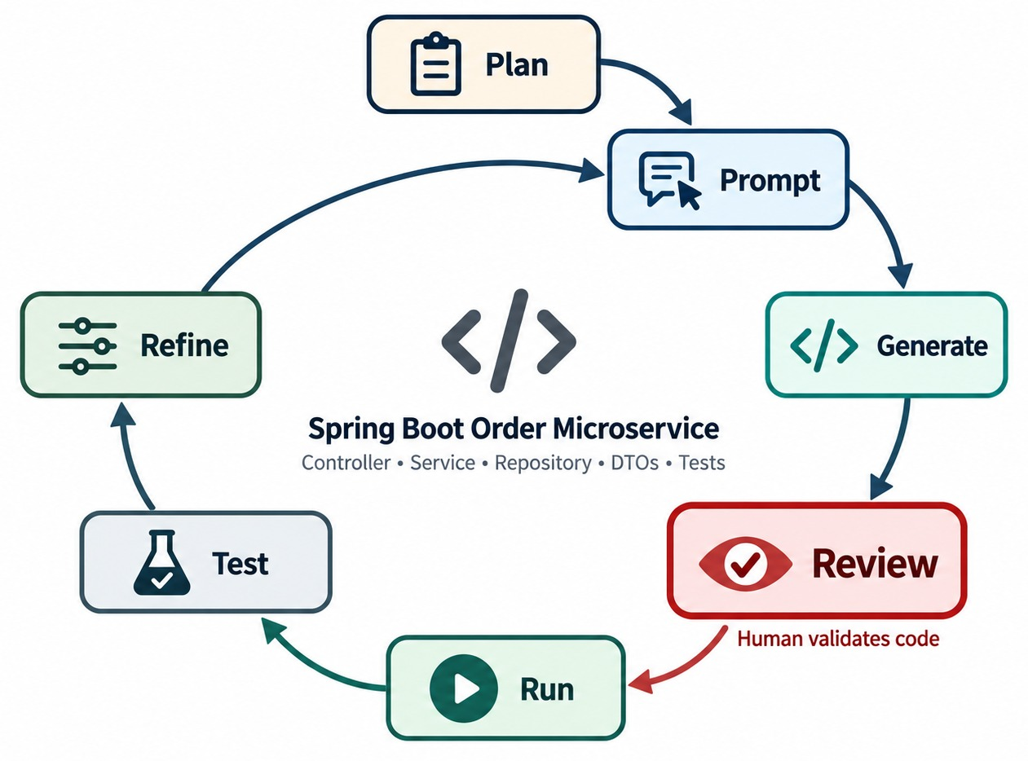
HOW COPILOT SUPPORTS THE DEVELOPER WORKFLOW
Plan → prompt → generate → review → run → test → refine.
Plan
Know the requirement and the design before prompting.
Review and run
Read every line; compile and run before trusting it.
Refine
Feed errors and failing tests back into the next prompt.
NOT ONE-SHOT Small loops beat one giant prompt.
KEY TAKEAWAY AI-assisted development is iterative: plan, prompt, generate, review, run, test, refine.
8
© 2026 by Innovation In Software Corporation
Notes:
KEY TALKING POINTS
------------------
- The most important workflow
This is the key workflow for the whole module: plan, prompt, generate, review, run, test, refine, and repeat.
- Plan and prompt
Plan means understanding the task before asking AI.
For example, for 'add order cancellation', decide the endpoint, business rules, error behavior and existing architecture first.
Prompt means giving Copilot those constraints.
- Generate and review
Copilot produces a candidate implementation.
Then read the code and ask: does this match our architecture?
Are the business rules correct?
Are there security problems?
- Run, test, refine
Compile and run the application.
Test both expected and unexpected cases.
Then improve the prompt or the code based on what you learn.
- Not one-shot
Avoid prompt, generate, accept everything.
Instead: prompt, inspect, validate, improve.
AI-assisted development should be iterative.
- What the diagram shows
A loop of plan, prompt, generate, review, run, test and refine.
- Key point
AI-assisted development is iterative, never one-shot.

Slide 9
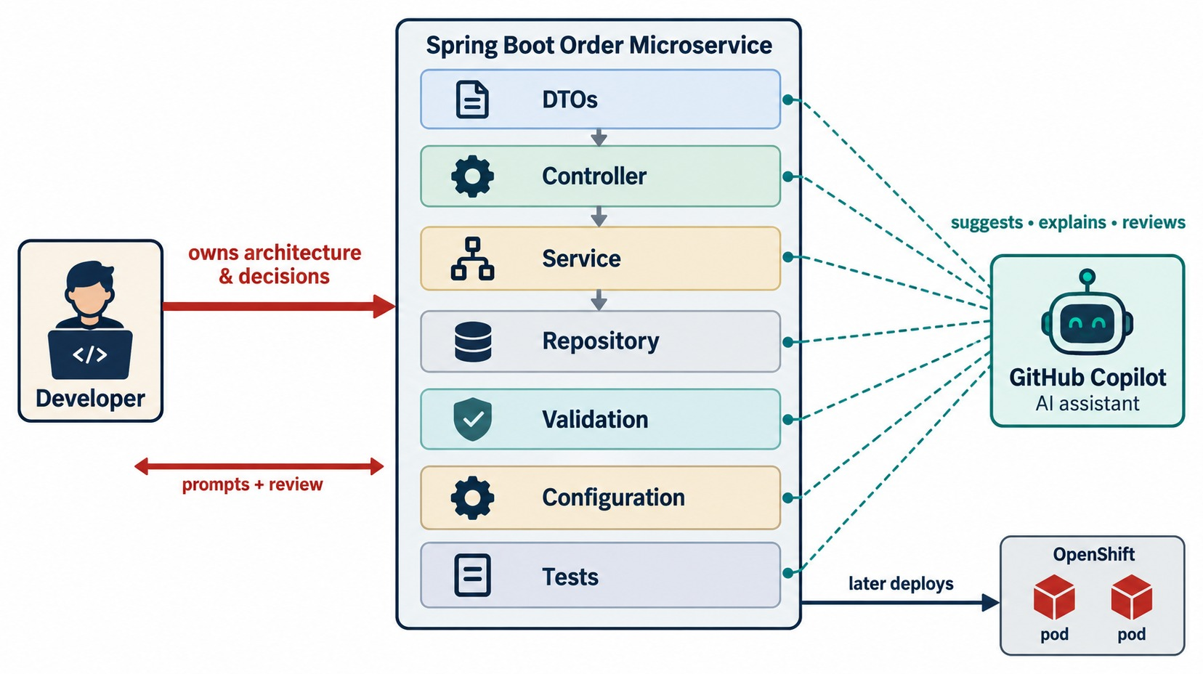
COPILOT IN A SPRING BOOT PROJECT
Help across controllers, services, repositories, DTOs, tests and config.
Great at
DTOs, mappings, boilerplate, test scaffolds, YAML and docs.
Review closely
Business rules, transactions, security and queries.
ASSIST ≠ DESIGN Boundaries and contracts stay your decision.
KEY TAKEAWAY Copilot helps implement each layer of an architecture you already understand.
9
© 2026 by Innovation In Software Corporation
Notes:
KEY TALKING POINTS
------------------
- Use the familiar architecture
Use the Order Service: client, OrderController, OrderService, OrderRepository, Order database.
- Help at every layer
Copilot can help with DTOs such as OrderRequest and OrderResponse, and with controller HTTP mappings.
It can help with service method structure and business rules, and with Spring Data repository interfaces.
It can also scaffold JUnit and Mockito tests.
It can help with configuration, validation, exceptions and documentation too.
- Assist is not design
Copilot helping at every layer does not mean Copilot should design every layer.
The architecture should already be understood before you start prompting.
- What the diagram shows
Copilot helping with DTOs, the controller, service, repository, validation, configuration and tests around Order Service.
- Key point
Copilot helps implement each layer of an architecture you already designed.

Slide 10
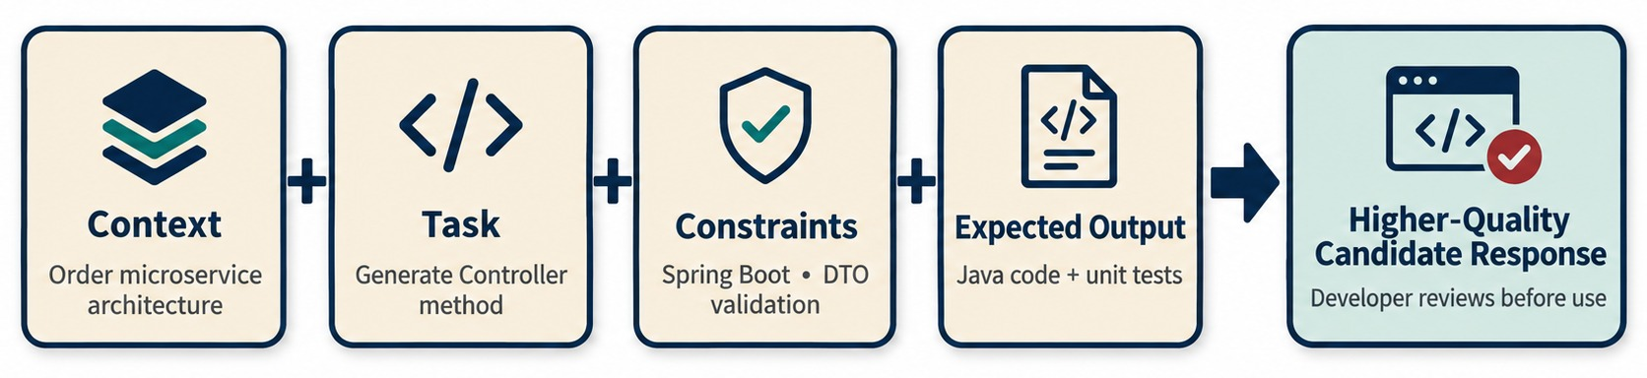
PROMPTING FUNDAMENTALS FOR BACKEND DEVELOPMENT
Context, intent, constraints and output format.
Context
Task
Constraints
Output
Spring Boot 3, Java 21, the package and existing classes.
Exactly what to build — one layer or method at a time.
Validation, status codes, no entities in responses.
Which files, and whether to include tests.
KEY TAKEAWAY Prompt quality matters: give context, task, constraints and the output you expect.
10
© 2026 by Innovation In Software Corporation
Notes:
KEY TALKING POINTS
------------------
- Four parts of a good prompt
Backend prompts get stronger when they include context, task, constraints and expected output.
- Context and task
Context tells Copilot the environment: Spring Boot 3, Java 21, Maven, an Order microservice, PostgreSQL.
Task says clearly what to build, for example: implement an endpoint for creating orders.
- Constraints
Constraints are the important rules.
For example: use constructor injection, use DTOs, do not expose JPA entities, and do not put business logic in the controller.
- Expected output
Say exactly what you want back.
For example: generate the controller method and the required DTOs, and do not change unrelated classes.
- The formula
A good prompt is context, plus goal, plus rules, plus expected result.
People often think AI quality depends only on the tool, but the prompt matters a lot.
- What the diagram shows
Context plus task plus constraints plus expected output leading to a higher-quality candidate response.
- Key point
Better inputs give better candidates — still only candidates.

Slide 11
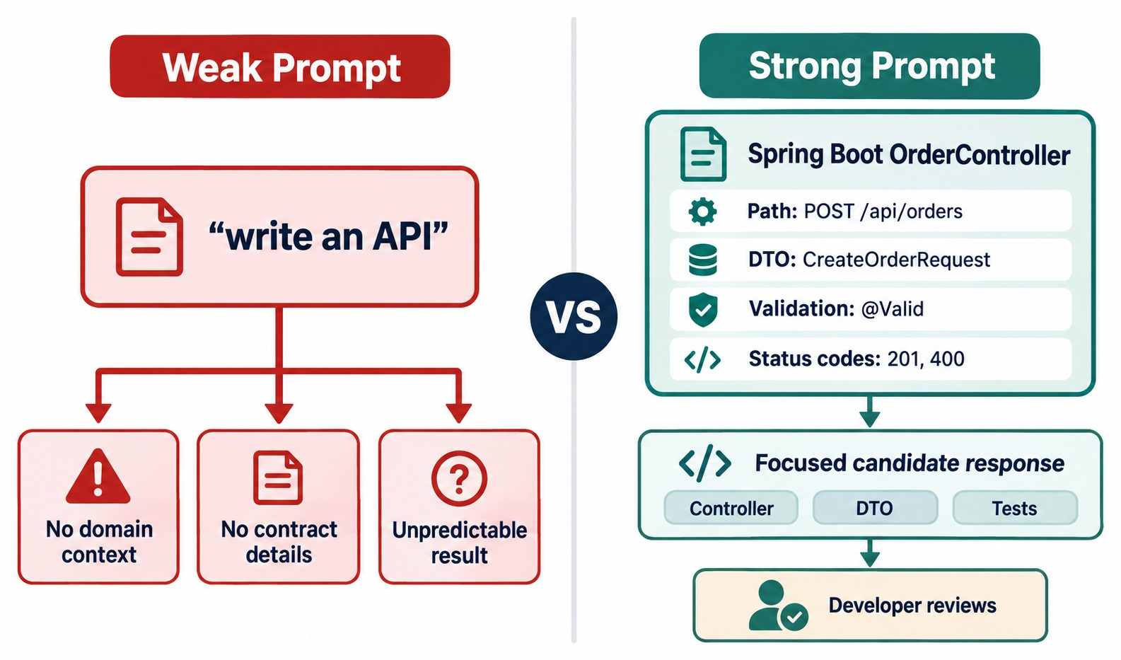
WEAK PROMPT VS. STRONG PROMPT
Compare vague and precise prompts.
✕
Weak
create order api
✓
Strong
Spring Boot 3 REST controller for
POST /api/v1/orders. Accept a validated
CreateOrderRequest, call OrderService,
return 201 with OrderResponse. Map
validation errors to 400. No entities
in responses.
STILL a strong prompt's output needs review.
KEY TAKEAWAY Better prompts reduce ambiguity, but generated output still needs review.
11
© 2026 by Innovation In Software Corporation
Notes:
KEY TALKING POINTS
------------------
- Ask the class
What is wrong with 'Create an order API'?
It leaves many decisions open: framework, version, endpoints, DTOs, validation, architecture, error handling and dependency injection.
- AI has to fill the gaps
With a vague prompt, the AI must either ask, guess or make assumptions.
- The strong prompt
The strong prompt names Spring Boot 3 and Java 21, the /orders base path, POST and GET endpoints, constructor injection, DTOs, Jakarta Validation and ResponseEntity.
It also says to delegate business logic to OrderService and not to call OrderRepository directly.
That removes most of the guesswork.
- An important distinction
A detailed prompt makes useful output more likely.
It does not guarantee correct output.
The generated code still has to be checked.
- What the diagram shows
A vague request next to a detailed Spring Boot prompt.
- Key point
Specific prompts remove guesswork.

Slide 12
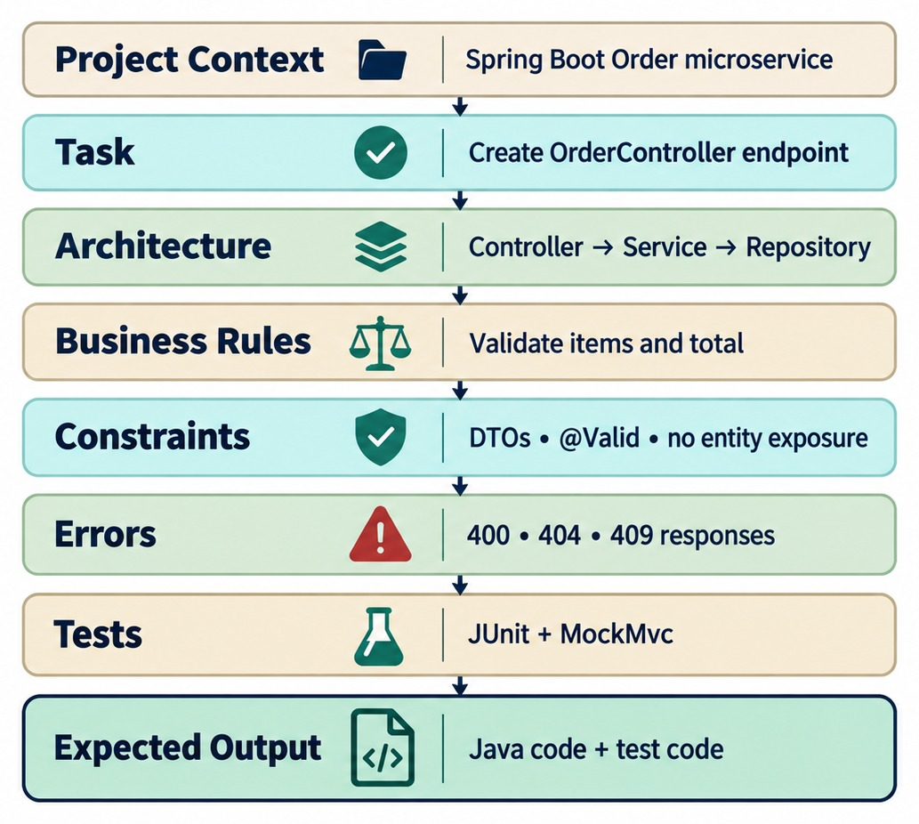
PROMPT STRUCTURE FOR SPRING BOOT TASKS
Context → task → constraints → standards → expected result.
A REUSABLE TEMPLATE
✓
Project context
✓
Task
✓
Architecture and layer
✓
Business rules
✓
Errors and status codes
✓
Tests expected
WHY Everyone on the team gets consistent results.
KEY TAKEAWAY A reusable prompt structure beats generic prompt-engineering tricks.
12
© 2026 by Innovation In Software Corporation
Notes:
KEY TALKING POINTS
------------------
- A reusable template
Give learners a structure they can reuse: project context, task, existing architecture, business rules, technical constraints, error behavior, test requirements and expected output.
- The example
The project is a Spring Boot 3, Java 21, Maven Order microservice, and the task is to add order cancellation.
Architecture is controller, service, repository.
Business rules: CREATED and CONFIRMED orders can be cancelled, but SHIPPED orders cannot.
- Errors, constraints, tests, output
A missing order throws OrderNotFoundException, and an invalid state throws InvalidOrderStateException.
Use constructor injection and do not change existing API contracts.
Add JUnit 5 and Mockito tests, and change only the classes that need it.
- Why it helps
Filling in this template forces the developer to think before generating code.
That thinking is valuable by itself, and more useful than generic prompt tricks.
- What the diagram shows
Project context, task, architecture, business rules, constraints, errors, tests and expected output, in order.
- Key point
A reusable structure makes prompts consistent across a team.

Slide 13
GIVE COPILOT YOUR STANDARDS ONCE
Repository instructions apply to every chat; a structured prompt handles the task.
.github/copilot-instructions.md
✓
A structured task prompt
# Order Service conventions
- Java 21, Spring Boot 3, Maven.
- Layers: controller -> service -> repository. No logic in controllers.
- Request/response DTOs are Java records; never return JPA entities.
- Validate with Jakarta Validation; errors via GlobalExceptionHandler.
- Constructor injection only. No field @Autowired.
- Tests: JUnit 5, Mockito, AssertJ; @WebMvcTest for controllers.
- Never log request bodies, tokens or account numbers.
Context: OrderService in com.example.order.service (open file).
Task: add cancelOrder(Long orderId).
Rules: only CREATED or PAID orders can be cancelled;
PAID orders publish OrderCancelled for a refund.
Errors: missing order -> OrderNotFoundException (404);
other status -> InvalidOrderStateException (409).
Constraints: @Transactional; follow existing naming.
Output: the method plus unit tests for all three cases.
Instructions file
Prompt
Result
Team standards apply to every Copilot chat in the repo.
Context, task, rules, errors, constraints, output.
Code that fits the codebase — still reviewed.
KEY TAKEAWAY Put team conventions in the repository once, and give each task a structured prompt.
13
© 2026 by Innovation In Software Corporation
Notes:
KEY TALKING POINTS
------------------
- Custom instructions
A .github/copilot-instructions.md file tells Copilot the project's standards, so they don't have to be repeated in every prompt.
- The prompt
It names the class, the business rules, the exact exceptions and status codes, and asks for tests.
- Why it works
Copilot has less to guess, so the draft follows the team's architecture and naming.
- Still review
Even with good instructions, the developer checks the logic and runs the tests.

Slide 14
EXERCISE: IMPROVE A WEAK PROMPT
Rewrite a vague request into a prompt a teammate could reuse.
PRACTICE EXERCISE
10 MIN
SCENARIO
YOUR TASKS
EXPECTED OUTCOME
A developer typed this into Copilot Chat and got an insecure, entity-returning controller:
1
List what Copilot had to guess
✓
Guessed: path, DTOs, validation, status codes, security
2
Rewrite the prompt with context, task, rules, errors and output
make a transfer endpoint
✓
POST /api/v1/transfers with a validated TransferRequest
3
Name two things you'd still check in the result
✓
Idempotency-Key; 201, 400, 404, 409 defined
✓
No entities, no logged account numbers
✓
Still check: authorization and the business rules
KEY TAKEAWAY A good prompt states context, rules, errors and output — and the result still gets reviewed.
14
© 2026 by Innovation In Software Corporation
Notes:
KEY TALKING POINTS
------------------
- What was missing
The prompt gave no path, no DTOs, no validation, no error codes and no security or idempotency requirements.
- A good rewrite
It names the endpoint, the request and response records, the rules, the status codes and asks for tests.
- Review
Even a perfect prompt can produce missing authorization checks or wrong business logic.

Slide 15
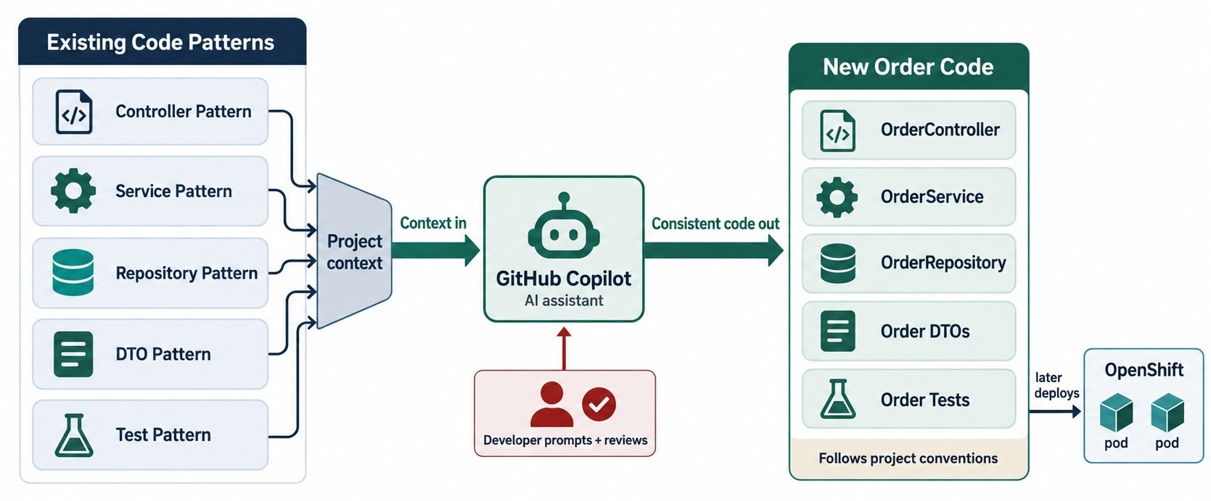
USING EXISTING CODE AS CONTEXT
Extend existing classes without breaking conventions.
Open the right files
Keep a similar controller, service and test open while prompting.
Say it
“Follow the pattern in PaymentController and its tests.”
GOAL New code that looks like the team wrote it.
KEY TAKEAWAY Give Copilot the existing patterns so new code fits the codebase you already have.
15
© 2026 by Innovation In Software Corporation
Notes:
KEY TALKING POINTS
------------------
- Rarely a blank project
Enterprise development almost never starts from an empty project.
Usually you are changing an existing system, so existing code is valuable context.
- Existing conventions
Say the project already uses constructor injection, records for DTOs, @RestControllerAdvice, specific package names, JUnit 5 and Mockito.
New code should match that.
- Say it in the prompt
A useful instruction is: follow the patterns already used by OrderController and PaymentController, and do not introduce a different exception-handling style.
Mention naming, package structure, exception patterns, DTO conventions, logging and testing libraries.
- The goal
Give focused, relevant context.
Don't expect AI to guess every convention.
Existing architecture plus a new requirement should give a consistent change, not a completely new coding style.
- What the diagram shows
Existing controller, service, repository, DTO and test patterns feeding Copilot so new code follows the same conventions.
- Key point
Show Copilot your patterns and it follows them.

Slide 16
PART 2: AI-ASSISTED IMPLEMENTATION
Generate one Spring Boot layer at a time — and review each one.
✓ Part 1
AI-assisted fundamentals
Part 2
AI-assisted implementation
Part 3
AI-assisted quality
Part 4
Enterprise governance
SO FAR
NEXT QUESTION
How do we use Copilot to build real service layers without importing bugs?
✓
Copilot drafts; the developer decides
✓
Structured prompts carry the rules
IN THIS PART
✓
Instructions files hold team standards
Generating a REST controller — with a review
1
2
Service-layer logic — with a review
3
Exercise: review AI-generated transfer code
4
DTOs and API contracts
5
Persistence code
6
Validation and error handling
16
© 2026 by Innovation In Software Corporation
Notes:
KEY TALKING POINTS
------------------
- From prompting to building
Part 1 was about asking well.
Part 2 generates actual layers of Order Service.
- The habit
Generate one layer, review it against Modules 2–5, compile, test — then move on.

Slide 17
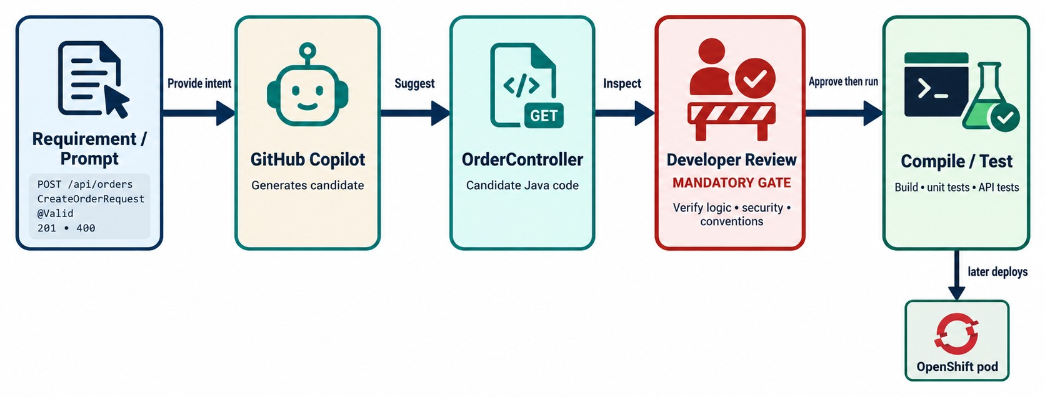
GENERATING A SPRING BOOT REST CONTROLLER
HTTP request → OrderController → OrderService → response DTO → HTTP response.
REVIEW CHECKLIST
✓
Resource paths and methods
✓
@Valid on request bodies
✓
201 with Location on create
✓
No business logic
✓
No entities returned
ONE LAYER at a time — then compile and test.
KEY TAKEAWAY Generate one layer at a time — then review architecture and API before you compile and test.
17
© 2026 by Innovation In Software Corporation
Notes:
KEY TALKING POINTS
------------------
- One layer at a time
Show learners how to generate one layer at a time.
The target is: HTTP request, OrderController, OrderService, response DTO, HTTP response.
- The prompt
Ask for OrderController with POST /orders and GET /orders/{id}.
Ask it to use @RestController, @RequestMapping, @Valid, ResponseEntity and constructor injection, and to delegate all business logic to OrderService.
- The output
Copilot might generate a controller with an injected OrderService.
Its create method validates the request, calls the service, and returns 201 Created with the response.
- Review it
Check the path, and that POST and 201 Created are right.
Check that validation is on and constructor injection is used.
Check that the controller does not call the repository directly, and that no business logic leaked in.
- The workflow
Generate, review the architecture, review the API, compile, then test.
- What the diagram shows
A requirement and prompt going to Copilot, producing OrderController, then developer review, compile and test.
- Key point
Generate, then review, compile and test — one layer at a time.

Slide 18
REVIEWING A GENERATED CONTROLLER
Copilot's first draft compiled — review turned it into a proper API.
✕
First draft
✓
After review
@RestController
public class OrderController {
@Autowired OrderRepository repo;
@PostMapping("/createOrder")
public Order create(@RequestBody Order order) {
if (order.getTotal().signum() <= 0)
return null;
return repo.save(order);
}
}
@RestController
@RequestMapping("/api/v1/orders")
class OrderController {
private final OrderService orders;
OrderController(OrderService orders) { this.orders = orders; }
@PostMapping
ResponseEntity<OrderResponse> create(
@Valid @RequestBody CreateOrderRequest req) {
OrderResponse created = orders.create(req);
return ResponseEntity
.created(URI.create("/api/v1/orders/" + created.id()))
.body(created);
}
}
Found
Found
Fixed
Verb path, entity in and out, repository in the controller.
Field injection, logic in the controller, null instead of 400.
Resource path, DTOs, @Valid, service call, 201 Created.
KEY TAKEAWAY Generated code that compiles can still break every rule from Modules 2 and 3 — review it.
18
© 2026 by Innovation In Software Corporation
Notes:
KEY TALKING POINTS
------------------
- The draft
It works, but it uses a verb path, accepts and returns the entity, injects a repository into the controller and returns null for invalid input.
- The review
Each problem maps to an earlier module: resource naming, DTOs, validation, layering and constructor injection.
- The fix
A thin controller with a validated request record that delegates to the service and returns 201 with a Location.
- Better prompt next time
Most of these issues disappear when the prompt and instructions file state the conventions.

Slide 19
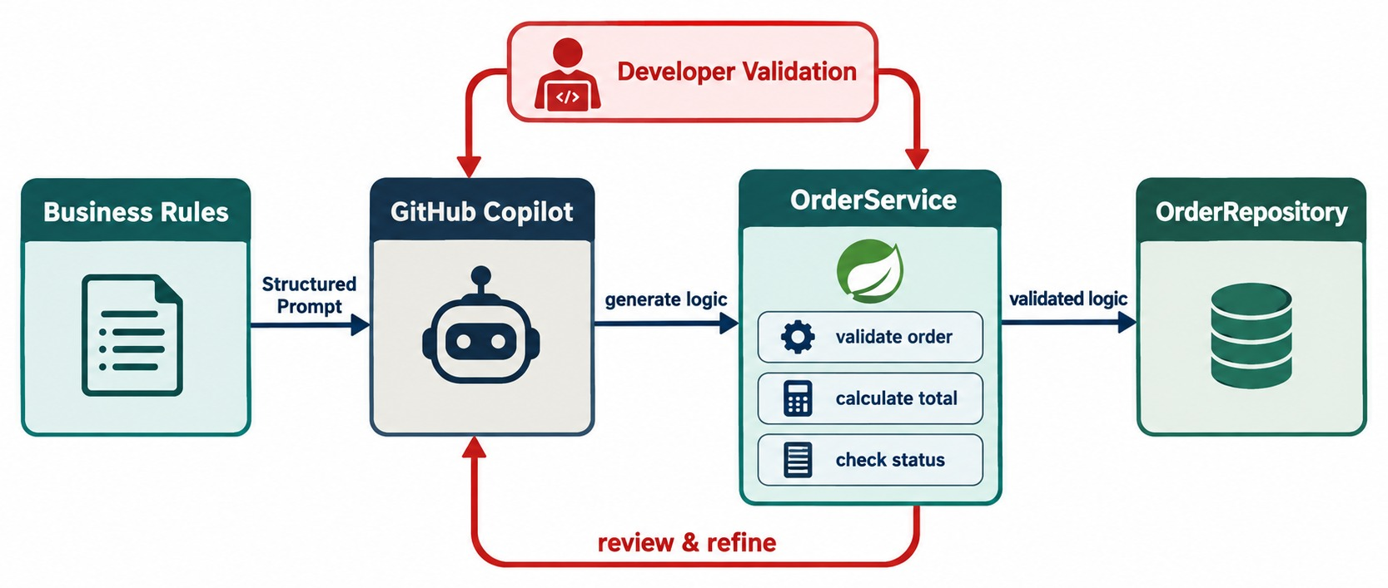
GENERATING SERVICE-LAYER LOGIC
Business rules, validation, dependency injection and separation of concerns.
VERIFY BY HAND
!
Every business rule present
!
Correct transaction boundary
!
Idempotency for money movement
!
Right exceptions
Why riskiest
Missing rules compile fine — they only fail in production.
LESSON Incomplete requirements give incomplete code.
KEY TAKEAWAY Incomplete requirements produce incomplete business behavior — even from AI.
19
© 2026 by Innovation In Software Corporation
Notes:
KEY TALKING POINTS
------------------
- The riskiest layer
The service layer is riskier to generate blindly because it holds business behavior: rules, state changes, validation and coordination.
- The prompt
Ask Copilot to implement cancelOrder.
It should find the order through OrderRepository, and throw OrderNotFoundException if it is missing.
CREATED and CONFIRMED orders may be cancelled, but SHIPPED orders may not.
Valid orders change to CANCELLED, and HTTP concerns stay out of the service.
- What Copilot may produce
It may find the order or throw, reject SHIPPED orders, set the status to CANCELLED, save it and map it to a response.
- Ask the class
Does this fully implement the business rule?
Maybe not.
What about an order that is already CANCELLED, or DELIVERED, or PAYMENT_PENDING?
- The lesson
AI can implement the rules you give it.
But incomplete requirements produce incomplete business behavior.
Business rules must come from developers and domain experts.
- What the diagram shows
Business rules turned into a prompt, Copilot producing OrderService and repository calls, with developer validation around the logic.
- Key point
Business logic needs the closest review.

Slide 20
REVIEWING GENERATED BUSINESS LOGIC
The draft moved money — the review made it correct, atomic and repeat-safe.
✕
Copilot draft
✓
After review
public void transferFunds(String from, String to,
BigDecimal amount) {
Account a = accounts.findById(from).get();
Account b = accounts.findById(to).get();
a.setBalance(a.getBalance().subtract(amount));
b.setBalance(b.getBalance().add(amount));
accounts.save(a);
accounts.save(b);
log.info("Transferred {} from {} to {}", amount, from, to);
}
@Transactional
public TransferResult transferFunds(TransferCommand cmd) {
return results.findByKey(cmd.idempotencyKey()).orElseGet(() -> {
if (cmd.amount().signum() <= 0) throw new InvalidAmountException();
Account from = accounts.findById(cmd.from())
.orElseThrow(() -> new AccountNotFoundException(cmd.from()));
Account to = accounts.findById(cmd.to())
.orElseThrow(() -> new AccountNotFoundException(cmd.to()));
from.debit(cmd.amount()); // throws if insufficient or frozen
to.credit(cmd.amount());
log.info("Transfer done transferId={}", cmd.transferId());
return results.save(TransferResult.of(cmd));
});
}
Missing
Missing
Leak
Transaction, amount and balance checks, account status.
Idempotency — a retry would move money twice.
Account numbers logged in plain text.
KEY TAKEAWAY Money-moving code needs a transaction, every rule, idempotency and safe logs — check each one by hand.
20
© 2026 by Innovation In Software Corporation
Notes:
KEY TALKING POINTS
------------------
- What the draft missed
No transaction, so a failure between saves loses money.
No check for a positive amount, sufficient balance or frozen accounts.
get() on an Optional crashes.
- Idempotency
A retried request would run the transfer again.
The reviewed version returns the stored result for a repeated key.
- Logging
The draft logs full account numbers.
The review logs only a transfer ID.
- Rules in the domain
debit enforces balance and status inside the entity, so every caller gets the same rules.

Slide 21
EXERCISE: REVIEW AI-GENERATED TRANSFER CODE
Decide what must be checked before this code could merge.
PRACTICE EXERCISE
12 MIN
SCENARIO
YOUR TASKS
EXPECTED OUTCOME
Copilot generated a transferFunds method for Transaction Service (the draft on the previous slide). The PR author says “tests pass”.
1
Which business rules must be checked manually?
✓
Positive amount, balance, account status, limits
2
Which tests should be added?
✓
Tests: insufficient funds, frozen, duplicate key
3
What security issues should be reviewed?
✓
Authorization: may this caller move this money?
4
Should the method be transactional — and what would be unacceptable?
✓
Yes, @Transactional — both updates or neither
✓
Unacceptable: logged account numbers, get()
KEY TAKEAWAY “Tests pass” proves little if the tests and the rules came from the same prompt.
21
© 2026 by Innovation In Software Corporation
Notes:
KEY TALKING POINTS
------------------
- Business rules
Amount, balance, account status and daily limits must all be checked against the requirement, not against the generated code.
- Tests
Generated tests often only cover the happy path.
Add insufficient funds, frozen accounts and duplicate requests.
- Security
Nothing checks whether the caller owns the source account, which is object-level authorization from Module 12.

Slide 22
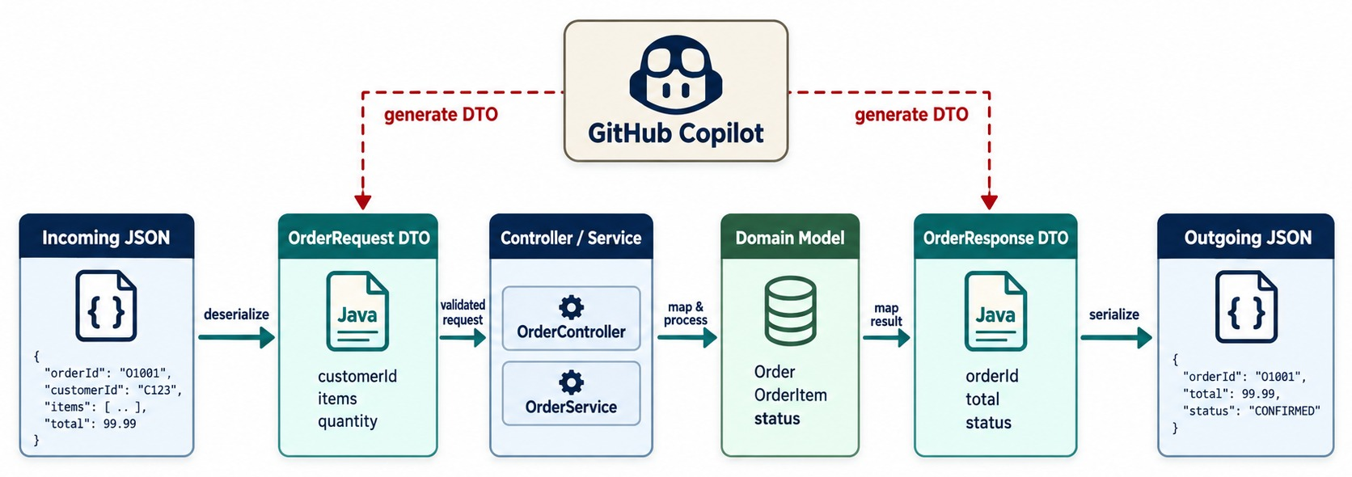
GENERATING DTOS AND API CONTRACTS
Request/response DTOs, validation annotations and stable API boundaries.
✓
Good boilerplate for Copilot
public record CreateOrderRequest(
@NotBlank String customerId,
@NotEmpty List<@Valid Item> items) {}
Check
Only the fields clients need — no IDs or audit fields in requests.
MODULE 3 DTOs keep the contract separate from entities.
KEY TAKEAWAY Let Copilot write DTO boilerplate — you keep the API contract separate from persistence.
22
© 2026 by Innovation In Software Corporation
Notes:
KEY TALKING POINTS
------------------
- The data flow
JSON comes in and becomes an OrderRequest.
It goes through the controller and service to the domain entity, then back out as an OrderResponse and JSON.
- The prompt
Ask for OrderRequest with a required customerId and a required total greater than zero.
Ask for OrderResponse with orderId, customerId, total and status.
Use Java records and Jakarta Validation, and do not expose the JPA entity directly.
- Possible output
OrderRequest can be a record with @NotNull on customerId and @NotNull @Positive on total.
OrderResponse can be a record with orderId, customerId, total and status.
- Module 3 reminder
Copilot is great for DTO boilerplate.
But the external API contract should not accidentally become the persistence model.
- What the diagram shows
JSON to OrderRequest, through the controller and service to the domain model, then OrderResponse and JSON, with Copilot helping create the DTOs.
- Key point
DTOs keep the API contract separate from persistence.

Slide 23
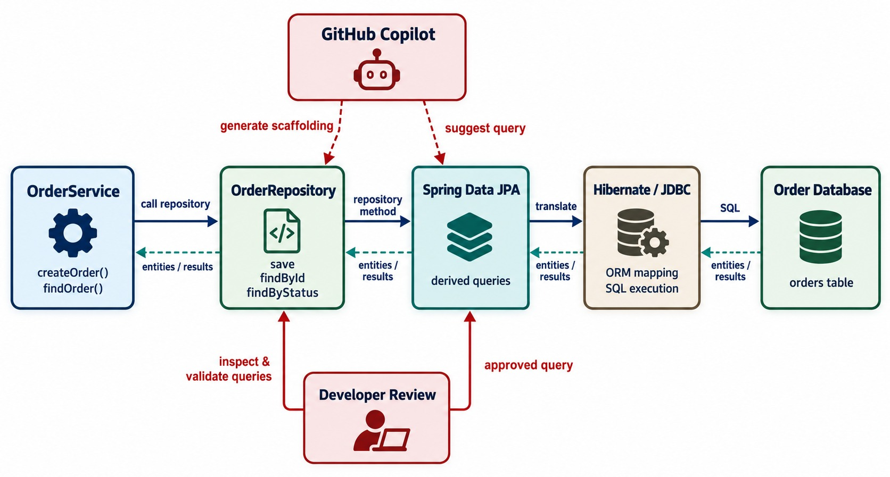
GENERATING REPOSITORY AND PERSISTENCE CODE
Spring Data JPA repositories, query methods and persistence concerns.
COMMON GENERATED PROBLEMS
!
Fields that don't exist
!
N+1 queries
!
findAll() on big tables
!
Missing indexes
How to check
Turn on SQL logging in a test and read the queries it runs.
MODULE 5 Relationships stop at the service boundary.
KEY TAKEAWAY Generated persistence code compiles easily — review its SQL, indexes, volume and N+1 risk.
23
© 2026 by Innovation In Software Corporation
Notes:
KEY TALKING POINTS
------------------
- The persistence path
OrderService calls OrderRepository, which uses Spring Data JPA, then Hibernate and JDBC, then the Order database.
Copilot can help with repository interfaces, derived query methods, JPQL scaffolding, entity mappings and persistence tests.
- The prompt
Ask for a Spring Data JPA repository for Order that extends JpaRepository, finds orders by status and by customerId, and pages customer orders.
It might generate a method like findByCustomerId with a Pageable.
- Review more deeply
Ask: what SQL might this produce?
Does the table need an index?
How much data could come back?
Is pagination needed?
Could this cause N+1 queries, meaning many extra queries in a loop?
- The lesson
AI can write repository code that compiles and still performs badly in production.
As Module 5 taught, data access is an architecture and performance concern, not just Java boilerplate.
- What the diagram shows
OrderService, OrderRepository, Spring Data JPA, Hibernate and JDBC to the database, with Copilot scaffolding repository queries.
- Key point
Generated queries compile easily — check what SQL they run.

Slide 24
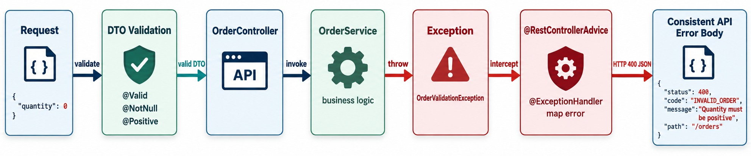
USING COPILOT FOR ERROR HANDLING AND VALIDATION
@Valid, exception handling and API error models.
Ask for one strategy
REJECT
MAP 400 validation · 404 missing · 409 conflict.
One GlobalExceptionHandler and one error record for every endpoint.
✕
Stack traces in responses
✕
500 for validation errors
✕
SQL details in messages
KEY TAKEAWAY Ask for one consistent error strategy — and review it for leaks and wrong status codes.
24
© 2026 by Innovation In Software Corporation
Notes:
KEY TALKING POINTS
------------------
- One consistent strategy
Ask Copilot for one consistent error strategy instead of local try/catch blocks everywhere.
The request is validated; invalid input returns 400.
Valid requests go to the service, business exceptions go to a global handler, and the client gets a consistent error.
- The prompt
Ask for centralized error handling with @RestControllerAdvice.
OrderNotFoundException maps to 404, InvalidOrderStateException to 409, and MethodArgumentNotValidException to 400.
Return errorCode, message, timestamp and path, and do not expose stack traces.
- Possible response
For example, errorCode ORDER_NOT_FOUND, the message 'Order 1001 was not found', a timestamp and the path /orders/1001.
- Review it
Check the status codes, consistency, sensitive information, internal exception leakage and logging behavior.
Never assume a generated exception handler is automatically secure.
- What the diagram shows
A request validated as a DTO, passing the controller and service, raising an exception handled by @RestControllerAdvice into a consistent API error.
- Key point
One error strategy for the whole service.

Slide 25
PART 3: AI-ASSISTED QUALITY
Use Copilot to test, refactor, review and debug — with proof.
✓ Part 1
AI-assisted fundamentals
✓ Part 2
AI-assisted implementation
Part 3
AI-assisted quality
Part 4
Enterprise governance
SO FAR
NEXT QUESTION
Can AI help prove the code is right — and keep it clean?
✓
Generate and review one layer at a time
✓
Business logic checked rule by rule
IN THIS PART
✓
DTOs, queries and errors reviewed
Unit and controller tests — with an example
1
2
Finding test gaps
3
Testing a policy table — and Exercise 5.2
4
Refactoring and code review
5
Troubleshooting — with an exercise
25
© 2026 by Innovation In Software Corporation
Notes:
KEY TALKING POINTS
------------------
- Why this part
Tests are where AI is most helpful and most misleading: it writes them fast, but they may prove nothing.
- What comes next
Test generation and gap analysis, the official policy-rules exercise, refactoring, review and troubleshooting.

Slide 26
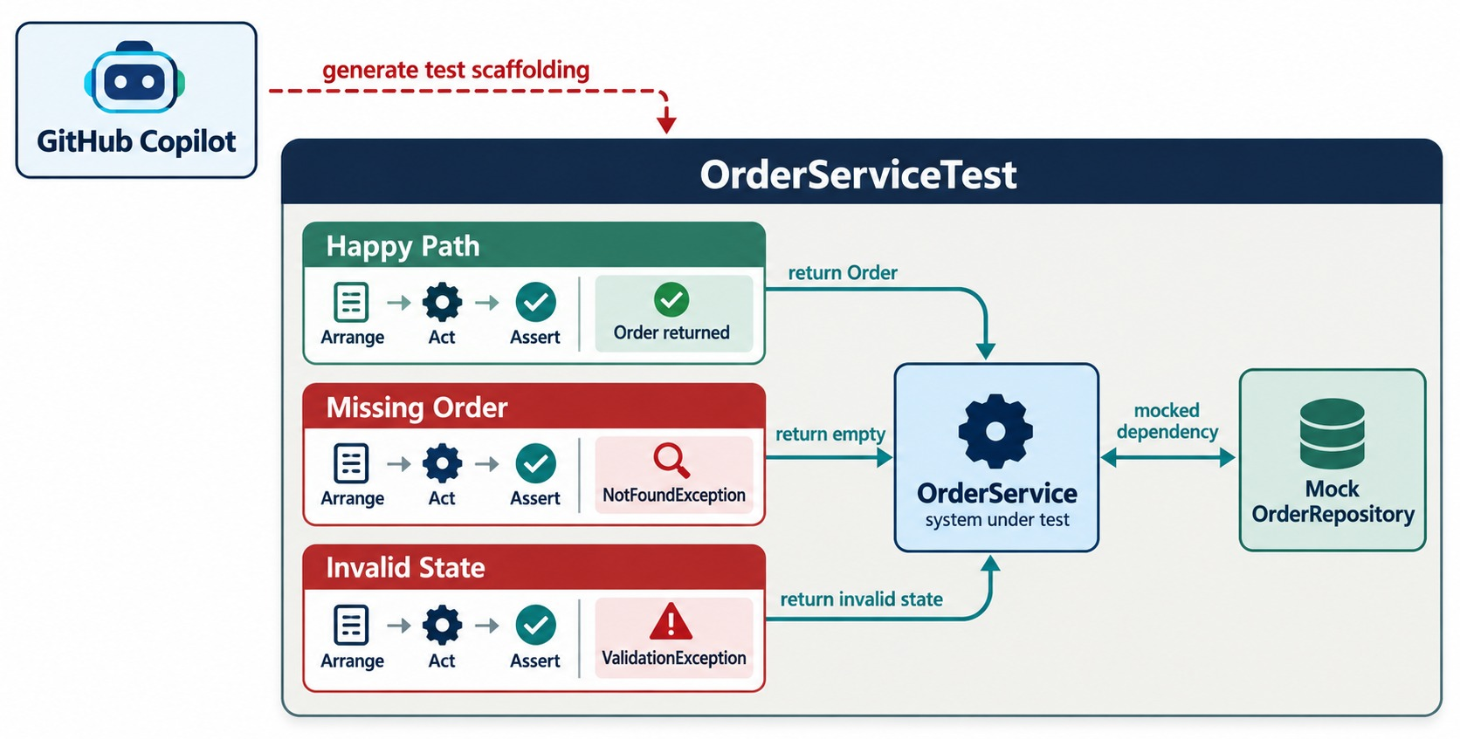
GENERATING UNIT TESTS WITH COPILOT
JUnit, Mockito and service-layer tests.
Prompt for cases
“Test happy path, missing order and invalid state for cancelOrder.”
Arrange-Act-Assert
Keep each test to one behavior.
ASK Would this test fail if the code were wrong?
KEY TAKEAWAY Let Copilot scaffold tests, then check that they actually verify the behavior.
26
© 2026 by Innovation In Software Corporation
Notes:
KEY TALKING POINTS
------------------
- Test scaffolding
Copilot can save a lot of time creating test scaffolding.
For service tests, OrderService is tested with a mocked OrderRepository.
- The prompt
Ask for JUnit 5 and Mockito tests for cancelOrder.
A CREATED order cancels successfully, a SHIPPED order throws InvalidOrderStateException, and a missing order throws OrderNotFoundException.
Use Arrange-Act-Assert, verify important repository interactions, and don't over-mock simple values.
- Arrange-Act-Assert
Arrange prepares the test data and mocks.
Act runs the behavior.
Assert checks the result.
- Does the test prove anything?
A generated test that only does assertNotNull(result) may pass but proves very little.
A stronger test checks that the status changed to CANCELLED, that the right repository call happened, and that the invalid state was rejected.
- What the diagram shows
OrderService under test with a mocked OrderRepository, and Copilot generating happy-path, missing-order and invalid-state tests.
- Key point
Copilot scaffolds tests; you check that they prove the behavior.

Slide 27
A TEST THAT PROVES NOTHING — AND ONE THAT DOES
Generated tests often assert that code runs, not that it's correct.
✕
Generated
✓
After review
@Test
void cancelOrderWorks() {
when(repo.findById(1L))
.thenReturn(Optional.of(order));
service.cancelOrder(1L);
assertNotNull(order);
}
@Test
void paidOrderIsCancelledAndRefundRequested() {
Order order = Order.withStatus(PAID);
when(repo.findById(1L)).thenReturn(Optional.of(order));
service.cancelOrder(1L);
assertThat(order.getStatus()).isEqualTo(CANCELLED);
verify(events).publish(any(OrderCancelled.class));
}
@Test
void shippedOrderCannotBeCancelled() {
when(repo.findById(1L))
.thenReturn(Optional.of(Order.withStatus(SHIPPED)));
assertThatThrownBy(() -> service.cancelOrder(1L))
.isInstanceOf(InvalidOrderStateException.class);
}
Weak
Strong
Negative case
assertNotNull passes even if cancel does nothing.
Asserts the new state and the published event.
Proves the rule that shipped orders can't cancel.
KEY TAKEAWAY A test is only useful if it fails when the behavior is wrong — check every generated assertion.
27
© 2026 by Innovation In Software Corporation
Notes:
KEY TALKING POINTS
------------------
- The generated test
It passes whether or not cancelOrder works, because it only checks the object still exists.
- The reviewed test
It sets a specific starting state, then asserts the new status and that the event was published.
- The negative test
It proves the business rule: a shipped order throws InvalidOrderStateException.
- A quick check
Break the code on purpose.
If the test still passes, it isn't testing anything.

Slide 28
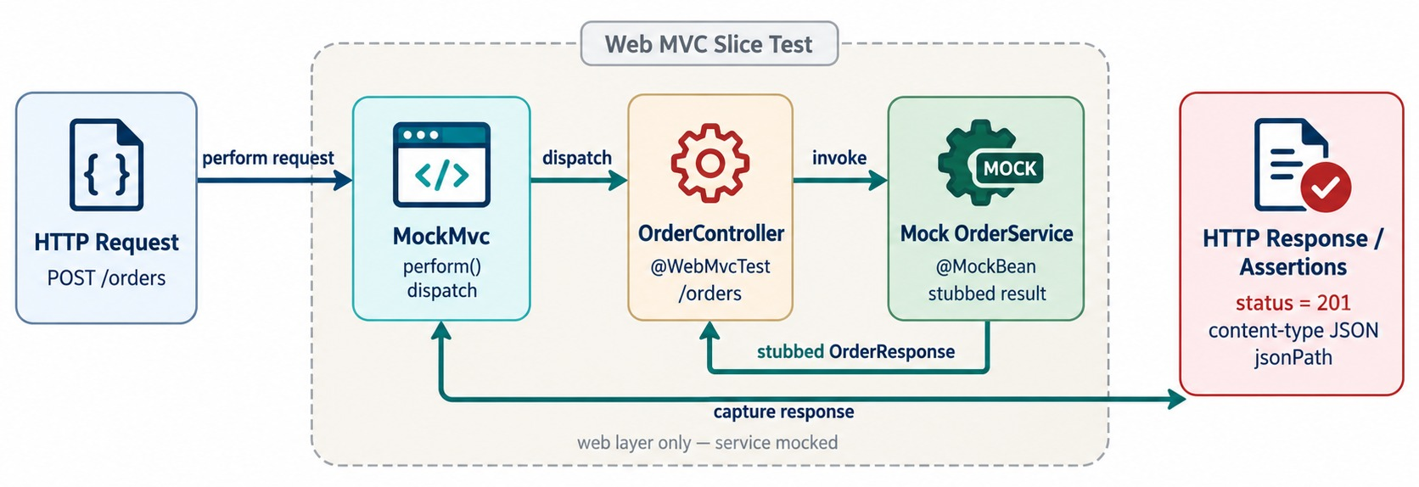
GENERATING CONTROLLER AND API TESTS
MockMvc/WebMvcTest, HTTP status and JSON assertions.
An HTTP contract test
mvc.perform(post("/api/v1/orders")
.contentType(APPLICATION_JSON)
.content("{}"))
.andExpect(status().isBadRequest());
Covers
Status codes, JSON shape, validation and security rules.
TWO QUESTIONS Service: is the logic right? Controller: is the contract?
KEY TAKEAWAY Service tests check business logic; controller tests check the HTTP contract.
28
© 2026 by Innovation In Software Corporation
Notes:
KEY TALKING POINTS
------------------
- Testing the HTTP layer
Controller tests check the HTTP layer.
The flow is: HTTP request, MockMvc, OrderController, a mocked OrderService, HTTP response.
- The prompt
Ask for Spring MVC tests using JUnit 5, @WebMvcTest and MockMvc.
POST /orders should return 201, and getting an existing order should return 200.
An invalid POST should return 400, and a missing order should map to 404.
Also verify the important JSON fields.
- What they cover
These tests focus on HTTP mappings, request parsing, validation, response serialization, status codes and exception mapping.
Copilot is especially useful for this repetitive scaffolding.
- Two different questions
Service tests ask: is the business logic correct?
Controller tests ask: is the HTTP contract behaving correctly?
- What the diagram shows
An HTTP request through MockMvc to OrderController with a mocked OrderService, then response assertions.
- Key point
Controller tests verify the HTTP contract.

Slide 29
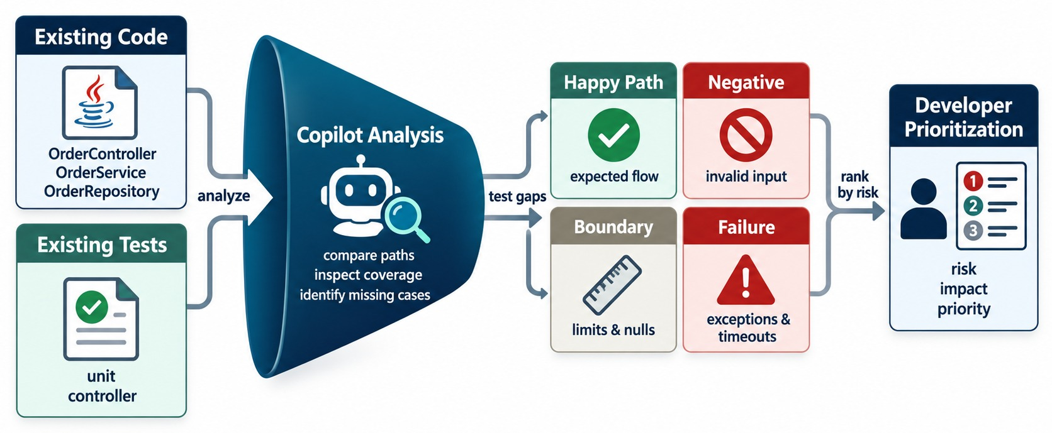
IMPROVING TEST COVERAGE WITH COPILOT
Edge cases, negative tests and boundary conditions.
Prompt
“List untested behaviors in OrderService, grouped by risk.”
GAPS IT OFTEN FINDS
Negative
Boundary
Failure
Concurrency
COVERAGE ≠ QUALITY Prioritize risk, not a percentage.
KEY TAKEAWAY Use Copilot to find the missing high-value tests — not to chase a coverage number.
29
© 2026 by Innovation In Software Corporation
Notes:
KEY TALKING POINTS
------------------
- A test strategy
Good confidence comes from happy paths, negative paths, boundary cases and failure cases together.
Ask: what behavior have we not tested?
- Use Copilot to analyze
Instead of repeatedly asking for more tests, ask Copilot to review OrderService and its current tests.
Have it find untested behavior, group the gaps as happy path, validation, state transition, boundary or failure, and rank the five most valuable ones.
Tell it not to generate code yet.
- Analyze, decide, generate
This is an important technique: analyze first, decide, then generate.
Don't generate everything.
- What it might find
Examples: zero total, negative total, an order that's already cancelled, a delivered order, a duplicate request, or a repository failure.
The developer then decides which cases matter.
- Coverage isn't quality
Asking to increase coverage to 100 percent is a weaker use of AI.
A coverage percentage alone does not prove quality.
- What the diagram shows
Existing code and tests analysed by Copilot into happy-path, negative, boundary and failure gaps, then prioritized by the developer.
- Key point
Use AI to find missing tests, not to chase a coverage number.

Slide 30
PROVING A POLICY TABLE WITH TESTS
Lab 5's policy-v1 rules as deterministic Java — and one test row per rule.
PolicyEngine.java
✓
PolicyEngineTest.java
public Decision decide(ModelResult model, BigDecimal amount) {
if (!model.ok())
return Decision.hold("MODEL_UNAVAILABLE");
if (amount.compareTo(policy.highValue()) >= 0)
return Decision.hold("HIGH_VALUE");
if (model.score() >= policy.declineScore())
return Decision.decline("HIGH_SCORE");
if (model.score() < policy.approveScore()
&& amount.compareTo(policy.lowValue()) < 0)
return Decision.approve("LOW_SCORE_LOW_VALUE");
return Decision.hold("REVIEW_BAND");
}
@ParameterizedTest
@CsvSource({
"false, 10, 100, HOLD, MODEL_UNAVAILABLE",
"true, 10, 5000, HOLD, HIGH_VALUE",
"true, 70, 100, DECLINE, HIGH_SCORE",
"true, 39, 999, APPROVE, LOW_SCORE_LOW_VALUE",
"true, 40, 999, HOLD, REVIEW_BAND"
})
void appliesPolicyV1(boolean ok, int score, BigDecimal amount,
Disposition expected, String reason) {
Decision d = engine.decide(new ModelResult(ok, score), amount);
assertThat(d.disposition()).isEqualTo(expected);
assertThat(d.reason()).isEqualTo(reason);
}
First match wins
Boundaries
Thresholds
Order of the if statements is the policy.
39 vs. 40 and 4999 vs. 5000 are where bugs hide.
From configuration — no magic numbers.
KEY TAKEAWAY Let Copilot draft the rules, then let a test row per rule — including model failure — prove them.
30
© 2026 by Innovation In Software Corporation
Notes:
KEY TALKING POINTS
------------------
- The engine
The Java PolicyEngine owns the decision.
The model only supplies a score; a model failure always becomes HOLD.
- Order matters
The first matching rule wins, so a high-value transfer is held even with a low score.
- The test
One parameterized row per policy row, including the boundary between approve and review.
- Copilot's role
Copilot can draft both the if/else chain and the test table.
The developer checks them against LAB-5-GUIDE.md before accepting.

Slide 31
EXERCISE 5.2 — APPROVE / HOLD / DECLINE POLICY RULES
Day 5 checkpoint B: synthetic approve, hold and decline thresholds.
OFFICIAL CHECKPOINT B
15 MIN
labs/day-05/exercises/exercise-5.2-policy-rules.md
SCENARIO
YOUR TASKS
EXPECTED OUTCOME
Lab 5's Risk Assessment Service gets a score from a model, then a deterministic Java PolicyEngine decides the disposition.
Scope: Account, Transaction and Risk Assessment only.
1
First match wins: model not OK → HOLD MODEL_UNAVAILABLE
✓
The policy-v1 table in Java
✓
One test per row
2
Amount ≥ 5000 → HOLD HIGH_VALUE; score ≥ 70 → DECLINE HIGH_SCORE
✓
Model failure tested
3
Score < 40 and amount < 1000 → APPROVE LOW_SCORE_LOW_VALUE; else HOLD REVIEW_BAND
✓
Implemented in Lab 5 Step 3
4
Use GitHub Copilot (Free, on the VM) to draft the if/else — review before accepting; tests must prove the table
KEY TAKEAWAY The policy-v1 table written in Java, with a test for every row — including model failure.
31
© 2026 by Innovation In Software Corporation
Notes:
KEY TALKING POINTS
------------------
- Official checkpoint
This is the official OUTLINE.md checkpoint.
Use the worksheet in labs/day-05/exercises.
- The rules
The five rows are evaluated in order, and the first match decides.
- Copilot
Copilot may write the draft, but a person reviews it and the tests must prove each row.

Slide 32
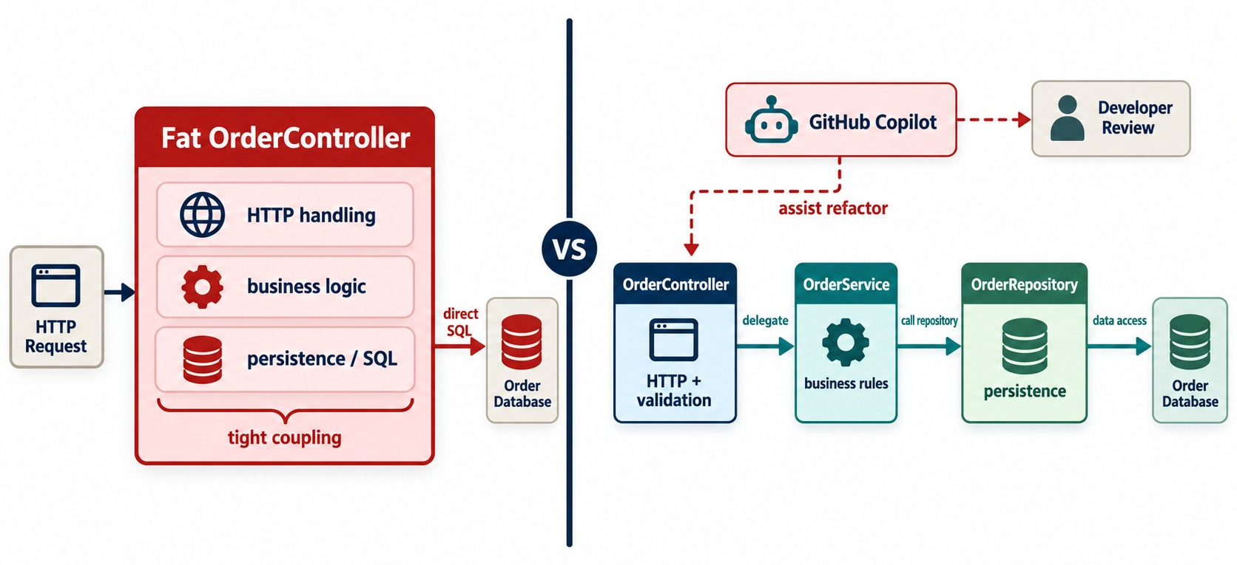
REFACTORING CODE WITH COPILOT
Simplification, duplication removal, method extraction and naming.
Analyze first
“What responsibilities does this class have?”
One change at a time
Extract the service, run tests; move queries, run tests again.
SAFETY NET No tests yet? Write them before refactoring.
KEY TAKEAWAY Refactor incrementally with Copilot — analyze, propose, review, then change one thing.
32
© 2026 by Innovation In Software Corporation
Notes:
KEY TALKING POINTS
------------------
- The problem
Suppose OrderController has grown to 300 lines.
It handles HTTP, validation, business rules, repository access and entity mapping all in one place.
- Analyze first
Ask Copilot to analyze the controller.
It should find responsibilities that don't belong in the controller layer, and propose a split into controller, service and supporting classes.
It must keep every API contract, and not change code yet.
- The sequence
Analyze, propose, developer review, then refactor.
Then ask for one change at a time, for example: move the cancellation business logic into OrderService, keeping current behavior and the endpoint contract.
- Small steps
Small refactoring steps are easier to review, test, revert and understand than a huge AI-generated rewrite.
- What the diagram shows
A large controller mixing business and persistence logic, refactored with Copilot into controller, service and repository.
- Key point
Refactor in small, tested steps.

Slide 33
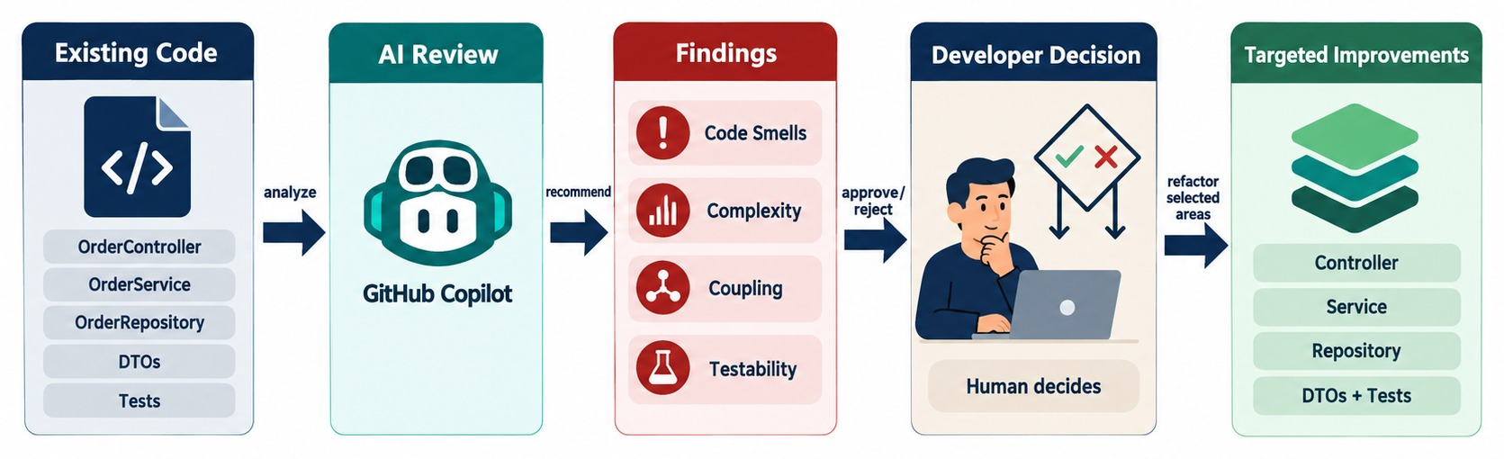
USING COPILOT FOR CODE REVIEW AND CODE QUALITY
Smells, complexity, maintainability and improvement suggestions.
USEFUL FINDINGS
Challenge it
WHO DECIDES The human reviewer still approves the PR.
Long methods
Duplication
Ask why — and reject changes that alter behavior.
Tight coupling
Null handling
KEY TAKEAWAY Use Copilot as an extra reviewer — the developer still decides what changes.
33
© 2026 by Innovation In Software Corporation
Notes:
KEY TALKING POINTS
------------------
- A review assistant
AI can be a useful extra reviewer.
Ask it to review OrderService for duplicated logic, long methods and unclear naming.
Also ask about unnecessary coupling, Spring anti-patterns, transaction-boundary concerns, weak exception handling and testability.
Have it rank findings by severity and not rewrite the code.
- Analyze before modifying
This produces a review report instead of changing the code right away.
It builds an important enterprise habit: ask AI to analyze before it modifies anything.
- Challenge the suggestions
Copilot may suggest a pattern that adds needless abstraction, conflicts with team conventions, makes simple code more complex, or changes behavior.
- Who decides
AI review is one more input into engineering judgment.
It is not the final review authority.
- What the diagram shows
Existing code reviewed by AI for smells, complexity, coupling and testability, then a developer decision and targeted improvements.
- Key point
AI suggests; the developer decides.

Slide 34
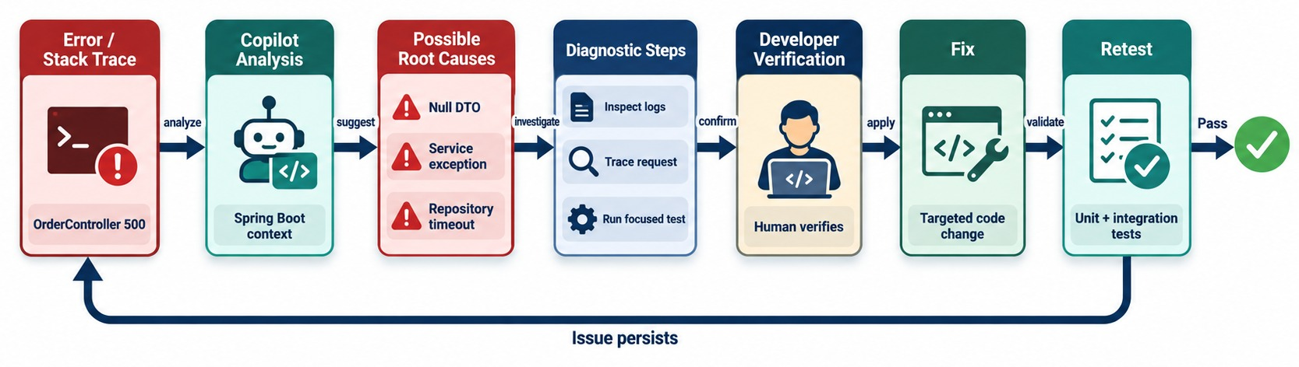
USING COPILOT FOR TROUBLESHOOTING
Explain stack traces and diagnose Spring Boot startup and configuration issues.
Give it evidence
COMMON STARTUP PROBLEMS
HABIT Verify the root cause before applying a fix.
The full stack trace, the config and what changed — not “fix this”.
Missing bean
Bad property
Port in use
DB refused
KEY TAKEAWAY Diagnose first: separate root cause from noise, verify, then make the smallest fix.
34
© 2026 by Innovation In Software Corporation
Notes:
KEY TALKING POINTS
------------------
- High value
Troubleshooting is one of the most valuable ways to use AI.
The flow is: error, stack trace or log, Copilot analysis, possible root causes, diagnostic steps, developer verification, fix, retest.
- Don't just say 'fix this'
Suppose Spring Boot fails with APPLICATION FAILED TO START.
Instead of 'fix this', ask Copilot to find the first real root-cause exception and separate it from the follow-on exceptions.
Ask for the three most likely causes and diagnostic steps before any code change, and only then the smallest fix.
- Common startup problems
Examples: a missing bean, a duplicate bean, a circular dependency, a port conflict, an invalid property, a database login failure, a migration failure, or a missing environment variable.
- The right habit
Observe, form a hypothesis, verify, then fix.
Don't go from error, to a random AI change, to a new error.
- What the diagram shows
An error or stack trace analysed by Copilot into possible root causes and diagnostic steps, then developer verification, a fix and a retest.
- Key point
Diagnose first, verify, then fix.

Slide 35
EXERCISE: TROUBLESHOOT A STARTUP FAILURE
Use Copilot as a diagnostic partner — then verify its answer.
PRACTICE EXERCISE
10 MIN
SCENARIO
YOUR TASKS
EXPECTED OUTCOME
Order Service fails at startup after a teammate's merge:
1
Write the prompt you'd give Copilot
✓
Prompt: error, package layout, recent change
APPLICATION FAILED TO START
Parameter 0 of constructor in
com.example.order.web.OrderController
required a bean of type
com.example.billing.PaymentClient
that could not be found.
2
List the likely causes it should consider
✓
Package outside component scan
Say how you'd verify before changing code
✓
Missing @Component or @Bean
3
✓
Profile-conditional bean not active
✓
Verify with --debug and the bean list
KEY TAKEAWAY Give Copilot the evidence, weigh its hypotheses, and verify the cause before you fix anything.
35
© 2026 by Innovation In Software Corporation
Notes:
KEY TALKING POINTS
------------------
- The prompt
Include the full error, the package of the main class, and what the merge changed.
- Likely causes
com.example.billing is outside com.example.order, so scanning misses it; or the class lacks a stereotype; or a @Profile bean isn't active.
- Verify
Run with --debug, check the conditions report and the active profiles, then make the smallest fix.

Slide 36
PART 4: ENTERPRISE GOVERNANCE
Speed is only valuable if safety, quality and accountability stay intact.
✓ Part 1
AI-assisted fundamentals
✓ Part 2
AI-assisted implementation
✓ Part 3
AI-assisted quality
Part 4
Enterprise governance
SO FAR
NEXT QUESTION
How does an enterprise team use Copilot safely — and who is accountable?
✓
Tests must fail when behavior is wrong
✓
Refactor in small, tested steps
IN THIS PART
✓
Troubleshooting starts with evidence
Security guardrails
1
2
Enterprise best practices
3
What Copilot should not decide
4
The hands-on lab workflow
5
The complete AI-assisted architecture
36
© 2026 by Innovation In Software Corporation
Notes:
KEY TALKING POINTS
------------------
- Why this part
In a bank, AI-generated code must meet the same security, compliance and review standards as any other code.
- What comes next
Guardrails, the enterprise workflow, the human responsibility boundary, the lab, and the full picture.

Slide 37
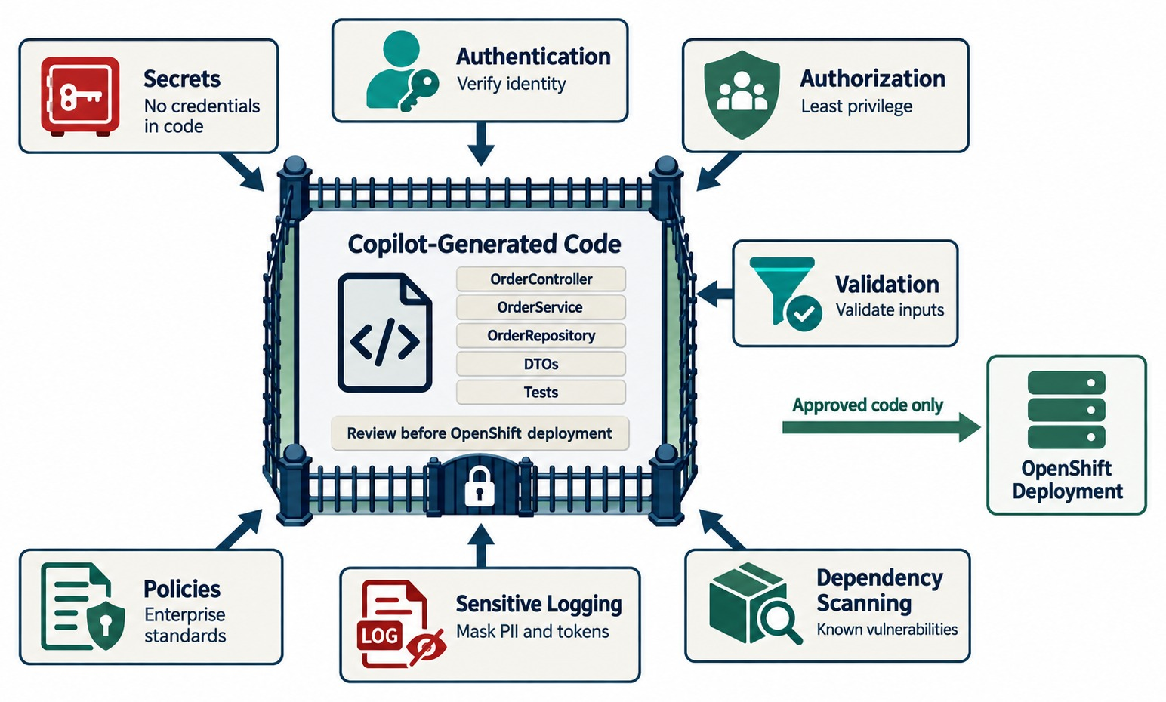
SECURITY AND ENTERPRISE GUARDRAILS
Secrets, insecure code, auth, dependency risk, sensitive data and validation.
NEVER PUT IN PROMPTS
✕
Customer or account data
✕
Passwords, tokens, keys
✕
Internal URLs and confidential code
Invented dependencies
Check that suggested libraries and APIs actually exist.
SAME GATES Scans, review and tests apply to AI code.
KEY TAKEAWAY AI-generated code passes the same security gates as any other code.
37
© 2026 by Innovation In Software Corporation
Notes:
KEY TALKING POINTS
------------------
- Same security rules
AI-generated code is not automatically trusted code.
It must pass the same security standards as any other code.
- Secrets
Do not paste production passwords, private keys, access tokens or customer secrets into prompts.
The only exception is when your organization's approved environment and policy explicitly allow it.
- Authentication and authorization
Check that generated endpoints correctly establish who the user is.
Then ask whether every authenticated user should be allowed to do this.
For example, DELETE /orders/1001 may need specific permission.
- Input, logging, dependencies
Generated endpoints should not blindly trust input.
Watch for logging of tokens or sensitive customer data.
Don't add every library the AI suggests.
Review the need, version, license, known vulnerabilities and maintenance.
- Link to Module 7
AI code still goes through a pull request, tests, static security analysis, dependency scanning and security review.
The bad path is prompt, generated security code, accept, production.
- What the diagram shows
Copilot-generated code surrounded by guardrails for secrets, authentication, authorization, validation, dependency scanning, sensitive logging and policies.
- Key point
AI-written code passes the same security gates.

Slide 38
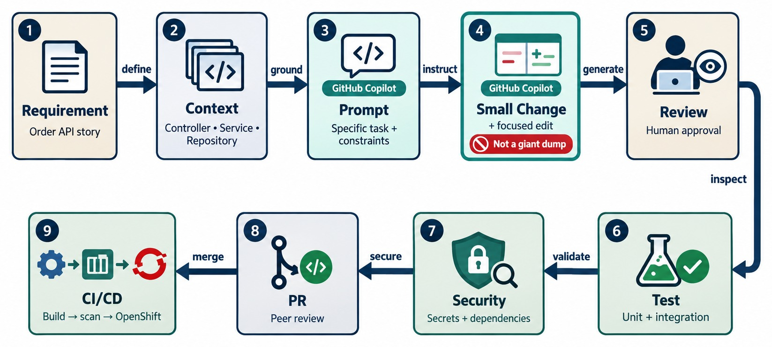
COPILOT BEST PRACTICES FOR ENTERPRISE DEVELOPMENT
Use Copilot to accelerate — not bypass — the engineering process.
TEAM HABITS
✓
Small, reviewable changes
✓
Understand before accepting
✓
Tests for every generated behavior
✓
PR and CI gates unchanged
Measure the right thing
Lead time and defect rates — not lines of code generated.
GOVERNANCE Org policies control features and data use.
KEY TAKEAWAY Use AI for speed while keeping every existing engineering control.
38
© 2026 by Innovation In Software Corporation
Notes:
KEY TALKING POINTS
------------------
- The enterprise workflow
Understand the requirement and give focused context.
Set constraints, generate small changes and review them.
Compile, test, check security and keep the architecture.
Use pull requests, and let CI/CD enforce the quality gates.
- Think, then give context
Rule 1: think before prompting.
AI can't reliably rescue an undefined requirement.
Rule 2: give relevant context, such as framework, version, architecture, business rules and existing conventions.
- Small steps and understanding
Rule 3: work in small steps.
Generate a DTO and review it, then a service method and review it.
Don't ask it to build a whole system.
Rule 4: ask AI to explain important code.
If you can't explain it, be careful about owning it in production.
- Tests and gates
Rule 5: test everything meaningful.
Rule 6: keep the quality gates.
Copilot works inside the engineering process: developer, Git, PR, CI/CD, security, deployment.
It does not go straight from Copilot to production.
- What the diagram shows
Requirement, context, prompt, a small change, review, test, security, pull request and CI/CD.
- Key point
Copilot speeds up the process — it doesn't skip any step.

Slide 39
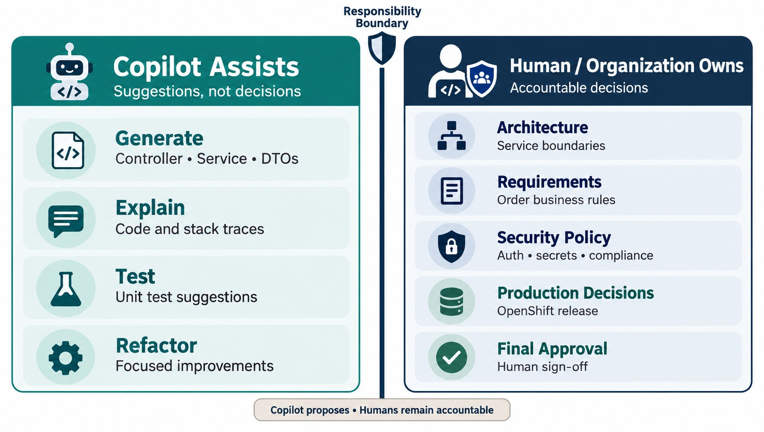
WHAT COPILOT SHOULD NOT DECIDE FOR YOU
Architecture, business correctness, security policy and production approval.
Modules 2 and 4
Service boundaries and integration style.
Module 5
Data ownership and transaction design.
Modules 6, 7, 8 and 12
Resilience policy, release approval and security.
MESSAGE Accountability stays with people.
KEY TAKEAWAY AI doesn't replace the architectural principles learned in Modules 1–8.
39
© 2026 by Innovation In Software Corporation
Notes:
KEY TALKING POINTS
------------------
- Connect the whole course
Copilot can help with implementation.
But humans and organizational controls stay responsible for business requirements, service boundaries, API and data ownership, and transaction strategy.
They also own security policy, compliance, SLA and SLO decisions, production access, deployment approval and final code acceptance.
- Modules 2 and 4
Should Order and Payment be separate services?
That's an architecture decision.
Should Order talk to Inventory with REST or an OrderCreated event?
That depends on the system's requirements: business meaning, coupling, latency and reliability.
- Module 5
Should several services share one database?
Copilot may generate that code easily, but that doesn't make it good architecture.
- Modules 6 and 8
What timeout should Payment use?
Base it on latency, dependency behavior, SLOs and user experience, not a number the AI picked.
How much CPU and memory should pods get?
Measure the real workload.
- The message
Copilot can help implement a decision.
It should not quietly become the authority that makes every decision.
- What the diagram shows
Copilot generating, explaining, testing and refactoring on one side; people owning architecture, requirements, security policy, production decisions and final approval on the other.
- Key point
Accountability never moves to the tool.

Slide 40
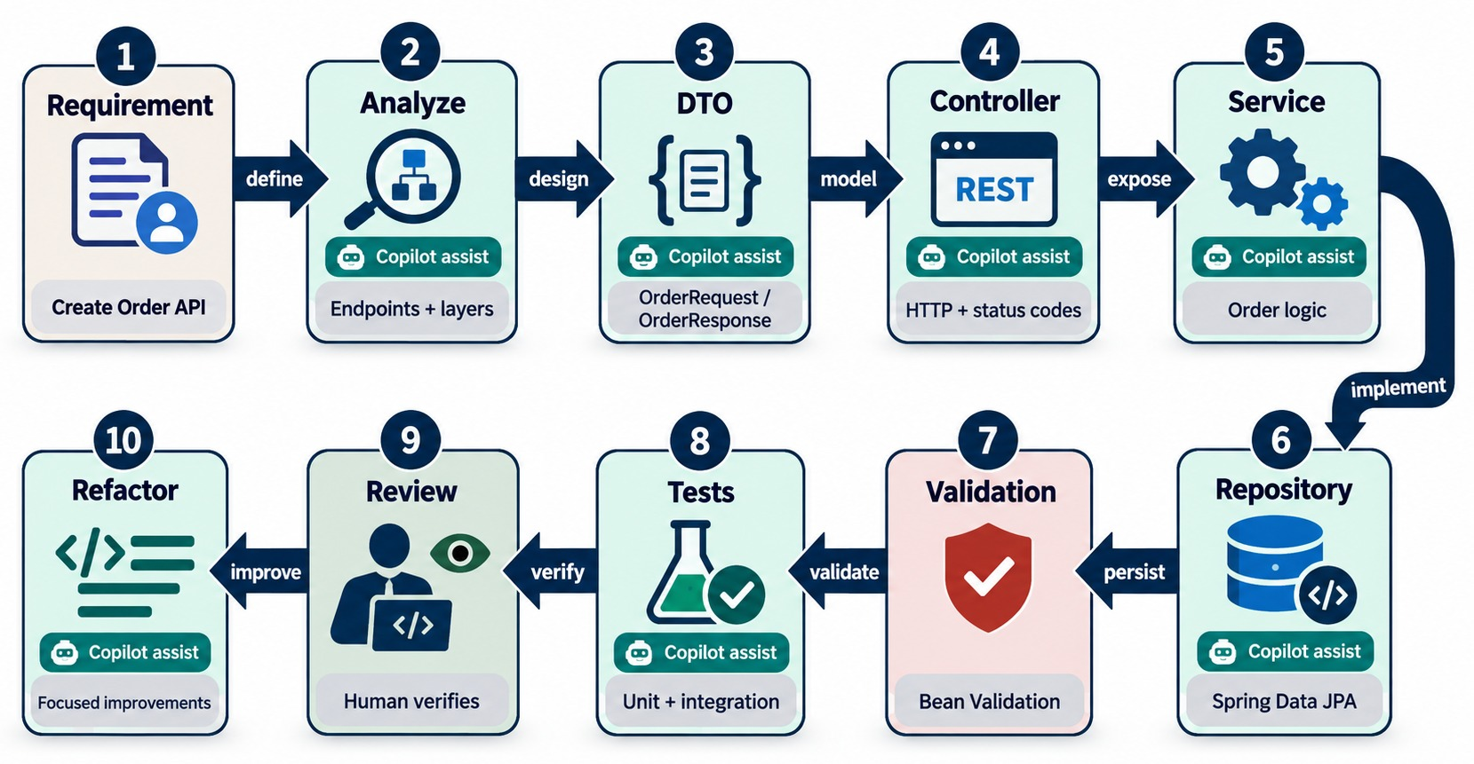
HANDS-ON LAB — BUILD AN ORDER MICROSERVICE WITH COPILOT
A guided, incremental AI-assisted development workflow.
DEFINITION OF DONE
✓
Endpoints match the contract
✓
Validation and errors tested
✓
No entity leaks or secrets
✓
Tests fail when code breaks
✓
Reviewed like any PR
DON'T use one giant prompt for the whole service.
KEY TAKEAWAY Work incrementally: plan, prompt, generate, review, test, refine — one layer at a time.
40
© 2026 by Innovation In Software Corporation
Notes:
KEY TALKING POINTS
------------------
- A real AI-assisted exercise
This should be a genuine AI-assisted exercise, not a copy-and-paste lab.
Build POST /orders, GET /orders/{id} and PATCH /orders/{id}/cancel with Spring Boot 3, Java 21, Maven, Spring Web, Validation, Spring Data JPA, JUnit 5 and Mockito.
- The requirement
An order has orderId, customerId, total and status.
Statuses are CREATED, CONFIRMED, SHIPPED and CANCELLED.
Customer ID is required, the total must be positive, and new orders start as CREATED.
Missing orders return 404, and SHIPPED orders cannot be cancelled.
- Don't use one giant prompt
Work step by step.
First ask Copilot to list the classes and responsibilities, with no code yet, and review that.
Then generate DTOs, the controller, service logic, persistence, and exception handling for 400, 404 and 409.
- Quality steps
Next generate unit tests and controller tests.
Ask Copilot for the five highest-risk missing test cases without changing code.
Then ask it to spot duplicated or overly complex code and suggest improvements without changing API behavior.
- Definition of done
The lab is not finished until the project compiles, tests pass, the API behaves correctly and the code has been reviewed.
- What the diagram shows
The lab path: analyze the requirement, then DTO, controller, service, repository, validation, tests, review and refactor.
- Key point
Build incrementally, verifying each layer.

Slide 41
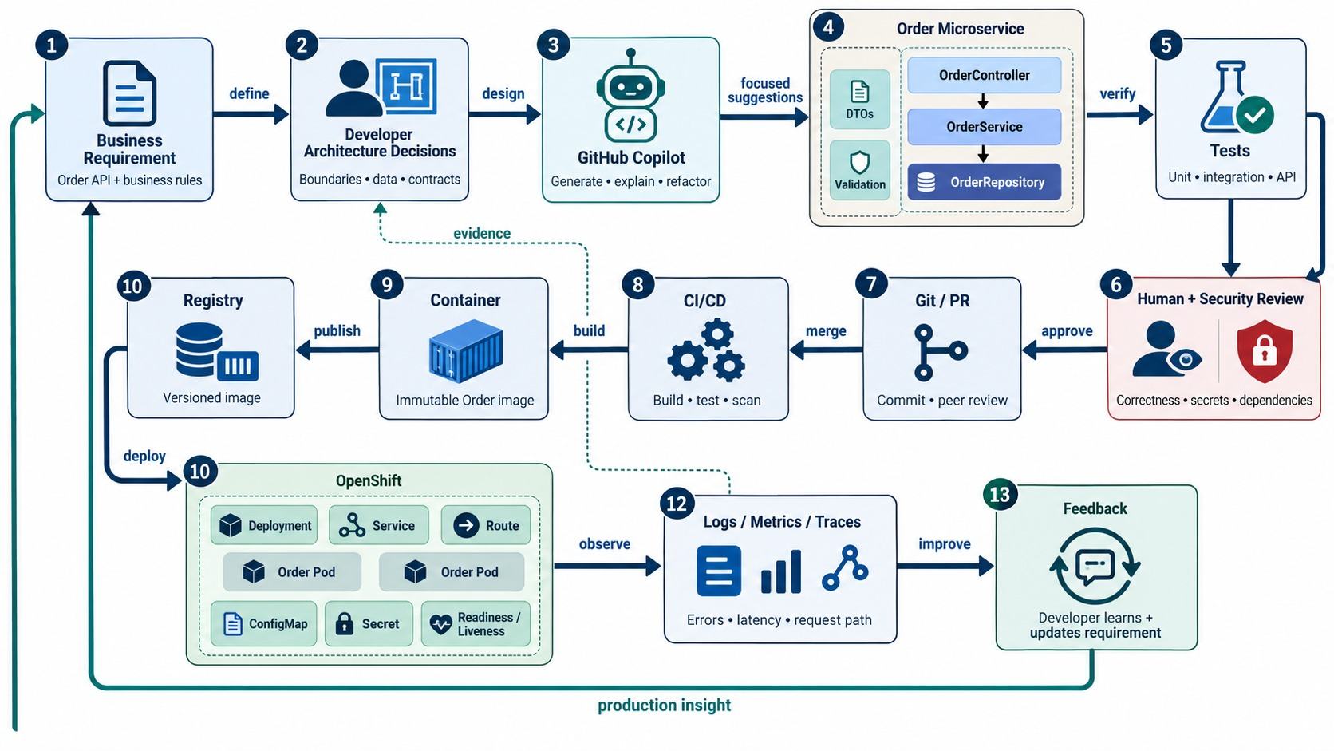
END-TO-END AI-ASSISTED DEVELOPMENT WORKFLOW
From requirement to production feedback, with Copilot inside every step.
EVERY PART OF THE COURSE
✓
People own requirements and architecture
✓
Copilot drafts code and tests
✓
Review, security and CI/CD gate it
✓
OpenShift runs it; observability feeds back
REMEMBER Accelerator, not authority.
KEY TAKEAWAY Use GitHub Copilot as an engineering accelerator, not an engineering authority.
41
© 2026 by Innovation In Software Corporation
Notes:
KEY TALKING POINTS
------------------
- Requirement and analysis
Use this slide to connect all nine modules.
A business requirement comes first, for example: customers must be able to cancel an order before it ships.
AI does not own this.
The developer works out the endpoint, states, errors, security and data impact.
- Architecture, prompt, candidate
Earlier modules give the constraints: controller, service, repository; Order owns its data; no direct access to the Payment database.
Give Copilot focused context.
It generates a candidate DTO, controller, service, repository, validation, exceptions and tests.
- Review, test, refactor
The developer checks that it meets the requirement, follows the architecture, and is maintainable and secure.
Automated tests check behavior: unit, controller and integration here, plus contract, end-to-end, performance, resilience and security where they fit.
Refactor carefully without changing behavior.
- Delivery and operations
AI code goes through the same review as human code.
Module 7 takes over with commit, pull request, quality gates and CI/CD.
Module 8 packages the JAR as a container image, stores it in the registry, and deploys it on OpenShift.
- Feedback and the final message
Module 6 observability with logs, metrics, traces and health feeds back bug fixes, performance work, new requirements and refactoring ideas.
That starts the next cycle.
Use GitHub Copilot as an engineering accelerator, not an engineering authority.
Architecture, business correctness, security, review, CI/CD and production decisions stay in the enterprise process.
- What the diagram shows
A business requirement and human architecture decisions, Copilot-assisted layers and tests, security review, Git and PR, CI/CD, container, registry, OpenShift, observability and feedback.
- Key point
The whole course, with Copilot accelerating each step.

Slide 42
COPILOT MISCONCEPTIONS AND ANTI-PATTERNS
Beliefs and habits that turn AI speed into production defects.
MISCONCEPTION
REALITY
ANTI-PATTERNS TO AVOID
It compiles, so it's correct
Compiling code can break every business rule
✕
One giant prompt for a whole service
✕
Pasting real customer data into prompts
✕
Accepting unknown dependencies
Generated tests prove the code works
Weak assertions prove nothing
✕
Skipping review for “simple” code
✕
Chasing coverage percentages
✕
Letting AI choose service boundaries
A good prompt removes the need to review
Better candidates still need review
REMEMBER Accelerator, not authority.
Copilot knows our architecture
Only what you give it as context
AI is responsible for AI-written bugs
The team owns every merged line
KEY TAKEAWAY AI speeds up good engineering habits — and multiplies the damage of bad ones.
42
© 2026 by Innovation In Software Corporation
Notes:
KEY TALKING POINTS
------------------
- Why this slide
Before the knowledge check, clear away the beliefs behind most AI-assisted defects.
- Correctness
Code that compiles and tests that pass can both be wrong.
Review and meaningful assertions are still required.
- Context and accountability
Copilot only knows what's in its context, and the team is responsible for everything that merges.
- Anti-patterns
Giant prompts, sensitive data in prompts, invented dependencies, skipped reviews, coverage chasing and AI-chosen architecture.

Slide 43
KNOWLEDGE CHECK
Answer in your own words — then compare with a partner.
What is GitHub Copilot used for?
Why aren't generated tests automatically trustworthy?
1
6
Why is prompt clarity important?
What is refactoring?
2
7
What should a controller prompt include?
What must never go into prompts?
3
8
Why review generated service code carefully?
What does AI hallucination mean?
4
9
One risk of generated repository methods?
Who is responsible for final code quality?
5
10
43
© 2026 by Innovation In Software Corporation
Notes:
KEY TALKING POINTS
------------------
- 1. Copilot
Suggestions, generation, explanations, tests, refactoring and documentation.
- 2. Prompt clarity
Context and constraints improve the quality of the output.
- 3. Controller prompt
Paths, methods, DTOs, validation, service delegation and status codes.
- 4. Service code
It holds business rules, transactions, events and exception behavior.
- 5. Repository risk
Methods may reference non-existent fields or produce inefficient queries.
- 6. Generated tests
Weak assertions, missing edge cases, or testing the wrong behavior.
- 7. Refactoring
Changing structure without changing external behavior.
- 8. Never in prompts
Customer data, account numbers, passwords, tokens, keys and confidential information.
- 9. Hallucination
Plausible but incorrect information or code.
- 10. Responsibility
The developer and engineering team.
- Practical scenario
For a generated transferFunds method: check every business rule, add negative and duplicate tests, review authorization, make it transactional, and reject logged account numbers.

Slide 44
MODULE 9 SUMMARY AND WHAT'S NEXT
From vague prompts to reviewed, tested, AI-assisted Spring Boot code.
YOU CAN NOW
NEXT: MODULE 10 — AGENTIC AI WITH MICROSOFT SERVICES
Structure prompts with context, rules, errors and output
1
What makes an AI system an agent?
✓
Generate Spring Boot layers one at a time and review them
2
How do agents call tools and business APIs safely?
✓
Turn weak generated tests into ones that prove behavior
Where do humans stay in the loop?
✓
3
Refactor, review and troubleshoot with Copilot
✓
Apply enterprise guardrails and keep accountability
BRING ALONG Your Lab 5 PolicyEngine — agents must respect rules like it.
✓
KEY TAKEAWAY Module 10 moves from AI that writes code to AI that takes actions — under control.
44
© 2026 by Innovation In Software Corporation
Notes:
KEY TALKING POINTS
------------------
- Recap
We used Copilot for prompting, generating layers, testing, refactoring and troubleshooting, all inside the normal engineering controls.
- Next module
Module 10 introduces agentic AI with Microsoft services: agents that plan and call tools against our microservices.

