Slide 1
"Controlled autonomy around clearly defined enterprise capabilities."
MODULE 10
Agentic AI with
Microsoft Services
From AI assistance to goal-driven autonomous workflows.
Agentic AI concepts
Copilot as an agent
Microsoft AI integration
Tools and function calling
Autonomous workflow design
API orchestration
Agentic microservices
Security and observability
SPRING BOOT MICROSERVICES BOOTCAMP • MODULE 10
Notes:
KEY TALKING POINTS
------------------
- From Module 9 to Module 10
Module 9 was about a developer using GitHub Copilot to write code.
Module 10 changes the role of AI.
Instead of only helping a developer write code, AI can take part in a business workflow.
- An example
A customer says: cancel order 1001 if it hasn't shipped, and refund the payment if needed.
A normal chat AI might explain how to do that.
An agent can understand the goal, check the order and its status, cancel it, check the payment, issue the refund and report back.
- The key distinction
Generative AI produces content.
Agentic AI uses reasoning plus approved tools to work toward a goal.
This module is about doing that safely in enterprise microservices.

Slide 2
LEARNING OBJECTIVES
Agents, tools, orchestration, Microsoft services and microservices use cases.
🎯
BY THE END OF THIS MODULE, YOU CAN
🧭
FIVE SECTIONS
1. Explain agentic AI
2. Distinguish assistants, copilots and agents
3. Identify core agent components
4. Explain an agent execution loop
5. Describe Microsoft agent services
6. Integrate agents with enterprise APIs
7. Design autonomous workflows
8. Use tool / function calling
9. Design single- and multi-agent solutions
10. Orchestrate Spring Boot microservices
11. Apply agent security guardrails
12. Monitor agent workflows
Agent fundamentals
1
Goal → Reason → Act → Observe
Microsoft agent ecosystem
2
Copilot Studio · Foundry · Models · Tools · Knowledge · Workflows
Workflow design
3
Goal → Plan → Tools → Conditions → Completion
Microservice orchestration
4
Agent → Order · Payment · Inventory · Shipping APIs
THE GOAL Controlled autonomy around clearly defined enterprise capabilities.
Enterprise controls
5
Identity · Authorization · Guardrails · Approval · Audit · Observability
KEY TAKEAWAY Learn to give agents controlled autonomy over well-defined enterprise capabilities.
2
© 2026 by Innovation In Software Corporation
Notes:
KEY TALKING POINTS
------------------
- By the end of this module
Learners should be able to explain agentic AI and tell assistants, copilots and agents apart.
They should name the parts of an agent, explain its execution loop and describe Microsoft's agent services.
They should connect agents to enterprise APIs, design workflows, use tool calling, and design single- and multi-agent solutions.
They should orchestrate Spring Boot microservices, apply security guardrails and monitor agent workflows.
- Five sections
Section 1 is agent basics: goal, reason, act, observe.
Section 2 is the Microsoft agent ecosystem: Copilot Studio, Microsoft Foundry, models, tools, knowledge and workflows.
Section 3 is workflow design, and Section 4 is microservice orchestration across the Order, Payment, Inventory and Shipping APIs.
Section 5 is enterprise controls: identity, authorization, guardrails, approval, audit and observability.
- The real goal
The goal is not an unrestricted autonomous system.
It is controlled autonomy around clearly defined enterprise capabilities.

Slide 3
KEY TERMS FOR THIS MODULE
Plain definitions for the words we'll use most.
1
Agentic AI
2
AI agent
AI that plans and takes steps toward a goal using tools, not just one answer.
A model plus instructions, tools, memory and guardrails that works toward a goal.
3
Large language model
4
Tool calling
A model trained on large amounts of text that generates language and reasoning.
The model asks the application to run a named function with arguments.
5
Grounding
6
Orchestration
Giving the model current, trusted enterprise data so its answers rest on facts.
Coordinating the steps, tools or agents needed to complete a task.
7
Stop condition
8
Human approval
A rule that ends an agent loop, such as done, blocked or out of steps.
A person must confirm a high-risk action before it happens.
KEY TAKEAWAY Agree on the words first — every later slide builds on them.
3
© 2026 by Innovation In Software Corporation
Notes:
KEY TALKING POINTS
------------------
- How to run this slide
Read each term once and give a quick example from the order platform or the banking lab.
- Agentic AI
AI that plans and takes steps toward a goal using tools, not just one answer.
- AI agent
A model plus instructions, tools, memory and guardrails that works toward a goal.
- Large language model
A model trained on large amounts of text that generates language and reasoning.
- Tool calling
The model asks the application to run a named function with arguments.
- Grounding
Giving the model current, trusted enterprise data so its answers rest on facts.
- Orchestration
Coordinating the steps, tools or agents needed to complete a task.
- Stop condition
A rule that ends an agent loop, such as done, blocked or out of steps.
- Human approval
A person must confirm a high-risk action before it happens.

Slide 4
FULL FORMS USED IN THIS MODULE
Every abbreviation on these slides, spelled out.
AI
Artificial Intelligence
HTTP
HyperText Transfer Protocol
PII
Personally Identifiable Information
API
Application Programming Interface
LLM
Large Language Model
RAG
Retrieval-Augmented Generation
FAQ
Frequently Asked Questions
MCP
Model Context Protocol
KEY TAKEAWAY When an abbreviation isn't clear, the full form is on this slide.
4
© 2026 by Innovation In Software Corporation
Notes:
KEY TALKING POINTS
------------------
- How to run this slide
Don't read every row.
Point out the few this module uses most, and say the full list is here for reference.
- Reference
AI is Artificial Intelligence; API is Application Programming Interface; FAQ is Frequently Asked Questions; HTTP is HyperText Transfer Protocol; LLM is Large Language Model; MCP is Model Context Protocol; PII is Personally Identifiable Information; RAG is Retrieval-Augmented Generation.

Slide 5
FROM MODULE 9 TO MODULE 10
AI helped us write the code — now AI takes actions on the running services.
MODULES 1–9 GAVE US
🧭
OUR PATH THROUGH MODULE 10
1
What agents are and how they loop
Part 1
✓
Order, Payment, Inventory and Shipping APIs
Events, idempotency and Sagas
2
Copilot, Foundry and grounding
Part 2
✓
Security, resilience and observability
3
Tools, loops and stop conditions
Part 3
✓
Pipelines and OpenShift
4
Single- and multi-agent designs
Part 3
✓
Copilot as a reviewed coding assistant
5
Orchestrating Spring Boot services
Part 4
✓
NOW Let AI agents act on these services — with limits, approvals and audit.
6
Guardrails, approval and policy
Part 5
7
Reliability, use cases and the big picture
Part 5
KEY TAKEAWAY Module 9 used AI to build services; Module 10 lets AI use them — under control.
5
© 2026 by Innovation In Software Corporation
Notes:
KEY TALKING POINTS
------------------
- Bridge from Module 9
Copilot suggested code a person reviewed.
An agent goes further: it decides and calls tools.
That raises the stakes.
- The path
Agent fundamentals, the Microsoft ecosystem, workflow design, orchestration of our microservices, and enterprise controls.
- Two examples
The slides use order support.
Exercise 5.1 and Lab 5 use the banking Risk Assessment Service, where a model scores and Java policy decides.

Slide 6
PART 1: AGENT FUNDAMENTALS
What turns a model into an agent — and why that changes the risk.
Part 1
Agent fundamentals
Part 2
Microsoft ecosystem
Part 3
Workflow design
Part 4
Orchestration
Part 5
Enterprise controls
SO FAR
NEXT QUESTION
What is an AI agent — and how is it different from a chatbot or Copilot?
✓
Copilot drafts code for people to review
✓
Services expose governed APIs
IN THIS PART
✓
Every action is secured and observable
Generative vs. agentic AI
1
2
From chatbot to autonomous agent
3
Core components of an agent
4
The execution loop
5
Levels of autonomy
6
Exercise: chatbot, copilot or agent?
6
© 2026 by Innovation In Software Corporation
Notes:
KEY TALKING POINTS
------------------
- Why start here
Teams often label any chatbot an agent.
Clear definitions decide how much control a design needs.
- What this part covers
The shift from answers to goals, the parts of an agent, the loop it runs, and how autonomy should match risk.

Slide 7
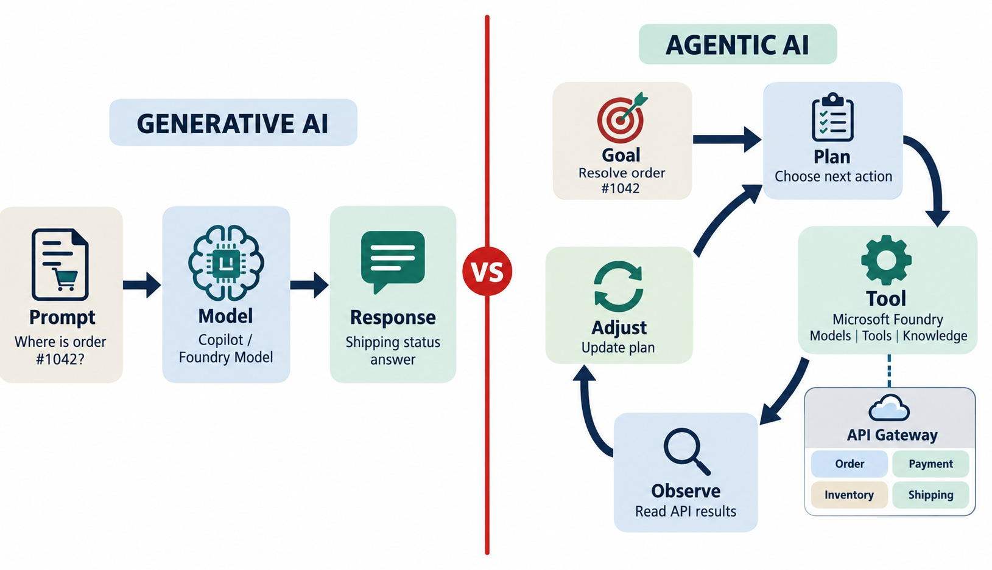
WHAT IS AGENTIC AI?
The difference between generative AI and goal-driven agents.
Generative AI
One prompt in, one response out — a person acts on it.
Agentic AI
A goal in; the agent plans, calls tools, reads results and adjusts.
DEFINING IDEA The agent takes part in the actions, not just the answer.
KEY TAKEAWAY An agent takes part in a multi-step loop of decisions and actions — not just one response.
7
© 2026 by Innovation In Software Corporation
Notes:
KEY TALKING POINTS
------------------
- Response-oriented AI
Traditional generative AI is mostly prompt, model, response.
If a user asks how an order can be cancelled, the AI gives instructions.
- Agentic behavior
Now the user says: cancel order 1001 if it is eligible.
The agent may need to get the order, check its status, and decide whether cancellation is allowed.
Then it calls the cancellation API, checks the result and reports completion.
- What it combines
Agentic AI combines reasoning, state, tools, actions and feedback.
- The defining idea
It is not just longer prompts.
It is AI taking part in a loop of decisions and actions: goal, plan, select action, use tool, observe result, adjust.
- What the diagram shows
A single prompt → model → response next to a goal → plan → tool → observe → adjust loop.
- Key point
Generative AI answers; agentic AI works toward a goal in steps.

Slide 8
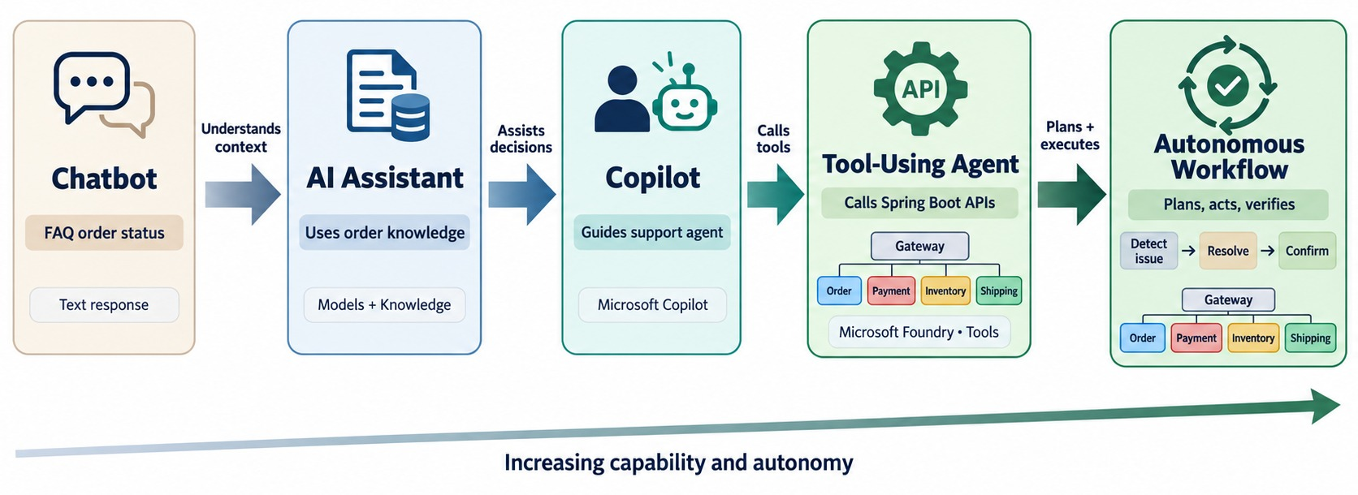
FROM PROMPT-RESPONSE AI TO AUTONOMOUS AGENTS
Prompt → response versus goal → plan → act → observe → iterate.
Chatbot and assistant
Answer questions; people take every action.
Copilot
Suggests and drafts inside a person's workflow.
Agent and autonomous workflow
Calls tools and completes steps — with limits.
KEY TAKEAWAY AI moves from answering prompts to pursuing goals — one step of autonomy at a time.
8
© 2026 by Innovation In Software Corporation
Notes:
KEY TALKING POINTS
------------------
- A spectrum
Teach this as a spectrum, not an on-off switch.
- Chatbot and assistant
A chatbot is mainly conversation: a question gets an answer.
An assistant uses extra context, such as knowledge, to give a better answer or recommendation.
- Copilot
A copilot works alongside the user, like a developer with GitHub Copilot.
- Agent
An agent can decide which approved action to take.
It selects an API, calls it and uses the result.
- Autonomous workflow
An autonomous workflow may start without anyone typing a prompt.
For example, an OrderDelayed event starts the workflow, the agent checks shipping and notifies the customer.
Microsoft describes Copilot Studio autonomous agents as reacting to events and taking actions based on triggers, instructions and guardrails.
- What the diagram shows
A progression from chatbot to assistant, copilot, tool-using agent and autonomous workflow.
- Key point
Each step adds autonomy — and needs more control.

Slide 9
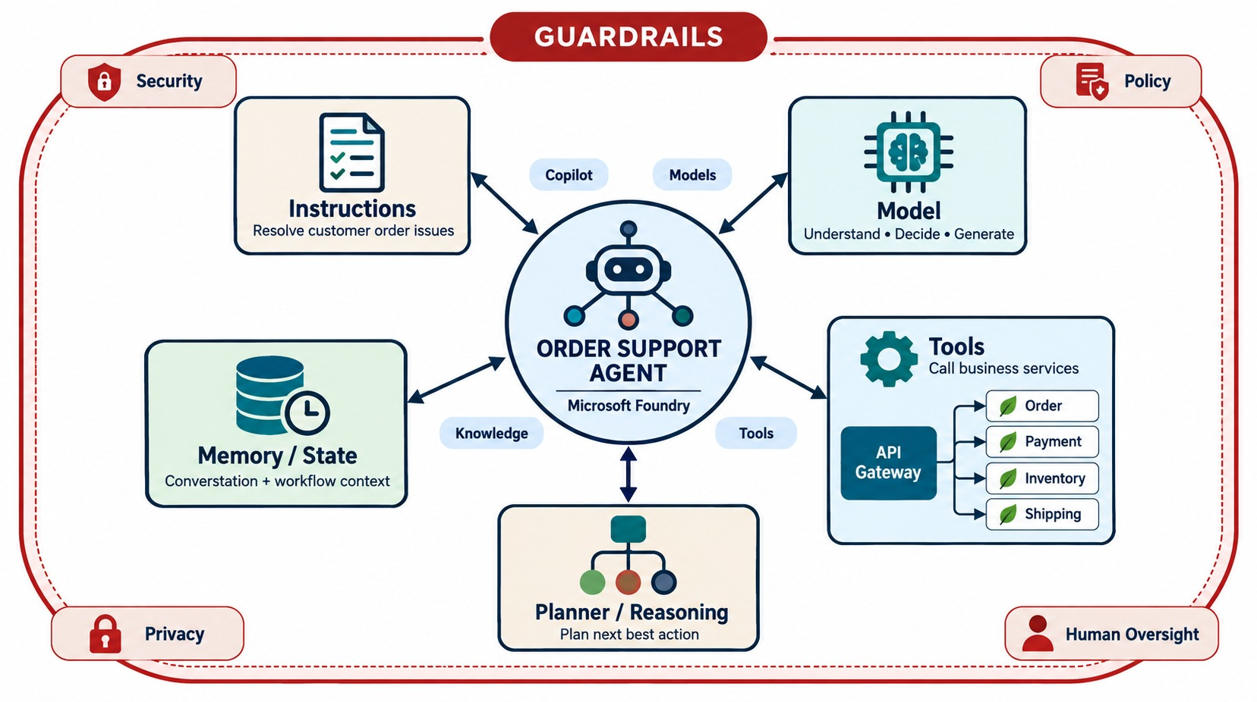
CORE COMPONENTS OF AN AI AGENT
Model, instructions, memory/state, tools, planner and guardrails.
Instructions
Role, goal, allowed actions and when to stop or escalate.
Tools
Narrow, approved functions — not raw database access.
State
What the agent has done so far in this task.
GUARDRAILS wrap everything: identity, policy, approval, audit.
KEY TAKEAWAY An agent is a model plus instructions, state, tools and guardrails.
9
© 2026 by Innovation In Software Corporation
Notes:
KEY TALKING POINTS
------------------
- More than a model
An agent is more than a large language model.
It has several parts.
- Instructions and model
Instructions define its behavior.
For example: you are an Order Support Agent, and never refund a payment unless the cancellation succeeded.
The model does the language understanding and reasoning.
- State and tools
State stores what the agent needs across steps, such as orderId 1001 and the current step being the payment check.
Tools let the agent act on systems, such as getOrder, cancelOrder, getPayment and refundPayment.
- Guardrails
Guardrails, identity and audit wrap around everything and limit what the agent may do.
- Why it matters
A model without tools can suggest an action.
An agent with tools may actually execute one.
That is why identity, authorization, validation and auditing matter so much.
- What the diagram shows
Instructions, model, memory and state, planner and tools, all surrounded by guardrails.
- Key point
An agent is a model plus instructions, state, tools and guardrails.

Slide 10
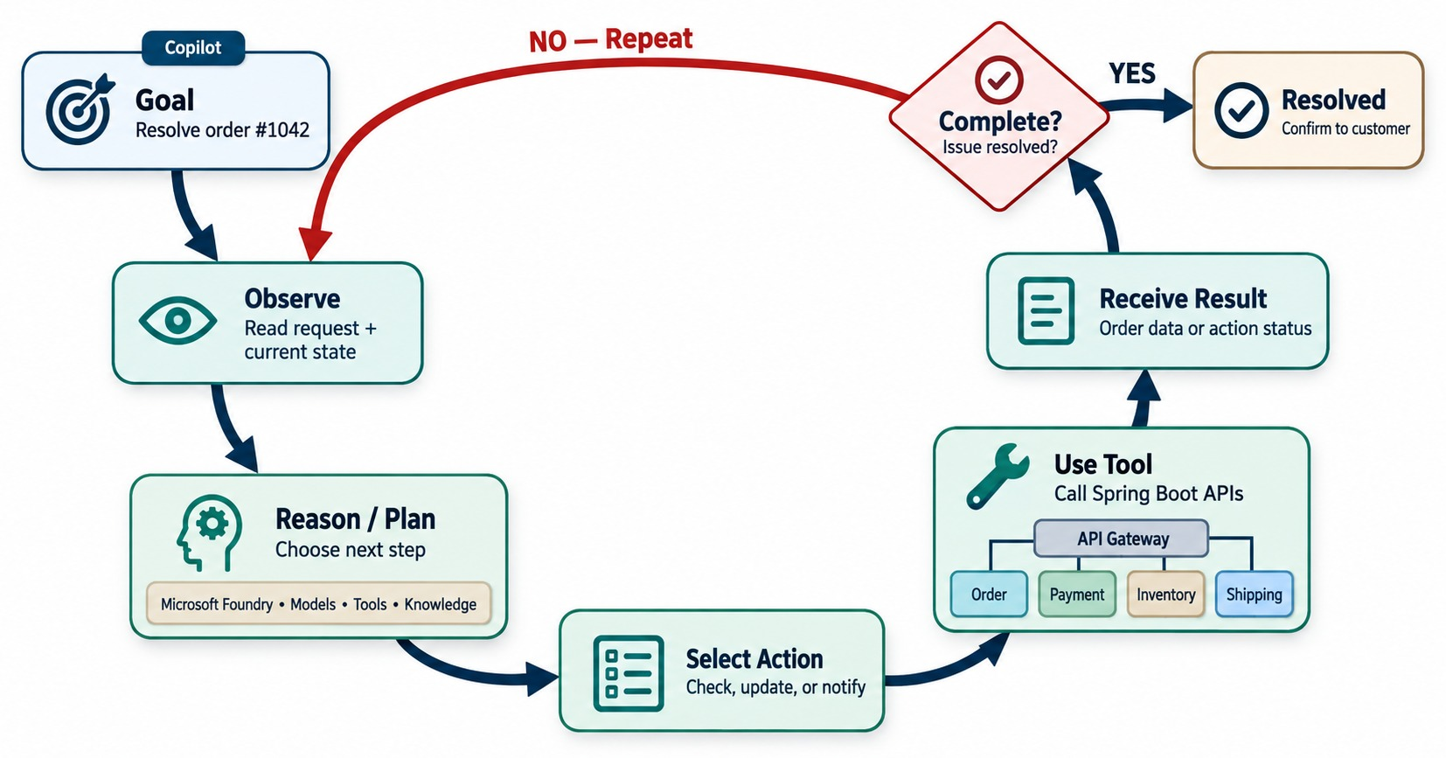
AGENTIC AI EXECUTION LOOP
Perceive → reason/plan → act → observe → adjust.
A WORKED EXAMPLE
✓
Goal: “Where is order 1045?”
✓
Plan: look up the order
✓
Act: call getOrder
✓
Observe: status SHIPPED
✓
Act: call getShipment
✓
Done: answer with tracking
STOP when done, blocked, or out of steps.
KEY TAKEAWAY Agents loop — observe, reason, act, read the result — until the goal is complete.
10
© 2026 by Innovation In Software Corporation
Notes:
KEY TALKING POINTS
------------------
- The loop
The agent loop is: goal, observe, reason and plan, select an action, use a tool, receive the result, then check if the goal is complete.
If not, repeat.
If yes, respond.
- A worked example
The goal: find out why order 1001 has not shipped.
The agent observes orderId 1001, and reasons that it needs the order status.
It calls getOrder(1001) and learns the status is CONFIRMED.
- It loops again
Now it realizes it needs shipping information.
It calls getShipment(1001) and learns the shipment status is LABEL_PENDING.
- Deciding it is done
It now has enough evidence to answer: the order is confirmed, but shipment creation hasn't finished.
- The key point
Each tool result becomes new evidence for the next decision.
- What the diagram shows
Goal, observe, reason and plan, select an action, use a tool, receive the result, check if complete, and repeat.
- Key point
The agent loops until the goal is met or a stop condition fires.

Slide 11
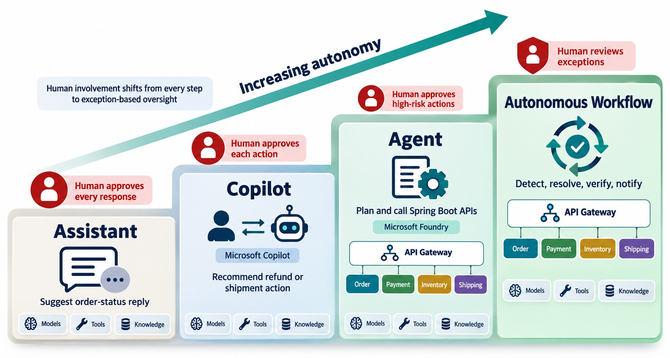
LEVELS OF AI AUTONOMY
Assistant, copilot, semi-autonomous agent and autonomous workflow.
Low risk
Read-only lookups can run without approval.
Medium risk
Drafts and recommendations — a person confirms.
High risk
Refunds, freezes, money movement — always approved.
RULE Match autonomy to risk, not to capability.
KEY TAKEAWAY Match autonomy to risk: the riskier the action, the stronger the control.
11
© 2026 by Innovation In Software Corporation
Notes:
KEY TALKING POINTS
------------------
- Match autonomy to risk
The amount of autonomy should match the risk of the action.
- Levels 1 and 2
Level 1 is a recommendation: the agent says 'I recommend cancelling the order', and a human does it.
Level 2 is approval-based: the agent proposes cancellation, a human approves, and then the agent calls the API.
- Levels 3 and 4
Level 3 is limited autonomy: low-risk tasks run automatically, like getting shipping status or sending a standard notification.
Level 4 is higher autonomy: the agent performs several approved actions without constant human involvement.
- Not unlimited
Enterprise systems should never read autonomy as unlimited permissions plus unlimited actions.
More autonomy needs stronger controls.
- What the diagram shows
Assistant, copilot, agent and autonomous workflow, with human approval points as autonomy increases.
- Key point
The higher the risk, the more human control.

Slide 12
EXERCISE: CHATBOT, COPILOT OR AGENT?
Classify each system — and decide the control it needs.
PRACTICE EXERCISE
10 MIN
SCENARIO
YOUR TASKS
EXPECTED OUTCOME
Five proposals from the business:
1
Label each: chatbot, copilot, agent or autonomous workflow
✓
1 chatbot; 2 copilot
1 FAQ bot answering fee questions
2 Drafts replies for support staff
3 Looks up order + shipment, answers
4 Cancels orders when customers ask
5 Nightly: finds stuck payments, retries
✓
3 agent — read-only tools
2
Mark which actions change state
✓
4 agent — needs approval
3
Choose the control each needs
✓
5 autonomous — limits and alerts
✓
State changes need identity and audit
KEY TAKEAWAY The label matters less than the actions: anything that changes state needs authority, limits and audit.
12
© 2026 by Innovation In Software Corporation
Notes:
KEY TALKING POINTS
------------------
- Reading vs. acting
The FAQ bot and the drafting copilot never act.
The lookup agent calls tools but only reads.
- Actions
Cancelling orders changes state, so it needs authorization, idempotency and usually approval.
- Autonomous workflow
The nightly job acts without a person in the loop, so it needs strict limits, a stop condition and alerts.

Slide 13
PART 2: THE MICROSOFT AGENT ECOSYSTEM
Where agents are built, which models they use and how they are grounded.
✓ Part 1
Agent fundamentals
Part 2
Microsoft ecosystem
Part 3
Workflow design
Part 4
Orchestration
Part 5
Enterprise controls
SO FAR
NEXT QUESTION
Which Microsoft services do we use to build agents — and what does each do?
✓
Agents loop toward a goal with tools
✓
Instructions, state and guardrails shape behavior
IN THIS PART
Autonomy must match risk
1
Copilot as an agent
✓
2
An order-support agent workflow
3
The Microsoft AI services landscape
4
Microsoft Foundry and models
5
Tool calling with Azure OpenAI
6
Grounding with enterprise data
13
© 2026 by Innovation In Software Corporation
Notes:
KEY TALKING POINTS
------------------
- From concept to platform
Part 1 defined agents.
Part 2 maps those parts to Microsoft services.
- What comes next
Copilot Studio agents, Foundry, the model and tool-calling loop, and grounding in enterprise data.

Slide 14
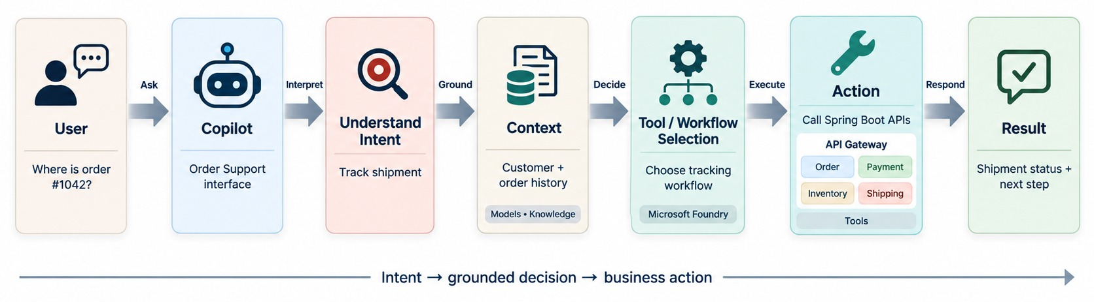
USING COPILOT AS AN AI AGENT
Copilot as an interface that reasons over context and invokes tools and workflows.
Knowledge
Tools and actions
COPILOT STUDIO builds these agents with low code.
Documents and sites the agent can read — it tells the agent something.
Connectors and APIs — they let the agent do something.
KEY TAKEAWAY Knowledge tells the agent something; tools let it do something.
14
© 2026 by Innovation In Software Corporation
Notes:
KEY TALKING POINTS
------------------
- When Copilot becomes agentic
Copilot becomes agentic when it moves beyond conversation into controlled actions.
The flow is: user, Copilot, understand intent, use context, select a tool or workflow, execute, return the result.
- From reading to acting
A user asks whether order 1001 qualifies for cancellation, so the agent retrieves information.
Then the user says 'cancel it', and the agent may call an approved action.
- In Microsoft Copilot Studio
Agents can be connected to knowledge sources, actions, triggers, tools and workflows.
Workflows can also be added as tools that an agent can call.
- Knowledge versus tools
Knowledge tells the agent something.
A tool lets the agent do something.
- What the diagram shows
A user's request to Copilot, which understands intent, gathers context, selects a tool or workflow, acts and returns a result.
- Key point
Copilot becomes an agent when it can take actions through tools.

Slide 15
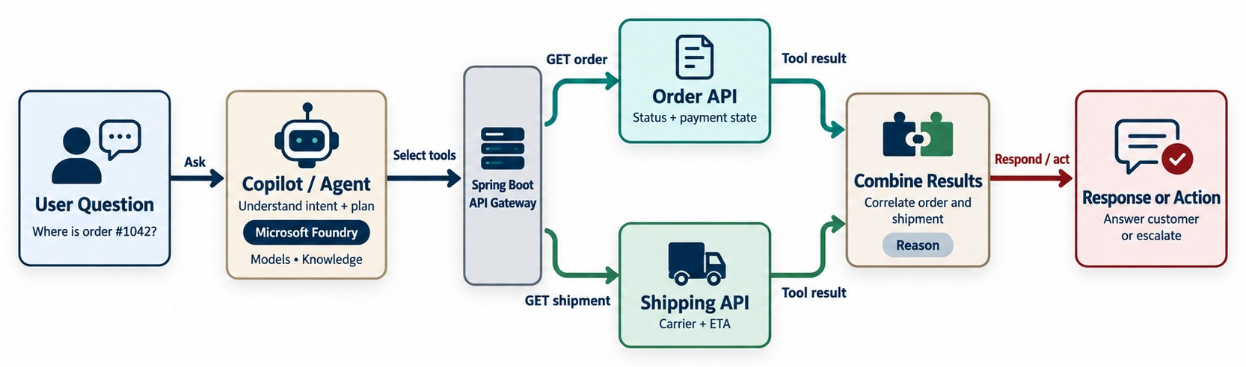
COPILOT AGENT WORKFLOW
User intent → context → reasoning → tool call → result → response/action.
Intent
Calls
STILL GOVERNED Tools run with the user's permissions, not admin rights.
“Where's my order, and can I change the address?”
getOrder, getShipment — then, if allowed, updateAddress.
KEY TAKEAWAY The agent turns natural-language intent into calls to governed enterprise APIs.
15
© 2026 by Innovation In Software Corporation
Notes:
KEY TALKING POINTS
------------------
- An order example
The user asks why order 1001 is delayed.
Copilot interprets the intent, and the agent calls the Order API and the Shipping API.
It reasons over the order status and shipment status, then returns an explanation.
- Translating intent
The user speaks naturally: why is my order delayed?
The system needs specific calls, like GET /orders/1001 and GET /shipments with the order ID.
The agent becomes an intelligence layer between human intent and enterprise capabilities.
- Adding action
Then extend the request: if it is delayed, notify the customer.
Now the agent is action-oriented rather than information-only.
- Still governed
This does not mean bypassing API contracts.
The agent should still use governed services.
- What the diagram shows
A user question handled by an agent that calls the Order API and Shipping API and combines the results into a response or action.
- Key point
The agent turns a question into governed API calls.

Slide 16
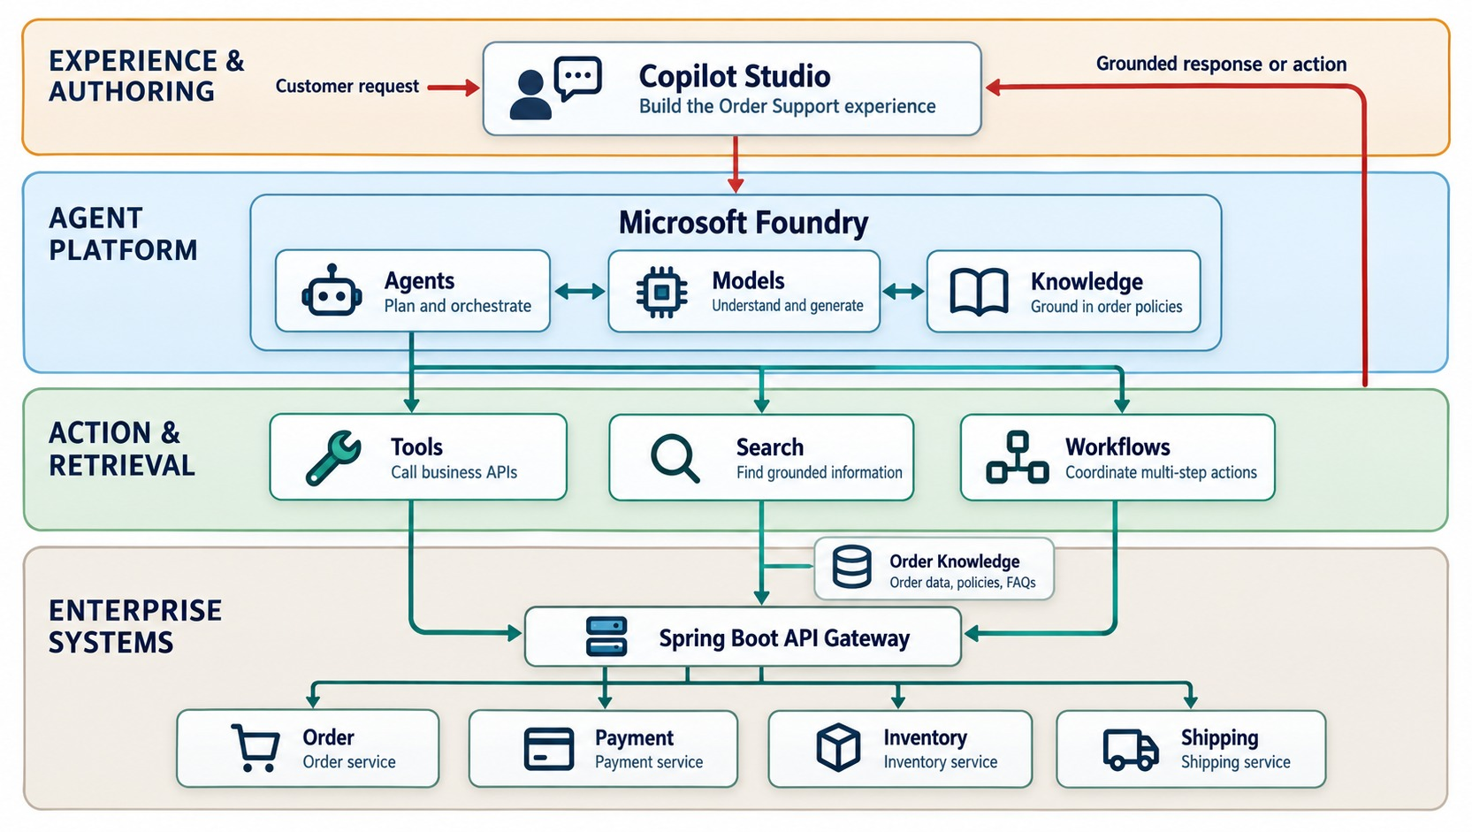
MICROSOFT AI SERVICES LANDSCAPE
Copilot Studio, Foundry, models, tools, knowledge and enterprise systems.
Copilot Studio
Build and publish agents with low code and connectors.
Microsoft Foundry
Pro-code agents, model deployments and evaluation.
Azure AI Search
Retrieval over enterprise content for grounding.
YOUR SYSTEMS stay the source of truth.
KEY TAKEAWAY Microsoft's AI services give agents models, tools and knowledge on top of your systems.
16
© 2026 by Innovation In Software Corporation
Notes:
KEY TALKING POINTS
------------------
- Roles, not a catalog
Teach product names as architectural roles, not as a product catalog.
- Copilot Studio and Foundry
Microsoft Copilot Studio is useful for building and orchestrating business-oriented agents and workflows.
Microsoft Foundry is a development platform for models and agents.
Its SDK supports getting model responses, creating agents, and running multi-turn agent conversations.
- Agents, tools, knowledge
These platforms give you agents, tools and knowledge, which connect down to enterprise systems.
Supporting capabilities include search and grounding, APIs, workflows, identity, monitoring and data.
- Your systems still matter
Your Spring Boot APIs, databases, messaging, search and business workflows remain important.
AI sits above or alongside them.
- What the diagram shows
Copilot Studio, Microsoft Foundry, models, agents, tools, knowledge, search, workflows and enterprise systems.
- Key point
Each service plays a role; your systems stay the source of truth.

Slide 17
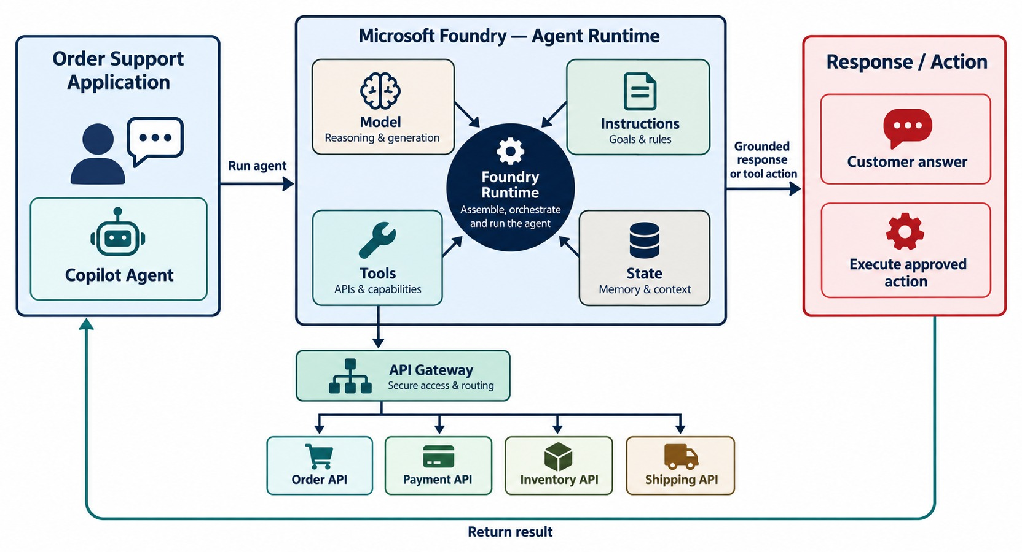
MICROSOFT FOUNDRY AND MODEL INTEGRATION
Model access, deployment, prompts, grounding and evaluation.
WHAT FOUNDRY PROVIDES
Model catalog
Deployments
Agent Service
Evaluations
Content safety
Tracing
Model choice
Pick for quality, latency and cost — then evaluate.
MORE THAN AN LLM CALL Instructions, tools, state and evaluation.
KEY TAKEAWAY Enterprise AI needs model choice, instructions, tools, state and evaluation — not just an LLM call.
17
© 2026 by Innovation In Software Corporation
Notes:
KEY TALKING POINTS
------------------
- More than calling an LLM
Don't teach an enterprise AI application as just a REST call to a large language model.
Real solutions need more.
- The questions
Model selection asks which model is right.
Instructions ask what role the agent has.
Tools ask what it is allowed to call.
Conversations ask what context should persist.
Responses ask what result the agent produced.
- Foundry runtime model
Foundry Agent Service describes agents, conversations and responses as its core runtime parts.
An agent combines a model with instructions and tools.
A conversation keeps history across turns.
- Supporting pieces
Evaluation, safety, monitoring and state support the whole flow.
This gives learners a practical mental model of the runtime.
- What the diagram shows
An application or agent using Foundry, which combines a model, instructions, tools and state to produce a response or action.
- Key point
Foundry hosts the agent runtime around the model.

Slide 18
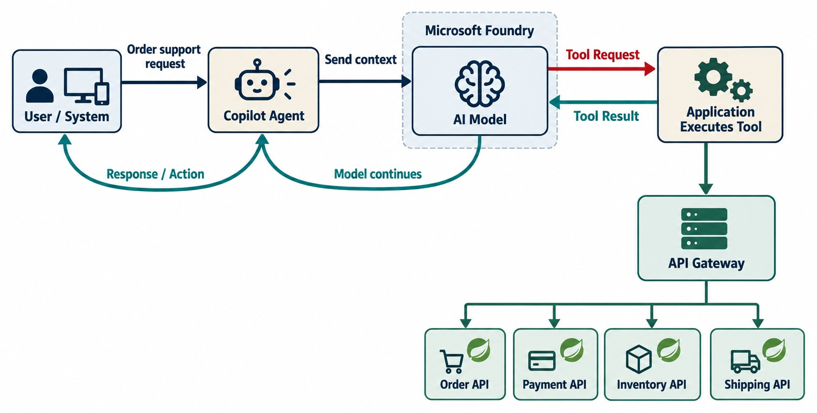
AZURE OPENAI IN AN AGENTIC ARCHITECTURE
The LLM as the reasoning engine inside an enterprise agent.
HOW TOOL CALLING REALLY WORKS
✓
The model never calls your API directly
✓
It returns a tool request with arguments
✓
Your code validates and executes it
✓
The result goes back to the model
CONTROL stays in the application.
KEY TAKEAWAY The model reasons and requests tools; the application executes them under control.
18
© 2026 by Innovation In Software Corporation
Notes:
KEY TALKING POINTS
------------------
- A common misconception
Many people think the model itself connects directly to every backend.
It does not.
- The safer architecture
The model requests a tool.
The agent or application layer runs the approved function and returns the result.
Then the model decides what to do next.
- An example
The model requests getOrder with orderId 1001.
The application runs GET /orders/1001 and returns JSON with orderId 1001 and status CONFIRMED.
- Controlled tools
The agent exposes controlled tools, such as getOrder, cancelOrder and getInventory.
This separation matters for security, logging, validation, authorization and error handling.
- What the diagram shows
An agent asking the model, the model requesting a tool, the application executing it, and the result returning to the model.
- Key point
The model requests tools; the application executes them.

Slide 19
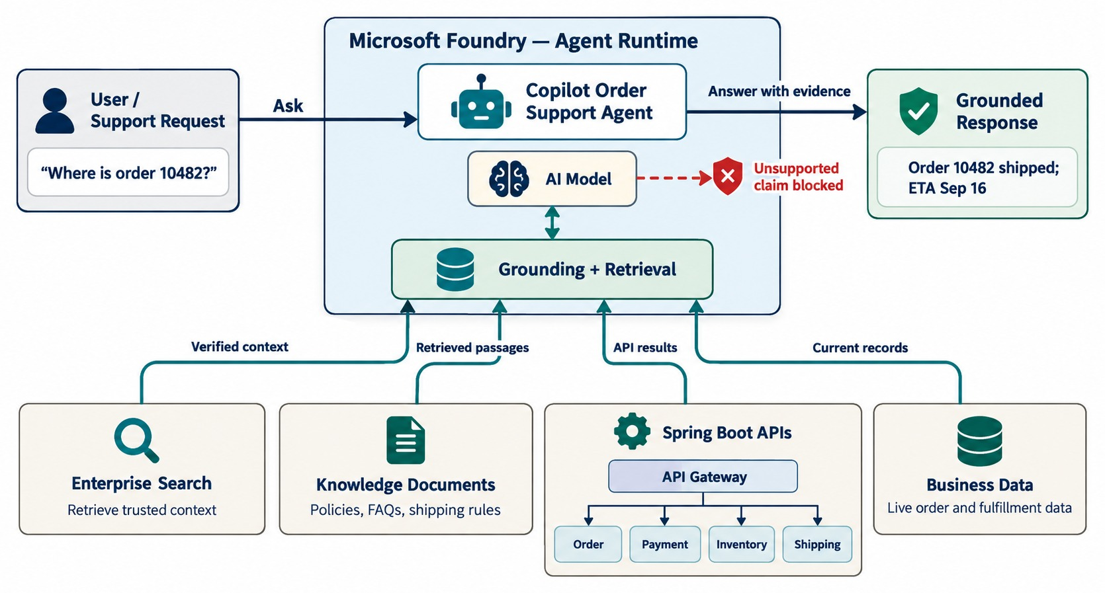
GROUNDING AGENTS WITH ENTERPRISE DATA
Search/RAG, internal knowledge, APIs and databases.
Knowledge grounding
Policies, runbooks and FAQs retrieved through search.
Live grounding
Current order and payment status from service APIs.
GROUNDING PREVENTS
✕
Guessing an order status
✕
Quoting an old policy
KEY TAKEAWAY Ground agents in enterprise data — current facts come from services, not model memory.
19
© 2026 by Innovation In Software Corporation
Notes:
KEY TALKING POINTS
------------------
- Models don't know current facts
Models don't automatically know current enterprise facts.
Relying on model memory creates a risk of hallucination, meaning confident but made-up answers.
- Where answers should come from
For 'what is the status of order 1001?', the answer should come from the Order Service, not model memory.
For 'what is our refund policy?', the answer may come from enterprise knowledge.
- Two kinds of grounding
Grounding means giving the model relevant trusted information at runtime.
Operational grounding uses APIs, databases through APIs, and business services.
Knowledge grounding uses documents, policies, FAQs and search indexes.
- The flow
A question comes in, and the agent retrieves trusted enterprise context and gives it to the model.
The model then produces a grounded answer based on that evidence.
- What the diagram shows
An agent connected to enterprise search, knowledge documents, APIs and business data, producing a grounded response.
- Key point
Current facts come from enterprise systems, not model memory.

Slide 20
PART 3: DESIGNING AGENT WORKFLOWS
Give an agent tools, a loop and clear limits.
✓ Part 1
Agent fundamentals
✓ Part 2
Microsoft ecosystem
Part 3
Workflow design
Part 4
Orchestration
Part 5
Enterprise controls
SO FAR
NEXT QUESTION
How do we design what an agent may do — and when it must stop?
✓
Copilot Studio and Foundry build agents
✓
The model requests; the app executes
IN THIS PART
✓
Grounding supplies current facts
Tools and function calling — a tool definition
1
2
Autonomous workflow design — a bounded loop
3
Single-agent and multi-agent patterns
4
State, memory and context
5
Exercise: design tools and stop conditions
20
© 2026 by Innovation In Software Corporation
Notes:
KEY TALKING POINTS
------------------
- Why this part
Most agent failures are design failures: tools that are too powerful, loops that never end, state kept in the wrong place.
- What comes next
Tool definitions, a bounded loop, one or many agents, and where state lives.

Slide 21
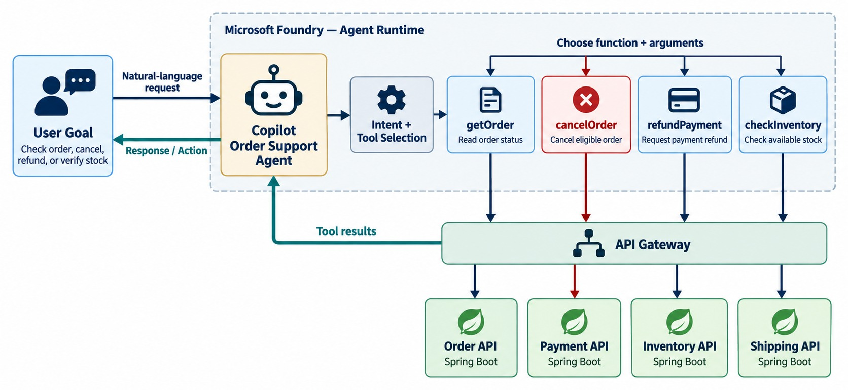
TOOLS AND FUNCTION CALLING
How agents invoke APIs and business operations.
Name and description
Tell the model when — and when not — to use it.
Schema
Strict, typed inputs the application can validate.
Scope
Read tools freely; state-changing tools need approval.
CRITICAL Approved capabilities only — never raw infrastructure.
KEY TAKEAWAY Models choose from approved capabilities — never unlimited access to infrastructure.
21
© 2026 by Innovation In Software Corporation
Notes:
KEY TALKING POINTS
------------------
- A core mechanism
Function calling is one of the core mechanisms behind agents.
Suppose the tools are getOrder, cancelOrder, getPayment and refundPayment.
- Describing a tool
The agent is told what each tool does, which parameters it needs, and what result to expect.
A tool definition has a name, description, parameters and result.
- How a call works
The prompt comes in and the model requests a function.
The application executes the function and returns the result.
Then the model continues.
Microsoft Foundry's function-calling docs follow this pattern: define and register the tools, let the agent request a call, run it in your app, then return the result.
- The critical point
The agent requests the capability.
Your application stays responsible for executing it securely.
The model picks from approved capabilities; it never gets unlimited access to infrastructure.
- What the diagram shows
A user goal, an agent choosing among getOrder, cancelOrder, refundPayment and checkInventory, and results returning to the agent.
- Key point
Agents choose from approved tools only.

Slide 22
DEFINING TOOLS FOR AN ORDER-SUPPORT AGENT
Narrow, typed, well-described tools — one to read, one to request an action.
✓
get_order_status (read-only)
request_order_cancellation (action)
{
"type": "function",
"name": "get_order_status",
"description": "Return status and shipment of ONE order.
Read-only. Use before answering status questions.",
"parameters": {
"type": "object",
"properties": {
"orderId": { "type": "string",
"pattern": "^ORD-[0-9]{4,}$" }
},
"required": ["orderId"],
"additionalProperties": false
}
}
{
"type": "function",
"name": "request_order_cancellation",
"description": "Create a cancellation REQUEST that a
person must approve. Never cancels directly.",
"parameters": {
"type": "object",
"properties": {
"orderId": { "type": "string" },
"reason": { "type": "string", "maxLength": 200 }
},
"required": ["orderId", "reason"],
"additionalProperties": false
}
}
Descriptions
Strict schemas
Requests, not actions
The model picks tools by reading them — make them precise.
Patterns and no extra properties block junk input.
The risky tool only creates a pending request.
KEY TAKEAWAY Design tools like public APIs: narrow purpose, strict schema, and no direct high-risk actions.
22
© 2026 by Innovation In Software Corporation
Notes:
KEY TALKING POINTS
------------------
- The read tool
get_order_status reads one order.
The pattern and additionalProperties false mean the application can reject invalid arguments.
- The action tool
It doesn't cancel.
It creates a request that a person approves, so the model can't cancel an order on its own.
- Descriptions
The model chooses tools from their names and descriptions, so they must say what the tool does and when not to use it.
- Module 11
MCP standardizes how tools like these are described and discovered.

Slide 23
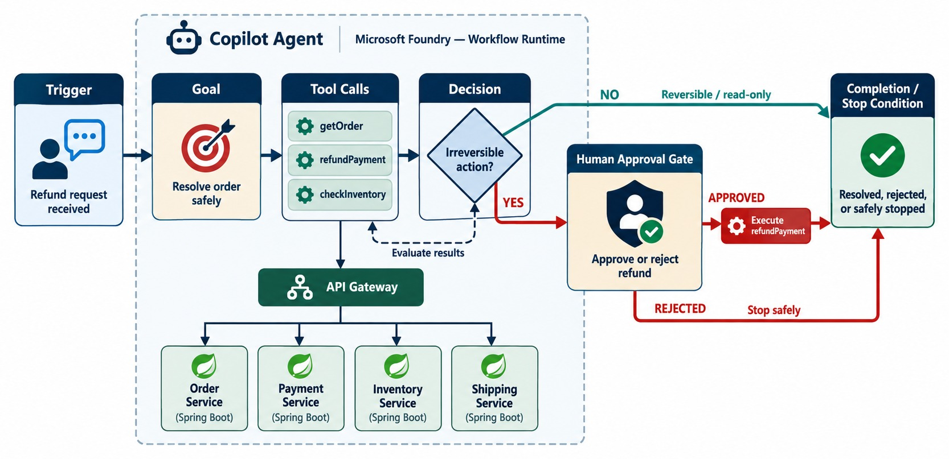
DESIGNING AUTONOMOUS WORKFLOWS
Goal, steps, tools, conditions, state, retry and termination.
BEFORE YOU BUILD
✓
Explicit goal and trigger
✓
Allowed tools only
✓
Decision authority defined
✓
Approval gate for risky steps
✓
Step, time and cost limits
STOP CONDITIONS Done, blocked, over budget — or escalate.
KEY TAKEAWAY Autonomous workflows need an explicit goal, trigger, tools, authority, approvals and stop condition.
23
© 2026 by Innovation In Software Corporation
Notes:
KEY TALKING POINTS
------------------
- Explicit boundaries
An autonomous workflow needs explicit boundaries.
Ask six questions: what is the goal, what starts it, what tools exist, what decisions AI may make, what needs approval, and when it stops.
- Goal, trigger, tools
The goal might be resolving delayed-order cases.
It could be triggered by an event, a schedule, a user request or an alert.
The tools might be the Order, Shipping and Notification APIs.
- Decision authority
The agent may be allowed to retrieve information, categorize the delay and send a standard message.
But it should not automatically refund five thousand dollars.
- The example flow
Check the order, then check the shipment.
If there is no delay, close it.
If there is, notify the customer, and if compensation is needed, get human approval.
- Stop conditions
The agent must know when the task is finished.
Without a clear stop condition, an autonomous loop can waste time, API calls and money.
- What the diagram shows
A trigger and goal leading to tool calls, decisions, an approval gate and a completion or stop condition.
- Key point
Every autonomous workflow needs an approval gate and a stop condition.

Slide 24
A BOUNDED AGENT LOOP
Allowed tools, approval for state changes, and hard limits on steps and time.
✓
AgentRunner.java (simplified)
Allow-list
public AgentOutcome run(Goal goal, User user) {
AgentRun run = AgentRun.start(goal, MAX_STEPS, Duration.ofSeconds(60));
while (true) {
ModelTurn turn = model.next(run.context(), tools.allowedFor(user));
if (turn.isFinalAnswer())
return run.complete(turn.answer());
ToolCall call = turn.toolCall();
if (!tools.isAllowed(call, user))
return run.escalate("TOOL_NOT_ALLOWED");
if (call.changesState())
return run.awaitApproval(call); // a person decides
run.record(call, tools.execute(call)); // timeout + audit inside
if (run.steps() >= MAX_STEPS || run.expired())
return run.escalate("LIMIT_REACHED");
}
}
Tools are filtered by the user's permissions first.
Approval
Any state change pauses for a human decision.
Limits
Step and time limits stop infinite loops.
AUDIT Every call and result is recorded.
KEY TAKEAWAY An agent loop is only safe with an allow-list, an approval gate and hard stop conditions.
24
© 2026 by Innovation In Software Corporation
Notes:
KEY TALKING POINTS
------------------
- The loop
Each turn, the model either answers or requests a tool.
The runner, not the model, decides what happens next.
- Allow-list
Only tools the user is allowed to use are offered, and each call is checked again.
- Approval
A state-changing call ends the automatic run and waits for a person.
- Limits
A maximum number of steps and a time budget guarantee the loop ends, even if the model keeps asking for tools.

Slide 25
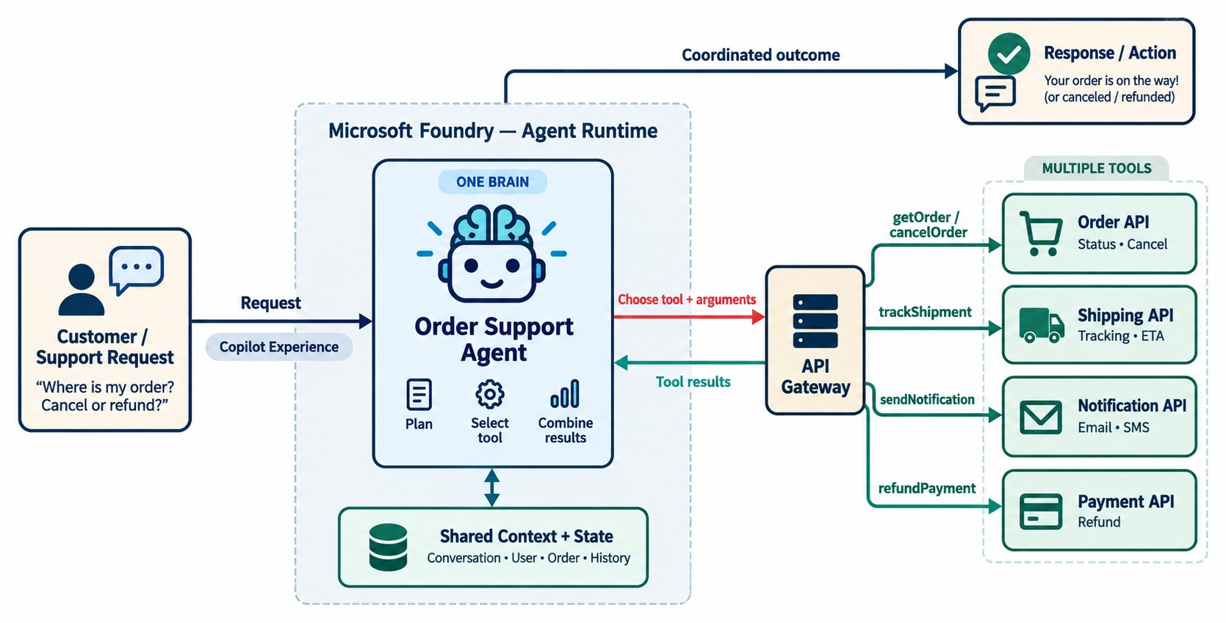
SINGLE-AGENT WORKFLOW DESIGN
One agent coordinating several business tools.
ADVANTAGES
✓
One set of instructions
✓
One audit trail
✓
Easier to test and debug
Keep tools focused
Four to ten well-described tools beats forty.
START HERE Split into more agents only when you must.
KEY TAKEAWAY One agent owning the goal is the simplest place to start.
25
© 2026 by Innovation In Software Corporation
Notes:
KEY TALKING POINTS
------------------
- Often the simplest
A single-agent pattern is often the simplest architecture.
One Order Support Agent owns the goal of resolving an order support request.
- Several tools
It uses several tools: getOrder, getShipment, then it works out the status.
Then it calls sendNotification and returns a resolution.
- Advantages
It is a simple mental model and easier to debug.
There are fewer handoffs, and it is easier to observe and to control access.
- Start here
Start with one agent unless specialization gives a clear advantage.
- What the diagram shows
One Order Support Agent coordinating the Order, Shipping, Notification and Payment APIs.
- Key point
One agent owning the goal is the simplest place to start.

Slide 26
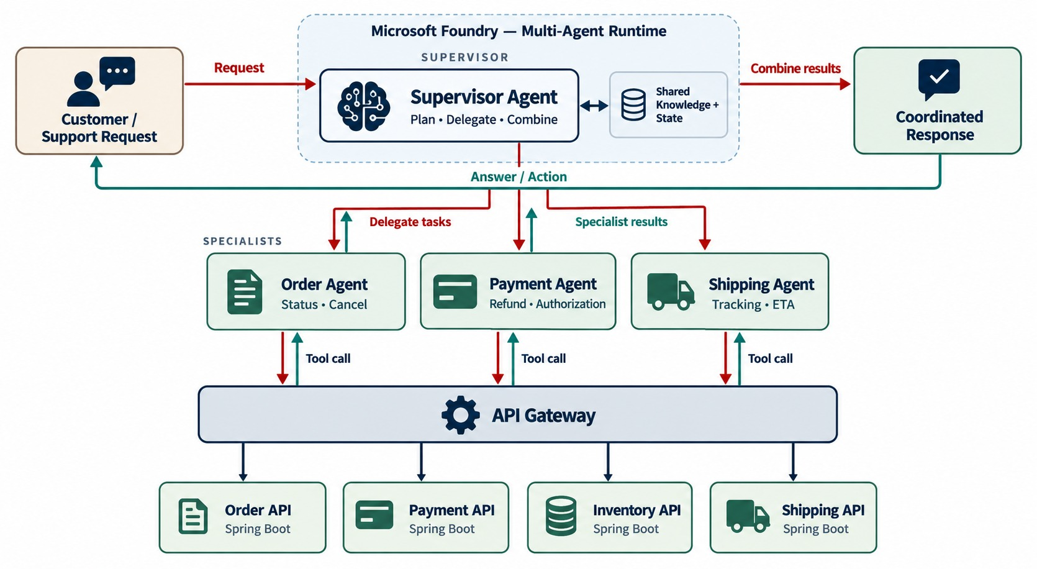
MULTI-AGENT WORKFLOW DESIGN
Specialized agents coordinating tasks.
Supervisor
Breaks the goal down and routes work to specialists.
Specialists
Order, Payment and Shipping agents with narrow tools.
TRADE-OFFS
!
More model calls and cost
!
Harder tracing
!
Agents misunderstanding each other
KEY TAKEAWAY Specialized agents can help complex domains — but every extra agent adds cost and complexity.
26
© 2026 by Innovation In Software Corporation
Notes:
KEY TALKING POINTS
------------------
- Specialized agents
A multi-agent system gives each agent a specialty.
The Order Agent knows the order lifecycle and cancellation rules.
The Payment Agent knows capture, refunds and payment status, and the Shipping Agent knows shipment status and carrier information.
- The supervisor
A supervisor agent takes the goal, delegates to the specialists, collects their results and resolves the case.
- A warning
More agents does not mean better architecture.
Multi-agent systems add coordination complexity, latency, state and cost.
They also make debugging harder and add security boundaries.
- When to use it
Use them when specialization actually helps.
If one deterministic workflow works, don't add five agents just because multi-agent sounds advanced.
- What the diagram shows
A supervisor agent coordinating specialized Order, Payment and Shipping agents.
- Key point
Specialized agents help complex domains, at extra cost and complexity.

Slide 27
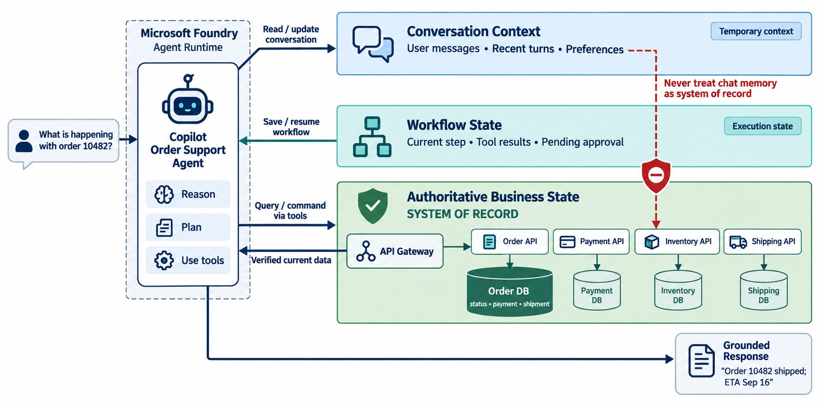
AGENT STATE, MEMORY, AND CONTEXT
Conversation state, workflow state, durable state and context limits.
Conversation context
What the user said — trimmed to fit the context window.
Workflow state
Steps done, pending approvals — stored durably.
Business state
Orders and payments — only in the owning services.
KEY TAKEAWAY Keep conversation, workflow and business state separate — services own the facts.
27
© 2026 by Innovation In Software Corporation
Notes:
KEY TALKING POINTS
------------------
- Three layers
Short-term context is the current conversation, such as 'earlier the user said order 1001'.
Workflow state tracks progress, like orderChecked true and paymentChecked false.
Business state is the authoritative enterprise data.
- Don't confuse them
Do not confuse AI memory with source-of-truth business data.
Order status, payment status and inventory quantity must come from the Order, Payment and Inventory services.
- An example
Order status SHIPPED should come from the Order service and its database.
It should not come from something the model remembers from the conversation.
- Link to Module 5
This keeps the data-ownership principles from Module 5.
- What the diagram shows
Conversation context, workflow state and the authoritative business state, kept separate.
- Key point
Services own the business facts; the agent only tracks its work.

Slide 28
EXERCISE: DESIGN TOOLS AND STOP CONDITIONS
Turn a business goal into a bounded agent design.
PRACTICE EXERCISE
12 MIN
SCENARIO
YOUR TASKS
EXPECTED OUTCOME
Support wants an agent that handles “my order hasn't arrived” requests.
It may look up orders and shipments, reship low-value orders and request refunds.
1
List the tools — read or state-changing
✓
Read: get_order, get_shipment
2
Decide which actions need human approval
✓
Action: request_reship, request_refund
Write three stop conditions
✓
Approval: refunds and reships above a limit
3
4
Say where workflow state is stored
✓
Stop: resolved, 8 steps, unclear intent → human
✓
State in a workflow store — not the chat
KEY TAKEAWAY Define read and action tools, approval rules and stop conditions before any prompt is written.
28
© 2026 by Innovation In Software Corporation
Notes:
KEY TALKING POINTS
------------------
- Tools
Lookups are read tools.
Reships and refunds are action tools that create requests rather than acting directly.
- Approval
Refunds always need approval; reships may be automatic below a value limit set by the business.
- Stop conditions
Stop when resolved, after a step or time limit, or when the request is unclear or out of policy — then hand over to a person.

Slide 29
PART 4: MICROSERVICE ORCHESTRATION
Agents act through our services — never around them.
✓ Part 1
Agent fundamentals
✓ Part 2
Microsoft ecosystem
✓ Part 3
Workflow design
Part 4
Orchestration
Part 5
Enterprise controls
SO FAR
NEXT QUESTION
How should an agent use the Order, Payment, Inventory and Shipping services?
✓
Tools are narrow, typed and described
✓
Loops have allow-lists, approvals and limits
IN THIS PART
Services own the business state
1
AI-assisted API orchestration
✓
2
A Spring Boot tool adapter — in code
3
Agents with Spring Boot microservices
4
Event-driven agentic workflows
5
Exercise: investigate a failed payment
29
© 2026 by Innovation In Software Corporation
Notes:
KEY TALKING POINTS
------------------
- Why this part
This is where agents meet everything from Modules 1–8: boundaries, APIs, events and security.
- What comes next
Orchestrating API calls, exposing a safe tool endpoint, using the gateway and events, and a support scenario.

Slide 30
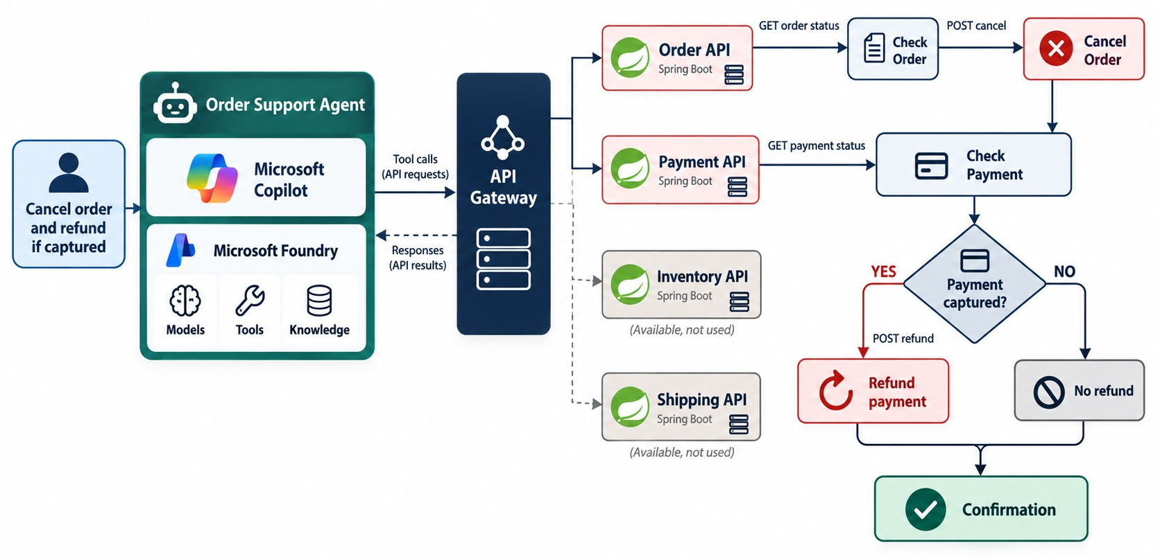
AI-ASSISTED API ORCHESTRATION
An agent choosing and calling multiple APIs based on intent.
Decision path
Check order → cancel → check payment → refund only if captured.
Business rules
The Order and Payment services still enforce them — the agent can't skip them.
IDEMPOTENCY Retries must never refund twice.
KEY TAKEAWAY The agent maps business intent to a sequence of API decisions — within the business rules.
30
© 2026 by Innovation In Software Corporation
Notes:
KEY TALKING POINTS
------------------
- Where agents meet microservices
This is where agentic AI becomes relevant to microservices.
The user says: cancel order 1001 and refund it if the payment has already been captured.
- The decision path
The agent gets the order status and asks if cancellation is allowed; if not, it explains why.
If yes, it cancels the order and gets the payment status.
If the payment wasn't captured, it finishes.
If it was, it refunds, verifies the result and responds.
- Intent to APIs
The user gives business intent: cancel and refund if appropriate.
The system offers technical capabilities: GET the order, PATCH to cancel, GET the payment, POST a refund.
The agent maps intent to a sequence of API decisions.
- Still bound by rules
This differs from a hard-coded workflow because the model may choose tools based on context.
But every action must still obey business rules.
- What the diagram shows
“Cancel the order and refund if captured”: the agent checks the order, cancels it, checks the payment and refunds only if needed.
- Key point
The agent maps intent to a sequence of API decisions.

Slide 31
A SAFE TOOL ENDPOINT IN SPRING BOOT
The agent requests; the service validates, authorizes, records and waits for approval.
✓
AgentToolController.java
Narrow scope
@RestController
@RequestMapping("/api/v1/agent-tools/orders")
class AgentToolController {
@PostMapping("/{orderId}/cancellation-requests")
@PreAuthorize("hasAuthority('SCOPE_orders.cancel.request')")
ResponseEntity<CancellationRequest> requestCancellation(
@PathVariable String orderId,
@RequestHeader("Idempotency-Key") String key,
@Valid @RequestBody CancellationReason body,
@AuthenticationPrincipal Jwt caller) {
CancellationRequest req = cancellations.request(
orderId, body.reason(), key, caller.getSubject());
audit.record("CANCEL_REQUESTED", orderId, caller.getSubject());
return ResponseEntity.accepted().body(req); // PENDING_APPROVAL
}
}
orders.cancel.request — not orders.admin.
Idempotent
A repeated tool call returns the same request.
202 Accepted
Nothing is cancelled until a person approves.
SAME RULES Order Service still checks the order's state.
KEY TAKEAWAY Expose agent actions as narrow, idempotent, audited requests — the service keeps the final say.
31
© 2026 by Innovation In Software Corporation
Notes:
KEY TALKING POINTS
------------------
- Authorization
The caller's token must carry a narrow scope for requesting cancellations, not a broad admin role.
- Idempotency
Agents retry.
The Idempotency-Key makes a repeated call return the same pending request.
- Approval
The endpoint returns 202 with a pending request.
A separate, human-only endpoint approves it.
- Audit
Every request records who asked, for which order and when.

Slide 32
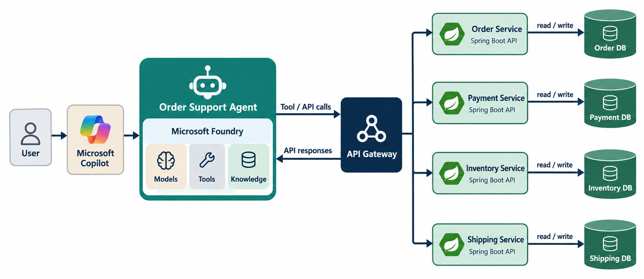
AGENTIC WORKFLOW WITH SPRING BOOT MICROSERVICES
Agent → API gateway → Order, Payment, Inventory and Shipping services.
BAD DESIGN
✕
Direct database access
✕
A shared super-user token
✕
Calling internal-only endpoints
Better design
Through the gateway, with the user's or a scoped workload identity.
WHY Validation, security and audit already live in the services.
KEY TAKEAWAY Agentic AI must respect the service boundaries established by the microservices.
32
© 2026 by Innovation In Software Corporation
Notes:
KEY TALKING POINTS
------------------
- Boundaries stay valid
Connect back to Module 2: microservice boundaries still apply.
The flow is user or Copilot, AI agent, API gateway, then the Order, Payment, Inventory and Shipping services, each with its own database.
- Bad design
A bad design lets the agent run SQL directly against the Order database and the Payment database.
- Better design
A better design has the agent go through the API gateway and approved tools to reach the Order and Payment services.
- Why
The service layer owns validation, authorization, business rules, transactions and data ownership.
Agentic AI should not destroy the architecture that microservices established.
- What the diagram shows
A user or Copilot calling an agent, which goes through the API gateway to the Order, Payment, Inventory and Shipping services and their own databases.
- Key point
Agents respect the same service boundaries as any client.

Slide 33
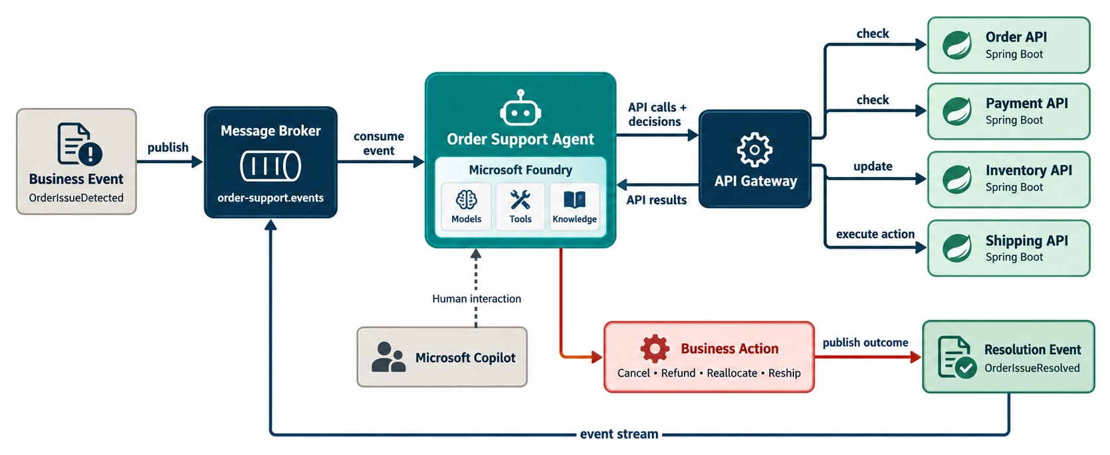
EVENT-DRIVEN AGENTIC WORKFLOWS
Events trigger agents; agents invoke services and publish outcomes.
An example
PaymentFailed
→ Incident agent investigates
→ calls Payment + Order APIs
→ publishes IssueTriaged
Idempotent consumer
The agent may receive the same event twice.
MODULE 4 Events, DLQs and correlation IDs still apply.
KEY TAKEAWAY Events can start agents, and agents can publish events — powering autonomous operations.
33
© 2026 by Innovation In Software Corporation
Notes:
KEY TALKING POINTS
------------------
- Not only chat
Agents don't have to start from a chat message.
They can be triggered by events, schedules, alerts or workflow state changes.
- An event-driven example
A ShipmentDelayed event is published to the message broker, and a support agent receives it.
It gets the order and shipment, and works out how serious the delay is.
It notifies the customer, escalates if it's a high-value order, and publishes a resolution event.
- Microsoft tooling
Copilot Studio supports autonomous agents with triggers and actions.
Its workflows can include conditions, loops, flows built in natural language, and agent steps that need AI reasoning or tools.
- Link to Module 4
Event-driven architecture plus agent reasoning gives an event-driven agentic workflow.
- What the diagram shows
A business event on the message broker triggering an agent, which calls APIs, decides, acts and publishes a resolution event.
- Key point
Events can start agents, and agents can publish events.

Slide 34
EXERCISE: INVESTIGATE A FAILED PAYMENT
Design an assistant that investigates — and drafts, but doesn't send.
PRACTICE EXERCISE
12 MIN
SCENARIO
YOUR TASKS
EXPECTED OUTCOME
An AI assistant is asked to investigate why a customer's payment failed and draft a response for the support agent.
1
Which microservice APIs should it call?
✓
Read: payment, transaction and order status
2
Which data must be masked?
✓
Mask account numbers and personal data
3
Should it send the response automatically?
✓
No — a person reviews and sends
4
What is logged — and what if Transaction Service is down?
✓
Log tools, IDs, correlation and outcome
✓
Service down → say so, don't guess
KEY TAKEAWAY Read-only tools, masked data, a human sender, full audit — and honest answers when a service is down.
34
© 2026 by Innovation In Software Corporation
Notes:
KEY TALKING POINTS
------------------
- APIs
Only read tools are needed: payment status, the transaction and the order.
- Data and sending
Mask account numbers and personal data in the prompt and the draft.
A support agent reviews and sends the reply.
- Failure
If Transaction Service is unavailable, the assistant reports that it couldn't check, rather than inventing a reason.

Slide 35
PART 5: ENTERPRISE CONTROLS
Identity, policy, approval, reliability and audit for every agent action.
✓ Part 1
Agent fundamentals
✓ Part 2
Microsoft ecosystem
✓ Part 3
Workflow design
✓ Part 4
Orchestration
Part 5
Enterprise controls
SO FAR
NEXT QUESTION
How do we trust an agent in a regulated enterprise?
✓
Agents call services through the gateway
✓
Tool endpoints are narrow and idempotent
IN THIS PART
✓
Events can start agent workflows
Guardrails and human approval — in code
1
2
Model versus policy — and Exercise 5.1
3
Reliability and observability
4
Enterprise use cases
5
The complete architecture
35
© 2026 by Innovation In Software Corporation
Notes:
KEY TALKING POINTS
------------------
- Why this part
In banking, an agent's action must be as controlled and explainable as a person's.
- What comes next
Approval gates, the model-policy boundary from Lab 5, reliability, use cases and the full picture.

Slide 36
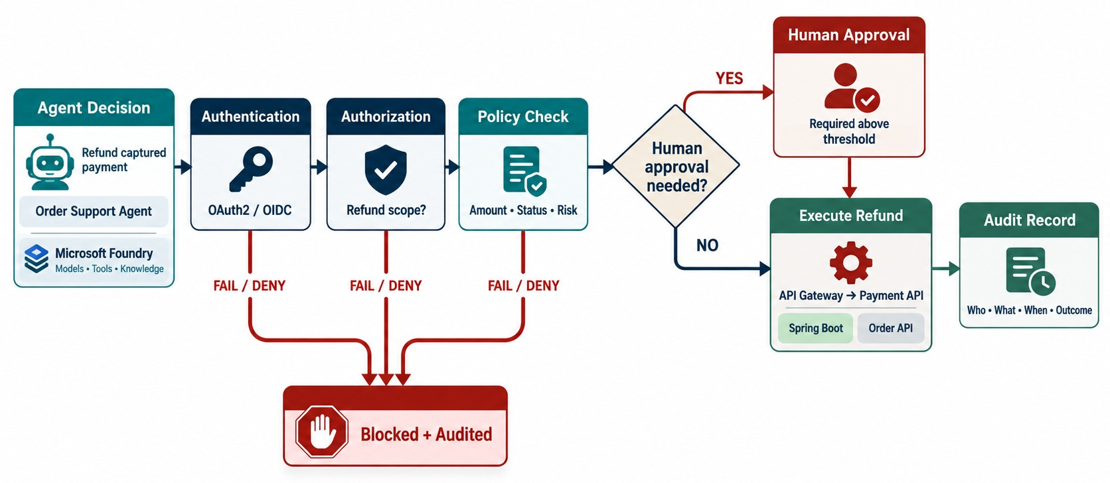
GUARDRAILS, SECURITY, AND HUMAN APPROVAL
Authorization, data boundaries, approval gates and auditability.
Identity
The agent acts as the user — or a scoped workload identity.
Policy
Deterministic rules decide what's allowed; the model doesn't.
Approval
High-risk actions wait for a person with the right role.
AUDIT Who asked, what ran, who approved, the outcome.
KEY TAKEAWAY Every agent action passes identity, authorization, policy and — when risky — human approval.
36
© 2026 by Innovation In Software Corporation
Notes:
KEY TALKING POINTS
------------------
- Security is not optional
A tool request passes through authentication, authorization and a policy check.
If it's high-risk, it needs human approval before it executes, and everything is audited.
- Identity and least privilege
Authentication asks who or what the agent is acting as.
Authorization asks what that identity may do.
An order-support agent should not get database admin, cluster admin or payroll access.
- Allow-lists and approval
Expose only approved operations through a tool allow-list.
A high-risk action like a five-thousand-dollar refund may need approval; a low-risk action like getting shipment status may not.
- Audit trail
Record who asked, what the agent decided, which tool it called, with what parameters, and what happened.
Also apply input and output validation, data isolation, rate limits and secret management.
- Microsoft guidance
Microsoft's guidance for autonomous agents stresses triggers, instructions and guardrails.
It is also adding safe-sharing controls to reduce unsafe sharing of identities or credentials in agent workflows.
- What the diagram shows
An agent decision passing authentication, authorization and a policy check, then human approval if needed, execution and audit.
- Key point
Every agent action is identified, authorized, checked and audited.

Slide 37
MODEL SCORES, POLICY DECIDES, PEOPLE APPROVE
Lab 5's boundary in code: a model failure becomes HOLD, never APPROVE.
ModelClient.java
✓
AssessmentService.java
public ModelResult score(Transaction tx) {
try {
return modelApi.post()
.uri("/v1/score")
.body(ScoreRequest.from(tx)) // no PII
.retrieve()
.body(ModelResult.class);
} catch (RestClientException e) { // timeout or 5xx
log.warn("Model unavailable transactionId={}", tx.id());
return ModelResult.unavailable();
}
}
@Transactional
public Assessment assess(TransactionSubmitted event) {
ModelResult model = modelClient.score(event.transaction());
Decision decision = policyEngine.decide(model, event.amount());
Assessment a = Assessment.of(event, model, decision);
if (decision.isHold())
a.markPendingReview(); // needs risk.write to resolve
return assessments.save(a);
}
Model
Policy
People
Returns a score and metadata — never a disposition.
Deterministic Java decides APPROVE, HOLD or DECLINE.
A reviewer with risk.write resolves every HOLD.
KEY TAKEAWAY Keep the model advisory: deterministic policy decides, failures fail safe, and people review holds.
37
© 2026 by Innovation In Software Corporation
Notes:
KEY TALKING POINTS
------------------
- ModelClient
It calls the model endpoint with a minimal request.
A timeout or server error returns an unavailable result instead of throwing.
- PolicyEngine
The Java policy table from Module 9 turns the score into a decision.
Model unavailable always becomes HOLD.
- Human review
HOLD assessments stay pending until someone with risk.write approves or declines them.
- The principle
The AI never approves money movement on its own.

Slide 38
EXERCISE 5.1 — MAP MODEL CALL → POLICY → DISPOSITION
Day 5 checkpoint A: clarity on the governance boundary.
OFFICIAL CHECKPOINT A
10 MIN
labs/day-05/exercises/exercise-5.1-model-policy-disposition.md
SCENARIO
YOUR TASKS
EXPECTED OUTCOME
Lab 5's Risk Assessment Service consumes TransactionSubmitted, calls a model on OpenShift AI, and records a disposition.
Scope: Account, Transaction and Risk Assessment only.
1
The model returns a score and metadata — it does not approve, hold or decline
✓
A three-box map
✓
Model (score) → Policy (disposition)
2
PolicyEngine is deterministic Java; HOLD routes to a human with risk.write
✓
→ Human review (HOLD only)
✓
Model failure is a HOLD
3
Timeout or 5xx → HOLD MODEL_UNAVAILABLE — never auto-approve
4
Workbenches and KServe stay lecture — call HTTP :8090 or MD287_MODEL_ROUTE
KEY TAKEAWAY A three-box map: Model (score) → Policy (disposition) → Human review (HOLD only).
38
© 2026 by Innovation In Software Corporation
Notes:
KEY TALKING POINTS
------------------
- Official checkpoint
This is the official OUTLINE.md checkpoint.
Use the worksheet in labs/day-05/exercises.
- The boundary
The model scores, the Java policy decides, and a person reviews every HOLD.
- Failure
When the model times out or errors, the result is HOLD MODEL_UNAVAILABLE — never an automatic approval.

Slide 39
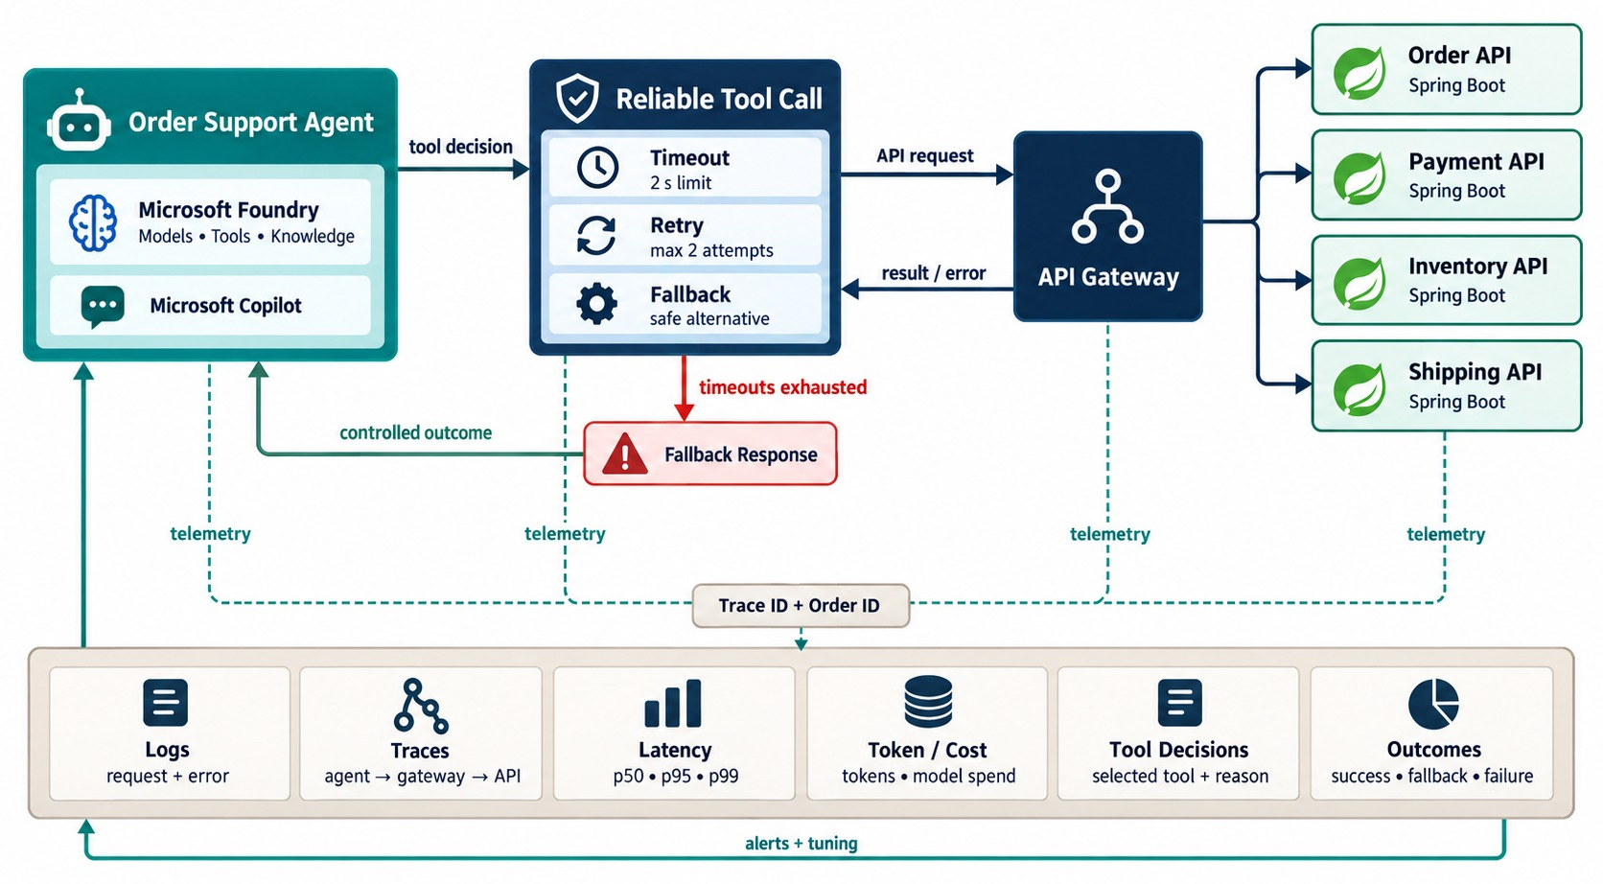
RELIABILITY AND OBSERVABILITY FOR AI AGENTS
Timeouts, retries, tool failures, tracing and token/cost monitoring.
An agent audit record
{
"agentRunId": "run-7f31",
"tool": "request_order_cancellation",
"caller": "user-2231",
"correlationId": "c-9a8e",
"outcome": "PENDING_APPROVAL",
"tokens": 1840, "latencyMs": 2310
}
WATCH
Tool errors
Steps per run
Token cost
Escalations
KEY TAKEAWAY Make the whole reasoning-and-action path resilient and observable.
39
© 2026 by Innovation In Software Corporation
Notes:
KEY TALKING POINTS
------------------
- Two uncertain layers
Agentic systems combine AI reasoning with distributed systems, and both can fail in surprising ways.
So Module 6 becomes very relevant.
- Timeouts and retries
What if the Payment API takes too long?
That needs a timeout.
Should the call be retried?
Be careful with actions that change data.
refundPayment must be idempotent, meaning a repeat call does no extra harm, or be protected against duplicates.
- Circuit breakers and fallback
What happens when the Shipping Service is down?
A circuit breaker stops calling it for a while.
A sensible fallback may be to escalate the case to a human instead of retrying again and again.
- Observability
Record the goal, agent decision, tool chosen, arguments, result, latency, errors, tokens and cost, and outcome.
Traditional tracing asks which service failed.
Agent tracing also asks why the agent chose that tool, what context it had, and what result shaped the next decision.
- What the diagram shows
An agent's tool calls protected by timeouts, retries and fallbacks, plus logs, traces, latency, token cost, tool decisions and outcomes.
- Key point
Make the reasoning path as observable as the service calls.

Slide 40
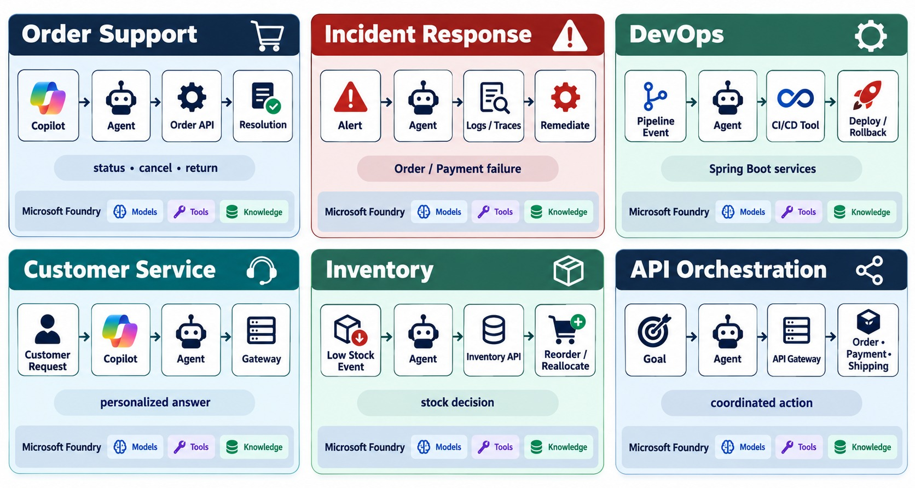
ENTERPRISE USE CASES IN MICROSERVICES ENVIRONMENTS
Operations, support, incident handling, order workflows and developer automation.
GOOD FITS
✓
The goal spans several services
✓
Steps are repetitive but vary
✓
Tools and data are well governed
POOR FITS
✕
A fixed rule is enough
✕
No clear owner or audit
START read-only, then add approved actions.
KEY TAKEAWAY Agentic AI adds the most value where a goal spans several enterprise services.
40
© 2026 by Innovation In Software Corporation
Notes:
KEY TALKING POINTS
------------------
- Order support and incidents
An order support agent answers 'where is my order?' by combining the Order, Payment and Shipping services.
An incident response agent reacts to an error-rate alert: it checks metrics, looks at recent deployments and summarizes the likely cause.
Destructive fixes stay behind approval.
- Developer operations
A developer operations agent can get pipeline status, deployment status, pod failures and logs from Git, CI/CD and OpenShift.
- Customer service and inventory
A customer service agent handles a ticket using customer, billing and order data.
An inventory exception agent reacts to LowStockDetected and recommends restocking with supplier data.
- API orchestration
An API orchestration agent turns a business goal in natural language into a controlled API workflow.
This is one of the strongest business cases for agentic AI.
- What the diagram shows
Six panels: order support, incident response, DevOps, customer service, inventory and API orchestration.
- Key point
Agents add value where one goal spans several services.

Slide 41
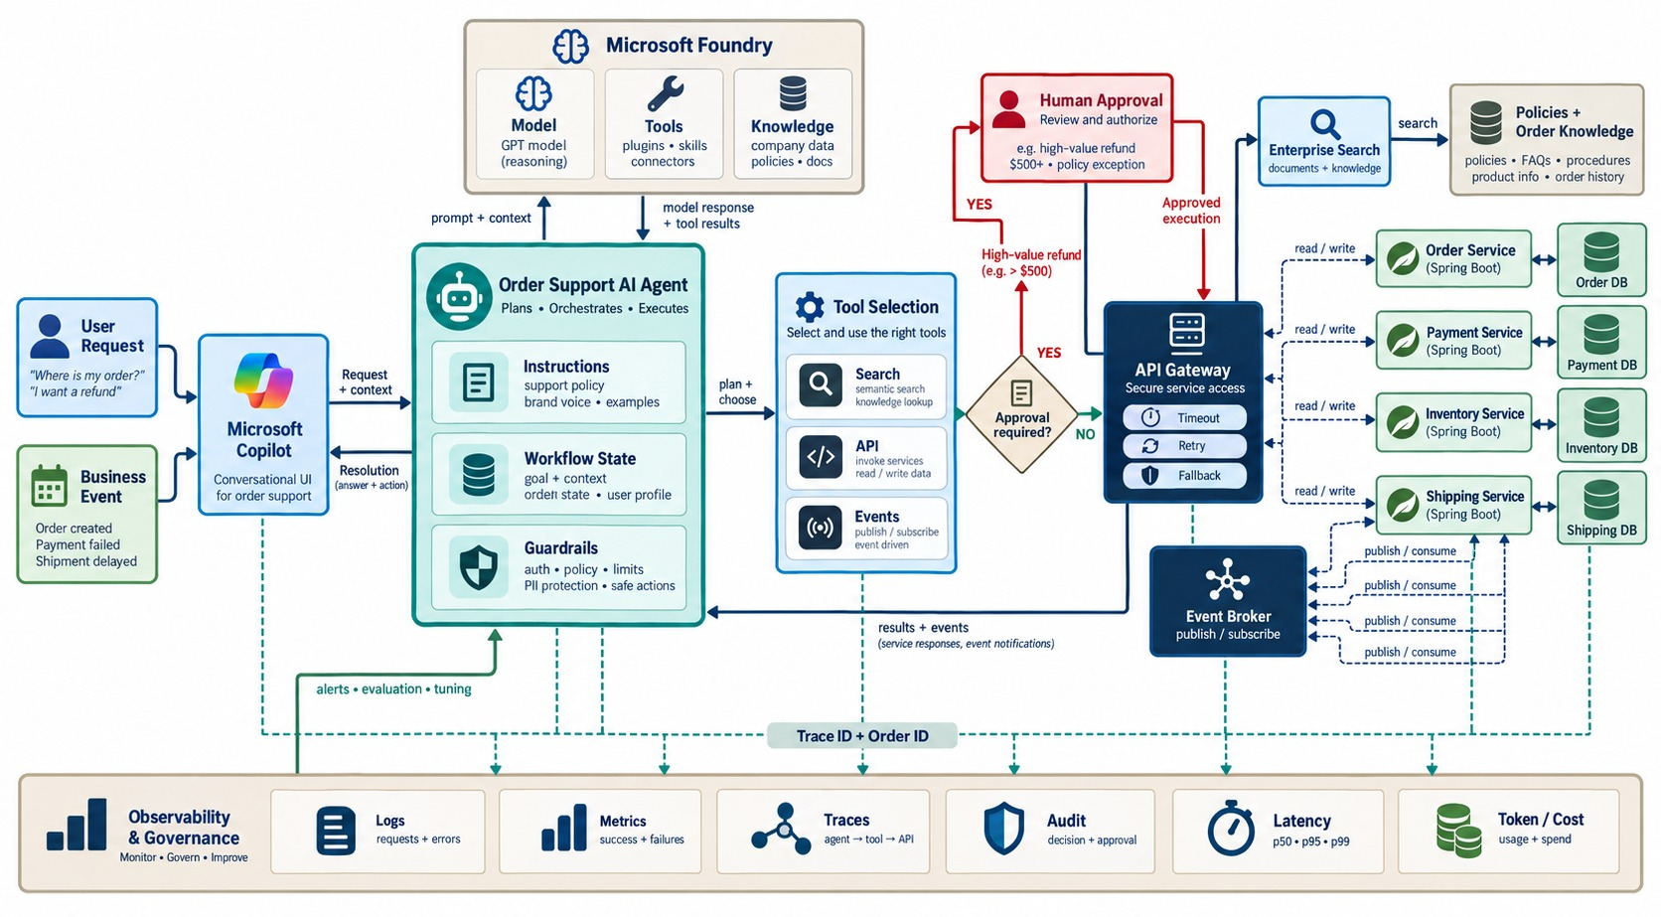
END-TO-END AGENTIC AI MICROSERVICES ARCHITECTURE
User/Copilot → agent → Microsoft AI → tools/APIs → microservices → observability.
EVERY PART OF THE MODULE
✓
Agent with instructions, state, guardrails
✓
Foundry model requests tools
✓
Tools reach services via the gateway
✓
Services and policy keep authority
✓
Approval, audit, traces and cost
REMEMBER Agents orchestrate above the services.
KEY TAKEAWAY Agents orchestrate above enterprise capabilities — never bypassing APIs, data ownership or controls.
41
© 2026 by Innovation In Software Corporation
Notes:
KEY TALKING POINTS
------------------
- Goal, interface, agent
A goal comes from a user or a business event, like OrderDelayed.
Copilot or another interface presents the agent, but the interface isn't the intelligence itself.
The agent gets instructions, such as never refunding over five hundred dollars without approval, plus state and guardrails.
- Model and tools
The model, through Microsoft Foundry, reasons over the goal: what do I know, what do I need, which tool should I use?
The agent calls approved tools like getOrder, getPayment, cancelOrder, refundPayment and getShipment.
- Services stay authoritative
Tools call the Spring Boot services, which still enforce domain rules, transactions, authorization and data ownership.
Each service owns its database.
Messaging events like OrderCreated, ShipmentDelayed or PaymentFailed can start or continue workflows.
- Approval and observability
High-risk actions need approval: the agent recommends a refund, a human approves, then it runs.
Record the trigger, tool decision, API call, result, latency, failures and final outcome, and feed that back.
- Final message
Agentic AI adds an intelligent orchestration layer above enterprise capabilities.
Spring Boot microservices stay authoritative for business logic and data.
Identity, authorization, guardrails, human approval, observability and auditing decide how much autonomy the agent really gets.
- What the diagram shows
A user or event reaching Copilot and an agent with instructions, state and guardrails, Microsoft Foundry and a model, tools reaching search, the gateway and broker, Spring Boot services and databases, with approval, audit and observability.
- Key point
Agents orchestrate above the services — never around them.

Slide 42
AGENTIC AI MISCONCEPTIONS AND ANTI-PATTERNS
Beliefs and habits that make agents unsafe, costly or unreliable.
MISCONCEPTION
REALITY
ANTI-PATTERNS TO AVOID
Any chatbot is an agent
Agents plan and act through tools
✕
Direct database access for agents
✕
One super-user token for all tools
✕
No step, time or cost limits
The model can decide approvals
Deterministic policy and people decide
✕
Sending customer data unmasked
✕
Auto-executing refunds or freezes
✕
No tracing of tool decisions
More agents mean better results
Start with one; add only when needed
REMEMBER Controlled autonomy over governed capabilities.
The agent remembers business facts
Services own the current state
Autonomy removes the need for audit
More autonomy needs more audit
KEY TAKEAWAY Useful agents have narrow tools, clear limits, human approval for risk and full audit.
42
© 2026 by Innovation In Software Corporation
Notes:
KEY TALKING POINTS
------------------
- Why this slide
Before the knowledge check, clear away the beliefs behind most unsafe agent designs.
- Authority
The model advises.
Policy, services and people make the binding decisions.
- Design
Multi-agent systems add cost and failure modes, and business facts belong in services, not the agent's memory.
- Anti-patterns
Database access, super-user tokens, unbounded loops, unmasked data, auto-executed high-risk actions and untraced decisions.

Slide 43
KNOWLEDGE CHECK
Answer in your own words — then compare with a partner.
What is agentic AI?
Why is API orchestration useful for agents?
1
6
How does an agent differ from a chatbot?
What data shouldn't be sent to AI services?
2
7
Why should agent tools be limited?
Why are audit logs important for agents?
3
8
What is a human-in-the-loop workflow?
What is a stop condition?
4
9
Name two Microsoft services for AI workflows.
Why must high-risk banking actions be approved?
5
10
43
© 2026 by Innovation In Software Corporation
Notes:
KEY TALKING POINTS
------------------
- 1. Agentic AI
AI that uses models, goals, tools and multi-step reasoning to complete tasks.
- 2. Agent vs. chatbot
An agent uses tools and continues through a workflow; a chatbot usually just answers.
- 3. Limited tools
They reduce risk and enforce least privilege.
- 4. Human-in-the-loop
AI prepares or recommends; a person approves before execution.
- 5. Microsoft services
For example Copilot Studio, Microsoft Foundry, Azure OpenAI, Azure AI Search, API Management, Key Vault and Azure Monitor.
- 6. API orchestration
It lets agents gather data and complete steps across several services.
- 7. Data
Customer data, account numbers, passwords, tokens, keys and unnecessary regulated information.
- 8. Audit logs
They show what the agent did, which tools it called and who approved.
- 9. Stop condition
A rule that tells the agent to stop, escalate or ask for help.
- 10. Approval
High-risk actions affect customers, money, compliance and legal outcomes.
- Practical scenario
Investigating a failed payment: read-only calls, masked data, a person sends the reply, everything logged, and an honest message if a service is down.

Slide 44
MODULE 10 SUMMARY AND WHAT'S NEXT
From prompt-response AI to controlled agents acting on microservices.
YOU CAN NOW
NEXT: MODULE 11 — MCP AND MICROSERVICES
Explain agents, their components and the execution loop
1
How do agents discover tools in a standard way?
✓
Map agent needs to Copilot Studio, Foundry and grounding
2
How do we expose Spring Boot APIs as MCP tools?
✓
Design narrow tools, bounded loops and stop conditions
How do we secure and scale MCP servers?
✓
3
Orchestrate Spring Boot services through safe tool endpoints
✓
Keep policy, approval and audit around every action
BRING ALONG The tools you designed today — Module 11 standardizes them with MCP.
✓
KEY TAKEAWAY Module 11 gives agents one standard, secure way to reach microservice capabilities.
44
© 2026 by Innovation In Software Corporation
Notes:
KEY TALKING POINTS
------------------
- Recap
We defined agents, mapped them to Microsoft services, designed tools and loops, orchestrated microservices and wrapped everything in enterprise controls.
- Next module
Module 11 introduces the Model Context Protocol, the standard way to expose tools and context to agents.

