Slide 1
"The agent reasons, MCP connects, the microservice stays the authority."
MODULE 11
Model Context Protocol
(MCP) and Microservices
Standardized AI access to enterprise capabilities.
MCP concepts
Clients and servers
Tools, resources, prompts
Calling Spring Boot services
Designing MCP-enabled services
Agent-to-backend integration
Security and authorization
Enterprise MCP patterns
SPRING BOOT MICROSERVICES BOOTCAMP • MODULE 11
Notes:
KEY TALKING POINTS
------------------
- The next question
Module 10 showed an agent reasoning, selecting a tool and calling an enterprise API.
The next question is: how should AI applications discover and use all these tools consistently?
- Without a common protocol
Without one, each agent needs custom integrations for Order, Payment, Inventory, Shipping and DevOps.
- What MCP adds
MCP, the Model Context Protocol, adds a standard interface.
The agent talks to MCP, and MCP exposes enterprise capabilities backed by the microservices.
- The central message
The agent reasons, MCP standardizes access, and the microservice stays responsible for the business operation.

Slide 2
LEARNING OBJECTIVES
MCP architecture, servers, clients, tools, microservices, security and design patterns.
🎯
BY THE END OF THIS MODULE, YOU CAN
🧭
FIVE SECTIONS
1. Explain why MCP exists
2. Describe MCP host / client / server roles
3. Differentiate tools, resources and prompts
4. Map REST APIs to MCP tools
5. Design useful MCP tool contracts
6. Connect MCP to Spring Boot microservices
7. Design scalable MCP servers
8. Apply authentication and authorization
9. Integrate agents with multiple services
10. Handle long-running operations
11. Monitor MCP interactions
12. Identify practical enterprise patterns
MCP fundamentals
1
Host → Client → Server
Capabilities
2
Tools · Resources · Prompts
Microservices integration
3
MCP → REST API → Spring Boot
Production architecture
4
Gateway · Security · Scaling · Observability
REMEMBER The agent reasons, MCP connects, the microservice stays the authority.
Agentic orchestration
5
Agent → MCP → multiple microservices → business outcome
KEY TAKEAWAY MCP gives agents a standard, secure way to reach microservice capabilities.
2
© 2026 by Innovation In Software Corporation
Notes:
KEY TALKING POINTS
------------------
- By the end of this module
Learners should explain why MCP exists, the host, client and server roles, and the difference between tools, resources and prompts.
They should map REST APIs to tools, design good tool contracts and connect MCP to Spring Boot.
They should design scalable servers, apply authentication and authorization, and integrate agents with several services.
They should also handle long-running operations, monitor MCP calls and recognize practical patterns.
- Five sections
Section 1 is MCP basics: host, client, server.
Section 2 is capabilities: tools, resources and prompts.
Section 3 is microservices integration: MCP, REST API, Spring Boot.
Section 4 is production architecture: gateway, security, scaling and observability.
Section 5 is agentic orchestration across multiple microservices.
- Keep repeating
The agent reasons, MCP connects, and the microservice remains the business authority.

Slide 3
KEY TERMS FOR THIS MODULE
Plain definitions for the words we'll use most.
1
Model Context Protocol
2
MCP host
An open standard for connecting AI applications to tools and data.
The AI application the user works in, such as an IDE or an agent.
3
MCP client
4
MCP server
The connector inside the host that talks to one MCP server.
A program that exposes tools, resources and prompts over MCP.
5
Tool
6
Resource
An action the model can invoke, such as get_order or request_refund.
Read-only context the server exposes, such as a refund policy document.
7
Prompt template
8
JSON-RPC
A reusable interaction the server offers, chosen by the user.
The simple request-and-response message format MCP uses on the wire.
KEY TAKEAWAY Agree on the words first — every later slide builds on them.
3
© 2026 by Innovation In Software Corporation
Notes:
KEY TALKING POINTS
------------------
- How to run this slide
Read each term once and give a quick example from the order platform or the banking lab.
- Model Context Protocol
An open standard for connecting AI applications to tools and data.
- MCP host
The AI application the user works in, such as an IDE or an agent.
- MCP client
The connector inside the host that talks to one MCP server.
- MCP server
A program that exposes tools, resources and prompts over MCP.
- Tool
An action the model can invoke, such as get_order or request_refund.
- Resource
Read-only context the server exposes, such as a refund policy document.
- Prompt template
A reusable interaction the server offers, chosen by the user.
- JSON-RPC
The simple request-and-response message format MCP uses on the wire.

Slide 4
FULL FORMS USED IN THIS MODULE
Every abbreviation on these slides, spelled out.
AI
Artificial Intelligence
JWT
JSON Web Token
RPC
Remote Procedure Call
API
Application Programming Interface
MCP
Model Context Protocol
SQL
Structured Query Language
HTTP
HyperText Transfer Protocol
OAuth
Open Authorization
TLS
Transport Layer Security
ID
Identifier
OIDC
OpenID Connect
URI
Uniform Resource Identifier
IDE
Integrated Development Environment
PAN
Primary Account Number
WAF
Web Application Firewall
JSON
JavaScript Object Notation
REST
Representational State Transfer
KEY TAKEAWAY When an abbreviation isn't clear, the full form is on this slide.
4
© 2026 by Innovation In Software Corporation
Notes:
KEY TALKING POINTS
------------------
- How to run this slide
Don't read every row.
Point out the few this module uses most, and say the full list is here for reference.
- Reference
AI is Artificial Intelligence; API is Application Programming Interface; HTTP is HyperText Transfer Protocol; ID is Identifier; IDE is Integrated Development Environment; JSON is JavaScript Object Notation; JWT is JSON Web Token; MCP is Model Context Protocol; OAuth is Open Authorization; OIDC is OpenID Connect; PAN is Primary Account Number; REST is Representational State Transfer; RPC is Remote Procedure Call; SQL is Structured Query Language; TLS is Transport Layer Security; URI is Uniform Resource Identifier; WAF is Web Application Firewall.

Slide 5
FROM MODULE 10 TO MODULE 11
Agents need tools — MCP gives them one standard, governed way to reach ours.
MODULE 10 GAVE US
🧭
OUR PATH THROUGH MODULE 11
1
What MCP is and how a request flows
Part 1
✓
Agents that plan and call tools
Narrow, typed tool definitions
2
Tools, resources, prompts, discovery
Part 2
✓
Bounded loops and stop conditions
3
Wrap Spring Boot APIs as MCP tools
Part 3
✓
Safe tool endpoints in Spring Boot
4
Design good tool contracts
Part 3
✓
Policy, approval and audit
5
Scale, gateway and security
Part 4
✓
NOW Standardize how agents discover and call microservice capabilities.
6
Reliability and tracing
Part 4
7
Orchestrate services through MCP
Part 5
KEY TAKEAWAY Module 10 designed agents; Module 11 connects them to microservices through one standard protocol.
5
© 2026 by Innovation In Software Corporation
Notes:
KEY TALKING POINTS
------------------
- Bridge from Module 10
In Module 10 every agent needed custom tool code.
MCP standardizes how tools and context are described, discovered and called.
- The path
Fundamentals, capabilities, wrapping microservices, production concerns, and orchestration across services.
- Two examples
The slides use the order platform.
Exercise 5.3 applies MCP controls to the banking Risk Assessment Service.

Slide 6
PART 1: MCP FUNDAMENTALS
Why a protocol — and which roles it defines.
Part 1
MCP fundamentals
Part 2
Capabilities
Part 3
Microservices
Part 4
Production
Part 5
Orchestration
SO FAR
NEXT QUESTION
Why do agents need a standard protocol to reach tools and context?
✓
Agents call tools to reach services
✓
Tools must be narrow and typed
IN THIS PART
✓
Services keep business authority
What MCP is
1
2
Why it matters for agentic AI
3
Host, client and server
4
How a request flows
5
The protocol messages — in JSON
6
© 2026 by Innovation In Software Corporation
Notes:
KEY TALKING POINTS
------------------
- Why start here
Without a standard, every AI app writes its own connector to every backend.
MCP solves that integration problem.
- What this part covers
The problem, the three roles, a request end to end, and what actually goes over the wire.

Slide 7
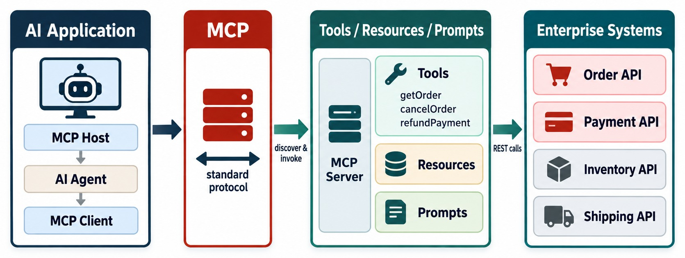
WHAT IS MODEL CONTEXT PROTOCOL?
Why MCP exists and what problem it solves.
An open standard
How AI applications discover and use tools, resources and prompts.
Not a replacement
Your REST APIs, security and business logic stay where they are.
ANALOGY Like a common plug shape for AI integrations.
KEY TAKEAWAY MCP is a standard protocol connecting AI applications to capabilities and context.
7
© 2026 by Innovation In Software Corporation
Notes:
KEY TALKING POINTS
------------------
- What MCP is
MCP is a protocol for connecting AI applications to outside capabilities and context in a standard way.
It exposes tools, resources and prompts that sit in front of enterprise systems.
- The problem without it
One agent needs Order, Payment, Git, file, database and search integrations.
Another AI application needs the same systems.
Without a standard, many AI applications times many integrations creates a lot of custom work.
- What it standardizes
MCP sets common concepts and message patterns for exposing capabilities.
- A careful analogy
REST standardized how many applications talk to HTTP services.
MCP standardizes a layer for AI applications to discover and use capabilities and context.
It is not simply 'REST for AI', but the analogy shows why a protocol boundary helps.
- What the diagram shows
An AI application using MCP to reach tools, resources and prompts in enterprise systems.
- Key point
MCP is the standard layer between AI applications and capabilities.

Slide 8
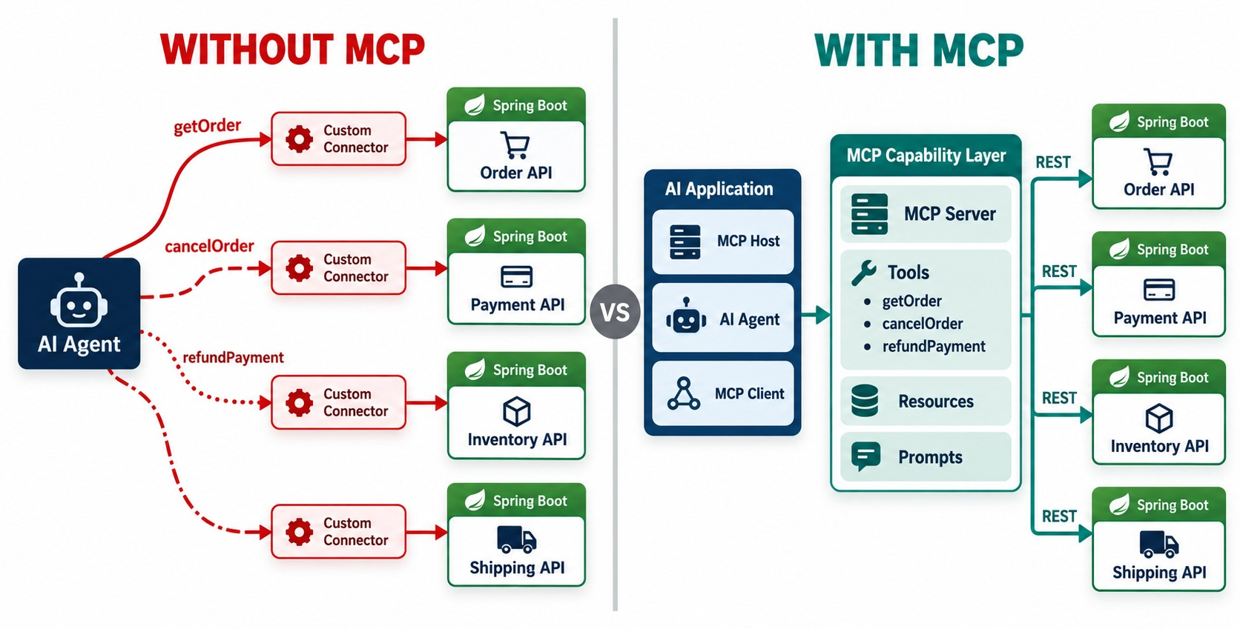
WHY MCP MATTERS FOR AGENTIC AI
Standardized tool and context access instead of custom integrations per agent.
Without MCP
N agents × M systems = N × M custom connectors to maintain.
With MCP
Each system exposes one MCP server; any client can use it.
MOST USEFUL when many AI clients need the same capabilities.
KEY TAKEAWAY MCP replaces one-off connectors with one standard way to find and call capabilities.
8
© 2026 by Innovation In Software Corporation
Notes:
KEY TALKING POINTS
------------------
- Without MCP
The agent needs a custom connector for Order, Payment, Shipping and Inventory.
Each connector follows its own conventions.
- With MCP
The agent uses an MCP client, which talks to a standard MCP interface on an MCP server.
That server exposes the enterprise services.
- What an agent needs to know
Recall Module 10.
An agent needs to know what capabilities exist and what parameters they need.
It also needs to know what each one does, how to call it and what result to expect.
MCP gives a standard way to describe and discover these.
- An example
An agent might discover getOrder, cancelOrder, getPayment, refundPayment and checkInventory.
The model reasons over their descriptions, instead of developers inventing a new convention for every agent.
- When it helps most
It is especially useful when many AI clients need access to many enterprise systems.
- What the diagram shows
A sprawl of custom connectors next to one standardized MCP capability layer.
- Key point
Build a capability once; every MCP-aware client can use it.

Slide 9
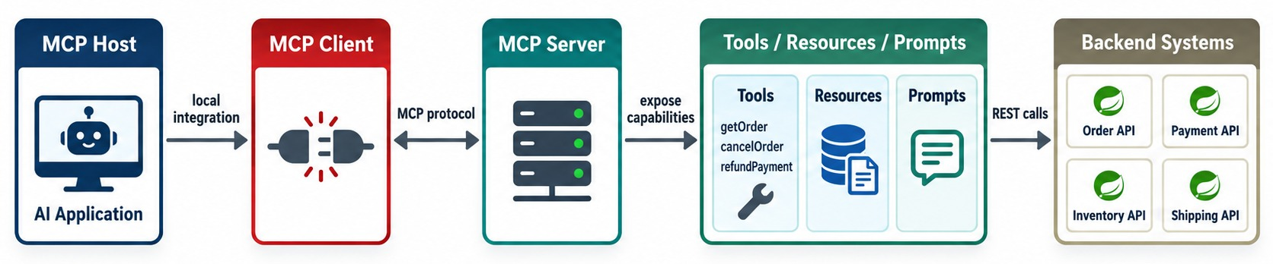
MCP ARCHITECTURE: HOST, CLIENT, AND SERVER
The core architectural roles.
Host
Client
Server
IMPORTANT The server holds no business data of its own.
The AI application — Copilot, an IDE or your agent.
Inside the host; one connection per MCP server.
Exposes capabilities and calls the real backend.
KEY TAKEAWAY Host holds the AI experience, the client speaks MCP, the server exposes capabilities.
9
© 2026 by Innovation In Software Corporation
Notes:
KEY TALKING POINTS
------------------
- The MCP host
The host is the application that contains the AI experience.
Examples are an AI assistant, an agent application, a developer tool or an enterprise copilot.
- The MCP client
The client is the component inside the host that communicates using MCP.
The host uses the client, and the client sends protocol messages.
- The MCP server
The server exposes selected capabilities: tools, resources and prompts.
In this course, a Commerce MCP Server sits in front of the Order, Payment, Inventory and Shipping APIs.
- An important point
An MCP server doesn't have to contain the actual business logic.
It can be an adapter in front of existing enterprise systems.
- What the diagram shows
The MCP host, client and server, with the server exposing tools, resources and prompts backed by backend systems.
- Key point
Host holds the experience, the client speaks MCP, the server exposes capabilities.

Slide 10
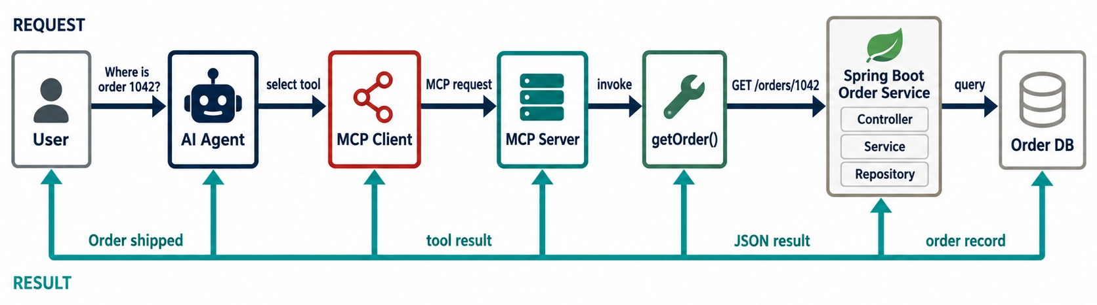
HOW AN MCP REQUEST FLOWS
AI host → MCP client → MCP server → backend capability → result.
STEP BY STEP
✓
Agent decides to call get_order
✓
Client sends tools/call
✓
Server calls GET /api/v1/orders/{id}
✓
Service validates, reads, returns
✓
Result goes back to the agent
SEPARATION Reasoning, protocol and business logic stay apart.
KEY TAKEAWAY A tool call flows agent → MCP → REST → Spring Boot, and the result returns to the agent.
10
© 2026 by Innovation In Software Corporation
Notes:
KEY TALKING POINTS
------------------
- Intent and reasoning
The user asks what's happening with order 1001.
The agent reasons that it needs order information, and sees a suitable capability: getOrder.
- Through MCP
The MCP client calls the MCP server with getOrder and orderId 1001.
The server maps that capability to GET /orders/1001.
- Inside Spring Boot
Spring Boot runs the business logic: OrderController, OrderService, OrderRepository, and the Order database.
The result goes back to the agent, which can answer or pick another tool.
- The separation
The agent understands business intent.
MCP exposes capabilities.
REST carries the backend request.
Spring Boot implements the business behavior.
- An abstraction layer
The agent deals with a meaningful tool like getOrder(orderId), not HTTP details.
That makes MCP an AI-facing abstraction layer.
- What the diagram shows
A user and agent calling getOrder through the MCP client and server, into the Spring Boot Order Service and database, and back.
- Key point
The tool call ends in an ordinary service API call.

Slide 11
WHAT GOES OVER THE WIRE
MCP messages are JSON-RPC: discover the tools, then call one.
tools/list — the result
✓
tools/call — request and result
{
"jsonrpc": "2.0", "id": 1,
"result": {
"tools": [{
"name": "get_order",
"description": "Status and items of one order. Read-only.",
"inputSchema": {
"type": "object",
"properties": { "orderId": { "type": "string" } },
"required": ["orderId"]
},
"annotations": { "readOnlyHint": true }
}]
}
}
{ "jsonrpc": "2.0", "id": 7,
"method": "tools/call",
"params": { "name": "get_order",
"arguments": { "orderId": "ORD-1045" } } }
{ "jsonrpc": "2.0", "id": 7,
"result": {
"structuredContent": {
"orderId": "ORD-1045", "status": "SHIPPED" },
"content": [{ "type": "text",
"text": "Order ORD-1045 is SHIPPED" }],
"isError": false } }
Discovery
Call
Result
tools/list returns names, descriptions and schemas.
tools/call sends the tool name and validated arguments.
Structured data for code, text for the model — or isError.
KEY TAKEAWAY MCP is plain JSON-RPC: list capabilities, call a tool, get structured results.
11
© 2026 by Innovation In Software Corporation
Notes:
KEY TALKING POINTS
------------------
- tools/list
The server describes each tool: name, description, input schema and hints such as read-only.
- tools/call
The client sends the tool name and arguments with a request id; the response matches that id.
- The result
structuredContent is machine-readable data; content is text the model can read.
Failures set isError to true.
- You rarely write this
SDKs such as Spring AI generate these messages; knowing them helps with debugging.

Slide 12
PART 2: MCP CAPABILITIES
What a server can offer — and how clients find it.
✓ Part 1
MCP fundamentals
Part 2
Capabilities
Part 3
Microservices
Part 4
Production
Part 5
Orchestration
SO FAR
NEXT QUESTION
What can an MCP server expose — and how do clients learn about it?
✓
MCP standardizes AI-to-capability access
✓
Host, client and server have distinct roles
IN THIS PART
Messages are JSON-RPC
1
Tools, resources and prompts
✓
2
Tools vs. resources for microservices
3
Enterprise context through resources
4
Discovery and capability listing
5
Exercise: tool, resource or prompt?
12
© 2026 by Innovation In Software Corporation
Notes:
KEY TALKING POINTS
------------------
- Why this part
Choosing the right capability type is the first design decision for any MCP server.
- What comes next
The three primitives, when to use each, reference context, and discovery.

Slide 13
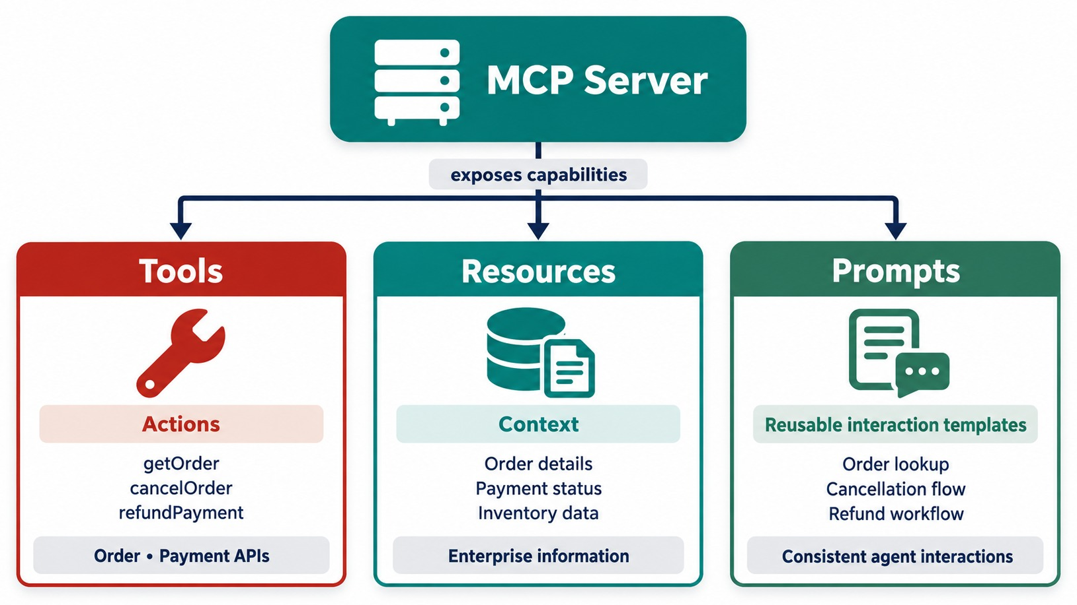
MCP CAPABILITIES: TOOLS, RESOURCES, AND PROMPTS
Different ways servers expose functionality and context.
Tools
Model-invoked actions: get_order, request_refund.
Resources
Read-only context by URI: policies, runbooks, schemas.
Prompts
User-chosen templates: “Investigate a failed payment.”
MENTAL MODEL Tools do, resources inform, prompts structure.
KEY TAKEAWAY Tools do, resources inform, prompts structure — servers can expose all three.
13
© 2026 by Innovation In Software Corporation
Notes:
KEY TALKING POINTS
------------------
- Tools
Tools let clients invoke capabilities, such as getOrder, cancelOrder and refundPayment.
- Resources
Resources expose context, such as the refund policy, service documentation or order status definitions.
- Prompts
Prompts are reusable prompt structures that clients can discover and use, such as an order investigation prompt.
- A simple mental model
A tool does something.
A resource reads something.
A prompt structures an interaction.
The official server SDK describes MCP servers as exposing tools, resources and prompts.
- For microservices
Tools usually matter most, because they connect agents to business operations.
- What the diagram shows
Three branches: tools for actions, resources for context, prompts for reusable interaction templates.
- Key point
Tools do, resources inform, prompts structure.

Slide 14
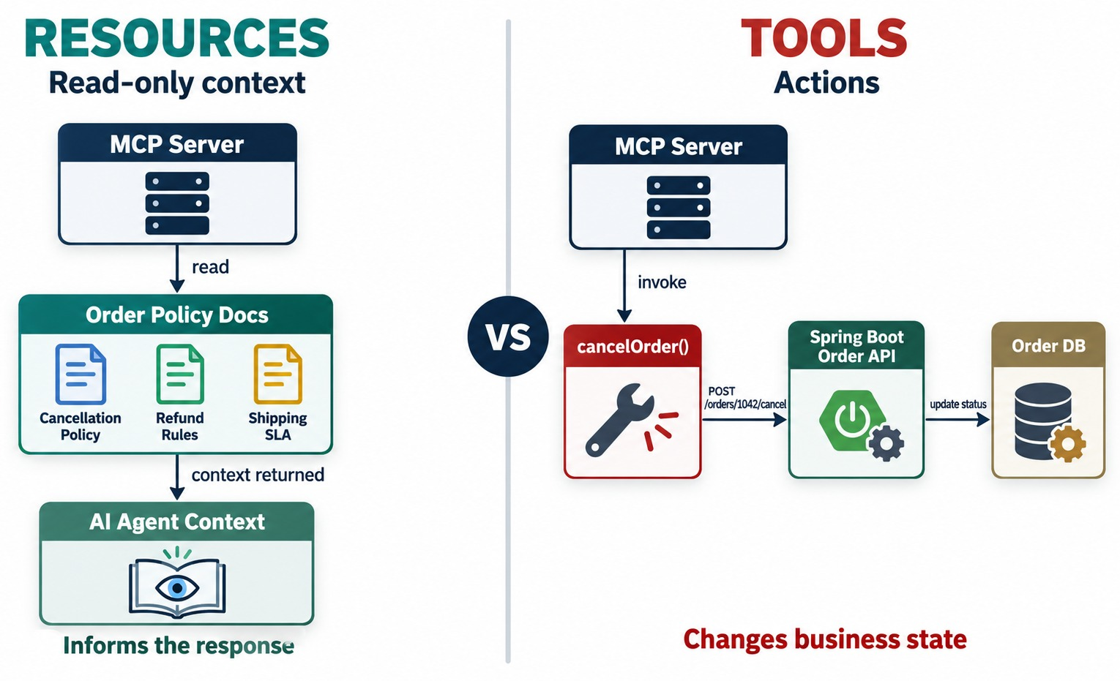
TOOLS VS. RESOURCES IN MICROSERVICES
Actions versus read-oriented context.
Resource
policy://refunds — what the refund rules say.
Tool
request_refund — actually starts a refund, under authorization.
RULE Knowing a policy never grants the right to act on it.
KEY TAKEAWAY Resources provide context; tools provide capability.
14
© 2026 by Innovation In Software Corporation
Notes:
KEY TALKING POINTS
------------------
- Two different requests
If the user asks 'can this payment be refunded?', the agent may need a resource: the refund policy.
If the user says 'refund payment 501', that needs an operation: refundPayment(501).
- Knowledge is not authority
Don't confuse knowledge with authority.
Knowing the refund policy does not give the agent permission to issue a refund.
- The rule
Resources provide knowledge; tools provide capability.
Tool execution still needs authorization.
Never expose a write operation as if it were passive context retrieval.
- What the diagram shows
A read-and-context path compared with an action-and-tool path.
- Key point
Resources provide context; tools provide capability.

Slide 15
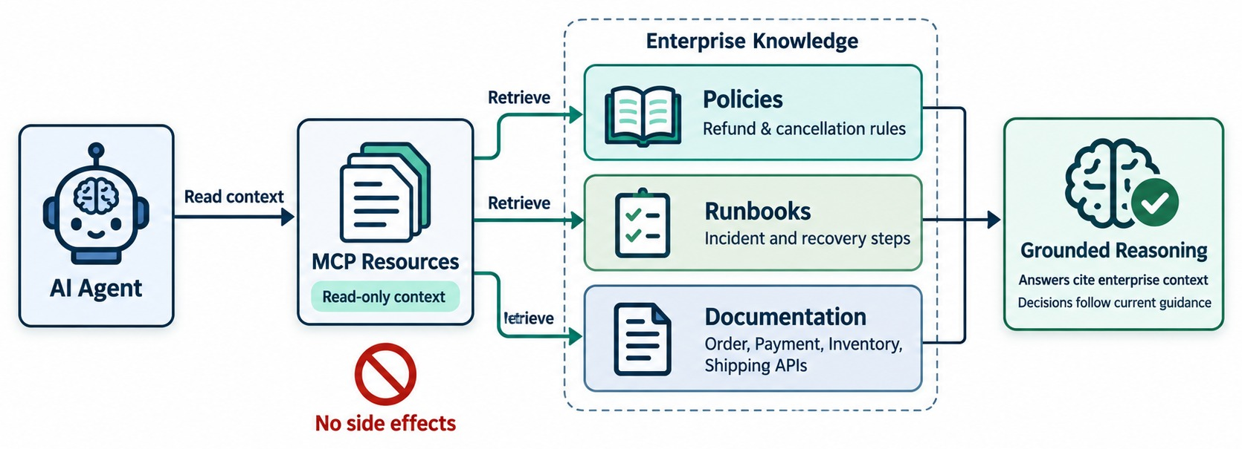
MCP RESOURCES FOR ENTERPRISE CONTEXT
Exposing read-only business and reference information safely.
A resource entry
{ "uri": "policy://payments/refunds/v3",
"name": "Refund policy",
"mimeType": "text/markdown" }
GOOD RESOURCES
Policies
Runbooks
API docs
Error catalogs
NOT FOR LIVE STATE Order status comes from a tool.
KEY TAKEAWAY Resources give reference context; live business state still comes from services.
15
© 2026 by Innovation In Software Corporation
Notes:
KEY TALKING POINTS
------------------
- Useful context
Resources suit contextual information: refund eligibility policy, order status definitions, shipping policy, service documentation and runbooks.
- Combining tool and resource
Suppose the user asks why order 1001 can't be refunded.
The agent may combine the payment status from the getPaymentForOrder tool with the refund policy from a resource.
- The distinction
Current business state comes from an authoritative service or tool.
Reference knowledge comes from a resource.
Keep authoritative operational state separate from reference context.
- What the diagram shows
An agent reading policies, runbooks and documentation as MCP resources for grounded reasoning.
- Key point
Resources give reference context; live state still comes from services.

Slide 16
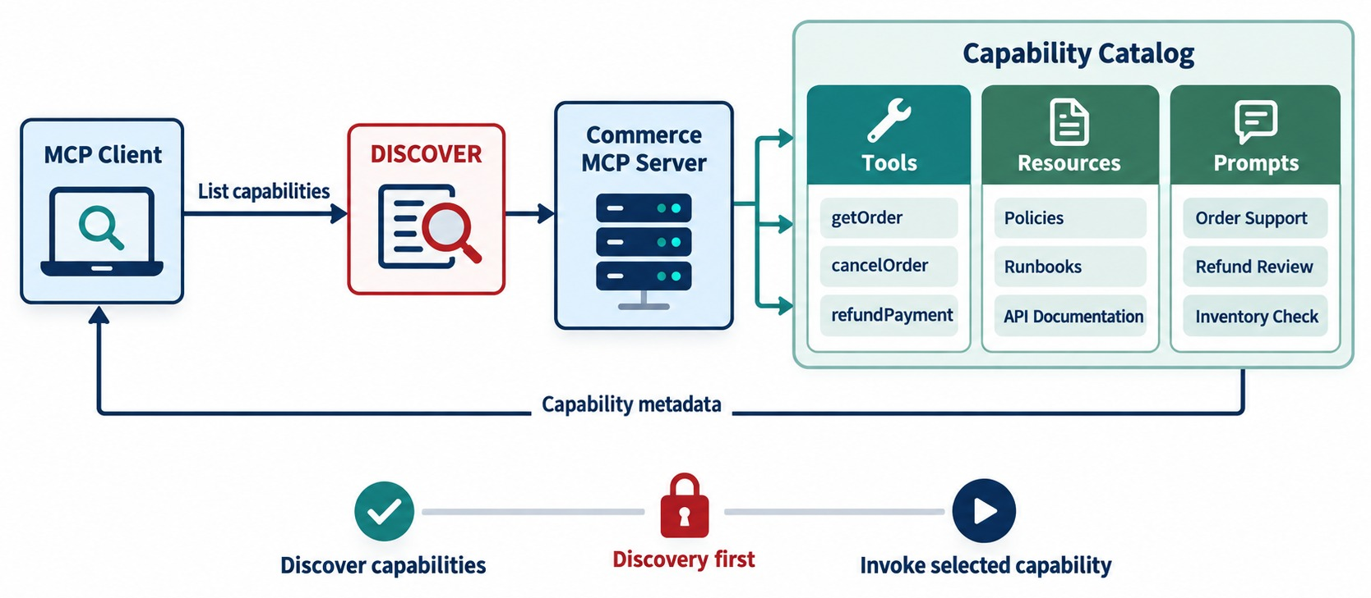
MCP DISCOVERY AND CAPABILITY LISTING
How clients discover available server capabilities.
Initialize
Client and server agree on protocol version and features.
List
tools/list, resources/list and prompts/list return the catalog.
Change
Servers can notify clients when the list changes.
CACHE Reuse the catalog while it's unchanged.
KEY TAKEAWAY Clients discover what a server offers — and cache it while it's unchanged.
16
© 2026 by Innovation In Software Corporation
Notes:
KEY TALKING POINTS
------------------
- How clients learn
How does an AI host know what a server offers?
It discovers the capabilities.
It asks what tools, resources and prompts the server exposes.
- An example catalog
An Order MCP Server might list the tools getOrder, createOrder and cancelOrder.
It might also list the resource order-status-guide and the prompt investigate-order.
- Discovery in the current spec
The current stateless specification adds server/discover for getting a server's capabilities.
It replaces the old connection-based initialization.
- Caching
List and read responses now carry cache hints such as ttlMs and cacheScope.
That way clients don't have to rediscover unchanged catalogs on every interaction.
Ten agents times a hundred requests against an unchanged tool list shouldn't mean needless rediscovery.
- What the diagram shows
An MCP client discovering the server's catalog of tools, resources and prompts.
- Key point
Clients learn what's available at runtime.

Slide 17
EXERCISE: TOOL, RESOURCE OR PROMPT?
Classify each capability for an order-support MCP server.
PRACTICE EXERCISE
8 MIN
SCENARIO
YOUR TASKS
EXPECTED OUTCOME
The team wants to expose:
1
Label each: tool, resource or prompt
✓
Tools: 1, 4, 6
1 Current status of an order
2 The refund policy document
3 “Investigate a failed payment” steps
4 Start a refund
5 The error-code catalog
6 Reserve stock for an order
✓
Resources: 2, 5
2
Mark which tools change state
✓
Prompt: 3
3
Say which need human approval
✓
State-changing: 4 and 6
✓
Approval: 4 always; 6 by policy
KEY TAKEAWAY Live data and actions are tools, reference content is a resource, reusable workflows are prompts.
17
© 2026 by Innovation In Software Corporation
Notes:
KEY TALKING POINTS
------------------
- Tools
Order status is live data, so it's a read tool.
Refunds and reservations change state, so they're action tools.
- Resources and prompts
Policies and error catalogs are reference documents.
The investigation steps are a reusable prompt template.
- Approval
Refunds move money and always need approval.
Stock reservations may be automatic within business limits.

Slide 18
PART 3: MCP AND MICROSERVICES
Put an MCP layer in front of the services we already built.
✓ Part 1
MCP fundamentals
✓ Part 2
Capabilities
Part 3
Microservices
Part 4
Production
Part 5
Orchestration
SO FAR
NEXT QUESTION
How do we expose our Spring Boot microservices to agents through MCP?
✓
Tools act; resources inform; prompts structure
✓
Clients discover capabilities at runtime
IN THIS PART
Actions are separated from context
1
MCP and REST together
✓
2
Calling Spring Boot through MCP — with Spring AI
3
Server design across services
4
Mapping APIs to tools
5
Tool contracts — with a schema
6
Exercises: MCP or REST? Map APIs to tools
18
© 2026 by Innovation In Software Corporation
Notes:
KEY TALKING POINTS
------------------
- Why this part
This is where MCP meets everything we built: controllers, services, security and data ownership.
- What comes next
Where MCP fits beside REST, a Spring AI MCP server, server boundaries, tool mapping and contracts.

Slide 19
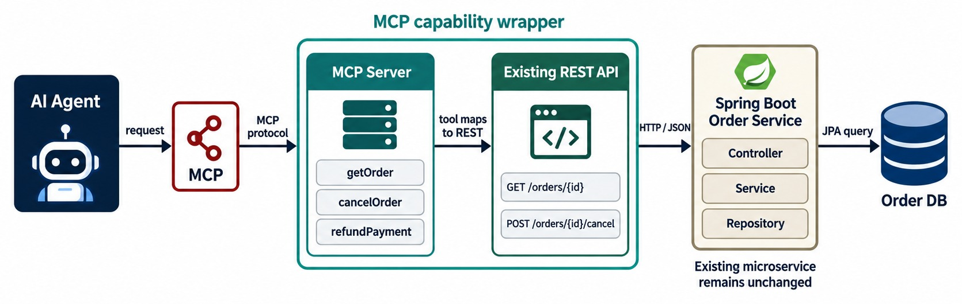
MCP AND TRADITIONAL REST APIS
MCP isn't a replacement for REST — it can wrap or orchestrate APIs.
REST keeps serving
Web apps, mobile apps and other services call the APIs directly.
MCP adds
An AI-friendly layer: descriptions, schemas, discovery.
MESSAGE MCP complements REST.
KEY TAKEAWAY MCP complements REST. It does not automatically replace it.
19
© 2026 by Innovation In Software Corporation
Notes:
KEY TALKING POINTS
------------------
- One of the most important slides
Don't tell learners that MCP replaces REST.
- REST still has users
Existing Spring Boot APIs may already serve web apps, mobile apps, other microservices, partners and API gateways.
There is no reason to throw those contracts away just because agents need access.
- Add a layer
An existing REST API plus an MCP capability layer gives an agent-accessible microservice.
- Each layer has a job
The MCP tool cancelOrder(orderId) maps to the REST call PATCH /orders/{id}/cancel.
That runs OrderService.cancelOrder() in Spring Boot.
Each layer serves a different purpose.
- The message
MCP complements REST.
It does not automatically replace it.
- What the diagram shows
An agent using MCP to reach an MCP server that calls an existing REST API on a Spring Boot service.
- Key point
MCP complements REST — it wraps existing APIs.

Slide 20
EXERCISE: MCP OR REST?
Decide which clients should use MCP — and which should stay on REST.
PRACTICE EXERCISE
8 MIN
SCENARIO
YOUR TASKS
EXPECTED OUTCOME
Consumers of the order platform:
1
Choose MCP or REST for each
✓
A, C, E: REST — fixed, known calls
A Mobile app showing order history
B Support copilot answering questions
C Payment Service calling Order
D IDE agent helping ops engineers
E Nightly reconciliation batch
2
Explain the reason in a few words
✓
B, D: MCP — AI clients discovering tools
3
Say what stays the same either way
✓
Both reach the same Order API
✓
Same authorization and validation
✓
No database shortcuts for either
KEY TAKEAWAY Use MCP for AI clients that discover capabilities; keep REST for fixed, programmatic integrations.
20
© 2026 by Innovation In Software Corporation
Notes:
KEY TALKING POINTS
------------------
- REST clients
Apps, services and batch jobs know exactly which endpoints they need, so REST is simpler and faster.
- MCP clients
Copilots and agents benefit from discovery, descriptions and schemas.
- What doesn't change
Both paths end at the same service API, with the same security and business rules.

Slide 21
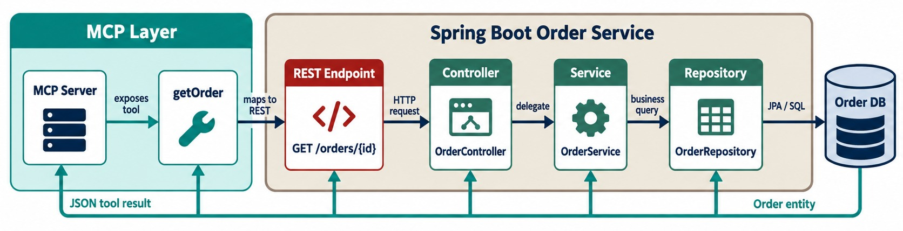
CALLING A SPRING BOOT MICROSERVICE THROUGH MCP
Agent → MCP tool → REST endpoint → Spring Boot service.
What the agent sees
The server's job
ARCHITECTURE RULE Call the service API — never its database.
get_order(orderId) — not URLs, headers or JSON mapping.
Map the tool to the API, pass identity, shape the result.
KEY TAKEAWAY MCP should call the service API — not bypass the service to reach its database.
21
© 2026 by Innovation In Software Corporation
Notes:
KEY TALKING POINTS
------------------
- Use the service we built
The existing endpoint is GET /orders/1001.
MCP exposes it as getOrder(orderId).
- What the agent doesn't need
The agent doesn't need to reason about the HTTP URL, the HTTP client library, serialization details or the controller structure.
It sees a capability with a meaningful description.
- The MCP server's job
The server takes the MCP input and validates it.
It maps it to a REST request, calls the Order Service, maps the response and returns an MCP result.
- The architecture rule
The MCP server should call the Order Service API, not the Order database directly.
The only exception is when direct data access is explicitly the design you intend.
This keeps the design principles from Modules 2 and 5.
- What the diagram shows
An MCP tool mapped to a REST endpoint, then controller, service, repository and database.
- Key point
The MCP server calls the API — never the database.

Slide 22
AN MCP SERVER WITH SPRING AI
Annotated methods become MCP tools that call the existing Order API.
✓
OrderTools.java
Register and configure
@Service
class OrderTools {
private final RestClient orderApi; // http://order-service:8080
OrderTools(RestClient.Builder builder) {
this.orderApi = builder.baseUrl("http://order-service:8080").build();
}
@Tool(name = "get_order",
description = "Status and items of one order. Read-only.")
OrderSummary getOrder(
@ToolParam(description = "Order id, e.g. ORD-1045") String orderId) {
return orderApi.get()
.uri("/api/v1/orders/{id}", orderId)
.retrieve()
.body(OrderSummary.class);
}
}
@Bean
ToolCallbackProvider orderToolProvider(OrderTools tools) {
return MethodToolCallbackProvider.builder()
.toolObjects(tools)
.build();
}
# pom.xml: spring-ai-starter-mcp-server-webmvc
# application.yml
spring:
ai:
mcp:
server:
name: order-mcp-server
version: 1.0.0
@Tool
RestClient
Starter
Name and description become the MCP tool definition.
The tool calls Order Service's API, with its rules.
The Spring AI MCP server starter handles the protocol.
KEY TAKEAWAY A Spring AI MCP server is a thin adapter: annotated tools calling your existing service APIs.
22
© 2026 by Innovation In Software Corporation
Notes:
KEY TALKING POINTS
------------------
- The tool
@Tool turns a method into an MCP tool.
Its parameters become the input schema, with descriptions from @ToolParam.
- The call
The tool calls GET /api/v1/orders/{id} on Order Service, so validation, security and data ownership are unchanged.
- Registration
A ToolCallbackProvider registers the tool object, and the MCP server starter exposes it over the protocol.
- Versions
Spring AI's MCP support is evolving quickly — check property names against the version you use.

Slide 23
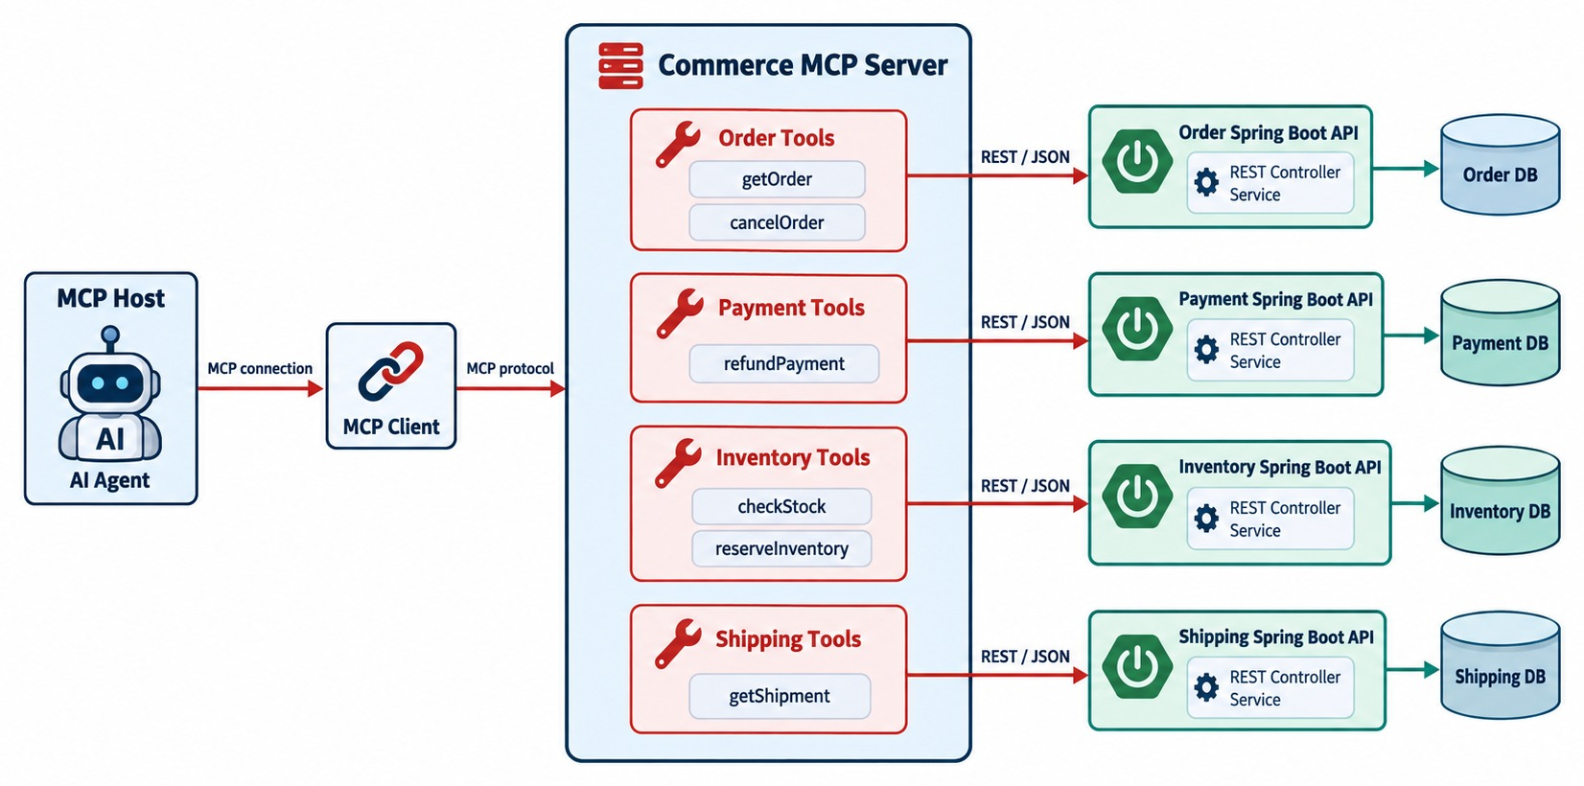
DESIGNING AN MCP SERVER FOR MICROSERVICES
An MCP adapter layer in front of Order, Payment and Inventory services.
One server per domain
Owned by each service team; clear ownership and permissions.
One aggregated server
Simpler for clients; watch it doesn't become a monolith.
MODULE 2 Choose server boundaries like service boundaries.
KEY TAKEAWAY Choose MCP server boundaries deliberately — weigh convenience against ownership.
23
© 2026 by Innovation In Software Corporation
Notes:
KEY TALKING POINTS
------------------
- Pattern A: domain-specific servers
One option is separate Order, Payment and Shipping MCP servers.
Advantages are clear ownership, a smaller security scope, easier independent deployment, and a domain-aligned capability catalog.
- Pattern B: an aggregated server
Another option is one Commerce MCP Server with Order, Payment, Inventory and Shipping tools.
Advantages are simpler discovery, one interface, and an easier experience across domains.
- The tradeoff
It is convenience versus isolation and ownership.
Discuss the tradeoff; don't claim one pattern is always right.
- Link to Module 2
MCP server boundaries should be intentional, just like microservice boundaries.
- What the diagram shows
A commerce MCP server exposing Order, Payment and Inventory tools that call separate services.
- Key point
Server boundaries are a design decision, like service boundaries.

Slide 24
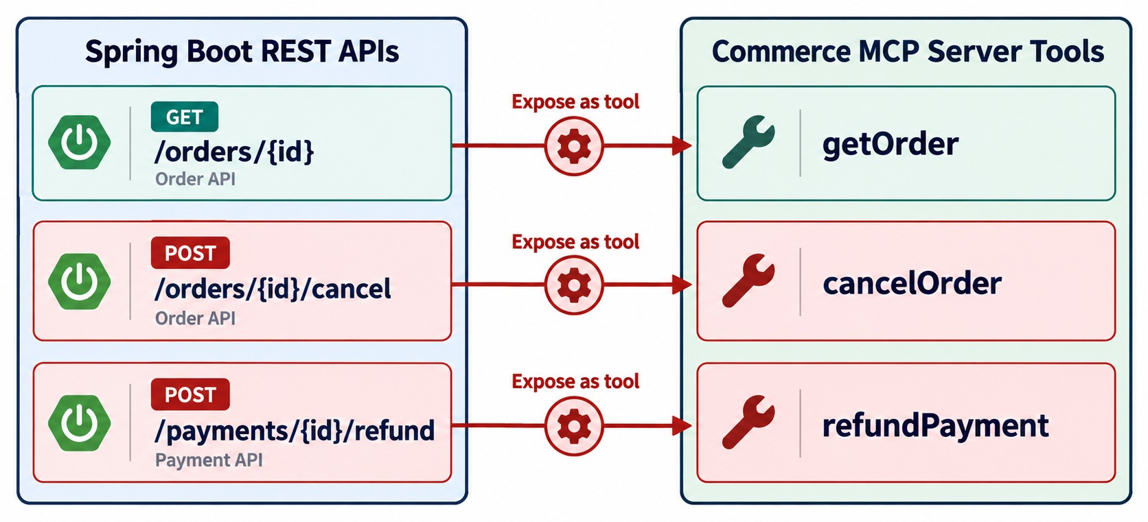
MAPPING MICROSERVICE APIS TO MCP TOOLS
getOrder, cancelOrder, refundPayment and other meaningful capabilities.
MAP CAPABILITIES
✓
GET /orders/{id} → get_order
✓
POST /orders/{id}/cancel → cancel_order
✓
POST /payments/{id}/refunds → request_refund
KEEP OUT
✕
Internal admin endpoints
✕
Bulk delete
✕
Health and metrics
KEY TAKEAWAY Expose meaningful business capabilities as tools — not every endpoint.
24
© 2026 by Innovation In Software Corporation
Notes:
KEY TALKING POINTS
------------------
- An example mapping
GET /orders/{id} becomes getOrder, and POST /orders becomes createOrder.
PATCH /orders/{id}/cancel becomes cancelOrder, and GET /payments/order/{id} becomes getPaymentForOrder.
POST /payments/{id}/refund becomes refundPayment, and GET /inventory/{sku} becomes checkInventory.
- Don't map mechanically
Don't expose every REST endpoint.
Turning 87 REST endpoints into 87 MCP tools is the wrong approach.
Ask which capabilities are actually useful to an agent.
- Keep internal endpoints out
Endpoints like /admin/rebuild-index, /internal/cache/flush or /debug/database-state probably should not become normal agent tools.
- The rule
A REST endpoint is not automatically an MCP tool.
A tool is a capability you intentionally expose to agents.
- What the diagram shows
Backend endpoints on the left mapped to meaningful business tools on the right.
- Key point
Expose business capabilities, not every endpoint.

Slide 25
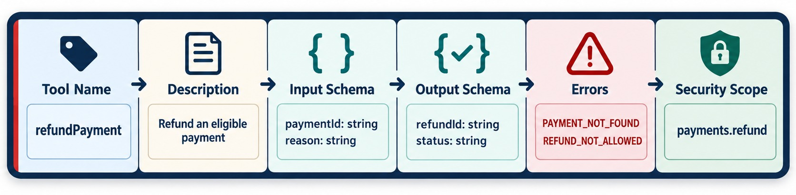
DESIGNING GOOD MCP TOOL CONTRACTS
Names, descriptions, schemas, inputs, outputs and errors.
Name
Schemas
Errors
TREAT IT AS AN API Version it and review changes.
verb_noun, specific: request_refund, not do_payment.
Typed input and output with patterns and limits.
Safe, structured errors — never invented data.
KEY TAKEAWAY Design tool contracts as carefully as any enterprise API contract.
25
© 2026 by Innovation In Software Corporation
Notes:
KEY TALKING POINTS
------------------
- Design matters
How you design a tool directly affects how reliably an agent can use it.
A tool contract has a name, description, input schema, output schema, error behavior and security requirements.
- Names and descriptions
cancelOrder is a much better name than process.
The description should say when to use it.
For example: cancels an existing order when its business state allows cancellation.
- Inputs and outputs
Specify the input, orderId, with the right type and validation.
Prefer predictable structured output, such as orderId, previousStatus CONFIRMED and newStatus CANCELLED.
- Schemas in the current spec
The current specification allows full JSON Schema 2020-12 for tools, including composition and conditional rules.
Input schemas still have an object at the root.
- The teaching point
Tool contracts are APIs for AI clients.
Design them as carefully as normal enterprise API contracts.
- What the diagram shows
A tool's name, description, input schema, output schema, errors and security scope.
- Key point
Tool contracts deserve the same care as API contracts.

Slide 26
A TOOL CONTRACT FOR A STATE-CHANGING ACTION
Precise description, strict input, structured output and honest hints.
✓
request_refund — tool definition
Description
{
"name": "request_refund",
"title": "Request a refund",
"description": "Create a refund REQUEST for a captured payment.
A person must approve it. Use only after get_payment shows
status CAPTURED. Never for partial amounts.",
"inputSchema": {
"type": "object",
"properties": {
"paymentId": { "type": "string", "pattern": "^PAY-[0-9]+$" },
"reason": { "type": "string", "maxLength": 200 }
},
"required": ["paymentId", "reason"],
"additionalProperties": false
},
"outputSchema": {
"type": "object",
"properties": {
"refundRequestId": { "type": "string" },
"status": { "enum": ["PENDING_APPROVAL", "REJECTED"] }
}
},
"annotations": { "readOnlyHint": false, "destructiveHint": false,
"idempotentHint": true }
}
Says when to use it — and when not to.
Input
Pattern, length limit and no extra properties.
Output
A pending request, not a finished refund.
HINTS are advisory — the server still enforces rules.
KEY TAKEAWAY A good tool contract tells the model when to use it and lets the server reject anything else.
26
© 2026 by Innovation In Software Corporation
Notes:
KEY TALKING POINTS
------------------
- Description
The model reads the description to choose tools, so it states preconditions and limits in plain words.
- Schemas
The input schema rejects malformed IDs and oversized text.
The output schema says the result is a pending request.
- Annotations
Hints such as idempotent or read-only help clients decide when to ask for confirmation, but they are not security controls.
- Enforcement
Authorization, approval and business rules are still enforced by the server and the Payment Service.

Slide 27
EXERCISE: MAP APIS TO TOOLS
Design the tool list for a commerce MCP server.
PRACTICE EXERCISE
10 MIN
SCENARIO
YOUR TASKS
EXPECTED OUTCOME
Existing endpoints:
1
Choose which endpoints become tools — and name them
✓
get_order, get_payment, check_stock: read
GET /api/v1/orders/{id}
POST /api/v1/orders/{id}/cancel
GET /api/v1/payments/{id}
POST /api/v1/payments/{id}/refunds
GET /api/v1/inventory/{sku}
DELETE /api/v1/admin/orders
GET /actuator/metrics
2
Mark each tool read or state-changing
✓
cancel_order: state-changing, scoped
List the endpoints you'd keep out, and why
✓
request_refund: state-changing, approval
3
✓
Out: admin bulk delete
✓
Out: actuator metrics
KEY TAKEAWAY Expose a small set of well-named business tools; keep admin and operational endpoints out.
27
© 2026 by Innovation In Software Corporation
Notes:
KEY TALKING POINTS
------------------
- Read tools
Order, payment and stock lookups are safe read tools with clear names.
- Action tools
Cancelling and refunding change state.
The refund tool creates a request that needs approval.
- Keep out
Bulk admin deletion and metrics are operational endpoints, not business capabilities for an agent.

Slide 28
PART 4: PRODUCTION ARCHITECTURE
Run MCP servers like any enterprise workload — scaled, secured and observed.
✓ Part 1
MCP fundamentals
✓ Part 2
Capabilities
✓ Part 3
Microservices
Part 4
Production
Part 5
Orchestration
SO FAR
NEXT QUESTION
How do we run MCP servers safely in production?
✓
MCP servers wrap existing APIs
✓
Tools map to business capabilities
IN THIS PART
✓
Contracts are precise and enforced
1
Stateless servers and horizontal scaling
2
MCP behind an API gateway
3
Authentication and authorization — in code
4
Defense in depth
5
Exercise 5.3: MCP security controls
6
Reliability and observability
28
© 2026 by Innovation In Software Corporation
Notes:
KEY TALKING POINTS
------------------
- Why this part
An MCP server is a new entry point to business capabilities, so it needs the same production controls as any API.
- What comes next
Scaling, gateways, OAuth-based security, layered defenses, the official security exercise, and tracing.

Slide 29
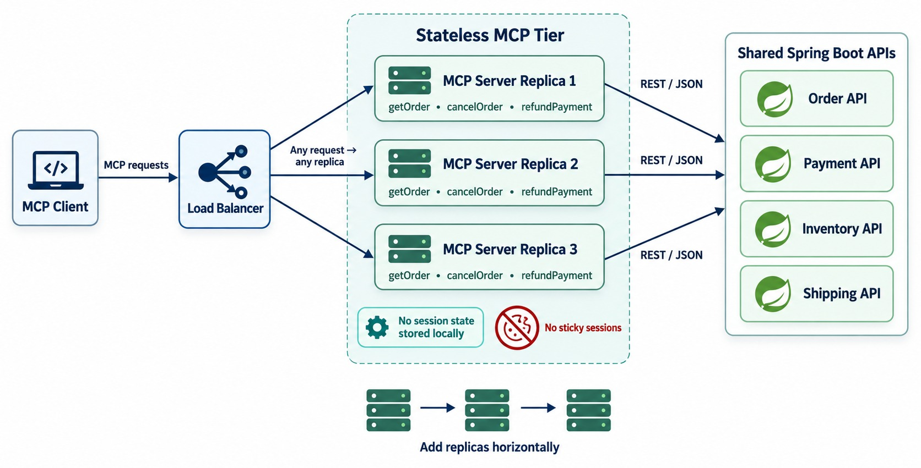
STATELESS MCP AND HORIZONTAL SCALABILITY
The current stateless core and load-balanced server instances.
Three replicas on OpenShift
spec:
replicas: 3
template:
spec:
containers:
- name: order-mcp-server
readinessProbe:
httpGet: { path: /actuator/health/readiness,
port: 8080 }
No sticky sessions
Any replica can serve any request.
MODULE 8 Same Deployments, probes and scaling.
KEY TAKEAWAY A stateless protocol core lets MCP servers scale like any cloud-native workload.
29
© 2026 by Innovation In Software Corporation
Notes:
KEY TALKING POINTS
------------------
- The earlier model
Older MCP deployments needed more connection and session handling: a client, a sticky session, one specific server, and shared session state.
- The current model
The 2026-07-28 specification moved the protocol core to stateless request and response.
The old protocol handshake and session model was removed.
Requests can reach any compatible server instance without sticky routing or a shared session store.
- Link to Module 8
Package the MCP server as an image and run it as an OpenShift deployment with several replicas behind a service.
Benefits are horizontal scaling, easier load balancing, better failure recovery, cloud-native deployment and simpler gateways.
- A very important distinction
Stateless MCP does not mean your business application has no state.
Order state still lives in the Order database, and workflow state can live in a suitable durable store.
- What the diagram shows
A load balancer spreading requests across three MCP server replicas that share backend APIs, with no sticky sessions.
- Key point
Stateless servers scale like any cloud-native workload.

Slide 30
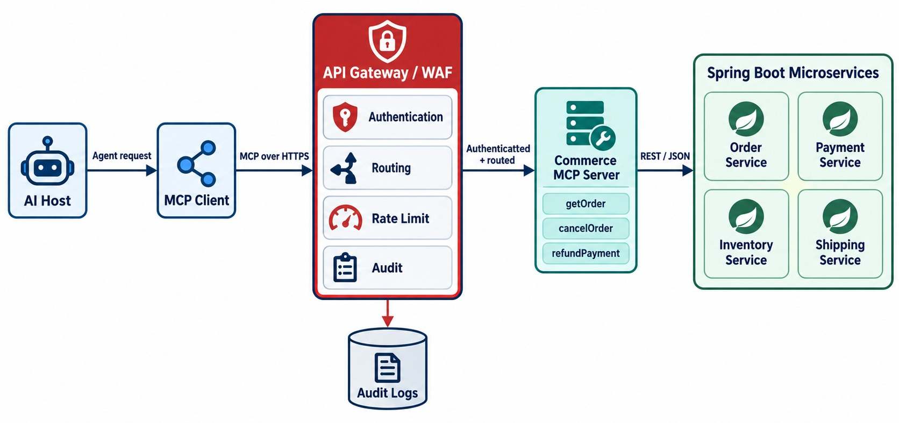
MCP BEHIND AN API GATEWAY
Routing, policy enforcement, rate limiting and tracing.
GATEWAY ENFORCES
TLS
Token validation
Rate limits
WAF rules
Routing
Audit logs
Agent traffic is bursty
Rate-limit per agent and per user.
STILL the MCP server and services authorize too.
KEY TAKEAWAY Treat MCP traffic like enterprise HTTP traffic — gateways route and govern it.
30
© 2026 by Innovation In Software Corporation
Notes:
KEY TALKING POINTS
------------------
- Same controls as other traffic
Production MCP traffic may need the same infrastructure controls as any enterprise traffic.
The flow is: AI host, MCP client, API gateway or web application firewall, MCP server, then the service APIs.
- What the gateway enforces
Authentication checks who is calling, and routing picks which MCP server gets the request.
Rate limiting prevents runaway or abusive tool use.
Policy decides whether this client may use this capability.
Observability records requests and latency.
- Routable headers
The current Streamable HTTP transport requires headers named Mcp-Method and Mcp-Name.
Gateways, load balancers and rate limiters can then see the requested operation without deeply parsing the JSON body.
That makes MCP fit better with normal enterprise HTTP infrastructure.
- What the diagram shows
An AI host and MCP client going through a gateway to the MCP server and microservices, with authentication, routing, rate limiting and audit.
- Key point
MCP traffic gets the same edge controls as any HTTP traffic.

Slide 31
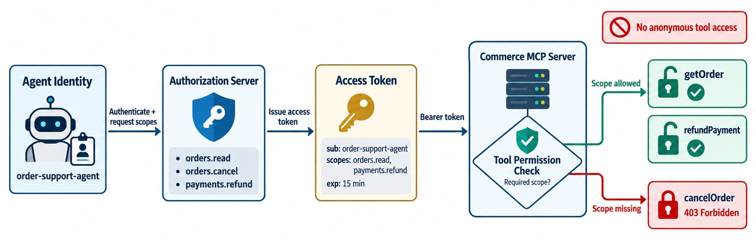
AUTHENTICATION AND AUTHORIZATION FOR MCP
OAuth-based access, identity propagation and least privilege.
Authenticate
The MCP server is an OAuth resource server; no anonymous calls.
Authorize per tool
get_order needs orders.read; request_refund needs refunds.request.
Propagate identity
Pass the user's token or a scoped one — never a super-user.
MODULE 12 OAuth2, OIDC and JWT in depth.
KEY TAKEAWAY Authenticate the caller, authorize each tool — never hand the model super-user access.
31
© 2026 by Innovation In Software Corporation
Notes:
KEY TALKING POINTS
------------------
- Two questions
Authentication asks: who are you?
Authorization asks: what may you do?
- The flow
The agent has an identity and gets an access token from an authorization server.
The MCP server checks tool permission before the backend service runs.
- Least privilege
An order-support agent might be allowed getOrder, checkInventory and cancelOrder, but not refundPayment.
That is a normal least-privilege design.
- The current spec
The current MCP specification hardened authorization to align more closely with OAuth and OpenID Connect deployments.
It includes issuer validation to reduce the risk of authorization-server mix-up.
The direction for client registration moves toward Client ID Metadata Documents instead of Dynamic Client Registration.
- Never a super-user
Connecting an agent to MCP should never mean giving the model one giant super-user credential.
- What the diagram shows
An agent identity getting a token from an authorization server, and the MCP server checking tool permissions.
- Key point
Authenticate the caller, then authorize every tool.

Slide 32
SECURING TOOLS IN THE MCP SERVER
Validate the token, check a scope per tool, forward identity and audit the call.
SecurityConfig.java
✓
PaymentTools.java
@Bean
SecurityFilterChain mcp(HttpSecurity http) throws Exception {
return http
.authorizeHttpRequests(a -> a
.requestMatchers("/actuator/health/**").permitAll()
.anyRequest().authenticated())
.oauth2ResourceServer(o -> o.jwt(Customizer.withDefaults()))
.build();
}
@Tool(name = "request_refund", description = "…")
@PreAuthorize("hasAuthority('SCOPE_refunds.request')")
RefundRequest requestRefund(String paymentId, String reason) {
Jwt caller = currentJwt();
RefundRequest result = paymentApi.post()
.uri("/api/v1/payments/{id}/refund-requests", paymentId)
.headers(h -> h.setBearerAuth(caller.getTokenValue()))
.header("Idempotency-Key", idempotencyKey(paymentId, reason))
.body(new RefundReason(reason))
.retrieve()
.body(RefundRequest.class);
audit.toolCall("request_refund", paymentId, caller.getSubject(),
correlationId(), result.status());
return result;
}
Resource server
Per-tool scope
Forward identity
Every MCP request carries a validated JWT.
The model can't use a tool the caller lacks.
Payment Service authorizes the same user again.
KEY TAKEAWAY Secure MCP like any API: validate tokens, scope each tool, forward identity and audit every call.
32
© 2026 by Innovation In Software Corporation
Notes:
KEY TALKING POINTS
------------------
- Resource server
The MCP endpoint requires a valid JWT.
Only the health endpoint stays public.
- Per-tool authorization
@PreAuthorize requires the refunds.request scope before the tool runs, so a read-only user's agent can't request refunds.
- Identity propagation
The caller's token is forwarded, so Payment Service checks the same identity.
The MCP server never uses a shared super-user token.
- Audit
Tool name, IDs, caller, correlation ID and outcome are recorded — never the token itself.

Slide 33
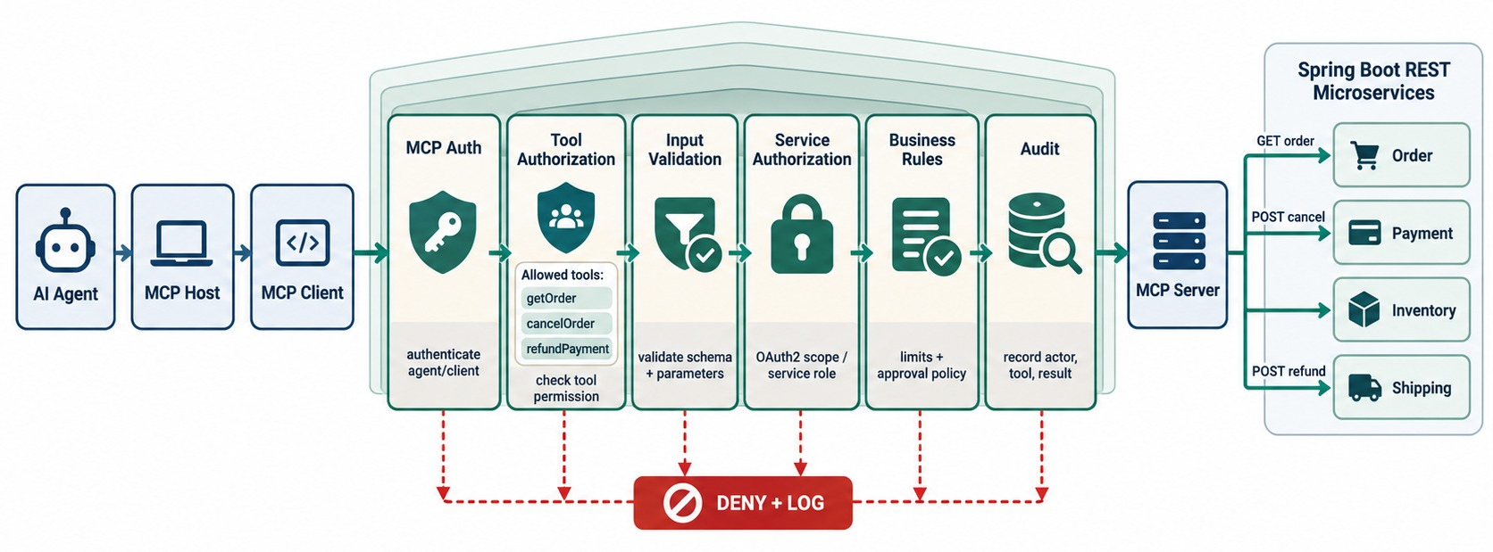
SECURING MCP-ENABLED MICROSERVICES
Tool allow-lists, validation, service credentials and audit.
MCP-SPECIFIC THREATS
!
Prompt injection in tool results
!
Poisoned tool descriptions
!
Over-powerful tools
!
Data leaking into prompts
Defenses
Trusted servers only, strict schemas, output sanitizing.
CRITICAL RULE The microservice still authorizes everything.
KEY TAKEAWAY Defense in depth still applies — every layer checks, including the microservice.
33
© 2026 by Innovation In Software Corporation
Notes:
KEY TALKING POINTS
------------------
- Layers one to three
Layer 1 is MCP identity: who is calling the MCP server?
Layer 2 is tool authorization: may this caller use refundPayment at all?
Layer 3 is input validation: is the orderId valid?
- Layers four to six
Layer 4 is backend authorization: the Order Service still protects itself.
Layer 5 is business rules: even an authorized caller can't cancel a SHIPPED order if the domain forbids it.
Layer 6 is audit: record sensitive actions.
- Principles
Use least privilege and a tool allow-list, and validate parameters.
Never expose secrets in tool responses, and rate-limit sensitive tools.
Separate read and write permissions, keep backend authorization, and audit high-risk calls.
- The critical rule
MCP authentication does not grant permission to do everything downstream.
Defense in depth still applies.
- What the diagram shows
MCP authentication, tool authorization, input validation, service authorization, business rules and audit as layers.
- Key point
Every layer checks — including the microservice.
- MCP-specific threats
Tool results can contain text that tries to steer the model, and a malicious server can publish misleading tool descriptions.
Use trusted servers, strict schemas and approval for risky actions.

Slide 34
EXERCISE 5.3 — MCP SECURITY CONTROLS FOR BANKING APIS
Day 5 checkpoint C: authentication, human-in-the-loop and audit for tool exposure.
OFFICIAL CHECKPOINT C
15 MIN
labs/day-05/lab5/starter/mcp-controls.md
SCENARIO
YOUR TASKS
EXPECTED OUTCOME
An assistant would call Lab 5's Risk Assessment Service through two MCP tools: get_assessment and submit_review.
Awareness only — no MCP runtime in the lab.
1
Walk mcp-controls.md: who may call get_assessment and submit_review?
✓
get_assessment: risk.read
✓
submit_review: risk.write, human-confirmed
2
Which tool needs a human in the loop before money-movement effects?
✓
No superuser token; no anonymous calls
3
Which audit fields would you persist (actor, tool, correlation ID, decision)?
✓
Audit: tool, IDs, caller, correlation, outcome
4
Don't start an MCP process, Keycloak or a Microsoft agent runtime
✓
Never log tokens, keys or PAN
KEY TAKEAWAY Tools carry the user's identity, need narrow scopes, keep humans on reviews and leave an audit trail.
34
© 2026 by Innovation In Software Corporation
Notes:
KEY TALKING POINTS
------------------
- Official checkpoint
This is the official OUTLINE.md checkpoint.
The worksheet is the starter mcp-controls.md in Lab 5, which is already filled in.
- Controls
get_assessment needs risk.read and submit_review needs risk.write.
The model never posts a review by itself.
- Scope
This is awareness only.
Learners discuss the controls; they don't run an MCP server.

Slide 35
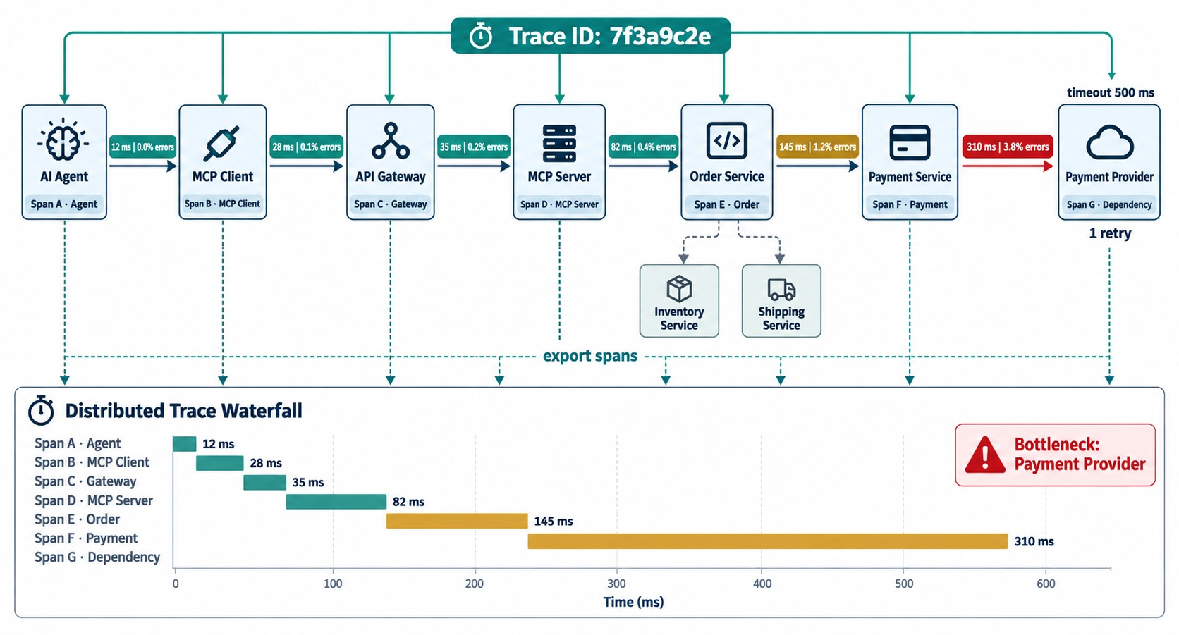
RELIABILITY AND OBSERVABILITY FOR MCP
Timeouts, retries, tracing, metrics and tool-call auditing.
Timeouts
Every backend call from a tool has one — Module 6.
Safe errors
Return isError with a clear reason; never guess the data.
TRACK
Tool latency
Tool error rate
Calls per agent
Trace ID
KEY QUESTION Which agent run caused this service call?
KEY TAKEAWAY An MCP tool call is a distributed request — make every hop resilient and traceable.
35
© 2026 by Innovation In Software Corporation
Notes:
KEY TALKING POINTS
------------------
- Another distributed request path
An MCP tool call is another request path through a distributed system.
It goes from the AI agent to the MCP client, gateway, MCP server, Spring Boot service, and database or dependency.
So Module 6 still applies.
- Timeouts and retries
What if the Payment Service doesn't respond?
Set timeouts.
Retrying getOrder is usually fine.
Don't blindly retry refundPayment unless it has idempotency protection, meaning a repeat does no extra harm.
- Circuit breakers and tracing
Circuit breakers protect MCP servers from failing dependencies.
The current MCP documentation standardizes passing W3C Trace Context.
That way one trace connects the client, MCP server, gateways and downstream systems.
- What to track
Track the trace ID, tool name, caller, latency, status, retries, errors, backend call and final outcome.
- The key question
A good trace answers: did the agent choose the wrong tool, did MCP fail, or did the backend service fail?
- What the diagram shows
An agent, MCP client, gateway, MCP server, Spring Boot service and dependency linked by trace IDs and metrics.
- Key point
A tool call is a distributed request — trace every hop.

Slide 36
PART 5: AGENTIC ORCHESTRATION
One agent, one protocol, many services — each keeping its authority.
✓ Part 1
MCP fundamentals
✓ Part 2
Capabilities
✓ Part 3
Microservices
✓ Part 4
Production
Part 5
Orchestration
SO FAR
NEXT QUESTION
How does an agent complete a business task across several services through MCP?
✓
MCP servers scale statelessly
✓
Tokens, scopes and audit protect tools
IN THIS PART
✓
Every tool call is traced
Agent + MCP + Spring Boot architecture
1
2
Multi-service orchestration
3
Long-running operations and tasks
4
Exercise: review a risky tool
5
Use cases and the complete architecture
36
© 2026 by Innovation In Software Corporation
Notes:
KEY TALKING POINTS
------------------
- Why this part
This brings Modules 10 and 11 together: agents reasoning, MCP connecting, services deciding.
- What comes next
The central architecture, a multi-step cancellation, long-running tasks, a design review, and the full picture.

Slide 37
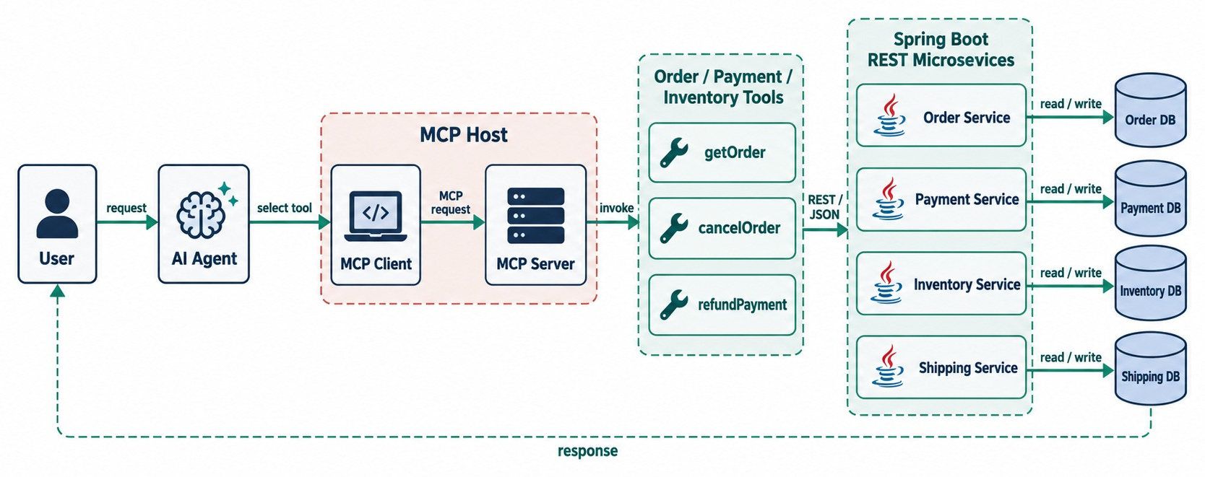
AI AGENT + MCP + SPRING BOOT ARCHITECTURE
An agent using MCP to safely interact with multiple microservices.
Agent
Understands intent and plans the steps.
MCP layer
Exposes tools, checks scopes, forwards identity.
Microservices
Validate, enforce rules, own the data.
KEY TAKEAWAY Agents use a standard MCP capability layer instead of custom integration code per backend.
37
© 2026 by Innovation In Software Corporation
Notes:
KEY TALKING POINTS
------------------
- The central architecture
This is the central architecture of the module.
The user talks to the AI agent, and the agent uses the MCP client to reach the MCP server.
Order, Payment and Inventory tools call their APIs and services, and each service has its own database.
- What the agent sees
The agent sees tools like getOrder, cancelOrder, getPayment, refundPayment and checkInventory.
It doesn't need to know controller classes, repository code, database tables or the internal network.
- Three responsibilities
The agent decides which capability it needs.
MCP provides standard access.
The microservice validates and executes the business behavior.
That separation is the foundation of the module.
- What the diagram shows
A user and agent using the MCP client and server to reach Order, Payment and Inventory tools, backed by Spring Boot services and databases.
- Key point
Agents use one standard capability layer instead of custom integrations.

Slide 38
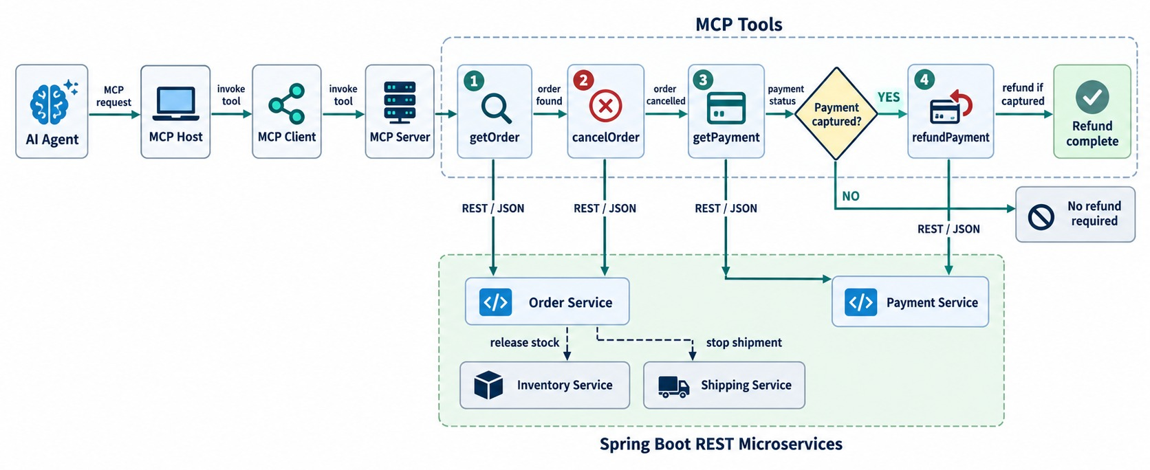
MCP FOR MULTI-SERVICE API ORCHESTRATION
One agent task invoking Order, Payment and Shipping tools.
THE DECISION PATH
✓
get_order: is it cancellable?
✓
cancel_order
✓
get_payment: was it captured?
✓
request_refund — only if captured
SUMMARY The agent orchestrates, MCP connects, services decide.
KEY TAKEAWAY The agent orchestrates, MCP connects, and each microservice keeps business authority.
38
© 2026 by Innovation In Software Corporation
Notes:
KEY TALKING POINTS
------------------
- Combining Modules 10 and 11
The user says: cancel order 1001 and refund the payment if it was captured.
The agent works through the MCP client and server.
- The decision path
It calls getOrder(1001).
If cancellation isn't allowed, it explains why.
If it is, it calls cancelOrder, then getPayment.
If the payment wasn't captured, it finishes.
If it was, it calls refundPayment, verifies the result and responds.
- Who owns what
The agent owns reasoning, sequencing and decisions.
MCP owns capability discovery, tool contracts and the call protocol.
The microservices own business rules, transactions, data and authorization.
- A memorable summary
Agent: why, and what next?
MCP: how do I access the capability?
Microservice: can this business operation happen?
- What the diagram shows
An agent calling getOrder, cancelOrder, getPayment and, only if needed, refundPayment.
- Key point
The agent orchestrates; each service keeps business authority.

Slide 39
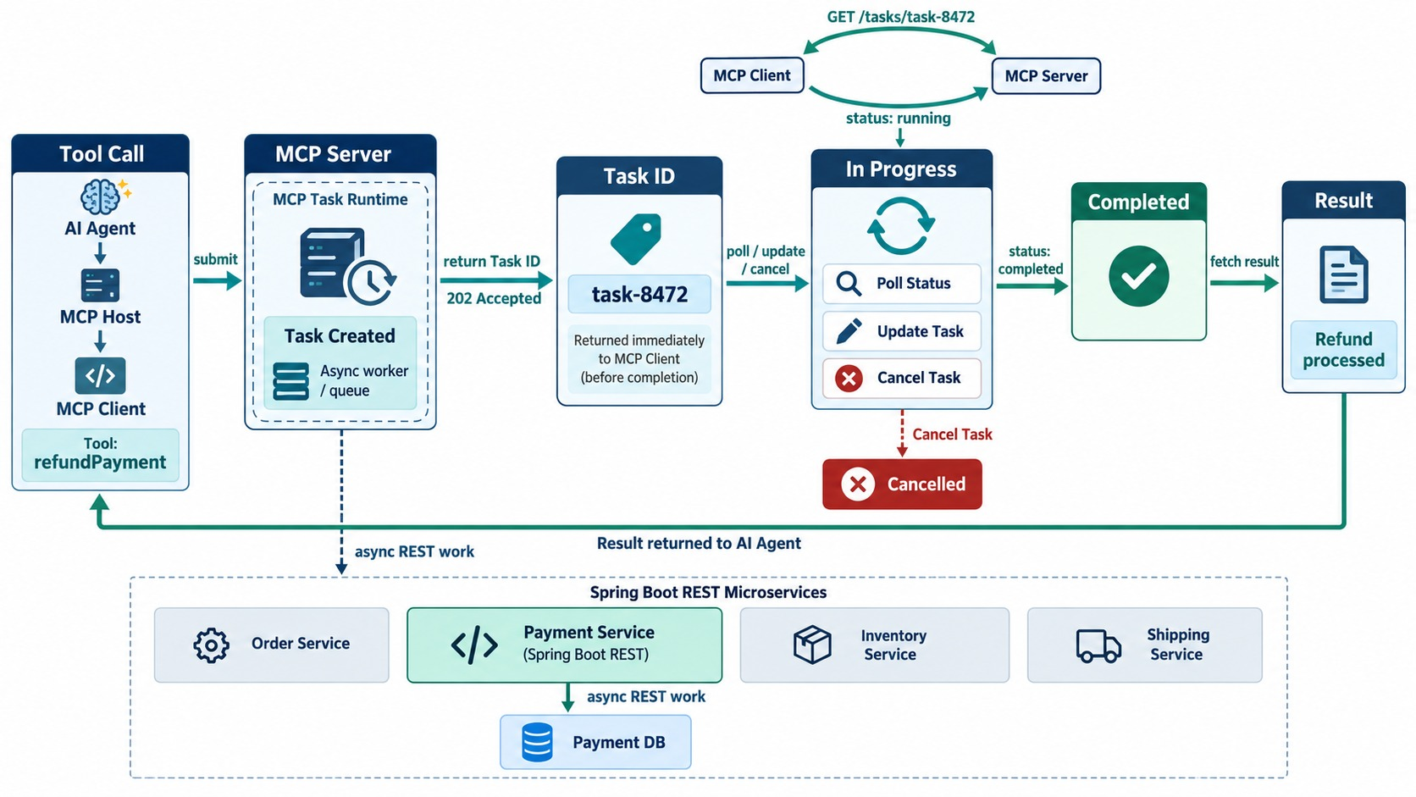
LONG-RUNNING OPERATIONS AND MCP TASKS
Handling operations that don't complete immediately.
Examples
Bulk reconciliation, report generation, a multi-step refund.
Task handle
Return an ID at once; the client polls or is notified.
Cancel
Clients can cancel a task that's no longer needed.
SECURITY Only the caller who started it may read or cancel.
KEY TAKEAWAY Tasks turn long tool calls into trackable, cancellable asynchronous work.
39
© 2026 by Innovation In Software Corporation
Notes:
KEY TALKING POINTS
------------------
- Not every call is quick
Some tool calls can't finish quickly.
Examples are generating a compliance report, running a vulnerability scan, provisioning an environment, batch reconciliation or analyzing thousands of logs.
A normal synchronous request could exceed the HTTP, gateway or agent timeout.
- The Tasks extension
The current MCP Tasks extension lets a server turn a tools/call into an asynchronous task.
The client then works with it using tasks/get, tasks/update and tasks/cancel.
The server decides when a call becomes a task; the client doesn't force it for every call.
- An example
runSecurityScan returns task ID T123.
The task shows RUNNING, then RUNNING, then COMPLETED, and then the scan result is available.
- Security still matters
Task IDs must be hard to guess.
Authorization must be checked on every task-related request.
- What the diagram shows
A tool call creating a task with an ID, then polling, updates or cancellation until completion and the result.
- Key point
Long operations become trackable, cancellable tasks.

Slide 40
EXERCISE: REVIEW A RISKY TOOL
Find the problems before this tool reaches production.
PRACTICE EXERCISE
10 MIN
SCENARIO
YOUR TASKS
EXPECTED OUTCOME
A team proposes this MCP tool:
1
Find at least five problems
✓
Vague name and description
name: run_payment_operation
description: Does payment stuff
input: { operation: string,
sql: string }
auth: shared service account
(payments admin)
effect: executes immediately
2
Explain the risk of each
✓
Free-form SQL → injection, bypasses the API
3
Redesign it as safe tools
✓
Shared admin account → no least privilege
✓
Executes immediately → no approval
✓
Redesign: get_payment + request_refund
KEY TAKEAWAY Replace one all-powerful tool with narrow, typed, scoped tools — and approvals for risky ones.
40
© 2026 by Innovation In Software Corporation
Notes:
KEY TALKING POINTS
------------------
- Contract
A vague name and description give the model no idea when to use it, and a free-form operation string accepts anything.
- Security
Raw SQL bypasses Payment Service's rules and ownership, and a shared admin account ignores who is actually asking.
- Redesign
Split it into a read tool and a request_refund tool that uses the caller's identity, a strict schema and human approval.

Slide 41
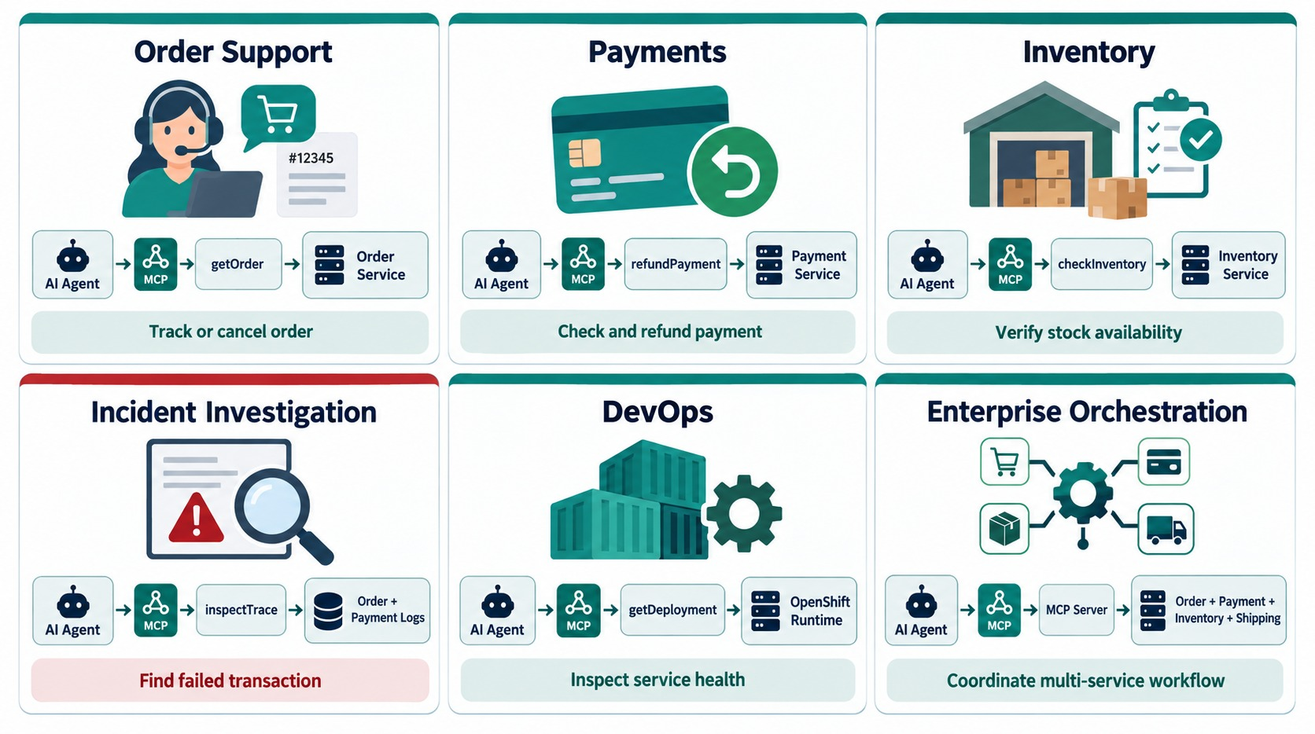
PRACTICAL MCP PATTERNS AND USE CASES
Support agent, DevOps agent, order operations and incident analysis.
GOOD FITS
✓
Many AI clients need the same capabilities
✓
Capabilities are well governed
✓
Actions have clear owners
USE PLAIN REST
✕
Service-to-service calls
✕
One fixed integration
START with read-only tools, then add approved actions.
KEY TAKEAWAY MCP pays off most when many AI clients need consistent access to controlled capabilities.
41
© 2026 by Innovation In Software Corporation
Notes:
KEY TALKING POINTS
------------------
- Support and payments
For order support, a user asks why order 1001 hasn't shipped, and the agent uses getOrder and getShipment through a Commerce MCP server.
For payment operations, the agent can read payment state and, with enough permission, start controlled actions.
- Inventory and incidents
For inventory, 'is SKU A100 available?' maps naturally to checkInventory.
For incident investigation, expose carefully designed read-oriented tools like getDeploymentStatus, searchServiceLogs and getServiceMetrics.
Be much more careful with destructive operations.
- Developer operations
Through a platform MCP server, an agent can inspect the CI pipeline, container image, OpenShift deployment and pod health.
- Cross-service orchestration
The agent combines several MCP tools to meet one business goal.
MCP is most valuable when many AI clients need consistent access to controlled capabilities.
- What the diagram shows
Six panels: order support, payments, inventory, incident investigation, DevOps and enterprise orchestration.
- Key point
MCP pays off when many AI clients need consistent capabilities.

Slide 42
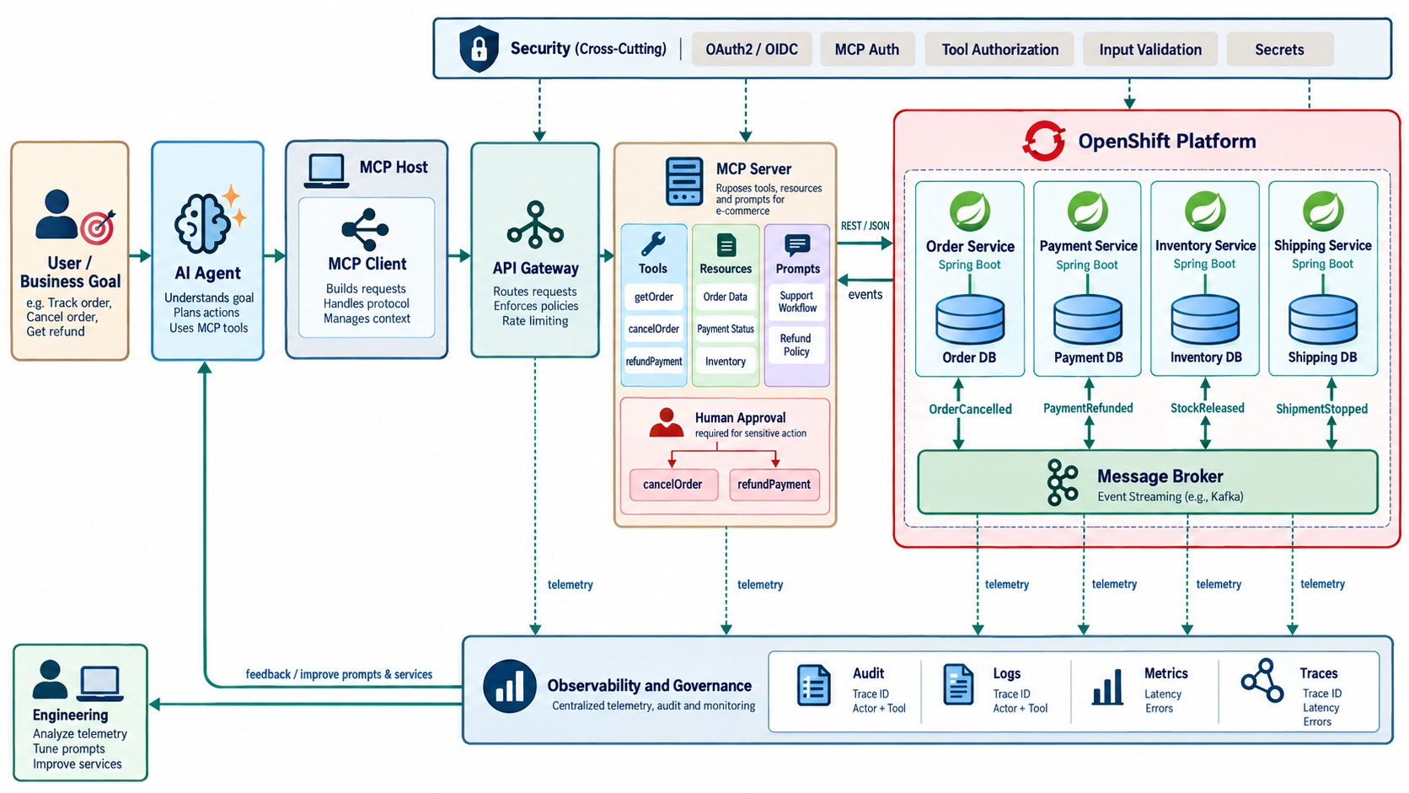
END-TO-END MCP-ENABLED MICROSERVICES ARCHITECTURE
Agent → MCP → gateway → Spring Boot → data, events and OpenShift.
EVERY PART OF THE MODULE
✓
Agent discovers tools through MCP
✓
Gateway authenticates and limits
✓
Server authorizes and forwards identity
✓
Services enforce rules and own data
✓
Audit, traces and metrics throughout
REMEMBER The microservice remains the business authority.
KEY TAKEAWAY The agent reasons, MCP connects, and the microservice remains the business authority.
42
© 2026 by Innovation In Software Corporation
Notes:
KEY TALKING POINTS
------------------
- Intent to discovery
The user gives business intent: cancel order 1001 and refund if appropriate.
The agent works out what it needs, and the MCP client discovers capabilities like getOrder, cancelOrder, getPayment and refundPayment.
- Gateway and server
The gateway protects MCP traffic with authentication, authorization, routing, rate limits, policy and tracing.
The MCP server exposes only intentional capabilities, not every internal API.
- Tool to Spring Boot
The agent selects getOrder(1001), and the MCP server calls GET /orders/1001.
Spring Boot enforces the domain through the controller, service, business rules and repository.
Each service's own database stays authoritative.
- Orchestration, events, platform
The agent may call more tools, such as cancelOrder, getPayment and refundPayment.
Services still publish events like OrderCancelled and PaymentRefunded; MCP doesn't replace event-driven architecture.
With the stateless protocol, MCP servers scale as normal replicated pods on OpenShift.
- Final message
The whole path from user to agent, tool, API and database should be traceable.
MCP should not replace a well-designed microservices architecture.
It adds a standard, intentional, secure AI-facing capability layer: the agent reasons, MCP connects, and the microservice stays the business authority.
- What the diagram shows
A user goal and agent, the MCP client, gateway and server, tools and resources, Spring Boot services with databases and a broker on OpenShift, with security, audit and observability.
- Key point
The agent reasons, MCP connects, the microservice stays authoritative.

Slide 43
MCP MISCONCEPTIONS AND ANTI-PATTERNS
Beliefs and habits that make MCP integrations fragile or unsafe.
MISCONCEPTION
REALITY
ANTI-PATTERNS TO AVOID
MCP replaces REST APIs
It adds an AI-friendly layer on top
✕
MCP server reading service databases
✕
One super-user token for all tools
✕
Vague tool names and descriptions
MCP handles security for us
Auth, scopes and audit are still our job
✕
Free-form SQL or command tools
✕
Untrusted third-party MCP servers
✕
No correlation between agent and service logs
Expose every endpoint as a tool
Expose business capabilities only
REMEMBER Agent reasons, MCP connects, service decides.
Tool hints enforce safety
Hints advise; servers enforce
Resources are live data
Live state comes from service tools
KEY TAKEAWAY MCP is only as safe as its tool design, identity handling and the services behind it.
43
© 2026 by Innovation In Software Corporation
Notes:
KEY TALKING POINTS
------------------
- Why this slide
Before the knowledge check, clear away the beliefs behind most risky MCP designs.
- Scope
MCP doesn't replace REST or provide security by itself, and not every endpoint belongs in a tool list.
- Enforcement
Tool annotations are hints for clients.
Authorization and business rules are enforced by servers and services.
- Anti-patterns
Database shortcuts, shared super-user tokens, vague or free-form tools, untrusted servers and missing correlation.

Slide 44
KNOWLEDGE CHECK
Answer in your own words — then compare with a partner.
What is MCP used for?
Why call APIs instead of service databases?
1
6
What does an MCP client do?
Read tool vs. action tool?
2
7
What does an MCP server do?
Why do correlation IDs matter for MCP?
3
8
What is an MCP tool?
What if a backend service times out?
4
9
Why keep tools narrow and task-specific?
Why require approval for sensitive actions?
5
10
44
© 2026 by Innovation In Software Corporation
Notes:
KEY TALKING POINTS
------------------
- 1. MCP
It connects AI clients to tools, resources and context through a structured protocol.
- 2. Client
It discovers and invokes tools from MCP servers.
- 3. Server
It exposes tools and resources and implements calls to backend systems.
- 4. Tool
A callable operation with structured inputs and outputs.
- 5. Narrow tools
They reduce risk, improve clarity and enforce least privilege.
- 6. APIs, not databases
APIs preserve ownership, validation, logging and security boundaries.
- 7. Read vs. action
Read tools retrieve information; action tools change state and need stronger controls.
- 8. Correlation IDs
They connect AI, MCP and backend service logs.
- 9. Timeouts
Return a safe structured error — never invent the missing data.
- 10. Approval
Sensitive actions affect customers, money, compliance or official records.
- Practical scenario
Investigating a failed payment: read tools for payment and transaction, masked data, approval for any refund, and tool calls logged with correlation IDs.

Slide 45
MODULE 11 SUMMARY AND WHAT'S NEXT
From custom connectors to a standard, secure capability layer for agents.
YOU CAN NOW
NEXT: MODULE 12 — SECURITY AND COMPLIANCE
Explain MCP hosts, clients, servers and messages
1
How do OAuth2 and OIDC protect every hop?
✓
Choose between tools, resources and prompts
2
How do we validate JWTs in Spring Boot?
✓
Wrap Spring Boot APIs as well-designed MCP tools
How do we manage secrets and prove compliance?
✓
3
Scale, secure and trace MCP servers
✓
Orchestrate several services through MCP safely
BRING ALONG The scopes you designed for MCP tools — Module 12 enforces them.
✓
KEY TAKEAWAY Module 12 secures every identity in this picture — users, services, agents and pipelines.
45
© 2026 by Innovation In Software Corporation
Notes:
KEY TALKING POINTS
------------------
- Recap
We explained MCP, designed tools and servers for our microservices, secured and scaled them, and orchestrated services through them.
- Next module
Module 12 goes deep on security and compliance: OAuth2, OIDC, JWT validation, secrets and audit.

