Slide 1
"Authenticate the identity, authorize the action, minimize the permissions."
MODULE 12
Security &
Compliance
Protecting identities, APIs, secrets and microservices.
Zero Trust principles
OAuth 2.0 and OpenID Connect
Keycloak / Microsoft Entra ID
JWT access tokens
Service-to-service security
Secrets management
API security
DevSecOps, audit and compliance
SPRING BOOT MICROSERVICES BOOTCAMP • MODULE 12
Notes:
KEY TALKING POINTS
------------------
- More boundaries
Security matters in a monolith too, but microservices add many more boundaries.
Instead of client, application and database, a request passes through the gateway, Order, Payment, Inventory and Shipping services, external APIs and a message broker.
- Questions at every step
Every interaction raises questions.
Who is calling?
Can they do this operation?
Can we trust the token?
Is the request valid and the connection encrypted?
Is a secret exposed, and can we audit what happened?
- The principle
Security is not a feature placed in front of the system.
It is a cross-cutting concern across every service, identity, API, deployment and data flow.

Slide 2
LEARNING OBJECTIVES
Identity, OAuth2/OIDC, secrets, API protection and compliance.
🎯
BY THE END OF THIS MODULE, YOU CAN
🧭
FIVE SECTIONS
1. Explain microservices security challenges
2. Apply Zero Trust principles
3. Differentiate authentication and authorization
4. Explain OAuth 2.0 and OpenID Connect
5. Understand common OAuth flows
6. Interpret JWT claims
7. Protect Spring Boot APIs
8. Integrate Keycloak or Microsoft Entra ID
9. Secure service-to-service calls
10. Manage secrets safely
11. Apply API security controls
12. Integrate security into CI/CD
13. Support auditing and compliance
Security foundations
1
Identity · Trust · Authentication · Authorization
OAuth2 / OIDC
2
Identity provider → Token → Protected API
Distributed security
3
Users · Services · Agents · MCP servers · CI/CD workloads
Secrets and APIs
4
Credentials · Certificates · API keys · Database passwords
Continuous security
5
Code → Build → Container → Deployment → Runtime → Audit
KEY TAKEAWAY Security is a cross-cutting concern across every service, identity, API and deployment.
2
© 2026 by Innovation In Software Corporation
Notes:
KEY TALKING POINTS
------------------
- By the end of this module
Learners should explain microservices security challenges, apply Zero Trust, and separate authentication from authorization.
They should explain OAuth 2.0, OpenID Connect, common flows and JWT claims, and protect Spring Boot APIs.
They should integrate Keycloak or Microsoft Entra ID and secure service-to-service calls.
They should also manage secrets, apply API security controls, add security to CI/CD, and support audit and compliance.
- Five sections
Section 1 is foundations: identity, trust, authentication and authorization.
Section 2 is OAuth2 and OIDC: identity provider, token, protected API.
Section 3 is distributed security, where users, services, agents, MCP servers and CI/CD workloads all need identities.
Section 4 is secrets and APIs.
Section 5 is continuous security from code to runtime and audit.

Slide 3
KEY TERMS FOR THIS MODULE
Plain definitions for the words we'll use most.
1
Authentication
2
Authorization
Proving who a caller is.
Deciding what an authenticated caller is allowed to do.
3
Zero Trust
4
OAuth 2.0
Never trust a request because of its network location — verify every one.
A standard for granting limited, token-based access without sharing passwords.
5
OpenID Connect
6
JSON Web Token
An identity layer on OAuth 2.0 that tells the application who signed in.
A signed token carrying claims such as subject, issuer, audience and scopes.
7
Scope
8
Secret
A permission in a token, such as accounts.read, that limits what the caller may do.
A sensitive value, such as a password or key, kept out of code and injected at runtime.
KEY TAKEAWAY Agree on the words first — every later slide builds on them.
3
© 2026 by Innovation In Software Corporation
Notes:
KEY TALKING POINTS
------------------
- How to run this slide
Read each term once and give a quick example from the order platform or the banking lab.
- Authentication
Proving who a caller is.
- Authorization
Deciding what an authenticated caller is allowed to do.
- Zero Trust
Never trust a request because of its network location — verify every one.
- OAuth 2.0
A standard for granting limited, token-based access without sharing passwords.
- OpenID Connect
An identity layer on OAuth 2.0 that tells the application who signed in.
- JSON Web Token
A signed token carrying claims such as subject, issuer, audience and scopes.
- Scope
A permission in a token, such as accounts.read, that limits what the caller may do.
- Secret
A sensitive value, such as a password or key, kept out of code and injected at runtime.

Slide 4
FULL FORMS USED IN THIS MODULE
Every abbreviation on these slides, spelled out.
AI
Artificial Intelligence
HTTPS
HyperText Transfer Protocol Secure
OIDC
OpenID Connect
API
Application Programming Interface
ID
Identifier
PKCE
Proof Key for Code Exchange
CI
Continuous Integration
IdP
Identity Provider
RBAC
Role-Based Access Control
CI/CD
Continuous Integration / Continuous Delivery
JWKS
JSON Web Key Set
SAST
Static Application Security Testing
CORS
Cross-Origin Resource Sharing
JWT
JSON Web Token
SBOM
Software Bill of Materials
DB
Database
MCP
Model Context Protocol
SQL
Structured Query Language
DTO
Data Transfer Object
MDC
Mapped Diagnostic Context
TLS
Transport Layer Security
HMAC
Hash-based Message Authentication Code
mTLS
Mutual Transport Layer Security
URL
Uniform Resource Locator
HTTP
HyperText Transfer Protocol
OAuth
Open Authorization
WAF
Web Application Firewall
KEY TAKEAWAY When an abbreviation isn't clear, the full form is on this slide.
4
© 2026 by Innovation In Software Corporation
Notes:
KEY TALKING POINTS
------------------
- How to run this slide
Don't read every row.
Point out the few this module uses most, and say the full list is here for reference.
- Reference
AI is Artificial Intelligence; API is Application Programming Interface; CI is Continuous Integration; CI/CD is Continuous Integration / Continuous Delivery; CORS is Cross-Origin Resource Sharing; DB is Database; DTO is Data Transfer Object; HMAC is Hash-based Message Authentication Code; HTTP is HyperText Transfer Protocol; HTTPS is HyperText Transfer Protocol Secure; ID is Identifier; IdP is Identity Provider; JWKS is JSON Web Key Set; JWT is JSON Web Token; MCP is Model Context Protocol; MDC is Mapped Diagnostic Context; mTLS is Mutual Transport Layer Security; OAuth is Open Authorization; OIDC is OpenID Connect; PKCE is Proof Key for Code Exchange; RBAC is Role-Based Access Control; SAST is Static Application Security Testing; SBOM is Software Bill of Materials; SQL is Structured Query Language; TLS is Transport Layer Security; URL is Uniform Resource Locator; WAF is Web Application Firewall.

Slide 5
FROM MODULE 11 TO MODULE 12
Users, services, agents and pipelines all call our APIs — secure every one of them.
MODULES 1–11 GAVE US
🧭
OUR PATH THROUGH MODULE 12
1
Why microservices security differs
Part 1
✓
Many services and APIs
Events, gateways and OpenShift
2
OAuth2, OIDC and PKCE
Part 2
✓
Pipelines holding deploy rights
3
JWT validation, scopes and roles
Part 2
✓
AI agents calling tools
4
Gateways and service identities
Part 3
✓
MCP servers with per-tool scopes
5
Secrets and API protection
Part 4
✓
NOW Give every identity, token, secret and API explicit, auditable trust.
6
Audit, logging and compliance
Part 5
7
DevSecOps and the secure architecture
Part 5
KEY TAKEAWAY Every earlier module created a new identity or boundary — Module 12 secures them all.
5
© 2026 by Innovation In Software Corporation
Notes:
KEY TALKING POINTS
------------------
- Bridge from Module 11
Module 11 introduced per-tool scopes and identity propagation.
Module 12 explains the identity system underneath them.
- The path
Foundations, OAuth2 and OIDC, distributed security, secrets and APIs, then continuous security and audit.
- Two examples
The slides use the order platform.
Exercise 3.2 and Lab 3 secure the banking Account and Transaction services.

Slide 6
PART 1: SECURITY FOUNDATIONS
Why distributed systems need a different security mindset.
Part 1
Foundations
Part 2
OAuth2 / OIDC
Part 3
Distributed security
Part 4
Secrets and APIs
Part 5
Continuous security
SO FAR
NEXT QUESTION
Why can't we secure microservices the way we secured a monolith?
✓
Every service exposes an API
✓
Agents and pipelines call those APIs
IN THIS PART
✓
Tokens and scopes appeared along the way
Why microservices security is different
1
2
Zero Trust
3
Authentication vs. authorization
4
Exercise: 401 or 403?
6
© 2026 by Innovation In Software Corporation
Notes:
KEY TALKING POINTS
------------------
- Why start here
More services mean more network hops, more credentials and more ways in.
The mindset has to change before the tools.
- What this part covers
The larger attack surface, Zero Trust, and the difference between proving identity and granting permission.

Slide 7
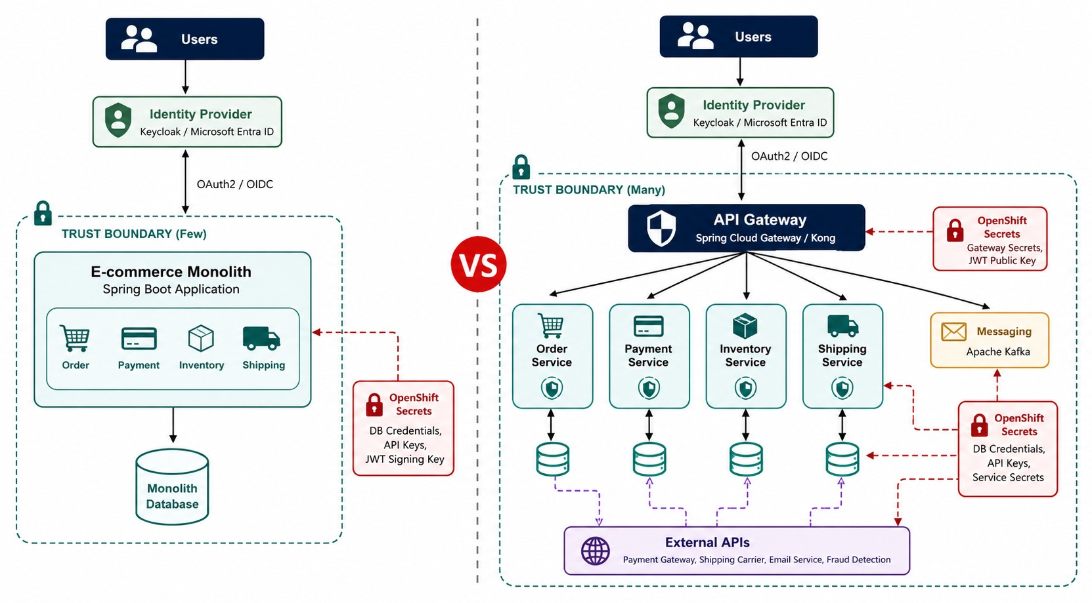
WHY MICROSERVICES SECURITY IS DIFFERENT
A larger attack surface, distributed trust, many APIs and identities.
QUESTIONS AT EVERY HOP
?
Who is calling?
?
With which identity?
?
What permission allows it?
?
Can we prove it later?
More credentials
Database passwords, service secrets, tokens and keys — per service.
TAKEAWAY Protect every interaction, not just the edge.
KEY TAKEAWAY Microservices security is about identity, controlled trust and protecting every interaction.
7
© 2026 by Innovation In Software Corporation
Notes:
KEY TALKING POINTS
------------------
- More trust boundaries
Microservices increase the number of trust boundaries.
One checkout request might pass through the gateway, Order, Payment, Inventory and Shipping services.
- Questions at each hop
At each hop, ask who started this request and which identity is being used.
Ask what permissions are needed and whether the downstream service can trust it.
- More credentials
Distributed systems also have more credentials: user tokens, service credentials, database passwords, certificates, cloud credentials, API keys and CI/CD credentials.
- The takeaway
Microservices security is mostly about identity, controlled trust, and protecting the interactions between independently deployed parts.
- What the diagram shows
A monolith with few trust boundaries next to microservices with a gateway, Order, Payment, Inventory, messaging and external APIs.
- Key point
More services mean more boundaries to protect.

Slide 8
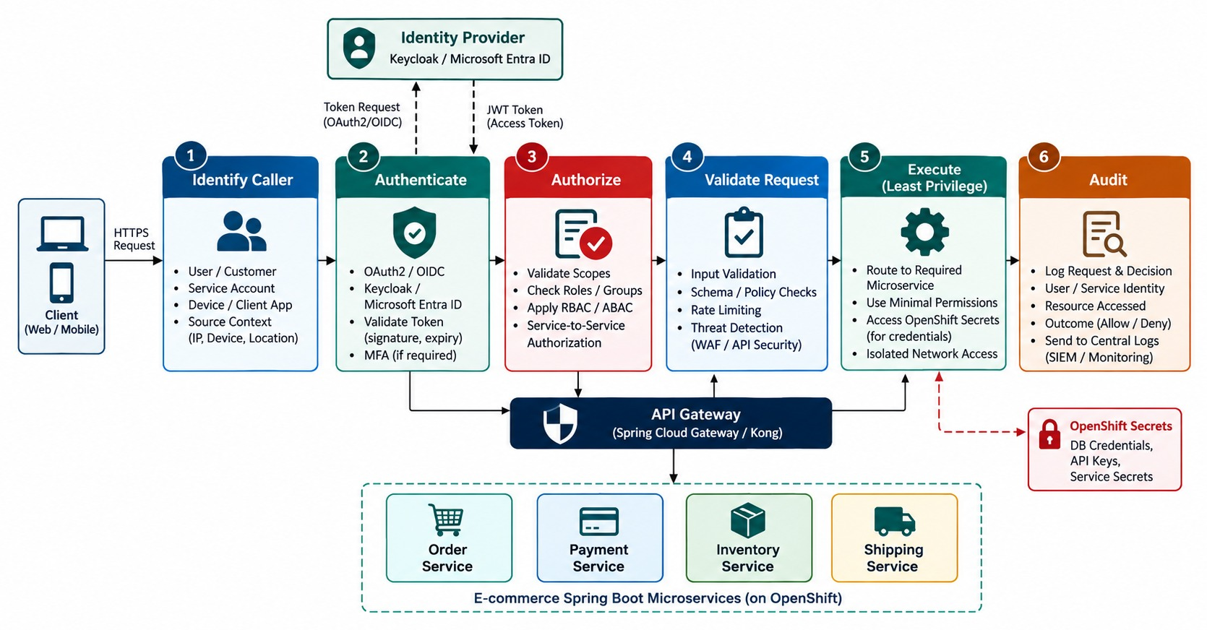
ZERO TRUST SECURITY FOR MICROSERVICES
Never trust a request based only on its network location.
Old thinking
“It's inside our network, so it's safe.”
Zero Trust
Verify identity, permission and policy on every request.
REMEMBER Never trust, always verify.
KEY TAKEAWAY Trust comes from identity, permission and policy — never from network location alone.
8
© 2026 by Innovation In Software Corporation
Notes:
KEY TALKING POINTS
------------------
- Three ideas
Zero Trust has three core ideas: verify explicitly, use least privilege, and assume breach, meaning plan as if an attacker is already inside.
- Old thinking is dangerous
Traditional thinking assumed that inside the network meant trusted.
That is dangerous today.
An attacker who compromises one workload should not automatically reach every other service.
- An example
The Inventory Service should not automatically be able to refund payments, delete customers or change authentication settings.
Running in the same OpenShift cluster doesn't grant that.
- What trust is based on
Trust comes from identity, context, permission, policy and the request itself, not network location.
Every request is identified, authenticated, authorized and validated.
It runs with the minimum access required and is audited.
- The phrase to remember
Authenticate the identity, authorize the action, and minimize the permissions.
- What the diagram shows
A request identified, authenticated, authorized, validated, executed with least privilege and audited.
- Key point
Every request earns trust at every step.

Slide 9
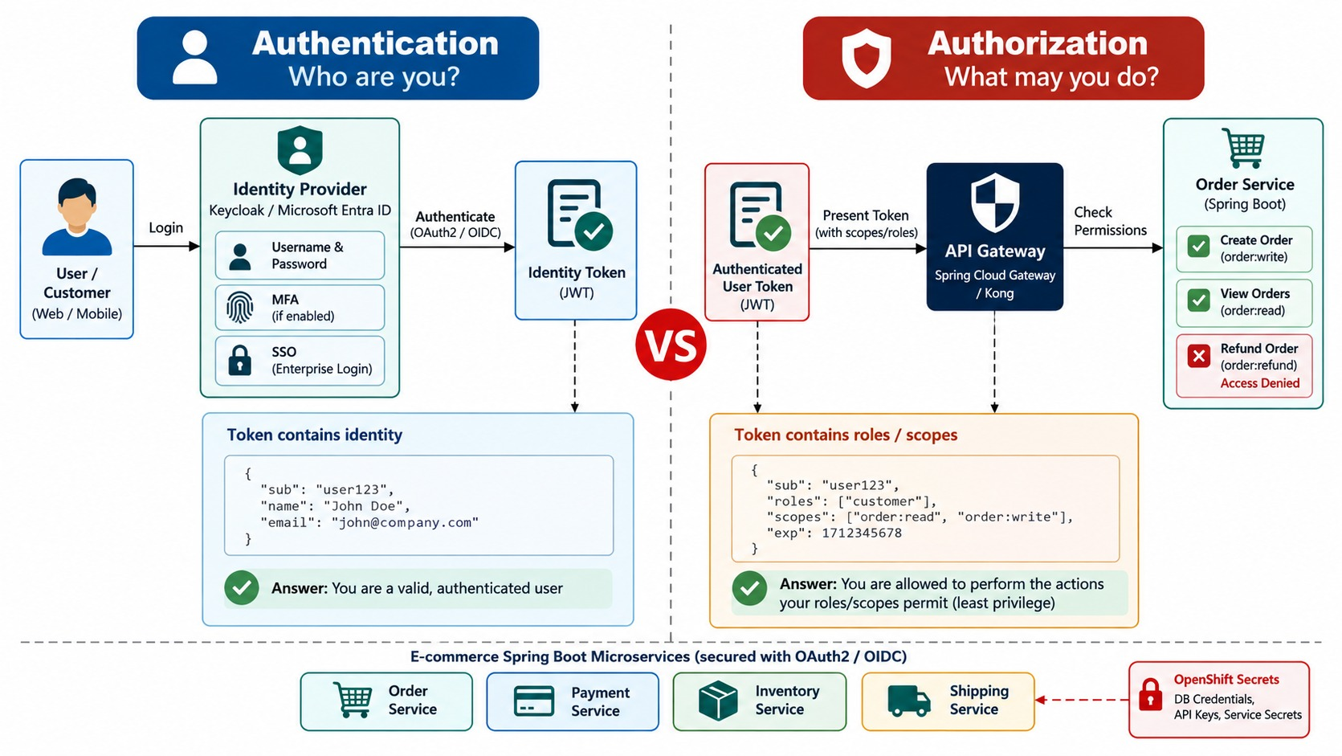
AUTHENTICATION VS. AUTHORIZATION
Who are you? versus what may you do?
Authentication
Proves identity — a valid, unexpired token from a trusted issuer.
Authorization
Decides access — scope, role and ownership of this object.
HTTP tells them apart
401 Unauthorized → not authenticated
403 Forbidden → not allowed
KEY TAKEAWAY Being authenticated never means being allowed to do everything.
9
© 2026 by Innovation In Software Corporation
Notes:
KEY TALKING POINTS
------------------
- Authentication
Authentication answers: who is the caller?
Examples are a password with MFA, an OIDC login, a client certificate, a workload credential or a signed access token.
- Authorization
Authorization answers: what may this identity do?
A customer can view their own order, and a support agent can view customer orders.
Payment support can issue certain refunds, and an administrator can manage configuration.
- Order matters
Authentication establishes identity first.
Authorization evaluates permission after that.
- Not unlimited access
Successful authentication does not mean unlimited access.
A valid token doesn't mean the user can read any customer's order.
That needs authorization against the actual resource.
- What the diagram shows
Two side-by-side flows: “Who are you?” and “What may you do?”.
- Key point
Authentication first; authorization for every action.

Slide 10
EXERCISE: 401 OR 403?
Decide the right response for each request to Account Service.
PRACTICE EXERCISE
8 MIN
SCENARIO
YOUR TASKS
EXPECTED OUTCOME
GET /api/v1/accounts/ACC-5001 is owned by customer CUST-0007.
1
Give the status code for each request
✓
A, B, F → 401 (authentication)
A no Authorization header
B expired token
C valid token, scope transactions.read
D valid token, accounts.read, sub CUST-0009
E valid token, accounts.read, sub CUST-0007
F token signed by an unknown issuer
2
Say whether it's authentication or authorization
✓
C → 403 (wrong scope)
✓
D → 403 or 404 (not the owner)
3
Decide what gets logged — and what never does
✓
E → 200
✓
Log subject and decision — never the token
KEY TAKEAWAY 401 means we don't know who you are; 403 means we know — and the answer is no.
10
© 2026 by Innovation In Software Corporation
Notes:
KEY TALKING POINTS
------------------
- 401 cases
Missing, expired or untrusted tokens fail authentication, so the answer is 401.
- 403 cases
A valid token without the right scope, or for someone who doesn't own the account, fails authorization.
Some APIs return 404 to avoid revealing the account exists.
- Logging
Record the subject, resource and decision, but never the Authorization header or token.

Slide 11
PART 2: OAUTH2 AND OPENID CONNECT
Tokens instead of passwords — and how Spring Boot validates them.
✓ Part 1
Foundations
Part 2
OAuth2 / OIDC
Part 3
Distributed security
Part 4
Secrets and APIs
Part 5
Continuous security
SO FAR
NEXT QUESTION
How do users and clients get tokens — and how does a service trust them?
✓
Every hop can be an attack path
✓
Zero Trust verifies every request
IN THIS PART
✓
401 is authentication; 403 is authorization
OAuth 2.0, OIDC and how they differ
1
2
The architecture and Authorization Code + PKCE
3
JWTs — and validating them in code
4
Roles, scopes, claims — and object-level checks
5
Exercise 3.2: JWT roles and scopes
6
Keycloak and Microsoft Entra ID
11
© 2026 by Innovation In Software Corporation
Notes:
KEY TALKING POINTS
------------------
- Why this part
OAuth2 and OIDC are how almost every enterprise system hands out and checks access today.
- What comes next
The protocols, the recommended login flow, token anatomy, Spring Security validation, authorization rules and two identity providers.

Slide 12
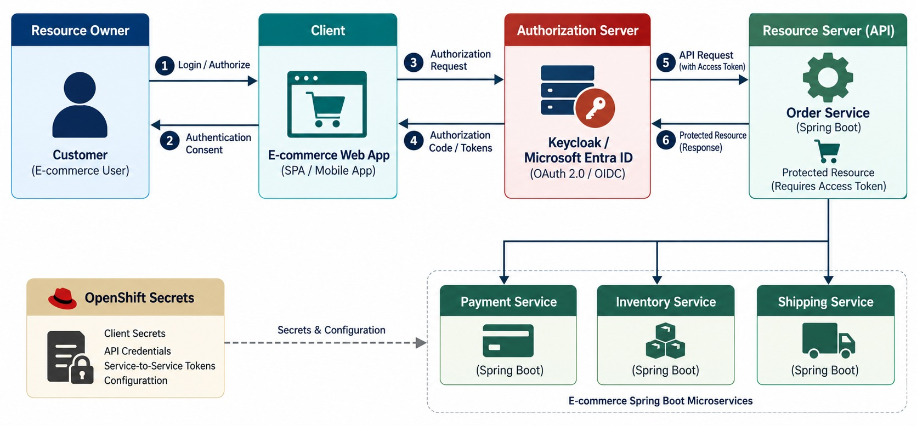
OAUTH 2.0 FUNDAMENTALS
Roles, access tokens, scopes and authorization flows.
Resource owner
The user who owns the data.
Client
The app acting on the user's behalf.
Authorization server
Issues tokens — Keycloak or Entra ID.
Resource server
Your API, which validates the token.
KEY TAKEAWAY OAuth 2.0 grants limited access with tokens and scopes — never shared passwords.
12
© 2026 by Innovation In Software Corporation
Notes:
KEY TALKING POINTS
------------------
- An authorization framework
OAuth 2.0 is mainly an authorization framework for granting controlled access to protected resources.
Microsoft describes it as giving limited access using tokens instead of sharing the owner's credentials with every client.
- The roles
The resource owner is the customer.
The client is the shopping application.
The authorization server is the identity provider.
The resource server is the Order API.
The access token carries the permission between them.
- No passwords to the API
The shopping app does not send a username and password to the Order API.
It sends an Authorization header with a Bearer access token, and the API validates that token.
- Scopes
OAuth allows controlled permissions such as orders.read, orders.write and payments.read, instead of one unrestricted credential.
- What the diagram shows
The resource owner, client, authorization server, access token and resource server.
- Key point
Clients get limited, token-based access — never passwords.

Slide 13
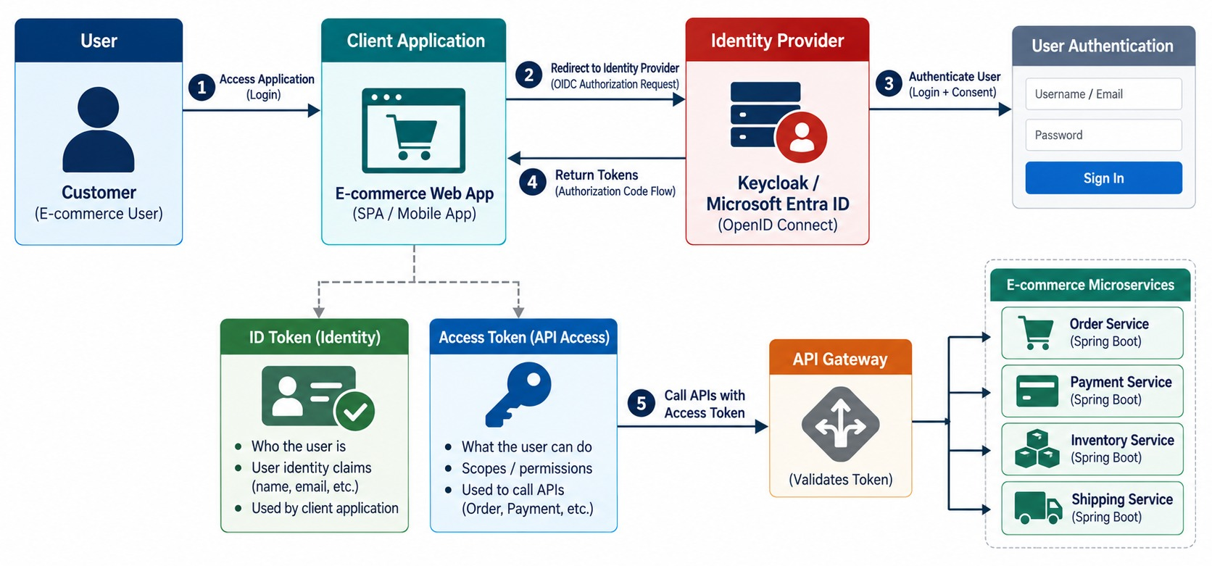
OPENID CONNECT FUNDAMENTALS
The authentication layer, ID token and user identity.
ID token
Who signed in — read by the client app.
Access token
What the client may access — sent to APIs.
RULE Never send an ID token to an API as authorization.
KEY TAKEAWAY OIDC adds identity on top of OAuth 2.0 — ID tokens for clients, access tokens for APIs.
13
© 2026 by Innovation In Software Corporation
Notes:
KEY TALKING POINTS
------------------
- An identity layer
OpenID Connect, or OIDC, adds an identity and authentication layer on top of OAuth 2.0.
OAuth mainly answers: can this client access this resource?
OIDC adds: who authenticated?
- The ID token
After a successful login, the client may receive an ID token.
It can include claims like sub, name, preferred_username and email, depending on the provider and requested claims.
- Two different tokens
The ID token gives identity information to the client.
The access token authorizes calls to an API.
Microsoft's identity platform separates access tokens, ID tokens and refresh tokens in the same way.
- The rule
Don't send the ID token as the normal credential for your backend API.
APIs generally expect an access token intended for that resource.
- What the diagram shows
A user signing in through the identity provider and the client receiving an ID token, distinguished from the access token.
- Key point
ID tokens are for the client; access tokens are for APIs.

Slide 14
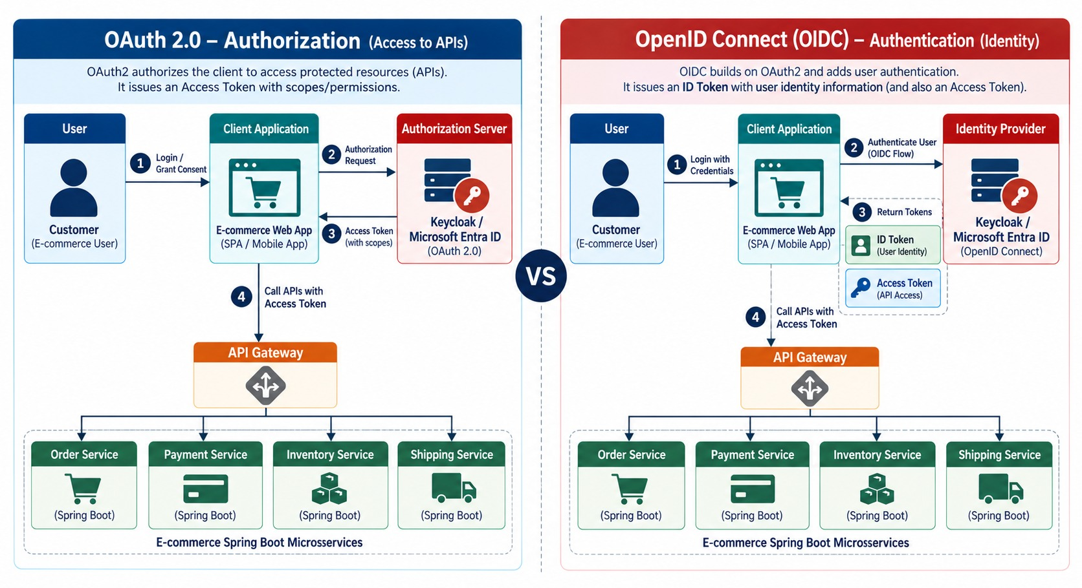
OAUTH2 VS. OPENID CONNECT
Authorization versus authentication.
OAuth 2.0 answers
What may this client access?
OIDC answers
Who is the signed-in user?
WHAT OIDC ADDS
openid scope
ID token
UserInfo
Discovery
KEY TAKEAWAY OIDC answers who signed in; OAuth 2.0 answers what the client may access.
14
© 2026 by Innovation In Software Corporation
Notes:
KEY TALKING POINTS
------------------
- Side by side
OAuth 2.0 is about authorization: what can this application access?
OpenID Connect is about authentication and identity: who signed in?
OIDC is built on top of OAuth 2.0.
- A login example
A user signs in to the e-commerce app.
OIDC tells the app that this user successfully authenticated.
OAuth gives the app an access token that might allow orders.read, and the app calls GET /orders/1001 with it.
- Two tokens, two purposes
One login session can involve both an ID token and an access token, but they serve different purposes.
- What the diagram shows
The authorization path next to the authentication and identity path, with OIDC built on OAuth2.
- Key point
OIDC adds identity on top of OAuth2.

Slide 15
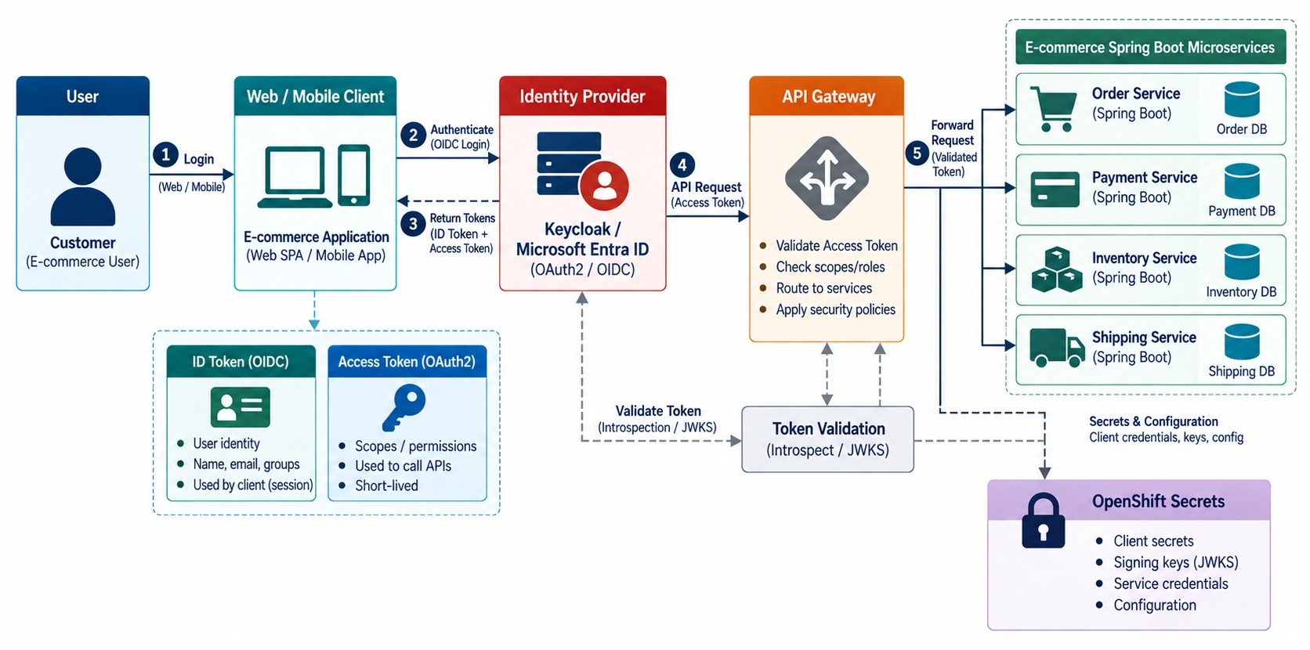
OAUTH2/OIDC ARCHITECTURE FOR MICROSERVICES
User → identity provider → token → API gateway → services.
AVOID
✕
Services storing passwords
✕
Only the gateway checking tokens
✕
Internal calls with no identity
Better
The gateway validates and routes; each service still authorizes.
STATELESS Services validate tokens without calling the IdP.
KEY TAKEAWAY Clients get tokens from the identity provider; every service still enforces authorization.
15
© 2026 by Innovation In Software Corporation
Notes:
KEY TALKING POINTS
------------------
- The flow
The user opens the application, which redirects them to an identity provider such as Keycloak or Microsoft Entra ID.
The user authenticates, and the client receives the right tokens.
- Calling the API
The client sends the access token in the Authorization header as a Bearer token.
The API verifies the token instead of asking for the user's password.
- Gateway and services
The gateway may do an initial validation.
But each microservice should still enforce authorization for its own business operations.
- Avoid this design
Don't build a system where the gateway validates the token and every backend service then trusts everything.
Prefer defense in depth, meaning several layers of protection.
- What the diagram shows
A user and client getting a token from Keycloak or Entra ID, then calling the API gateway and Spring Boot services.
- Key point
The identity provider issues tokens; every service enforces access.

Slide 16
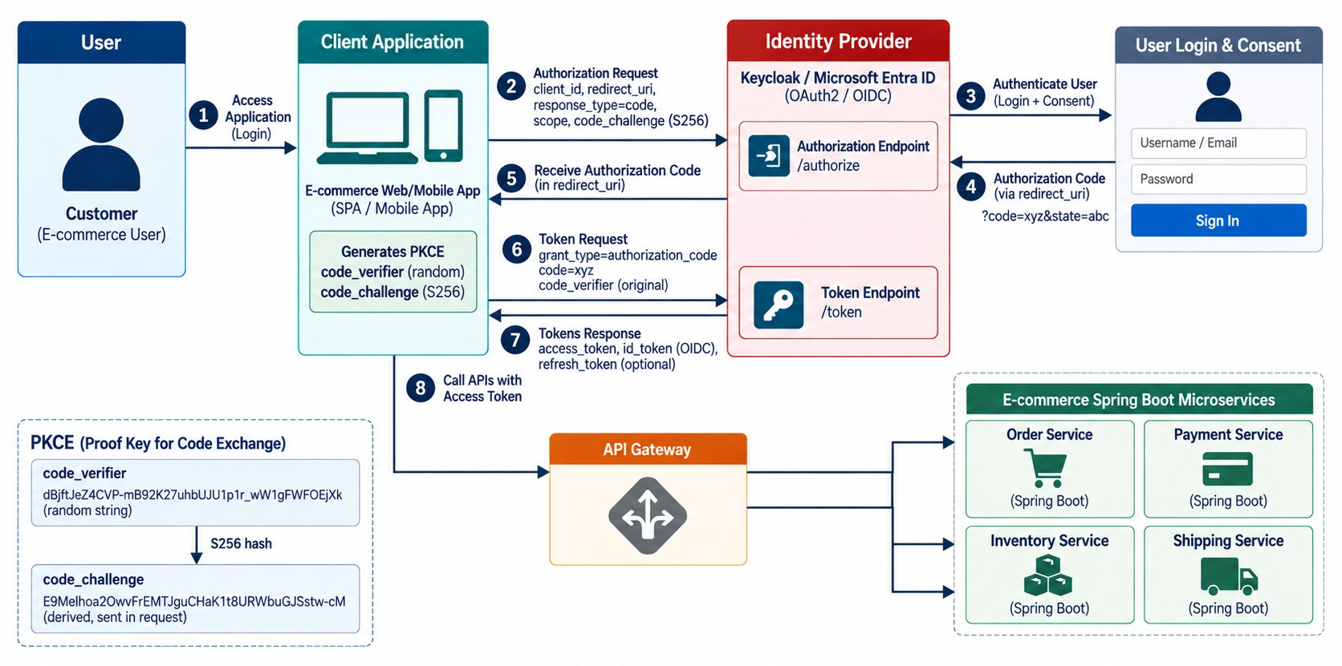
AUTHORIZATION CODE FLOW WITH PKCE
The recommended interactive user authentication flow.
Verifier
The client makes a random secret and sends only its hash.
Exchange
Code + verifier → token; the server checks they match.
DON'T USE
✕
Implicit flow
✕
Password grant
KEY TAKEAWAY Authorization Code + PKCE protects the code exchange; stolen codes alone are useless.
16
© 2026 by Innovation In Software Corporation
Notes:
KEY TALKING POINTS
------------------
- The recommended flow
The Authorization Code flow is widely used for interactive apps.
Microsoft currently recommends it with PKCE for single-page apps, mobile and desktop apps, and server-based web apps.
- The steps
The user opens the client, which redirects to the authorization endpoint with a code challenge.
The user logs in, and the client receives an authorization code.
The client exchanges the code plus the code verifier at the token endpoint, receives an access token, and calls the API.
- PKCE in simple terms
PKCE stands for Proof Key for Code Exchange.
The client creates a secret code_verifier and derives a code_challenge from it, which it sends when authorization starts.
When exchanging the code, it proves it has the verifier.
So a stolen authorization code alone is useless.
Keycloak also supports PKCE for OIDC clients.
- Avoid older flows
Current Keycloak guidance says not to use the password or direct grant, and not to use the implicit flow.
Users should sign in at the identity provider; the application shouldn't collect or store their password.
- What the diagram shows
The client sending the user to authorize, receiving a code, then exchanging code plus verifier for an access token.
- Key point
A stolen code is useless without the verifier.

Slide 17
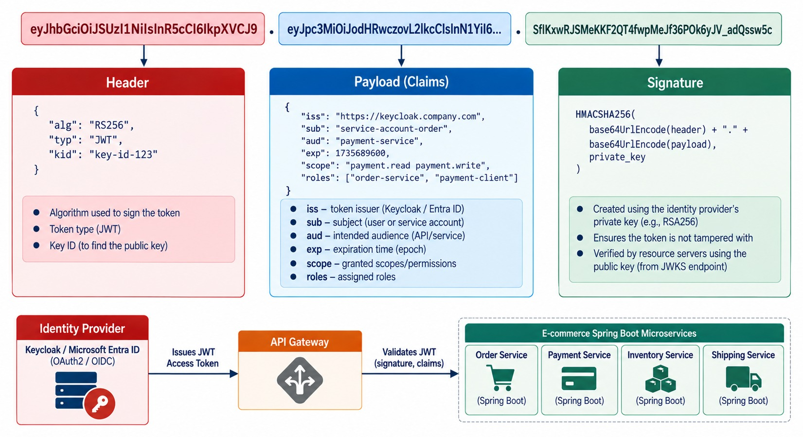
UNDERSTANDING JWT ACCESS TOKENS
Header, payload, signature and claims.
A decoded payload
{
"iss": "https://idp.example.com/realms/md287",
"sub": "CUST-0007",
"aud": "account-service",
"exp": 1789472400,
"scope": "accounts.read",
"roles": ["teller"]
}
ENCODED ≠ ENCRYPTED Anyone can read the claims — keep secrets out.
KEY TAKEAWAY A JWT is signed and encoded — not encrypted — so keep secrets out of its claims.
17
© 2026 by Innovation In Software Corporation
Notes:
KEY TALKING POINTS
------------------
- What a JWT is
JWT stands for JSON Web Token.
Many identity platforms issue access tokens in this format, including Microsoft's identity platform.
- Three parts
The header describes metadata such as the signing algorithm.
The payload contains claims, like sub user-123, aud order-api, scope orders.read and an exp expiry time.
The signature lets the API verify that a trusted issuer signed it and nobody changed it.
- Common claims
iss is the issuer, sub the subject, and aud the intended audience.
exp is the expiry and iat is when it was issued.
scope and roles carry permissions.
- Encoded, not encrypted
JWT payloads are normally encoded, not encrypted.
Anyone holding the token can often decode the claims.
So never put passwords, secrets, private keys or unnecessary sensitive data in token claims.
- What the diagram shows
Header, payload and signature, with claims such as iss, sub, aud, exp, scope and roles.
- Key point
A JWT is signed and encoded — not encrypted.

Slide 18
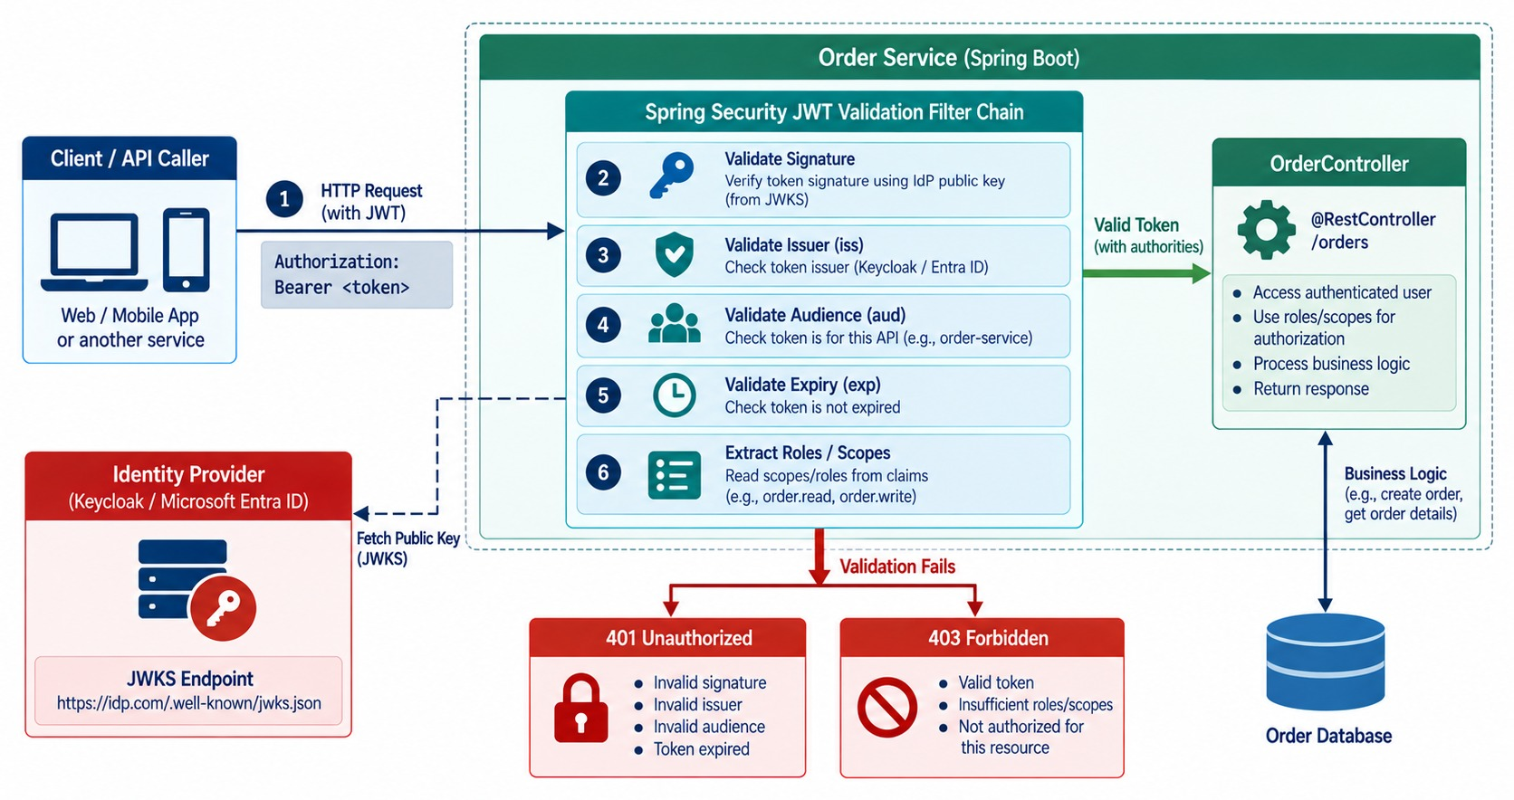
VALIDATING TOKENS IN SPRING BOOT
Resource-server validation: signature, issuer, audience and expiry.
SPRING CHECKS
✓
Signature from the issuer's keys
✓
iss matches the issuer
✓
aud includes this API
✓
exp not passed
Then
Scopes and roles decide 403 or the controller.
KEYS Fetched from the issuer's JWKS endpoint and cached.
KEY TAKEAWAY Validate signature, issuer, audience, expiry and permissions before trusting any token.
18
© 2026 by Innovation In Software Corporation
Notes:
KEY TALKING POINTS
------------------
- Don't trust appearances
A token should not be trusted just because it looks like a JWT.
Spring Security's resource-server support validates tokens from a trusted issuer.
- The checks
The signature must come from the expected identity provider, and the issuer (iss) must be trusted.
The token must not be expired (exp), and the audience (aud) must be this API.
Finally it must carry the scopes or roles the operation needs.
- Configuration
In Spring Boot, you usually configure the resource server with the issuer URI.
It can then discover the keys and endpoints it needs.
- 401 versus 403
401 Unauthorized usually means authentication is missing or invalid.
403 Forbidden means the identity is known but lacks permission.
This difference helps a lot when troubleshooting.
- The rule
A JWT existing does not mean the JWT is trusted.
It must be validated.
- What the diagram shows
A bearer token checked by Spring Security for signature, issuer, audience, expiry and roles or scopes, ending in 401, 403 or the controller.
- Key point
Validate everything before trusting a token.

Slide 19
A SPRING BOOT RESOURCE SERVER
Let Spring Security validate every JWT, then map endpoints to scopes.
application.yml
✓
SecurityConfig.java
spring:
security:
oauth2:
resourceserver:
jwt:
issuer-uri: https://idp.example.com/realms/md287
audiences: account-service
# Spring fetches the signing keys from the
# issuer's discovery document and JWKS
@Bean
SecurityFilterChain api(HttpSecurity http) throws Exception {
return http
.csrf(c -> c.disable()) // stateless bearer API
.sessionManagement(s -> s.sessionCreationPolicy(STATELESS))
.authorizeHttpRequests(a -> a
.requestMatchers("/actuator/health/**").permitAll()
.requestMatchers(GET, "/api/v1/accounts/**")
.hasAuthority("SCOPE_accounts.read")
.requestMatchers(POST, "/api/v1/accounts/**")
.hasAuthority("SCOPE_accounts.write")
.anyRequest().authenticated())
.oauth2ResourceServer(o -> o.jwt(Customizer.withDefaults()))
.build();
}
issuer-uri
audiences
Scopes
Signature, issuer and expiry are checked automatically.
Tokens minted for other APIs are rejected.
The scope claim becomes SCOPE_ authorities.
KEY TAKEAWAY Configure the issuer and audience, then map each endpoint to the narrowest scope.
19
© 2026 by Innovation In Software Corporation
Notes:
KEY TALKING POINTS
------------------
- Configuration
issuer-uri tells Spring where to find the signing keys.
audiences rejects tokens issued for a different API.
- The filter chain
Health stays public for OpenShift probes.
Reading accounts needs accounts.read; changing them needs accounts.write.
- CSRF and sessions
A stateless API authenticated by bearer tokens doesn't use cookies, so CSRF protection can be disabled and no session is created.
- Responses
A missing or invalid token gives 401.
A valid token without the scope gives 403.

Slide 20
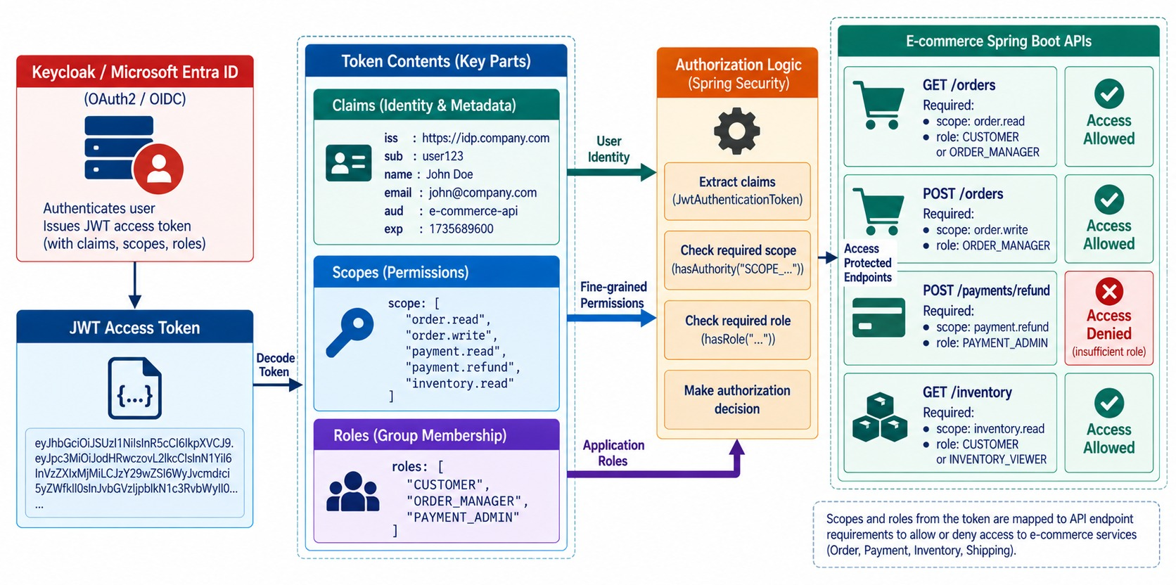
ROLES, SCOPES, AND CLAIMS
Coarse- and fine-grained authorization.
Scope
What the client may do: accounts.read.
Role
The user's job: teller, ops, readonly.
Claim
Any fact in the token: sub, tenant, branch.
AVOID One broad admin role for everything.
KEY TAKEAWAY Map each operation to the narrowest scope or role that allows it.
20
© 2026 by Innovation In Software Corporation
Notes:
KEY TALKING POINTS
------------------
- Claims, scopes, roles
A claim is a statement about the token or identity, such as sub, tenant or department.
A scope usually represents delegated access, such as orders.read.
A role supports role-based authorization, such as SUPPORT.
- Mapping operations
GET /orders/{id} needs orders.read.
POST /orders and cancelling an order need orders.write.
POST /payments/{id}/refund needs payment.refund.
- Avoid broad roles
Don't give ordinary services SUPER_ADMIN because it's easier.
Prefer narrow permissions like ORDER_READ, ORDER_CANCEL, PAYMENT_READ and PAYMENT_REFUND where appropriate.
- Least privilege
Give the smallest permission that is needed.
- What the diagram shows
A token split into claims, scopes and roles, mapped to protected endpoints.
- Key point
Map each operation to the narrowest permission that allows it.

Slide 21
OBJECT-LEVEL AUTHORIZATION
A valid scope isn't enough — check this caller may touch this account.
✕
Only checks the scope
✓
Checks ownership too
@GetMapping("/{accountId}")
@PreAuthorize("hasAuthority('SCOPE_accounts.read')")
AccountResponse get(@PathVariable String accountId) {
return accounts.find(accountId);
}
// any customer can read ANY account
// by changing the id in the URL
@GetMapping("/{accountId}")
@PreAuthorize("hasAuthority('SCOPE_accounts.read')")
AccountResponse get(@PathVariable String accountId,
@AuthenticationPrincipal Jwt jwt) {
Account account = accounts.find(accountId);
boolean staff = jwt.getClaimAsStringList("roles")
.contains("teller");
if (!staff && !account.customerId().equals(jwt.getSubject()))
throw new AccessDeniedException("Not the account owner");
return AccountResponse.from(account);
}
Broken object-level authorization
Ownership
Staff roles
The top API security risk.
Compare the token subject with the resource owner.
Allowed by role — and audited.
KEY TAKEAWAY Authorize the object, not just the endpoint — compare who's asking with who owns it.
21
© 2026 by Innovation In Software Corporation
Notes:
KEY TALKING POINTS
------------------
- The problem
The scope check alone lets any customer with accounts.read read any account just by changing the ID.
- The fix
The service loads the account and compares its owner with the token subject.
Tellers are allowed by role.
- Why here
Only the service knows who owns the account, so this check can't live in the gateway.
- Response choice
Some APIs return 404 instead of 403 so they don't reveal that the account exists.

Slide 22
EXERCISE 3.2 — SECURE AN ENDPOINT WITH JWT ROLES/SCOPES
Day 3 checkpoint B: roles and scopes on protected APIs.
OFFICIAL CHECKPOINT B
10 MIN
labs/day-03/exercises/exercise-3.2-jwt-roles-scopes.md
SCENARIO
YOUR TASKS
EXPECTED OUTCOME
Lab 3 secures the banking Account and Transaction services with JWTs issued by issue-jwt.py (HMAC). Keycloak and Entra ID stay lecture-only.
1
No Bearer token → 401; wrong scope → 403 — not a silent 200
✓
A scope matrix per role
✓
Testable with issue-jwt.py teller / ops / readonly
2
teller: accounts.read/write; ops: transactions + accounts.read; readonly: *.read
✓
401 and 403 in the right places
3
Transaction Service forwards the caller's JWT when it GETs Account Service
No tokens or claims in logs
✓
4
Never log Authorization headers or JWT claims
KEY TAKEAWAY A scope matrix you can test with issue-jwt.py teller, ops and readonly.
22
© 2026 by Innovation In Software Corporation
Notes:
KEY TALKING POINTS
------------------
- Official checkpoint
This is the official OUTLINE.md checkpoint.
Use the worksheet in labs/day-03/exercises.
- The matrix
Each role maps to scopes, and each endpoint to a required scope.
Missing tokens give 401; wrong scopes give 403.
- Propagation and logging
Transaction Service forwards the caller's JWT to Account Service.
Tokens and claims are never logged.

Slide 23
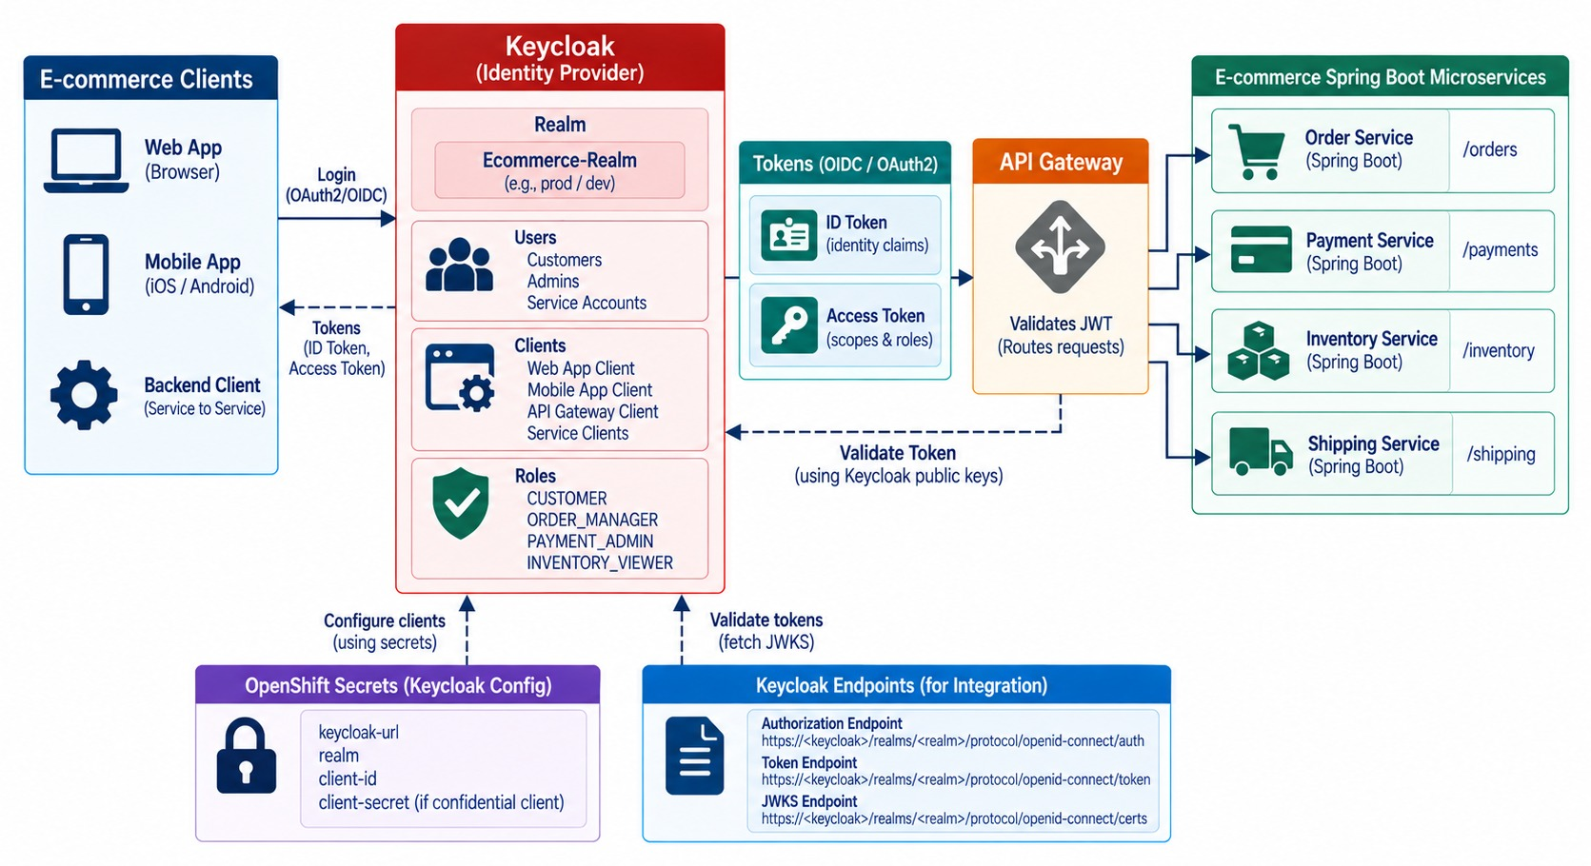
KEYCLOAK ARCHITECTURE AND INTEGRATION
Realm, clients, users, roles, tokens and a Spring Boot resource server.
Realm
An isolated security domain — for example md287.
Client
Each app or service registered with the realm.
Roles
Realm and client roles mapped into token claims.
Spring points at the realm
issuer-uri: https://keycloak.example.com/realms/md287
KEY TAKEAWAY Keycloak realms, clients, users and roles become standard OIDC tokens for Spring Boot.
23
© 2026 by Innovation In Software Corporation
Notes:
KEY TALKING POINTS
------------------
- What Keycloak is
Keycloak is an identity and access management platform that supports OpenID Connect and OAuth 2.0.
- Core concepts
A realm is a logical security domain, for example ecommerce.
A client is a registered application or service, like web-store, order-service or payment-service.
Users are human identities, and roles hold authorization structures.
Service accounts are machine identities for confidential clients.
- Discovery
Keycloak publishes standard OIDC endpoints through a realm discovery document at /realms/{realm}/.well-known/openid-configuration.
It lists the authorization, token, user-info and key endpoints.
- Spring integration
The Spring application can use the issuer information instead of hard-coding every endpoint.
- What the diagram shows
A realm with clients, users and roles issuing tokens to the gateway and Spring Boot resource servers.
- Key point
Keycloak concepts become standard OIDC tokens.

Slide 24
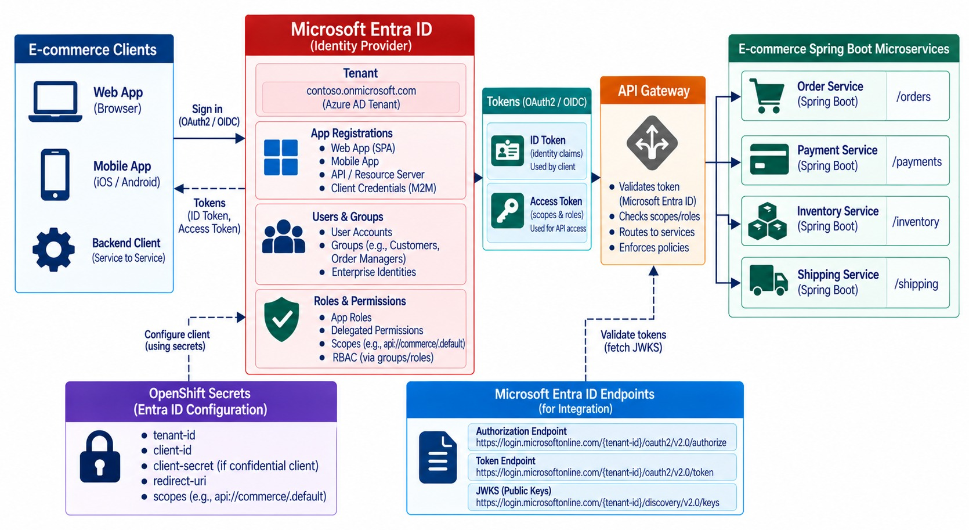
MICROSOFT ENTRA ID (FORMERLY AZURE AD)
App registration, identity platform, tokens and Spring Boot APIs.
App registration
Defines the API, its scopes and app roles.
Tokens
Standard OAuth2 and OIDC — with tenant and app-role claims.
Same Spring configuration
issuer-uri: https://login.microsoftonline.com/<tenant>/v2.0
STAY PORTABLE Code against OAuth2, not one vendor.
KEY TAKEAWAY Microsoft Entra ID issues standard OAuth2/OIDC tokens that Spring Boot validates.
24
© 2026 by Innovation In Software Corporation
Notes:
KEY TALKING POINTS
------------------
- The name change
Microsoft Entra ID is the current name for Azure Active Directory.
Learners may still see Azure AD in older material.
- App registrations
Applications using the Microsoft identity platform are usually represented by app registrations.
A registration sets identifiers and settings like the application or client ID and redirect URIs.
- Key concepts
Other concepts are the tenant, scopes, app roles and the service principal, which is the app's identity in a tenant.
- An example
A web application has a client ID.
The Order API exposes a permission called Orders.Read, and the client requests it.
Entra ID issues an access token, and Spring Boot validates it and applies authorization.
- Stay portable
Keycloak or Entra ID both speak OIDC and OAuth 2.0 to Spring Security.
Rely on standards so your services aren't tightly tied to one provider.
- What the diagram shows
A tenant and app registration issuing OAuth2 and OIDC tokens to the gateway and a Spring Boot API.
- Key point
Entra ID issues standard tokens Spring Boot validates.

Slide 25
PART 3: DISTRIBUTED SECURITY
Users aren't the only identities — services, agents and pipelines are too.
✓ Part 1
Foundations
✓ Part 2
OAuth2 / OIDC
Part 3
Distributed security
Part 4
Secrets and APIs
Part 5
Continuous security
SO FAR
NEXT QUESTION
How do services, gateways and agents prove who they are to each other?
✓
OAuth2 issues tokens; OIDC adds identity
✓
Spring validates issuer, audience and expiry
IN THIS PART
Services check scopes and ownership
1
Client credentials — in code
✓
2
API gateway security
3
Service-to-service authentication
25
© 2026 by Innovation In Software Corporation
Notes:
KEY TALKING POINTS
------------------
- Why this part
Most calls in a microservice system are service to service.
They need identity too.
- What comes next
Machine tokens, gateway responsibilities and workload identity.

Slide 26
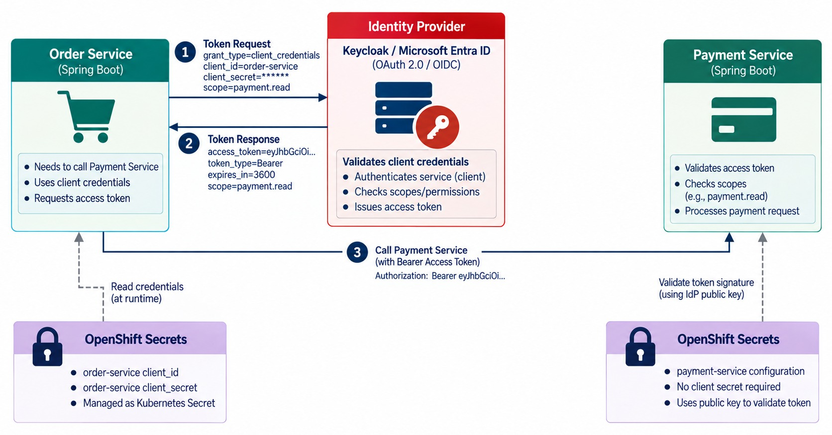
CLIENT CREDENTIALS FLOW FOR SERVICE-TO-SERVICE SECURITY
Machine identities for microservice communication.
A machine acting as itself
Order Service authenticates with its own client ID, not a user's.
Least privilege
It gets payments.authorize — not payments.admin.
AUDIT Logs show which service made each call.
KEY TAKEAWAY Services authenticate as themselves with narrowly scoped tokens.
26
© 2026 by Innovation In Software Corporation
Notes:
KEY TALKING POINTS
------------------
- A machine acting as itself
The Client Credentials flow is for an application acting on its own behalf, not for an interactive user.
Keycloak documents it for services getting access as themselves.
- An example
The Order Service needs to create a payment.
It gets its own service token from the identity provider and calls the Payment Service.
Batch processors calling the Inventory Service work the same way.
- It matters for audit
The token represents the Order Service, not John the customer.
That distinction matters when you audit who did what.
- Least privilege
The Order Service token might allow payment.create and payment.read, but not payment.refund.
Give service identities the minimum scopes.
Never issue broad administrator credentials just because service-to-service authentication feels inconvenient.
- The rule
Users need user identities.
Services need workload identities.
Never reuse human credentials for backend services.
- What the diagram shows
Order Service getting a service access token from the identity provider to call Payment Service.
- Key point
Services authenticate as themselves with narrow scopes.

Slide 27
SERVICE TOKENS WITH CLIENT CREDENTIALS
Spring fetches, caches and attaches a service token to every outgoing call.
application.yml
✓
PaymentClientConfig.java
spring:
security:
oauth2:
client:
registration:
order-service:
provider: idp
client-id: order-service
client-secret: ${ORDER_CLIENT_SECRET}
authorization-grant-type: client_credentials
scope: payments.authorize
provider:
idp:
issuer-uri: https://idp.example.com/realms/md287
@Bean
RestClient paymentClient(RestClient.Builder builder,
OAuth2AuthorizedClientManager clients) {
var oauth = new OAuth2ClientHttpRequestInterceptor(clients);
oauth.setClientRegistrationIdResolver(req -> "order-service");
return builder
.baseUrl("http://payment-service:8080")
.requestInterceptor(oauth) // adds Bearer token
.build();
}
// Payment Service requires SCOPE_payments.authorize
Secret
Caching
Lab 3 instead
From an OpenShift Secret — never in the file.
Tokens are reused until they expire.
Forwards the caller's JWT to keep user context.
KEY TAKEAWAY Give each service its own client, narrow scopes and automatic token handling.
27
© 2026 by Innovation In Software Corporation
Notes:
KEY TALKING POINTS
------------------
- Registration
Order Service is a client of the identity provider with the client credentials grant and one narrow scope.
- Interceptor
OAuth2ClientHttpRequestInterceptor, in Spring Security 6.4 and later, obtains a token, caches it and adds it to each request.
- On the other side
Payment Service validates the token like any other and requires the payments.authorize scope.
- Two patterns
Use client credentials when a service acts for itself.
Forward the user's token, as Lab 3 does, when the downstream service must know the user.

Slide 28
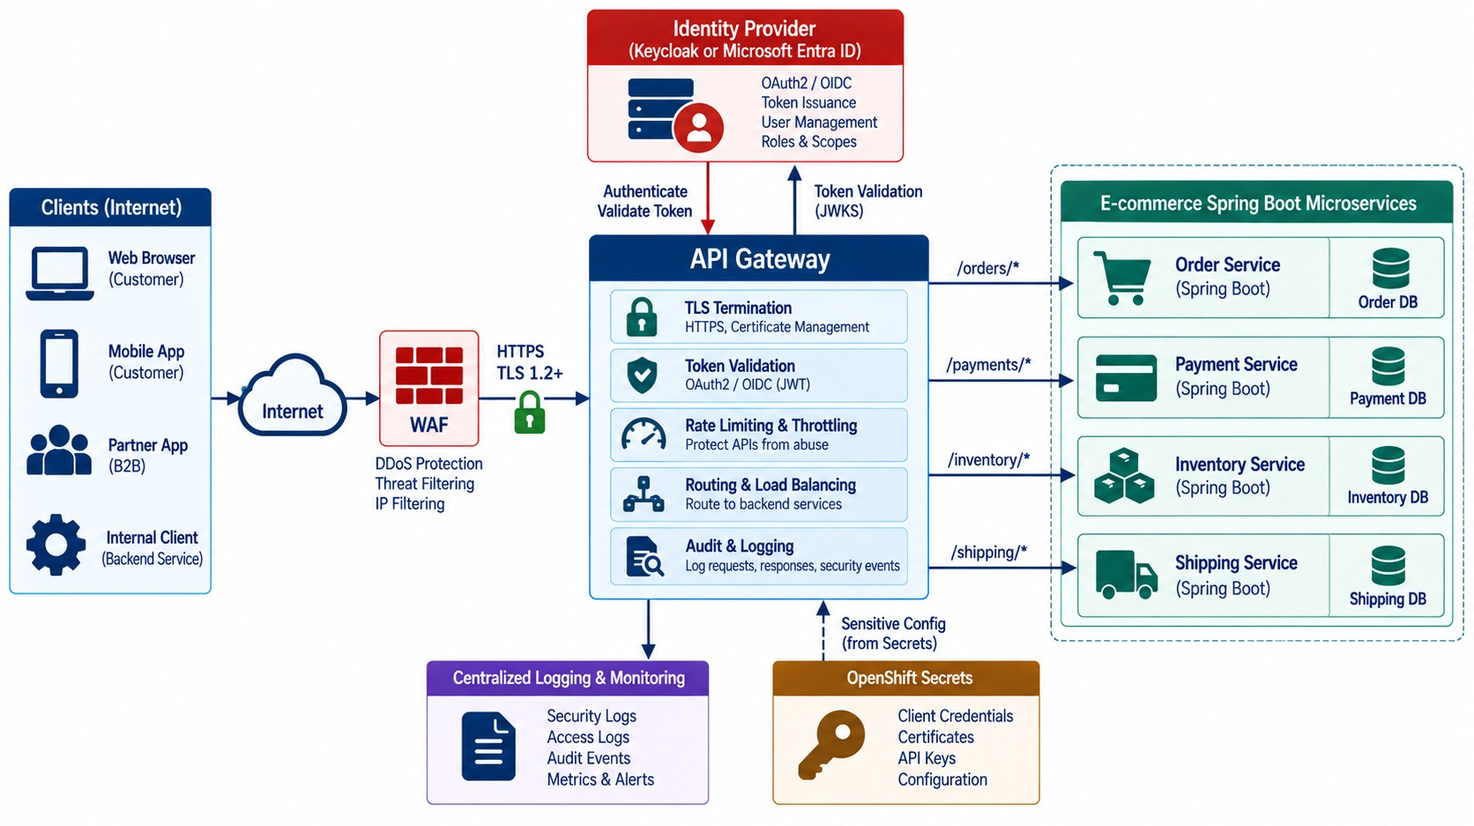
API GATEWAY SECURITY
Central protection, routing, throttling and policy — but not the only layer.
AT THE EDGE
TLS
WAF
Token checks
Rate limits
Routing
Audit
NOT AT THE GATEWAY
✕
Object ownership
✕
Business rules
WHY Internal callers can bypass the gateway.
KEY TAKEAWAY Protect the edge at the gateway and still enforce authorization in every service.
28
© 2026 by Innovation In Software Corporation
Notes:
KEY TALKING POINTS
------------------
- A strong enforcement point
The gateway can terminate TLS, encrypting external traffic, and reject obviously invalid tokens.
It can rate-limit excessive requests and use a web application firewall against malicious HTTP traffic.
It also routes only to exposed services and centralizes logging.
- Not enough alone
Don't teach that the gateway is enough by itself.
The bad pattern is: the gateway validated the request, so the backend trusts everything.
The better pattern is gateway protection plus service authorization.
- Why
Backend calls may come from other services, internal jobs, messaging, administrative processes or agent and MCP workloads.
Not all of them go through the gateway.
- What the diagram shows
Internet traffic through an API gateway and WAF with TLS, token checks, rate limiting, routing and audit, then to services.
- Key point
Protect the edge — and still authorize in each service.

Slide 29
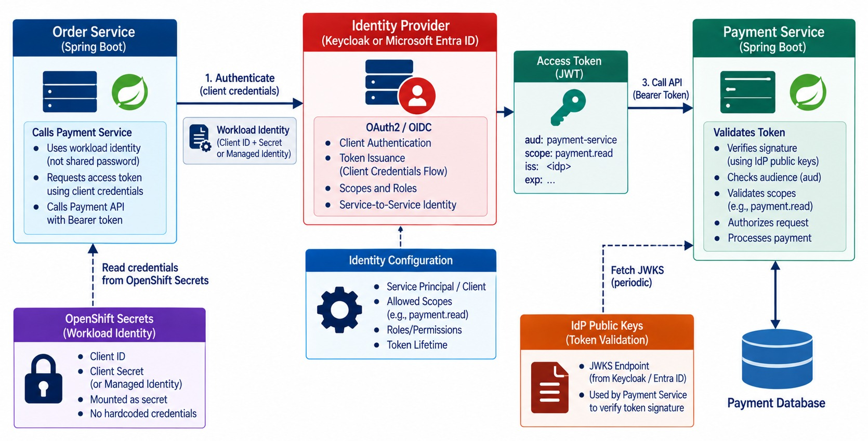
SERVICE-TO-SERVICE AUTHENTICATION
Machine identity, bearer tokens and workload credentials.
Workload identity
The platform gives each pod an identity — no long-lived secret to leak.
mTLS
A service mesh can authenticate both ends of every call.
IDENTITIES TO SECURE
Services
Agents
MCP servers
CI/CD jobs
KEY TAKEAWAY Every workload authenticates with its own identity and least-privilege scopes.
29
© 2026 by Innovation In Software Corporation
Notes:
KEY TALKING POINTS
------------------
- Users aren't the only identities
A microservices environment has many machine identities.
They include the Order, Payment and Inventory services, MCP servers, background workers, CI/CD pipelines and AI agents.
- An example
The Order Service calls the Payment Service using its workload identity and an access token.
The Payment Service validates the token, sees the caller is order-service, and checks whether it may call POST /payments.
- Service-level least privilege
Don't let the Order Service call the refund endpoint unless that capability is genuinely required.
- Link to Modules 10 and 11
AI agents, MCP servers and microservices are all machine identities.
Each should get only the permissions it needs.
- What the diagram shows
Order Service using its workload identity to get an access token and call Payment Service, which checks the scope.
- Key point
Every workload has its own identity and least-privilege scopes.

Slide 30
PART 4: SECRETS AND API PROTECTION
Keep credentials out of code — and harden every endpoint.
✓ Part 1
Foundations
✓ Part 2
OAuth2 / OIDC
✓ Part 3
Distributed security
Part 4
Secrets and APIs
Part 5
Continuous security
SO FAR
NEXT QUESTION
Where do credentials live — and what else protects our APIs?
✓
Services have their own identities
✓
Gateways protect the edge
IN THIS PART
✓
Services still authorize every call
Secrets management fundamentals
1
2
Secrets in OpenShift — in code
3
Exercise: find the secret leaks
4
API security best practices
5
Common API threats — with an exercise
30
© 2026 by Innovation In Software Corporation
Notes:
KEY TALKING POINTS
------------------
- Why this part
A leaked database password or broken authorization check is how many real breaches start.
- What comes next
Secret handling, OpenShift delivery, a leak hunt, API hardening and threat mapping.

Slide 31
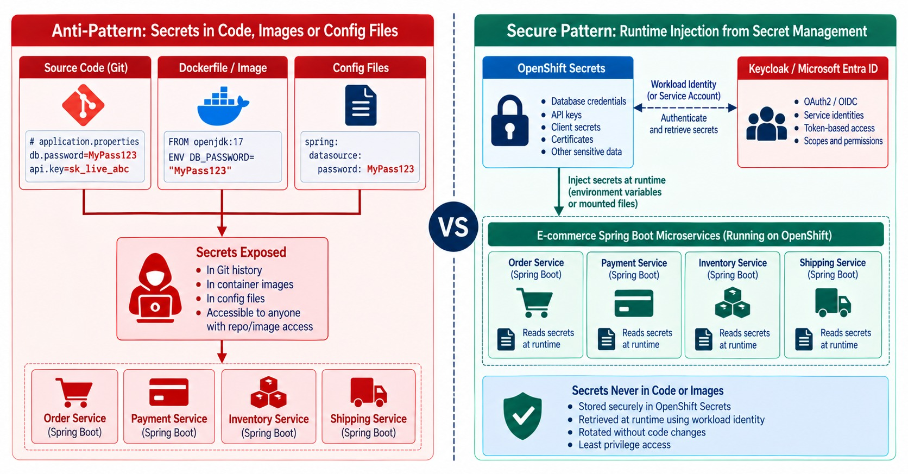
SECRETS MANAGEMENT FUNDAMENTALS
Why credentials don't belong in code, images or config repositories.
WHAT COUNTS AS A SECRET
DB passwords
Client secrets
API keys
Signing keys
TLS private keys
Images remember
A secret in any layer stays in the image history.
LIFECYCLE Store, restrict, rotate, audit, revoke.
KEY TAKEAWAY Secrets need stronger storage, access, rotation and audit than normal configuration.
31
© 2026 by Innovation In Software Corporation
Notes:
KEY TALKING POINTS
------------------
- What counts as a secret
Secrets include passwords, API keys, client secrets, certificates and private keys, database credentials and cloud credentials.
- Where they don't belong
Never put secrets in source code, Git, a Dockerfile, a container image, public configuration or logs.
Is application.yml a secure place for a password?
No. If a datasource password is committed, it's exposed.
- Images remember
A line like ENV DB_PASSWORD in a Dockerfile bakes the secret into the image and its history.
- A proper process
The application should get secrets at runtime from a secrets management system.
The process covers storage, access, distribution, rotation, expiry, auditing and revocation.
- Config versus secret
Normal configuration like SERVER_PORT=8080 is fine.
A DATABASE_PASSWORD is a secret and needs stronger protection.
- What the diagram shows
Secrets in Git, Dockerfiles and config next to runtime injection from a secret-management system.
- Key point
Inject secrets at runtime; never store them with code.

Slide 32
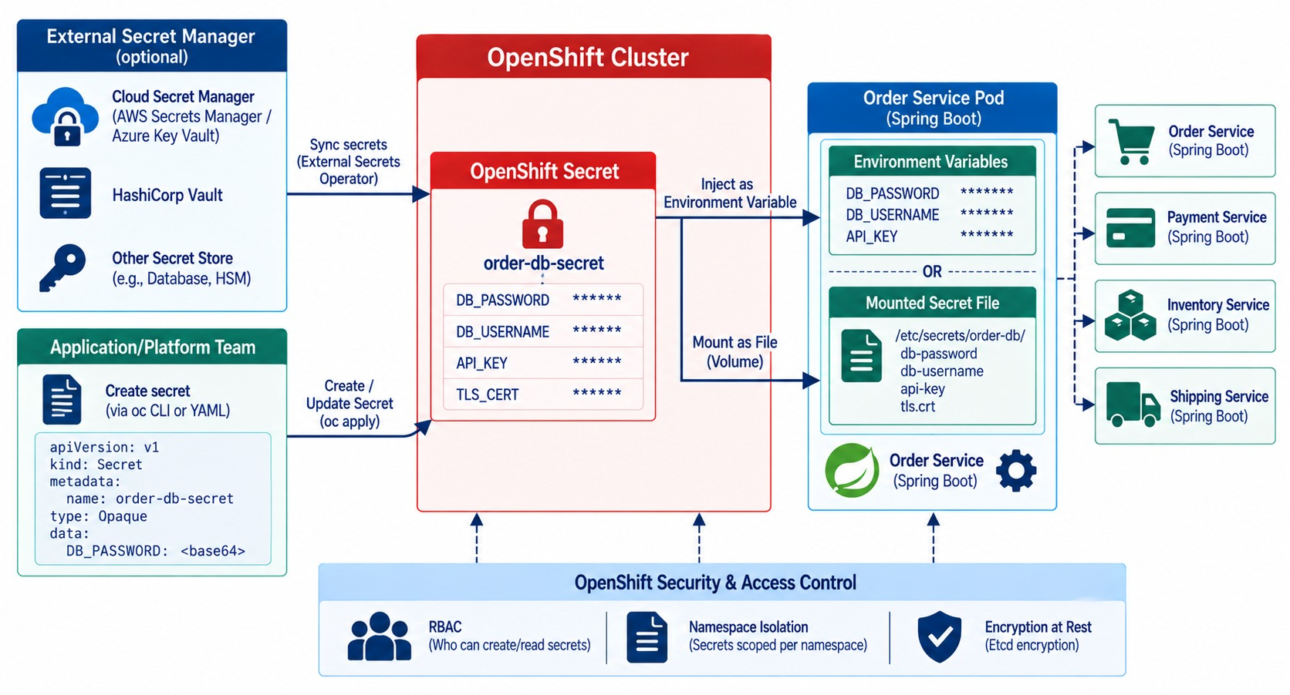
SECRETS MANAGEMENT IN OPENSHIFT
Secret injection, environment variables and files, external secret stores.
Delivery, not strategy
OpenShift Secrets deliver values; a vault manages and rotates them.
EXTERNAL MANAGERS
HashiCorp Vault
Azure Key Vault
External Secrets
CyberArk
RBAC Only the service account may read its Secret.
KEY TAKEAWAY Inject secrets at runtime with tight access — never bake them into the image.
32
© 2026 by Innovation In Software Corporation
Notes:
KEY TALKING POINTS
------------------
- OpenShift Secrets
OpenShift supports Kubernetes-style secrets for workloads, such as database credentials, TLS certificates and API credentials.
A secret reaches the pod as an environment variable or a mounted file.
- Delivery, not strategy
An OpenShift Secret is an access-controlled delivery mechanism.
It doesn't remove the need for a broader secrets-management strategy.
- External managers
Red Hat notes that dedicated external secret managers add centralized auditing, monitoring and control.
The application reaches them using its workload identity.
- Good practices
Separate secrets by environment, and limit which service accounts can read them.
Rotate secrets, never log them, and prefer short-lived credentials.
Use external vaults when appropriate.
- Link to Module 8
The same image runs in DEV, TEST and PROD, with different secrets supplied at runtime.
- What the diagram shows
A secret store feeding an OpenShift Secret, delivered to the pod as an environment variable or mounted file.
- Key point
Deliver secrets at runtime with tight access.

Slide 33
MOUNTING SECRETS AS FILES
Files are harder to leak than environment variables — and Spring reads them directly.
Deployment (excerpt)
✓
application.yml
spec:
template:
spec:
serviceAccountName: account-service
volumes:
- name: db-credentials
secret:
secretName: account-db-secret
containers:
- name: account-service
volumeMounts:
- name: db-credentials
mountPath: /etc/secrets
readOnly: true
spring:
config:
import: "optional:configtree:/etc/secrets/"
# Secret keys become files, file names become
# properties:
# /etc/secrets/spring.datasource.password
# -> spring.datasource.password
# never:
# log.info("config: {}", dataSourceProperties);
Read-only mount
configtree
Rotation
The pod can read, not modify, its secrets.
Spring maps each file to a property.
Updated Secret files appear without rebuilding the image.
KEY TAKEAWAY Mount secrets read-only at runtime and let Spring read them — never bake or log them.
33
© 2026 by Innovation In Software Corporation
Notes:
KEY TALKING POINTS
------------------
- The mount
The Secret becomes read-only files under /etc/secrets inside the pod, visible only to that container.
- configtree
spring.config.import with configtree turns each file into a property, so the datasource password needs no environment variable.
- Why files
Environment variables can leak through crash dumps, debug endpoints and child processes.
Files are easier to restrict.
- Rotation
When the Secret is updated, the mounted files change; the application may still need a restart to reload them.

Slide 34
EXERCISE: FIND THE SECRET LEAKS
Review a release for places a credential could escape.
PRACTICE EXERCISE
10 MIN
SCENARIO
YOUR TASKS
EXPECTED OUTCOME
A release of Payment Service contains:
1
Find four leaks
✓
API key in Git → secret store + rotate
application-prod.yml:
gateway.api-key: sk_live_9f2c...
Dockerfile:
ENV DB_PASSWORD=Payments#2026
PaymentService.java:
log.info("Calling gateway with {}", headers)
ci.yml:
run: echo $REGISTRY_TOKEN
2
Say who could see each secret
✓
Password in image layer → runtime Secret
3
Fix each one — and decide what to rotate now
✓
Headers logged → mask Authorization
✓
Token echoed in CI → masked secrets
✓
Rotate everything already exposed
KEY TAKEAWAY Anything committed, baked, logged or echoed is exposed — move it to a store, and rotate it.
34
© 2026 by Innovation In Software Corporation
Notes:
KEY TALKING POINTS
------------------
- Git and images
The API key is in Git history and the password is in an image layer.
Both are readable by anyone with repository or registry access.
- Logs and CI
Logging request headers exposes Authorization values, and echoing a token prints it into CI logs.
- Rotation
Removing the value isn't enough — every exposed credential must be rotated.

Slide 35
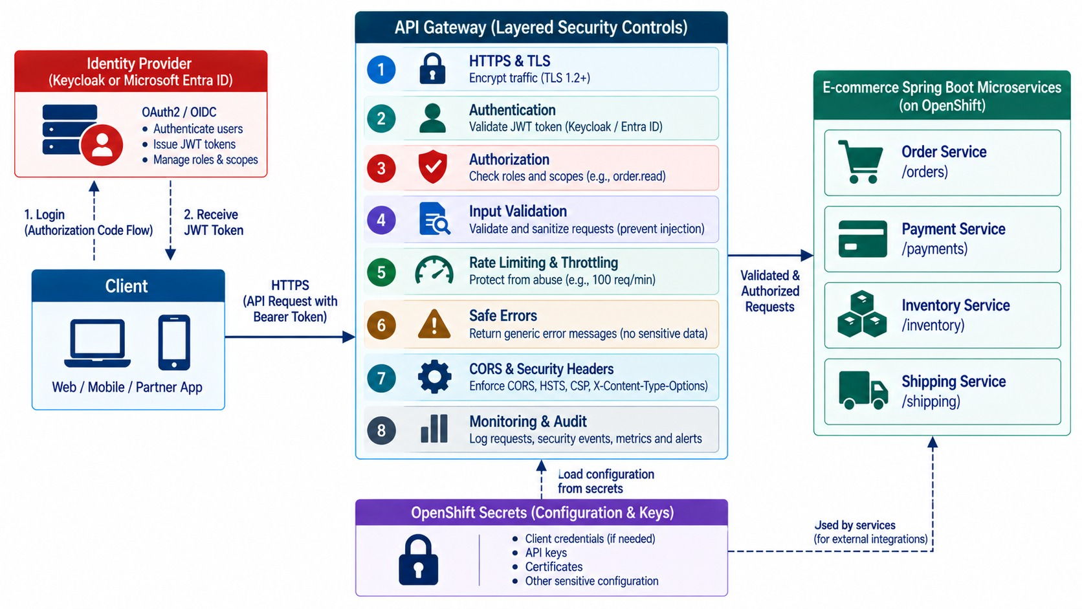
API SECURITY BEST PRACTICES
HTTPS, input validation, authorization, CORS, rate limiting and safe errors.
✓
Safe error
{ "error": "TRANSFER_REJECTED",
"message": "The transfer could not be completed." }
NEVER RETURN
✕
Stack traces
✕
SQL details
✕
Internal hostnames
MONEY APIS need an Idempotency-Key.
KEY TAKEAWAY Layer the controls: encrypt, authenticate, authorize, validate, limit, respond safely, monitor.
35
© 2026 by Innovation In Software Corporation
Notes:
KEY TALKING POINTS
------------------
- HTTPS and identity
Use HTTPS everywhere; never send access tokens over plain HTTP in production.
Authenticate callers so you know the user or service.
Authorize every sensitive action, not just whether a token exists.
- Validate and rate-limit
Validate every input: path variables, request parameters, request bodies and headers.
Rate-limit to protect against brute force, abuse, cost amplification and resource exhaustion.
- Safe errors
Avoid verbose errors like a raw SQLException naming a card_number column.
Return something like code PAYMENT_PROCESSING_ERROR and 'Unable to process payment'.
Keep the internal details in secure logs.
- CORS and monitoring
CORS is a browser security policy, not an authentication mechanism, so don't allow everything without understanding why.
And monitor: security controls without visibility are hard to evaluate.
- What the diagram shows
HTTPS, authentication, authorization, input validation, rate limiting, safe errors, CORS and headers, and monitoring as layers.
- Key point
Many layers, each catching what the others miss.

Slide 36
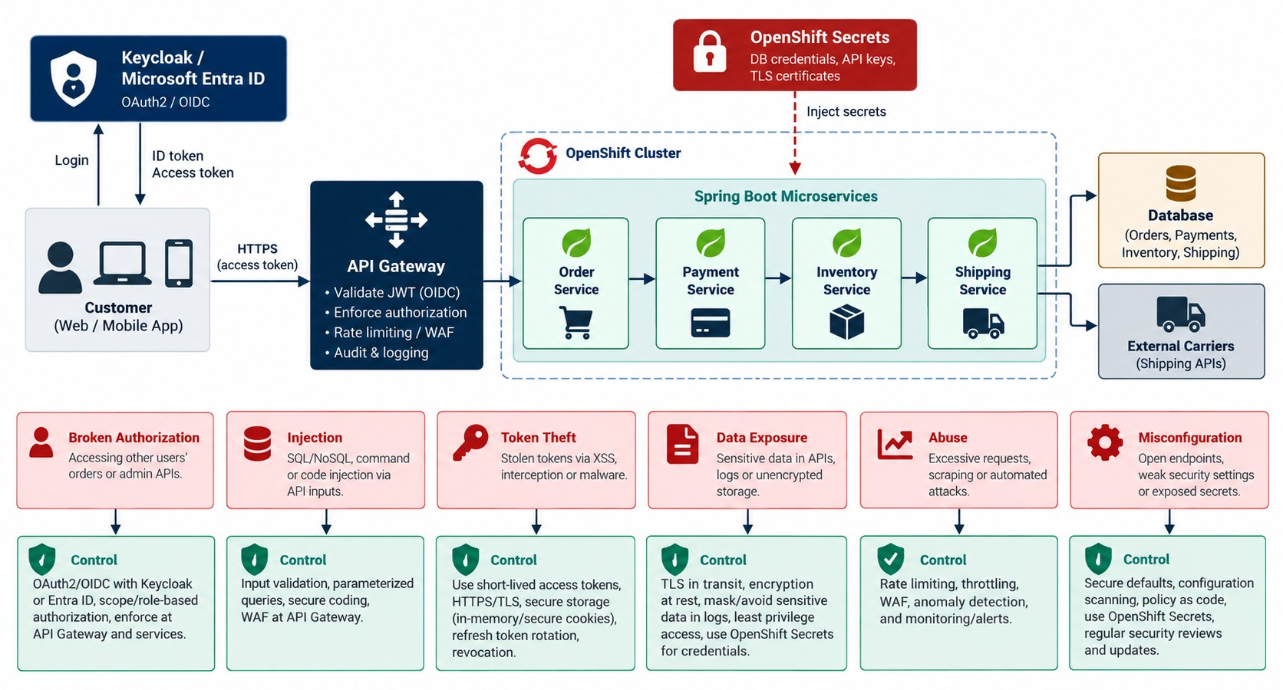
COMMON API SECURITY THREATS
Broken authorization, injection, token leakage, data exposure and abuse.
Broken object authorization
→ check ownership in the service.
Excessive data exposure
→ DTOs with only needed, masked fields.
Token theft
→ short lifetimes, HTTPS, no tokens in logs.
REFUNDS need step-up checks and audit.
KEY TAKEAWAY A valid token isn't enough — authorize each object and action, and expose only what's needed.
36
© 2026 by Innovation In Software Corporation
Notes:
KEY TALKING POINTS
------------------
- Six threats and controls
Broken authorization needs per-resource checks, and injection needs validation and safe persistence.
Token theft needs TLS and careful token handling.
Excessive data exposure needs DTOs and minimal responses.
API abuse needs rate limiting, and misconfiguration needs secure defaults and automation.
- Object-level authorization
Take GET /orders/1001.
A user has a valid token, but does that let them view order 1001?
No. The app must check whether the order belongs to this user, or whether the user has support permission.
- Refunds need more
POST /payments/501/refund needs more than an authenticated user.
It may require the payment.refund scope, a role, and business constraints.
- Excessive data exposure
Don't return a whole persistence entity that contains internal fields.
Map OrderEntity to an OrderResponseDTO that includes only what the client needs.
- What the diagram shows
Threats — broken authorization, injection, token theft, data exposure, abuse, misconfiguration — each mapped to a control.
- Key point
Every common threat has a known control.

Slide 37
EXERCISE: MAP THREATS TO CONTROLS
Match each finding from a security review to its fix.
PRACTICE EXERCISE
10 MIN
SCENARIO
YOUR TASKS
EXPECTED OUTCOME
Findings from a review of the Transfer API:
1
Name the threat behind each finding
✓
1 Broken object authorization → service check
1 Changing accountId shows others' data
2 Response includes full card number
3 No limit on POST /transfers
4 Error returns the SQL statement
5 Retrying a timeout sends money twice
6 CORS allows any origin
2
Choose the control that fixes it
✓
2 Data exposure → masked DTO
3
Say where the control belongs
✓
3 Abuse → rate limit at the gateway
✓
4 Info leak → safe error handler
✓
5 Replay → Idempotency-Key; 6 → allow-list
KEY TAKEAWAY Each common threat has a known control — and a right place to enforce it.
37
© 2026 by Innovation In Software Corporation
Notes:
KEY TALKING POINTS
------------------
- Authorization and exposure
Ownership checks belong in the service.
Responses expose only masked, necessary fields.
- Abuse and errors
Rate limits sit at the gateway.
Error handlers return safe codes and log details internally.
- Money and browsers
Idempotency keys stop duplicate transfers.
CORS lists only trusted origins.

Slide 38
PART 5: CONTINUOUS SECURITY AND COMPLIANCE
Prove security, not just claim it — and keep checking.
✓ Part 1
Foundations
✓ Part 2
OAuth2 / OIDC
✓ Part 3
Distributed security
✓ Part 4
Secrets and APIs
Part 5
Continuous security
SO FAR
NEXT QUESTION
How do we prove to auditors — and ourselves — that controls work every day?
✓
Secrets live in stores, not code
✓
APIs validate, limit and fail safely
IN THIS PART
✓
Threats map to known controls
Security logging and audit — in code
1
2
DevSecOps and continuous security
3
The complete secure architecture
38
© 2026 by Innovation In Software Corporation
Notes:
KEY TALKING POINTS
------------------
- Why this part
In banking, security has to be demonstrated with evidence, and it has to stay true after every release.
- What comes next
Audit events, security in the pipeline, and the architecture that ties it all together.

Slide 39
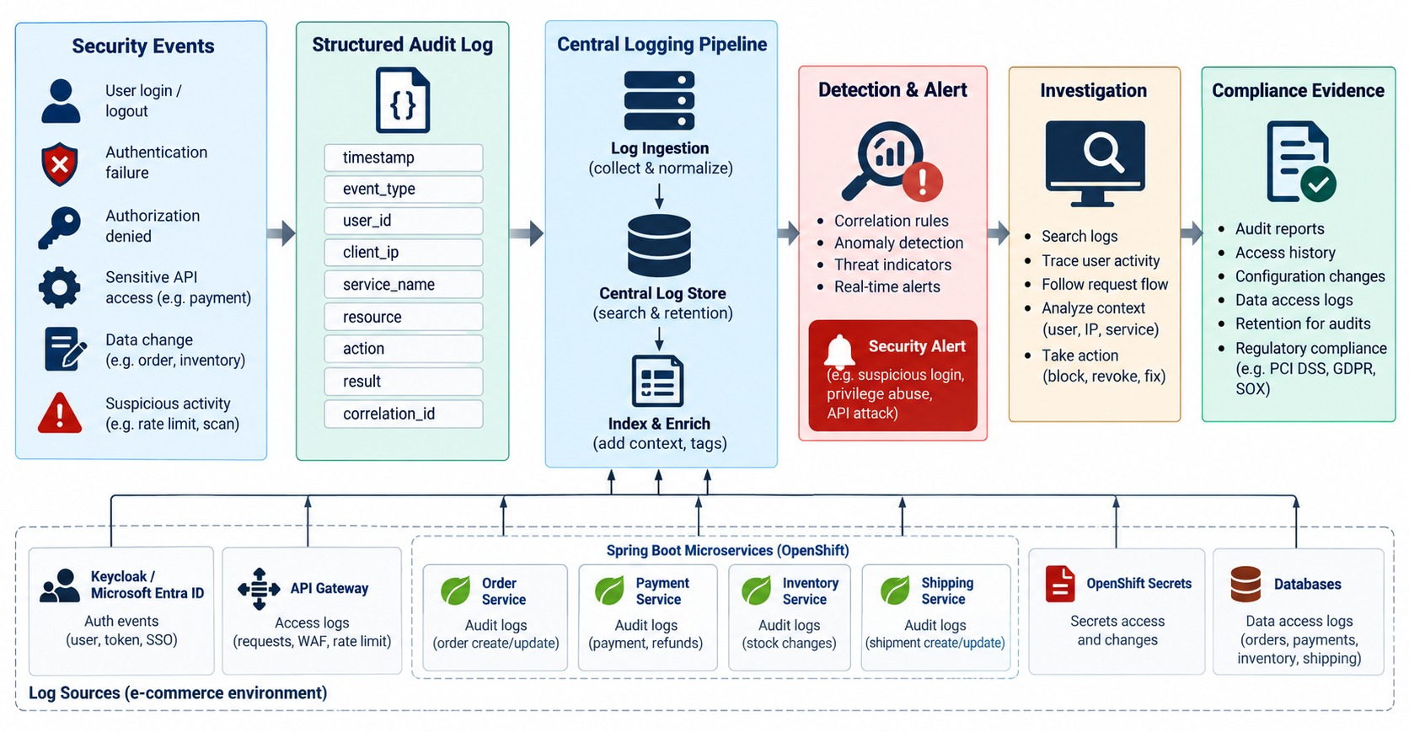
SECURITY LOGGING, AUDITING, AND COMPLIANCE
Audit events, traceability, privacy, retention and evidence.
EVERY AUDIT EVENT
✓
Who — subject and client
✓
What — action and resource
✓
Decision — allowed or denied
✓
When, and correlation ID
NEVER LOG
✕
Tokens, passwords
✕
Full card or account numbers
KEY TAKEAWAY Make security observable: record who did what, to which resource, and when.
39
© 2026 by Innovation In Software Corporation
Notes:
KEY TALKING POINTS
------------------
- The audit path
A security event becomes a structured audit log in a central log platform.
That drives detection and alerts, supports investigation, and becomes compliance evidence.
- What to log
Log authentication failures, authorization failures, sensitive operations, role changes, refunds, secret access and admin actions.
- What never to log
Never log passwords, access tokens, refresh tokens, private keys, raw secrets or unnecessary sensitive data.
- Application log versus audit event
An application log says 'Payment API responded in 120 milliseconds'.
An audit event says 'user support-42 refunded payment 501 for 75 dollars at 14:32 UTC'.
Useful audit fields are timestamp, actor, action, resource, result, correlation ID and source.
- Compliance
Compliance often means proving who accessed or changed data, who approved an action, and when.
It needs evidence, not just good intentions.
So security must be observable.
- What the diagram shows
A security event written as a structured audit log, centralized, detected and alerted, investigated and kept as compliance evidence.
- Key point
Security must be observable and provable.

Slide 40
WRITING A SECURITY AUDIT EVENT
Structured, masked, correlated — and separate from ordinary debug logs.
✓
AuditLogger.java
What it produces
private static final Logger AUDIT = LoggerFactory.getLogger("security.audit");
public void accountFrozen(String accountId, Jwt actor, boolean allowed) {
AUDIT.atInfo()
.setMessage("security_audit")
.addKeyValue("event", "ACCOUNT_FREEZE")
.addKeyValue("actor", actor.getSubject())
.addKeyValue("client", actor.getClaimAsString("azp"))
.addKeyValue("accountId", mask(accountId))
.addKeyValue("decision", allowed ? "ALLOWED" : "DENIED")
.addKeyValue("correlationId", MDC.get("correlationId"))
.log();
}
{
"logger": "security.audit",
"event": "ACCOUNT_FREEZE",
"actor": "ops-user-17",
"client": "ops-console",
"accountId": "ACC-***5001",
"decision": "ALLOWED",
"correlationId": "c-9a8e",
"timestamp": "2026-09-18T14:22:11Z"
}
Dedicated logger
Denials too
Masked IDs
Route audit events to protected, retained storage.
Denied attempts are often the most important.
Enough to investigate, not enough to misuse.
KEY TAKEAWAY Emit structured, masked audit events for every sensitive decision — allowed or denied.
40
© 2026 by Innovation In Software Corporation
Notes:
KEY TALKING POINTS
------------------
- The logger
A dedicated security.audit logger can be routed to tamper-resistant storage with longer retention.
- The fields
Actor, client, masked resource, decision and correlation ID answer who did what, to which object, with what outcome.
- Denials
Denied attempts reveal probing and misuse, so they're recorded too.
- Compliance
These events become the evidence auditors ask for.

Slide 41
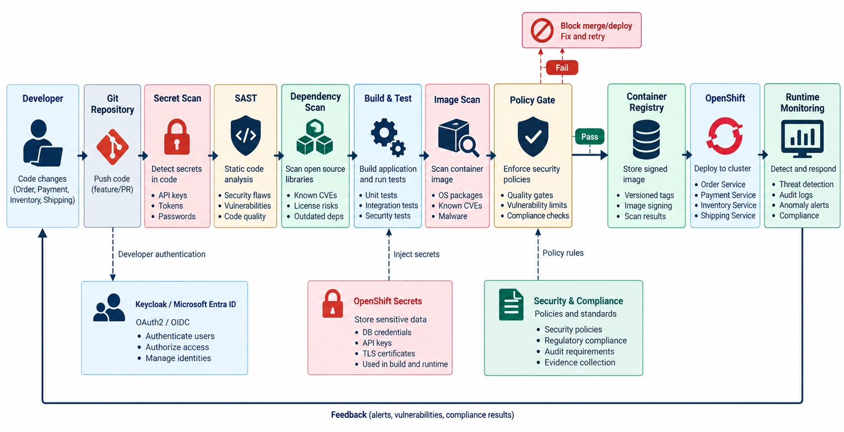
DEVSECOPS AND CONTINUOUS SECURITY
SAST, dependency, secret and image scanning with policy gates.
Before merge
Secret scan and SAST on every pull request.
Before deploy
Dependency and image scans, SBOM and signature.
At runtime
Admission policies, alerts and regular access reviews.
MODULE 7 built these gates into the pipeline.
KEY TAKEAWAY Scan code, dependencies, images and deployments continuously — the whole supply chain.
41
© 2026 by Innovation In Software Corporation
Notes:
KEY TALKING POINTS
------------------
- Start early
Connect directly to Module 7.
Security should start in development, not the day before production.
The pipeline runs from developer and Git, through secret scanning, SAST, dependency scanning, build and test.
Then come the container build, image scanning, a policy gate, the registry, OpenShift and runtime monitoring.
- Before commit and in CI
Secret scanning catches credentials accidentally committed to Git, and secure code review looks for weaknesses.
In CI, SAST, meaning static analysis, finds classes of code weaknesses.
Dependency scanning matters because a Spring Boot app has hundreds of transitive dependencies.
- Container and deployment
Scan the base OS packages, Java runtime, dependencies and image configuration.
A policy gate might block deployment when there's a critical vulnerability.
Deploy with least privilege and secret injection.
- Runtime and the message
Keep monitoring after deployment with logs, alerts, identity monitoring and vulnerability management.
Secure code alone is not enough.
Security is part of the delivery pipeline, not a final checklist.
- What the diagram shows
Developer and Git, secret scan, SAST, dependency scan, build and test, image scan, policy gate, registry, OpenShift and runtime monitoring.
- Key point
Security runs through the whole delivery pipeline.

Slide 42
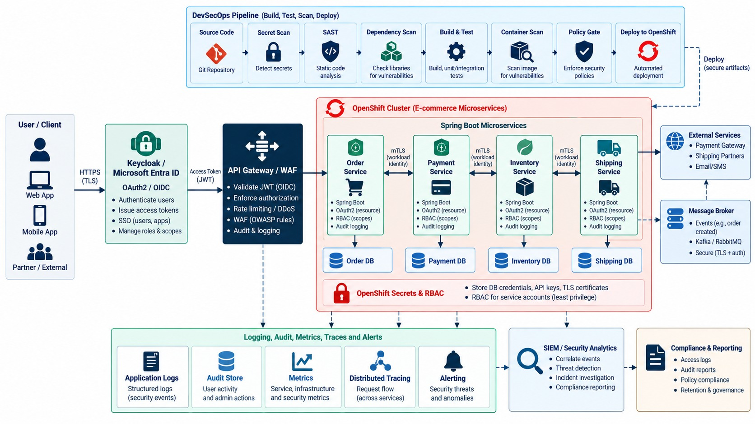
END-TO-END SECURE MICROSERVICES ARCHITECTURE
User → IdP → gateway → Spring Boot services → secrets and data → OpenShift → monitoring.
EVERY PART OF THE MODULE
✓
HTTPS and OIDC login with PKCE
✓
Gateway validates, limits and audits
✓
Services check scopes and ownership
✓
Workload identities between services
✓
Secrets at runtime; DevSecOps and audit
REMEMBER Trust identity and policy — never the network.
KEY TAKEAWAY Security rests on identity and explicit trust at every boundary — not network location.
42
© 2026 by Innovation In Software Corporation
Notes:
KEY TALKING POINTS
------------------
- Transport, identity, tokens
The client uses HTTPS and authenticates with an identity provider, either Keycloak or Microsoft Entra ID.
OAuth and OIDC then issue tokens suited to the client and the resource.
- Gateway and services
The gateway applies TLS, token checks, rate limits, routing and WAF controls.
Each Spring Boot service still checks identity, token, permission, input and business rules.
- Service identity and data
When the Order Service calls the Payment Service, it uses its own workload identity.
Each service owns its data, and authorization happens before anything reaches persistence.
- Secrets, platform, pipeline
Credentials are injected at runtime, never stored in Git, the JAR or the image.
OpenShift adds service accounts, RBAC, secrets, network and platform policies, and resource isolation.
DevSecOps scans code, dependencies, images and deployments continuously.
- Audit and the final message
Capture evidence to answer who did what, to which resource, when, whether it was allowed, and what happened.
Secure microservices by establishing explicit identity and trust at every important boundary.
Authenticate users and workloads, and authorize each sensitive operation with least privilege.
Keep secrets out of code and images, scan the supply chain, and keep enough audit evidence.
- What the diagram shows
A user over HTTPS, an identity provider issuing tokens, the gateway and WAF, secured Spring Boot services with workload identity, owned databases, OpenShift Secrets and RBAC, DevSecOps and audit.
- Key point
Identity and explicit trust at every boundary.

Slide 43
SECURITY MISCONCEPTIONS AND ANTI-PATTERNS
Beliefs and habits behind most microservice security incidents.
MISCONCEPTION
REALITY
ANTI-PATTERNS TO AVOID
Inside the network is safe
Zero Trust verifies every request
✕
Secrets in Git or images
✕
One admin role for everything
✕
Logging Authorization headers
A valid token allows everything
Check scopes and object ownership
✕
Implicit or password grant flows
✕
Skipping audience validation
✕
No audit of denied attempts
JWTs are encrypted
Signed and encoded — anyone can read them
REMEMBER Authenticate early, authorize close to the action, audit decisions.
The gateway handles authorization
Each service must authorize too
Base64 Secrets are secure
Restrict access and use a vault
KEY TAKEAWAY Security is explicit trust at every hop — verified, least-privilege and auditable.
43
© 2026 by Innovation In Software Corporation
Notes:
KEY TALKING POINTS
------------------
- Why this slide
Before the knowledge check, clear away the beliefs behind most security incidents.
- Trust
Network location proves nothing, and a valid token still needs scope and ownership checks.
- Tokens and secrets
Anyone can decode a JWT, and Kubernetes Secrets are only base64-encoded without access controls and a vault.
- Anti-patterns
Committed secrets, broad admin roles, logged headers, legacy grant flows, missing audience checks and unaudited denials.

Slide 44
KNOWLEDGE CHECK
Answer in your own words — then compare with a partner.
Authentication vs. authorization?
What is Keycloak used for?
1
6
What is OAuth2 primarily used for?
What is Microsoft Entra ID used for?
2
7
What does OpenID Connect add to OAuth2?
Why keep secrets out of source code?
3
8
What is a JWT?
What is object-level authorization?
4
9
Which JWT claims should APIs validate?
Why secure internal APIs too?
5
10
44
© 2026 by Innovation In Software Corporation
Notes:
KEY TALKING POINTS
------------------
- 1. AuthN vs. AuthZ
Authentication verifies identity; authorization decides allowed actions.
- 2. OAuth2
Delegated authorization to protected resources.
- 3. OIDC
Authentication and identity information.
- 4. JWT
A signed token containing claims.
- 5. Claims to validate
Signature, issuer, audience, expiration, and required scopes or roles.
- 6. Keycloak
Identity and access management with OAuth2 and OIDC support.
- 7. Entra ID
Enterprise identity, single sign-on, app registrations and access control.
- 8. Secrets
Code can be copied, logged or exposed; secrets need controlled storage and rotation.
- 9. Object-level authorization
Checking the caller may access the specific object, such as one account.
- 10. Internal APIs
Compromised services, misconfiguration or unauthorized internal callers can abuse them.
- Practical scenario
GET /accounts/5001 with a bearer token: validate signature, issuer, audience and expiry; require accounts.read; check ownership; expired gives 401; log subject and decision, never the token.

Slide 45
MODULE 12 SUMMARY AND WHAT'S NEXT
From a larger attack surface to explicit, verified trust at every boundary.
YOU CAN NOW
NEXT: CAPSTONE — PUTTING IT ALL TOGETHER
Apply Zero Trust and tell 401 from 403
1
How do all twelve modules fit one platform?
✓
Explain OAuth2, OIDC, PKCE and client credentials
2
What must the final demo prove?
✓
Validate JWTs and enforce scopes and ownership in Spring Boot
Is the system ready for production?
✓
3
Deliver secrets at runtime and harden APIs
✓
Produce audit evidence and secure the pipeline
BRING ALONG Your Lab 1–5 services — the capstone connects them end to end.
✓
KEY TAKEAWAY The Capstone combines every module into one secure, observable, AI-assisted platform.
45
© 2026 by Innovation In Software Corporation
Notes:
KEY TALKING POINTS
------------------
- Recap
We applied Zero Trust, OAuth2 and OIDC, validated tokens, secured service-to-service calls, managed secrets, hardened APIs and made security auditable.
- Next
The Capstone brings every module together and asks teams to demonstrate a production-ready platform.

