Slide 1

PROMPTUS
ENSURING SAFE AND EFFECTIVE PROMPTS
INNOVATION CHALLENGE DECEMBER 2024

Slide 2
TABLE OF CONTENT
OPTIMIZING PROMPTS FOR A SAFER, SMARTER AI INTERACTION
01
04
Introduction
Solution Overview
02
05
Technical Architecture
Problem Statement
03
06
Goal
Demo

Slide 3

INTRODUCTION
OPTIMIZING AI PROMPTS FOR EVERYONE
So what’s the problem?

Slide 4


PROBLEM STATEMENT
IMPACT
The lack of adequate prompts reduces the effectiveness of AI usage and can lead to inaccurate or risky results
Difficulty in creating effective and safe AI prompts, especially for users without technical expertise
KEY FIGURES
75% of people use generative AI in their work
46% of these users started in the last six months
URGENCY
As AI usage increases, the need for precise and safe prompts becomes increasingly important
Solution Overview
THE CHALLENGE
Design a system that auto-corrects and validates user inputs before sending them to the AI

Slide 5
OUR GOAL
A system that optimizes and validates user prompts before they are processed by AI, ensuring clarity, safety, and effectiveness. By addressing issues like grammatical errors, unclear inputs, and harmful language, the system enhances prompt quality while safeguarding user privacy and ethical compliance. This approach empowers users, regardless of technical expertise, to achieve better, risk-free AI interactions.
Introducing our groundbreaking solution

Slide 6
OUR SOLUTION
1.- SAFETY LAYER
A) Content safety check
B) Moderation
Our system harnesses the power of Azure AI services and Azure OpenAI's LLMs to create a comprehensive pre-processing layer for prompts. Here's how it works
2. - IMPROVEMENT LAYER
Decision maker: Analyzes the prompt using the Role-Task-Context-Format (RTCF) framework to assess if it contains enough relevant information.
If the prompt is adequate:
Reorganization and enhancement:
If the prompt is inadequate:
Clarification and completion:

Slide 7

THE OUTCOME

Slide 8
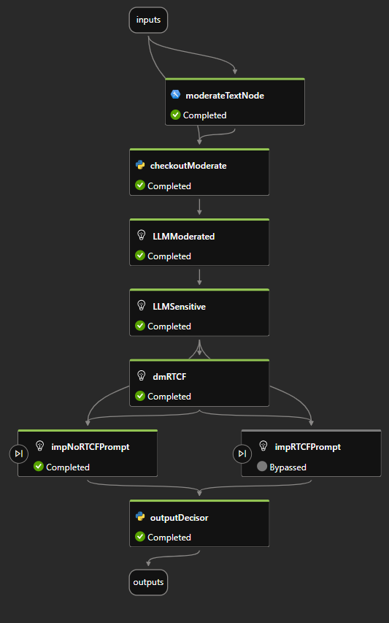
Figure 1: General view of the pormptflow.
ARCHITECTURE OVERVIEW

Slide 9
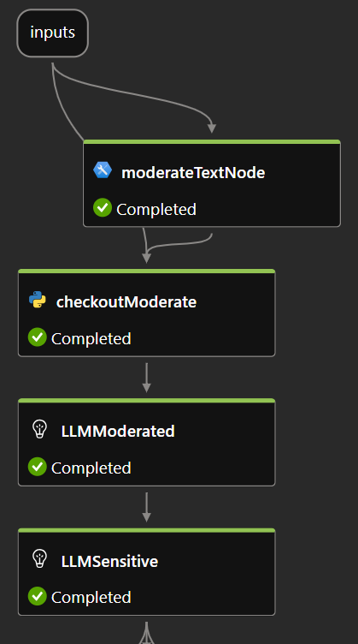
SAFETY LAYER
Figure 2: Detail of safety layer.
The Safety Layer is responsible for ensuring that the input prompt does not contain harmful or sensitive content. It consists of the following components:
Inputs
moderateTextNode
checkoutModerate
LLMModerated
LLMSensitive

Slide 10
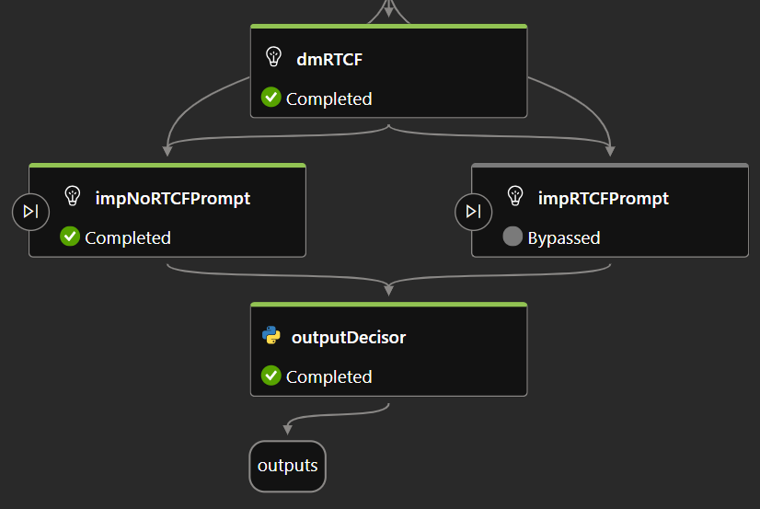
PROMPT IMPROVEMENT LAYER
The Prompt Improvement Layer is designed to enhance the quality and clarity of the user’s prompt. It includes the following components:
dmRTCF (Decision-Maker for RTCF Framework)
impRTCFPrompt (Improvement for RTCF-Compliant Prompts)
impNoRTCFPrompt (Improvement for Non-RTCF-Compliant Prompts)
outputDecisor

Slide 11
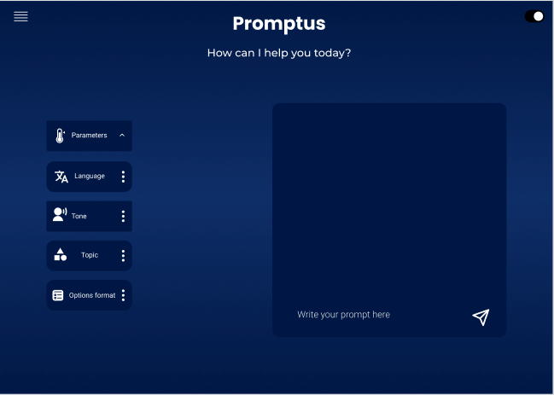

Slide 12
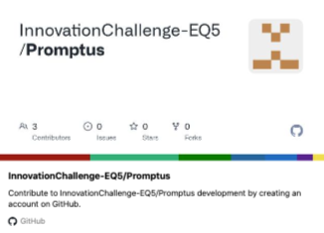
THANK YOU FOR YOUR TIME
Promptus is here to ensure that every interaction with AI is safe, clear, and effective taking a step closer to an ethical and accessible digital future.
https://github.com/InnovationChallenge-EQ5/Promptus

