Slide 1


Xamarin + Microsoft Azure Hands On
99/4A
Ben Ishiyama-Levy
Xamarin Evangelist
ben@xamariners.com
http://www.meetup.com/SingaporeMobileDev/

Slide 2
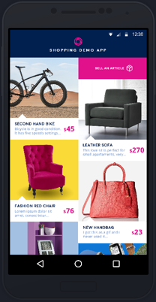
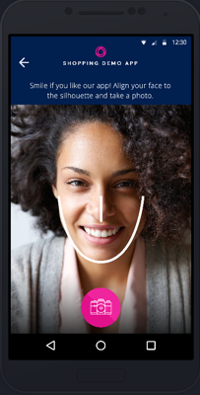
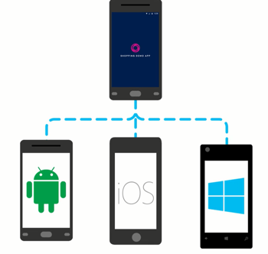
Shopping Demo App Overview
Learn how to connect your Xamarin mobile apps to the cloud.

Slide 3


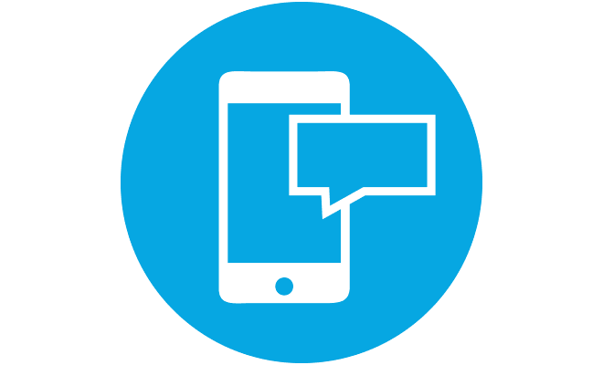

Shopping Demo App Overview
We are going to build a cross platform shopping app that uses a wide range of Azure services to help users:
authenticate with Facebook or Twitter
sell and buy personal items
get notifications when items are purchased
rate the app with a smile

Slide 4

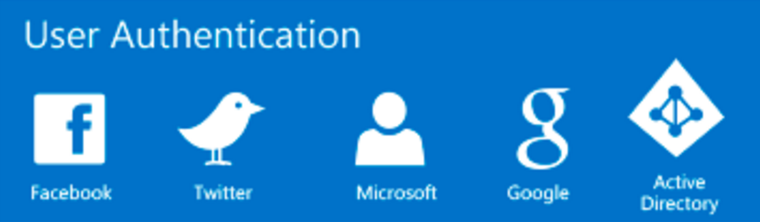
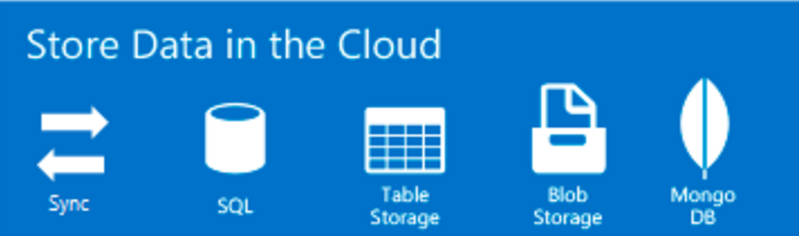
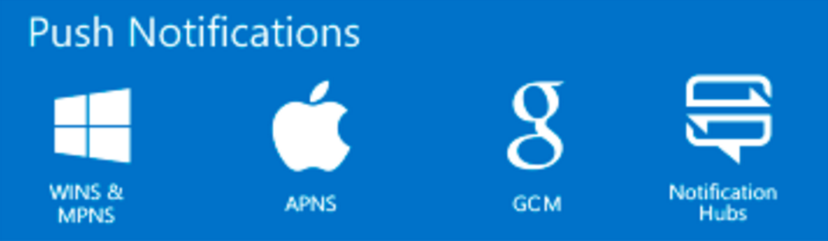
App Service
App Service is a platform-as-a-service (PaaS) offering of Microsoft Azure. It allows to create mobile apps for any platform or device.
You can integrate your apps with several SaaS solutions as Authentication, Push Notifications, Storage, etc.

Slide 5
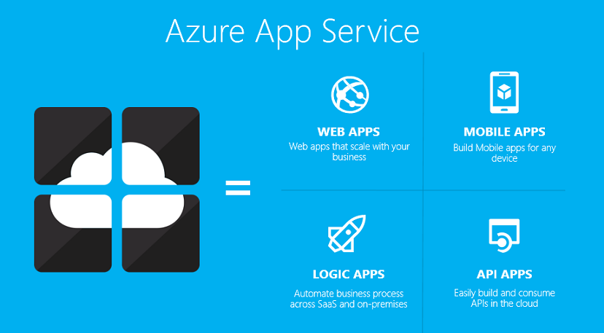
Notes:
Xamarin Forms is a new set of APIs allowing you to quickly and easily write shared User Interface code that is still rendered natively on each platform, while still providing direct access to the underlying SDKs if you need it.

Slide 6


Authenticate and authorize users with Twitter and Facebook
User Authentication enables single sign-on for your mobile app, so users can effortlessly authenticate with any cloud and on-premises app.
App Service supports five identity providers out of the box, including: Azure Active Directory, Facebook, Google, Microsoft Account, and Twitter, as well as your own custom identity solution.

Slide 7
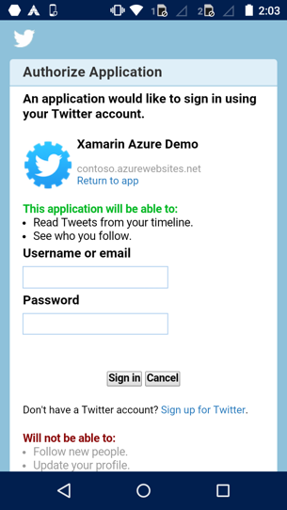
Authenticate and authorize users with Twitter and Facebook
Let’s add Twitter and Facebook authentication through Azure App Service with Mobile Apps in the Shopping Demo App.
https://github.com/Microsoft/XamarinAzure_ShoppingDemoApp/wiki/Authentication-Authorization

Slide 8
Sign up for Microsoft Azure
Open an Azure account for free: You get $200 azure credits that can be used to try out paid Azure services. Even after the credits are used up, you can keep the account and use free Azure services and features, such as the Web Apps feature in Azure App Service.
https://azure.microsoft.com/en-us/free
Activate Visual Studio subscriber benefits: Your Visual Studio subscription gives you $50 credits every month that you can use for paid Azure services.
https://my.visualstudio.com/benefits
Activate Visual Studio Dev Essentials benefits: Get $25 azure credits every month by joining Visual Studio Dev Essentials.
https://azure.microsoft.com/en-us/pricing/member-offers/vs-dev-essentials

Slide 9
Or set a temp App Service app
If you want to get started with Azure App Service before you sign up for an Azure account, go to Try App Service. There, you can immediately create a short-lived starter mobile app in App Service—no credit card required, and no commitments.
https://tryappservice.azure.com/

Slide 10

Set up the development environment
To start, set up your development environment by installing the latest version of:
Azure SDK
Xamarin
Visual Studio 2015
SQLite for Universal Windows Platform

Slide 11

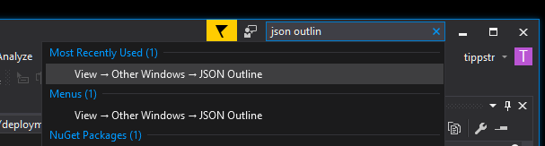
Setup backend web app
With Azure Deployment Templates
Online Azure Backend Setup:
https://deploy.azure.com/?repository=
https://github.com/Microsoft/XamarinAzure_ShoppingDemoApp#/form/setup
More about Azure Deployment templates:
https://azure.microsoft.com/en-us/documentation/articles
/vs-azure-tools-resource-groups-deployment-projects-create-deploy/
Note: The Visual Studio JSON Outline window is pretty useful for editing your
deployment templates

Slide 12
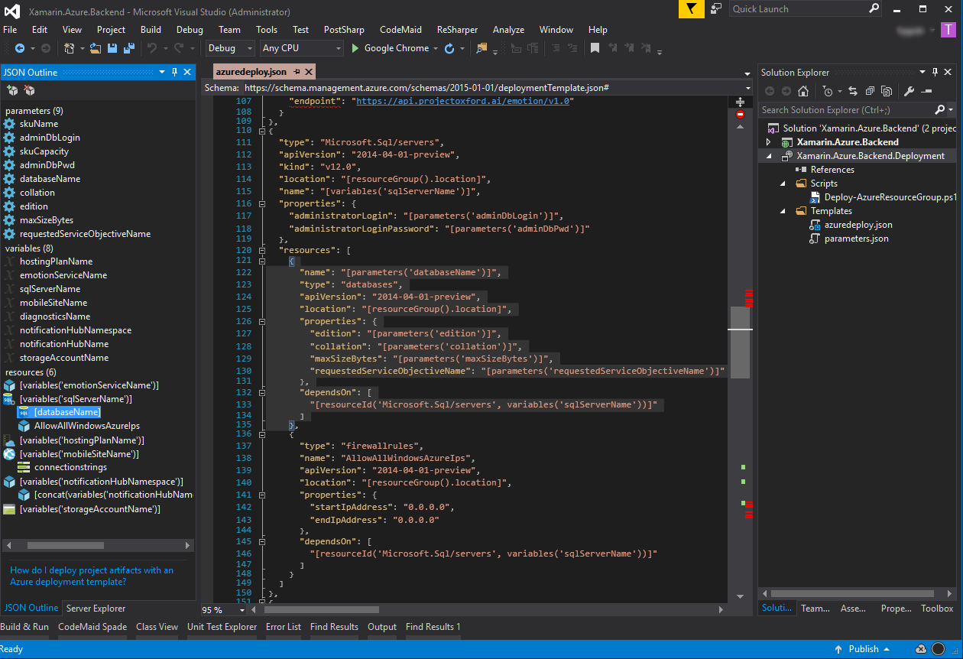
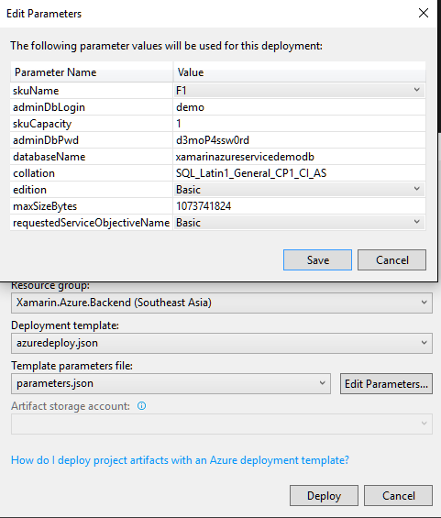

Deploy Xamarin.Azure.Backend
With Azure Deployment Templates
Deploy here

Slide 13
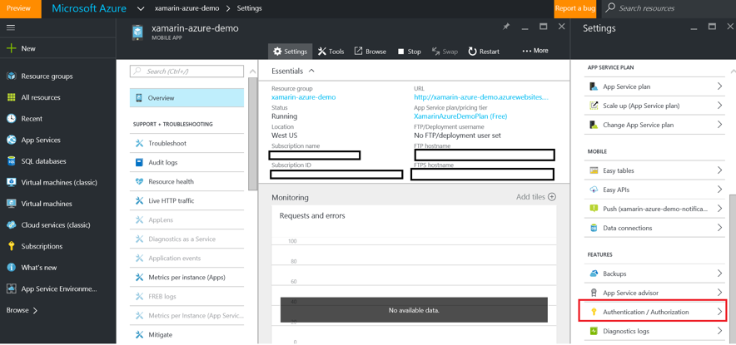
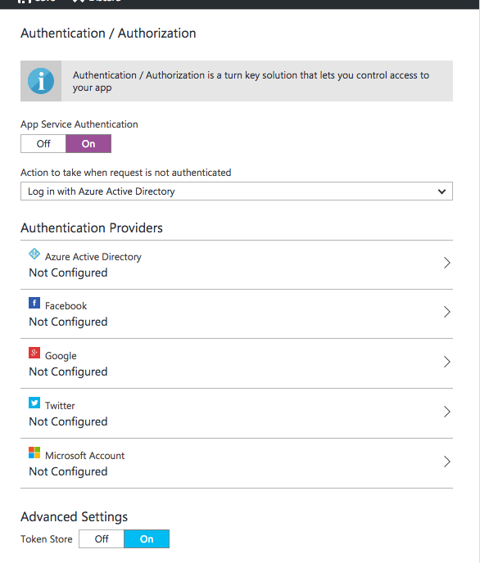
Setup Authentication in Azure Mobile Apps
Configuring Authentication in Azure is done within the Mobile App context.
Sign-up to Azure using the same subscription you used to deploy the Azure backend.
Within the Mobile App, you can find Authentication/Authorization in the Settings Pane
under Features.
Enable Authentication/Authorization by tapping on “On”.
Since we want to authenticate users just for selling new items,
we will allow requests when the user is not authenticated, i.e. taking no action,
and control manually that scenario.

Slide 14
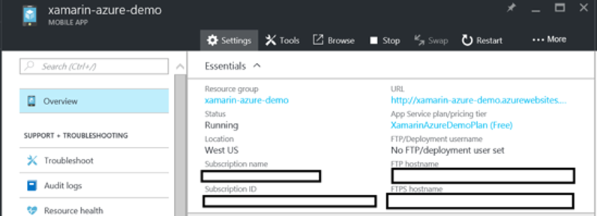
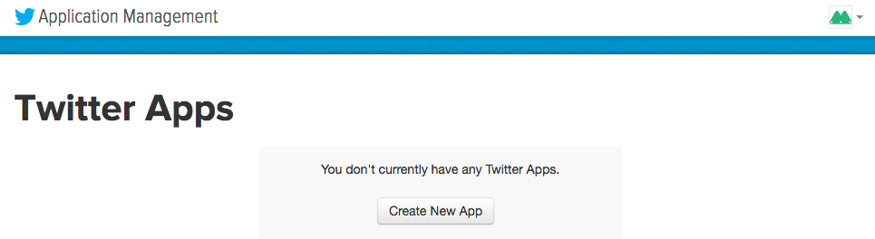
Configure twitter Authentication:
Register your application with Twitter
You must have a Twitter account that has a verified email address and phone number. To create a new Twitter account, go to twitter.com
Log on to the Azure portal https://portal.azure.com/ , and navigate to your application. Copy your URL. You will use this to configure your Twitter app
Navigate to the Twitter Developers website https://apps.twitter.com/ , sign in with your Twitter account credentials, and click Create New App.

Slide 15
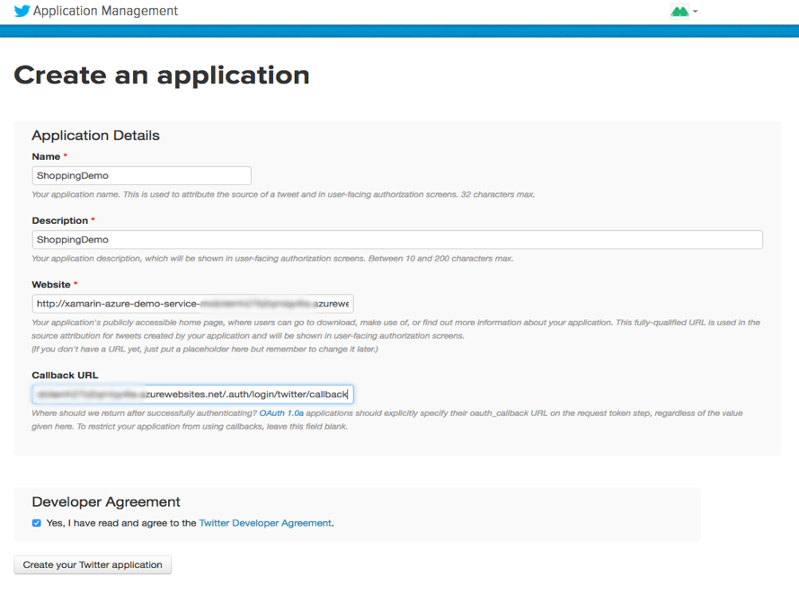
Configure twitter Authentication:
Register your application with Twitter
Type in the Name and a Description for your new app. Paste in your application's URL for the Website value.
For the Callback URL, paste the Callback URL you copied earlier. This is your Mobile App gateway appended with the path, /.auth/login/twitter/callback. For example https://contoso.azurewebsites.net/.auth/login/twitter/callback. Make sure that you are using the HTTPS scheme.
At the bottom the page, read and accept the terms. Then click Create your Twitter application. This registers the app displays the application details.

Slide 16
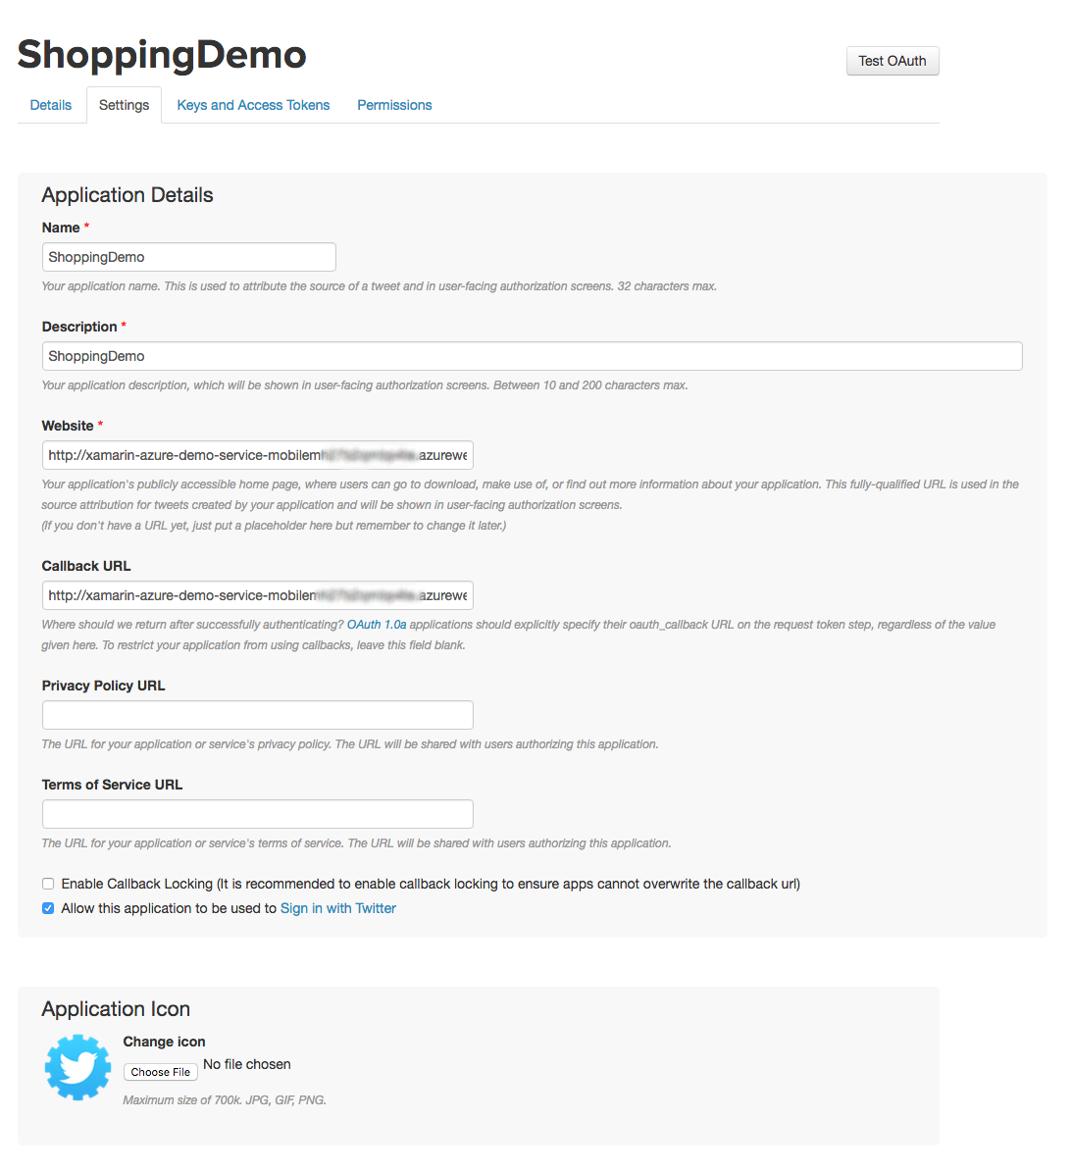
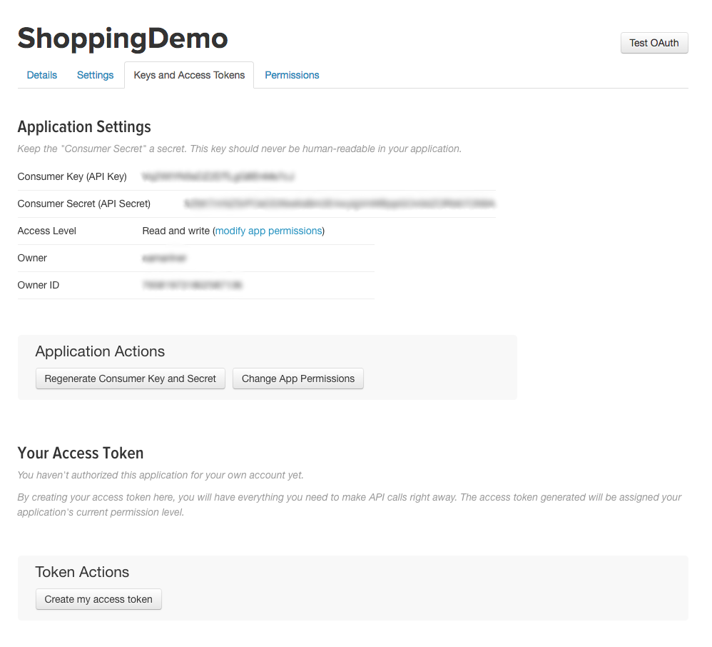
Configure twitter Authentication:
Register your application with Twitter
Click the Settings tab, check Allow this application to be used to sign in with Twitter, then click Update Settings.
Select the Keys and Access Tokens tab. Make a note of the values of Consumer Key (API Key) and Consumer secret (API Secret). The consumer secret is an important security credential. Do not share this secret with anyone or distribute it with your app.

Slide 17
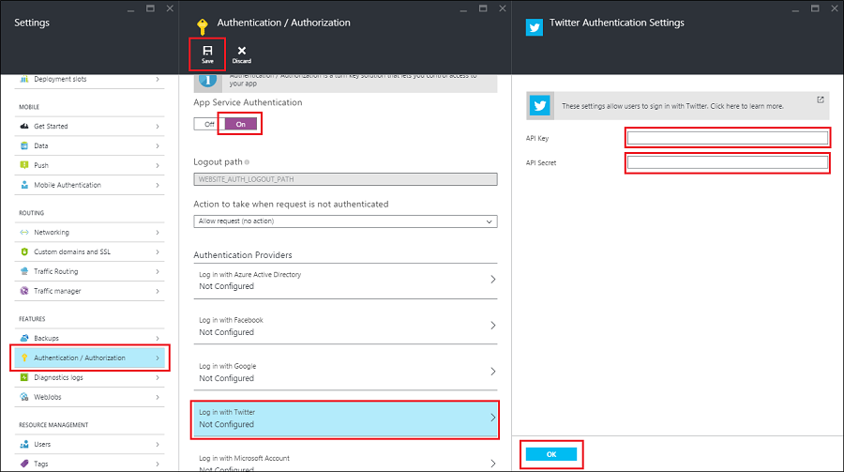
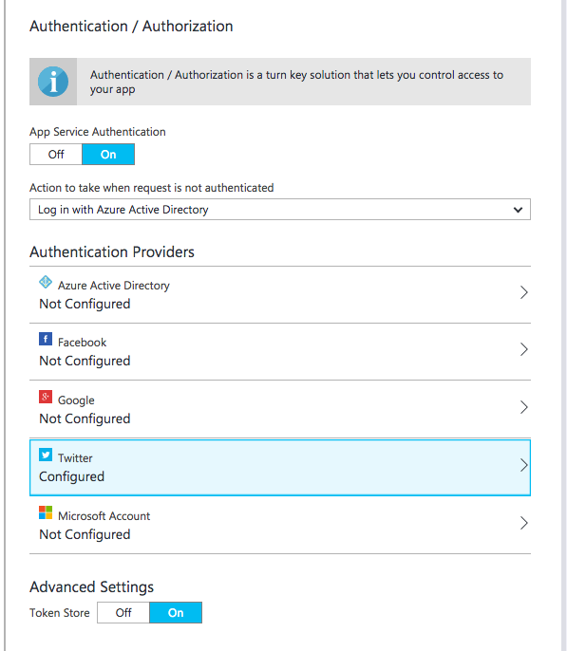
Configure twitter Authentication:
Add Twitter information to your application
Back in the Azure portal, navigate to your application. Click Settings, and then Authentication / Authorization.
If the Authentication / Authorization feature is not enabled, turn the switch to On.
Click Twitter. Paste in the App ID and App Secret values which you obtained previously. Then click OK.
By default, App Service provides authentication but does not restrict authorized access to your site content and APIs. You must authorize users in your app code.
(Optional) To restrict access to your site to only users authenticated by Twitter, set Action to take when request is not authenticated to Twitter. This requires that all requests be authenticated, and all unauthenticated requests are redirected to Twitter for authentication.
Click Save.

Slide 18
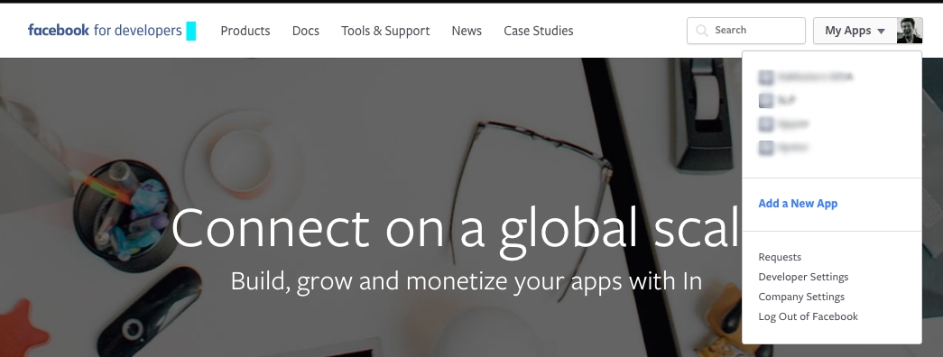
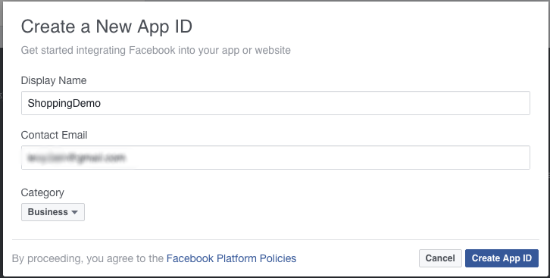
Configure facebook Authentication:
Register your application with Facebook
You must have a Facebook account that has a verified email address and phone number. To create a new Twitter account, go to facebook.com
Log on to the Azure portal https://portal.azure.com/ , and navigate to your application. Copy your URL. You will use this to configure your Facebook app
In Display Name, type a unique name for your app, type your Contact Email, choose a Category for your app, then click Create App ID and complete the security check. This takes you to the developer dashboard for your new Facebook app.
Navigate to the Facebook Developers website https://developers.facebook.com/ , sign in with your Facebook account credentials, and click My App/ Add New App.

Slide 19
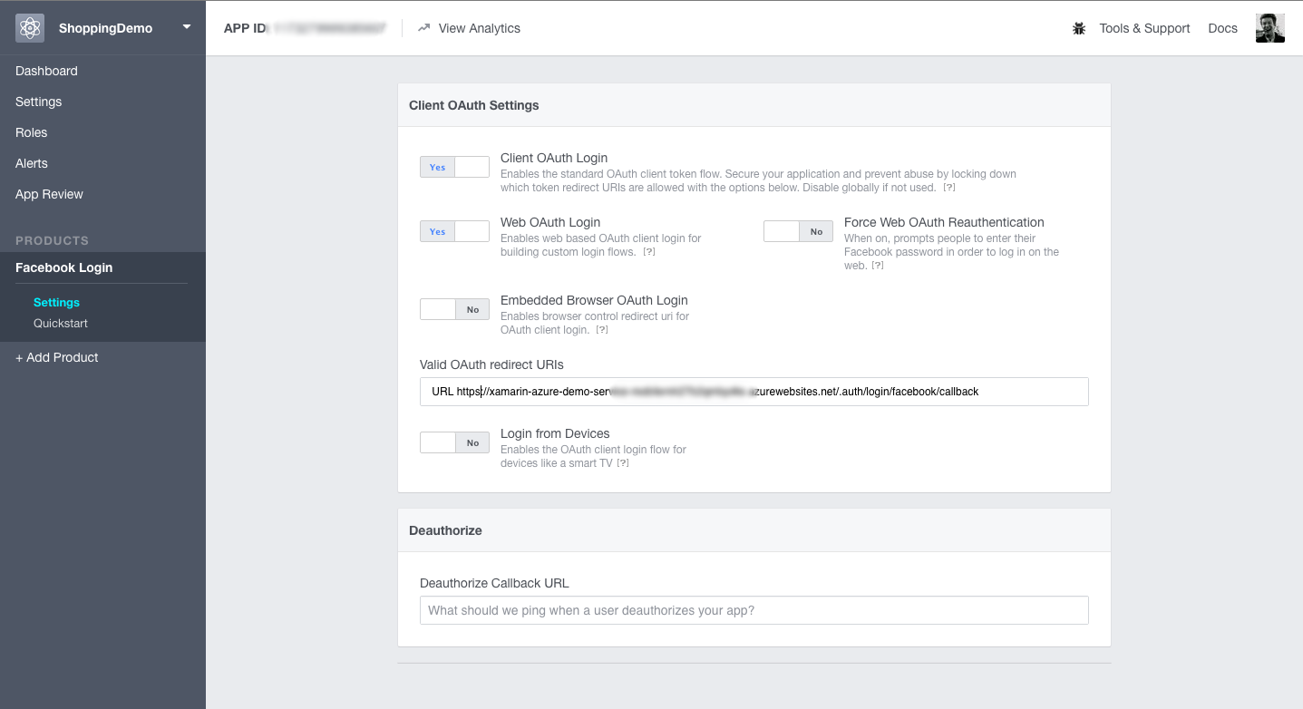
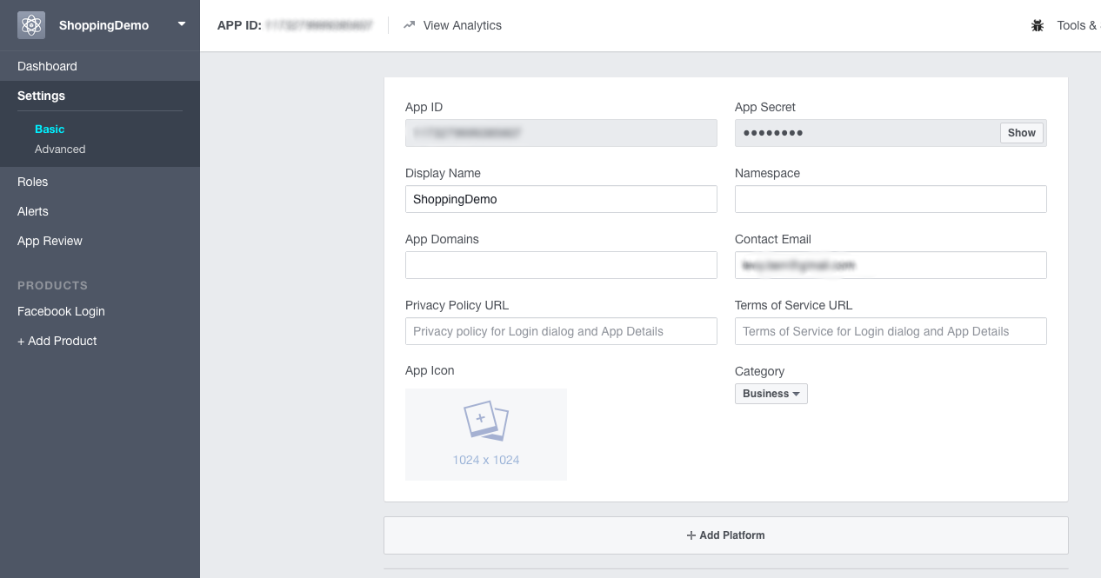
Configure facebook Authentication:
Register your application with Facebook
Under "Facebook Login," click Get Started / Settings. Add your application's Redirect URI to Valid OAuth redirect URIs, then click Save Changes. Your redirect URI is the URL of your application appended with the path, /.auth/login/facebook/callback. For example, https://contoso.azurewebsites.net/.auth/login/facebook/callback. Make sure that you are using the HTTPS scheme.
In the left-hand navigation, click Settings. On the App Secret field, click Show, provide your password if requested, then make a note of the values of App ID and App Secret. You use these later to configure your application in Azure.
The Facebook account which was used to register the application is an administrator of the app. At this point, only administrators can sign into this application. To authenticate other Facebook accounts, click App Review and enable Make public to enable general public access using Facebook authentication.

Slide 20
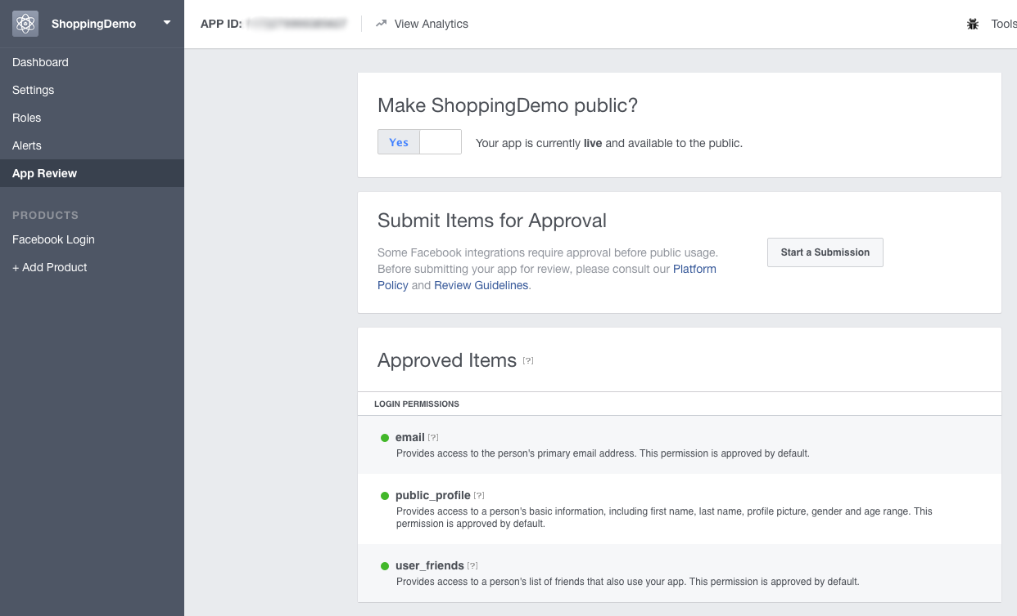
Configure facebook Authentication:
Register your application with Facebook
The Facebook account which was used to register the application is an administrator of the app. At this point, only administrators can sign into this application. To authenticate other Facebook accounts, click App Review and enable Make public to enable general public access using Facebook authentication.

Slide 21
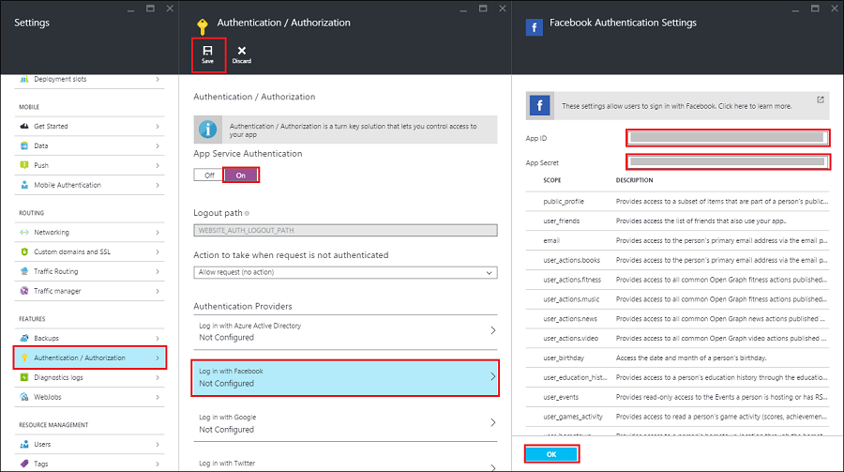
Configure facebook Authentication:
Add Facebook information to you application
Back in the Azure portal, navigate to your application. Click Settings > Authentication / Authorization, and make sure that App Service Authentication is On.
Click Facebook, paste in the App ID and App Secret values which you obtained previously, optionally enable any scopes needed by your application, then click OK.
By default, App Service provides authentication but does not restrict authorized access to your site content and APIs. You must authorize users in your app code.
(Optional) To restrict access to your site to only users authenticated by Facebook, set Action to take when request is not authenticated to Facebook. This requires that all requests be authenticated, and all unauthenticated requests are redirected to Facebook for authentication.
When done configuring authentication, click Save.

Slide 22
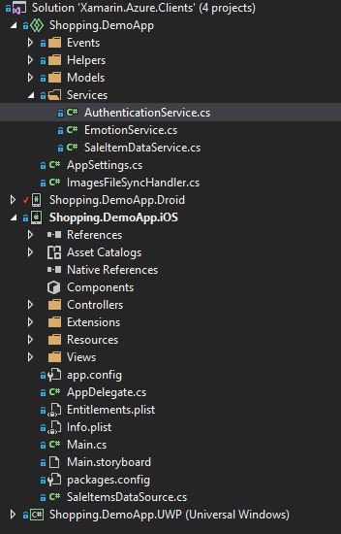
Set up Authentication in client side
The client authentication happens entirely in the Shared Project. AuthenticationService class provides a singleton instance which simplifies everything to a single call: RequestLoginIfNecessary(). Authentication starts when the app asks user user to select a preferred provider: Facebook or Twitter, and executes the Azure’s Authentication broker consequently based on user selection.
Depending on the target platform the call to LoginWithProviderAsync() differs, although differences are subtle and assure the consistence with OS’ SDK.

Slide 23

Set up Authentication in client side
Xamarin.iOS
private Task<MobileServiceUser> LoginWithProviderAsync(MobileServiceAuthenticationProvider provider)
{
var window = UIKit.UIApplication.SharedApplication.KeyWindow;
var vc = window.RootViewController;
// take top presented view controller
while (vc.PresentedViewController != null)
{
vc = vc.PresentedViewController;
}
return SaleItemDataService.Instance.MobileService.LoginAsync(vc, provider);
}

Slide 24

Set up Authentication in client side
Xamarin.Android
private Task<MobileServiceUser> LoginWithProviderAsync(MobileServiceAuthenticationProvider provider)
{
return SaleItemDataService.Instance.MobileService.LoginAsync
(Plugin.CurrentActivity.CrossCurrentActivity.Current.Activity, provider);
}

Slide 25

Set up Authentication in client side
Windows 10 Mobile
//// In UWP we need to be logged in to subscribe to push notifications
private async Task<MobileServiceUser> LoginWithProviderAsync(MobileServiceAuthenticationProvider provider)
{
var serviceUser = await SaleItemDataService.Instance.MobileService.LoginAsync(provider);
return serviceUser;
}

Slide 26
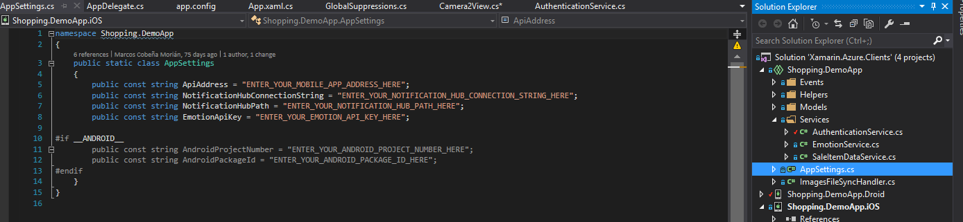
Set up Authentication in client side
Let’s run
Set the AppSettings ‘ApiAddress’ string with your mobile app address (https):
Run the App

Slide 27
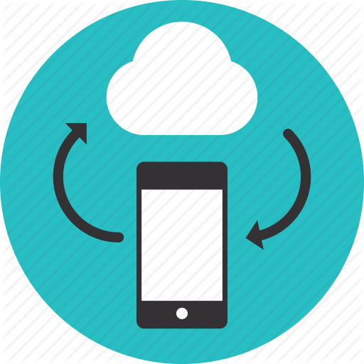


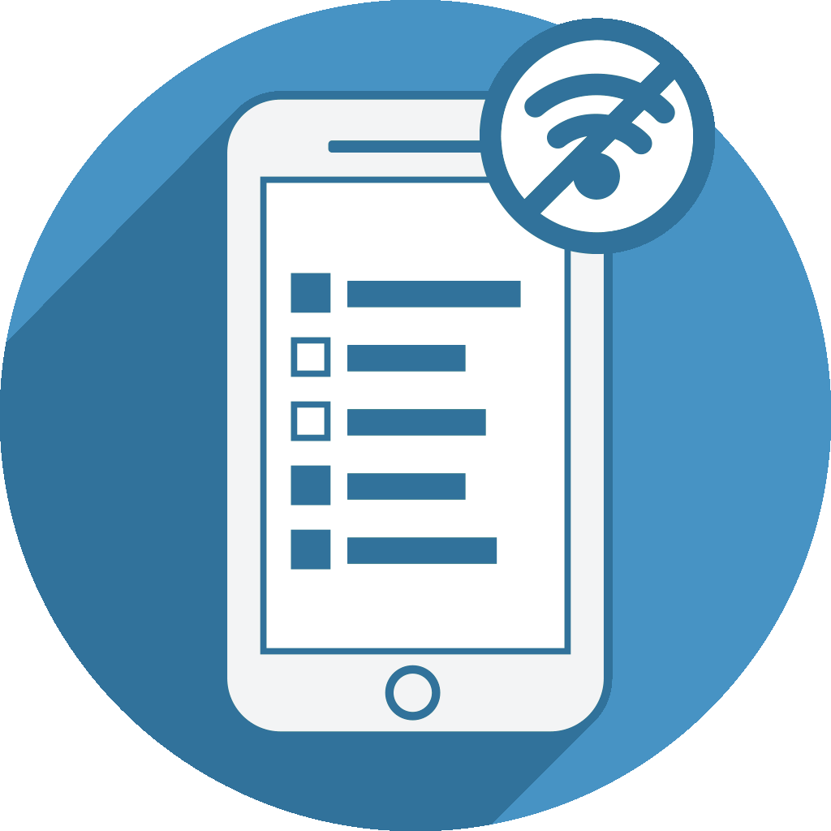
Offline Data Sync:
Allow your app to work offline and sync after with Offline Data Sync
Mobile users need to access data at all times, on and offline. Use offline data sync to make sure your users can view, create, and modify data, even when they experience connectivity issues or are offline.
The Azure Mobile SDK includes offline data sync capabilities, creating apps that remain functional without a network connection. When apps are in offline mode, users can access, create, and modify data of any type. Changes are stored locally, and, when the app detects a network connection, checks for conflicts with Azure Mobile App backend, and synchronizes locally stored data accordingly.
When your app is in offline mode, users can still create and modify data, which will be saved to a local store. When the app is back online, it can synchronize local changes with your Azure Mobile App backend.

Slide 28


Offline Data Sync:
Allow your app to work offline and sync after with Offline Data Sync
The feature also includes support for detecting conflicts when the same record is changed on both the client and the backend. Conflicts can then be handled either on the server or the client.
Apps render information from a remote server. When users experience connectivity issues or are offline, a common development practice is to keep a local version of the information. However, this approach is not optimal.
Azure’s Offline Data Sync helps developers solve offline scenarios with few lines of code. Offline Data Sync allows to push and pull data on demand. If eventually the Internet connection breaks up, the client automatically pulls data recovers from local storage.

Slide 29
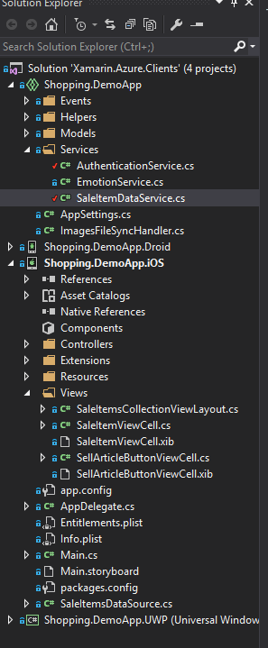
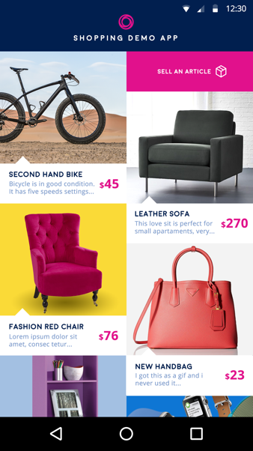
Offline Data Sync:
Enabling Offline Data Sync in client side
The following tutorial is focused the Shopping Demo App’s home page, where users can see a collection of items to be sold.
The Shopping Demo App consumes the Web App “Xamarin.Azure.Backend” we deployed in Azure.
The Xamarin.Azure.Backend project provides a shared API that enables offline sync within Xamarin.Android, Xamarin.iOS and Windows 10 Mobile project. On this project, you also need to use the NuGet package Microsoft.Azure.Mobile.Client.SQLiteStore for every platform.
The collection view which shows items in the home page consumes the SaleItemDataService class, wrapping the initialization and retrieval of elements.
Every platform must call SaleItemDataService.Initialize() before pulling items:

Slide 30

Offline Data Sync:
Enabling Offline Data Sync in client side
This method initializes the SQLite local storage (just for the very first time), instantiates the client which will let us consume the Web API, and gives the app a “sync. table” for the sale items. This table is a mirror of the data available in Azure, letting us work with it locally and, finally, pushing everything to the cloud.
public async Task Initialize()
{
const string path = "syncstore.db";
//Create our client
this.MobileService = new MobileServiceClient(AppSettings.ApiAddress);
//We add MobileServiceFileJsonConverter to the list of available converters to avoid an internal that occurs randomly
this.MobileService.SerializerSettings.Converters.Add(new MobileServiceFileJsonConverter(this.MobileService));
//setup our local sqlite store and intialize our table
var store = new MobileServiceSQLiteStore(path);
store.DefineTable<SaleItem>();
//Get our sync table that will call out to azure
this.saleItemsTable = this.MobileService.GetSyncTable<SaleItem>();
}

Slide 31
Offline Data Sync:
Enabling Offline Data Sync in client side
From client platforms we will consequently call SaleItemDataService.GetSaleItems(), which assures saleItemsTable is synced prior to projecting the list back to the views.
The important bits regarding data syncing happen in the following lines of code:
await this.MobileService.SyncContext.PushAsync();
await this.saleItemsTable.PullAsync("allSaleItems", this.saleItemsTable.CreateQuery());
Two things happen here which are noticeable:
Every modification is pushed to Azure in advance.
The latest version of the data from Azure, regarding sale items, is downloaded to the client.
That way we assure data to represent is coherent with data stored in Azure, including data changes performed by the user locally.

Slide 32
Set up Offline Data Sync in client side
Xamarin.iOS

Slide 33
Set up Offline Data Sync in client side
Xamarin.Android

Slide 34
Set up Offline Data Sync in client side
Windows 10 Mobile

Slide 36
Thank You! Questions?
Ben Ishiyama-Levy
Xamarin Evangelist
ben@xamariners.com

