Slide 1

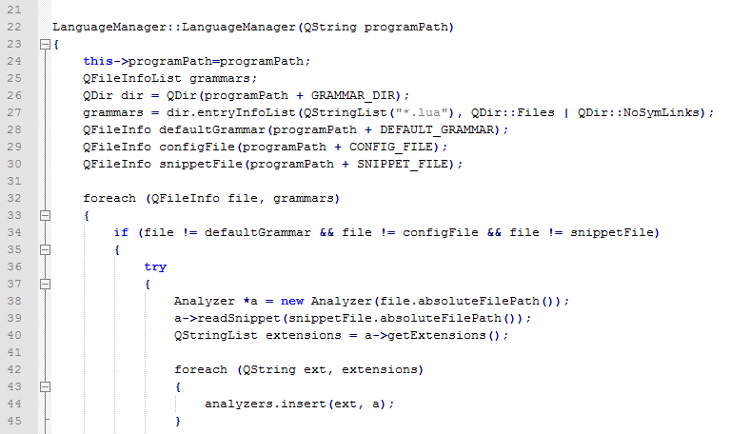


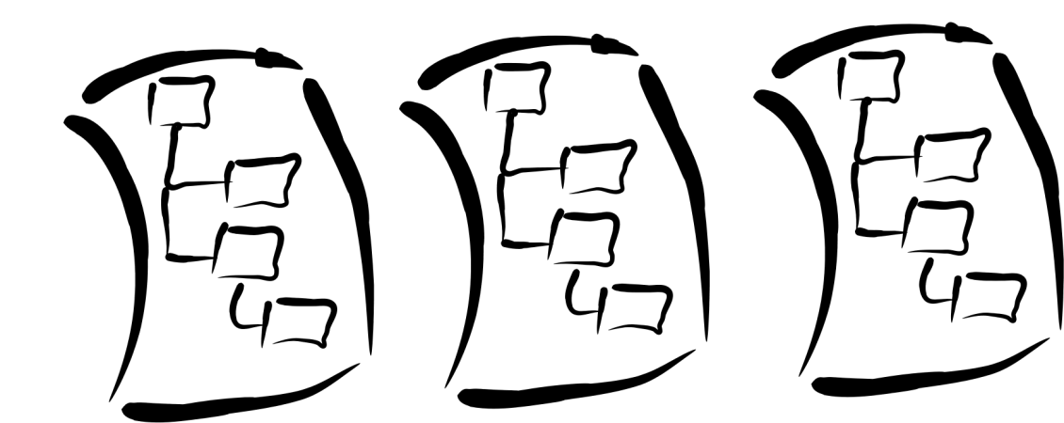




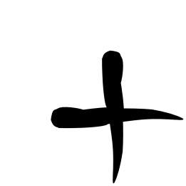

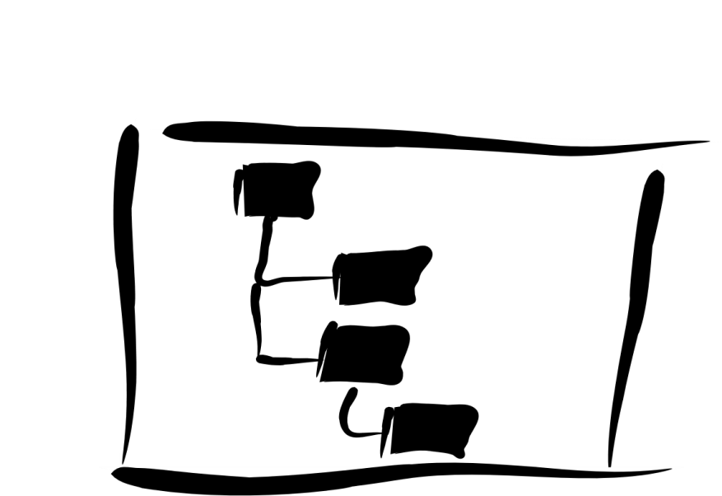

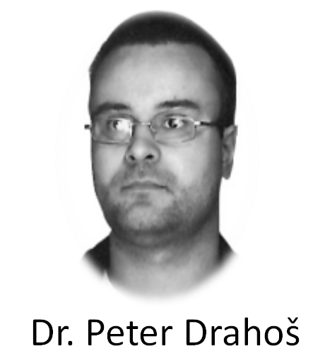


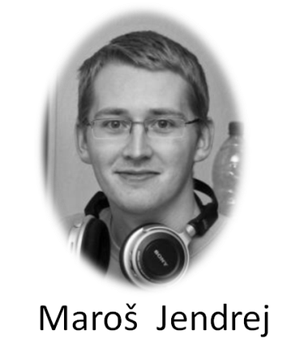
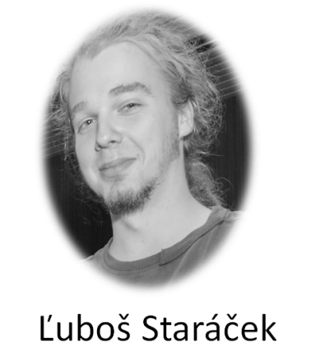


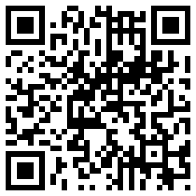


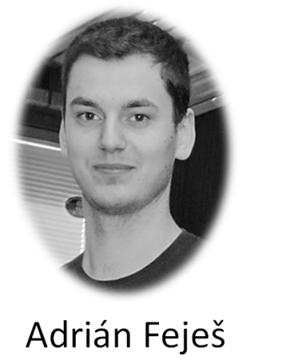
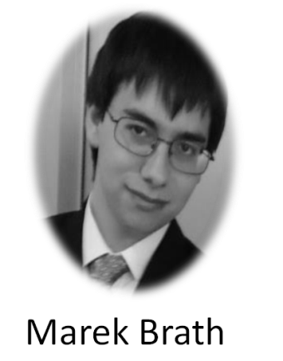

TrollEdit
Different approach of source code editing
Introduction
Today editors usually use simple color highlighting without any sign of graphic enrichment features. However enriching the source code with graphic elements can be beneficial for the understanding of the structure of given code and thus lead to better understanding of its structure and meaning for the programmer. This basic observation is the driving idea behind TrollEdit.
Approach
The core functionality of TrollEdit is based on the use of LPeg pattern matching library. Using this library we are able to parse source code according to its grammar into an abstract syntactic tree (AST). This data is then used to enhance the text visualization and so we are able to parse the content on any open file assuming that we have a matching language grammar.
Application
Trolledit is a dekstop applicaton based on multiplatform framework Qt. Basically TrollEdit is an enhanced text editor developed as a real market product. It's strongest feature is based on graphical text enrichment based on semantically analyzed file content.
How classical text editor
see source code
How TrollEdit see source code
Why to use TrollEdit?
Simple and easy to use editor
Code visualizazion as a structure of blocks
More opened files in single tab -> more tabs
Select and move files in tab
Drag n drop whole blocks in and between files
Insert files (Img., Link, etc.) right into code
Write documentation into code
(Literate programming by D. Knuth)
Work in two modes :
as simple text < - > with graphical elements
Can it be seen better?
Yes, answer is TrollEdit
Grammars
Source
Source with graphical enhancements
Conclusion
Our main goal to achieve is to create a real product, which will be a helpfull alternative to common text editors on market. We want to ensure that TrollEdit will be an original and very practical editor designated with extensibility, efficiency and flexibility in mind.
ToDo list management, File trees, shortcuts configuration, parallelized run of text analysis and new appealing user interface are just some of the features witch were recently implemented into editor and it's still not over. We can always add new grammar for support of new languages without any invasion to editor, or create module to extend its core functionalities even more.
Despite the facts work on editor is still in progress so feel free to contribute so we can create even better TrollEdit.
AST
Team
Used technology
© 2012 Team Innovators
http://innovators-team10.github.com
tp-team-10@googlegroups.com

