Slide 1
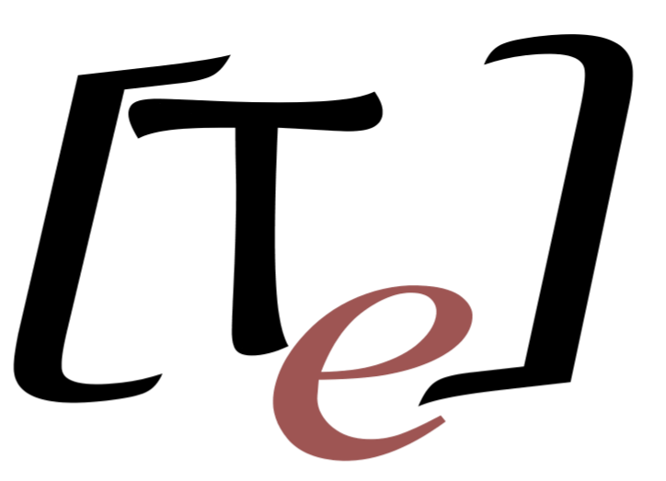

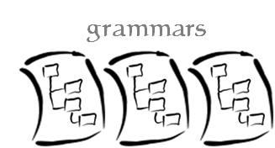




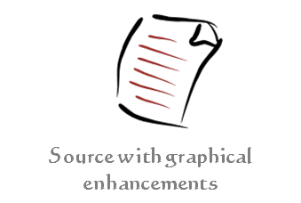
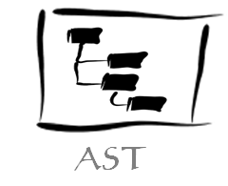
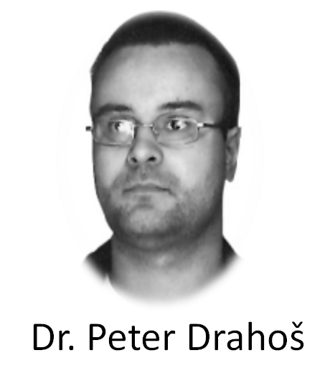
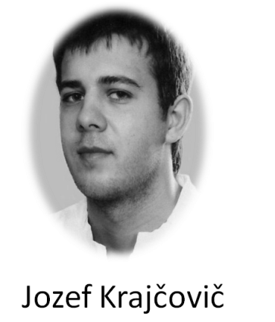
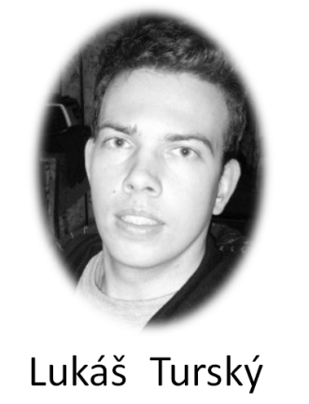
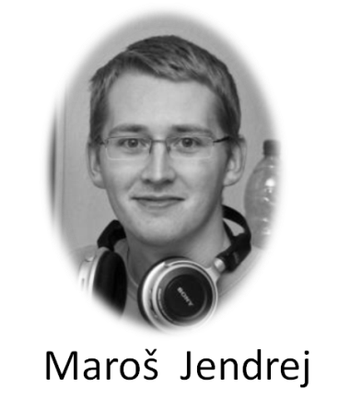
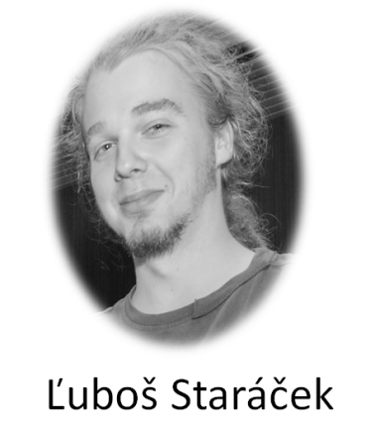




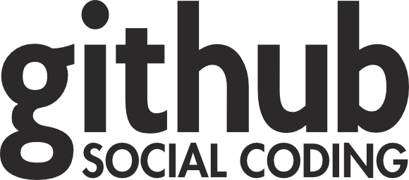


TrollEdit
New way of source code editing
Introduction
Today programmers use editors and IDEs that usually use simple color highlighting without any sign of graphic enrichment features. However enriching the source code with graphic elements can be beneficial for the understanding of the structure of given code and thus lead to better understanding of its structure and meaning for the programmer. This basic observation is the
driving idea behind TrollEdit.
TrollEdit is an experimental editor that tries to enrich source code with graphical elements for easier manipulation. Source code editing can sometimes be very problematic especially when reviewing unknown code that the programmer is not familiar with. Most of the time programmers are trying to familiarize themselves with the syntax of the source and only then follow to analyze its semantic meaning. TrollEdit tries to address both of these steps by enriching the text editor with graphical elements instead of relying on colorized text
How it Works
Today programmers use editors and IDEs that usually use simple color highlighting without any sign of graphic enrichment features. However enriching the source code with graphic elements can be beneficial for the understanding of the structure of given code and thus lead to better understanding of its structure and meaning for the programmer. This basic observation is the
driving idea behind TrollEdit. // dopisat a pridat obr
How it Works
Today programmers use editors and IDEs that usually use simple color highlighting without any sign of graphic enrichment features. However enriching the source code with graphic elements can be beneficial for the understanding of the structure of given code and thus lead to better understanding of its structure and meaning for the programmer. This basic observation is the
driving idea behind TrollEdit. // dopisat a pridat obr
How it Works
Today programmers use editors and IDEs that usually use simple color highlighting without any sign of graphic enrichment features. However enriching the source code with graphic elements can be beneficial for the understanding of the structure of given code and thus lead to better understanding of its structure and meaning for the programmer. This basic observation is the
driving idea behind TrollEdit. // dopisat a pridat obr
Autors
Team Innovators
Used technology
SLOVAK UNIVERSITY OF TECHNOLOGY IN BRATISLAVA
Faculty of Informatics and Information Technologies
tp-team-10@googlegroups.com

