Slide 1
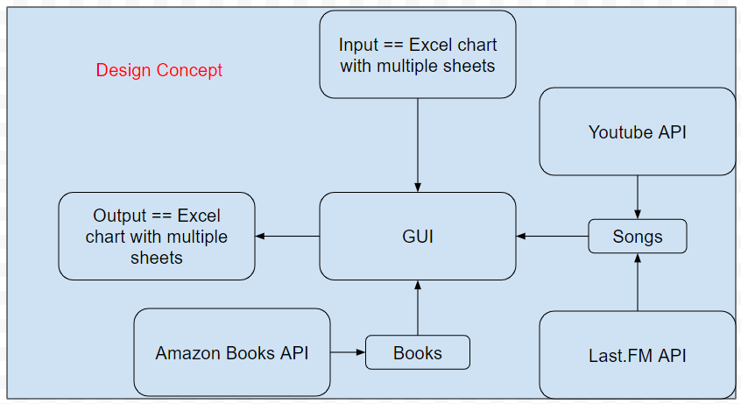
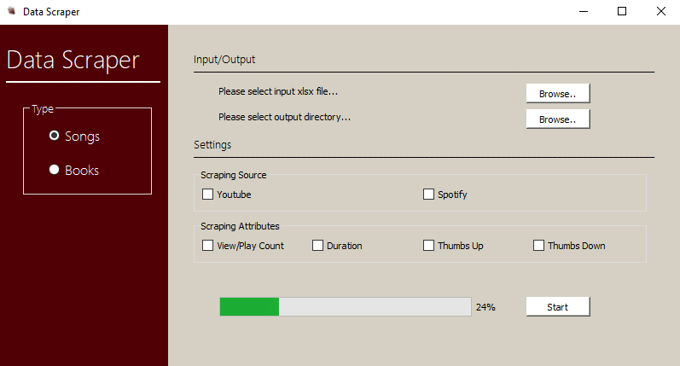

LAW SCHOOL COPYRIGHT PROJECT
Presenter: Aditya Atul Vijayvergia Chen Liang, David Qin, Fengqiao Wang, Joseph Cineros, Sicong Huang, Paul Quek Client: Dr. Glynn Lunney
Gather data to test the stories that we tell about copyright. Do one of these two projects: (1) test how well popular music endures by scraping the number of times each song in the year-end Hot 100 singles chart for the last 60 years has been streamed on YouTube. Re-scrape the same data at intervals, three months, six months, a year, to test how popularity changes over time. This permits test of stories regarding copyright’s optimal duration and also stories regarding the supposed correlation between incentives and creative output. (2) Test how much copyright increases the price for a copy of popular works. Scrape prices from Amazon and possibly other sources, for physical and electronic copies of the most popular novels from the 19th and 21st centuries. Because the 19th century books are out of copyright, while the 21st century books are all still protected by copyright, this would provide a direct measure of the surcharge or “tax” that copyright imposes on readers.
UI Design
asd
zxc
qwe
Youtube Data API
Public API that allows the user to gather youtube related data. In our case, we look for common video statistics such as likes, duration, and views for various popular songs.
Powerful and cheap requests that provide json readable data
Search queries can gather multiple videos at once and can process many searches in succession
Amazon Books API
asd
zxc
qwe
Last.FM API
Free, allows mass data queries
REST request
JSON response
Extensive availability
Other Module
REFERENCES:
https://arxiv.org/pdf/1802.01873.pdf
https://github.com/1adrianb/face-alignment
https://corochann.com/mnist-training-with-multi-layer-perceptron-1149.html
https://scikit-learn.org/stable/modules/generated/sklearn.neural_network.MLPClassifier.html#
https://scikit-learn.org/stable/modules/generated/sklearn.svm.LinearSVC.html#sklearn.svm.LinearSVC

