Slide 1
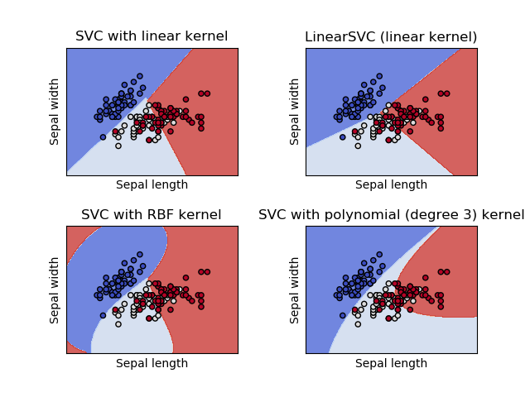
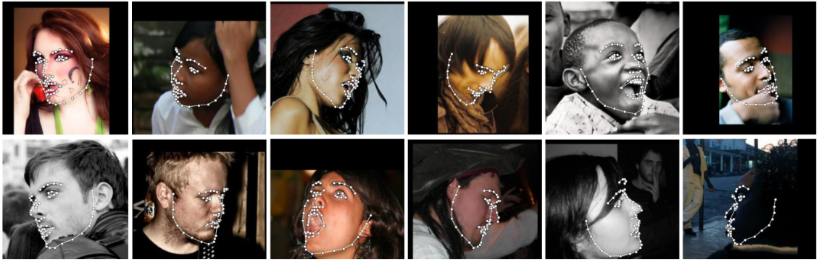


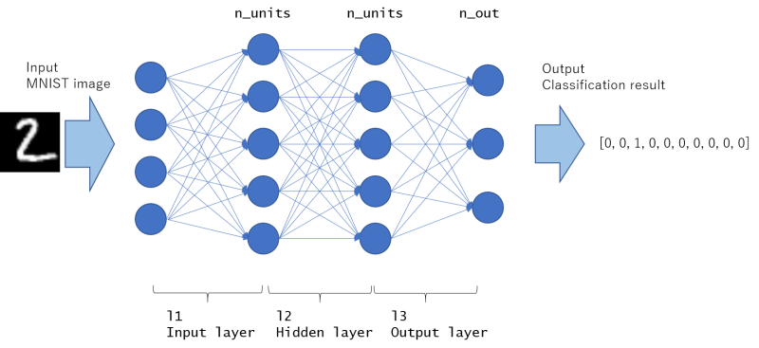
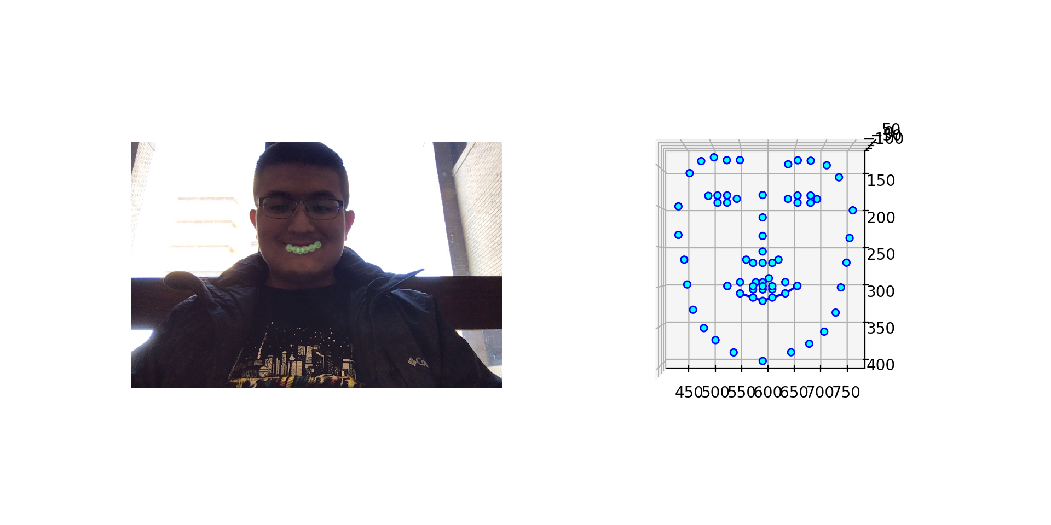


STATIC FACIAL EXPRESSION RECOGNITION WITH MULTI-LAYER DEEP LEARNING
Presenter: Sicong Huang Advisor: Dr. Anxiao (Andrew) Jiang
There are many factors that can play a role during encoding, which makes the recognition not accurate enough. In addition, based on the previous research that has been done in facial recognition, the images in facial action coding system are still very limited. My research builds on the existing methods for facial recognition and focus on generating more accurate and diverse results by using deep learning with advanced facial landmarks technique and categorical model. This research is focusing on improving the accuracy and diversity of facial expression recognition with deep learning.
SVM:
Supported Vector Machine
Local neural network
Polynomial kernel with degree of 3-11
Radial basis function kernel (rbf)
 | rbf | poly 3 | poly 6 | linear | sigmoid
auto gamma | 89.6059 | 85.7763 | 85.0824 | 82.9353 | 64.7059
scale gamma | 72.5294 | 74.7824 | 78.4412 | 85.6882 | 63.8706
Facial Landmarks
Facial landmark detection is the process of finding
points of interest in an image of a human face.
Facial landmarks used in this research:
Dimpler
Outer brow raiser
MLP:
Multilayer Perception
Global neural network
Stochastic gradient descent with adaptive learning rate
Stochastic gradient-based optimizer (adam)
REFERENCES:
https://arxiv.org/pdf/1802.01873.pdf
https://github.com/1adrianb/face-alignment
https://corochann.com/mnist-training-with-multi-layer-perceptron-1149.html
https://scikit-learn.org/stable/modules/generated/sklearn.neural_network.MLPClassifier.html#
https://scikit-learn.org/stable/modules/generated/sklearn.svm.LinearSVC.html#sklearn.svm.LinearSVC

