Slide 1

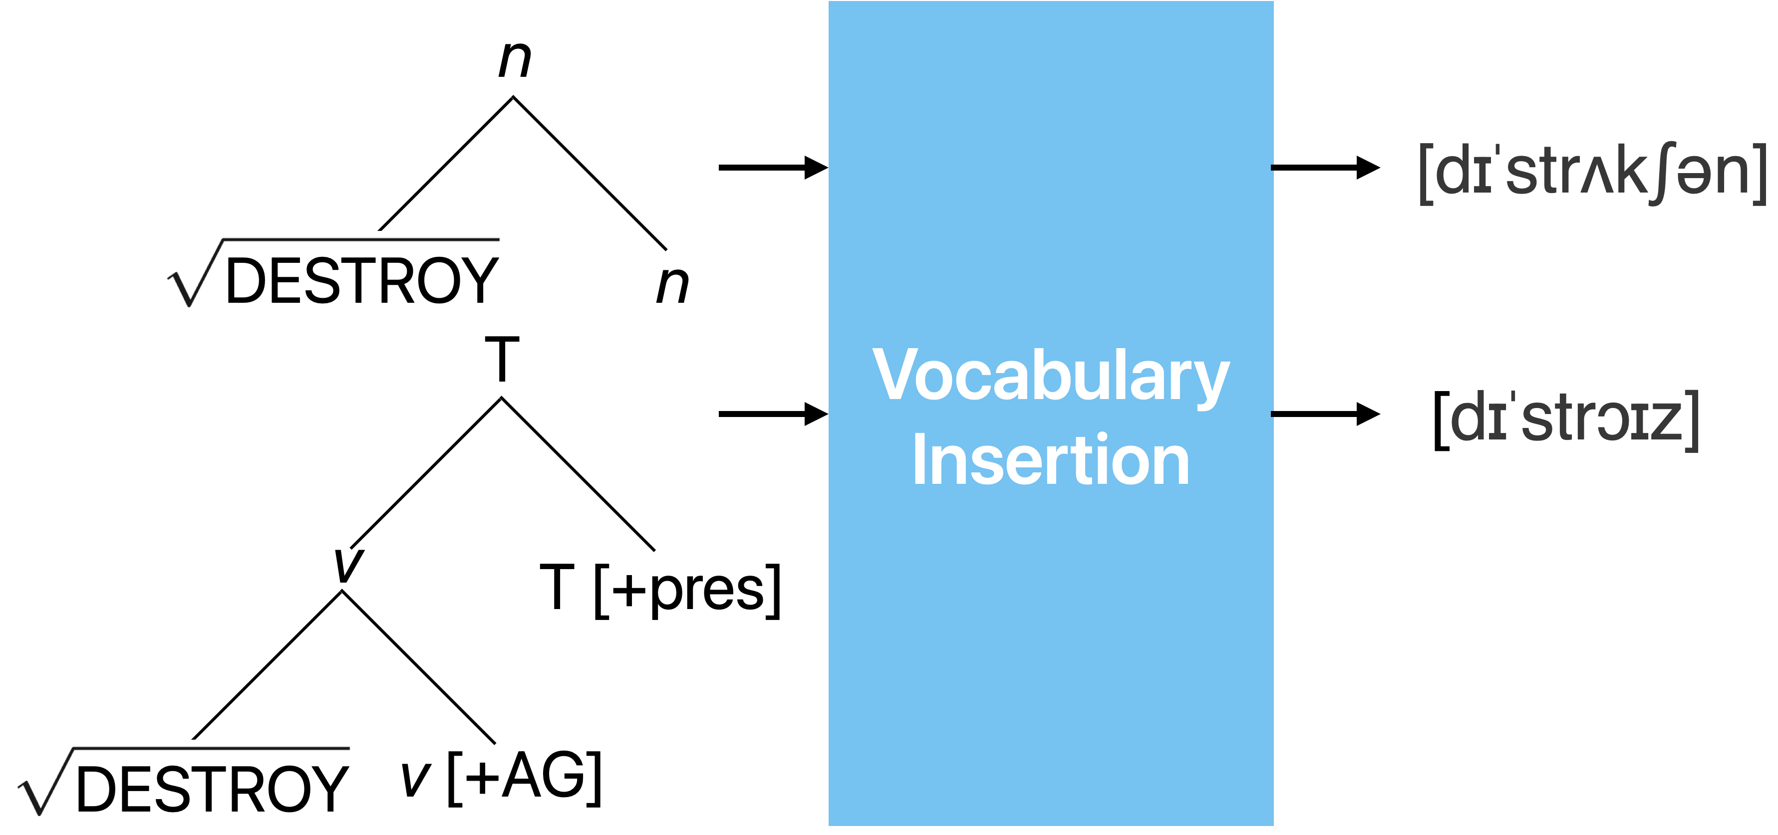
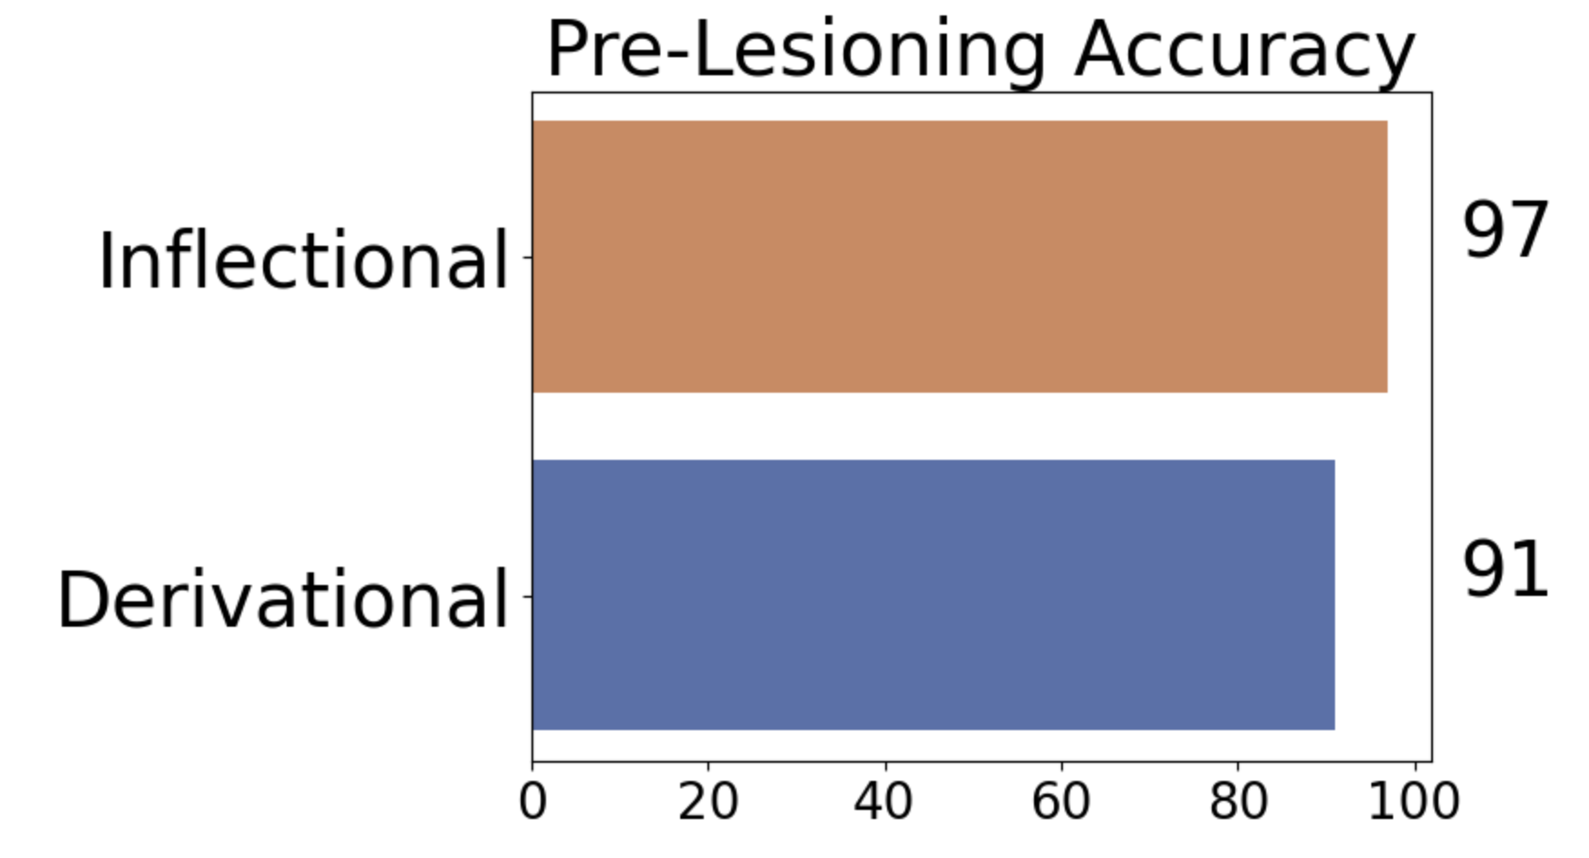
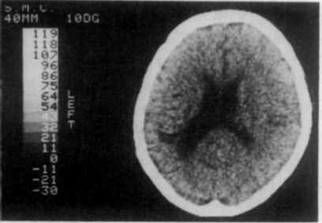
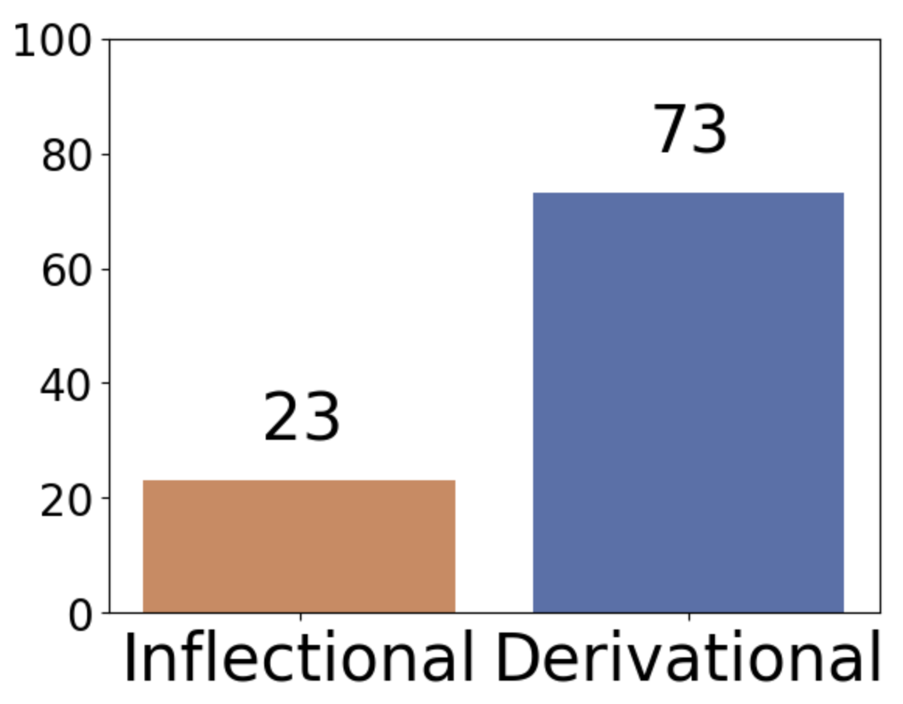
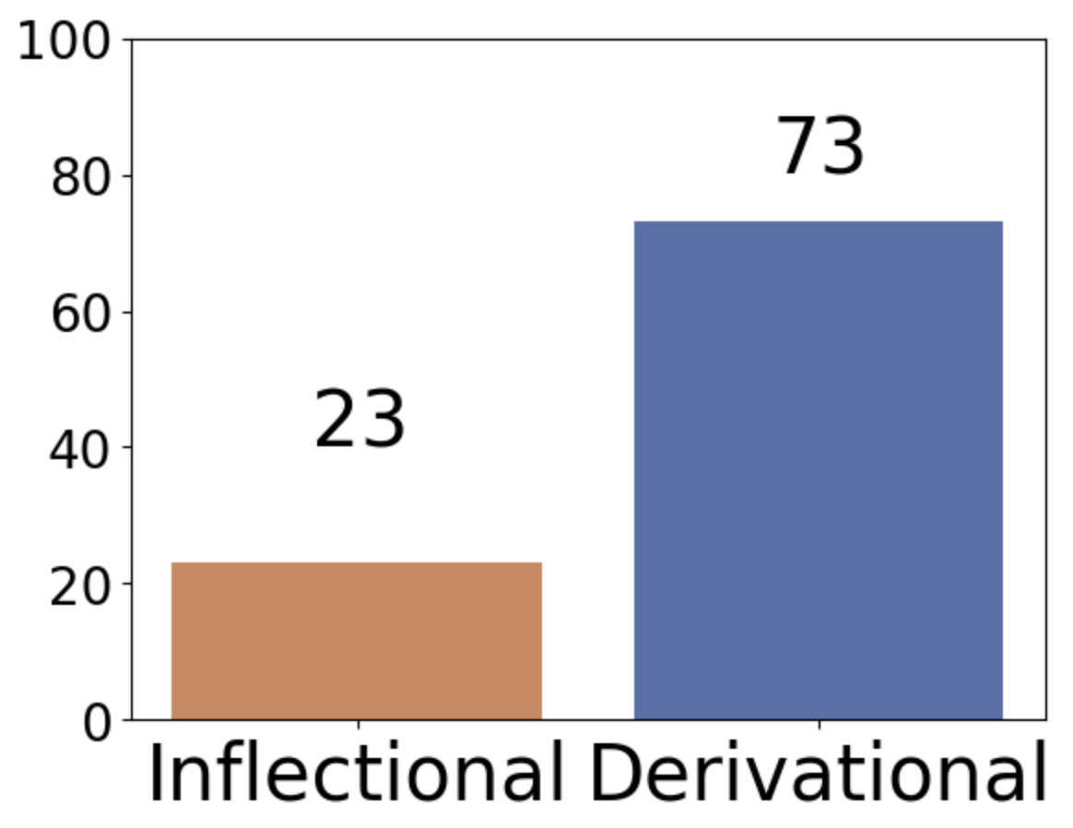
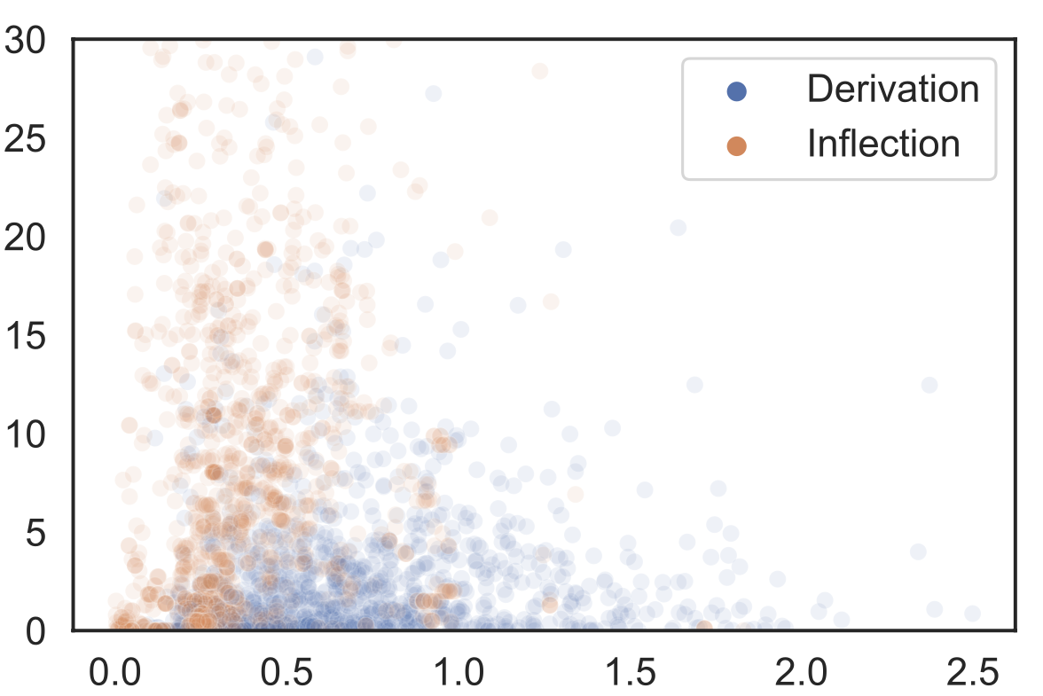
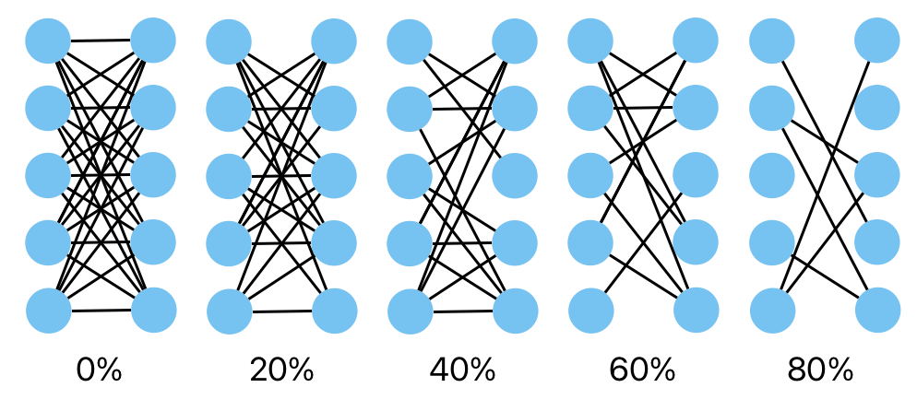

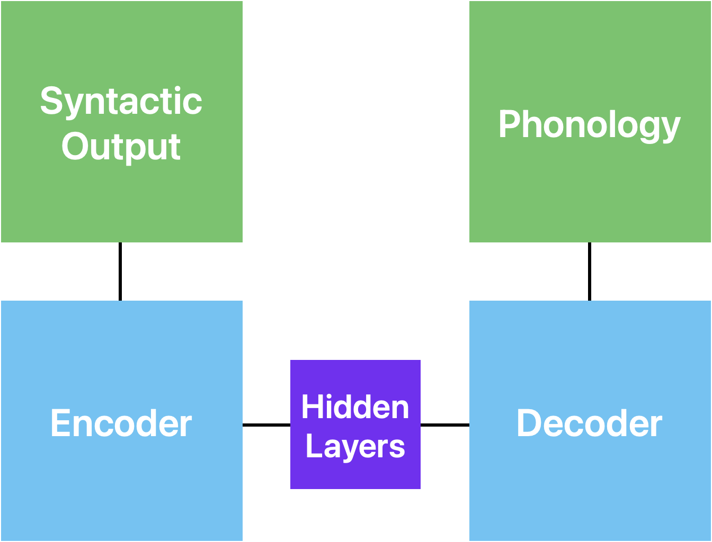

Modeling the inflectional/derivational dissociation in agrammatic aphasia with a RNN
Simon Chervenak^{1,2}, Alex Krauska², Naomi H. Feldman^{2,3}
¹ University of Maryland, Department of Computer Science; ² University of Maryland, Department of Linguistics; ³ University of Maryland, UMIACS
Two Categories of Morphology
Inflectional Derivational
Meaning Preserved Meaning Changed
The Inflectional Deficiency
People with aphasia regularly make more errors while producing inflectional morphemes [1].
This has been observed cross-linguistically in cases of agrammatic aphasia [2].
Modern syntax
One process to give phonological form to an abstract syntactic object [3].
Preliminary Testing
"walked" | walked
"chairs" | chairs
"painter" | painter
"redo" | redo
Production Accuracy
Motivation: Dichotomy vs Continuum
A cross-language study showed that these categories may be overlapping [4].
Can lesioning a model with a single component explain the dissociation in the data of people with aphasia?
Lesioning
To model agrammatic aphasia, we randomly set some proportion of the model’s weights to 0.
Large lesions visible in the left hemisphere.
Δ Form
Traditional Explanation
Miceli & Caramazza theorized two components that each controlled one type of morphology. F.S. would have a problem with one of these components.
Δ Meaning
The Encoder-Decoder
The data: Italian phonology data from PhonItalia [5], morpheme data from spaCy and nltk
The model: Encoder-Decoder architecture, originally designed for translation [6]
Future Work
We will lesion the model and calculate the accuracy levels for inflectional and derivational morphemes based on a test set.
If lesioning the single-route model can replicate the clinical data, we argue that there is no neural distinction between these classes of morphemes.
References: [1] Miceli, G., & Caramazza, A. (1988). Dissociation of Inflectional and Derivational Morphology. Brain and Language, 35, 24–65. [2] Gheitury, A., Dianat, L., & Rezaei, S. T. (2017). Dissociation of Inflectional and Derivational Morphology in Persian: Evidence from Aphasic Patients. Journal of Modern Rehabilitation, 11(1), 37–44. [3] Embick, D. (2021). The Motivation for Roots in Distributed Morphology. Annual Review of Linguistics, 2021(7), 69–88. [4] Coleman Haley, Edoardo M. Ponti, and Sharon Goldwater. 2023. Language-Agnostic Measures Discriminate Inflection and Derivation. In Proceedings of the 5th Workshop on Research in Computational Linguistic Typology and Multilingual NLP, pages 150–152, Dubrovnik, Croatia. Association for Computational Linguistics. [5] Goslin, J., Galluzzi, C. & Romani, C. PhonItalia: a phonological lexicon for Italian. Behav Res 46, 872–886 (2014). https://doi.org/10.3758/s13428-013-0400-8 [6] Kirov, C., & Cotterell, R. (2018). Recurrent neural networks in linguistic theory: Revisiting pinker and prince (1988) and the past tense debate. Transactions of the Association for Computational Linguistics, 6, 651–665.
The training: Use perplexity sampling to focus on least-confident inputs
The testing: Lesion the model at 5%
increments, test on a balanced subset of the training verbs
Code used:

Slide 2
