Slide 1

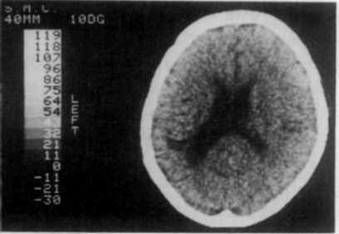
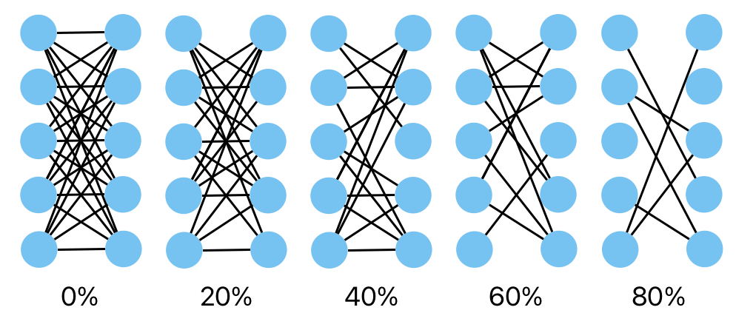
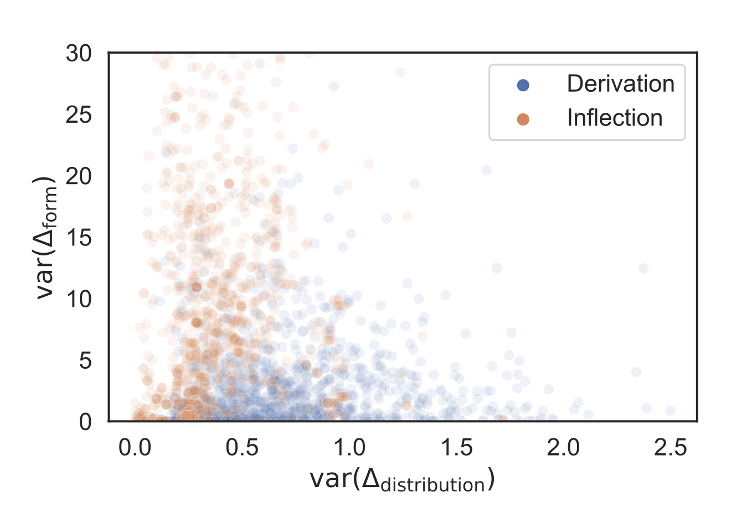

Revisiting the Divide: Modeling the inflectional/derivational dissociation in agrammatic aphasia with a RNN
Simon Chervenak^{1,2}, Alex Krauska², Naomi H. Feldman^{2,3}
¹ University of Maryland, Department of Computer Science; ² University of Maryland, Department of Linguistics; ³ University of Maryland, UMIACS
Are different morphemes handled differently in the brain?
To investigate this question, we created a model, lesioned it, and compared the results to the single- and dual-route accounts.
The Model
Encoder-decoder model <- describe a bit deeper
this is what the model is doing
Single & dual route model
If single route model replicates things that implies there is not a neural distinction
Results
{ model accuracy }
{ lesioning accuracy }
add dot for FS
Background information
Inflectional morphemes Derivational morphemes
walk-ed paint-er
chair-s re-do
Meaning Preserved Meaning Changed
Non-Fluent Aphasiac Data – clinical observation
{ graph }
Dichotomy vs Continuum
Lesioning
Can lesioning a single-route model effectively capture the data we see in non-fluent aphasia patients?
Conclusions
Several big takeaway points – what do you want them to remember?
Full Paper:
Contact: scherven@umd.edu Website: innoviox.github.io
References: [1] Miceli, G., & Caramazza, A. (1988). Dissociation of Inflectional and Derivational Morphology. Brain and Language, 35, 24–65.

