Slide 1

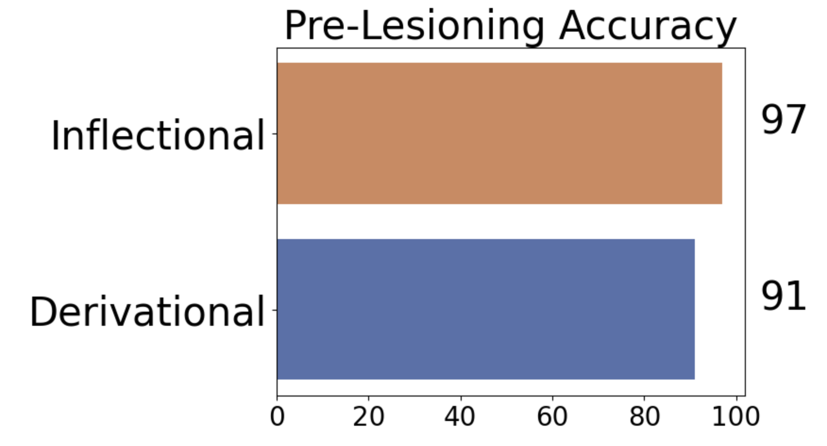
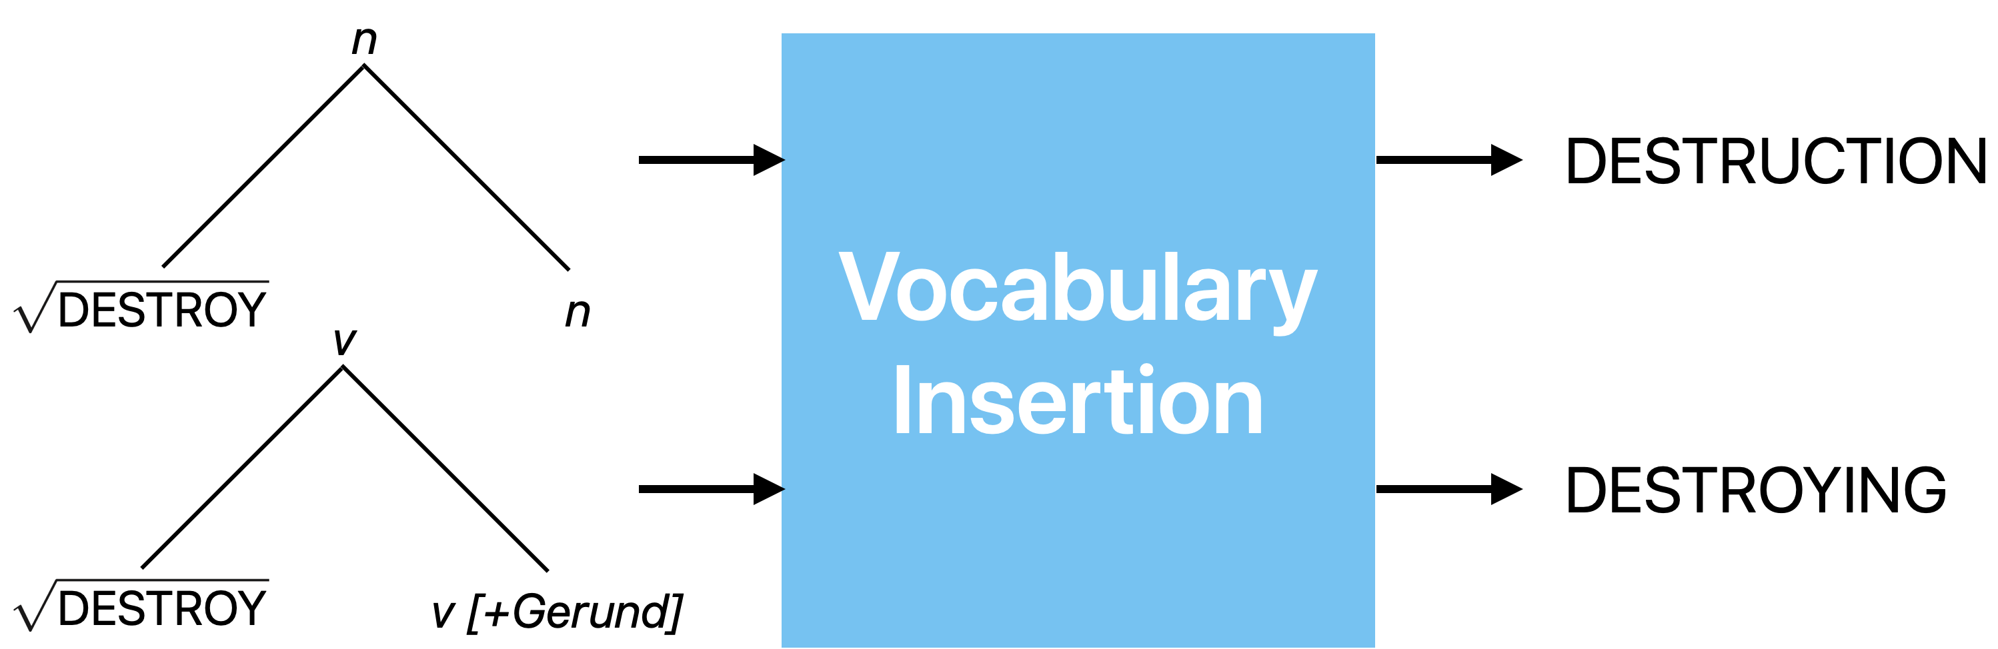
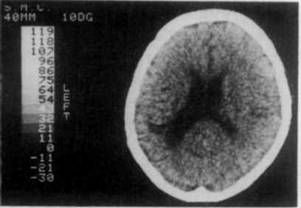
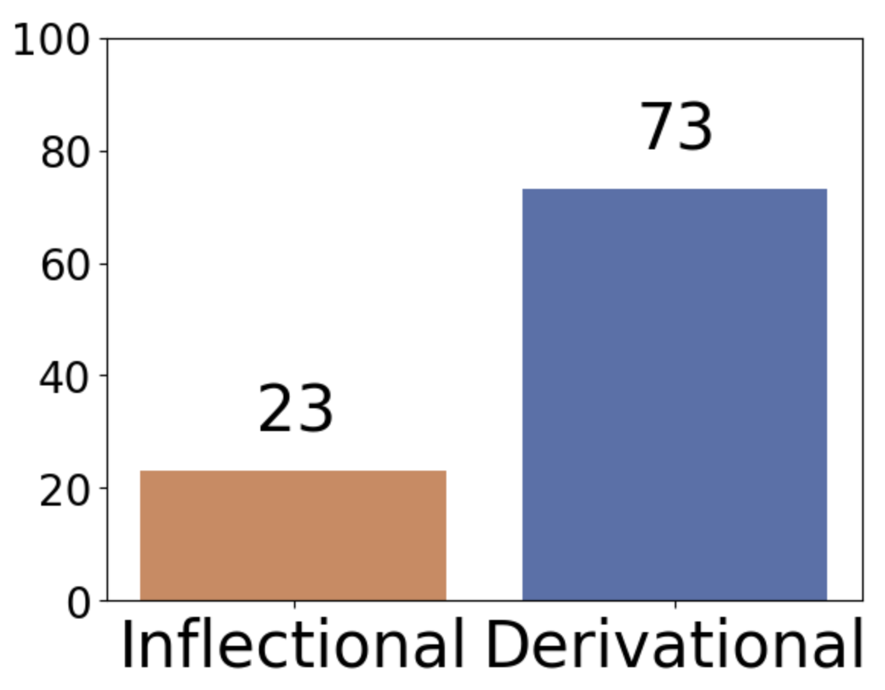
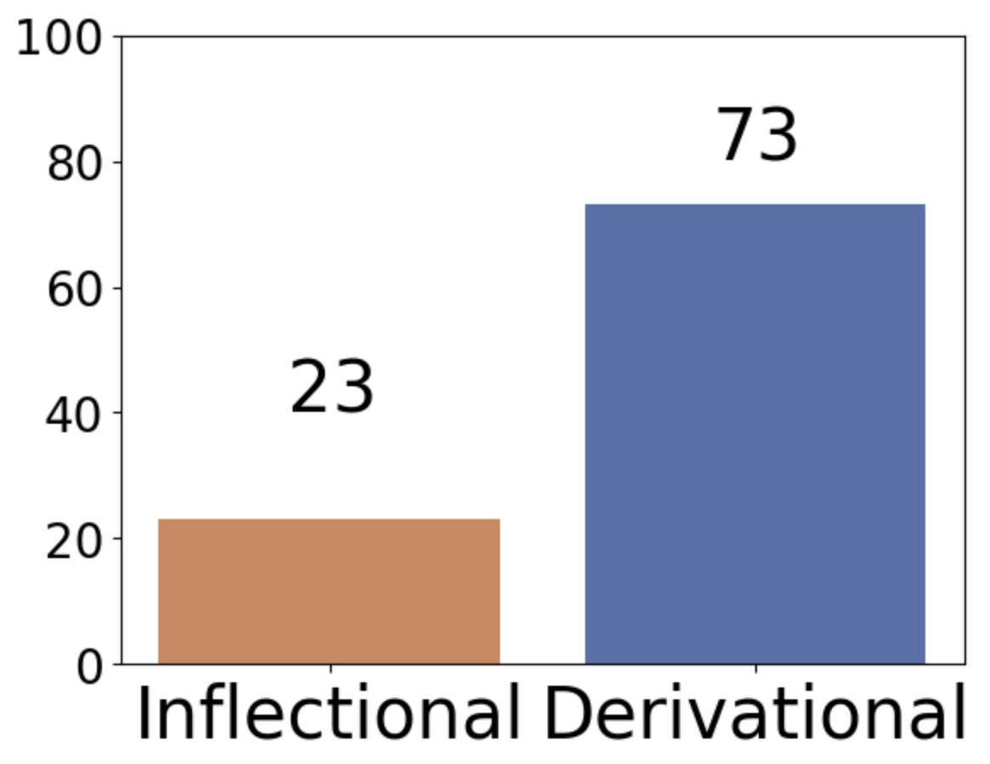
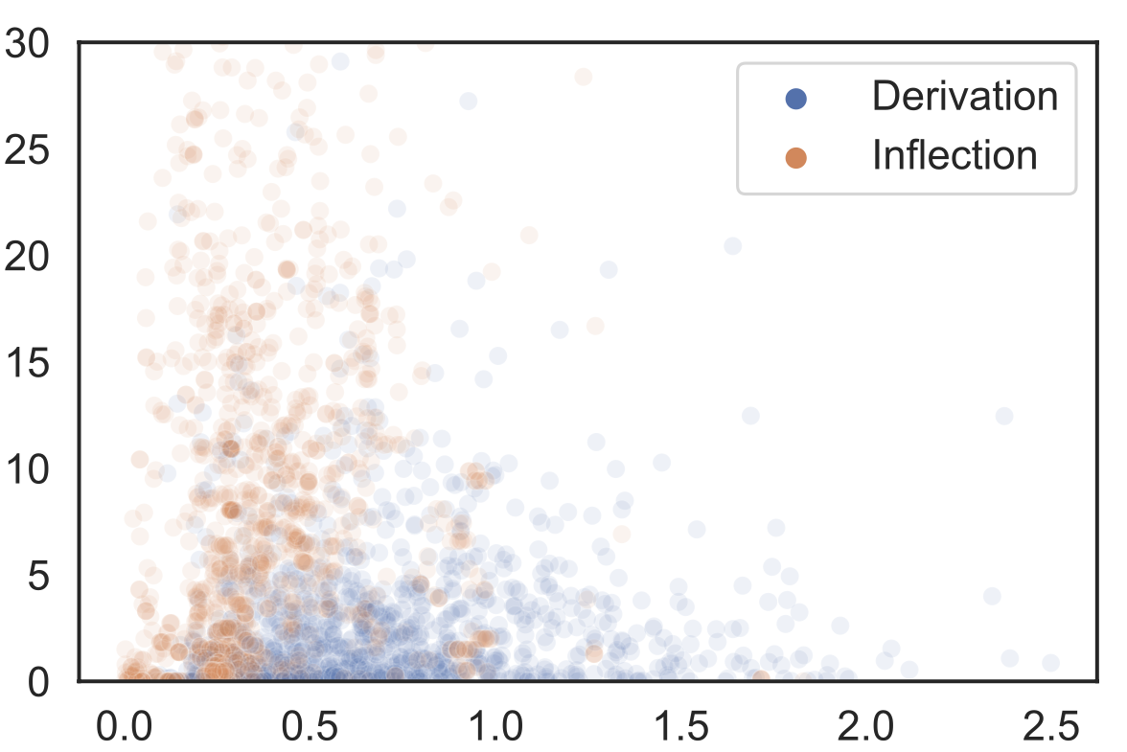
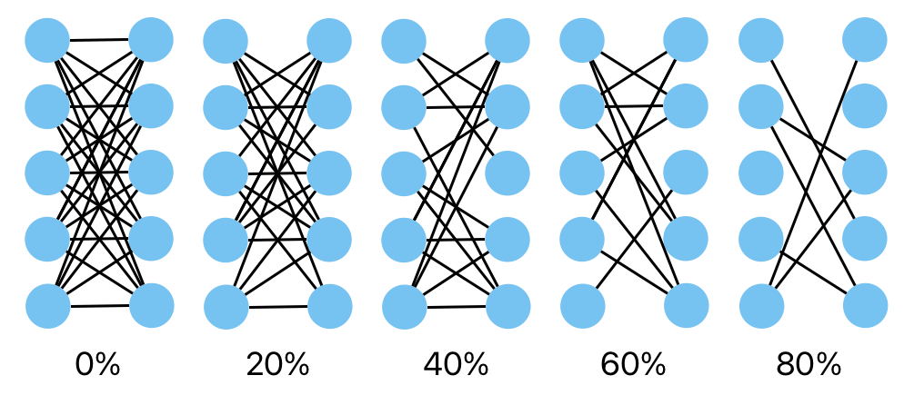
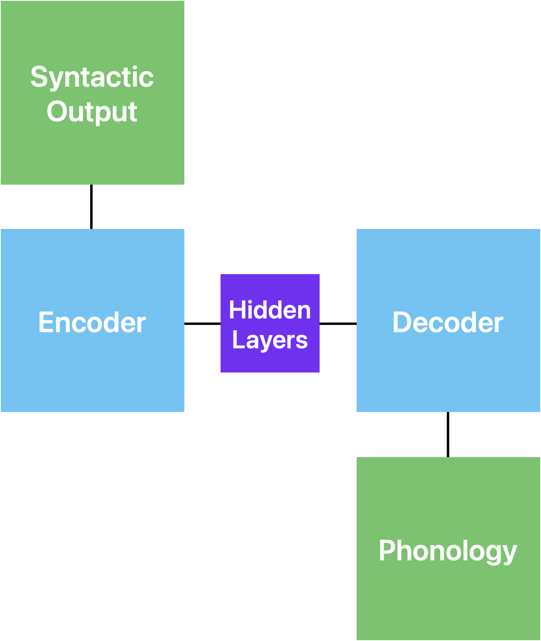


Modeling the inflectional/derivational dissociation in agrammatic aphasia with a RNN
Simon Chervenak^{1,2}, Alex Krauska², Naomi H. Feldman^{2,3}
¹ University of Maryland, Department of Computer Science; ² University of Maryland, Department of Linguistics; ³ University of Maryland, UMIACS
Two Categories of Morphology
Inflectional Derivational
Meaning Preserved Meaning Changed
The Inflectional Deficiency
People with aphasia regularly make more errors while producing inflectional morphemes [1].
This has been observed cross-linguistically in cases of agrammatic aphasia [4, 5].
Modern syntax
One process to give phonological form to an abstract syntactic object [3].
"walked" | walked
"chairs" | chairs
"painter" | painter
"redo" | redo
Motivation: Dichotomy vs Continuum
A cross-language study showed that these categories may be overlapping [6].
Production Accuracy
Can lesioning a model with a single component explain the dissociation in the data of people with aphasia?
Lesioning
To model agrammatic aphasia, we randomly set some proportion of the model’s weights to 0.
Δ Form
Large lesions visible in the left hemisphere.
Traditional Explanation
Miceli & Caramazza theorized two components that each controlled one type of morphology. F.S. would have a problem with one of these components.
Δ Meaning
The Encoder-Decoder
The data: Italian phonology data from PhonItalia [4], morpheme data from spaCy and nltk
The model: Encoder-Decoder architecture, originally designed for translation [5]
The training: Use perplexity sampling to focus on least-confident inputs
The testing: Lesion the model at 5%
increments, test on a subset of the training verbs
Future Work
We will lesion the model and calculate the accuracy levels for inflectional and derivational morphemes based on a test set.
If lesioning the single-route model can replicate the clinical data, we argue that there is no neural distinction between these classes of morphemes.
Code used:
References: [1] Miceli, G., & Caramazza, A. (1988). Dissociation of Inflectional and Derivational Morphology. Brain and Language, 35, 24–65.

Slide 2
