Slide 1

Exploratory Data Analysis
Cab Investment firm
<Sep 06> Inna Soltsman-Groysman

Slide 2
Agenda
Executive Summary
Problem Statement
Approach
EDA

Slide 3
Executive Summary
XYZ is a private firm in US.
Due to remarkable growth in the Cab Industry in last few years (2016-2018) and multiple key players in the market, it is planning for an investment in Cab industry and as per their Go-to-Market(G2M) strategy they want to understand the market before taking final decision.

Slide 4
Problem Statement
help the company identify the right company of cabs to make their investment

Slide 5
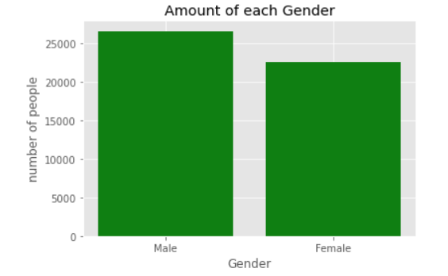
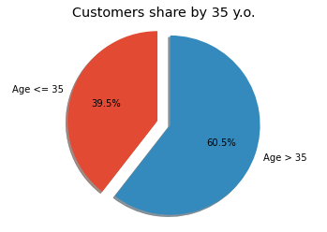
EDA Visualization
About the customer

Slide 6
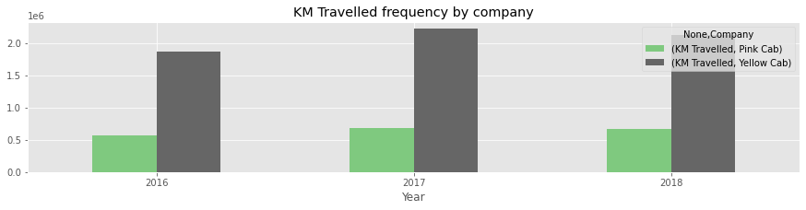
EDA for Company
We can see the amount of KM Travelled with the Yellow Cab company is higher than the Pink Cab

Slide 7
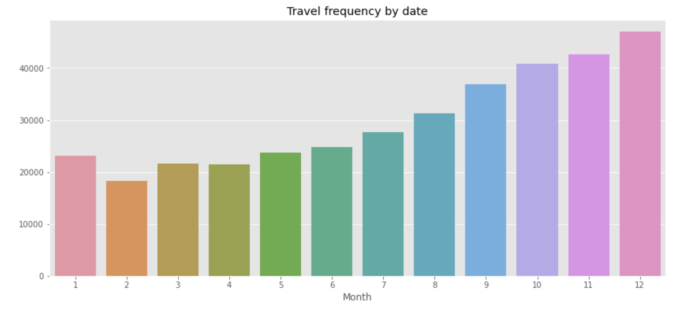
EDA for Company
Most of the rides were in the end of the year.
The amount in December is twice higher than in February.

Slide 8
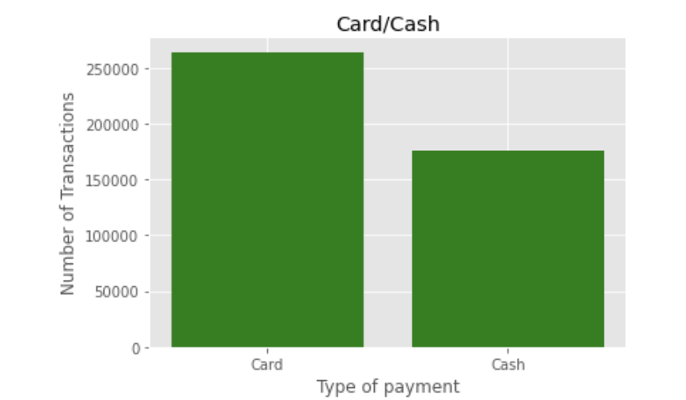
EDA for Company
Most of the rides were paid by Card

Slide 9
Thank You

