Slide 1
EFFICIENT VARIANTS OF THE ICP ALGORITHM
Szymon Rusinkiewicz
Marc Levoy

Slide 2
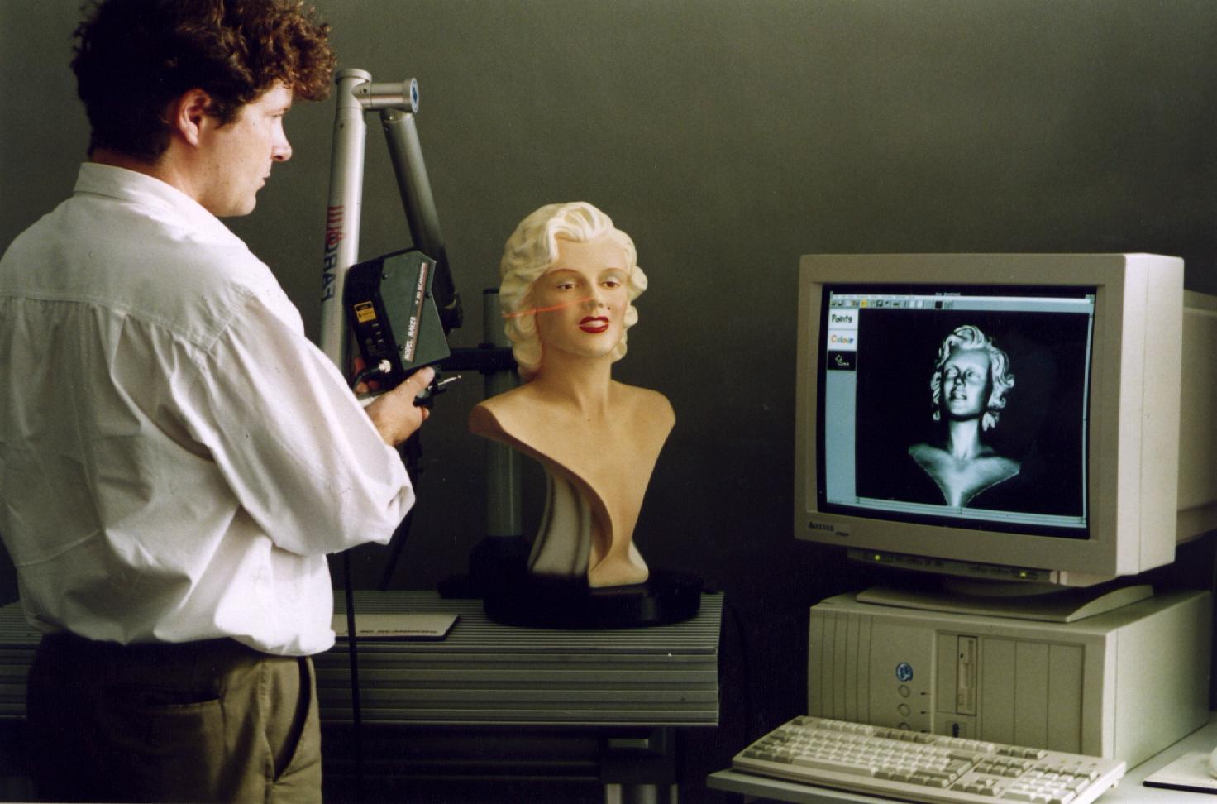
Introduction
Problem of aligning 3D models, based on geometry or color of meshes
ICP is the chief algorithm used
Used to register output of 3D scanners
[1]

Slide 3
ICP
Starting point: Two meshes and an initial guess for a relative rigid-body transform
Iteratively refines the transform
Generates pairs of corresponding points on the mesh
Minimizes an error metric
Repeats

Slide 4
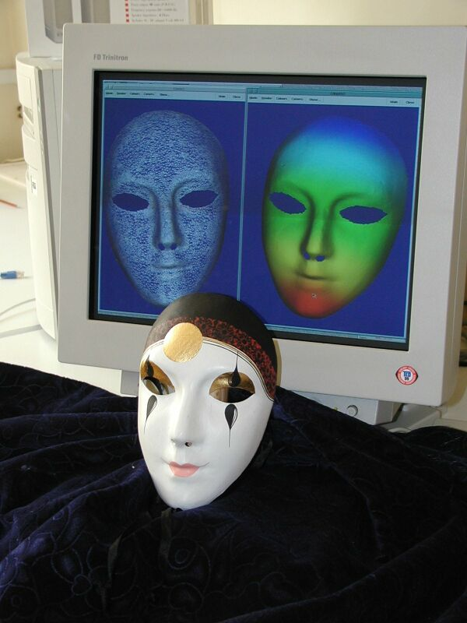
Initial alignment
Tracking scanner position…
Indexing surface features…
Spin image signatures…
Exhaustive search…
User Input……
[2]

Slide 5
Constraints
Assume a rough initial alignment is available
Focus only on a single of meshes
Global registration problem not addressed

Slide 6
Stages of the ICP
Selection of the set of points
Matching the points to the samples
Weighting corresponding pairs
Rejecting pairs to eliminate outliers
Assigning an error metric
Minimizing the error metric

Slide 7
Focus
Speed
Accuracy
Performance in tough scenes
Introducing test scenes
Discuss combinations
Normal-space directed sampling
Convergence performance
Optimal combination

Slide 8
Comparison Methodology
Baseline Algorithm: [Pulli 99]
Random sampling on both meshes
Matching to a point where the
normal is < 45 degrees from the source
Uniform weighting
Rejection of edge vertices pairs
Point-to-plane error metric
“Select-match-minimize” iteration

Slide 9
Assumptions
2000 source points and100,000 samples
Simple perspective range images
Surface normal is based on the four nearest neighbors
Only geometry (color, intensity excluded)

Slide 10
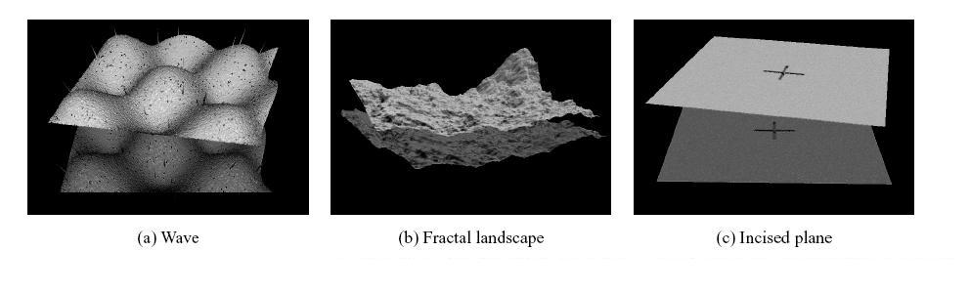
Test Scenes
a) Wave Scene
Fractal Landscape
Incised Plane

Slide 11

Sample scanning application
Representative of different kinds of surfaces
Low frequency
All frequency
High Frequency
Shamelessly stolen from [3]

Slide 12
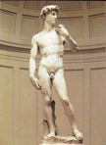


Smooth statues
Unfinished statues
Fragments
More shameless lifts from [3]

Slide 13
Comparison Stages
Selection of the set of points
Matching the points to the samples
Weighting corresponding pairs
Rejecting pairs to eliminate outliers
Assigning an error metric
Minimizing the error metric

Slide 14
Selection of point pairs
Use all available points
Uniform sub-sampling
Random sampling
Pick points with high intensity gradient
Pick from one or both meshes
Select points where the distribution of the normal between these points is as large as possible

Slide 15
Normal Sampling
Small features may play a critical role
Distribute the spread of the points across the position of the normals
Simple
Low-cost
Low robustness

Slide 16
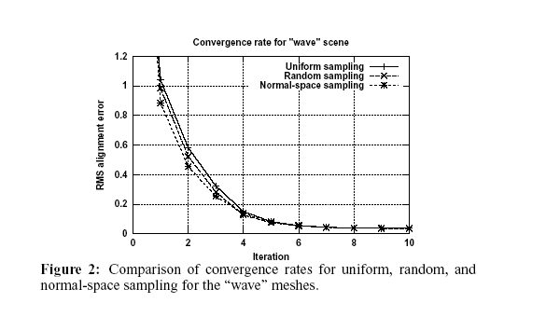
Comparison of performance
Uniform sub-sampling
Random sampling
normal-space sampling

Slide 17
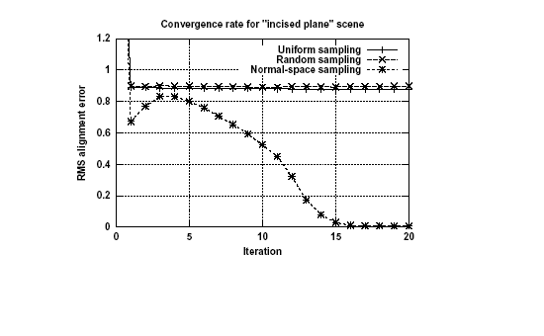
Comparison of performance
Incised Plane: Only the normal-space sampling converges

Slide 18
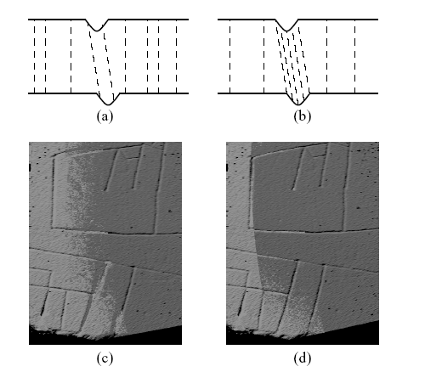
Why?
Samples outside the grooves: 1 translation, 2 rotations
Inside the grooves: 2 translations, 1 rotation
Fewer samples + noise + distortion
= bad results

Slide 19
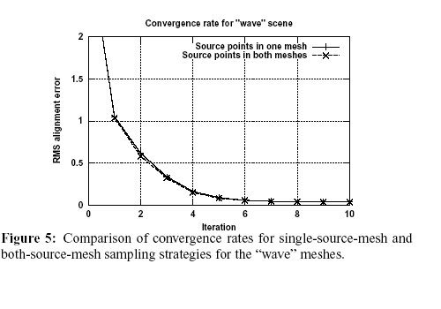
Sampling Direction
Points from one mesh vs. points from both meshes
Difference is minimal, as algorithm is symmetric

Slide 20
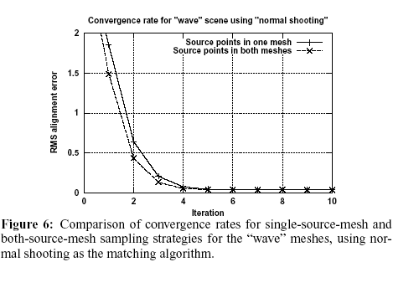
Sampling direction
Asymmetric algorithm
Two meshes is better
If overlap is small, two meshes is better

Slide 21
Comparison Stages
Selection of the set of points
Matching the points to the samples
Weighting corresponding pairs
Rejecting pairs to eliminate outliers
Assigning an error metric
Minimizing the error metric

Slide 22
Matching Points
Match a sample point with the closest in the other mesh
Normal shooting
Reverse calibration
Project source point onto destination mesh; search in destination range image
Match points compatible with source points

Slide 23
Variants compared
Closest point
Closest compatible point
Normal shooting
Normal shooting to a
compatible point
Projection
Projection followed by a search : uses steepest-descent neighbor-neighbor walk
k-d tree

Slide 24
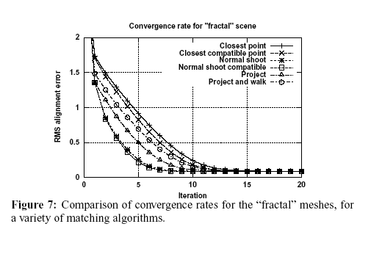
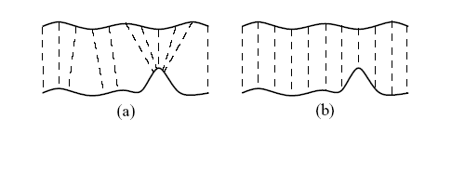
Fractal Scene
Best: normal shooting
Worst: closest-point

Slide 25
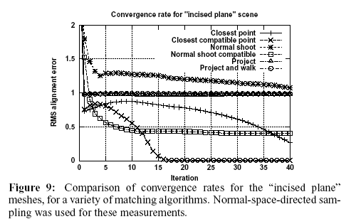
Incised Plane
Closest point converges: most robust

Slide 26
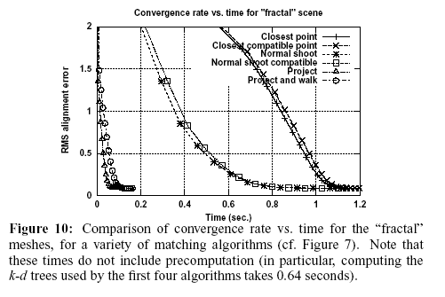
Error
Error as a function of running time
Applications that need quick running of the ICP should choose algorithms with the fastest performance
Best: Projection algorithm

Slide 27
Comparison Stages
Selection of the set of points
Matching the points to the samples
Weighting corresponding pairs
Rejecting pairs to eliminate outliers
Assigning an error metric
Minimizing the error metric

Slide 28
Algorithms
Constant weight
Lower weights for points with higher point-point distances
Weight = 1 – [Dist(p₁, p₂)/Dist _{max}]
Weight based on normal compatibility
Weight = n₁* n₂
Weight based on the effect of noise on uncertainty

Slide 29
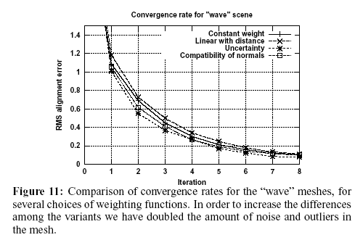
Wave Scene

Slide 30
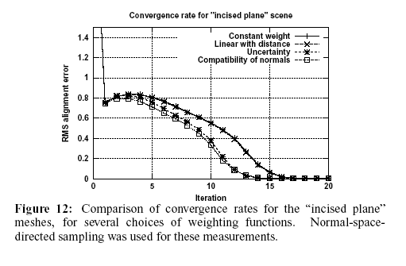
Incised Plane

Slide 31
Comparison Stages
Selection of the set of points
Matching the points to the samples
Weighting corresponding pairs
Rejecting pairs to eliminate outliers
Assigning an error metric
Minimizing the error metric

Slide 32
Rejecting Pairs
Pairs of points more than a given distance apart
Worst n% pairs, based on a metric (n=10)
Pairs whose point-point distance is > multiple m of the standard deviation of distances (m = 2.5)

Slide 33
Rejecting Pairs
Pairs that are not consistent with neighboring pairs
Two pairs are inconsistent iff
| Dist(p₁,p₂) – Dist(q₁,q₂) |
Threshold:
0.1 * max(Dist(p₁,p₂) – Dist(q₁,q₂) )
Pairs containing points on mesh boundaries

Slide 34
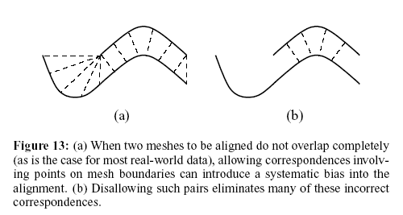
Points on mesh boundaries
Incomplete overlap:
Low cost
Fewer disadvantages

Slide 35
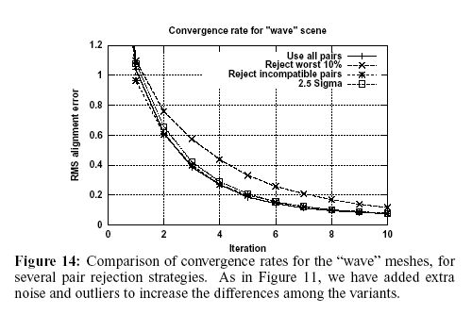
Rejection on the wave scene
Rejection of outliers does not help with initial convergence
Does not improve convergence speed

Slide 36
Comparison Stages
Selection of the set of points
Matching the points to the samples
Weighting corresponding pairs
Rejecting pairs to eliminate outliers
Assigning an error metric
Minimizing the error metric

Slide 37
Error metrics
Sum of squared distances between corresponding points
1) SVD
2) Quaternions
3) Orthonormal Matrices
4) Dual Quaternions

Slide 38
Error metrics
Point-to-point metric, taking into account distance and color difference
Point-to-plane method
The least-squares equations can be solved either by using a non-linear method or by linearizing the problem

Slide 39
Search for the alignment
Generate a set of points
Find a new transformation that minimizes the error metric
Combine with extrapolation
Iterative minimization, with perturbations initially, then selecting the best result
Use random subsets of points, select the optimal using a robust metric
Use simulated annealing and perform a stochastic search for the best transform

Slide 40
Extrapolation algorithm
Besl and McKay’s algorithm
For a downward parabola, the largest x-intercept is used
The extrapolation is multiplied by a dampening factor
Increases stability
Reduces overshoot

Slide 41
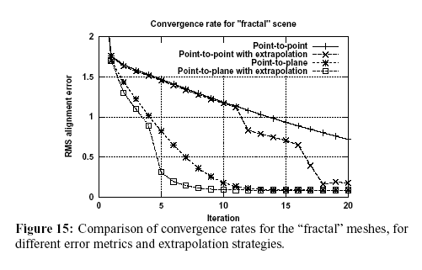
Fractal Scene
Best: Point-to-plane error metric

Slide 42
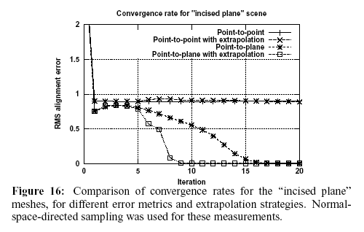
Incised Plane
Point-to-point cannot reach the right solution

Slide 43
High-Speed Variants
Applications of ICP in real time:
1) Involving a user in a scanning process for alignment
“Next-best-view” problem
“Given a set of range images, to determine the position/orientation of the range scanner to scan all visible surfaces of an unknown scene” [4]
2) Model-based tracking of a rigid object

Slide 44
Optimal Algorithm
Projection-based algorithm to generate point correspondences
Point-to-plane error metric
“Select-match-minimize” ICP iteration
Random sampling
Constant weighting
Distance threshold for pair rejection
No extrapolation of transforms (Overshoot)

Slide 45
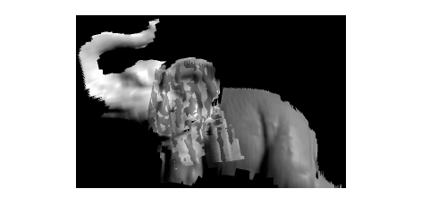
Optimal Implementation
Former implementation using point-to-point metric
Point-to-plane is much faster

Slide 46
Conclusion
Compared ICP variants
Introduced a new sampling method
Optimized ICP algorithm

Slide 47
Future Work
Focus on stability and robustness
Effects of noise and distortion
Algorithms that switch between variants would increase robustness

Slide 48
References
[1]
http://foto.hut.fi/opetus/ 260/luennot/9/9.html
[2] http://www.sztaki.hu/news/2001_07/maszk_allthree.jpg
[3]
http://graphics.stanford.edu/projects/mich/
[4] http://www.cs.unc.edu/~sud/courses/comp258/final_pres.ppt#257,2,Problem Statement

Slide 49


