Slide 1

Dynamic fusion
Internship Week 1
Environment settings

Slide 2
Last meeting
Nguyen’s final meeting:
  DepthMap conversion, segmentation, tsdf, volumetric integration
  Tracking origin’s?
  Matlab
Plan for Inoe :
  Environment settings (python, github)
  Get data’s from Nguyen
  Catch up what Nguyens has done

Slide 3
Progress
Papers, data and some code from Nguyens
Python:
  Anaconda + spyder
  Fundamentals of coding
  Need to learn more about OOP with python
Github

Slide 4
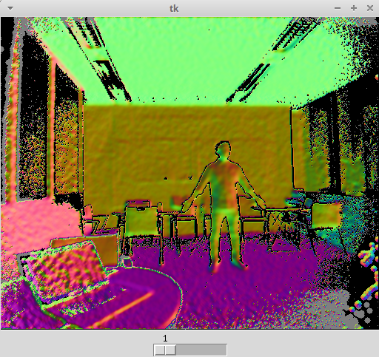
Progress
Python: numpy use of array and matrix
Optimize :
  Vmap : 2s to 3 ms
  Nmap : 40s to 250 ms
  Draw : 3s to 100 ms

Slide 5
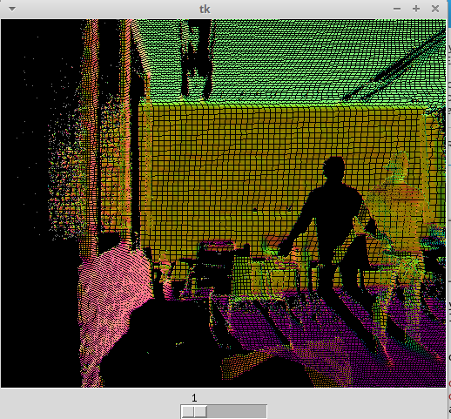
Progress
Python: numpy use of array and matrix
Optimize :
  Vmap : 2s to 3 ms
  Nmap : 40s to 250 ms
  Draw : 3s to 100 ms

Slide 6
Action plan
Tracking :
  Theory
  Coding
Volumetric representation (TSDF) :
  Theory

Slide 7
Q&A
Di(u) => global bilateral filter. How to choose sigma space and sigma color? Value in uint16 but convert in uint8
Border effects of Vmap and Nmap ?

