Slide 1

Dynamic fusion
Internship Week 10
Fusion : Marching cubes
27 April 2017

Slide 2
Last meeting
Previously
  Bounding Boxes done
  OpenCL installed
  Fusion :
    marching cube wrong input
    residuals
Plan for the week:
  Marching Cubes
  Generate depth image from marching Cubes

Slide 3
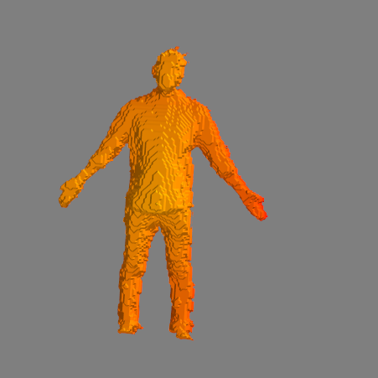
Progress
Marching Cubes
  Using lib skimage,
  measure
  => no save
  but can use outputs
  TSDF ?

Slide 4
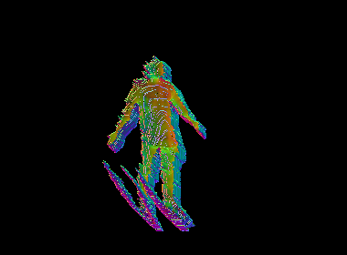
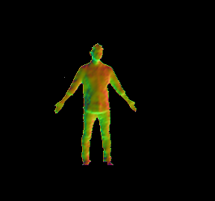
Results
Generating depth image from Marching Cubes
Using draw_optimize :
Recompute depth image,
Vertexes, normals
Using vertexes and normals from the output of marching cubes

Slide 5
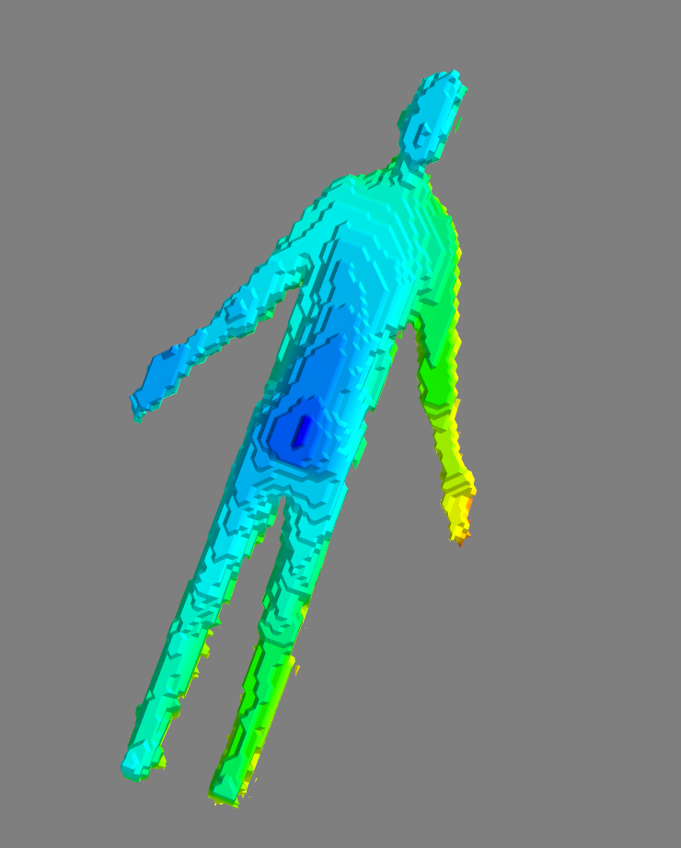
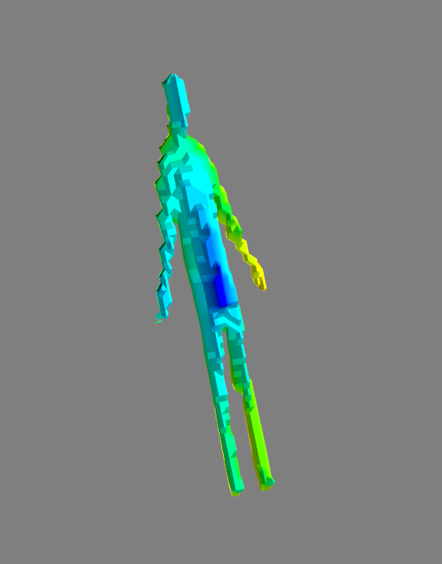
Result
Non segmented Fusion
  Disappearing
Adding test in TSDF
Comparing normals :
  Points are corresponding only if points going outside the depthmap frame are considered
Fusion for 1 image
Fusing 10 images

Slide 6
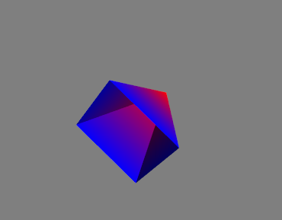
Result
TSDF for segmented part
  Wrong TSDF values (e.g: 0.13 → 2) => cannon choose 0.0 as iso-surfaces
Result for an iso-surface at 0.2

Slide 7
Action plan
Recreate depth map properly
Global Fusion
Segmented Fusion (Kinect or Dynamic)

Slide 8
Q&A
Depth image and dynamic Fusion

