Slide 1

Dynamic fusion
Internship Week 4-5
Kinect Fusion and Segmentation
24 March 2017

Slide 2
Last meeting
Previously
  Segmentation code translated but still partly from Nguyen’s data.
  Tracking
  Kinect Fusion explanation
Plan for the week:
  Finish polygon optimize method
  Presentation of Kinect Fusion
  Segmentation from Kinect device data.
  (Bounding boxes, coordinates changes for each segmented part of the body)

Slide 3
Kinect Fusion
Pipeline
  Drift-free sensor tracking
    Tracking : estimating the pose of the sensor (assuming perfect scene)
    Mapping : improving and expanding map using a global optimisation
  Dense tracking and mapping:
    Point-plane metric for convergence improvement
    Projective data association
  Dense scene representations
    TSDF : negative, zero crossing = surface, positive
    Used of reconstructed surface to sensor pose estimation
    Rendering :
      Marching cube algo + rastering rendering pipeline
      Raycasting
  Dense SLAM (simultaneous localization and mapping)
    With GPU, accumulated global reconstruction (erase ambiguities due to ICP)

Slide 4
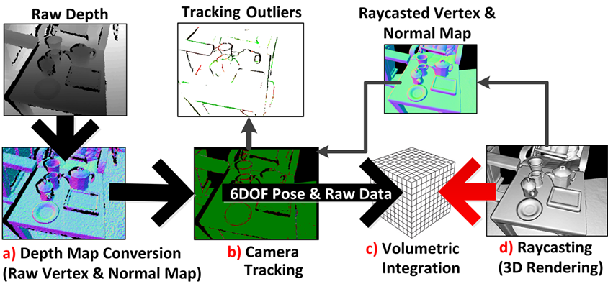
Kinect Fusion

Slide 5
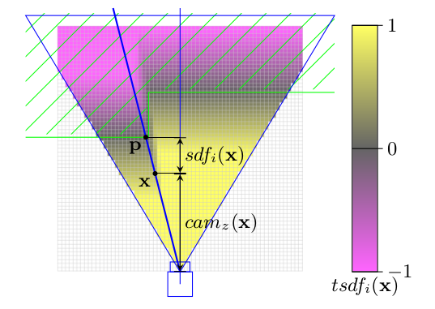
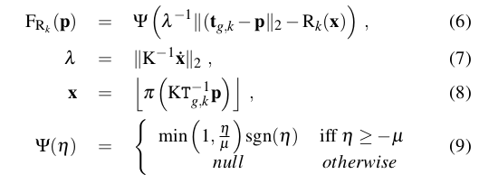
Kinect Fusion
TSDF Equations

Slide 6
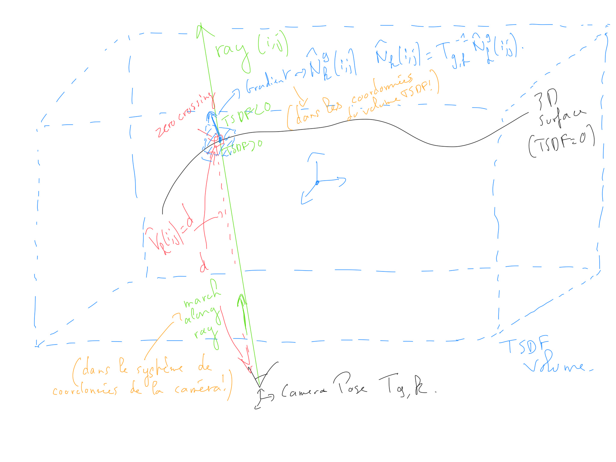
Kinect Fusion
Raycasting the TSDF

Slide 7
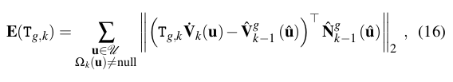
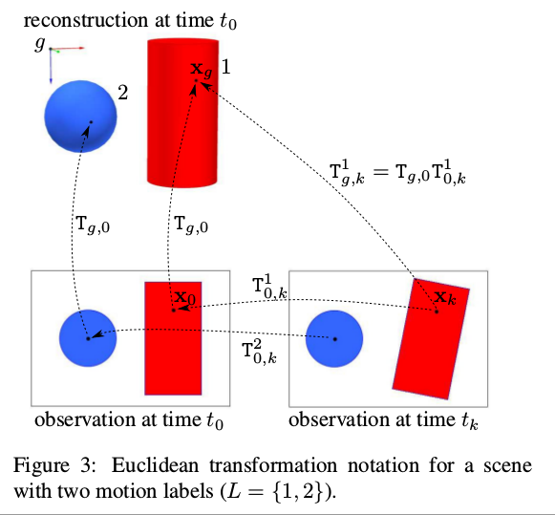

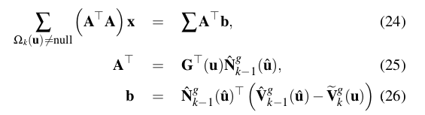
Kinect Fusion
Tracking

Slide 8
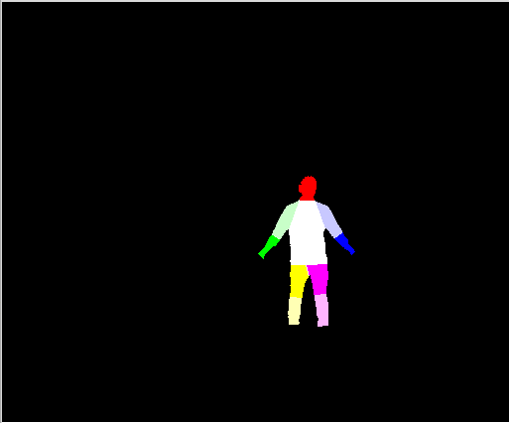
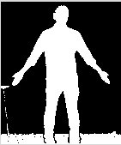
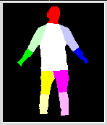
Progress
Image segmentation from data given by Kinect device but hard-coded values necessary for threshold => cropped image (bounding boxes)
Cropped and then Thresholded image
Segmentation through cropped image
Segmentation done starting with kinect data device

Slide 9
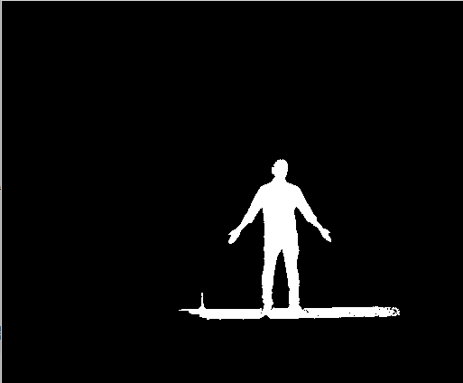
Progress
Cannot get the same data as Nguyen but segmentation possible

Slide 10
Action plan
Bounding Boxes + coordinates changes
Optimize TSDF
Understand Dynamic Fusion

Slide 11
Q&A
4DFusion : http://tinyurl.com/n8cmb9q
Deadlines?

Slide 12
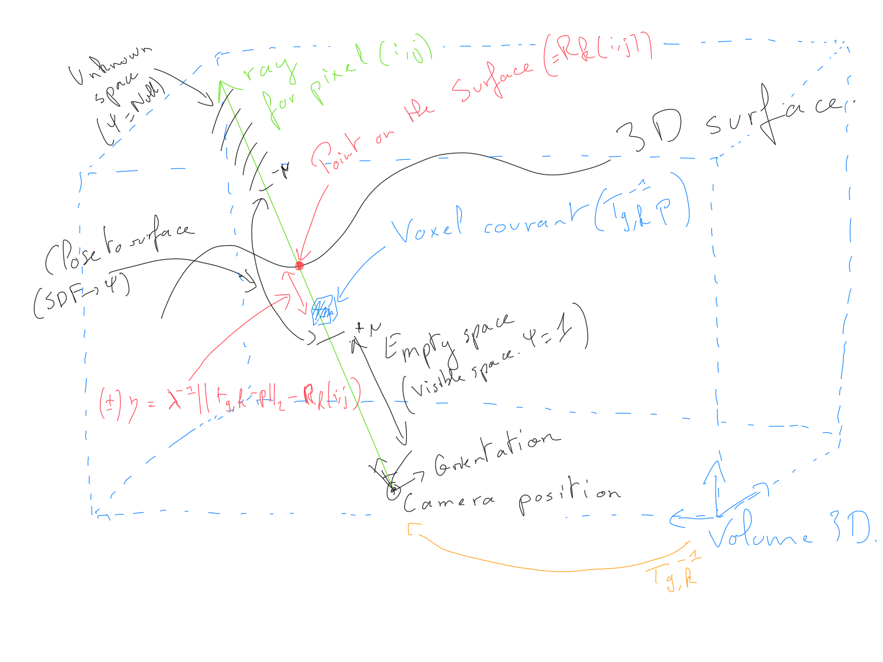
Kinect Fusion
TSDF
TSDF

Slide 13
