Slide 1

Dynamic fusion
Internship Week 6
Bounding Boxes and Segmentation
31 March 2017

Slide 2
Last meeting
Previously
  Presentation of Kinect Fusion.
  Segmentation data from kinect
  Cropped
Plan for the week:
  Presentation 1 part of Dynamic Fusion
  Bounding Boxes (output = Transform and size)
  Segmentation of hand and feet
  Optimize ray tracing

Slide 3
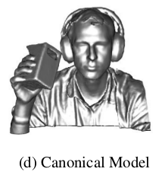
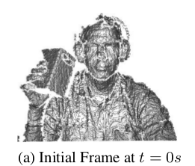
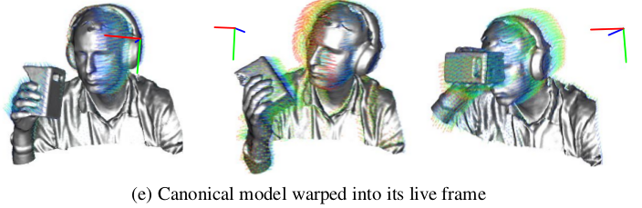
Dynamic Fusion
From rigid body to motion
Kinect Fusion
Dynamic Fusion

Slide 4
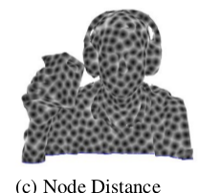



Dynamic Fusion
Motion Field
  Node structure
  Sparse transformation
  Interpolation
  Update position and normal
  Global transform

Slide 5

Dynamic Fusion
Surface : update canonical model (TSDF)
  Step1 : projection xc fixed to live
  Step2 : projection live to depth
  Step3 : compare values of voxels and surface.
  Step4 : TSDF Fusion with greater incertitude.
  Fusion : instead of taking all nodes as weight, just take the k-nearest node.

Slide 6
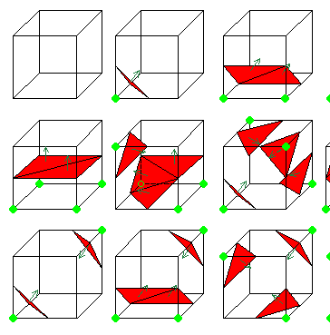
Dynamic Fusion
Estimation of new motion field state
  Mesh creation from TSDF
  Projection in live frame
  estimation of canonical
  Project new frame to canonical
  Point-plane:minimize the distance
  of each estimated point to the tangent plan of the corresponding point in the new canonical frame.

Slide 7
Dynamic Fusion
In Kinect Fusion, we have seen how the make a 3D rendering from the data obtain by the Kinect Sensor. In this case, the kinect sensor can move but if an object in the scene moves, the rendering is full of errors. With Dynamic Fusion, we want to go one step further, namely be able to rendering moving object in scene while the Kinect sensor moves too. To achieve this result, an additional space is created.

Slide 8
Dynamic Fusion
Idea : Rigid canonical frame reconstruction (kinect fusion) for denoising. Then with the inverse map the information of the line of sight is clearly revealed => location in live frame easy to compute

Slide 9
Dynamic Fusion
Key contributions:
Inverse map + line of sight (new method)
Volumetric wrap efficiency (fast computing)

Slide 10
Dynamic Fusion
Explain canonical frame and Wrap field
  Canonical frame : 3D reconstruction of Kinect Fusion
  Wrap function : function that wrap the live frame into canonical frame
  Wrap-field : field of representation of the scene in which there are deformations. Define by n nodes. Each nodes have a position in the canonical frame and its transformation in the live frame.

Slide 11
Dynamic Fusion
DQB: Sparse transfo + interpolation
  Efffient computation
  High quality interpolation done with k-nearest node
  Weighted average

Slide 12
Dynamic Fusion
SE3(.) : transform DQB into matrix transfo
Definition of a wrap field with n node to pass from one type of frame to another

Slide 13
Dynamic Fusion
Reconstruction the canonical frame S
Update with TSDF:
  Rather than TSDF in live frame => in depth map (transfo plus project°)
  Vertex in Live frame to canonical frame to depth frame

Slide 14
Dynamic Fusion
New Warp-Field = estimation update
Data term :Dense ICP
  Surface prediction with marching cube
Reg term penalise non-smooth and ensures rigid deformation

Slide 15
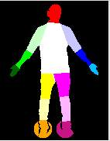
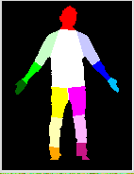
Progress
  Segmentation of hand and feet
Floor
No floor
Depending on the image there will be the floor. Idea uses the RGB images from the Kinect to get contours (with Canny or Deriche filter). Need to get new data with RGB image.

Slide 16
Progress
Coordinates change has been coded but need some corrections
Bounding boxes : try to install OBB_Maya or trimesh Librairy
Optimize raycasting done by Diego but cannot run it since I do not have opencl yet.

Slide 17
Action plan
Bounding Boxes
Coordinates changes
Presentation : Last part of dynamic Fusion

Slide 18
Q&A
Frame 40 wrong skeleton due to Kinect
Frame 30 hard time thresholding
“This TSDF technique greatly simplifies the non rigid reconstruction process over methods where all frames are explicitly warped into a canonical frame.”?
Regularisation : do I need to understand Tukey and Huber?
Rastering rendering pipeline?

