Slide 1

Dynamic fusion
Internship Week 7
Bounding Boxes 31 March 2017

Slide 2
Last meeting
Previously
  Presentation of 1st part dynamic fusion.
  Segmentation of hand and feet (think in time)
  No result for bounding boxes
Plan for the week:
  Bounding Boxes (output = Transform and size)
  Visualization
  Second presentation of dynamic fusion
  OpenCL

Slide 3
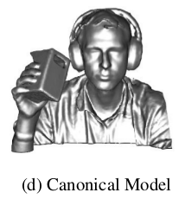
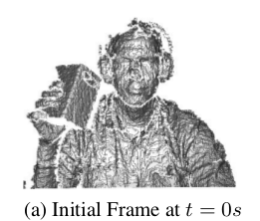
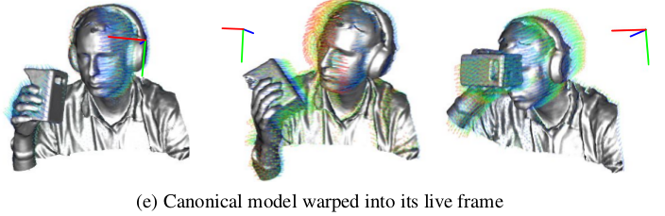
Dynamic Fusion
From rigid body to motion
Kinect Fusion
Dynamic Fusion

Slide 4
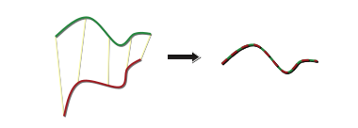
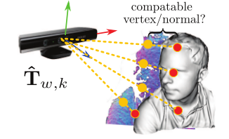
Dynamic Fusion
Estimating the surface
Find correspondence
=
Data association
Point to metric correspondence
=
Minimize point to plan distance

Slide 5

Dynamic Fusion
Regularization:
  Estimate whole space for new views
  Hierarchical Deformation Tree
    Smoothness
    Computational
Edge
Preserving discontinuity
Rigidity
L=0
1
2
3
L=1
1
2
3
L=1
1
2
3

Slide 6

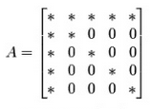
Dynamic Fusion
Optimization:
  Gauss-Newton approximation of Hessian
  Simplifications:
Reformulation
Arrow-head

Slide 7
Dynamic Fusion
Limitations:
  Opening topology
  Large inter-frame motion
  Highly dynamic scene
  Memory
  Growing warp field

Slide 8
Dynamic Fusion
Inserting new nodes:
  Ensure Deformation < emerging surface and soon to be observed space
  From estimated canonical space compare distance of transformation and distance between voxel center to the center of the node
  Lamda = enforce global deformation smoothness
  Epsilon : effective resolution of the motion field
  Update node info by computing the transfo with DQB

Slide 9
Dynamic Fusion
Updating the Regularisation Graph:
  Level 0 = Nwrap
  Level > 0 : consider a bit more nodes and then link each node of the former level to its k-nearest node in the current level

Slide 10
Dynamic Fusion
DQB: Sparse transfo + interpolation
  Efffient computation
  High quality interpolation done with k-nearest node
  Weighted average

Slide 11
Dynamic Fusion
SE3(.) : transform DQB into matrix transfo
Definition of a wrap field with n node to pass from one type of frame to another

Slide 12
Dynamic Fusion
Reconstruction the canonical frame S
Update with TSDF:
  Rather than TSDF in live frame => in depth map (transfo plus project°)
  Vertex in Live frame to canonical frame to depth frame

Slide 13
Dynamic Fusion
New Warp-Field = estimation update
Data term :Dense ICP
  Surface prediction with marching cube
Reg term penalise non-smooth and ensures rigid deformation

Slide 14
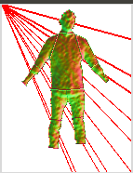
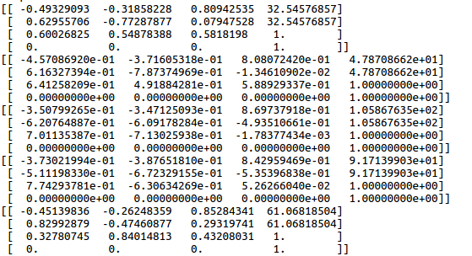
Progress
  Bounding Boxes
    Code done but still debbugging
No coordinates system in the visualization for now
Center computation on cropped image

Slide 15
Progress
OpenCL:
  My personal computer do not have GPU
  Licence for windows

Slide 16
Action plan
Finish Bounding Boxes
OpenCL, Windows
Start fusing data for segmented body

Slide 17
Q&A
Internship Oral
Windows : time
How can I change the image that is sensible to keyboard or mouse?

