Slide 1

Dynamic fusion
Internship Week 8
Bounding Boxes
13 April 2017

Slide 2
Last meeting
Previously
  No good results for Bounding Boxes
  Second presentation of dynamic fusion
  OpenCL => windows
Plan for the week:
  Bounding boxes : 1) center; 2) coordinates system vector; 3) oriented boxes
  Installation of windows for OpenCL

Slide 3
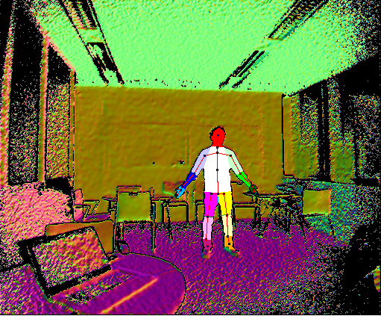
Progress
  Segmentation in the depth image
New draw skeleton

Slide 4
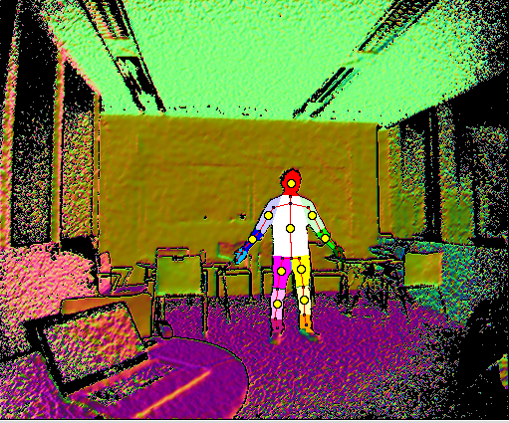

Progress
  Centers of Bounding Boxes
    Hands and feet have some separated pixels from the main part.
    Do not use draw to plot the point (center of mass of vertex).

Slide 5
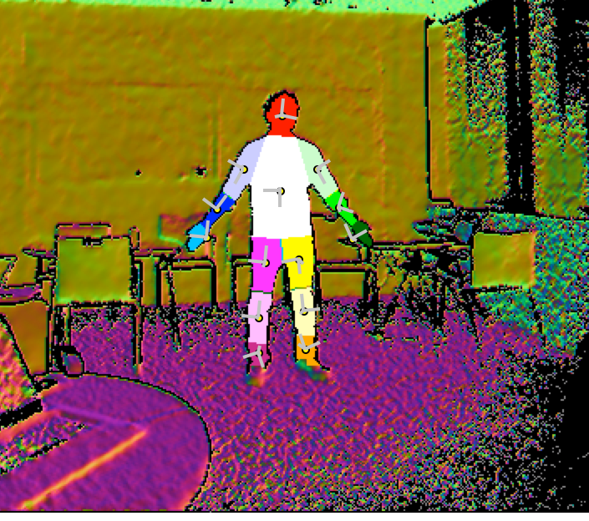
Progress
  Coordinates systems of Bounding Boxes

Slide 6
Progress
Windows
  Installed and segmentation code OK
  OpenCL not installed yet.

Slide 7
Action plan
OpenCL on Windows
Boxes
Start fusing data for segmented body

Slide 8
Q&A
Keep the visualization.
Sklearn : pca

