Slide 1

Dynamic fusion
Internship Week 9
Bounding Boxes & Fusion
21 April 2017

Slide 2
Last meeting
Previously
  Bounding Boxes :
    Center was median (!=not mean)
    Coordinates systems OK
  Windows installed but still missed OpenCL
Plan for the week:
  OpenCL on Windows
  Finish Bounding Boxes
  Start fusing data for segmented body

Slide 3
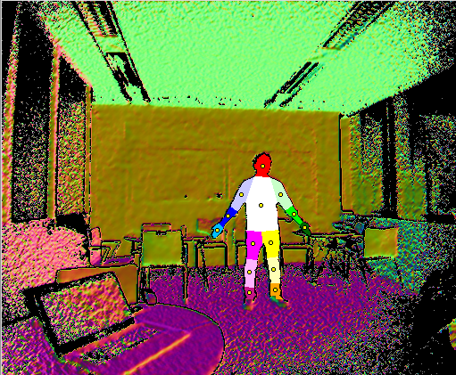
Progress
Bounding Boxes
Centers + labels corrected

Slide 4
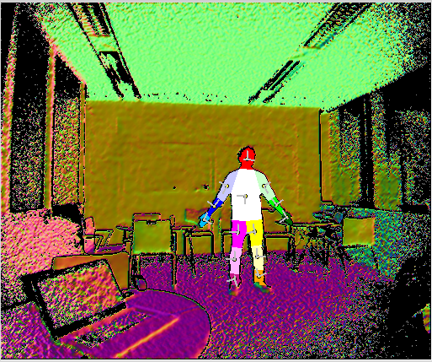

Progress
Bounding Boxes
Coordinates systems
Bounding Boxes

Slide 5
Progress
PyOpenCL Installed
Fused segmented body part
  Segmented TSDF
  Marching cubes
  Following two images (no global model)
  Pose estimation on whole body

Slide 6
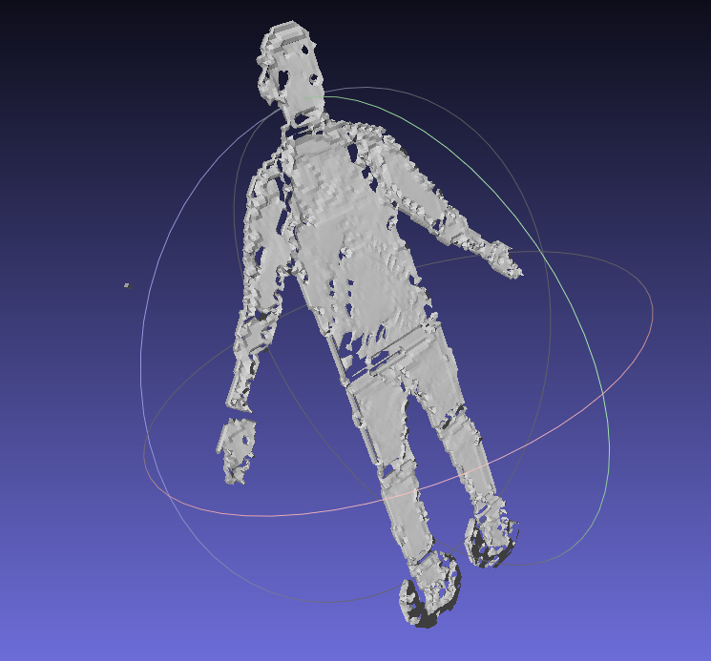
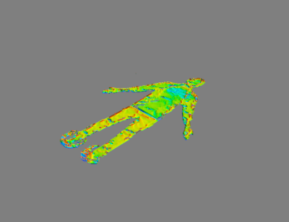
Progress
Marching cubes : 2 visualizations
MeshLab
Mayavi
Can select the iso-surface=> change visualization

Slide 7
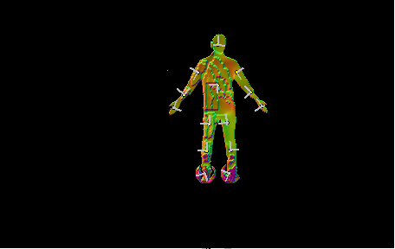
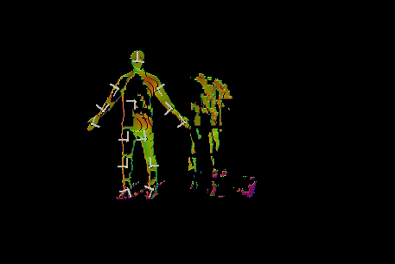
Progress
Fusion of two consecutive images
Complete reconstruction but not unified
Time processing : 30~40sec
Move with ‘d’

Slide 8
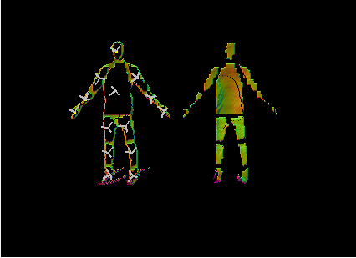

Progress
Fusion with global TSDF
Complete reconstruction but not unified
Time processing : 2min~2min30sec
Move with ‘d’

Slide 9
Action plan
Global fusing data for segmented body
  Debug rendering, fusion with model.
Get new data for dynamic fusion
  Install Kinect, Matlab
If necessary : do something for the feet

Slide 10
Q&A
Fusion for segmented part : only do the fusion(TSDF)?
Adapt segmentation for GPU?
In Global TSDF threshold weight value?
‘x’ moves the coordinates systems

