Slide 1
Building Effective Teams
‘Tobi Odunowo www.tobiodunowo.org

Slide 2
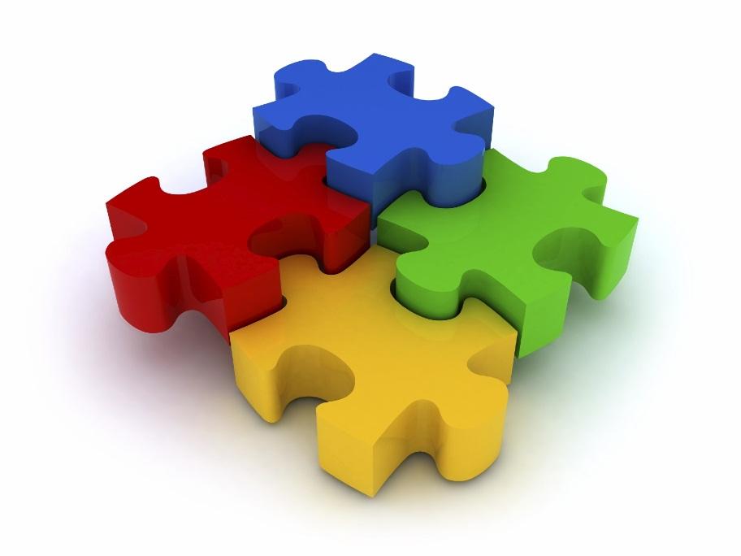
What is a Team?
‘a group in which the individuals
have a common aim and in which the
jobs and skills of each member fit in
with those of others.’
BERNARD BABINGTON SMITH, TRAINING IN SMALL GROUPS

Slide 3
Features of a Team
A team has a definable membership which is sometimes given a name.
The members consider themselves a group, they have a conscious identification with each other.
There is a shared sense of purpose within a team to achieve the common task.
The members rely on one another to be able to complete the common task.
The members communicate, influence and interact with one another in the process of working towards the common task.

Slide 4
Stages of Team Development
FORMING: The group asks ‘What is the task?’ There is considerable anxiety at this stage as the team works out what is expected of them.
STORMING: The group asks ‘Why are we being asked to do this?’ and ‘How are we going to do it?’ Conﬂict may arise over these questions and the leaders’ authority may be questioned as they try to regain control of the group.

Slide 5
Stages of Team Development
NORMING: The group begins to co-operate with the leader and with each other as they formulate their plans and communication develops. Mutual support comes into play as group cohesion grows.
PERFORMING: Work begins on the task and progress is made towards achieving the end result. The group structures itself to its best advantage in relation to the particular task.
DORMING: This is when the team structure becomes dominated by routine and systems, the group spirit becomes comfortable and activity declines. It may happen because the team is satisﬁed.

Slide 6
Team Building Exercises
Red and Blues Exercise

