Slide 1
ORGANIZATIONAL VALUES -A Brief Exploration-
‘ Tobi Odunowo

Slide 2
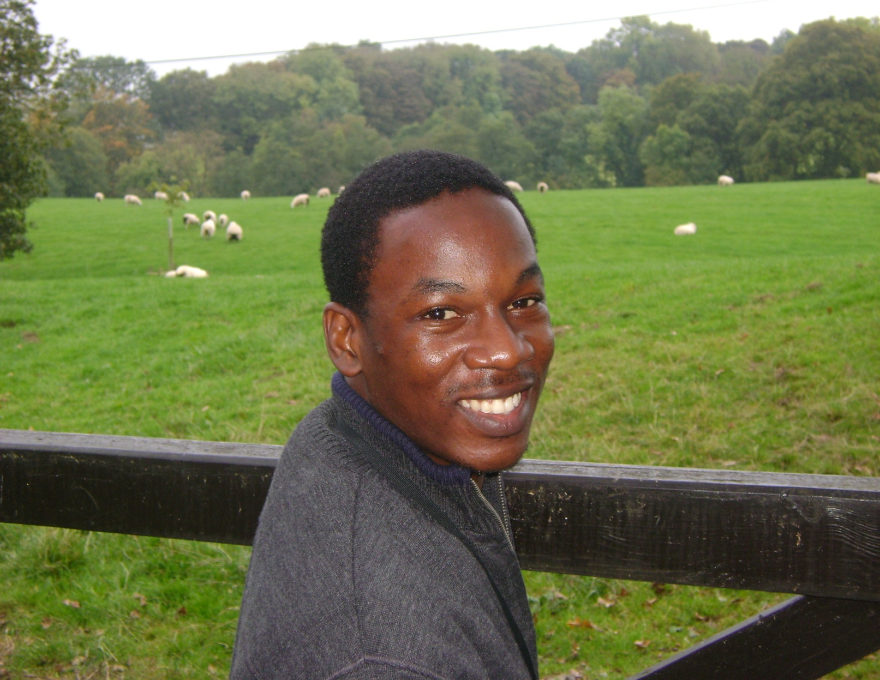






‘Tobi Odunowo B. Agric (2002), MA Management Learning & Leadership (2011)
9+ years experience in Organization and People Development
Work experience spans 3 countries – Nigeria, Ghana, India
Visited or lived in about 19 countries in Africa, Asia and Europe

Slide 3
Balanced Organization- 5 Basic Elements
Culture
(Earth)
Shared Values; Team Culture; Growth Attitude
Leadership
(Fire)
Inspiring Vision; Energized Leaders; Clear Communication
Employees
(Metal)
Strategically Aligned; Empowered; Innovative
Capabilities
(Wood)
Creativity; Leveraged Diversity; Leadership Development
Performance
(Water)
Motivation, Coaching, Measurement

Slide 4
Defining “Shared Values”
Shared values are what “engender” trust and link an organization together.
Shared values are also the identity by which an organization is known throughout its business areas.
These values are stated as both corporate objectives and individual values.

Slide 5
Exploring “Individual Values”
Exploring Life Realities.
The very familiar you and him/you and her story of love
FOUR CORNERS GAME…
Exploring life realities through a simulation

Slide 6
Defining “Organizational Values”
Beliefs and ideas about what kinds of goals members of an organization should pursue and ideas about the appropriate kinds or standards of behavior organizational members should use to achieve these goals
Organizational values define the acceptable standards which govern the behaviour of individuals within the organization. Without such values, individuals will pursue behaviours that are in line with their own individual value systems, which may lead to behaviours that the organization doesn't wish to encourage

Slide 7

Organizational Values= Shared Individual Values?
I am different and so we all must be different!

Slide 8
Establishing Shared Values- Some 6 Steps
Engage members in creating a list of shared values that define what your organisation stands for
Define and reinforce the mission of your organization through available formal documentations
Organise training programmes that emphasize organisational values
Socialise with other members and stakeholders
Document organisations histories/success stories that dramatise guiding values and organise "storytelling events“
Work out unique, shared corporate language that reflects values

Slide 9
