Slide 1
Image Steganographer
Secretly hiding encrypted text inside an image using cryptography and digital image steganography

Slide 2

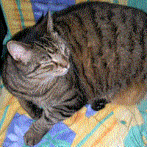
Steganography
Steganography is the practice of concealing a file, message, image, or video within another file, message, image, or video.
Hiding information by increasing dimensionality or altering some part of the data
R (10001101)
G (01010010)
B (01101001)
A (11111111)
R complete value: 137
R last 3 bit value: 5
Actual image
Hidden Image

Slide 3
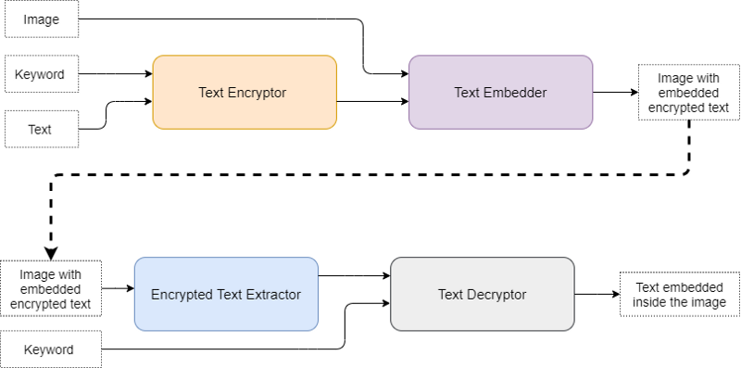
How image steganogapher works?

Slide 4
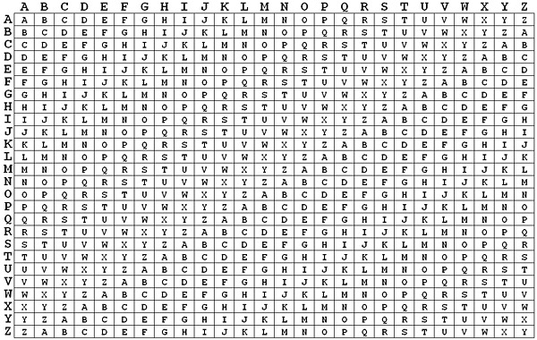
Encryption: Vigenere’s Cipher
T | H | I | S |  | I | S |  | C | O | O | L
A | P | P | L |  | E | A |  | P | P | L | E
T | W | Y | D |  | M | S |  | R | D | Z | P

Slide 5
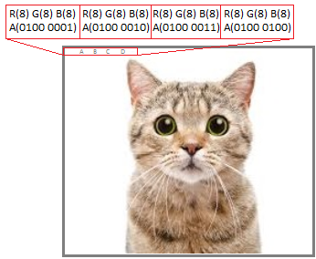
Embedding text inside image
Modify the alpha channel

Slide 6
Pros
Nobody will know that a text is hidden inside in the image
Requires users to enter a keyword, thus locking the text from unauthorized access
Cons
This implementation requires more computation and a new image when there is a large amount of text.
If the keyword is lost by the user there is no way in which the user can decrypt the message.

Slide 7
Conclusion
Successfully designed a method to encrypt the text using a user-provided keyword and then embed it into an image also provided by the user.
This method was then implemented on a website to make the service available to everyone.
Demo link:
https://inputblackboxoutput.github.io/Image-Steganographer/

Slide 8
Thank you

