Slide 1
PREMIER UNIVERSITY Department of Computer Science & Engineering
Final Project Presentation
On
Calories Burnt Prediction
Group Name: “BurnIt”
Name | Student ID
MD: Emran Hossen Inquyad Bin Mahbub Mohammad Ashikur Rahman | 1803510201694 2103910202110 2103910202111

Slide 2
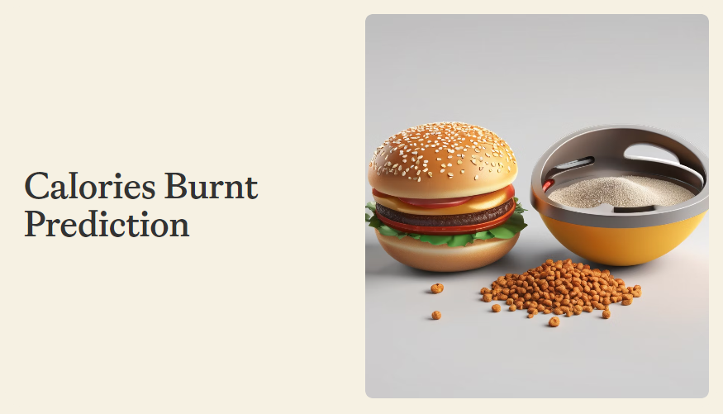

Slide 3
Introduction
Importance of Calorie Tracking
Calorie tracking is crucial for managing weight, improving fitness, and preventing health issues.
Problem Statement
There is a lack of accurate methods for estimating calorie expenditure during exercise.
Objectives
The objective of this project is to develop a predictive model that can accurately estimate calories burnt during exercise.
Structure
This report provides an overview of the sections covered in the project, including the abstract, introduction, literature review, methodology, results, and conclusion.

Slide 4
Literature Review
Existing studies on calorie prediction methods were reviewed.
Various approaches, such as machine learning algorithms and wearable devices, were explored.
Studies focused on data collection, feature engineering, and model selection to predict calorie burn accurately.

Slide 5
Dataset Description
The dataset used for the project contains information on physical activities and corresponding calorie burn.
Size: 15,000 data points
Source: Fitness tracking devices and mobile applications
Variables: Activity type, duration, heart rate, age, body temp, height, weight, and gender

Slide 6
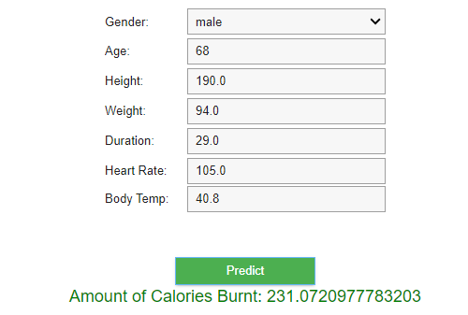
Results
The final result in this project is this graphical user interface view.
Here, a user can give his/her necessary data to predict the amount of data he/she need to burn

Slide 7
Future Work
There are several potential areas for further study in the field of calorie prediction.
One avenue of research is to incorporate additional variables, such as heart rate, body composition, or environmental factors, to enhance the accuracy of the predictive model.
Another area of exploration is to improve the model's performance for specific activities or populations, such as different age groups or individuals with certain health conditions.
Additionally, investigating the feasibility of integrating machine learning algorithms or advanced data analytics techniques can further enhance the predictive capabilities of the model.

Slide 8
Benefits
Accurate calorie prediction can greatly benefit individuals in managing their fitness goals. With this predictive model, users can better plan their workouts, track their progress, and make informed decisions about their exercise routines and dietary choices.

Slide 9
Conclusion
The project 'Calories Burnt Prediction' has successfully developed a predictive model to estimate calorie expenditure during physical activities. The model has demonstrated high accuracy and reliability in predicting calorie burn based on various input variables.

Slide 10


