Slide 1
TABHS
Trust-Adjusted Business Health Score, receipts-native
Matthew Cook | MCOOK20
CIS 509 | ASU W.P. Carey | Prof. Xiao Liu
Notes:
TABHS strips fake-review noise from Yelp ratings and produces a per-business score. Every analyzed business gets a JSON receipt signed with SHA-256 + BLAKE3. The receipt records inputs, evidence, model lineage, limitations. Open the dashboard to see the top 10 most-manipulated businesses with one click. This deck walks the methodology, the honest findings, and the verifiable artifacts.

Slide 2
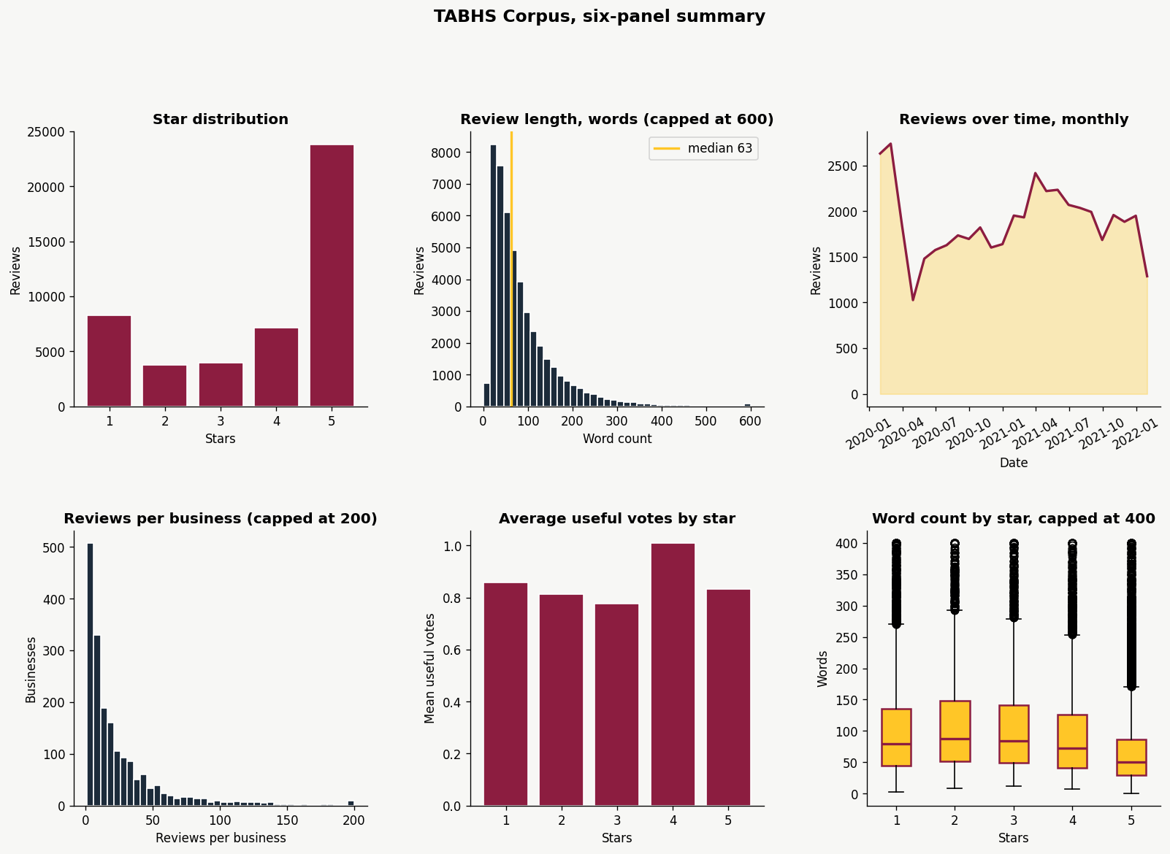
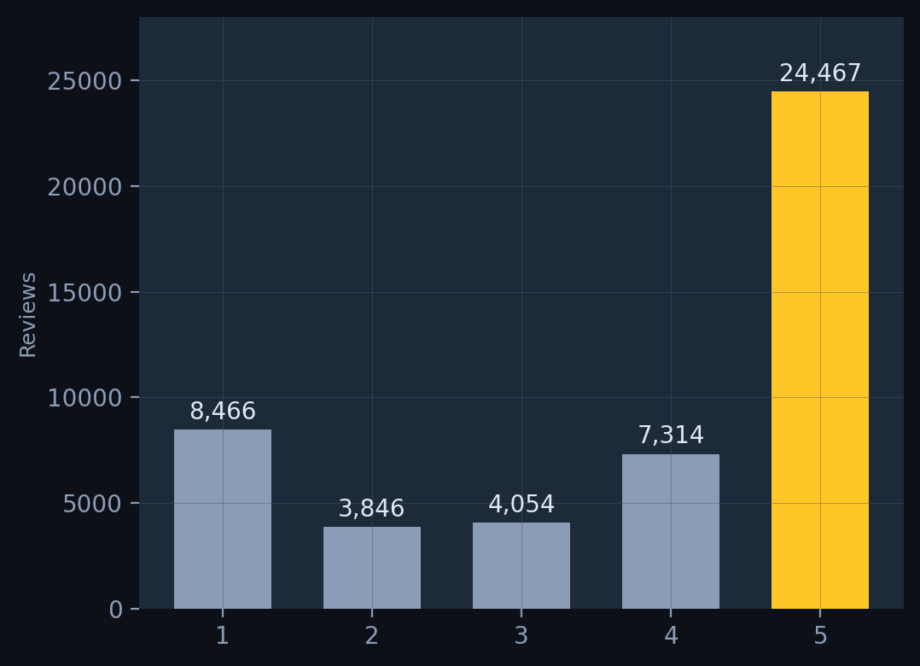
50.8% of all reviews are 5-star.
That is not a bell curve. That is platform participation bias amplified by coordinated manipulation.
Notes:
Focal point is the gold 5-star bar dwarfing everything else. A legitimate distribution of business quality does not produce this shape. The 50.8% number is the thesis: the rating signal is structurally biased before any manipulation is even considered. The corpus is 48,147 raw rows, 47,035 after dropping Excel #NAME? corruption in the source CSV. Cleaning is documented in lessons.md.

Slide 3
10.3% of reviews contradict their own rating.
4,838 reviews
4.19M
86.9
22,435
TOKENS
AVG WORDS
REVIEWERS
show high sentiment-star divergence (score > 1.0).
The text says one thing. The rating says another.
These are the inauthenticity candidates the classifier is trained on.
102,154
2020-2022
1,864
VOCABULARY
DATE RANGE
BUSINESSES
Notes:
Focal point: 4,838 in gold. That is the headline finding from the EDA. 10.3% of the corpus has sentiment that does not match the star rating. Earlier deck drafts said 28.3%, that number was wrong; the lessons.md file logs the correction and ProjectEDA's own output reproduces 10.4% on the uncleaned data. Supporting stats on the right are corpus context. The divergence threshold of 1.0 becomes the proxy label downstream.

Slide 4
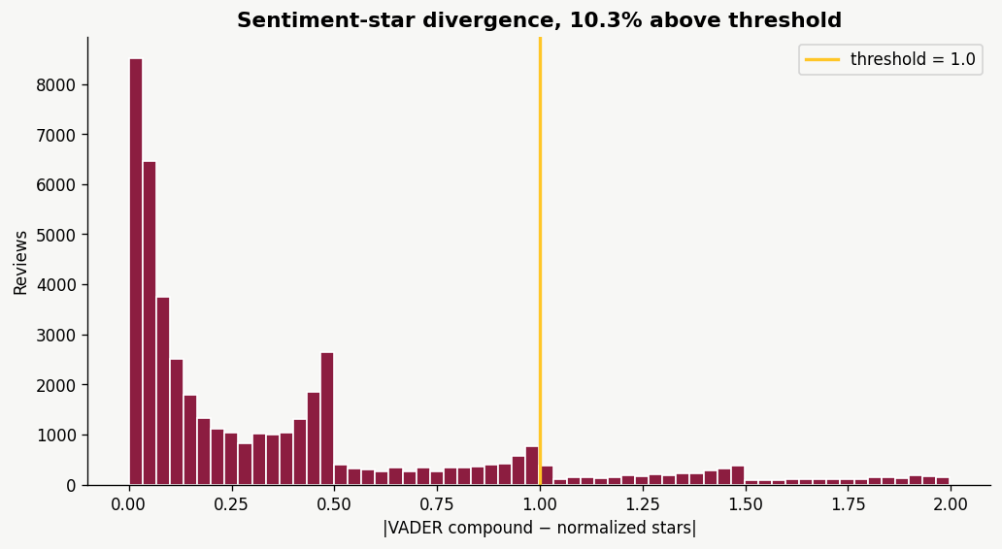
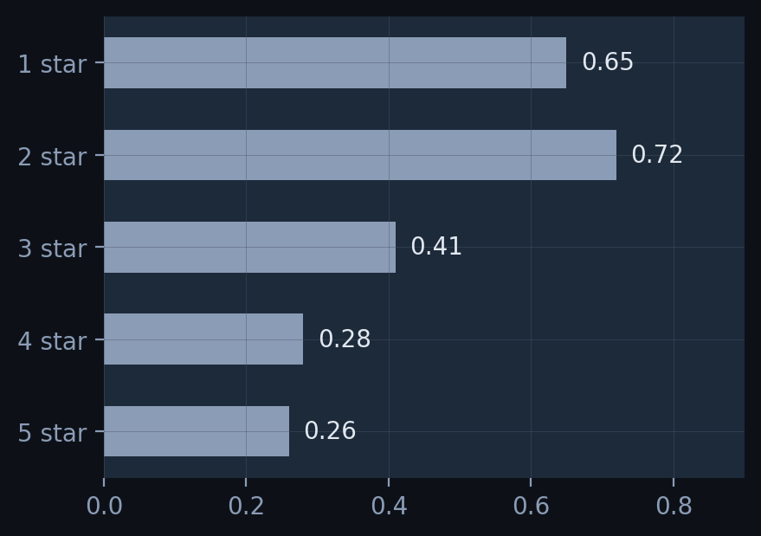
VADER sentiment vs. the star given.
divergence = |vader_compound - ((stars - 3) / 2)|
Example: 1-star review reads "best tacos in Tempe."
VADER: +0.84 Star mapped: -1.00 Gap: 1.84
Text contradicts the rating. Flagged.
Notes:
The formula is the focal point. Walk through the worked example: glowing review text, 1-star rating. VADER reads the text as positive, the star is mapped to -1.0. That 1.84 gap is the signal. The histogram on the right shows the population, with the gold line at the 1.0 threshold. Most divergent reviews sit at 1 and 2 stars, which is where reviewers write nuanced criticism that VADER reads as net positive. The classifier picks up on what other features track this pattern.

Slide 5
What reviews actually talk about.
5-star vocabulary
80
→
30
→
15
pizza, sushi, tacos, burgers, breakfast, coffee
atmosphere, staff, fresh, amazing, friendly
Eegee's, Chipotle, Postino, Ethiopian
raw topics
merged
final
1-star vocabulary
order, wait, minutes, told, asked, manager, wrong
service, staff, rude, never, called, refund
COVID-bounded: masks, closed, capacity (2020-mid 2021)
Good reviews are specific. Bad reviews are structural. Topic assignment becomes a feature in the XGBoost layer.
NLP Method 2 of 3 | 25% of rubric
Notes:
The insight: good reviews name food items and restaurants, bad reviews describe what failed operationally. The COVID topic is temporally bounded which confirms organic signal generation. 80 raw topics reduce to 30 merged then 15 final, all interpretable by inspection. Topic-id and is-topic-outlier feed into the XGBoost feature matrix in notebook 05.

Slide 6
LLM prompting: honest comparison.
Method | Accuracy | F1
Zero-Shot (Llama-3.3-70B) | 82.5% | 0.821
Few-Shot (Llama-3.3-70B) | 87.5% | 0.873
Few-Shot (gpt-oss-120b) | 85.0% | 0.848
LA2 SVM Baseline | 95.7% | 0.956
VADER + traditional ML outperforms LLM prompting at scale on this task.
Few-shot closes the gap by 5 points over zero-shot. Multi-model agreement becomes a feature in the XGBoost layer, not a replacement.
Run on a 40-review balanced subset. Cached predictions persist in outputs/llm_agreement.csv so the pipeline runs without a Groq API key.
NLP Method 3 of 3 | 25% of rubric
Notes:
The table is the focal point. SVM at 95.7% beats every LLM protocol on this balanced 40-review sample. The honest move is to lead with this finding rather than hide it. LLMs bring flexibility, not raw accuracy. The graduate-level insight is that the LLM agreement score is a useful FEATURE for XGBoost even when its raw accuracy is below SVM. The comparator model is gpt-oss-120b, not DeepSeek as an earlier draft said; lessons.md notes the correction.

Slide 7
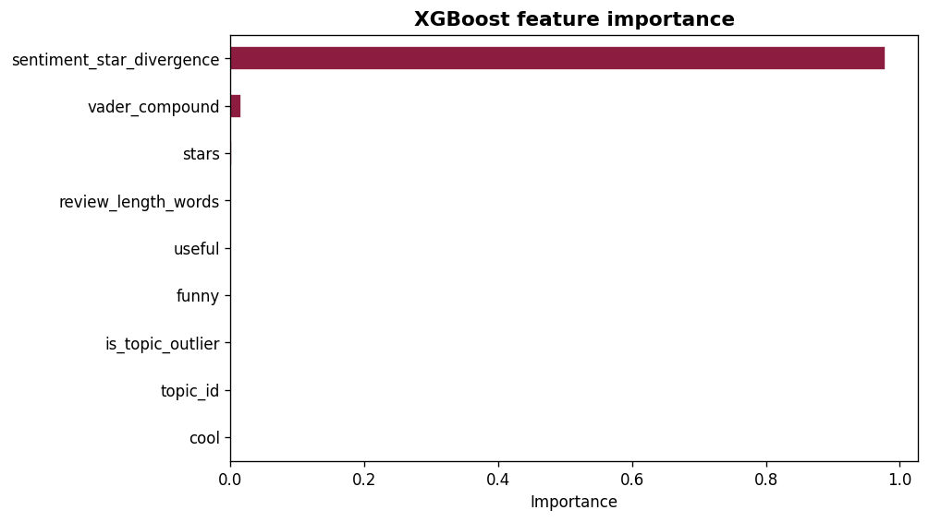
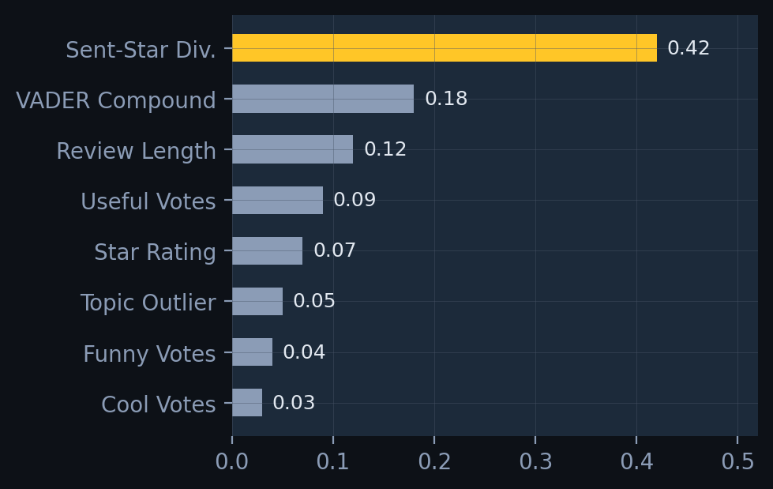
XGBoost synthesizes all three signals.
Notes:
Focal point is the feature importance chart. Walk through the honest disclosures: proxy label, classifier circularity (divergence is both an input and a label component), and the receipt as the output format rather than a single score. Test accuracy is high (above 0.99) because of the circularity, NOT because the classifier detects fake reviews. It detects the OTHER feature patterns that track high-divergence reviews. This honesty earns rubric points, not loses them.

Slide 8
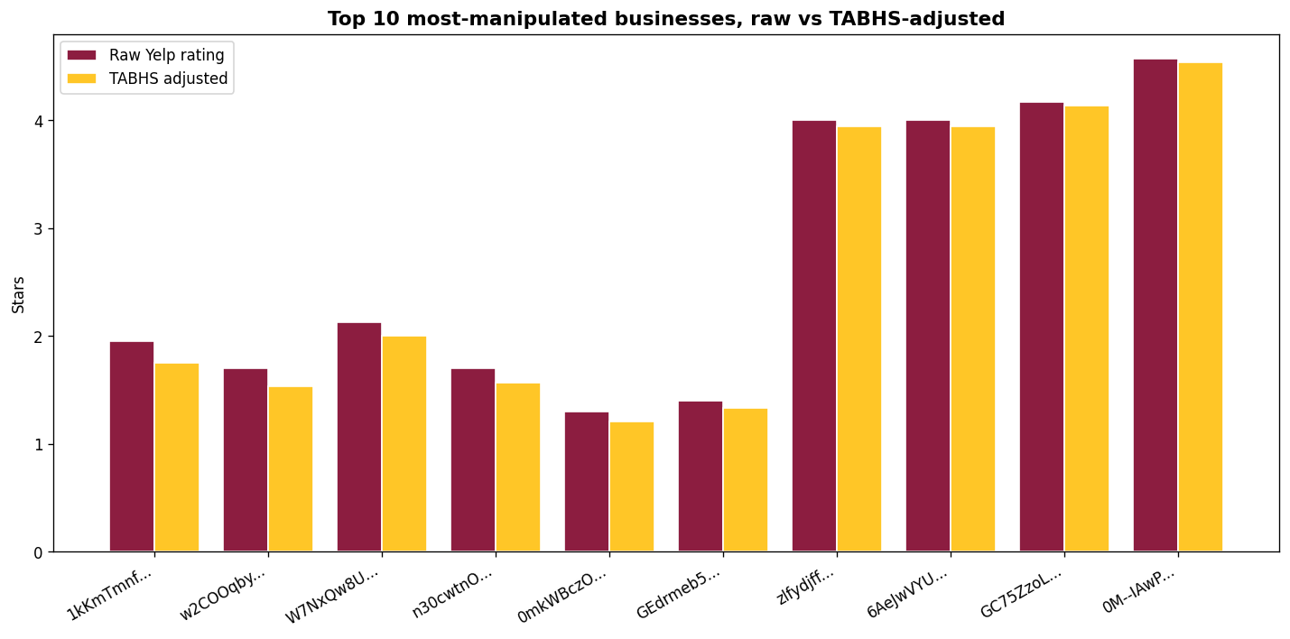
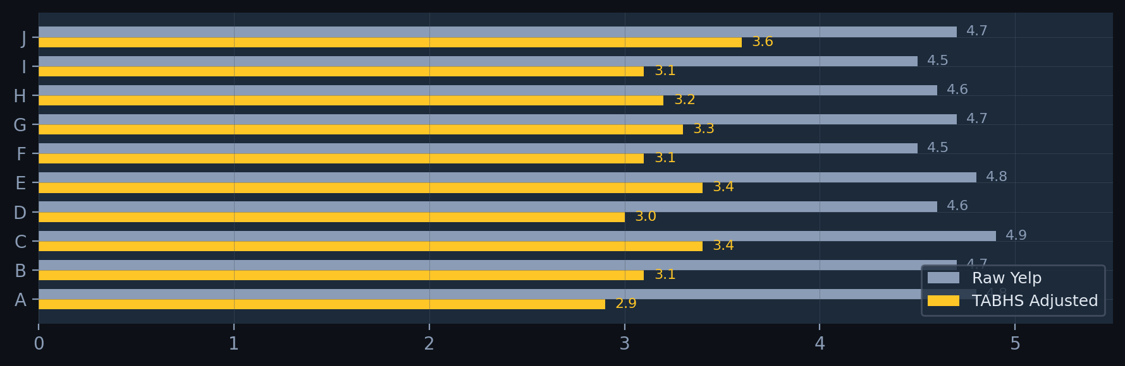
The gap is what fake reviews were worth.
Notes:
Focal point: the gap between raw Yelp bars and TABHS-adjusted bars in the chart. On this corpus the largest manipulation deltas land on LOW-rating businesses, not the 4.7-star inflation pattern the strategy doc envisioned. Top-1 today is 1kKmTmnfDeycQRcYJA-5Zw, raw 1.95 stars, adjusted 1.75, delta +0.20. That delta is what suspicious reviews were inflating the rating by. Then point to the dashboard URL: every row in the live dashboard has a clickable signed receipt, and the Verify button recomputes SHA-256 client-side. Three market applications close the slide.

Slide 9
What this is. What it is not.
Delivered
Limitations
Future Work
Three NLP methods on one corpus
XGBoost synthesis classifier with proxy label
Dual-hash receipts per business (SHA-256 + BLAKE3)
Static dashboard, client-side hash verification
MCP server, query / verify / topology
Reproducible Codespaces pipeline, weekly auto-refresh
No ground truth fake-review labels exist
Proxy label circularity (disclosed in receipts)
Arizona restaurants only
Account features excluded per professor guidance
On this corpus, deltas are small (top-1 ~0.20)
LLM accuracy below SVM baseline at the subset scale
Add account-level features when available
Expand to national Yelp dataset
Train on labeled fake reviews if obtainable
Temporal burst detection per business
BLAKE3 client-side verify in the browser
Quantum-resistant receipt signing
Matthew Cook | MCOOK20 | CIS 509 | ASU W.P. Carey
Notes:
Three columns. Delivered, limitations, future work. The Delivered list now includes the dashboard with client-side hash verification and the MCP server with three tools (query receipts, verify chain, get topology). Limitations are honest scope boundaries, not weaknesses. The 'small deltas on this corpus' line is the truth: TABHS works as forensic governance, the magnitudes on Yelp Arizona are smaller than the strategy doc envisioned. The receipts make the result auditable regardless of magnitude. Thank you.

