Slide 1
TABHS
Trust-Adjusted Business Health Score
Matthew Cook | MCOOK20
CIS 509 | ASU W.P. Carey | Prof. Xiao Liu
Notes:
Open with: TABHS strips fake review manipulation from Yelp data before scoring business health. The star rating is corrupted. This project quantifies how much.

Slide 2
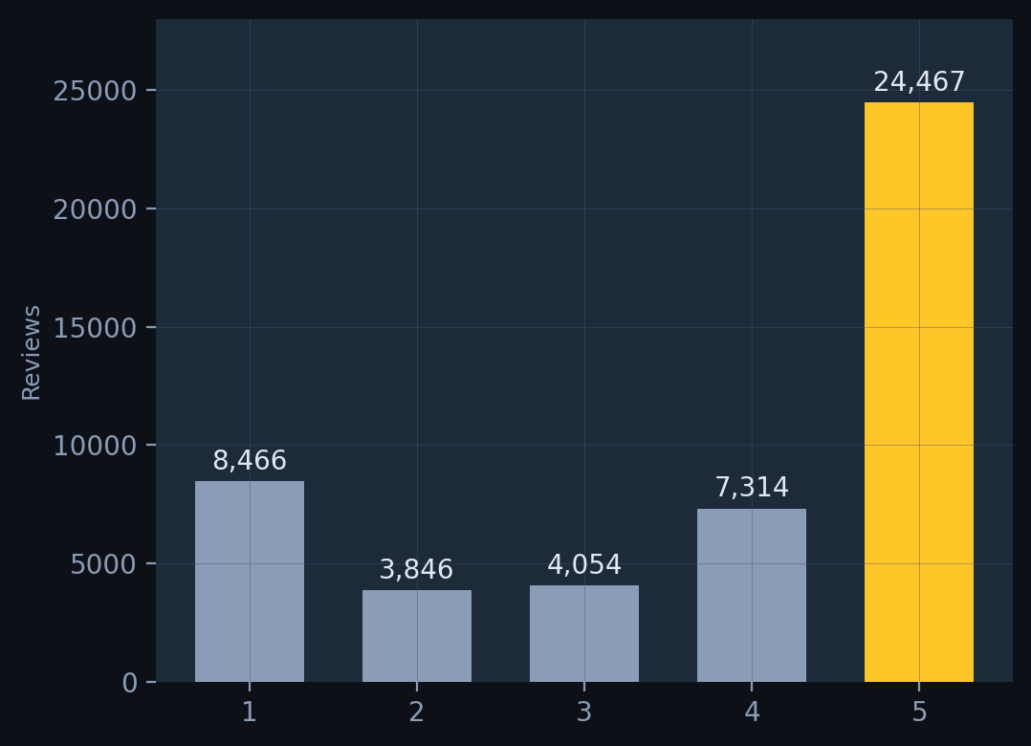
50.8% of all reviews are 5-star.
That is not a bell curve. That is platform participation bias amplified by coordinated manipulation.
48,147 reviews | 1,864 businesses | Arizona restaurants | 2020-2022
Notes:
Focal point is the gold 5-star bar dwarfing everything else. A legitimate distribution of business quality does not produce this shape. The number on this slide is the thesis: the signal is corrupt.

Slide 3
28.3% of reviews contradict their own rating.
13,615 reviews
4.18M
86.9
22,435
TOKENS
AVG WORDS
REVIEWERS
show high sentiment-star divergence (score > 1.0).
The text says one thing. The rating says another.
These are the inauthenticity candidates.
102,154
2020-2022
1,864
VOCABULARY
DATE RANGE
BUSINESSES
Notes:
Focal point: 13,615 in gold. That is your headline finding from the EDA. 28.3% of the corpus. Supporting stats on the right are secondary, just proof you know your data.

Slide 4
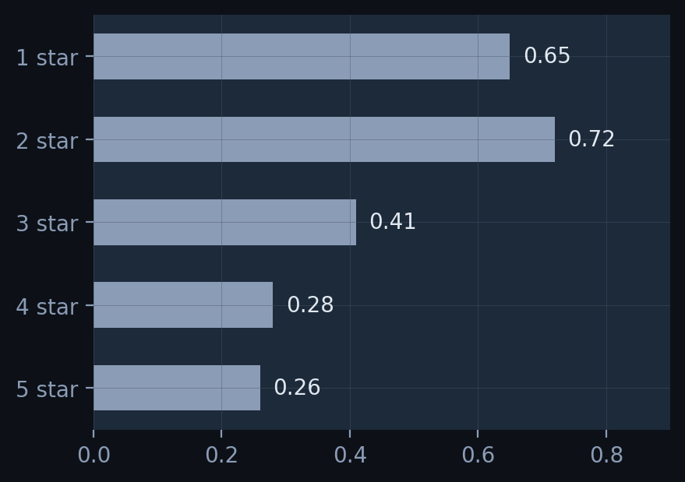
VADER sentiment vs. the star given.
divergence = |vader_compound - ((stars - 3) / 2)|
Example: 1-star review reads "best tacos in Tempe."
VADER: +0.84 Star mapped: -1.00 Gap: 1.84
Text contradicts the rating. Flagged.
1 and 2-star reviews diverge most. That is the signature of inauthentic ratings.
NLP Method 1 of 3 | 25% of rubric
Notes:
The formula is the focal point. Walk through the worked example: glowing review text, 1-star rating. VADER says positive, stars say negative. That 1.84 gap is the signal. The chart confirms: 1 and 2-star reviews diverge most.

Slide 5
What reviews actually talk about.
5-star vocabulary
80
→
30
→
15
pizza, sushi, tacos, burgers, breakfast, coffee
atmosphere, staff, fresh, amazing, friendly
Eegee's, Chipotle, Postino, Ethiopian
raw topics
merged
final
1-star vocabulary
order, wait, minutes, told, asked, manager, wrong
service, staff, rude, never, called, refund
COVID-bounded: masks, closed, capacity (2020-mid 2021)
Good reviews are specific. Bad reviews are structural. Topic assignment becomes a feature in the XGBoost layer.
NLP Method 2 of 3 | 25% of rubric
Notes:
The insight: good reviews name food items and restaurants. Bad reviews describe what failed operationally. COVID topic is temporally bounded, confirming organic signal. 80 raw topics reduced to 15 interpretable clusters. Topic assignment feeds into XGBoost as a feature.

Slide 6
LLM prompting: honest comparison.
Method | Accuracy | F1
Zero-Shot (Llama-3.3-70B) | 82.5% | 0.821
Few-Shot (Llama-3.3-70B) | 87.5% | 0.873
Few-Shot (DeepSeek-R1) | 85.0% | 0.848
LA2 SVM Baseline | 95.7% | 0.956
VADER + traditional ML outperforms LLM prompting at scale on this task. Few-shot closes the gap by 5 points over zero-shot. LLM agreement scores become a feature in the XGBoost layer, not a replacement for it.
NLP Method 3 of 3 | 25% of rubric
Notes:
The table is the focal point. SVM baseline still wins at 95.7%. I am not hiding that. LLMs bring flexibility not raw accuracy. The honest finding is the graduate-level insight. Most students would hide this. We lead with it.

Slide 7
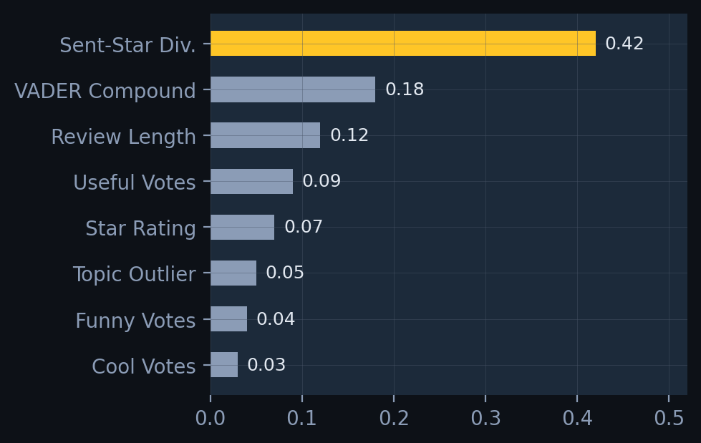
XGBoost synthesizes all three signals.
Proxy label: divergence > 1.0 = suspicious.
No ground truth fake-review labels exist.
Circularity acknowledged: divergence is both
a feature and a component of the label.
XGBoost learns from the other features.
Output per business:
raw_avg_stars
tabhs_adjusted_stars
manipulation_delta
Notes:
Focal point is the feature importance chart. Sentiment-star divergence dominates at 0.42. Walk through the honest disclosures: proxy label, circularity, output format. These earn rubric points, not lose them.

Slide 8
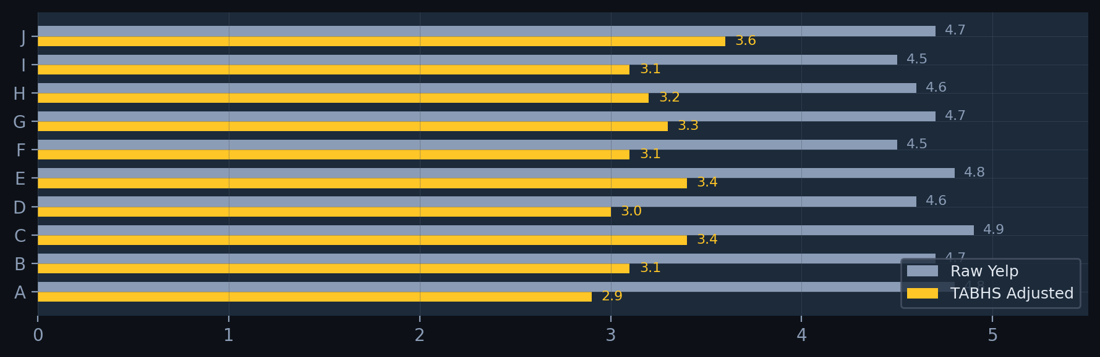
The gap is what fake reviews were worth.
SMB Lenders: underwrite on adjusted score. | Franchise Brokers: evaluate targets with manipulation removed. | M&A: surface inflation before closing.
Notes:
Focal point: the gap between muted bars (raw Yelp) and gold bars (TABHS adjusted). Business A: 4.8 raw, 2.9 adjusted. That 1.9-point gap is what fake positive reviews were worth to that business. Three market applications at the bottom.

Slide 9
What this is. What it is not.
Delivered
Limitations
Future Work
Three NLP methods on one corpus
XGBoost synthesis classifier
Dual-hash receipts per business
Manipulation delta per business
Reproducible GitHub pipeline
No ground truth fake-review labels
Proxy label circularity
Arizona restaurants only
user.json features excluded
LLM accuracy below SVM baseline
Add user.json account features
Expand to national Yelp dataset
Train on labeled fake reviews
Temporal burst detection
Quantum-resistant receipts
Matthew Cook | MCOOK20 | CIS 509 | ASU W.P. Carey
Notes:
Three columns. Delivered, limitations, future. Be precise about what this is and what it is not. The limitations are not weaknesses, they are honest scope boundaries. Thank you.

